Slide 1

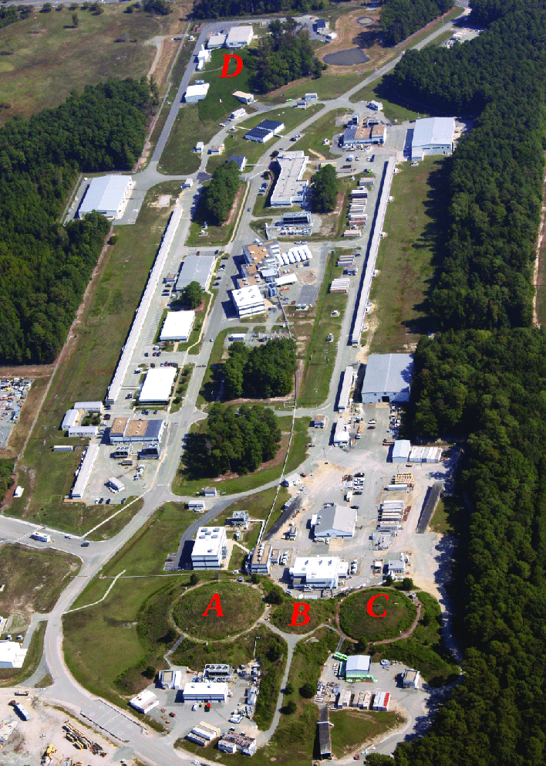

The nature of baryons in the light of electroproduction experiments
Volker D. Burkert
Jefferson Laboratory
International School of Nuclear Physics 44th Course
From quarks and gluons to hadrons and nuclei
Erice-Sicily, September 18-24, 2023
Notes:
Thank you to the organizers for the invitation to talk about what we learn from electroproduction experiments about the nature of baryons.
---click

Slide 2
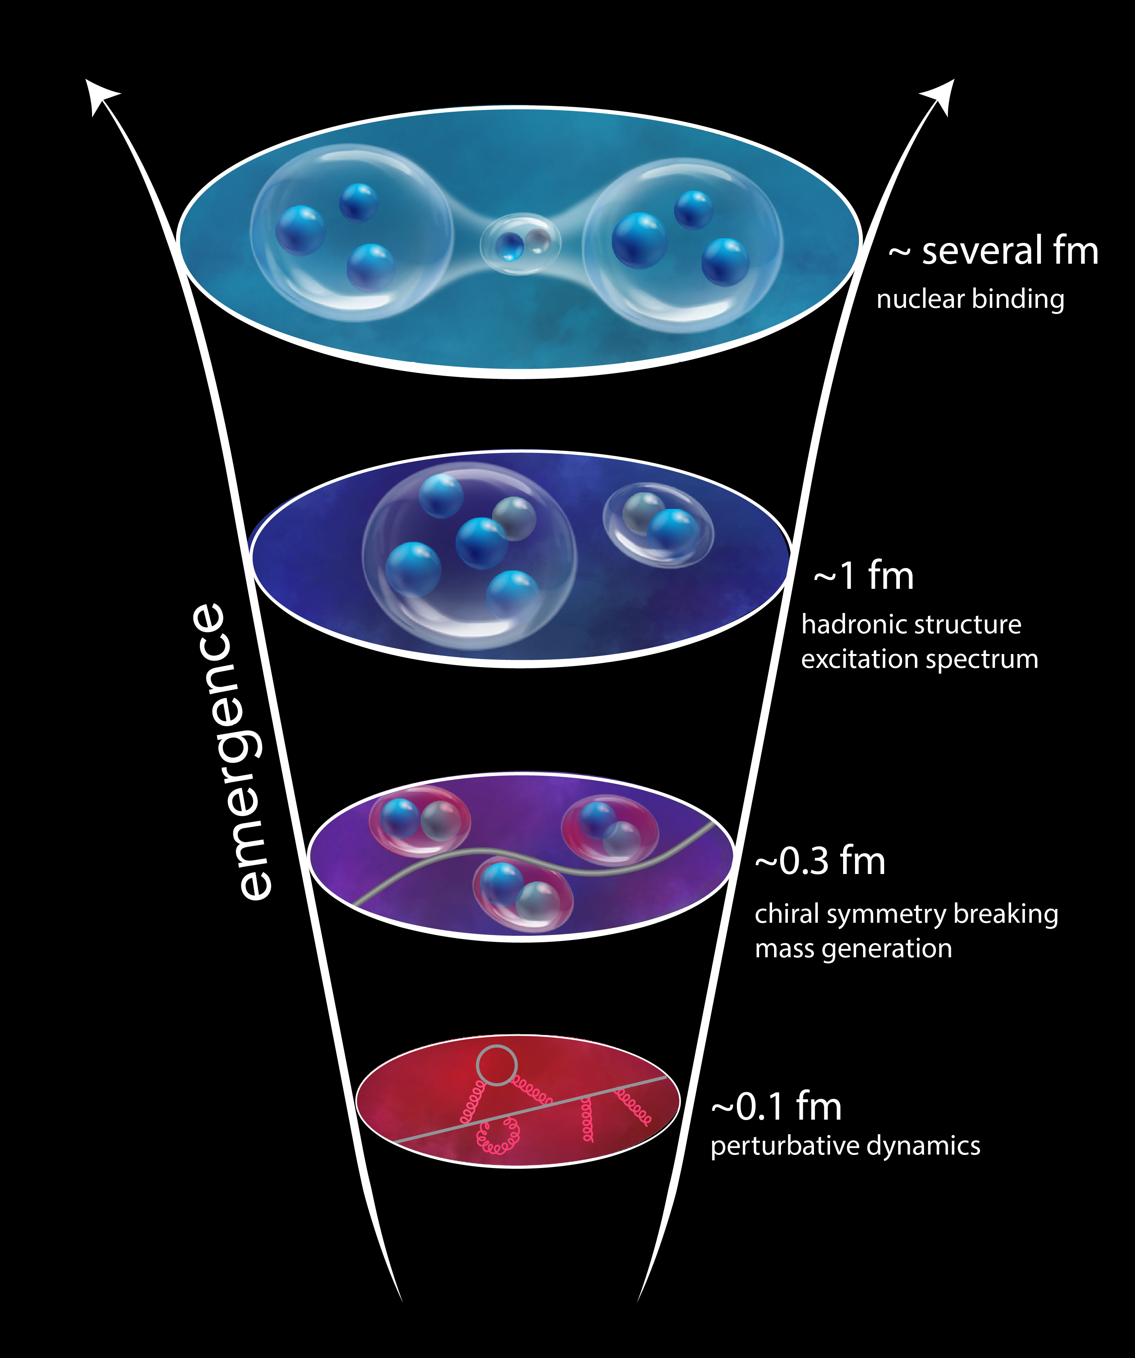
Strong-QCD is born ~ 1μsec after the Big Bang
Time after the Big Bang
T ~ 700, 000, 000 yrs: galaxies
T ~ 400, 000 yrs: atoms
T ~ : 10² s: nuclei
T ~ 10⁻⁶ s: nucleons
T~ 10⁻⁹ s: quark-gluon-plasma
chiral symmetry is broken
light quarks acquire mass
color confinement manifest
→ With the existing accelerators we can explore these events.
Notes:
In the history of our universe the transition from the quark-gluon plasma phase to the hadron phase and the forming of stable nucleons has been one of the most consequential events.
click
It occurred just microseconds after the Big Bang and was governed by the excitation of possibly all baryon states that are listed in the RPP.
click
In this process chiral symmetry is broken, light quarks acquire mass, and color confinement becomes manifest.
click
It presented us with the
strong interaction science we are exploring today with the existing electron accelerators in isolation.
--click

Slide 3
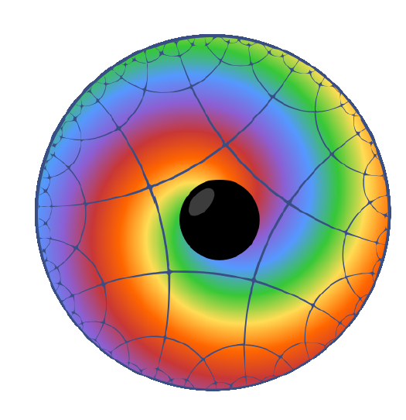
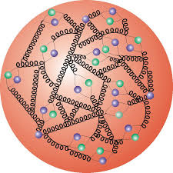
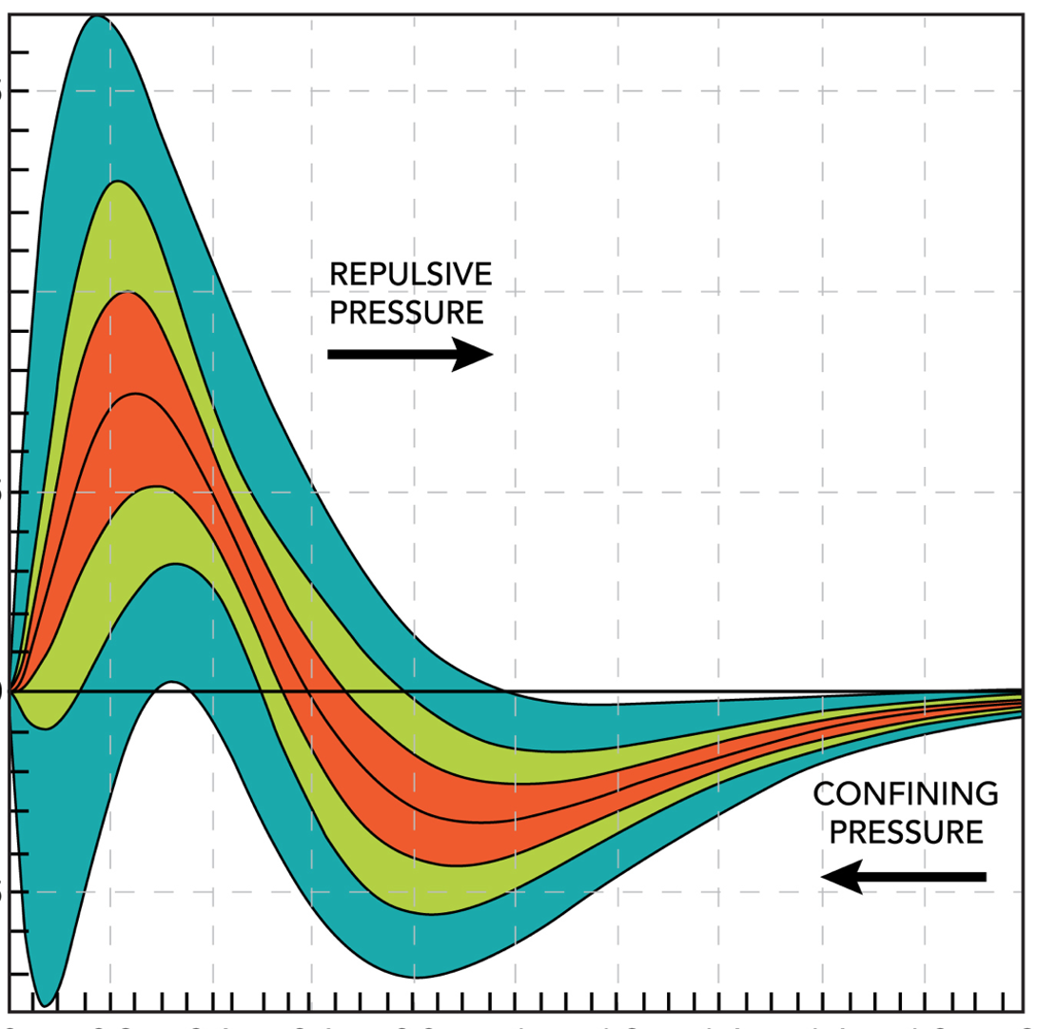
Basic questions about the proton
Elementary quarks contribute a fraction to the proton’s mass
What is the origin of its physical mass?
The strong interaction is thought responsible for confinement
What is the mechanism leading to confinement ?
We know the proton’s mass and its spin
  How are these properties internally distributed?
Notes:
What are some of the basic questions about the proton that we try to address?
click
We know that protons make up nearly 90% of the ordinary mass in the universe, and quarks contribute just a small fraction to the proton’s mass,
we should ask "what is the origin of the proton’s physical mass"?
- click
The strong interaction is thought responsible for confinement. What is the mechanism leading to confinement?
click
We know the proton’s external mass and angular momentum. How can we access the proton’s internal mechanical properties?
click
→ N* resonances and exclusive DIS processes play important roles in addressing these questions.
---click

Slide 4
Probing structural properties of the proton
The structure of strongly interacting matter may be probed by means of the weaker, fundamental forces: electromagnetic, weak, and gravity.
Electro-magnetism
Vector
Tensor
Gravity
J = 1
J = 2
Q_{p} , μ_{p}
M_{p} J_{p} D_{p}
The probe is well understood
It can be prepared with tunable properties
Experiments successfully carried out for over 70 years
Notes:
The structure of strongly interacting quarks and gluons maybe probed by means of the weaker, fundamental forces: electromagnetic, weak interaction, and gravity.
---click
In this presentation I focus on the e.m. probe and on gravity, one is a vector coupling, the other is tensor coupling revealing different properties.
-click
Electromagnetic interaction is well understood, it couples to the charge and the magnetic moment , and it can be prepared in experiments with tunable properties, and has been successfully used for 70 years.
---click

Slide 5
Structure of excited baryons
[56,2⁺]
  effective degrees of freedom
  running quark mass
  → reveal nature of N* states
[SU(6),O(3)]
N(1680)5/2⁺
2
L_{3q}
[70,1⁻]
Roper N(1440)1/2⁺ and N(1535)1/2⁻ dynamically generated resonances?
N(1675)5/2⁻
N(1520)3/2⁻
N(1535)1/2⁻
Δ(1620)1/2⁻
e’
π, η, ππ, K
e
γ_{v}
1
N*,△*
Q
N
N, Y
A_{1/2}, A_{3/2}, S_{1/2}
[56,0⁺]
Δ(1232)3/2⁺
N(940)1/2⁺
N(1440)1/2⁺
N(1710)1/2⁺
[56,0⁺]
0
[70,0⁺]
0
1
N [ħω]
2
Notes:
Meson photoproduction proved very effective in the search for new excited states. To access the internal structure of excited states requires measurement of structural observables such as transition form factors as a function of Q2.
For the states in the boxes, which in the quark model are members in various SU6xO3 multiplets, we have information about the e.m. transition from electroproduction experiments to test some of the underlying properties.
I will discuss information we have on the bold-faced states in different super-multiplets. Especially two of these states, highlighted in green color, have been claimed not to be quark states, but dynamically generated resonances.

Slide 6
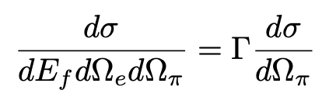
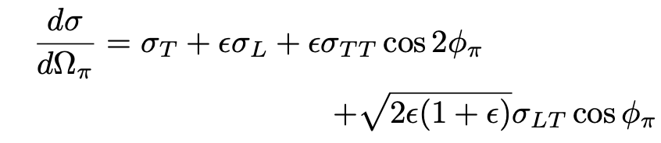
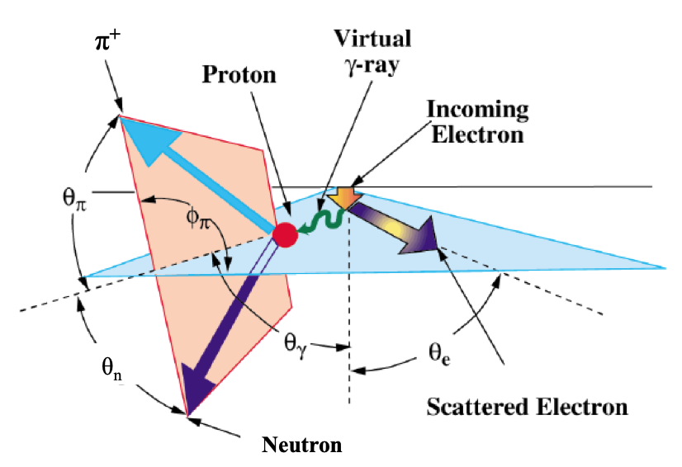
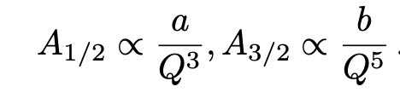

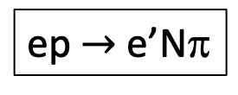
Single pion electroproduction
ep $→$ e’Nπ
The resonant transitions are expressed in term of transverse and scalar transition amplitudes A_{1/2} (Q²), A_{3/2}(Q²), S_{1/2}(Q²) for specific resonances.
In the NΔ(1232) case, the magnetic, electric, and scalar multipoles are used: M₁₊, E₁₊ , S₁₊ .
Asymptotic behavior:
, $Q2→∞$
R_{EM} = E₁₊/M₁₊ $→$ +1, R_{SM} = S₁₊/M₁₊ $→$ -1, $Q2→∞$
V. B. Nucleon resonances and transition form factors 2212.08980 (2022)
I.G. Aznauryan, V.D. Burkert, Electroexcitation of nucleon resonances, Prog.Part.Nucl.Phys. 67 (2012), 1109.1720
Notes:
I should discuss briefly how these electrocoupling amplitudes are experimentally determined. Most of electroproduction results have been from single pion or eta production with the kinematics as shown here:
The unpolarized diff. cross section has 4 response function sigma_T , sigma_L and two interference cross section sigma_TT and sigma_LT which can be separated by measurement of the phi dependence of the cross section.
All response function depend on the hadronic mass W, Q2, and the polar angle theta,. The analysis finds the resonances that couple to these final states,and determine the transverse and scalar electro coupling transition amplitudes A1/2, A3/2, S1/2. for each of the resonances.
In case of the lowest mass state, the Delta (1232) the magnetic, electric, and scalar multipoles are often used.
There are model-independent prediction for the asymptotic behavior in Q^2. More details on the formalism can be found in these references.

Slide 7
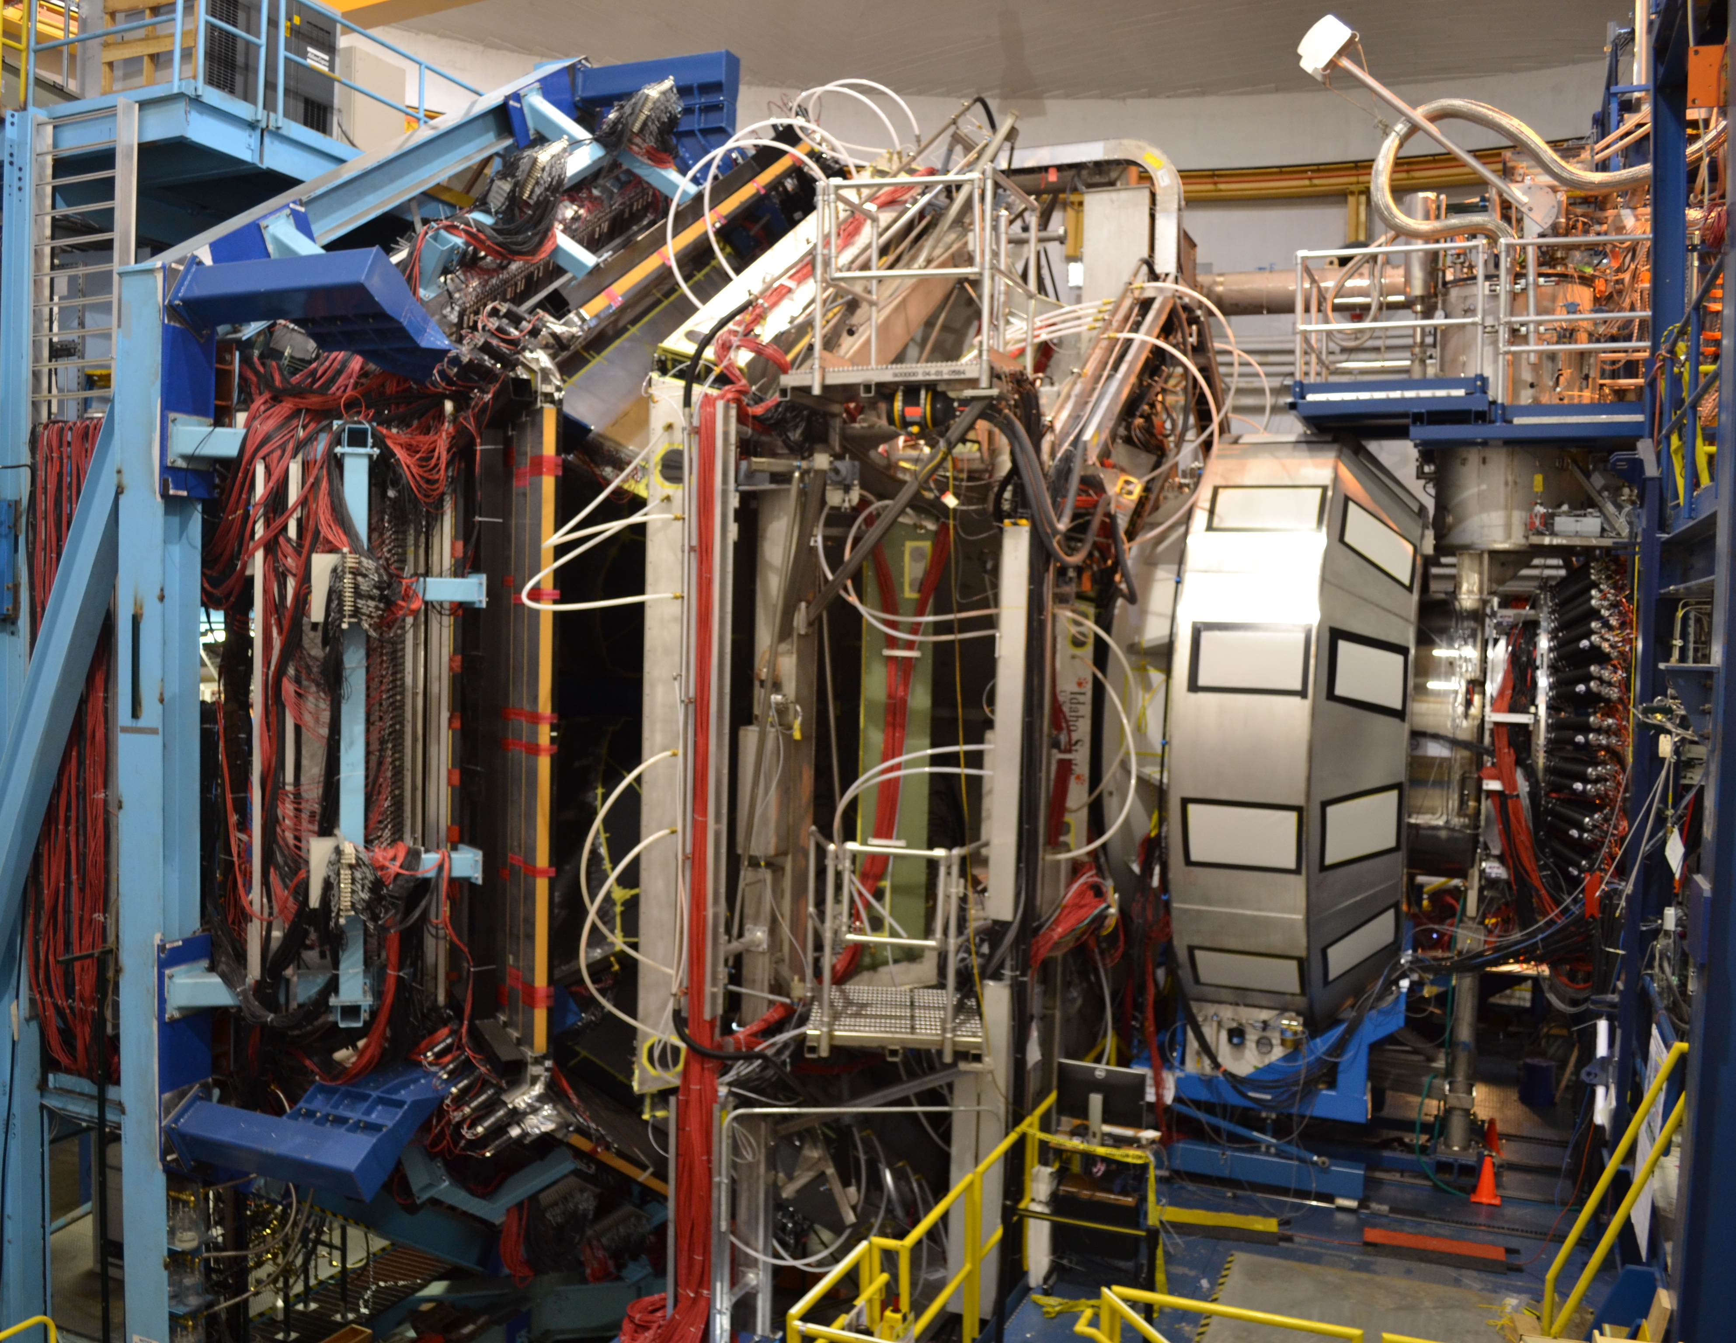








Equipment for electroproduction experiments
CLAS6
CLAS12
CEBAF 6/12
CHL-2
Hall B with CLAS12 (CLAS6) large acceptance detectors, s.c. torus & solenoid magnets, polarized solid targets.
Experiments are run & analyzed by international collaboration of scientists & students with over 200 members.
The cw electron beam with different energies directed to 3 (4) experiments
Beam polarization > 85%
Wide variety of science programs
Notes:
Electroproduction experiments have been carried out at JLab in in 3 end stations A, B, C. CEBAF beam is CW, highly polarized, and can be delivered simultaneously to several end station with different energies serving a wide variety of science programs. I will here only discuss results from the 6 GeV era most using the CLAS6 detector. Higher energy data have been taken with CLAS12, shown on the right, but so far exclusive processes in the nucleon resonance region are still in the analysis stage.

Slide 8
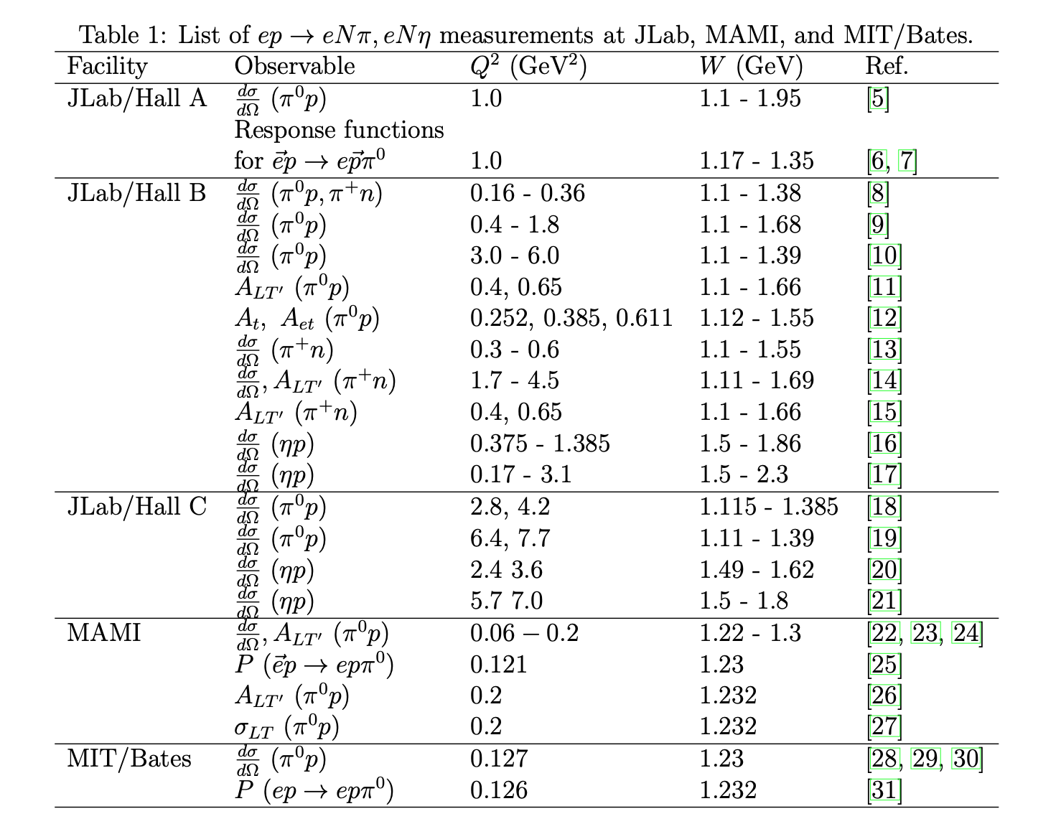
Input data in global analysis
Approaches:
Unitary Isobar Model - MAID 2007
D. Drechsel et al. Eur. Phys. J. A 34 (2007) 69-97
Dispersion relation & Unitary isobar model,
Aznauryan, Phys. Rev. C 67 (2003) 015209
→ V. Mokeev, JM Reaction model for pπ⁺π⁻
Over 120,000 unique kinematic bins.
I.G. Aznauryan, V.D. Burkert, Electroexcitation of nucleon resonances, Prog.Part.Nucl.Phys. 67 (2012), 1109.1720
Notes:
The data sets used in this analysis are shown in this table. There are over 120,000 kinematic bins in W, Q2, theta and phi. The data were analyzed with the same two codes based on the UIM in MAID, and the Fixed-t-dispersion relation. This enables cross checks and assigning systematic uncertainties.

Slide 9
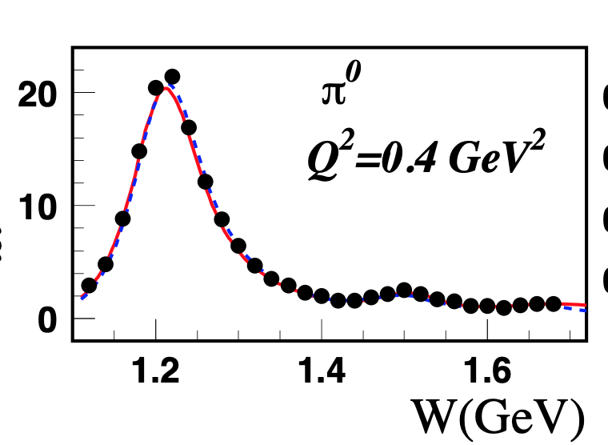
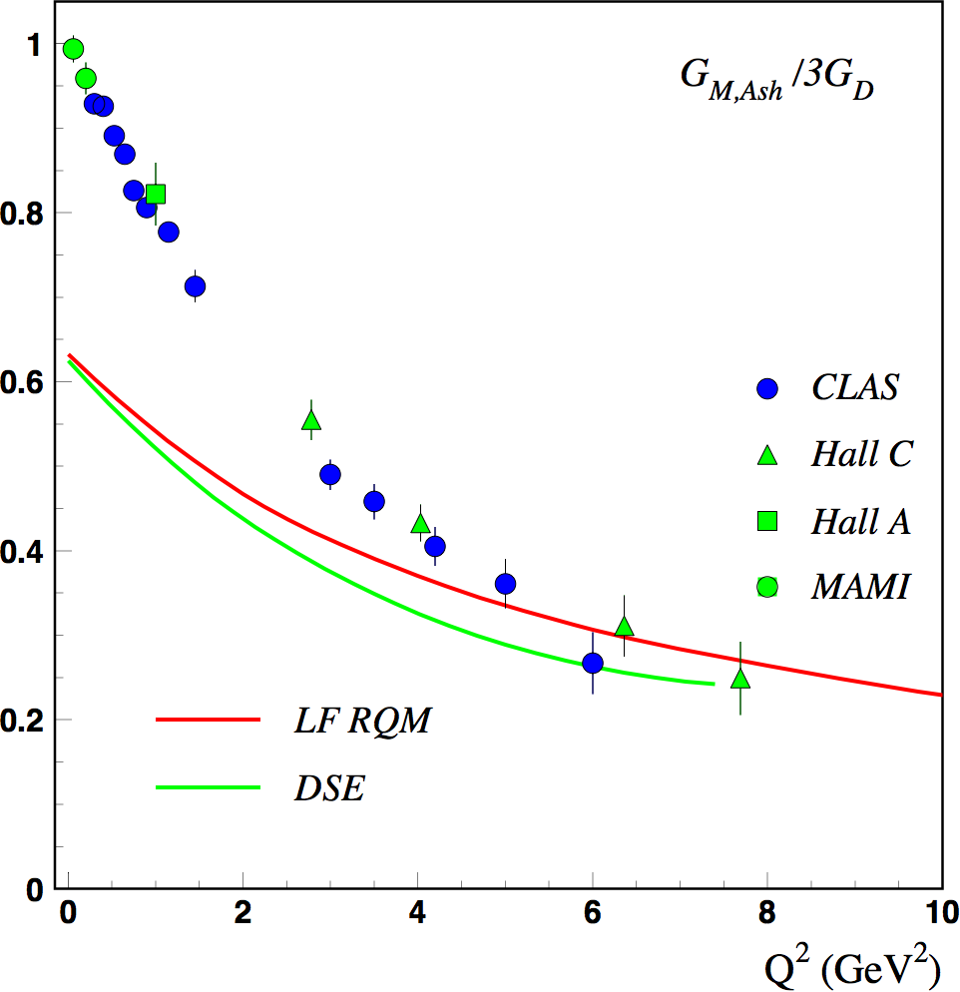
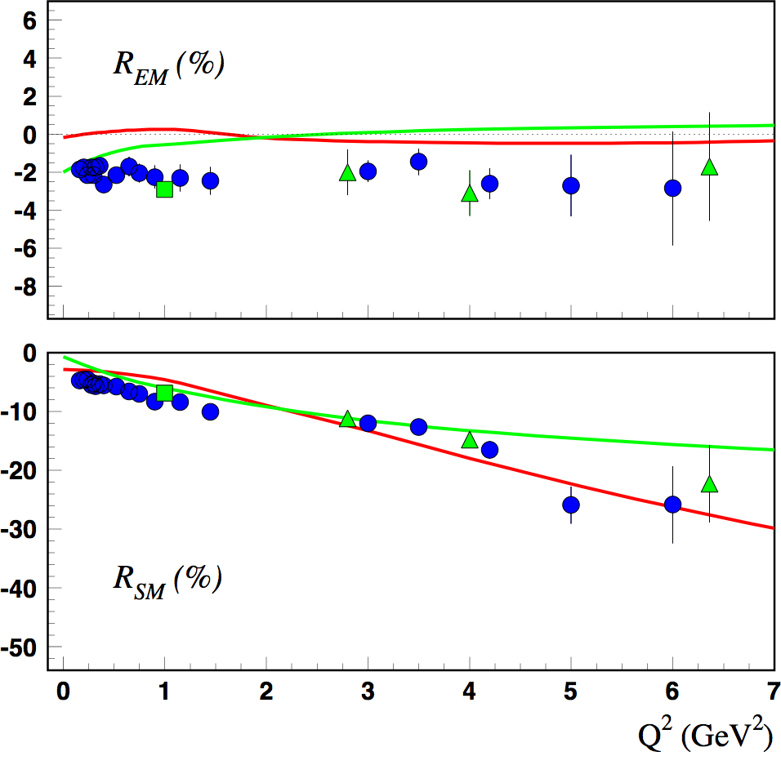
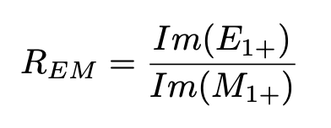
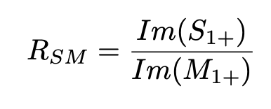
The γpΔ⁺(1232)3/2⁺ transition form factors
LF RQM: I. Aznauryan, V.B. , Phys.Rev.C 92 (2015) 3, 035211
DSE: J. Segovia, C.D. Roberts et al., PRC94 (2016) 042201
pπ⁰
G_{M}/3G_{D}
Dominance of |q³> magnetic dipole transition contribution at Q² > 3 GeV²
1.2
1.4
1.6
W GeVc²
Magnetic transition in ground state
γ
u u d
u u d
R_{EM} = -2% consistent with MB, no trend towards asymptotic behavior (R_{EM}→ +100% )
R_{SM} ~ consistent with q³ dominance, R_{SM}→ - 100%.
J^{P} = 1/2⁺
J^{P} = 3/2⁺
Notes:
The proton-Delta(1232) transition is the most studied resonance and has by far the greatest strength when excited in hadronic or photon interaction. In quark models, the dominant magnetic transition form factors proceeds via a single quark spin flip.
-- Click
The comparison with advanced LF RQM and DSE calculations shows that above 3 GeV2 the quark core dominates, while at low Q^2 non-quark contributions are significant, accounting for 35% of the total strength at the photon point.
-- Click
The electric quadrupole transition ratio is small, and nearly flat at -2%, with no trend seen towards the predicted asymptotic behavior at Q2 -> infinity.
This is consistent with LF RQM and DSE.
--click
The scalar quadrupole ratio rises in magnitude with Q² qualitatively consistent with LF RQM, slightly different trend of DSE at high Q².

Slide 10
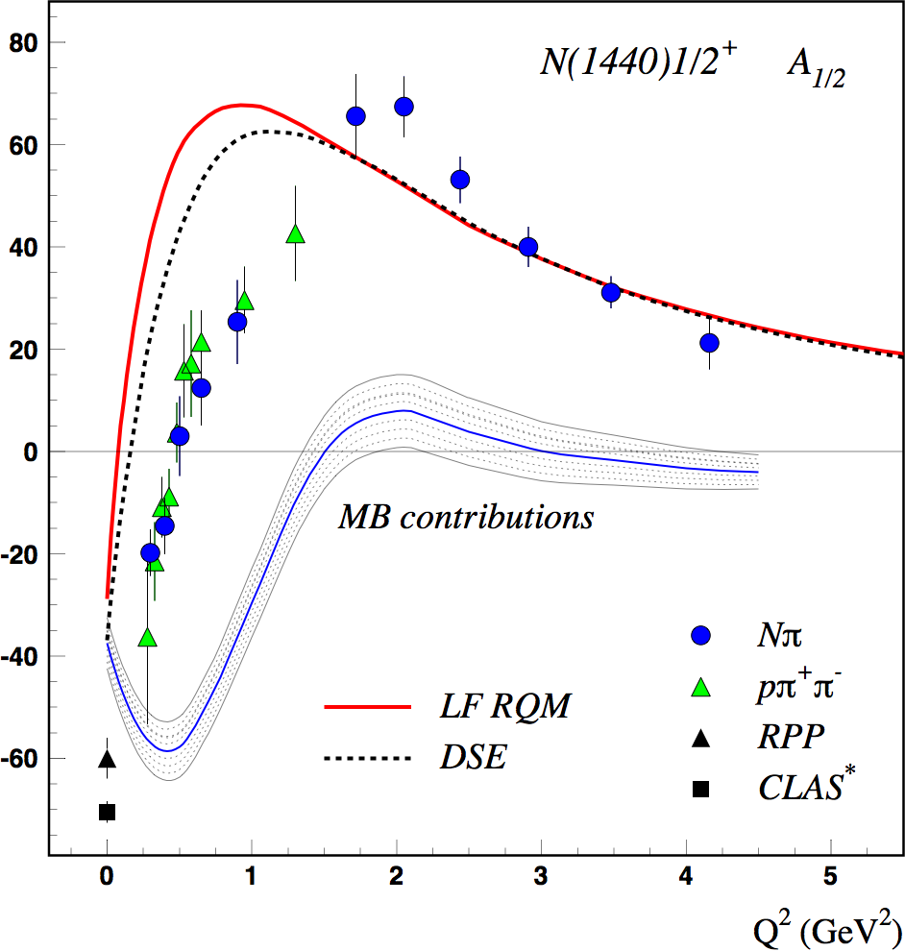
Is the Roper resonance dynamically generated?
N(940)1/2⁺
[2ħω]
N(1440)1/2⁺
EFT: T. Bauer, S. Scherer, L. Tiator, PRC90 (2014) 015201
LF RQM: I. Aznauryan, V.B. arXiv:1603.06692 (2016)
DSE: J. Segovia, C.D. Roberts et al., PRC94 (2016) 042201
[56,0⁺]
[56,0⁺]
At Q² > 2 GeV² the state emerges as the 1st radial excitation of its quark core.
Relativistic models predict the sign change in A_{1/2} (Q²).
10⁻³GeV-^{1/2}
Non-quark contributions are significant at Q² < 1.5 GeV², and at Q² < 0.5 GeV² they have been modeled successfully in EFT.
  Nature of the Roper resonance:
  The state is consistent with the 1st radial excitation of its quark core that is complemented by a complex meson-baryon cloud.
EFT
Review: V.B., C. Roberts, Rev. Mod. Phys. 91 (2019) 011003
Notes:
The Roper resonance is one of the most interesting and for a long time among the most puzzling N* resonance. Non-relativistic quark models predicted A1/2(0) as positive and large, while the data show opposite sign. The state has a large coupling το the 2-pion final states. This has led to suggestions that this state is a molecular state.
--click
At Q² > 2GeV2 it is well described by both relativistic quark-based models, the LF RQM and the DSE which show the same Q2 behavior. and the Roper emerges as the 1st radial excitation as the probe penetrates the MB cloud. The relativistic models also describe the change in sign at small Q2.
---click
From the difference with quark-based calculations we may infer the non-quark contributions are significant at Q2 < 1.5. Relativistic calculations also predict the sign change of A1/23.
-- click
As for the nature, the Roper IS consistent with the 1st radial excitation of its quark core that is surrounded by a complex meson-baryon cloud that modifies the low Q2 behavior.
--click

Slide 11
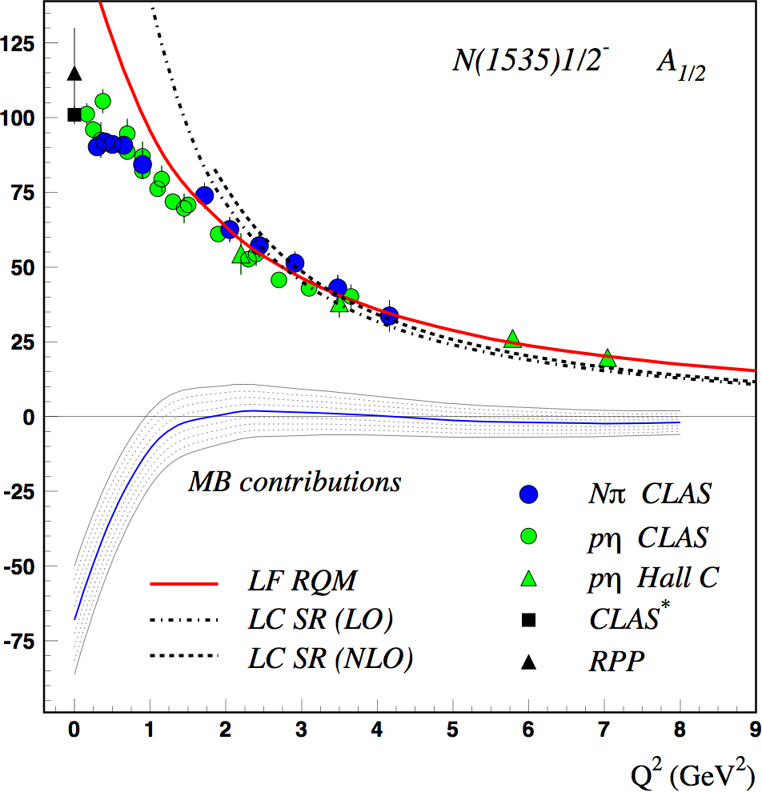
N(1535)1/2⁻ – parity partner to the nucleon
LF RQM describes data at Q² > 1.0 GeV²
LC SR describe transition at Q² > 1.5 GeV²
Non-quark contributions significant only at Q² < 1.5 GeV²
Dynamically generated resonance incompatible with data
[70,1⁻]
10⁻³GeV-^{1/2}
N(1675)5/2⁻
N(1520)3/2⁻
N(1535)1/2⁻
Δ(1620)1/2⁻
DGR
[56,0⁺]
N(940)1/2⁺
1 ħω
Nature of N(1535)1/2⁻ resonance:
The quark core excitation is consistent with the 1st orbital excitation of the nucleon complemented with a minor MB could.
LC SR: I. Anikin, V. Braun, N. Offen, PRD92 (2015) 014018
LF RQM: I. Aznauryan, VB, Phys.Rev.C 95 (2017) 6, 065207
DGR: D. Jido, M. Doering, E. Oset, PRC 77 (2008) 065207
Notes:
The data extent to the highest Q2=7GeV2 and allow solid conclusions regarding its nature.
--click
The behavior above Q2 >1-1.5 GeV2 is well described by both relativistic models, LF RQM and LC SR in LO and in NLO.
The DGR prediction is incompatible with the data.
---click
Non-quark contributions significant only below 1.5 GeV^{2,}
--click
The state is consistent with the 1st orbital excitation of the nucleon and shows a meson cloud located closer to the periphery compared to the Roper.
--click

Slide 12
Electrocoupling amplitudes N⁺(1520)3/2⁻
[70,1⁻]
N(1675)5/2⁻
N(1520)3/2⁻
N(1535)1/2⁻
Δ(1620)1/2⁻
A_{hel}
Helicity Asymmetry
A_{3/2} dominant at Q² < 0.25 GeV², large MB at Q² < 0.25 GeV²,
A_{1/2} dominant for Q² > 1 GeV², sole contributor at Q² > 2.5 GeV²
Helicity structure at Q²>1 GeV² well described by LF RQM.
A²_{1/2} - A²_{3/2}
Helicity Asymmetry
A_{hel} =
A²_{1/2} + A²_{3/2}
Notes:
The N*(1520) is the lowest mass spin=3/2 N* state. It is interesting as it flips its helicity structure from A3/2 dominance at Q=0 as seen in the large A3/2 amplitude and the near zero A1/2 amplitude. A1/2 becomes quickly dominant with increasing Q2 and is the sole contributor at Q2 > 3 GeV2. This is best seen in the helicity asymmetry shown on the right. The the photon point the asymmetry is -1, total helicity 3/2 dominance, while at larger Q2 it is close to +1, total helicity ½ dominance.

Slide 13
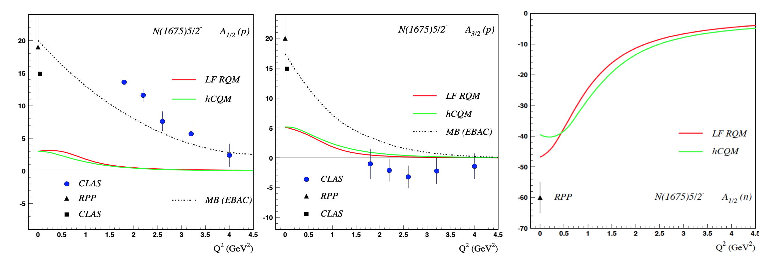
N⁺(1675)5/2⁻ photo/electrocoupling amplitudes
[70,1⁻]
N(1675)5/2⁻
N(1520)3/2⁻
N(1535)1/2⁻
Δ(1620)1/2⁻
On proton target the quark transverse amplitudes are suppressed due to selection rule. → MB contributions to dominate at all Q²
On neutron target quark contribution to dominate at all Q².
10⁻³GeV-^{1/2}
Nature of the N(1675)5/2-
The large quark component on the neutron and its absence on proton shows that the quark core of N(1675)5/2⁻ is the L=1 excited state of the nucleon.
Notes:
The final resonance I discuss is the lowest spin 5/2- state, the N(1675)5/2-, which is member of the same super-multiplet as the previous 2 states, N(1535) and N(1520).
However, there is a peculiarity, called the Moorhouse selection rule, that prevents the quark core from being excited from a proton target. Quark models predict indeed very small contributions to the measured A1/2 and A3/2 strengths, while dynamical coupled channel calculations reproduce the measured results.
The selection rule does not apply for neutrons, and we expect quark models to predict large A1/2 (and A3/2) amplitudes while only 25% can be attributed to the MB contributions as the photon point (right graph). A similar result is seen for the neutron A3/2 amplitude (not shown).
--click
As a conclusion: the N(1675) resonance is a strong L=2 orbitally excited quark state, although its quark core cannot be excited in photoproduction from the proton target.
-- click
One can also compute that the isospin contribution of the meson-baryon cloud is isovector.

Slide 14
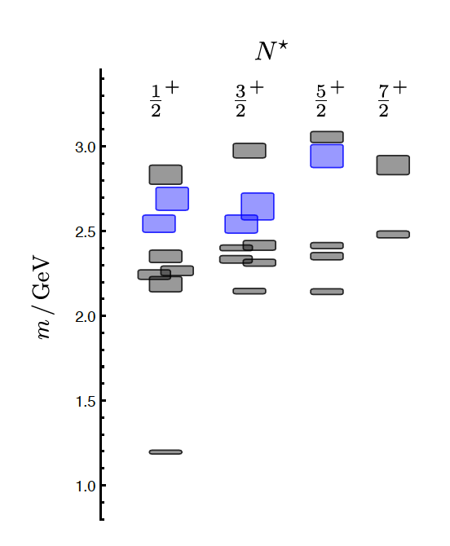
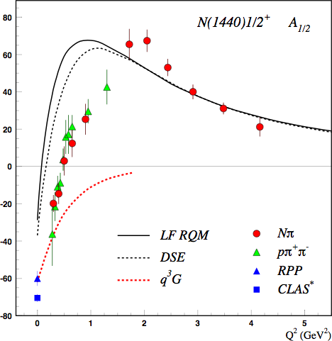
Are there gluonic excitations q³G ?
J.J. Dudek and R.G. Edwards, PRD 85 (2012) 054016
LQCD
Hybrid states clustered
in mass
1.3GeV
‘hybrid’ states
q³
N
Electroproduction of the Roper resonance as a hybrid state. Z.P. Li, V. B., Z.J. Li, PRD 46 (1992) 70
→ Experiments are scheduled for 2023/24 with CLAS12 to search for such states with masses > 2 GeV.
Notes:
As we are trying to understand the nature of excited states, we must consider the possible existence of excited baryons with dominant gluonic content. LQCD predictions show a possible spectrum of gluonic states marked in blue.
The lowest hybrid should be a J^{P} =½ + nucleon state. LQCD projects a mass of 1.3 GeV above the nucleon mass, i.e. ~2.2GeV, and several others should appear close by in ½+ and 3/2+ spin-parity.
---click
Hybrid baryons have same spin-parity as ordinary baryons, which limits our options of separating such states from ordinary 3-quark states. How do we identify them as hybrid states?
--click
One possibility is to look at the transition form factors where one expects a different Q2 dependence. The sensitivity is demonstrated for the Roper resonance, which was considered as a possible lowest hybrid state with ½+ JP parity. The black lines show quark-core based calculations for the A1/2 amplitude, while the dashed red line shows the predictions for the lowest gluonic state. It shows that a hybrid state should have a fast dropping from factor.
---click
Experiments are scheduled for this fall and 2024 to search for hybrid states with CLAS12 with masses > 2 GeV .

Slide 15
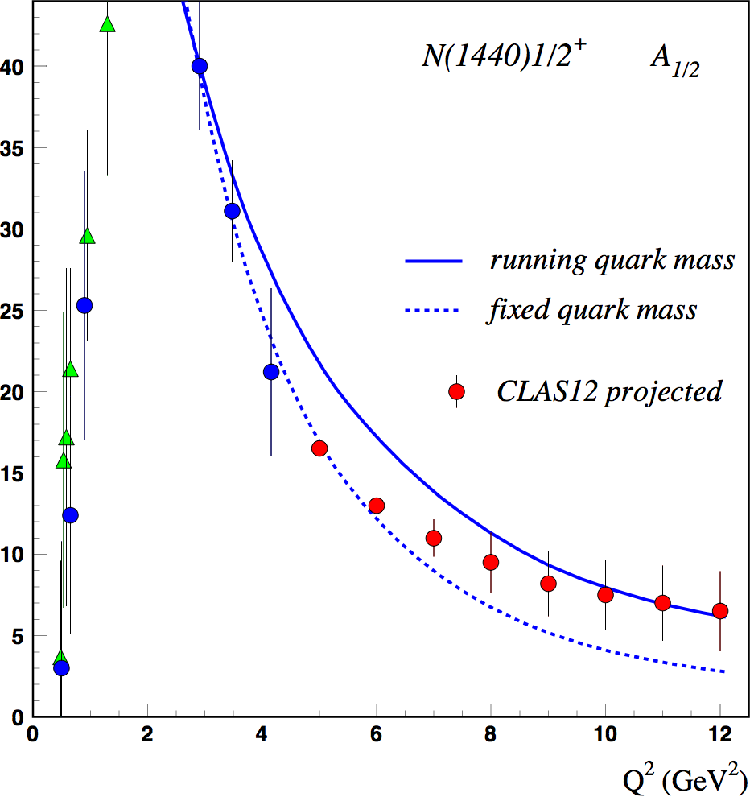
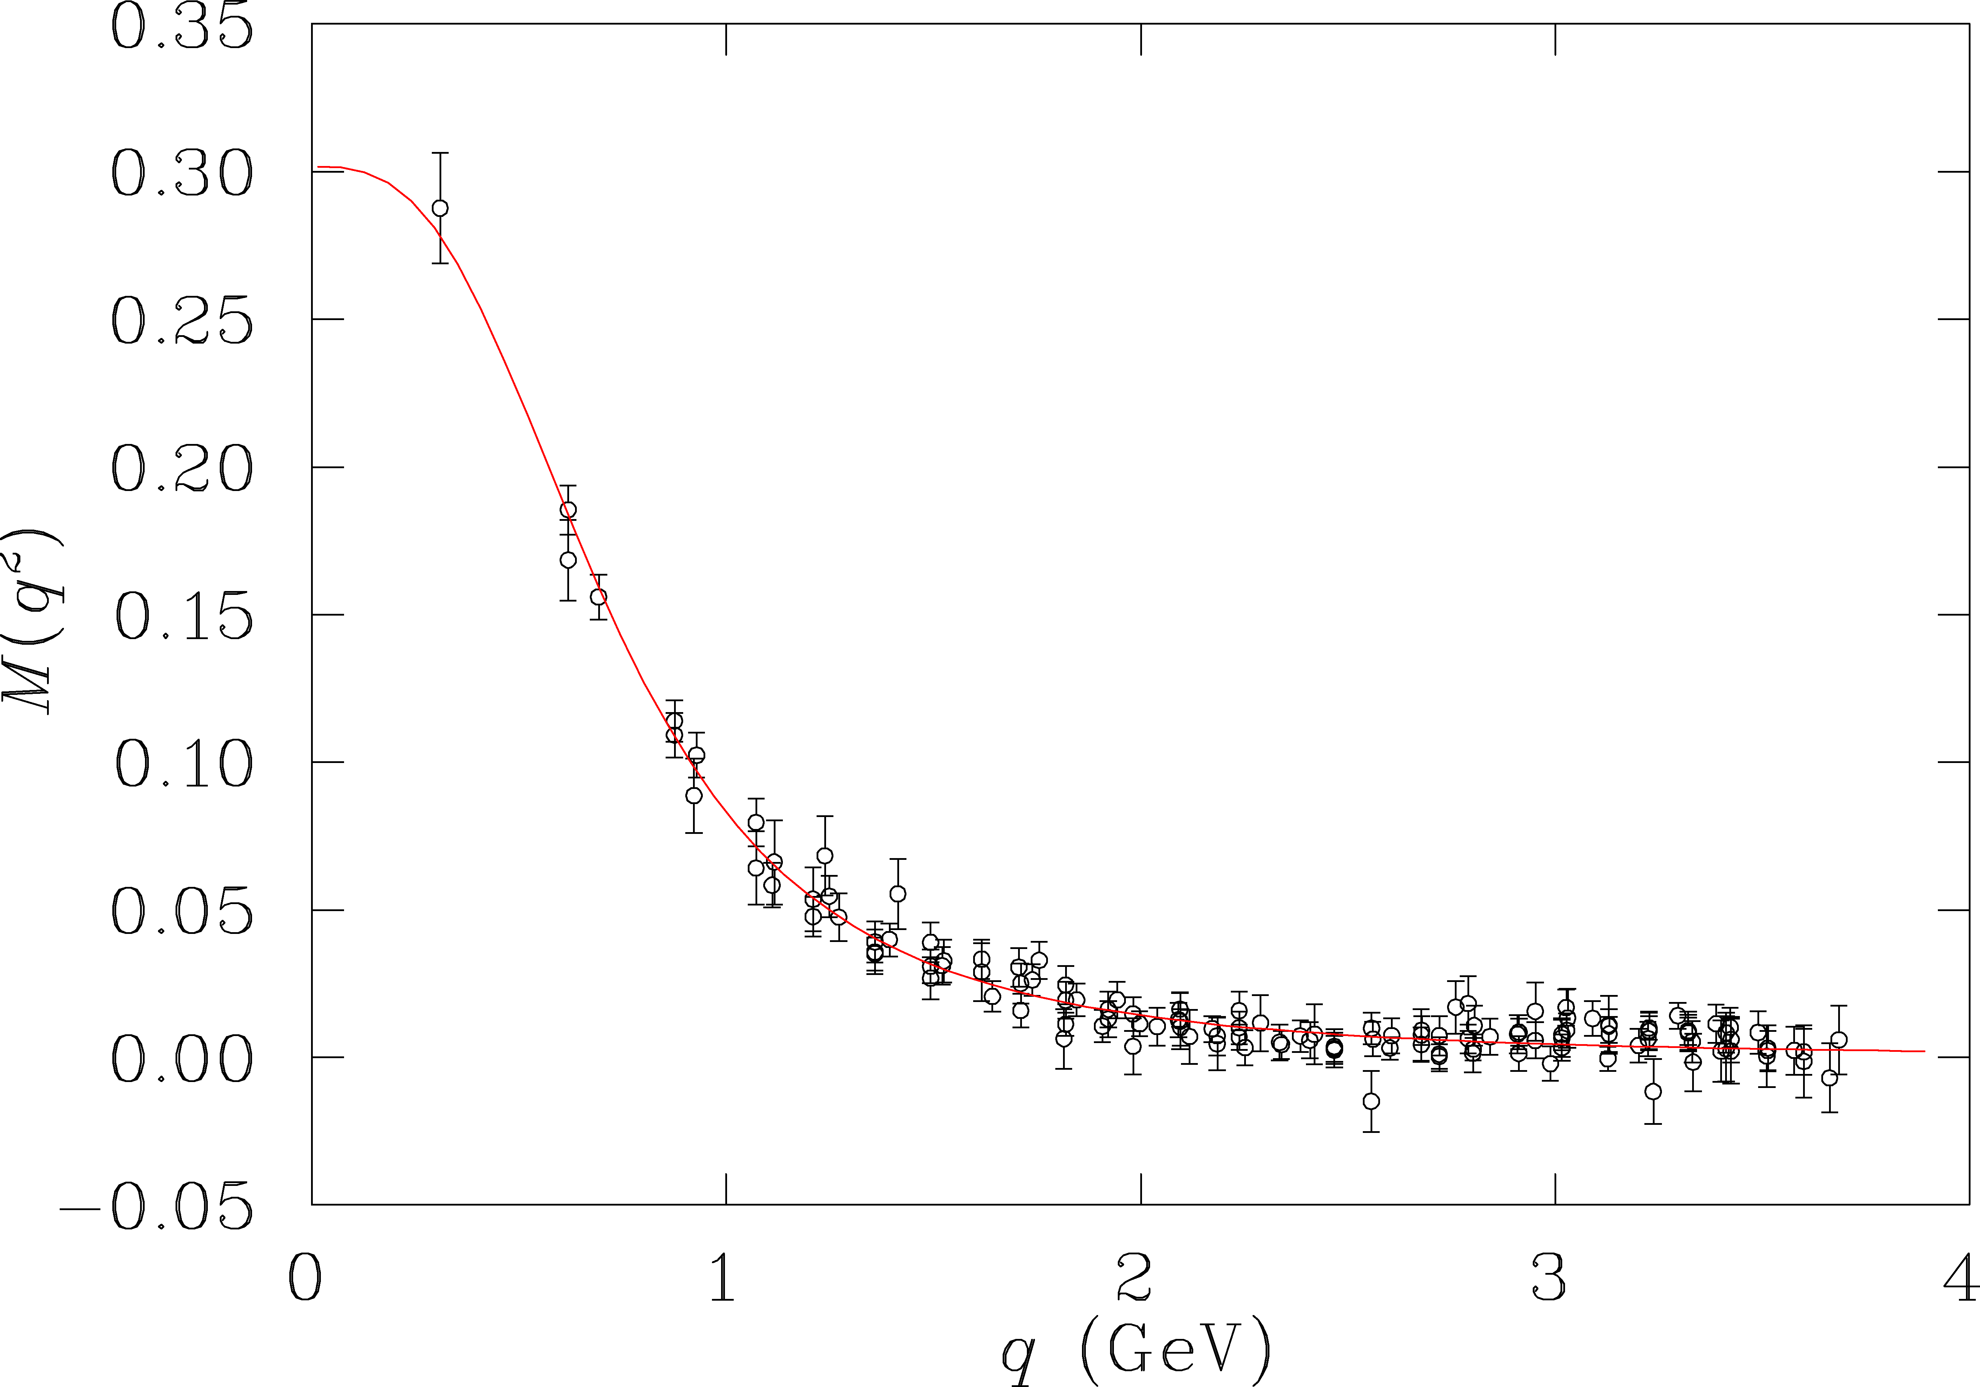
Probing the running quark mass at JLab12
Roper resonance
Running quark mass
accessible
at 6 GeV
LQCD
DSE
LF RQM
accessible
at 12 GeV
10⁻³GeV-^{1/2}
quark mass (GeV)
accessible
at 22 GeV
The Q² dependence probes the transition from dressed quarks to elementary quarks.
Notes:
The Roper resonance may show possible effect of the running quark mass on the transition form factors. The left graph show A1/2 amplitude of the Roper resonance computed within a LF RQM with a fixed and a momentum dependent quark mass. With the current data the effects are small.
---click
Significant effects are seen for Q2 > 6 GeV2. The extension to higher Q2 will allow measuring transition amplitudes to higher Q2, which allows probing the running quark mass from an average quark momentum of 0.5 GeV to 1.2 GeV/c, which probes the quark mass down to about 50MeV.
---click
At even higher energies, one probes quark dressed mass below 50 MeV.
--click
At higher energies one probes the transition from interaction with dressed quarks to elementary quarks.

Slide 16
Probing mechanical properties of the proton
Electro-magnetism
Vector
Tensor
Gravity
J = 1
J = 2
M_{p} J_{p} D_{p}
As gravitational interaction is many orders of magnitude weaker than electromagnetism, its direct use in experiments is impractical in the extreme.
A substitute is needed!
D_{p} is as fundamental as mass & spin, but its value has attracted significant interest in the community only in recent years.
V. Burkert, L. Elouadrhiri, F.X. Girod, Nature 557 (2018) 7705, 396
M. Polyakov, P. Schweitzer, Int.J. Mod. Phys. A33 (26), 1830025 (2018)
Notes:
So far I have talked about probing the proton through the electro-magnetic, i.e. vector interaction. In this second part I will discuss what we may learn from employing gravity-like interactions in studying the structure of the proton.
Gravity is the by far weakest of all interaction and couples through tensor interaction to mass, angular momentum and a property call "Druck", or the D term.
--click
“Druck” is as fundamental a property of the proton as mass and spin but its value has attracted significant interest in the hadron/nuclear science community only recently.
---click
As gravitational interaction is many orders of magnitude weaker than electromagnetism, its use in laboratory experiments is impractical in the extreme. How can we get information about it? A substitute with the same coupling properties except many orders of magnitude stronger is needed. Deeply virtual Compton scattering (DVCS) may be that substitute.

Slide 17
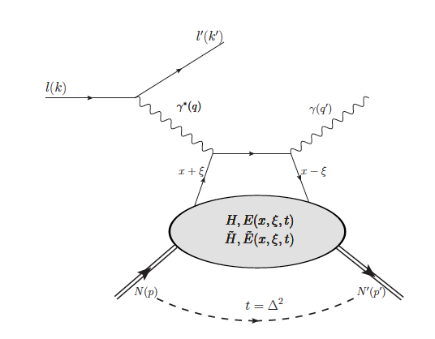
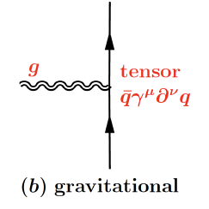
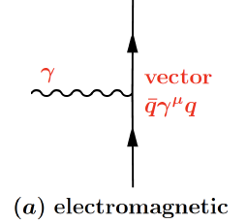
DVCS, GPDs & Gravity
D. Müller et al., F. Phys. 42,1994
X. Ji, PRD 55 (1997) 7114
X. Ji, PRL 78 (1997) 610
A. Radyushkin, PRD 56 (1997) 5524
p
G p p
G
hard scattering
x_{B}
J=2
ξ =
p
factorization
2 - x_{B}
soft part
p
p
γ
p
J=2
γγ p p
γ_{v}
p
4 chiral even GPDs describe soft part. GPD H is essential to access gravitational form factor D(t).
The 2γ field couples to the EMT as gravity does, with many orders of magnitude greater strength.
DVCS is a suitable probe of
gravitational properties of particles!
Notes:
DVCS involves a hard scale part provided by the virtual photon coupling to a quark. The quark emits a high energy real photon, while the proton remains intact. ξι defines the longitudinal momentum transfer to the quark.
The soft part we want to study is described by chiral even amplitudes that are the GPDs which depend on 3 kinematic quantities x, xi, t. For the purpose of this talk, the GPD H is most relevant to access the gravitational form factor D(t).
---click
The analogy of DVCS and gravity is shown in these cartoons. The top one showing the tensor coupling of a graviton with spin = 2. The bottom one shows the DVCS process where two photons each with spin=1, can couple as a total spin = 2 to the proton.
--- click
DVCS may thus be employed as suitable probe to access mechanical properties of the proton.

Slide 18
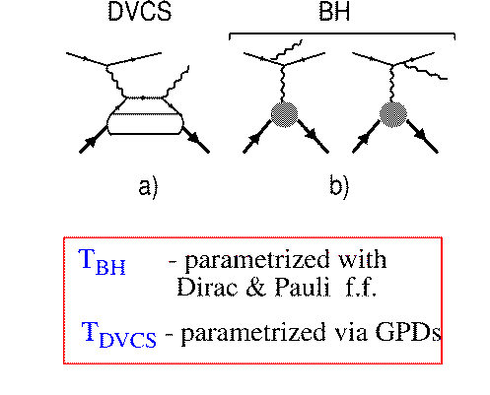

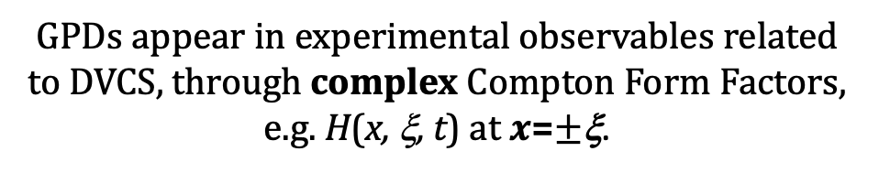
DVCS - A path towards the CFFs
DVCS
BH
ξ ~ x_{B}/(2-x_{B})
k = t/4M²
GPDs appear in experimental observables related to DVCS, through complex Compton Form Factors, e.g. H(x, ξ, t) at $x$=$±$ξ.
Polarized beam, unpolarized target:
H (ξ,t)
~
Δσ_{LU} ~ sinφ {F₁H + ξ(F₁+F₂)H +kF₂E }dφ
Notes:
In DVCS measurements the direct observables are the Compton Form Factors, not the GPDs. The CFF are complex-valued moments of GPDs. The Im(H) is accessed through the interference of the BH with DVCS. The real part is determined through the analysis of the unpolarized cross section where the real part of H dominates in some parts of the phase space.

Slide 19

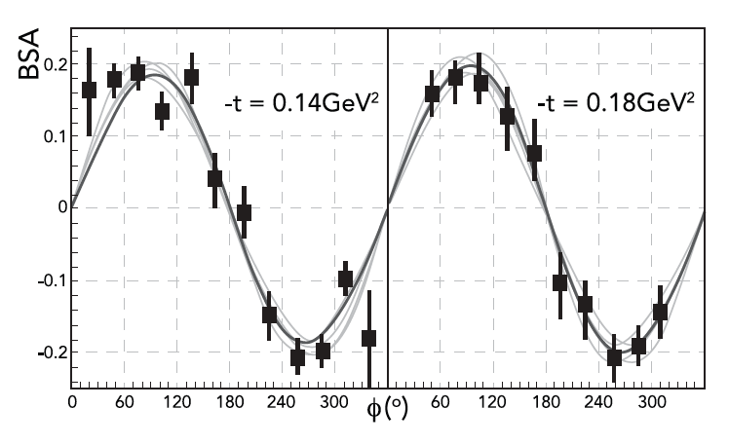
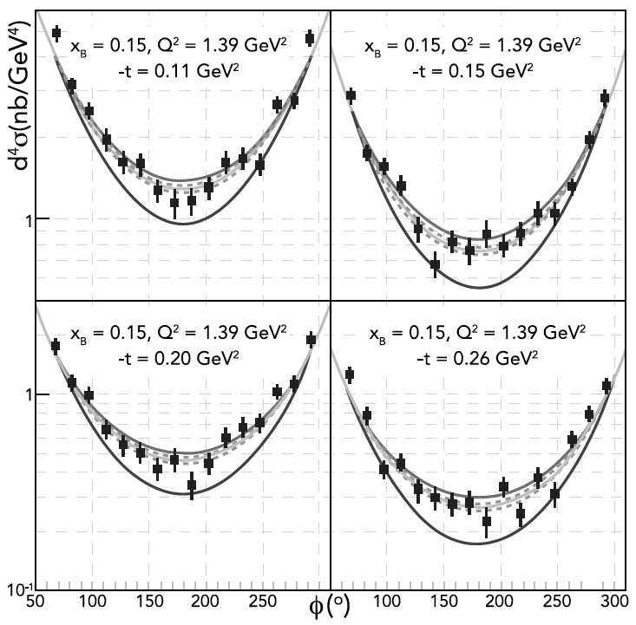
Sample fits to determine ImH and ReH
Samples of Beam Spin Asymmetry with fits
Samples of differential cross sections with fits
BH only
ImH=0
Global parameterization:
Fixed-t dispersion relation
C_{H}(t) +
K. Kumericki et al, EPJ A 52, 159 (2016)
I.V. Anikin, O. Teryaev, Phys.Rev.D 76 (2007) 056007
M. Diehl, D. Yu. Ivanov, Eur.Phys.J.C 52 (2007) 919-932
Notes:
This graph shows fits to samples of data at fixed values of xi and -t. The global fit includes world data and is shown with the solid gray line, and the local fits are shown with the thin lines. The global fit is constrained with the locally extracted precise data. The lines around the global fits are part of the systematic uncertainties. The magnitude of the BSA is linearly dependent on Im(H), showing that this CFF can be very precisely determined locally. The Re(H) is extracted from cross section data, samples of which are shown on the right, Uncertainties are larger as DVCS and BH are additive. The data are fit together at fixed kinematics points in xi and in t. These points are then fit with the global parameterization and constrained through the fixed-t dispersion relation, which connects the Re and Im parts of CFF H, shown here. It has been shown that the subtraction terms is linked to the D-term we aim to determine.

Slide 20
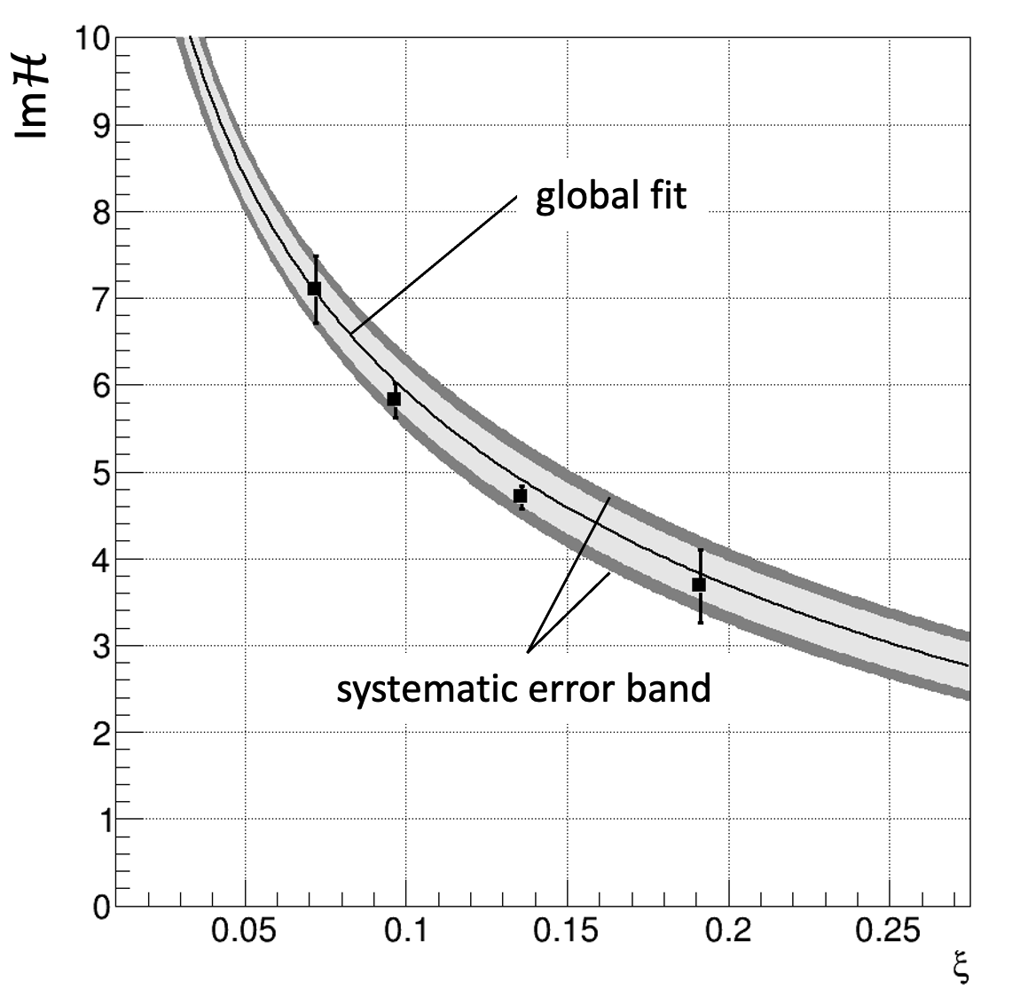
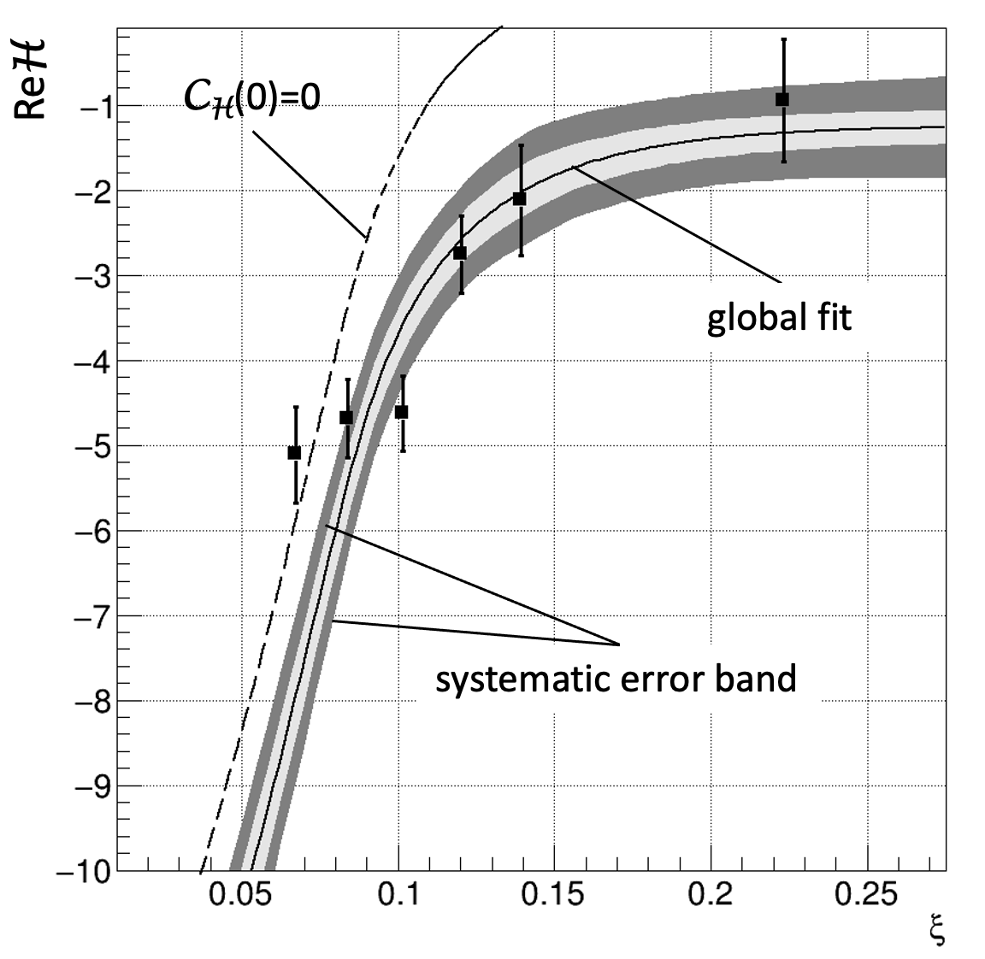
Extracting CFF ImH and ReH
-t ~ 0.13 GeV²
Local kinematics fits:
Beam-Spin-Asymmetry from CLAS data to determine ImH(ξ,t)
Differential cross section from CLAS data s to determine ReH(ξ,t)
Global parameterizations constrained by local fits:
Subtracted fixed-t dispersion relation constraint → ReH(ξ,t)
Global parametrizations:
K. Kumericki and D. Müller,
EPJ Web Conf. 112 (2016) 01012
ReH exhibits strong sensitivity to C_{H} (t)
Notes:
These graphs show the imaginary and real parts of the CFF. The markers show the results of the data analysis at one fixed t value (-t ~ 0.13 GeV2). The central lines are the global fits and the shaded areas correspond to systematic uncertainties estimates. The upper line in Re(H) shows the contribution of the D-term is large and negative.

Slide 21
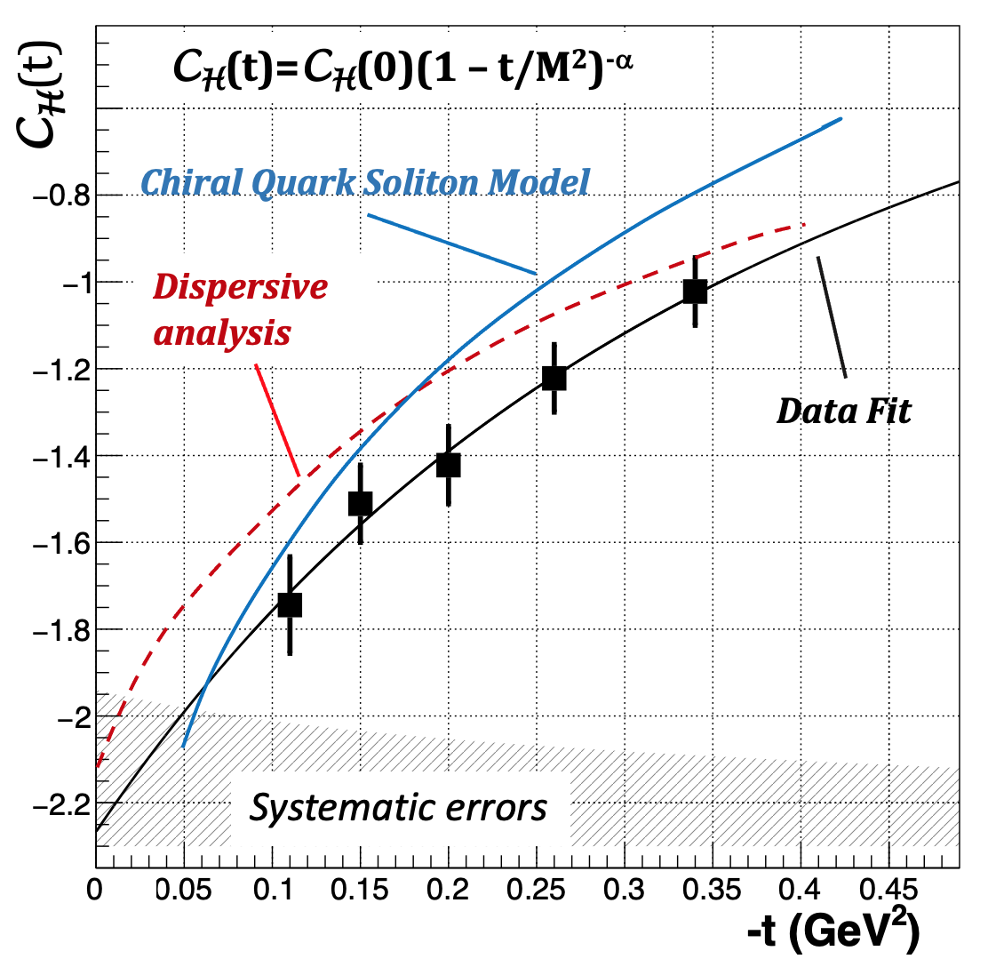
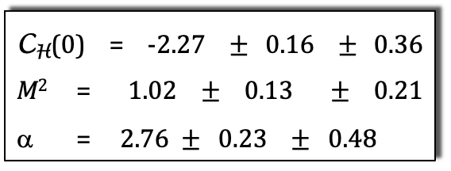
Extraction of C_{H}(t) and d₁(t) for quark distribution
C_{H}(0) = -2.27 $±$0.16 $±$0.36
M² = 1.02$±$0.13 $±$0.21
α = 2.76 $±$ 0.23 $±$ 0.48
C_{H}(t) =
-1<z= x/ξ <1
d₁^{Q}(t) = 9/10 C_{H}(t)
Proton’s gravitational form factors of the EMT in QCD
→ Important results: The D-term is negative!
Nature 557 (2018) 7705, 396-399
Notes:
---click
The results for the subtraction term is shown here. also shows the multipole fit to the t-dependence. Parameter alpha is consistent with dimensional scaling, which requires alpha = 3. The extracted subtraction term is related to the first coefficient in the Gegenbauer polynomial expansion d1(t), which is one of the gravitational form factors of the proton’s matrix element of the EMT in QCD.
---click
One imporrtant observation: The D-term is negative. Why that is important will see in a few slides.
---click

Slide 22
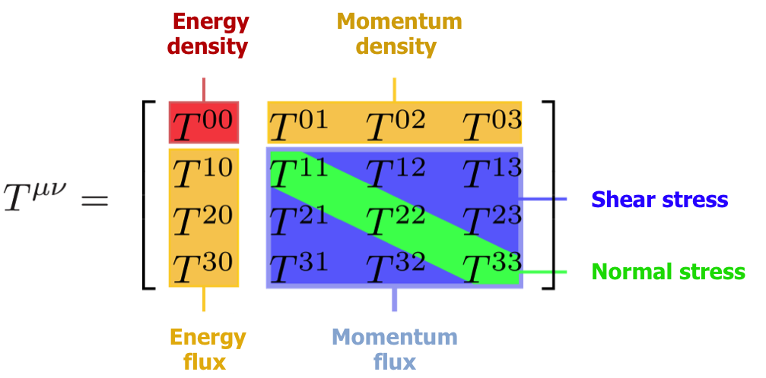
Energy Momentum Tensor T^{μν}
Now that the first experimental data exist on the D-term of the proton, we can use the multipole form to determine the first mechanical properties of the proton.
Yu. Kobzarev and L.B. Okun, JETP 16, 5 (1963)
H. Pagels, Phys. Rev. 144 (1966) 1250-1260
s^{Q}(r): shear stress; p^{Q}(r): normal stress
j_{0 ,} j₂: 0th, 2nd order spherical Bessel functions
Determine s^{Q}(r), p^{Q}(r) by inverting the above integrals.
“… there is very little hope of learning anything about the detailed mechanical structure of a particle, because of the extreme weakness of the gravitational interaction.” (H. Pagels, 1966)
M. Polyakov, P. Schweitzer, Int.J. Mod. Phys. A33 (26), 1830025 (2018)
Notes:
Now that the first experimental data exist on the D-term of the proton, we can use the multipole form to determine the first mechanical properties of the proton.
The elements of interest here are the ones inside the red frame, the off-diagonal ones are related to the shear stress and the diagonal elements related to the normal stress or pressure as expressed here. Their relation to the D-term is through these Fourier integrals integrals with the J’s being the 0th and the 2nd order spherical Bessel functions. To get to pressure and shear the integral need to be inverted.

Slide 23
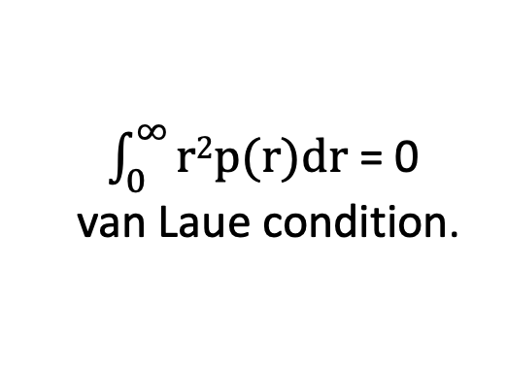
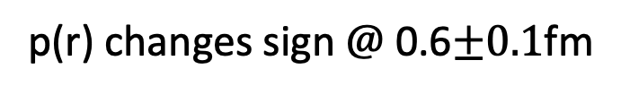
Pressure on Quarks in the Proton
M. Polyakov, PL B555 (2003) 57
p(r) changes sign $@$ 0.6$±0.1$fm
χQSM
repulsive
pressure
Data fit
$\int_{0}^{∞}{r2p(r)}$dr = 0
van Laue condition.
confining
pressure
The negative sign of the D-term determines the positive pressure on the inside, and the negative pressure to the periphery.
With the opposite sign, the proton would be unstable.
p(0.6) = 0
V.B., L. Elouadrhiri, F.X. Girod, Nature 557 (2018) 7705, 396
Notes:
The pressure distribution is shown here. The inner part has a positive pressure pushing outwards, while the outer part is negative, and pushing inwards. The black curve is the result of the global fit to the DVCS data. The magenta curve is the prediction of the Chiral Quark Soliton model. The widths of the blue and green bands are estimates of systematic uncertainties. The peak value of the pressure in the center corresponds to 10³⁵ Pascal. At r = 0.6 fm, the pressure changes sign. we give the distribution of normal forces resulting in peak value of 20,000 Newton or 2.1 metric tons.

Slide 24

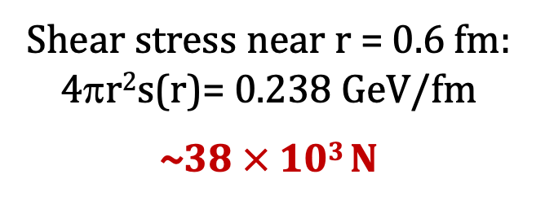
Shear Stress on Quarks
Shear stress r²s^{Q}(r)
Shear stress near r = 0.6 fm:
4πr²s(r)= 0.238 GeV/fm
~38$×$10³ N
systematic error band
4 metric tons
this result
χQSM
Notes:
The results of the shear force is shown here. It is interesting to quote the peak shear stress near 0.6 femtometer of 38,000 Newton or 4 metric tons.
Again, data fit and chiral Quark Soliton model show consistent peak values while the r-dependence is different at small distances.

Slide 25
Normal & Tangential Stress on Quarks
Normal stress: F_{n}= 4πr²[2/3 s(r) + p(r)]
Tangential stress: F_{t}= 4πr²[-1/3 s(r) + p(r)]
Normal stress is positive at all r
Tangential stress changes direction near r ~ 0.45 fm
Notes:
This shows the 2D stress distributions, the normal on the left, and the tangential on the right. While the normal stress is always positive the tangential stress changes direction near a radial distance of 0.45 fm from the center. I should point out that the arrows give the direction and size of the forces, they do not indicate movement, everything is static.

Slide 26
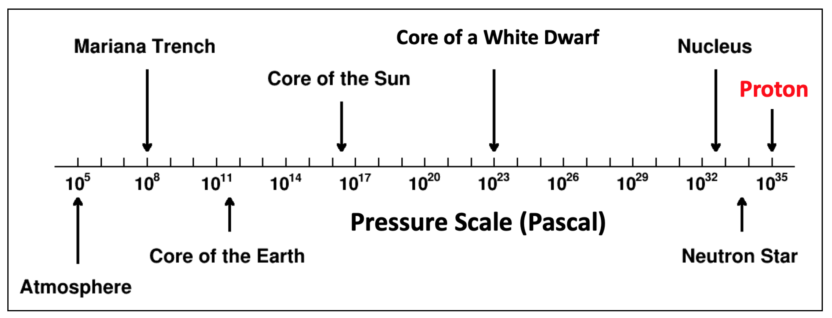
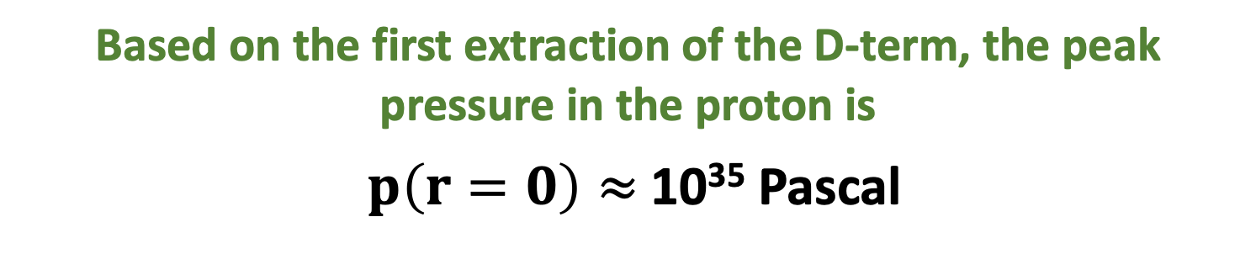
Message on mechanical properties of proton
Based on the first extraction of the D-term, the peak pressure in the proton is
$p\left(r=0\right)≈$10³⁵ Pascal
Notes:
The main message from this result is that the peak pressure in the proton exceeds the peak pressure of all known macroscopic objects in the universe.
--click
The first results on the D-term from experimental data have been confirmed from measurements of time-like Compton scattering as well as LQCD calculations.

Slide 27
Time-like Compton Scattering γp e⁺e⁻p
P. Chatagnon et al. (CLAS), PRL 127 (2021) 26, 262501
TSC
BH
M = 1.81 GeV
J/ψ
ω
φ
M(e⁺e⁻)cut
M = 2.25 GeV
d₁(t)
ImH(ξ, t), ReH(ξ, t) are projected out through the beam polarization ν and the φ, and θ dependence of the interference term.
A_{FB} confirms the large contribution of the D-term to ReH
Notes:
In TCS one starts with a real or quasi-real photon beam and measures the proton and lepton-pair production in the final state. The beam spin asymmetry accesses the Im(H) as in DVCS. What is unique in TCS is that one can define the forward-backward asymmetry which accesses the Re(H).
---click
The mass of the e+e- pair provides the large scale (Q2). It is divided into 2 ranges 1.81 MeV and 2.25 GeV. The beam-spin asymmetry at the bottom is large and consistent with the DVCS results where they overlap.
---click
The forward backward asymmetry shows also consistent results with the DVCS as the D-term analysis was used as input in the prediction. The difference of the solid and dashed magenta lines is due to the D-term.
--click

Slide 28
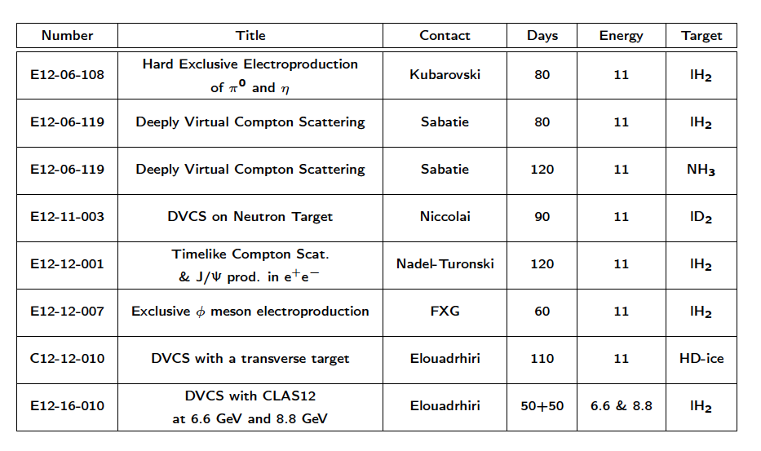
CLAS12 GPD program
Data status
50%
45%
100%
45%
35%
Girod
60%
NH₃
Design
phase
D’Angelo
scheduled
2023/24
Notes:
The more complete program on Imaging and mechanical properties is shown in this table that also includes other hard exclusive processes that are relevant to this program, such as pseudoscalar meson production, phi production and DVCS on transverse polarized target. In several cases about 50% of the anticipated data have been collected, and the analysis is underway.

Slide 29
Sample cross section – DVCS @ 10.6 GeV
The first BSA in DVCS at 10.6 GeV have been published from Hall B in extended kinematics and higher precision.
The first DVCS cross sections are in the final approval state.
Hall A cross section data at high Q² and high x_{B} have been published
Global analyses including DVCS data at higher energy are in preparation.
0.25 < |t| < 0.4 GeV²
Preliminary
Notes:
Looking to the near term, BSA DVCS data at higher energy have already been published but have not been included in global analysis.
New DVCS cross section data at higher energy and higher statistics are in the process of being published. This graphs shows sample data at
fixed bin in –t showing the DVCS + BH cross section.

Slide 30
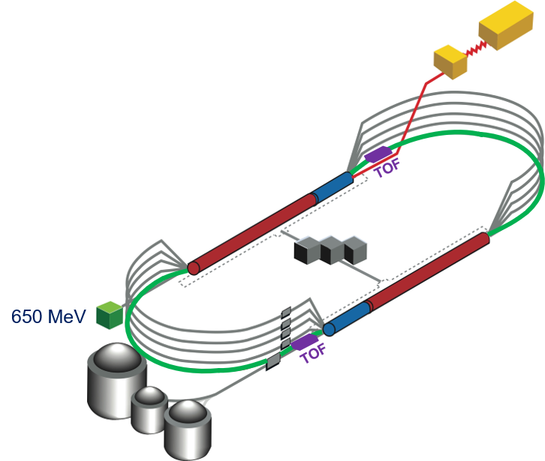
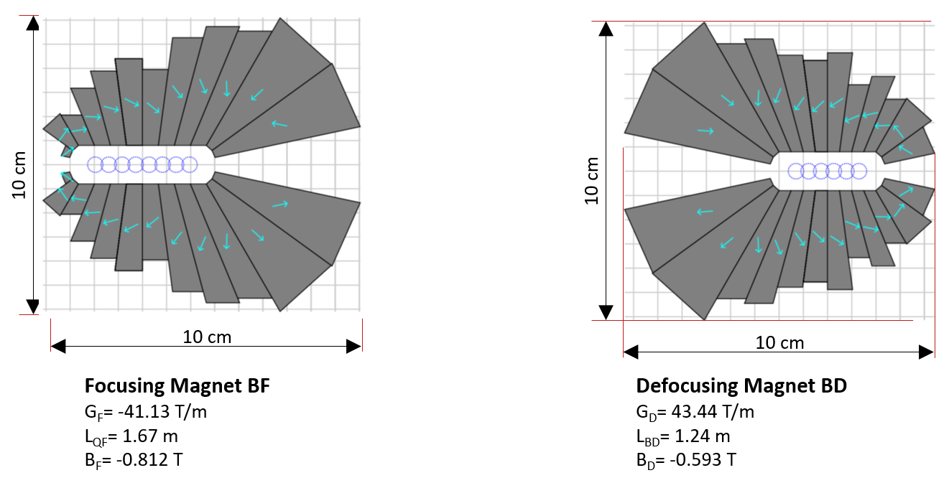
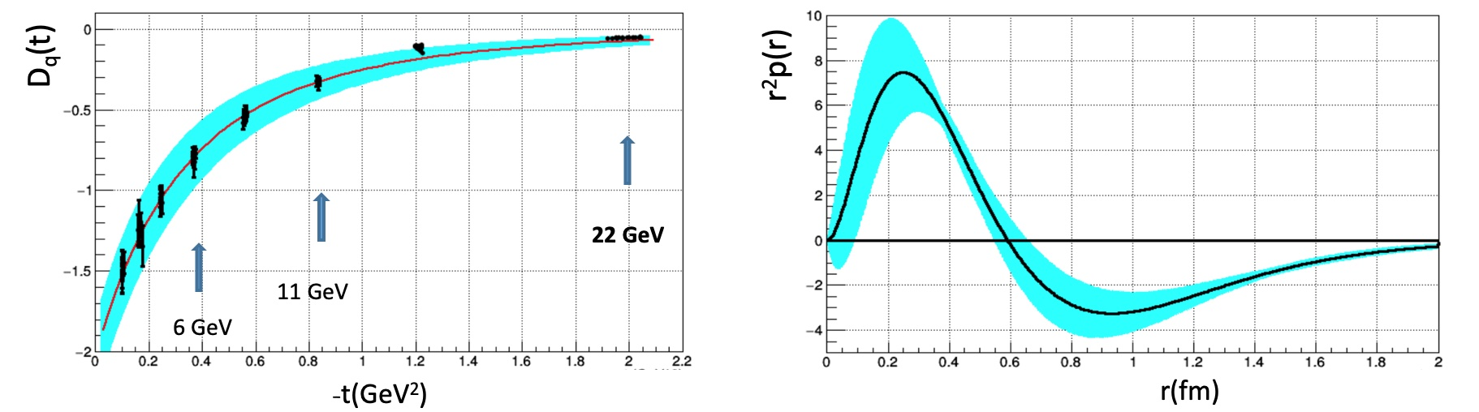
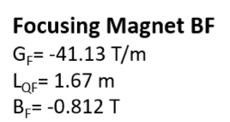
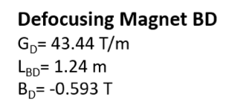
Proton pressure distribution at 22 GeV
Strong Interaction Physics at the Luminosity Frontier with 22 GeV Electrons at Jefferson Lab, e-Print: 2306.09360
→ Allows maintaining the high luminosity operation in external fixed target setup.
The larger coverage in ξ (x_{B}) and in t leads to significant reductions of systematic error in the extraction of the D-term, and in the radial distribution of pressure inside the proton.
Notes:
An interesting energy extension is the proposed 22 GeV energy upgrade of the CEBAF accelerator. It makes use of a novel technology of permanent magnets that enable concentrated magnetic field with very different strength to live next to each other. To make use of this possibility the 2 highest energy arcs can be replaced with five FFA arcs that will transport electrons N times with dE = N x 2.2 GeV increase in energy. At 22 GeV the kinematics reach is significantly increased adding smaller xi and larger –t range with –t/Q^2 < 0.2.

Slide 31
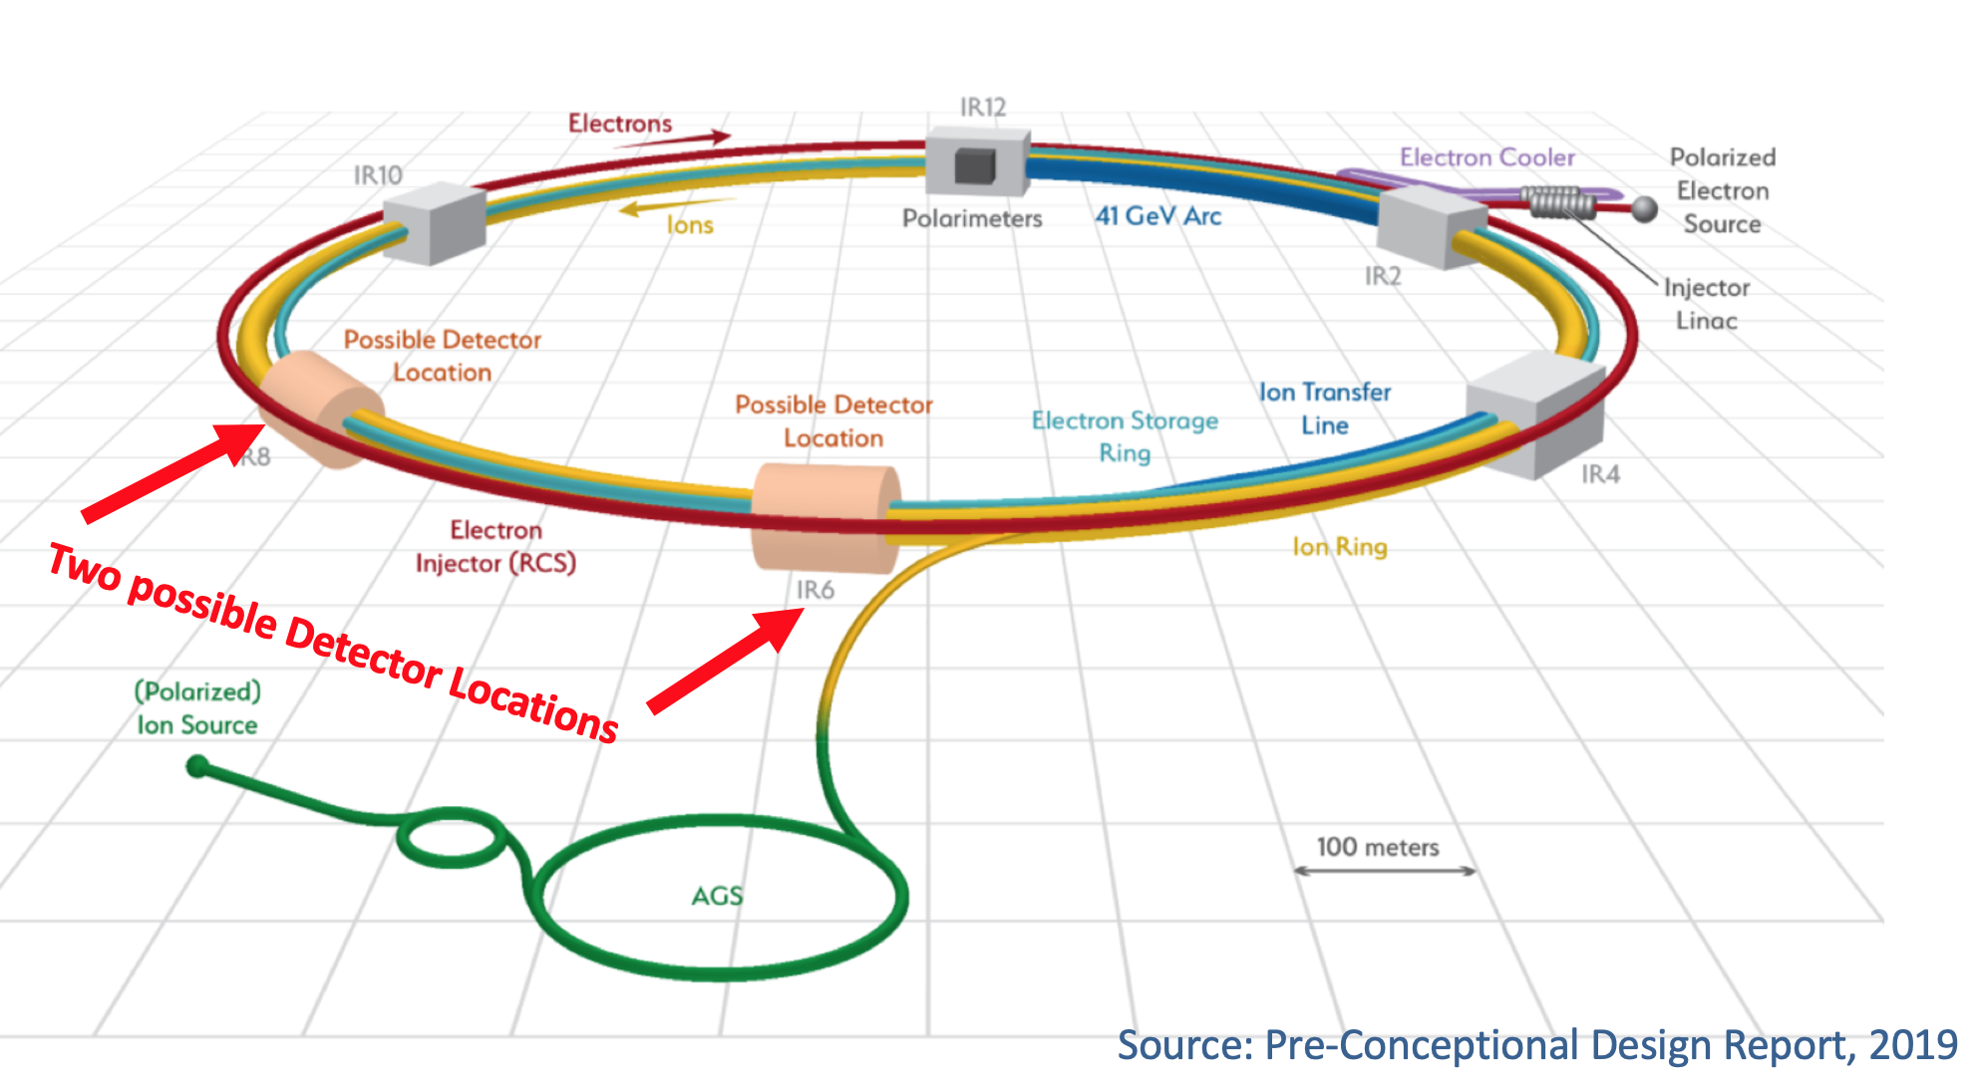
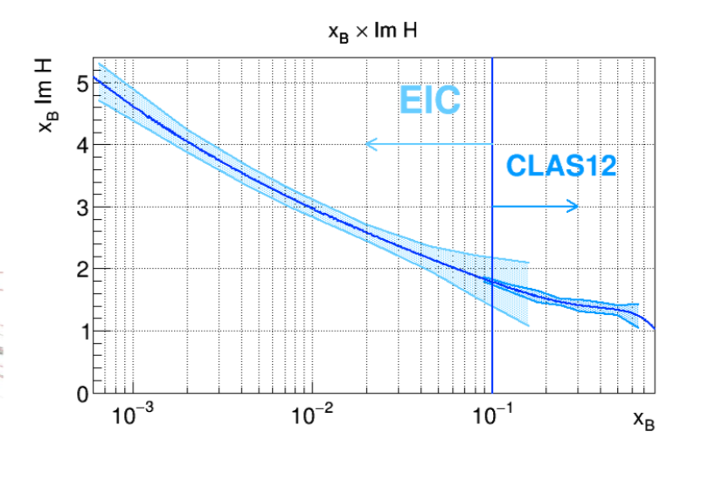
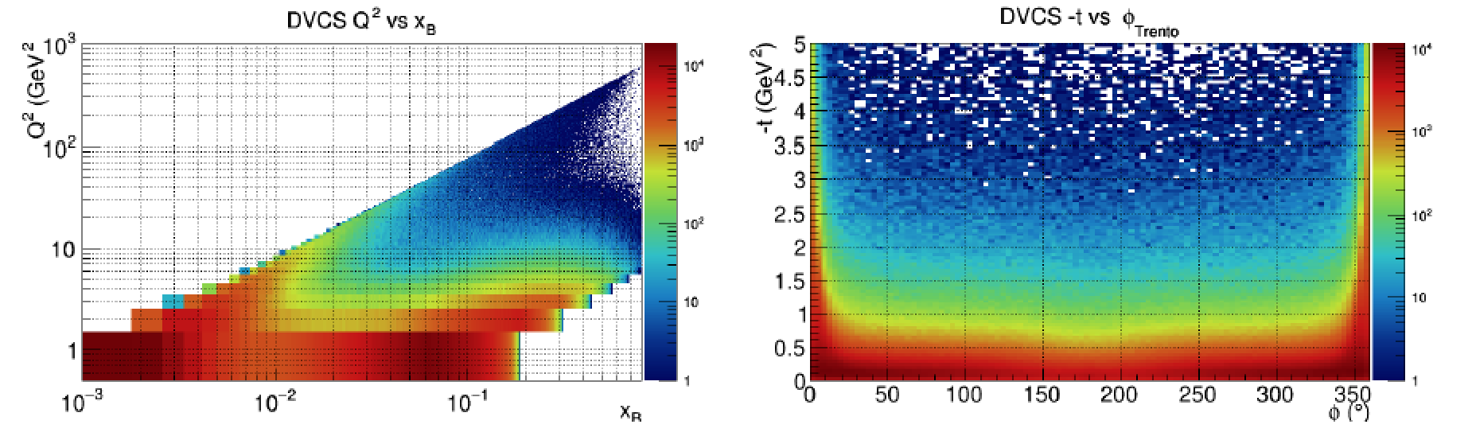


GFF studies at the Electron Ion Collider
CFF H(x,t) extraction at EIC kinematics with integrated lumi-nosity of 200 fb⁻¹ w/ polarized electrons and polarized protons.
x_{B} ImH
DVCS Kinematics @ $\sqrt{s}$ = 30 GeV
x_{B} ReH
Prog. Part. Nucl. Phys. 131 (2023) 104032, e-Print: 2211.15746
Credit: F.X. Girod
Notes:
The EIC has the potential for extending the relevant DVCS processes with polarized electrons and polarized protons to the smaller xi range given sufficiently high luminosity. The figure below shows the DVCS kinematics at the lowest CM energy. The right part shows the Imaginary and Real part of Compton FF H from simulations of the full x-range at medium energies and high luminosity, including polarized electrons and protons. At high x_B it links up with the 12 GeV data enabling complete kinematic coverage.

Slide 32
Conclusions
The nature of excited baryon states is revealed in probing them in interactions using a probe with tunable spatial resolution.
The transition amplitudes of different excited states of the proton reveal complex internal structures of excited states that are composed of a central quark core and a peripheral meson-baryon cloud.
the Roper N(1440)1/2⁺ and N(1535)1/2⁻ have been identified as regular states, including a quark core consistent with [SU(6)xO(3)] symmetry and a complex meson-baryon cloud.
DVCS is the basis for studying gravity-like interactions, it enables the extraction of gravitational form factors and the pressure and shear stress when linked to the proton’s energy-momentum tensor.
Ongoing experiments at 12 energy and at high luminosity cover a larger kinematic range and enable higher precision results.
The new science of gravitational structure of particles supports the JLab operation with positron beam and the energy upgrade to 22 GeV, as well as the operation of the EIC at high luminosity.

Slide 33
Additional Slides

Slide 34






Light front transition charge densities
Roper N(1440)1/2⁺
ρ₀
N(1535)1/2⁻
ρ₀
ρ_{T}
ρ_{T}
charge densities
charge densities
Electric Dipole
b_{y} (fm)
L. Tiator, M. Vanderhaeghen, PLB672 (2009) 344-348
b²ρ_{T}
P
P
The Roper resonance exhibits a softer core and a more complex meson cloud than the N(1535) state, which shows a hard core and a more confined meson cloud.
b²ρ_{T}
b_{y} (fm)
J_{m} = +½ -> -½
Electric Dipole
Notes:
At this point I want to compare he Roper and the N*(1535) states by determining the transition charge densities on the light-front.
Using both helicity amplitudes A1/2 and S1/2, we can convert them into the transition form factors F₁^{NN*,} and F₂^{NN*} as shown here.
The F1 and F2 can be isolated, and the transition charge and magnetization densities can be determined.
In a Fourier transform using 0th -order and a 1st -order spherical Bessel functions we can determine unpolarized and the polarized transition densities.
-- click
The Roper resonance on the left is compared with the N*1535 on the right, shows a softer core and broader wings.
If the transition occurs in a transverse magnetic field (i.e. spin polarization) in the 2D image is shows a larger shift of the core and a wider distribution of the wings.
The N(1535) core remains in place in the magnetic field, while the Roper’s charge density center is shifted in the magnetic field and developed wider electric dipole wings.
--click
As for the nature of these state , the Roper exhibits a much softer core and a more complex meson cloud than the N(1535) resonance, which exhibits a hard core and a more confined meson cloud.

Slide 35
N(1675)5/2⁻ Meson-Baryon contributions
Using the quark selection rule and the LF RQM and hCQM we obtain insight into the isospin components of the MB contributions to the γpN⁺(1675)5/2⁻ and γnN⁰(1675)5/2⁻ transitions.
MB contributions at Q²=0 are dominated by isovector amplitudes.
[15] R. Workman et al.
Notes:
We can extract the isotopic nature of the MB amplitudes at AQ2=0, which are dominant isovector.

Slide 36
Impact of the Discovery on Nuclear Science
Since the publication in 2018, the research in this novel area of hadron physics has been strong
  Over 230 papers (mostly theory) have been published in this area
  Extraction of gluonic GFF J/ψ production at threshold from photoproduction experiments
New experiments have been conducted at higher energy (JLab@ 12 GeV) with new equipment
Proposals for measurements at the EIC
Justification of the development of a positron beam at JLab.
Included in the next NSAC Long Range Plan as part of the science program
Provides justification for an energy upgrade at JLab/CEBAF to 22 GeV.

Slide 37

DVCS - A path towards the GPDs
DVCS
BH
ξ ~ x_{B}/(2-x_{B})
k = t/4M²
Polarized beam, unpolarized target:
H(ξ,t)
~
Δσ_{LU} ~ sinφ {F₁H + ξ(F₁+F₂)H +kF₂E}dφ
Unpolarized beam, longitudinal target:
~
~
H(ξ,t)
Δσ_{UL} ~ sinφ {F₁H+ξ(F₁+F₂)H +ξ/(1+ξ)E)}dφ
Unpolarized beam, transverse target:
E(ξ,t)
Δσ_{UT} ~ cosφsin(φ_{σ}−φ){k(F₂H – F₁E)}dφ
Notes:
In order to get information about the GPDs DVCS is currently the most convenient process to access Compton Form Factors, which are moments of GPDs through the analysis of the DVCS process with polarized electron beam.

Slide 38
Something to remember
“It can be shown that any massless spin-2 field would give rise to a force indistinguishable* from gravitation, because a massless spin-2 field would couple to the stress–energy tensor in the same way that gravitational interactions do”.
Misner, Charles W.; Kip S. Thorne; John Archibald Wheeler (September 1973). Gravitation. San Francisco: W. H. Freeman. ISBN 0-7167-0344-0.
*except for its strength

Slide 39
Light-quarks acquire mass
T>10¹⁴K
DSE/QCD
Lattice QCD
quark mass (GeV)
At lower temperature quarks acquire mass and form resonances before stable nucleons are formed.
T<10¹²K
→ Measure observables in electroproduction that are sensitive to the quark mass, e.g. resonance production rate vs temperature (energy) .
9/21/23
V. Burkert Baryons 2016, Tallahassee, May 16-20, 2016
39
Notes:
At high energies up quark and down quarks have masses of few MeV. As temperature lowers light quarks acquire mass through coupling to gluons and form resonances.
click
We can experimentally test this in electroproduction by measuring observables that are sensitive to the quark mass, e.g. the resonance production cross section for specific N* resonances.
---click

Slide 40


NΔ⁺(1232)3/2⁺ helicity amplitudes
LF RQM [m_{q}(p)]
p(e,e’)π⁰
MB - inferred
MB contributions consistently present at Q² ≤ 3 GeV² for all amplitudes.

