Slide 1
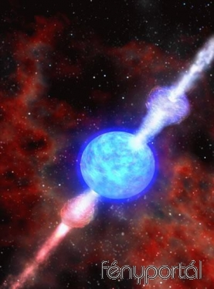
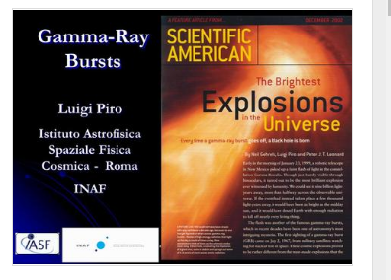
Gravitational Waves, Fusion of two Neutron Stars and Gamma Ray Burst
D.Fargion, P.Oliva
See also Solving the missing GRB neutrino and GRB-SN puzzles

Slide 2
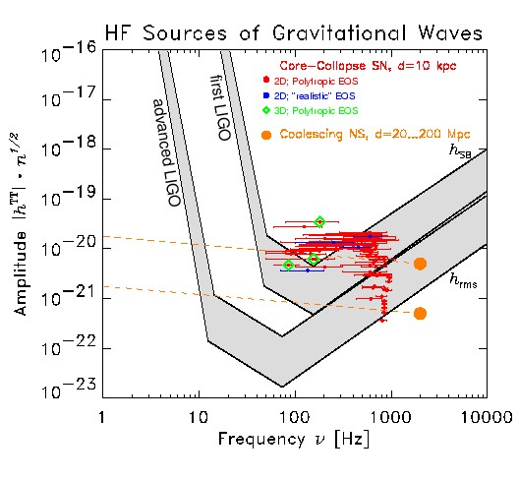
A main question arised since a month and worried us :
Could GRB 170817 be correlated to the Ligo Virgo NS-NS GW170818?
(DF, Maxim Khlopov,P.Oliva, in press)

Slide 3
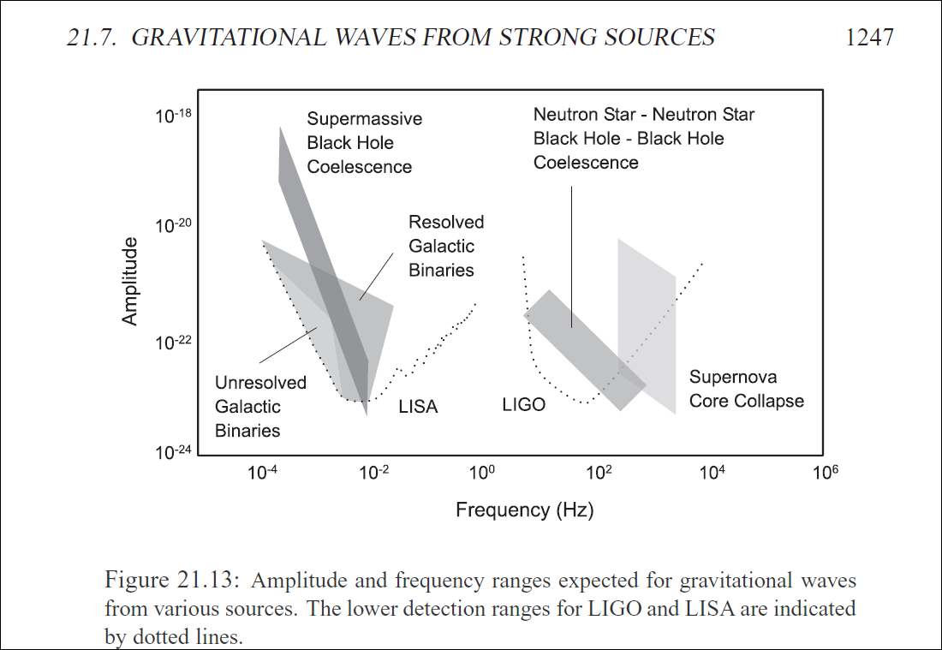

Slide 4
The Fermi message: Short GRB
the Fermi Gamma-Ray Burst Monitor triggered and located GRB 170817A (trigger 524666471 / 170817529). The on-ground calculated location, using the GBM trigger data, is RA = 176.8, DEC = -39.8 (J2000 degrees, equivalent to 12 h 47 m, -39 d 48'), with an uncertainty of 11.6 degrees …The GRB light curve shows a weak short pulse with a duration (T90) of about 2 s (50-300 keV). …the cutoff energy, parameterized as Epeak, is 82 +/- 21 keV The event fluence (10-1000 keV) in this time interval is (2.3 +/- 0.4)E-07 erg/cm^2. ..

Slide 5
One month ago, on 17 August , UT, 12:41:06...

Slide 6
An amazing surprising huge discover
There are several reasons to be surprised:
(and maybe to be very sceptic):
1) The first triple Ligo Virgo signal in 25 days!
2) The first NS NS event!!
3) The nearest Short GRB by FERMI (40 Mpc)!!!
4) The FIRST Fermi GRB-GW signal!???
GW are almost spherical,OK, we agree;
BUT GRB must must be a jet beamed to us: how could be at the very first event blazing a jet just pointing to us?

Slide 7
A Ligo-Virgo (probable) discover of a NS NS collapse: a few pubblic data. Omerta’?
The HST has made a series of observations of NGC 4993 recently. This sequence of observations started at 2017 August 22d 07h UTC and was for the following three HST proposals:
HST Proposal 14804: Rapid ToO observations of the first gravitational wave counterparts
HST Proposal 15346: Verifying a candidate counterpart to gravitational waves
HST Proposal 15382: UV Spectroscopy of GRB170817A
PI: Matt Nicholl (Harvard University)
GRB170817A is the most nearby short GRB ever discovered. We detected an optical counterpart using DECam and propose to obtain a UV spectrum using STIS. See LINK:
https://archive.stsci.edu/proposal_search.php?mission=hst&id=15346

Slide 8
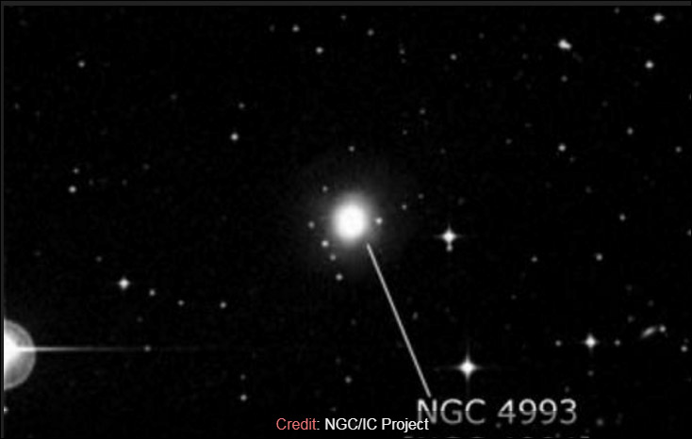
Hubble Telescope , Chandra, Fermi, Integral ..
all looking to NGC4993

Slide 9
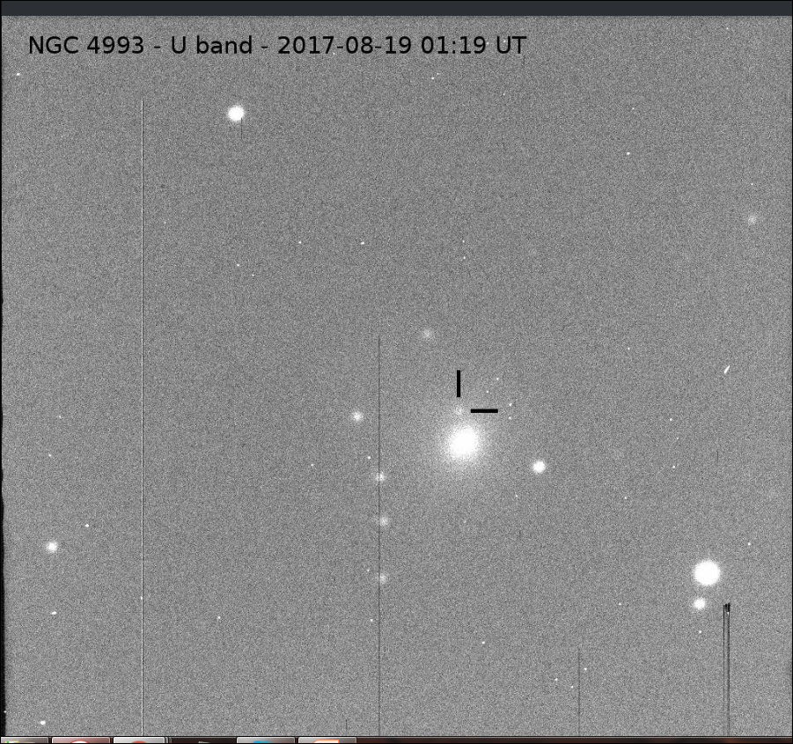
A Variable OT on 19 August: the GRB 170817° afterglow ?

Slide 10
Very hidden news
While LIGO on its own can give only an annulus on the sky from the two detectors, and VIRGO would localise that to a small region where three annuli overlap (3 by any 2-of-3), LIGO also gives luminosity distance from the measured strain. If that was around 40 Mpc, even with a quite large uncertainty, the known range limits the number of candidate galaxy hosts in the search volume.
Chandra has observed the X afterglow

Slide 11
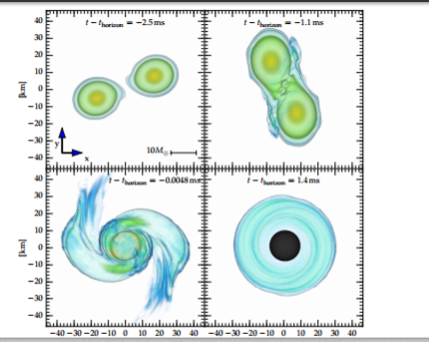
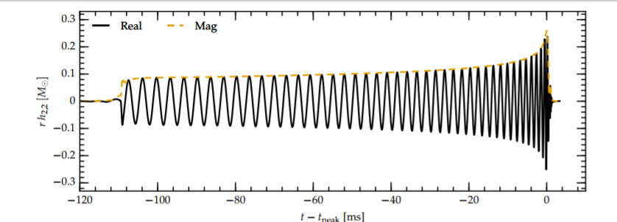
Simulations of inspiraling and merging double neutron stars using the Spectral Einstein Code: THE MODEL
arXiv:1604.00782v2 [gr-qc] 25 Jun 2016

Slide 12
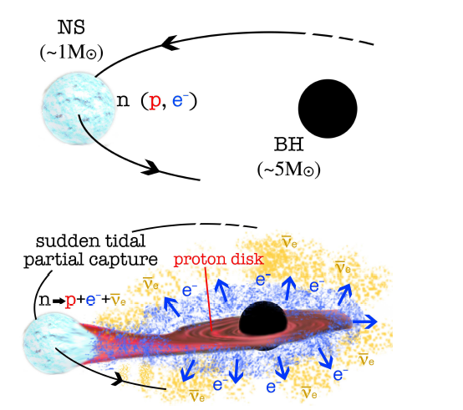
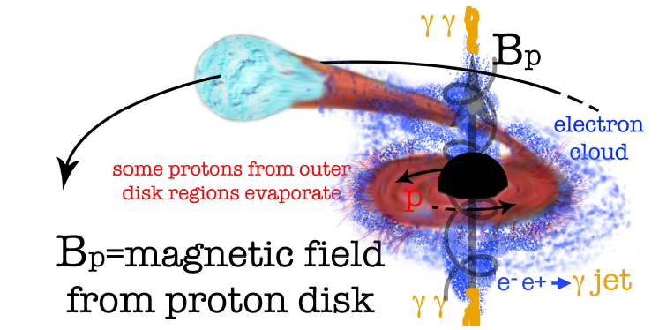
There is a missing picture: NS NS or NS BH, must make a GRBs by Jets

Slide 13
First approximated values assuming NS NS at 40 Mpc
Released GW energy for 2 NS-NS merging
EGW = 3 * 10^(53) erg ( 2M/Msun)^2
Egamma_Fermi_iso= 4.1 +_ 0.6 * 10^(46) erg
Pgamma_Fermi_iso = 2 *10^(46) erg s^(-1)
RATE NS NS merging assuming one event a year
RNS_NS = 1.56 * 10^4 Gpc/year
Galactic Event rate (assuming a galaxy for Mpc)
R_galaxy = 16 Myr^(-1)
Huge (SN like) thermal 10-20 MeV neutrino burst

Slide 14
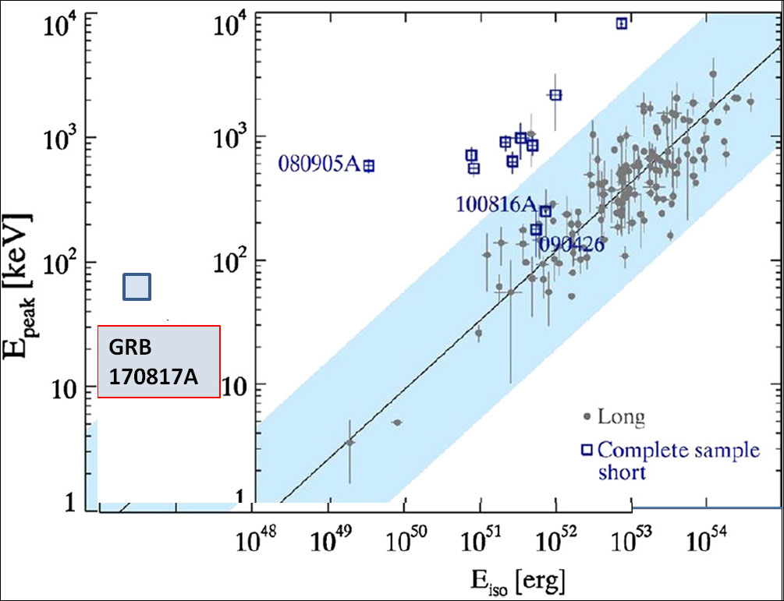
Extreme GRB170817a: To explain the GRB spread we need collimated or off axis jets

Slide 15
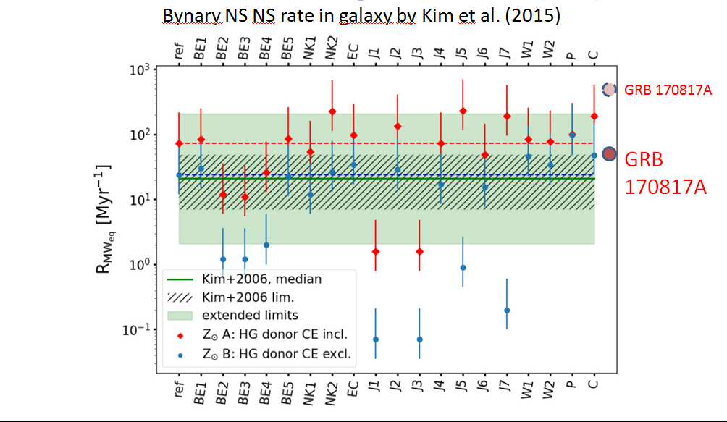
r-processes , chemical pollution, and expected NS NS rate at the edge

Slide 16
Fig 6

Slide 17
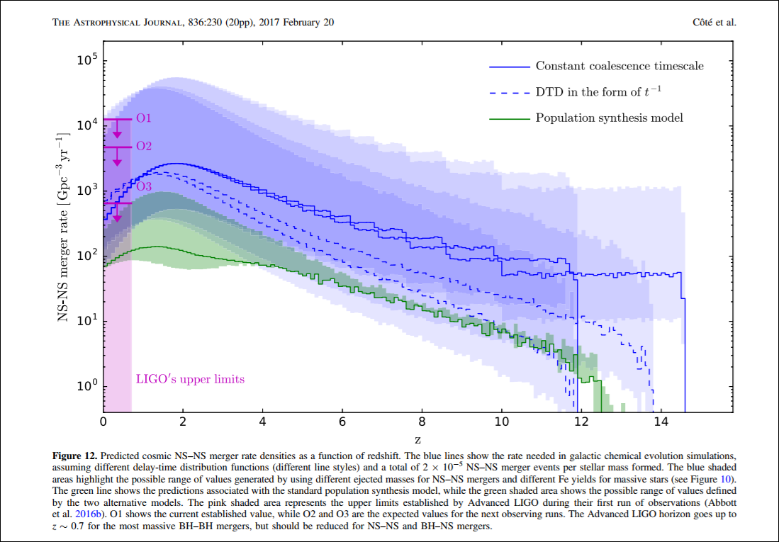
Last 2016 paper: extreme range
GRB 170817A

Slide 18
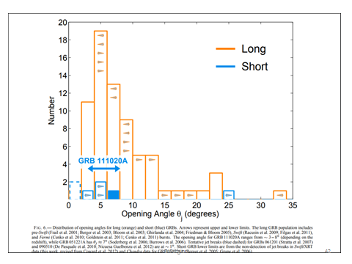
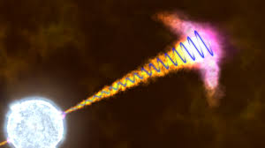
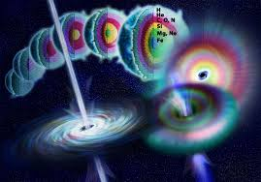
Usual GRB short beam angle 5 degree (one shoot event), 0.05 degree for precessing thinner jet at thousand Lorentz factor

Slide 19
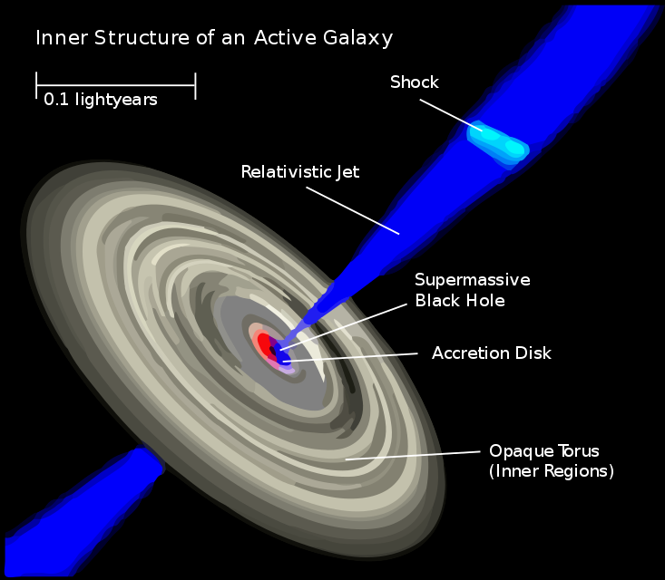
Is it all GRB 170817°-GW170818 unexplainable?
The very possibility to be real it is in the same exeptional Fluxes and softness of the event
We may just been observing an OFF AXIS
GRB as off axis Quasar –BL Lac jet; see also
The same proposal was
Suggested on 1998 for the
Near soft GRB 980425 benn
seen off axis:

Slide 20
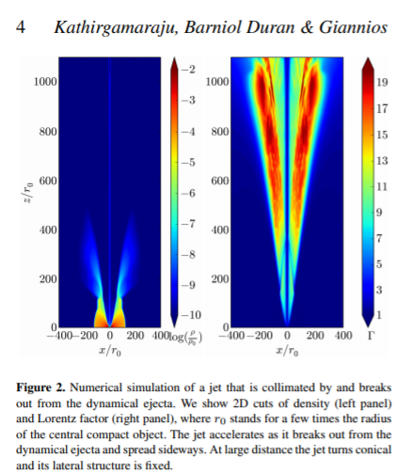
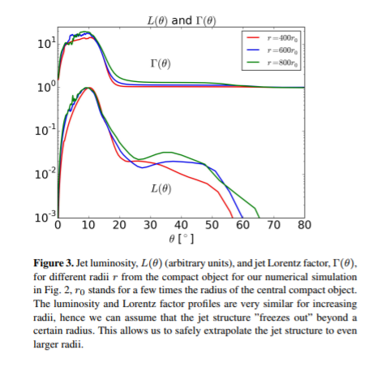
Beaming angle recent paper arXiv:1708.07488v2

Slide 21
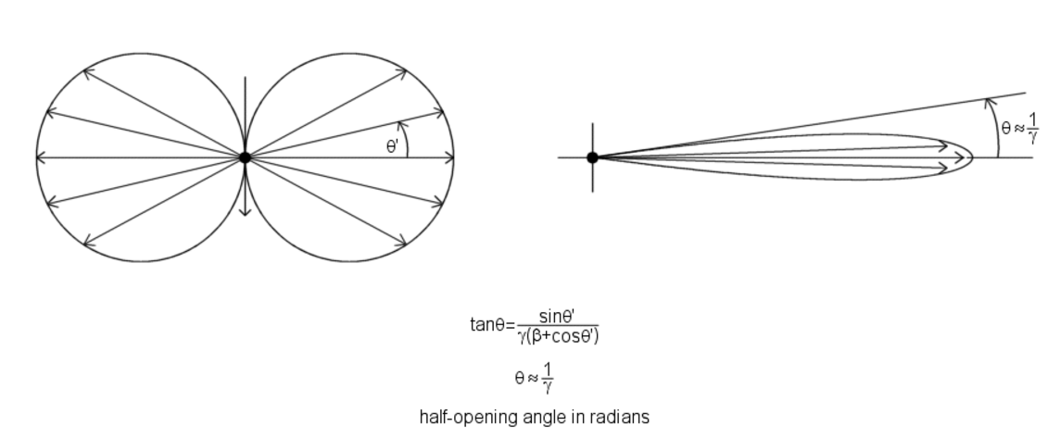
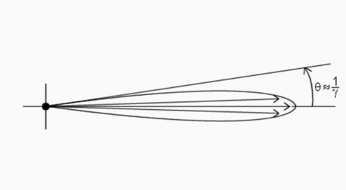
The simplest beaming jet
Different Lorentz factor, different beaming, different apparent Luminosity Peak: THERE MUST BE A Power Spectra in electron jet and consequent spread gamma jet too.

Slide 22
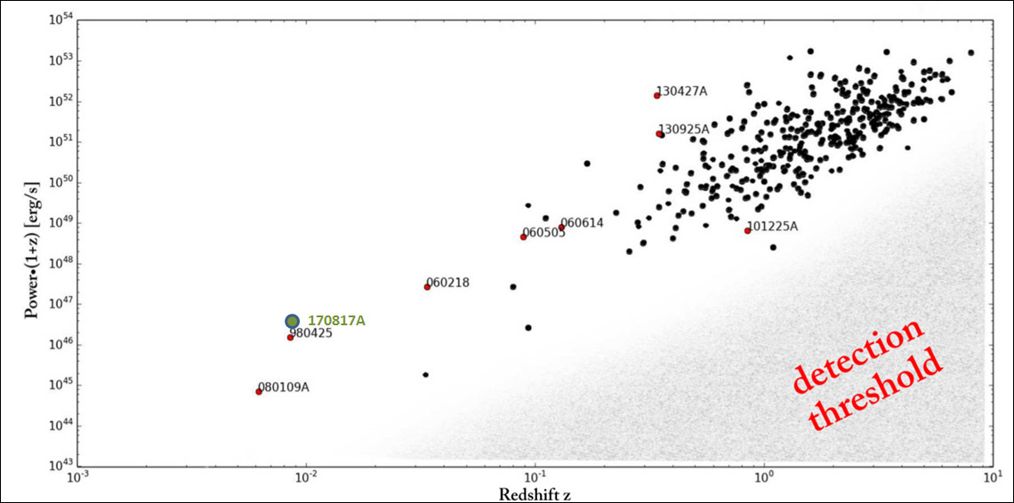
Fluency all GRB and redshift
The GRBs and Peak Luminosity versus GRB170817A
Almost 8 order of magnitude require thin jet beam

Slide 23
Astron. Astrophys. Suppl. Ser. 138, 507–508 (1999) On the nature of GRB-SGRs blazing jets
Peak Luminosity estimate for ICS

Slide 24
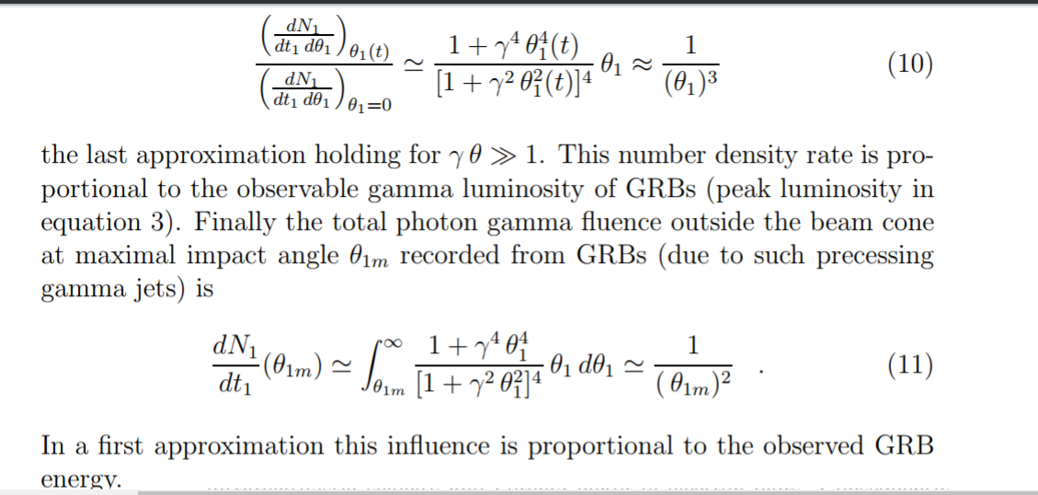
Beaming at different angle different peak luminosity

Slide 25
Conclusion: a possible explanation for GRB off axis ( with a little lucky off axis: 20 degree wide)
Assuming Gamma = 3000; theta 0.02 degree.
Assuming off axis Theta= 1/3 radiant =19 degree
(probability to be off-axis = 0.04)
Ratio between peak intensity on and off
(on axis at 1/3000 rad ): one million!
Same ratio between probability to be inside the
Nearby 40 Mpc versus 4 Gpc.: a million times
Peak Luminosity almost as the observed ratio at max. Luminosity peak:
10^53 erg s^(-1): cosmic versus
10^46 erg^(-1): GRB 170817°
SAME ARGUMENT USED on 1998 to explain near 40 Mpc GRB 980425°
See also Also : https://arxiv.org/pdf/astro-ph/9808005.pdf

Slide 26
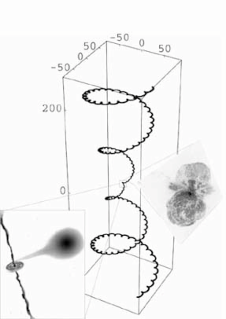
Thank you for your beamed attention

Slide 28
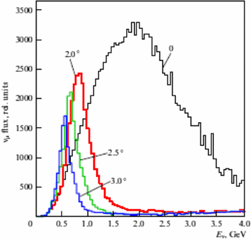
Beaming with energy and angle Nova : Shanahan

Slide 29
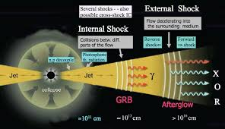
Old GRB Fireball stories

Slide 30
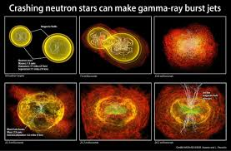
Old Models

Slide 31
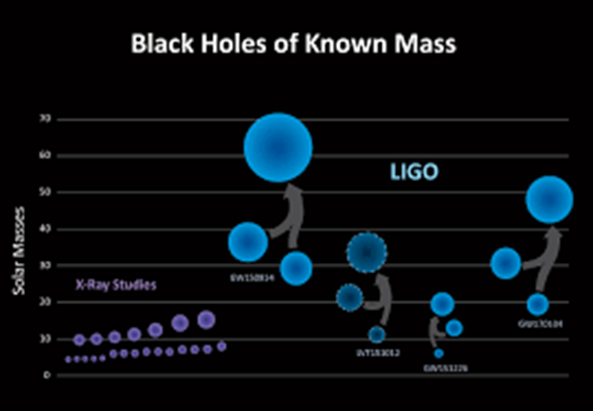

Slide 32
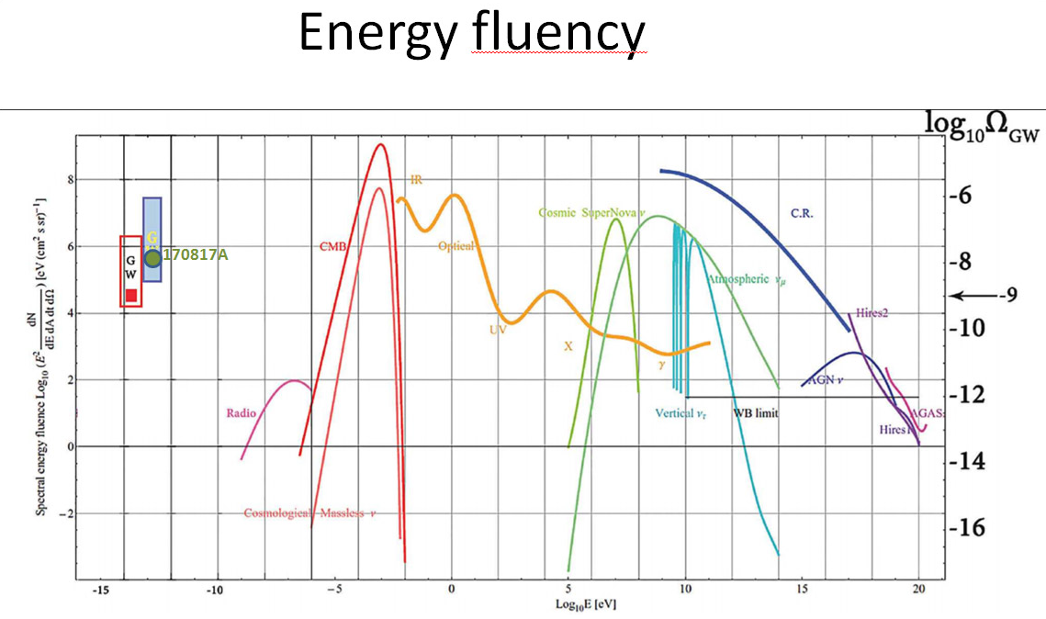
Fig 7

Slide 33
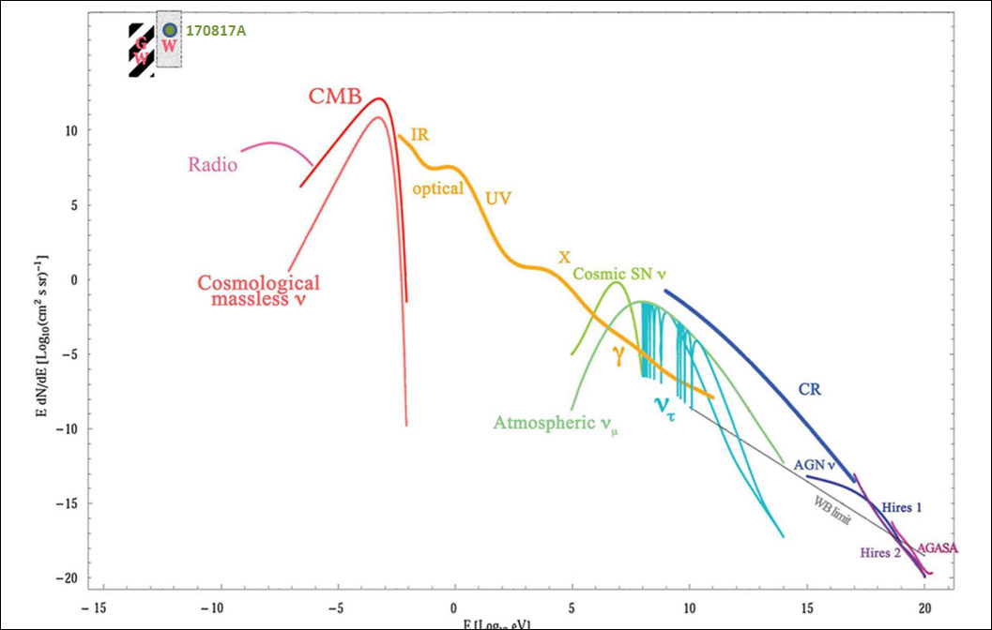
Number flux

Slide 35
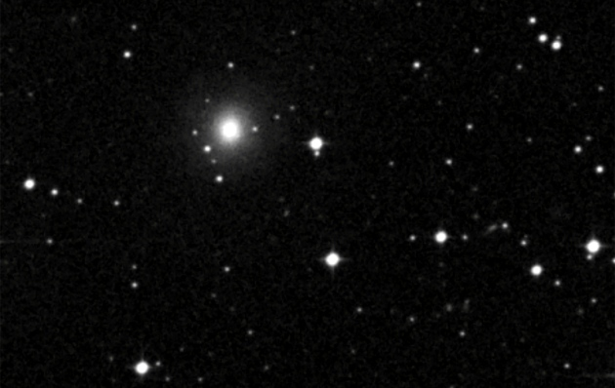
GWS SGRB 170817A
30-08-2017

Slide 36
15382( 4) - 22-Aug-2017 12:33:20 - [ 1] HUBBLE SPACE TELESCOPE OBSERVING PROGRAM 15382Version: 4 Check-in Time: 22-Aug-2017 12:33:20 STScI Edit Number: 2 TitleUV Spectroscopy of GRB170817A ------------------------------------------------------------------------------------Type CycleGO/DD 25 ------------------------------------------------------------------------------------Investigators Contact? PI: Matt Nicholl Harvard University Y CoI: Prof. Edo Berger Harvard University N CoI: Mr. Philip Cowperthwaite Harvard University N ------------------------------------------------------------------------------------AbstractGRB170817A is the most nearby short GRB ever discovered. We detected an optical counterpart using DECam and propose to obtain a UV spectrum using STIS. ------------------------------------------------------------------------------------ Observations Description ------------------------ 1 orbit UV spectrum of LIGO BNS optical counterpart. Using STIS + G230L for wide wavelength coverage. ------------------------------------------------------------------------------------ 15382( 4) - 22-Aug-2017 12:33:20 - [ 2]TARGET LIST Fixed Targets------------------------------------------------------------------------------------------------------------------------------------Tar| Target | Target | Target |Coord | Radial | Flux dataNo | Name | Description | Position |Eqnx | Vel. |------------------------------------------------------------------------------------------------------------------------------------1 BNS-MERGER EXT-STAR, GAMMA RAY RA=13H09M48.0900S +/- 1", J2000 V = 18 +/- 2 UVW1 ~ 17.7 BURSTER DEC=-23D22'53.35" +/- 1" Reference Frame: ICRS Extended: NO------------------------------------------------------------------------------------------------------------------------------------2 GRB170817A EXT-STAR, GAMMA RAY RA=13H09M48.0900S +/- 1", J2000 V = 18 +/- 2 UVW1 ~ 17.7 BURSTER DEC=-23D22'53.35" +/- 1" Reference Frame: ICRS Extended: NO------------------------------------------------------------------------------------------------------------------------------------ 15382( 4) - 22-Aug-2017 12:33:20 - [ 3]Visit: 01 Visit Requirements: <none> On Hold Comments: <none> Additional Comments: <none> Exposures------------------------------------------------------------------------------------------------------------------------------------Exp | Target | Instr | Oper. | Aper |Spectral|Central| Optional |Num| Time | SpecialNum | Name | Config | Mode | or FOV |Element |Waveln.| Parameters |Exp| (Total) | Requirements------------------------------------------------------------------------------------------------------------------------------------1 GRB170817A STIS/CCD ACQ 50CCD MIRROR 1 90 S (90 S) ------------------------------------------------------------------------------------------------------------------------------------2 GRB170817A STIS/NUV ACCUM 52X0.2 G230L 2376 1 2000 S -MAMA (2000 S) ------------------------------------------------------------------------------------------------------------------------------------Sub Exposures------------------------------------------------------------------------------------------------------------------------------------Target | Exp |Instr | Oper. | Aper |Spectral|Cent.|Primary |Secondary |Iteration |CR-SPLIT |Orbit |DurationName | Num |Config | Mode | or FOV |Element |Wave.|Pattern Pos |Pattern Pos |Num |Num |Number |------------------------------------------------------------------------------------------------------------------------------------GRB170817A 1 STIS/CCD ACQ 50CCD MIRROR none none none none 1 N/A GRB170817A 2 STIS/NUV ACCUM 52X0.2 G230L 2376 none none none none 1 N/A -MAMA 15382( 4) - 22-Aug-2017 12:33:20 - [ 4] Summary Form for Proposal 15382 Item Used in this proposal ------------------------------------------------------------------------------------------------------------------------------------ Apertures 50CCD, 52X0.2 ------------------------------------------------------------------------------------------------------------------------------------ Configurations STIS/CCD, STIS/NUV-MAMA ------------------------------------------------------------------------------------------------------------------------------------ Opmodes ACCUM, ACQ ------------------------------------------------------------------------------------------------------------------------------------ Optional Parameters ------------------------------------------------------------------------------------------------------------------------------------ Spectral Elements G230L, MIRROR ------------------------------------------------------------------------------------------------------------------------------------ Target Names GRB170817A ------------------------------------------------------------------------------------------------------------------------------------

Slide 37
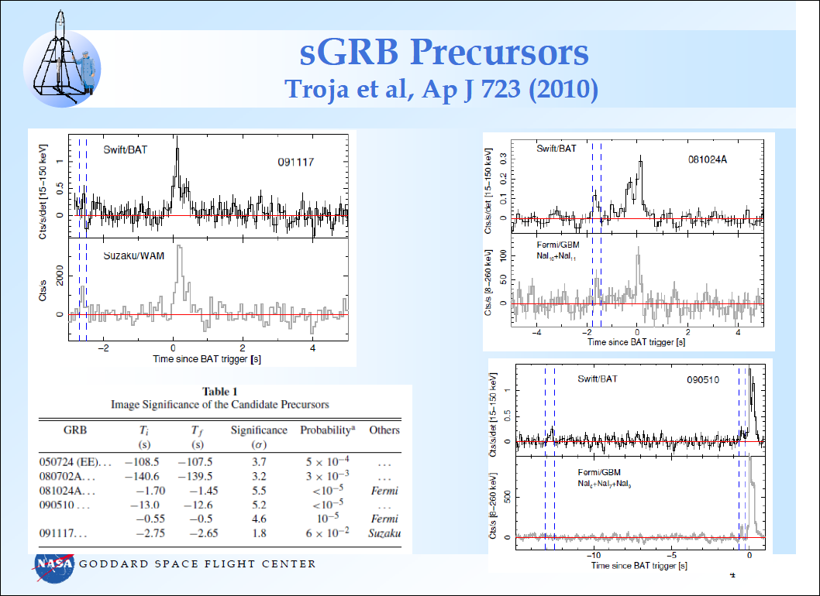

Slide 38
la galassia Ngc 4993, nella costellazione dell’Idra, a circa 130 milioni di anni luce da noi, dove sarebbe stato osservato un lampo gamma.
The galaxy NGC 4993 (fuzzy bright spot) in the constellation Hydra, where detectors are rumoured to have spotted gravitational waves from a neutron star merger.

Slide 39
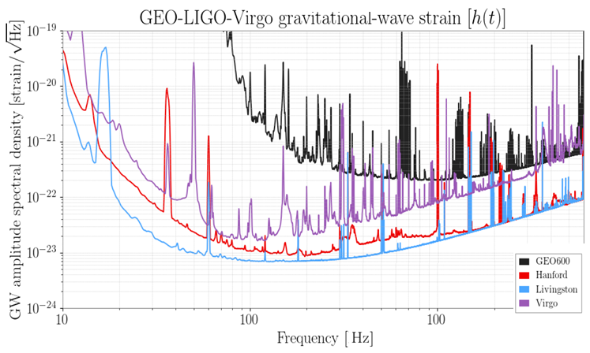

Slide 41
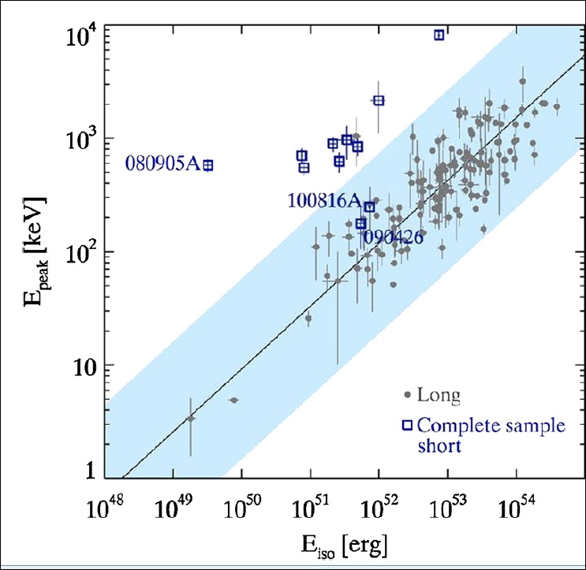
GRB 170817A

Slide 42
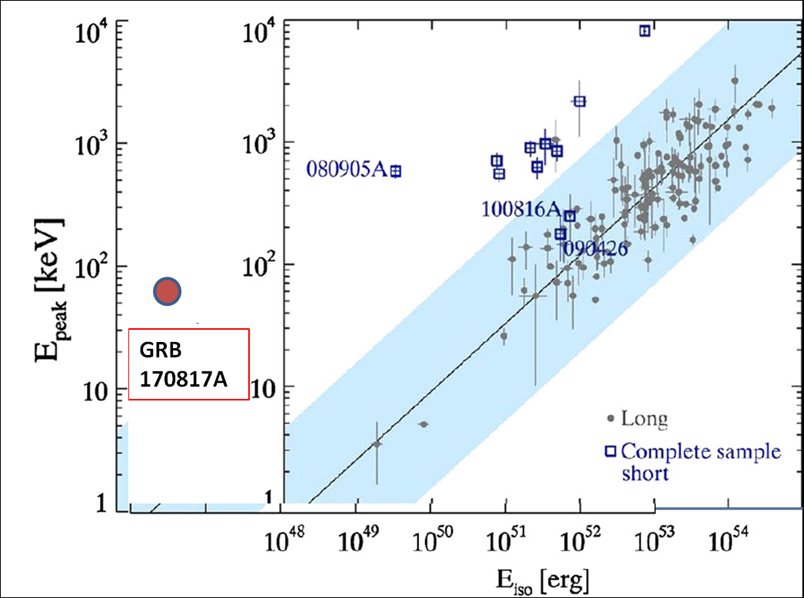
Da usare

Slide 43
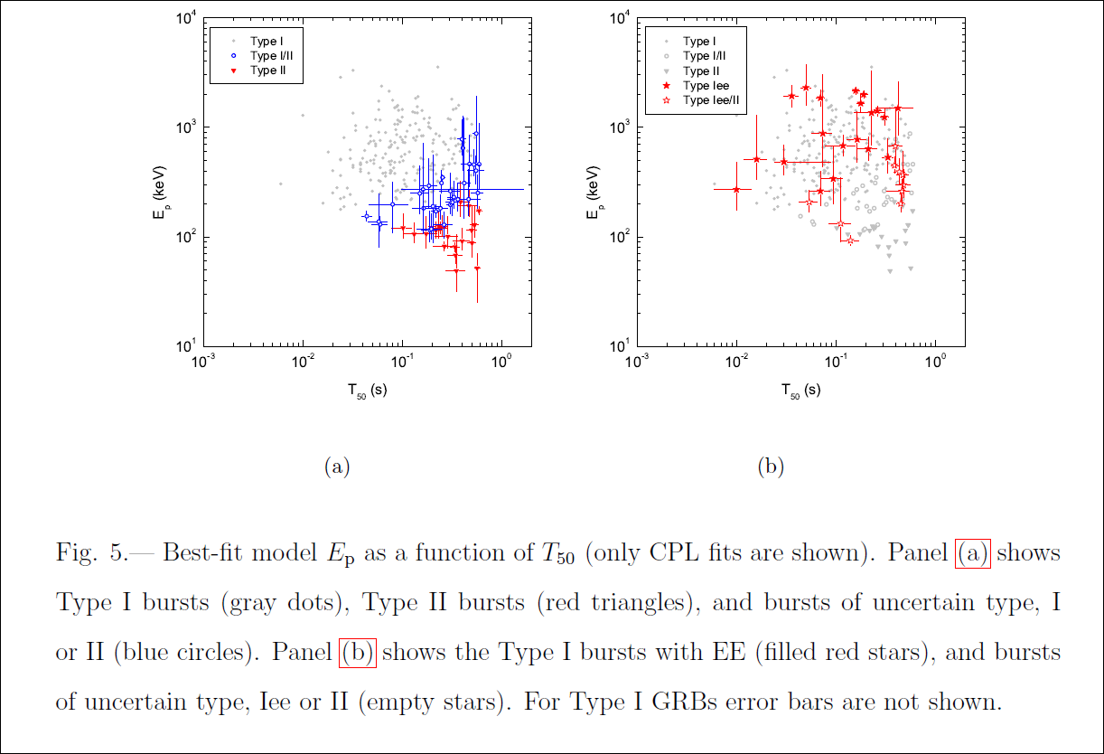

Slide 44
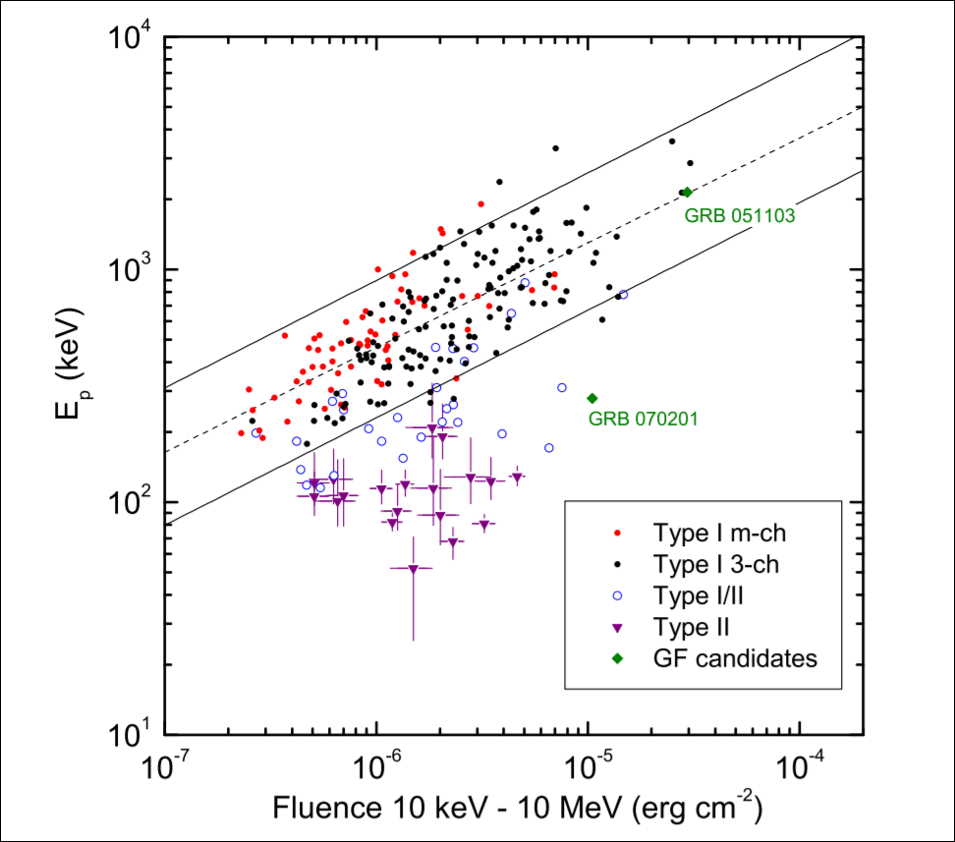
arXiv:1603.06832v1 [astro-ph.HE] 22 Mar 2016
GRB 170817A

Slide 45
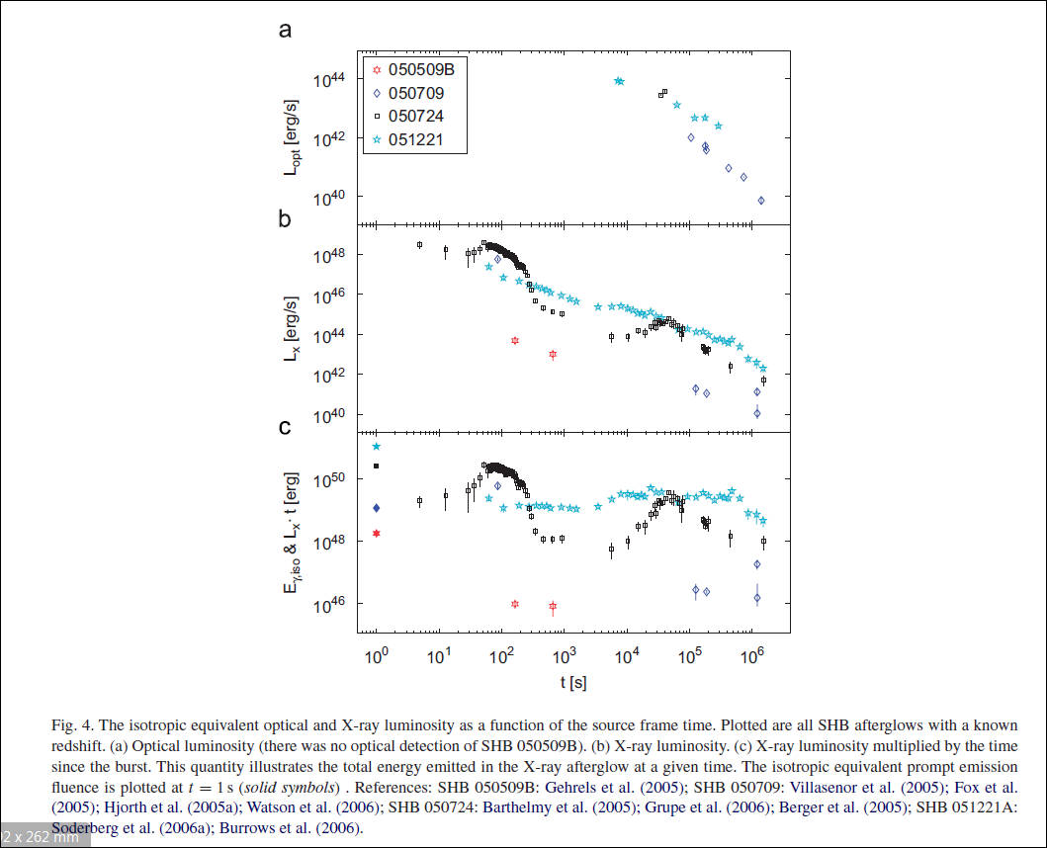

Slide 46
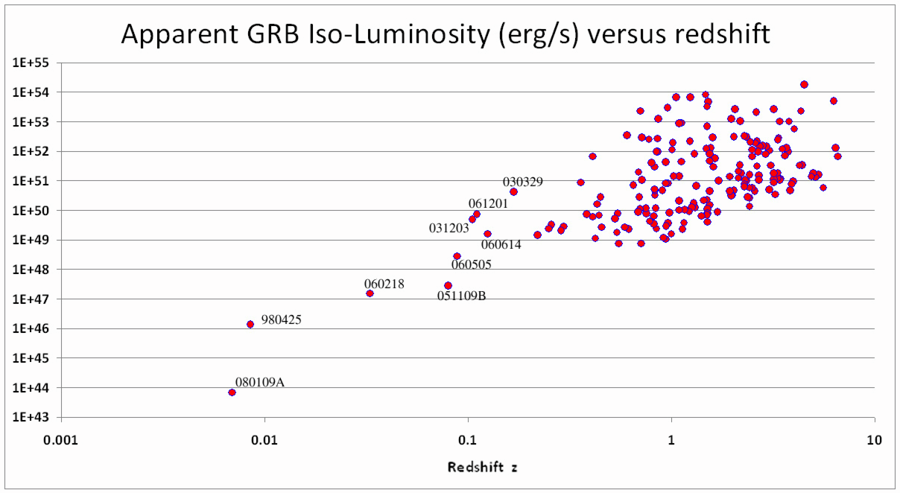
vecchia
170817A

Slide 47
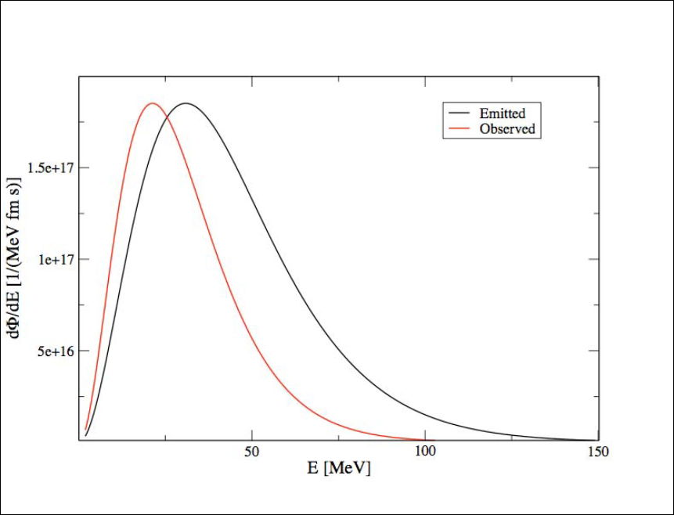
Caballero-NS_NS

Slide 48
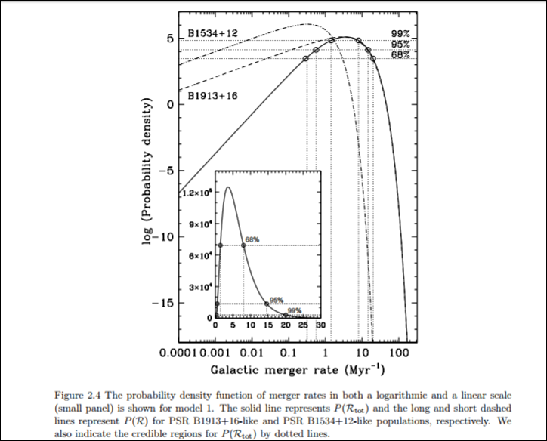
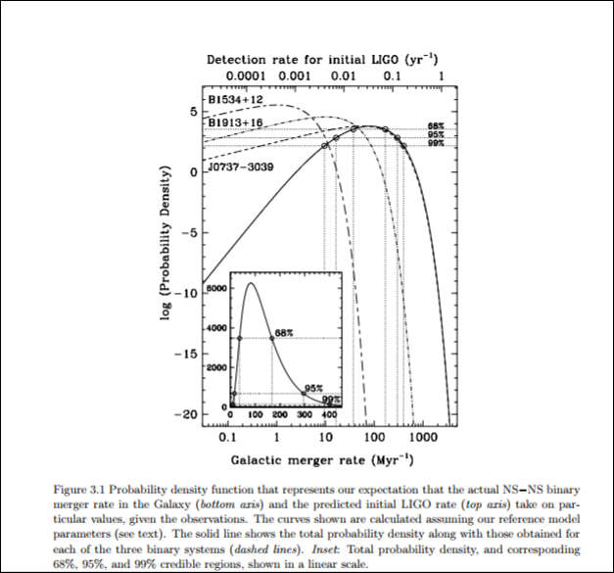
Kim 2005_Prima e dopo

Slide 49
2015_Theoretical Astrophysics, Mike Guidry-CH21

Slide 50
Ns Ns merging last stages
L = 6.3* 10^(51) erg s^(-1) (M/Msol)^(10/3)*(0.01 s./P)^(10/3)
Maxima output at 2-3 ms.
Total energy radiated into bigger NS
Delta ENsNs = 3* 10^(53) erg (Mfin/2 Msun)^2
Delta ENsNs = 6.87* 10^(53) erg (Mfin/3Msun)^2

Slide 51
Thermal emission /Like SN_NS
Peak GW at 0.02-0.03 solar mass
Peak Thermal neutrino at 0.01 solar mass
Peak at frequency t= 0.01 s.
GRB by accreting NS mass powered by persistent jet whose Power is nearly 10^44-10^45 erg s^(-1)
Duration week long life

Slide 52
TITLE: GCN CIRCULAR NUMBER: 21520 SUBJECT: GRB 170817A: Fermi GBM detection DATE: 17/08/17 20:00:07 GMT FROM: Andreas von Kienlin at MPE <azk@mpe.mpg.de> A. von Kienlin (MPE), C. Meegan (UAH) and A. Goldstein (USRA) report on behalf of the Fermi GBM Team: "At 12:41:06.47 UT on 17 August 2017, the Fermi Gamma-Ray Burst Monitor triggered and located GRB 170817A (trigger 524666471 / 170817529). The on-ground calculated location, using the GBM trigger data, is RA = 176.8, DEC = -39.8 (J2000 degrees, equivalent to 12 h 47 m, -39 d 48'), with an uncertainty of 11.6 degrees (radius, 1-sigma containment, statistical only; there is additionally a systematic error which we have characterized as a core-plus-tail model, with 90% of GRBs having a 3.7 deg error and a small tail suffering a larger than 10 deg systematic error. [Connaughton et al. 2015, ApJS, 216, 32] ). The angle from the Fermi LAT boresight at the GBM trigger time is 91 degrees. The GRB light curve shows a weak short pulse with a duration (T90) of about 2 s (50-300 keV). The time-averaged spectrum from T0-0.512 s to 2.048 s is well fit by a power law function with an exponential high-energy cutoff. The power law index is -0.89 +/- 0.5 and the cutoff energy, parameterized as Epeak, is 82 +/- 21 keV The event fluence (10-1000 keV) in this time interval is (2.3 +/- 0.4)E-07 erg/cm^2. The 1.024-sec peak photon flux measured starting from T0-0.32 s in the 8-1000 keV band is 1.9 +/- 0.2 ph/s/cm^2. The spectral analysis results presented above are preliminary; final results will be published in the GBM GRB Catalog."

Slide 53
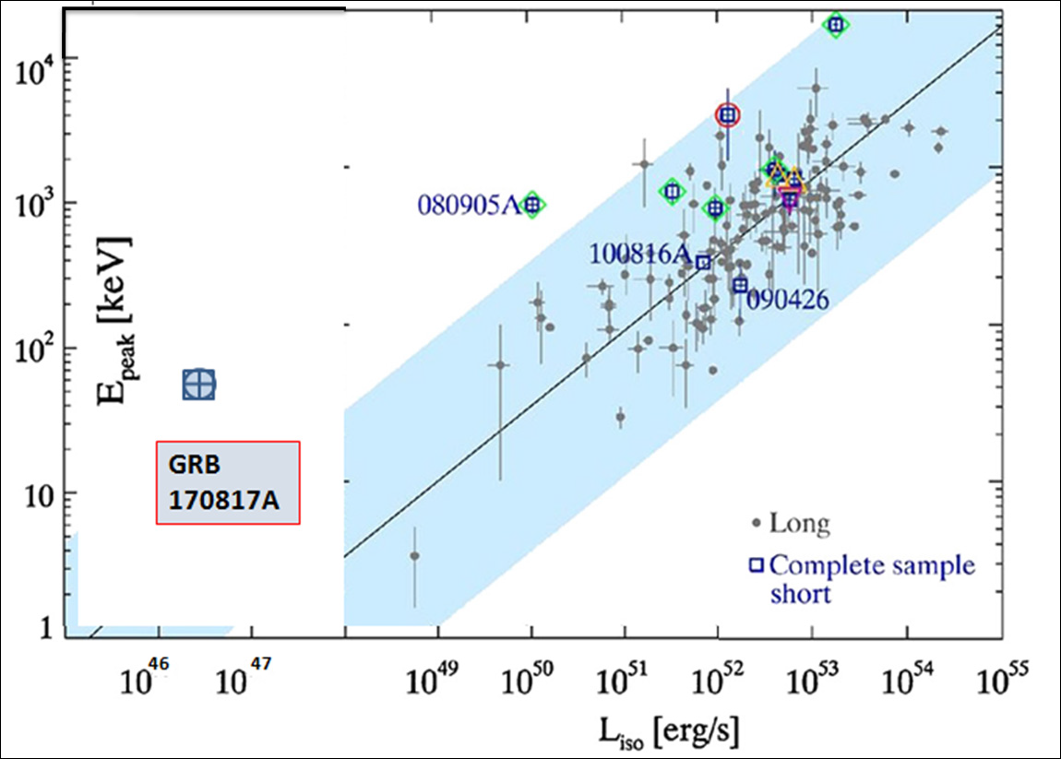
Fig 2b Luminosity extreme

Slide 54
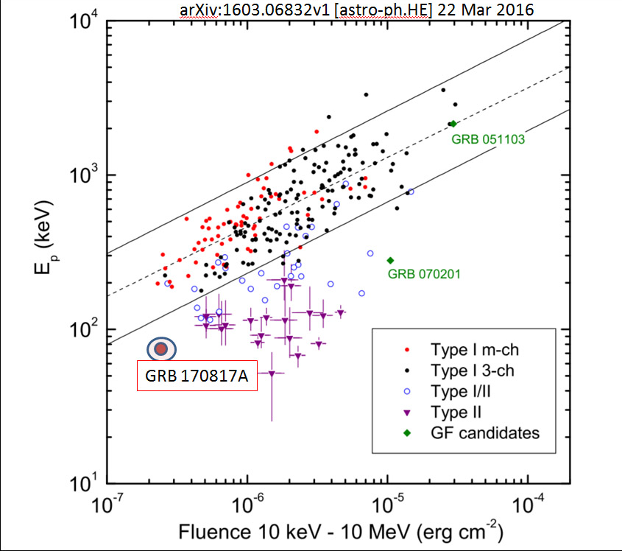
Fig 3

