Slide 1
Description of the Determine of the Neutrino Mass by Electron Capture
Amand Faessler
University of Tuebingen;
1)Faessler, Gastaldo, Simkovic, J. Phys. G 42, 015108 (2015)
2)Faessler, Simkovic, Phys. Rev C91, 045505 (2015)
3)Faessler, Enss, Gastaldo, Simkovic, Phys. Rev. C91, 064302 (2015)
4) Faessler, Gastaldo, Simkovic, Phys. Rev. C95, 045502 (2017)
5) Faessler, Int. J. Mod. Phys., Walter Greiner Memorial Vol. 2018
Notes:
,

Slide 2
Determination of the Electron-Neutrino Mass by
Capture of a bound electron in Holmium:
¹⁶³₆₇Holmium (Proton) + bound Electron →
¹⁶³₆₆Dysprosium*(Neutron) + Electron-Neutrino
ECHo = Electron Capture by Ho; Heidelberg (Loredana Gastaldo), Mainz, Tübingen.
Other Experiments: HOLMES, Milano; NuMECS, LosAlamos (Gerd Kunde);
Neutrino
Mass
Calorimeter Spectrum of Dy Deexitation
Q=2.8 keV
Total Deexcitation energy of Dy

Slide 3
1) Electron at nucleus → s1/2 and p1/2 2) Electron binding energy < Q-value ≈ 2.8 [keV]
For Electron Capture (in Holmium 163):
E(1s_{1/2}, K,Ho) = 55.6 keV
E(2s_{1/2}, L1,Ho) = 9.4 keV
E(2p_{1/2},L2,Ho) = 8.9 keV
E(2p_{3/2},L3,Ho) = 8.1 keV
E(3s_{1/2} ,M1,Ho) = 2.0 keV
E(3p_{1/2},M2,Ho) = 1.8 keV
E(4s_{1/2} , N1,Ho) = 0.4 keV
E(4p_{1/2}, N2,Ho) = 0.3 keV
E(5s_{1/2} ,O1,Ho) = 0.05 keV

Slide 4
Selfconsistent Dirac-Hartree-Fock approach:
Holmium
Shake-up and Shake-off
Dysprosium
A. Faessler, E. Huster, O. Krafft, F. Krahn, Z. Phys. 238 (1970) 352.

Slide 5
Sudden Desription of Bolometer Spectrum
¹⁶³ ₆₇ Ho: p + e- → n + ν; ¹⁶³ ₆₆ Dy*
5s, 5p, 6s,
5s‘, 5p‘, 6s‘,
4s, 4p, 4d, 4f
4p‘,4d‘,4f‘
3s,3p,3d
3p‘, 3d‘
2s, 2p
2s‘, 2p‘
1s
1s‘

Slide 6
An upper limit for Shake-off.

Slide 7
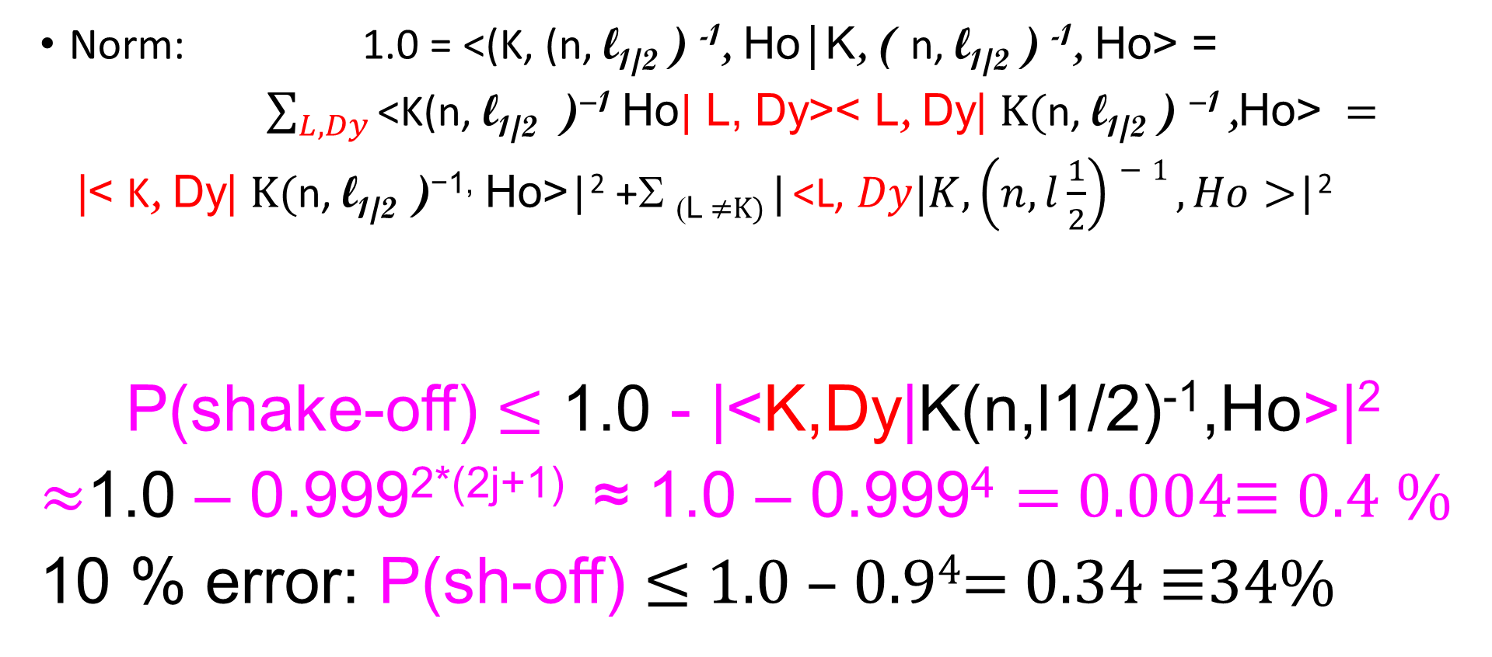
How large can Shake-off be?
Norm: 1.0 = <(K, (n, l_{1/2} ) ⁻¹, Ho|K, ( n, l_{1/2} ) ⁻¹, Ho> =
$\sum_{L,Dy}{\text{<}\text{K}\text{(}\text{n}\text{, }\text{l}\text{1/2 } \text{)}\text{−1} \text{Ho}|}$ L, Dy>< L, Dy| $K(\text{n}\text{, }\text{l}\text{1/2 }\text{) }\text{−1 }\text{,}\text{Ho}\text{>} =$
|< K, Dy| $K(\text{n}\text{, }\text{l}\text{1/2} \text{)}\text{−1}\text{,} \text{Ho}\text{>}$|² +Σ _{(L ≠K)} | <L, $Dy|K, \left(n, l\frac{1}{2}\right)−1 ,Ho>$|²
P(shake-off) ≤ 1.0 - |<K,Dy|K(n,l1/2)⁻¹,Ho>|²
≈1.0 – 0.999^{2*(2j+1)} ≈ 1.0 – 0.999⁴ = 0.004≡ 0.4 %
10 % error: P(sh-off) ≤ 1.0 – 0.9⁴= 0.34 ≡34%

Slide 8

1-Hole,2-hole and shake-off Bolometer Spectrum in ⁶⁶Dy
$$\sum_{f=f^{′};p^{′}<F;q^{′}>0}{°}$$

Slide 9
Theoretical Bolometer Spectrum
Q = 2.8 keV

Slide 10
2-Hole States in Dy and Shake-off contributions
Q=2.8 keV: Dy excitation shake
up or shake off E_{e-} + E_{ν}(m_{ν} = 0)
Q=2.8 keV

Slide 11
Comparison with EHO-Data P. C. Ranitzsch et al. J. Low Temp Phys. 167 (2012) 1004

Slide 12
How did we improve Intemann and Pollock (Phys.Rev.157(1967)41 ? (in the version used by DeRujula and Lusignoli, JHEP1605(2016) 015)
Bound wave functions Ho +Dy Dirac-Hartree-Fock → non-relativistic screened Coulomb for Ho + first order perturbation Dy.
Dirac continuum wavefunctions in selfconsistent potential of Dy → first order perturbation.
Overlap <3s,HO|3s,Dy> limits shake-off to 0.4 %
bad wave functions factor 100 larger.
We show the results without modifications!!! The only other shake-off calculation (DeRujula+Lusignoli, JHEP 1605) fits the spectrum. They write:

Slide 13
Summary
Determination of the neutrino mass by electron capture in principle possible, but difficult.
Shake-off proposed by Intemann and Pollock (Phys. Rev. 157 (1967) 41) is an interesting effect .
But it is small and probably not relevant for the neutrino mass determination in electron capture in Ho.
The End

