Slide 1
The effects of collective neutrino oscillations on explosive nucleosynthesis in core-collapse supernovae
International School of Nuclear Physics
39th Course, Erice-Sicily, Sep. 16-24, 2017.
1/14
H. Sasaki^{1,2}, T. Kajino^{1,2}, T. Takiwaki², T. Hayakawa³,
A. B. Balantekin⁴ and Y. Pehlivan⁵
Phys. Rev. D 96, 043013, 2017.
1 Department of Astronomy, The University of Tokyo
2 National Astronomical Observatory of Japan
3 National Institutes of Quantum and Radiological Science and Technology
4 Department of Physics, University of Wisconsin, Madison
5 Mimar Sinan Fine Arts University
Notes:
----- 会議メモ (2015/07/16 14:14) -----
指導教員があってもいい
位置をそろえる
----- 会議メモ (2015/07/24 17:53) -----
ニュートリノニュートリノという
----- 会議メモ (2016/03/04 17:53) -----
()いらない

Slide 2
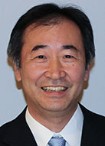
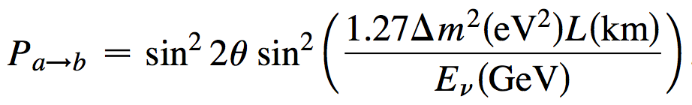
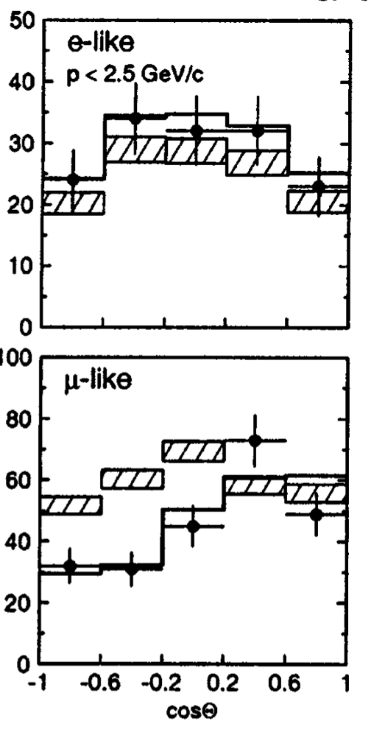
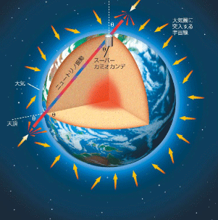
ν_{α}
ν_{β}
(α,β=e,μ,τ)
Neutrino oscillations were observed
4/15
Probability: ν_{a} ν_{b}
(Nobel prize in 2015)
SK collaboration, PRL 81,8,1998
T. Kajita (Nobel Prize in 2015)
Θ
Neutrino oscillations
w/o osc.
w/ osc.
Atmospheric
ν direction

Slide 3
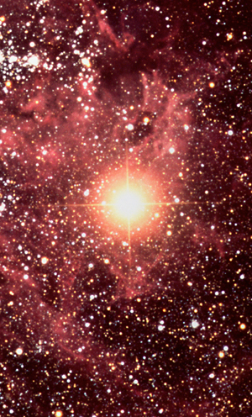
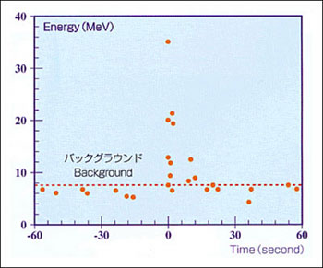
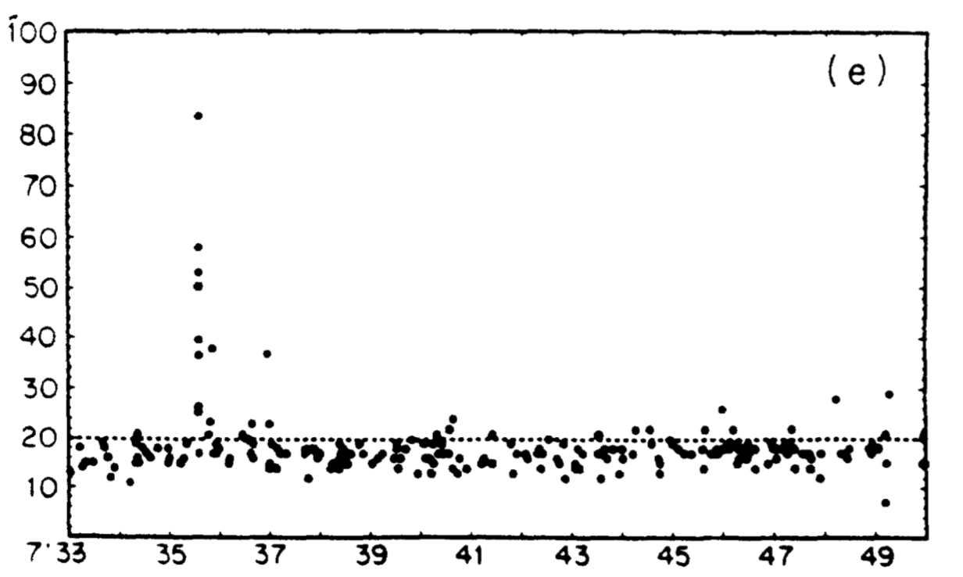
Neutrinos in core-collapse supernova
5/14
99% of gravitational energy 〜10⁵³ erg
are carried by neutrinos during 〜10 s
Neutrino oscillations inside the supernova
affect neutrino-induced reactions
K.S.Hirata, PRL 38,2,1987
Explosion mechanism and nucleosynthesis
1987A
1987A

Slide 4
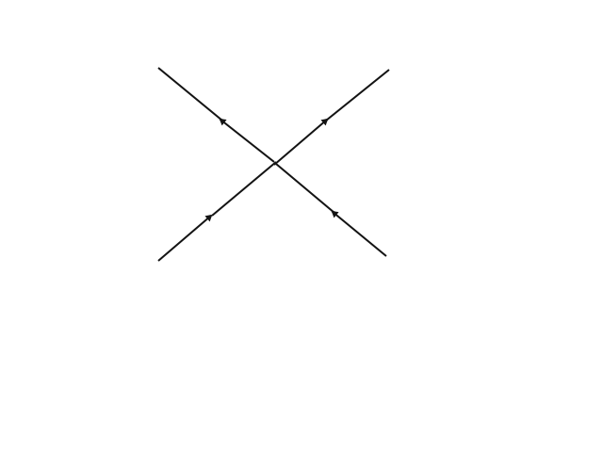
Neutrino oscillations in core-collapse supernovae
r〜10² km: Collective neutrino oscillations
O-Ne-Mg
layer
(ν-ν coherent scatterings)
ν
ν
Neutrino
driven wind
r 〜10³ km
ν
ν
ν
Duan, et al.,PRD74, 105014, 2006.
Proto-neutron star
r 〜20 km
r 〜10³ km: MSW effect
e⁻
ν_{e}
ν_{e}
e⁻
L. Wolfenstein,PRD17, 2369, 1978.

Slide 5
Nucleosynthesis in neutrino-driven winds
O-Ne-Mg
layer
νp process
(T=2-3×10⁹ K, Y_{e} > 0.5)
Neutrino
driven wind
r 〜10³ km
Supply free neutrons
⁶⁴Ge (n,p)⁶⁴Ga(p,γ)…
Proto-neutron star
r 〜20 km
β⁺ decay
⁶⁴Ge: waiting point for β⁺ decay
t=1.06 m
^{92,94}Mo, ^{96,98}Ru,..
p-nuclei
Origin of solar
abundances,
still unknown !
Purpose
1. Precise collective neutrino oscillations
2. Effect on vp-process

Slide 6
Calculation methods of collective oscillations
Mean field
9/19
Dasgupta,B.,Mirizzi,A.,Tamborra,I.,&Tomas,R.,2010,Phys Rev.D,81,093008
Yes
No
2 flavor
3 flavor
e , x
e , μ , τ
Single angle approximation
What we did
We first combine 3 flavor multi-angle
calculation with the νp process
Yes
No
Yes
No
Step 1
Step 2
Step 3
Step 4
Step 5
Reality
Previous numerical studies
Notes:
----- 会議メモ (2016/03/04 17:53) -----
立ち位置

Slide 7
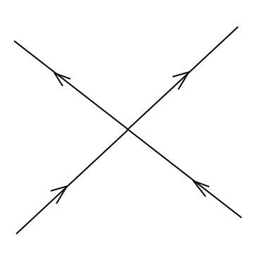
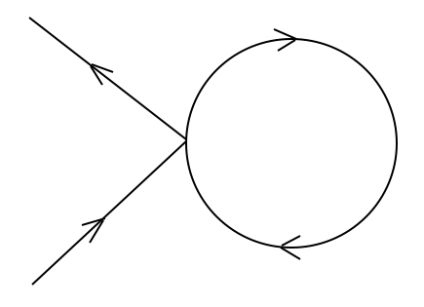
Our model
8/14
1. Hydrodynamics
・1D explosion model
Initial neutrino number spectra
Flux (a.u.)
・40 M◉ progenitor, 1.1 s after core bounce
ν_{e}
S.E. Woosley and T.A.Weaver,1995,ApJS,101,181
H. Sotani and T. Takiwaki, Phys. Rev. D, 94, 044043,2016
ν_{e}
2. Neutrino oscillations
ν_{x} = ν_{μ}ν_{μ}ν_{τ}ν_{τ}
・Spherical symmetric
・Neutrino sphere: R = 18 km
0 10 20 30 40 50 60
MeV
・Mean field ν-ν forward scattering term
ν_{β}
ν_{α}
ν_{β}
p
q
Mean field
p
p
q
p
α, β = e, μ, τ
ν_{α}
ν_{β}
ν_{α}
S.E. Woosley and T.A.Weaver, ApJS 101,181,1995
H. Sotani and T. Takiwaki, PRD 94, 044043,2016
・
Notes:
----- 会議メモ (2016/09/08 20:56) -----
式を書く

Slide 8
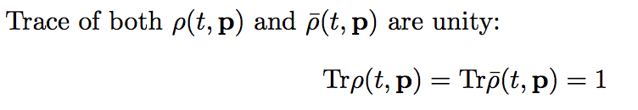
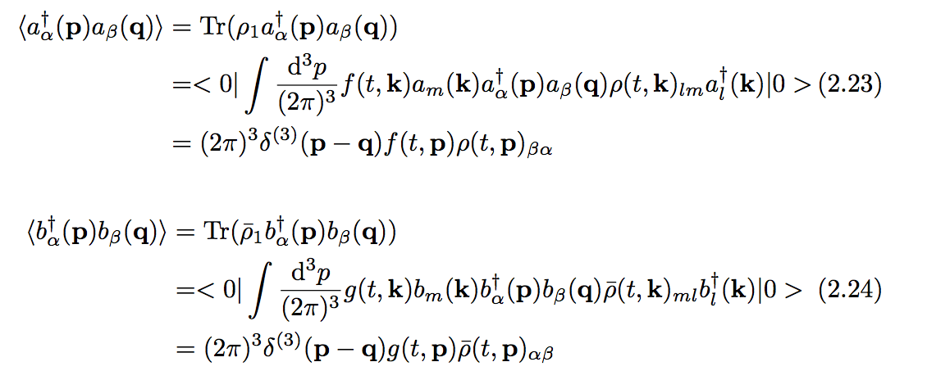
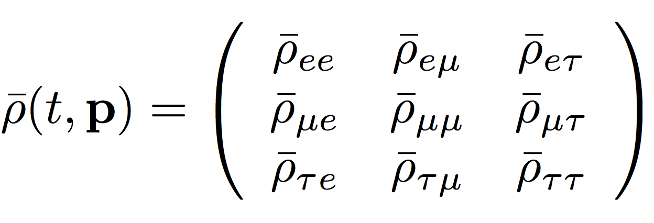
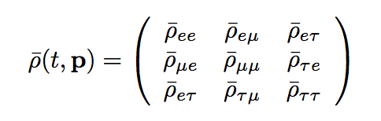
How to calculate neutrino oscillations
9/14
We calculate the evolution of
3 x 3 density matrices !
Neutrino
Anti-neutrino
G. Sigl and G. Rafflet,Nucl. Phys. B 406, 423, 1993
Diagonal components ρ_{αα} represents the probability of finding ν_{α}

Slide 9
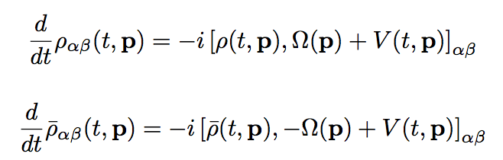

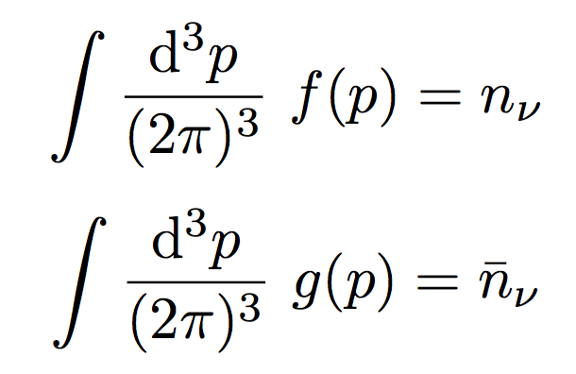
G. Sigl and G. Rafflet,Nucl. Phys. B 406, 423, 1993
EOMs of density matrices
13/19
We solve these equations !
……Vacuum Hamiltonian
Matter effect from e⁻
…… Potential in flavor space
Mean field ν-ν coherent scattering term
Notes:
----- 会議メモ (2016/03/04 17:53) -----
retention probability
前に持ってくる

Slide 10
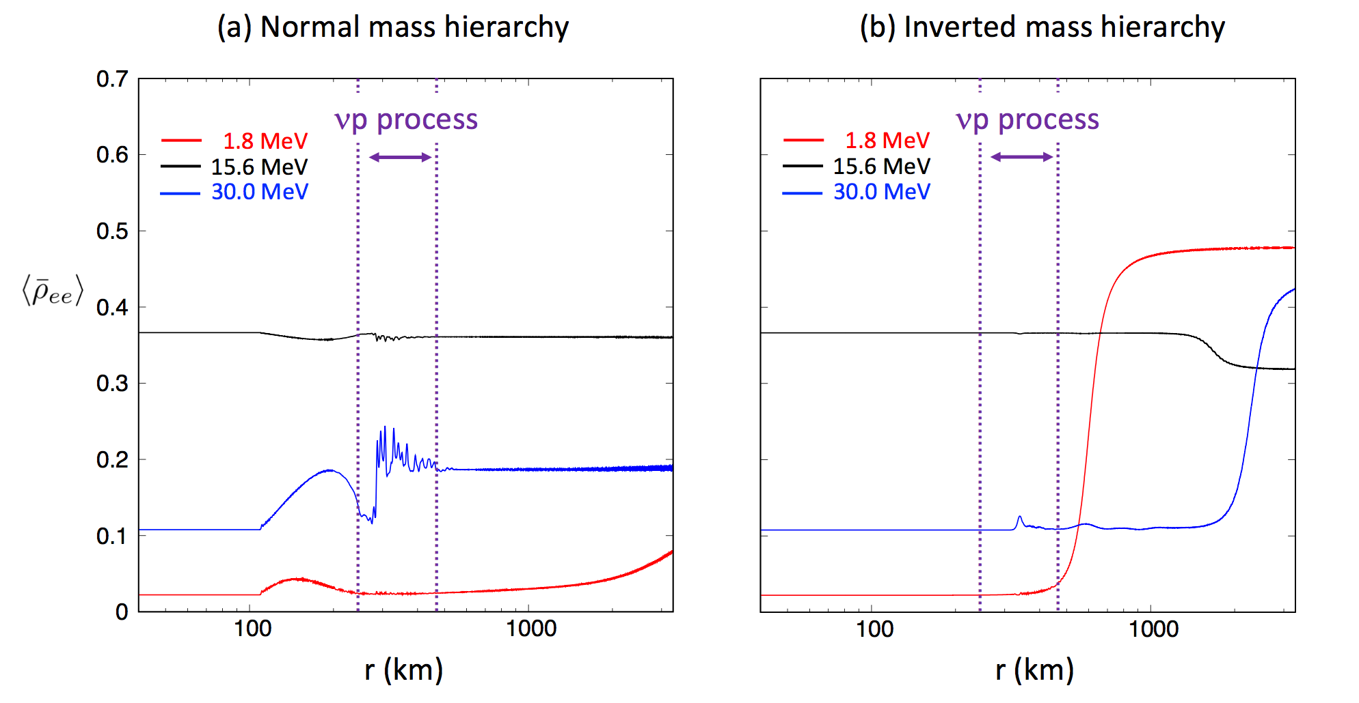
Evolution of (ν_{e} probability)
15/19
Normal mass hierarchy Inverted mass hierarchy
(T〜2-3×10⁹ K)
(T〜2-3×10⁹ K)
Collective neutrino
oscillations !!

Slide 11
Flavor transitions in normal hierarchy
13/22
ν_{μ} = ν_{τ}
ν_{e}
ν_{e}
Initial (40 km)
r = 400 km
ν_{μ}
ν_{τ}
ν_{e}
Flux (a.u.)
ν_{e}
ν_{e}
ν_{μ} ,ν_{τ}
ν_{μ} ,ν_{τ}
Increase
0 10 20 30 40 50 60
MeV
MeV
Notes:
----- 会議メモ (2016/03/04 17:53) -----
Energy swap のエネルギーは理論で解析的に決まっていない

Slide 12
Flavor transitions in inverted hierarchy
13/22
ν_{μ} = ν_{τ}
ν_{e}
ν_{e}
Initial (40 km)
r = 400 km
ν_{μ}
ν_{τ}
ν_{e}
Flux (a.u.)
ν_{e}
ν_{e}
ν_{μ} ,ν_{τ}
ν_{μ} ,ν_{τ}
0 10 20 30 40 50 60
MeV
MeV
Notes:
----- 会議メモ (2016/03/04 17:53) -----
Energy swap のエネルギーは理論で解析的に決まっていない

Slide 13
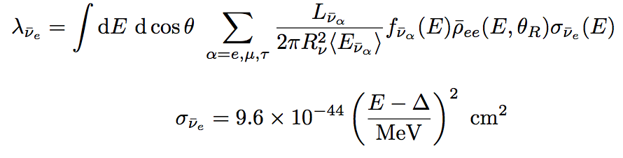
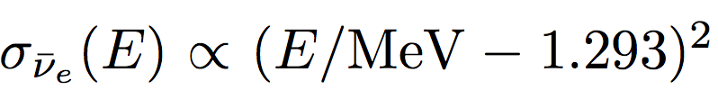
Reaction rate of
11/14
Cross section
(T〜2-3×10⁹ K)
High λ creates more neutrons
… neutron abundance
… proton abundance
… gas velocity
( Δm²₃₂ > 0 )
( Δm²₃₂ < 0 )

Slide 14
Enhanced abundances of p-nuclei
12/14
In normal hierarchy, p-nuclei
are increased by 〜10-10⁴ times
In inverted hierarchy, nearly the
same result as that in no oscillation
Abundance of p-nuclei / Solar abundance
Neutrino oscillations in T〜2-3×10⁹ K affect abundances of p-nuclei
The necessity of collective oscillations
for the precise nucleosynthesis
Determine the neutrino
mass hierarchy !?

Slide 15
Summary
13/14
・Collective neutrino oscillations will play significant roles in
nucleosynthesis in core collapse supernovae
・We study the effect of collective neutrino oscillations on the νp process
nucleosynthesis in a consistent manner.
・In normal hierarchy, collective oscillations enhance the νp process,
increasing abundances of p-nuclei by 10〜10⁴ times.
・Our simulation results suggest the necessity of collective neutrino
oscillations for the precise nucleosynthesis
In inverted hierarchy, free neutrons are created by MSW effects but after
νp process, so the effect of oscillations are negligible.

Slide 16
Future prospect
Mean field
9/19
3 flavor multi angle calculation
Dasgupta,B.,Mirizzi,A.,Tamborra,I.,&Tomas,R.,2010,Phys Rev.D,81,093008
Yes
No
2 flavor
3 flavor
e , x
e , μ , τ
Single angle approximation
Beyond mean field approximation !
Yes
No
Yes
No
Step 1
Step 2
Step 3
Step 4
Step 5
Reality
Previous numerical studies
Notes:
----- 会議メモ (2016/03/04 17:53) -----
立ち位置

Slide 17
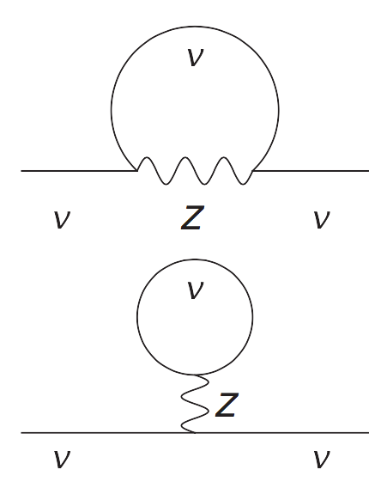
Future prospect
• Consider higher order diagrams
Mean field
Beyond mean field
Vlasenko et al., Phys. Rev. D 89, 105004, 2014.

Slide 18
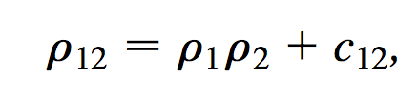
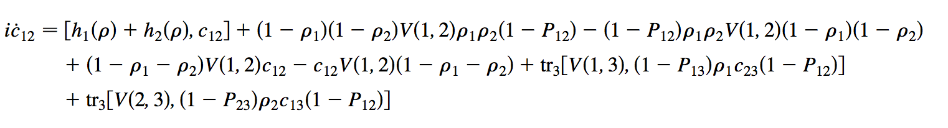
Future prospect
• Consider fluctuation c₁₂
C. Volpe et al., Phys. Rev. D 87, 113010, 2013.

Slide 19
Thank you for your attention !

Slide 21
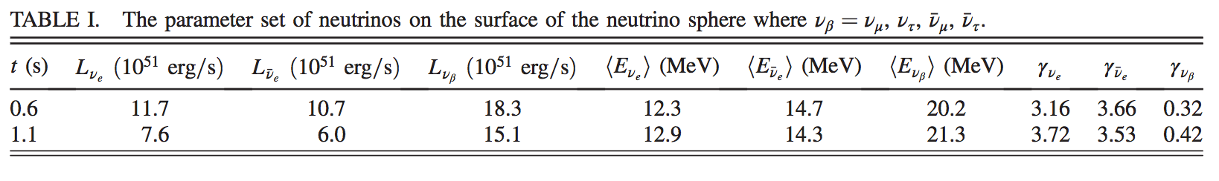
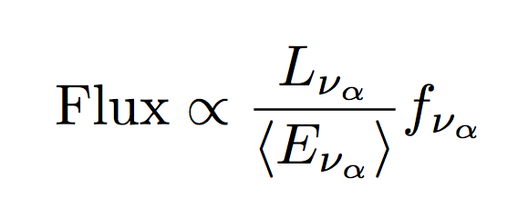
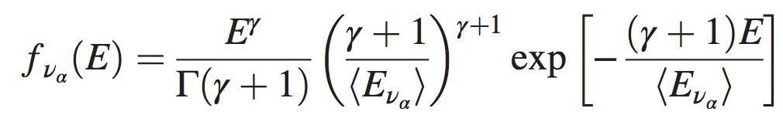
Neutrino spectra on the surface of neutrino sphere
Flux (a.u.)
Initial neutrino number flux
ν_{e}
ν_{e}
ν_{x} = ν_{μ}ν_{μ}ν_{τ}ν_{τ}
0 10 20 30 40 50 60
MeV
Normalized neutrino spectra

