Slide 1
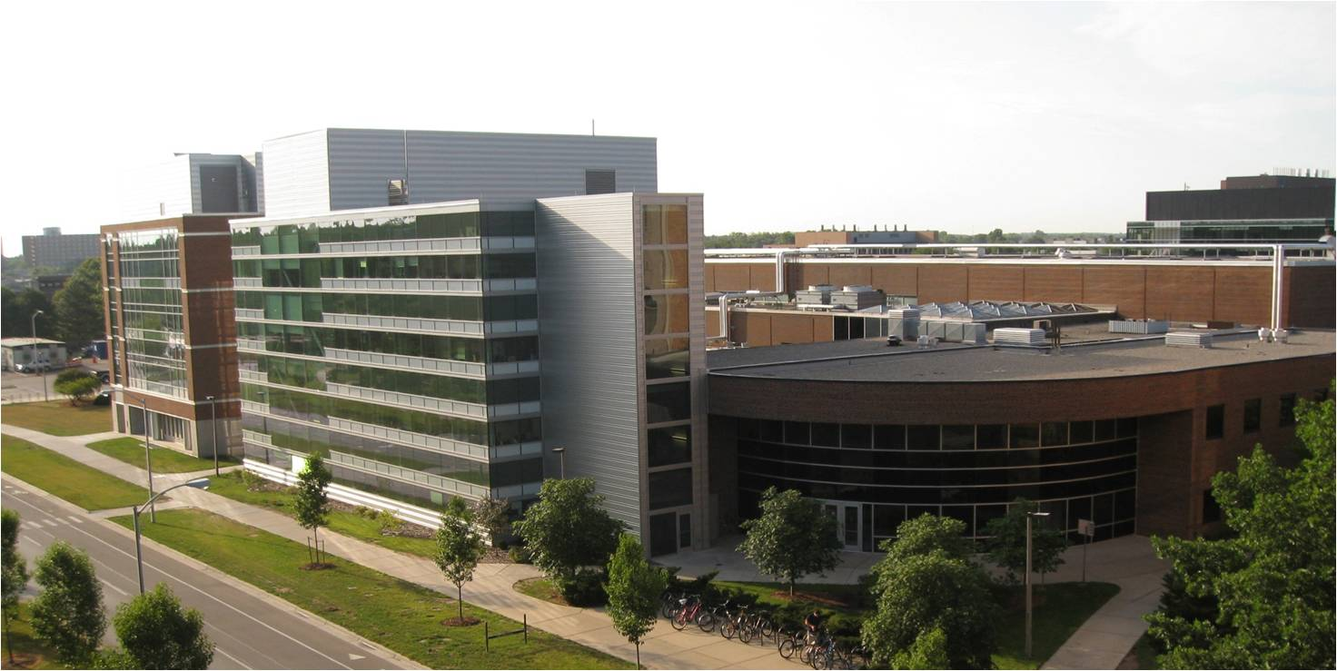
Nuclear science at NSCL and prospects for FRIB
Alexandra Gade
Professor of Physics
NSCL and Michigan State University

Slide 2
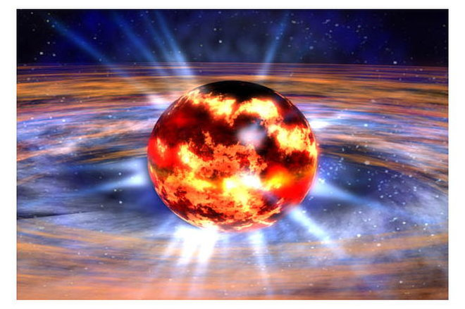
Nuclear science at NSCL and prospects for FRIB
Alexandra Gade
Professor of Physics
NSCL and Michigan State University
What can we learn about Neutron Stars?

Slide 3
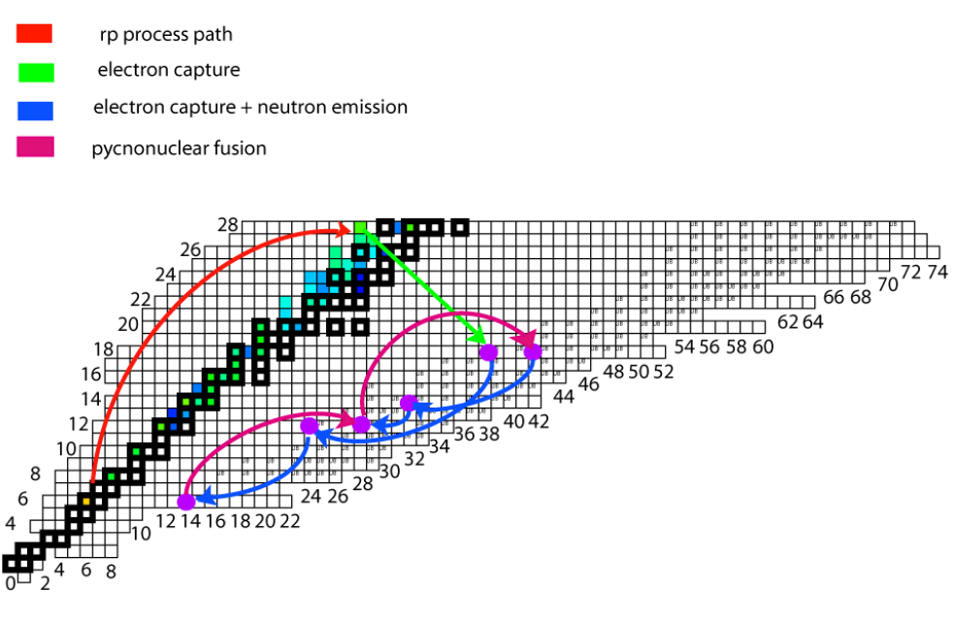
Outline
NSCL and FRIB
  Who we are and what we do
Examples of measurements relevant for processes in neutron stars
  On the surface of accreting neutron stars: X-ray bursts and the rp process (γ-ray spectroscopy)
  Reactions in the neutron-star crust:
    Q values from mass measurements
    The existence of ⁴⁰Mg
Outlook
Remco Zegers’ talk
Figure adapted from M. Beard, Notre Dame (2010)

Slide 4
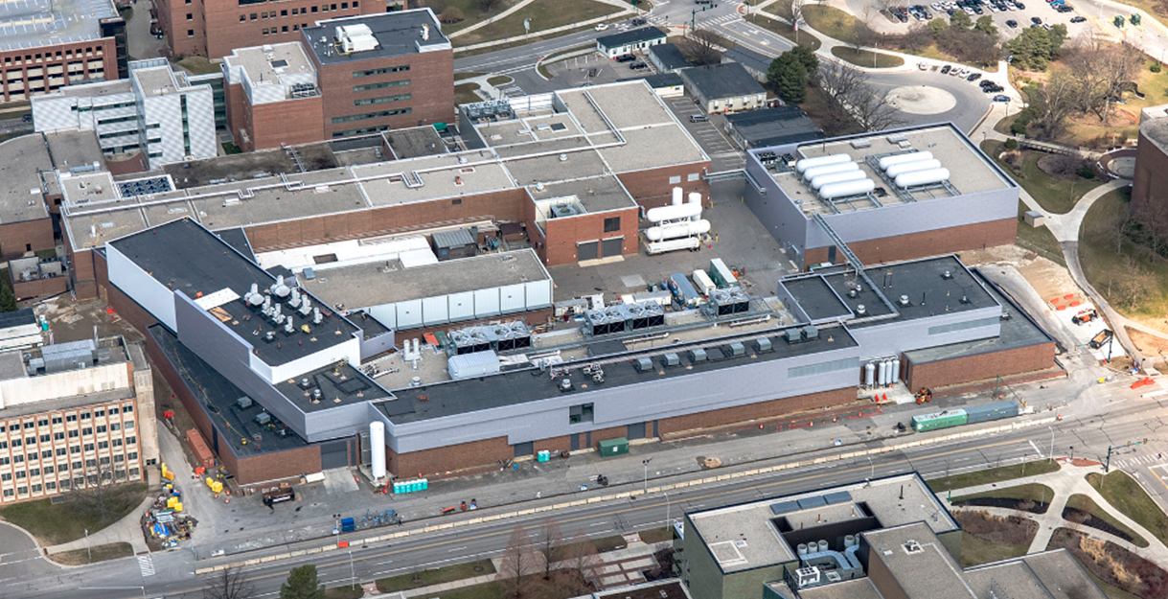
Who we are - NSCL and FRIB Laboratory
>780 employees, incl. >40 faculty, >100 graduate and >160 undergraduate students as of September 15, 2017
NSCL is funded by the U.S. National Science Foundation to operate a user facility for rare isotope research and education in nuclear science, nuclear astrophysics, accelerator physics, and societal applications
FRIB will be a national user facility for the U.S. Department of Energy Office of Science – when FRIB becomes operational, NSCL will transition into FRIB
Located on the campus of Michigan State University

Slide 5
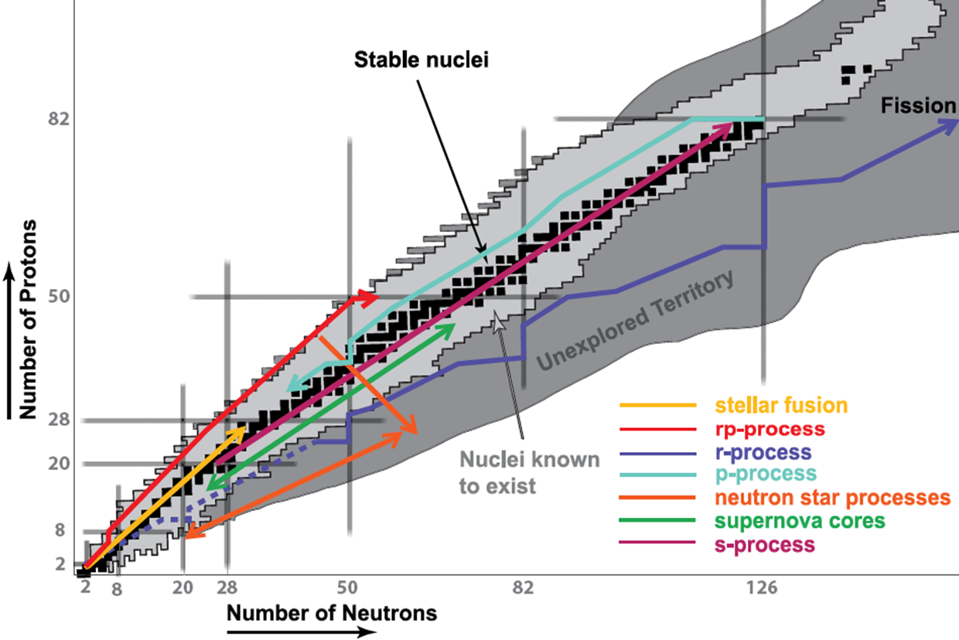
The themes of rare isotope science
Properties of nuclei
  Develop a predictive model of nuclei and their interactions
  Determine the limits of elements and isotopes
Astrophysical processes
  Origin of the elements in the cosmos
  Explosive environments: novae,
  supernovae, X-ray bursts …
  Properties of neutron stars
Tests of fundamental symmetries
  Effects of symmetry violations are
  amplified in certain nuclei
Societal applications and benefits
  Medicine, biology, environment,
  material sciences, national security

Slide 6
Production of rare isotopes
1. Accelerate an ion to high energy and break it up in a target (random removal of protons and neutrons)
part that collides
Fast moving part that continues forward
projectile
target
2. After they settle down, separate the pieces in flight
rare isotope beam
fast moving part
3. Use the rare isotopes to explore the limits of atomic nuclei

Slide 7
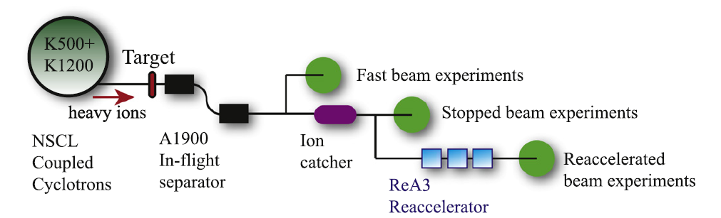
Broad experimental opportunities
Fast beams: Furthest reach towards neutron-rich nuclei – exploit variety of direct reactions, neutron, charged-particle and γ-ray spectroscopy, time-of-flight mass measurements
“Stopped” beams: Precision decay measurements (β, βn, βp, α, isomer, p, 2p …), high-precision mass spectrometry, laser spectroscopy
Reaccelerated beams: Direct reactions, fusion, capture reactions, Coulomb excitation around the Coulomb barrier (no chemistry limitation unlike with ISOL)

Slide 8
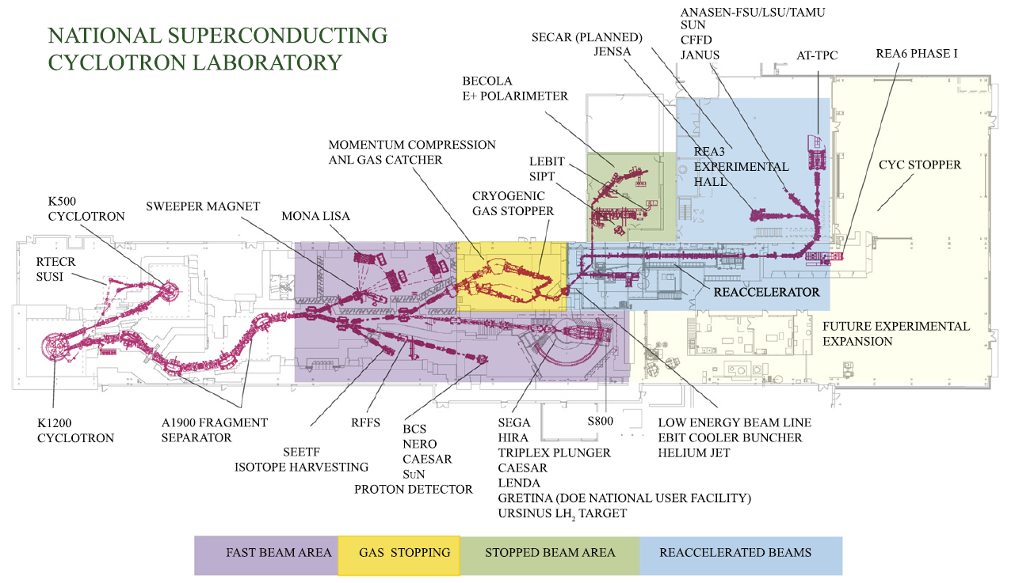
Layout of the NSCL – enabling research with fast, stopped and reaccelerated rare-isotope beams
A. Gade and B.M. Sherrill, Phys. Scr. 91, 053003 (2016) - Review

Slide 9
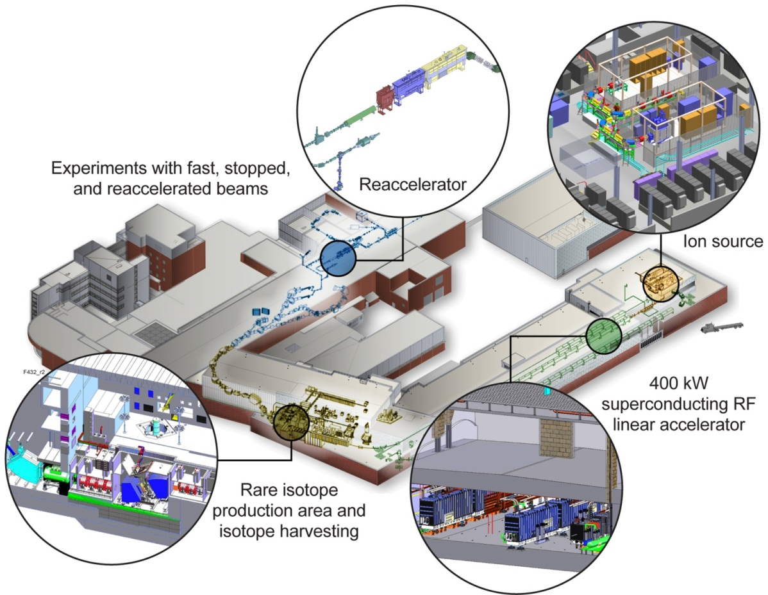
Major US project – Facility for Rare Isotope Beams, FRIB
Funded by DOE Office of Science – 2022 completion
8 June 2009 – DOE-SC and MSU sign Cooperative Agreement
Key Feature is 400kW beam power (5 x10¹³ ²³⁸U/s)
Separation of isotopes in-flight
  Fast development time for any isotope
  Suited for all elements and short half-lives

Slide 10
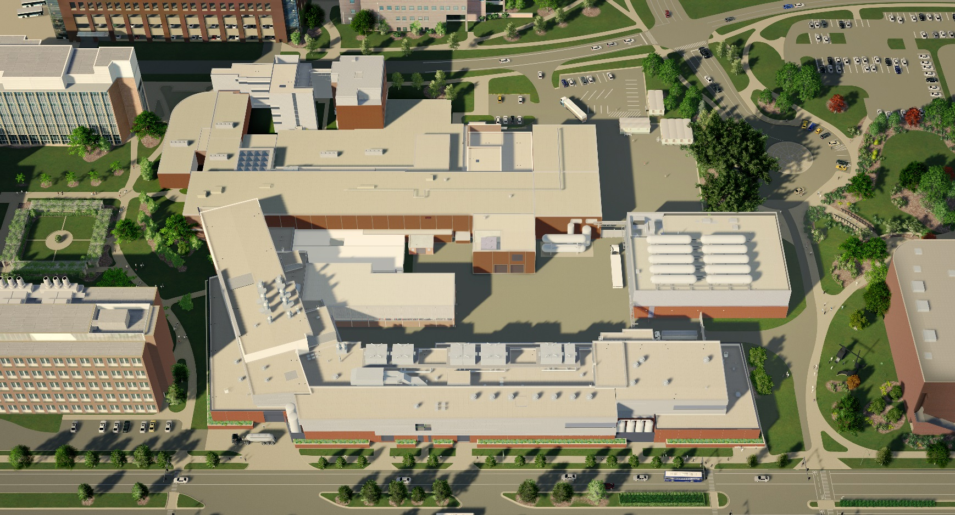
FRIB facility overview
Existing NSCL
Target Facility
LINAC Building

Slide 11
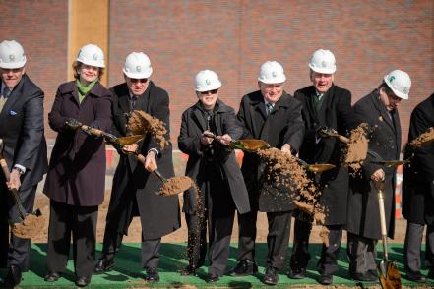
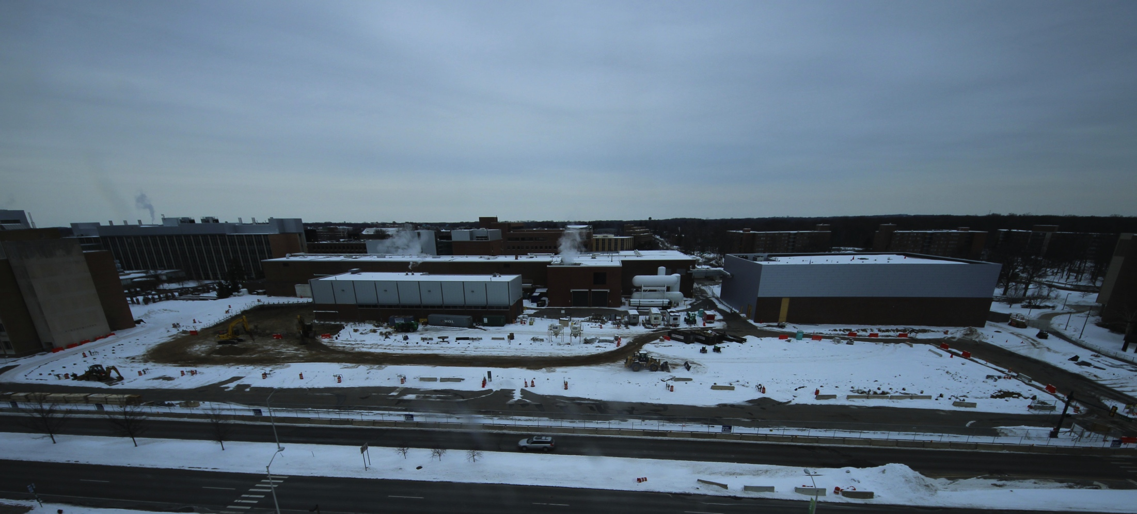
FRIB ground breaking on March 17, 2014

Slide 12

Civil construction substantially complete
Beneficial occupancy in March 2017
Web cameras at www.frib.msu.edu

Slide 13
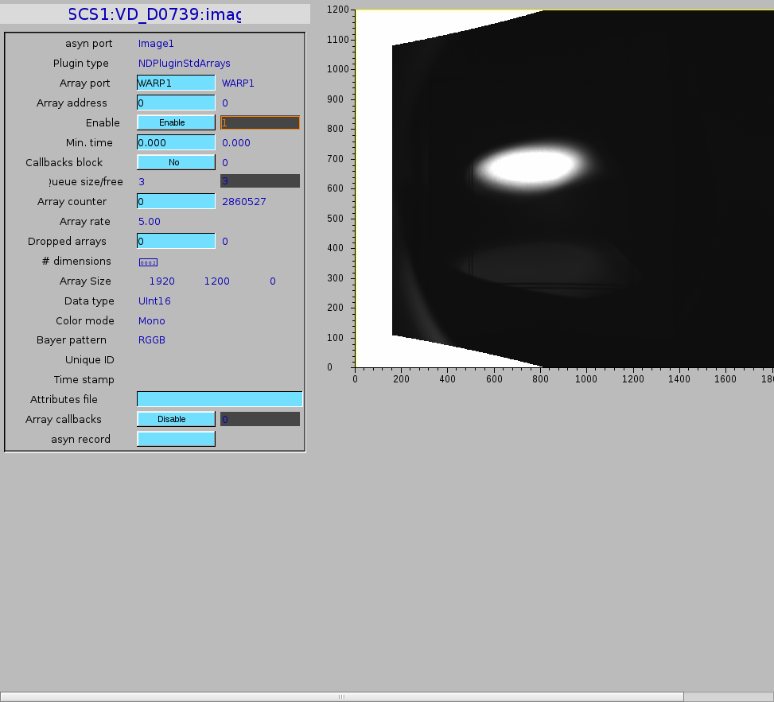
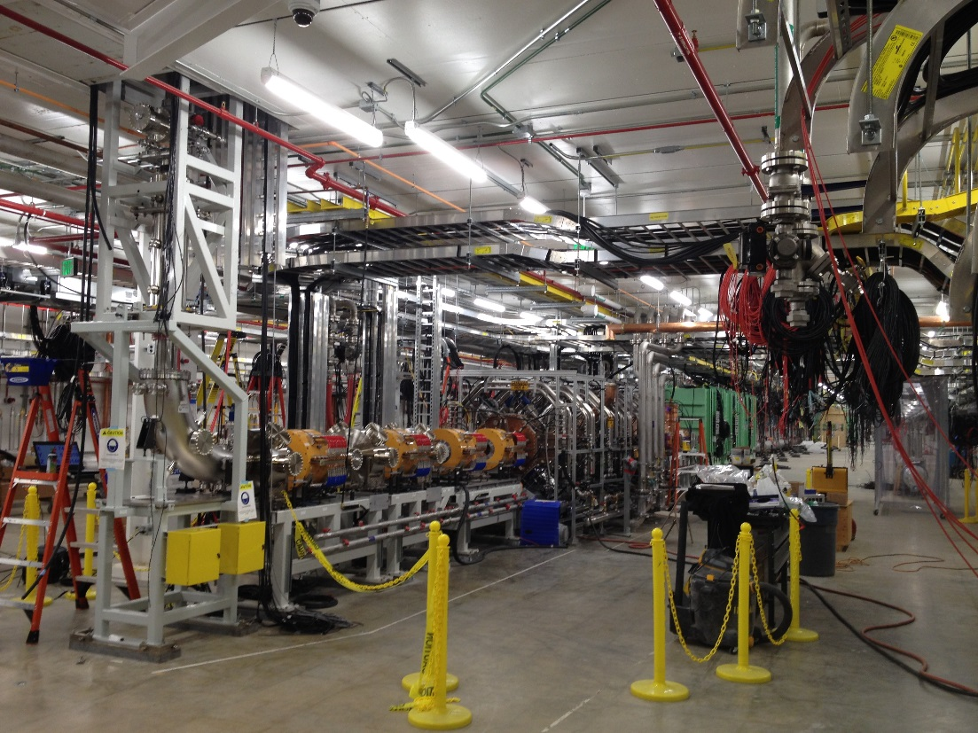
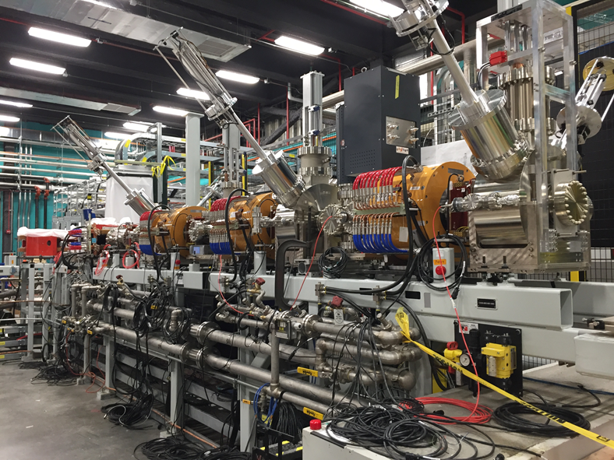
Transported first beam (Ar) through the low-energy beam transport system
Argon beam at end of U-LEBT, May 2017
⁴⁰Ar⁹⁺, I=10 μA,
100% Transmission
FRIB RFQ in April 2017
FRIB Lower LEBT, RFQ, MEBT, and the three β=0.041 cryomodules installed
FRIB ARTEMIS ECR ion source
and the upper LEBT

Slide 14
Rare isotopes from the proton to the neutron dripline are important
rp-process ashes left after X-ray bursts on the surface of neutron stars sink into the neutron-star crust
In the crust, the atomic nuclei are fully ionized and embedded in degenerate, relativistic electrons
In this e⁻-rich environment, electron capture (EC) drives the proton-rich, stable ashes towards the neutron dripline (neutronization)
In the regime of low S_{n} and when the neutron dripline is reached, neutron emission drives the composition to light neutron-rich systems in the range of ¹⁶⁻²⁴C, ¹⁸⁻²⁸O, ³⁰⁻⁴⁰Ne and ³⁴⁻⁴⁰Mg
At the increased density deeper and deeper in the crust, pyconuclear reactions occur, the fusion of exotic systems such as ⁴⁰Mg+⁴⁰Mg
Figure adapted from M. Beard, Notre Dame (2010)

Slide 15
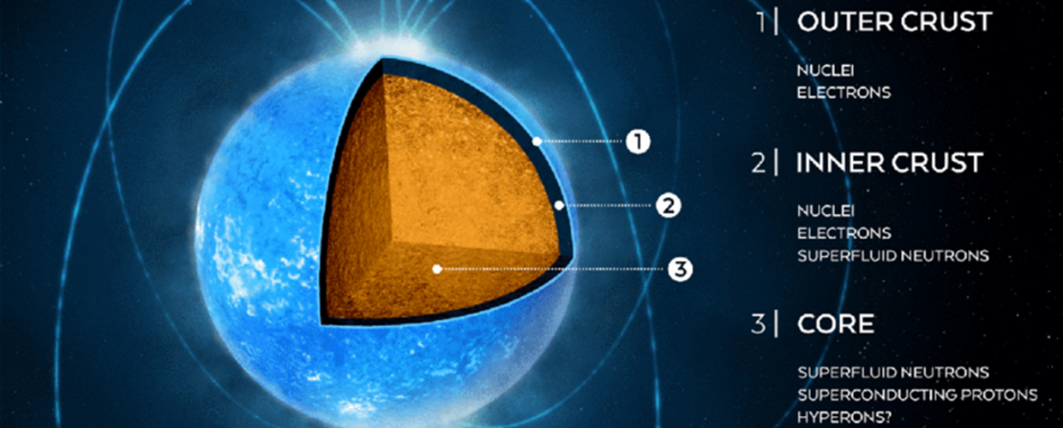
Rare isotope science and neutron stars
Nuclear physics questions and needs:
  Composition of the rp-process ashes → need to understand rp capture network
  Need to model weak interactions very well for many nuclei to model neutronization (Remco Zegers’ talk)
  Trends in nuclear masses of very neutron-rich nuclei need to be known to describe heating and cooling of the crust during EC
  Need to know where the limit of existence is and what nuclei may serve as seeds of pyconuclear fusion
Figure from A. Watts et al., Rev. Mod. Phys. 88, 021001 (2016)

Slide 16
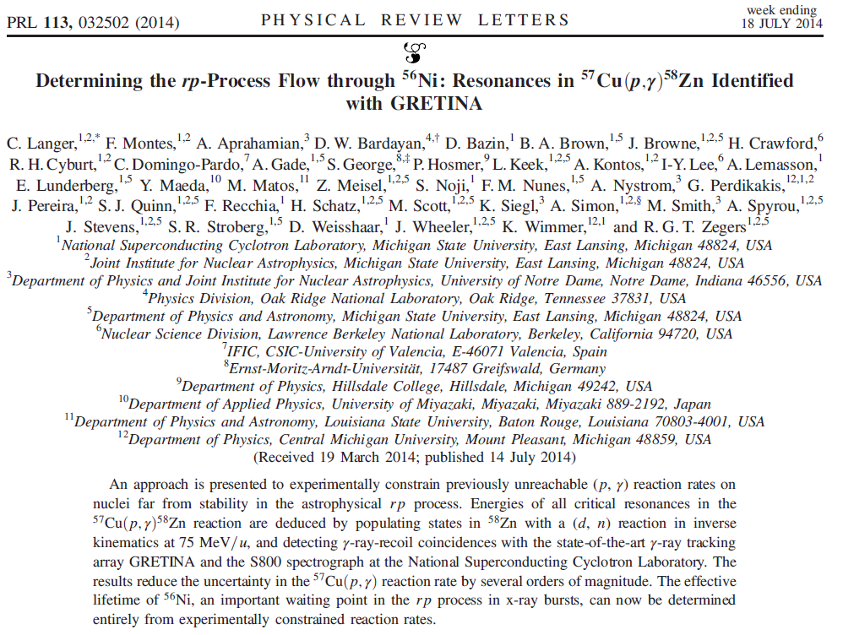
Type I x-ray bursts on the surface of accreting neutron stars

Slide 17
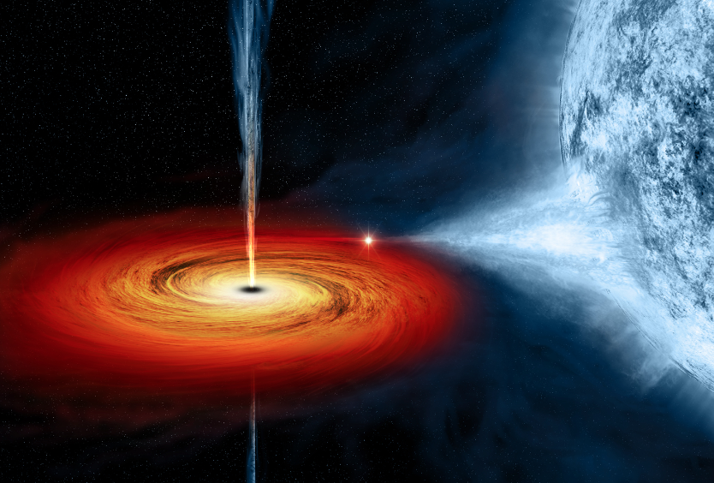
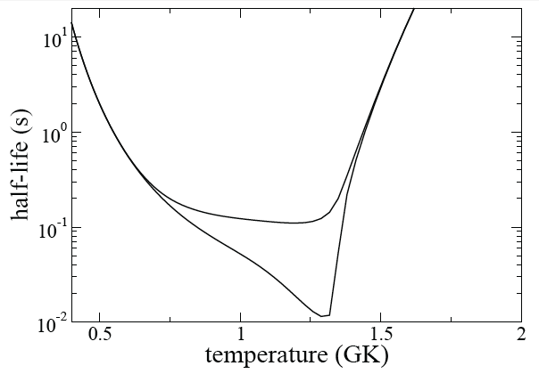
Nuclear Astrophysics - Spectroscopy of proton-rich ⁵⁸Zn
Nuclear reaction flow powers X-ray bursts
through important waiting point ⁵⁶Ni
Explore the nuclear structure and search for resonance
⁵⁶Ni and ⁵⁷Cu are in a (p,γ)-(γ,p) equilibrium; variations of ⁵⁷Cu(p,γ)⁵⁸Zn
affect the eff. lifetime of ⁵⁶Ni
Reaction rate dominated by 2⁺ resonances
/10
2₄⁺
2₃⁺
2₂⁺
x10
⁵⁷Cu + p
2₁⁺
C. Langer et al., PRL 113, 032502 (2014)
⁵⁸Zn
0⁺

Slide 18
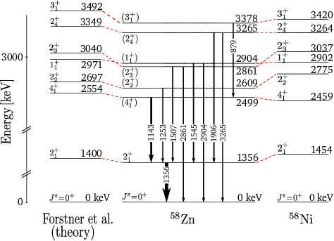


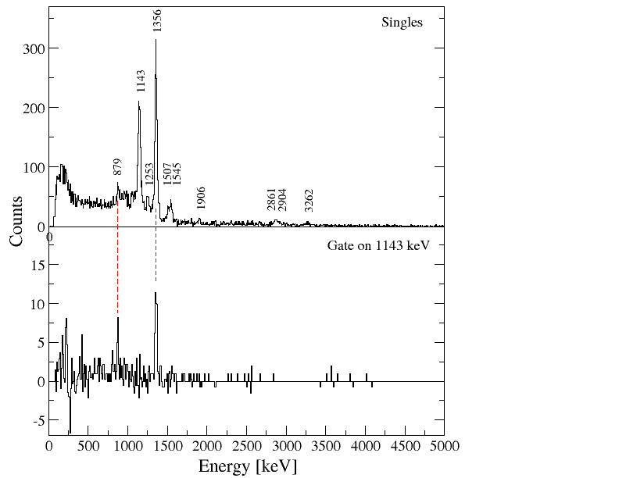
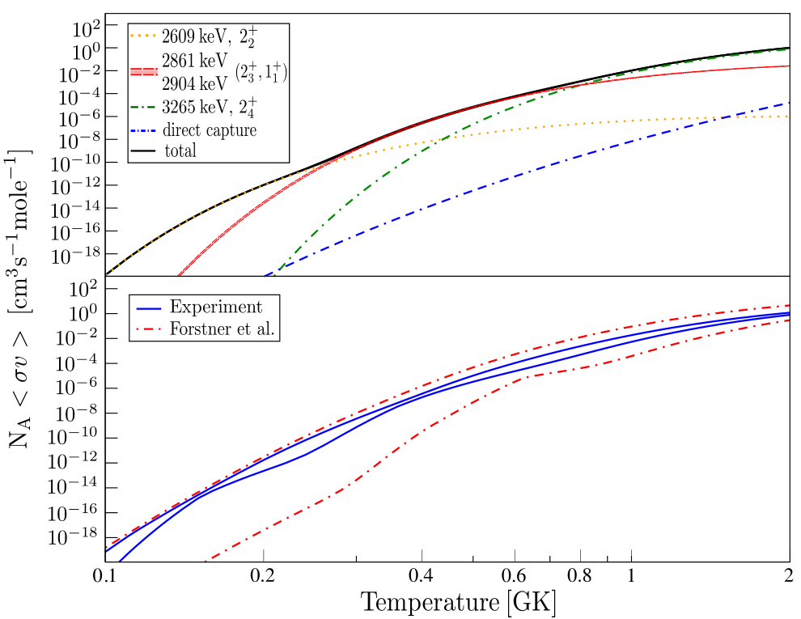
Spectroscopy of ⁵⁸Zn and reduced uncertainty in important reaction rate
C. Langer et al., PRL 113, 032502 (2014)
Experimental results and
level scheme ⁵⁸Zn
GRETINA
γ
β ̴ 0.32c
⁵⁷Cu
⁵⁸Zn*
⁵⁸Zn
d
n
γ
to focal plane S800
⁵⁷Cu(d,n)⁵⁸Zn @ 75 MeV/u
Resulting astrophysical rate
⁵⁷Cu(p,Ɣ)⁵⁸Zn rate
uncertainty highly reduced!
→ Reliable prediction of A=56 in ashes
First & Last Name - Title, this is an example
18

Slide 19
FRIB reach for novae and X-ray burst reaction rate studies
10^{>10}
rp-process
10⁹⁻¹⁰
10⁸⁻⁹
Key reaction rates can be indirectly measured including ⁷²Kr waiting point
10⁷⁻⁸
direct (p,γ)
10⁶⁻⁷
direct (p,α) or (α,p)
transfer
10⁵⁻⁶
10⁴⁻⁵
(p,p),
some transfer
10²⁻⁴
Most reaction rates up to ~Sr can be
directly measured
All reaction rates up to ~Ti can be directly measured
Direct reaction rate measurements are possible with the Separator for Capture Reactions (SECAR)

Slide 20
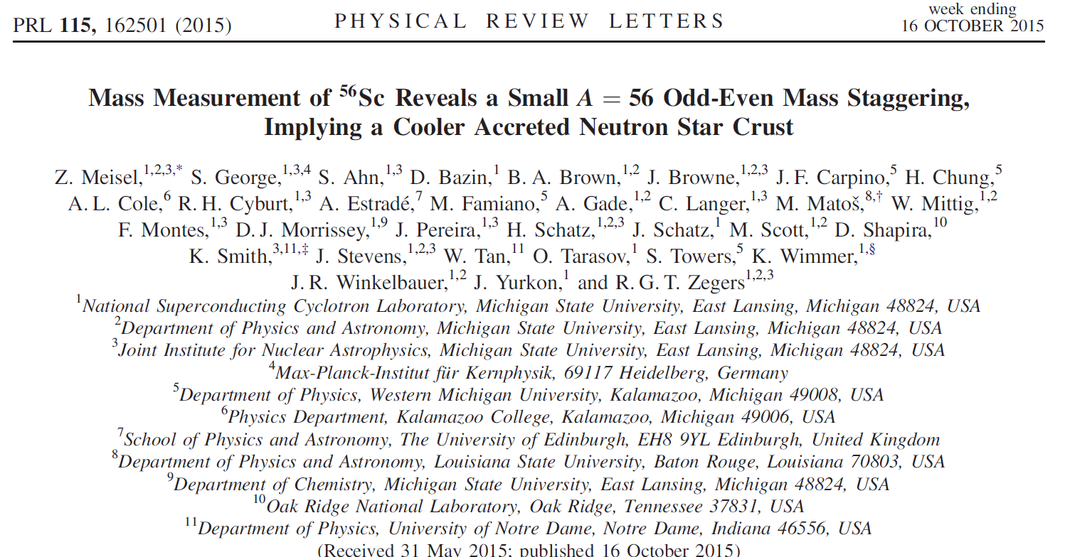
Staying with the N=56 ashes – neutronized deeper in the crust

Slide 21
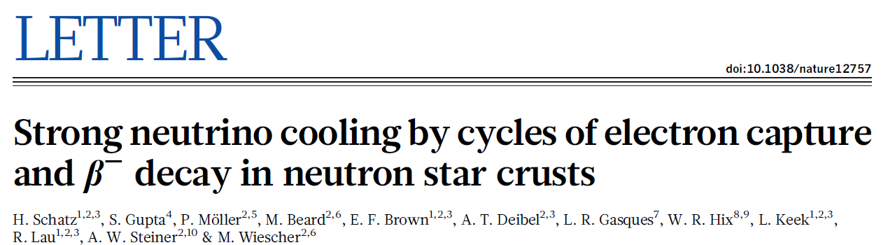



Crust heating and cooling in accreting neutron stars
H. Schatz et al., Nature 505, 62 (2014)
Prediction: Cycles of electron capture and its inverse, β⁻ decay, involving neutron-rich nuclei at a typical depth of about 150 meters, cool the outer neutron star crust by emitting neutrinos.
One such cycle:
With blocked subsequent EC:
Several such cycles are predicted and their existence strongly depends on energetics and nuclear structure (Q values (masses), energetics, EC rates, …)
Notes:
TOF ~ 500ns
D TOF=100ps (resolution) and centroid determination to 1ps

Slide 22
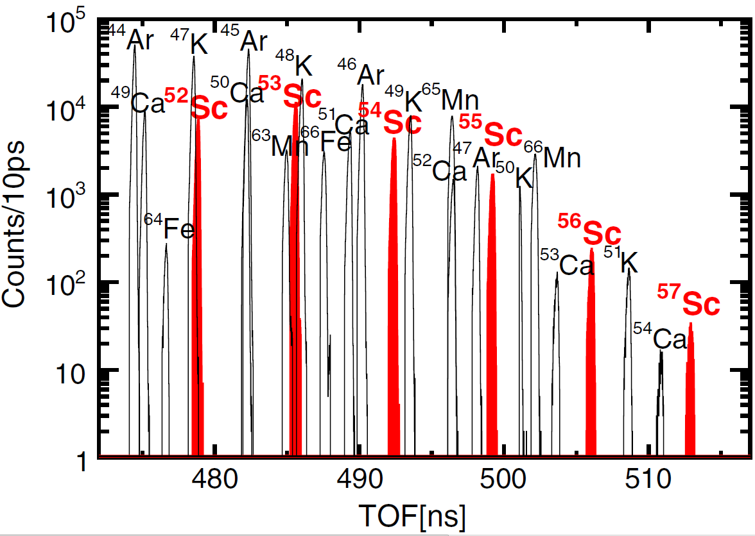
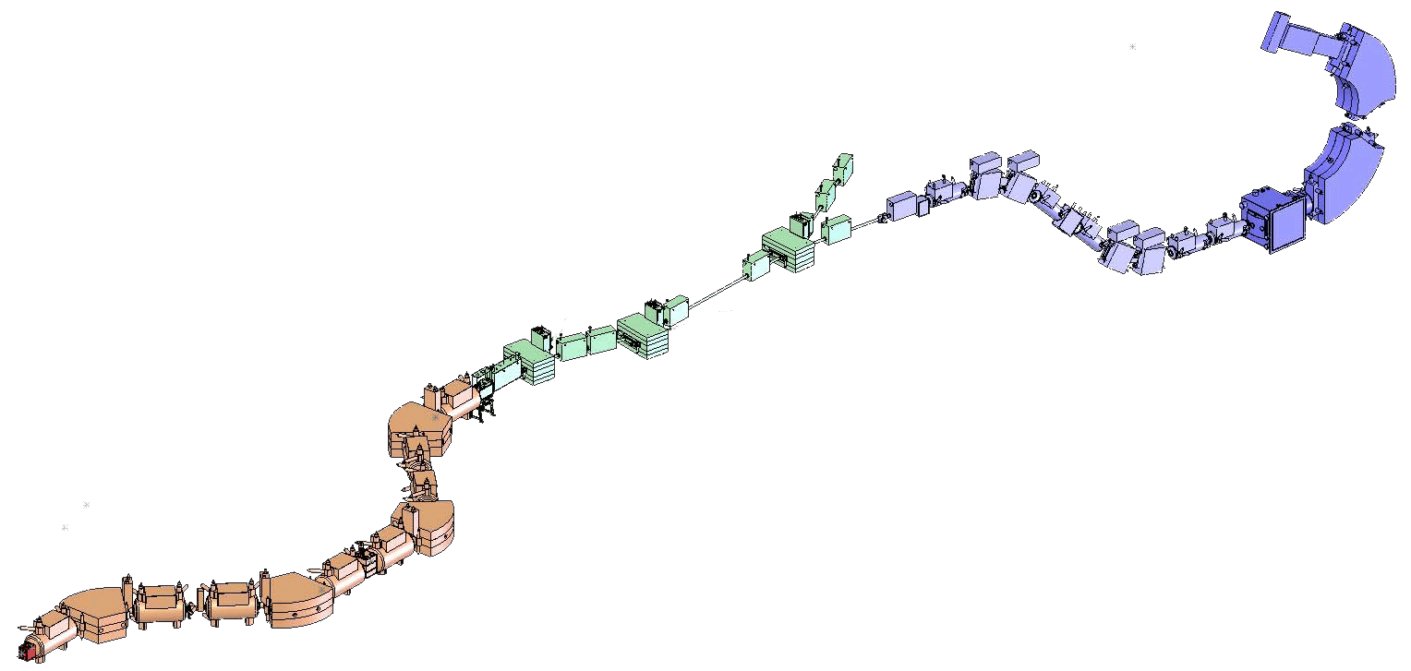
TOF mass measurements
– using NSCL’s magnetic separators
TOF mass measurements on neutron-rich isotopes: δm = 0.4-0.5 MeV for A~60
TOF stop
58m flight path
A1900+S800 at NSCL
Measured many masses simultaneously (>100)
Mass accuracy: ΔME=400-500 keV (should be possible to get to 200 keV)
Beam rate: few particles/second
Works for very short-lived nuclei
Bρ=γm/q (dx/dt)
Measure Bρ and TOF
TOF start
Z. Meisel et al., PRL 115, 162501 (2015)
M. Matos et al., NIM A 696, 171 (2012)
Notes:
TOF ~ 500ns
D TOF=100ps (resolution) and centroid determination to 1ps

Slide 23
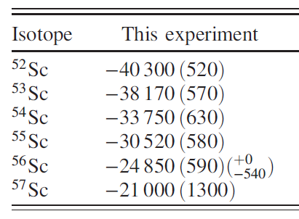
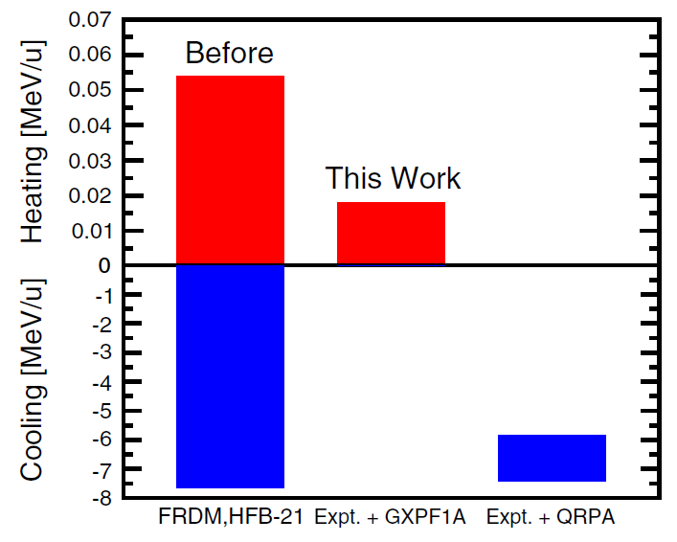

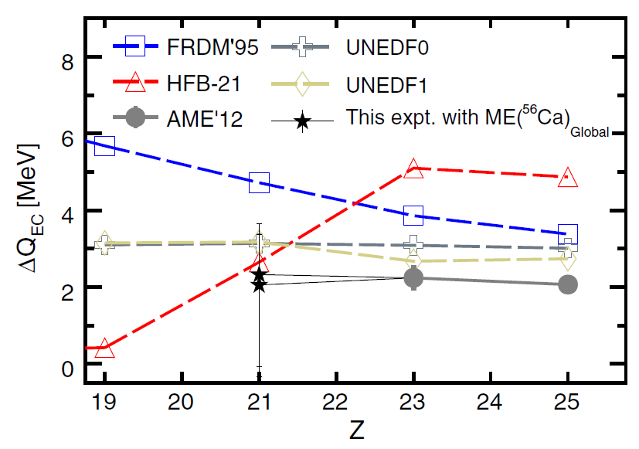
The verdict: Heating or cooling?
Mass excess
Prior to this work, depending on mass model, either heating or strong cooling predicted; now neither strong heating nor cooling
Z. Meisel et al., PRL 115, 162501 (2015)
Notes:
TOF ~ 500ns
D TOF=100ps (resolution) and centroid determination to 1ps

Slide 24
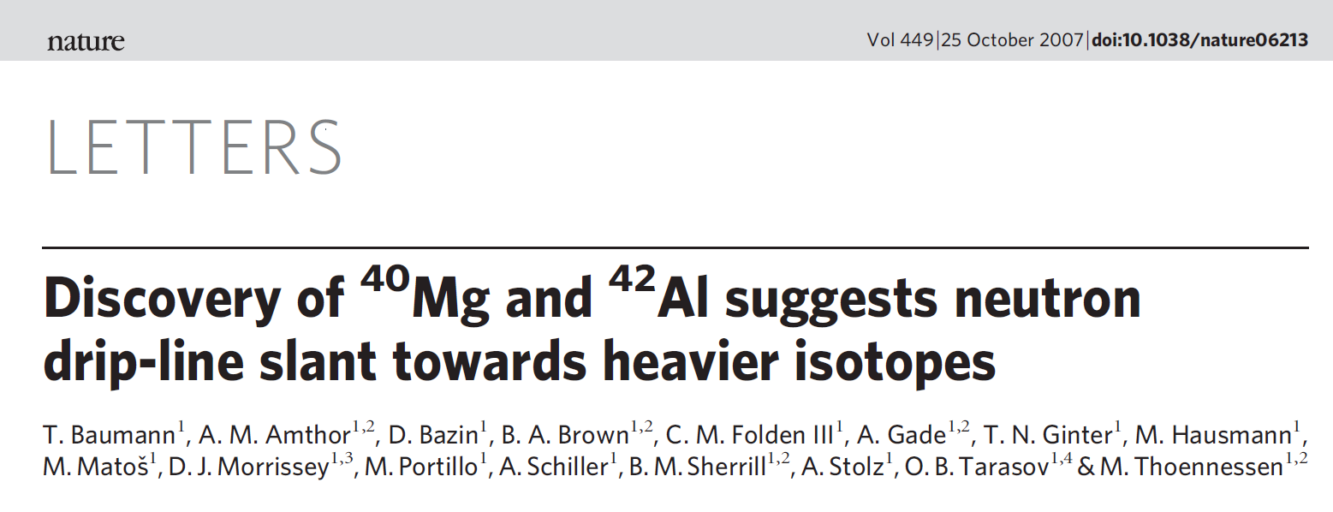
How do you know that ⁴⁰Mg even exists? Produce it and identify it …
Pyconuclear fusion of ⁴⁰Mg+⁴⁰Mg deeper in the crust?!
Discovery experiments – at the heart of rare-isotope science
T. Baumann et al., Nature 449, 1022 (2007)

Slide 25
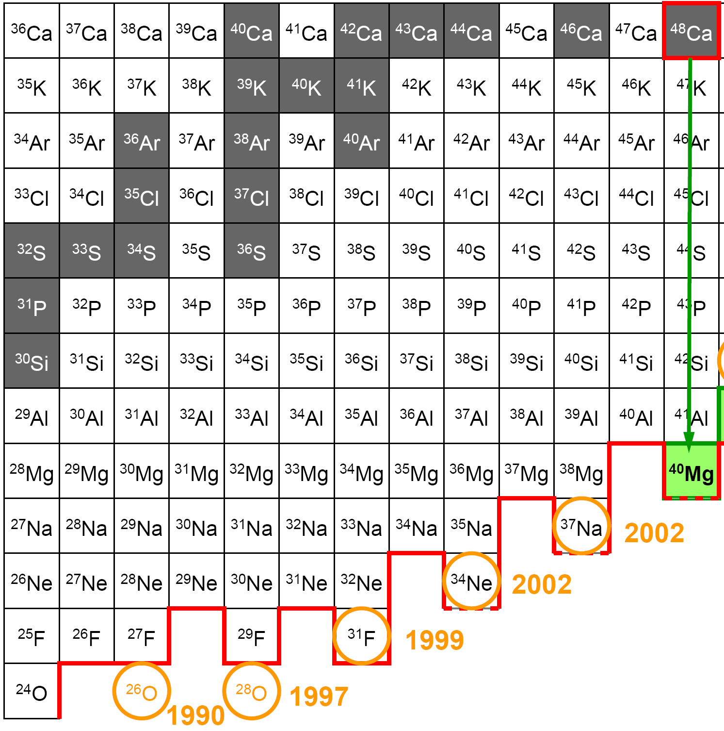
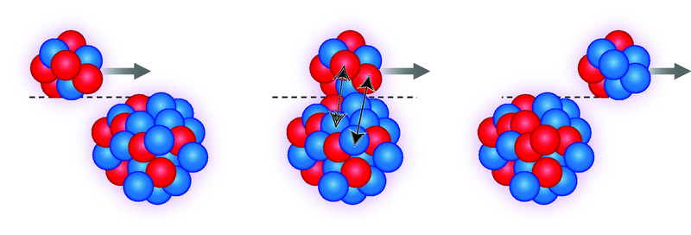
Search for new isotopes – an example
T. Baumann et al., Nature 449, 1022 (2007)
The dripline is a benchmark that nuclear models can be measured against
Nuclear structure is qualitatively different (halo structures and skins)
1990: Guillemaud-Mueller et al., Z. Phys. A 332, 189
1997: Tarasov et al., Phys. Lett. B 409, 64
1999: Sakurai et al., Phys. Lett. B 448, 180
2002: Notani et al., Phys. Lett. B 542, 49
Lukyanov et al., J. Phys. G 28, L41
⁴⁸Ca (Z=20, N=28)
Target
Production of ⁴⁰Mg from ⁴⁸Ca:
Net loss of 8 protons with no
neutrons removed!

Slide 26
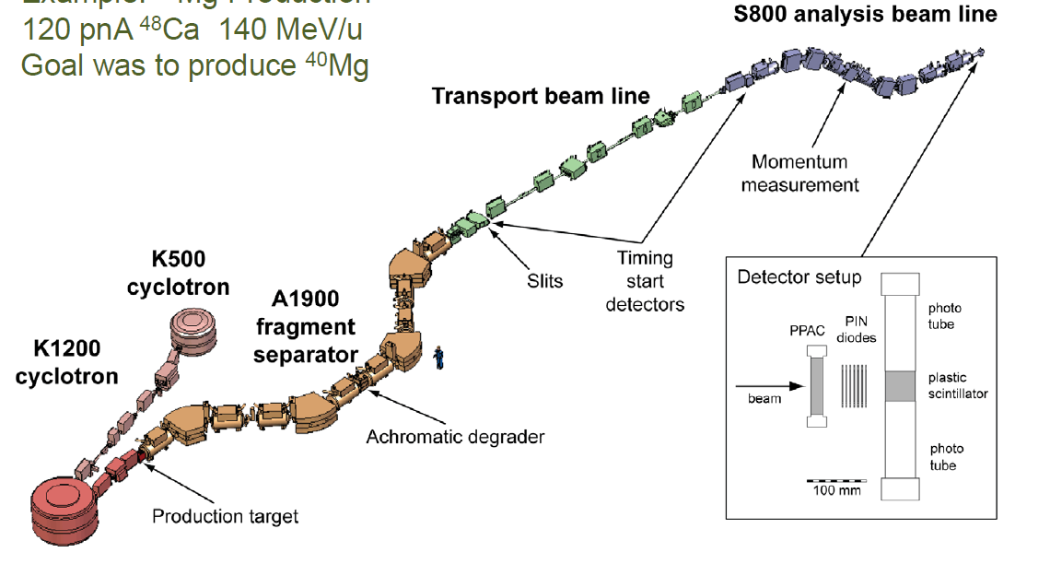
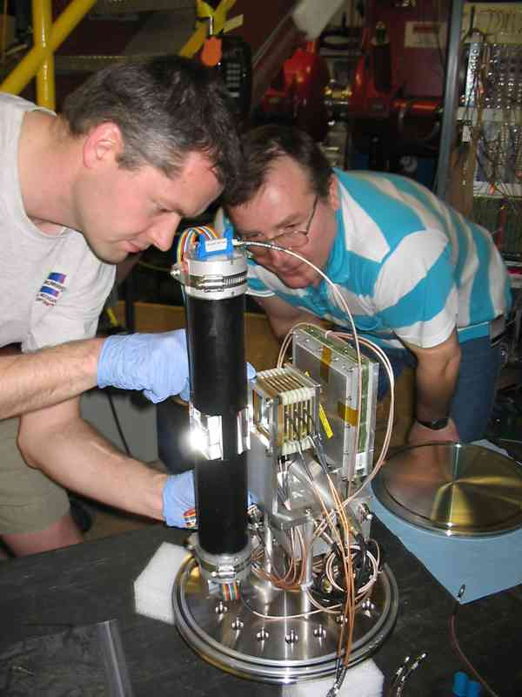
Search for new isotopes – How?
T. Baumann et al., Nature 449, 1022 (2007)
^{nat}W(⁴⁸Ca,²⁹F) 140 MeV/u

Slide 27
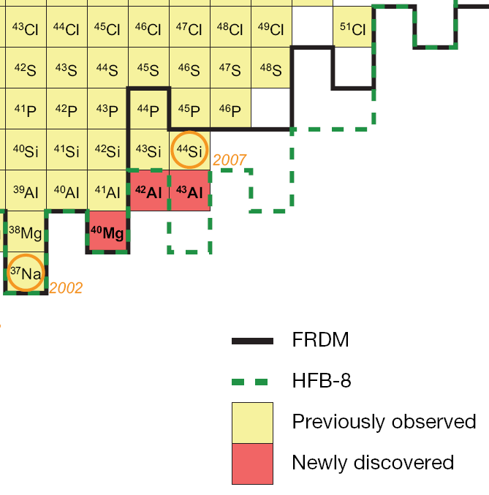
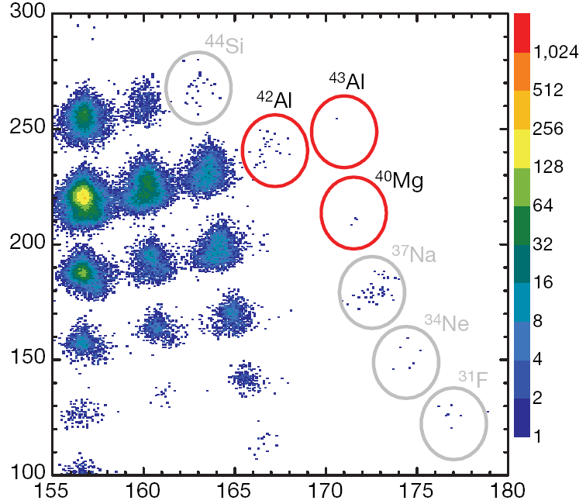
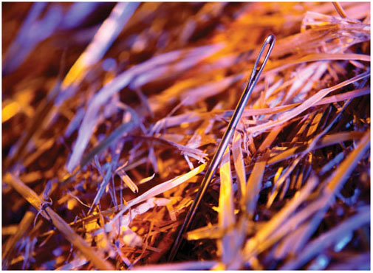
⁴⁰Mg and more!
T. Baumann et al., Nature 449, 1022 (2007)
Energy loss [chn]
ToF [chn]
Data taking: 7.6 days at 5 x10¹¹ particles/second
3 events of ⁴⁰Mg
23 events of ⁴²Al
1 event ⁴³Al
The existence of ^{42,43}Al indicates that the neutron dripline might be much further out than predicted by most of the present theoretical models, certainly out of reach at present generation facilities.

Slide 28
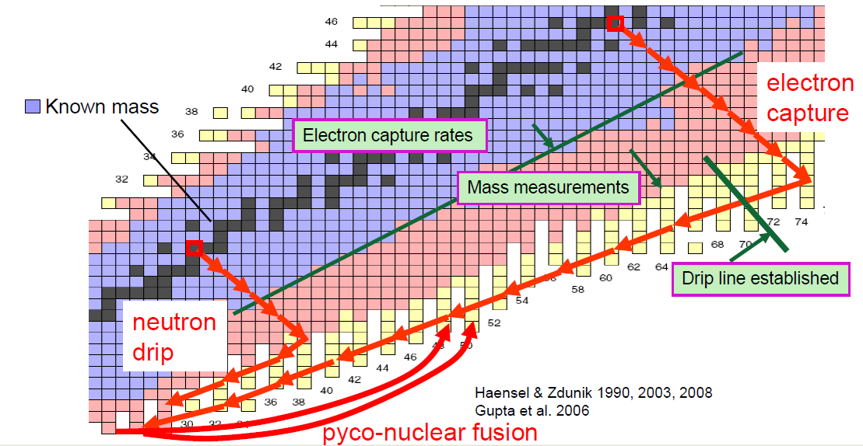
FRIB reach for crust processes
Notes:
TOF ~ 500ns
D TOF=100ps (resolution) and centroid determination to 1ps

Slide 29

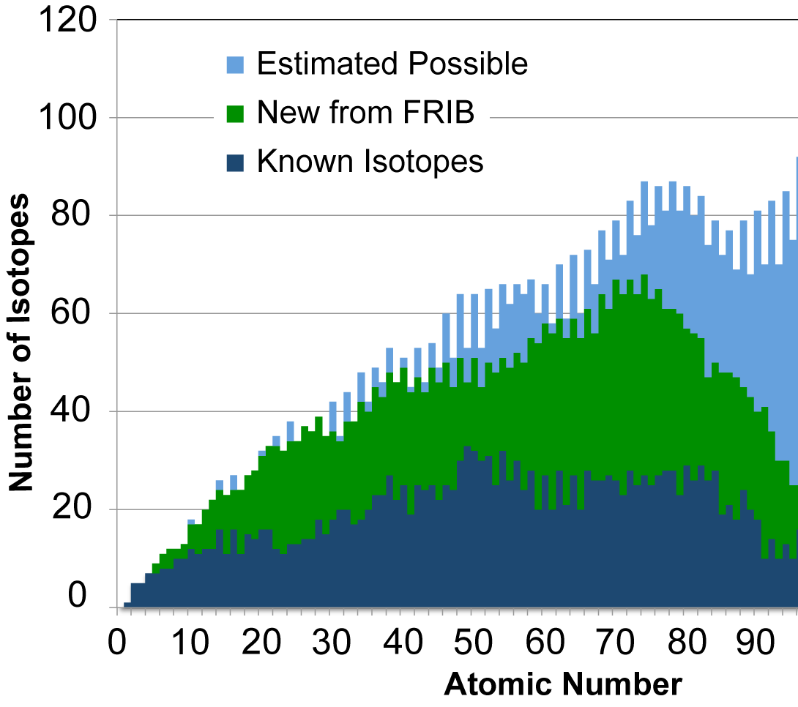
Outlook
Estimated possible: J. Erler et al., Nature 486, 509 (2012), based on a study of various energy density functionals
“Known” defined as isotopes with at least one excited state known
For Z<90, FRIB is predicted to make > 80% of all possible isotopes
Bright future with FRIB and the opportunities at RIBF/RIKEN, ISOLDE, TRIUMF, and FAIR

Slide 30
Thank you!

