Slide 1
Atomic mass measurements of ultralow Q-value nuclei
39th Erice School 2017
Tommi Eronen
University of Jyväskylä

Slide 2
OUTLINE
Q-value from atomic mass spectrometry
Nuclei with potential ultralow Q-value
(On-line) Penning trap atomic mass spectroscopy
+PI-ICR technique
Program at JYFLTRAP, Jyväskylä
Q-value for a reaction is the amount of energy released by that reaction.

Slide 3
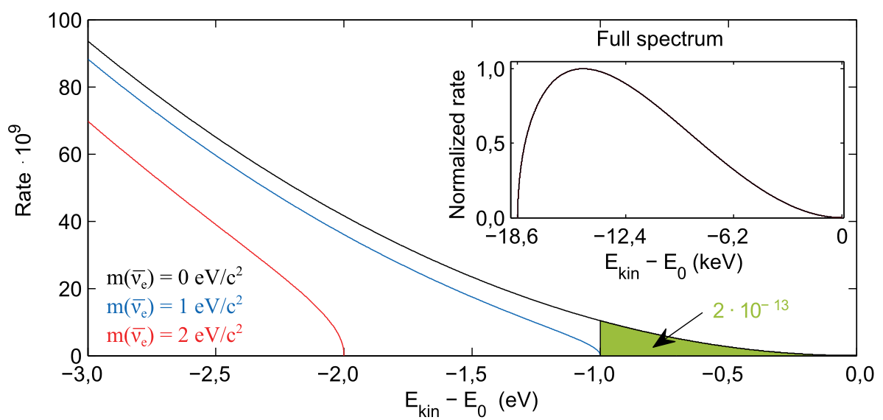
Q-value from mass spectroscopy
Provides the FULL energy available
$Q=m_{parent}−m_{daughter}$
Tritium beta decay electron spectrum
from
parent-daughter
mass difference
Notes:
- Q-value is “spent” to creation of particles, kinetic energy of the created particles
- Here tritium. If no neutrino mass, it is just kinematics

Slide 4
Q-values from masses for neutrino studies
Several cases already studied..
2νββ, 0νββ
0νECEC – Search for resonant enhancement
Now: Ordinary (highly forbidden) β and EC decays
Ground-state-to-ground state decays:
Direct neutrino mass probes, e.g. tritium, ¹⁶³Ho
Ground-state-to-excited-state decays
Low Q-values of highly forbidden decays

Slide 5
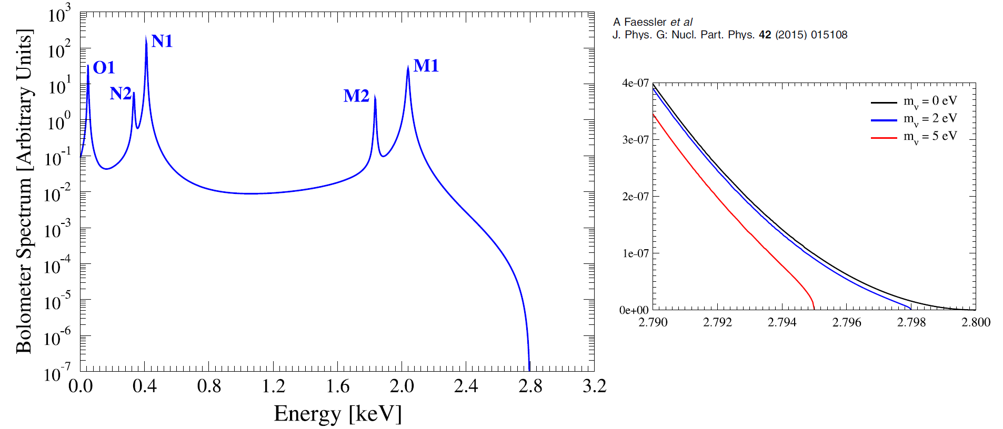
Low Q-value
For example EC Q-value of ¹⁶³Ho ($T_{1/2}≈4600$ years)
Ground state to ground state decay
Q-value from Penning trap mass spectroscopy
Eliseev et al., PRL 115, 062501 (2015) [PI-ICR technique]

Slide 6
Ultralow Q-value nuclei
Single β⁻ and EC capture decays
Decay with very low Q-value to an excited state
Bigger fraction of the Q-value in neutrino mass
Search for ”slightly positive” Q-value
β⁻/EC
parent
Q-value
excited state
mass
difference
excitation
energy
Ground state
Daughter
Notes:
Mass measurements are “cheap” for ruling out unfit transitions..

Slide 7
Required experimental quantities
Parent-daughter decay Q-value – mass difference
From mass spectroscopy
Daughter excited state excitation energy
β⁻/EC
parent
Q-value
excited state
mass
difference
excitation
energy
Ground state
Daughter

Slide 8
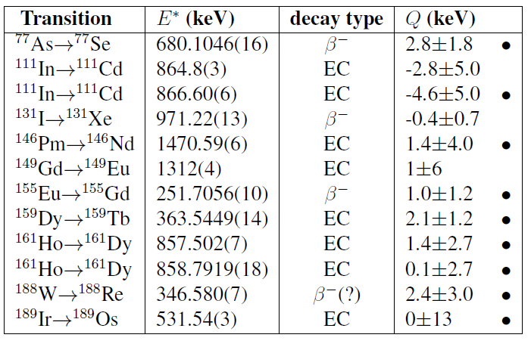
Candidates
Immediate improvement
With precise
Mass difference
measurement
Half-lives range from few hours to few days
J. Suhonen, Phys. Scr. 89, 054032 (2014).
Notes:
One even-even (188W), one odd-odd 146Pm, others even-odd

Slide 9
¹¹⁵In decay
Cattadori et al. Nucl. Phys A 748, 333 (2005)
Q-values:
JYFLTRAP 350(170) eV E. Wieslander, J. Suhonen, T. Eronen et al. PRL 103, 122501 (2009)
FSU-TRAP 155(24) eV B.J. Mount, M. Redshav, E.G. Myers, PRL 103, 122502 (2009)
Notes:
These are “stable”

Slide 10
Precisions
The goal: Find ”slightly positive Q-value” cases:
Phase 1: Coarse selection
Daughter state excitation energies < 100 eV
~100 eV gs-gs precision with Penning traps (TOF-ICR)
Phase 2: Finer selection
If survived phase 1
Daughter state excitation energies < 10 eV
~10-50 eV gs-gs precision with Penning traps (PI-ICR)
Phase 3: Ultimate
Push to eV-level with non-destructive Penning trap mass measurement techniques
E.g. with PENTATRAP in MPIK, Heidelberg

Slide 11
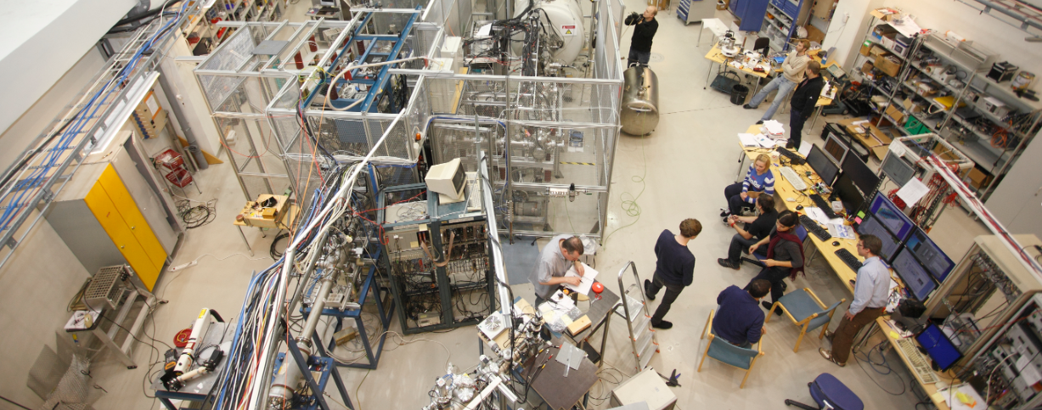
Production of ions of interest
Half-lives few days up to few years
Need (near) on-line production
IGISOL facility at Uni Jyväskylä accelerator lab
K130 and K30 cyclotrons
Proton/deuteron induced fusion reactions
E.g. ⁷⁷As production: ⁷⁶Ge(d,n)⁷⁷As @ 7 MeV

Slide 12
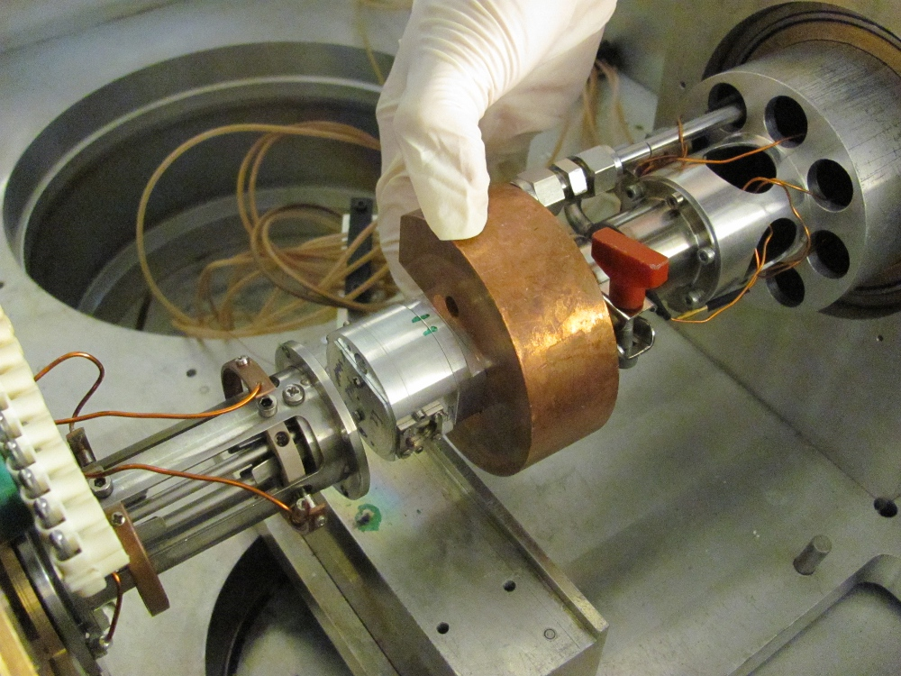
IGISOL
IGISOL
Ion Guide Isotope Separator OnLine
ISOL-system for all elements, fast ( ~ms)
Stopping reaction products into (helium) gas
Extraction as ions – no need to reionize
But: relatively low efficiency
Different geometries for
Light-ion fusion
Fusion evaporation
p/d fission
n-induced fission
Cryogenic

Slide 13
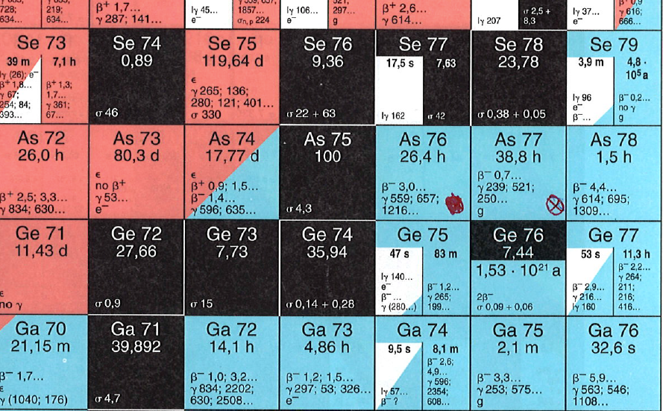
Parent and daughter production
For example ⁷⁷As -> ⁷⁷Se Q-value
Parent: ⁷⁶Ge(d,n)⁷⁷As @ 7 MeV
Daughter: stable selenium exists as a contaminant
BOTH available simultaneously
Notes:
Doublet and near-simultaneous measurement

Slide 14
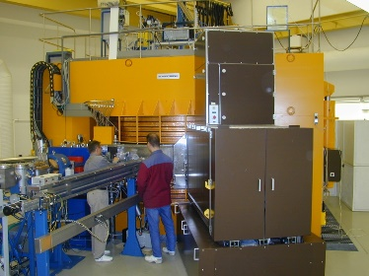
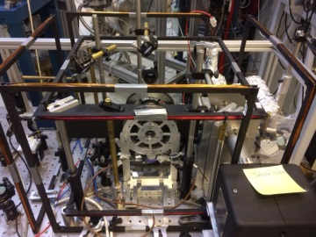
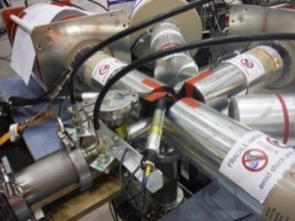
IGISOL-4 FACILITY LAYOUT
From K130 cyclotron
MCC30/15 light-ion cyclotron
Atom trap
Dipole magnet
$$M/∆M≈350$$
30 keV
IGISOL-4 target area
Decay Spectroscopy station
RFQ cooler/buncher
JYFLTRAP, Double Penning Trap
High precision mass measurements
Isobaric/Isomeric purification of RIB
→ Trap assisted spectroscopy
→ High purity ion samples
Collinear laser Spectroscopy
Post-trap decay spec

Slide 15
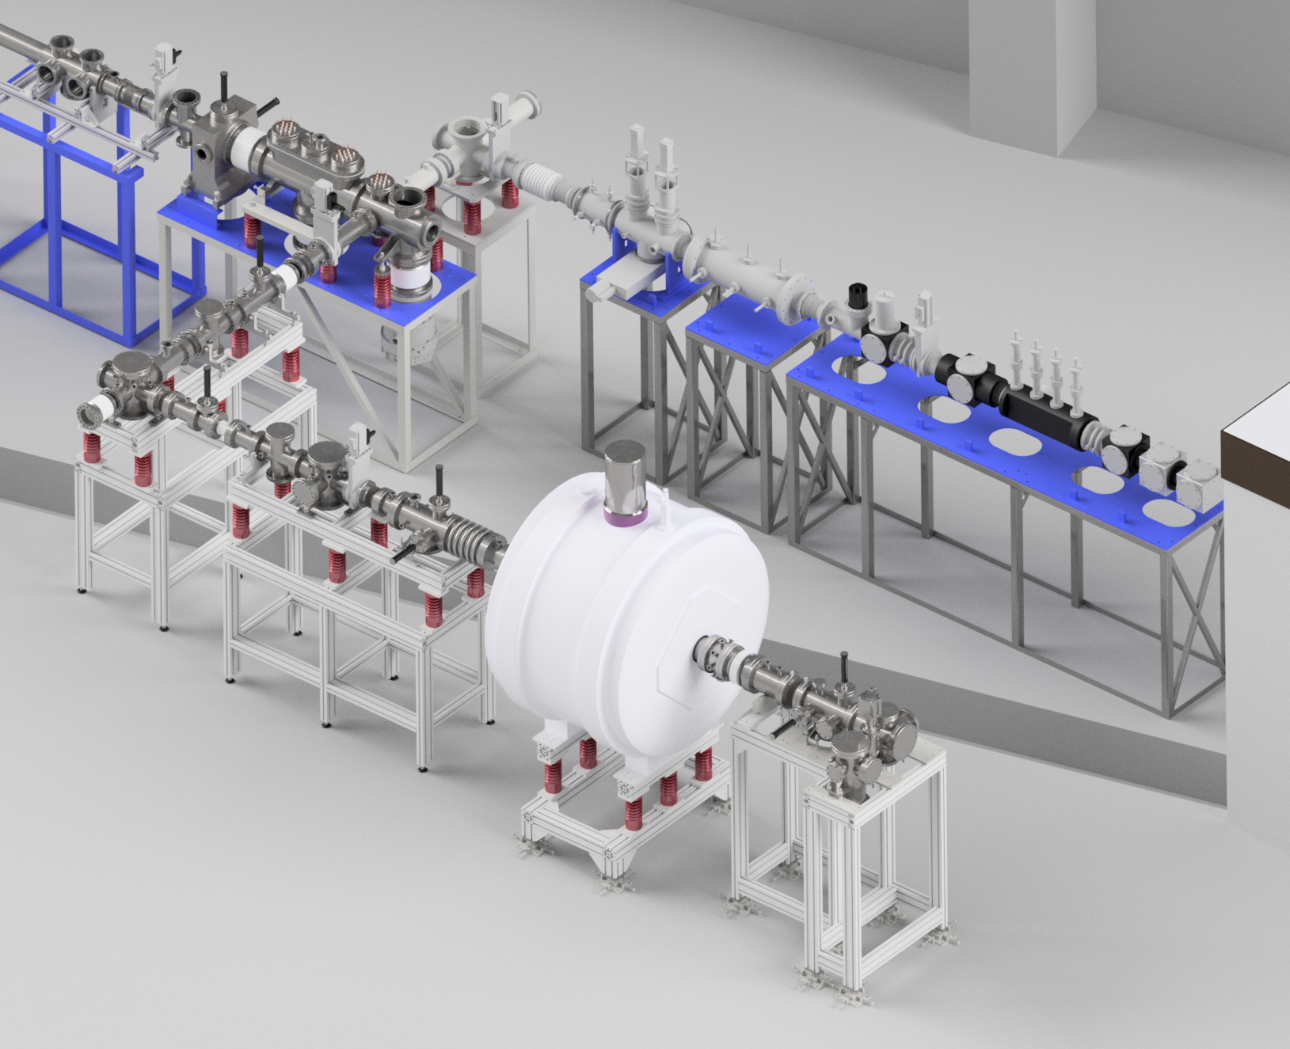
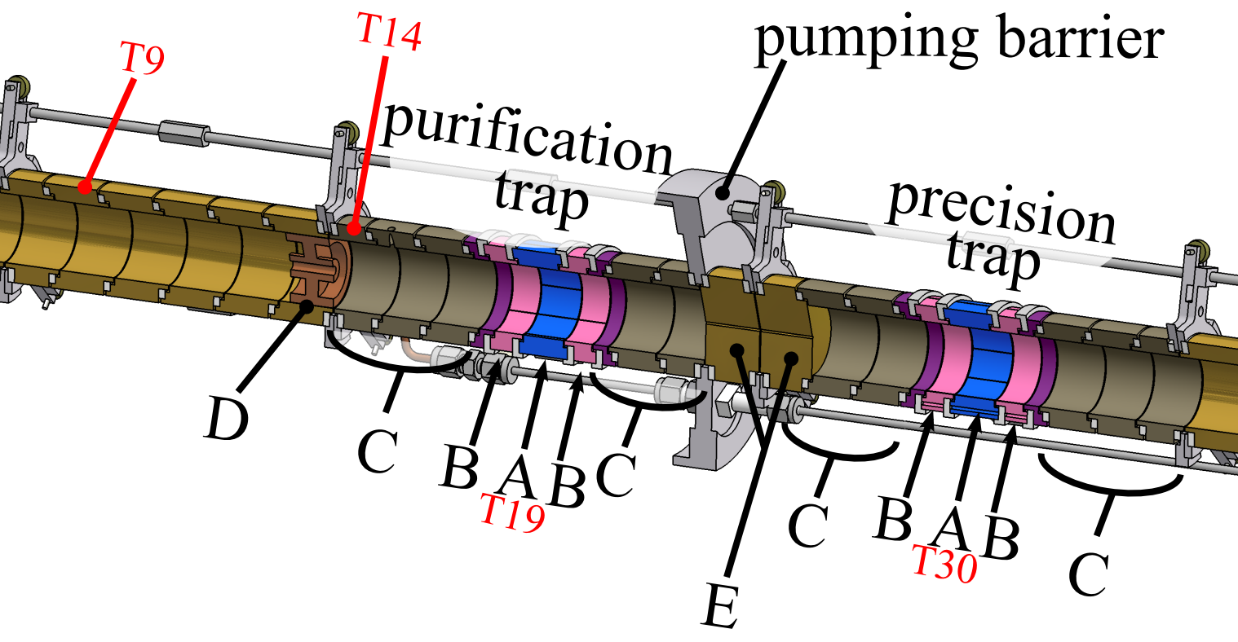
JYFLTRAP
Buncher
2 Penning traps
Purification trap
Precision trap
30 keV
buncher
1 keV
30 keV
Penning
traps

Slide 16
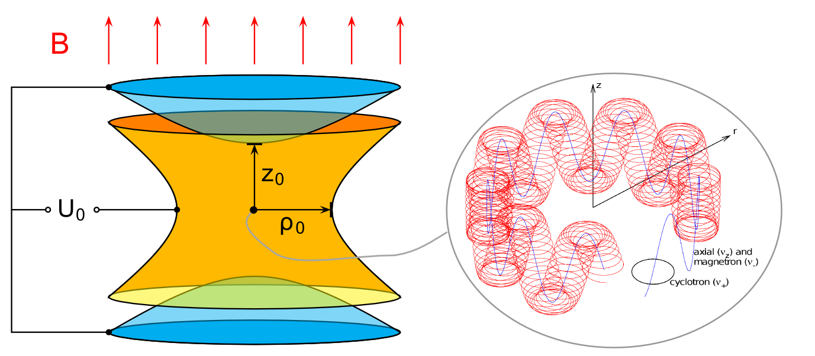
Penning trap – confining charged particles
Three eigenmotions
Axial ν_{z}
Magnetron ν₋
Modified cyclotron ν₊
Notes:
Dimensioista – mm – cm
Staattinen; sielläs ovat

Slide 17
Free-space cyclotron frequency
Mass measurements through
SIDEBAND FREQUENCY:
G. Gabrielse, Int. J. Mass. Spec. 279 (2009) 107–112

Slide 18
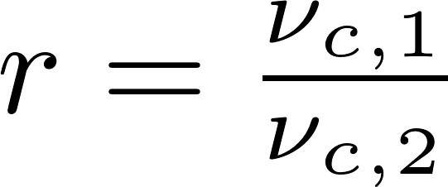
Q-value from cyclotron frequencies
daughter
Frequency ratio – experimental quantity
Q-value (for singly charged ions)
parent
For same A/q:
parent
daughter

Slide 19
Time-of-flight ion cyclotron resonance (TOF-ICR) method for mass measurements - ”phase 1”

Slide 20
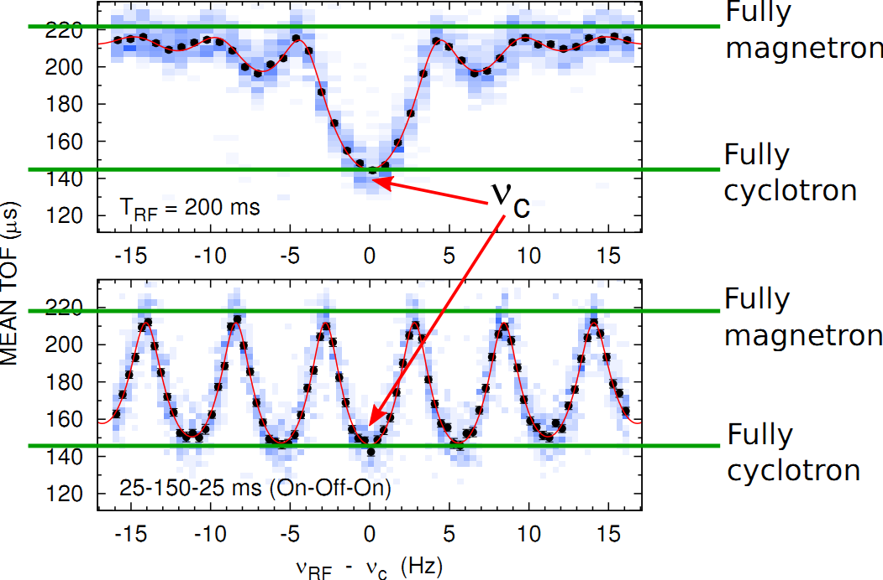
Example resonances,
Notes:
So far nearly all Penning trap measurements with this TOF-ICR technique

Slide 21
Phase imaging ion cyclotron resonance (PI-ICR) method for mass measurements ”phase 2”

Slide 22
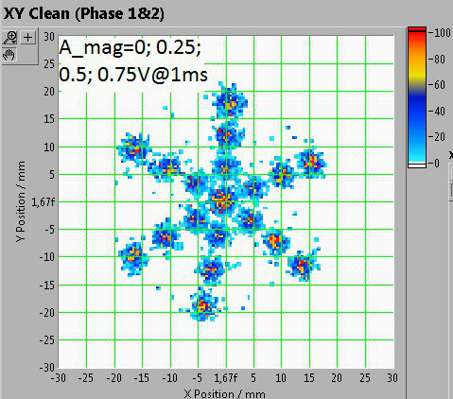
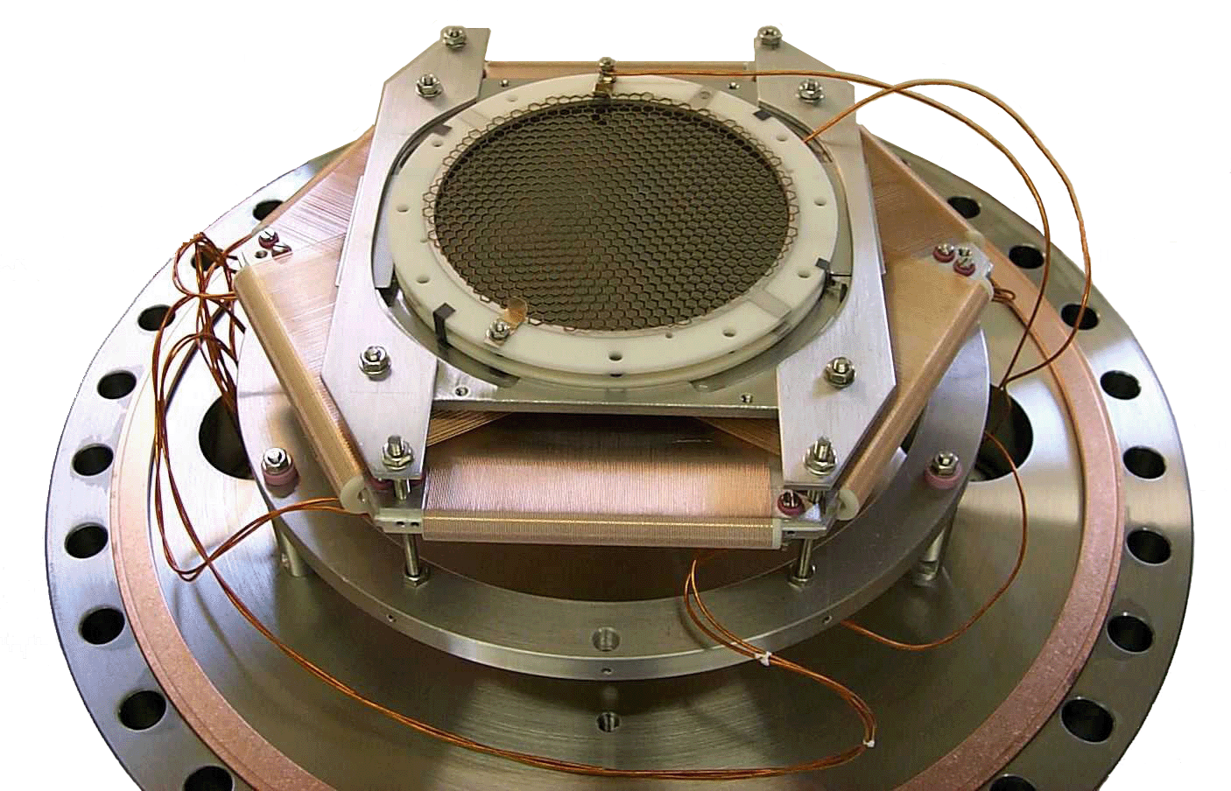
PI-ICR method
Novel Penning trap mass measurement technique
Developed by Sergey Eliseev, MPIK Heidelberg at SHIPTRAP GSI
Faster by 40x

Slide 23
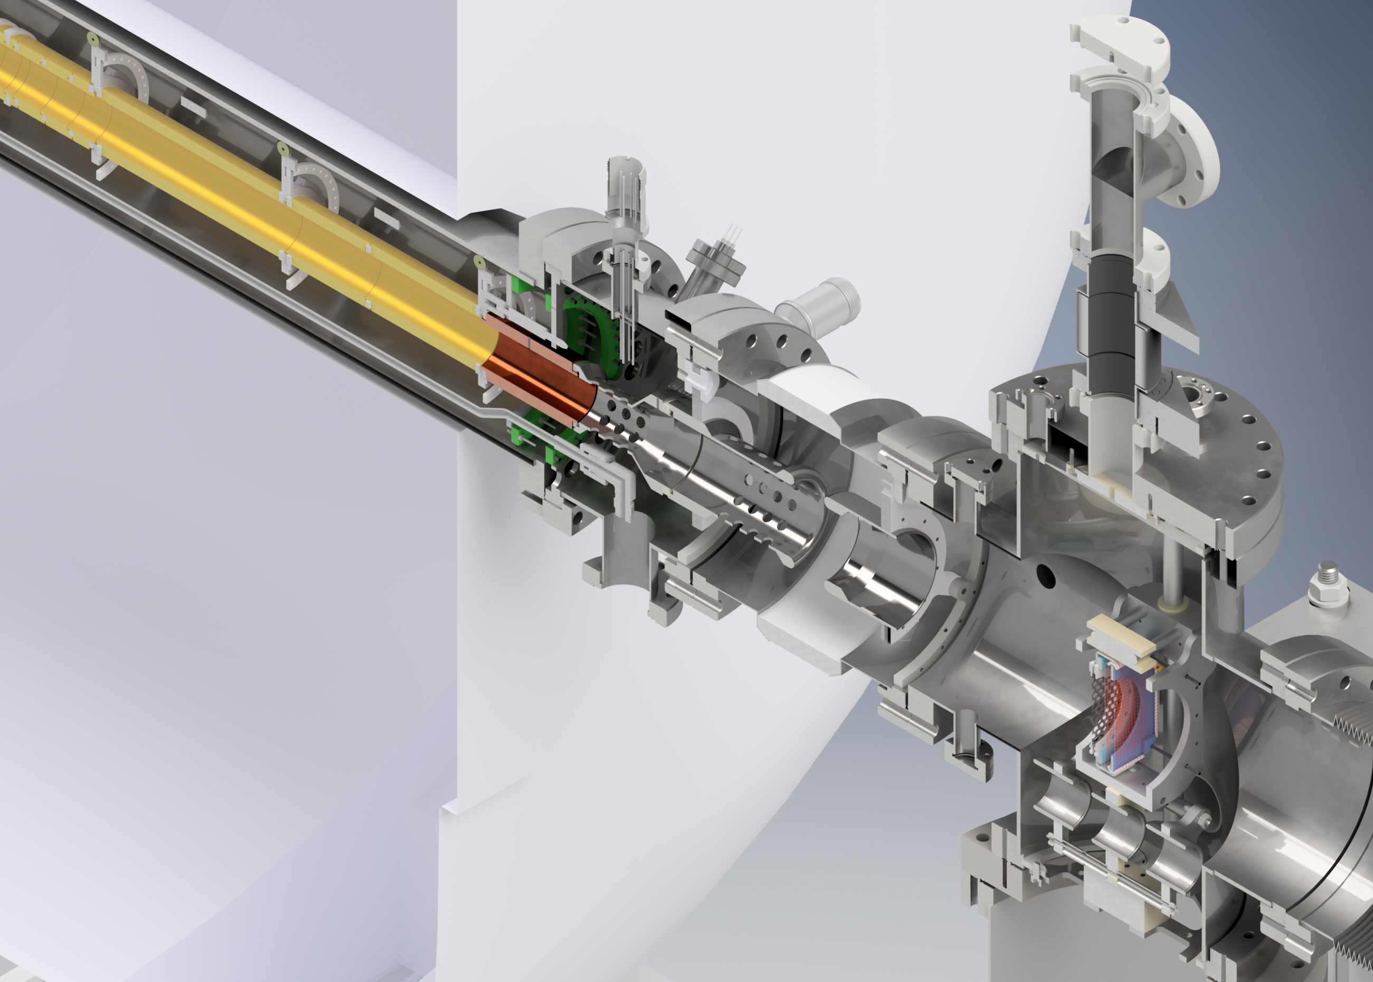
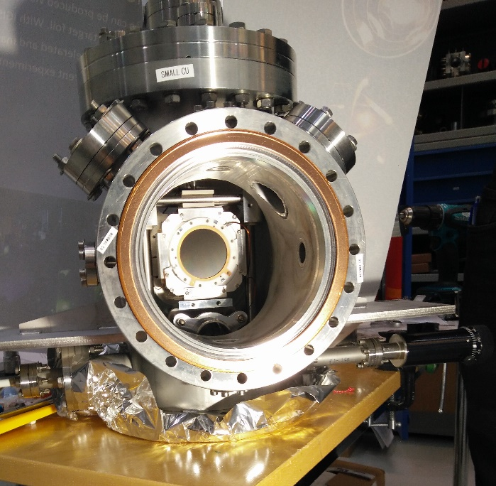
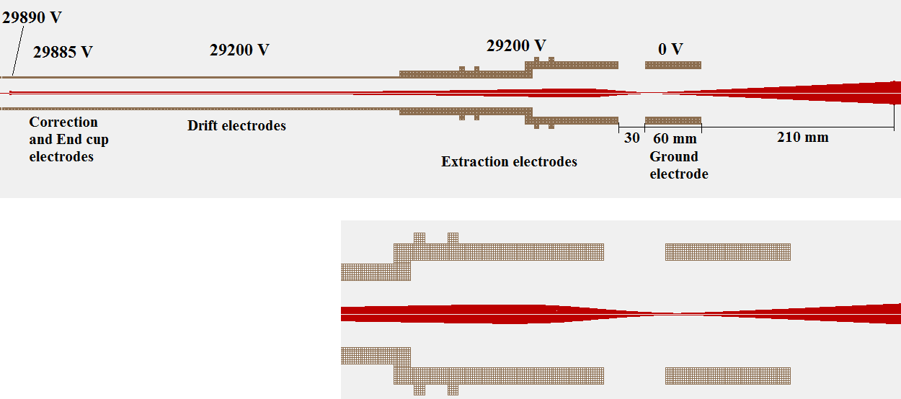
PI-ICR at JYFLTRAP
Detector installed in June 2017
Trap
center

Slide 24
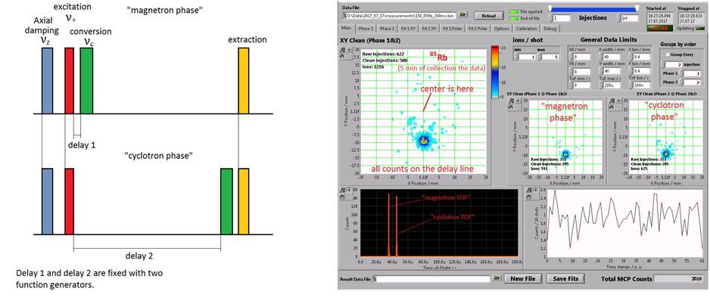
PI-ICR scheme for mass measurements

Slide 25
PI-ICR results
SHIPTRAP at GSI: ¹⁶³Ho-¹⁶³Dy Q-value with uncertainty 30_{stat} + 15_{syst} eV
Eliseev et al., PRL 115, 062501 (2015)
JYFLTRAP test measurement ⁸⁵Rb-⁸⁷Rb
52 eV precision (preliminary, room for improvement)
This is better than 10⁻⁹ !
In general: few ten eV precision available
(few x 10⁻¹⁰ frequency ratio precision)

Slide 26
After Q-value measurement..
J. Suhonen et al. will be busy for a while
Branching ratio
A potential case will have
Very low Q-value (< 100 eV)
Reasonable branching ratio
Low background near the endpoint
With very small Q-value atomic effects might interfere with beta decay

Slide 27
Final remarks
IGISOL + JYFLTRAP is the ideal facility for low Q-value measurements
Easy production, “cheap” beamtime
Simultaneous availability of parent, daughter (A/q doublet mass measurement)
PI-ICR technique allows to push to ~20 eV level
11 days of beamtime approved for 6 cases
Collaboration with J. Suhonen’s group

Slide 28
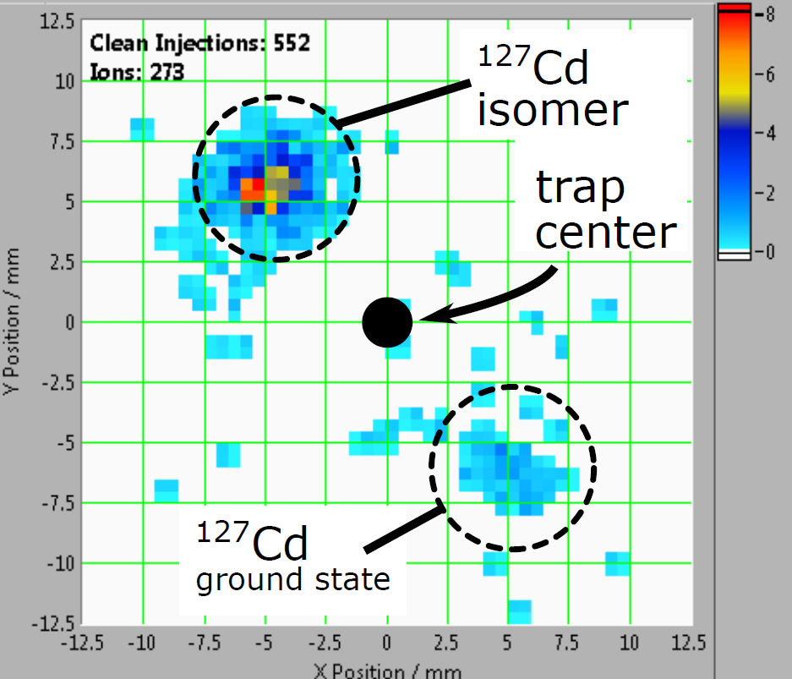
Advertisement
Isomerically clean beams available with unprecedented resolution!
Phase-sensitive cleaning
For A/q = 100
50 keV isomer
45 deg phase difference
Need 200 ms
250 ms

Slide 29
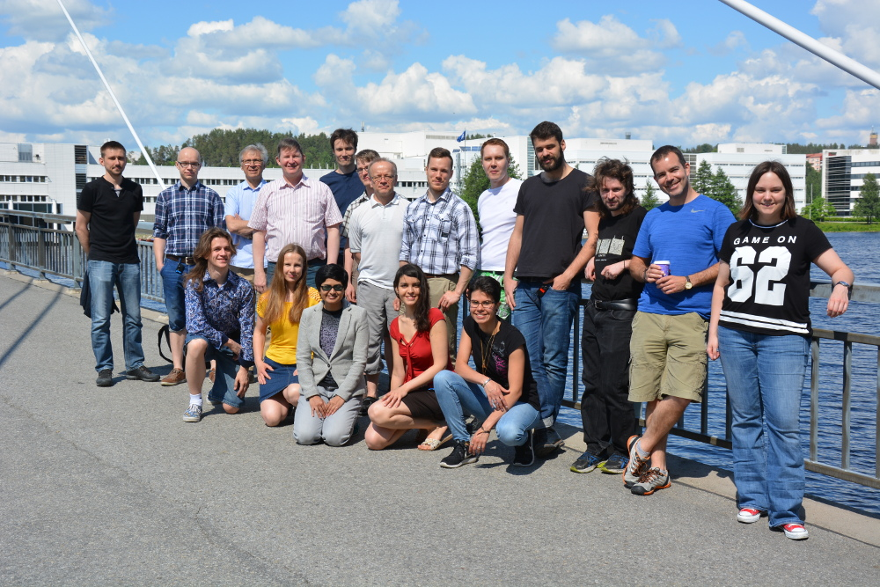
Acknowledgments
EXPERIMENT:
L. Canete
T. Eronen
S. Geldhof
A. Jokinen
A. Kankainen
I.D. Moore
D. Nesterenko
H. Penttilä
I. Pohjolainen
A. de Roubin
M. Reponen
S. Rinta-Antila
A. Takkinen
M. Vilen
J. Äystö
THEORY:
J. Suhonen
M. Haaranen
J. Kostensalo
J. Kotila
P. C. Srivastava (Roorkee, India)
Thank you!
http://research.jyu.fi/igisol

