Slide 1

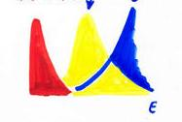
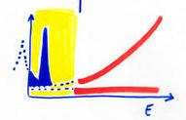
LUNA: the scientific program with the new
3.5 MV accelerator under Gran Sasso
Stellar Energy+Nucleosynthesis
Hydrogen Burning
σ(E_{star}) with E_{star} << E_{Coulomb}
Carlo Broggini
INFN-Padova
σ(E) = S(E) e^{–2πη} E⁻¹
2πη = 31.29 Ζ₁Ζ₂ √μ/Ε
μ = m₁m₂ / (m₁+m₂), Ε in keV
∫
Reaction Rate(star) ÷
Φ(E) σ(E) dE
Gamow Peak
σ
Meas.
Extrap.
S(E)
Maxwell
Boltzmann
σ

Slide 2
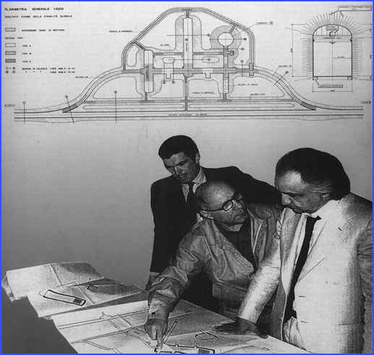
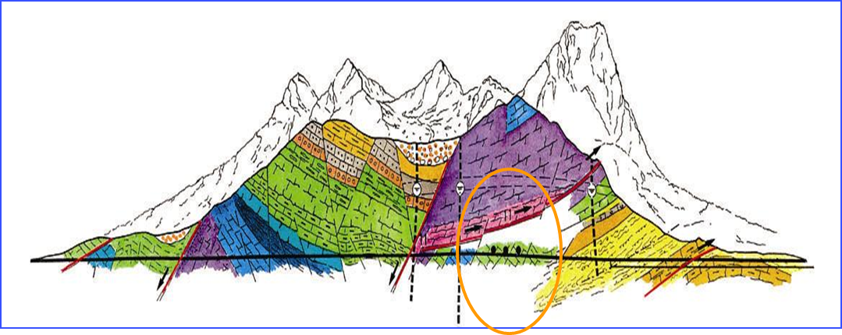
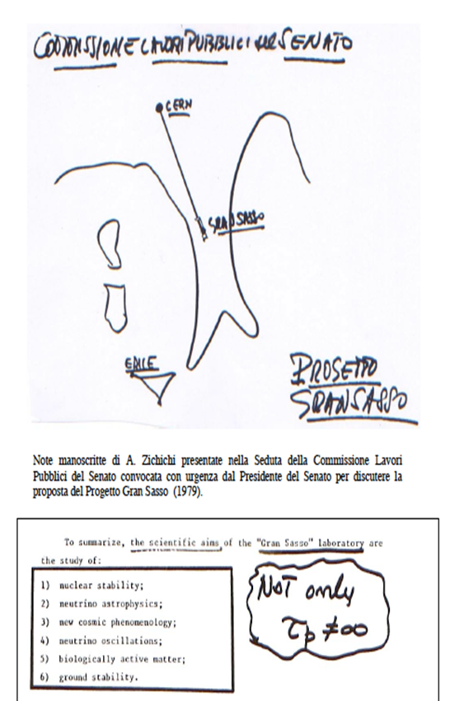
1979 Gran Sasso Lab proposed by A. Zichichi 1989 first underground experiment ON
1400 m of dolomite rock, CaMg(CO₃)₂, (~3800 m w.e.)
Surf.: 17 800 m², Vol.: 180 000 m³, Ventilation: 1 vol / 3.5 hours (Rn in air 20-80 Bq m⁻³)
Muon flux: 1.1 m⁻²h⁻¹, 6 orders of magnitude reduction
Neutron flux, mainly from (α,n) : 2.92 10⁻⁶ cm⁻²s⁻¹ (0-1 keV), 0.86 10⁻⁶ cm⁻²s⁻¹ (> 1 keV), 3 orders of magnitude reduction
Gamma rays: only 1 order of magnitude reduction, but with thick shield (no muon activation) about 5 orders of magnitude in the region of natural radioactivity and 4-5 orders above 3.2 MeV without any shield (gamma rays due to n-interaction)
Alpha particles: ~ factor 15 background reduction below 2 MeV in silicon detectors

Slide 3
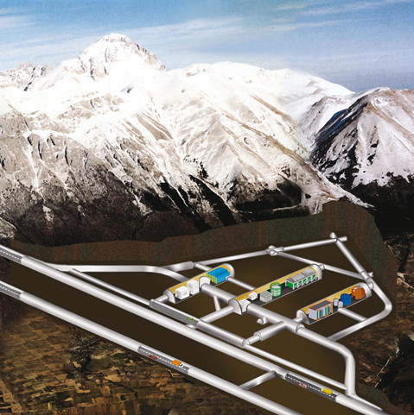
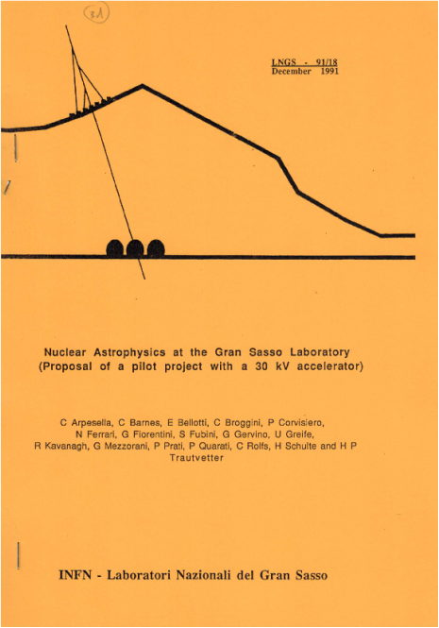

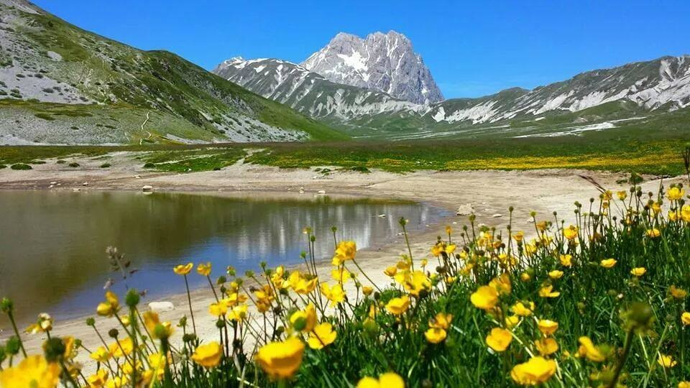
Laboratory for Underground
Nuclear Astrophysics: LUNA
400 kV
50 kV
3.5 MV

Slide 4
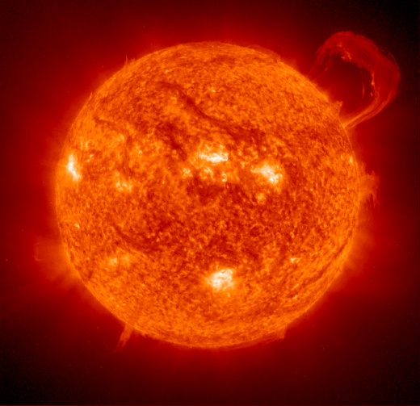
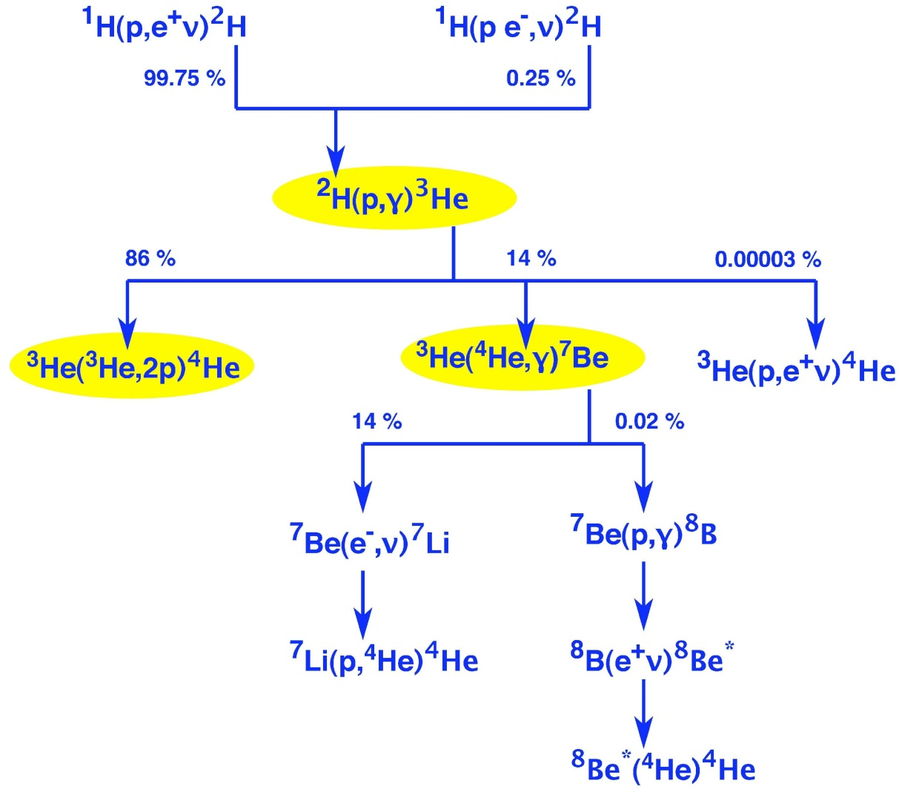
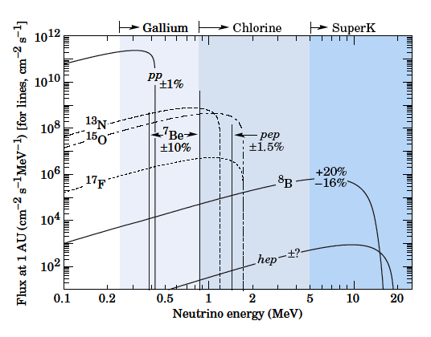
Hydrogen burning in the Sun
@15*10⁶ degrees:
6*10¹¹ kg/s H He
+0.7% M_{H} E
4H He +2e⁺ +2
ν_{e}
+26.7 MeV
³He burning in the p-p chain
Resonance @ solar Gamow peak?
Activation=prompt gamma
no monopole contribution to σ
σ at low energy with 4% error

Slide 5
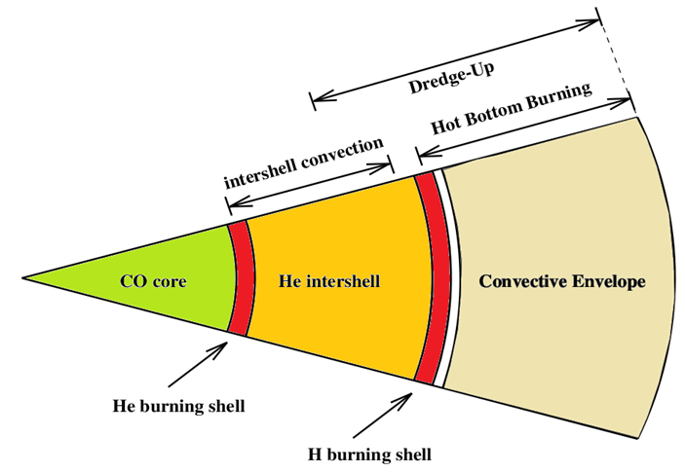
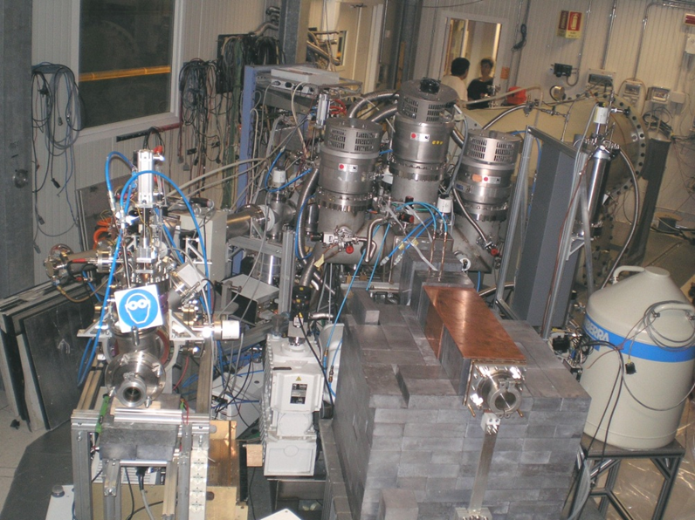
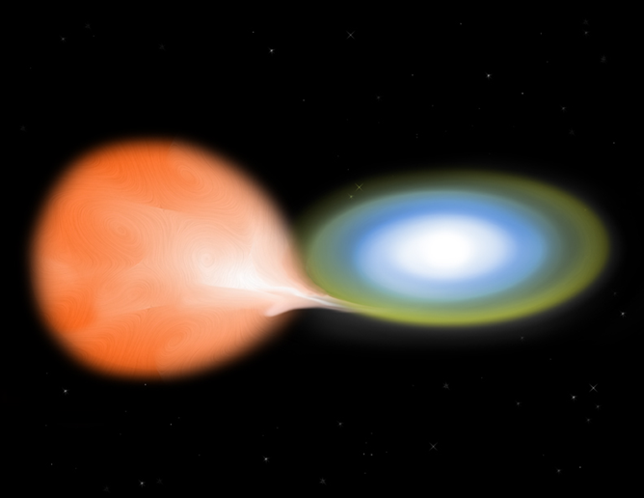
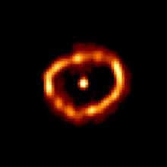
LUNA beyond the Sun: isotope production in the hydrogen burning shell of
AGB stars (~30-100 T₆), Nova nucleosynthesis (~100-400 T₆) and BBN
Nova Cigni 1992

Slide 6
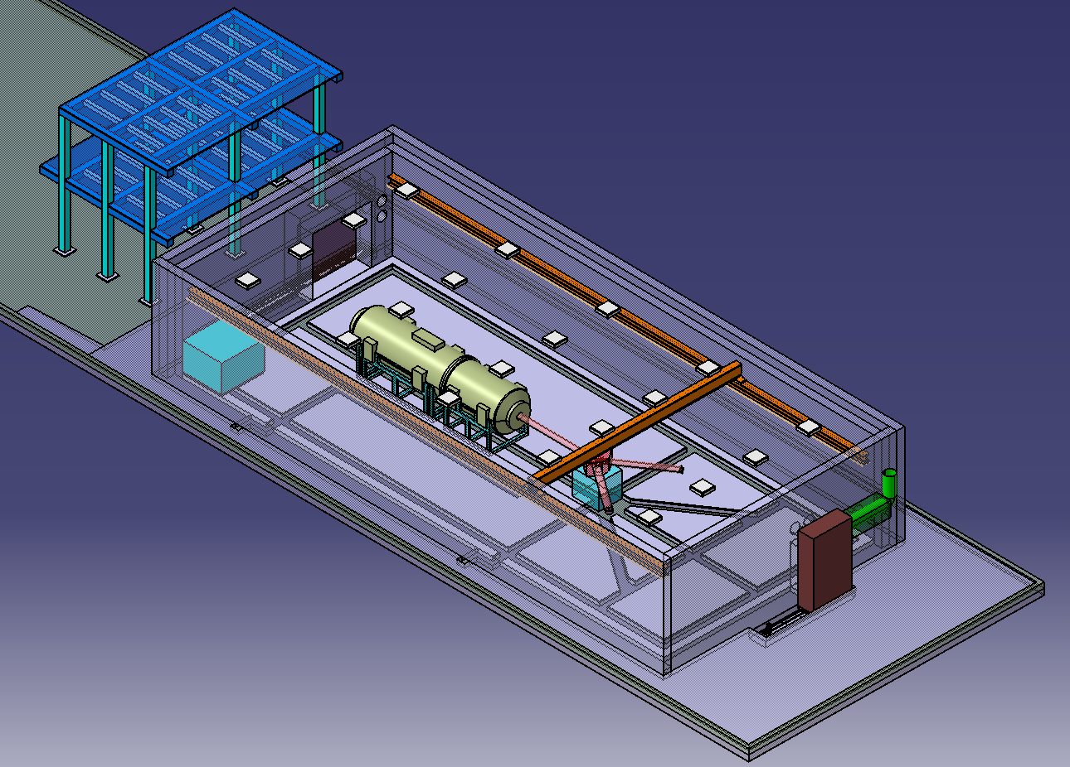
A new accelerator, LUNA-MV, will be installed next year in Hall B of LNGS (ex Icarus). New LUNA hall: 27 x 12.5 x 5 m³

Slide 7
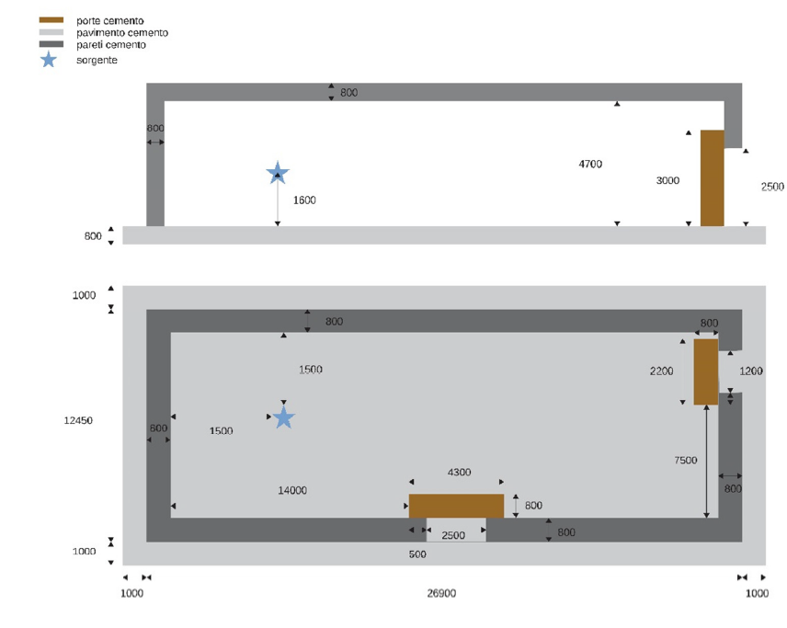
The accelerator and the neutron shielding
H
¹H⁺ (TV: 0.3 – 0.5 MV): 500 μA
- inline Cockcroft Walton accelerator
- TERMINAL VOLTAGE: 0.2 – 3.5 MV
- Precision of terminal voltage reading: 350 V
- Beam energy reproducibility: 0.01% TV
- Beam energy stability: 0.001% TV / h
- Beam current stability: < 5% / h
¹H⁺ (TV: 0.5 – 3.5 MV): 1000 μA
He
⁴He⁺ (TV: 0.3 – 0.5 MV): 300 μA
⁴He⁺ (TV: 0.5 – 3.5 MV): 500 μA
C
¹²C⁺ (TV: 0.3 – 0.5 MV): 100 μA
¹²C⁺ (TV: 0.5 – 3.5 MV): 150 μA
¹²C⁺⁺ (TV: 0.5 – 3.5 MV): 100 μA
80 cm thick concrete shielding calculated by GEANT4 & MCNP
E_{n} = 5.6 MeV, 2*10³ n/s, isotropic
MCNP: Φ_{n} = 1.38*10⁻⁷ n/(cm² s)
GEANT4: Φ_{n} = 3.40*10⁻⁷ n/(cm² s)
Φ_{n}(LNGS) = 3*10⁻⁶ n/(cm² s)

Slide 8

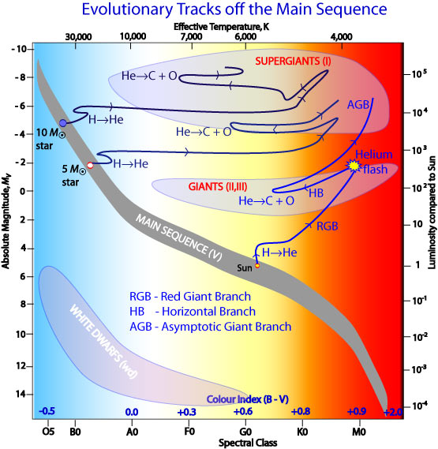
The scientific program for the first five years of LUNA-MV
From hydrogen burning to helium and carbon burning
Nucleosynthesis: from p-p chain, CNO, NeNa and MgAl cycles to the region beyond Fe
Stellar evolution: from Main Sequence stars to thermonuclear supernovae and core collapse supernovae

Slide 9
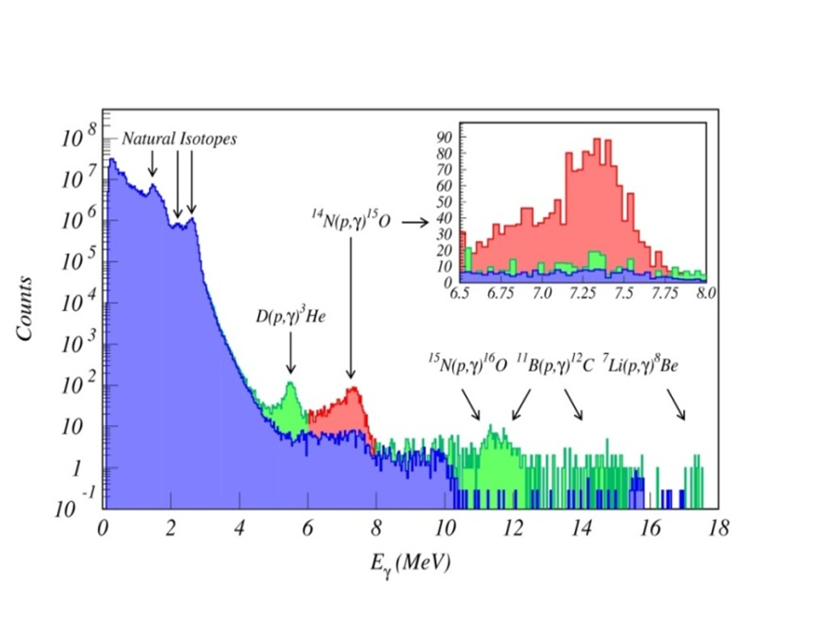
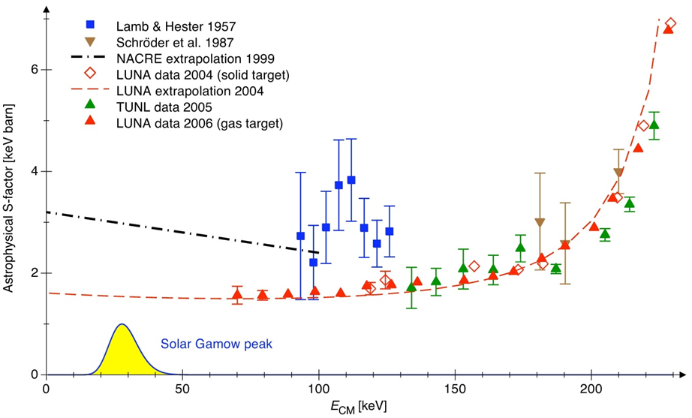
¹⁴N(p,γ)¹⁵O
278
7556
1/2 ⁺
The bottleneck reaction of
the CNO cycle already studied
by LUNA (2004-11)
7297
7276
7/2 ⁺
¹⁴N+p
(p,γ)
6859
5/2 ⁺
¹³C
¹⁴N
-21
6793
3/2 ⁺
(p,γ)
- 504
6176
3/2 ⁻
β⁺
5241
5/2 ⁺
¹³N
¹⁵O
5183
1/2 ⁺
(p,γ)
β⁺
(p,α)
(p,γ)
¹²C
¹⁵N
¹⁶O
¹⁵O
0
1/2 ⁻
LUNA: S_{t}(0)=1.57±0.13 keV b
S_{gs}(0)=0.20±0.05 keV b
Adelberger et al. 2011 : S_{t}(0)=1.66±0.12 keV b
S_{gs}(0)=0.27±0.05 keV b
Q. Li et al. 2016, study over a wide energy
region of 6.79 MeV and g.s. transitions: S_{gs}(0)=0.42±0.04 ⁺⁰⁰⁹ _{-0.19} keV b
It is mandatory to have a low background measurement over a wide energy region

Slide 10
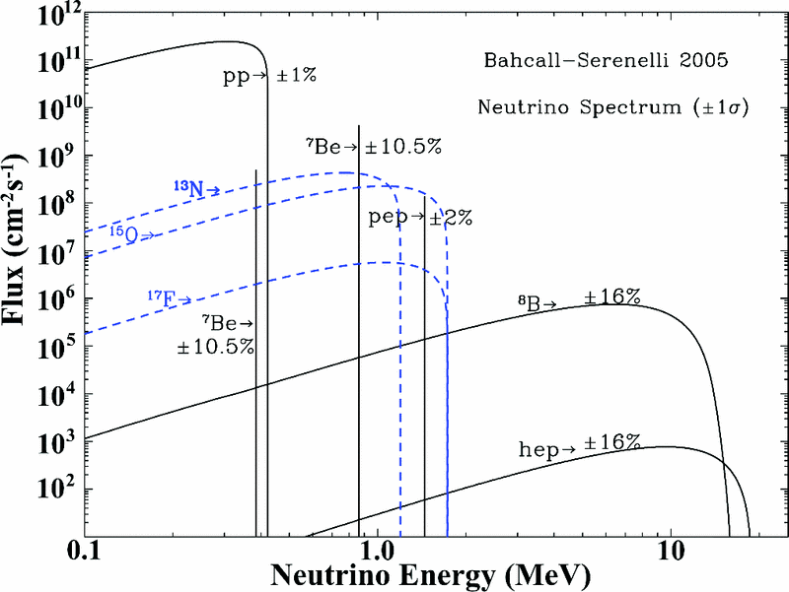
The solar abundance problem
new (2009) spectroscopic determination of the solar photosphere, in
particular C, N and O: 30-40% lower than before
SSM predictions disagree with heliosysmology results
Conditions in the solar core, in particular the temperature profile,
are determined by pp-chain.
CNO luminosity ~1%
ν_{cno} = LF(S_{1,14},C+N_{core})
probe of the (C+N) abundance
in the Sun core
Borexino: ν_{cno}< 7.7*10⁸ cm-²s-¹
From A.Serenelli, Topical Issue on
underground nuclear astrophysics and
solar neutrinos EPJA 52(2016):
Intrinsic error on the (C+N) prediction of 11%, 2.6% from heavy element settling
and 10.6% from nuclear cross sections (S₁₇ and S₁₁₄, ~7.5% each).
CNO neutrino flux with 10% uncertainty C+N abundance in the Sun core
with ~15% uncertainty

Slide 11
¹⁴N(p, γ)¹⁵O @LUNA MV: day zero experiment to verify accelerator
and solid target set-up + to reduce the error on S₁₁₄
Set-up: several gamma ray detectors to study the angular distribution
(if necessary, there is space for an array).
Expected beam time: ~6 months

Slide 12
¹²C+ ¹²C the trigger of Carbon burning
* The lower stellar mass bound M_{up} for the Carbon ignition:
white dwarf (+Nova or thermonuclear supernova) or
massive O-Ne WD or core collapse supernova (+neutron star or
black hole)
* Protons and alpha injection for nucleosynthesis in massive stars
Coulomb barrier: E_{C}= 6.7 MeV
¹²C+¹²C→ ²⁰Ne + α Q=4.62 MeV
¹²C+¹²C→ ²³Na + p Q=2.24 MeV
¹²C+¹²C→ ²⁴Mg + γ Q=13.93 MeV negligible
¹²C+¹²C→ ²³Mg + n Q=-2.62 MeV endothermic
¹²C+¹²C→ ¹⁶O + 2α Q=-0.12 MeV three particles
¹²C+¹²C→ ¹⁶O + ⁸Be Q=-0.21 MeV higher Coulomb barrier

Slide 13
Energy (CM) region of interest:
0.9-3.4 MeV
explosive C-burning from
0.7 MeV
Relevant energy range in stars
¹²C+¹²C→ ²⁰Ne + α_{i} + γ_{i}
¹²C+¹²C→ ²³Na + p_{i} + γ_{i}
E_{γ} = 440 keV
Detection: particles (Silicon
detectors, ΔE-E telescopes,
ionization chambers)
and gammas (from the first
excited state, Ge detectors)
E_{γ} = 1634 keV
Main advantage deep
underground @LNGS: gamma
ray suppression in a shielded
detector (~5 orders of
magnitude)

Slide 14
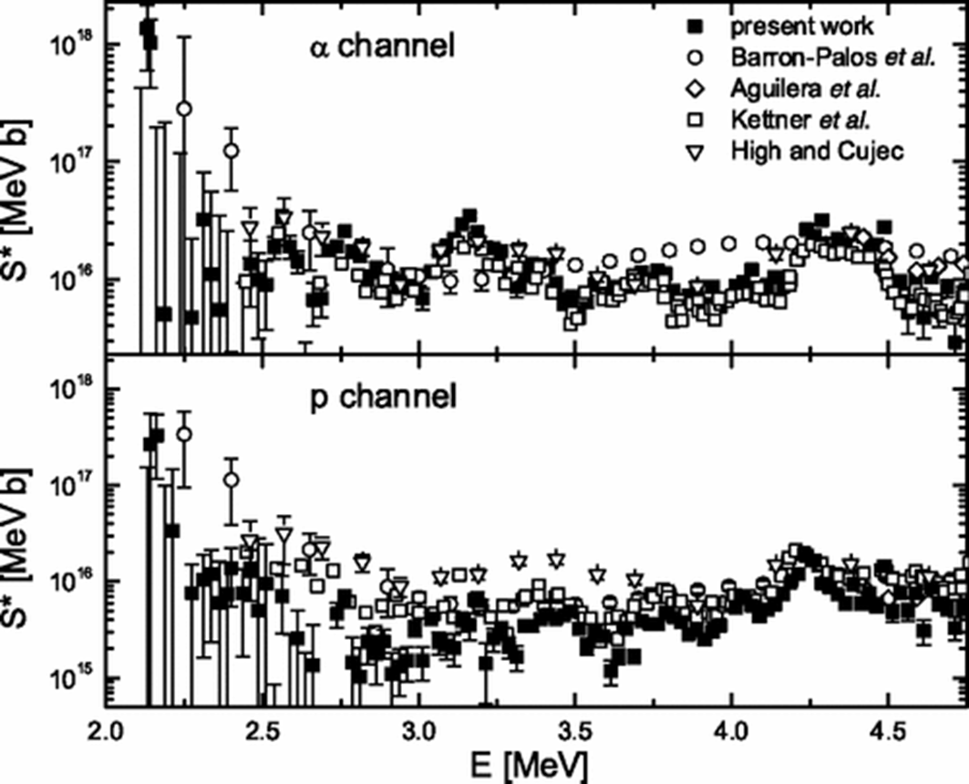
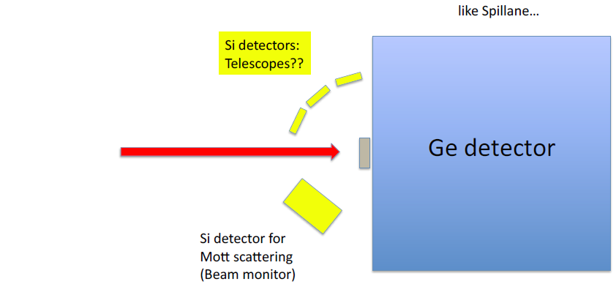
T. Spillane et al., Phys Rev Lett. 98 (2007) 122501
Several resonances spaced by 300-500 keV, typical width Γ≈10 keV
Improvements @LNGS:
With a shielded Ge detector bck of 52 cpd 425-455 keV and 1 cpd 1619-1649 keV
Minimum energy 1955 for the proton channel
(bck limited) and 1605 keV for the alpha channel (time limited). All this with 1mm thick carbon target, 5 keV spacing and 30% stat. error)
Expected beam time: ~2.5 years
Beam induced bck: ¹H and ²H in the target
Gamma detection: ²H(¹²C,p₁ γ)¹³C
and ¹H(¹²C,γ )¹³N
Particle detection (at backward
angles): ²H(¹²C,²H)¹²C + ¹²C(d,p)¹³C
Heating at high temperature
is able to reduce the contamination
D
educe

Slide 15
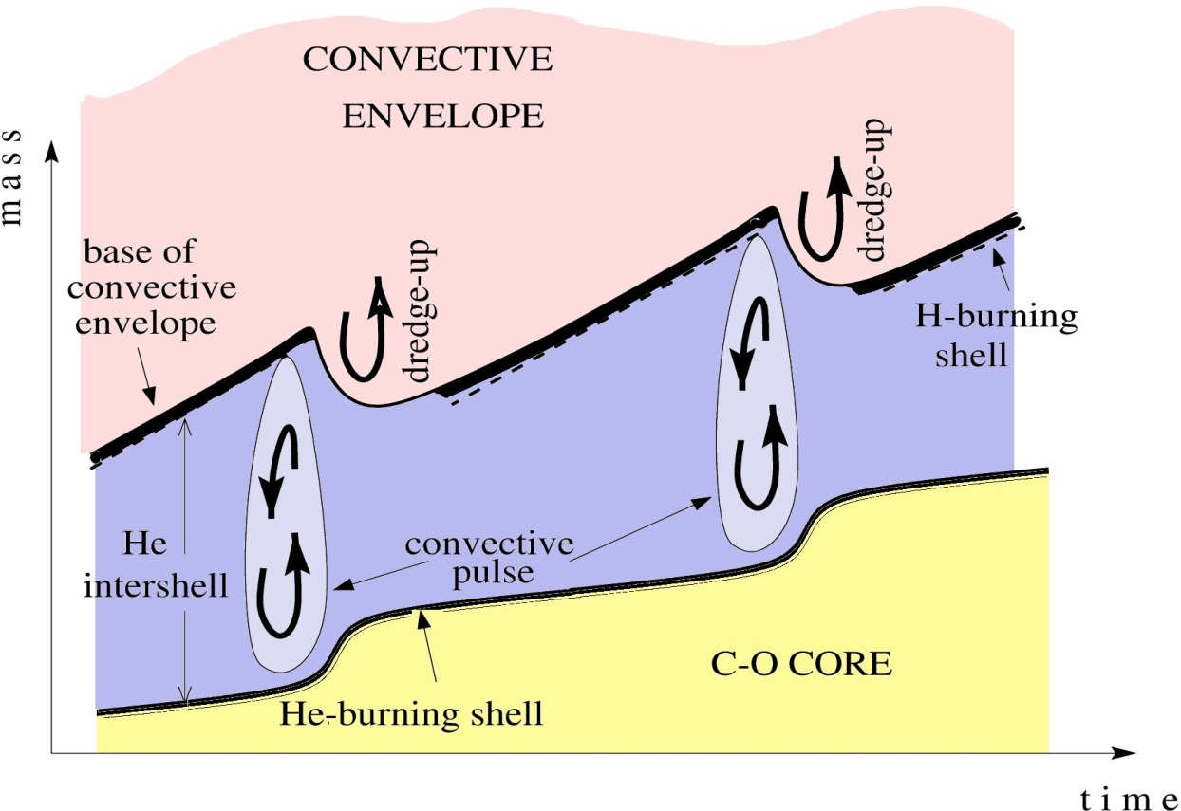
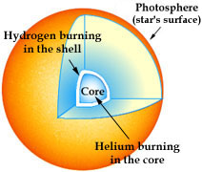
The neutrons for the s-process: nucleosynthesis of half of all elements heavier than Fe (e.g. W, Pd, La, Nd)
Two components were identified and connected to stellar sites:
Main s-process ~90<A<210
Weak s-process A<~90
TP-AGB stars
massive stars > 10 M⊙
shell H-burning He-flash
T₉ ~ 0.1 K 0.25 ≤ T₉ ~ 0.4 K
10⁷⁻10⁸ cm⁻³ 10¹⁰-10¹¹ cm⁻³
¹³C(α,n)¹⁶O ²²Ne(α,n)²⁵Mg
core He-burning shell C-burning
3-3.5·10⁸ K ~10⁹ K
10⁶ cm⁻³ 10¹¹-10¹² cm⁻³
²²Ne(α,n)²⁵Mg
¹³C(α,n)
²²Ne(α,n)

Slide 16
³He (³He,2p)⁴He: σ down to 16 keV
no resonance within the solar Gamow Peak
¹⁴N(p,g)¹⁵O: σ down to 70 keV
ν_{cno} reduced by ∼ 2 with 8% error Sun core metallicity
Globular cluster age increased by 0.7-1 Gy
More carbon at the surface of AGB stars
First 5 years of LUNA-MV (first run 2019):
The LUNA collaboration
¹⁴N(p,g)¹⁵O: the bottleneck reaction of the CNO cycle in connection
with the solar abundance problem
¹²C + ¹²C: the trigger of carbon burning in star, White Dwarf (+Nova or thermonuclear SN) or O-Ne WD or core collapse SN (+neutron star or black hole)

Slide 17
Sources of the neutrons responsible for the S-process: 50% of the elements beyond Iron (neutron capture followed by beta decay):
¹³C(α,n)¹⁶O: isotopes with A≥90 during H-burning in shell of low mass AGB stars (4 solar masses)
²²Ne(α,n)²⁵Mg: isotopes with A‹90 during He burning in high mass AGB stars and during He and C burning in massive stars
¹²C(α,g)¹⁶O: the flagship reaction of the next 5 year plan

Slide 18
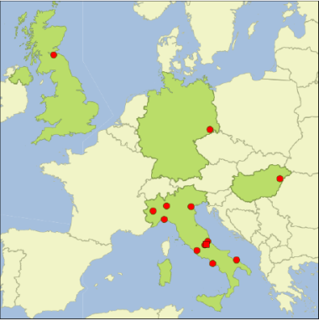
The LUNA Collaboration
L. Csedreki, G.F. Ciani*, L. Di Paolo, A. Formicola, I. Kochanek, M. Junker| INFN LNGS /*GSSI, Italy
D. Bemmerer, K. Stoeckel , M. Takacs, | HZDR Dresden, Germany
C. Broggini, A. Caciolli, R. Depalo, P. Marigo, R. Menegazzo, D. Piatti | Università di Padova and INFN Padova, Italy
C. Gustavino | INFN Roma1, Italy
Z. Elekes, Zs. Fülöp, Gy. Gyurky, T. Szucs | MTA-ATOMKI Debrecen, Hungary
M. Lugaro | Monarch University Budapest, Hungary
O. Straniero | INAF Osservatorio Astronomico di Collurania, Teramo, Italy
F. Cavanna, P. Corvisiero, F. Ferraro, P. Prati, S. Zavatarelli | Università di Genova and INFN Genova, Italy
A. Guglielmetti| Università di Milano and INFN Milano, Italy
A. Best, A. Di Leva, G. Imbriani, | Università di Napoli and INFN Napoli, Italy
G. Gervino | Università di Torino and INFN Torino, Italy
M. Aliotta, C. Bruno, T. Davinson | University of Edinburgh, United Kingdom
G. D’Erasmo, E.M. Fiore, V. Mossa, F. Pantaleo, V. Paticchio, R. Perrino, L. Schiavulli, A. Valentini| Università di Bari and INFN Bari, Italy
.

