Slide 1
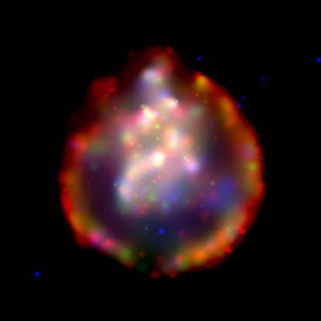
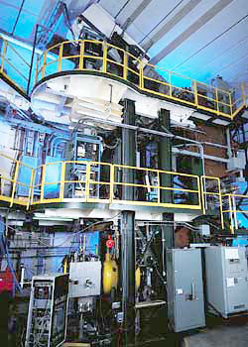
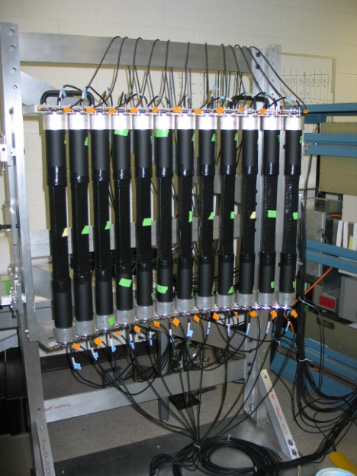
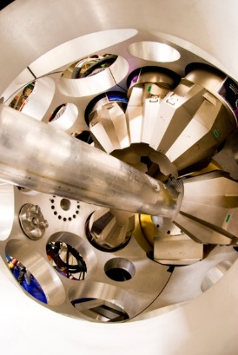
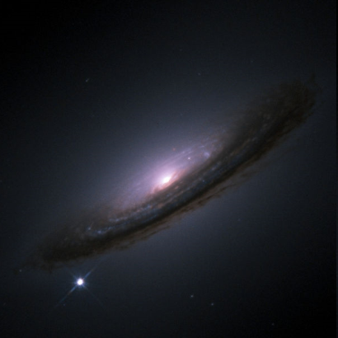







Charge-exchange reactions as a tool for probing weak interactions of relevance for astrophysics and double beta decay
Remco G.T. Zegers
For the NSCL Charge-Exchange group and Collaborators
INTERNATIONAL SCHOOL OF NUCLEAR PHYSICS
39th Course
Neutrinos in Cosmology,
in Astro-, Particle- and Nuclear Physics
Erice-Sicily: September 16-24, 2017

Slide 2
2 basic questions
How can one test and improve weak reaction rates that are used in simulations of explosive astrophysical phenomena and help us understand their evolution and contribution to galactic chemical evolution and nucleosynthesis?
How can we constrain and improve the matrix elements that enter calculations for (neutrinoless) double beta decay?

Slide 3
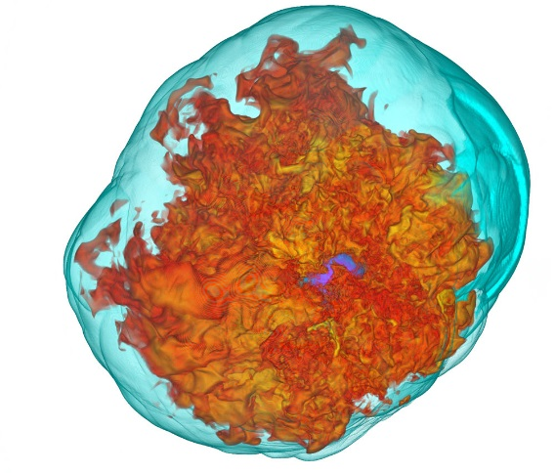
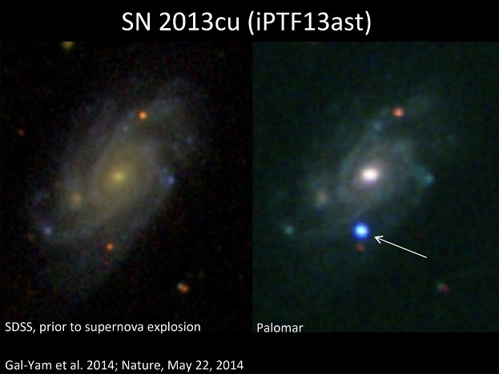
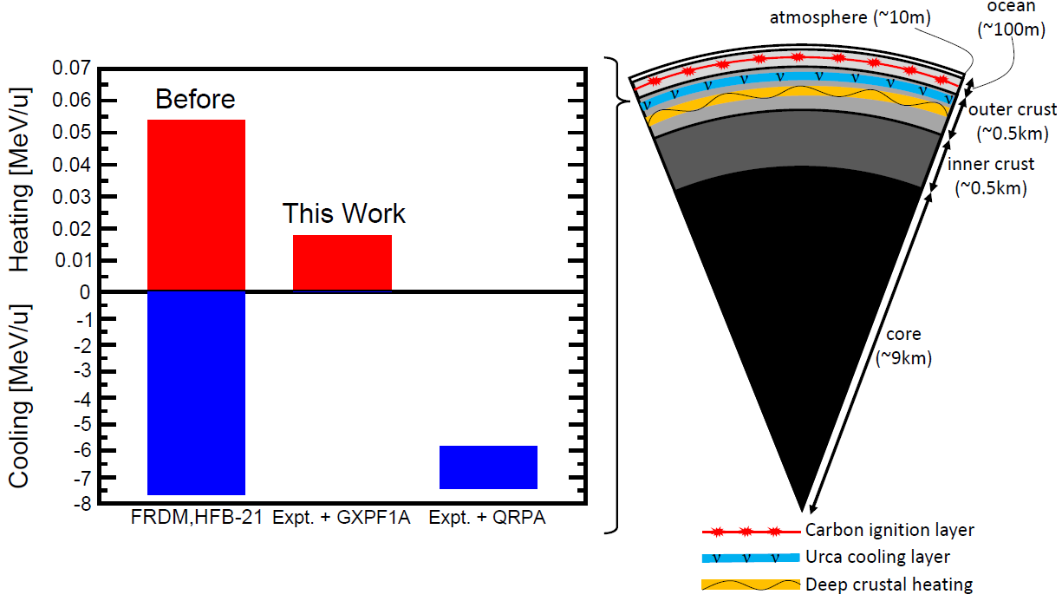
Question I – weak rates in astrophysics
“Despite experimental and theoretical progress, lack of knowledge of relevant or accurate weak-interaction data still constitutes a major obstacle in the simulation of some astrophysical scenarios today (2003).”
K. Langanke and G. Martinez-Pinedo, RMP 75, 819 (2003).
Cooling & heating in accreting neutron star crusts
Core-collapse supernovae
Thermonuclear supernovae
Sean M. Couch
Z. Meisel et al.
Electron capture, β-decay, and neutrino interactions play important role in many
astrophysical phenomena and processes, yet the relevant rates are poorly constrained

Slide 4

electron capture rates on nuclei
on groundstate
Dominated by allowed (Gamow-Teller ΔL=0, ΔS=1, ΔT=1) weak transitions between states in the initial and final nucleus. Each transitions is characterized by a Q-value and a strength, B(GT).
EC
on exited state
β
from groundstate
j=…
Due to finite temperature in stars, Gamow-Teller transitions from excited states in the mother nucleus can occur
E_{x}
Direct empirical information on strength of transitions [B(GT)] is limited to low-lying excited states e.g. from the inverse (β-decay) transitions, if at all
j=3
j=2
Q_{g.s.→g.s.}
j=1
groundstate
EC rates on many (unstable) nuclei are important. Only fraction of transitions can be measured.
Must rely on theoretical models benchmarked by experiments.
i=2
groundstate
i=1
Daughter (Z,A)
Mother (Z+1,A)

Slide 5
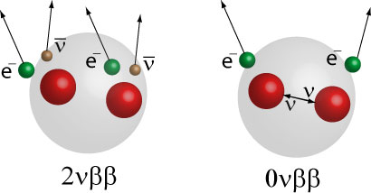
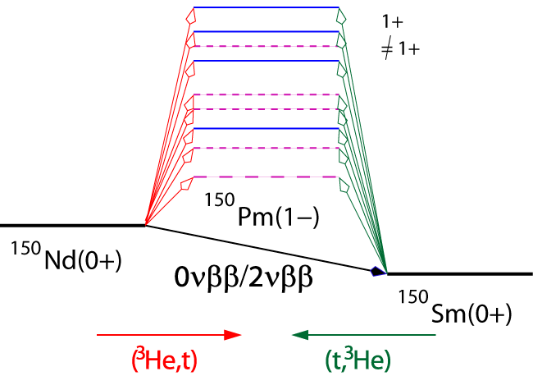
Question II - Double beta decay
Can one derive 2νββ half-lives from GT Matrix elements?
Can we constrain the theoretical models used for estimating matrix elements for and half-lives for 0νββ? If 0νββ were to be discovered, can we have calculate matrix elements that are sufficiently accurate to learn something about the neutrino masses?
Phases?

Slide 6

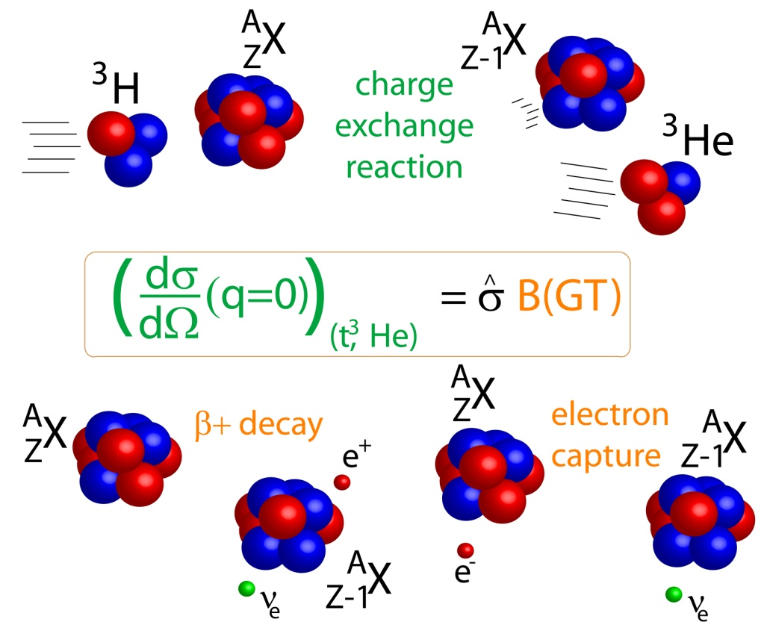
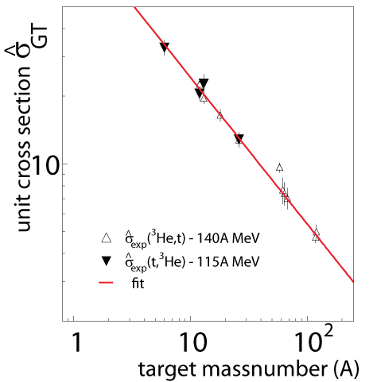
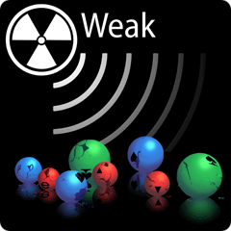
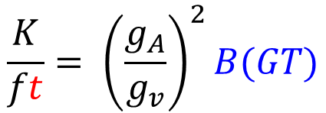
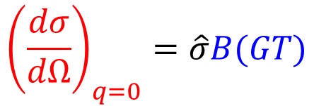
Charge-exchange reactions & β/EC-decay
$${\left(\frac{dσ}{dΩ}\right)}_{q=0}=\hat{σ}B(GT)$$
Perform experiments ~ 100 AMeV or above
$$\frac{K}{ft}= {\left(\frac{g_{A}}{g_{v}}\right)}^{2}B(GT)$$
The unit cross section is calibrated against transitions for which β-decay data are available

Slide 7
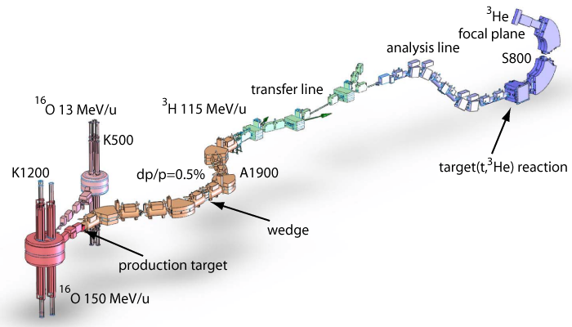
Producing a triton beam for (t,³He) experiments
Primary ¹⁶O beam 150 MeV/n
  rate @ A1900 FP 1.2x10⁷pps @ 130 pnA ¹⁶O
  transmission to S800 spectrometer ~70%
  ³H rate at S800: up to 2x10⁷ pps
S800 spectrometer
Reconstruct momentum
and angle of ³He particle
Extract excitation-energy and center-of-mass scattering angle from two-body kinematics
Without wedge
Thin wedge is needed to remove ⁶He (⁹Li)
Background channel ⁶He->³He + 3n
G.W. Hitt Nucl. Instr. and Meth. A 566 (2006), 264.

Slide 8
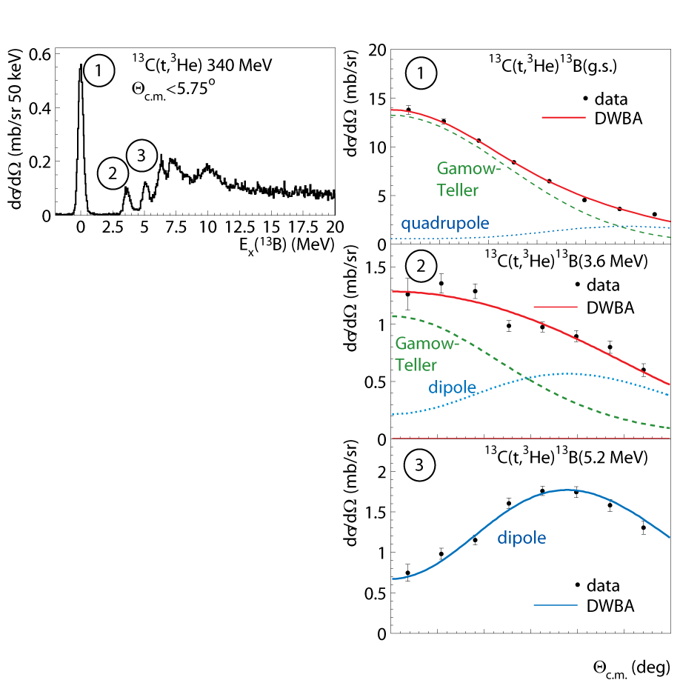
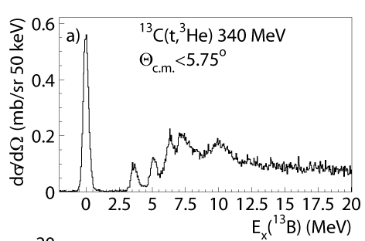
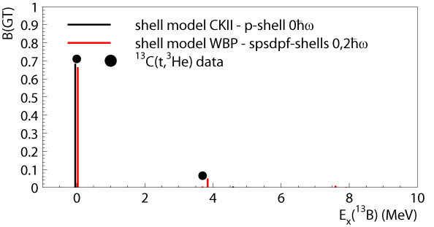

Multipole decomposition
1
Multipole
Decomposition
Analysis
3
2
0 1 2 3 4 5
C. Guess et al., Phys. Rev. C 80, 024305 (2009)

Slide 9
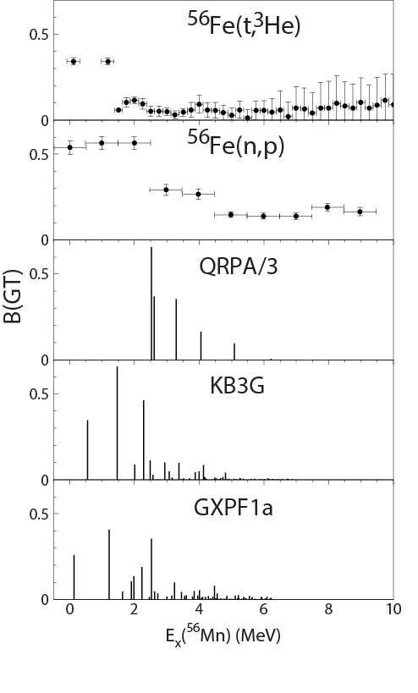
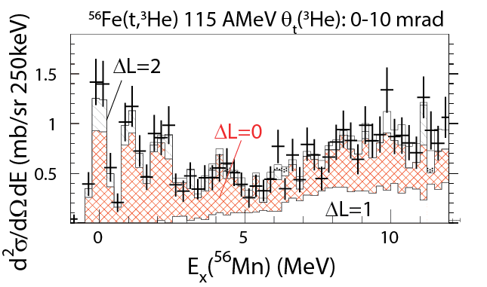
⁵⁶Fe(t,³He)
Result from multipole decompositions analysis
Experiment
⁵⁶Fe(t,³He) - M. Scott et al., PRC 90, 025801 (2014)
⁵⁶Fe(n,p) - S. El-Kateb et al., PRC 49, 3128 (1994)
⁵⁶Fe(d,²He) – D. Frekers et al. – in analysis
Theory – Shell model
KB3G - A. Poves et al., NPA694, 157 (2001)
GXPF1a - M. Honma et al. PRC 65, 061301(R) (2002)
Theory – QRPA
P. Moller and J. Randrup, NPA514, 1 (1990); S. Gupta
Used in astrophysical modelling

Slide 10
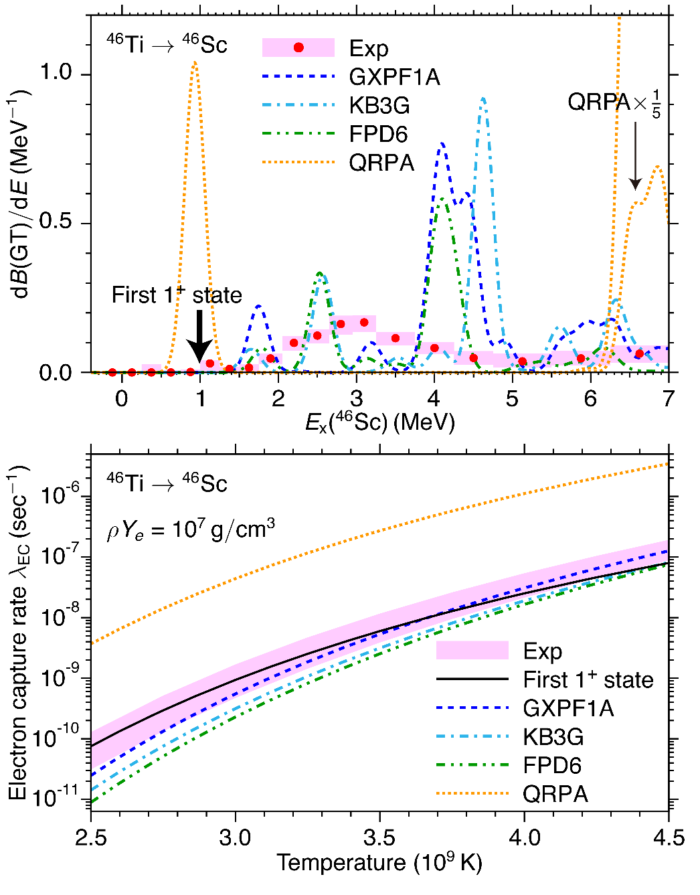
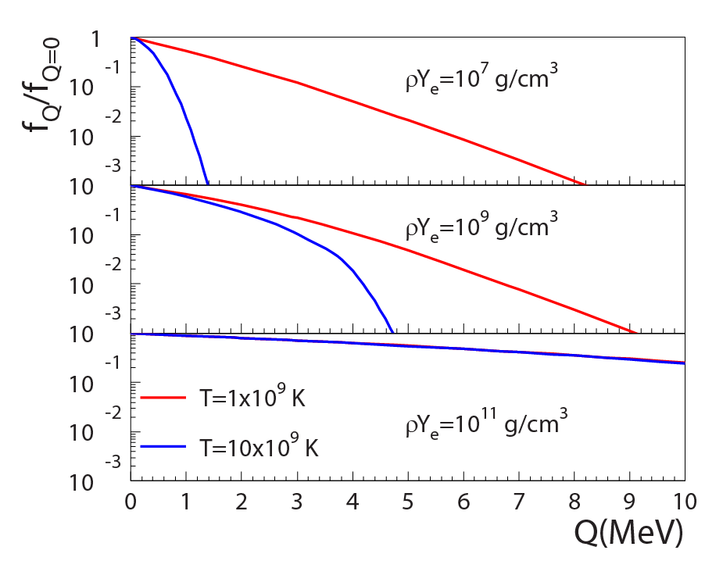
⁴⁶Ti(t,³He)
Contribution of excited states (at Q>0) to electron-capture rate
Large differences between theory and data are observed for ⁴⁶Ti
How to identify important, but weak low-lying states?
S. Noji et al., Phys. Rev. C 92, 024312 (2015), Phys. Rev. Lett. 112, 252501 (2014)

Slide 11

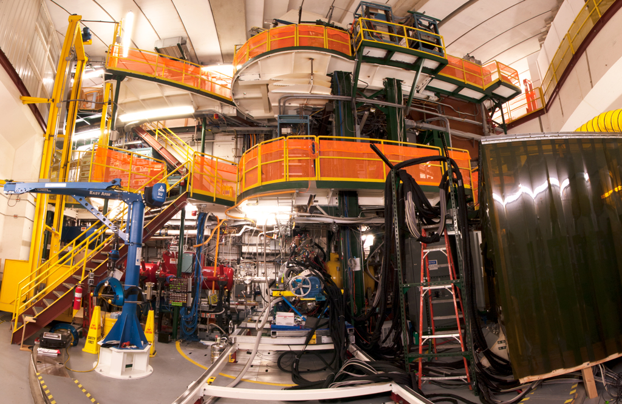

(t,³He) & (t,³He+γ) S800 Spectrograph (+Gretina)
Gretina
γ-detection
Gamma-Ray Energy Tracking
In-beam Nuclear Array
³He ejectiles
S800
³H (100 MeV/u)
~10M pps
target (~10 mg/cm²)

Slide 12
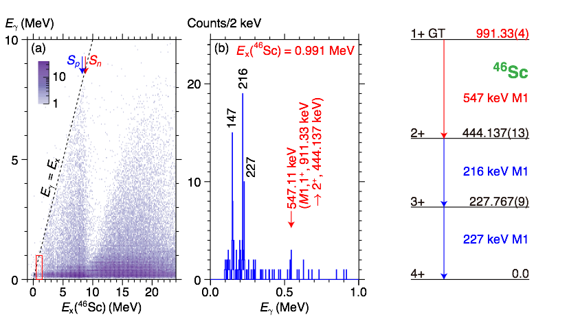
Low-lying GT strength: ⁴⁶Ti(t,³He+γ)
For ⁴⁶Ti: weak low-lying GT transition is observed in γ-coincident data:
B(GT)_{0.991}=0.009 ± 0.005(exp) ± 0.003 (sys)
Not Separable in singles data.

Slide 13
Electron-capture rates in pre-supernovae star
This low-lying transition is important for estimating an accurate electron-capture rate in pre-supernovae stars.

Slide 14
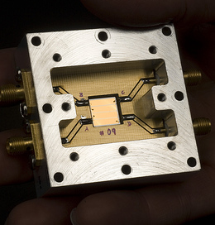
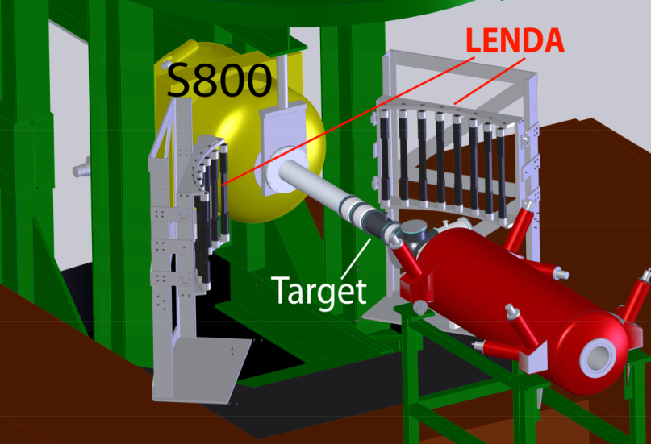
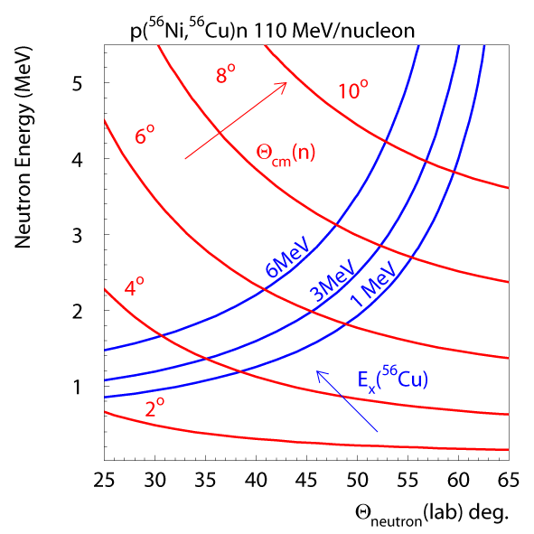
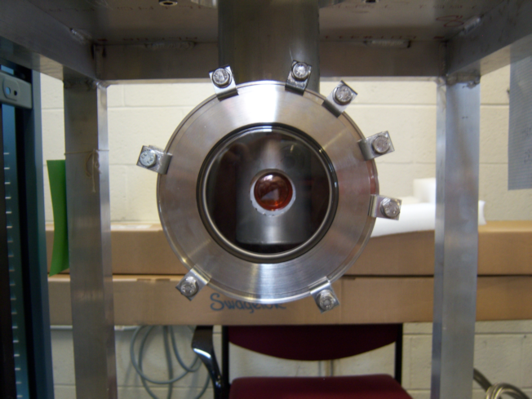
(p,n) in inverse kinematics
S800 spectrometer
Heavy residue collection
Bρ< 4 Tm /130º bend
Particle identification
Diamond detector
Beam particle timing
30 cm
Low Energy Neutron
Detector Array (LENDA)
neutron detection
Plastic scintillator
24 bars 2.5x4.5x30cm
150 keV < E_{n} < 10 MeV
ΔE_{n} ~ 5% Δθ_{n} < 2º
efficiency 15-40%
n
RI beam
Liquid Hydrogen target
“proton” target
65 mg/cm² (~7 mm)
~3.5 cm diameter
T=20 K ~1 atm

Slide 15
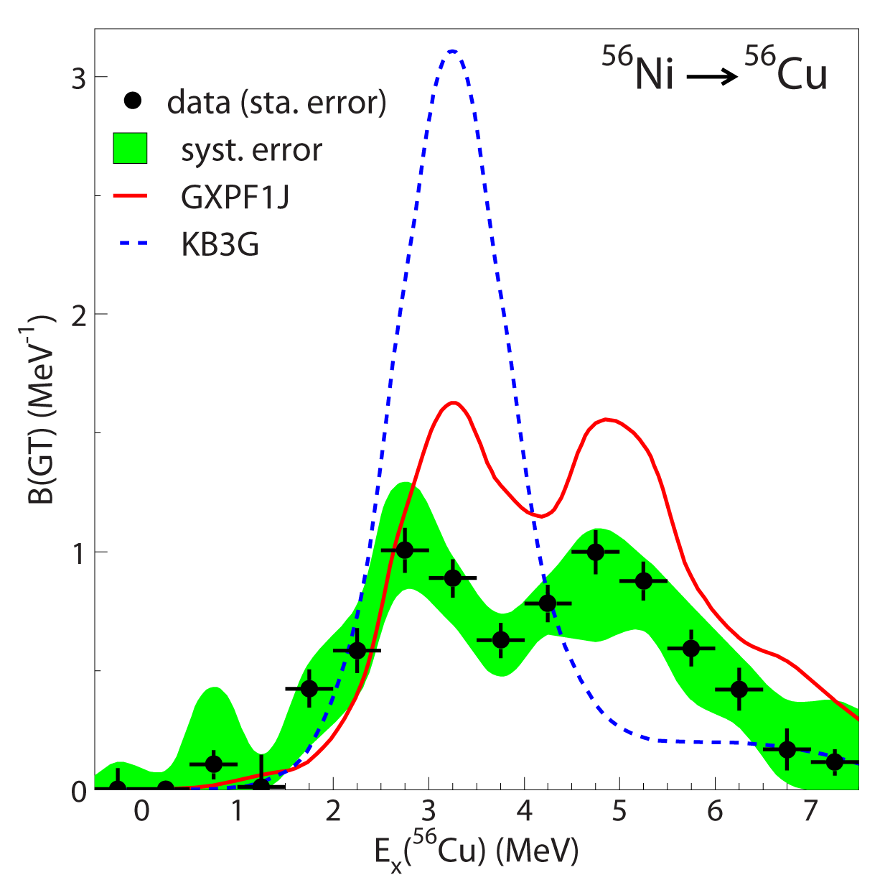
Experiment on key nuclei can reveal and clarify specific differences between theoretical models
⁵⁶Ni(p,n) in inverse kinematics provided key input for understanding the difference between leading shell-model calculations
Experiment provided information on important nucleus for astrophysics
M. Sasano et al., Phys. Rev. C 86, 034324 (2012), Phys. Rev. Lett. 107, 202501 (2011)

Slide 16
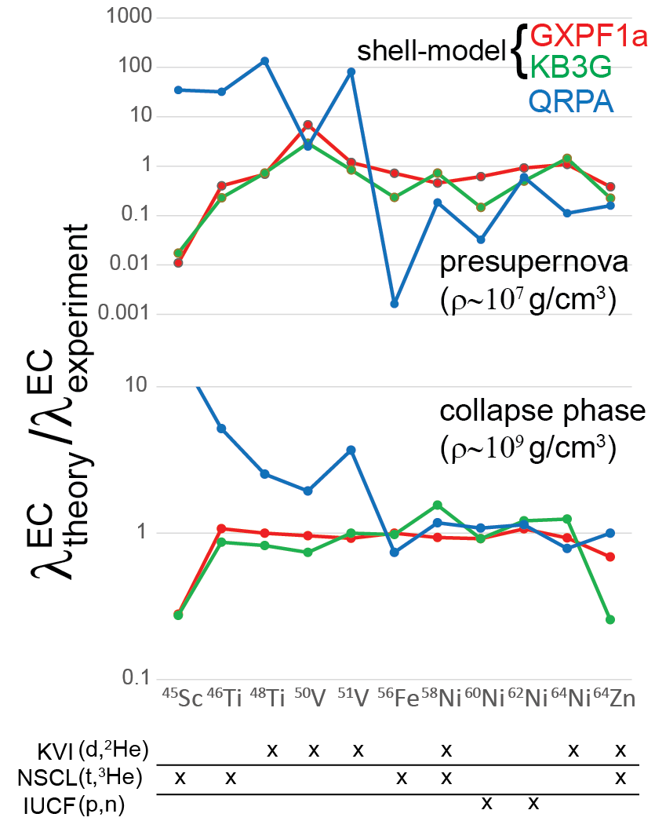
Systematic EC rate comparisons
Systemic comparison of EC rates calculated from theory and derived from data provide framework for error estimation of theoretical rates
Systematic studies provide a way to benchmark and improve theoretical calculations
Experimental results from different facilities and probes are combined to perform comprehensive comparisons
A.L. Cole et al., PRC 86, 015809 (2012)

Slide 17
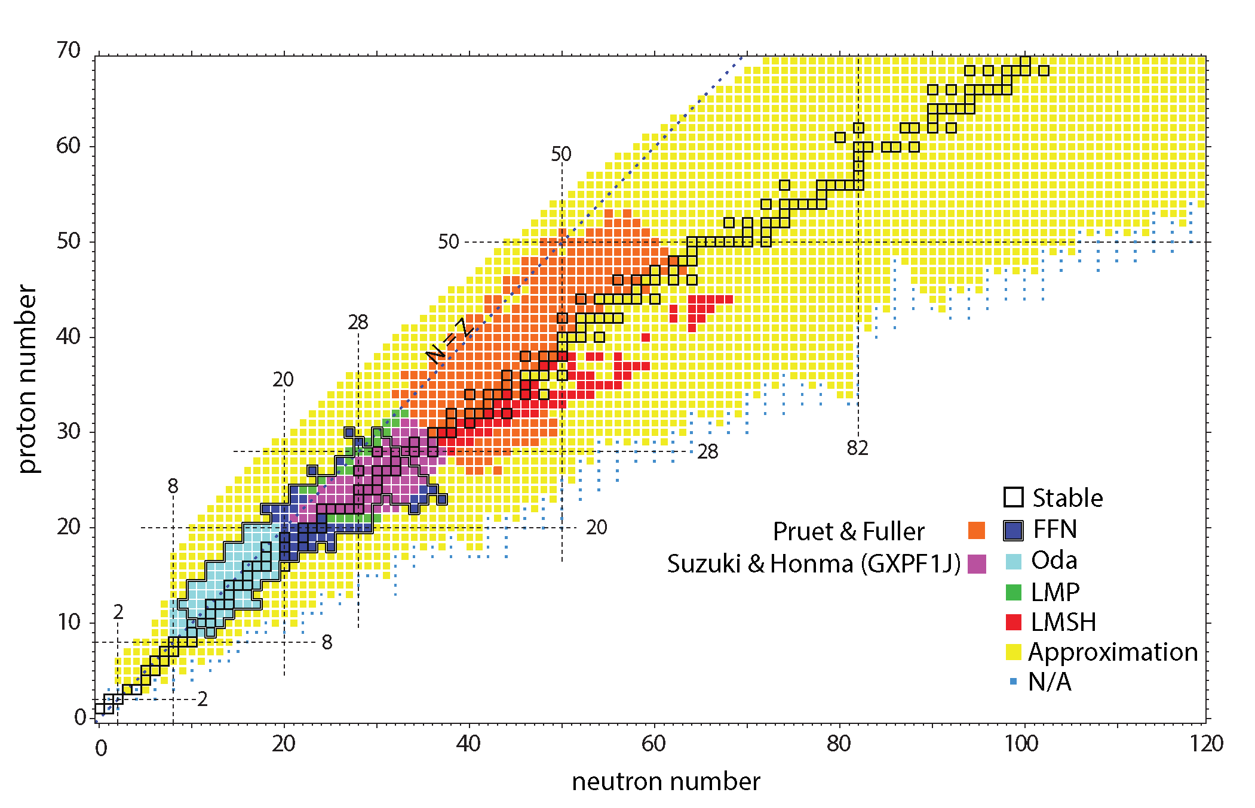
New weak rate library
C. Sullivan et al., Ap. J., 816, 44 (2015) https://github.com/csullivan/weakrates
Open source library aims to standardize the incorporation of weak rates in astrophysical simulations
Library is implemented into neutrino-interaction library NuLib (http://www.nulib.org/; E. O’Connor); plain rate table with recommended rates will soon be available as well.

Slide 18
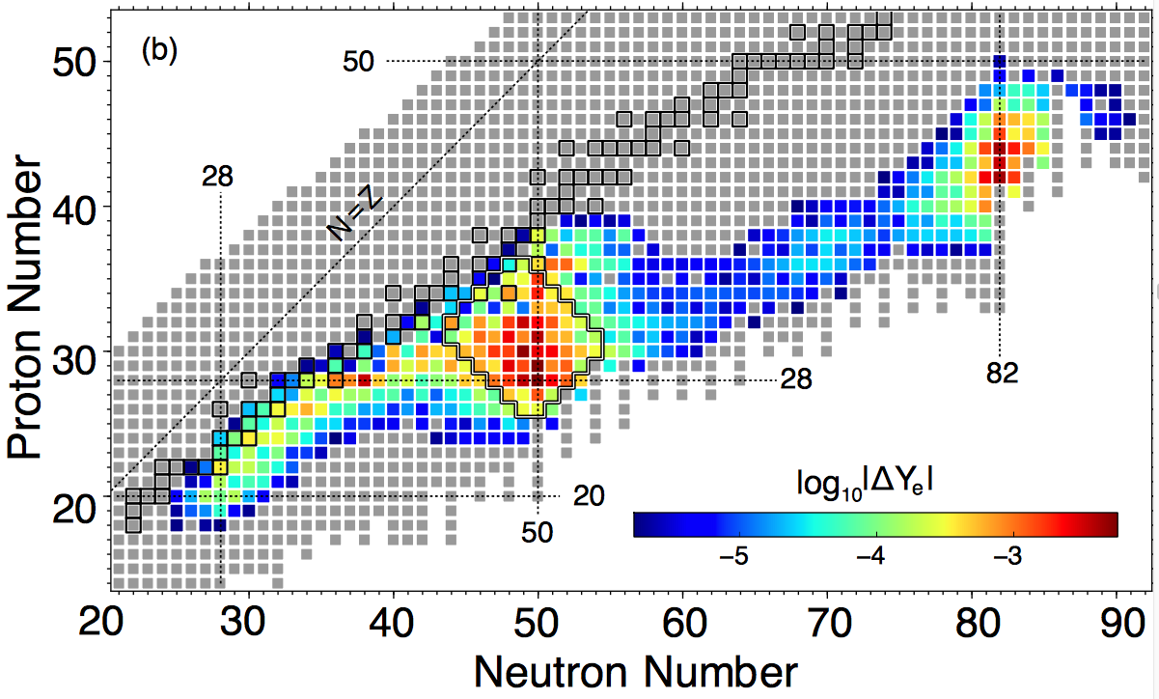
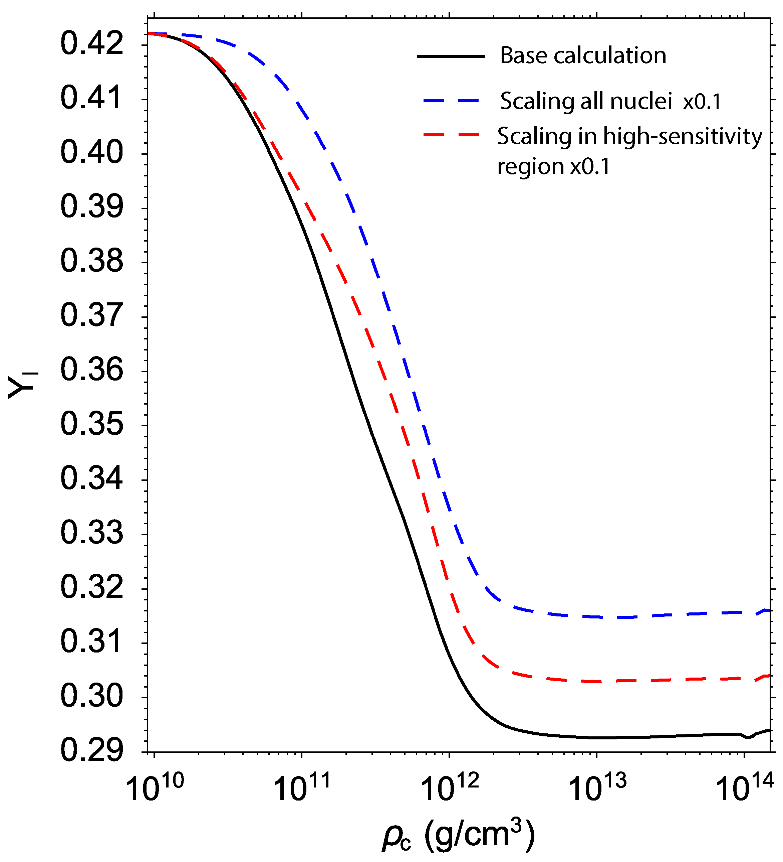
Sensitivity Study of Core Collapse Supernovae
C. Sullivan et al., Ap. J., 816, 44 (2015)
GR1D simulation with modern weak rate estimates up to 100 ms after bounce
Calculations guide experimental and theoretical efforts, building on previous work focused on EC rates by e.g. Martínez-Pinedo, Langanke, Hix, Heger…
Which nuclei contribute most to deleptonization of central zone?
R. Titus et al., to be published

Slide 19
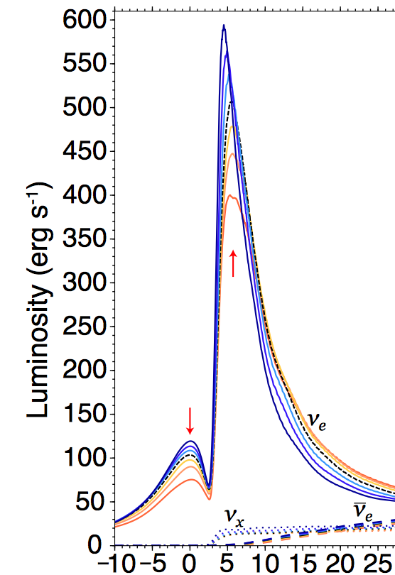
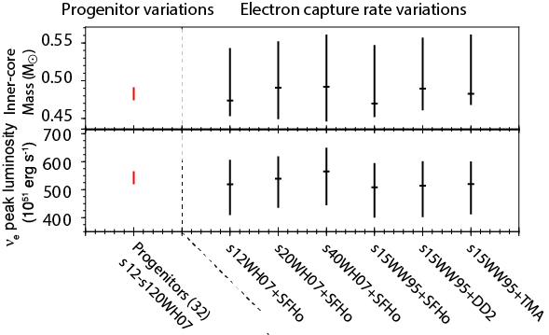
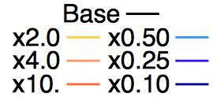
Sensitivity study of key parameters of CCSN
By varying the EC rate within uncertainties of theoretical rates models determined by benchmarking against experiments, the sensitivity of the core-collapse simulations to input weak rates can be compared with other uncertainties, such as in progenitor and equation-of-state models
Strong impact
on ν spectra:
EC Variation:
Time (ms)

Slide 20
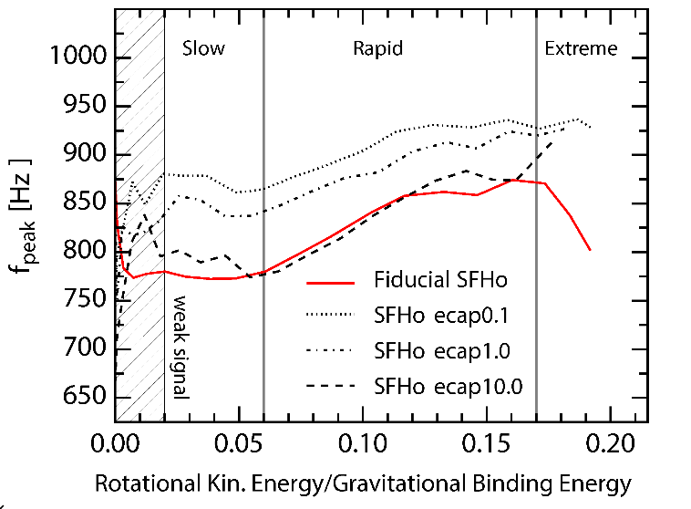
Library is already used in GR1D (1D), CoCoNuT (2D), FLASH (3D) core-collapse simulation codes
S. Richters et al., Phys. Rev. D 95, 063019 (2017)
Uncertainties in frequency of gravitational waves from CCSNe due to uncertainties in EC rates is comparable to the uncertainties in EoS

Slide 21
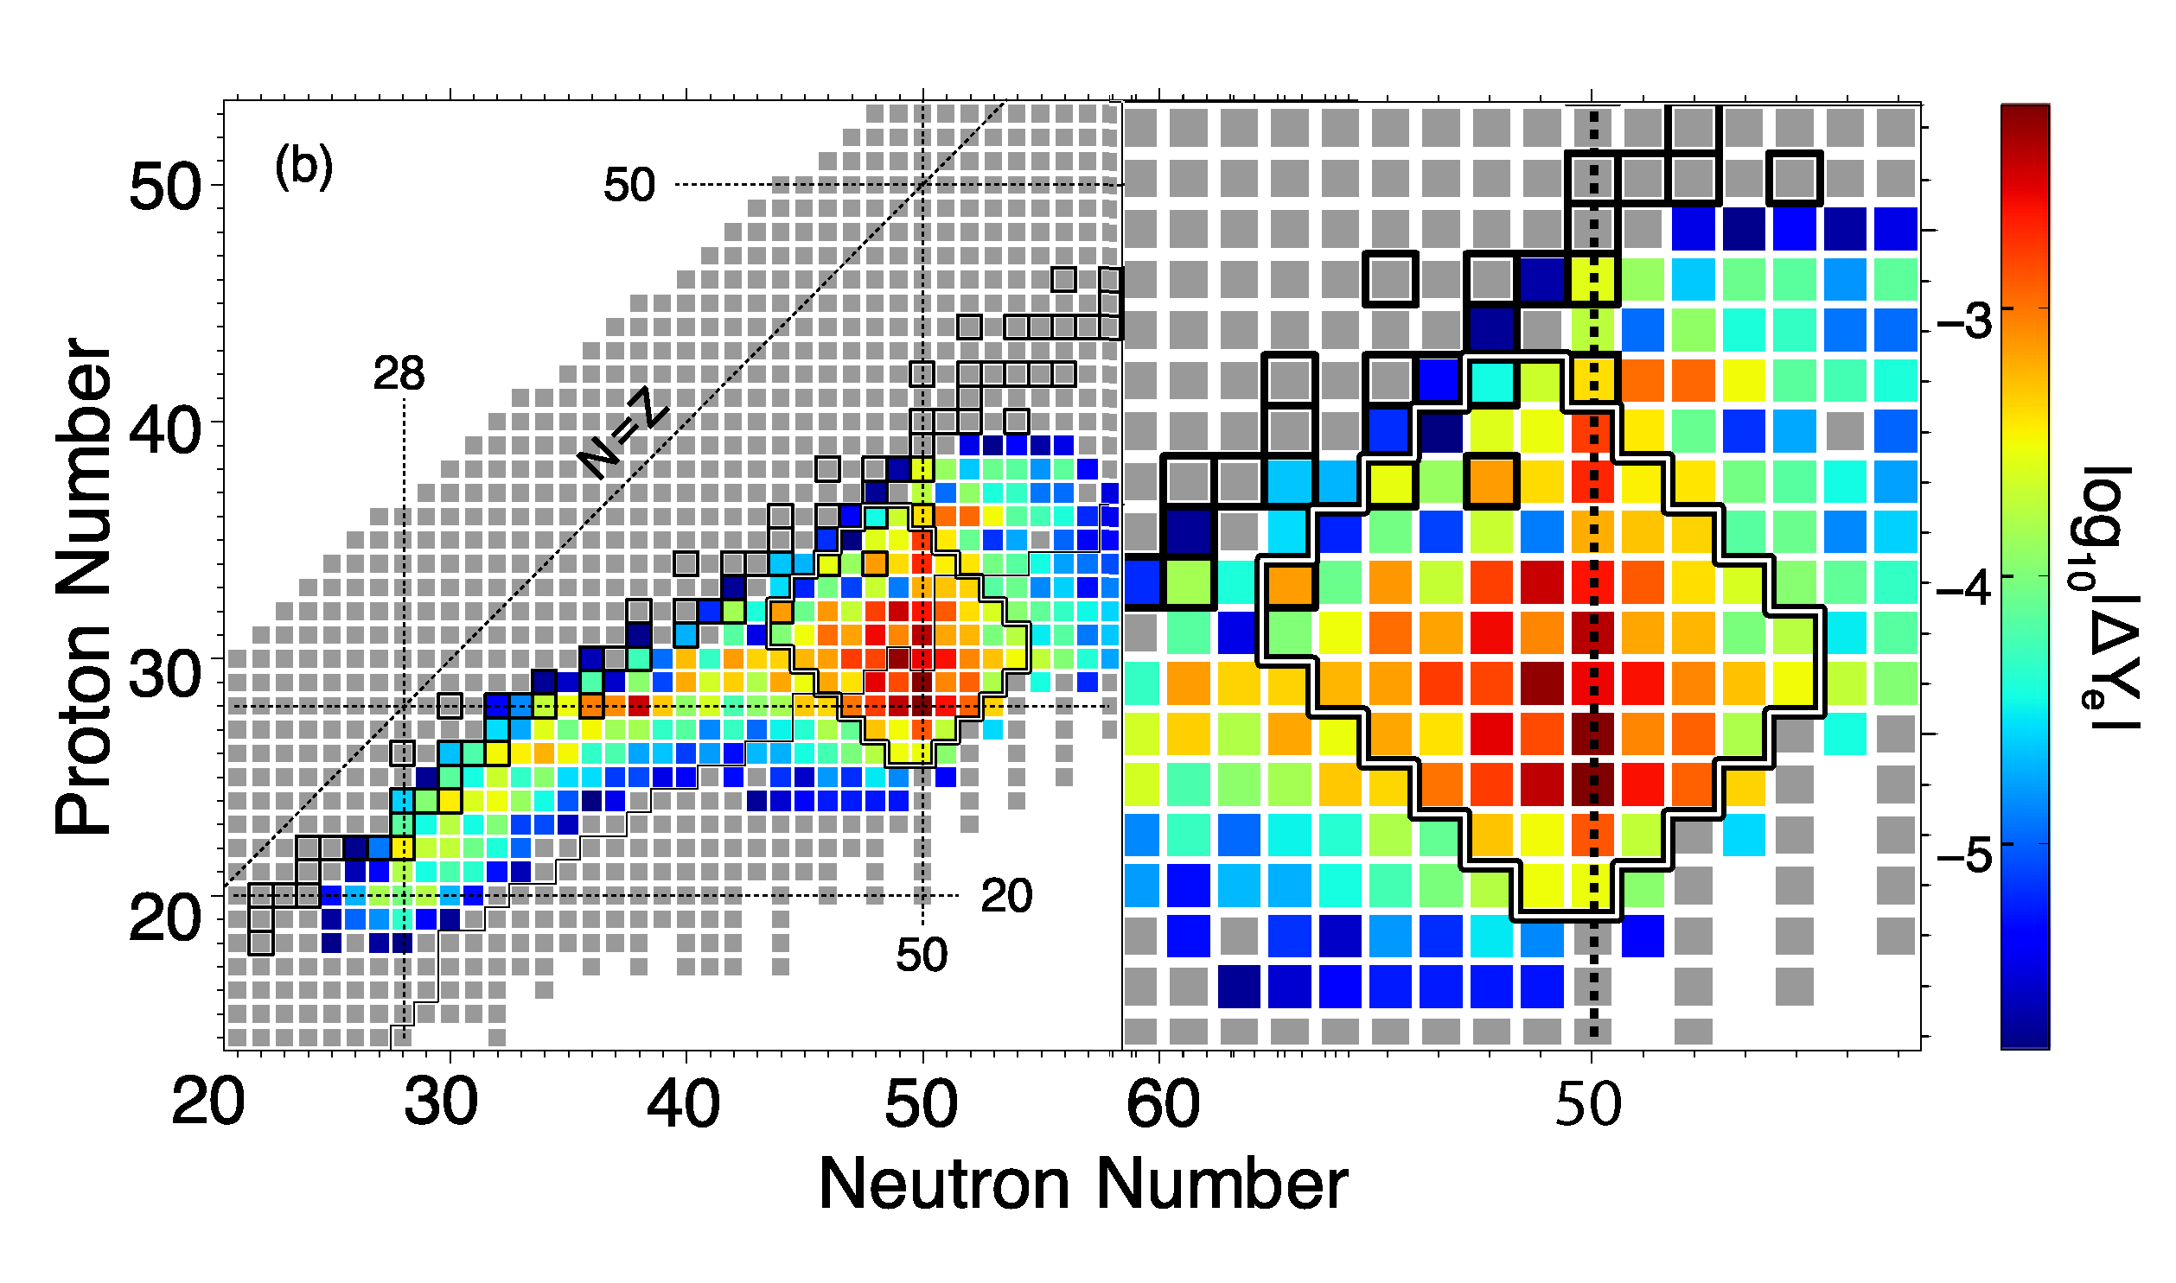
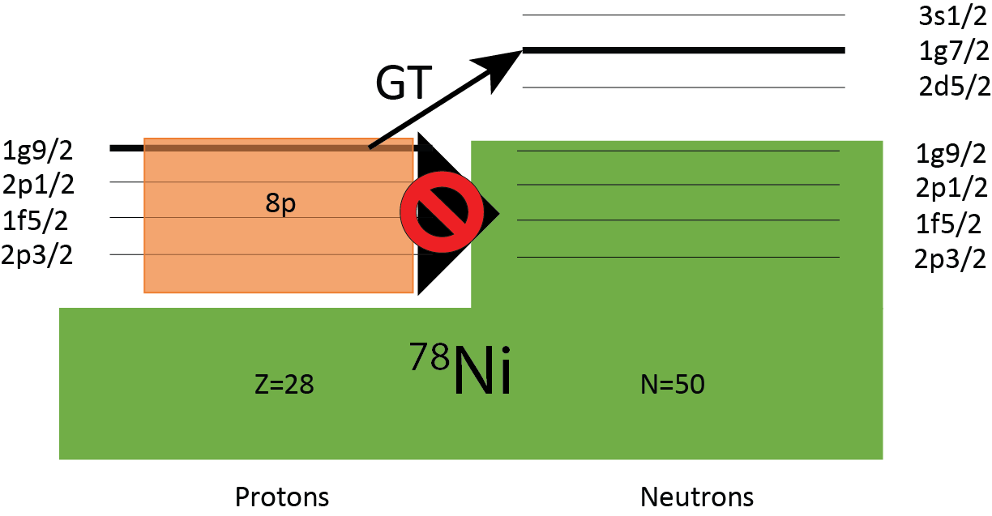
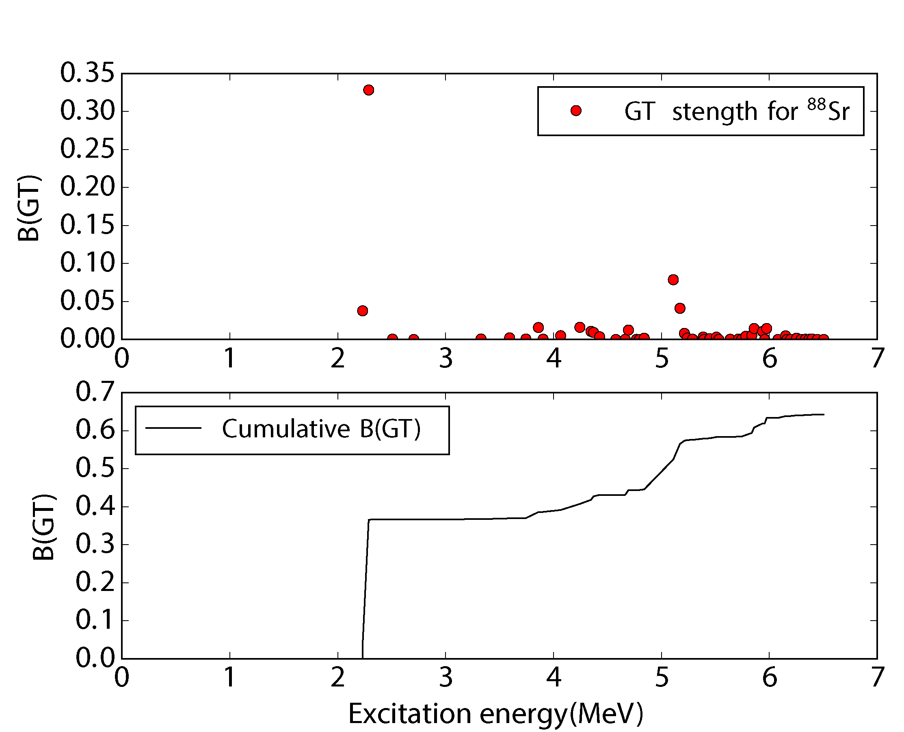
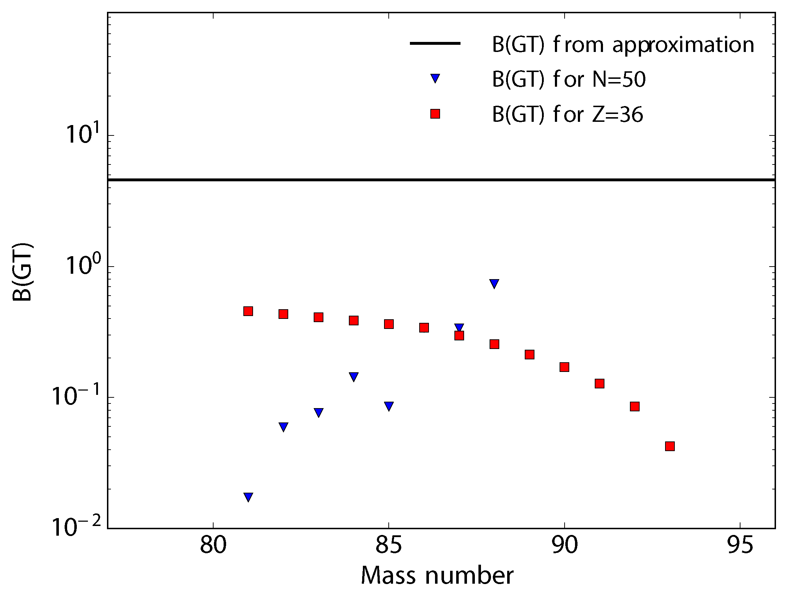
GT+ strengths along N=50
10p
R. Titus et al., to be published

Slide 22
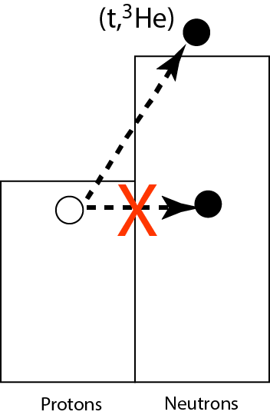
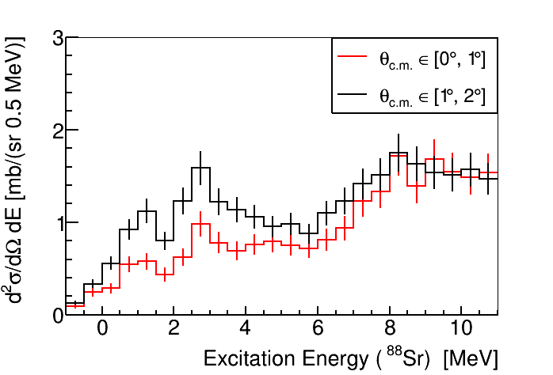
⁸⁸Sr(t,³He+γ) – very preliminary
There appears to be very little GT+ strength at low excitation energy
γ coincidence data is being analyzed – online analysis also indicated that known 1⁺ states were not (or very weakly) populated
Also investigating ⁸⁶Kr and ⁹³Nb data
J. Zamora, B. Gao, R. Titus et al.
(⁸⁸Rb)
Pauli-blocking along N=50 appears stronger than expected from theoretical estimates
In high-temperature stellar environments, thermal Pauli unblocking can be strong. To accurately describe this temperature-dependent Pauli unblocking, the T=0 system must be well described and tested by experiment.

Slide 23
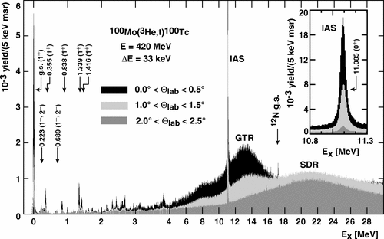
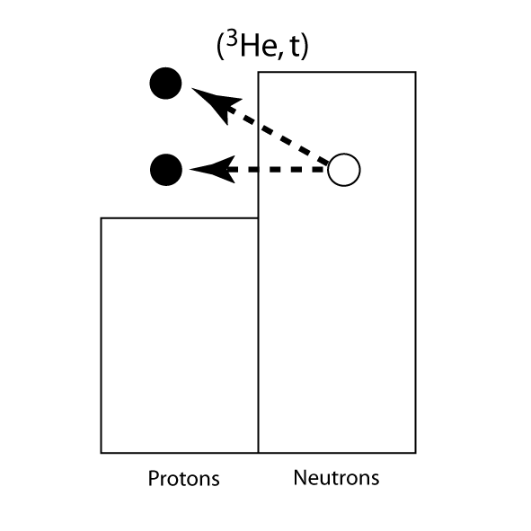
¹⁰⁰Mo(³He,t) – RCNP Osaka
J. Thies et al., Phys. Rev. C 86, 044309 (2012)

Slide 24
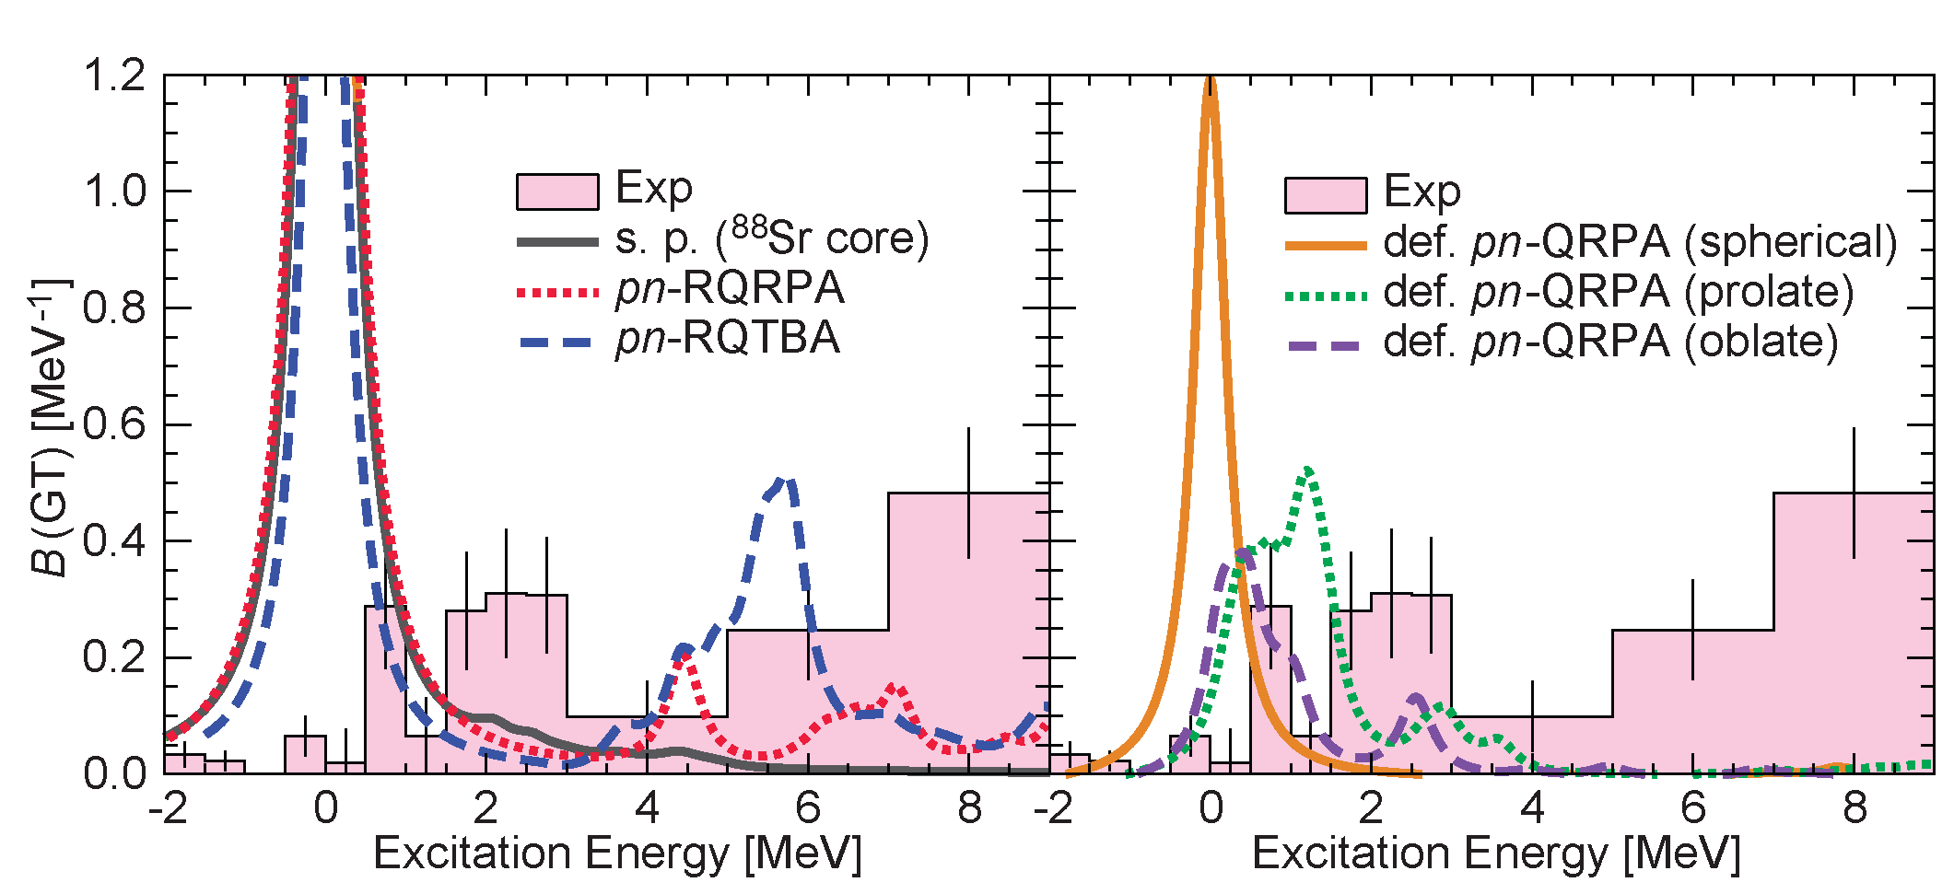
Gamow-Teller strengths near N=50
Gamow-Teller strengths for medium-heavy nuclei are poorly constrained
Pauli-blocking effects lead to strong reduction in transition strength
K. Miki et al., PLB 769, 339, (2017)
Gamow-Teller strengths extracted from ¹⁰⁰Mo(t,³He) experiment at NSCL indicate that the inclusion of deformation is necessary, but not sufficient, for making accurate predictions and thus calculate reliable EC rates.

Slide 25
Question II - Double beta decay
Can one derive 2νββ half-lives from GT Matrix elements?
Can we constrain the theoretical models used for estimating matrix elements for and half-lives for 0νββ? If 0νββ were to be discovered, can we have calculate matrix elements that are sufficiently accurate to learn something about the neutrino masses?
Phases?

Slide 26
Double beta decay: the case of ¹⁵⁰Nd
Most 0/2νββ partners have over the past decade been investigated through charge-exchange reactions:
(³He,t) – RCNP
(d,²He) – KVI
(p,n)/(n,p) – RCNP
(t,³He) – NSCL
RCNP
Osaka U.
NSCL
MSU
Goal: test the theoretical models used to estimate double beta decay half lives under the premises that models that aim to accurately estimate matrix elements for double beta decay must be able to accurately estimate matrix elements for single beta decay

Slide 27
¹⁵⁰Nd(³He,t) and ¹⁵⁰Sm(t,³He) data
C. Guess et al., Phys. Rev. C 83, 064318 (2011)
¹⁵⁰Sm(t,³He) at 115 AMeV
¹⁵⁰Nd(³He,t) at 140 AMeV

Slide 28
Multipole Decomposition Analysis
Gamow-Teller Resonance
(³He,t)
Spin-dipole resonance
(t,³He)

Slide 29
Comparison with QRPA calculations
Isovector Spin Giant Monopole Resonance
Calculations by Fang, Rodin et al.

Slide 30
Gamow-Teller strengths & 2νββ matrix elements
Phases?

Slide 31
Conclusions & Outlook
Charge-exchange experiments are useful tools for studying Gamow-Teller strength distributions in nuclei and are key to the development of accurate theoretical models with applications in astrophysics and neutrino physics
Extension to forbidden transitions? Applicability of proportional relationship between CE cross section and strength less clear and extraction becomes less model independent
First CE experiments in inverse kinematics with rare isotopes have been successfully performed – probes used are (p,n) and (⁷Li,⁷Be) in inverse kinematics. (d,²He) in inverse kinematics is in development
Ability to study CE reaction far from stability at next generation rare-isotope beam facilities – RIBF, FAIR, FRIB

Slide 32
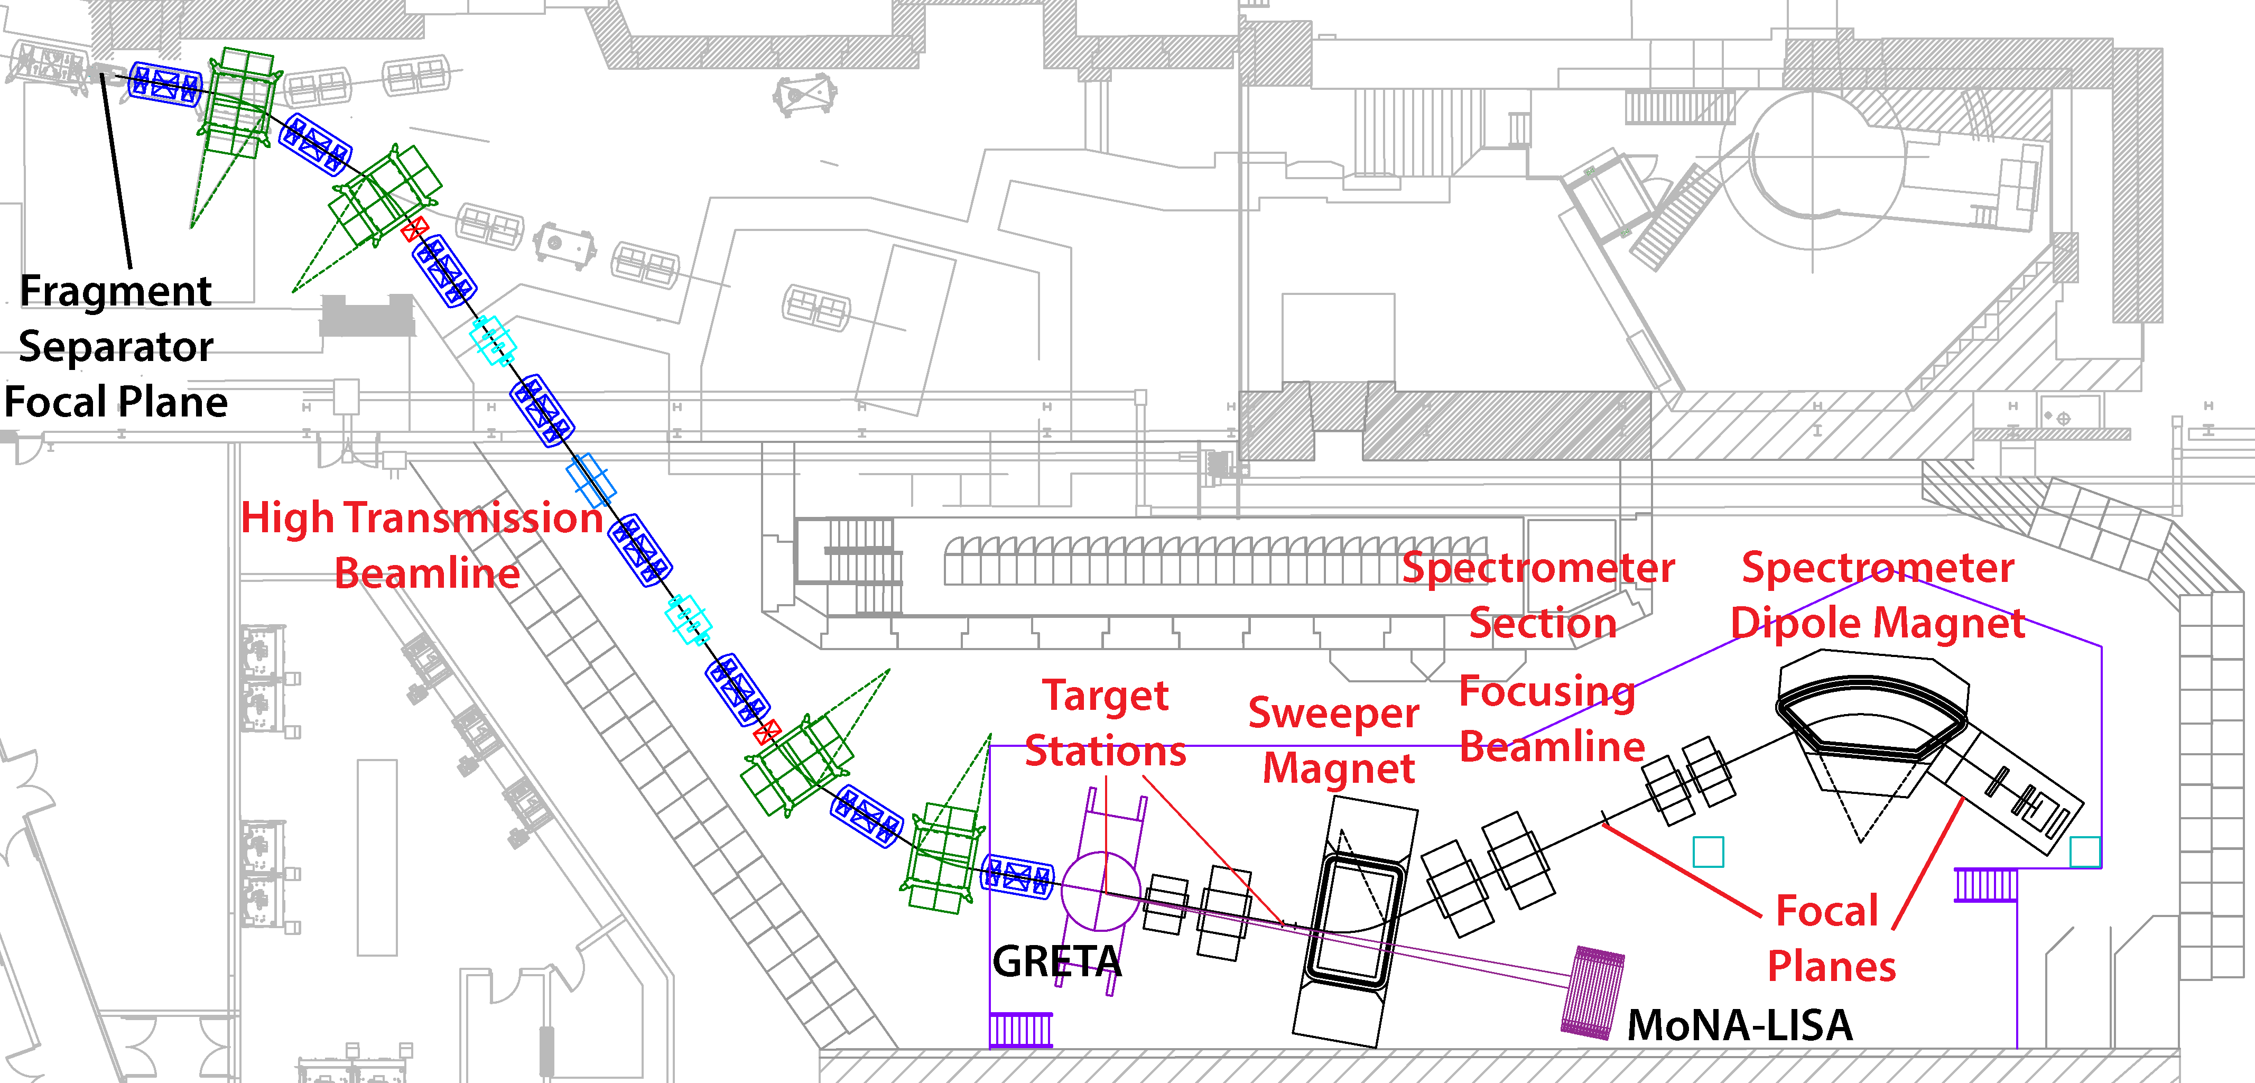
High-Rigidity Spectrometer at FRIB
(Status of FRIB: See talk by Alexandra Gade)

Slide 33
EC rates in nuclear astrophysics
Graduate students
Sam Lipschutz
Chris Sullivan (CCSN calculations)
Rachel Titus (⁸⁶Kr)
Jaclyn Schmitt
Postdocs
Juan Zamora (⁸⁸Sr)
Bingshui Gao (⁹³Nb)
And…
Sam Austin
Daniel Bazin
Jorge Pereira
Shumpei Noji (⁴⁵Sc,⁴⁶Ti)
Previous members who analyzed data shown in this presentation:
Carol Guess (A=150) M. Scott, Y. Shimbara (⁵⁶Fe)
Masaki Sasano (⁵⁶Ni) A.L. Cole
Kenjiro Miki (¹⁰⁰Mo)
…and our local and outside collaborators, in particular Alex Brown, the NSCL gamma group (Alexandra Gade, Dirk Weisshaar), H. Schatz, Ed Brown, Sean Couch, Sean Liddick, Artemis Spyrou, Andreas Stolz, Evan O’Connor (NCSU), Yoshi Fujita (Osaka U.), Muhsin Harakeh (KVI), Dieter Frekers (U. Muenster), Sanjib Gupta (IITR), Hide Sakai (RIKEN), Tomohiro Uesaka (RIBF), Elena Litvinova, Caroline Robin (WMU), Karlheinz Langanke (GSI), Gabriel Martínez-Pinedo (TU Darmstadt), Lew Riley (Ursinus), B. Rubio (IFIC,Valencia)Gianluca Colò (Milano), Gretina collaboration, A1900 and CCF staff, and many others!
This work was supported by the US NSF grant PHY-1430152 (Joint Institute for Nuclear Astrophysics – Center for the Evolution of Elements). GRETINA was funded by the US DOE Office of Science. Operation of the array at NSCL is supported by NSF under Cooperative Agreement PHY-1565546 (NSCL) and DOE under grant DE-AC02-05CH11231 (LBNL)

