Slide 1
EXO-200 and nEXO: present and future
Andreas Piepke
For the EXO-200 and nEXO collaborations
University of Alabama

Slide 2
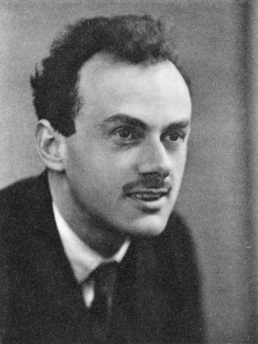
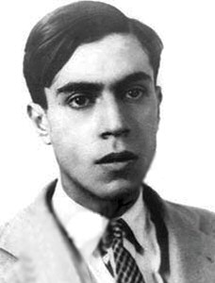
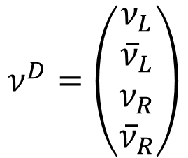
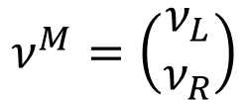
Introduction
I will not give an introduction to what double beta decay is, assuming this has already been done by the previous speakers.
Neutrinos carry no electrical charge. Particle and anti-particle can therefore not be distinguished by their charge.
Since the 1930-ies the question therefore has been how to describe them?
Dirac four spinor:
Majorana two spinor:
$$ν^{D}=\left(\begin{matrix}ν_{L} \\ {\overline{ν}}_{L} \\ ν_{R} \\ {\overline{ν}}_{R}\end{matrix}\right)$$
$$ν^{M}=\left(\begin{matrix}ν_{L} \\ ν_{R}\end{matrix}\right)$$
Familiar but, perhaps, containing redundant states.
More efficient but results in Lepton number violation.

Slide 3
Since the discovery of neutrino oscillations and the realization that neutrinos have a non-vanishing mass this distinction has become testable via neutrinoless double beta decay.
Experiments need to find out which of the descriptions is the adequate one.
It is this possibility to experimentally test the nature of the neutrino and Lepton number conservation that motivates many researches to mount new experiments.
Neutrinoless double beta decay can proceed in many different ways. However, it has been shown that no matter what the exact process, its existence always implies that neutrinos are Majorana particles.
Added to this possibility of discovering a novel aspect of nature is the capability to determine the value of the neutrino mass. This utilizes one particular decay mechanism: the exchange of light neutrinos. For Majorana neutrinos this has to be there.

Slide 4

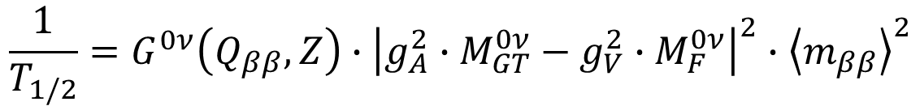
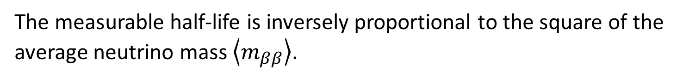
0νββ−decay driven by exchange of light neutrinos
e⁻
e⁻
u
u
The measurable half-life is inversely proportional to the square of the average neutrino mass $\left\langle m_{ββ}\right\rangle$.
ν_{e}
W
W
$$\frac{1}{T_{1/2}}=G^{0ν}\left(Q_{ββ},Z\right)∙{\left|g_{A}^{2}∙M_{GT}^{0ν}−g_{V}^{2}∙M_{F}^{0ν}\right|}^{2}∙{\left\langle m_{ββ}\right\rangle }^{2}$$
d
d
$$0νββ$$
Phase space: decay energy and nuclear charge dependent. Obtained by solving Dirac equation for electron travelling from edge of nucleus to infinity.
Nuclear matrix elements: obtained from approximate solutions of the nuclear many-body problem
Axial vector coupling constant: expresses the modification of the strength of the weak force due the presence of the strong force. Comes from neutron decay, β-decays.
Problematic
Calculable
Problematic
Only one of the possible decay mechanisms
Needs nuclear models to connect data with the physics, here neutrino mass
Allows to quantify results in terms of a quantity of scientific interest AND allows to compare experiments utilizing different nuclides with each other.

Slide 5
The nuclear matrix element problem
Nuclear theory uses different techniques to solve the many body problem, all approximate.
Here a selection used in EXO-200/nEXO evaluations (¹³⁶Xe M_{GT} and M_{F} combined, g_{A}=1.25):
Method | M^{0ν} | Reference
QRPA | 2.30 | Rodin et al., NPA 793 (2007) 213
NSM | 1.77 | Menedez et al., NPA 818 (2009) 139
IBM-2 | 3.35 | Barea & Iachello, PRC 79 (2009) 044301
RQRPA-1 | 2.69 | Simkovic et al., PRC 79 (2009) 055501
EDF | 4.20 | Rodrigues & Martinez, PRL 105 (2010) 252503
IBM-2 | 3.67 | Barea et al., PRL 109 (2012), 042501
IBM-2 | 3.33 | Barea et al., PRC 87 (2013) 014315
QRPA | 2.46 | Simkovic at al., PRC 87 (2013) 045501
Skyrme QRPA | 1.55 | Mustonen & Engel, PRC 87 (2013) 064302
QRPA | 2.02 | Engel et al., PRC 89 (2014) 064308
IBM-2 | 3.05 | Barea et al., PRC 91 (2015) 034304
pnQRPA | 2.91 | Havärinen & Suhonen, PRC 91 (2015) 024613
There is considerable variability.
The ratio of max over min is a factor 2.7. This is what’s usually stated.
When quantifying variability we rarely use the ratio of max over min as a measure of the width. Assuming that these different models sample various uncertainties randomly, one may invoke the central limit theorem. The standard deviation divided by the mean is only 0.3. Maybe a factor 3 is a bit too pessimistic.

Slide 6
Just in case there is an outcry because I am calling variability of theoretical models random, here the binned distribution of the matrix elements I cited on the previous page.
Bin width: 0.5
Bin width: 1.0
Bin width: 0.5
Bin width: 0.5
Bin width: 0.5
Bin width: 0.5
Notes:
Phase space factors taken from: Kotila & Iachello, PRC 85 (2012) 034316

Slide 7

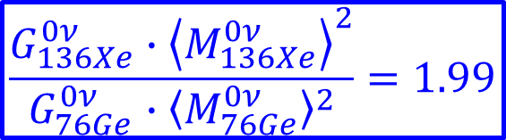
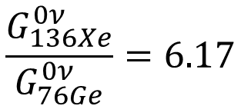

Nuclide | <M^{0ν}> | σ_{M} | σ_{M} / M^{0ν} [%]
⁷⁶Ge | 4.89 | 0.95 | 19
⁸²Se | 4.17 | 0.78 | 19
¹⁰⁰Mo | 4.35 | 0.76 | 18
¹³⁰Te | 3.70 | 1.04 | 28
¹³⁶Xe | 2.78 | 0.80 | 29
Independent of A, all matrix element distributions show a Gauss-like distribution.
The relative width of all these distributions is 20-30%, again there is no strong visible A-dependence.
The conclusions I draw from this: the matrix element calculations show less variability than the often claimed factor of 3.
There is probably only little nuclide dependence in the reliability of these calculations.
This evaluation ignores the possibility of shortcomings all models have in common.
After all this said: how does ¹³⁶Xe, on average, compare to ⁷⁶Ge?
$$\frac{G_{136Xe}^{0ν}}{G_{76Ge}^{0ν}}=6.17$$
$$\left\langle M_{136Xe}^{0ν}\right\rangle =2.78±0.80$$
$$\left\langle M_{76Ge}^{0ν}\right\rangle =4.89±0.95$$
$$\frac{G_{136Xe}^{0ν}∙{\left\langle M_{136Xe}^{0ν}\right\rangle }^{2}}{G_{76Ge}^{0ν}∙{\left\langle M_{76Ge}^{0ν}\right\rangle }^{2}}=1.99$$
Notes:
SM: uses limited valence space but all configurations of valence nucleons are included
QRPA: uses large valence space but only a particular class of configurations is included

Slide 8
The g_{A} problem (sometimes called beta quenching) skip
Nuclear models reproduce nuclear ground state properties, excitation spectra, electric moments and transitions relatively well.
Nuclear models consistently overestimate single β-decay (Gamow-Teller) rates. This problem can be fixed by reducing (quenching) the value of g_{A}. Is it really the value of g_{A} that differs in nuclei from the that obtained from neutron decay or not? How does this effect impact the calculations of the 0νββ-rate?
Different causes are being considered in the nuclear theory community:
Many-nucleon correlations are missing in models (short range correlations, multi-phonon states, particle-hole excitation outside SM configuration space,…)
Unaccounted for many-nucleon weak currents (non-nucleonic degrees of freedom e.g. Δ excitations, in-medium modification of π-physics.
The consequences this has on the 0νββ-rate calculations depends on the mechanism.
Argumentation follows that in Engel & Menendez, Rep. Prog. Phys. 80 (2017) 046301

Slide 9
Is it actually clear that quenching is relevant?
β- and 2νββ-decay involve only small momentum transfers of order MeV and go mainly through GT-transitions.
0νββ-decay involves the exchange of virtual particles, leading to momentum transfers of order 100 MeV. Quenching needed when modeling nuclear μ-capture (also involving large momentum transfer) is weaker than in β-decay. The same holds for charged current nuclear neutrino scattering (ν_{e} + ¹²C → e⁻ + ¹²N): there is little evidence for quenching.
If quenching is due to many body effects it may significantly impact calculated 0νββ-rates.
If the problem is due to unaccounted for many-nucleon currents the effect on 0νββ-decay may be small. This could be as little as 30% change in the ME.
Saying that we know that 0νββ-rates need g_{A}⁴ scaling because β- and 2νββ-need it is, most likely, a little over simplified. One would not expect a pronounced A-dependence.
Argumentation follows that in Engel & Menendez, Rep. Prog. Phys. 80 (2017) 046301

Slide 10
0νββ-decay with ¹³⁶Xe: EXO-200 and nEXO

Slide 11
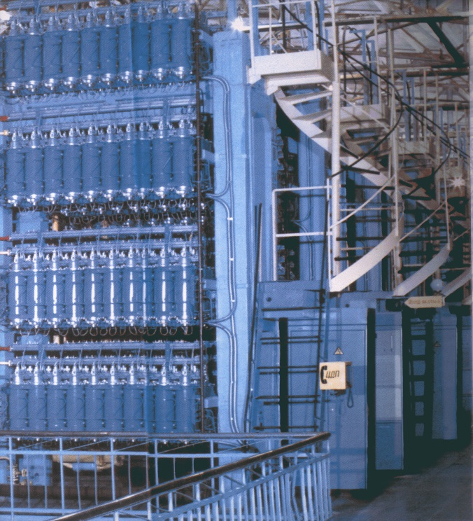
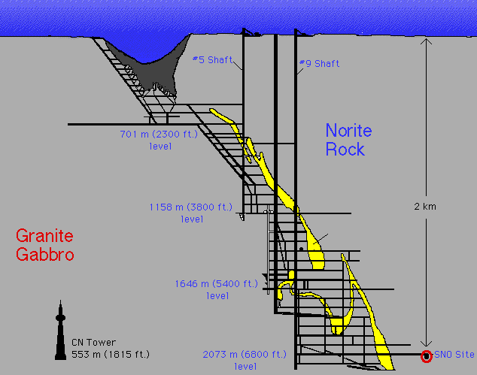
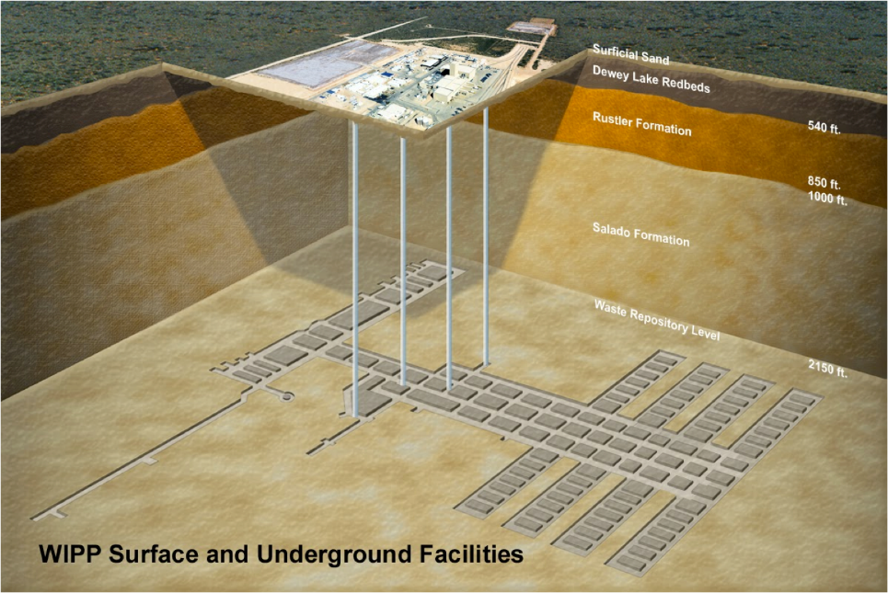
Four requirements for modern experiments:
1) Isotopic enrichment of the source material
(that is generally also the detector)
100 kg – class experiments running or
completed.
Ton – class experiments under planning.
2) Underground location to shield
cosmic-ray induced background
Several underground labs
around the world,
next round of experiments 1-2 km deep.
655 m (1624 mw.e.)
Notes:
07/01/09
11

Slide 12
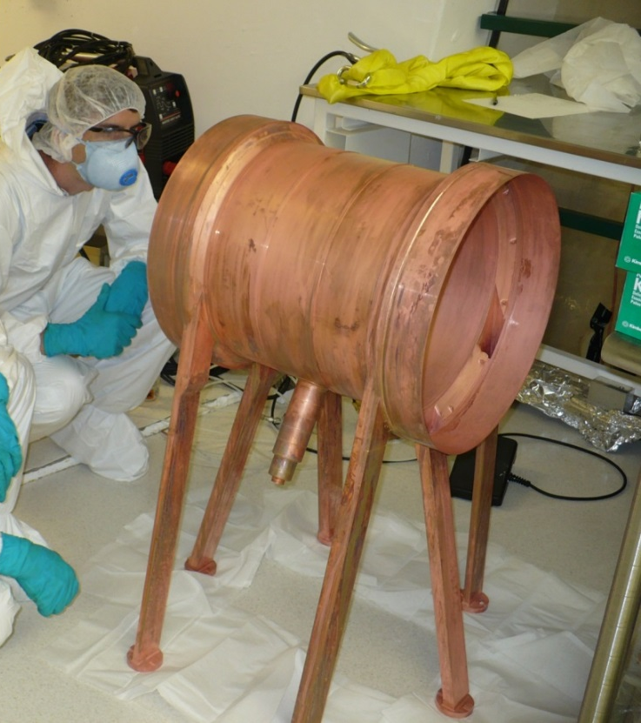
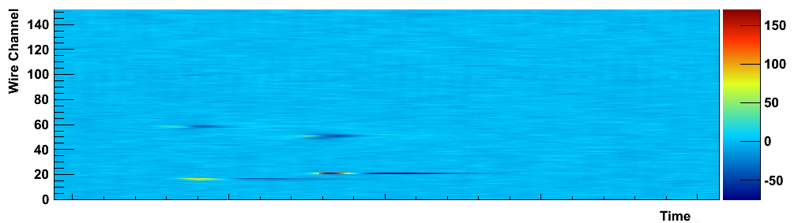
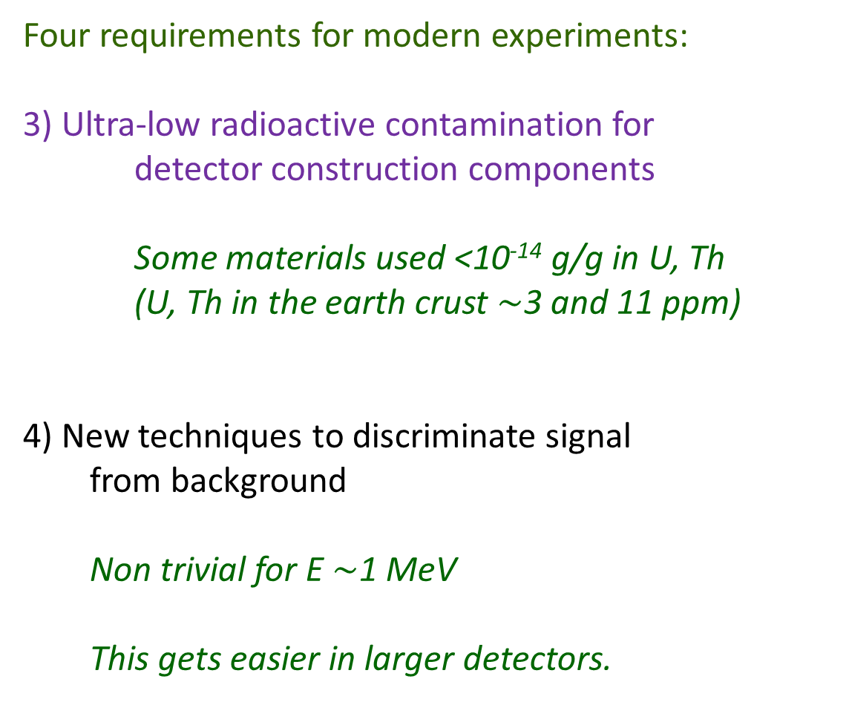
Four requirements for modern experiments:
3) Ultra-low radioactive contamination for
detector construction components
Some materials used <10⁻¹⁴ g/g in U, Th
(U, Th in the earth crust $∼$3 and 11 ppm)
4) New techniques to discriminate signal
from background
Non trivial for E $∼$1 MeV
This gets easier in larger detectors.
Notes:
07/01/09
12
Average earth crust specific activities: U 33 Bq/kg and Th 45 Bq/kg

Slide 13
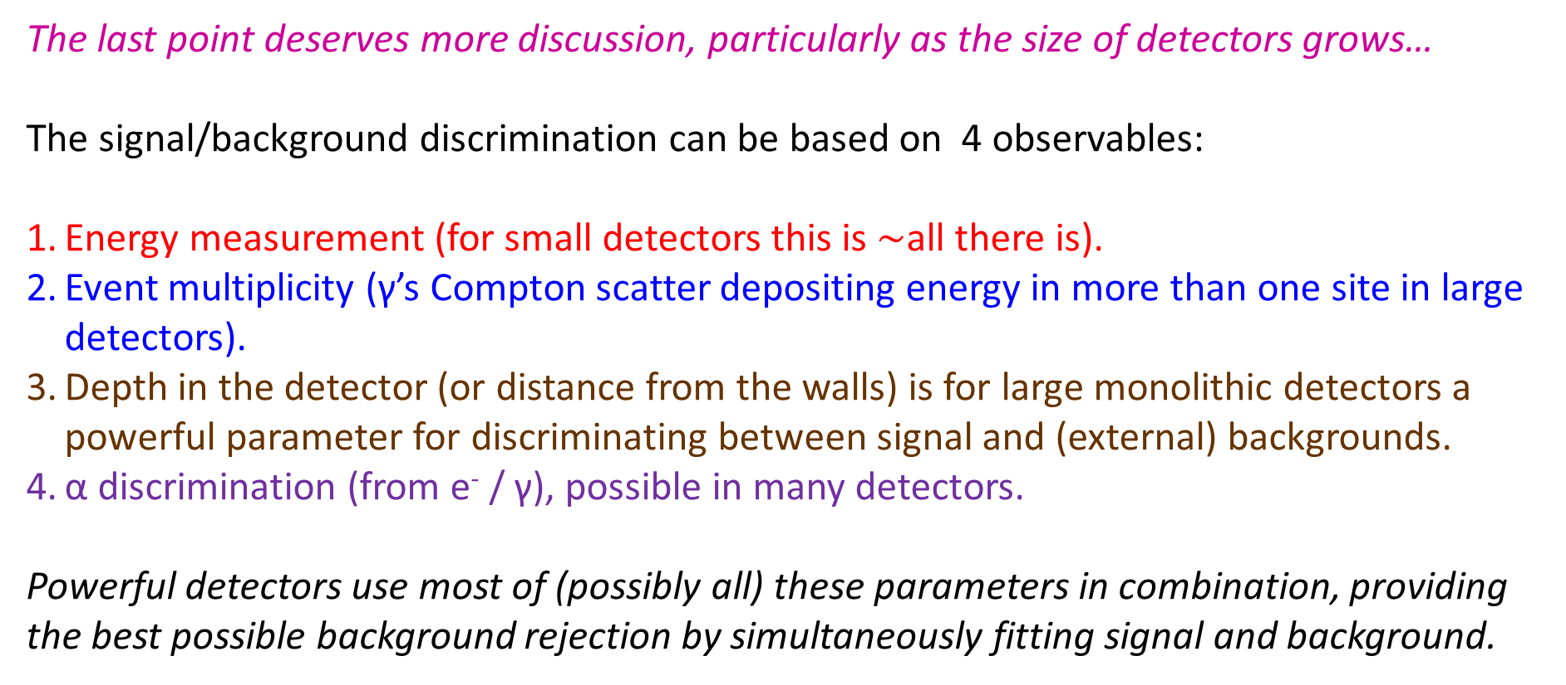
The last point deserves more discussion, particularly as the size of detectors grows…
The signal/background discrimination can be based on 4 observables:
Energy measurement (for small detectors this is $∼$all there is).
Event multiplicity (γ’s Compton scatter depositing energy in more than one site in large detectors).
Depth in the detector (or distance from the walls) is for large monolithic detectors a powerful parameter for discriminating between signal and (external) backgrounds.
α discrimination (from e⁻ / γ), possible in many detectors.
Powerful detectors use most of (possibly all) these parameters in combination, providing the best possible background rejection by simultaneously fitting signal and background.
Notes:
Signal identification based mostly on energy + multiplicity
Compton scatters for gammas
Find our actual position resolution

Slide 14
The EXO program
Use ¹³⁶Xe in liquid phase
Initial R&D on energy resolution using scintillation-ionization correlation
Performed extensive radioactivity studies
Build EXO-200, first 100 kg-class experiment to produce results. Run II in progress.
Build a ton-scale detector (nEXO) with 100 × the discovery reach and able to cover the inverted hierarchy (for the standard mechanism)
Explore the possibility of tagging the final state Ba atom to extend the sensitivity of a second phase nEXO detector

Slide 15
EXO-200

Slide 16
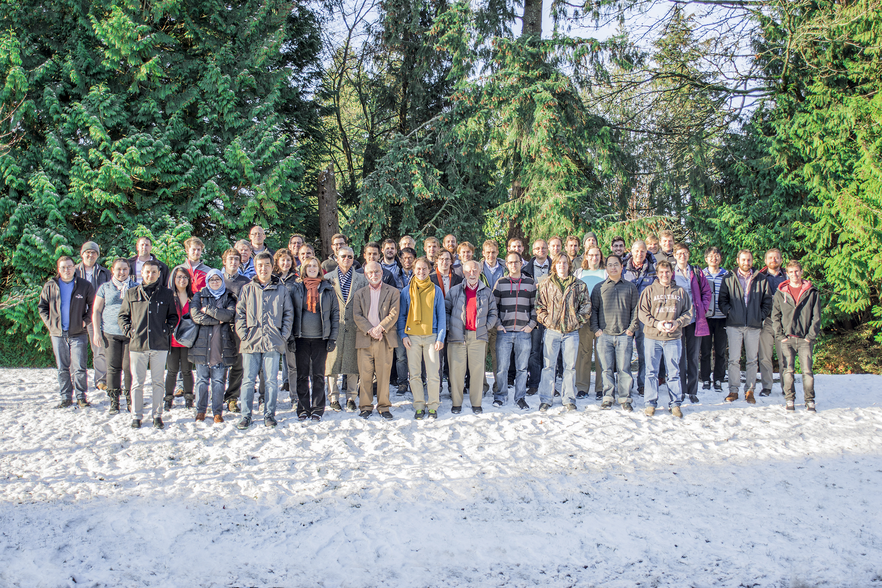








University of Alabama, Tuscaloosa AL, USA — M Hughes, I Ostrovskiy, A Piepke, AK Soma, V Veeraraghavan
University of Bern, Switzerland — J-L Vuilleumier
University of California, Irvine, Irvine CA, USA — M Moe
California Institute of Technology, Pasadena CA, USA — P Vogel
Carleton University, Ottawa ON, Canada — I Badhrees, W Cree, R Gornea, K Graham, T Koffas, C Licciardi, D Sinclair
Colorado State University, Fort Collins CO, USA — C Chambers, A Craycraft, W Fairbank Jr, D Harris, A Iverson, J Todd, T Walton
Drexel University, Philadelphia PA, USA — MJ Dolinski, EV Hansen, YH Lin, Y-R Yen
Duke University, Durham NC, USA — PS Barbeau
Indiana University, Bloomington IN, USA — JB Albert, S Daugherty
Laurentian University, Sudbury ON, Canada — B Cleveland, A Der Mesrobian-Kabakian, J Farine, A Robinson, U Wichoski
University of Maryland, College Park MD, USA — C Hall
University of Massachusetts, Amherst MA, USA — S Feyzbakhsh, S Johnston, A Pocar
McGill University, Montreal QC, Canada — T Brunner, Y Ito, K Murray
The EXO-200 Collaboration
SLAC National Accelerator Laboratory, Menlo Park CA, USA — M Breidenbach, R Conley, T Daniels, J Davis,
S Delaquis, A Johnson, LJ Kaufman, B Mong, A Odian, CY Prescott, PC Rowson, JJ Russell, K Skarpaas, A Waite, M Wittgen
University of South Dakota, Vermillion SD, USA — J Daughhetee, R MacLellan
Friedrich-Alexander-University Erlangen, Nuremberg, Germany
G Anton, R Bayerlein, J Hoessl, P Hufschmidt, A Jamil, T Michel, M Wagenpfeil, G Wrede, T Ziegler
IBS Center for Underground Physics, Daejeon, South Korea — DS Leonard
IHEP Beijing, People’s Republic of China — G Cao, W Cen, T Tolba, L Wen, J Zhao
ITEP Moscow, Russia — V Belov, A Burenkov, M Danilov, A Dolgolenko, A Karelin, A Kuchenkov, V Stekhanov, O Zeldovich
University of Illinois, Urbana-Champaign IL, USA — D Beck, M Coon, S Li, L Yang
Stanford University, Stanford CA, USA — R DeVoe, D Fudenberg, G Gratta, M Jewell, S Kravitz, G Li, A Schubert, M Weber, S Wu
Stony Brook University, SUNY, Stony Brook, NY, USA — K Kumar, O Njoya, M Tarka
Technical University of Munich, Garching, Germany — W Feldmeier, P Fierlinger, M Marino
TRIUMF, Vancouver BC, Canada — J Dilling, R Krücken, Y Lan, F Retière, V Strickland
Yale University, New Haven CT, USA — Z Li, D Moore, Q Xia

Slide 17
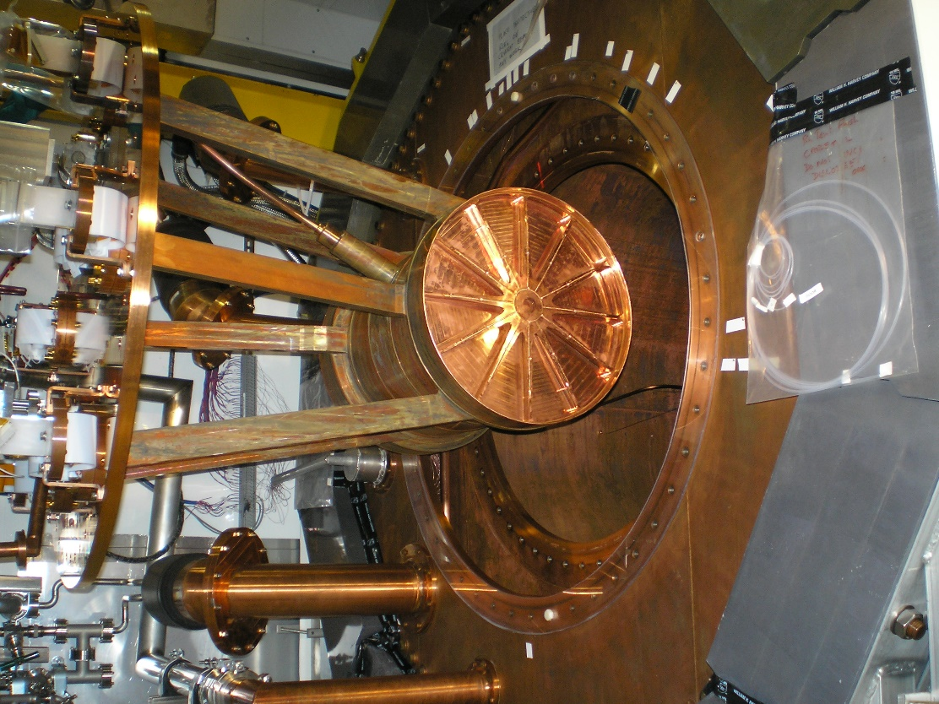
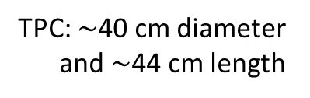
EXO-200 at the Waste Isolation Pilot Plant (US)
High purity
coolant
HFE 7000
> 50 cm
TPC: $∼$40 cm diameter
and $∼$44 cm length
25 mm each
at 167K
VETO PANELS

Slide 18
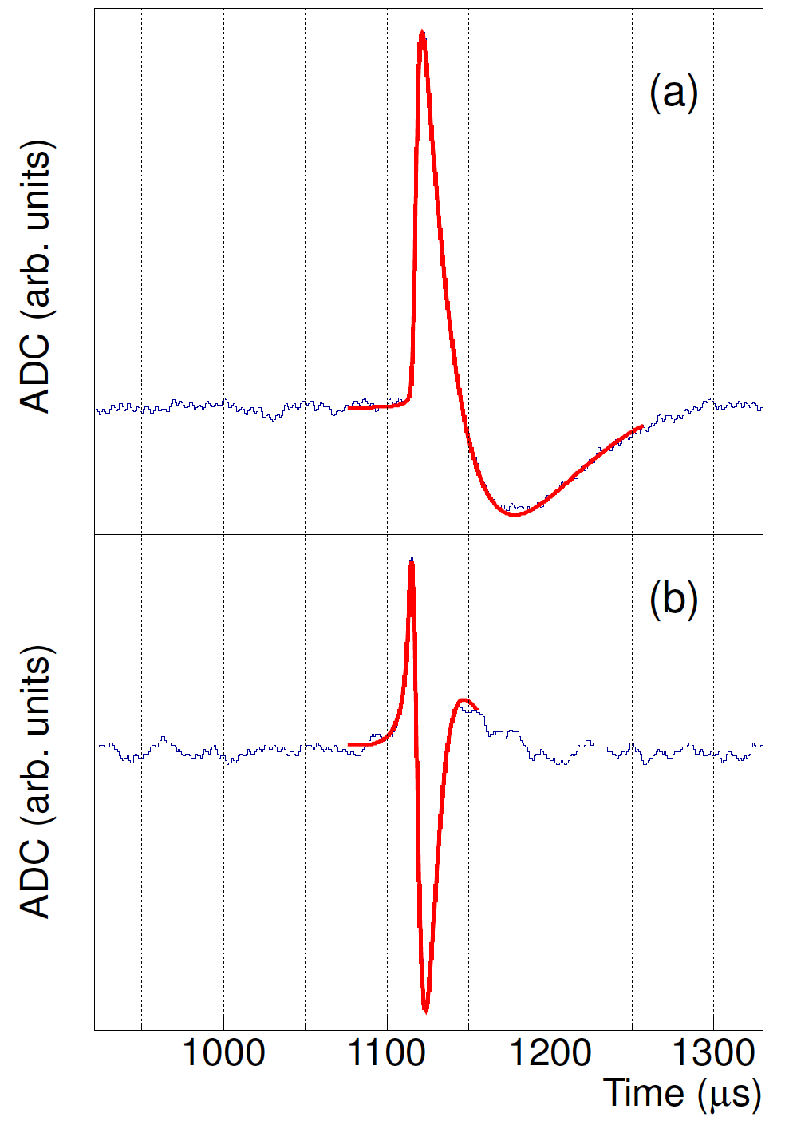
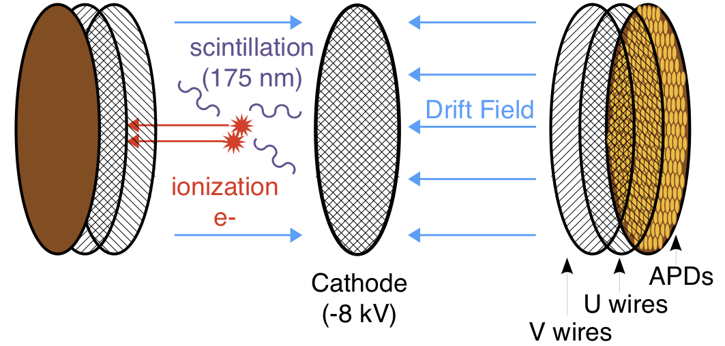
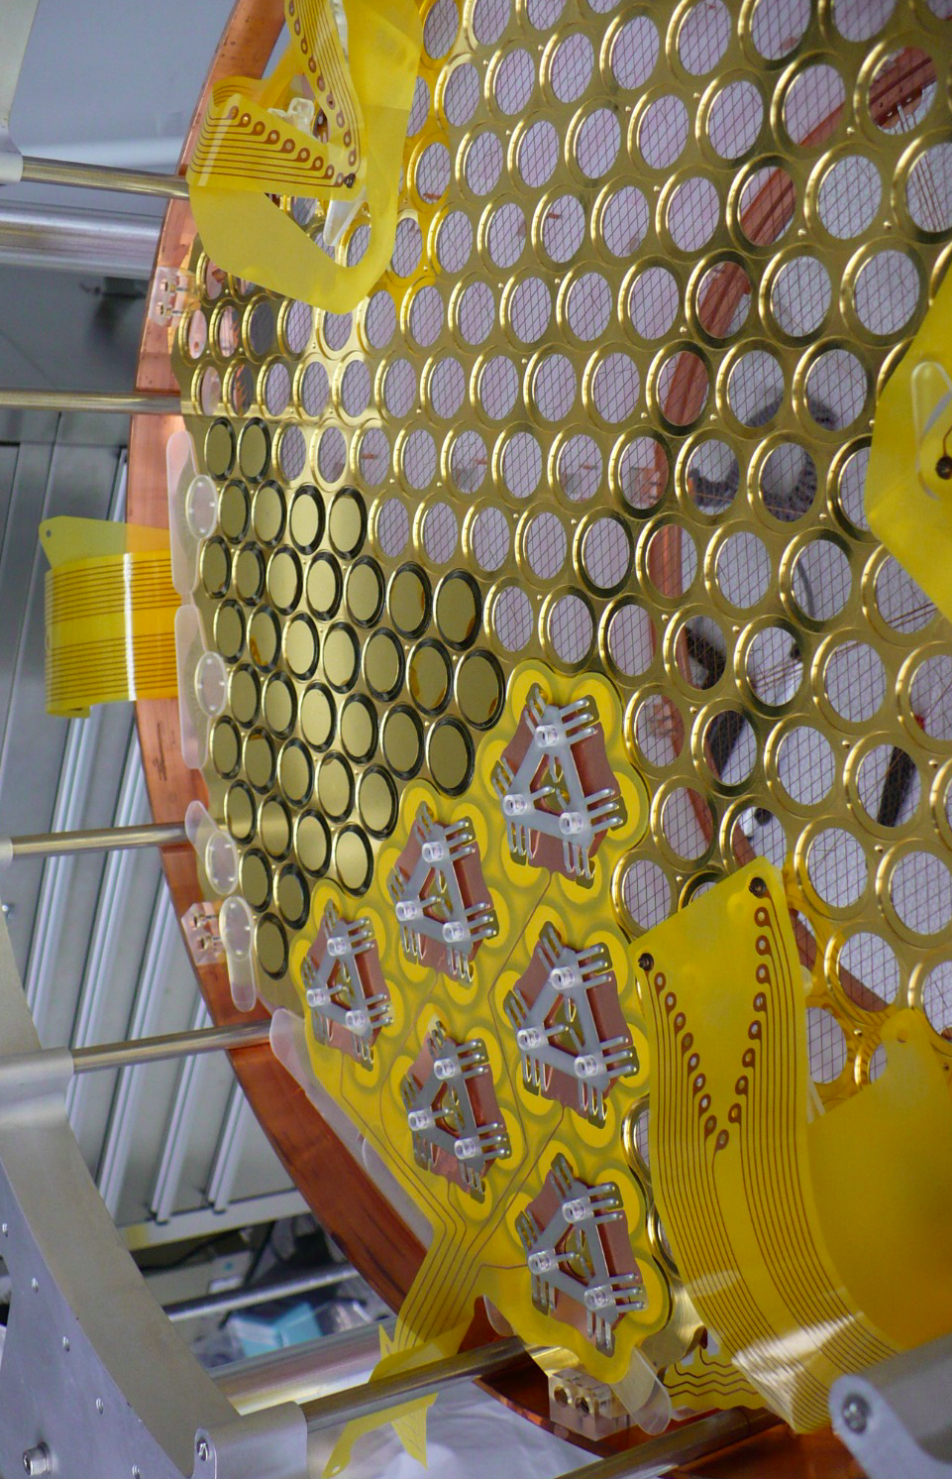
The EXO-200 Time Projection Chambers
Collection
Induction
175 kg LXe, 110 kg in active region. Enriched to 80.6% in 136Xe
More than a calorimeter: besides energy measurement spatial resolution (x,y,z) particle ID
  Discriminate single site (SS) 0νββ-events from multi-site (MS) background
  Tag α-events via characteristic charge to light ratio
  Perform coupled SS/MS fit to measure signal and background simultaneously
  Measure spatial event distribution, “resolve” signal both in energy and space

Slide 19
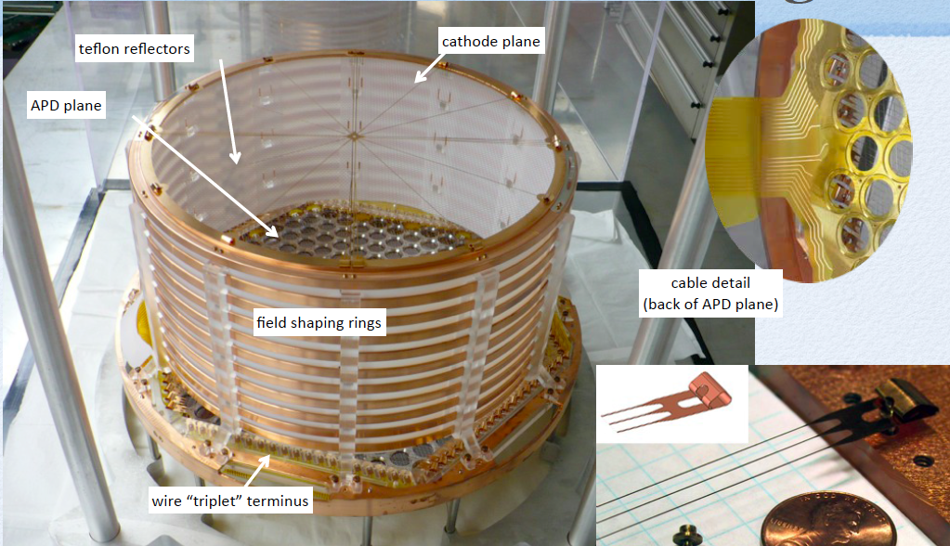

Slide 20
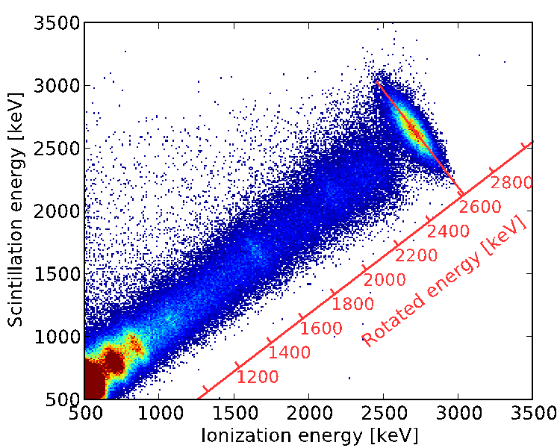
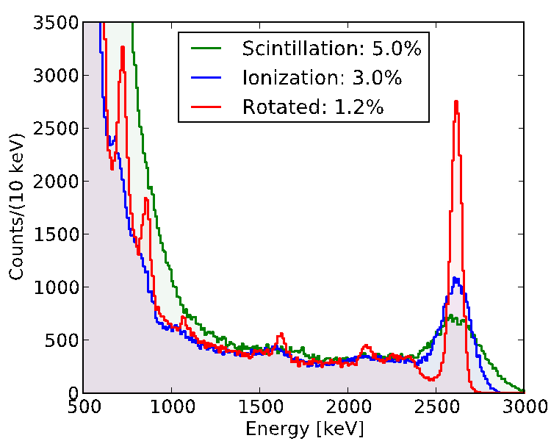
Combining Ionization and Scintillation
Anticorrelation between scintillation and ionization in LXe known since early EXO R&D
E.Conti et al. Phys Rev B 68 (2003) 054201
By now this is a common technique in LXe
2615 keV γ line
²²⁸Th source SS
Qββ

Slide 21
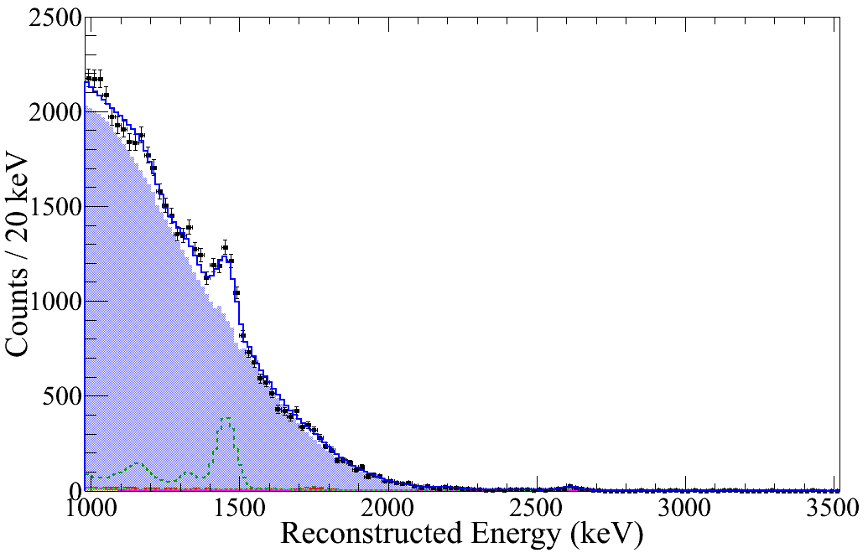
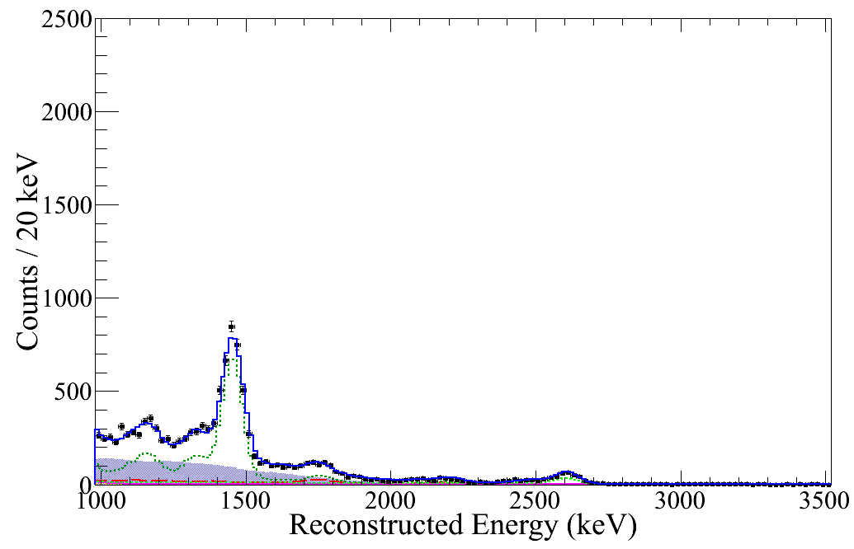
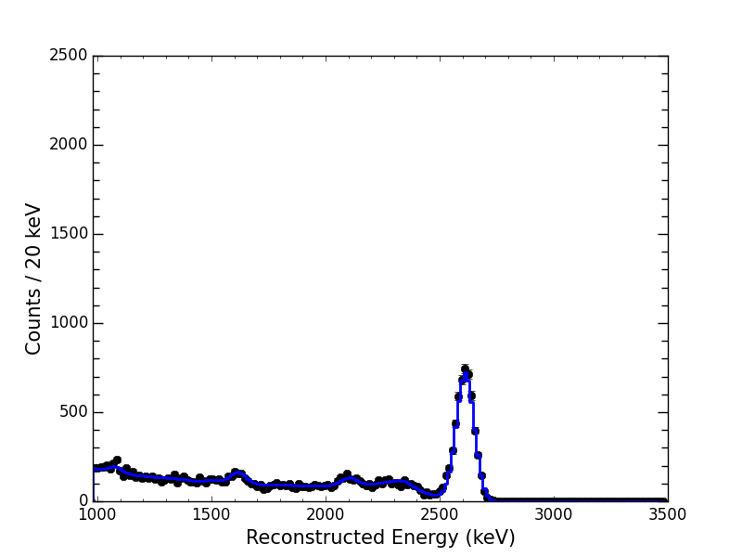
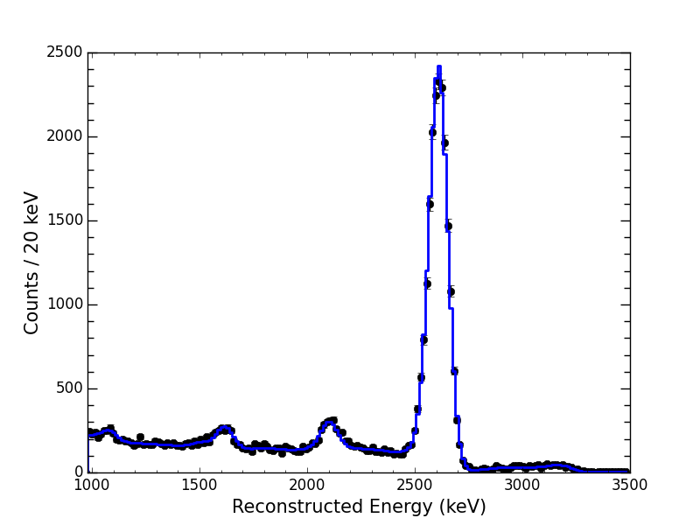
Using event multiplicity to characterize backgrounds
single cluster
multiple cluster
Low background
data
2νββ
²²⁸Th calibration
source
γ
γ

Slide 22
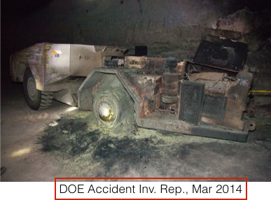
End of phase I
WIPP Events:
5 Feb. 2014: Fire in WIPP underground
14 Feb. 2014: Unrelated airborne radiological event
EXO-200:
18 Feb. 2014 Remote recovery of xenon
Oct. 2015 – Jan. 2016, system cooldown, gas purification and liquid xenon filling
Feb. – April 2016:
  Electronics upgrade
  Installation of “de-radonator” for air gap between lead and cryostat
April 2016, Phase-II physics data taking begins

Slide 23
EXO-200 Phase-II Operation
EXO-200 Phase-II operation began on 31 Jan 2016, after enriched liquid xenon fill.
Data shows that the detector reached excellent xenon purity and ultra-low internal Rn level shortly after restart.
Good Physics Data
Good Physics Data
4.2 µBq/kg
31 Jan ‘16
31 Jan ‘16

Slide 24
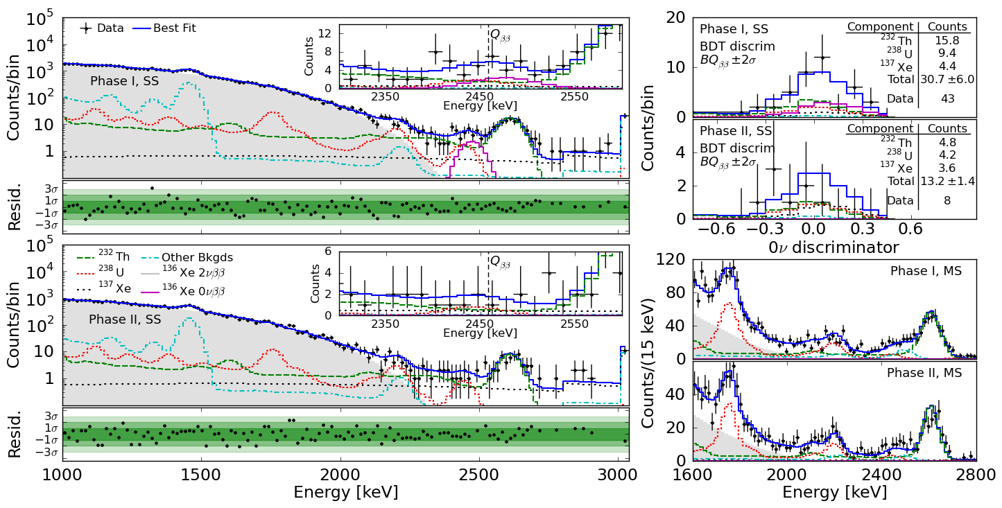

Most Recent Results
Background model + data → maximum likelihood fit
Combine Phase I + Phase II profiles
No statistically significant excess: combined p-value $∼$1.5$⋅$σ

Slide 25
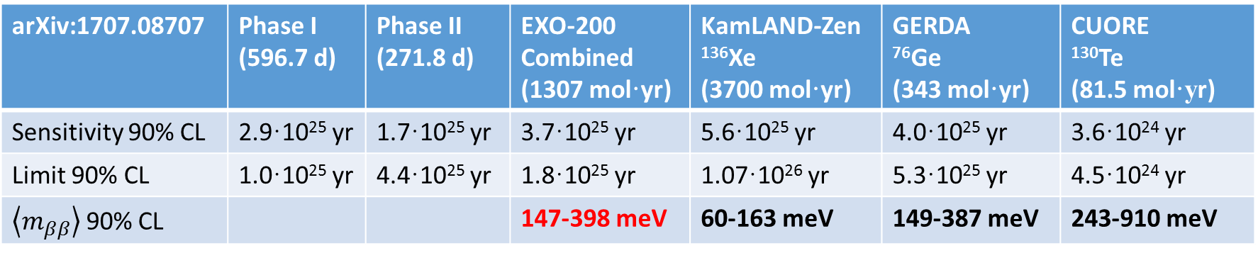
arXiv:1707.08707 | Phase I (596.7 d) | Phase II (271.8 d) | EXO-200 Combined (1307 mol·yr) | KamLAND-Zen ¹³⁶Xe (3700 mol·yr) | GERDA ⁷⁶Ge (343 mol·yr) | CUORE ¹³⁰Te (81.5 mol·yr)
Sensitivity 90% CL | 2.9·10²⁵ yr | 1.7·10²⁵ yr | 3.7·10²⁵ yr | 5.6·10²⁵ yr | 4.0·10²⁵ yr | 3.6·10²⁴ yr
Limit 90% CL | 1.0·10²⁵ yr | 4.4·10²⁵ yr | 1.8·10²⁵ yr | 1.07·10²⁶ yr | 5.3·10²⁵ yr | 4.5·10²⁴ yr
$\left\langle m_{ββ}\right\rangle$ 90% CL |  |  | 147-398 meV | 60-163 meV | 149-387 meV | 243-910 meV
The sensitivity is the appropriate estimator for the power of a measurement. It contains all the information and is free of the random fluctuations of the few events at the Q-value.
The “background index” is
B=(1.5±0.2)×10⁻³ cnts / (kg·yr·keV).
It offers an incomplete description.
B=(0.107±0.014) cnts / (kg·yr·FWHM)
for σ_{ββ}/Q_{ββ}=1.23%
Contributions to BQ±2σ | Phase I 122.0 kg·y (cts) | Phase II 55.6 kg·y (cts)
²³²Th | 15.8 | 4.8
²³⁸U | 9.4 | 4.2
¹³⁷Xe | 4.4 | 3.6
Total | 30.7±6.0 | 13.2±1.4
Data | 43 | 8
external γ-radiation
external γ-radiation
n-induced
Notes:
CUORE: combined results of CUORICINO + CUORE-0 + CUORE has 145 mol*y and T_{1/2} > 6.6e24 yr

Slide 26
The extremely low EXO-200 background was achieved by:
Rigorous radioactivity testing program utilizing
  ICPMS / GDMS
  NAA
  Ge counting
  Rn atom counting
Coordination with the Monte Carlo simulation to formulate quantitative acceptance criteria for every experiment component.
Detector design and construction decisions were governed by these criteria.
Method | ²³²Th cnts in Q_{ββ}±2·σ_{ββ} | ²³⁸U cnts in Q_{ββ}±2·σ_{ββ}
EXO-200 data | 10.3-13.9 | 5.3-7.1
EXO-200 radioassay | 0.5-7.7 | 2.0-9.5
Pre-data prediction | 0.9-10.3 | 6.3-26.8
This approach works and we have shown it with an experiment as complex as EXO-200.
For nEXO we’ll apply the same techniques.
From 477.6 d of phase I running, 90% CL ranges for number of background events.
Notes:
J. Albert et al., PRC 92 (2015) 015503

Slide 27
nEXO

Slide 28
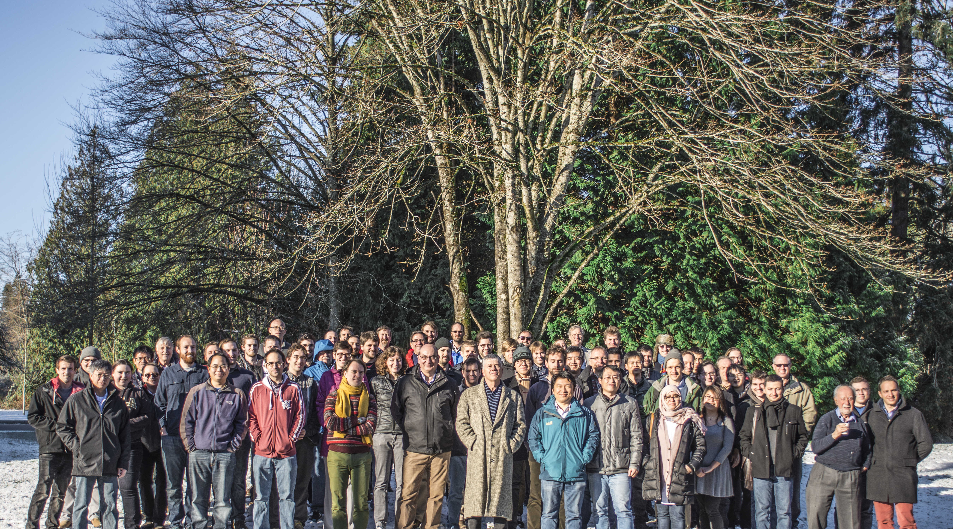







University of Alabama, Tuscaloosa AL, USA
M Hughes, I Ostrovskiy, A Piepke, AK Soma, V Veeraraghavan
University of Bern, Switzerland — J-L Vuilleumier
Brookhaven National Laboratory, Upton NY, USA
M Chiu, G Giacomini, V Radeka, E Raguzin, T Rao, S Rescia, T Tsang
California Institute of Technology, Pasadena CA, USA — P Vogel
Carleton University, Ottawa ON, Canada
I Badhrees, M Bowcock, W Cree, R Gornea, K Graham, T Koffas, C Licciardi, D Sinclair
Colorado State University, Fort Collins CO, USA
C Chambers, A Craycraft, W Fairbank Jr, D Harris, A Iverson, J Todd, T Walton
Drexel University, Philadelphia PA, USA
MJ Dolinski, E Hansen, YH Lin, E Smith, Y-R Yen
Duke University, Durham NC, USA — PS Barbeau
University of Erlangen-Nuremberg, Erlangen, Germany
G Anton, R Bayerlein, J Hoessl, P Hufschmidt, A Jamil, T Michel, M Wagenpfeil, T Ziegler
IBS Center for Underground Physics, Daejeon, South Korea — DS Leonard
IHEP Beijing, People’s Republic of China — G Cao, W Cen, Y Ding, X Jiang,
Z Ning, X Sun, T Tolba, W Wei, L Wen, W Wu, X Zhang, J Zhao
IME Beijing, People’s Republic of China — L Cao, X Jing, Q Wang
ITEP Moscow, Russia
V Belov, A Burenkov, A Karelin, A Kobyakin, A Kuchenkov, V Stekhanov, O Zeldovich
University of Illinois, Urbana-Champaign IL, USA — D Beck, M Coon, S Li, L Yang
Indiana University, Bloomington IN, USA — JB Albert, S Daugherty, G Visser
University of California, Irvine, Irvine CA, USA — M Moe
Laurentian University,Sudbury ON,Canada
B Cleveland, A Der Mesrobian-Kabakian, J Farine, A Robinson, U Wichoski
Lawrence Livermore National Laboratory, Livermore CA, USA
O Alford, J Brodsky, M Heffner, A House, S Sangiorgio
University of Massachusetts, Amherst MA, USA
S Feyzbakhsh, S Johnston, CM Lewis, A Pocar
McGill University, Montreal QC, Canada — T Brunner, Y Ito, K Murray
Oak Ridge National Laboratory, Oak Ridge TN, USA — L Fabris, RJ Newby, K Ziock
Pacific Northwest National Laboratory, Richland, WA, USA
I Arnquist, EW Hoppe, JL Orrell, G Ortega, C Overman, R Saldanha, R Tsang
Rensselaer Polytechnic Institute, Troy NY, USA — E Brown, K Odgers
Université de Sherbrooke — F Bourque, S Charlebois , M Côté, D Danovitch,
H Dautet, R Fontaine, F Nolet, S Parent, JF Pratte, T Rossignol, J Sylvestre, F Vachon
SLAC National Accelerator Laboratory, Menlo Park CA, USA
J Dalmasson, T Daniels, S Delaquis, A Dragone, G Haller,
LJ Kaufman, A Odian, M Oriunno, B Mong, PC Rowson, K Skarpaas
University of South Dakota, Vermillion SD, USA — J Daughhetee, R MacLellan
Stanford University, Stanford CA, USA
R DeVoe, D Fudenberg, G Gratta, M Jewell, S Kravitz, G Li, A Schubert, M Weber, S Wu
Stony Brook University, SUNY, Stony Brook NY, USA — K Kumar, O Njoya, M Tarka
Technical University of Munich, Garching, Germany — P Fierlinger, M Marino
TRIUMF, Vancouver BC, Canada
J Dilling, P Gumplinger, R Krücken, Y Lan, F Retière, V Strickland
Yale University, New Haven CT, USA — D Moore
The nEXO Collaboration

Slide 29
How does one scale-up an experiment like EXO-200?
The scaling should incorporate all the strong points of EXO-200, reducing technical risk.
The scaling should optimally utilize the opportunities opened by a much larger detector, whose linear dimensions will be much larger than the attenuation lengths of energetic γ-radiation estimated to be the largest background contributor.
It should reduce the risk that an unknown γ-transition leads to a false claim of discovery.
The nEXO collaboration started an active R&D program to address these challenges.
Our approach:
Use sufficient amount to cover the inverted mass hierarch range
Use a multi-parameter measurement to “resolve” 0νββ-decay in more than one dimension.
Build a homogenous detector to take full advantage of the fact that the linear detector dimensions are much larger than the photon attenuation lengths. Have no passive materials inside the detector to fully exploit this fact.

Slide 30
LXe mass (kg) | Diameter or length (cm)
5000 | 130
150 | 40
5 | 13
A cartoon illuminating the last point
2.45 MeV γ
attenuation length
8.7 cm =
5kg
150kg
5000kg
This works best for a monolithic detector

Slide 31
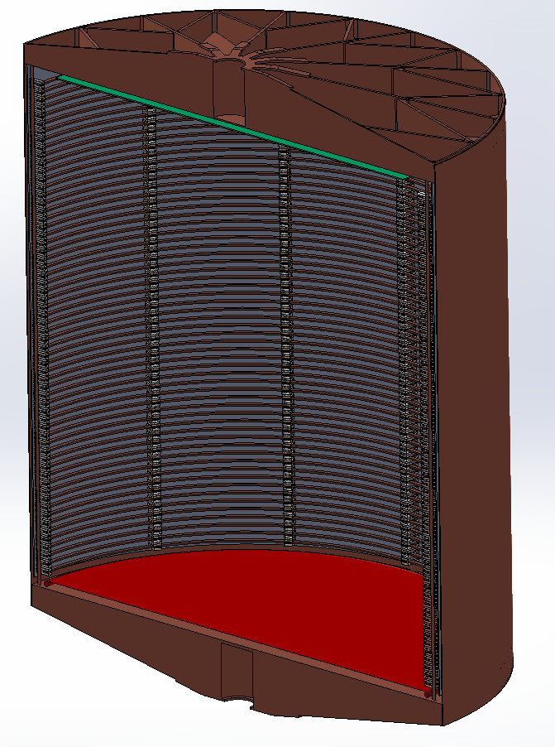
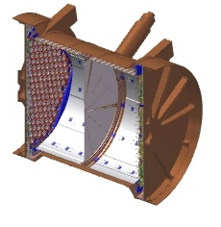
The nEXO detector
A 5000 kg enriched LXe TPC, directly extrapolated from EXO-200
130 cm
46 cm

Slide 32
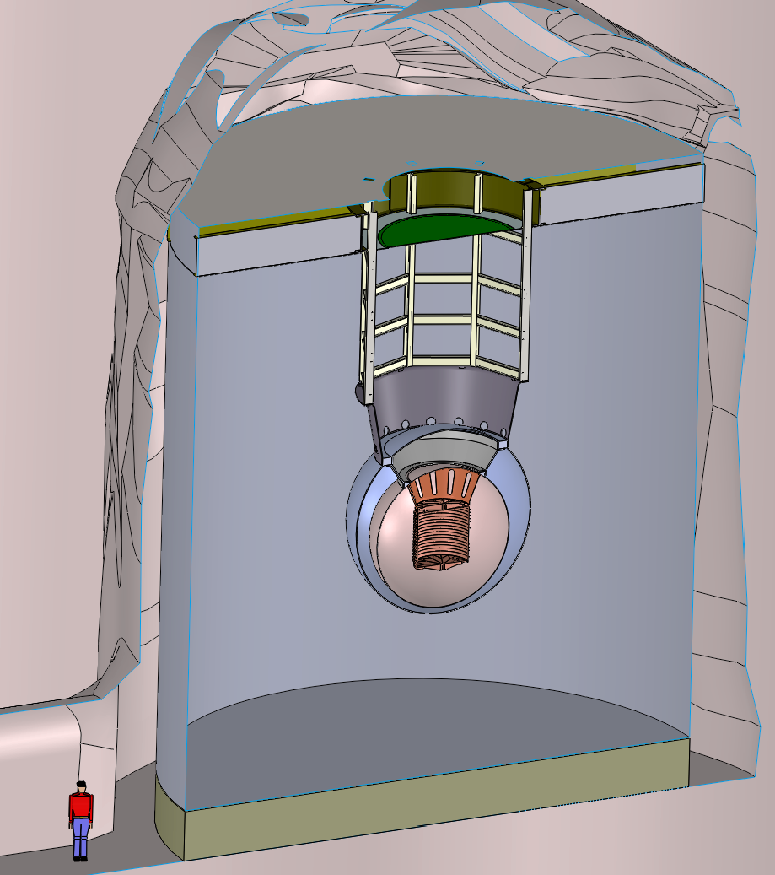
Artist view of nEXO in the SNOlab Cryopit
13m
14m
14 m
Ø13 m

Slide 33
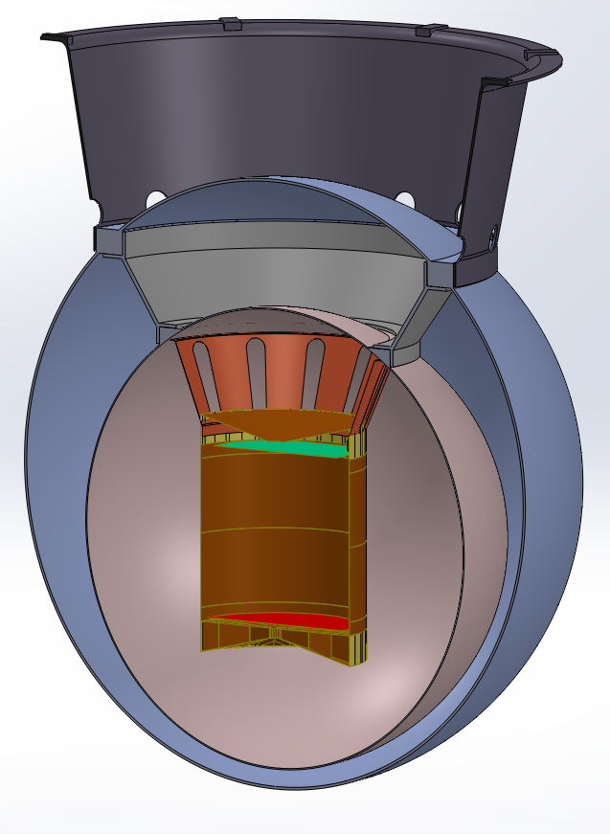
The nEXO baseline TPC
Charge readout
strips (anode)
In LXe
electronics
(charge and SiPMs)
SiPM `staves’
plastering
barrel behind
field-shaping
rings
1.3 m
e⁻ drift
Cathode
33

Slide 34
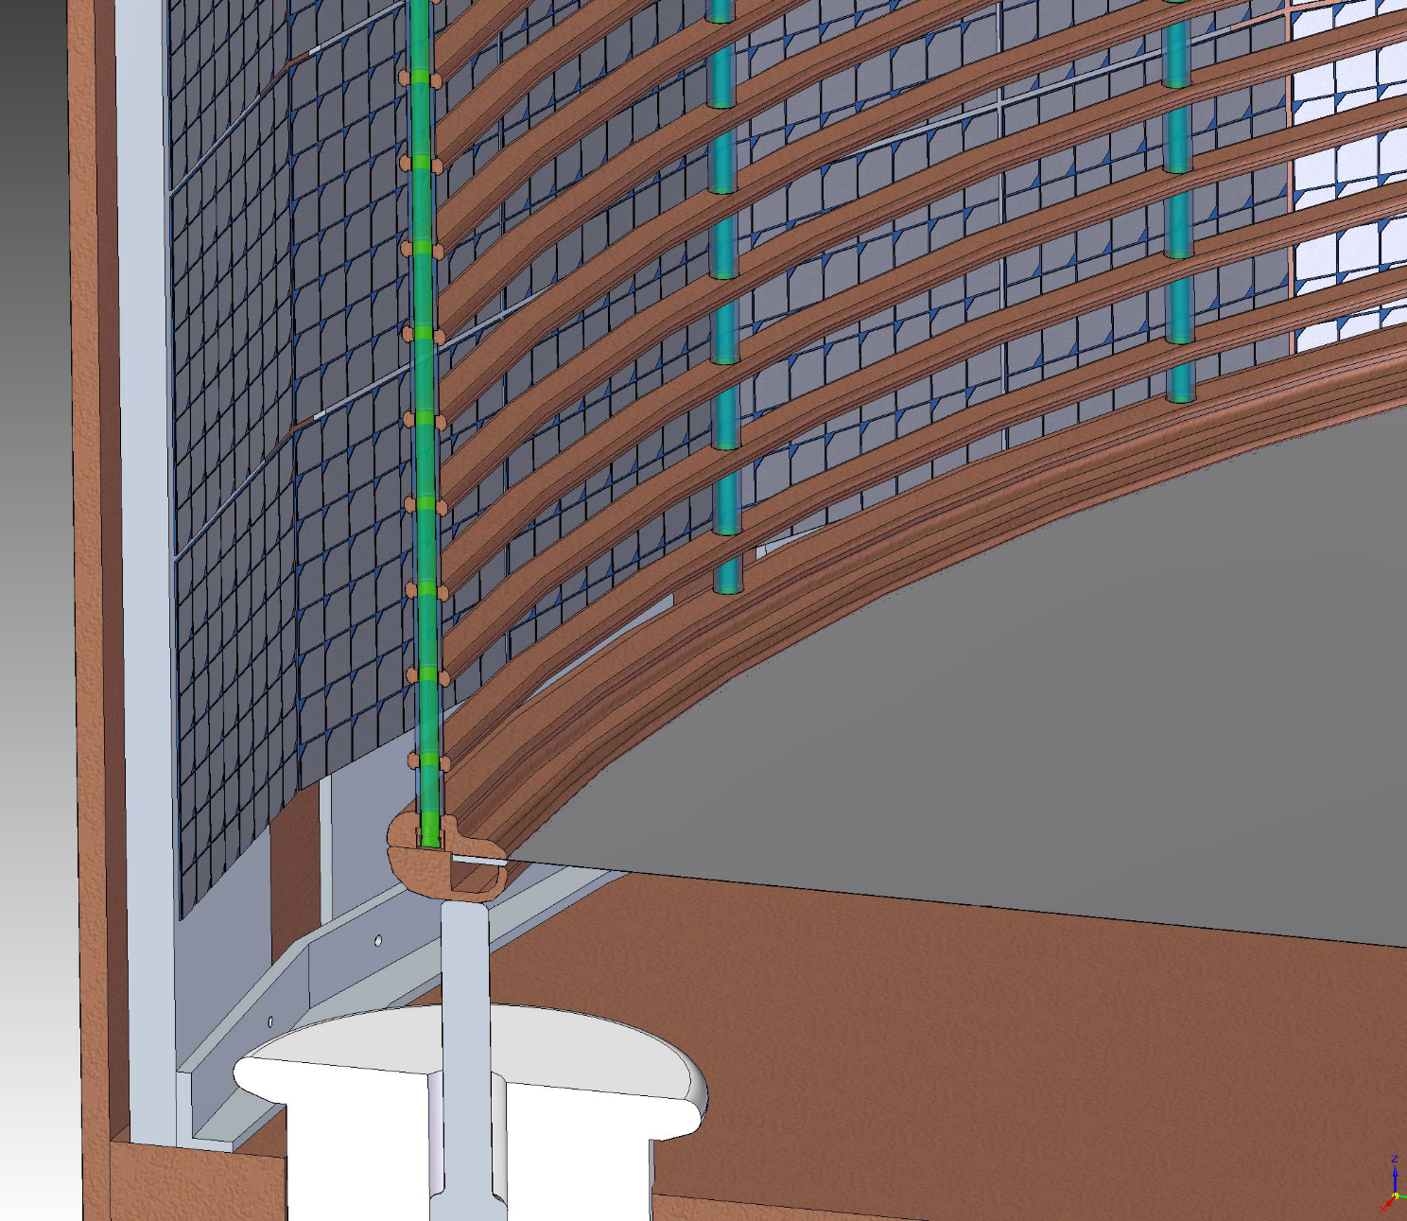
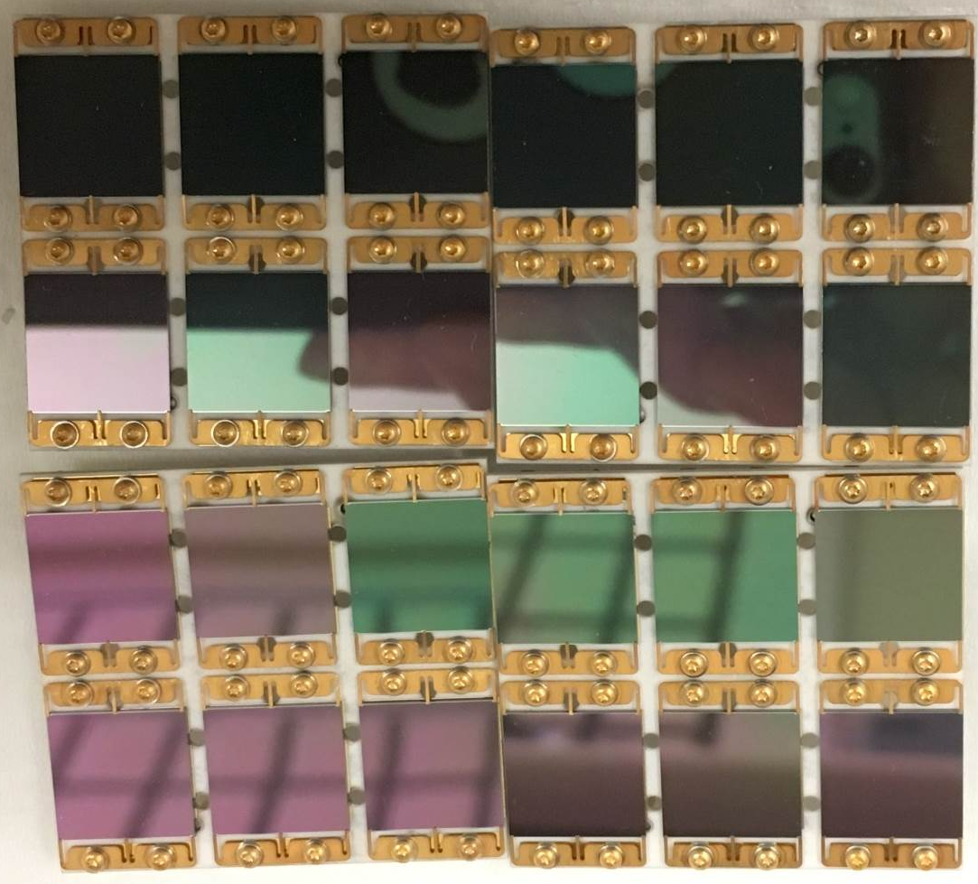
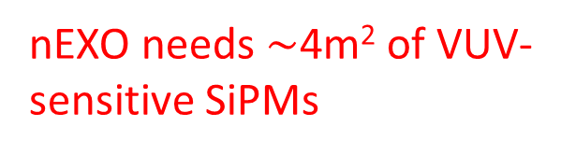
nEXO needs $\sim$4m² of VUV-sensitive SiPMs
1cm

Slide 35
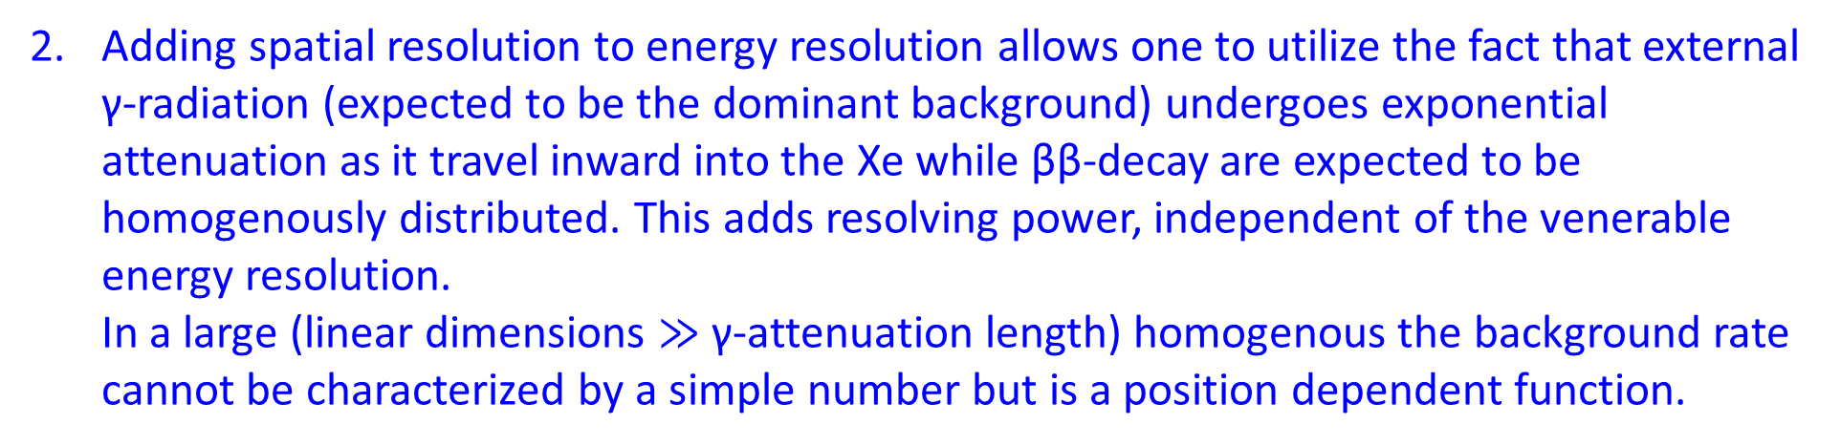
Resolving a 0νββ-signal in more than one dimension
The picture that a search for 0νββ-decay is essentially a peak search in a 1D-energy spectrum, characterized by energy resolution and a background value is no longer true.
Categorization into SS and MS event sets allows for simultaneous fitting of event sets enriched in signal (SS) and background (MS). The latter is not some “throw away data”, as sometimes portrayed, but enables the measurement of the background together with the signal.
Adding spatial resolution to energy resolution allows one to utilize the fact that external γ-radiation (expected to be the dominant background) undergoes exponential attenuation as it travel inward into the Xe while ββ-decay are expected to be homogenously distributed. This adds resolving power, independent of the venerable energy resolution.
In a large (linear dimensions $≫$ γ-attenuation length) homogenous the background rate cannot be characterized by a simple number but is a position dependent function.

Slide 36
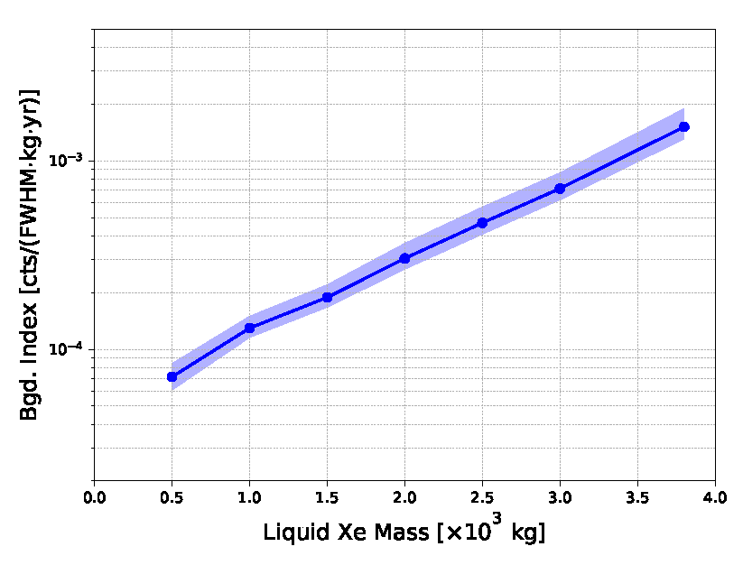
In nEXO the expected background has distinct spatial dependence. The background rates are based on a detailed materials measurement program (is in full swing) as in EXO-200 AND on a detailed simulation and event reconstruction effort.
Large experiments are no longer characterized by a single background value.
This simplification only makes sense for small experiments or experiments without spatial information (integrating detectors).
The key issue here is that we are expecting (based on the EXO-200 experience) the background to be dominated by external γ–radiation.
The background estimation therefore relies on data and GEANT4’s γ–ray cross sections.
Notes:
Error band from radioassay errors (correlations accounted for through sampling), MC error. It corresponds to 95% CL.

Slide 37
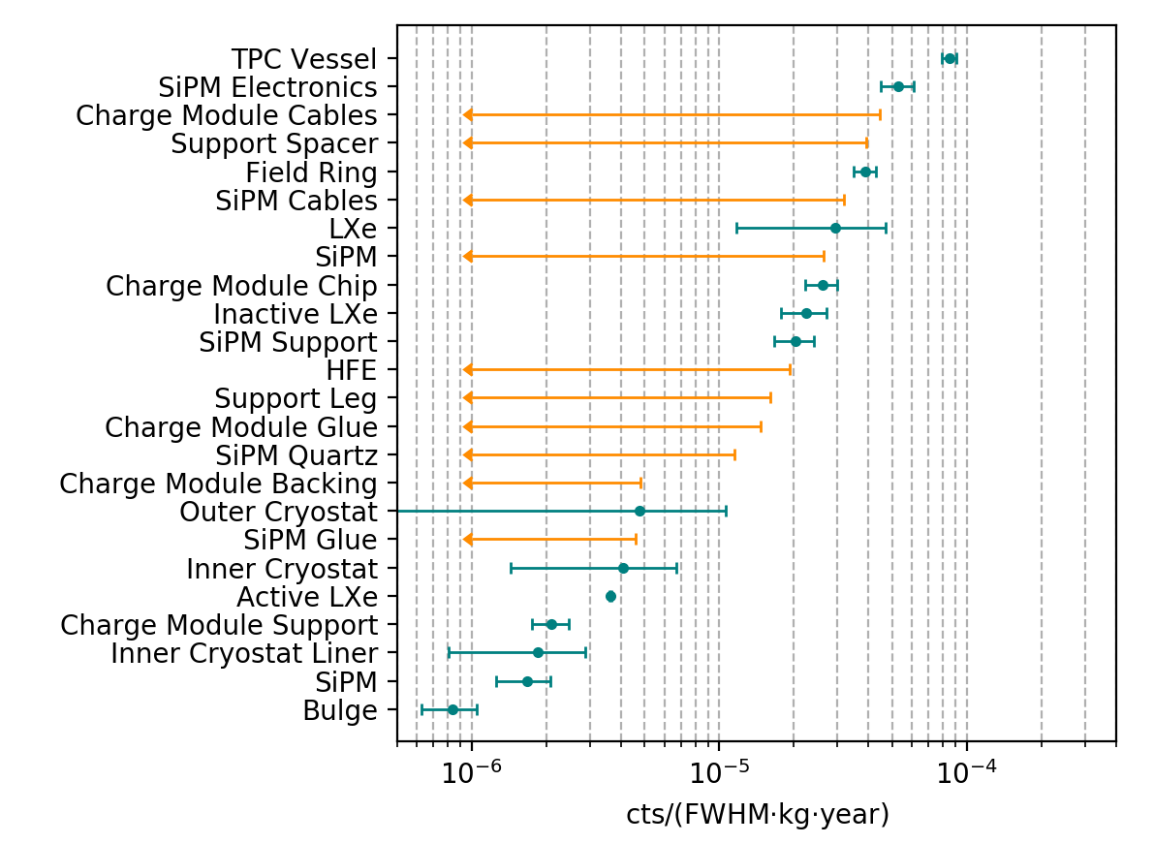
Background budget by component and material
This same procedure predicted the EXO-200 background spot-on
Internal materials dominate (as expected)
Apart for the TPC vessel several items contribute in a similar way (this is part of the optimization)
Several radioassay entries with only 90% CL limit (more measurements may improve the estimated background)

Slide 38
How is this information best used? How low does the background need to be, given that we can resolve a signal in multiple dimensions (this is not a one dimensional peak search).
We derive the experiment sensitivity from the full analysis and compare to a simple rate analysis (apply simple cuts and throw away data outside the cut boundaries).
Note, the latter approach still utilizes the position measurement capability of nEXO, just in a sub-optimal but easy to understand way.
The full analysis is about a factor 1.5 more powerful than the simple rate analysis.
It optimally uses all xenon (no maximum in curve), some is more useful for determining the background (outer layers) some for looking for the signal (inner volume).

Slide 39
The detailed, EXO-200 informed, detector model, normalized by actual materials data, is used to estimate the nEXO sensitivity. We use the MC derived PDFs to perform repeated experiment analyses and then derive the sensitivity from a frequentist analysis.
This procedure does not require any inappropriate square root approximations and doesn’t utilize Wilk’s theorem. The very low statistics is properly treated.
Based on this, we estimate the 90% CL sensitivity of nEXO to be:
T_{1/2} > 9.1·10²⁷ yr (6.5-17.7 meV)

Slide 40
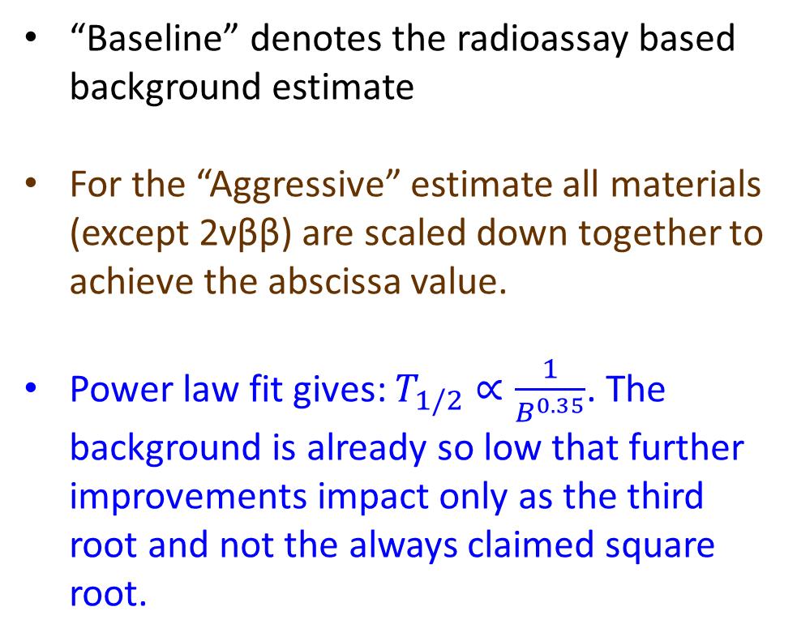
How important is the exact knowledge of the background rate for the sensitivity?
“Baseline” denotes the radioassay based background estimate
For the “Aggressive” estimate all materials (except 2νββ) are scaled down together to achieve the abscissa value.
Power law fit gives: $T_{1/2}∝\frac{1}{B^{0.35}}$. The background is already so low that further improvements impact only as the third root and not the always claimed square root.

Slide 41
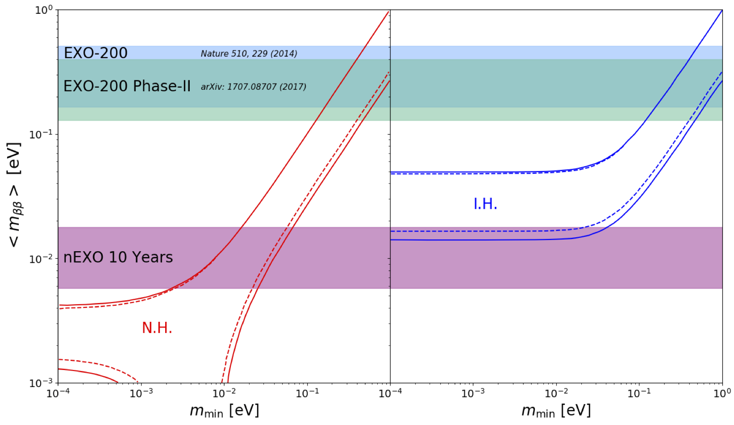
The “standard mechanism” produces the “classic” plot below, that assumes an array of NMEs (hence the bands) and the unquenched value of g_{A} .
In addition:
- Allowed masses from oscillations: 90% CL, D.V. Forero et al, PRD 90 (2014) 093006 and M. Tortola private comm.
- nEXO sensitivity assuming 10 yr of data, resulting in T_{1/2} > 9.1·10²⁷yr @ 90%CL

Slide 42
The case for discovery (skip)
This is what our community is really excited about!
“Selling” an important discovery to a critical audience is not simply achieved by multiplication of the sensitivity with some factor.
nEXO’s discovery potential was quantified using the repeated analysis of toy Monte Carlo experiments. 0νββ-signals of varying strengths were added.
We find a median 3·σ discovery potential of: $T_{1/2}>5.1∙{10}^{27} yr$ (8.7-23.6 meV).
This is achieved through the simultaneous measurement of signal and background. Not only the energy information enters but also the different spatial distributions of internal signal and external γ-ray background.

Slide 43
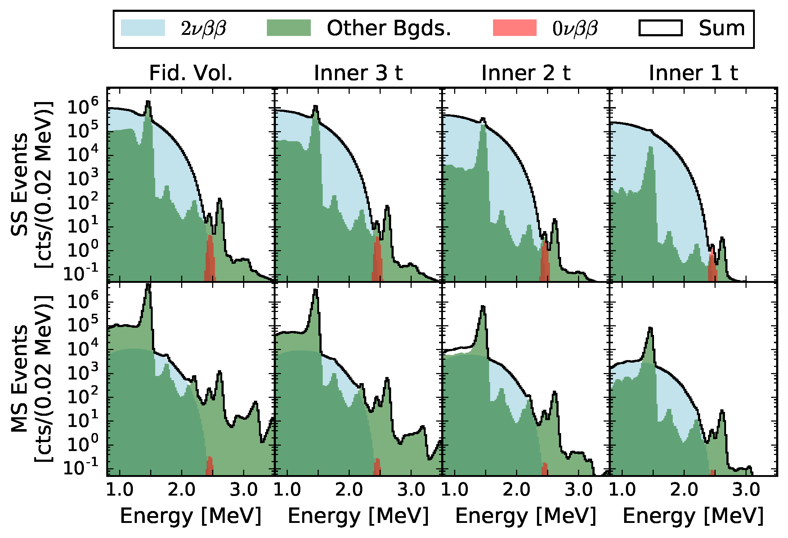
Particularly in the larger nEXO, background identification and rejection fully use a fit that considers simultaneously energy, multiplicity and event position.
➔ The power of the homogeneous detector, this is not just a calorimetric measurement!
SS
10 yr data, 0νββ at the stated discovery threshold, or T_{1/2}=5.1x10²⁷ yr
MS

Slide 44
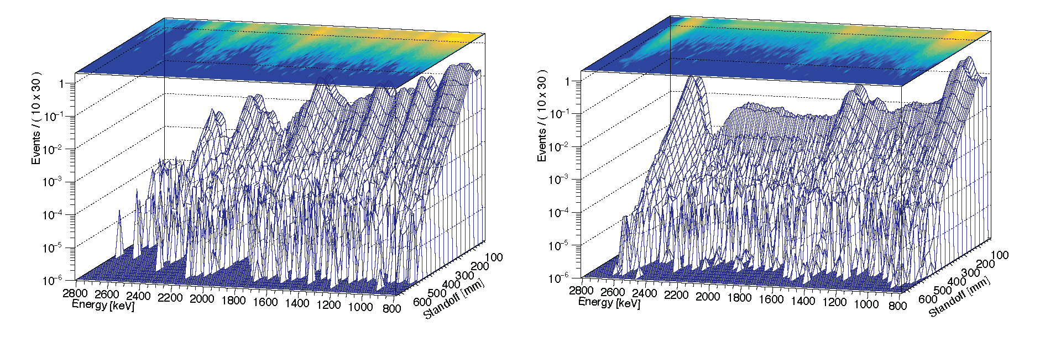
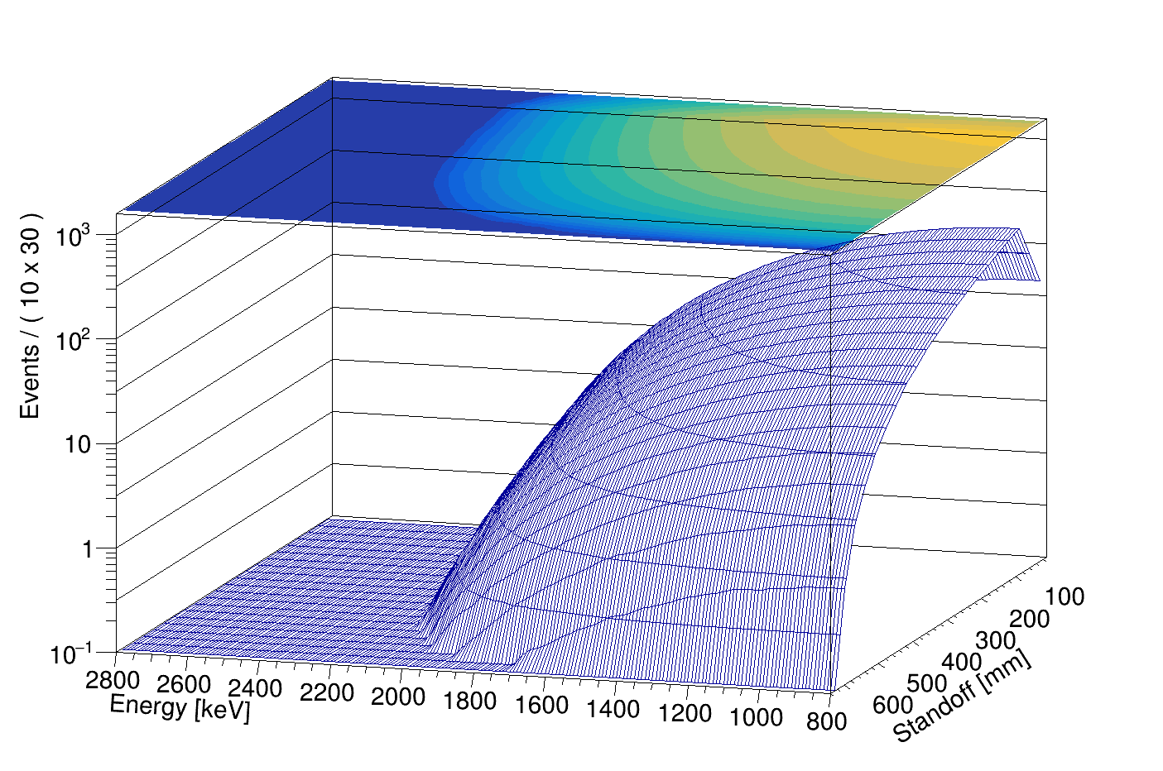
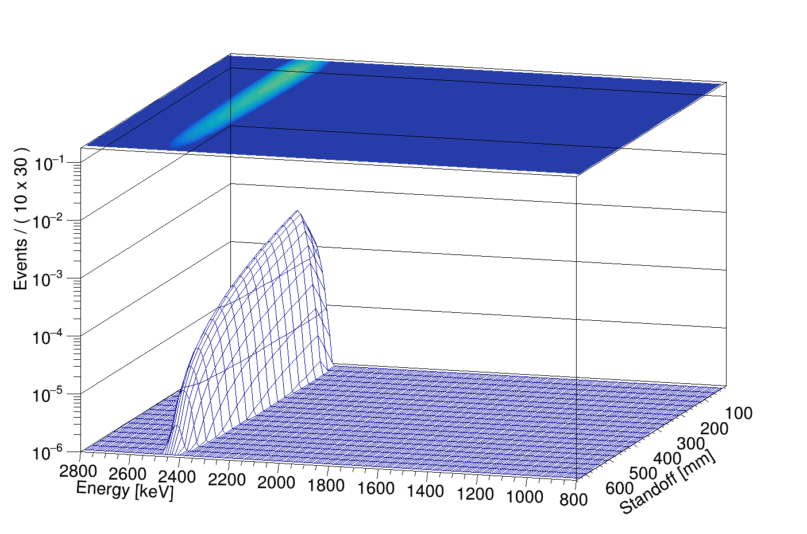
²³⁸U SS
²³²Th SS
2νββ SS
0νββ SS

Slide 45
In order for an unknown γ-peak at the Q-value to yield a signal equivalent to a 3·σ discovery in the inner 3000 kg of Xe, it would produce a p < 0.00001 discrepancy in the multi-site event distribution in the outer volume.
nEXO could run filled with natural Xe.
Ba-tagging could be implemented.
Of course having more than one experiment, using more than one technology, different decaying nuclides with different Q-values would be the ultimate defense.
This is why the ββ-community is planning for more than one experiment worldwide.

Slide 46
Conclusion
¹³⁶Xe is, experiment wise, a competitive 0νββ candidate
  Xe is obtainable in large quantity from the atmosphere
  Is relatively cost effective to enrich, doesn’t need expensive crystal growth
  Generally scales to large detector sizes
Results obtained with large amounts of ¹³⁶Xe are among the best in the field: KamLAND-Zen and EXO-200
A new generation of a ton-scale search using ¹³⁶Xe, called nEXO, is under active development.

