Slide 1
Future physics at nuSTORM

Slide 2
What is nuSTORM?
Future physics at nuSTORM

Slide 3
Neutrinos from stored muons
Scientific objectives:
  %-level (ν_{e}N)cross sections
    Double differential
  Sterile neutrino search
    Beyond Fermilab SBN
Precise neutrino flux:
  Normalisation: < 1%
  Energy/flavour precise
π ➔ μ injection pass:
  “Flash” of ν_{μ}

Slide 4
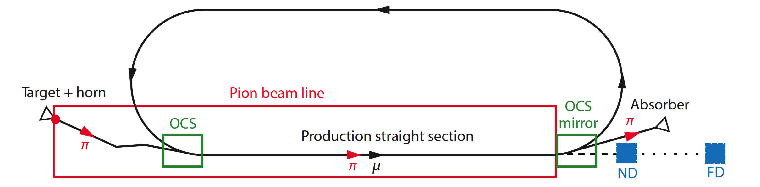
nuSTORM oveview
Fast extraction at >~ 100 GeV
Conventional pion production and capture (horn)
  Quadrupole pion-transport channel to decay ring

Slide 5
Neutrino flux
10.1146/annurev-nucl-102014-021930
ν_{μ} flash:
  Pion: 6.3 × 10¹⁶ m⁻² at 50m
  Kaon: 3.8 × 10¹⁴ m⁻² at 50m
    Well separated from pion neutrinos
ν_{e} and ν_{μ} from muon decay:
  ~10 times as many ν_{e} as, e.g. J-PARC beam
  Flavour composition, energy spectrum
    Use for energy calibration

Slide 6
Why study neutrino interactions?
Future physics at nuSTORM

Slide 7
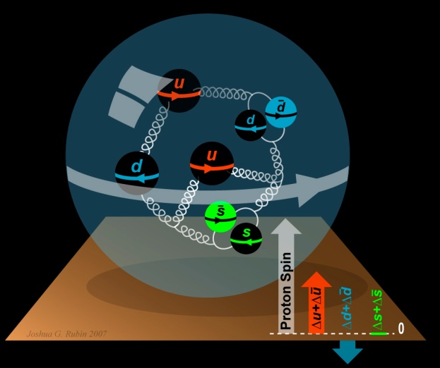

To understand the nucleon and the nucleus
Neutrino unique probe: weak and chiral:
  Sensitive to flavour/isospin and 100% polarised
How could neutrino scattering help?
  Nucleon (e.g.):
    Spin puzzle
  Nucleus (e.g.):
    Multi-nucleon correlations
    Precise determination of:
      Model parameters or, better,
      Theoretical (ab initio) description
Can the neutrino’s unique properties
compete with the rate in, e.g. electron scattering?
  To be studied!
Benefit of nuSTORM:
  Precise flux and energy distribution

Slide 8
Systematic uncertainty and/or bias
Phys.Rev. D89 (2014) no.7, 073015; Coloma et al
Uncertainty
(cross section
and ratio)
Event mis-classification
Energy scale mis-calibration
Phys.Rev. D92 (2015) no.9, 091301; Ankowski et al
Missing energy (neutrons)

Slide 9
Search for CPiV in lbl oscillations
Seek to measure asymmetry:
  P(ν_{μ}➤ν_{e}) – P(ν_{μ}➤ν_{e})
Event rates convolution of:
  Flux, cross sections, detector mass, efficiency, E-scale
    Measurements at %-level required
Lack of knowledge of cross-sections leads to:
  Systematic uncertainties; and
  Biases; pernicious if ν and ν differ

Slide 10
The benefit of nuSTORM
Future physics at nuSTORM

Slide 11
ν_{e}N cross section measurements
Morfin

Slide 12
Systematic uncertainties
Morfin

Slide 13
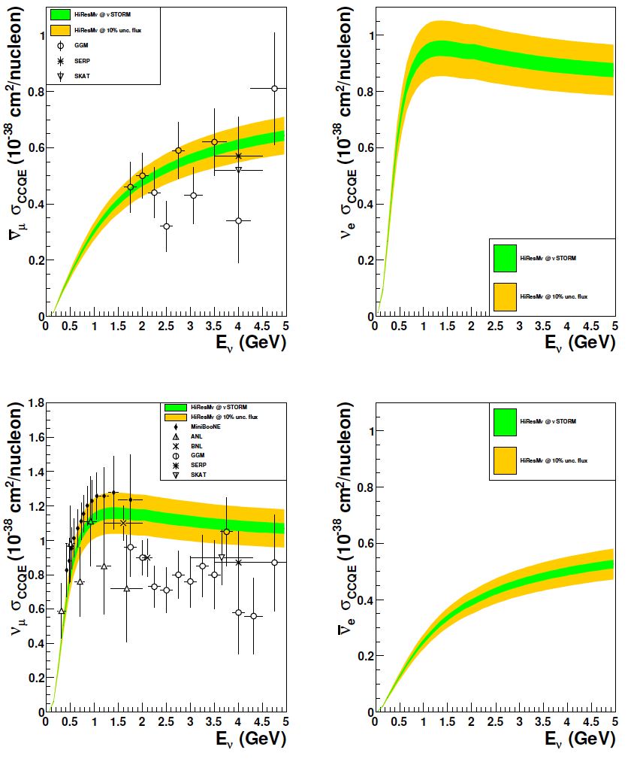
CCQE measurement at nuSTORM
CCQE at nuSTORM:
  Six-fold improvement in systematic uncertainty compared with “state of the art”
  Electron-neutrino cross section measurement unique
Require to demonstrate:
  ~<1% precision on flux
10.1103/PhysRevD.89.071301; arXiv:1305.1419
Individual ν_{e} measurements from T2K and MINERvA
[10.1103/PhysRevLett.113.241803, 10.1103/PhysRevLett.116.081802 ]

Slide 14
nuSTORM
& the CERN Physics Beyond Colliders Study group
Future physics at nuSTORM

Slide 15
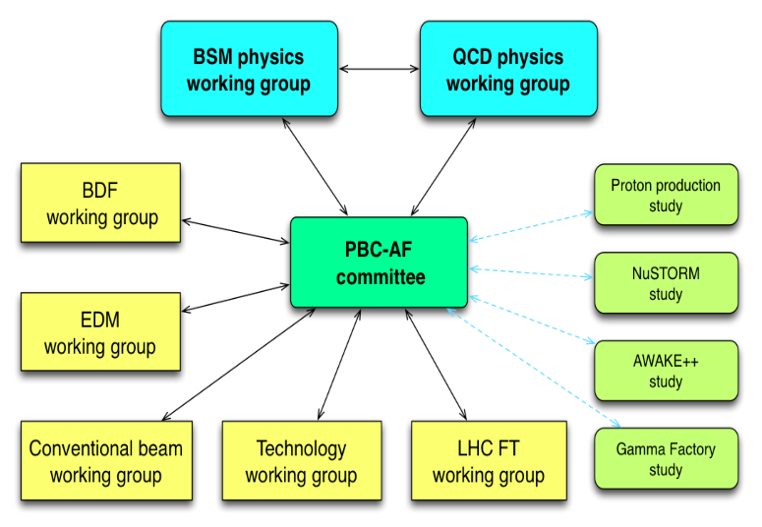
Physics Beyond Colliders study group
http://pbc.web.cern.ch

Slide 16
Elements of study
Physics case:
  Neutrino-scattering for:
    Oscillation
    Nuclear
Specification:
  Energy range:
    Long- and short-baseline neutrino
    Nuclear and particle physics
  Acceptance:
    Rate
    Neutrino-energy calibration
Accelerator:
  Full simulation that demonstrates <~1% flux precision
  Energy range (i.e. sweep down from max)
Implementation:
  Feasibility at CERN (see next slide)
Detector:
  Others are “on this”, so:
    Adopt performance of typical, or assumed, detector

Slide 17
Implementation @ CERN Exploratory study
An initial proposal for siting at CERN, including:
  SPS requirements
  Fast extraction, beam-line
  Target and target complex
  Horn
  Siting
  Civil engineering
  Radio-protection implications

Slide 18
Conclusions
Future physics at nuSTORM

Slide 19
Conclusions
nuSTORM can deliver:
  nN scattering measurements with precision required to:
    Serve the long- and short-baseline neutrino programmes
    Provide a valuable probe for nuclear physics
CERN PBC study: innovative programme:
    nuSTORM:
      Delivers critical measurement: ν_{e}/ν_{μ} N scattering;
      Has discovery potential: sterile neutrinos;
      Potential for 6D ionization-cooling programme to follow MICE
Muon accelerators have the potential to:
  Revolutionise neutrino physics
  Provide multi-TeV lepton-anti-lepton collisions

