Slide 1
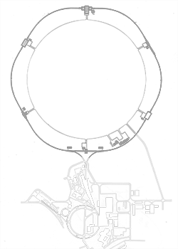


Dilepton Measurements at RHIC
Frank Geurts
Rice University
Erice School 2016
Nuclear Matter under Extreme Conditions –
Relativistic Heavy-Ion Collisions
Sept. 16 - 24, 2016
Notes:
Image credits: BNL

Slide 2
Outline
Motivation
Past
  dielectron spectra and v₂ in Au+Au at √s_{NN} = 200 GeV
Present
  dielectron spectra from U+U and Beam Energy Scan
  recent detector upgrades
Future
  Beam Energy Scan – Phase 2
  proposed detector upgrades
Summary

Slide 3
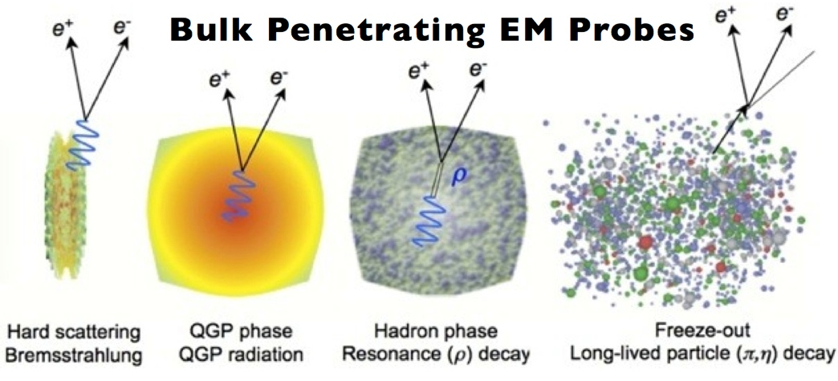
Dilepton Physics
Dileptons are excellent penetrating probes
  very low cross-section with QCD medium
  created throughout evolution of system
courtesy of Stefan Bass
High Mass Range (HMR)
    M_{ee} > 3 GeV/c²
  primordial emission, Drell-Yan
  Heavy quarkonia: J/Ψ and ϒ suppression
Intermediate Mass Range (IMR)
    1.1 < M_{ee}< 3 GeV/c²
  QGP thermal radiation
  semi-leptonic decay of correlated charm: heavy-flavor modification
Low Mass Range (LMR)
    M_{ee}< 1.1 GeV/c²
  in-medium modification of vector mesons
  fireball lifetime measurement
courtesy of Axel Drees

Slide 4
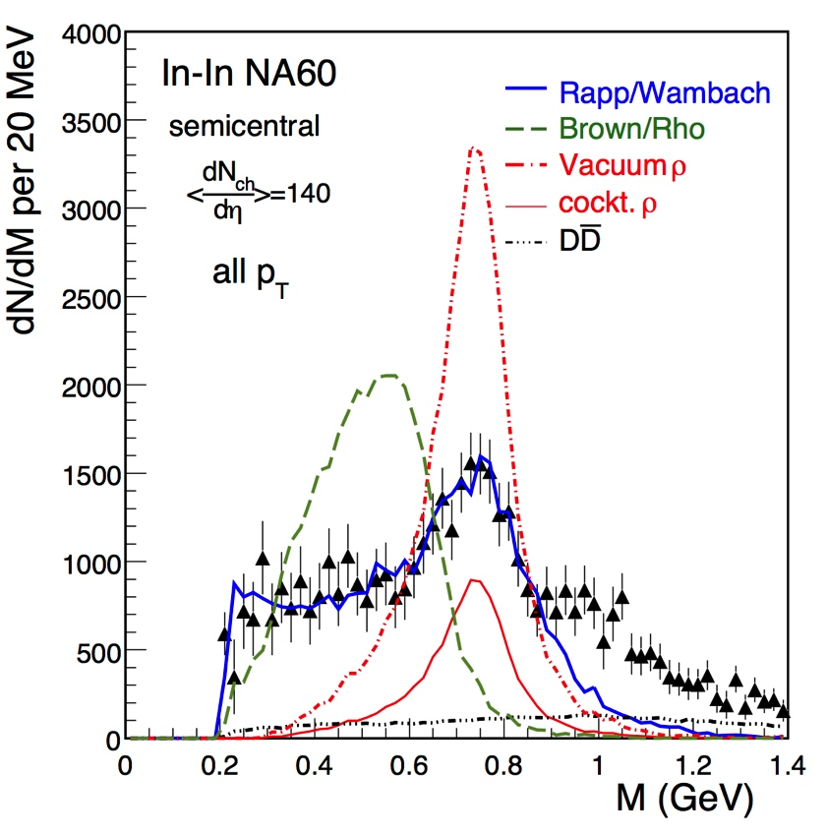
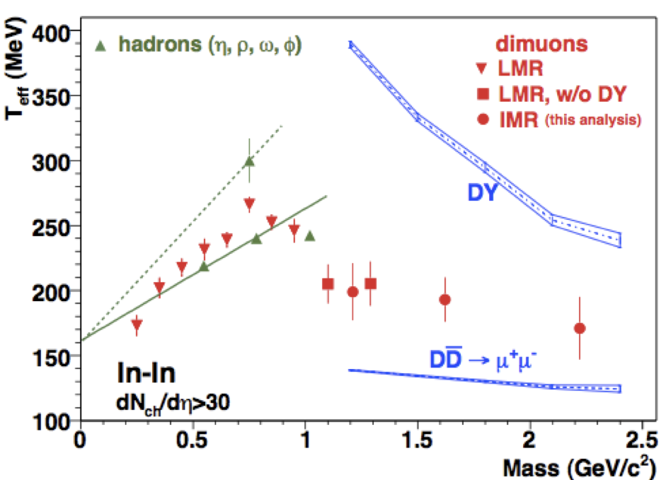
What did we learn from SPS?
PRL 96 (2006) 162302
PRL 100 (2008) 022302
EPJ C61 (2009) 711
NA60, EPJ C 59 (2009) 607
Precise dimuon mass spectrum
favors ρ broadening through interactions with hadronic medium
Inverse slope parameter from m_{T} distributions
IMR: no indication of mass dependence
indicative of thermal radiation from partonic medium, T=205 ± 12 MeV

Slide 5
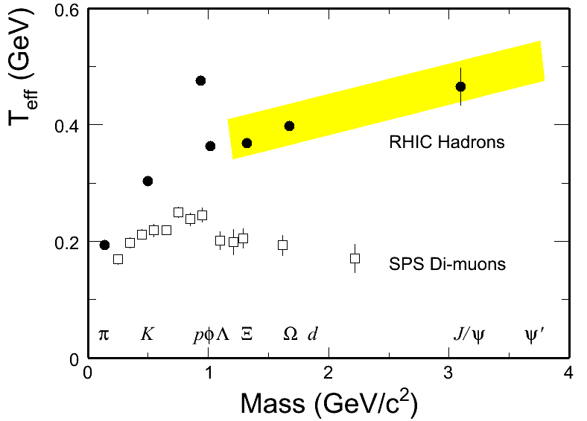
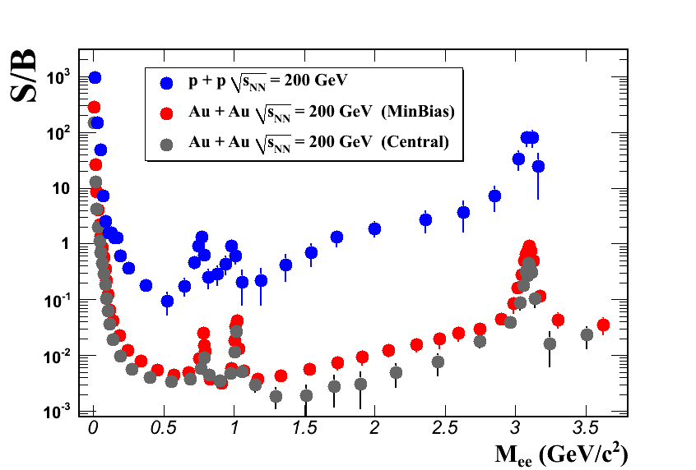
What to expect at RHIC?
Opportunities:
expect significant increase of partonic source contribution
Beam Energy Scan provides unique opportunities to
  systematically study in-medium ρ broadening
  on-set of QGP thermal radiation
Challenges:
increased particle multiplicities at higher √s_{NN} lead to significant increase in combinatorial backgrounds
STAR at 200 GeV for M_{ee}~ 0.5 GeV/c²
  p+p: S/B ~1/10
  Au+Au: S/B ~1/250

Slide 6
Past Measurements at RHIC

Slide 7
Production in Au+Au at 200 GeV
STAR Au+Au @ √s_{NN}=200GeV
Run 10: PRL 113 (2014) 022301; Run 10+11: PRC 92 (2015) 024912
Low Mass Range:
enhancement
  when compared to cocktail (w/o ρ)
  Model calculations with in-medium broadened ρ spectrum function describe LMR excess
Hadron Cocktail excl. ρ
Hadron Cocktail incl. vacuum ρ
Intermediate Mass Range:
  within errors consistent with cocktail
  dominated by correlated charm contributions
  thermal QGP radiation
  modification of charm?
difficult to disentangle
Run-14/16 with STAR’s HFT/MTD upgrades will address this
  R. Rapp, Phys.Rev. C 63 (2001) 054907
O. Linnyk et al., Phys. Rev. C 85 024910 (2012)

Slide 8
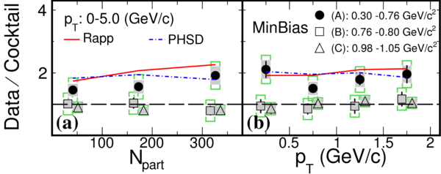
Centrality and p_{T} Dependence
Combined statistics of Run 10 and 11
data/cocktail “enhancement factor”: No strong dependence on centrality or p_{T}
model calculations continue to give a reasonable description
Run 10 only
PRL 113 022301

Slide 9
Low-Mass Excess: Rapp & PHSD
Both models describe NA60 & STAR
agreement w/in uncertainties
vacuum ρ disfavored
low-mass dielectron yield increase ~(N_{part}) ^{α} with α=1.44 ± 0.10
Ralf Rapp (priv. comm.)
  R. Rapp, Phys.Rev. C 63 (2001) 054907
  R. Rapp & J. Wambach, EPJ A 6 (1999) 415
Complete evolution (QGP+HG)
PHSD (Linnyk, priv.comm.)
O. Linnyk et al., Phys. Rev. C 85 024910 (2012)
Collisional broadening & radiation from QGP
PRC 92 (2015) 024912
A: ρ-like 0.30 - 0.76 GeV/c²
B: ω-like 0.76 - 0.80 GeV/c²
C: φ-like 0.98 - 1.05 GeV/c²

Slide 10
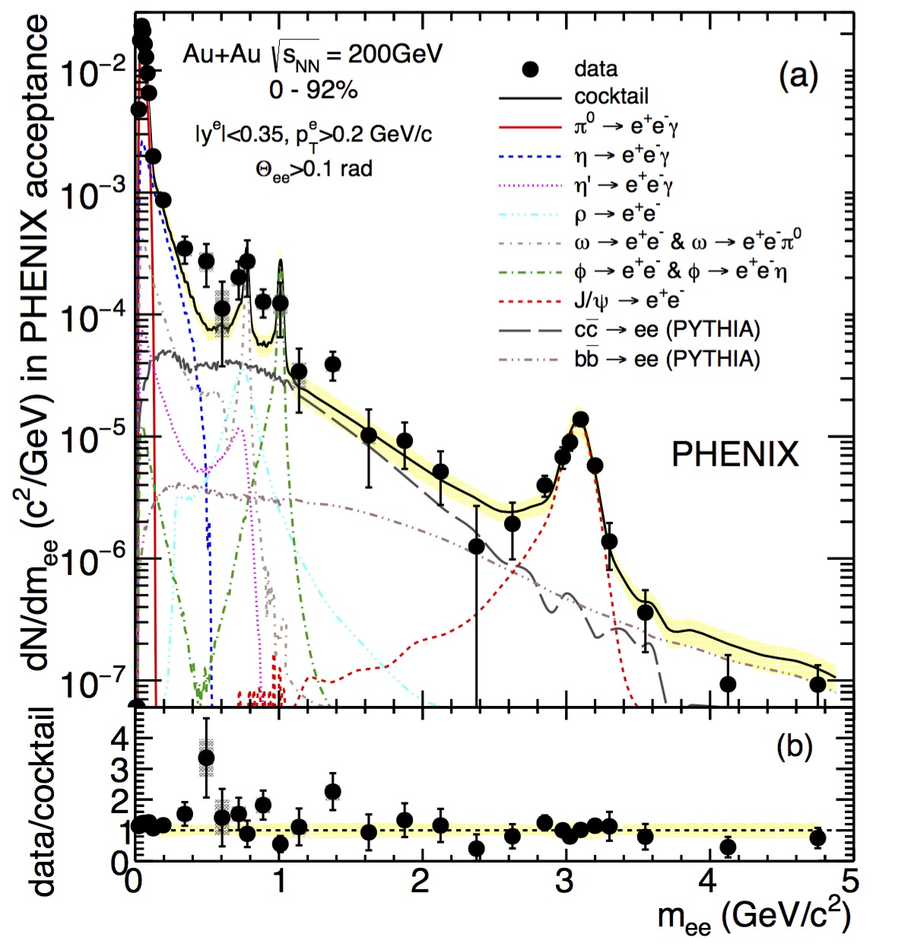
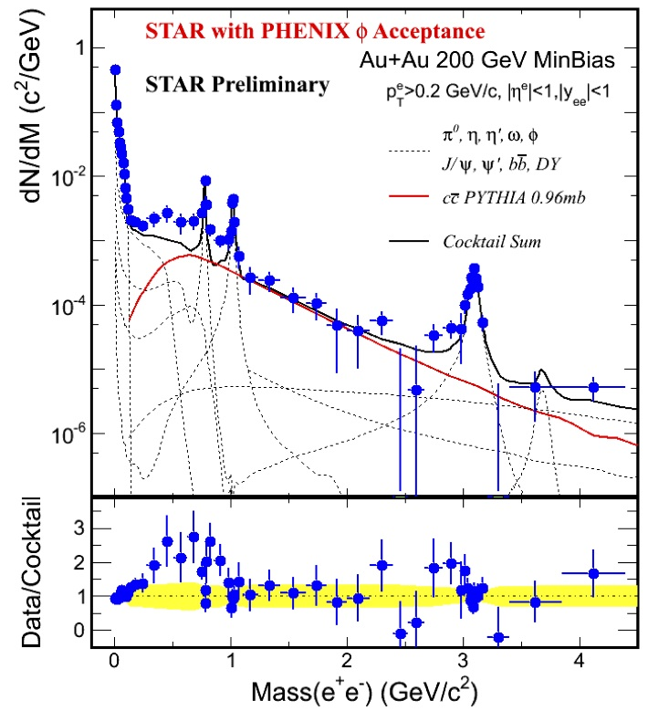
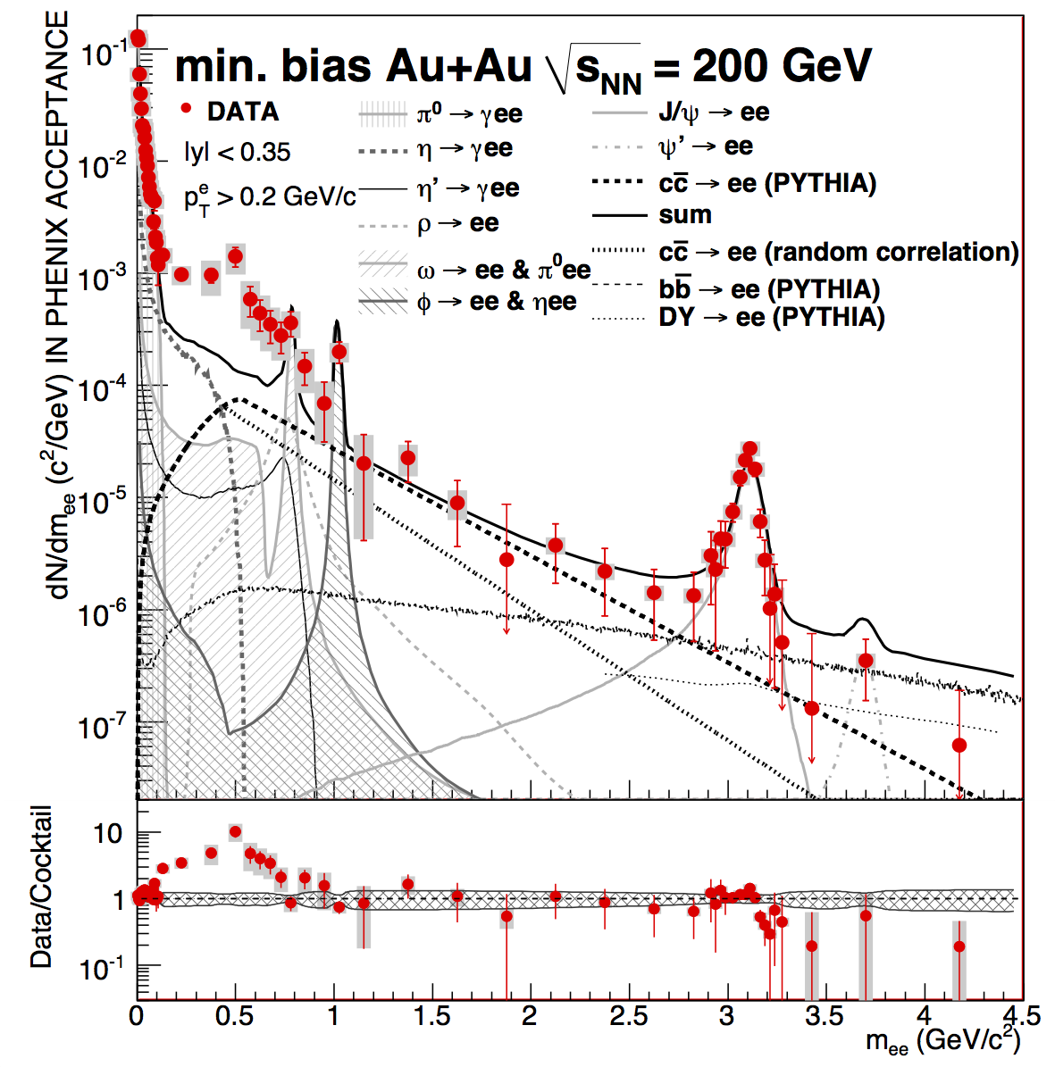
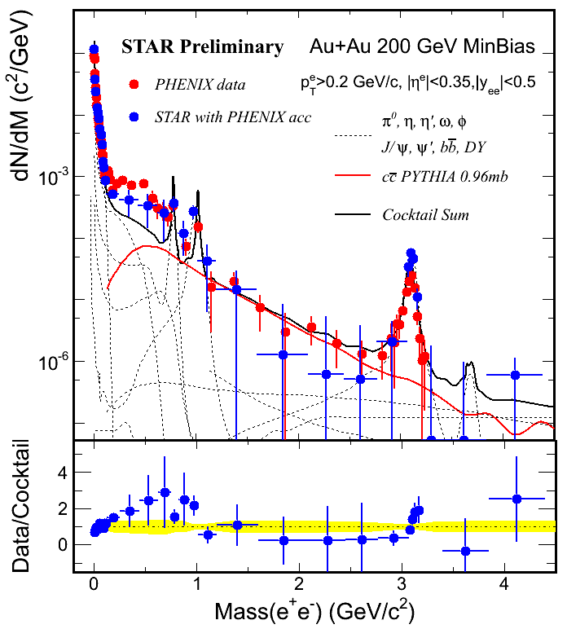
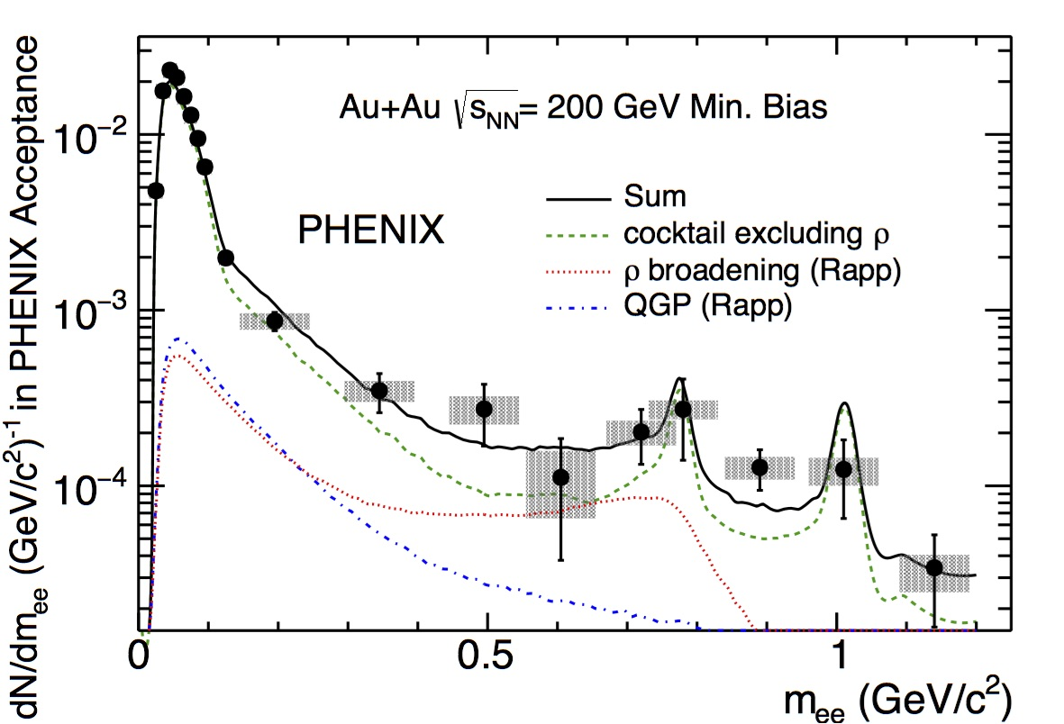
RHIC: PHENIX vs. STAR
PHENIX – PRC 81 (2010) 034911
STAR in PHENIX acceptance
Hard Probes 2012
PHENIX – PRC 93 (2016) 014904
Large quantitative differences in the low-mass , low-p_{T} region
Lot of work in past years: STAR combined Run 10 and 11 data sets
PHENIX Run-10 data with HBD analysis (QM2015)

Slide 11
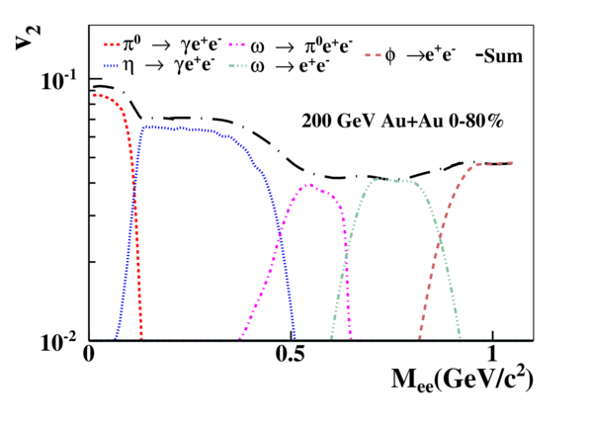
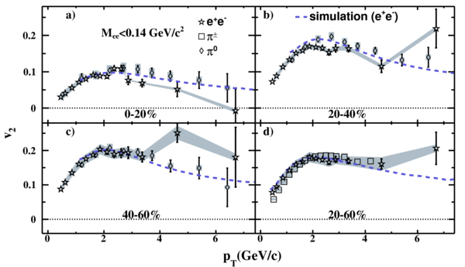
First Measurements of Dielectron v₂
STAR, PRC 90 (2014) 64904
challenge: isolate v₂ of excess dielectrons
cocktail simulations based on published light-hadron v₂ measurements
v₂ from π⁰ Dalitz decay consistent with simulations based on published π v₂

Slide 12
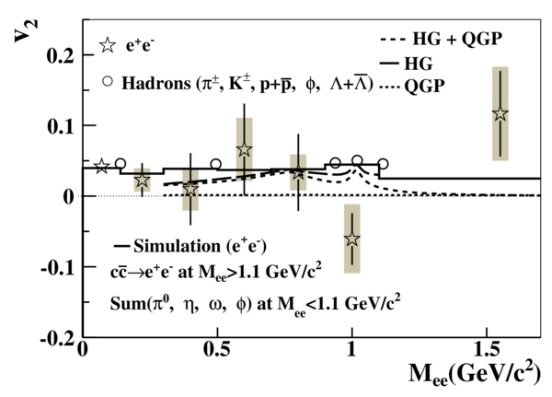
Proof-of-Principle Measurement
PRC 90 (2014) 64904
based on combined Run 10 and 11 data (760M events)
p_{T} integrated v₂ of dielectrons in STAR acceptance
Given the current precision:
dielectron v₂ is consistent with cocktail simulations and measured hadron v₂
Chatterjee et al
PRC 75 (2007) 054909
Vujanovic, et al.,
PRC89 (2014)034904
to distinguish between HG and QGP v2 need uncertainties < 4% …

Slide 13
Recent Measurements at RHIC

Slide 14
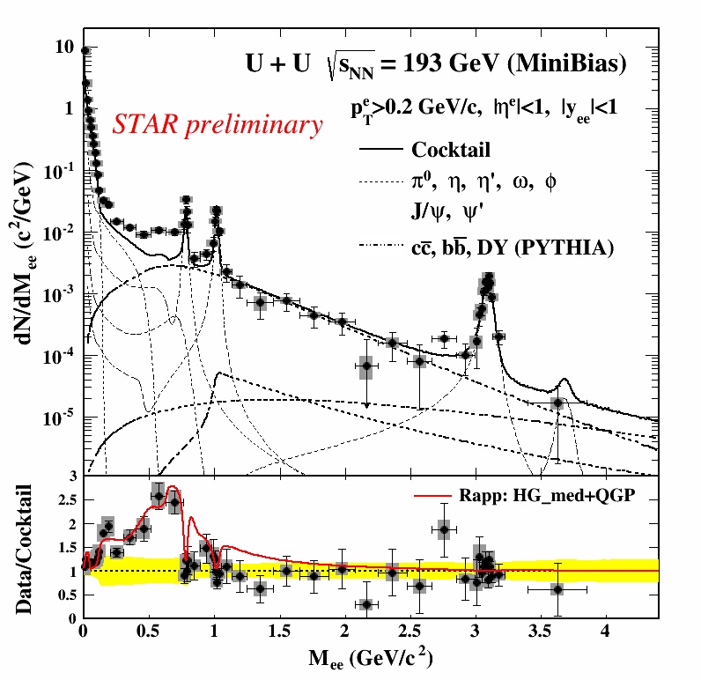
Dielectron Production in U+U at 193GeV
Expect energy density to be higher by 20% than that in Au+Au at 200GeV
    Kikola et al., PRC84 054907 2011
  longer life time of the medium?
  higher excess yields in low mass range?
Significant enhancement w.r.t. cocktail in 𝜌 range
    for 300 < M_{ee} < 760 MeV/c²
  2.1 ± 0.1 (stat) ± 0.2 (syst) ± 0.3 (cocktail)
  significant charm contribution in this range: 48.5%
    𝜎_{cc}=797 μb, 𝜎_{bb}=3.7 μb, 𝜎_{DY}=42nb
  model comparison again show good agreement
  Model simulation:
  R. Rapp – Adv. High energy Phys. (2013) 148253
  Cocktail simulations:
  STAR, PRC 92 (2015) 024912
Shuai Yang, QM2015

Slide 15
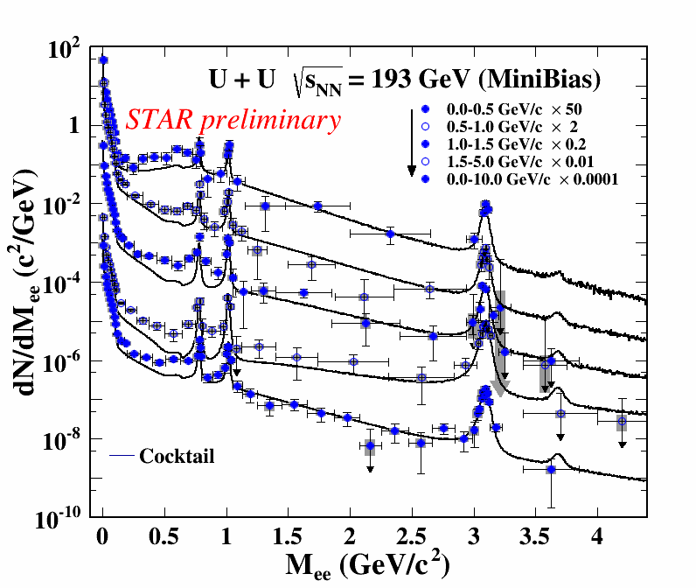
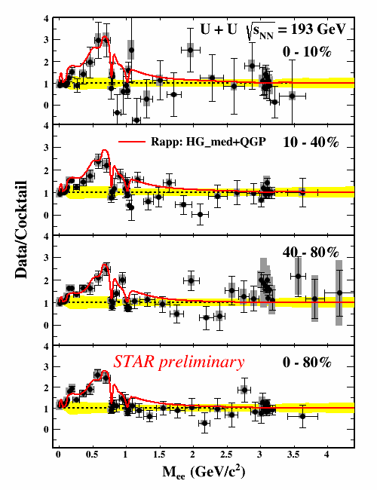
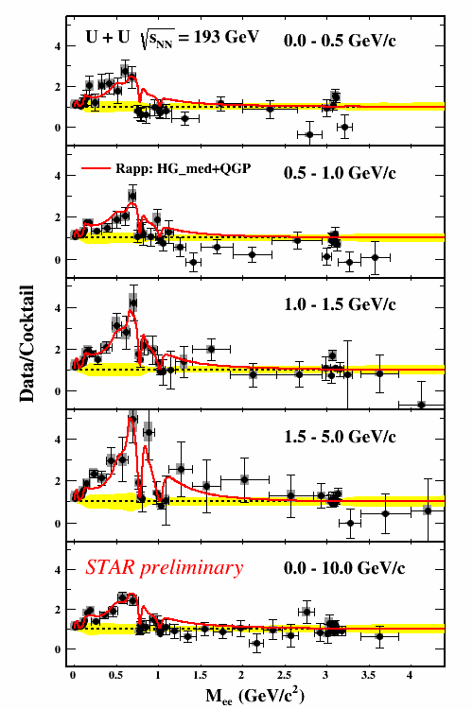
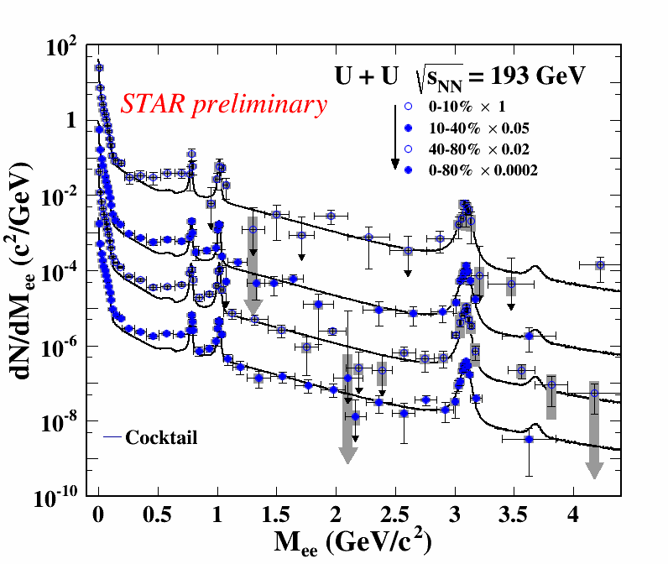
U+U@193GeV: Centrality and p_{T} Differentials
Shuai Yang, QM2015
Model calculation consistently describes low-mass range

Slide 16
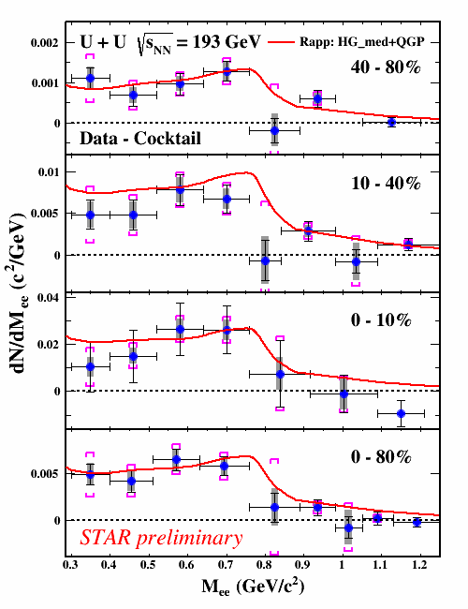
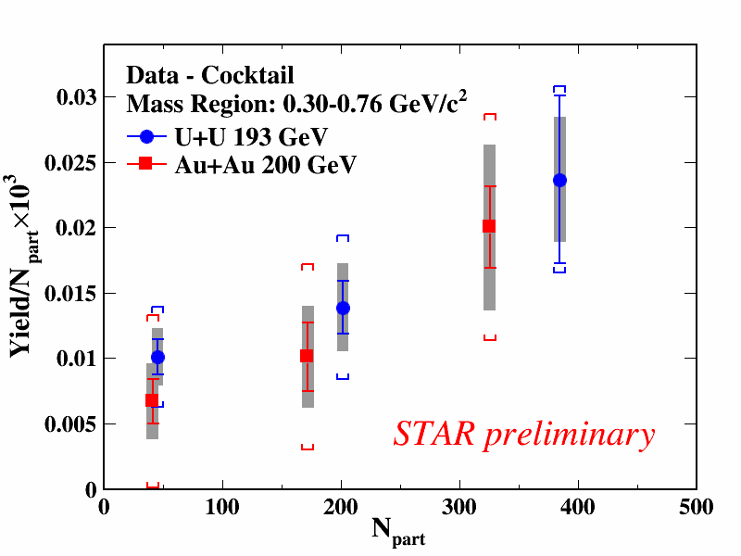
U+U@193GeV: Excess Spectrum
Shuai Yang, QM2015
STAR, PRL 113 (2014) 022301
Observe excess yield in 𝜌-like mass region
  increase faster than N_{part} scaling
  sensitive to medium dynamics?

Slide 17
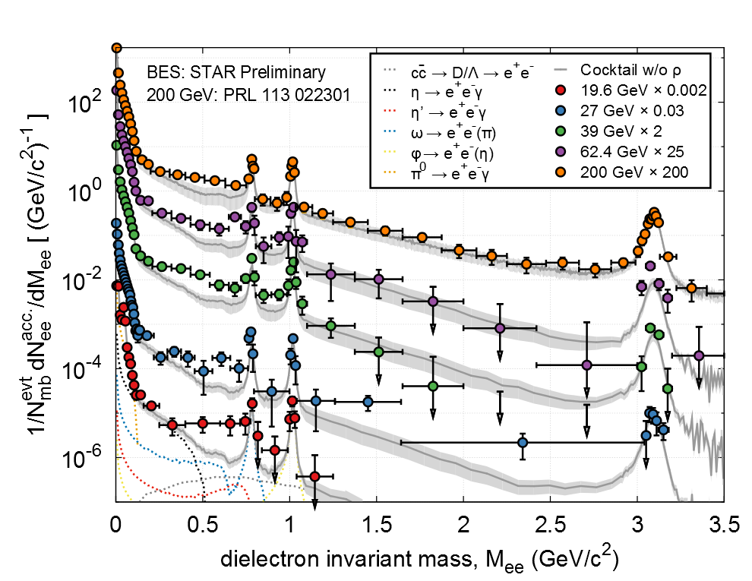
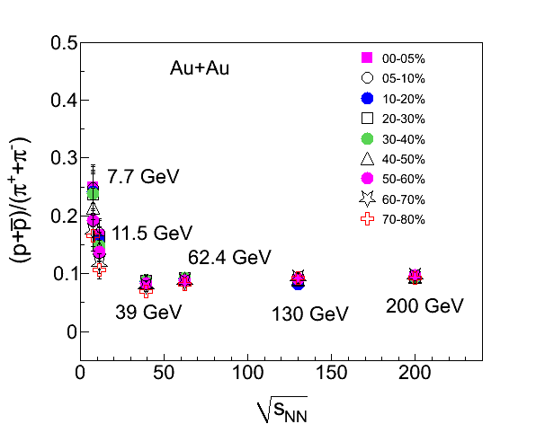
Dielectron Production at Lower √s_{NN}
Observed low-mass enhancement at top RHIC energy
  in-medium modification effects?
  indication of chiral symmetry restoration?
Explore low-mass range down to SPS energies
  change initial conditions, net-baryon density
  ~constant total-baryon density
  possible enhancement, consistent model description?
arXiv:1409.5675
Beam Energy Scan Dielectrons:
  2010 – 2011 Au+Au at
62.4, 39, 27, and 19.6 GeV

Slide 18
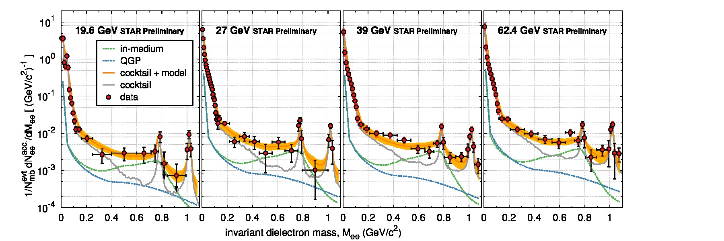
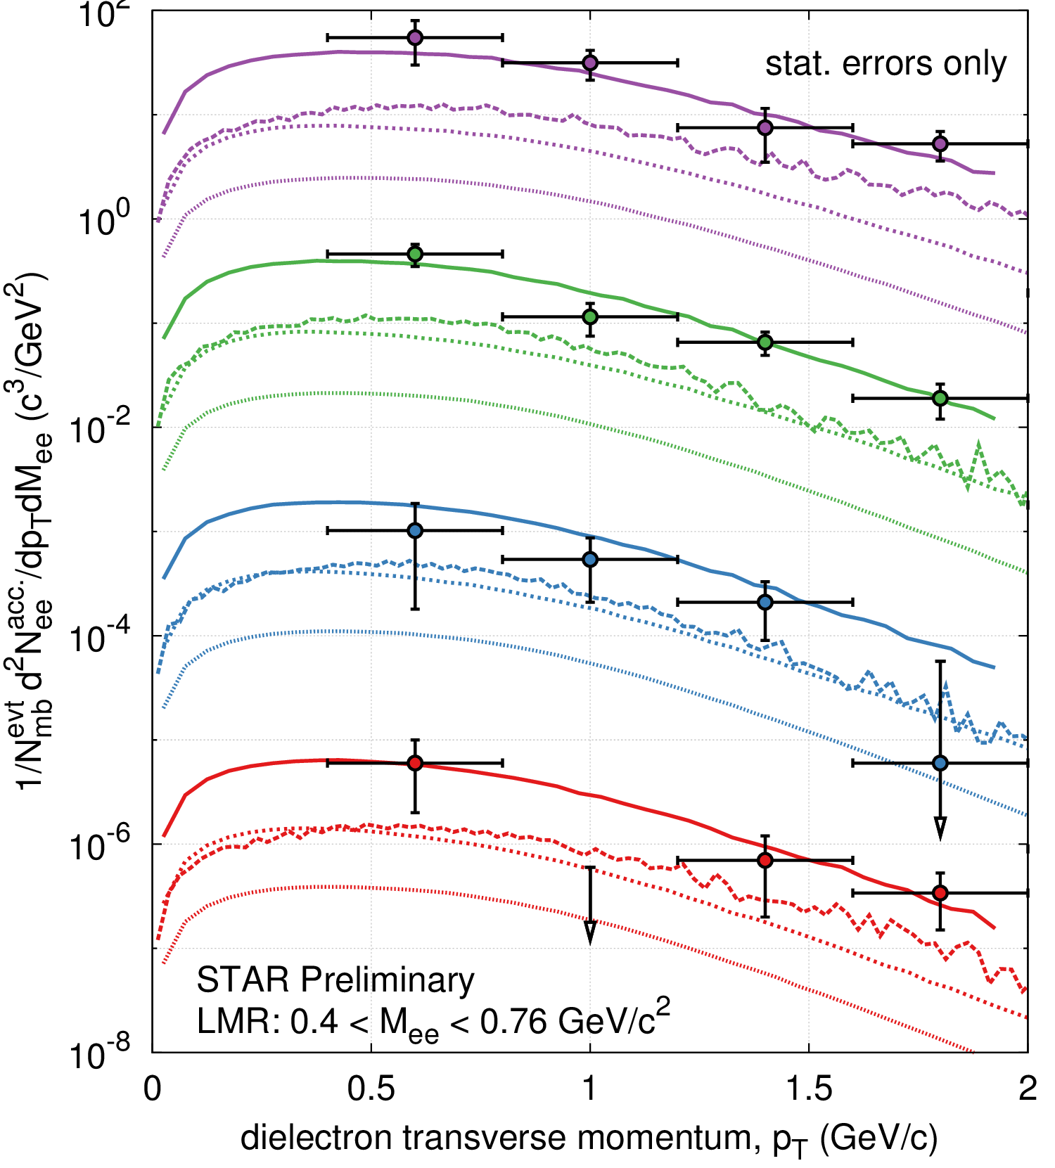
Compare to Theory: In-Medium ρ
Butterworth, TPD’14
Sustained low-mass excess radiation
  top RHIC down to SPS energies
Robust theoretical description
  black dotted curve: cocktail + in-medium ρ (Rapp)
Consistent with in-medium ρ broadening
  expected to depend on total baryon density
Hohler & Rapp: “Is ρ-meson melting compatible with chiral restoration? ”
arXiv:1409.5675
Notes:
For 19.6GeV – model calculations: Tinit=224MeV tau0=0.33fm/c

Slide 19
A Phenomenological Approach
Experiment: Strong evidence ρ meson “melts”
Input
  vector SF (ρ meson) from phenomenological model, verified against experimental data
  T dependence of the condensate: from lQCD
QCD sum rules
  constrain vector/axial-vector SFs individually
Weinberg sum rules
  difference between vector & axial-vector SFs
Output …
Quantatively compatible with (approach to ) chiral restoration
Hohler, Rapp
PLB 731 (2014) 103
But, still need microscopic calculations of a₁(1260) … (Massive Yang-Mills)

Slide 20
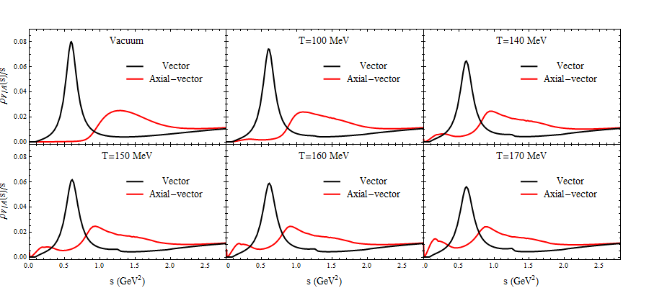
Effective Chiral Langrangian
Gauge ρ and a₁ into chiral pion Lagrangian
Massive Yang-Mills in hot pion gas
  starting point for evaluation of chiral restoration in medium
Hohler, Rapp,
Annals Phys 368 (2016) 70
Supports “burning” of chiral-mass splitting as a mechanism for chiral restoration
  as in sum rule analysis

Slide 21
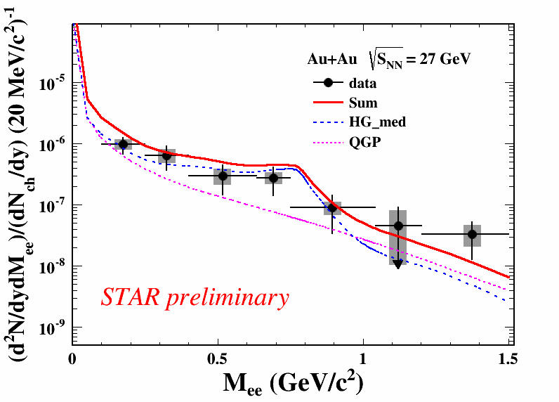
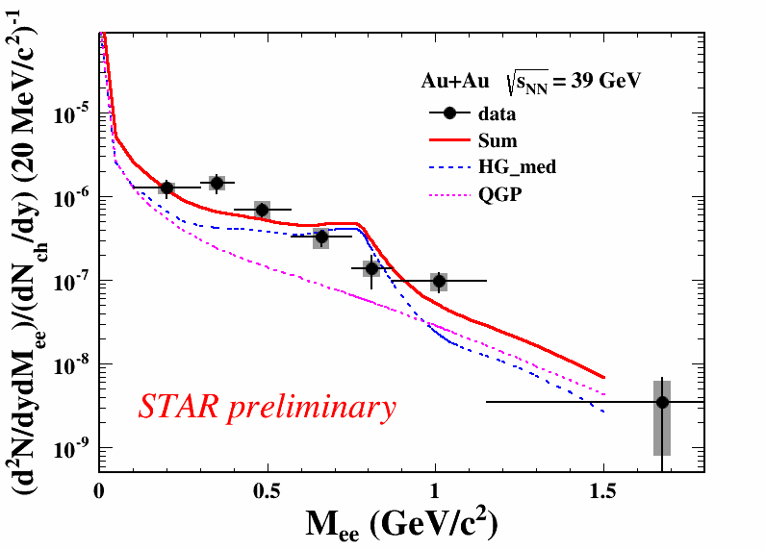
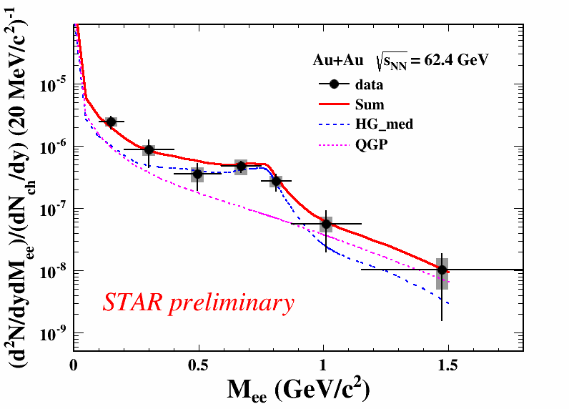
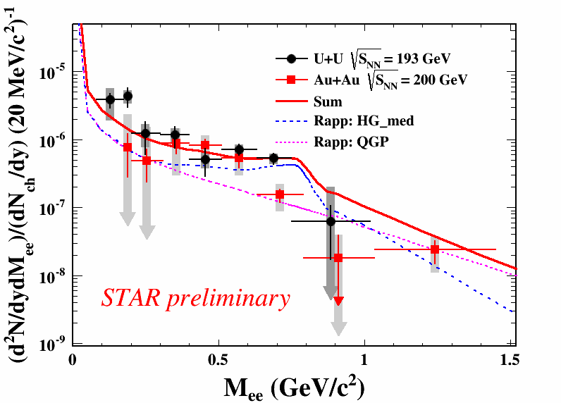
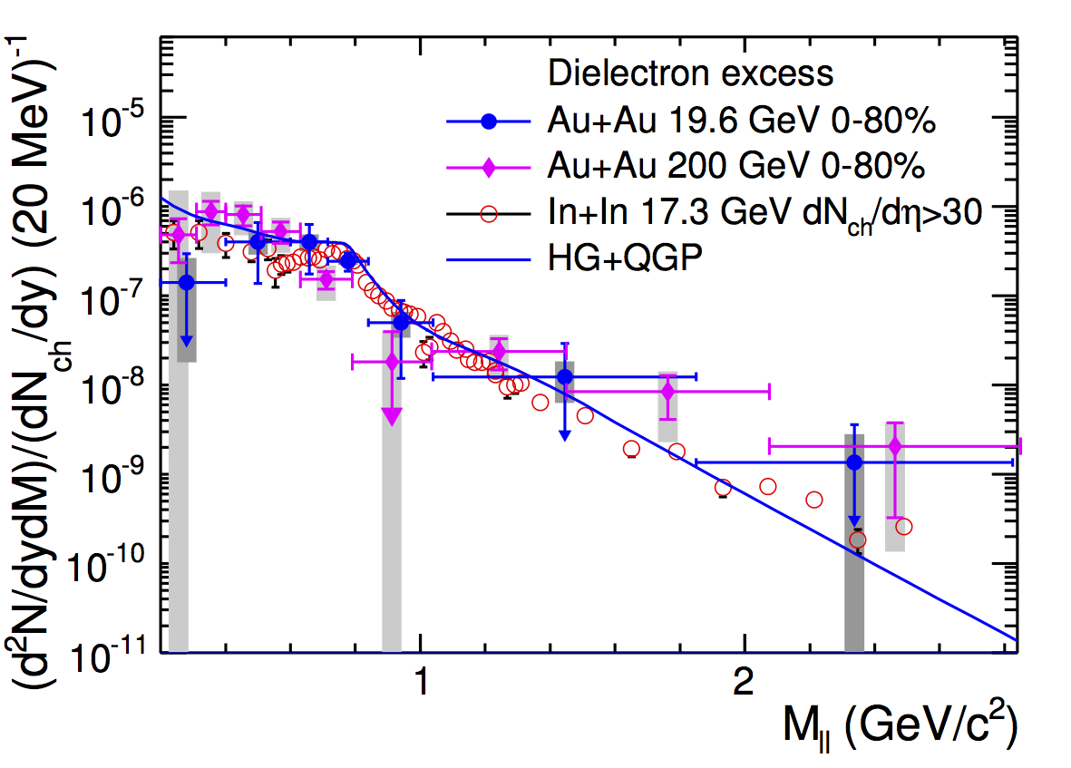
Acceptance Corrected Excess Spectra
STAR-acceptance corrected excess spectra
Au+Au at 19.6 and 200 GeV
normalized to (dN_{ch}/dy)_{y=0} to cancel out volume effects
17.3 GeV (NA60) and 19.6 GeV consisten
Acceptance-corrected spectra for BES energies at 27, 39, and 62 GeV, as well as U+U at 193 GeV
Shuai Yang, QM 2015
STAR, PLB 750 (2015) 64
Acceptance-corrected excess mass spectra well described by broadened 𝜌 SF

Slide 22
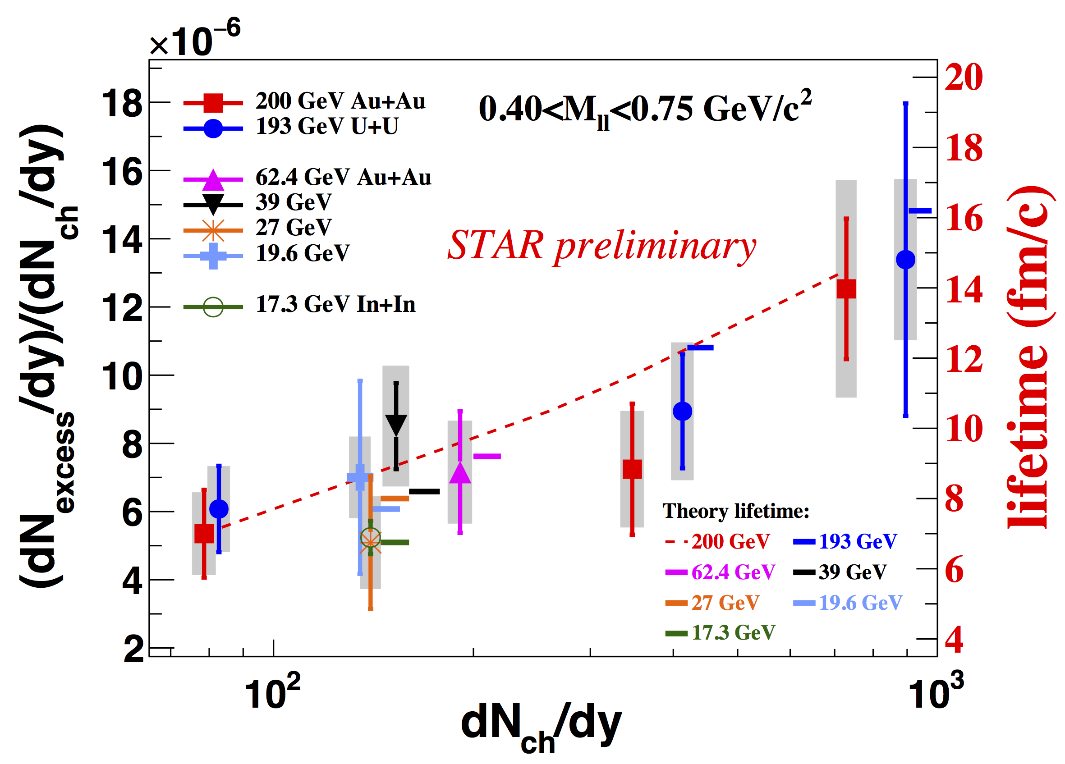
Excess Yields and Medium Lifetimes
Normalized excess yields in LMR proportional to medium life time (QGP+HG) for √s_{NN}=17.3–200 GeV
  nearly constant total baryon density
  emission rates dominated around T_{C}
Yields in U+U@193GeV and Au+Au@200GeV
  higher yields in central than in lower energies
  observe increase from peripheral to central
Indications of longer medium lifetime in central UU@193GeV and central AuAu@200GeV

Slide 23
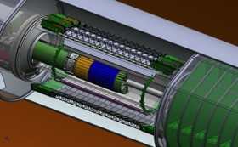
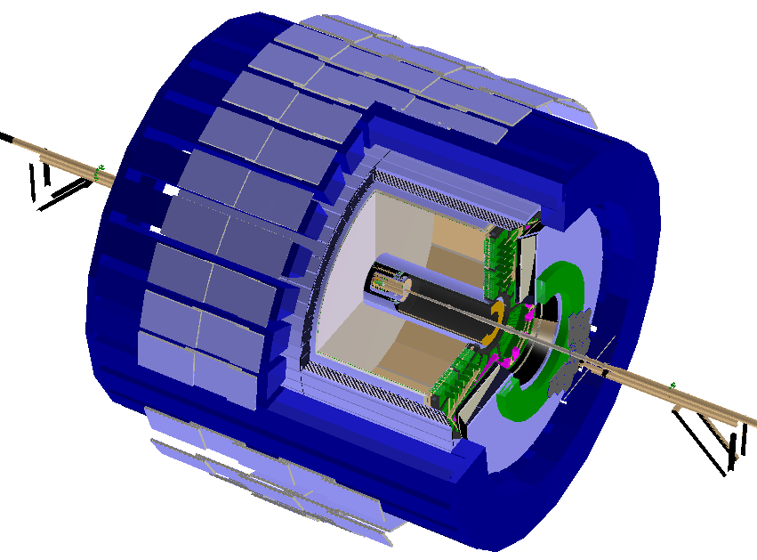
RHIC Program 2014-2016: Heavy Flavors
Heavy Flavor Tracker
RHIC upgrades
  fully implemented stochastic cooling
STAR upgrades
  Heavy Flavor Tracker
  Muon Telescope Detector
    dedicated muon triggers: e.g. e-muon
2014: Au+Au statistics
  200 GeV: 1.2B events
  14.6 GeV: 20M events
2015: p+p, p+Au, p+Al
2016: Au+Au
  200 GeV: 1.5B min-bias events
Muon Telescope Detector

Slide 24
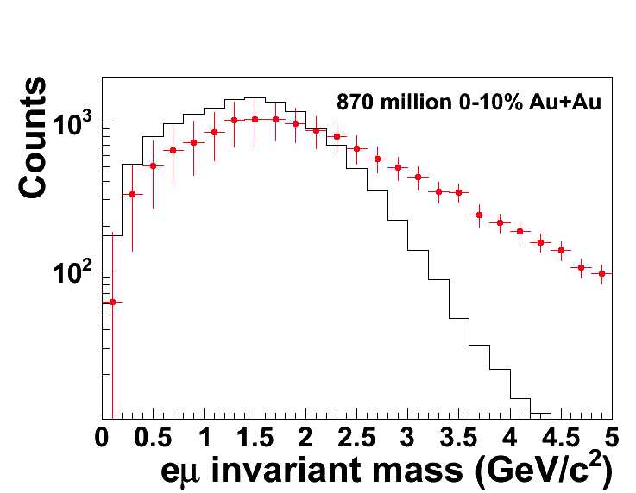
MTD Dilepton Physics
Significant charm contribution spanning low and intermediate-mass range
  also relevant in LMR at high energies
  distinguish thermal and charm production
  use e-μ correlation to get a handle on charm contributions
Dimuon continuum:
  LMR: vector meson in-medium modifications
  IMR: radiation from QGP
  dimuon elliptic flow
PRL 113 022301
MTD Simulations
red: PYTHIA ccbar-> eμ
black: de-correlated + energy loss
S/B >2 for M(eμ)>3GeV/c²

Slide 25
Future Measurements at RHIC

Slide 26
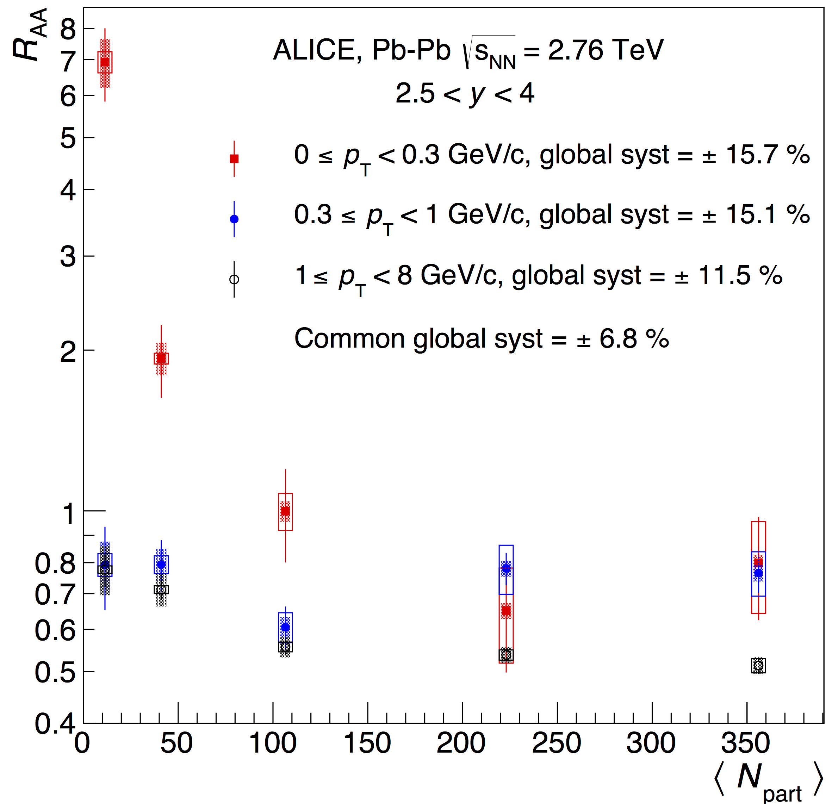
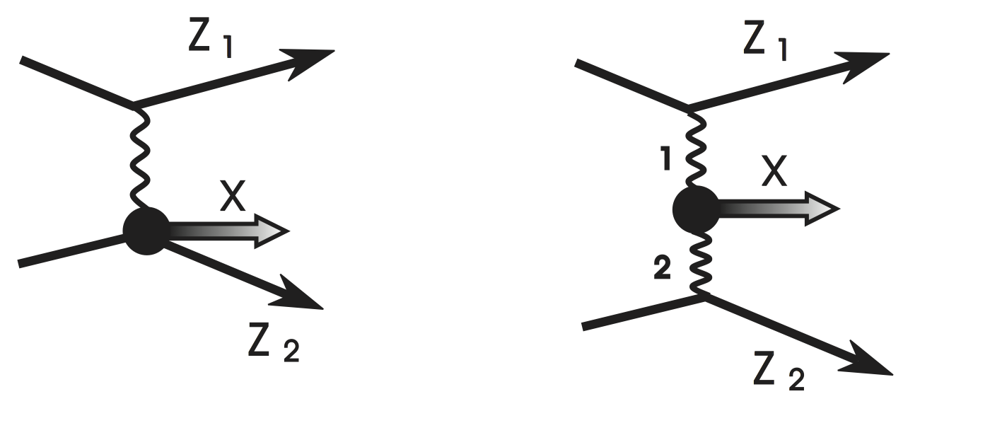
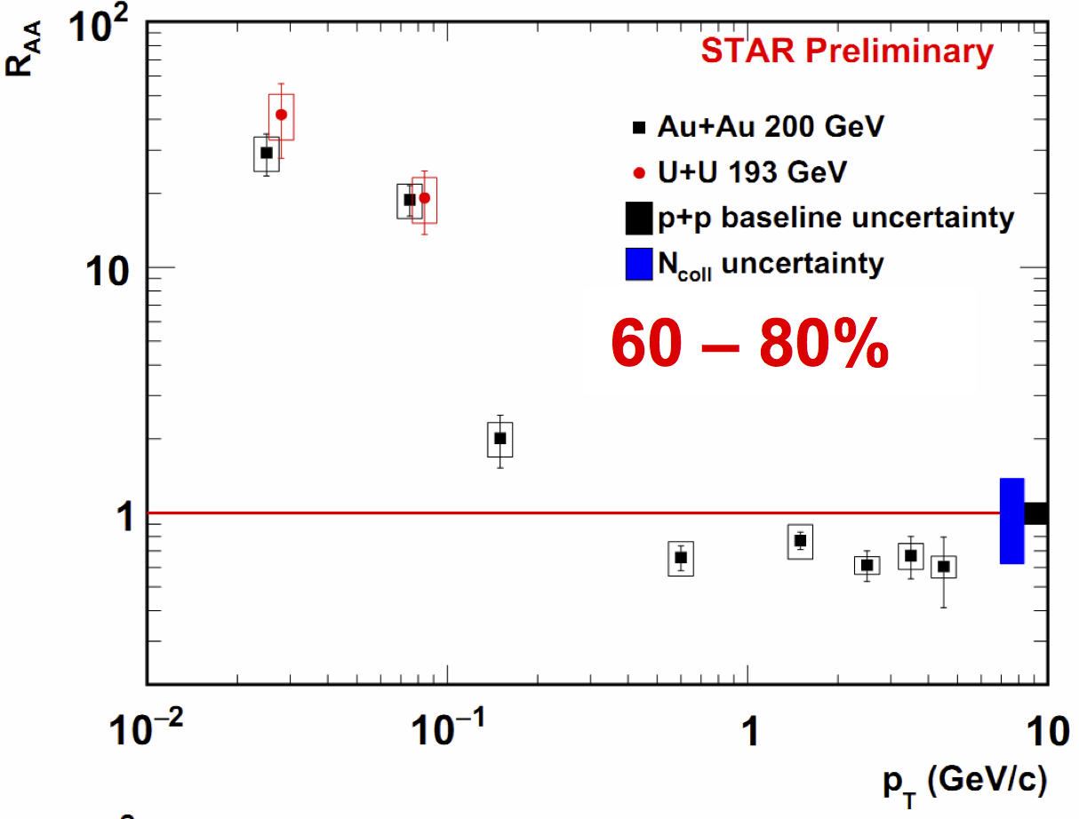
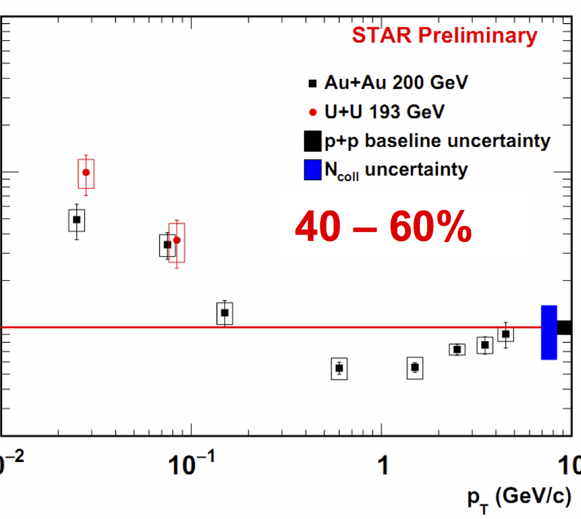
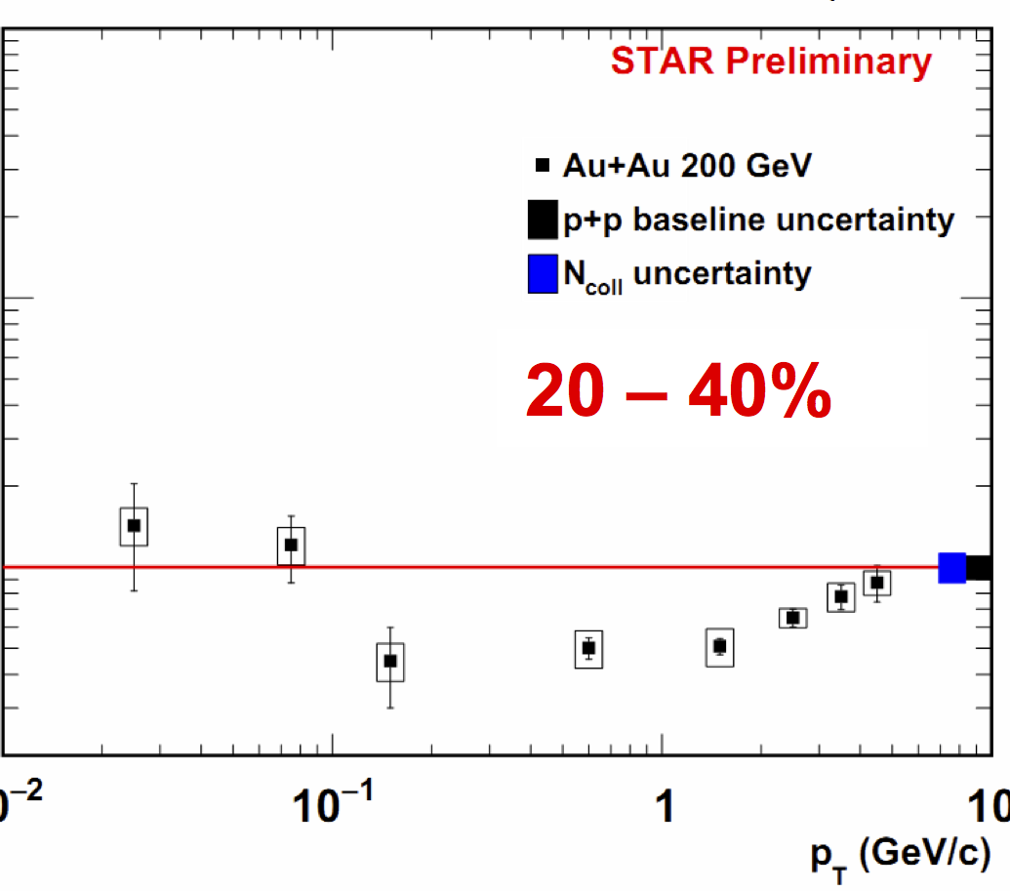
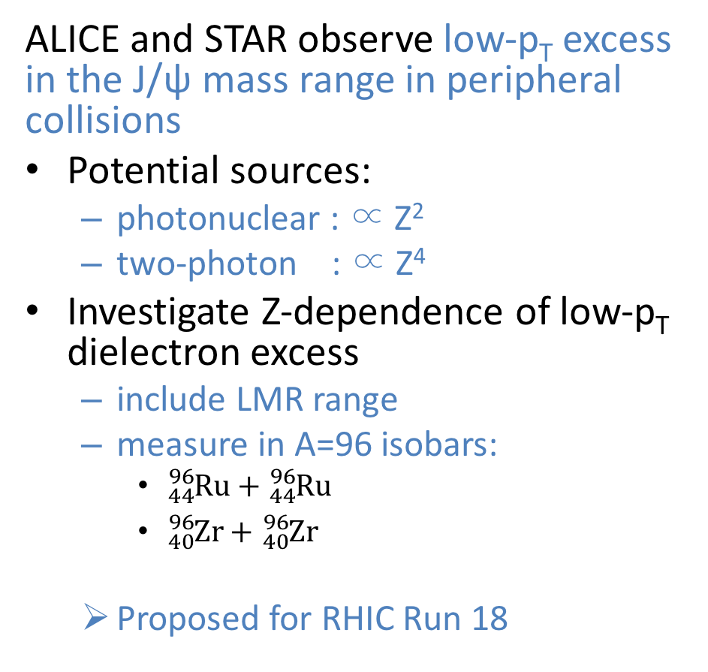
Near Future Opportunities:
Dielectron Production in Isobaric Collisions
ALICE and STAR observe low-p_{T} excess in the J/ψ mass range in peripheral collisions
Potential sources:
  photonuclear : ∝ Z²
  two-photon : ∝ Z⁴
Investigate Z-dependence of low-p_{T} dielectron excess
  include LMR range
  measure in A=96 isobars:
    ${}_{44}^{96}{\text{Ru}}+{}_{44}^{96}{\text{Ru}}$
    ${}_{40}^{96}{\text{Zr}}+{}_{40}^{96}{\text{Zr}}$
  Proposed for RHIC Run 18
ALICE – PRL 116 (2016) 222301
Bertulani, Klein, Nystrand,
Ann.Rev.Nucl.Part.Sci. 55 (2005) 271
Wangmei Zha, SQM 2016

Slide 27
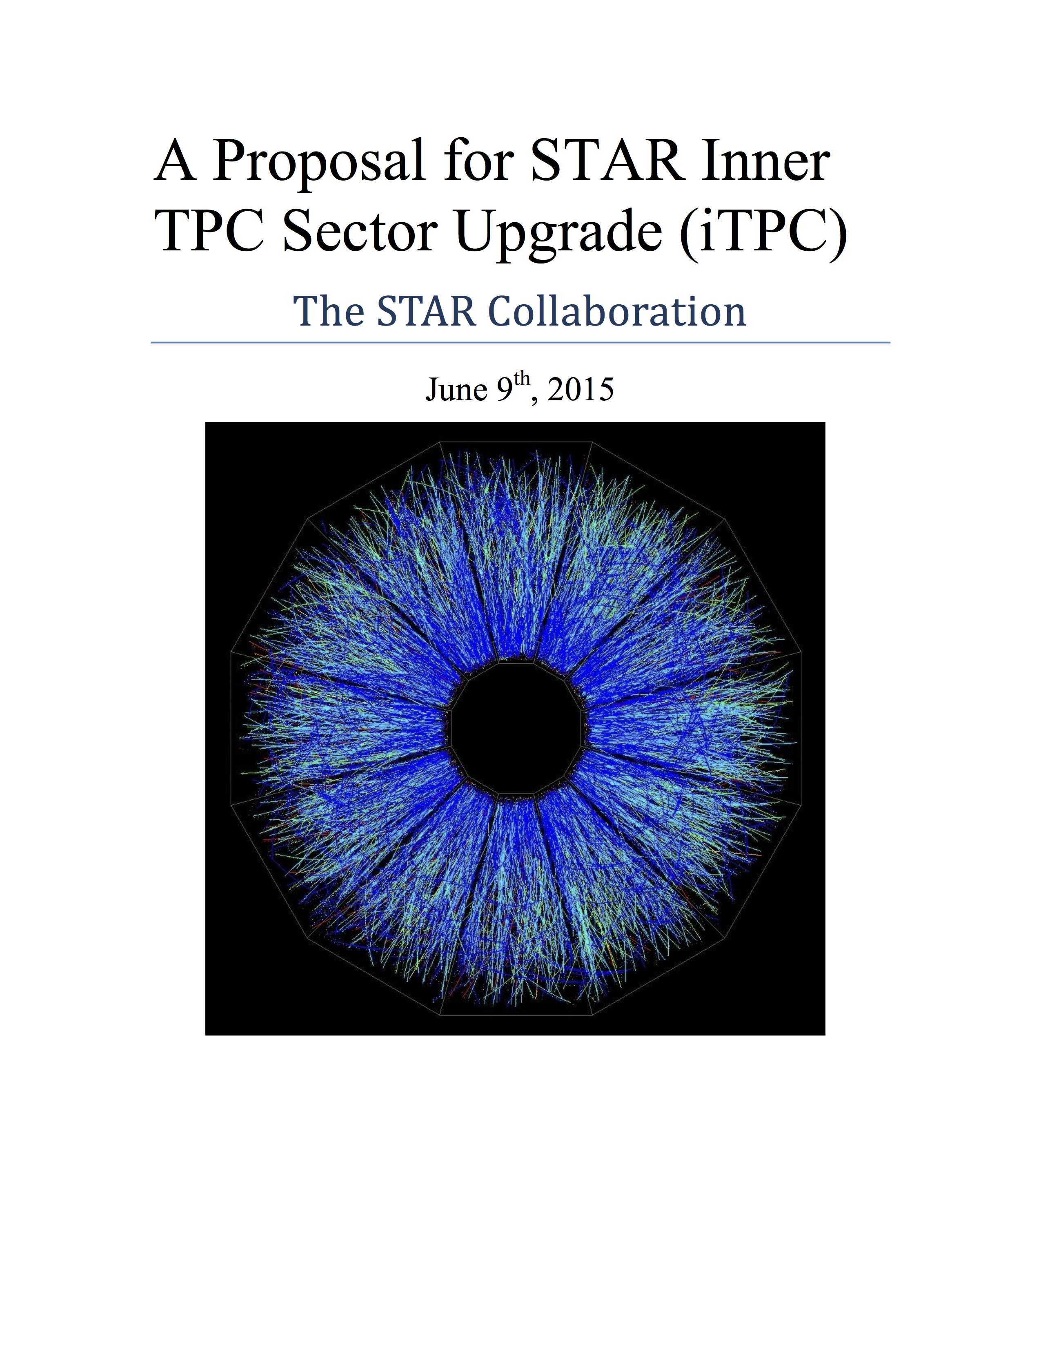
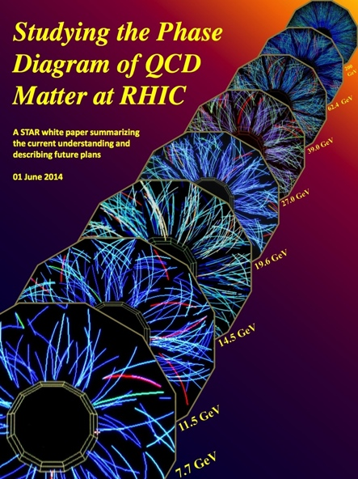
RHIC Beam Energy Scan: Phase-2
  Broader Context:
  Refine our understanding of phase structures of QCD matter
  Phase 2: 2019 – 2020
    revisit lower energies
    improve statistics
STAR White Papers
  Systematically study dielectron continuum from √s_{NN} = 7.7 – 19.6 GeV

Slide 28
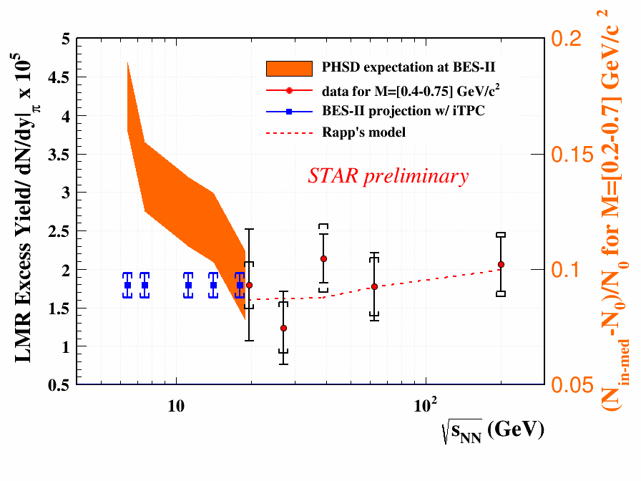
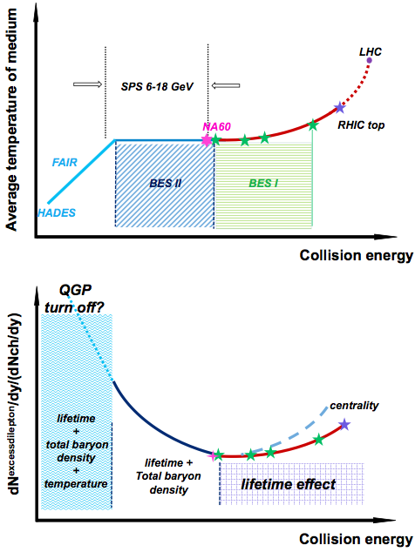
BES-2 Dileptons: 2019-2020
STAR Note 619
BES Phase 1: 19.6 – 200 GeV
Dilepton emission dominant in T_{C} region and constant baryon density
emission proportional to lifetime
BES Phase 2: 7.7 – 19.6 GeV
Probe life time + baryon density dependence of the ρ-meson spectral function
Close to CP, expect increase in correlation lengths …
… critical slow-down?
Look for anomalous increase in the lifetime of the fireball
Down to FAIR energies
  CBM, HADES
probe lifetime, total baryon density, and temperature dependence
At SPS: proposed NA60+
overlap with RHIC and FAIR
Ruan, Rapp – TPD’14

Slide 29
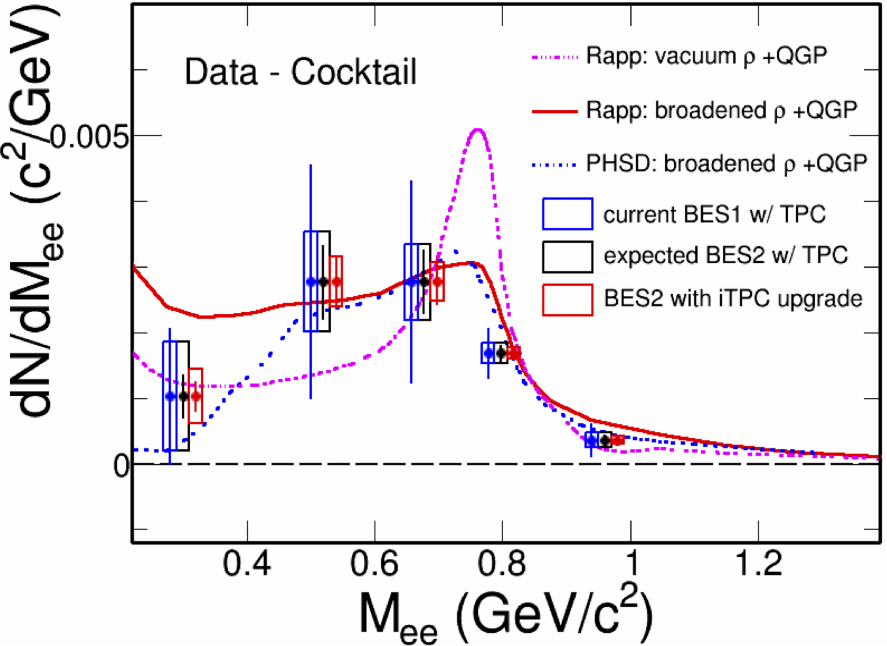
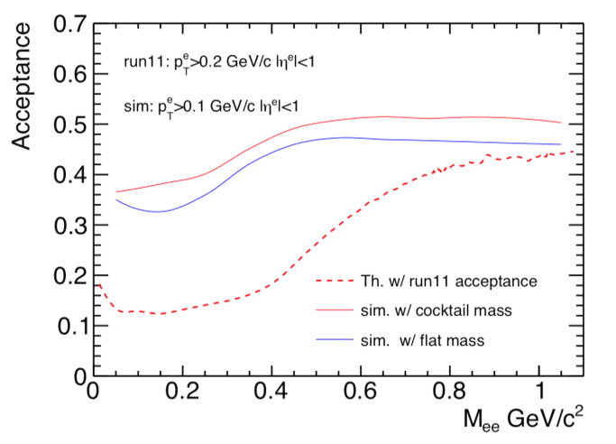
Detector Upgrades Towards BES 2 :: iTPC
STAR proposes upgrade of the inner sectors of its TPC
increase in rapidity coverage
p_{T} thresholds lowered
dE/dx (PID) resolution improved
Substantial improvement in purity of electron sample
  reduction of hadron contamination in dielectron
dielectrons dominated by systematics
expect to reduce by 2x
STAR Note 619
Expected dielectron excess spectrum in 19.6 GeV in BES-II with and without iTPC upgrade

Slide 30
Detector Upgrades Towards BES 2 :: eTOF
STAR proposes CBM TOF installation
to be mounted on east poletip
increase PID rapidity coverage
  take advantage of large iTPC coverage
Dielectron measurements:
include rapidity differential
LMR excess expected to depend on total baryon density
π yields drop by a factor of two from y=0 to y=1.2 →“baryon density” drops by factor of two.
analysis at y=1.2 is equivalent to lowering the beam energy

Slide 31
Summary
At SPS, NA60 and CERES demonstrated the physics potential of accurate dilepton measurements
At RHIC, PHENIX & STAR both developed a strong dilepton program
  BES phase-1 program allowed for a continued systematic measurement from top RHIC down to top SPS energies
At the same time, important progress thermal field theory computations of dilepton production in heavy-ion collisions
Detector upgrades improve and/or enable new detection capabilities
  2014-2016: high statistics A+A, p+p, and p+A
  dilepton program: revisit top energies, disentangle charm, dimuon continuum.
BES Phase 2 (2019-2020): systematic dilepton measurements down to √s_{NN}=7.7GeV
  measure baryon density dependence
  measure p_{T} slopes both in LMR and IMR
  look for anomalous increases in yield, suggestive of a critical point
  STAR proposed two detector upgrades: help improve/expand its dielectron measurements

Slide 32
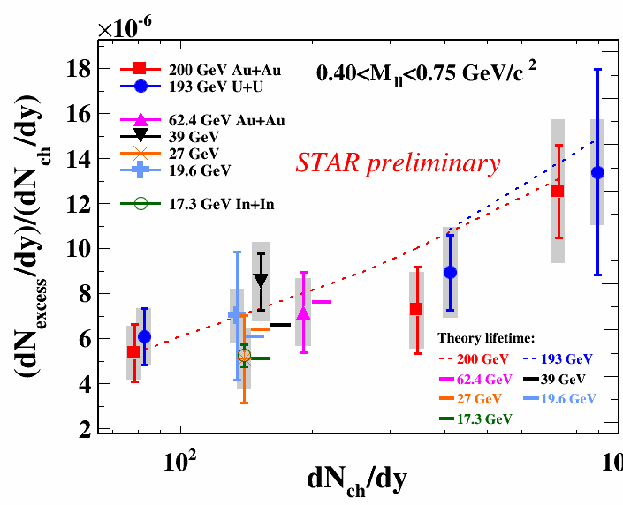
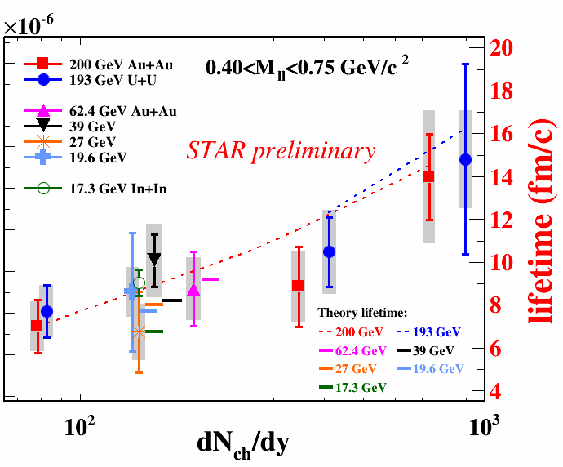
In+In@17.3 GeV
NA60, Eur. Phys. J. C 59 (2009) 607
In+In@17.3 GeV
NA60, AIP Conf. Proc. 1322 (2010) 1
AuAu@200 GeV, 19.6 GeV
STAR, PLB 750 (2015) 64

Slide 33
RHIC Run 18 Isobar Dielectron Measurements
source: STAR Note 657
RHIC Beam Use Request For Runs 17 and 18
https://drupal.star.bnl.gov/STAR/starnotes/public/sn0657

