Slide 1
The early eighties: predictions of QCD phase structure
1. two different phase transitions:
Svetitsky&Yaffe: F.O.P.T. in pure gauge YM theory:
“glueplasma – GlueBall fluid” – no quarks!
Pisarski&Wilczek: chiral massless quarks
F.O.PT QGP-Hadrons, but crossing if quark mass nonzero
2. - two chemical saturation eq. timescales in RHICs:
Raha/Sinha; Shuryak; T. Biro, B. Mueller, X.Y. Wang Transport Theory
Fast chemical saturation: pure glue! But Slow saturation: quarks !
Search for pure gauge YM F.O.P.T. at early times in colliders?
=> Early pp, pA: Glue <=> GlueBall: new QCD phase structure?

Slide 2
Acknowledgements
Transport: Zhou, Seizel, Xu, Zhuang, C. Greiner...
Early phase e-m probes: Raha, Sinha, Gorenstein, Vovchenko, Satarov, Mishustin, A. Srivastava, Csernai ...
Lattice: Fodor, Borsanyi, Panero, Karsch, Philipsen...
GlueBall-Hydro YM vs. QCD: Niemi, Pang, Vovchenko…

Slide 3
Lattice QCD
vs.
Lattice YM:
… just GlueBalls and glue?

Slide 4
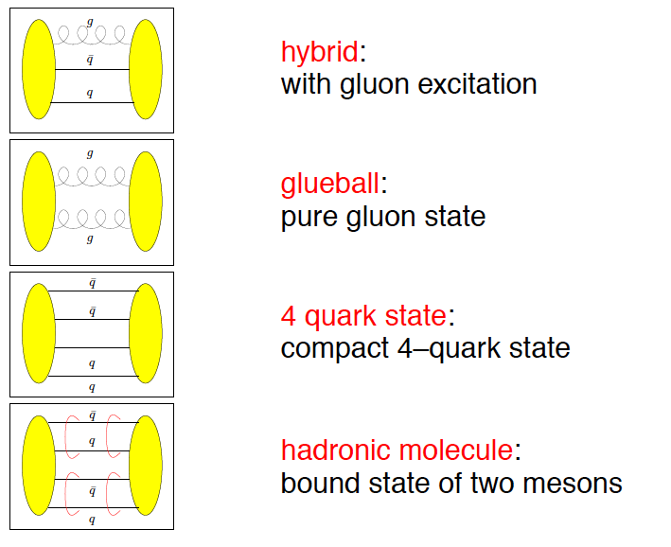
Beyond standard quark configurations
QCD allows much more than what we have observed:
Exotica
Baryons
Mesons
may have J^{PC} not allowed for qq
_
Courtesy C. Hanhart

Slide 5
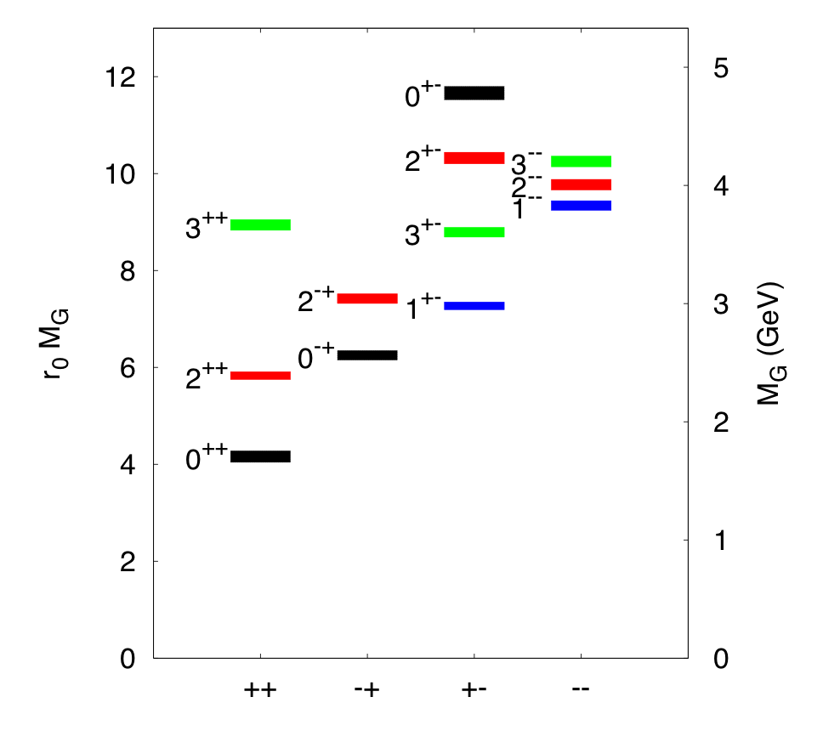
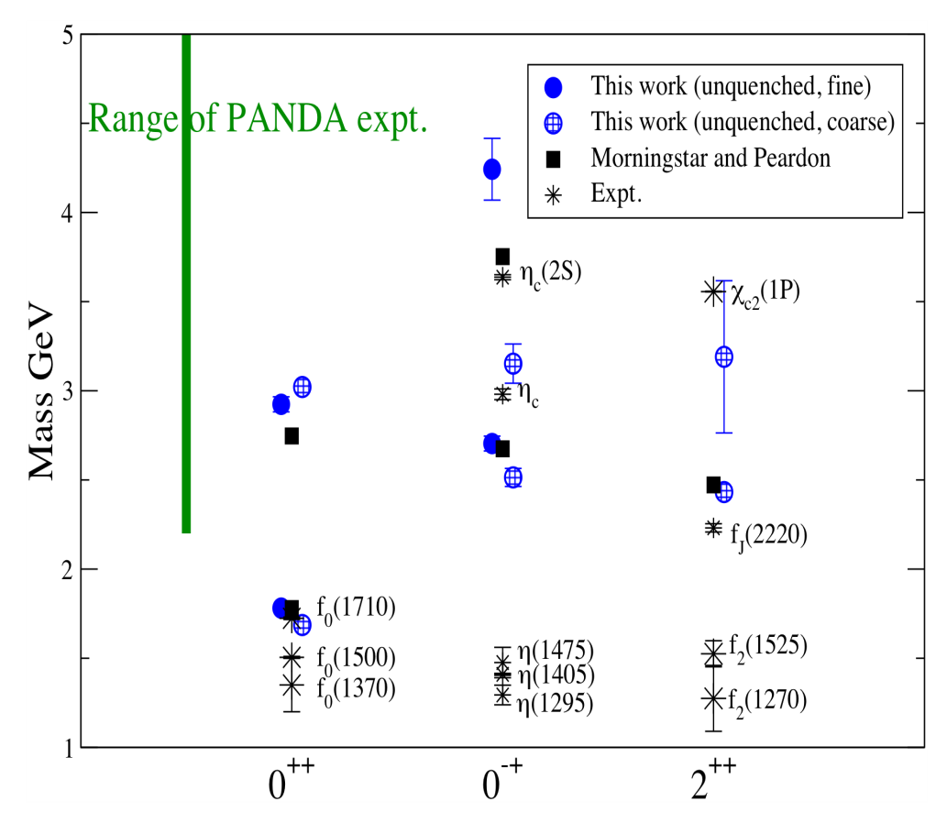
Glueball spectrum
Quenched results:
Morningstar-Peardon
Phys.Rev. D73 014516 (‘06)
First unquenched results:
pion mass 360 MeV
UKQCD coll. PRD82 (‘10) 34501

Slide 6
Pure YM gauge theory on the lattice:
a hot glue plasma
a 1. Order PhaseTransition,
and a warm Glueball Fluid ! ?

Slide 7
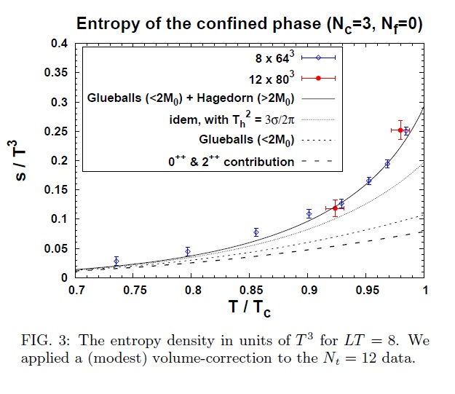
Pure LGT thermal GlueBall-matter observed at RHIC and LHC !?
Harvey Meyer, Univ. Mainz

Slide 8
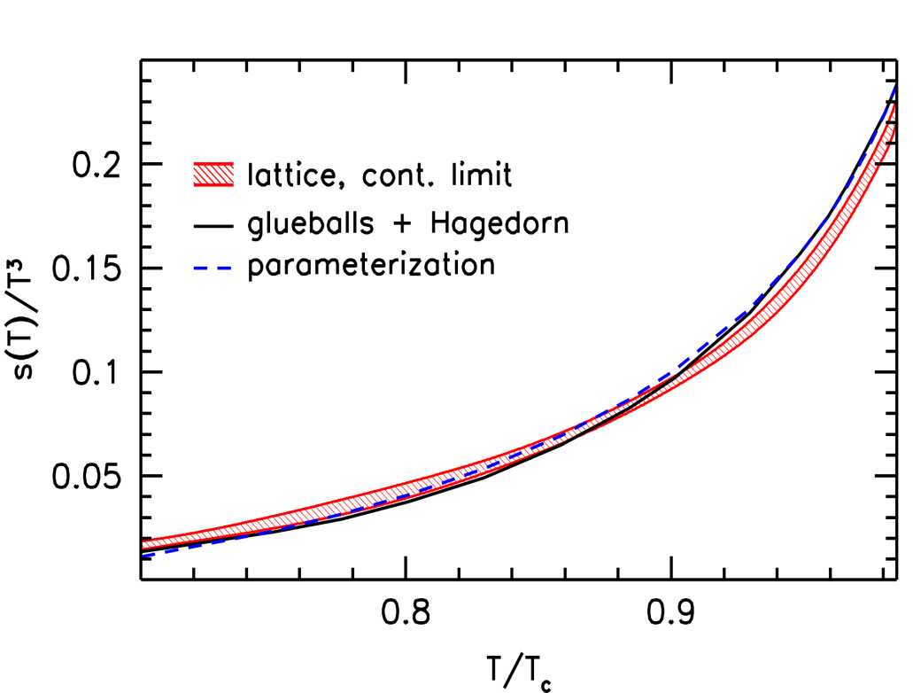
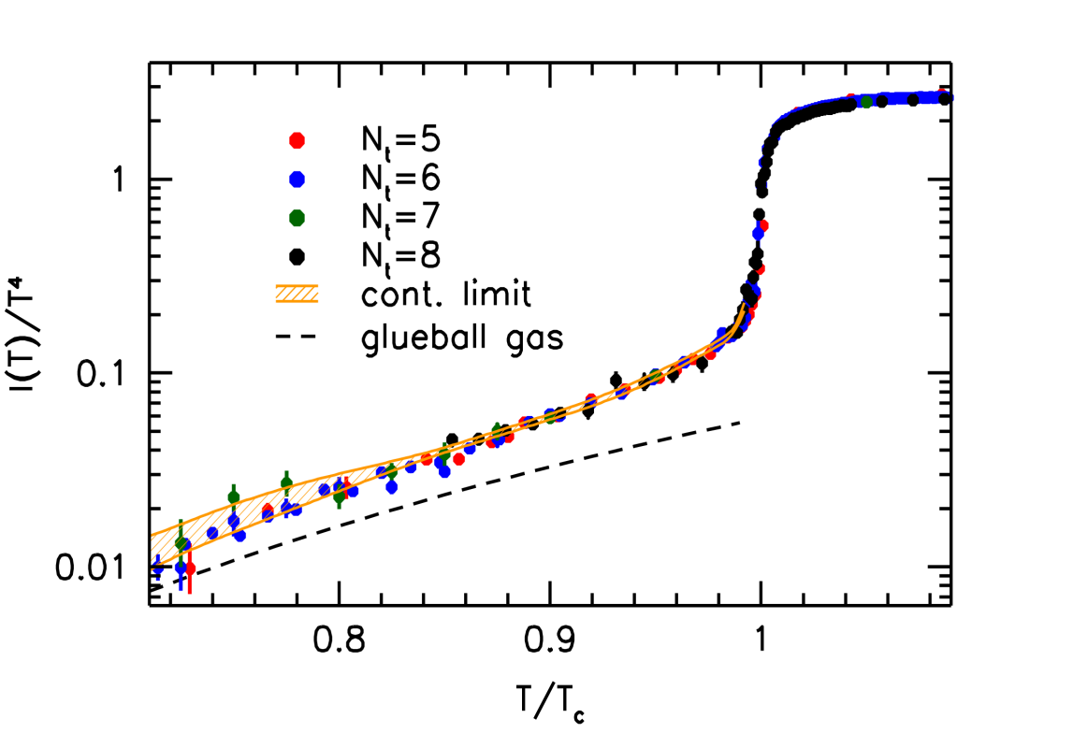
Lattice Gauge Thermodynamics of the GlueBall-matter fluid
Pure YM gauge: Glue Plasma
Glueball-Hagedorn-States
Glueball-Hagedorn-States
12 Glueballs
Wuppertal-Budapest (W.-B.)Collaboration: JHEP 1207 56 (‘12)
High precision continuum result for the quenched equation of state.
Low temperature behavior and phase transition described by Hagedorn-GlueBall spectrum.
W.-B. use 12 GlueBall states (Morningstar-Peardon) plus Hagedorn-GB towers
(as proposed by Harvey Meyer).

Slide 9
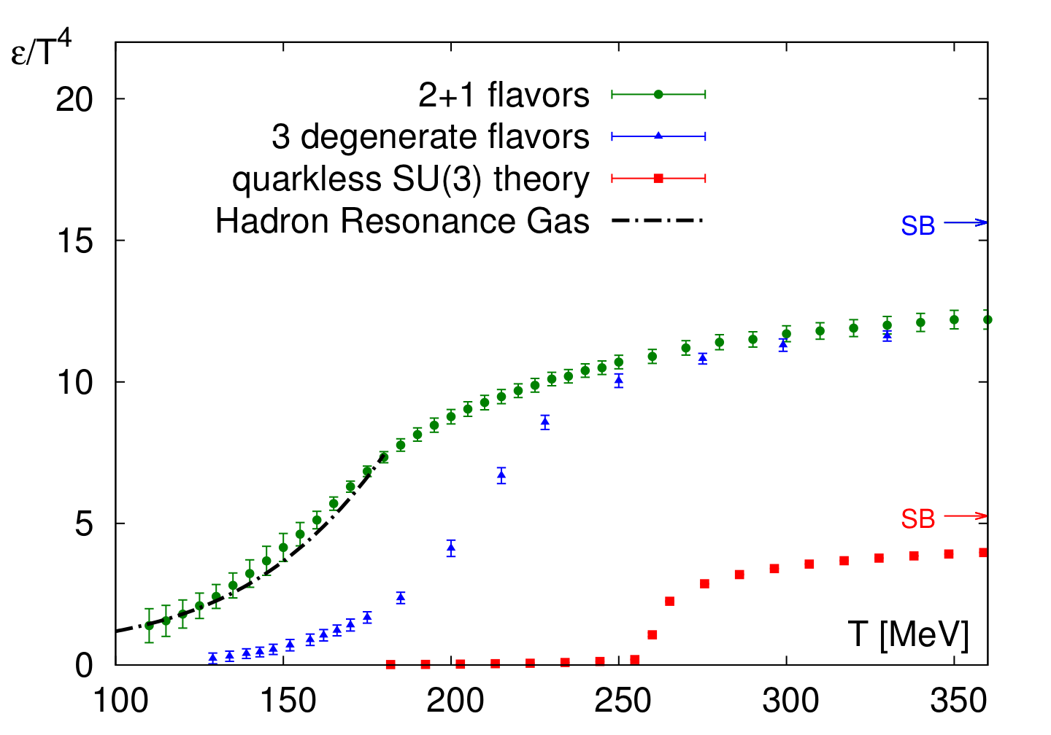
Pure YM LGT vs. 2+1 flavor Lattice QCD Energy density (EoS) DIFFERENT for different quark masses
Energy density from
Sz. Borsanyi et al., W.P.
Wuppertal-Budapest coll
JHEP 1011, 2010,077;
PLB730, 2014, 99
“physical point” 2+1
T_c.o. = 155 MeV
N_f = 3, m_{u,d} = m_{s}
T_c.o. = 220 MeV
pure gauge YM
T_c = 270 MeV
Quenched: W.B. coll.
JHEP 1207, 2012, 056
1. O.P.Transition from glue-plasma to GlueBall-Hagedorn St.
HagedornStates decay

Slide 10
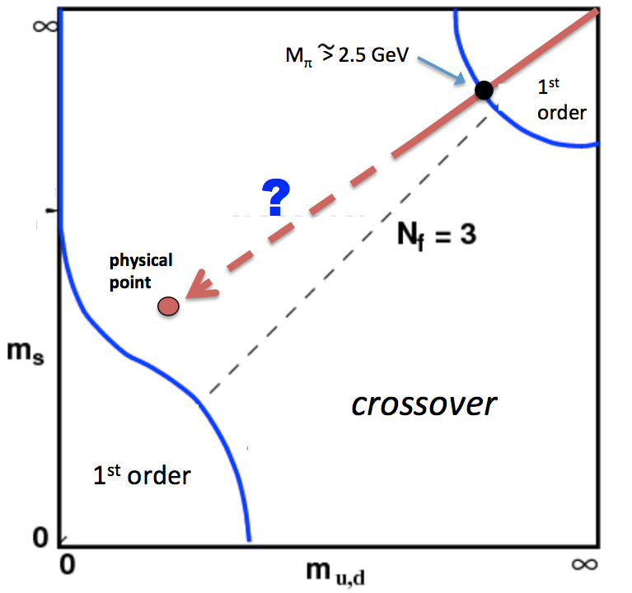
SU(3)_color Lattice Gauge Theory Columbia Plot: Order of Phase Transition depends on quark masses
pure gauge: glue only!
t=0.1fm/c : No Quarks !
LHC & RHIC: high mult. pp & AA events
Quenched QCD glue + GlueBalls
few heavy Quarks
T_cp =250 MeV

Slide 11
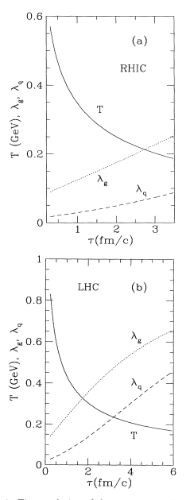
Time evolution of fugacity
of gluons and quarks (g, q)
from pQCD-based rate eq.
T. S. Biró, B. Mueller, X. Wang,
BMW , PRC48,1275 (1993)
Fast gluon saturation,
slow quark saturation

Slide 12
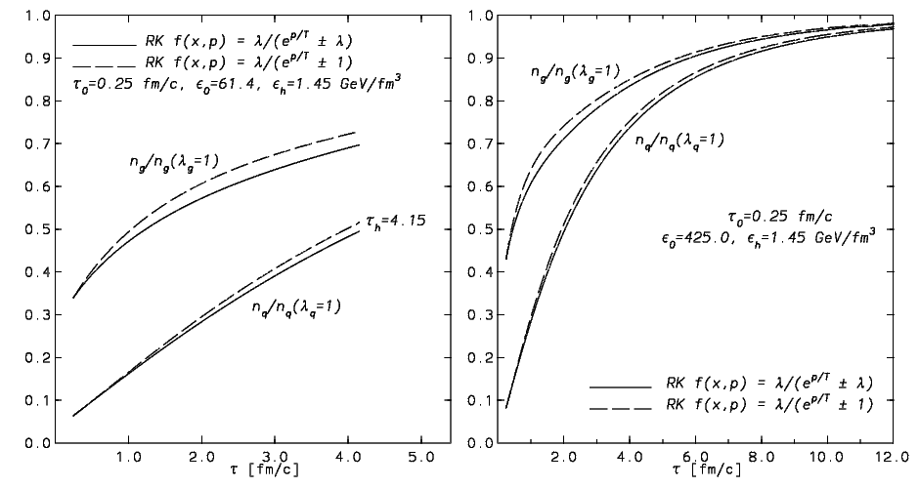
LHC
Fast gluon saturation,
slow quark saturation
Fast gluon saturation,
slow quark saturation
RHIC
Rate equation calculation
D.M. Elliott, D.H. Rischke,Nucl.Phys. A671,583 (2000)

Slide 13
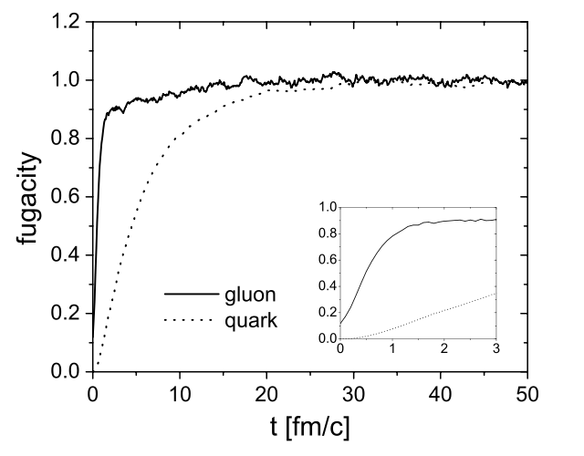
Time evolution of fugacity(g,q) - analog to Nf (t)
BAMPS Box calculation
Z.Xu, C.Greiner,
PRC71,064901(2005)
fugacity ~ ½ flavor number Nf:
Nf(t)
2
1
0.2
0.1
Fast gluon saturation,
slow quark saturation
t/fm/c

Slide 14
Time evolution of high multiplicity pp AA
at RHIC and LHC in pure YM scenario

Slide 15
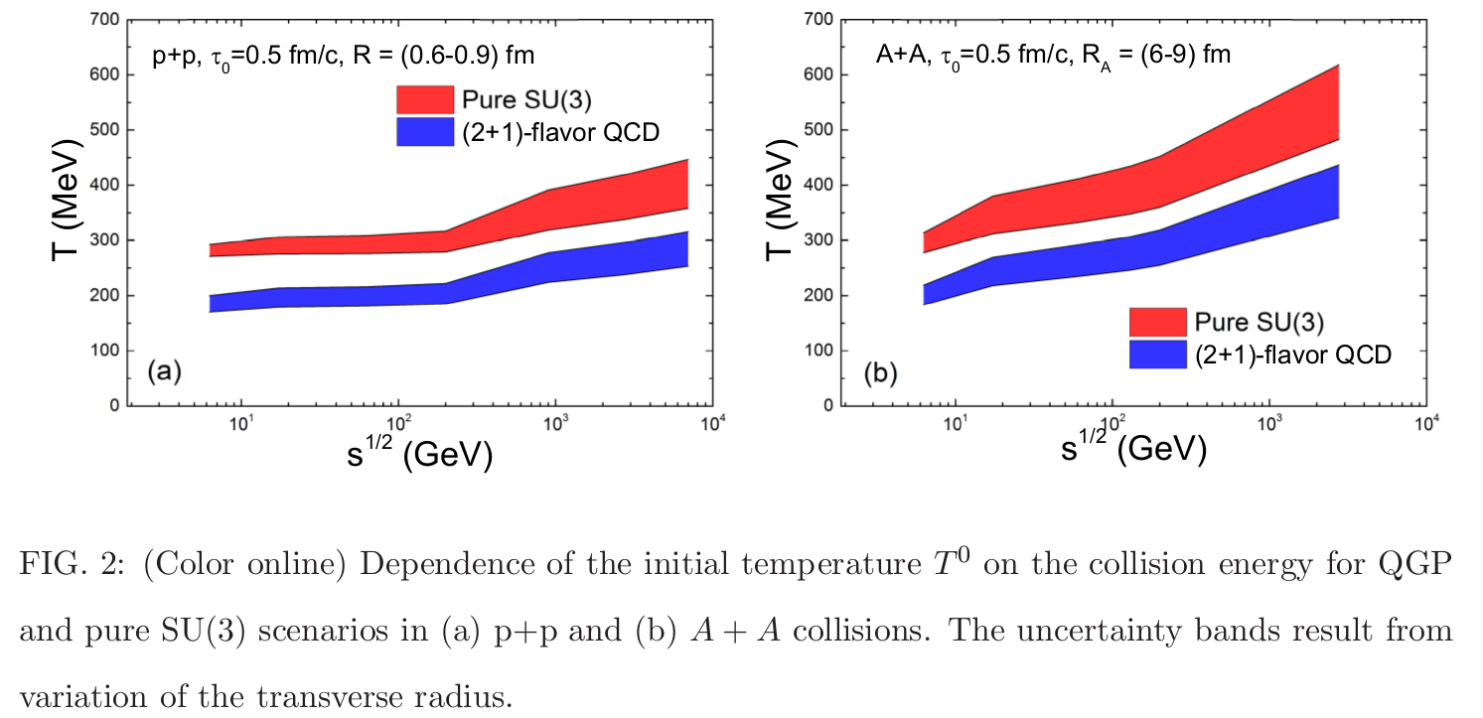

Slide 16
Alternate Scenario: pure gauge matter in pp, pA – AA ?
Initial Color Glass Condensate Glasma thermalizes fast equilibration of Gluons, slow equil. of quarks high pressure, entropy gluon plasma fast hydrodynamic expansion of gluon plasma.
1. Order Phase Transition at T_c = 270 MeV of flavorless QCD.
Transition from glue plasma in GlueBall fluid
Glueball-Hagedornstates mix with quarks, decay into Hadrons

Slide 17
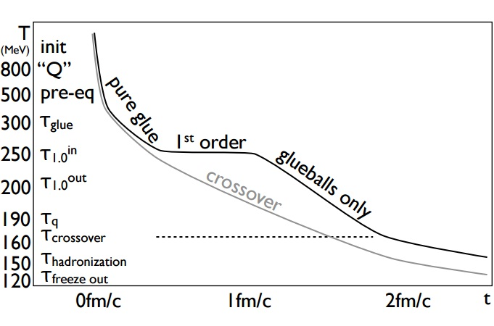
Eff.Nf(t)
0.0
0.1
0.2
0.3
0.6
0.9
GlueBalls decay
Eff. Nf(t): 0 0.1 0.2 0.3 0.6 1.2 ...
Eff. Nf(t) is U.S. – parameter : Nf = 2+1 ~ fugacity = 1

Slide 18
Hydro time evolution of high multiplicity pp AA at RHIC and LHC :
YM scenario vs. 2+1 flavor QCD

Slide 19
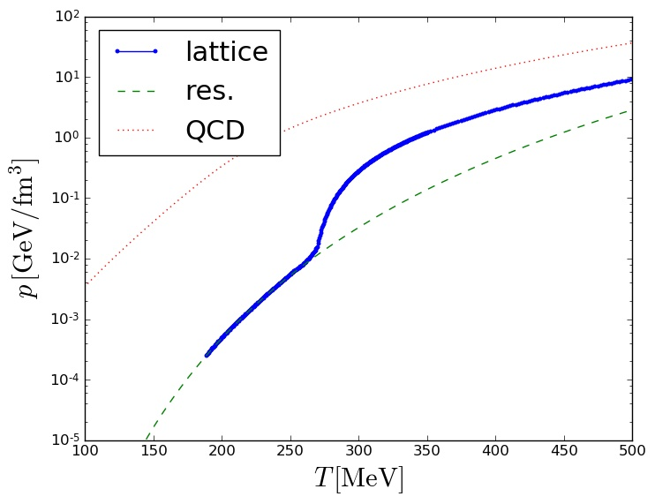
H. Niemi, LongGang Pang, V. Vovchenko, HST

Slide 20
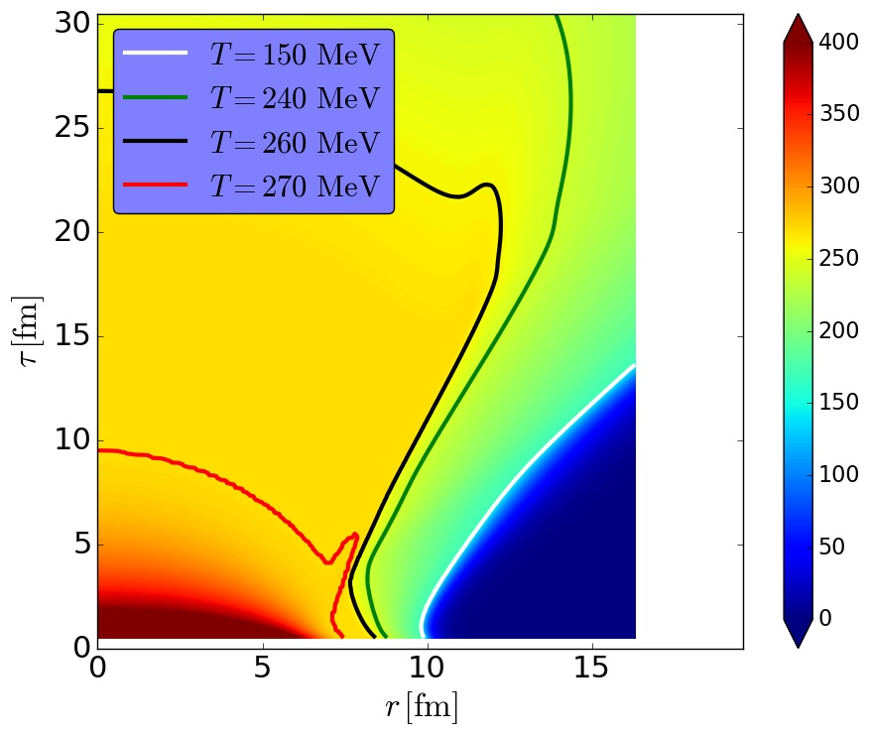
H. Niemi, LongGang Pang, V. Vovchenko, HST

Slide 21
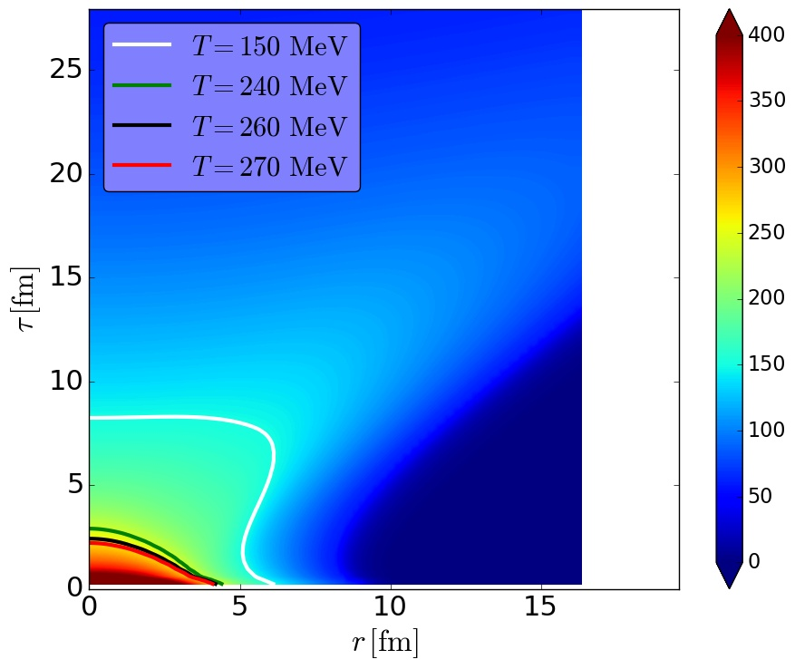
H. Niemi, LongGang Pang, V. Vovchenko, HST

Slide 22
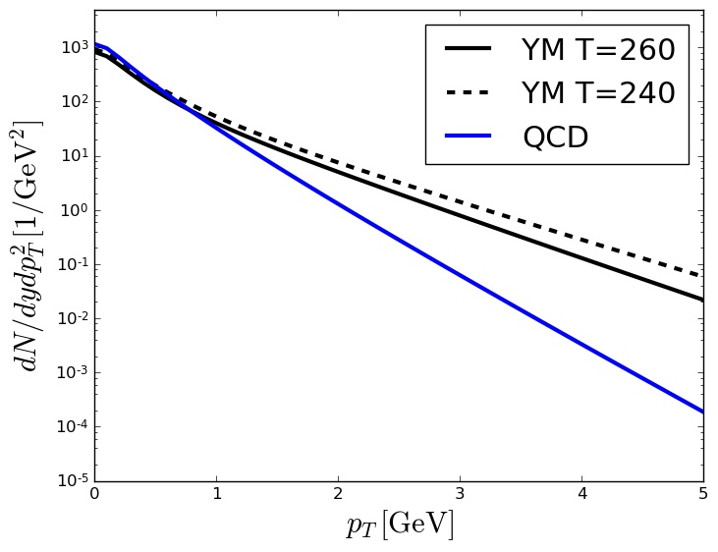
H. Niemi, Long Gang Pang, V. Vovchenko, HST

Slide 23
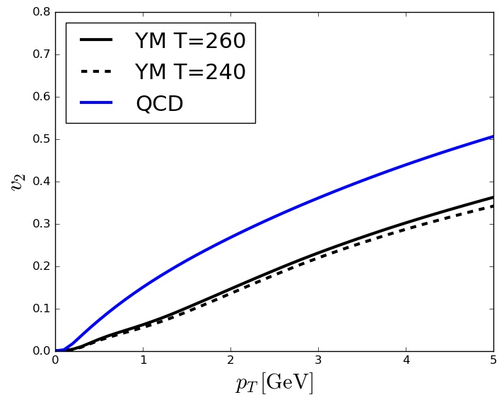

Slide 24
How do electromagnetic probes,
i.e. Dileptons and Photons, come out
from pure glue FOPT scenario?
V. Vovchenko, Gorenstein, Satarov, Mishustin,
Csernai, et al.

Slide 25
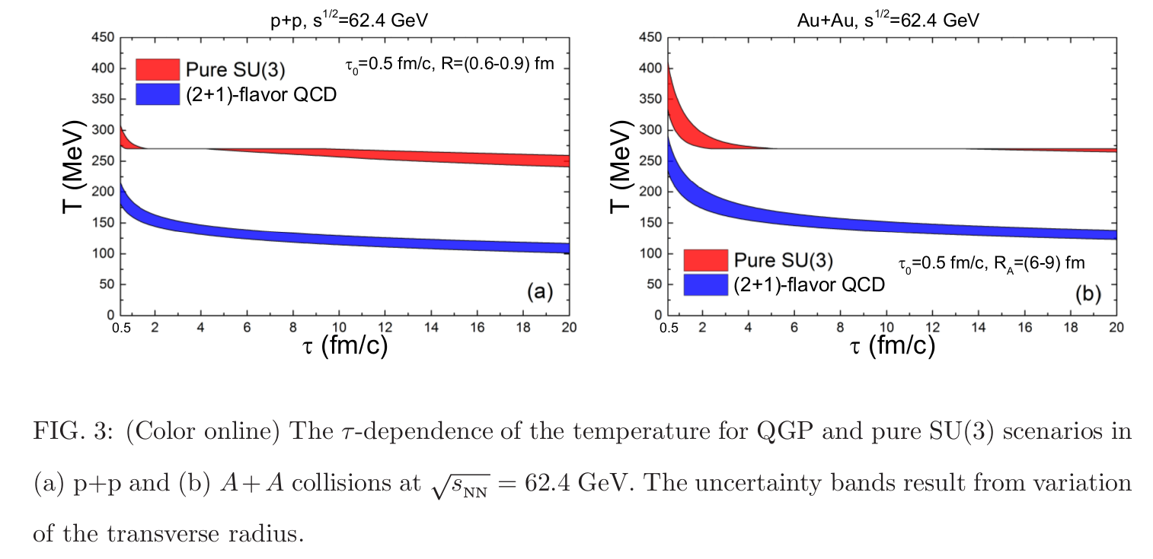
Time evolution T(t) of pp vs AA collisions at RHIC
Pure YM
L~ 0
L~0.3
L~0.5
L~0.7
L~0.9
L~ 0
L~0.3
L~0.5
L~0.7
L~0.9
2+1 flavors
V. Vovchenko et al.

Slide 26
Bjorken evolution of US Plasma
Pure glue initial state: $λ=0$ at $τ=τ_{0}$
quark suppression $λ\left(τ\right)=1−\exp\left(\frac{τ_{0}−τ}{τ_{∗}}\right), τ_{∗}=1, 5, 10$fm/c saturation time
$$ε=ε\left(τ_{0}\right) {\left(\frac{τ_{0}}{τ}\right)}^{4/3}$$
Energy conservation
Temperature: $T=T_{0}{\left(\frac{τ_{0}}{τ}\right)}^{1/3}{\left(1+αΛ_{4}\right)}^{−1/4}$
Entropy density: $s=s_{0}{\left(\frac{T}{T_{0}}\right)}^{3}\left(1+αΛ_{4}−βΛ_{3}ln⁡λ\right)$
$\frac{dS}{dη}=πR_{A}^{2} sτ$
Freezeout: $T_{f}=156$ MeV, $\frac{dS(τ_{f})}{dη}=6.3{\left.\frac{dN_{π}}{dy}\right|}_{y=η}=πR_{A}^{2} s(τ_{f})τ_{f}$
$$T_{0}, { τ}_{f}$$

Slide 27
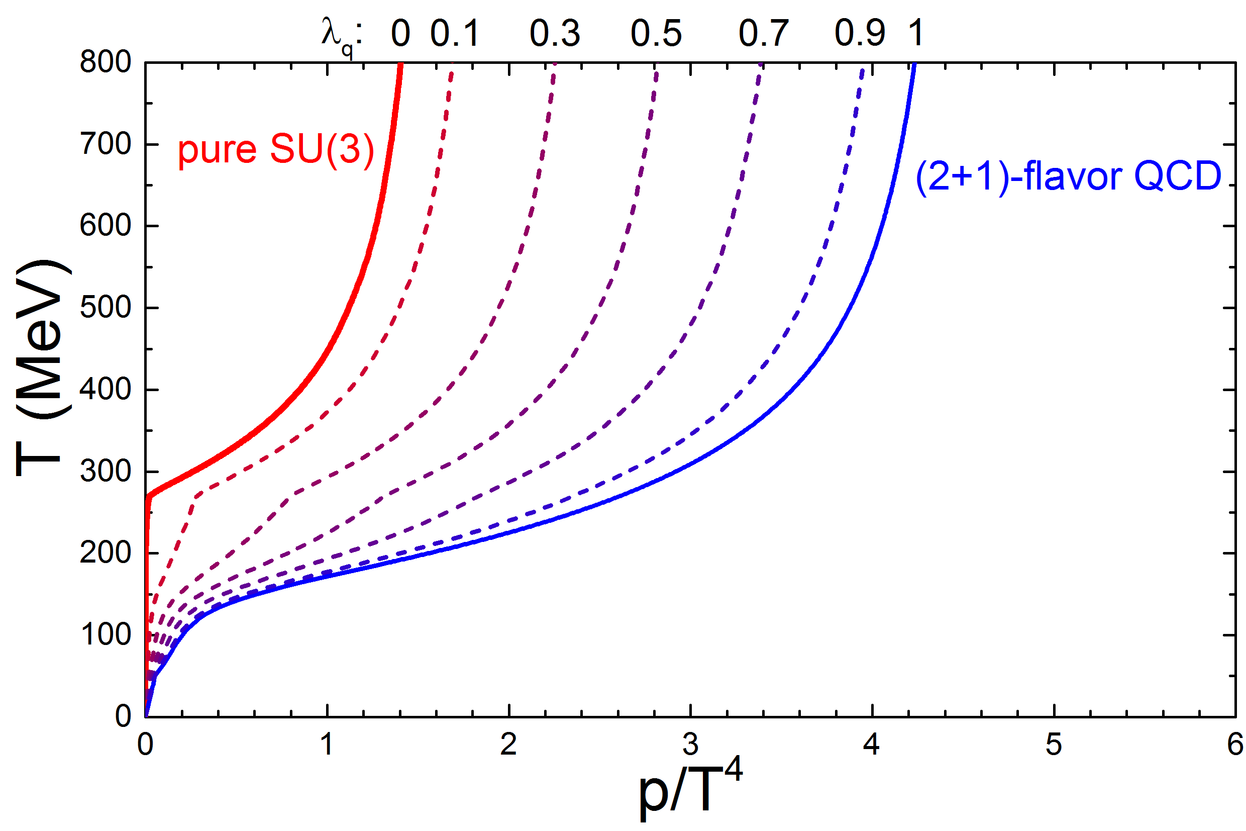
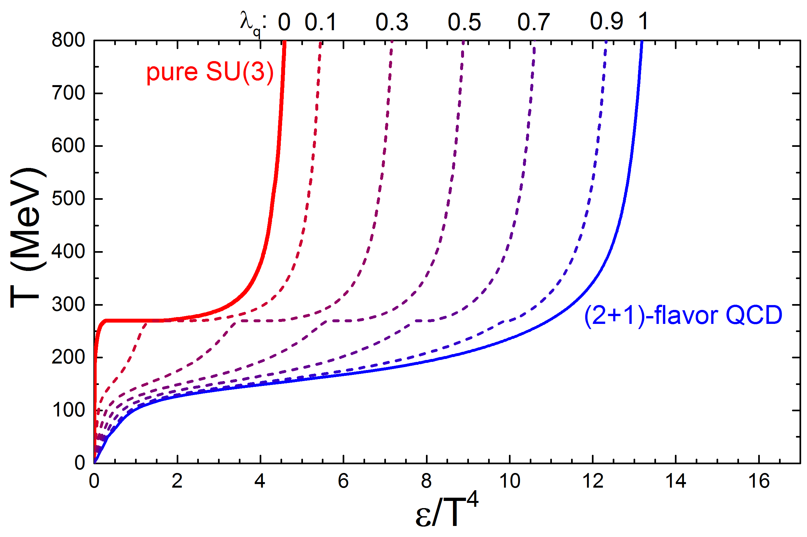
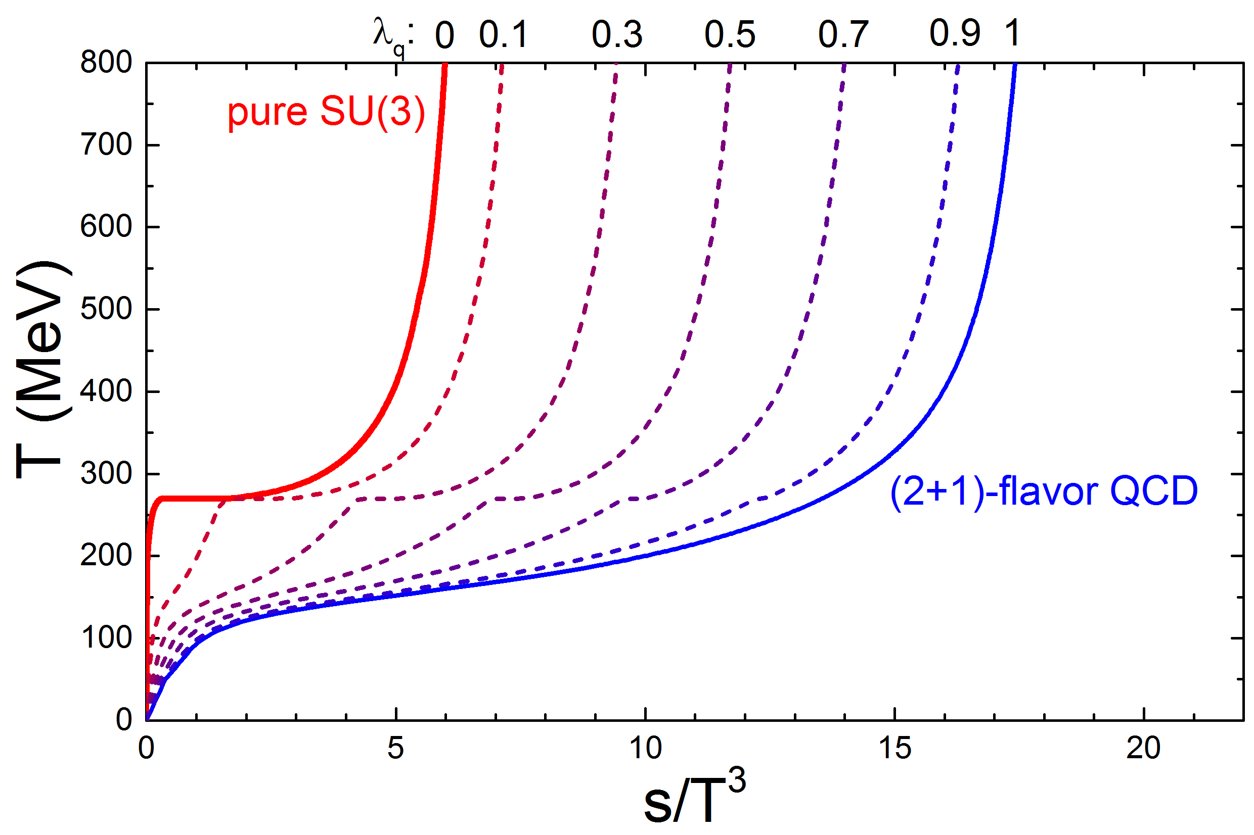
pressure
energy density
entropy density

Slide 28
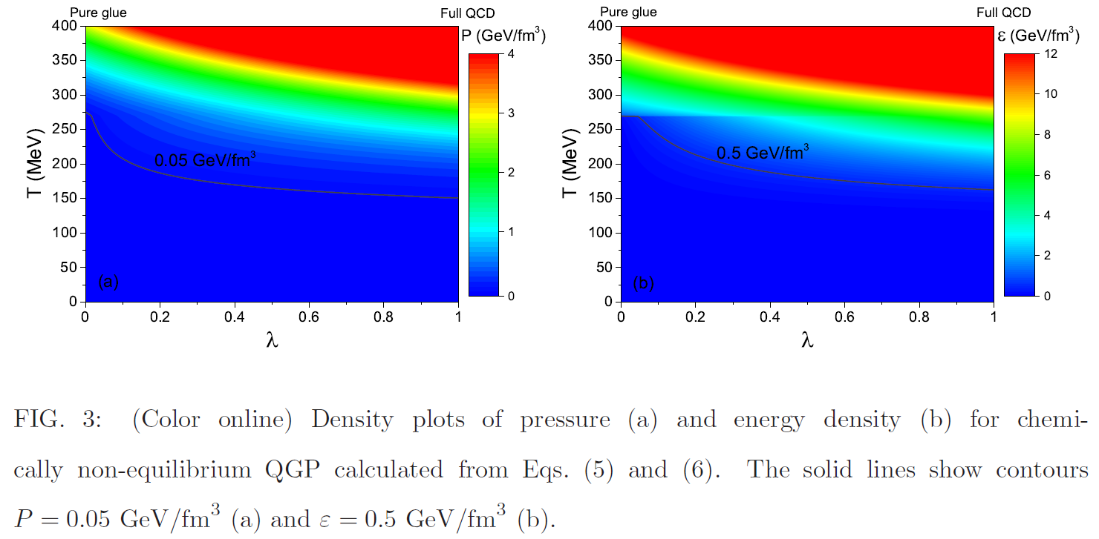

Slide 29
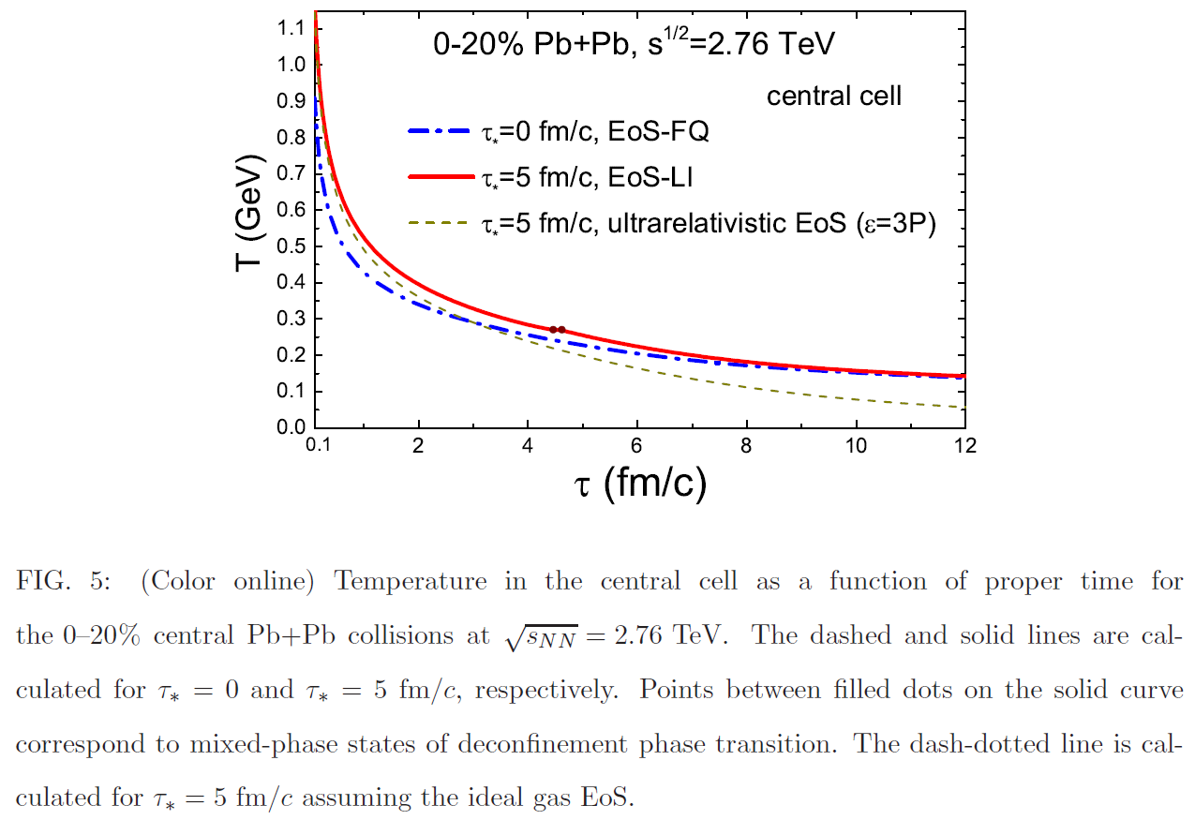

Slide 30
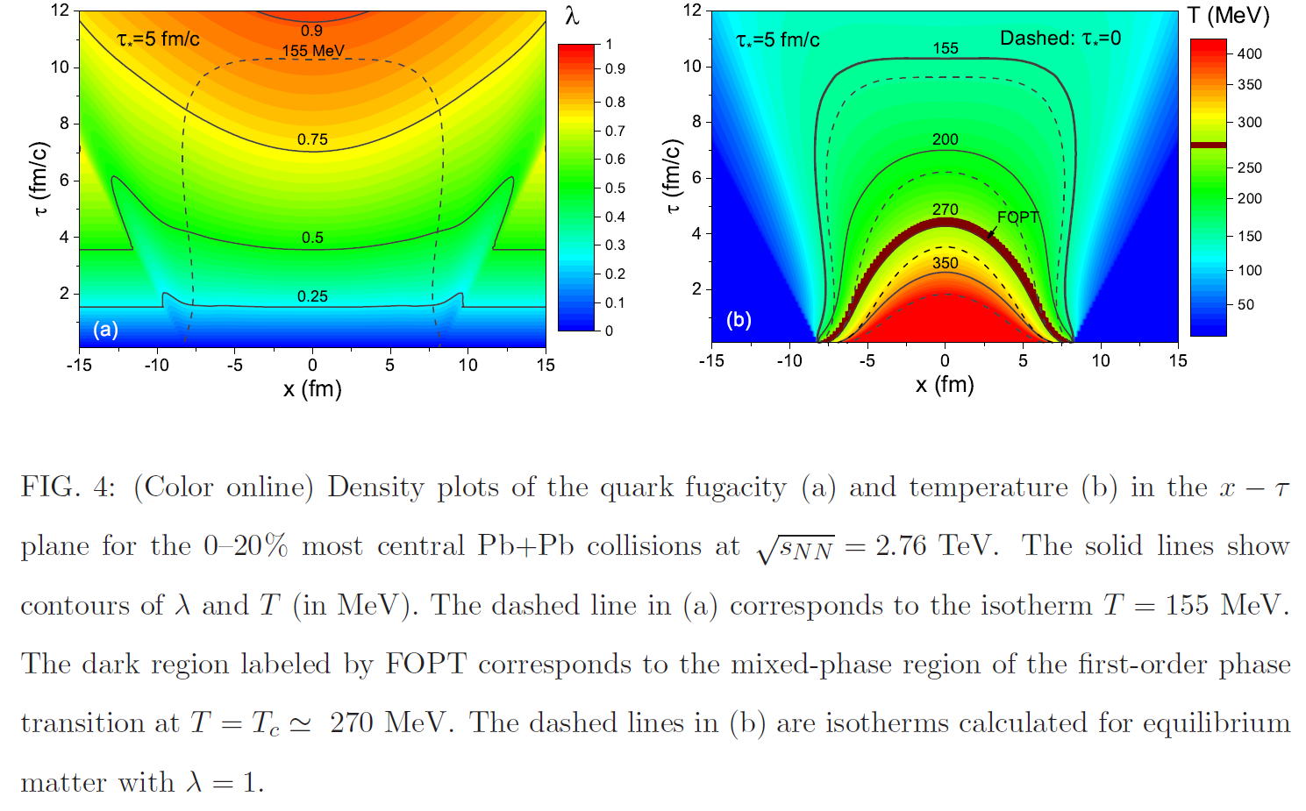

Slide 31
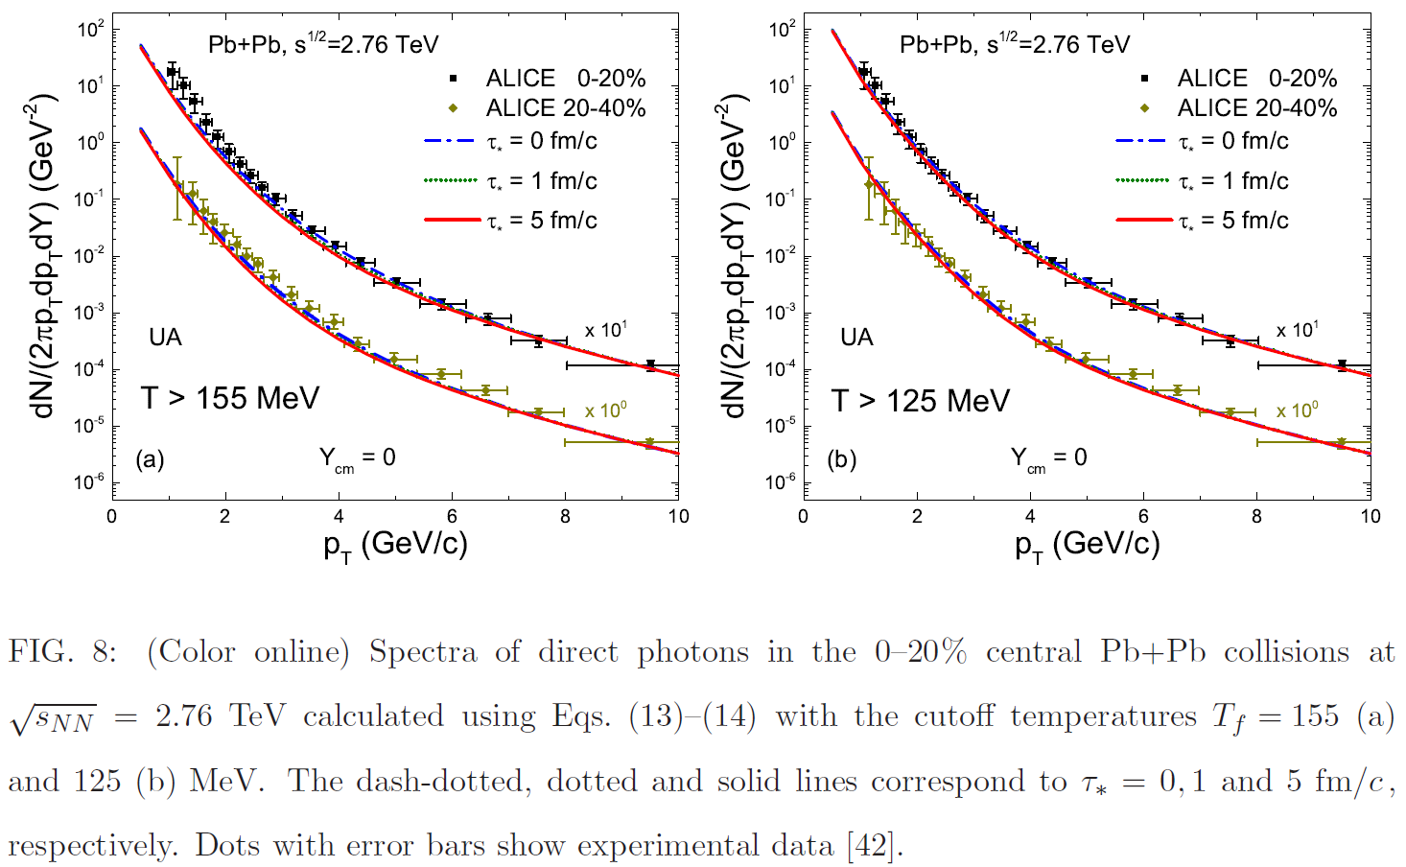

Slide 32
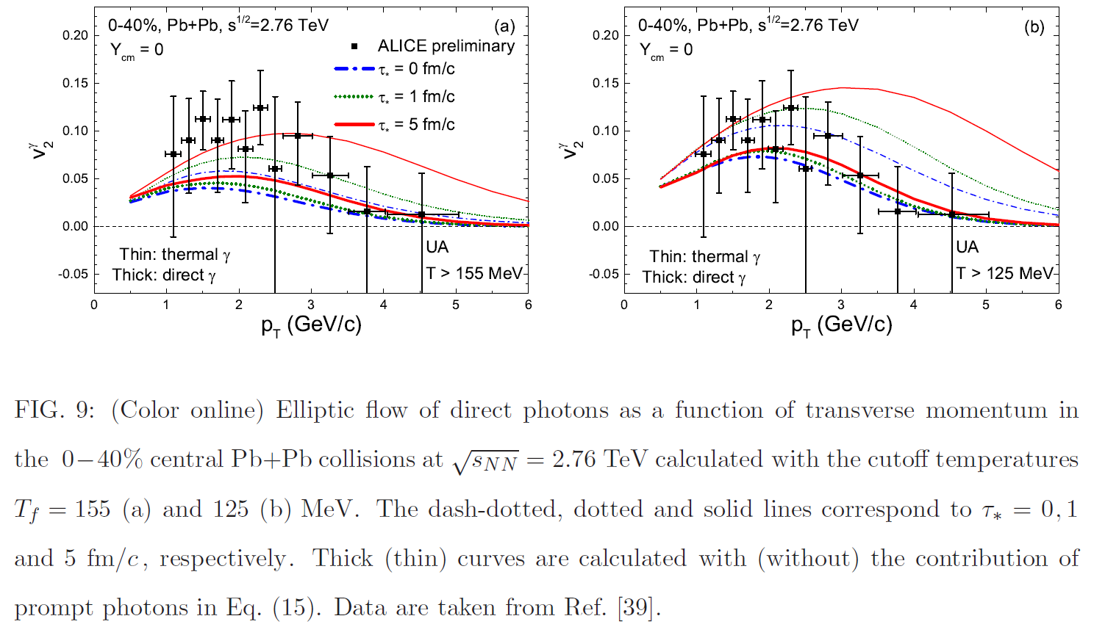

Slide 33
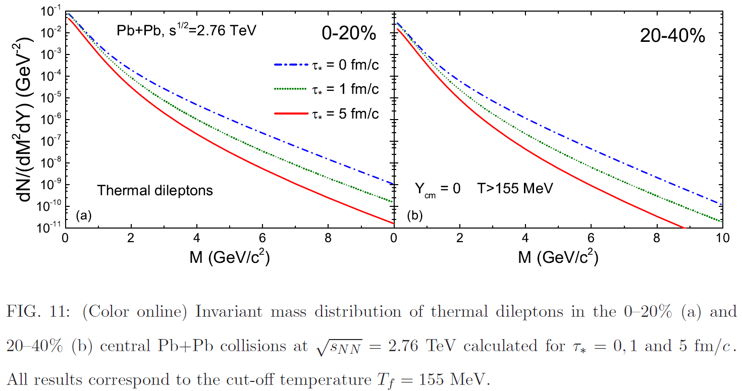

Slide 34
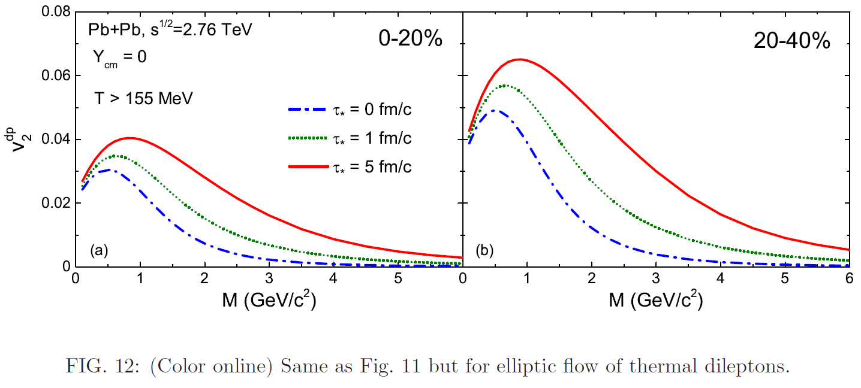

Slide 35
Signatures for pure glue->glueball scenario:
New event-class in high multiplicity pp & pA at RHIC and LHC

Slide 36
Time dependence in Columbia …. RHIC and LHC as Glueball Factories…
violent pp (& AA) collisions
initial state at LHC:
Color Glass Condensate
t=0.1fm/c: glue thermalizes
pure glue-plasma created
Quenched Lattice SU(3)_c :
T_c =270MeV
glue plasma -> GlueBall fluid
1. Order Phase Transition
Expansion to critical point
T_cp =240 MeV t~1-2 fm/c
GlueBalls + Hagedorn States Mix
more and more quarks produced: T_co =155MeV crossover transition
Observables from Columbia plot
T>T_cp: Zero e.m. radiation
Measure T~270 MeV Dilepton mass
T_c: Flow collapse as barometer
T_cp: Critical Scattering (MG,WG),
Kurtosis , # fluctuations
T_c ~ 2*T_co =>
P_t(pp) ~ 2*p_t(AA)
M_GlueBalls < 2GeV: „No“ Baryons
p/pi ~ 0 : Yield p+pBar << mesons
Lightest GlueBall decays:
- No decays to 2 Omega, no 2 Rho
Glue Flavor blind !
K/pi=1 Yields: Kaons ~ pions

Slide 37
Outlook: Alternative Class of High M events in pp, pA @ LHC – AA?
Initial Color Glass Condensate Glasma thermalizes fast equilibration of gluons, slow equil. of quarks high pressure, entropy in gluon plasma fast hydrodynamic expansion of gluon plasma.
1. Order Phase Transition at T_c = 270 MeV of flavorless QCD.
Transition from glue plasma in GlueBall fluid
Glueballs’ Hagedorn states decay directly into Hadrons

