Slide 1

Application of Covariant Density Functional Theory to Nuclear Structure Studies

Slide 2
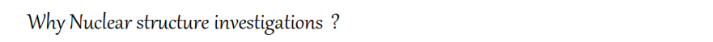
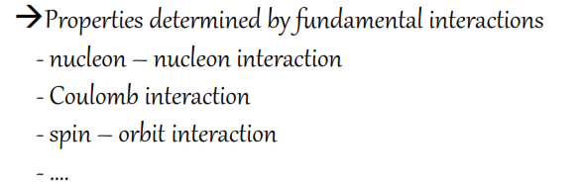
Structure and stability of normal and exotic nuclei with extreme proton/neutron asymmetries
* Formation of neutron skin and halo structures
* Deformations
* Mapping of drip lines
* Evolution of shell structure
* Structure of Superheavy elements
* Superdeformed bands, Giant resonances, …etc.

Slide 3
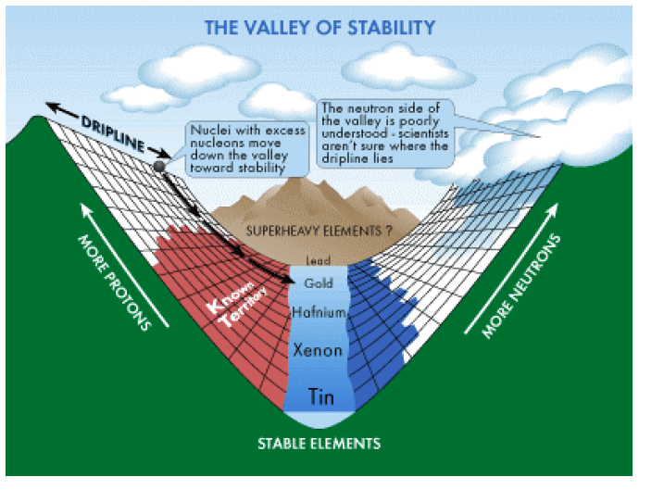
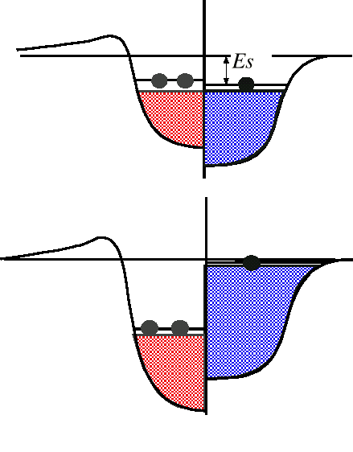
β⁺
β⁻

Slide 4

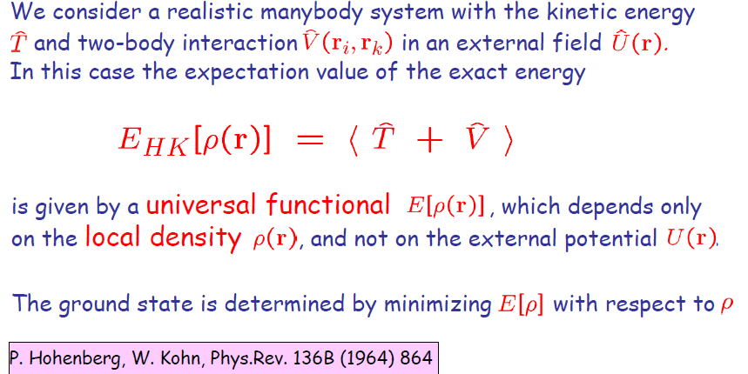

Slide 5
Density functional theory
Density functional theory in nuclei:
The exact energy of a quantum mechanical many body system is a functional of
the local density.
This functional is universal. It does not depend on the system, only on the interactions
Slater determinant
density matrix
Mean field:
Eigenfunctions:
Interaction:

Slide 6



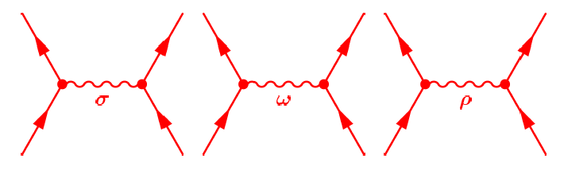
Walecka model
Walecka model
Finite Range (Meson-Exchange Model)
Nucleons are coupled by exchange of mesons
through an effective Lagrangian (EFT)
(J^{π},T)=(0⁺,0)
(J^{π},T)=(1⁻,0)
(J^{π},T)=(1⁻,1)
Sigma-meson:
attractive scalar field
Omega-meson:
short-range repulsive
Rho-meson:
isovector field

Slide 7
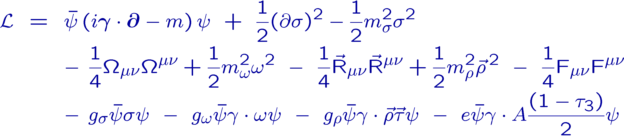
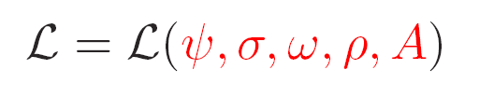
Lagrangian density
free Dirac particle
free meson fields
free photon field
Parameter:
meson masses: m_{σ}, m_{ω}, m_{ρ}
meson couplings: g_{σ}, g_{ω}, g_{ρ}
interaction terms

Slide 8
equations of motion
Equations of motion
for the nucleons we find the Dirac equation
No-sea approxim. !
for the mesons we find the Klein-Gordon equation

Slide 9
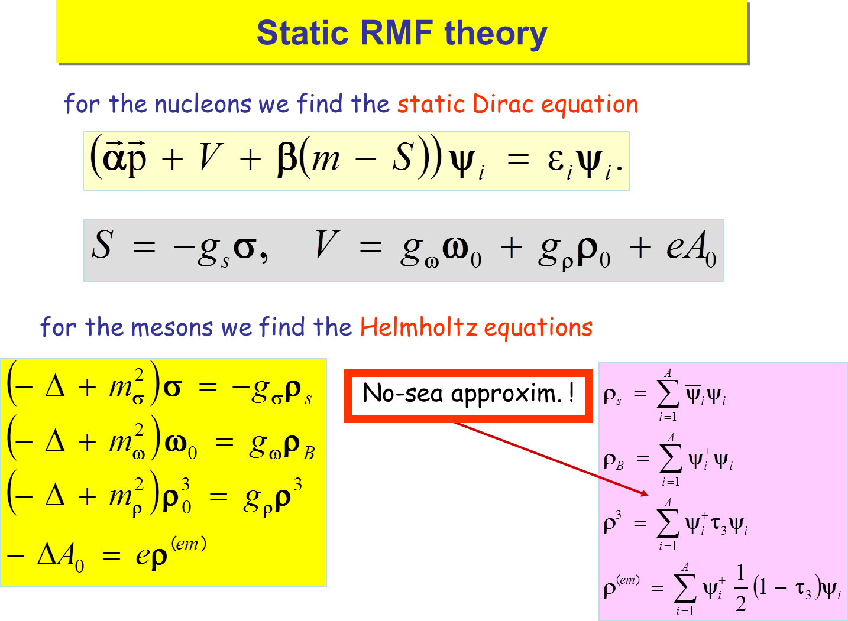

Slide 10
Density dependence
Effective density dependence:
non-linear potential:
NL1,NL3, NL3*...
Boguta and Bodmer, NPA 431, 3408 (1977)
density dependent coupling constants:
R.Brockmann and H.Toki, PRL 68, 3408 (1992)
S.Typel and H.H.Wolter, NPA 656, 331 (1999)
T. Niksic, D. Vretenar, P. Finelli, and P. Ring, PRC 56 (2002) 024306
g → g(ρ(r))
DD-ME1,DD-ME2

Slide 11
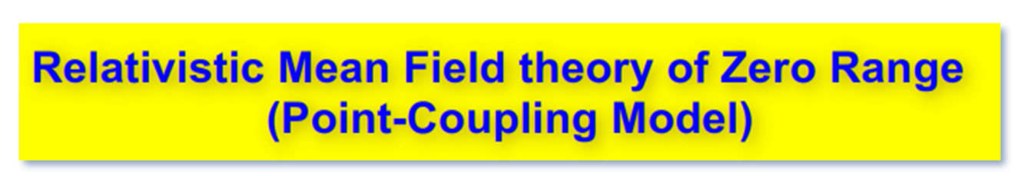
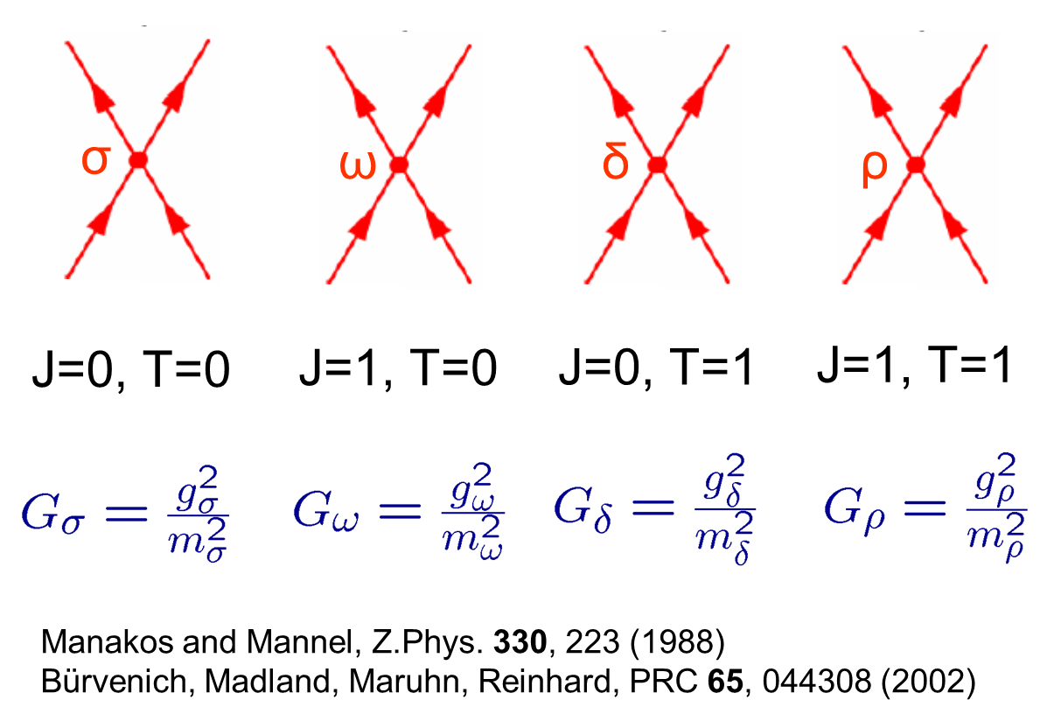

Slide 12

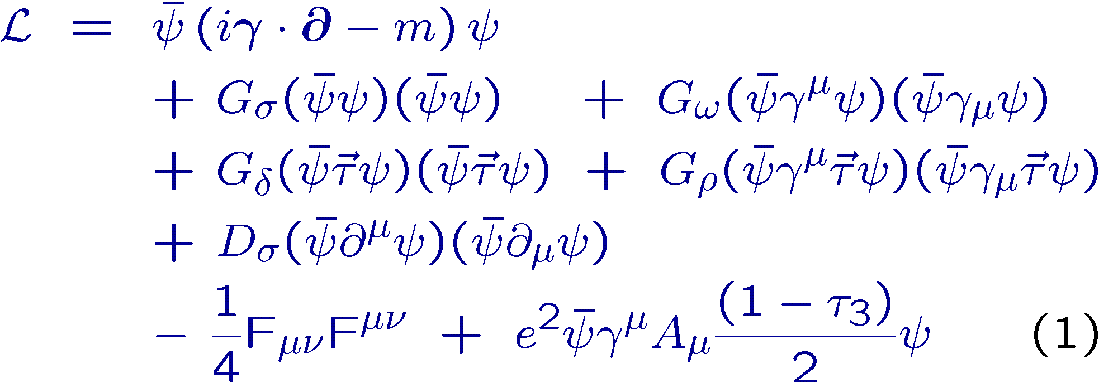
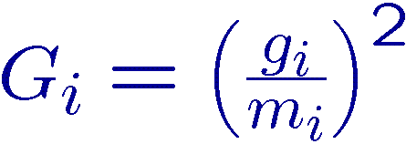
free Dirac particle
interaction terms
interaction terms
Parameter:
point couplings: G_{σ}, G_{ω}, G_{δ ,} G_{ρ,}
derivative terms: D_{σ}
photon field

Slide 13
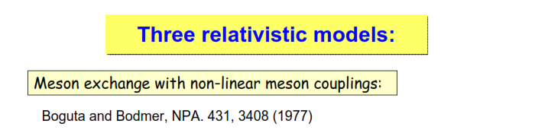

DD-PC1, …
Non-relativistic Skyrme Model
Self-consistent HFB+THO formalism
SkM*, SkP, SLy4, SLy5

Slide 14
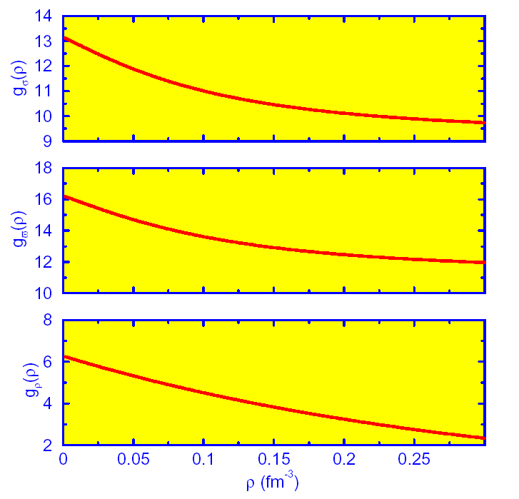
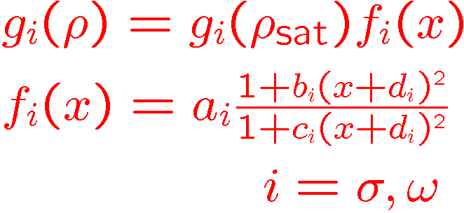
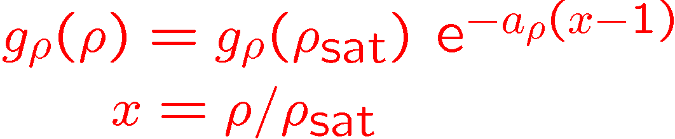

PARAMETRIZATION OF THE DENSITY DEPENDENCE
MICROSCOPIC: Dirac-Brueckner calculations of nucleon self-energies in
symmetric and asymmetric nuclear matter
saturation density
PHENOMENOLOGICAL:
g_{σ}(ρ)
g_{ω}(ρ)
g_{ρ}(ρ)

Slide 15
Pairing correlations are taken care in
Relativistic Hartree–Bogoliubov (RHB) model with D1S parameterization of the Gogny force.

Slide 16
Relativistic Hartree Bogoliubov (RHB)
chemical potential
quasiparticle energy
Dirac hamiltonian
quasiparticle
wave function
pairing field

Slide 17
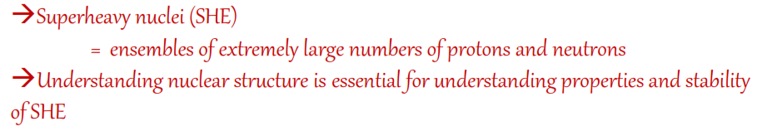

Slide 18
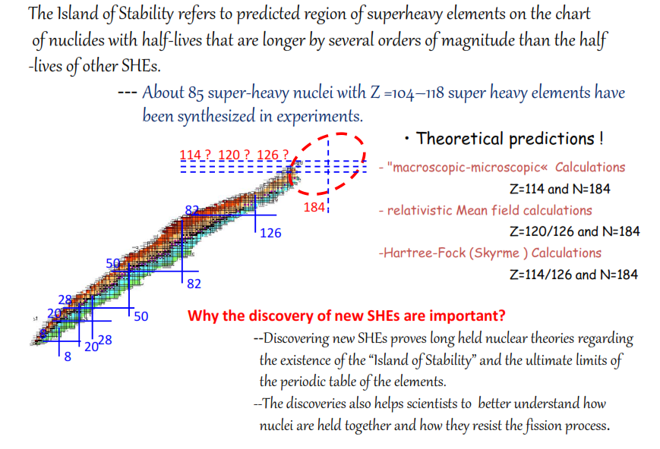
N=172

Slide 19
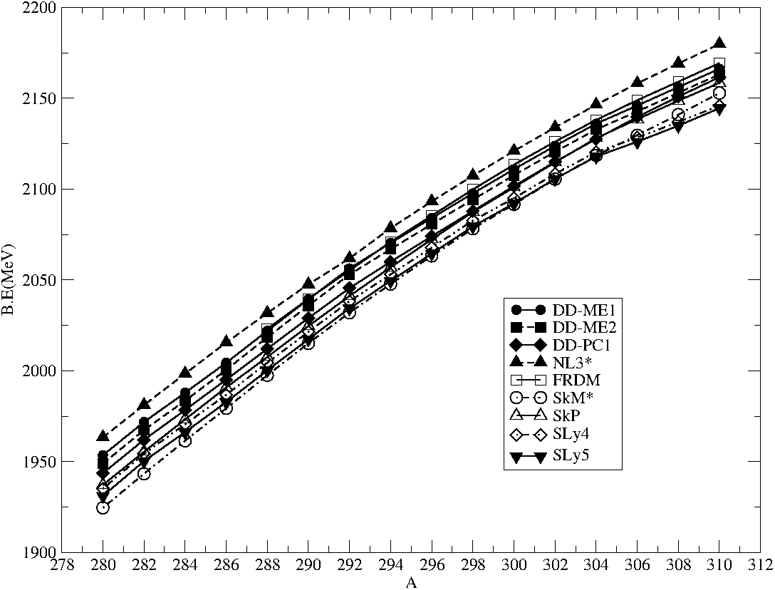


Slide 20
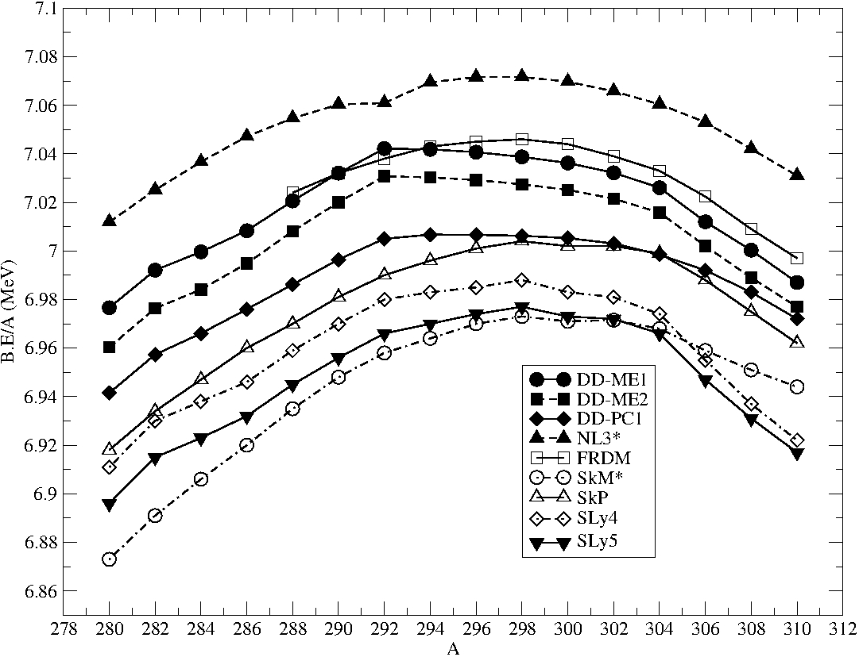
Z=120 Isotopes
NL3*
DD-ME1
DD-ME2
DD-PC1
FRDM
SkM*
SkP
SLy4
SLy5

Slide 21
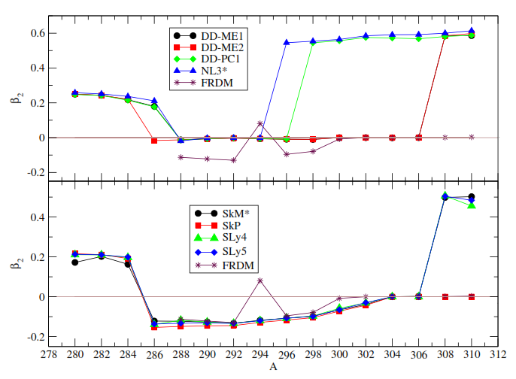
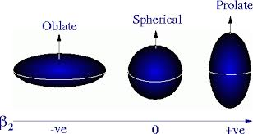

Slide 22
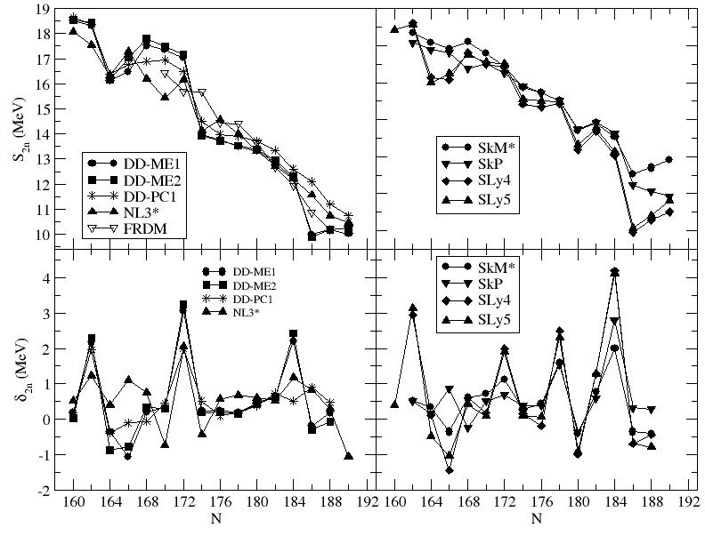
N=162
N=162
N=172
N=172
N=178
N=184
N=184

Slide 23
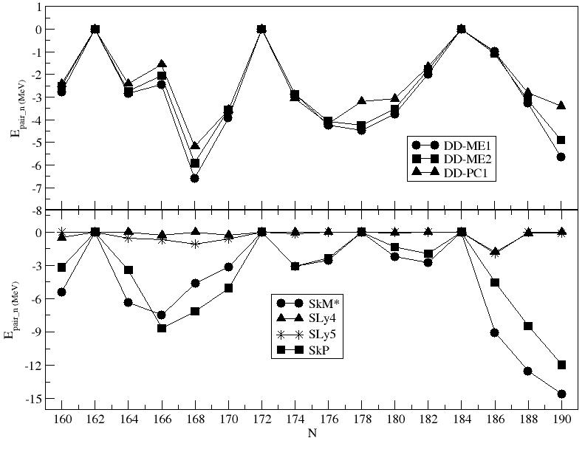
N=162
N=172
N=184

Slide 24
We have calculated Q_{α} – decay series and α-decay half life of four different Isotopes of Z=120 nuclei:
²⁹²120 (N=172, neutron shell closure)
²⁹⁸120 (experimental data available)
²⁹⁹120 (experimental data available)
³⁰⁴120 (N=184, neutron shell closure)

Slide 25
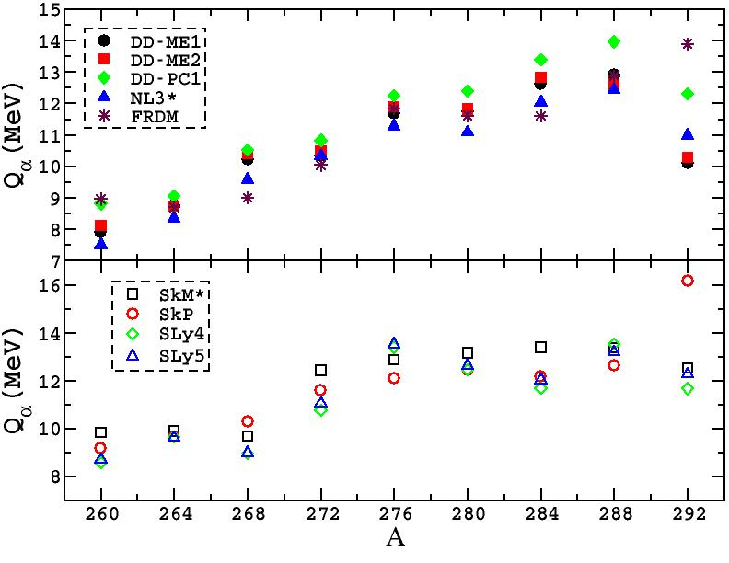
Q_{α} – decay series of ²⁹²120 (N=172)

Slide 26
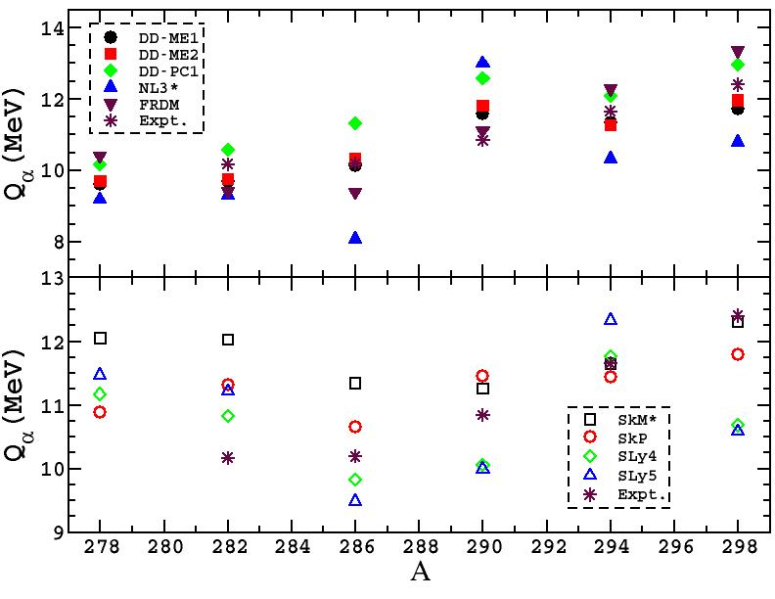
Q_{α} – decay series of ²⁹⁸120

Slide 27
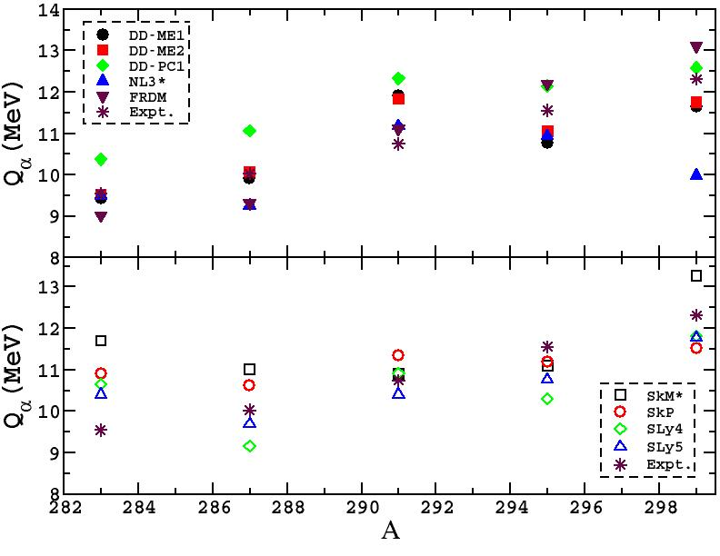
Q_{α} – decay series of ²⁹⁹120

Slide 28
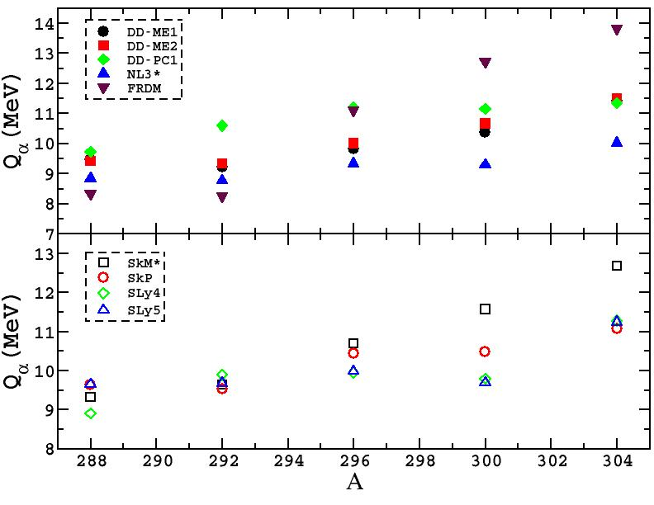
Q_{α} – decay series of ³⁰⁴120 (N=184)

Slide 29
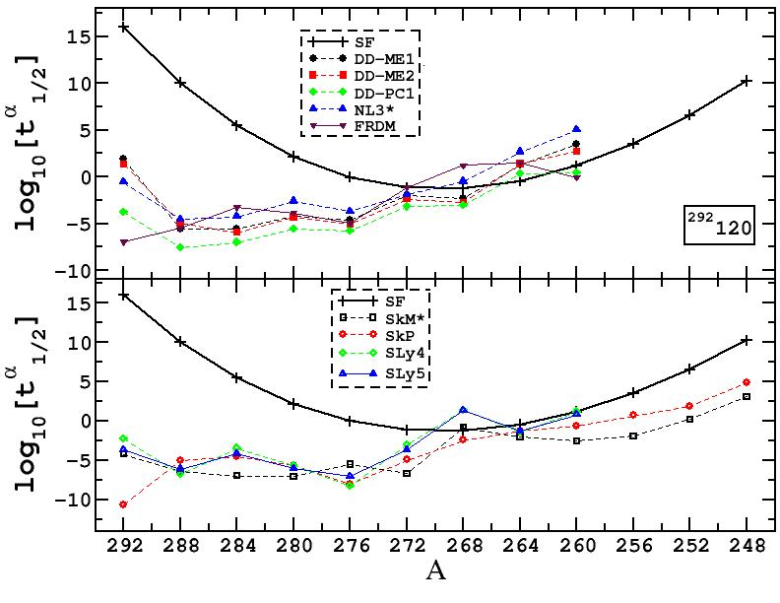
α– decay half life ²⁹²120 (N=172)

Slide 30
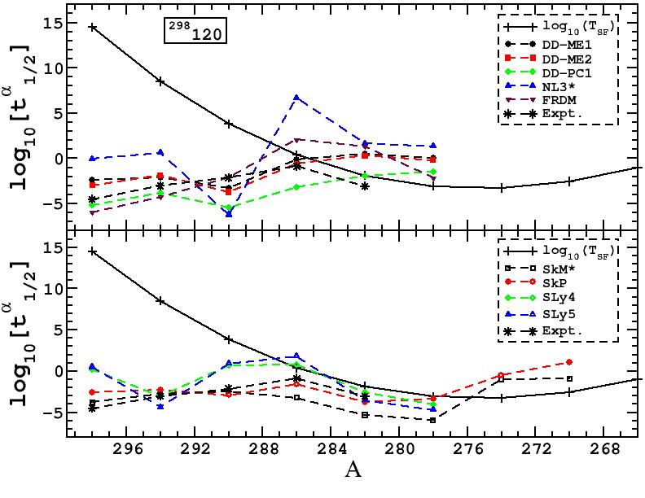
α– decay half life ²⁹⁸120

Slide 31
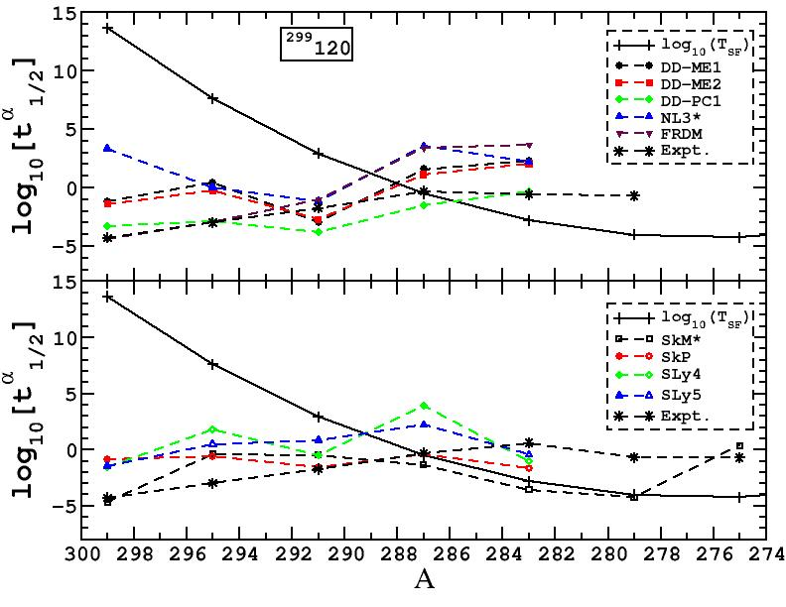
α– decay half life ²⁹⁹120

Slide 32
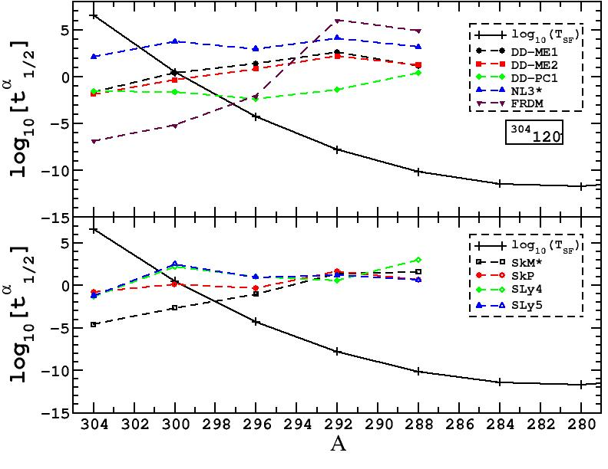
α– decay half life ³⁰⁴120 (N=184)

Slide 33
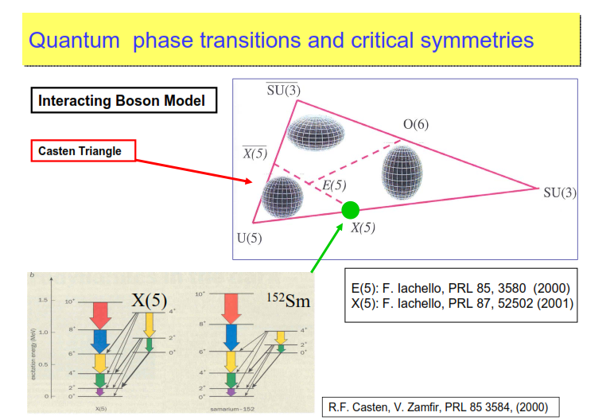
Spherical, Axially deformed
& gamma-unstable shapes
X(5), E(5) Critical symmetries
Critical point symmetry : transition region From a spherical vibrator to an axial rotor

Slide 34
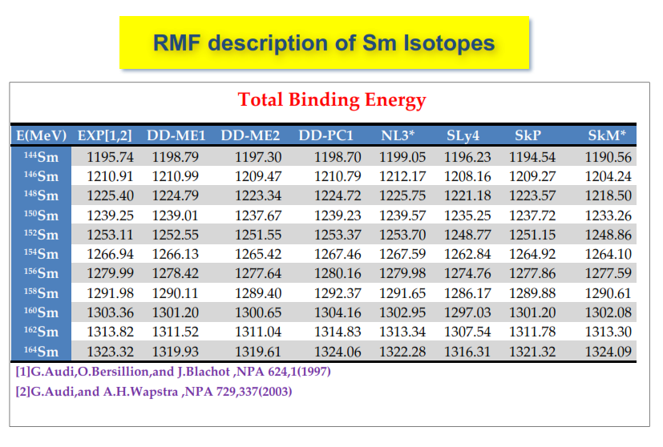

Slide 35
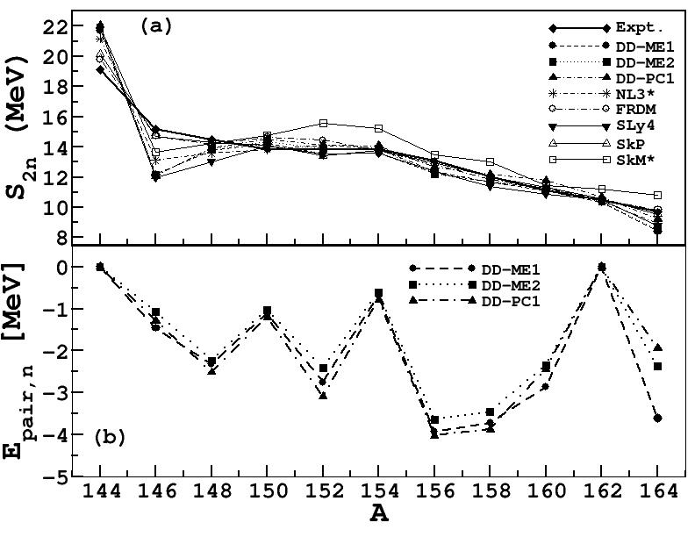
N=82
N=100

Slide 36
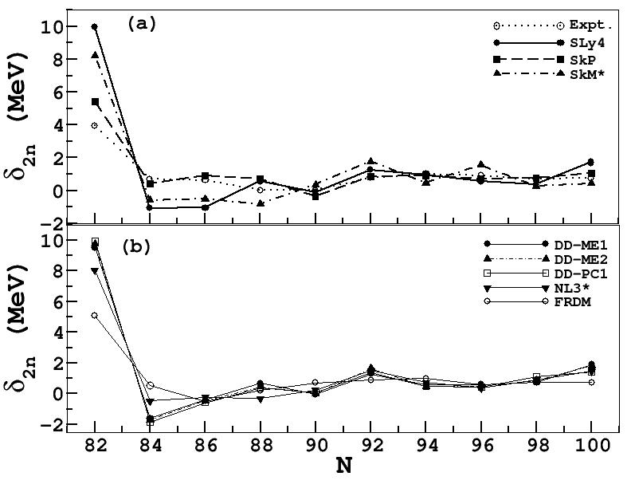
X
X
N=82

Slide 37
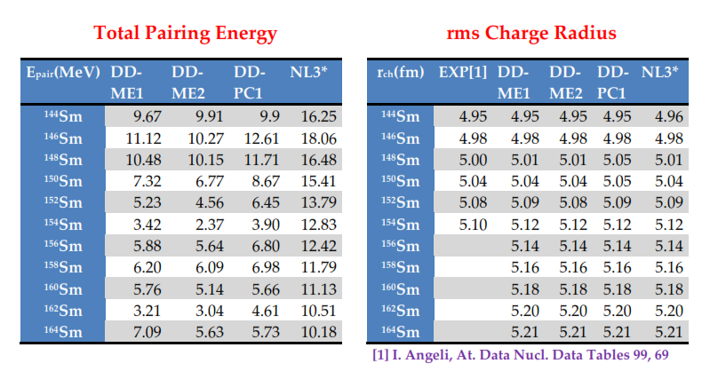

-E_{pair} (neutrons+protons)
The rms charge radius is calculated from the Proton radius by using the relation
taking the finite size of proton 0.8 fm.
$$r_{ch}=\sqrt{r_{}^{2}+0.64}$$

Slide 38
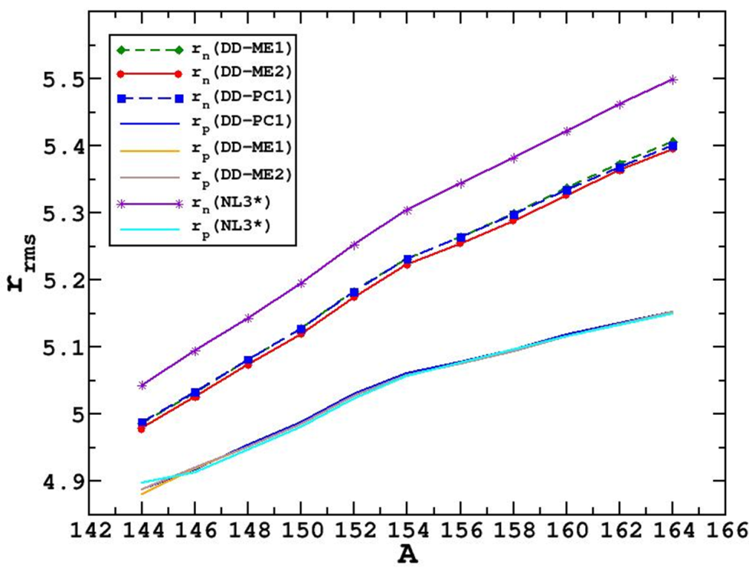
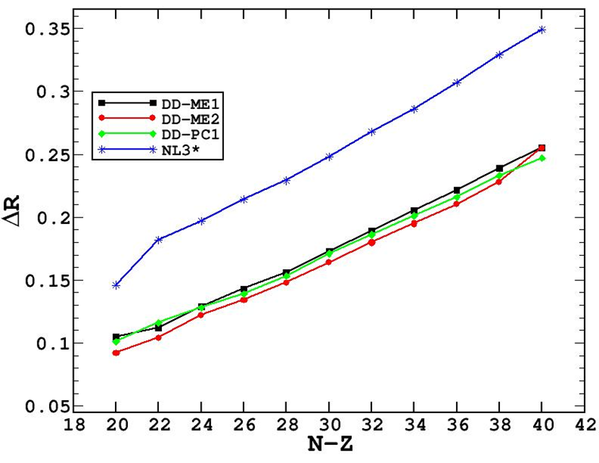
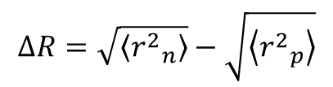
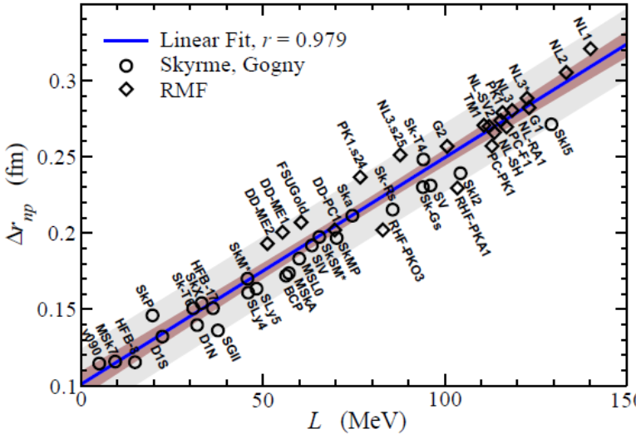
indication for the
development
of neutron skin
Eur. Phys. J. A50, 27 (2014)
= Slope parameter of the symmetry
energy at saturated density

Slide 39
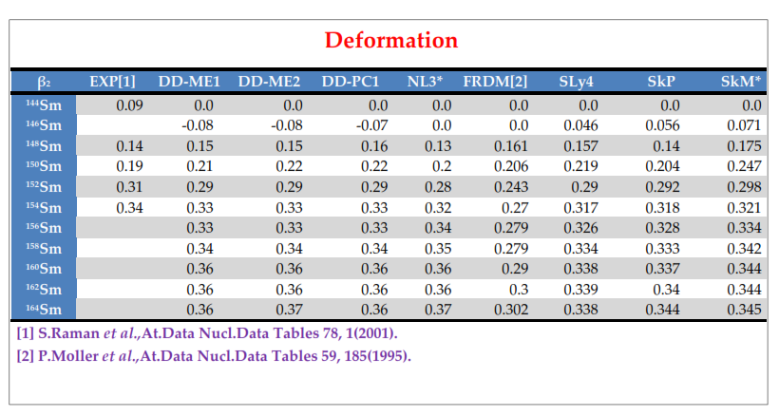

Slide 40
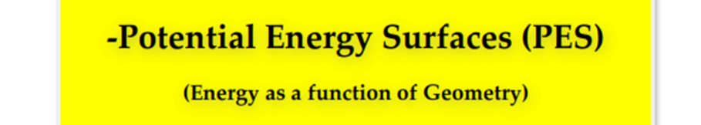

* Analysis of geometry
* Reaction dynamics
* Physically stable solution (minima)
* Saddle points corresponds to transition states
* Fission barrier
The calculations are performed imposing constraints on the axial mass Quadrupole moments. The method of quadratic constraints uses a variation of the function
where <H> is the total energy, and ,<Q₂₀> denotes the expectation value of the mas
Quadrupole operators
q₂₀ is the constrained value of the multipole moment.
C₂₀ is the corresponding stiffness constant.

Slide 41
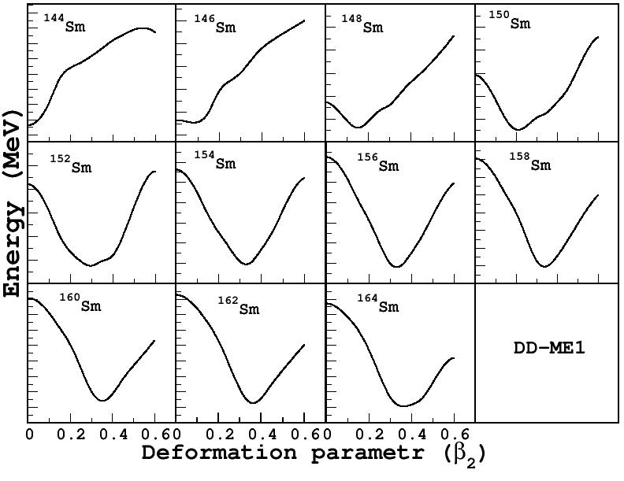
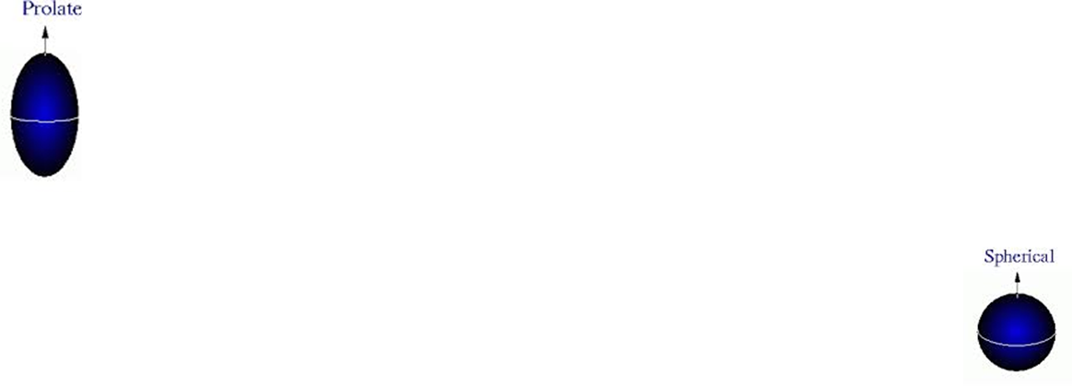
13 MeV
9 MeV
β₂-soft nuclei in the transition region
U(5) ------ X(5) -------SU(3)

Slide 42
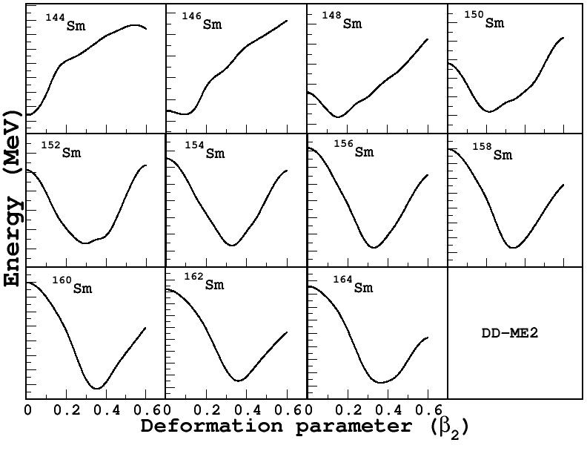

Slide 43
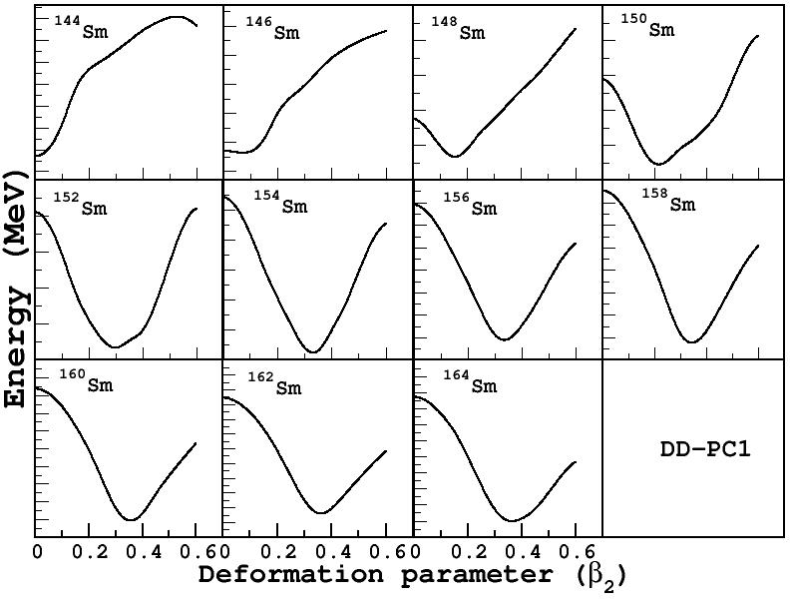

Slide 44
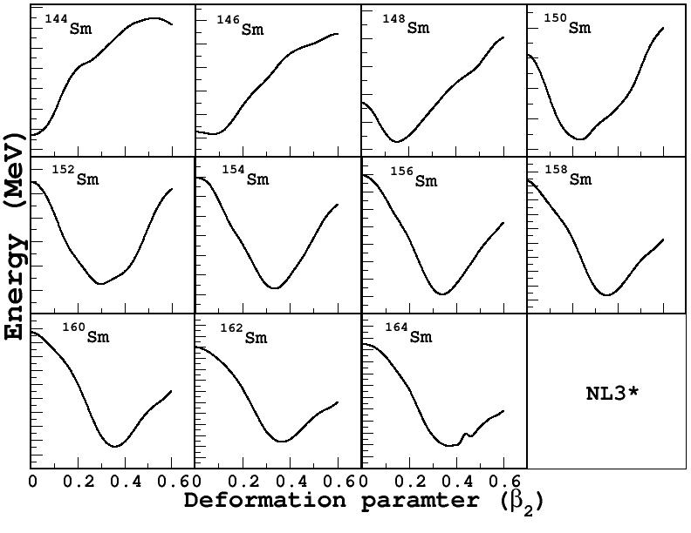

Slide 45
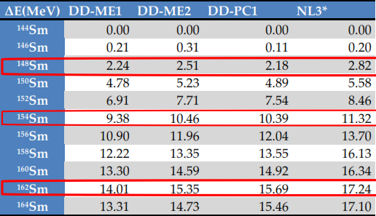
To analyze the transition region of shape change
ΔE = BE (ground state) – BE (spherical shape)
This discontinuity supports the N=100 as neutron shell closure
and ¹⁶²Sm as deformed magic number as predicted by some earlier calculations

Slide 46

Fermi level
Even parity levels
Odd parity levels
Ground state single particle energy levels
¹⁶²Sm

Slide 47
Summary
We have carried out systematic investigations to study the bulk ground state
properties and the microscopic structure of
* Super-heavy nuclei Z=120 (²⁸⁰⁻³¹⁰120 Isotopes) (^{292, 298, 299, 304}120 Isotopes)
* Even-even neutron rich ¹⁴⁴⁻¹⁶⁴Sm transitional nuclei.
Relativistic (CDFT) and non-relativistic (HFB) models used in this investigation.
Force parameters used are relativistic D-M1, DD-ME2, DDPC1, NL3*,
and non-relativistic Skyrme SLy5, SLy4, SkP and SkM*.
The investigation suggest the model independent results as well as model dependent
results such as on predicting the shell-closure location.
Stable isotopes are found near to the predicted magic number N=172, 184.
Neutron shell closure are found at N=162, 172, 184.
²⁹²120 and ³⁰⁴120 are spherical doubly magic nuclei, and ²⁸²120 is deformed doubly
magic nuclei.
Our predicted α-decay energy Qα and half-life time agree nicely within the model
parameters and with the FRDM and other experimental results.

Slide 48
Shape Transitions is observed in different interactions.
Potential energy surface and the single particle levels have been studied to
understand the phase transition and the critical-point behavior of ¹⁴⁴⁻¹⁶⁴Sm nuclei.
Signature of ¹⁶²Sm as a deformed magic nuclei is not very evident, as the weaker Shell closure indications at N=100.
The critical point nuclei ¹⁴⁸⁻¹⁵²Sm belongs to the transition region, and yes ¹⁵²Sm is candidate for X(5) symmetry.
Overall good agreement is found between the calculated and experimental results.

