Slide 1
Hadron properties from Lattice QCD
– Towards precision calculations –
Hartmut Wittig
PRISMA Cluster of Excellence, Institute for Nuclear Physics and Helmholtz Institute Mainz
Hirschegg 2014
Hadrons from Quarks and Gluons
Hirschegg, 12 – 18 January 2014
TexPoint fonts used in EMF.
Read the TexPoint manual before you delete this box.: AAAAAAAAAAAAAAAA

Slide 2
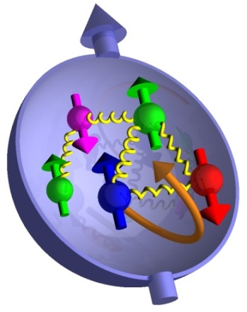
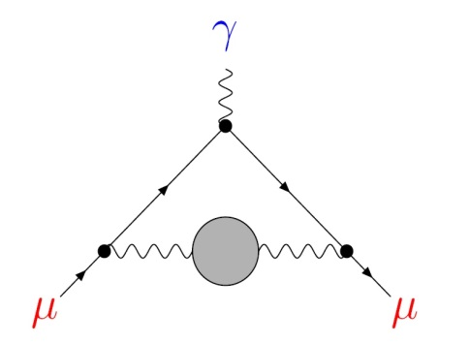
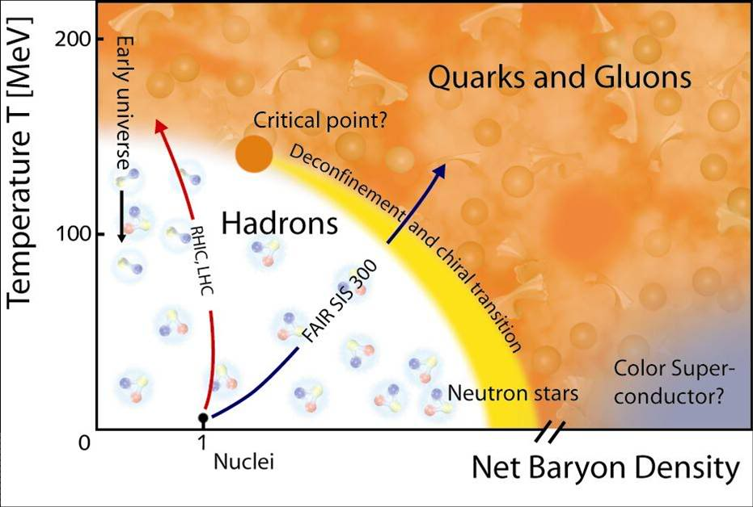
Low-Energy QCD in the LHC Era
Quantitative understanding of hadronic properties:
Hadron masses and decays
Structural properties
Determination of Standard Model parameters
Quark masses, strong coupling constant
Precision tests of the Standard Model at low energies:
QCD corrections to weak decay amplitudes
Hadronic contributions to the muon $(g−2)$
Non-perturbative input for QCD phase diagram:
Transition temperature; critical endpoint
Equation of State
Transport properties

Slide 3
Lattice QCD: Basic concepts
Non-perturbative treatment; regularised Euclidean functional integrals
lattice spacing: $a, x_{μ}=n_{μ}a, a^{−1}∼Λ_{UV}$
finite volume: $L^{3}⋅T$
Stochastic evaluation of $〈Ω〉$ via Markov process
Simulation algorithm: Hybrid Monte Carlo
[Duane et al., 1987]
Strong growth of numerical cost near physical $m_{u}, m_{d}$
Pion mass, i.e. lightest mass in the pseudoscalar channel:
$$≈500 MeV$$
(2001)
$$≈130−200 MeV$$
(2013)
$$⟶$$

Slide 4
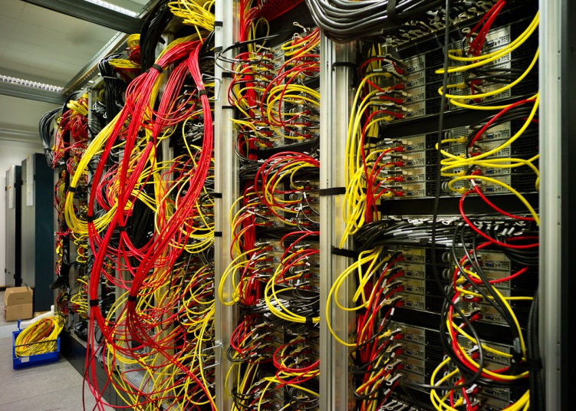
Machines
Commercial supercomputers (e.g. BlueGene/Q)
Custom-built machines (e.g. QPACE)
Commodity clusters (Intel, AMD, Infiniband; GPUs)
“Clover” @ HIM / IKP Mainz
5120 cores; Intel Ivybridge, 2.6 GHz
QDR Infiniband
120 TFlops (peak)

Slide 5
Systematic Effects
Lattice artefacts:
$⟶$ extrapolate to continuum limit from $a≈0.05−0.12 fm$
Finite volume effects:
Empirically: $m_{π}L ≳4$ sufficient for many purposes
Unphysical quark masses:
Chiral extrapolation to physical values of $m_{u}, m_{d}$ becomes obsolete
Inefficient sampling of SU(3) group manifold:
Simulations trapped in topological sectors as $a→0$
Use open boundary conditions in time direction
[Lüscher & Schaefer, 2012]

Slide 6
Outline
Global Lattice Averages
Nucleon form factors and axial charge
Anomalous Magnetic Moment of the Muon
Conclusions

Slide 7
I. Global Lattice Averages

Slide 8
The FLAG Working Group
[Colangelo et al., Eur Phys J C71 (2011) 1695; Aoki et al., arXiv:1310.8555]
Compilation of published results
Rate lattice results according to “quality criteria”
“when the systematic error has been […] convincingly shown to be under control”
“when a reasonable attempt […] has been made, although this could be improved”
“when no or a clearly unsatisfactory attempt […] has been made”
$$m_{π}^{min}<200 MeV$$
Chiral extrapolation:
$${200 MeV≤m}_{π}^{min}≤400 MeV$$
Chiral extrapolation:
Continuum extrapolation:
Continuum extrapolation:
$≥3$ lattice spacings, at least 2 points below $a=0.1 fm$
$≥2$ lattice spacings, at least 1 points below $a=0.1 fm$
Finite-volume effects:
Finite-volume effects:
$m_{π}^{min}L>4$ or at least 3 volumes
$m_{π}^{min}L>3$ and at least 2 volumes
Renormalisation:
Renormalisation:
Non-perturbative
1-loop perturbation theory, including truncation error

Slide 9
The FLAG Working Group
Quantities studied so far:
Light quark masses; strong coupling constant
Pion and kaon decays: $f_{π},$ $K_{ℓ2}$ and $K_{ℓ3}$; kaon B-parameter
LECs of mesonic ChPT
D and B-meson decays and mixing
Provide PDG-style “global averages”
Perform weighted averages, excluding results with red tags
Account for correlated systematic uncertainties

Slide 10
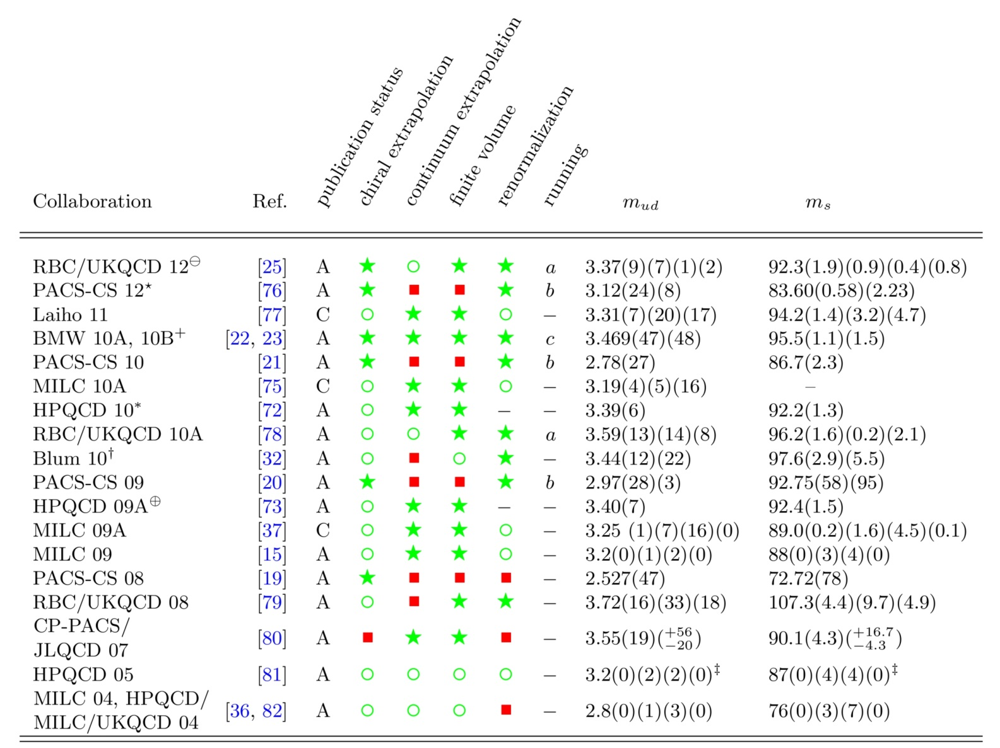
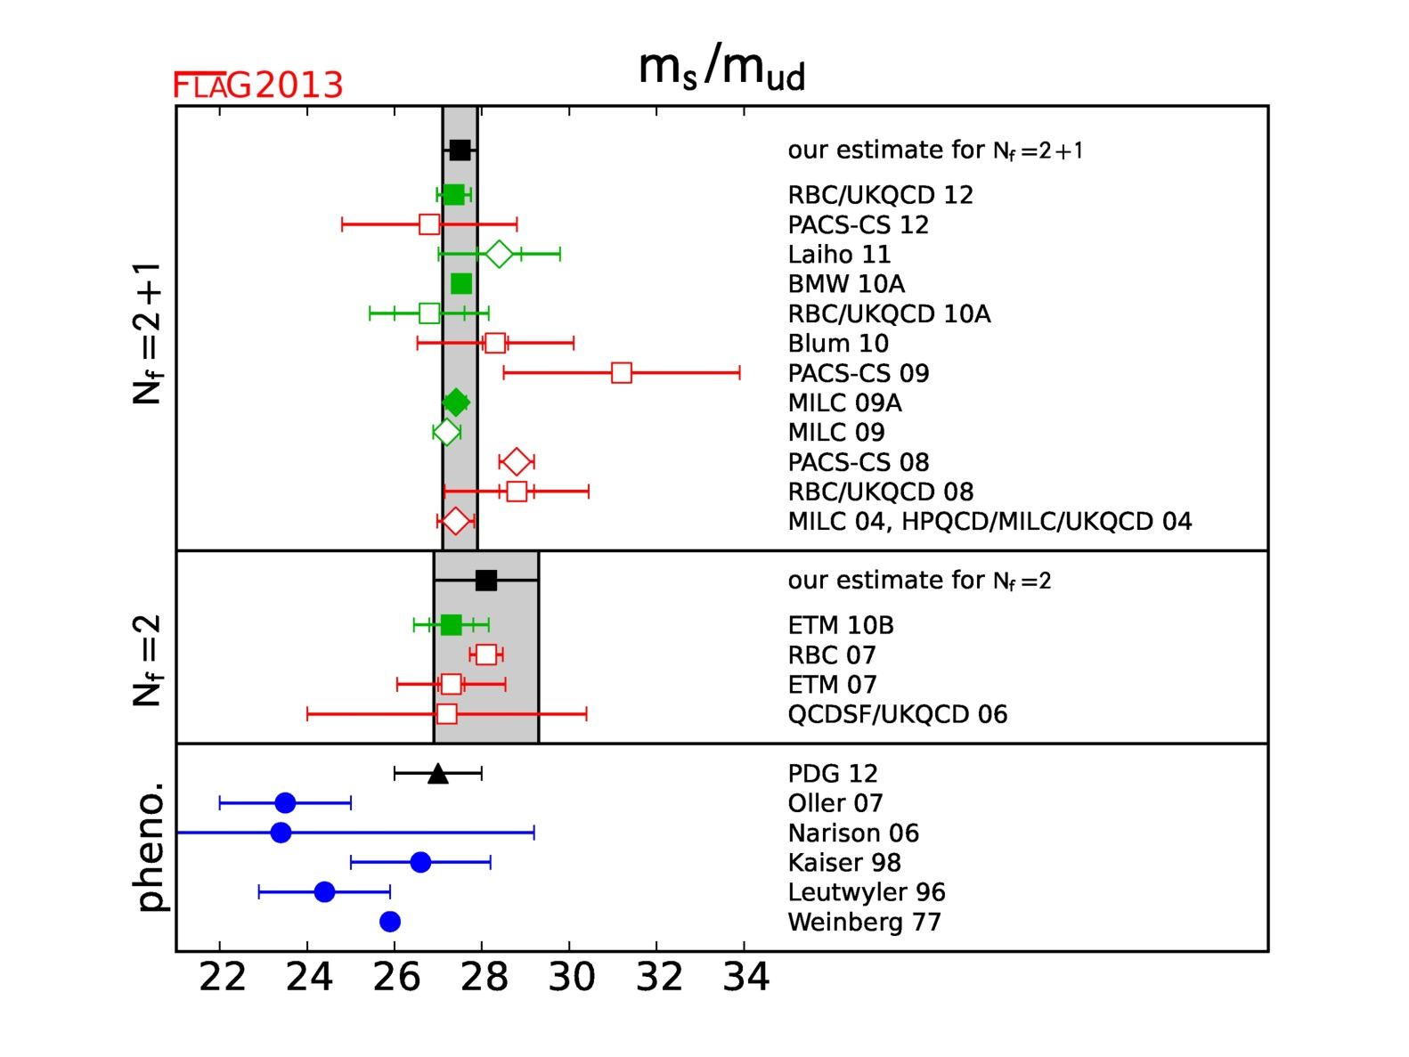
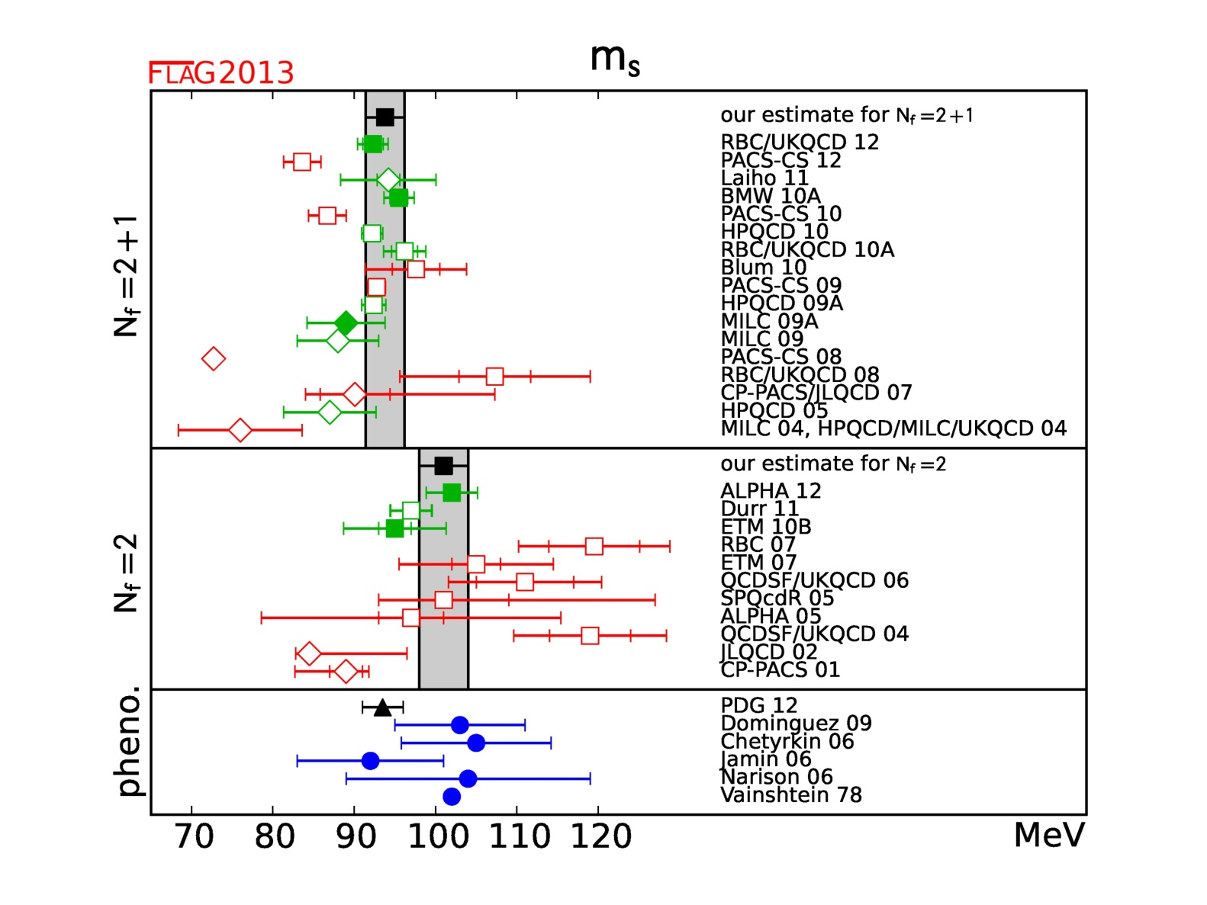
Light Quark Masses

Slide 11
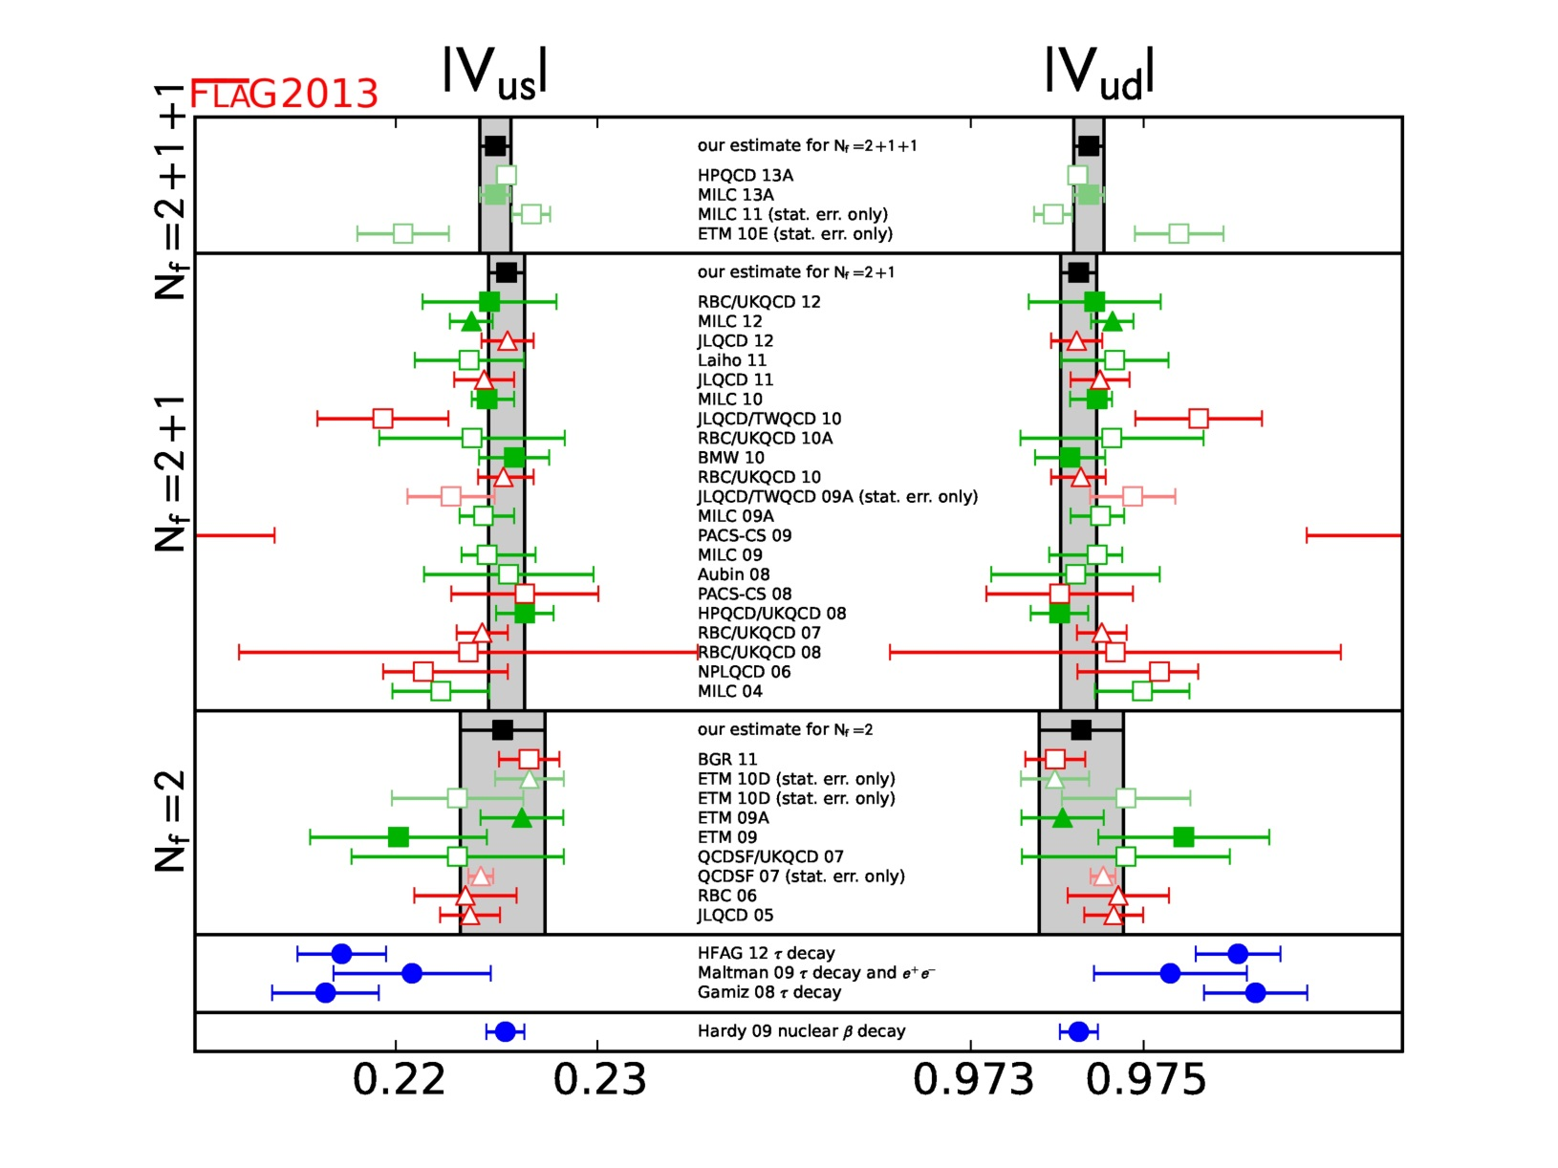
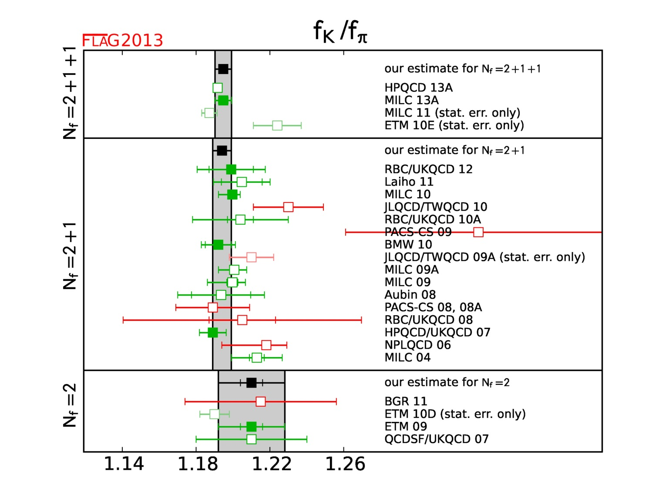
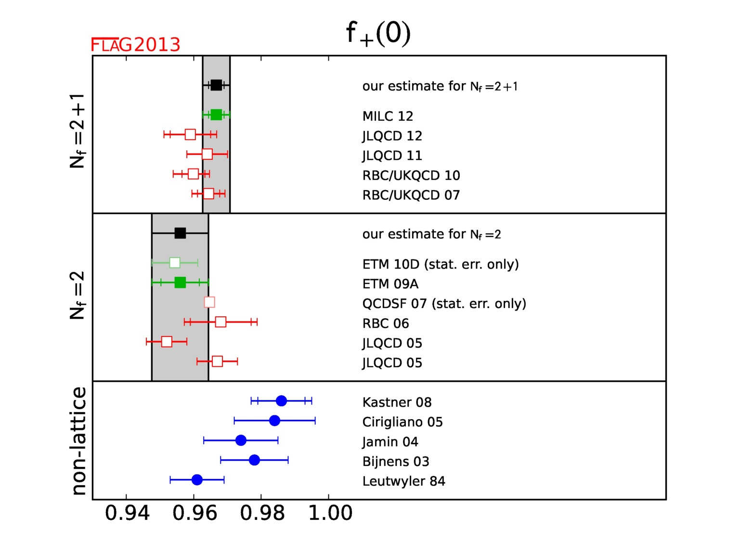
Pion and kaon decays – |V_{us}| and |V_{ud}|

Slide 12
Summary
Selection of “world averages” by FLAG-2013 ($N_{f}=2+1$):
 | Estimate | Rel. accuray
$$m_{s}^{\overline{MS}}\left(2 GeV\right)[MeV]$$ | $$93.8±2.4$$ | 2.6%
$$m_{u}^{\overline{MS}}\left(2 GeV\right)[MeV]$$ | $$2.16±0.09±0.07$$ | 5.3%
$$m_{u}/m_{d}$$ | $$0.46±0.02±0.02$$ | 6.1%
$${Σ_{\overline{MS}}^{}(2 GeV)}^{1/3} [MeV]$$ | $$265±17$$ | 6.4%
$$F_{π}/F$$ | $$1.0620±0.0034$$ | 0.3%
$$F_{K}/F_{π}$$ | $$1.192±0.005$$ | 0.4%
Lattice estimates of SM and low-energy parameters with percent-level accuracy

Slide 13
II. Nucleon Form Factors
and Axial Charge

Slide 14
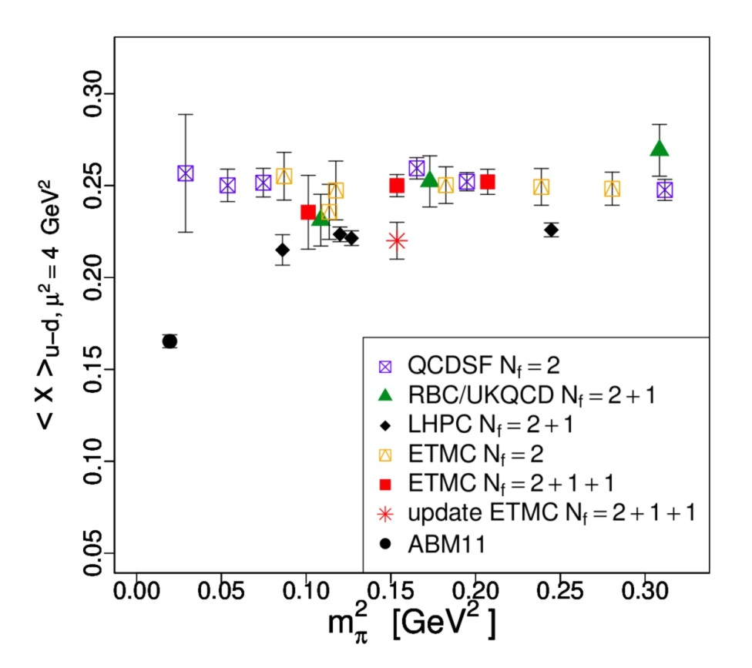
Can we understand nucleon structure from first principles?
Lattice simulations:
underestimate nucleon charge radii, axial charge $g_{A}$
overestimate moments of PDFs: ${\left\langle x\right\rangle }_{u−d}$
Systematic effects not fully controlled
Lattice artefacts
Chiral extrapolation to physical pion mass
Finite-volume effects
“Contamination” from excited states
Quark-disconnected diagrams ignored
[Alekhin, Blümlein, Moch, Phys Rev D86 (2012) 054009]

Slide 15
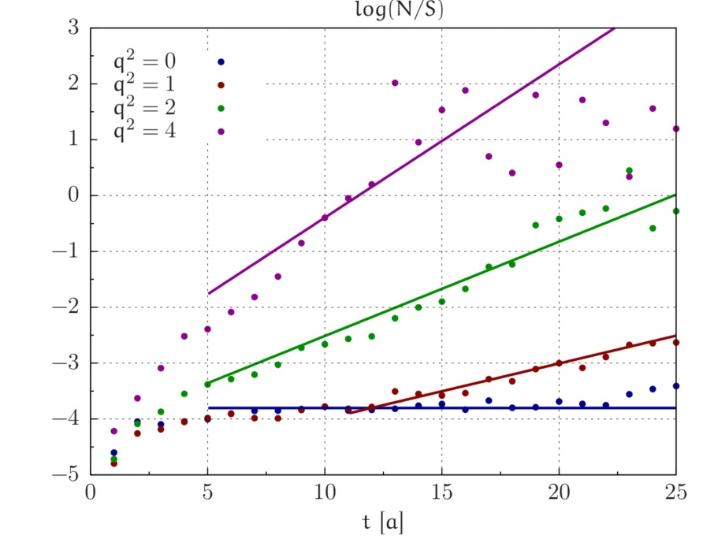
Baryon correlation functions
Exponentially increasing noise-to-signal ratio:
Nucleon at rest: $R_{NS}\left(x_{0}\right)∼e^{\left(m_{N}− \frac{3}{2}m_{π}\right)x_{0}}$
Pion at $\vec{p}≠0$:
$$R_{NS}\left(x_{0}\right)∼e^{\left(\sqrt{m_{π}^{2}+{\vec{p}}^{2}}−m_{π}\right)x_{0}}$$
Challenge for accurate calculations of baryon form factors

Slide 16
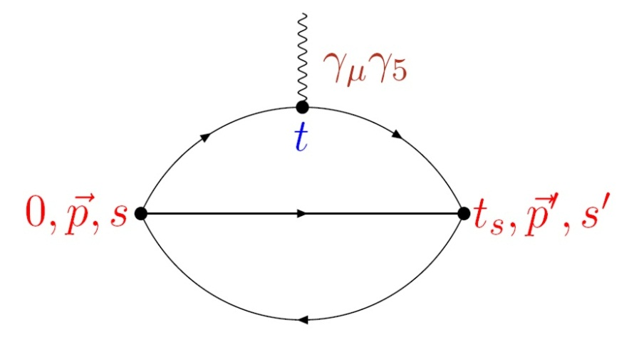
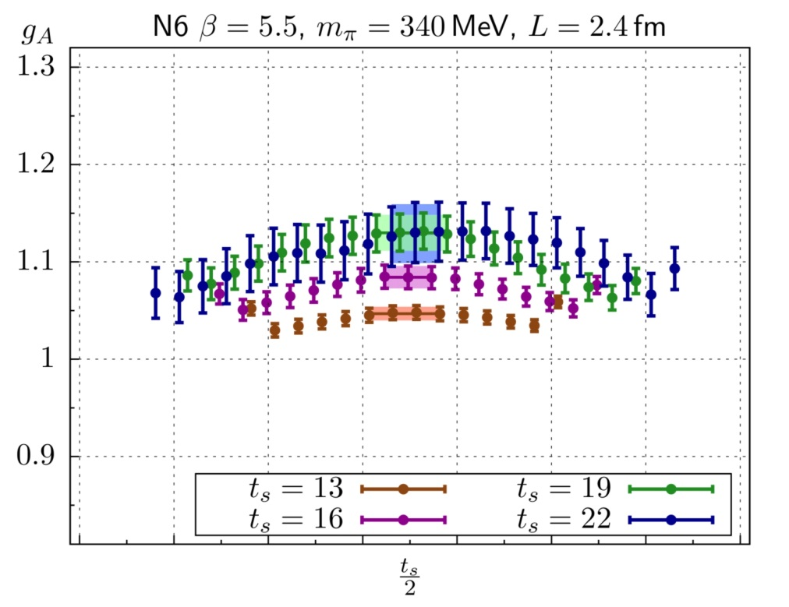
Plateau Method
Extract nucleon hadronic matrix elements from ratios of three- and two-point correlation functions, e.g.
Statistical fluctuations impose $t_{s}≲1.3 fm$
Axial charge $g_{A}:$
$$m_{π}=340 MeV$$
$$t_{s}=0.7−1.1 fm$$
$$L=2.4 fm$$

Slide 17
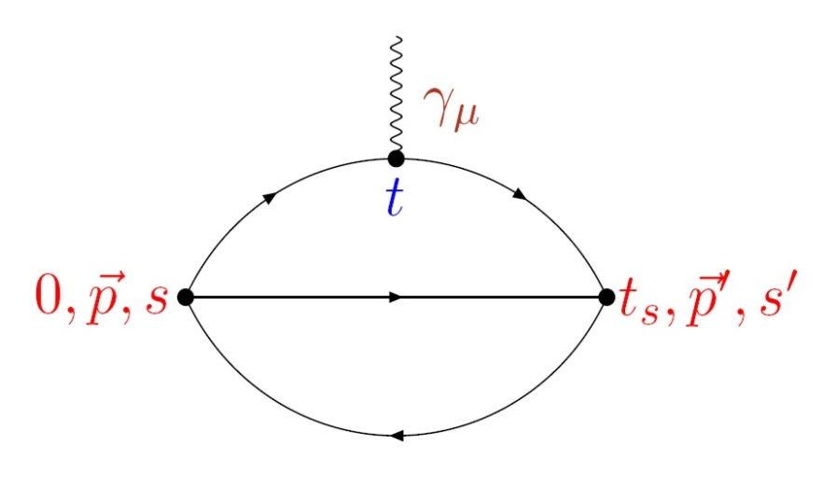
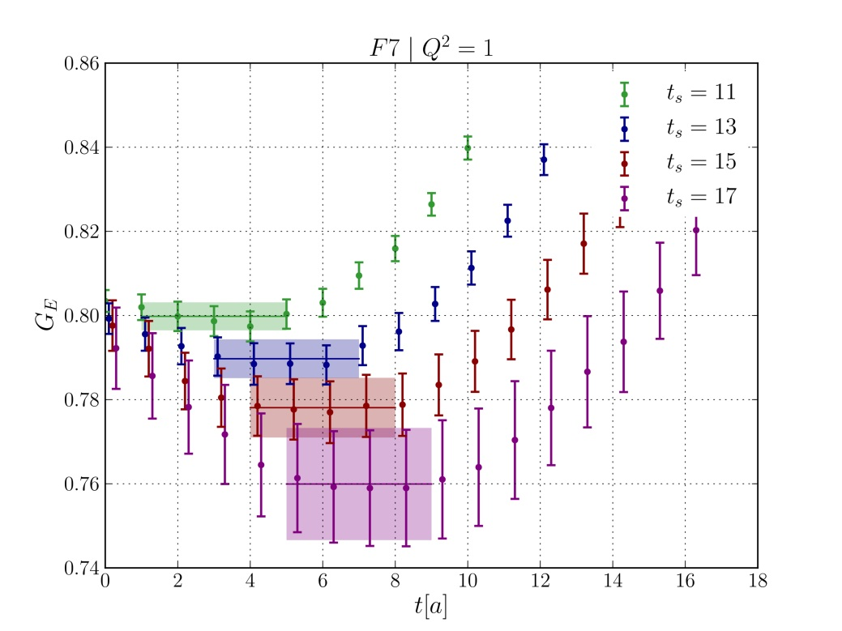
Plateau Method
Extract nucleon hadronic matrix elements from ratios of three- and two-point correlation functions, e.g.
Statistical fluctuations impose $t_{s}≲1.3 fm$
Electric FF $G_{E}\left(Q^{2}\right):$
$$m_{π}=277 MeV$$
$$t_{s}=0.7−1.1 fm$$
$$L=3.0 fm$$
$$\left|\vec{q}\right|={2π}/L$$

Slide 18
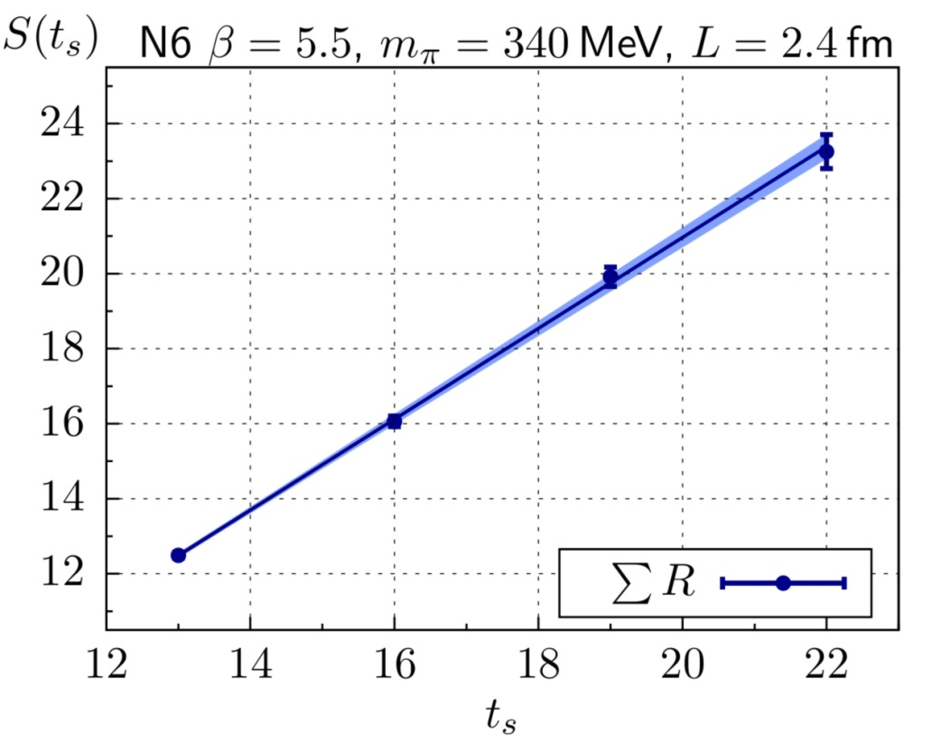
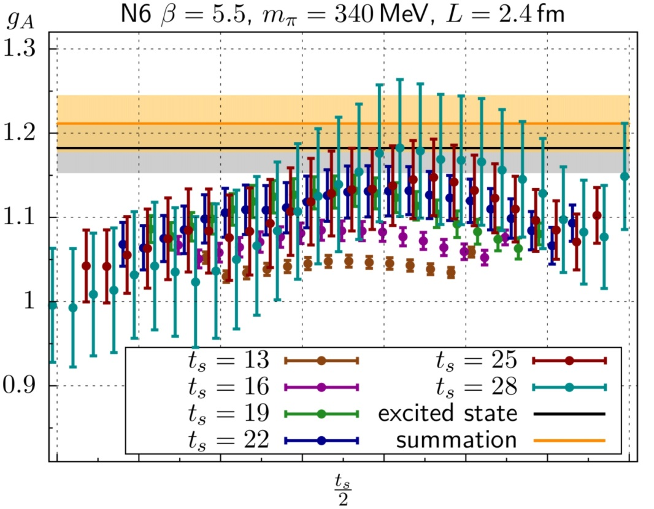
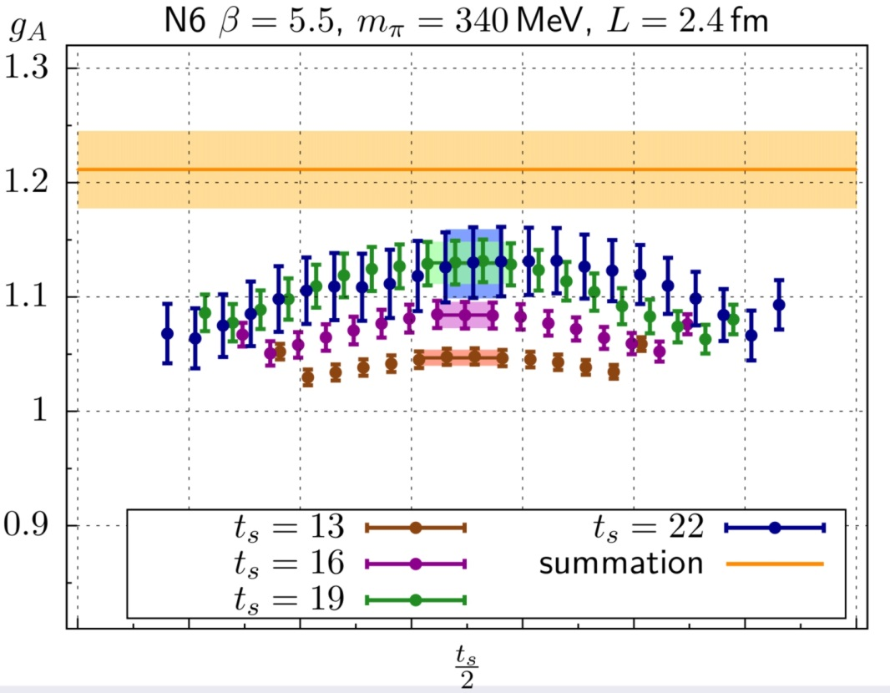
Summed Insertions
[Maiani et al. 1987, Güsken et al. 1989, Bulava et al., Capitani et al.]
Plateau method: $R_{Γ}\left(\vec{q},t,t_{s}\right)=ℳ_{Γ}(\vec{q})+O\left(e^{−Δt},e^{−Δ^{′}\left(t_{s}−t\right)}\right)$
Summed insertion:
$$S_{Γ}\left(t_{s}\right)≡\sum_{t=0}^{t_{s}}{R_{Γ}\left(\vec{q},t,t_{s}\right)}=K_{Γ}+t_{s}\left\{ℳ_{Γ}(\vec{q})+O\left(e^{−Δt_{s}}, e^{−Δ^{′}t_{s}}\right)\right\}$$
Excited state contributions more strongly suppressed
Determine $ℳ_{Γ}(\vec{q})$ from linear slope of summed ratio
(axial charge)
(axial charge)
(axial charge)

Slide 19
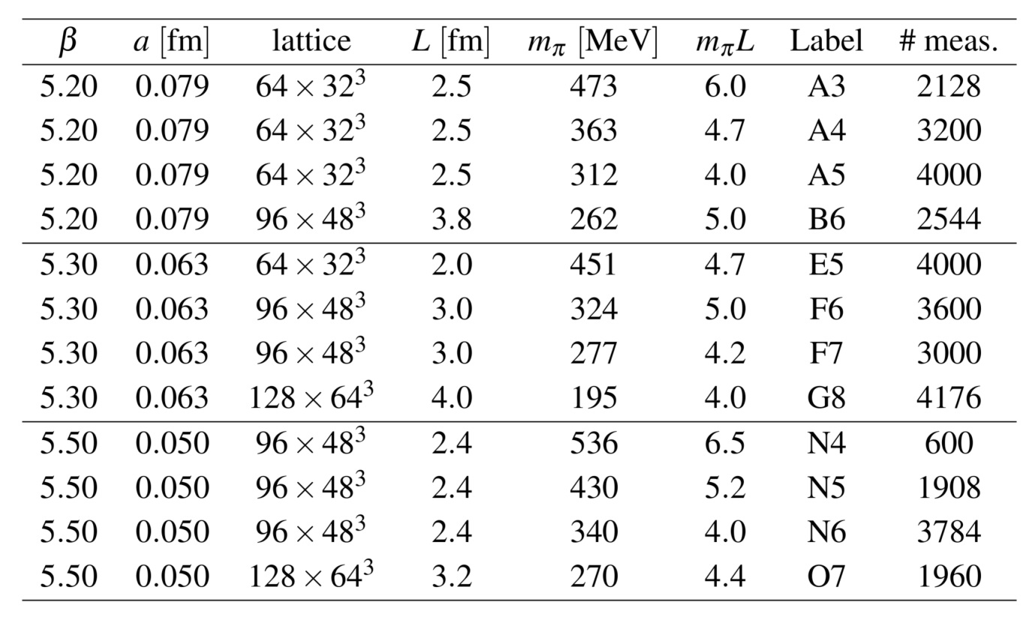
Nucleon axial charge in two-flavour QCD
[Capitani, Della Morte, von Hippel, Jäger, Jüttner, Knippschild, Meyer, H.W., Phys Rev D86 (2012) 074502]
$O\left(a\right)$ improved Wilson fermions: $a=0.05, 0.063, 0.079$ fm

Slide 20
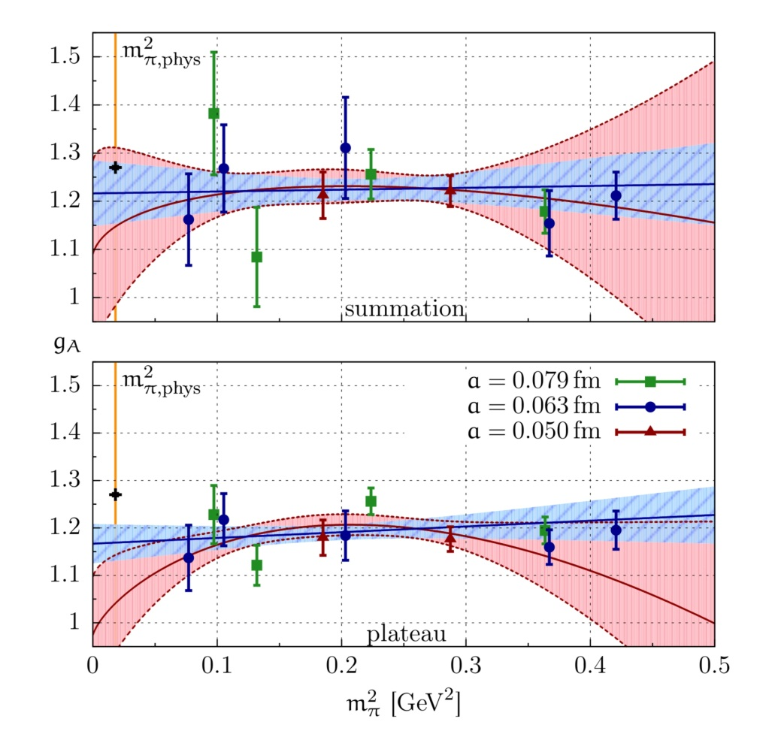
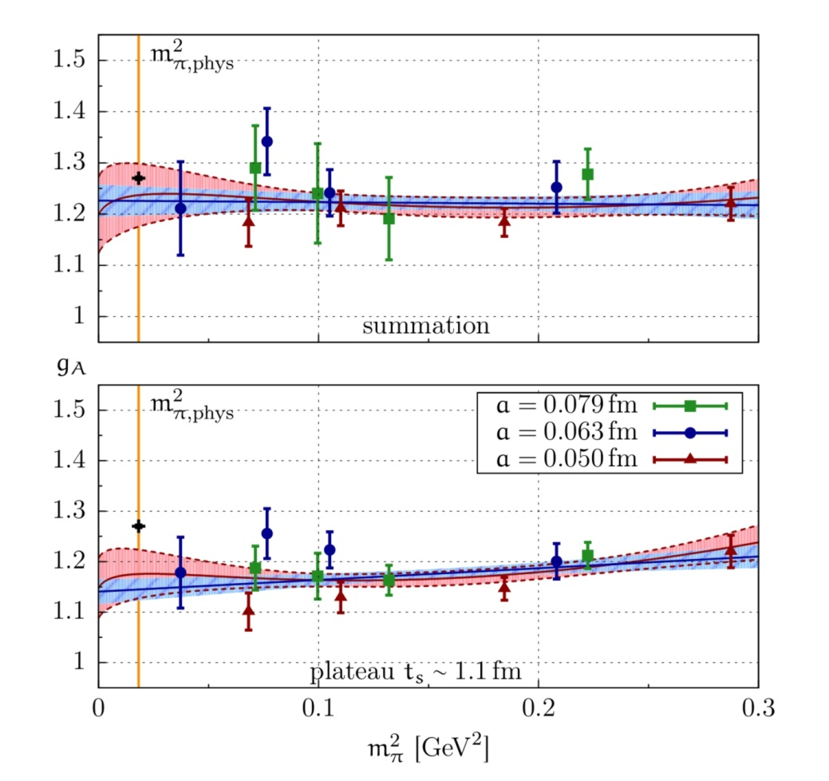
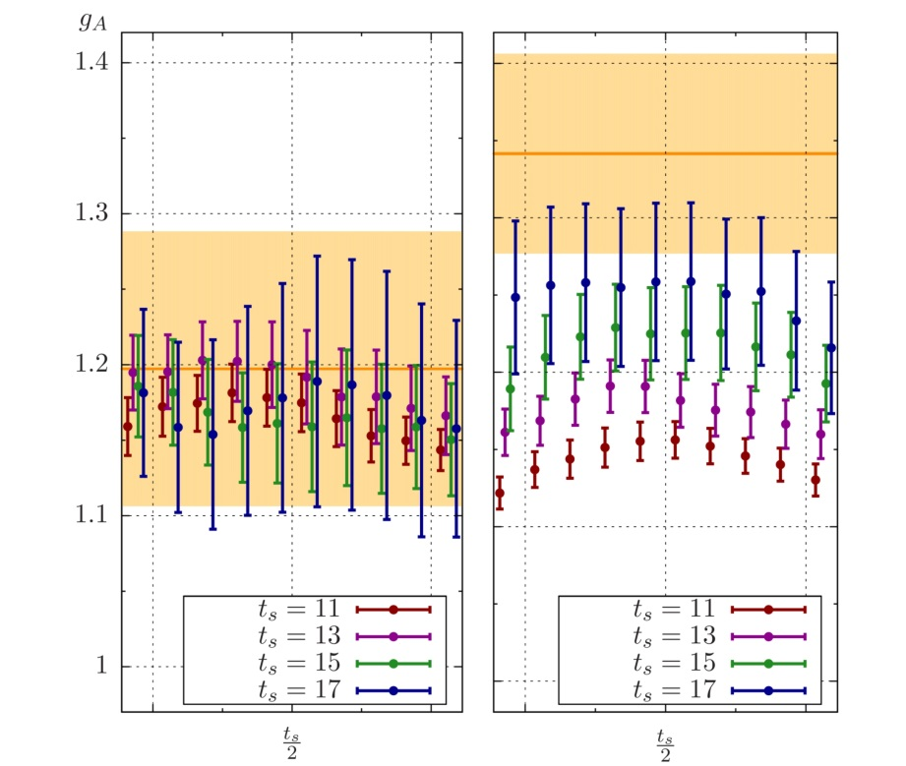
Nucleon axial charge in two-flavour QCD
[Capitani, Della Morte, von Hippel, Jäger, Jüttner, Knippschild, Meyer, H.W., Phys Rev D86 (2012) 074502]
$O\left(a\right)$ improved Wilson fermions: $a=0.05, 0.063, 0.079$ fm
Plateau and Summation methods; investigate chiral behaviour
Increased statistics (factor 3):
$$g_{A}=1.223±{0.063}_{stat}^{} (_{−0.060}^{+0.035})_{syst}$$

Slide 21
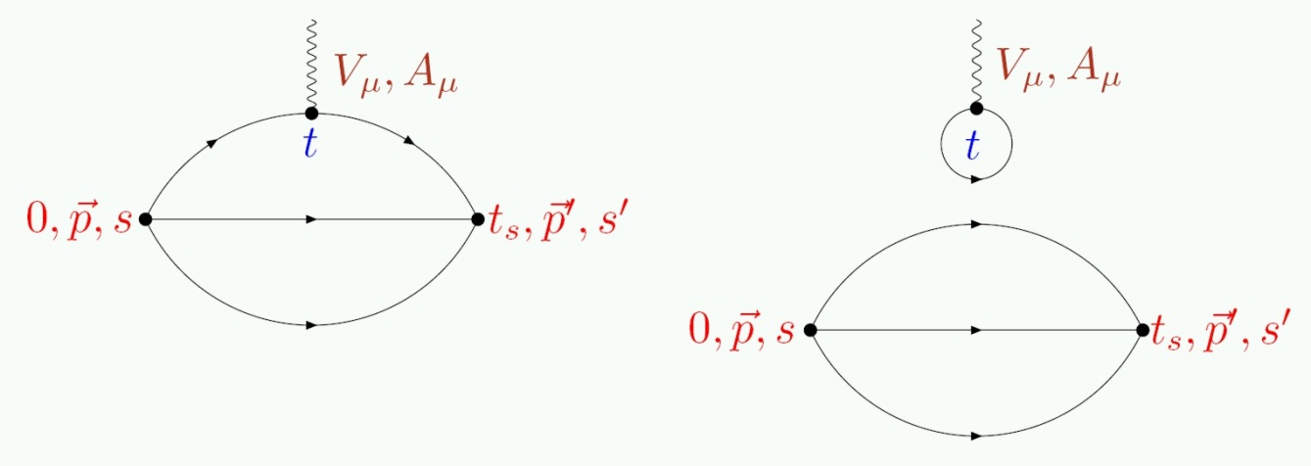
Vector form factors and charge radii
[Jäger, Rae, Capitani, Della Morte, Djukanovic, von Hippel, Knippschild, Meyer, H.W., arxiv:1311.6975]
Dirac and Pauli form factors:
Quark-disconnected diagrams contribute to iso-scalar form factors
Focus on iso-vector quantities:

Slide 22
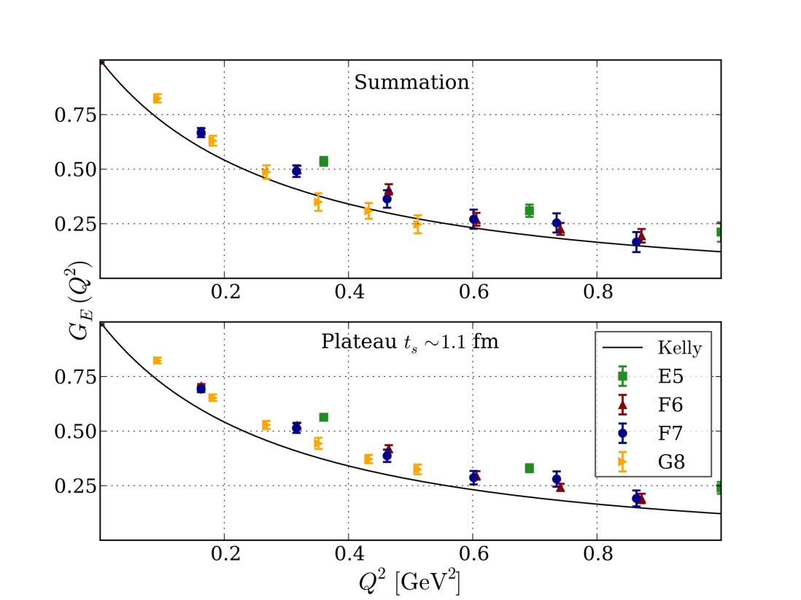
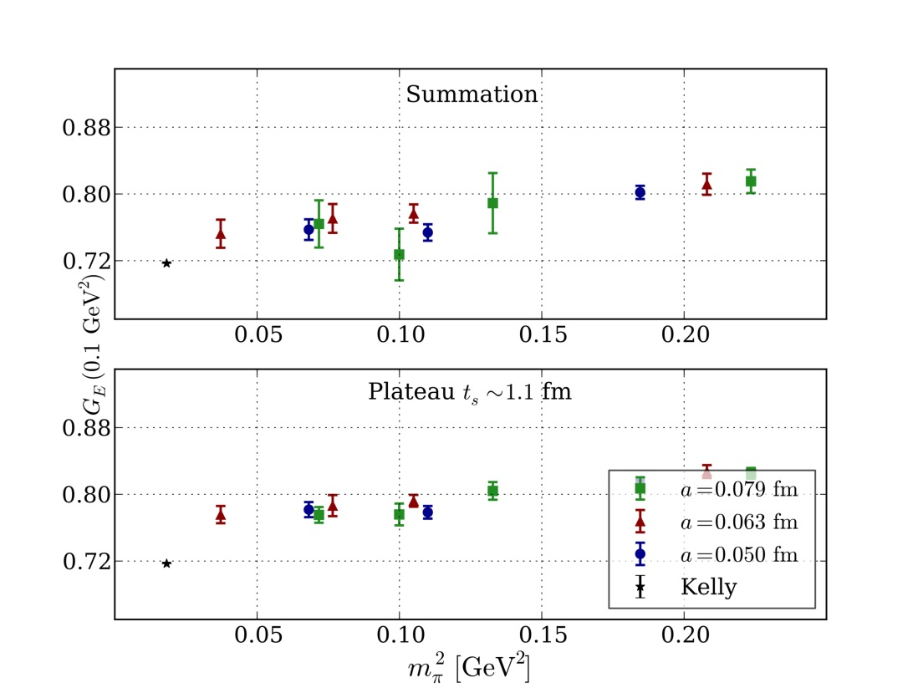
Vector form factors and charge radii
[Jäger, Rae, Capitani, Della Morte, Djukanovic, von Hippel, Knippschild, Meyer, H.W., arxiv:1311.6975]
$Q^{2}−$dependence; iso-vector electric form factor:
$$a=0.063 fm,$$
$$Q^{2}≈0.1 {GeV}^{2},$$
$$m_{π}=195−450 MeV$$
$$a=0.05−0.79 fm$$

Slide 23
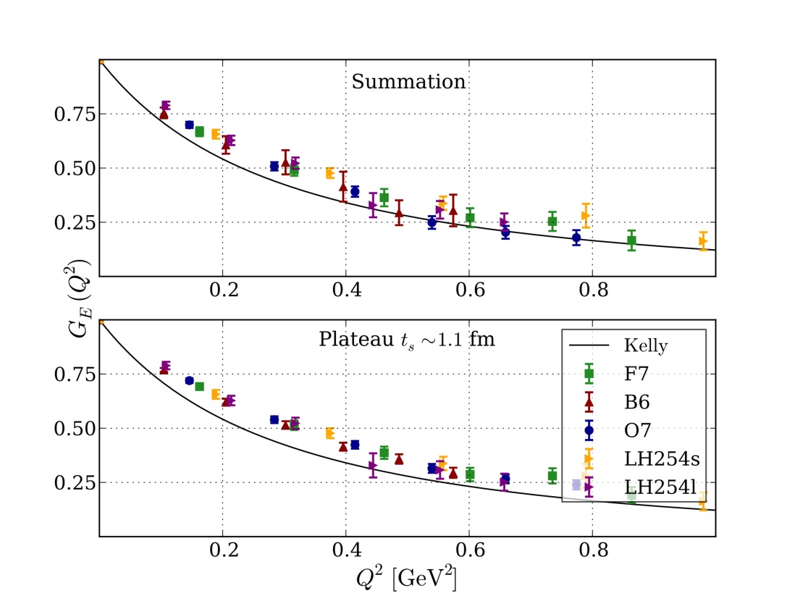
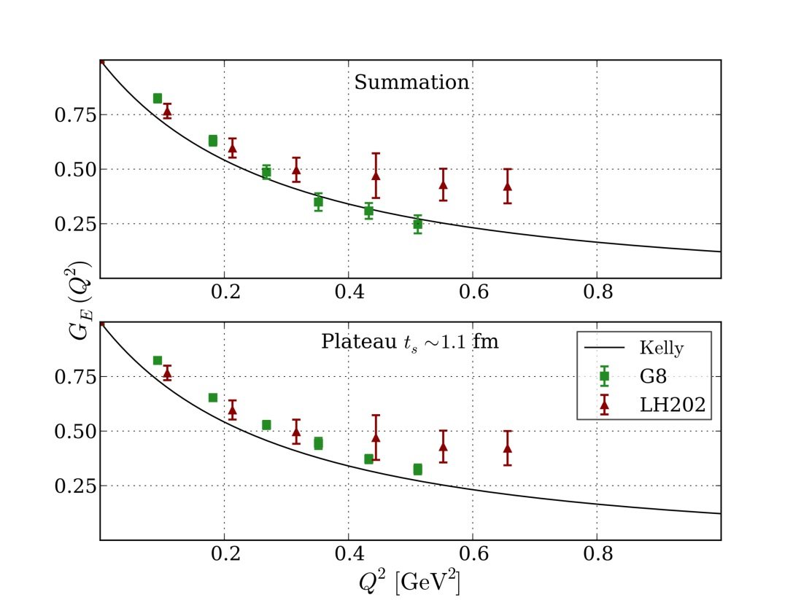
Vector form factors and charge radii
[Jäger, Rae, Capitani, Della Morte, Djukanovic, von Hippel, Knippschild, Meyer, H.W., arxiv:1311.6975]
$Q^{2}−$dependence; comparison with LHP Collaboration:
$$m_{π}≈270 MeV$$
$$m_{π}≈200 MeV$$

Slide 24
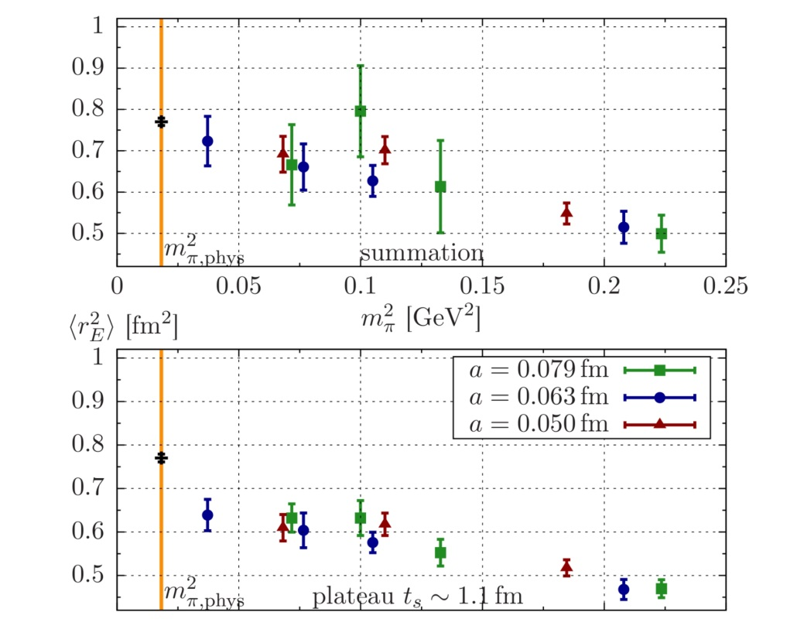
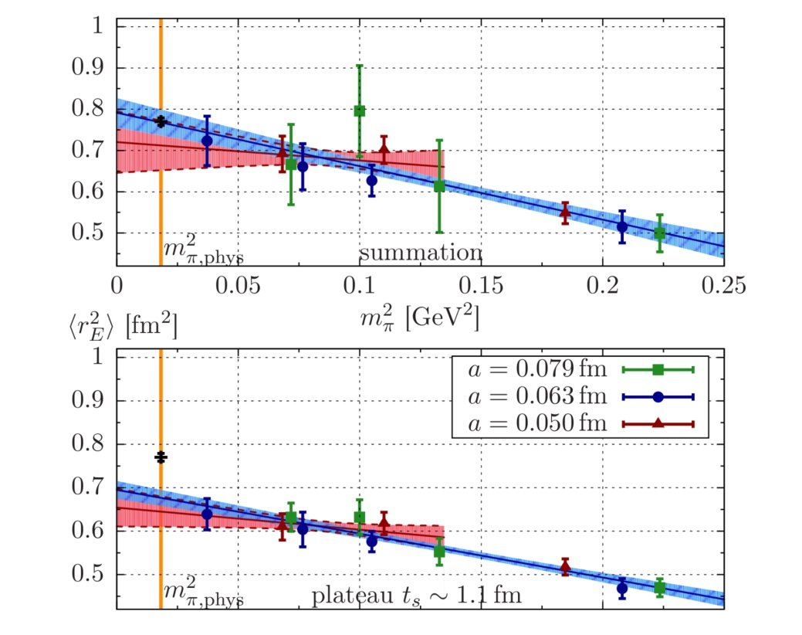
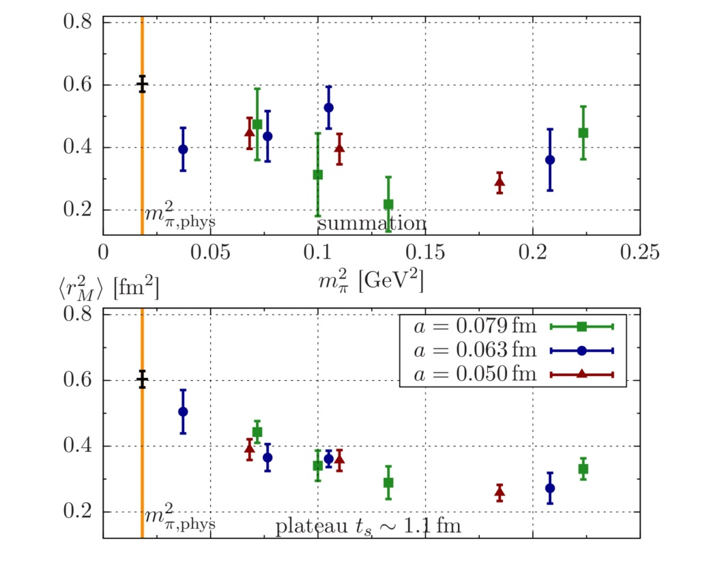
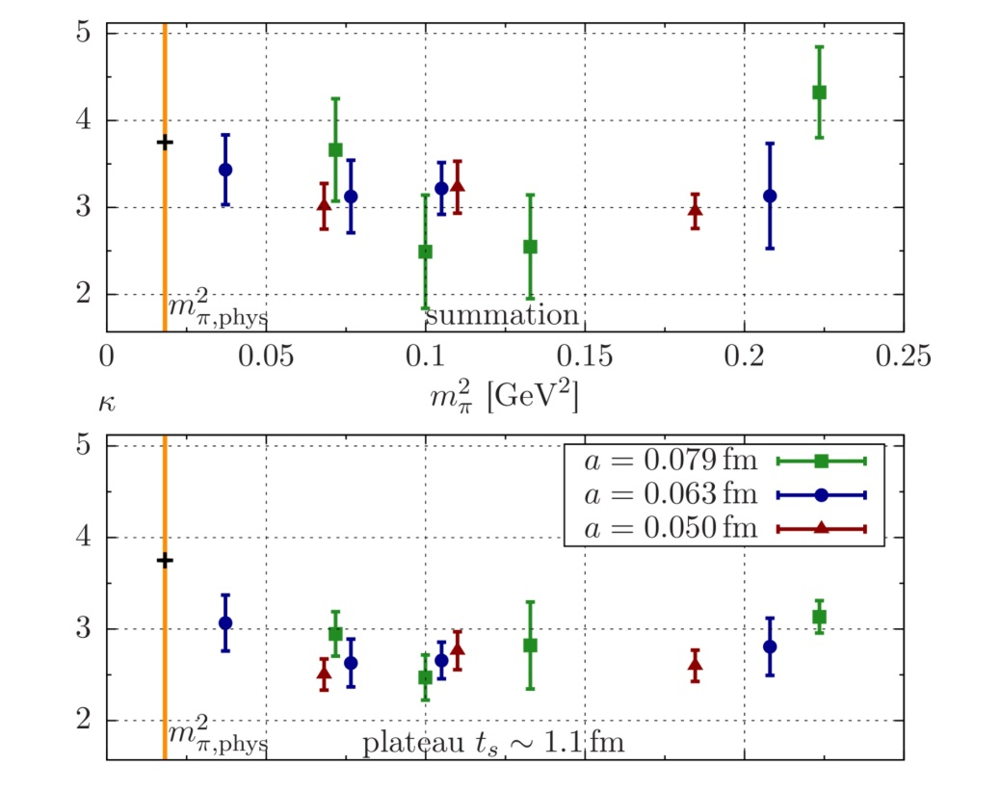
Vector form factors and charge radii
[Jäger, Rae, Capitani, Della Morte, Djukanovic, von Hippel, Knippschild, Meyer, H.W., arxiv:1311.6975]
Chiral behaviour and fits:

Slide 25
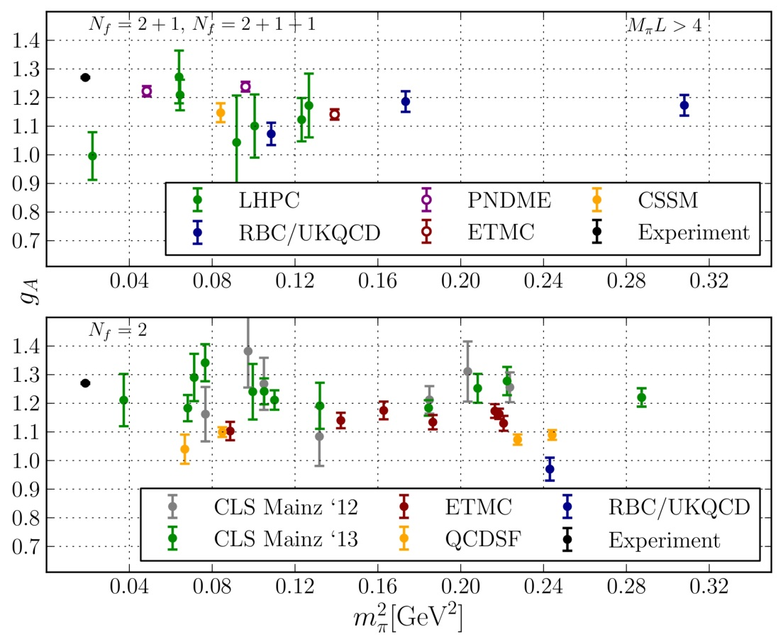
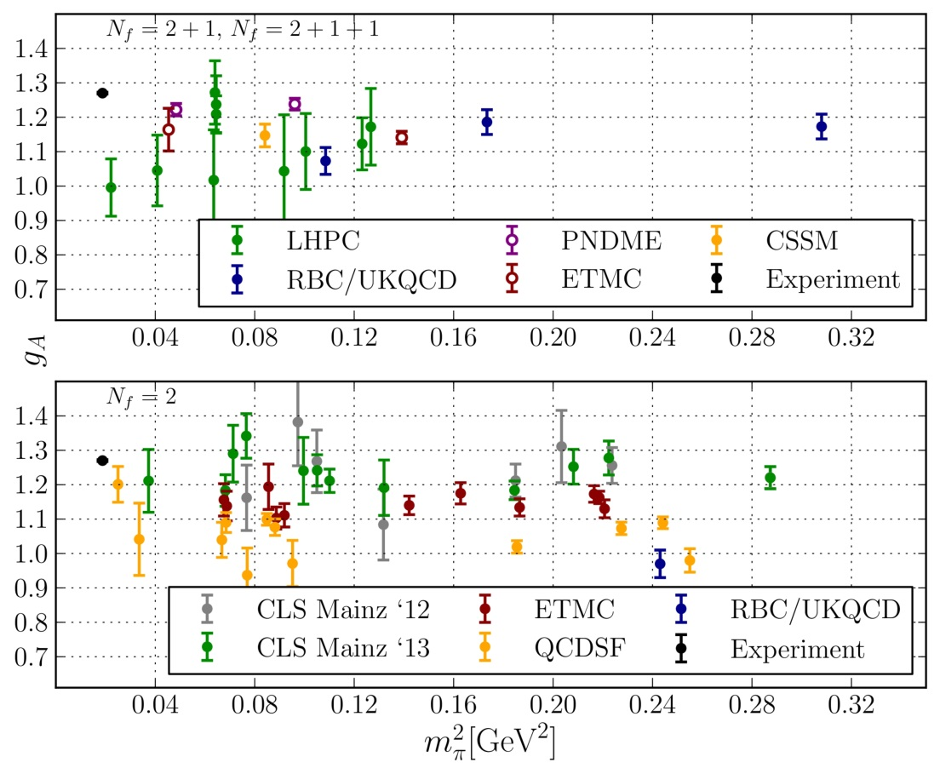
Nucleon form factors and axial charge
Plateau method: $t_{s}≲1.2 fm$ not sufficient to rule out bias from excited state contributions
Agreement with phenomenology improved by
Removing excited state “contamination”
Using near-physical pion masses
Detailed investigation of chiral behaviour and fits in progress
Small finite-volume effects for $m_{π}L≳4$
[Green et al., arXiv:1310.7043]

Slide 26
III. Anomalous Magnetic Moment of the Muon

Slide 27
Hadronic vacuum polarisation contribution to ${\left(g−2\right)}_{μ}$
$$a_{μ}^{VP;had}=(6923±42±3)∙{10}^{−11}$$
(combined $e^{+}e^{−}$ data)
Theory prediction uses experimental data as input
Ab initio estimate from Lattice QCD: total accuracy of $≤0.5\%$ required!

Slide 28
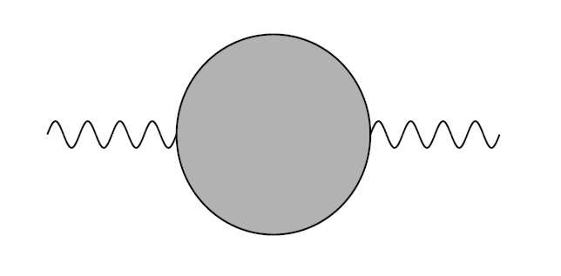
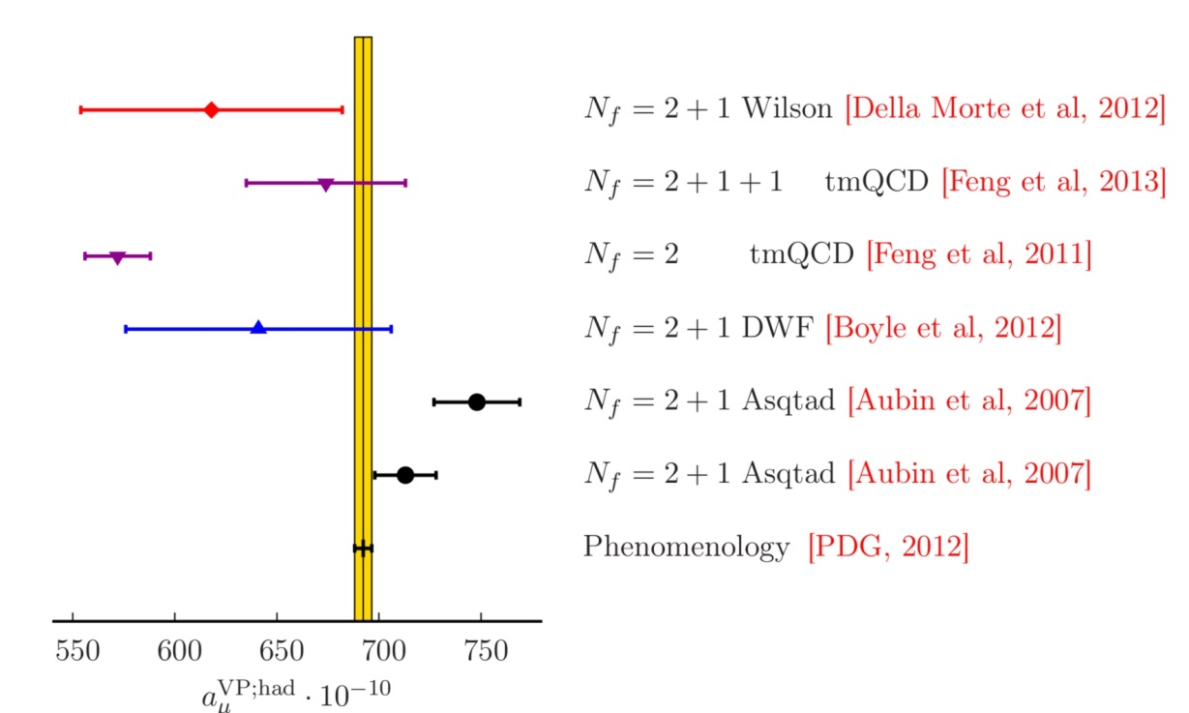
Hadronic vacuum polarisation on the Lattice
Lattice approach: evaluate convolution integral over Euclidean momenta
Current lattice estimates not competitive with dispersive approach

Slide 29
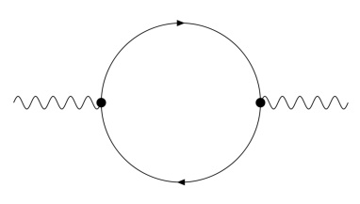
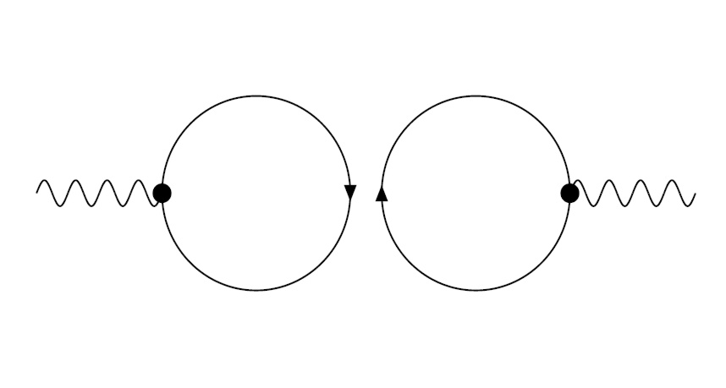
Hadronic vacuum polarisation on the Lattice
Increase statistical accuracy in lattice calculation of $Π(q^{2})$
Reduce systematic uncertainty associated with $q^{2}−$ dependence:
Convolution function peaked far below lowest Fourier momentum:
Maximum of $f\left(q^{2}\right)$ near $\left(\sqrt{5}−2\right)m_{μ}^{2}≈0.003 GeV^{2}≪{\left(\frac{2π}{T}\right)}^{2}≈0.06 GeV^{2}$
Subtracted amplitude required: $\hat{Π}\left(q^{2}\right)≡Π\left(q^{2}\right)−Π(0)$
$⟶$ determine $Π(0)$ via extrapolation $q^{2}→0$
Quark-disconnected diagrams:

Slide 30
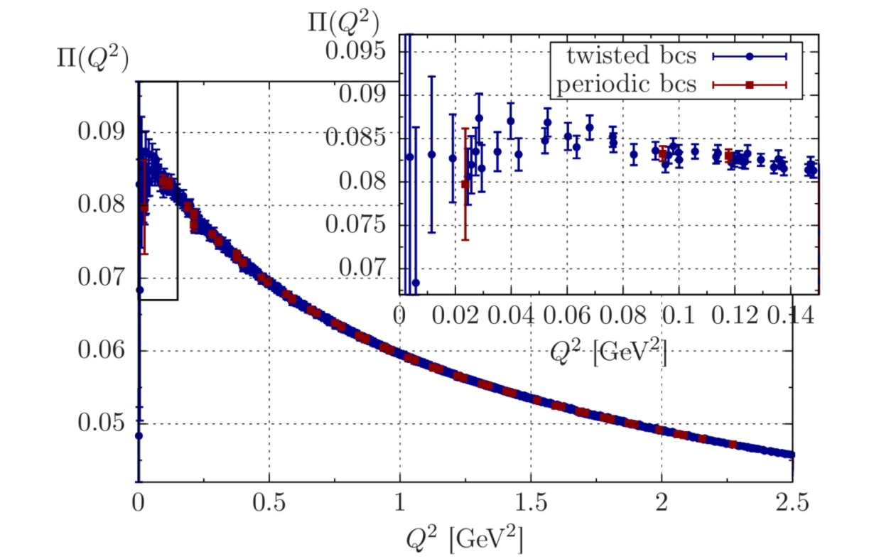
Low-momentum region of $Π(q^{2})$
$$ψ\left(x+L{\hat{e}}_{k}\right)=e^{iθ_{k}} ψ\left(x\right) ⟹ p_{μ}=\frac{2π}{L}+\frac{θ_{μ}}{L}$$
Twisted boundary conditions:
$$m_{π}≃195 MeV$$
$$L≃4 fm$$
[Della Morte, Jäger, Jüttner, H.W., JHEP 1203 (2012) 055; PoS LATTICE2012 (2012) 175]

Slide 31
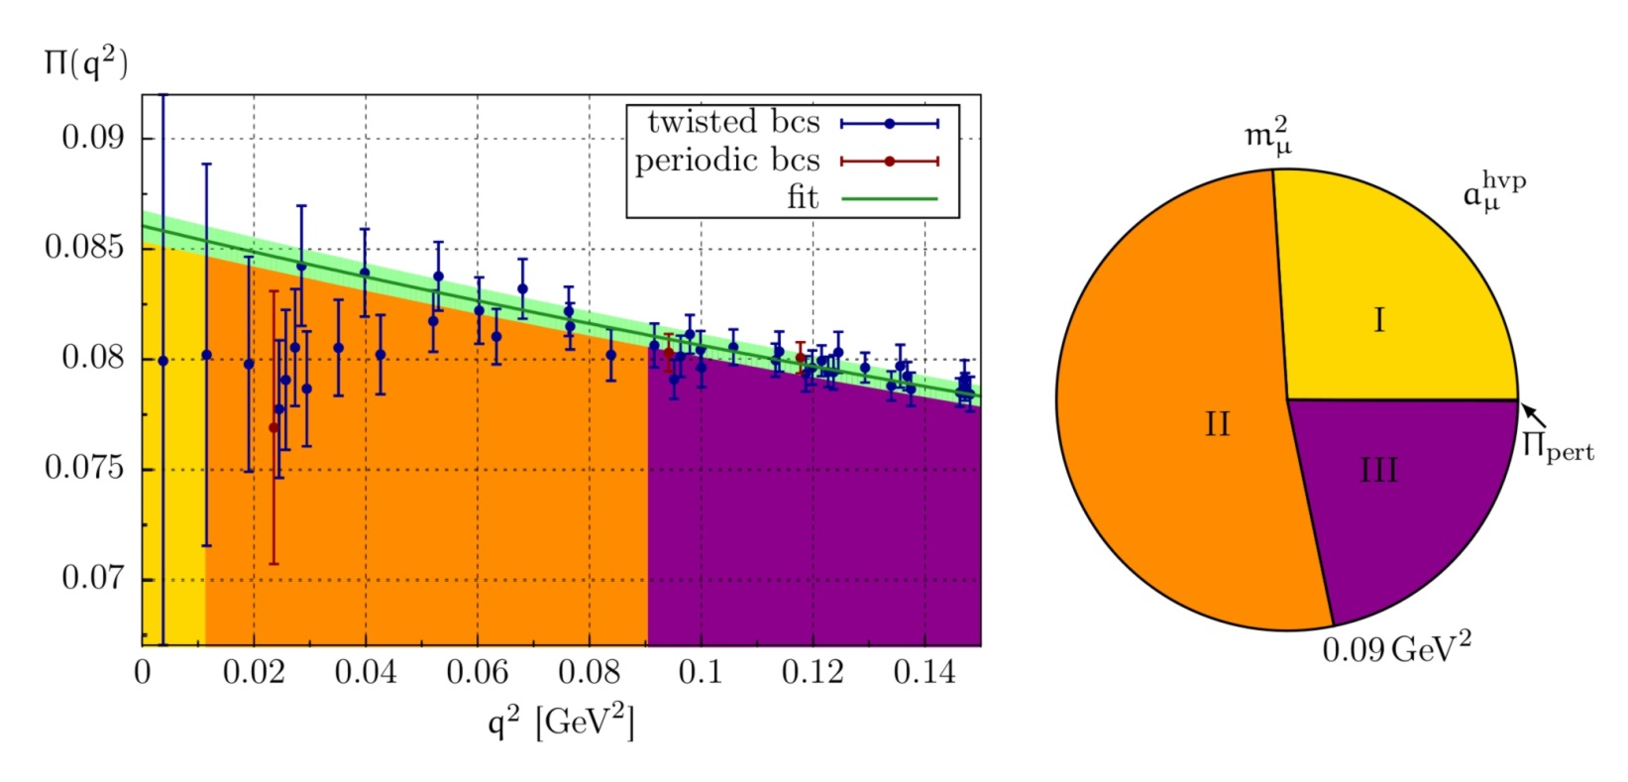
Low-momentum region of $Π(q^{2})$
$$ψ\left(x+L{\hat{e}}_{k}\right)=e^{iθ_{k}} ψ\left(x\right) ⟹ p_{μ}=\frac{2π}{L}+\frac{θ_{μ}}{L}$$
Twisted boundary conditions:
$$m_{π}≃195 MeV$$
$$L≃4 fm$$
[Della Morte, Jäger, Jüttner, H.W., JHEP 1203 (2012) 055; PoS LATTICE2012 (2012) 175]
$q^{2}$-dependence described by [2,3] Padé ansatz [Blum, Golterman & Peris, 2012]

Slide 32
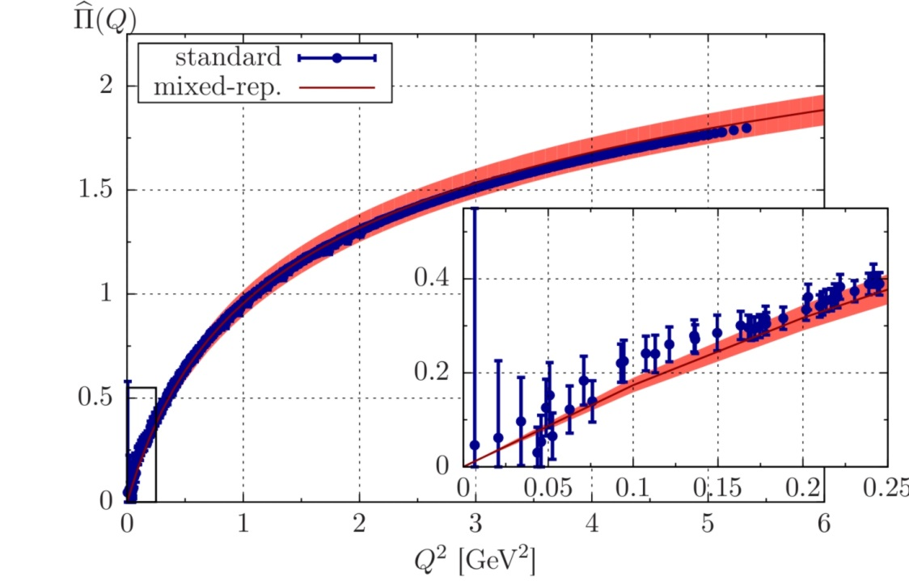
Low-momentum region of $Π(q^{2})$
Mixed-representation correlator:
[Bernecker & Meyer, 2010; Feng et al., 2013]
Momentum $Q^{2}$ is tunable parameter
Constrain momentum dependence near $Q^{2}=0$
Allows for determination of the Adler function
[Francis, Jäger, Meyer, H.W., PRD 88 (2013) 054502]
$$m_{π}≃325 MeV$$

Slide 33
Conclusions
“Mature” lattice calculations:
Estimates for SM and low-energy parameters with percent accuracy
Accurate information on hadron spectrum
Global estimates dominated by systematics
Nucleon matrix elements:
Large noise-to-signal ratio in baryonic correlation functions
Systematic effects may be hidden in the data
Good progress in reconciling experiment and lattice calculations
Hadronic contributions to the muon (g – 2):
Hadronic vacuum polarisation: improve statistical accuracy
Better control over low-$Q^{2}$ regime required
Light-by-light scattering even tougher; but 25% overall accuracy sufficient

Slide 34
Spares

Slide 35
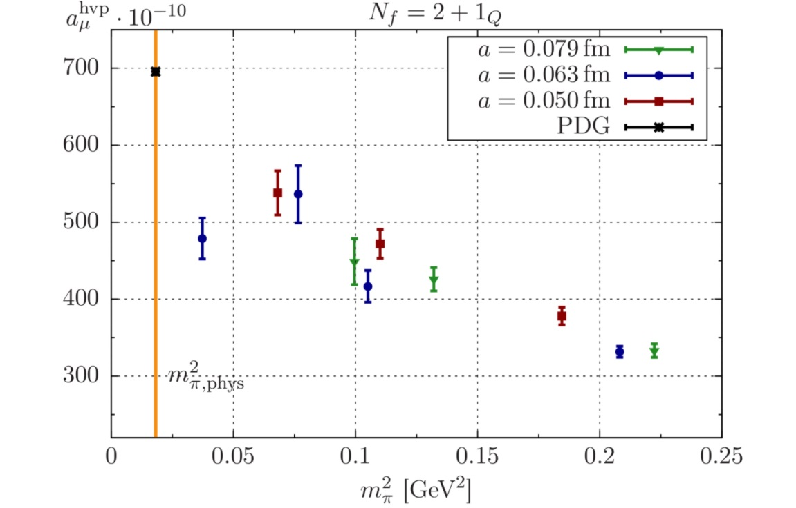
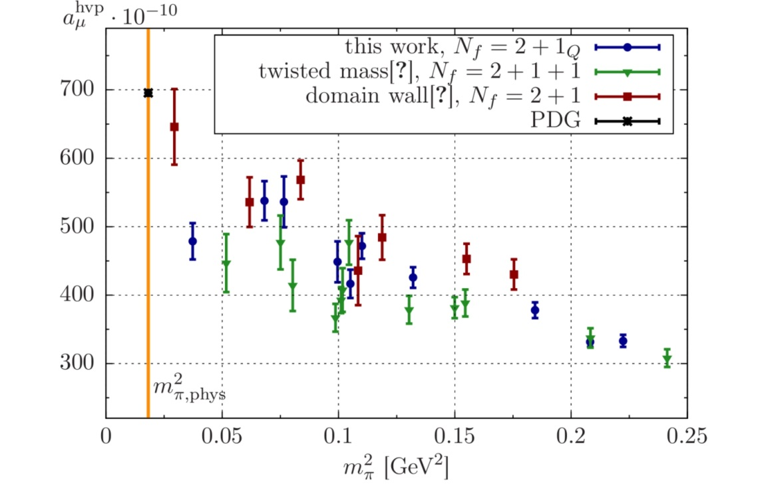
Low-momentum region of $Π(q^{2})$
Chiral behaviour:
Influence of low-energy region on chiral behaviour?

Slide 36
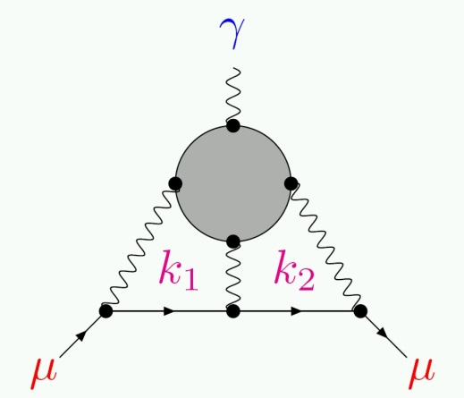
Hadronic light-by-light scattering
Brute force:
Compute 4-point function
Integrate over internal momenta
Extrapolate: $q^{2}→0$
Simultaneous QCD+QED simulations:
[Blum, Chowdury et al.]
Difference yields desired contribution up to $O(α^{3})$

Slide 37
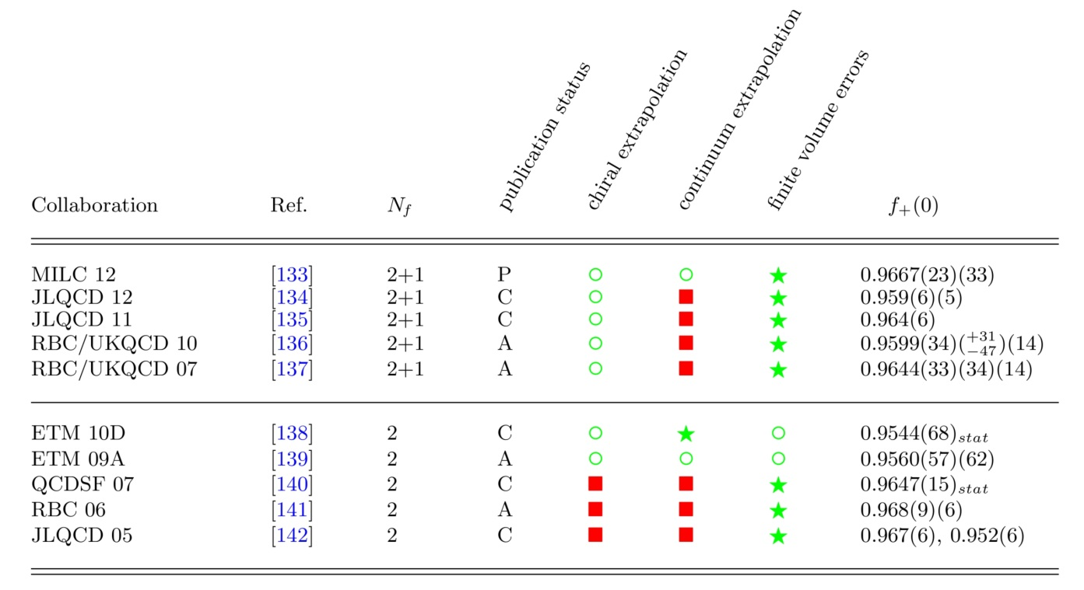
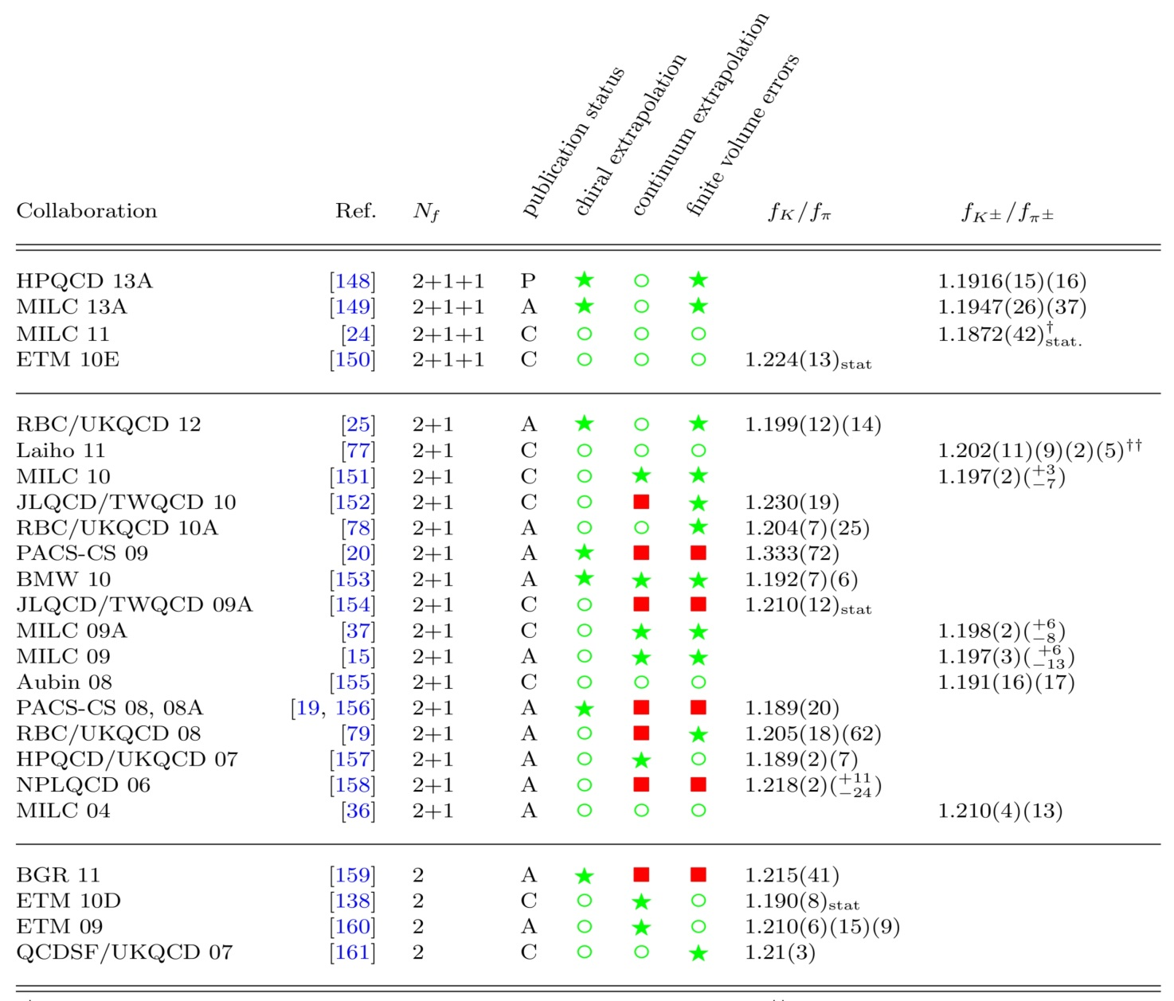
Pion and kaon decays – |V_{us}| and |V_{ud}|

