Slide 1
Quarkyonic Chiral Spirals
1/21
Toru Kojo (RBRC)
In collaboration with
Y. Hidaka (Kyoto U.), L. McLerran (RBRC/BNL), R. Pisarski (BNL)

Slide 2
2/21
Contents
1, Introduction
- Quarkyonic matter, chiral pairing phenomena
2, How to formulate the problem
- Model with linear confinement
- Dimensional reduction from (3+1)D to (1+1)D
3, Dictionaries
- Mapping (3+1)D onto (1+1)D: quantum numbers
- Dictionary between μ = 0 & μ ≠ 0 condensates
4, Summary

Slide 3
3/21
1, Introduction
Quarkyonic matter, chiral pairing phenomena

Slide 4
4/21
Dense QCD at T=0 : Confining aspects
E
E
Colorless
Allowed phase space differs → Different screening effects
e.g.)
MD 〜 Nc^{–1/2} x f(μ)
MD, μ << ΛQCD
μ, MD >> ΛQCD
T ~ 0
μ
confined hadrons
deconfined quarks
MD << ΛQCD << μ
quark Fermi sea with confined excitations

Slide 5
5/21
Quarkyonic Matter
McLerran & Pisarski (2007)
(MD << ΛQCD << μ)
hadronic excitation
As a total,
color singlet
→ deconfined quarks
Quark Fermi sea + baryonic Fermi surface → Quarkyonic
・Large Nc: MD 〜 Nc^{–1/2} → 0
Quarkyonic regime always holds.
(so we can use vacuum gluon propagator )

Slide 6
6/21
Quarkyonic Matter near T=0
・Bulk properties:
deconfined quarks in Fermi sea
(All quarks contribute to Free energy, pressure, etc. )
・Phase structure:
degrees of freedom near the Fermi surface
cf) Superconducting phase is determined by dynamics near the Fermi surface.
What is the excitation properties near the Fermi surface ?
Confined.
Quarkyonic matter → excitations are
Chiral ??
Is chiral symmetry broken in a Quarkyonic phase ?
If so, how ?

Slide 7
7/21
Chiral Pairing Phenomena
・Candidates which spontaneously break Chiral Symmetry
Dirac Type
E
L
Pz
R
PTot=0 (uniform)

Slide 8
7/21
Chiral Pairing Phenomena
・Candidates which spontaneously break Chiral Symmetry
Dirac Type
E
L
It costs large energy,
so does not occur spontaneously.
Pz
R
PTot=0 (uniform)

Slide 9
7/21
Chiral Pairing Phenomena
・Candidates which spontaneously break Chiral Symmetry
Dirac Type
Exciton Type
Density wave
E
E
E
L
L
L
R
R
Pz
Pz
Pz
R
PTot=0 (uniform)
PTot=0 (uniform)
PTot=2μ (nonuniform)
Long
～μ
We will identify the most relevant pairing:
Exciton & Density wave solutions
will be treated and compared simultaneously.
Trans

Slide 10
8/21
2, How to solve
Dimensional reduction from (3+1)D to (1+1)D

Slide 11
9/21
Preceding works on the chiral density waves
(Many works, so incomplete list)
・Nuclear matter or Skyrme matter:
Migdal ’71, Sawyer & Scalapino ’72.. : effective lagrangian for nucleons and pions
・Quark matter:
Perturbative regime with Coulomb type gluon propagator:
Deryagin, Grigoriev, & Rubakov ’92: Schwinger-Dyson eq. in large Nc
Shuster & Son, hep-ph/9905448: Dimensional reduction of Bethe-Salpeter eq.
Rapp, Shuryak, and Zahed, hep-ph/0008207: Schwinger-Dyson eq.
Effective model:
Nakano & Tatsumi, hep-ph/0411350, D. Nickel, 0906.5295
Nonperturbative regime with linear rising gluon propagator:
→ Present work

Slide 12
10/21
Set up of the problem
・Confining propagator for quark-antiquark:
(linear rising type)
cf) leading part of Coulomb gauge propagator
(ref: Gribov, Zwanziger)
But how to treat conf. model & non-uniform system??
・2 Expansion parameters in Quarkyonic limit
1/Nc → 0
: Vacuum propagator is not modified
Guo, Szczepaniak,arXiv:0902.1316 [hep-ph]).
(ref: Glozman, Wagenbrunn, PRD77:054027, 2008;
ΛQCD/μ → 0
: Factorization approximation
We will perform the dimensional reduction of nonperturbative
self-consistent equations, Schwinger-Dyson & Bethe-Salpeter eqs.

Slide 13
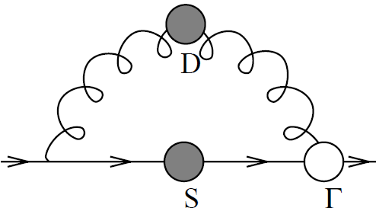
11/21
e.g.) Dim. reduction of Schwinger-Dyson eq.
quark self-energy
including ∑
・Note1: Mom. restriction from confining interaction.
Δk〜 ΛQCD
small momenta
PT 〜 0
PT 〜 0
PL 〜 μ
PL 〜 μ
PL 〜 μ

Slide 14
12/21
e.g.) Dim. reduction of Schwinger-Dyson eq.
quark self-energy
・Note2: Suppression of transverse and mass parts:
〜 μ
〜 ΛQCD
・Note3: quark energy is insensitive to small change of kT :
along E = const. surface
ΔkL〜 ΛQCD
E= const. surface
ΔkT〜 ΛQCD

Slide 15
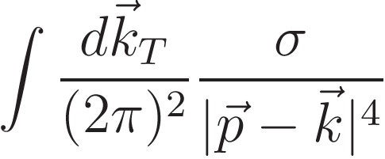
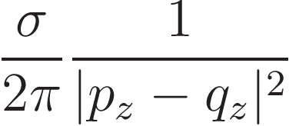
13/21
e.g.) Dim. reduction of Schwinger-Dyson eq.
insensitive to kT
factorization
⊗
smearing
confining propagator in (1+1)D:
Schwinger-Dyson eq. in (1+1) D QCD in A1=0 gauge
Bethe-Salpeter eq. can be also converted to (1+1)D

Slide 16
14/21
Catoon for Pairing dynamics before reduction
ΔkT〜 ΛQCD
quark
hole
insensitive to kT
〜 μ
gluon
sensitive to kT

Slide 17
14/21
1+1 D dynamics of patches after reduction
ΔkT〜 ΛQCD
bunch of quarks
bunch of holes
〜 μ
smeared gluons

Slide 18
15/21
3, Dictionaries
Mapping (1+1)D results onto (3+1)D phenomena

Slide 19
16/21
Flavor Doubling
・At leading order of 1/Nc & ΛQCD/μ
Dimensional reduction of Non-pert. self-consistent eqs：
4D “QCD” in Coulomb gauge
2D QCD in A1=0 gauge
(confining model)
・One immediate nontrivial consequence:
PT/PL → 0
Absence of γ1, γ2 → Absence of spin mixing
suppression of spin mixing
no angular d.o.f in (1+1) D
spin SU(2) x SU(Nf)
SU(2Nf)
(3+1)-D side
(1+1)-D side
cf) Shuster & Son, NPB573, 434 (2000)

Slide 20
17/21
Flavor Multiplet
particle near north & south pole
R-handed
spin
L -handed

Slide 21
17/21
Flavor Multiplet
particle near north & south pole
R-handed
spin
mass term
L -handed

Slide 22
17/21
Flavor Multiplet
particle near north & south pole
R-handed
spin
mass term
L -handed

Slide 23
17/21
Flavor Multiplet
spin doublet
ψ
“flavor: φ”
“flavor: χ”
right-mover (+)
left-mover (–)
R-handed
spin
left-mover (–)
right-mover (+)
L -handed
Moving direction: (1+1)D “chirality”
(3+1)D – CPT sym. directly convert to (1+1)D ones

Slide 24
18/21
Relations between composite operators
・1-flavor (3+1)D operators without spin mixing:
Flavor singlet in (1+1)D
・All others have spin mixing:
ex)
(They will show no
flavored condensation)
Flavor non-singlet in (1+1)D

Slide 25
19/21
2nd Dictionary: μ = 0 & μ ≠ 0 in (1+1)D
・μ ≠ 0 2D QCD can be mapped onto μ = 0 2D QCD
: chiral rotation (or boost)
(μ ≠ 0)
(μ = 0)
(due to special geometric property of 2D Fermi sea)
・Dictionary between μ = 0 & μ ≠ 0 condensates:
μ = 0
μ ≠ 0
induced by anomaly
( = 0 )
( = 0 )
“correct baryon number”

Slide 26
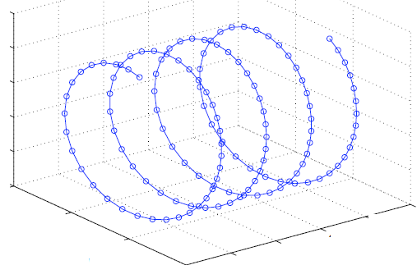
20/21
Chiral Spirals in (1+1)D
・At μ ≠ 0: periodic structure (crystal) which oscillates in space.
z
cf)
・Chiral Gross Neveu model (with continuous chiral symmetry)
Schon & Thies, hep-ph/0003195; 0008175; Thies, 06010243
Basar & Dunne, 0806.2659; Basar, Dunne & Thies, 0903.1868
・`tHooft model, massive quark (1-flavor)
B. Bringoltz, 0901.4035

Slide 27
20/21
Quarkyonic Chiral Spirals in (3+1)D
・Chiral rotation evolves in the longitudinal direction:
z
L-quark
z
R-hole
( not conventional pion condensate
in nuclear matter)
・Baryon number is spatially constant.
・No other condensates appear in quarkyonic limit.

Slide 28
21/21
Summary
Quarkyonic Chiral Spiral
breaks chiral sym. locally but restores it globally.
V
V
σ
σ
T
π
Spatial distribution
σ
z
0
vacuum value
Num. of zero modes 〜 4Nf ² + .... (not investigated enough)

Slide 29
Topics not discussed in this talk
(Please ask in discussion time or personally during workshop)
・Origin of self-energy divergences and how to avoid it.
- Quark pole need not to disappear in linear confinement model.
・Explicit example of quarkyonic matter:
- 1+1 D large Nc QCD has a quark Fermi sea but confined spectra.
・Coleman’s theorem on symmetry breaking.
- No problem in our case.
・Beyond single patch pairing.
- Issues on rotational invariance, working in progress.

Slide 30
25/30
Phase Fluctuations & Coleman’s theorem
・Coleman’s theorem:
No Spontaneous sym. breaking in 2D
V
V
σ
σ
T
T
≠ 0
≠ 0
(SSB)
＝ 0
(No SSB)
IR divergence in (1+1)D phase dynamics
・Phase fluctuations belong to:
Excitations
ground state properties
(physical pion spectra)
(No pion spectra)

Slide 31
26/30
Non-Abelian Bosonization in quarkyonic limit
・Fermionic action for (1+1)D QCD:
+ gauge int.
・Bosonized version:
U(1) free bosons & Wess-Zumino-Novikov-Witten action :
(Non-linear σ model + Wess-Zumino term)
“Charge – Flavor – Color Separation”
+ gauge int.
conformal inv.
dimensionful
gapless phase modes
gapped phase modes

Slide 32
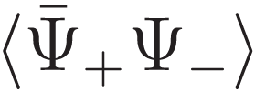
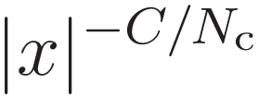
27/30
Quasi-long range order & large Nc
・Local order parameters:
gapless modes
gapped modes
〜
⊗
⊗
due to IR divergent
phase dynamics
0
0
finite
But this does not mean the system is in the usual symmetric phase!
・Non-Local order parameters:
: symmetric phase
〜
: long range order
(including disconnected pieces)
: quasi-long
range order
(power law)

Slide 33
29/30
How neglected contributions affect the results?
・Neglected contributions in the dimensional reduction:
〜 μ
〜 ΛQCD
(3+1)D
(1+1)D
spin mixing → breaks the flavor symmetry explicitly
mass term → acts as mass term
Expectations:
1, Explicit breaking regulate the IR divergent phase fluctuations,
so that quasi-long range order becomes long range order.
2, Perturbation effects get smaller as μ increases, but still
introduce arbitrary small explicit breaking, which stabilizes
quasi-long range order to long range order.
(As for mass term, this is confirmed by Bringoltz analyses for massive `tHooft model.)
Final results should be closer to our large Nc results!

Slide 34
15/30
In this work, we will not discuss the interaction between
different patches except those at the north or south poles.
(Since we did not find satisfactory treatments)

Slide 35
20/30
2nd Dictionary: μ = 0 & μ ≠ 0 in (1+1)D
E
fast
slow
L(–)
R(+)
&
P
or
〜 μ
Then
・Dictionary between μ = 0 & μ ≠ 0 condensates:
μ = 0
μ ≠ 0
induced by anomaly
( = 0 )
( = 0 )
“correct baryon number”

Slide 36
30/30
Summary
Confining aspects
MD << ΛQCD << μ: Quarkyonic
MD, μ << ΛQCD
μ, MD >> ΛQCD
T ~ 0
confined
hadrons
deconfined
quarks
μ
Chiral aspects
Locally Broken, But Globally Restored
Broken
Restored
T ~ 0
Dirac Type
μ

Slide 37
Confining aspects
MD << ΛQCD << μ: Quarkyonic
MD, μ << ΛQCD
μ, MD >> ΛQCD
T ~ 0
confined
hadrons
deconfined
quarks
μ
Chiral aspects
Locally Broken, But Globally Restored
Broken
Restored
T ~ 0
Dirac Type
Chiral Spiral
μ

Slide 38
25/28
Quasi-long range order & large Nc
・Local order parameters:
gapless modes
gapped modes
〜
⊗
⊗
due to IR divergent
phase dynamics
0
0
finite
But this does not mean the system is in the usual symmetric phase!
・Non-Local order parameters:
: symmetric phase
〜
: long range order
large Nc limit (Witten `78)
(including disconnected pieces)
: quasi-long
range order
(power law)

Slide 39
18/25
Dense 2D QCD & Dictionaries
・μ ≠ 0 2D QCD can be mapped onto μ = 0 2D QCD
: chiral rotation (or boost)
(μ ≠ 0)
(μ = 0)
(due to geometric property of 2D Fermi sea)
・μ=0 2D QCD is solvable in large Nc limit!
dressed quark propagator, meson spectra, baryon spectra, etc..
・We have dictionaries:
μ=0 2D QCD μ ≠ 0 2D QCD μ ≠ 0 4D QCD
(solvable!)
exact
at quarkyonic limit

Slide 40
Quarkyonic Chiral Spiral
19/25
(1+1)D spiral partner:
(3+1)D spiral partner:
x3
& No other condensate appears.

Slide 41
24/30
4, A closer look at QCS
Coleman’s theorem & Strong chiral phase fluctuations

Slide 42
21/21
Summary
Conventional chiral restoration occurs both locally and globally.
V
V
σ
σ
π
π
Spatial distribution
σ
z
0
vacuum value

