Slide 1
Understanding continuum effects on nuclei near the driplines
Joshua Wylie
Facility for Rare Isotope Beams (FRIB)
ERICE 2024
September 18, 2024

Slide 2
Outline
Introduction to the continuum and Open Quantum Systems
Introduction to the Gamow Shell Model
Case studies on the impact of the continuum in nuclei
  Continuum impact on Spectroscopic Factors
  Exotic “states” above particle-emission threshold
Conclusions and future work

Slide 3
Outline
Introduction to the continuum and Open Quantum Systems
Introduction to the Gamow Shell Model
Schematic overview of continuum and model
Case studies on the impact of the continuum in nuclei
  Continuum impact on Spectroscopic Factors (SFs): Continuum suppresses SF for removing well-bound nucleons!
  Exotic “states” above particle-emission threshold: We see that some of the states become continuum features
Conclusions and future work
Thanks Marek!

Slide 4

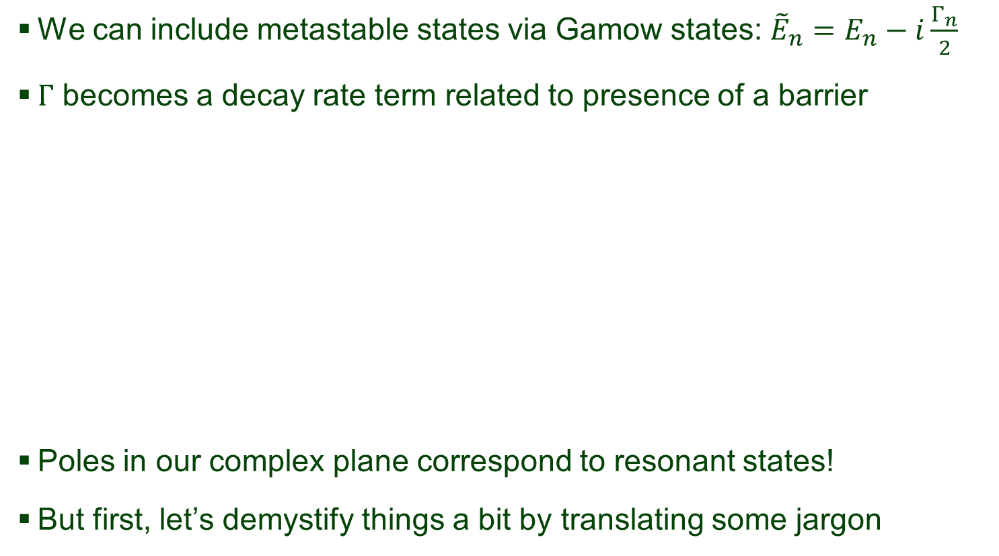







Reminder – Gamow States
Marek discussed this!
We can include metastable states via Gamow states: ${\tilde{E}}_{n}=E_{n}−i\frac{Γ_{n}}{2}$
$Γ$ becomes a decay rate term related to presence of a barrier
Poles in our complex plane correspond to resonant states!
But first, let’s demystify things a bit by translating some jargon
$$E$$
$$E>V_{B}$$
Im$\left(k\right)$
$$V_{B}$$
$$k∝\left\{\begin{aligned}i\sqrt{−E}, for E<0 \\ \sqrt{\left(E−\frac{iΓ}{2}\right)}, for Γ>0 \\ \sqrt{E}, for E>0\end{aligned}\right.$$
Re$\left(k\right)$
$$E=0$$
$$E<0$$
Notes:
To provide a lead-in to the general framework of the S-matrix, I will discuss the very simple case (about 30 seconds total for this slide).
For closed systems, an example is any case where we are totally isolated from the environment i.e. V\rightarrow \infty.
Opening our system essentially entails allowing two distinct regions to exist: bound and scattering state regions. Resonances appear as a special consequence of the later case when there are additional barriers to our particle in the scattering region.

Slide 5
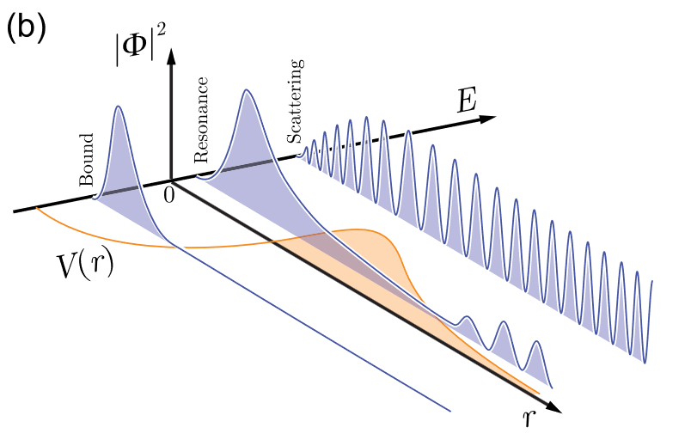
Introduction – Resonant State Analogy
Let’s go over some of the technical jargon!
[1] M. Pfutzner, I. Mukha, S.M. Wang, Prog. Part. Nucl. Phys. 132 (2023) 104050.

Slide 6

Introduction – Resonant State Analogy
Let’s go over some of the technical jargon!
  Bound states are like a group of friends who stick around together!
[1] M. Pfutzner, I. Mukha, S.M. Wang, Prog. Part. Nucl. Phys. 132 (2023) 104050.
Becomes a part
of the group

Slide 7
Introduction – Resonant State Analogy
Let’s go over some of the technical jargon!
  Bound states are like a group of friends who stick around together!
  Resonant states are where someone hangs around for a time and then leaves!
Hi everyone!
[1] M. Pfutzner, I. Mukha, S.M. Wang, Prog. Part. Nucl. Phys. 132 (2023) 104050.

Slide 8
Introduction – Resonant State Analogy
Let’s go over some of the technical jargon!
  Bound states are like a group of friends who stick around together!
  Resonant states are where someone hangs around for a time and then leaves!
  Scattering states are when someone just says “hello” and then leaves
[1] M. Pfutzner, I. Mukha, S.M. Wang, Prog. Part. Nucl. Phys. 132 (2023) 104050.
Thanks for the food!
Doesn’t significantly
alter structure

Slide 9
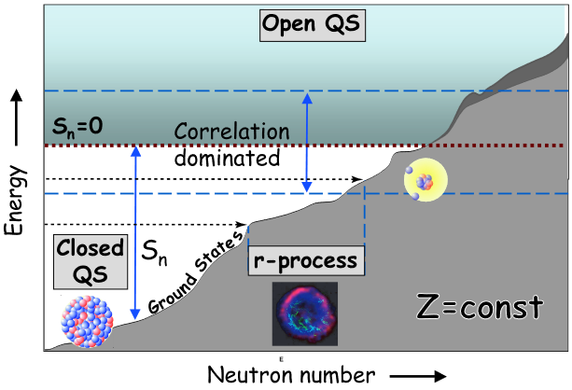
Introduction – Exotic Nuclei
9N
10N
8C
9C
10C
6B
7B
8B
9B
10B
5Be
6Be
7Be
8Be
9Be
10Be
3Li
4Li
5Li
6Li
7Li
8Li
9Li
10Li
2He
3He
4He
5He
6He
7He
8He
9He
10He
1H
2H
3H
4H
5H
6H
7H
[2] N Michel et al 2009 J. Phys. G: Nucl. Part. Phys. 36 013101
1n
2n
4n
Where can we find these continuum dominated states in light nuclei?
Notes:
Based on the title, we show the location of the nuclei of interest, on the edges of the nuclear chart.
Next animation highlights the general areas where open-quantum-system descriptions become increasingly important. FRIB and other new accelerators will allow us to push ever closer to the edges of the nuclear chart where coherent descriptions of these nuclei are important.
In these exotic regions we will likely find interesting behaviors and need to question what detected signals are truly states or are features which present themselves near thresholds.

Slide 10
Introduction – Exotic Nuclei
9N
10N
8C
9C
10C
6B
7B
8B
9B
10B
5Be
6Be
7Be
8Be
9Be
10Be
3Li
4Li
5Li
6Li
7Li
8Li
9Li
10Li
2He
3He
4He
5He
6He
7He
8He
9He
10He
[2] N Michel et al 2009 J. Phys. G: Nucl. Part. Phys. 36 013101
1H
2H
3H
4H
5H
6H
7H
There are an abundance of light nuclei which fits in this region
The nuclei shown are our focus for the current discussion
Notes:
Based on the title, we show the location of the nuclei of interest, on the edges of the nuclear chart.
Next animation highlights the general areas where open-quantum-system descriptions become increasingly important. FRIB and other new accelerators will allow us to push ever closer to the edges of the nuclear chart where coherent descriptions of these nuclei are important.
In these exotic regions we will likely find interesting behaviors and need to question what detected signals are truly states or are features which present themselves near thresholds.

Slide 11
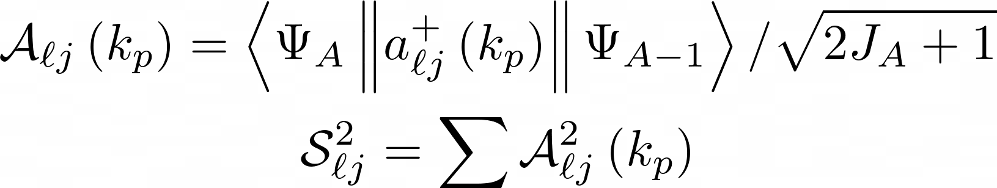
Spectroscopic Factors
Spectroscopic Factors (SFs) are the overlap between a parent and daughter nucleus
Essentially how similar do the two configurations look?
If we consider two examples
⁸Li
⁷Li
⁸Li
⁷He

Slide 12

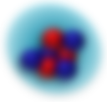

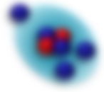




Spectroscopic Factors
Spectroscopic Factors (SFs) are the overlap between a parent and daughter nucleus
Essentially how similar do the two configurations look?
If we consider two examples
One looks very similar (just
missing a spectator neutron),
the other not so much!
$$a_{ℓj}$$
$$S^{2}→1$$
⁸Li
⁷Li
$$a_{ℓj}$$
$$S^{2}≪1$$
⁸Li
⁷He

Slide 13
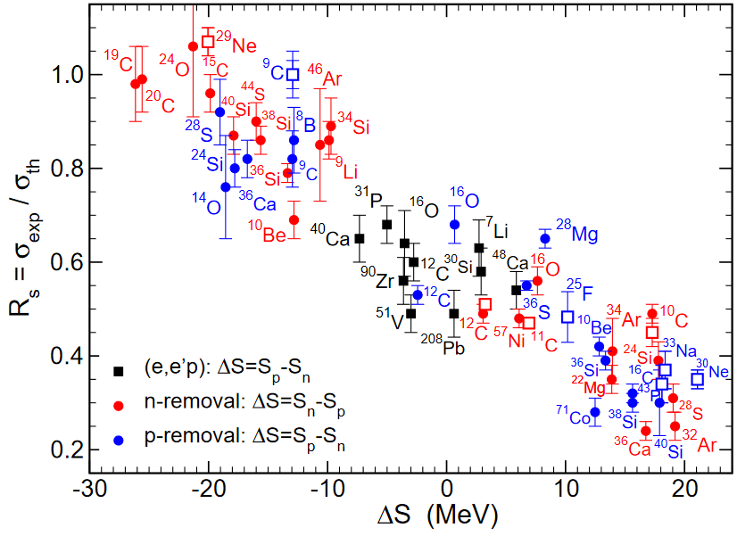
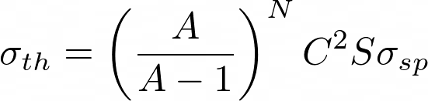

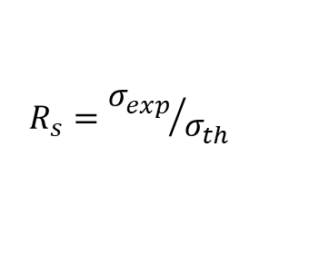
Spectroscopic Factors
More accurate definition: level of single-particle strength in nucleus
Not an observable but
interpreted as ratio $R_{s}$
Systematic dependence
on isospin asymmetry
Trends we notice?
$$R_{s}={σ_{exp}}/{σ_{th}}$$
[3] J. A. Tostevin and A. Gade, Phys. Rev. C 103, 054610 (2021)

Slide 14

Spectroscopic Factors
Trends we notice…
Removal of majority
species nucleons yields
$R_{s}=1$
Removal of minority
species nucleons yields
$R_{s}≪1$
From a structure
perspective, why might
this happen?
Probably some missing
physics…
[3] J. A. Tostevin and A. Gade, Phys. Rev. C 103, 054610 (2021)

Slide 15
Spectroscopic Factors
The Shell Model SFs might contribute to this issue by
  Removing well-bound vs weakly bound nucleons gives different daughter
  Daughter might be a resonance / unbound nucleus!
This would certainly motivate an investigation into continuum coupling!
⁸Li
⁷Li
⁸Li
⁷Li
⁸Li
⁷He
⁸Li
⁷He

Slide 16
Spectroscopic Factors
We will systematically increase the continuum coupling
  For example: ⁸C
And we can investigate the changes to SFs with changing continuum effects…
HO Basis
3 particles in
the continuum
4 particles in
the continuum

Slide 17
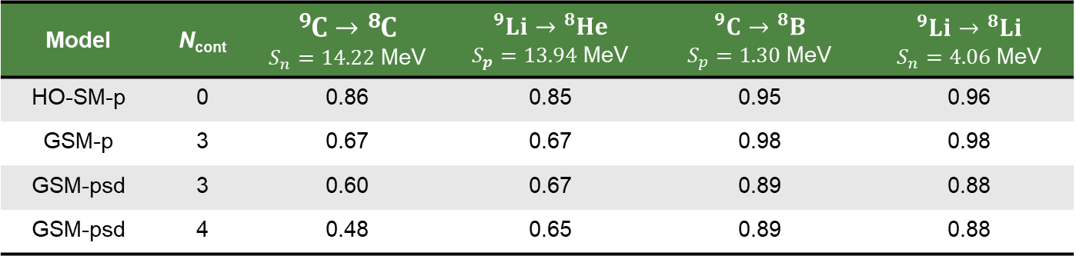
Spectroscopic Factors
How does this affect the SFs?
Suppression for well-bound removal
Little change for weakly-bound removal
We can investigate configurations for additional insight…
[4] J. Wylie, J. Okołowicz, W. Nazarewicz, M. Płoszajczak, S. M. Wang (王思敏), X. Mao (毛兴泽), and N. Michel, Phys. Rev. C 104, L061301 (2021)
Model | N_{cont} | $${}_{ }^{9}C→{}_{ }^{8}C$$ $S_{n}=14.22$ MeV | $${}_{ }^{9}{Li}→{}_{ }^{8}{He}$$ $S_{p}=13.94$ MeV | $${}_{ }^{9}C→{}_{ }^{8}B$$ $S_{p}=1.30$ MeV | $${}_{ }^{9}{Li}→{}_{ }^{8}{Li}$$ $S_{n}=4.06$ MeV
HO-SM-p | 0 | 0.86 | 0.85 | 0.95 | 0.96
GSM-p | 3 | 0.67 | 0.67 | 0.98 | 0.98
GSM-psd | 3 | 0.60 | 0.67 | 0.89 | 0.88
GSM-psd | 4 | 0.48 | 0.65 | 0.89 | 0.88

Slide 18
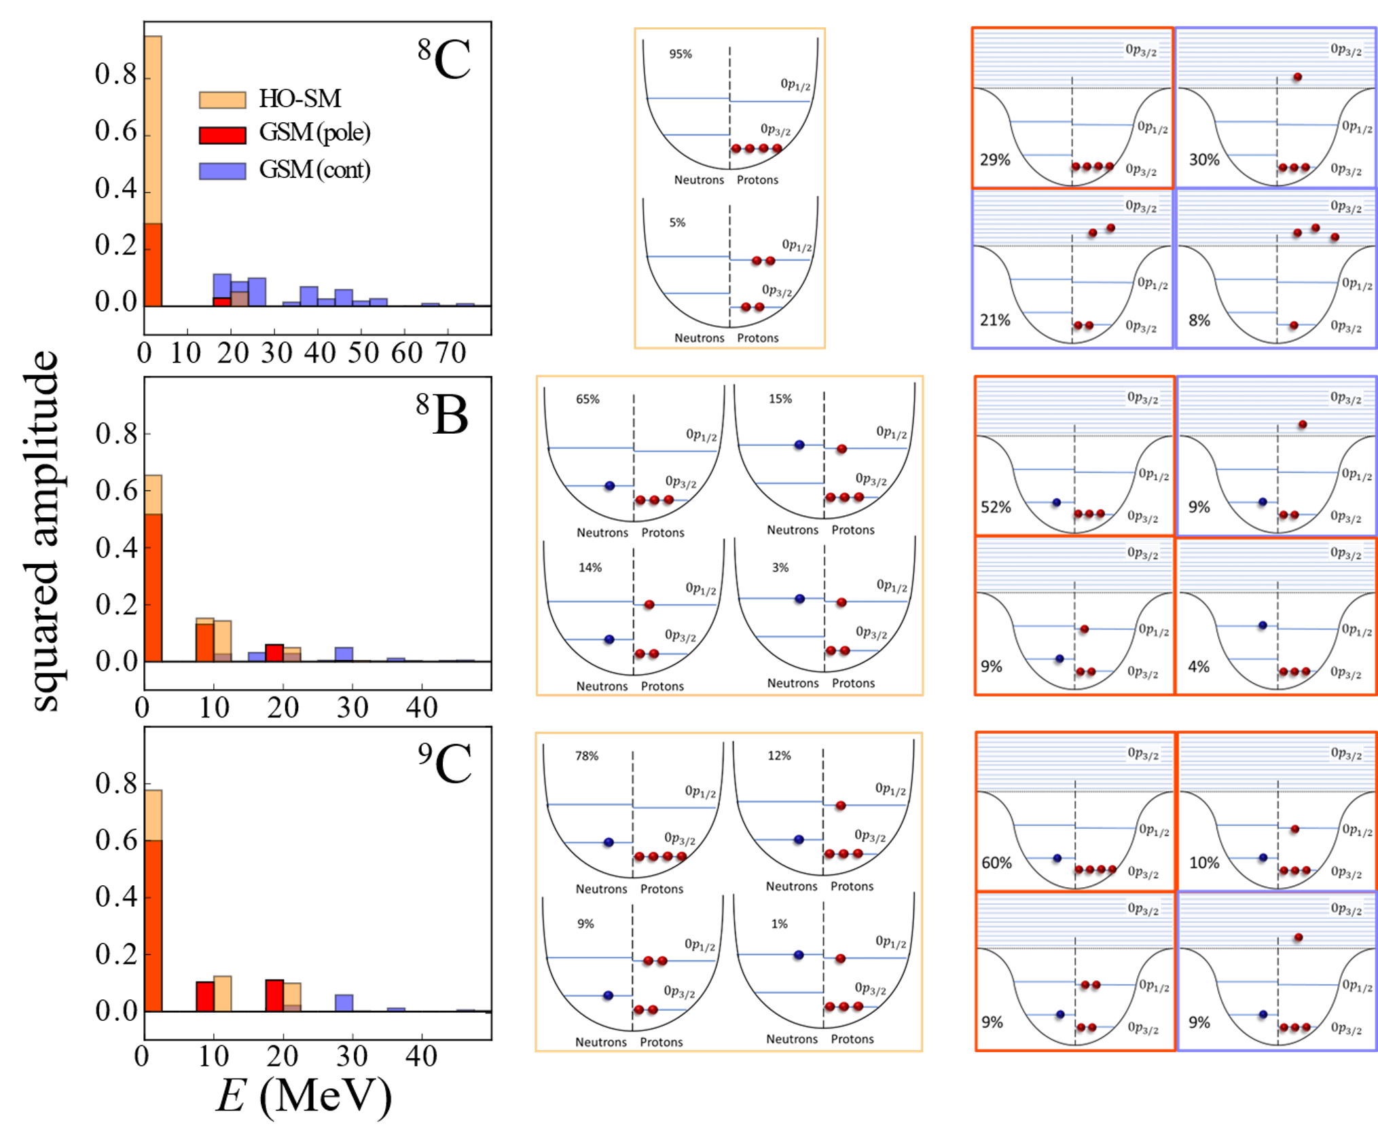
Spectroscopic Factors
For resonant ⁸C, we are dominated by the continuum (HO basis a poor representation)
For ⁸B we are largely dominated by bound poles (HO basis OK representation)
In summary…

Slide 19
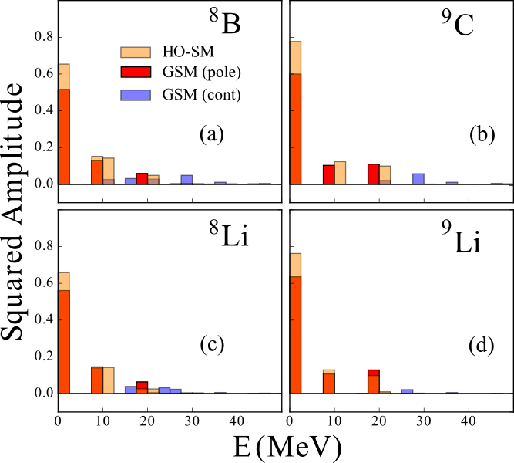
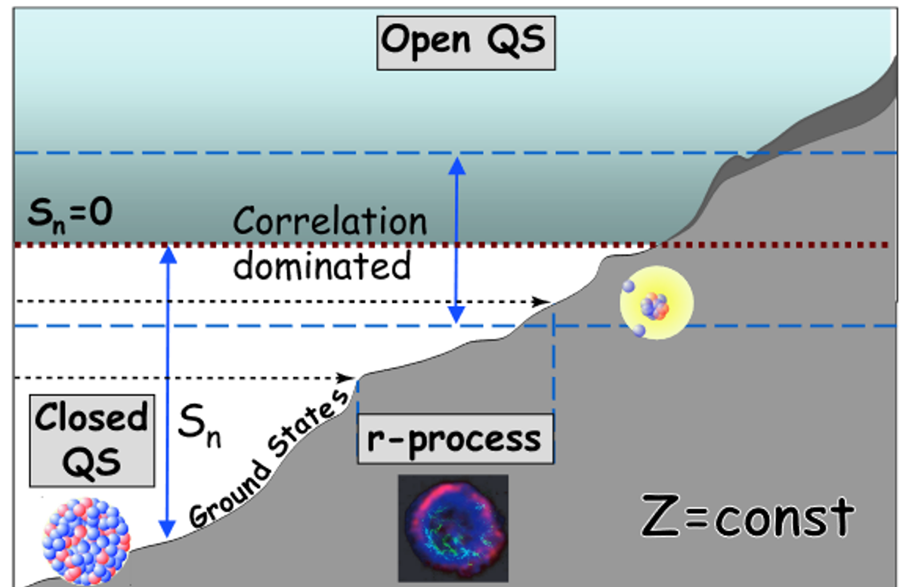
Spectroscopic Factors
When we remove a majority species nucleon, we move away from the drip line (towards stability)
¹⁰N
¹¹N
¹²N
⁸C
⁹C
¹⁰C
¹¹C
⁷B
⁸B
Stable nuclei should be less continuum dependent thus we see little configuration change due to the continuum
⁸Li
⁹Li
¹⁰Li
¹¹Li
⁷He
⁸He
⁹He
⁶H
⁷H
No strong changes to core when removing weakly-bound nucleon (Parent/daughter are similar)
p
⁹C
⁸B
Notes:
Removing the weakly-bound nucleon moves us closer to stability and requires little structure change between the parent and daughter.

Slide 20
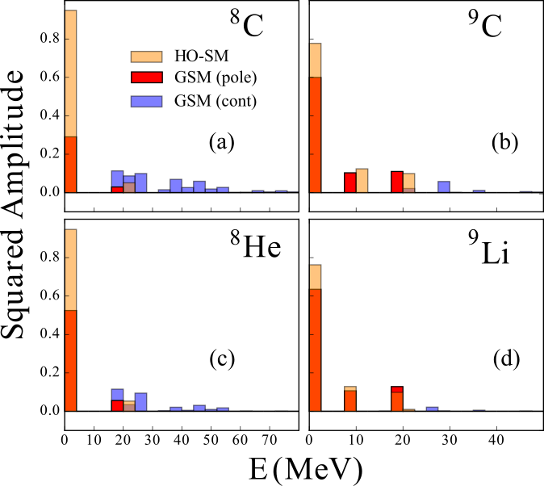
Spectroscopic Factors
¹⁰N
¹¹N
¹²N
When we remove a minority species nucleon, we move towards the drip line
⁸C
⁹C
¹⁰C
¹¹C
⁷B
⁸B
Weakly-bound nucleons experience even more continuum effects after reaction
⁸Li
⁹Li
¹⁰Li
¹¹Li
⁷He
⁸He
⁹He
⁶H
⁷H
Significant configuration changes (Parent/daughter are different)
n
⁹C
⁸C
Notes:
Removing the well-bound nucleon moves us further from stability and requires significant structure change between the parent and daughter. Since SFs are a measure of single-particle nature, dissimilar parent and daughter structures force complexity beyond a single particle description.

Slide 21

You can read the paper here →
Let’s now consider cases where the continuum dominates
structure features!

Slide 22
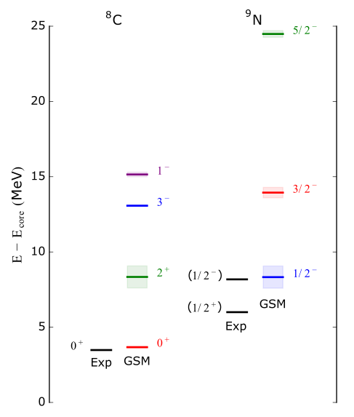
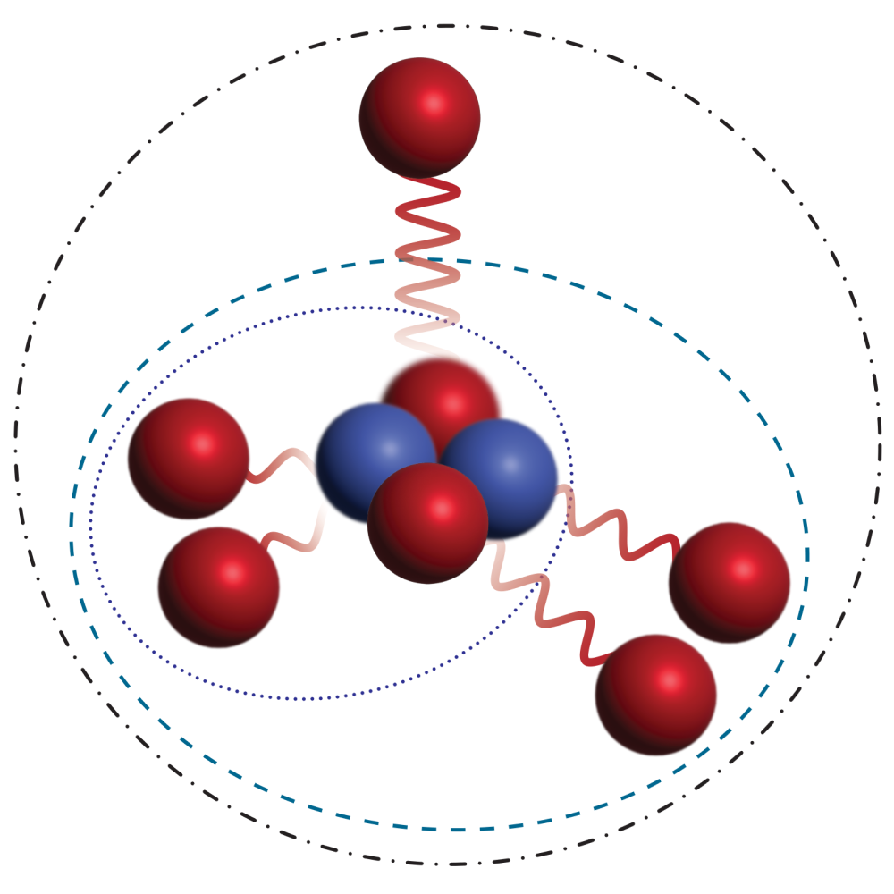
Motivation – Nitrogen-9
Recent experimental results in very proton rich systems indicated strong evidence of ⁹N (7 protons and 2 neutrons!)
Initial predictions from GSM only show one low-lying state
Image taken from: [5] Schirber, M. (2023, October 27). Five Protons Spew Out of Extreme Nucleus. Physics, 16. https://physics.aps.org/articles/v16/186
Notes:
We were asked to provide predictions for states in the two nuclei (before seeing experimental data).

Slide 23
Nitrogen-9
Looking at the experimental results^{[6]} which:
  Indicated possible doublet structure
  Are strongly anti-correlated (couldn’t be individually constrained)
  Unknown if there was one or two peaks (can GSM help?)
Looked at mirror nucleus ⁹He to
try to understand behavior
(shows similar doublet)
(1/2⁺)
(1/2⁻)
(3/2⁻)?
9N
10N
8C
9C
10C
7B
8B
9B
10B
6Be
7Be
8Be
9Be
10Be
5Li
6Li
7Li
8Li
9Li
10Li
4He
5He
6He
7He
8He
9He
10He
[6] R. J. Charity, J. W., et al. Phys. Rev. Lett. 131, 172501 (2023)
Notes:
Since the experimental results were anti-correlated, we wanted to also inform our perspective by considering 9N’s mirror (9He).
The ground state of 9He is disputed as it presents a similar doublet of a possible 1/2+ state first followed closely by a 1/2-. Since more information was available for 9He we applied the same parameters to the neutron-rich system.

Slide 24
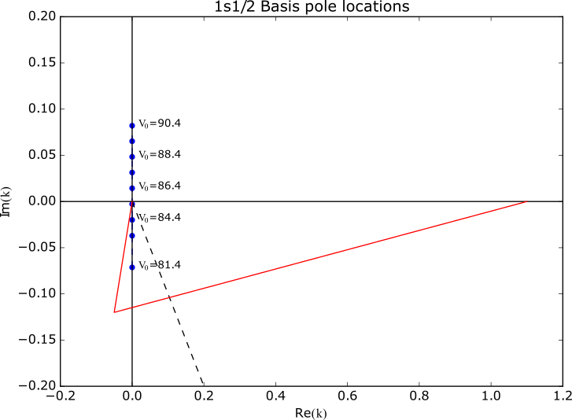
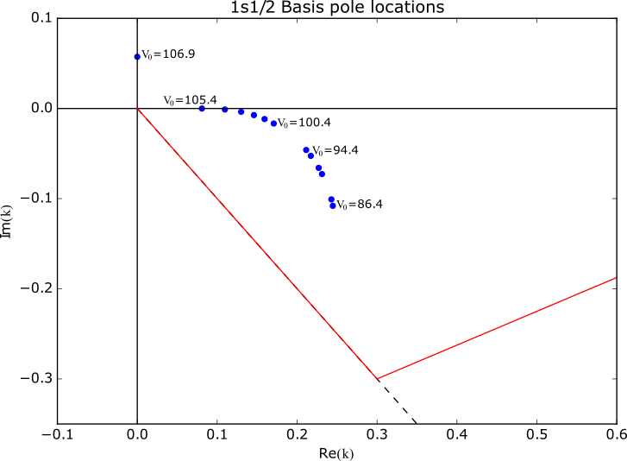
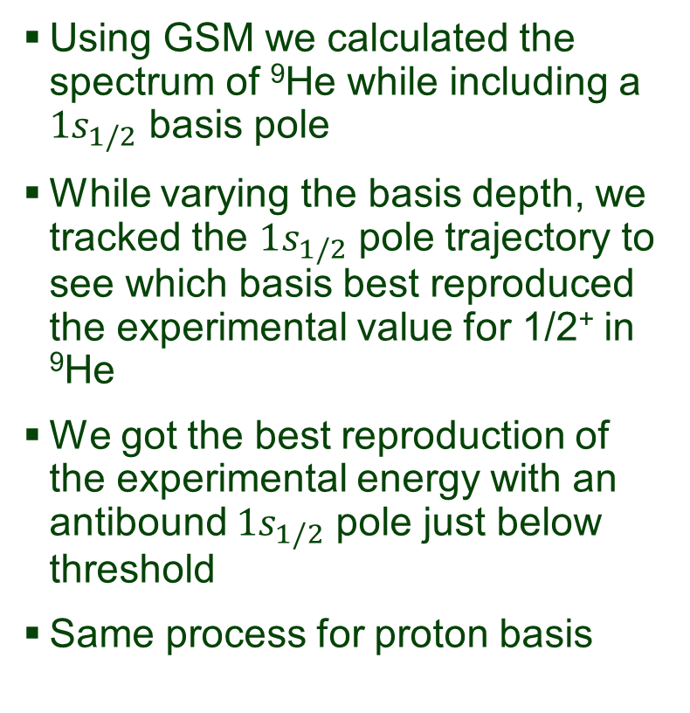
Nitrogen-9
Using GSM we calculated the spectrum of ⁹He while including a $1s_{1/2}$ basis pole
While varying the basis depth, we tracked the $1s_{1/2}$ pole trajectory to see which basis best reproduced the experimental value for 1/2⁺ in ⁹He
We got the best reproduction of the experimental energy with an antibound $1s_{1/2}$ pole just below threshold
Same process for proton basis
Neutron basis
Proton basis
Notes:
We see here that there is reasonable reproduction of the 1/2+ of 9He. We found that this state shifted slightly as a function of basis potential but not too severely.
Since we could only calculate a reasonable 1/2+ state in 9He using the antibound contour, we concluded that it is likely an antibound state which is marked by a squiggly line to denote a “feature” as opposed to a true nuclear state. Due to the uncertainty in 9N, it is marked as a line and squiggle to indicate its uncertain status as a resonance or a subthreshold resonance (more closely related to a final-state effect feature).

Slide 25
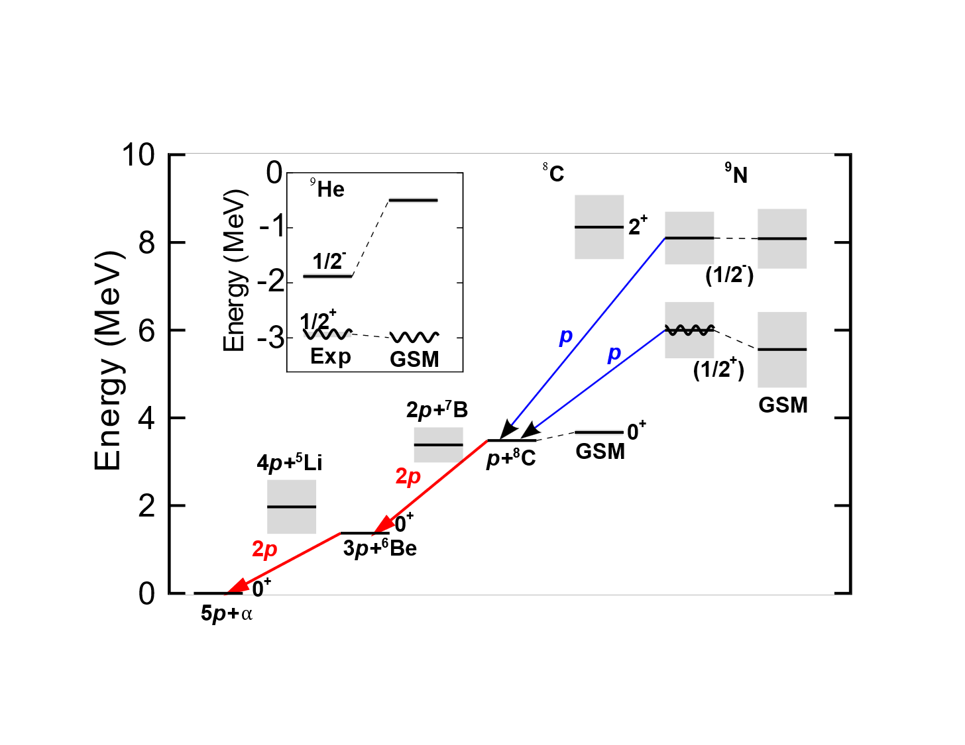
Nitrogen-9
Resulting ⁹He(1/2⁺) was found to be very continuum dependent
We found a value for the 1/2⁺ state in ⁹N by following the same procedure
Notes:
We see here that there is reasonable reproduction of the 1/2+ of 9He. We found that this state shifted slightly as a function of basis potential but not too severely.
Since we could only calculate a reasonable 1/2+ state in 9He using the antibound contour, we concluded that it is likely an antibound state which is marked by a squiggly line to denote a “feature” as opposed to a true nuclear state. Due to the uncertainty in 9N, it is marked as a line and squiggle to indicate its uncertain status as a resonance or a subthreshold resonance (more closely related to a final-state effect feature).

Slide 26
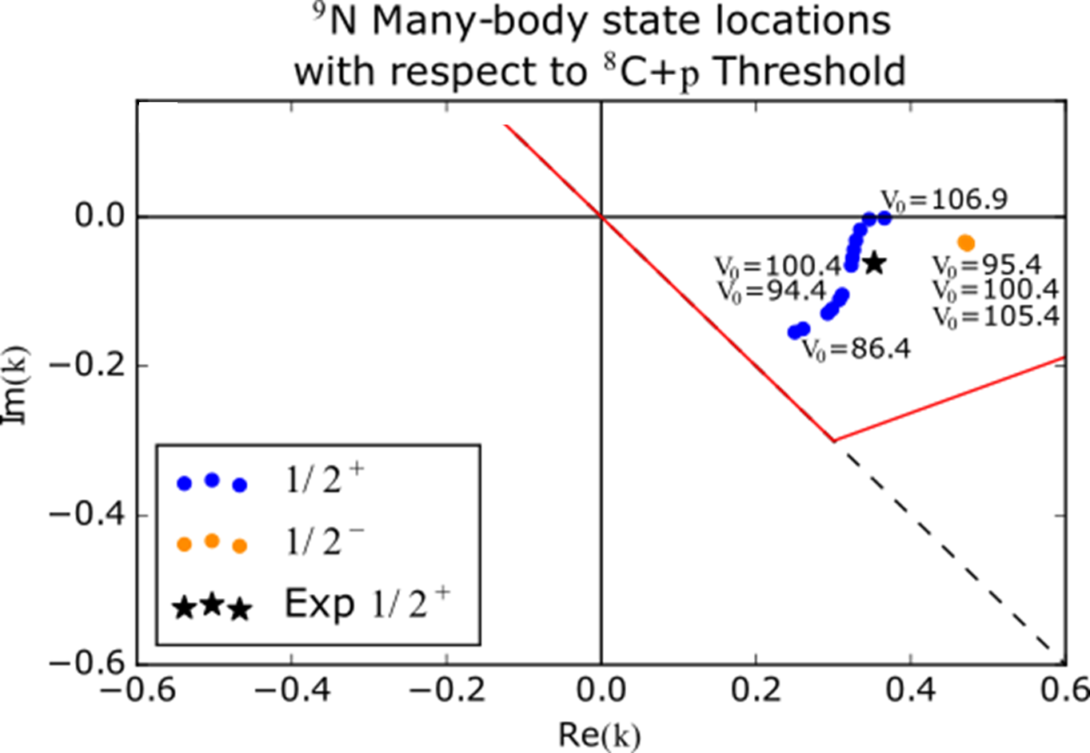

Nitrogen-9
Following the same procedure and varying the $1s_{1/2}$ basis pole for ⁹N
We find that the many-body state
trajectory goes from a broad
to narrow resonant state
When using narrow resonant
$1s_{1/2}$ basis poles, we are
around V₀=100.4 MeV
1/2⁻ state is basis
independent
Experimentalists constrain
their two peak picture using
GSM 1/2⁻ energy and decay width…
Notes:
We see here that there is reasonable reproduction of the 1/2+ of 9He. We found that this state shifted slightly as a function of basis potential but not too severely.
Since we could only calculate a reasonable 1/2+ state in 9He using the antibound contour, we concluded that it is likely an antibound state which is marked by a squiggly line to denote a “feature” as opposed to a true nuclear state. Due to the uncertainty in 9N, it is marked as a line and squiggle to indicate its uncertain status as a resonance or a subthreshold resonance (more closely related to a final-state effect feature).

Slide 27
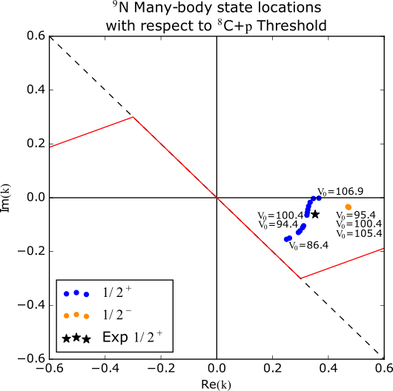

Nitrogen-9
Two-peak character within 5$σ$!
Used GSM 1/2⁻ state to constrain for $R$-matrix 1/2⁺
  $Q_{1p}=2.50(21)$MeV
  [$Q_{5p}=5.98(21)$MeV]
  $Γ=1.81(53)$MeV
Notes:
Our initial calculations were coincidentally at V0=100.4MeV which corresponds to the closest GSM result near the experimental value. We do see however that the 1/2+ state is very basis dependent which contributes to our uncertainty of the state. Since GSM cannot traverse below the pi/4 line, we don’t know the full trajectory of the many-body states, however it can clearly range anywhere between the subthreshold to narrow resonance range.
Note too that despite varying the basis, the 1/2- state changes little which is comforting and provides a good example of how a well-defined nuclear state would be expected to behave.

Slide 28

You can read the paper here →
Investigations into states in extremely proton or neutron rich
nuclei demand reasonable treatment of the continuum!
We can also try to explore and quantify the continuum
coupling strength in GSM.

Slide 29


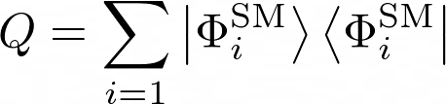
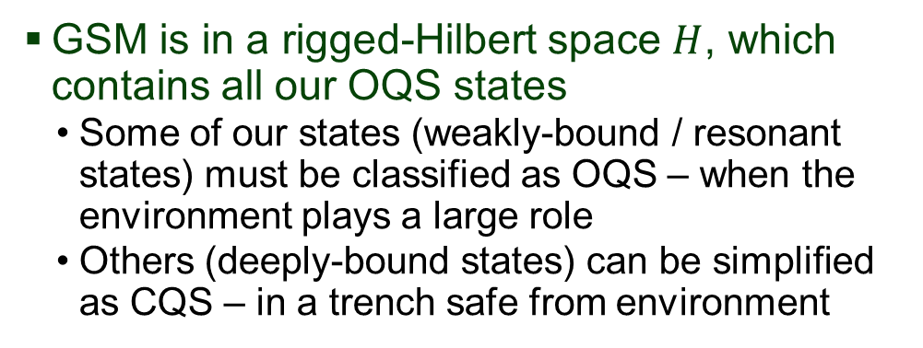
Quantifying the continuum
GSM is in a rigged-Hilbert space $H$, which contains all our OQS states
  Some of our states (weakly-bound / resonant states) must be classified as OQS – when the environment plays a large role
  Others (deeply-bound states) can be simplified as CQS – in a trench safe from environment
Notes:
Let’s start by building our space. We initially define our Q operator via a closed space and want to ensure we have a complete set. Assuming we picked a good representation for our Q operator, the complement would then be the remainder.

Slide 30
Quantifying the continuum
GSM is in a rigged-Hilbert space $H$, which contains all our OQS states
  Some of our states (weakly-bound / resonant states) must be classified as OQS – when the environment plays a large role
  Others (deeply-bound states) can be simplified as CQS – in a trench safe from environment
If we consider that there must be some CQS description in GSM
  We create a CQS operator through CQS eigenstates (like HO-SM)
Notes:
Let’s start by building our space. We initially define our Q operator via a closed space and want to ensure we have a complete set. Assuming we picked a good representation for our Q operator, the complement would then be the remainder.

Slide 31

Quantifying the continuum
GSM is in a rigged-Hilbert space $H$, which contains all our OQS states
  Some of our states (weakly-bound / resonant states) must be classified as OQS – when the environment plays a large role
  Others (deeply-bound states) can be simplified as CQS – in a trench safe from environment
If we consider that there must be some CQS description in GSM
  We create a CQS operator through CQS eigenstates (like HO-SM)
  Assuming a large enough basis to fully encompass long range effects, the scattering space operator would then be the complement
Notes:
Let’s start by building our space. We initially define our Q operator via a closed space and want to ensure we have a complete set. Assuming we picked a good representation for our Q operator, the complement would then be the remainder.

Slide 32
Quantifying the continuum
We can then say that our Hamiltonian (or any other operator) can be projected as
CQS
Coupling terms
Scattering space
Biggest choice to make: what states should define $Q$?
Notes:
Of course, we then can use our projection operators to get projected components of operators.
After we have a code which does this projection given a set of states for Q, we can easily get our results. So the question is, what’s the best choice for our Q states?

Slide 33
Quantifying the continuum
We can then say that our Hamiltonian (or any other operator) can be projected as
Similar to the idea of SMEC
(discussed by Marek!)
but projects from a whole
space onto subspace
CQS
Coupling terms
Scattering space
Biggest choice to make: what states should define $Q$?
Notes:
Of course, we then can use our projection operators to get projected components of operators.
After we have a code which does this projection given a set of states for Q, we can easily get our results. So the question is, what’s the best choice for our Q states?

Slide 34
Conclusions
Continuum coupling impacts nuclei in many ways:
  Spectroscopic factors (single-particle strength) can be easily suppressed compared to other models
  Structure can begin to dissolve and notion of nuclear “states” begins to disappear
  GSM can still predict many genuine resonant states quite well, but there is some room for improvement
Ongoing work: Quantification of continuum coupling strength can give insight into these exotic systems compared to closed system

Slide 35
Acknowledgements
Collaborators: W. Nazarewicz^{1,2} and S. M. Wang^{3,4}
  Facility for Rare Isotope Beams, Michigan State University
  Department of Physics and Astronomy, Michigan State University
  Key Laboratory of Nuclear Physics and Ion-beam Application (MOE), Institute of Modern Physics, Fudan University, Shanghai 200433, China
  Shanghai Research Center for Theoretical Nuclear Physics, NSFC and Fudan University, Shanghai 200438, China
This material is based upon work supported by grant number DOE-DE-SC0013365
Thank you for your attention!

Slide 36
Backup Slides

Slide 37




Introduction – Harmonic Oscillator solutions
Closed quantum system, we have only bound states
If we consider a finite potential, what do we see?
$$E$$
Im$\left(k\right)$
Re$\left(k\right)$
$k∝$ $i\sqrt{−E}, for E<0$
Notes:
To provide a lead-in to the general framework of the S-matrix, I will discuss the very simple case (about 30 seconds total for this slide).
For closed systems, an example is any case where we are totally isolated from the environment i.e. V\rightarrow \infty.
Opening our system essentially entails allowing two distinct regions to exist: bound and scattering state regions. Resonances appear as a special consequence of the later case when there are additional barriers to our particle in the scattering region.

Slide 38
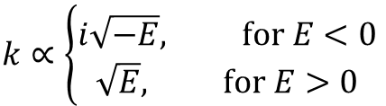




Introduction – Finite Well solutions
Finite potentials have two classifications of solutions:
  Bound states
  Scattering states
This is nice for bound and unbound systems, but is there something else we should consider?
$$E$$
Unbound
Im$\left(k\right)$
Re$\left(k\right)$
Threshold $E=0$
Bound
$$k∝\left\{\begin{aligned}i\sqrt{−E}, for E<0 \\ \sqrt{E}, for E>0\end{aligned}\right.$$
Notes:
To provide a lead-in to the general framework of the S-matrix, I will discuss the very simple case (about 30 seconds total for this slide).
For closed systems, an example is any case where we are totally isolated from the environment i.e. V\rightarrow \infty.
Opening our system essentially entails allowing two distinct regions to exist: bound and scattering state regions. Resonances appear as a special consequence of the later case when there are additional barriers to our particle in the scattering region.

Slide 39
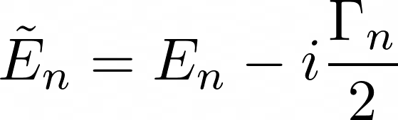
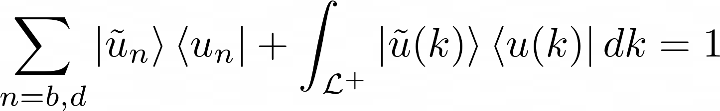


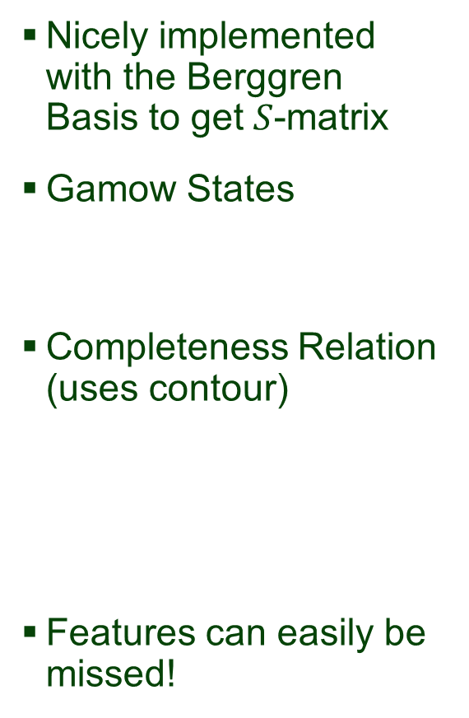

Introduction – Gamow Shell Model
Nicely implemented with the Berggren Basis to get $S$-matrix
Gamow States
Completeness Relation (uses contour)
Features can easily be missed!
Im$\left(k\right)$
Scattering features
Bound states
Re$\left(k\right)$
Gamow States
(Resonances)
Capturing States
Antibound (virtual) states
$\frac{−π}{4}$ line
Notes:
We use the complex energy formalism with the Berggren basis to naturally generate poles in the S-matrix to equally describe all possible states and structure features.
In the Berggren formalism, we nicely obtain the Gamow States (with decay widths) in a coherent framework.
If we were to break down the complex plane based on the completeness relation, we find that:
- The sum includes bound states, but also resonant state poles
- The integral is our scattering continuum, which requires a contour to capture our poles in the complex plane

Slide 40
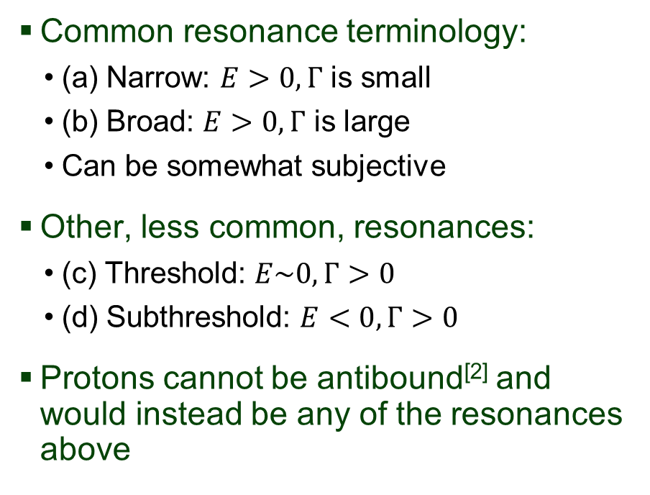



Introduction – Resonant State Classifications
Im$\left(k\right)$
Common resonance terminology:
  (a) Narrow: $E>0, Γ$ is small
  (b) Broad: $E>0, Γ$ is large
  Can be somewhat subjective
Other, less common, resonances:
  (c) Threshold: $E\sim 0, Γ>0$
  (d) Subthreshold: $E<0, Γ>0$
Protons cannot be antibound^{[2]} and would instead be any of the resonances above
Scattering
c
a
b
Re$\left(k\right)$
d
Antibound
$\frac{−π}{4}$ line
[2] S. M. Wang, W. Nazarewicz, R. J. Charity, and L. G. Sobotka. Structure and decay of the extremely proton- rich nuclei ^{11,12}O. May 6, 2019. Phys. Rev. C 99, 054302 (2019)
Notes:
Sometimes we throw out different resonance names. I realize it could be confusing if you’re not familiar with the technical jargon, so I’ve attempted to provide a rough illustration and boundaries for the types of resonances we tend to talk about.
It’s been shown that the Coulomb effects from protons push antibound states away from the imaginary momentum axis towards the resonance regions. Unfortunately, any state which falls below the pi/4 line is not calculable by GSM and would require models which can include this region such as GCC.

Slide 41
Quick aside – antibound states
A scattering feature!
  Not a genuine state
  Like when someone wants to be friends but doesn’t quite have the social energy to do so ☹
  Can seem to impact the group, but the structure doesn’t change
I don’t know if I can do this…
[1] M. Pfutzner, I. Mukha, S.M. Wang, Prog. Part. Nucl. Phys. 132 (2023) 104050.

Slide 42
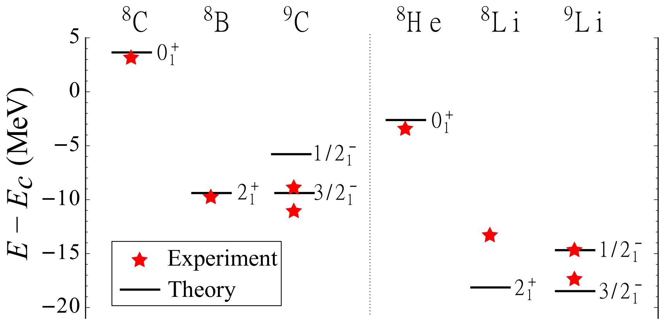
Spectroscopic Factors
Energy of maximum particles in the continuum and model space

Slide 43
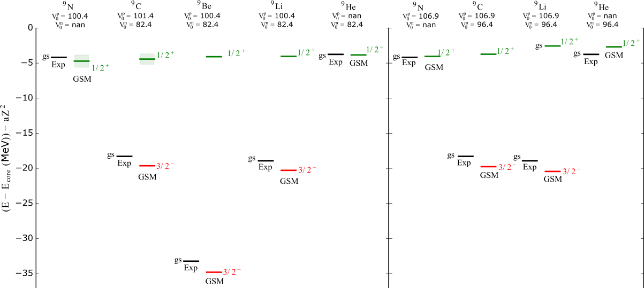


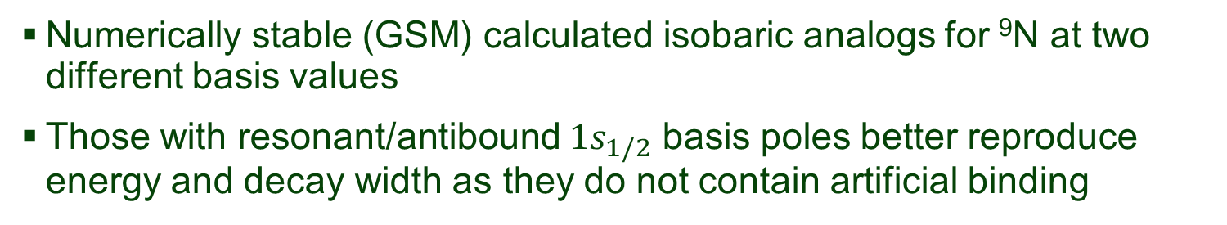
Backup – Stable results of isobaric analogs
Resonant / Antibound $1s_{1/2}$ basis pole
Bound $1s_{1/2}$ basis pole
Numerically stable (GSM) calculated isobaric analogs for ⁹N at two different basis values
Those with resonant/antibound $1s_{1/2}$ basis poles better reproduce energy and decay width as they do not contain artificial binding

Slide 44
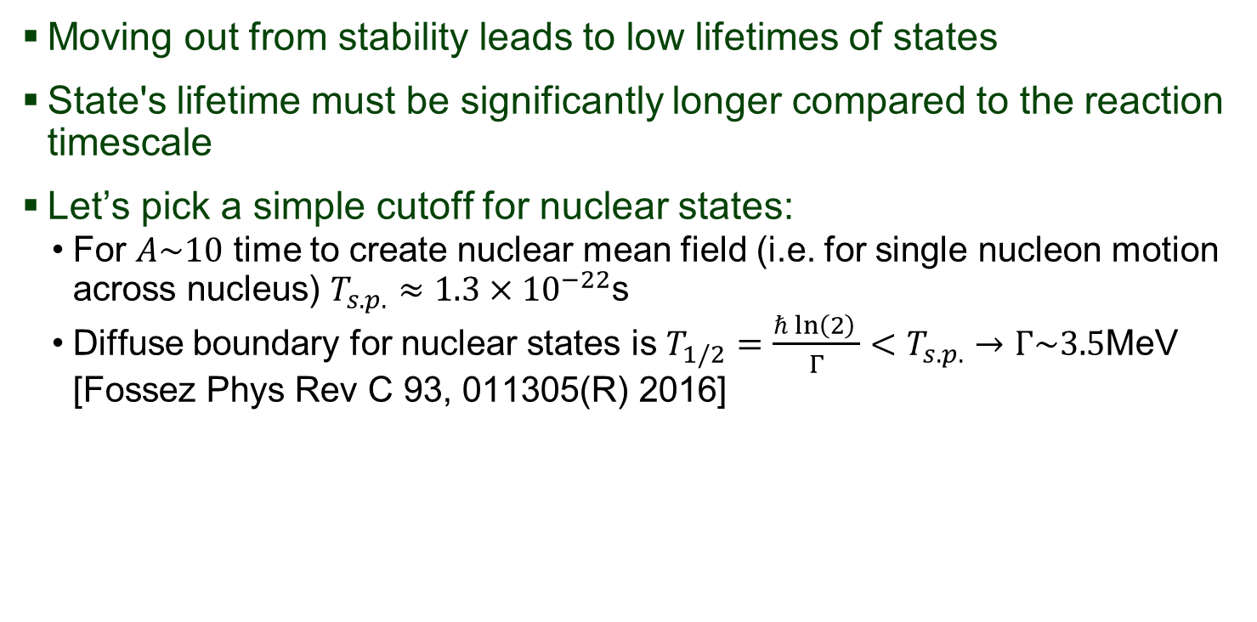
Backup – What can we call a state?
Moving out from stability leads to low lifetimes of states
State's lifetime must be significantly longer compared to the reaction timescale
Let’s pick a simple cutoff for nuclear states:
  For $A\sim 10$ time to create nuclear mean field (i.e. for single nucleon motion across nucleus) $T_{s.p.}≈1.3×{10}^{−22}$s
  Diffuse boundary for nuclear states is $T_{1/2}=\frac{ℏ ln\left(2\right) }{Γ}<T_{s.p.}→Γ\sim 3.5$MeV [Fossez Phys Rev C 93, 011305(R) 2016]

Slide 45



⁸C(2⁺) results – What can we call a state?
Our estimate: $T_{1/2}=\frac{ℏ ln\left(2\right) }{Γ}<T_{s.p.}→Γ_{s.p.}\sim 3.5$ MeV
⁸C (0⁺)
⁸C (2⁺)
$Γ_{s.p.}>Γ_{GSM}\left(0^{+}\right)=0.12$ MeV
$Γ_{s.p.}>Γ_{GSM}\left(2^{+}\right)=1.46$ MeV
⁸C_{Exp} (2⁺)
$Γ_{s.p.}>Γ_{Exp}\left(2^{+}\right)=4.50(1.10)$MeV

Slide 46
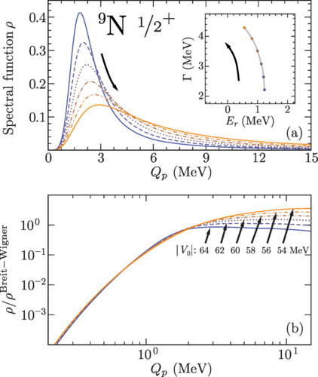
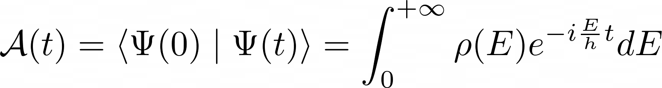
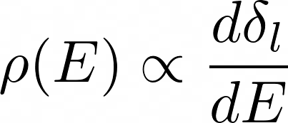
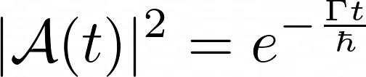
How can we improve our understanding?
Proposed recently^{[7]} and with experimental suggestions
Survival Amplitude
Spectral Function
Breit-Wigner resonance
⁹N(1/2⁺) doesn’t have Breit-Wigner shape
S.M. Wang, W. Nazarewicz, A. Volya, and Y. G. Ma, Probing the nonexponential decay regime in open quantum systems. June 23, 2023. Phys. Rev. Res. 5 023183 (2023)
Notes:
There are a few avenues we can pursue to better understand resonant states near threshold. In the case of experimental data, we can try essentially characterizing their energy profiles to inform their decay behavior. Deviations from Breit-Wigner shapes are non-exponential (non-narrow resonance) shapes.
Any state which doesn’t have strong exponential behavior is already starting in a continuum-dominated region.

Slide 47
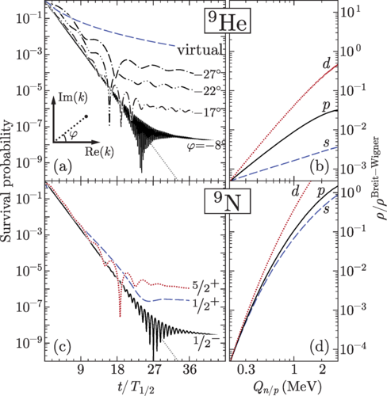
How can we improve our understanding?
Theoretically:
Look at lifetime plot, specifically where do we deviate from exponential to power law (more scattering continuum dependence)
Biggest challenges are computational!
  Dense contour discretization for antibound states too expensive
  Large truncations to our model space used
  Ideally, we’d calculate with all 5 valence nucleons in the continuum, but we had to truncate to 2 due to large dimensions
S.M. Wang, W. Nazarewicz, A. Volya, and Y. G. Ma, Probing the nonexponential decay regime in open quantum systems. June 23, 2023. Phys. Rev. Res. 5 023183 (2023)
Notes:
This slide is to highlight again the computational challenges in GSM when trying to calculate antibound states. If our GSM state is also reproduced in GCC, we can at least time propagate it to see how it evolves (I imagine this is still expensive!).

Slide 48
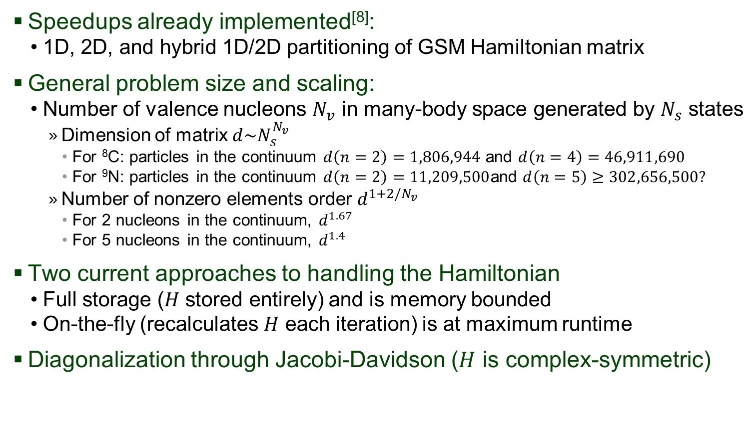
Computational bottlenecks
Speedups already implemented^{[8]}:
  1D, 2D, and hybrid 1D/2D partitioning of GSM Hamiltonian matrix
General problem size and scaling:
  Number of valence nucleons $N_{v}$ in many-body space generated by $N_{s}$ states
    Dimension of matrix $d\sim N_{s}^{N_{v}}$
      For ⁸C: particles in the continuum $d\left(n=2\right)=1,806,944$ and $d\left(n=4\right)=46,911,690$
      For ⁹N: particles in the continuum $d\left(n=2\right)=11,209,500$and $d\left(n=5\right)≥302,656,500?$
    Number of nonzero elements order $d^{1+2/N_{v}}$
      For 2 nucleons in the continuum, $d^{1.67}$
      For 5 nucleons in the continuum, $d^{1.4}$
Two current approaches to handling the Hamiltonian
  Full storage ($H$ stored entirely) and is memory bounded
  On-the-fly (recalculates $H$ each iteration) is at maximum runtime
Diagonalization through Jacobi-Davidson ($H$ is complex-symmetric)
N. Michel, H.M. Aktulga, Y. Jaganathen, Towards scalable many-body calculations for nuclear open quantum systems using the Gamow Shell Model. October 3, 2019. Comput. Phys. Commun. 247 106978 (2019)

Slide 49

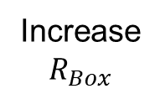









Thesis project – quantifying the continuum
We generate single-particle (s.p.) states in a box
  Complete set of states can be easily obtained without truncations issues
  Box radius can be approximation of openness of system
  Larger radius → finer momentum discretization and representation of continuum states
$$E$$
$$V_{Box}=∞$$
$$E$$
HO
$$V_{Box}=∞$$
$$V_{B}$$
$$V_{B}$$
$$R_{Box}$$
$$R_{Box}$$
HO
Increase
$$R_{Box}$$
$${−V}_{0}$$
$${−V}_{0}$$
Notes:
Listing changes required and some of the possible pros and cons (which will be explored with more benchmarking).

