Slide 1
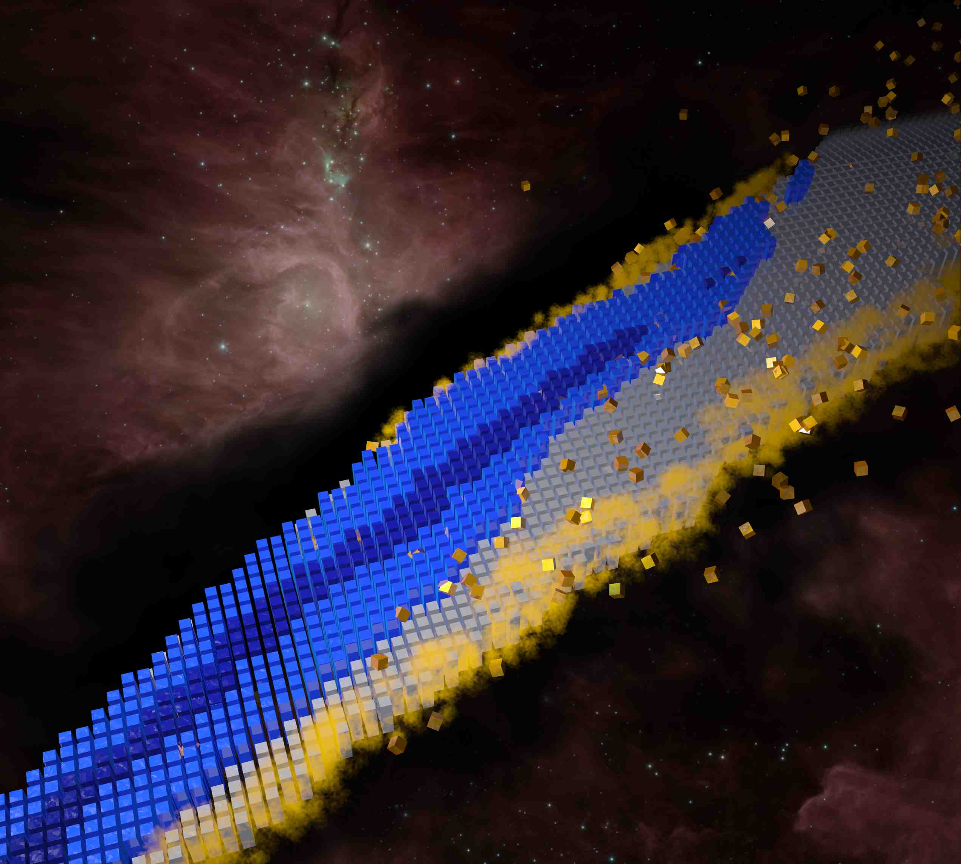
Structure of rare isotopes: theoretical challenges
Witold Nazarewicz (FRIB/MSU)
International School of Nuclear Physics, 45th Course
Erice, Sicily Sep.16-22 2024
Menu
General perspective
Uncertainty quantification
Extrapolations (driplines, superheavies)
Examples

Slide 2


The nucleus is a complex many-body system. Exact* realistic nuclear models do not exist.
model emulators
Resolution (depends on questions asked!)
expensive model
compare!
experiment
*parameter-free; “fully-microscopic”

Slide 3
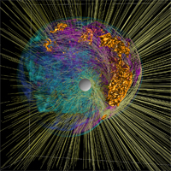
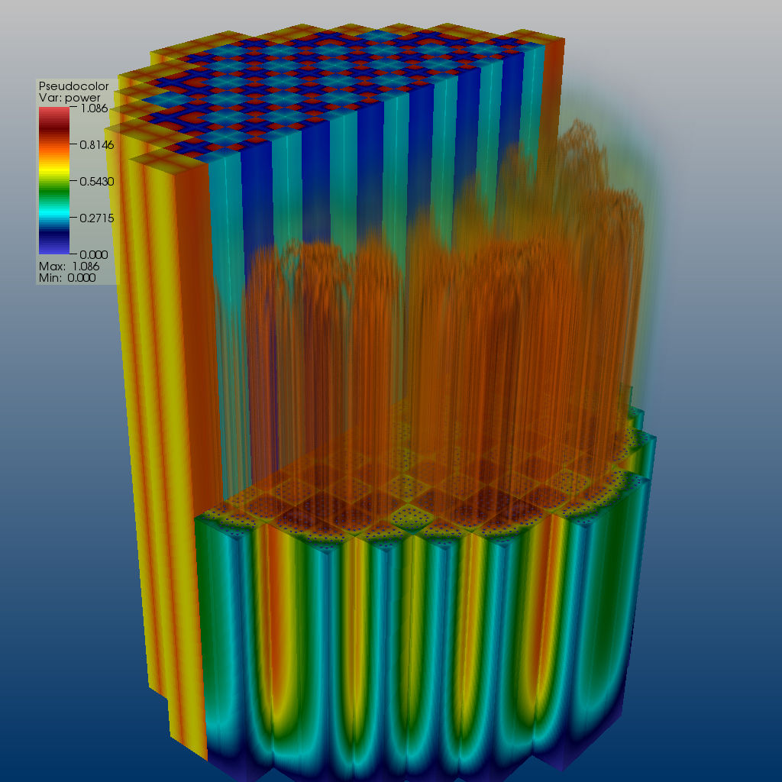
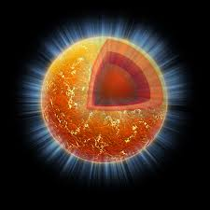

Machine learning & quantified low-energy nuclear theory: Why?
ML tools can help us to speed up the scientific method cycle and hence facilitate discoveries
  Enabling big simulations by fast emulation of expensive models
  Providing meaningful input to applications and planned measurements by means of experimental design
ML tools can help us to reveal the structure of our models
  Model reduction by eliminating redundant parameters
  Identifying crucial experimental data for better constraining theory and revealing the information content of measured observables
ML tools can help us to provide predictive capability
  ML enables uncertainty quantification (UQ)
  Theoretical models are often applied to entirely new nuclear systems and conditions that are not accessible to experiment

Slide 4
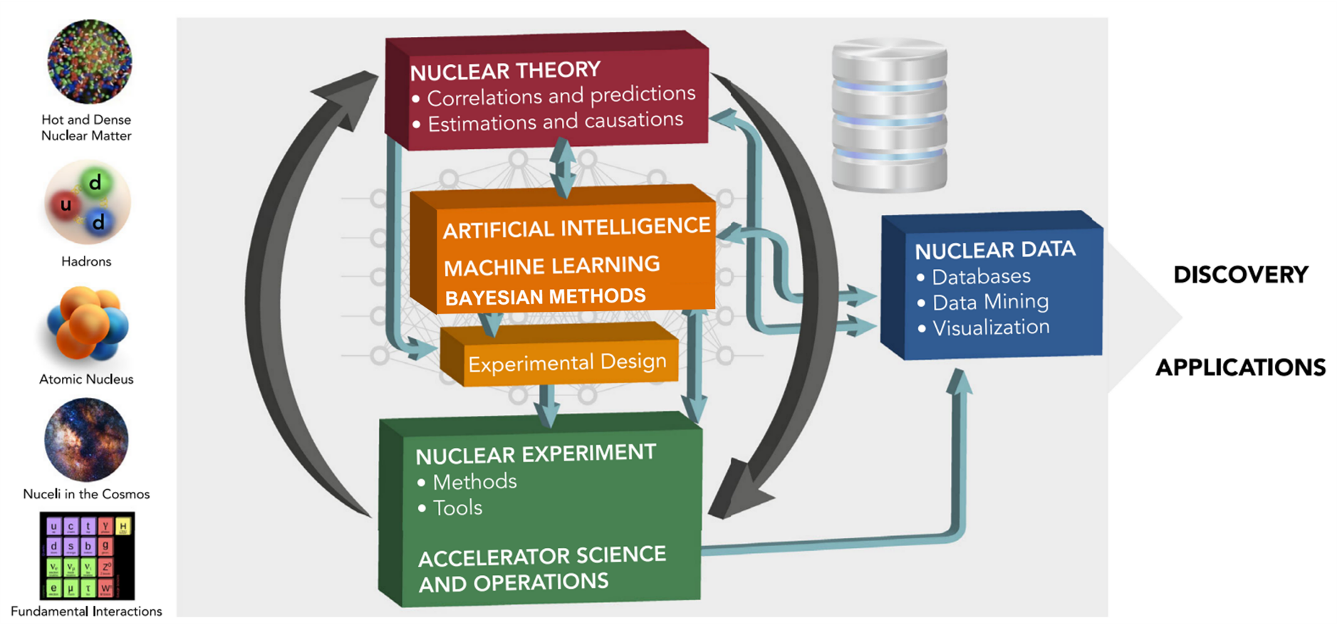
Machine learning and nuclear theory: big picture
Artificial Intelligence and Machine Learning in Nuclear Physics
A. Boehnlein et al., Rev. Mod. Phys. Rev. Mod. Phys. 94, 031003 (2022)
Many examples can be found there!
  Speeding-up the cycle of the scientific method

Slide 5
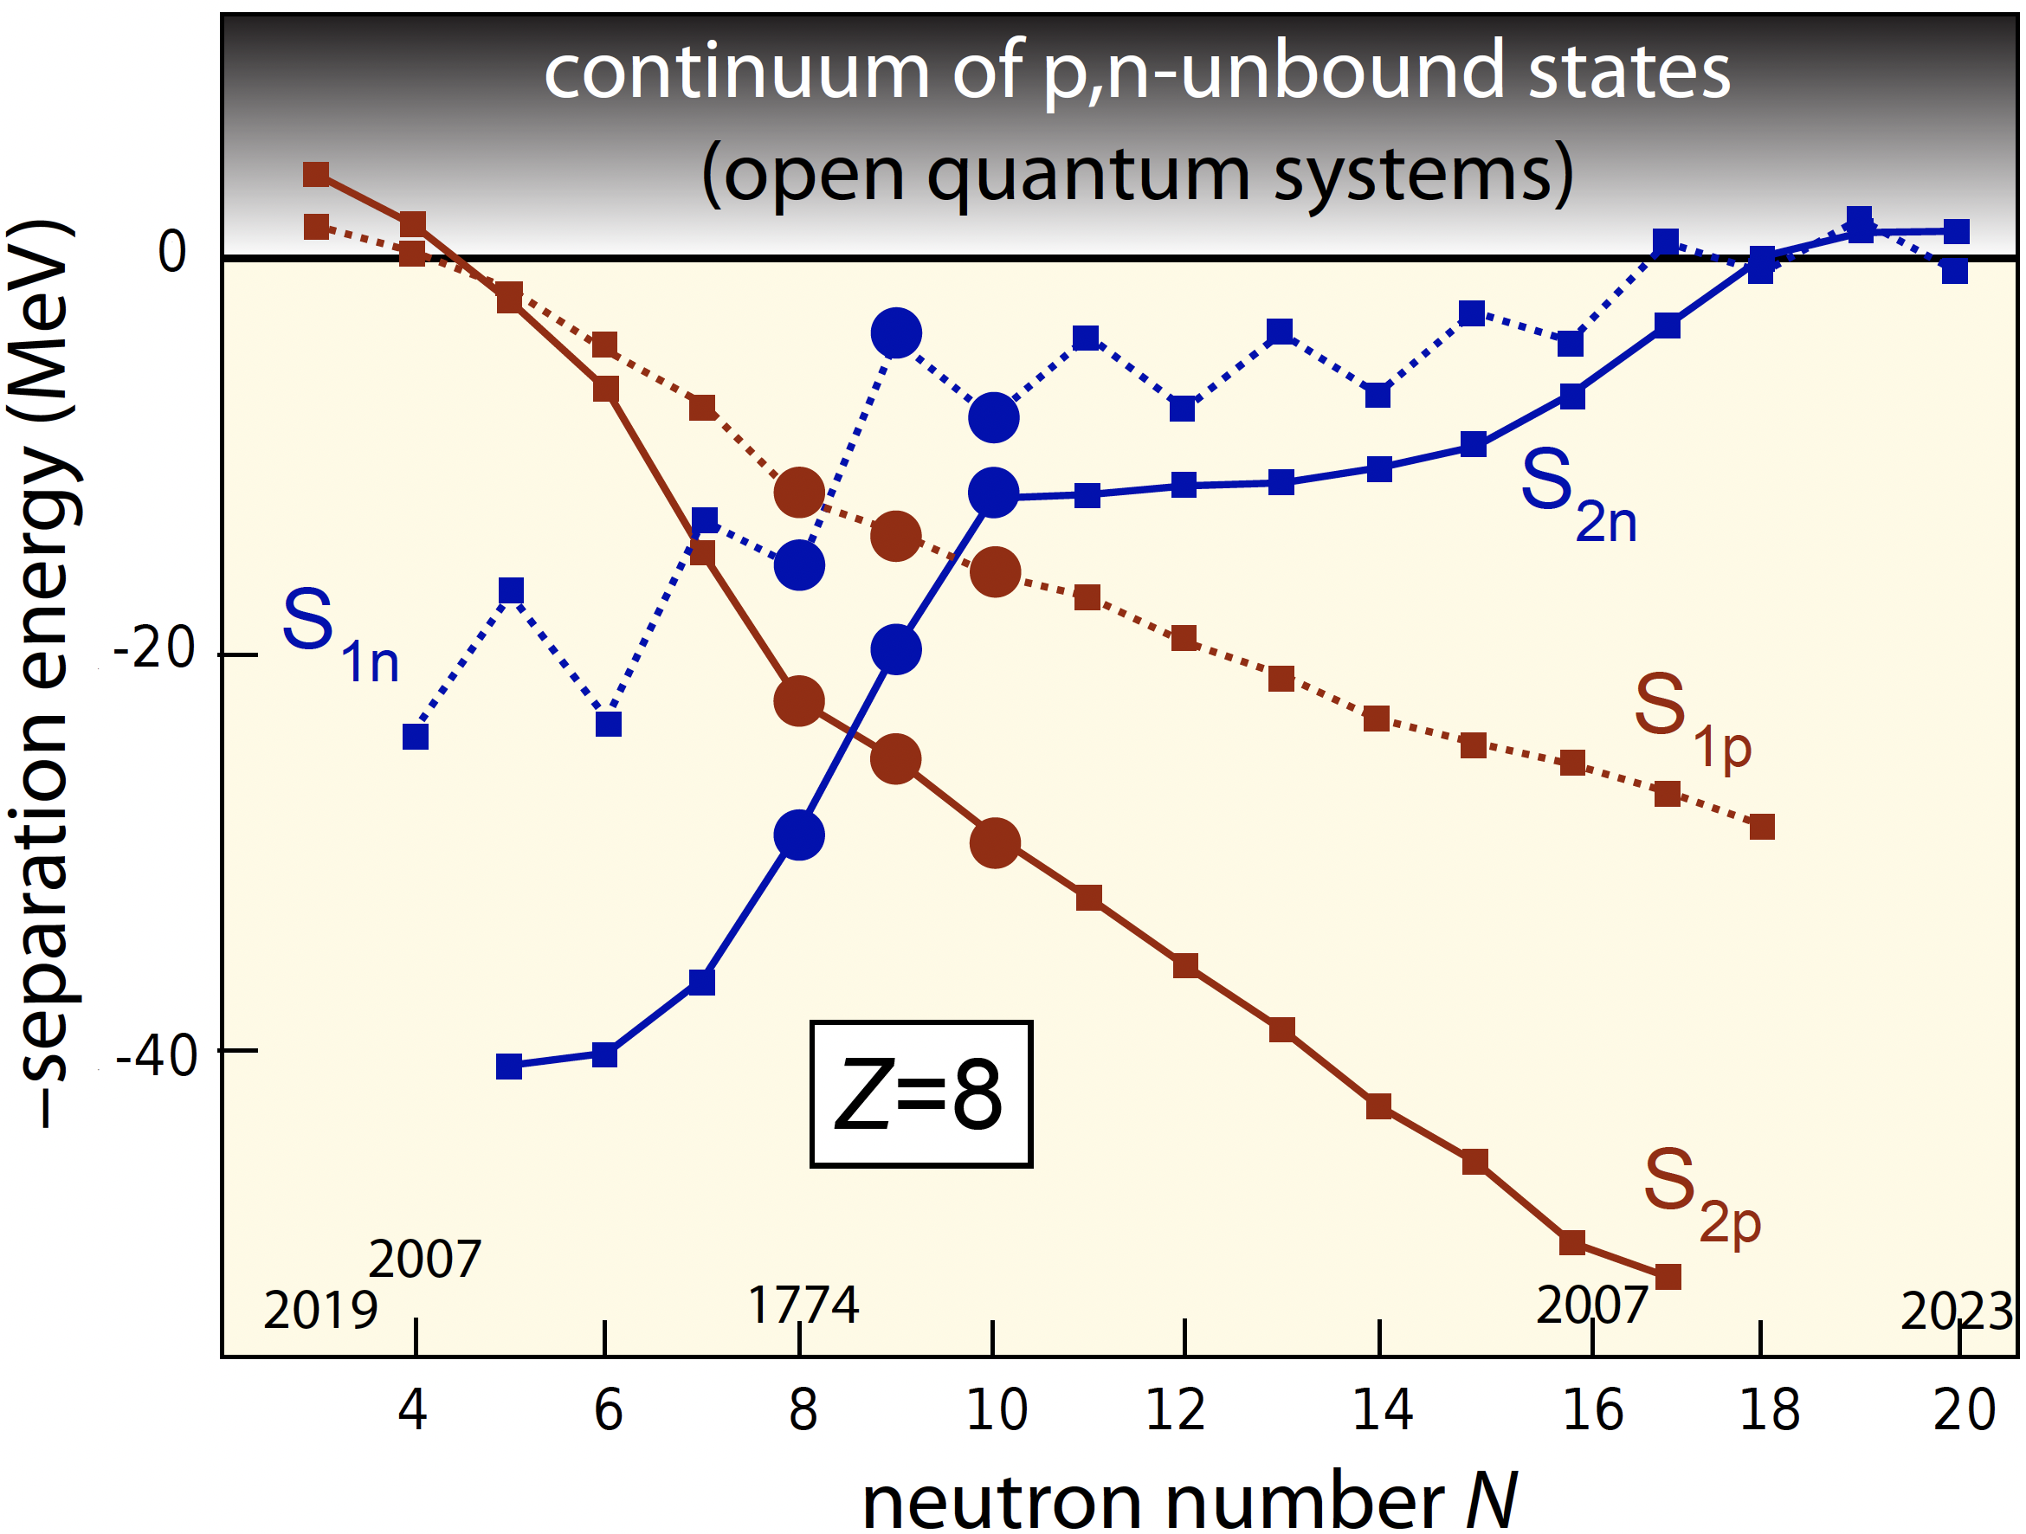
Approaching the nuclear ephemeral zone
resonances,
scattering
features
correlations
Discovery

Slide 6

Ephemeral nucleus ⁹N: 5-proton emitter
Charity at al., Phys. Rev. Lett. 131, 172501 (2023)
virtual state
threshold
resonance

Slide 7
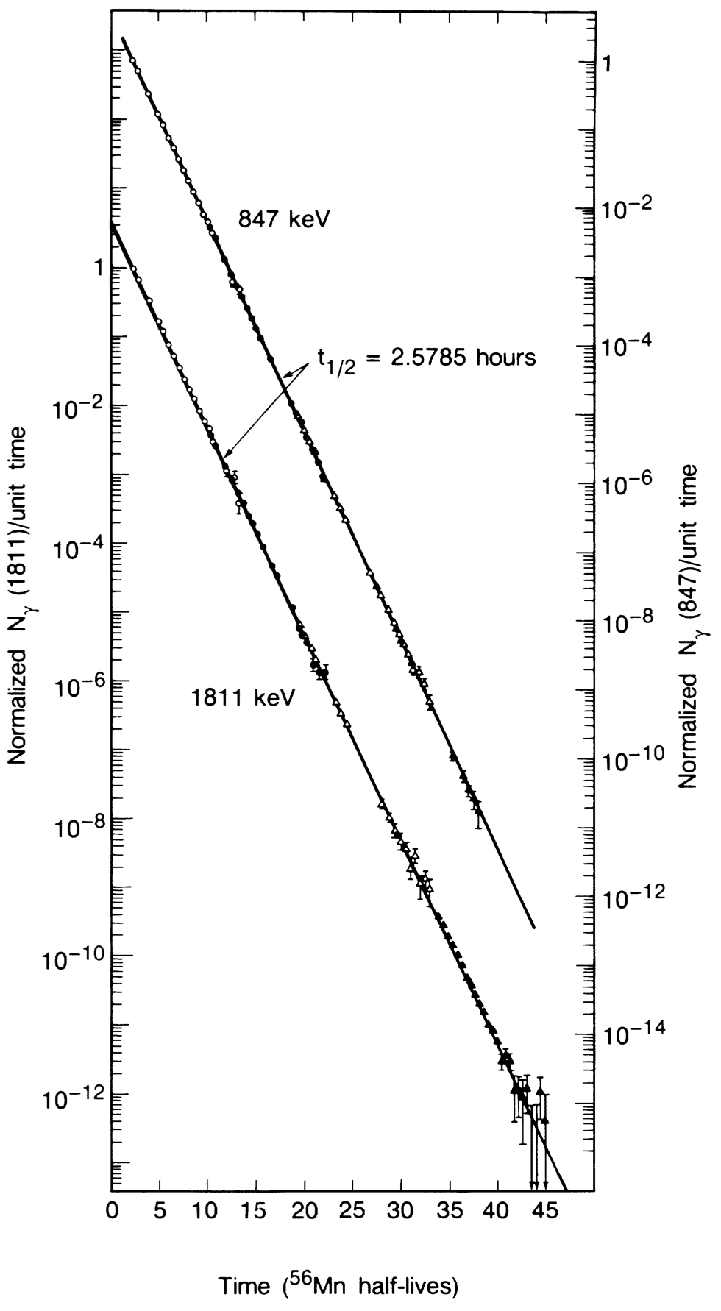
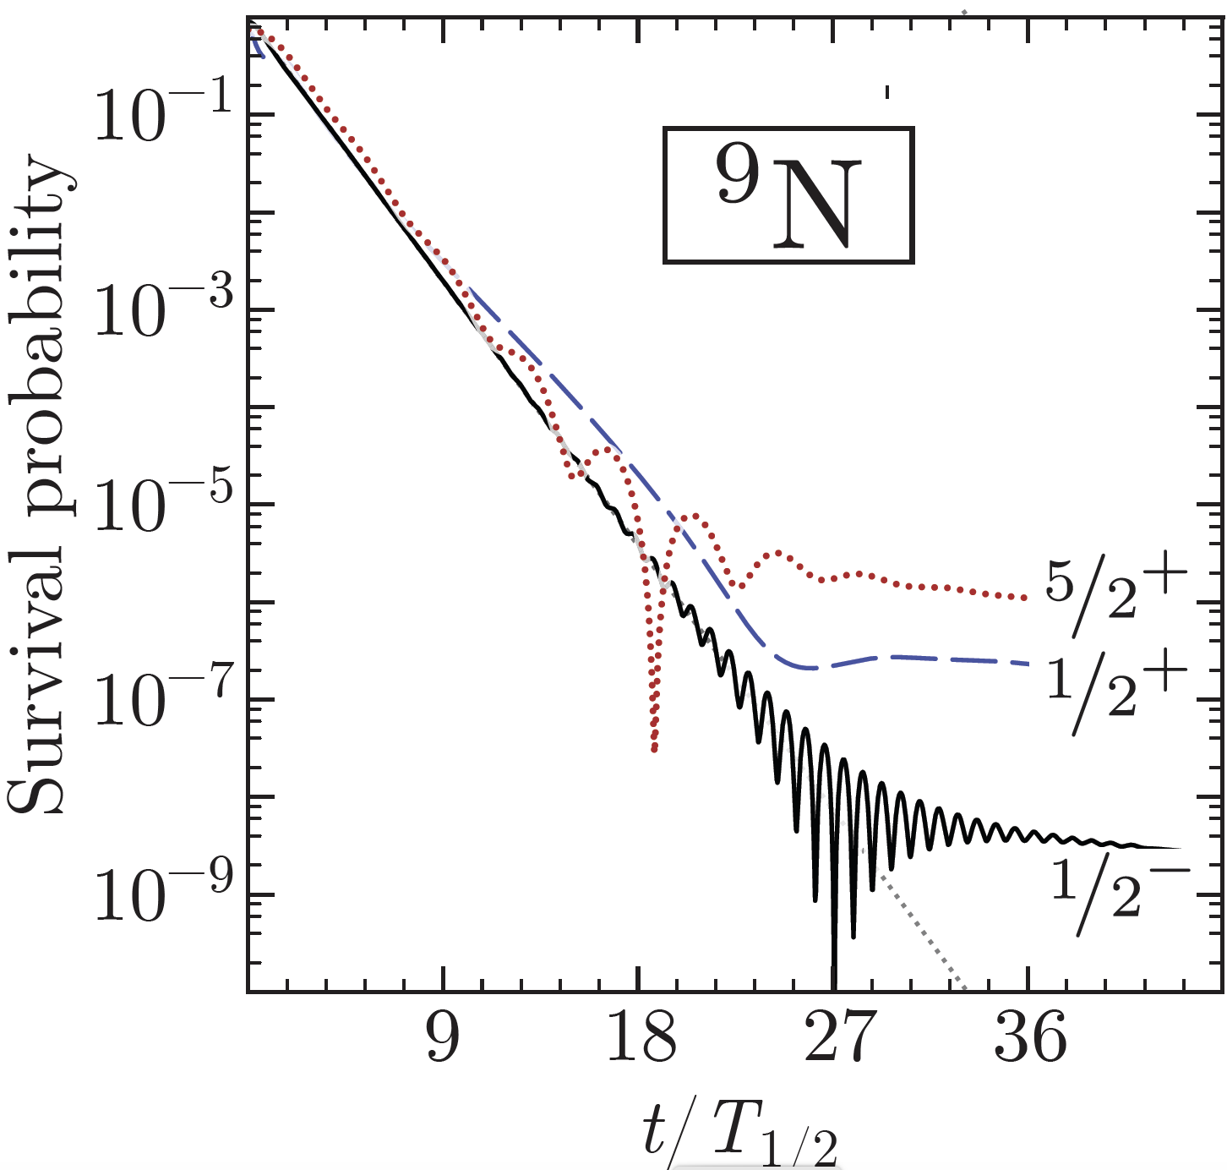
Probing the nonexponential decay
survival
amplitude
spectral function
For a Breit-Wigner resonance
E. Norman et al., PRL 60, 2246 (1988) [⁶⁰Co and ⁵⁶Mn] and Phys. Lett. B 357, 521 (1995) [⁴⁰K]
The Decay law at long times
S.M. Wang et al., Phys. Rev. Res. 5, 023183 (2023)
A long-term nonexponentiality is expected theoretically to probe the nonresonant background components of the initial wave function.

Slide 8
Quantitative predictions require many scientific-method loops
Charge radii of Ca isotopes in Fayans-DFT
Nat. Phys. 15, 432 (2019)
Understanding the charge radii data in the Ca chain took time and effort…
Magnetic (spin-orbit) contribution to nuclear charge density
New data on neutron- and proton-rich isotopes
Dependence of pairing functional on the gradient of density
HFB treatment of weakly-bound 36Ca
Calibration of the Fayans functional to differential radii

Slide 9
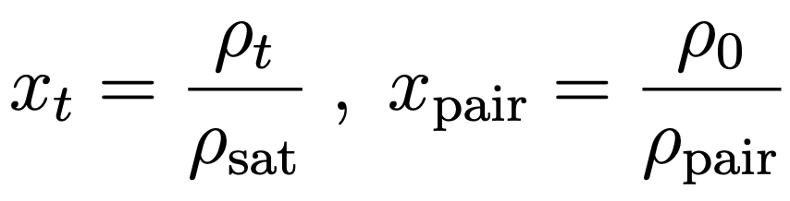
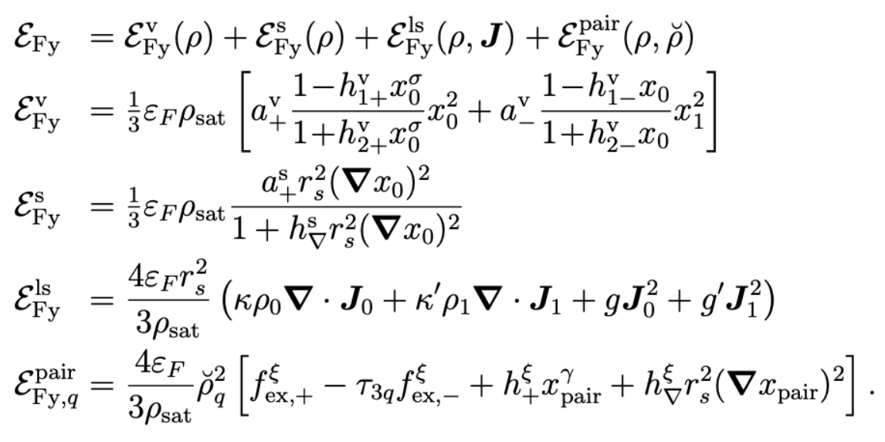
Example: Fayans functional
Reinhard et al., J. Phys. G 51, 105101 (2024)
Isovector pairing term
13 (14) parameters

Slide 10
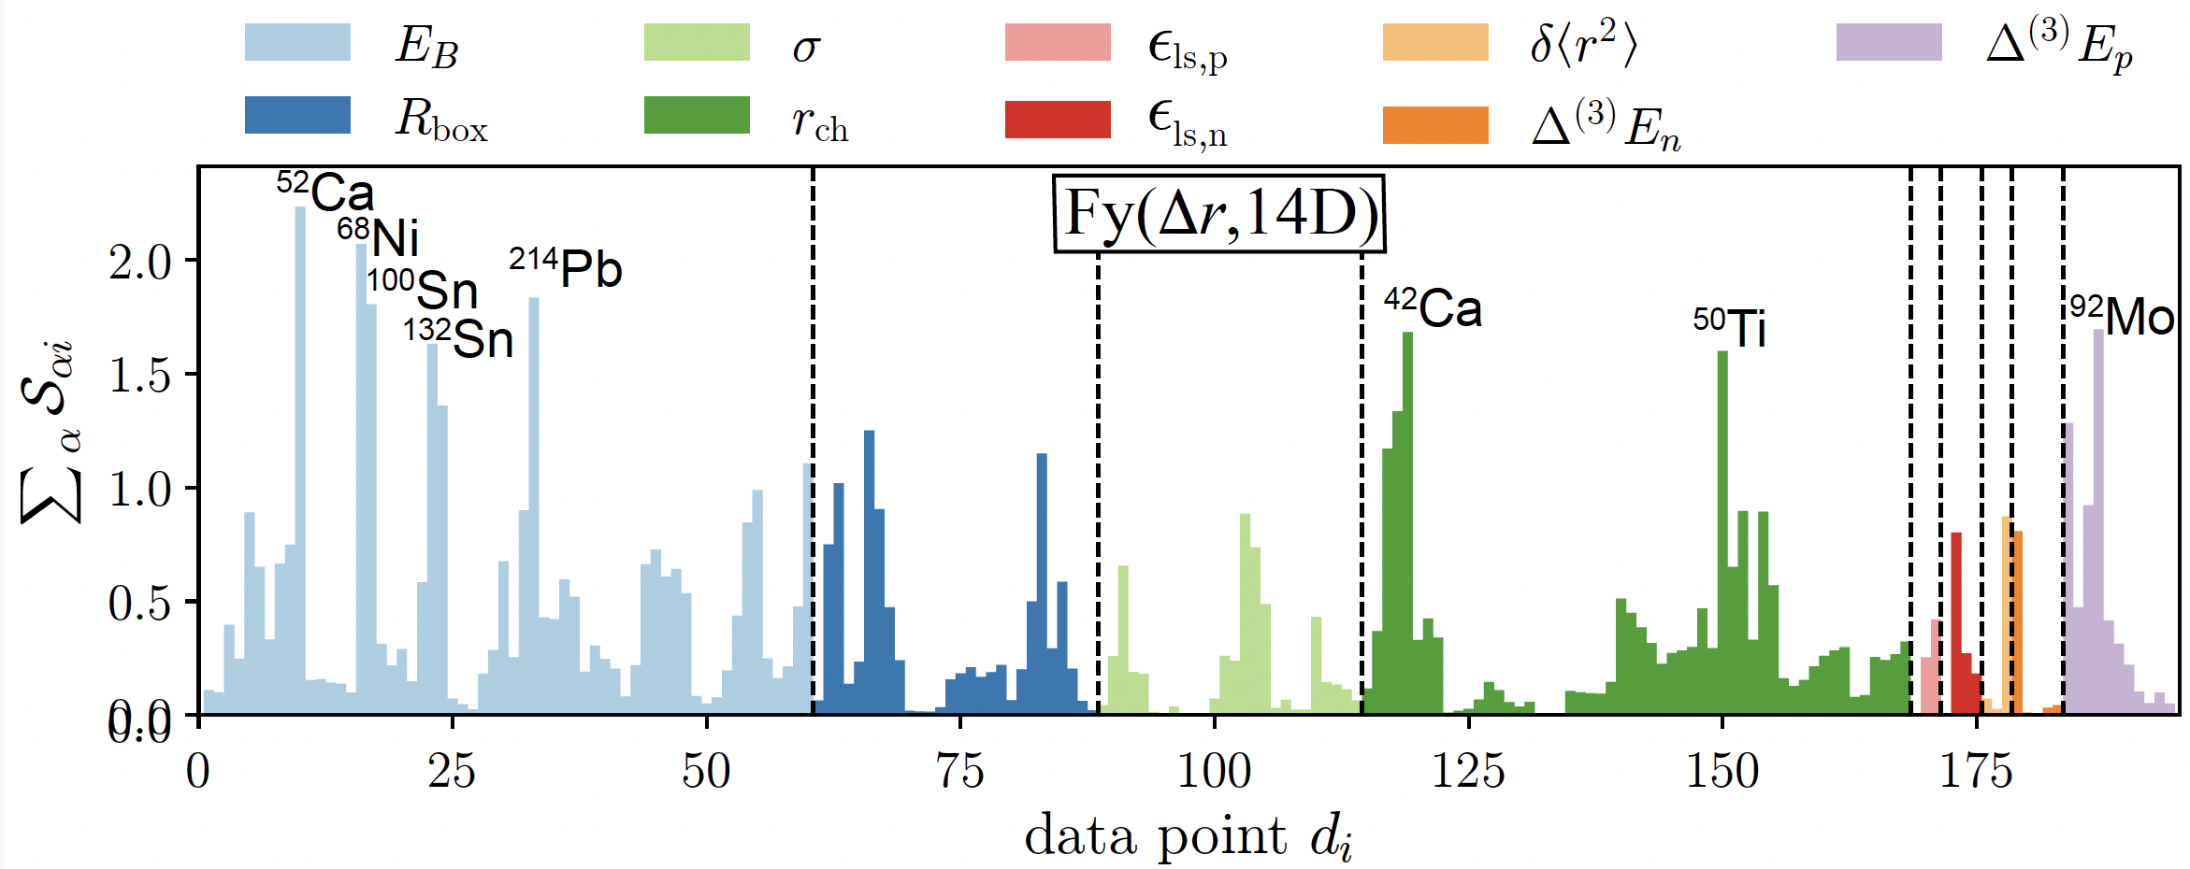
Identifying crucial experimental data
Example: Fayans functional calibration
O’Neal et al., in preparation (2024)
The total impact of a data point on the parameters of the functional

Slide 11
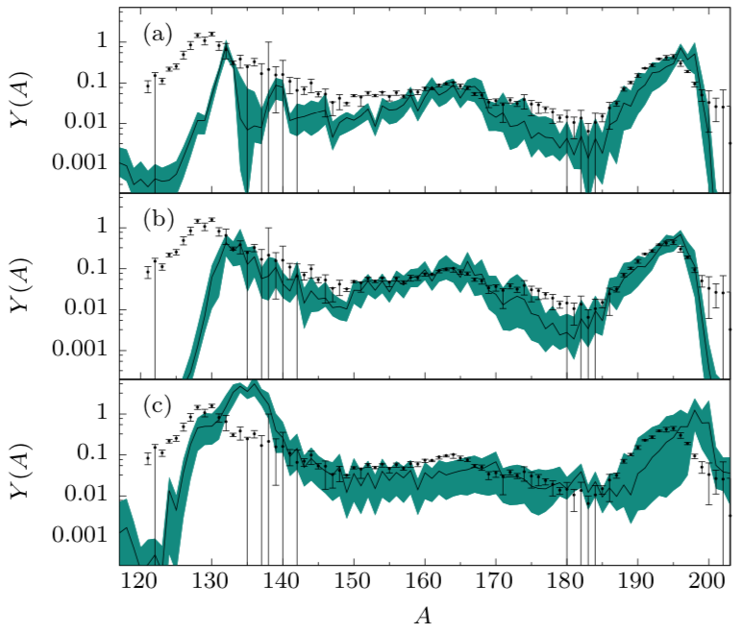
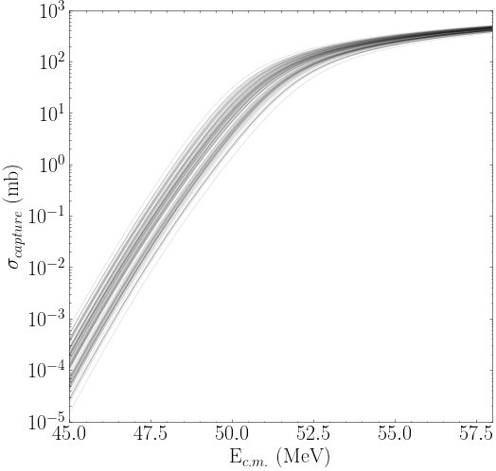
Example: Quantified DFT
McDonnell et al. Phys. Rev. Lett. 114, 122501 (2015)
Sprouse et al. Phys. Rev. C 101, 055803 (2020)
high-entropy
low-entropy
r-process
modeling
fission recycling
heavy-ion fusion
Bivariate marginal estimates of the posterior distributions for the 12-dimensional UNEDF1 EDF
Godbey et al. Phys. Rev. C 106, L051602 (2022)
The zoo of functionals – no longer

Slide 12
Naïve nuclear theorist’s approach to a systematic (model) error estimate (trends analysis):
Take a set of reasonable global models Mi, hopefully based on different assumptions/formalism, that satisfy basic theoretical requirements (here comes the expert belief thing).
Make predictions.
Compute average and variation within this set
Compute rms deviation from existing experimental data.

Slide 13
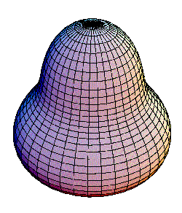
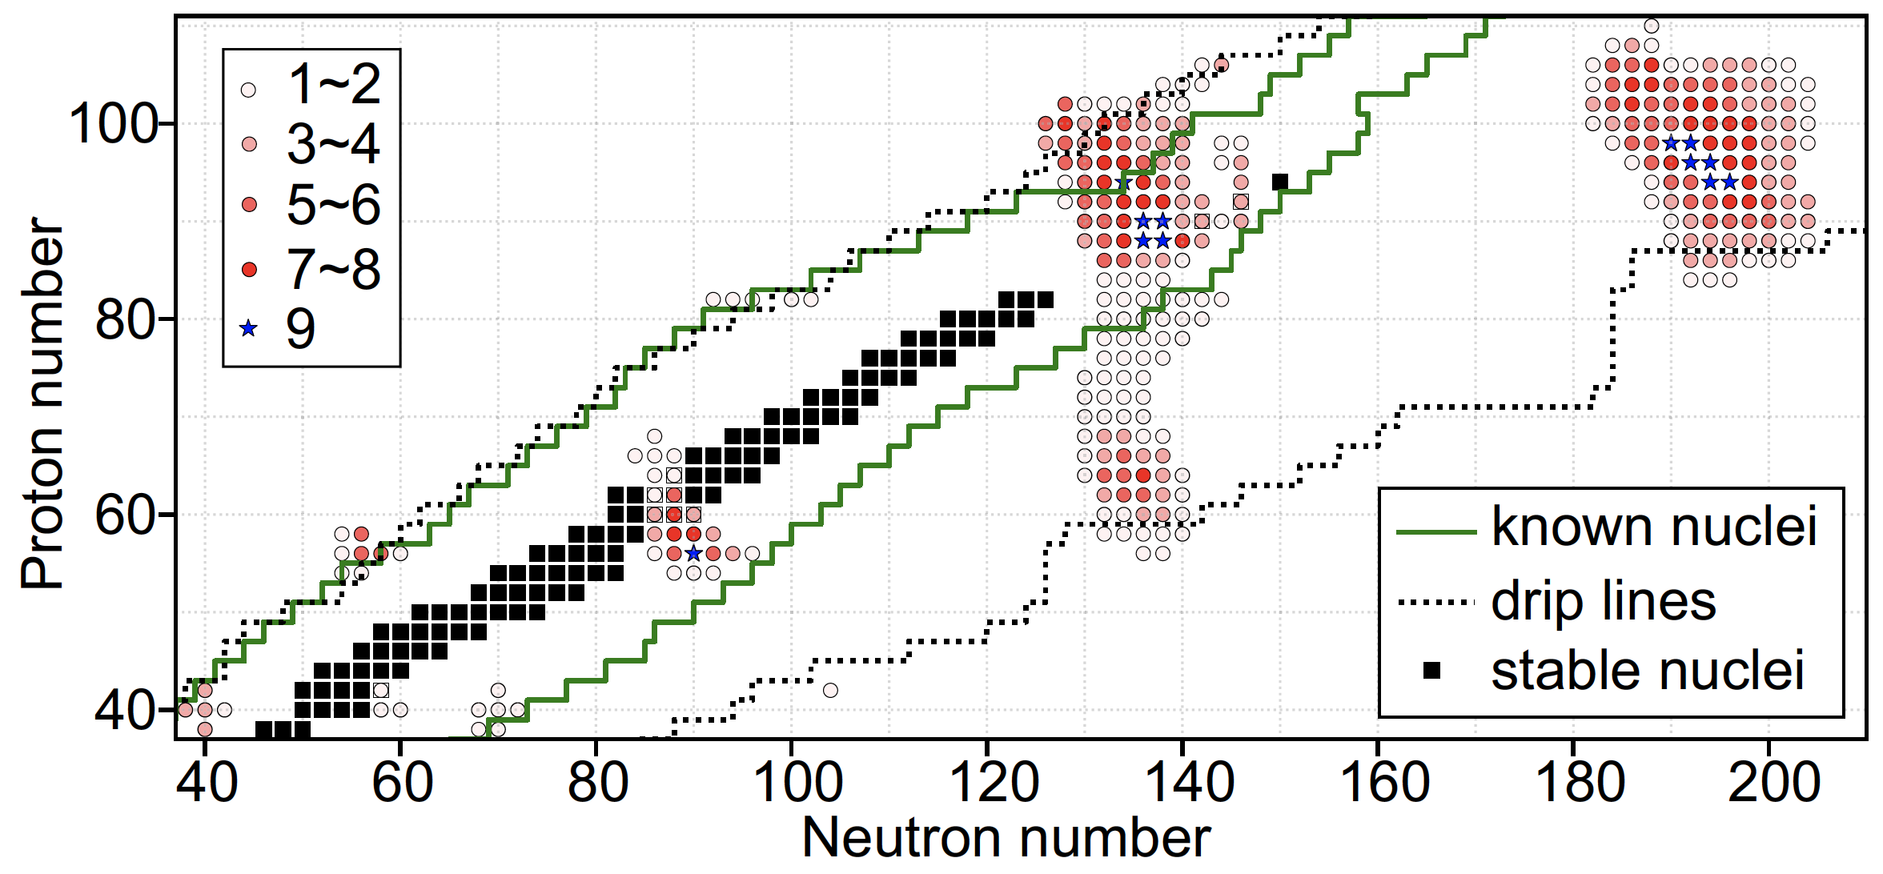
Example: Assessing systematic uncertainty
by comparing different models
Landscape of pear-shaped even-even nuclei
Phys. Rev. C 102, 024311 (2020)

Slide 14
We can do better by mixing models!
In this way, collective wisdom of several models is maximized by providing the best prediction rooted in the most current experimental information.
Bayesian Model Averaging (BMA) or Bayesian Model Mixing (BMM) incorporate insights from different models into a unified prediction in a statistically rigorous way.
BMA: the total pdf is an average over pdf’s of individual models.
observable of interest
evidence (target) dataset
model weight
model
In the more advanced BMM, it is assumed that the total prediction is an average over predictions of individual models.

Slide 15
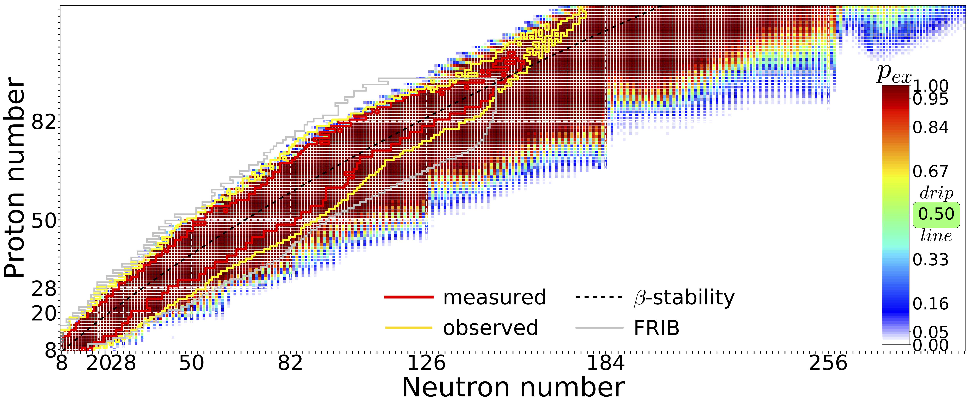
Quantified predictions based on current data and current theoretical knowledge (extrapolations are tough!)
Neufcourt at al , Phys. Rev. C 101, 044307 (2020)
Predictions made with 11 global mass model and Bayesian model averaging
More advanced Bayesian model mixing techniques on the horizon!
    Local model mixing
    Model orthogonalization
    Web-based mass interface (BMEX)
    Masses and covariances!

Slide 16
In many cases physics models may have a similar mathematical foundation but their parameters are calibrated using different methodologies. It is also possible that models are identical despite their different formulations. How to eliminate model redundancy?
Model orthogonalization and Bayesian mixing of nuclear mass models via Principal Component Analysis
P. Giuliani, K. Godbey, V. Kejzlar, W. Nazarewicz, Phys. Rev. Research 6, 033266 (2024)
The resulting scheme: the Bayesian Model Combination (BMC)
Projections of 15 realistic models of the nuclear binding energy into the first two principal components. This representation allows us to visualize inter-model relationships.

Slide 17
Superheavy nuclei: exercise in extrapolations
Odile Smits et al., Nat. Rev. Phys. 6, 86 (2024)

Slide 18
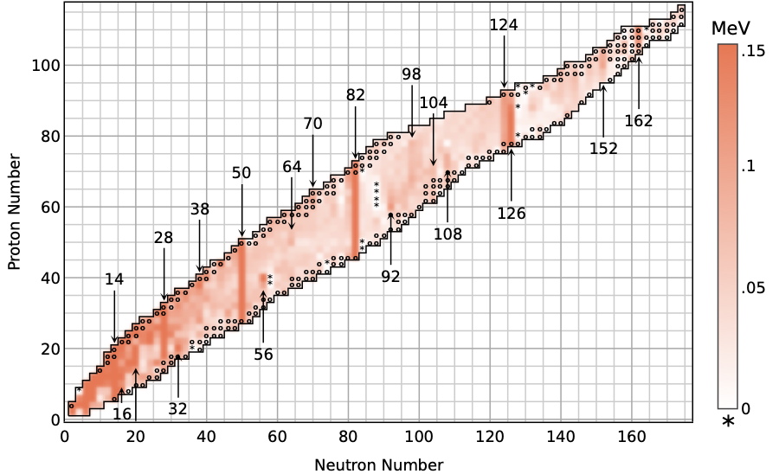

Nucleonic shells from nuclear masses
http://bmex.dev
L. Buskirk et al., Phys. Rev. C 109, 044311 (2024)

Slide 19
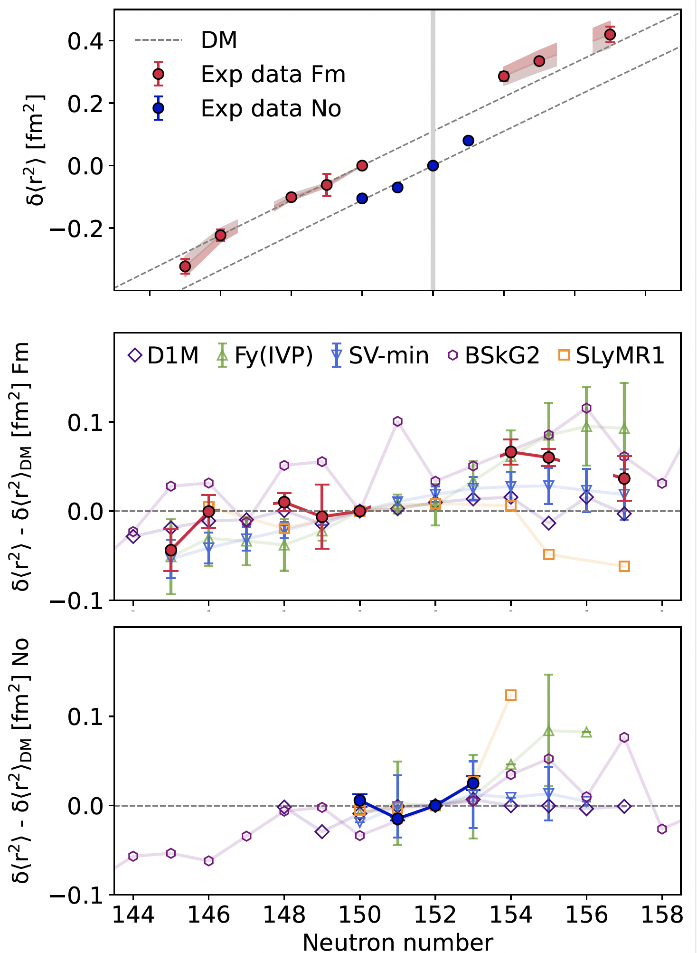
Laser spectroscopy of fermium isotopes: diffused shell effects in the heaviest nuclei
J. Warbinek et al., Nature (2024)
Superheavy nuclei are ~bulk systems (by nuclear standards). Macroscopic liquid-drop arguments based on leptodermous expansion and semi-classical arguments often apply.
But… their mere existence hangs on subtle quantum shell effects!

Slide 20
Fission in the r-process and superheavy nuclei
Phys. Rev. C 105, 014619 (2022)
Fragment charge distributions of ²⁵⁴Pu,²⁹⁰Fm, and ²⁹⁴Og obtained in DFT+stat work (blue bands) and predicted in previous work by neglecting odd-even staggering (red dashed bands). Predictions of BSM and SPM models are shown by dashed and dash-dotted lines, respectively.
Challenge: uncertainty quantification of current theories of fission. Little has been done!

Slide 21
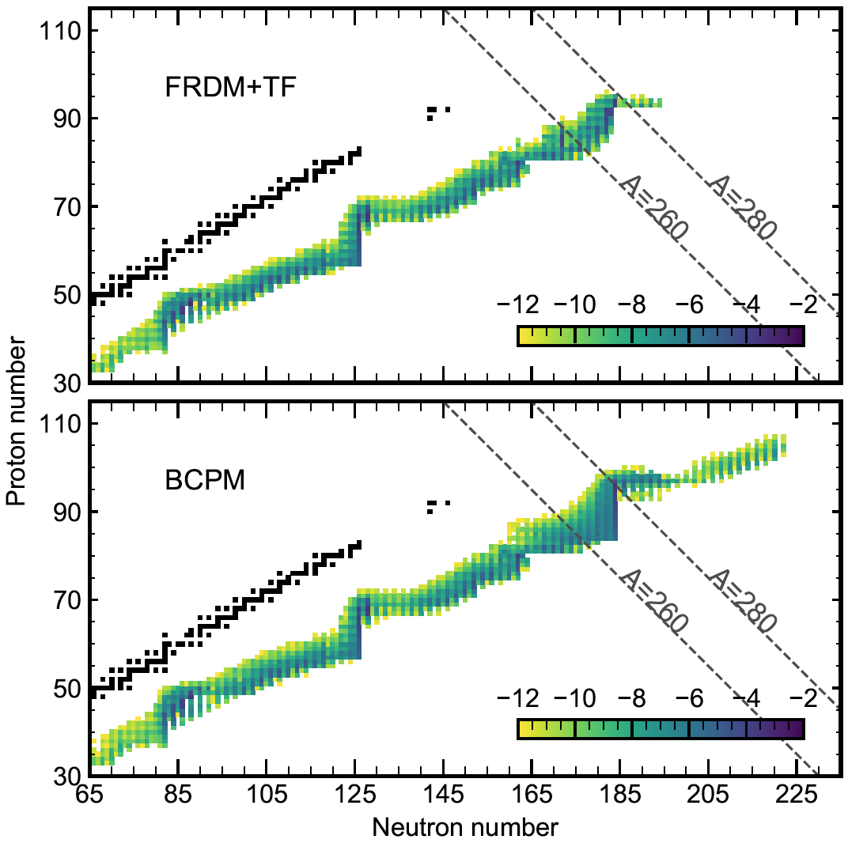
Fission yields of super-heavy nuclei be formed in the r-process strongly depend on predicted nuclear data
S. Giuliani et al. Phys. Rev. C 102, 045804 (2020)
Abundances (in log scale) at freeze-out in the hot dynamical ejecta of neutron star mergers. At N=184, the r-process path obtained with BCPM model can substantially populate nuclei up to ²⁸⁰Cm.

Slide 22
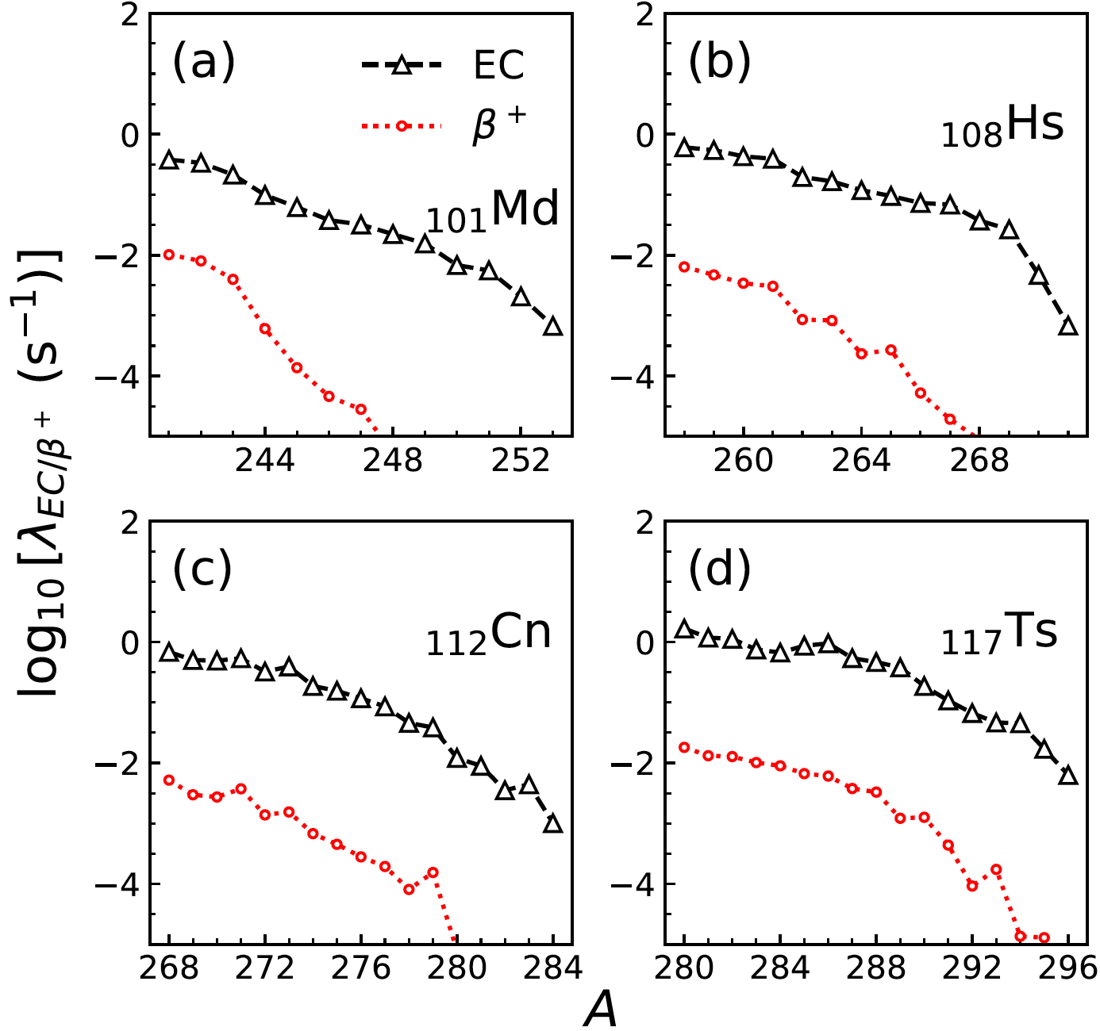
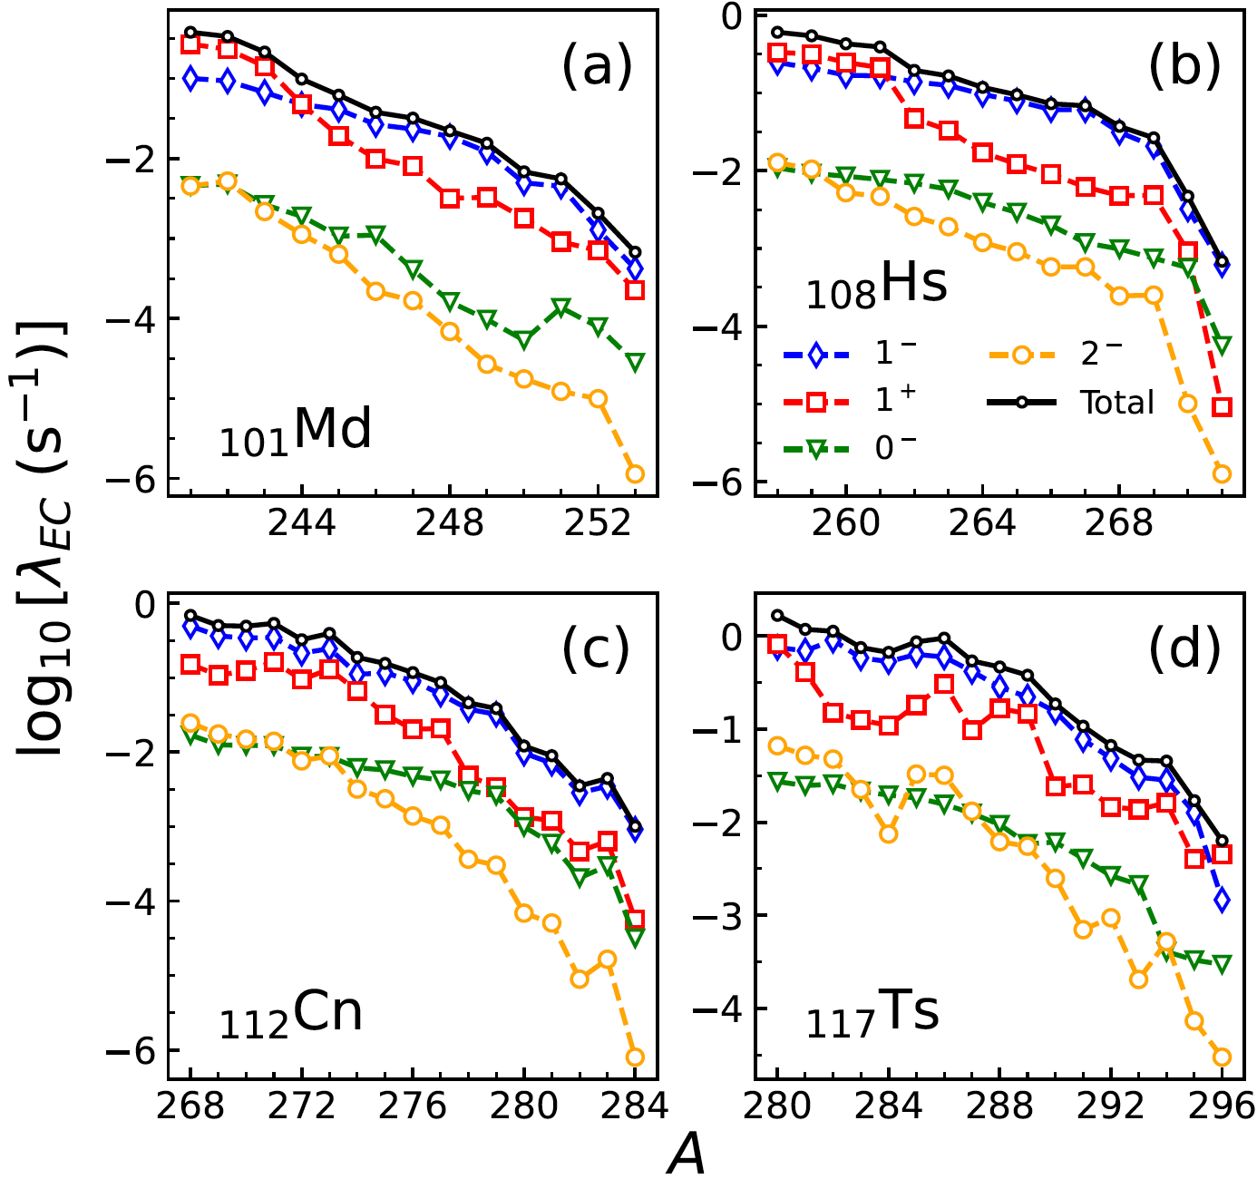
Weak decays in superheavy nuclei
A. Ravlić, WN, arXiv:2409.04620
EC dominates over β⁺
FF dominate

Slide 23
Summary
The nucleus is a complex many-body system. Exact quantitative nuclear models do not exist.
Nuclear ephemeral zone requires special treatment.
Imperfect models are used to make far extrapolations.
While all models are wrong, those models that know how and when they are wrong are useful. (after G. Box)
One can assess the progress in in nuclear physics theory by means of uncertainty quantification and machine learning.
To solve many complex problems in the field and facilitate discoveries, multidisciplinary efforts efforts are required involving scientists in nuclear physics, statistics, computational science, and applied math.

Slide 24

Assessment through quantification
Nuclear theory as of 1984
How can one meaningfully assess the progress based on the average values only?
observable
reasonable model
good model
“nice results”
EXP
TH1
TH2
TH3
tenor.com
Nuclear theory as of 2024
Is new more precise measurement warranted?
Are more data needed?
observable
accurate
precise
accurate
imprecise
inaccurate
imprecise
EXP
TH1
TH2
TH3

Slide 25
Backup

Slide 26
Isovector observables and symmetry energy
Reinhard, Roca-Maza WN, Phys. Rev. Lett. 127, 232501 (2021) and Phys. Rev. Lett. 129, 232501 (2022)
Until the tension between theory and experiment, or between the two measurements, is resolved, one should exercise extreme caution when interpreting the A_{pv} measurements in the context of neutron skins or nuclear symmetry energy.

