Slide 1
Threshold Effects in
Nuclear Astrophysics
Michael Wiescher
University of Notre Dame
Department of Physics and Astronomy
Joint Institute for Nuclear Astrophysics
Nature of threshold effects
Thresholds in Nuclear Physics
Thresholds in Nuclear Astrophysics
Nuclear reactions near the threshold
Nuclear reaction rates and the Universe

Slide 2
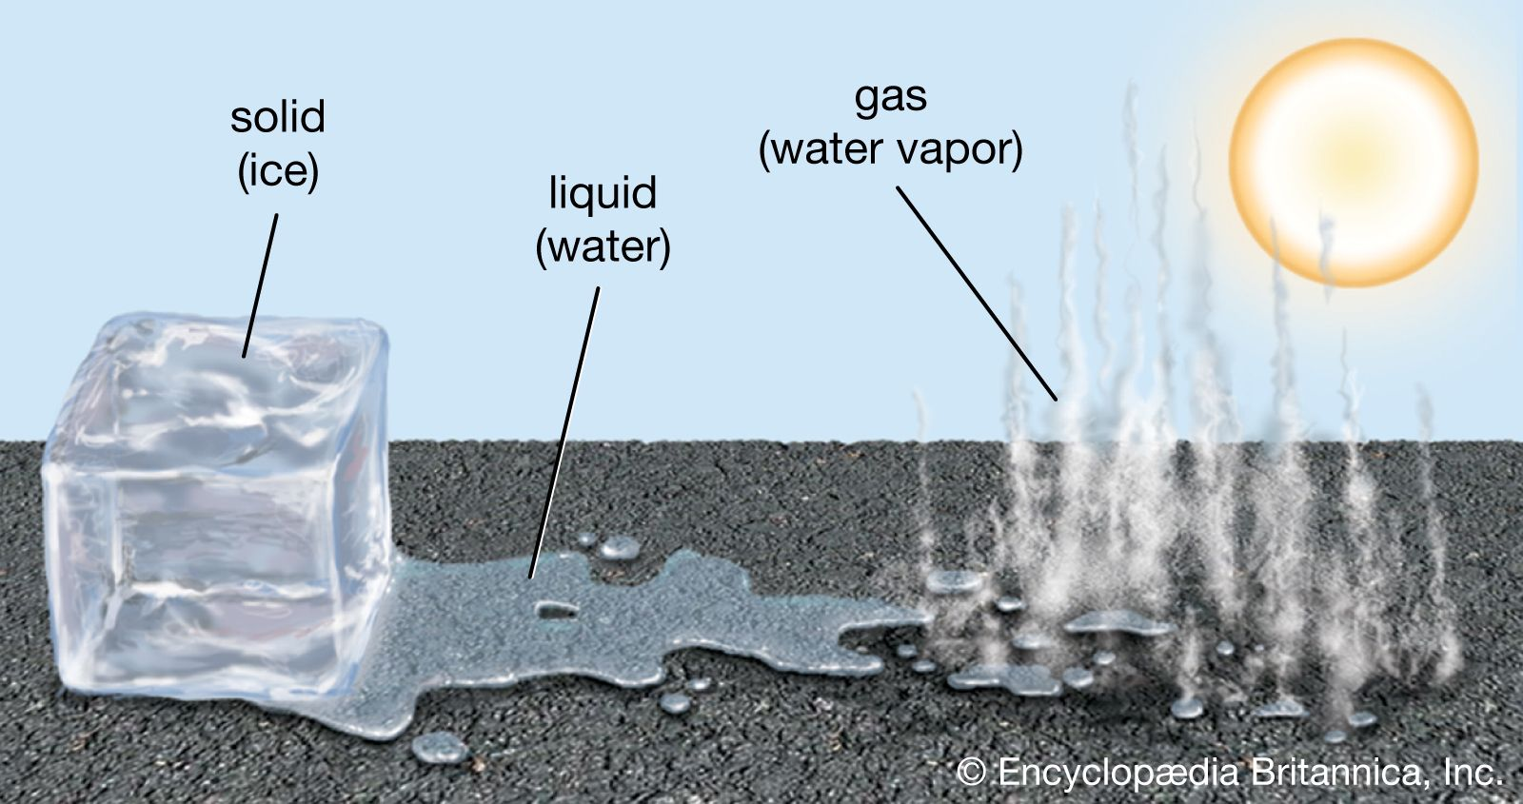
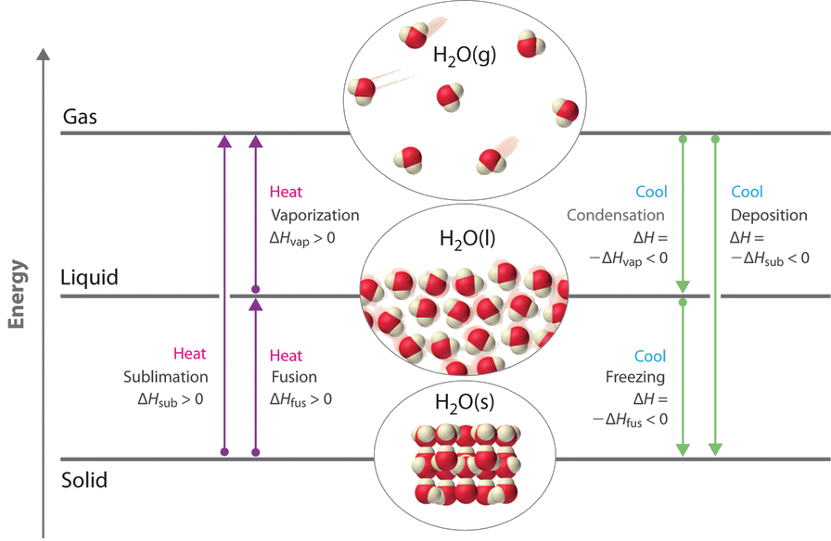
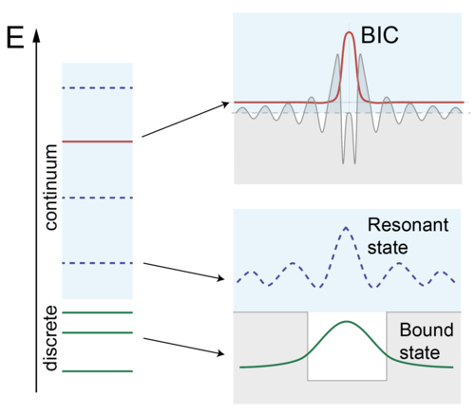

Threshold and Phase Transition
Threshold effects occur in cases of phase transitions when a system transforms from one configuration into another one. Threshold effects accelerator or delay such a transition.
In Nuclear Reaction Physics threshold effect can be observed in cross section behavior when a reaction channel opens in capture or fusion processes
In Nuclear Structure Physics threshold effects are associated with single particle or cluster features in the wave functions due to coupling effects
In Nuclear Astrophysics, threshold effects determine reaction rates in quiescent as well as explosive stellar burning.
$$σ(E)=S(E)⋅\frac{1}{E}⋅\exp\left(−2πη\right)$$

Slide 3
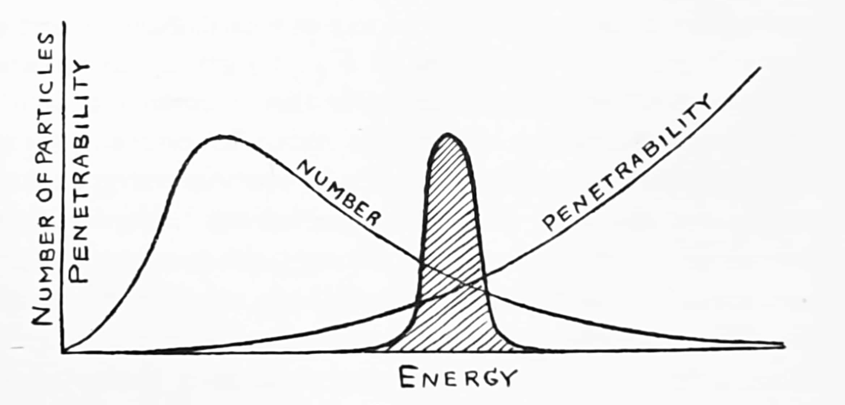
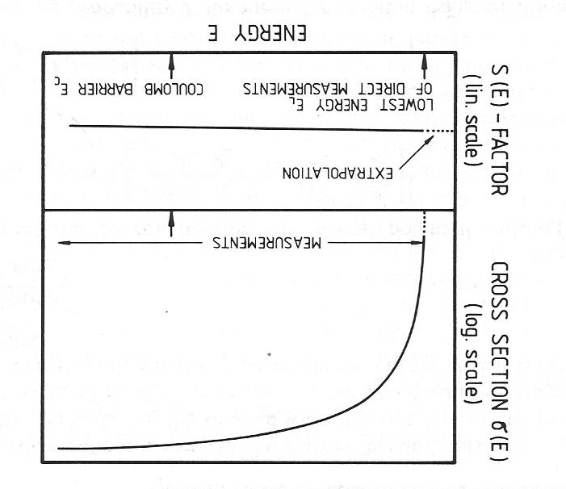
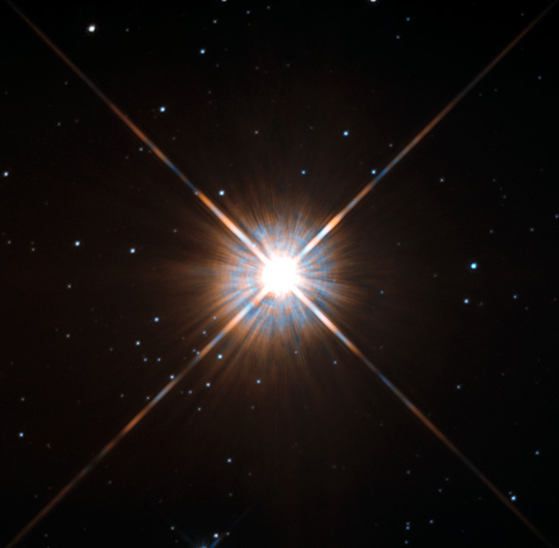
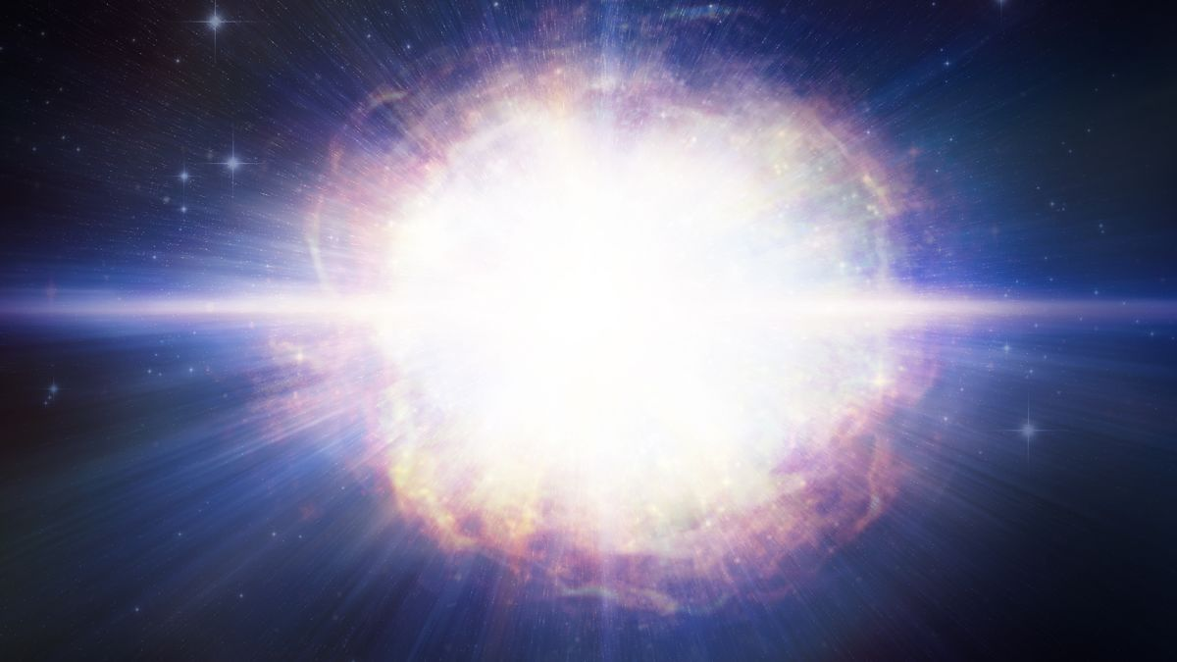
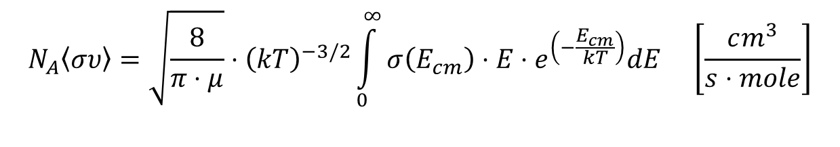

Nuclear Reactions in Stars
Identified by Gamow and Teller in 1938
$$N_{A}\left\langle συ\right\rangle =\sqrt{\frac{8}{π⋅μ}}⋅{\left(kT\right)}^{−3/2}\int_{0}^{∞}{σ\left(E_{cm}\right)}⋅E⋅e^{\left(−\frac{E_{cm}}{kT}\right)}dE \left[\frac{cm^{3}}{s⋅mole}\right]$$
Stars are cold T=0.01 – 0.1 GK
Supernovae are cold T=1 – 5 GK
How does the S-factor extrapolate towards the threshold?
$$σ(E)=S(E)⋅\frac{1}{E}⋅\exp\left(−2πη\right)$$

Slide 4
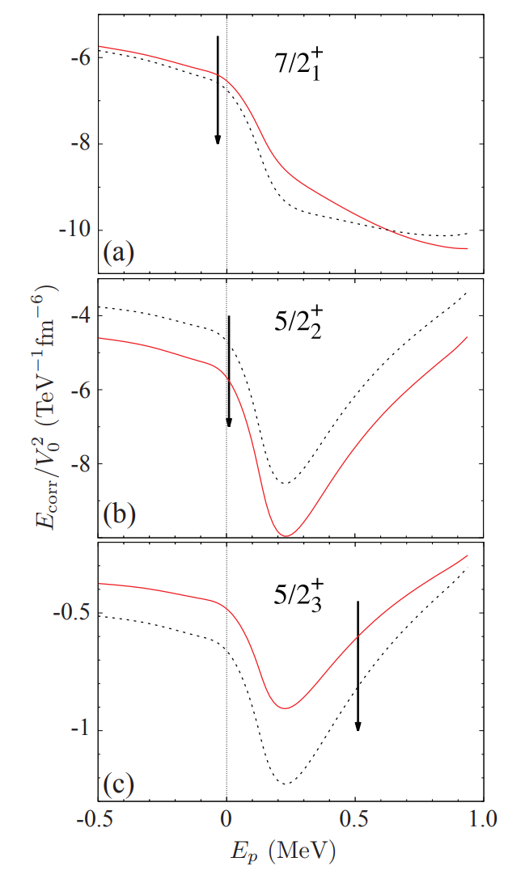
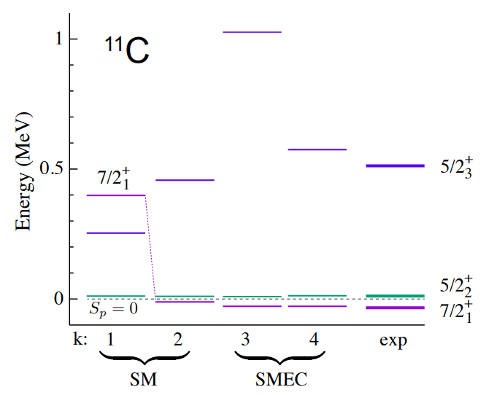
SMEC Model
Threshold resonances emerge through continuum-coupling induced collectivization of bound shell model levels embedded in the unbound continuum.
Near-threshold resonances in ¹¹C and the ¹⁰B(p,α)⁷Be aneutronic reaction
J. Okołowicz, M. Płoszajczak, and W. Nazarewicz
Phys. Rev. C 107, (2023) L021305
SMEC (shell model embedded in the continuum)

Slide 5
Experimental data and R-matrix fit
The fits show a number of broad structures as predicted by SMEC, including the state at 500 keV, all have a substantial α width, suggesting strong α clusterization.
Radiative capture data: Wiescher et al. PRC 1982
Scattering and reaction data
SMEC based nuclear potential predictions

Slide 6
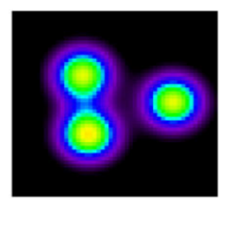
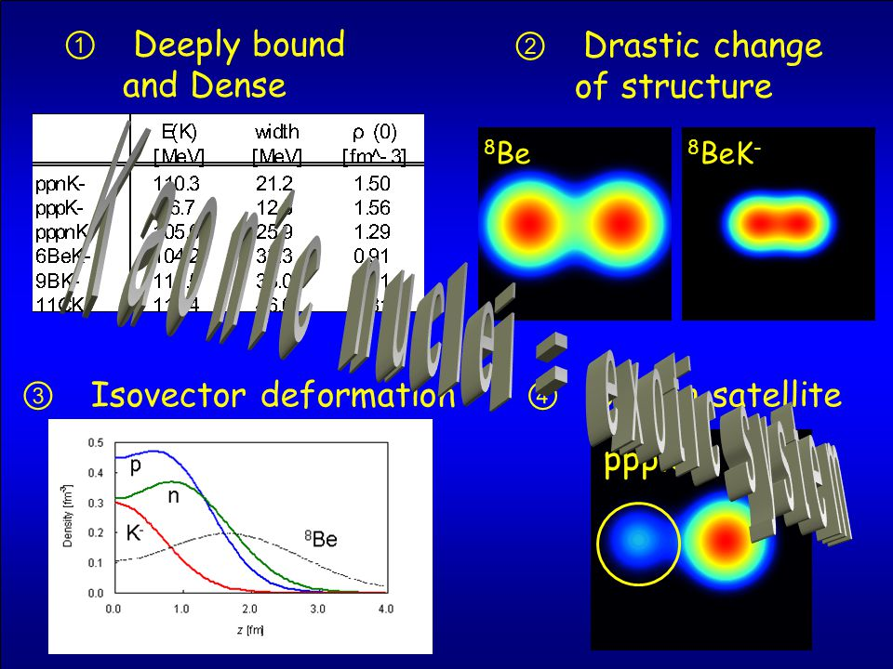
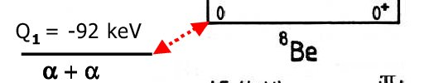


Cluster Formation near Threshold
The observation of nuclear clusters near the threshold is generally described in terms of the phenomenology of the Ikeda model by potential matching or the use of double potentials. W. von Oertzen, Martin Freer, Yoshiko Kanada-En’yo
Nuclear clusters and nuclear molecules
Physics Reports 432 (2006) 43 – 113
¹²C Hoyle State
0⁺
8
0⁺
¹²C
2⁺
Clustering is the generic near-threshold phenomenon in Open Quantum Systems that originate from the coupling of bound shell model states to unbound scattering states near a newly opened threshold as in the case of ⁸Be and ¹²C etc
¹²C
0⁺
Jacek Okolowicz, Marek Ploszajczak and Witold Nazarewicz
On the Origin of Nuclear Clustering
Progress of Theoretical Physics Supplement No. 196, (2012) 230-243

Slide 7
Present attempts for <αα> and <α⁸Be>
  Li et al. 2024:
  Fitting different inelastic scattering and transfer data sets towards ⁸Be(α,γ)¹²C
Actual resonance at 94 keV
Red, with GS
Gray, without GS
Ghost peak of ground state at 184 keV!
  Haydenburg and Temmer (1956)
  Tombrello and Senhouse (1963)
Fitting inelastic scattering data sets towards ⁴He+ ⁴He

Slide 8
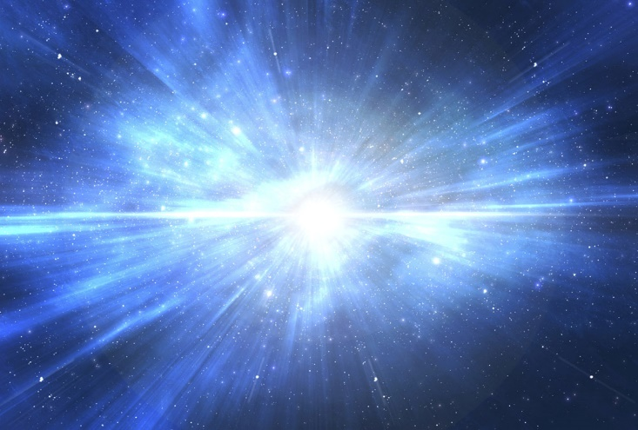
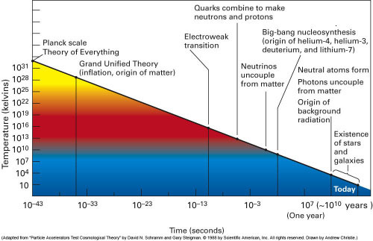
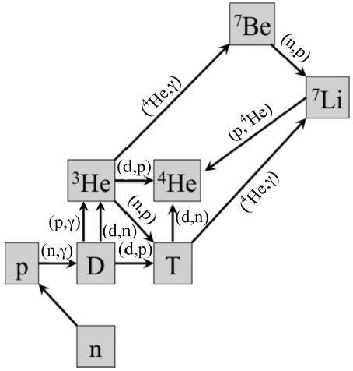
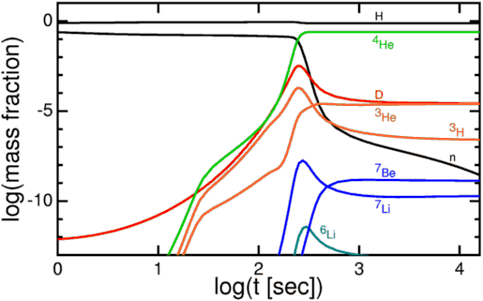
Big Bang Nucleosynthesis
Plank time
Neutrino decoupling
Onset of nucleosynthesis with the freeze out of deuterium photo-dissociation
Inflation
Quark confinement
deuterium freeze-out
Photon decoupling
stars

Slide 9
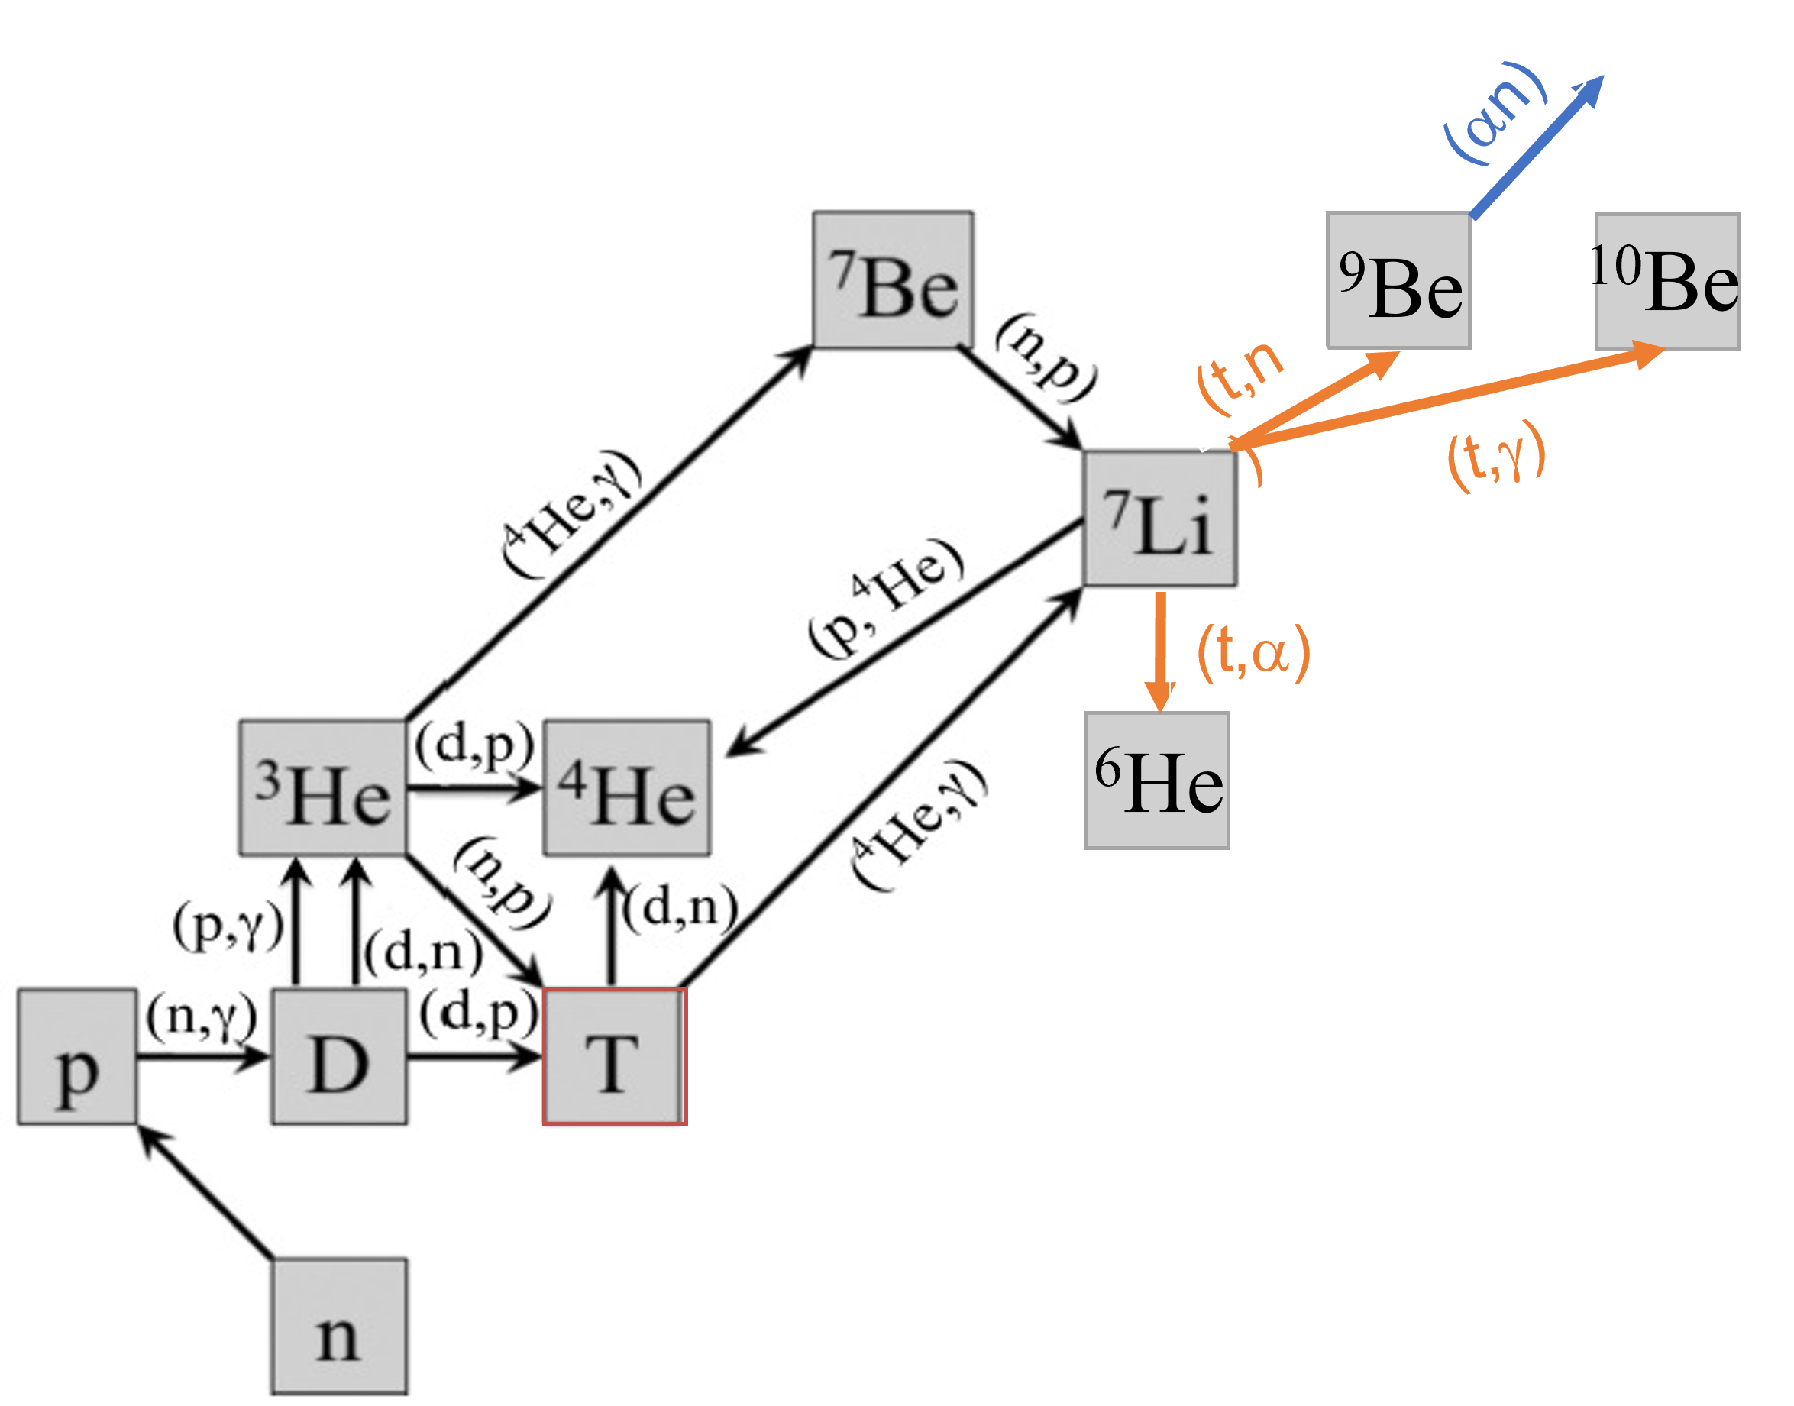
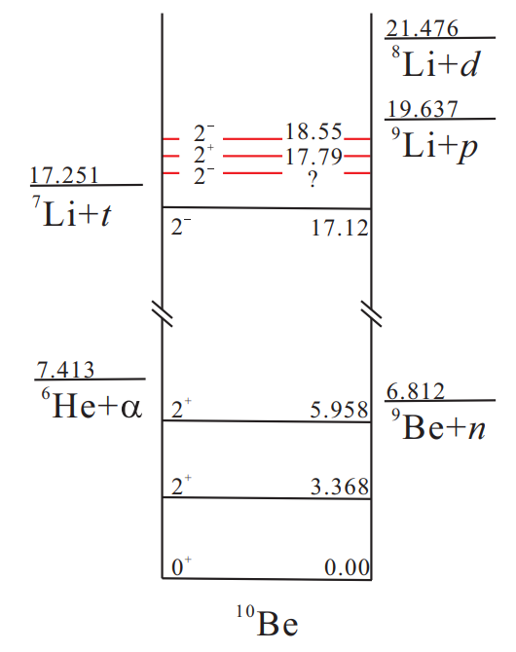
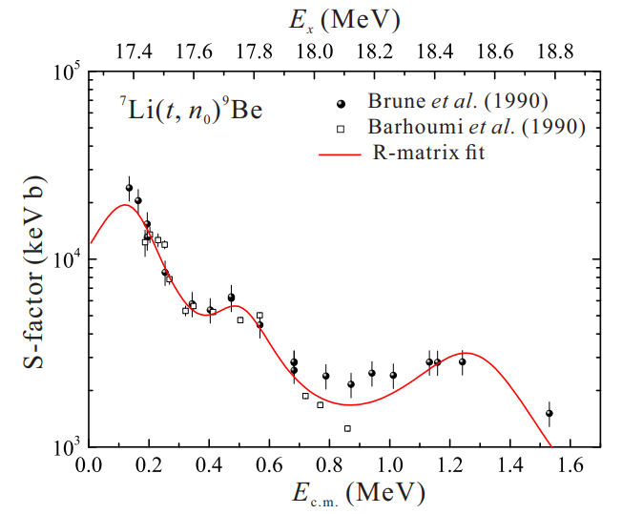
Impact of threshold states in ¹⁰Be: Tritium on ⁷Li
Impact of near threshold s-wave resonance states may cause order of magnitude increase in reaction rate!
Fictitious state?
Low energy ³H+⁷Li measurements in an underground accelerator or laser induced fusion environment necessary to explore the impact at threshold!
Hu et al., R-matrix analyses for the ⁷Li(t,n)⁹Be and ⁷Li(3He,p)⁹Be reactions and their improved thermonuclear reaction rates, PRC 106, 045802 (2022)

Slide 10
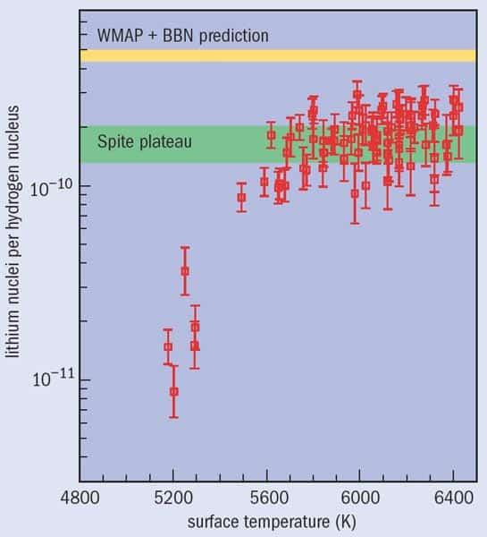
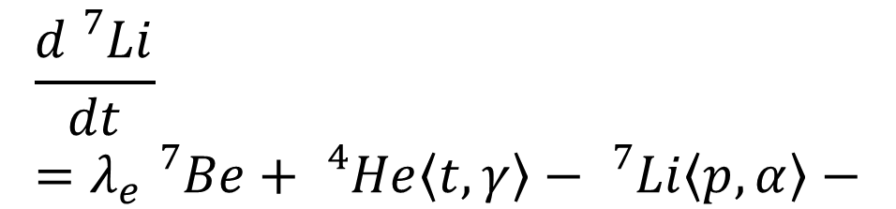
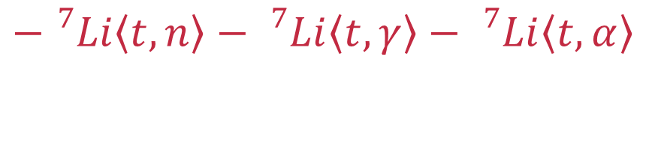
Fixing the ⁷Li problem by reduction via ⁷Li(t,n)⁹Be
$$\frac{d{}_{}^{7}{Li}}{dt}=λ_{e}{}_{}^{7}{Be+{}_{}^{4}{He\left\langle t,γ\right\rangle −{}_{}^{7}{Li}\left\langle p,α\right\rangle −}}$$
$$−{}_{}^{7}{Li}\left\langle t,n\right\rangle −{}_{}^{7}{Li}\left\langle t,γ\right\rangle −{}_{}^{7}{Li}\left\langle t,α\right\rangle$$
Observations of metal-poor halo stars
Reduction of ⁷Li to ⁹Be with subsequent alpha capture, ¹⁰Be with decay to ¹⁰B and return to ⁷Be (cycle) and ⁶He with decay to ⁶Li leading to a ⁶Li enhancement (~1000)!
⁷Li/⁶Li predicted as 10⁵

Slide 11
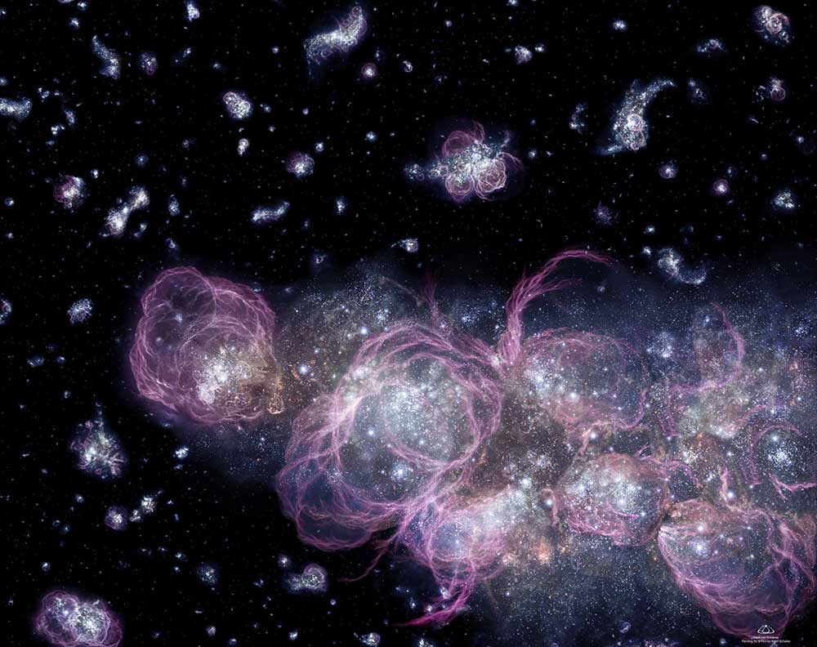
Nucleosynthesis in First (POP III) Stars
~400 Million years after Big Bang

Slide 12
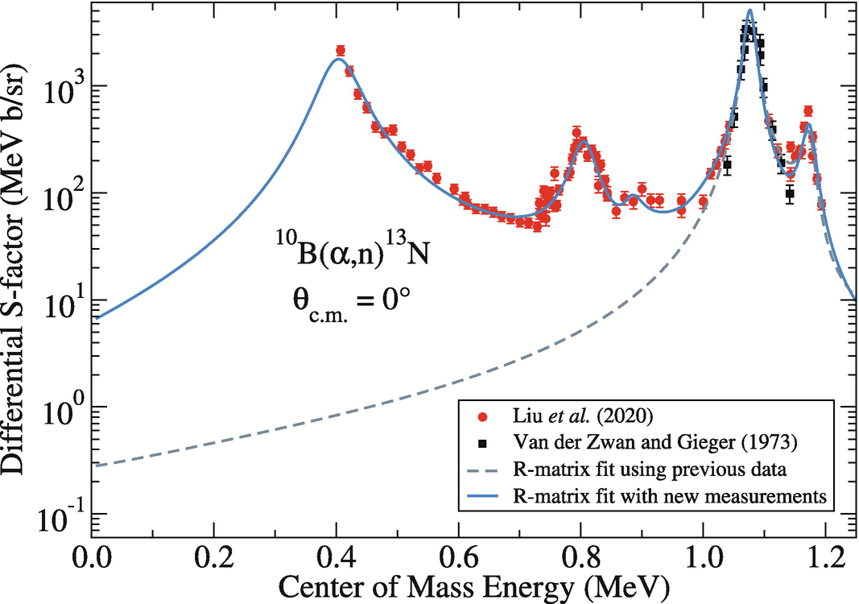
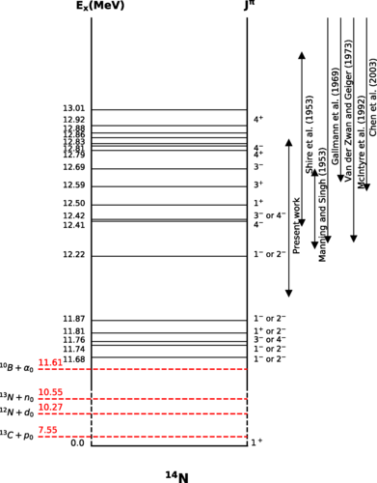
The ¹⁰B+α reaction channels
At least two orders of magnitude increase, due to alpha-cluster resonance!
Resonance energy needs experimental confirmation! Further increase in rate is possible!

Slide 13
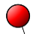

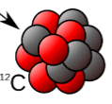

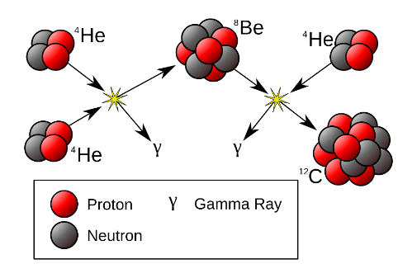













Impact on Carbon Formation in First Stars
n
⁴He
⁸Be
⁴He
¹³N
⁴He
²H
⁶Li
⁴He
γ
γ
¹⁰B
¹²C
²H
⁴He
⁴He
⁴He
¹H
¹²C
⁴He
¹³C
α ⇨ ⁸Be ⇨ ¹²C
d ⇨ ⁶Li ⇨ ¹⁰B ⇨ ¹⁴N
d ⇨ d⊗α ⇨ d⊗⁸Be ⇨ d⊗¹²C
2α⇨α⊗α ⇨α⊗⁸Be

Slide 14
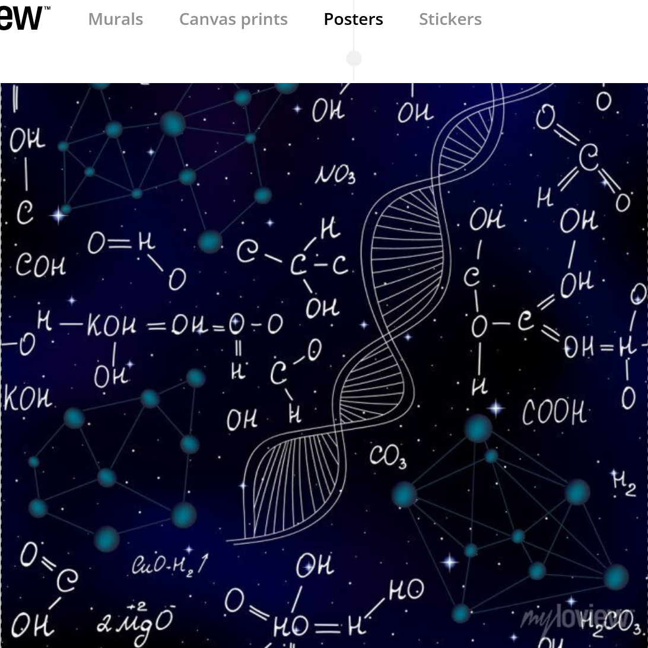
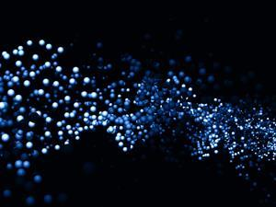
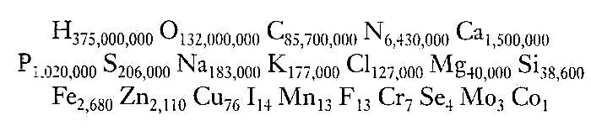
¹²C(α,γ)¹⁶O
Carbon is the source of all biological systems -- life
But it also limits the masses of stars

Slide 15
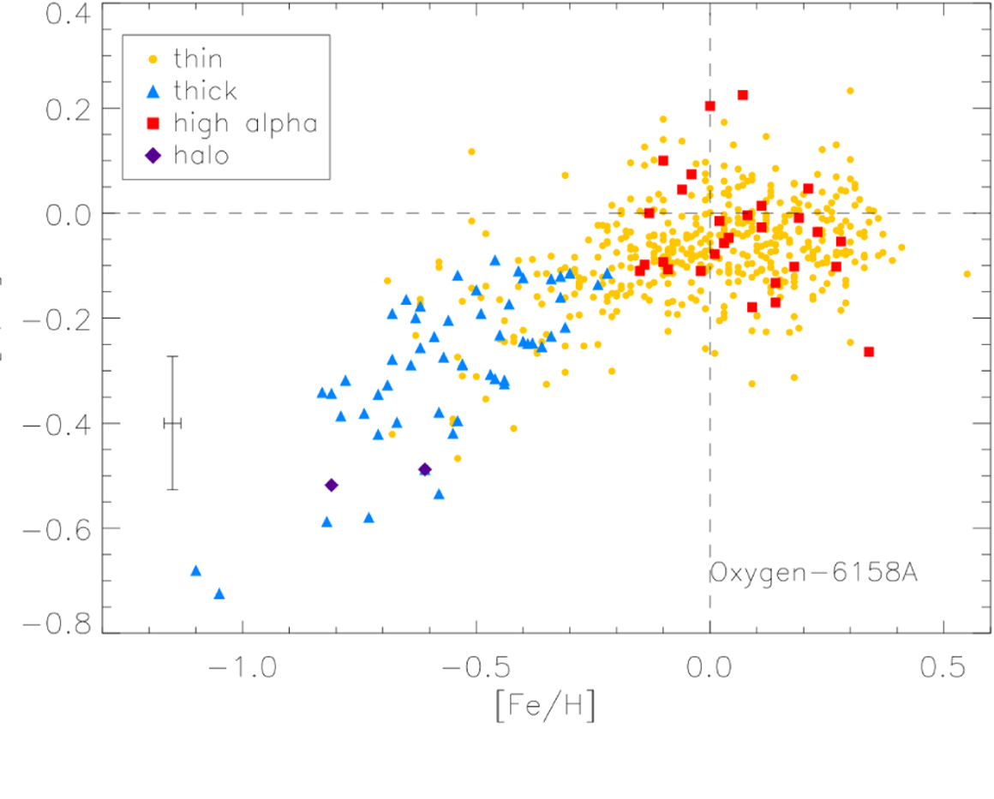
¹²C(α,γ)¹⁶O determines the carbon oxygen ratio in our universe
In the literature, it is common to consider the solar C/O ratio as determined with solar abundances with values of 0.55 (A(C) = 8.43, A(O) = 8.69).
C/O=0.55
Within 1 Gy the present level of the ¹²C/¹⁶O ratio was established
– in early universe CEMP stars –
Human body: oxygen (~ 24%), carbon
(~ 12%) C/O ≈ 0.5 (for bacteria C/O ≈ 1)
time

Slide 16
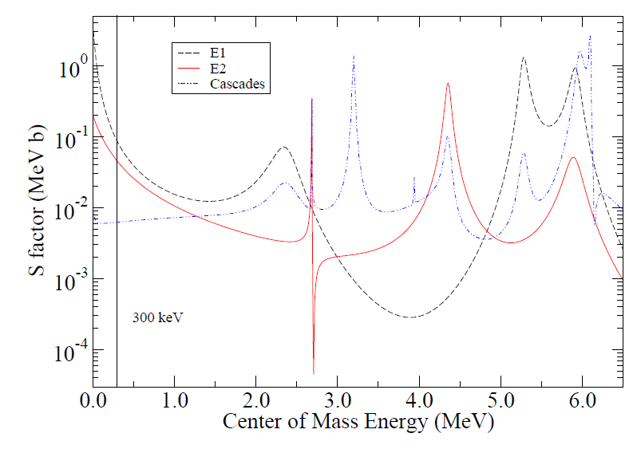
From Cluster Configuration to Cross Section
Different E1, E2, and cascade reaction components, reflecting the interference patterns between 1⁻ states and 2⁺ states with direct capture, respectively.
R-matrix fits with AZURE2, relying on ANC values of sub-threshold states!

Slide 17
Overall Cross Section Prediction

Slide 18
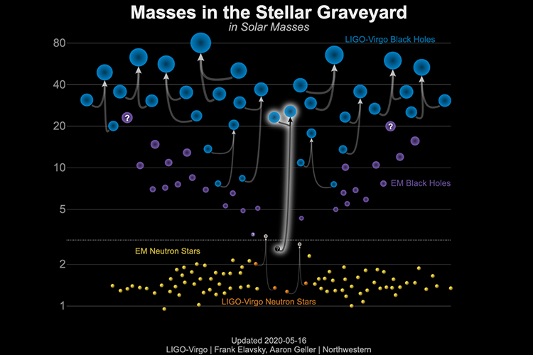
Impact on Black Hole Mass Gap
For hot helium burning in very massive star internal γ rays become so energetic that they trigger pair production, destabilizing the stellar core. This causes explosive oxygen burning (¹⁶O+¹⁶O) disrupting the star without remnant (NS or BH). This causes a mass gap in the black hole distribution. The mass limits are determined by ¹²C(α,γ)¹⁶O!
upper BH mass gap
1st BH mass gap

Slide 19
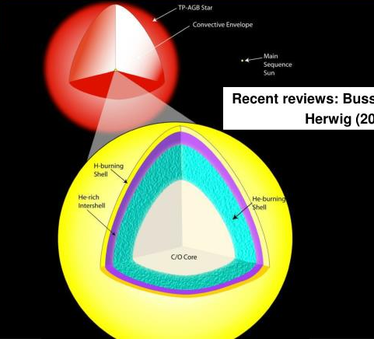
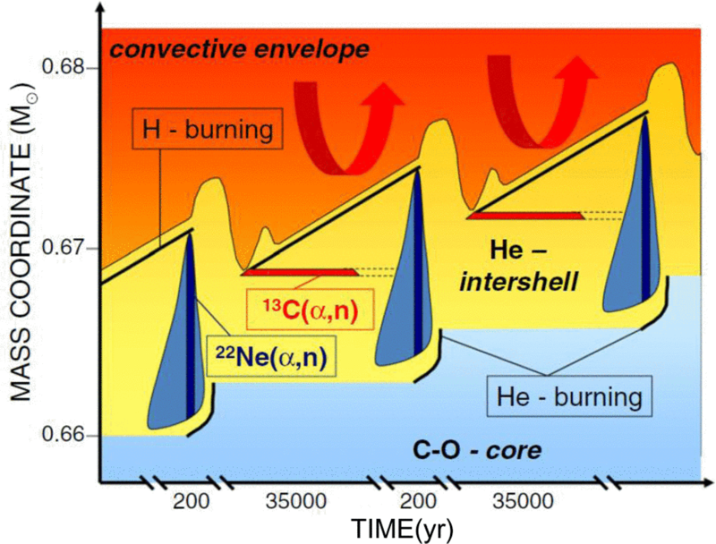
Neutron Sources for the s- and i-Process
The neutron source ¹³C(α,n), is product of mixing hydrogen into a ¹²C rich bubble in He shell burning, causing the reaction sequence ¹²C(p,γ)¹³N(β⁺ν)¹³C

Slide 20
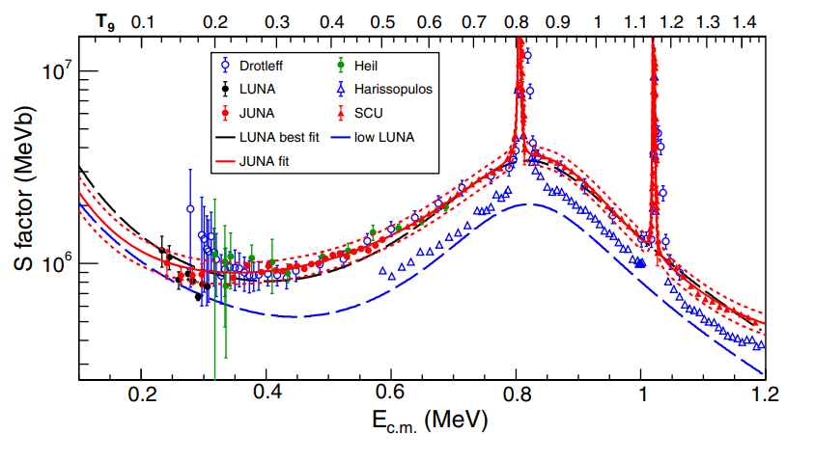
¹³C(α,n)¹⁶O - levels and excitation curve
Subthreshold state tail
Most likely due to old leaky
³He counter tubes from Caltech
New neutron channels open up towards higher energies!
Inconsistencies in the data for a long time between Drotleff & Heil and Harrisopulos, consistent data for LUNA and JUNA!

Slide 21
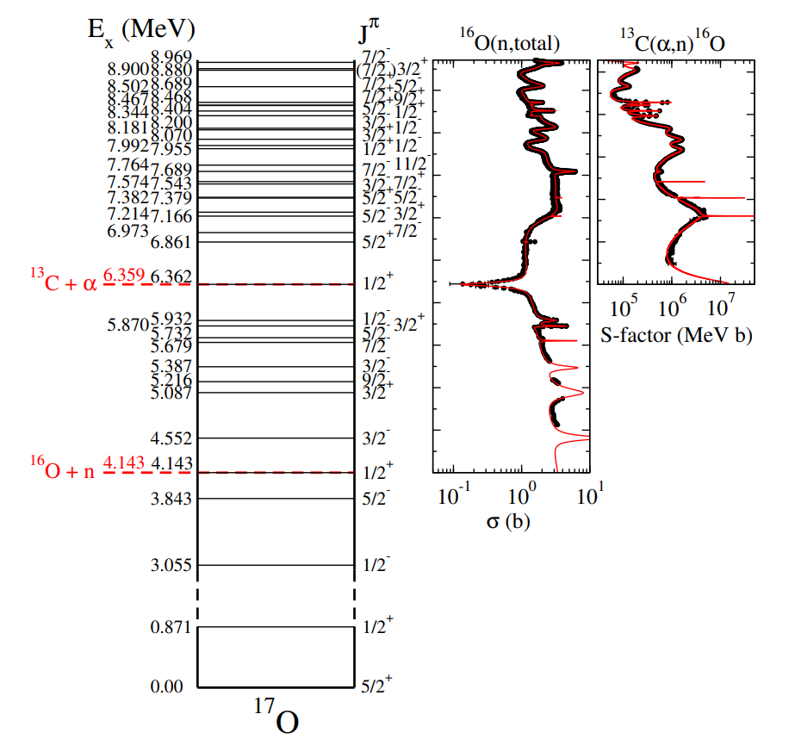
¹³C(α,n)¹⁶O - neutrino detector background
R-matrix fits describe
the entire excitation range rather well, unlike previous Hauser-Feshbach predictions that exist in the literature!

Slide 22
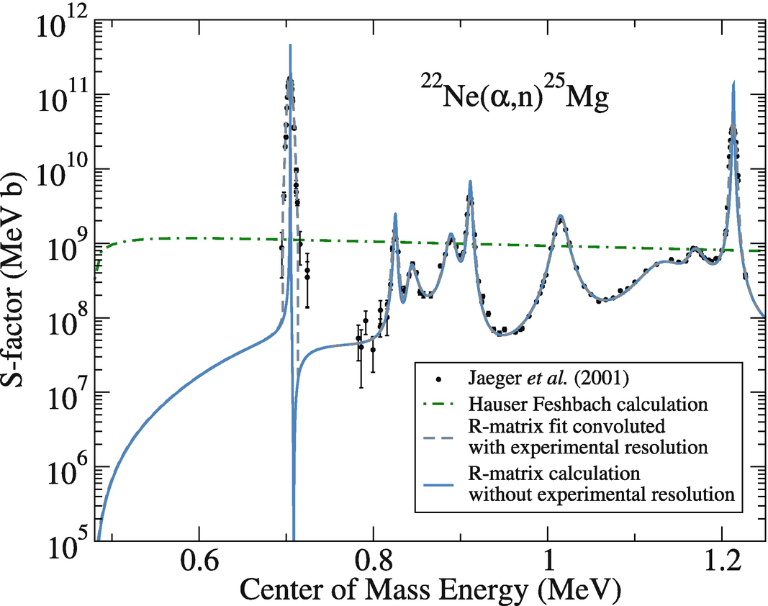
²²Ne(α,n)²⁵Mg - levels and excitation curve
Pronounced α cluster configuration 5α⊗2n
How strong is this resonance at 830 keV?
Only natural parity states can contribute for parity conservation

Slide 23
Strength of pronounced α cluster state confirmed

Slide 24
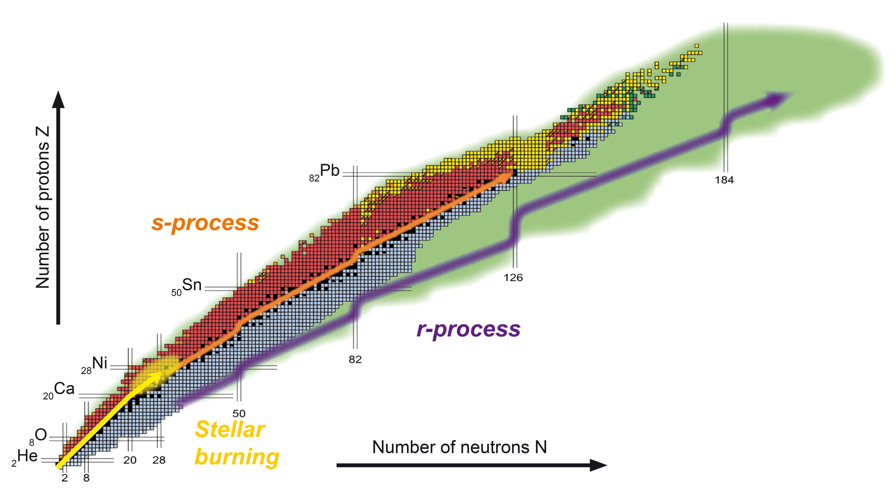
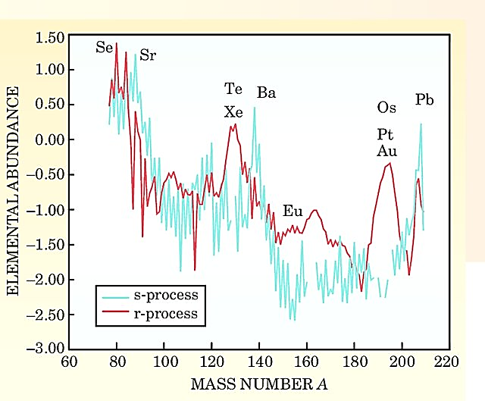
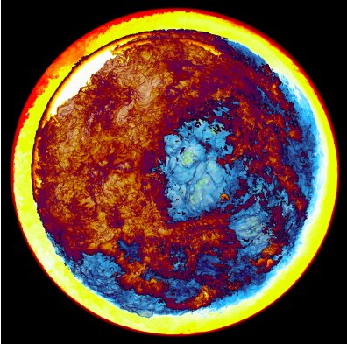
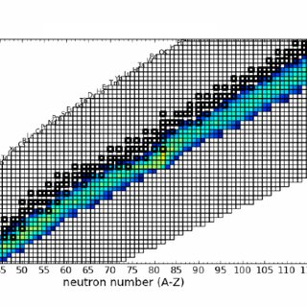
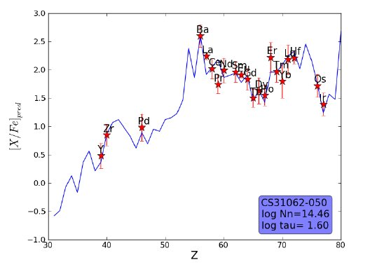
The s- and i-Process Signatures
In the Sun and in CEMP Stars

Slide 25
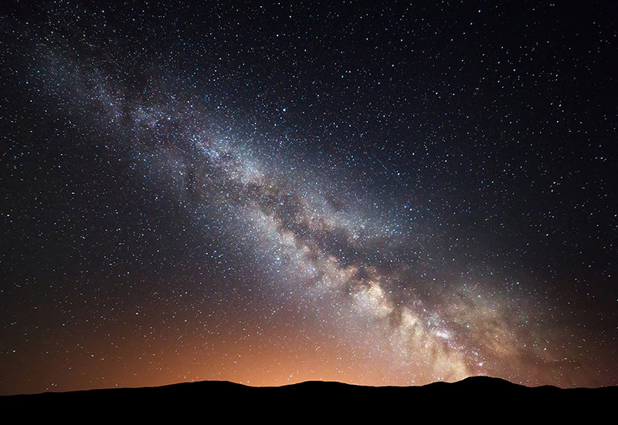
Conclusion
Threshold effects constitute a major uncertainty in nuclear astrophysics
Threshold effects frequently determine the reaction rate
Threshold effects appear as subthreshold states, near threshold resonances of interferences at low energies.
Nature is governed by the quantum physics of the threshold!

