Slide 1
FIRST TEMPERATURE-DEPENDENT RELATIVE SELF-ABSORPTION EXPERIMENT AT THE S-DALINAC
Kiriaki Prifti

Slide 2
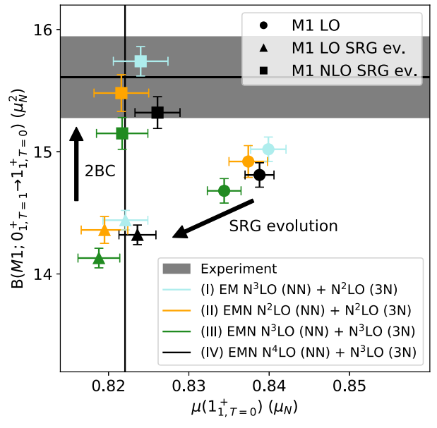
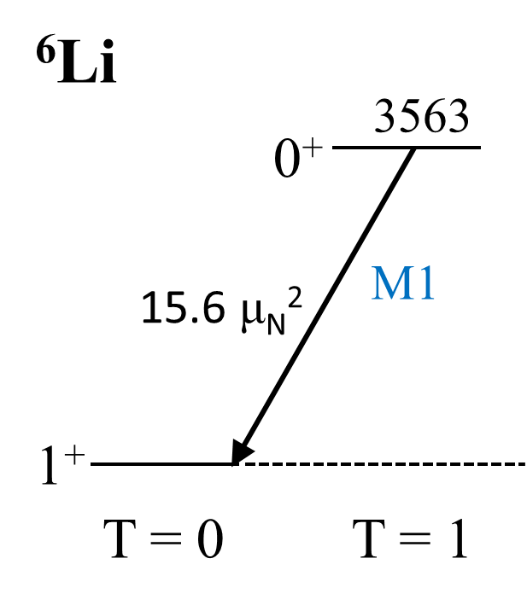
Motivation
Importance of 2- and 3-body interactions using the ChEFT and the role of the 2-body currents (2BC) in decay transitions
Measurement of the decay width of the excited $0_{1}^{+}$ state of ⁶Li using the RSA technique
High precision level width measurement
$$R_{exp }=0.5192{\left(20\right)}_{stat.}$$
$$Γ_{γ,0_{1}^{+}→1_{1}^{+}}=8.17{\left(14\right)}_{stat.}{\left(11\right)}_{syst.} eV$$
$$B\left(M1;0_{1}^{+}→1_{1}^{+}\right)=15.61\left(33\right)μ_{N}^{2}$$
U. Friman-Gayer et al., Phys. Rev. Lett. 126 (2021) 102501

Slide 3
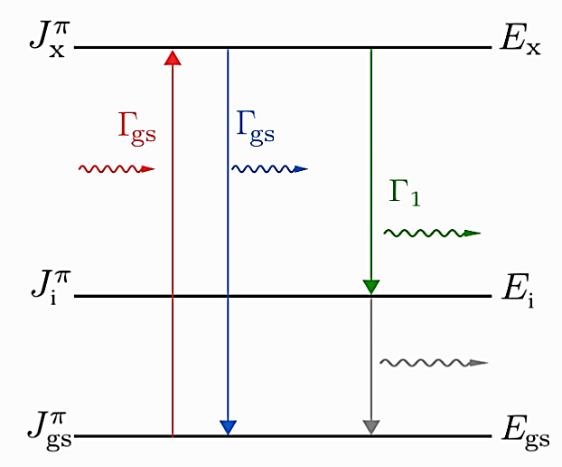
Nuclear resonance fluorescence (nrf)
Some observables in NRF are:
Excitation energy $E_{r}$
Spin J
Parity π
Lifetime τ
Decay branching ratio $\frac{Γ_{j}}{Γ_{0}}$
Partial width $Γ_{j}$
Multipole mixing ratio δ
Transition strength B(λL)
…
$$τ ⋅Γ=ℏ$$
$$Γ=\sum_{j}{Γ_{j}}$$
$$Γ_{0}∝B(λL)$$

Slide 4
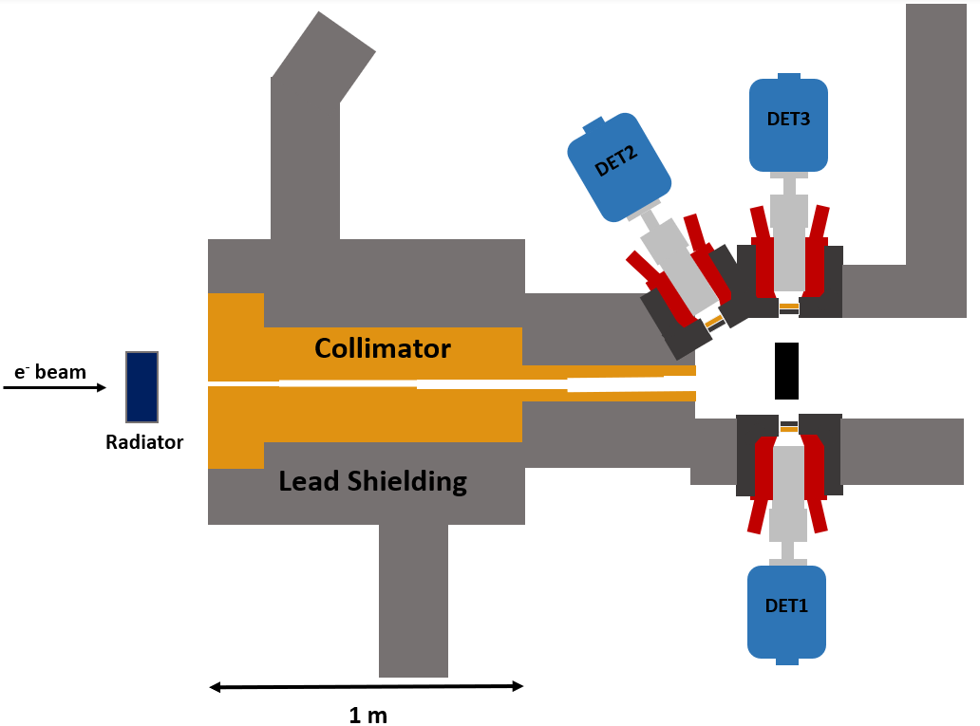
Nuclear resonance fluorescence (nrf)

Slide 5
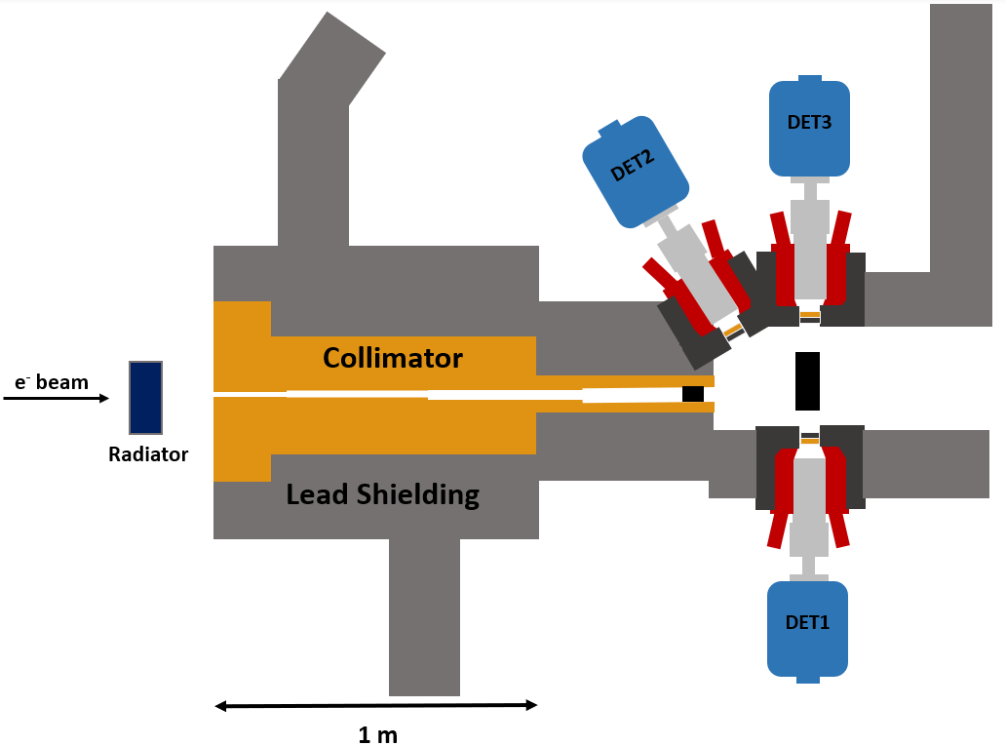
Relative self-absorption (rsa)
RSA method is based on the NRF technique
Absorber made of the same material as the scatterer
In the absorber, nuclei are resonantly excited to higher-lying states
Scattering target is used as a high-resolution detector for the absorption lines

Slide 6
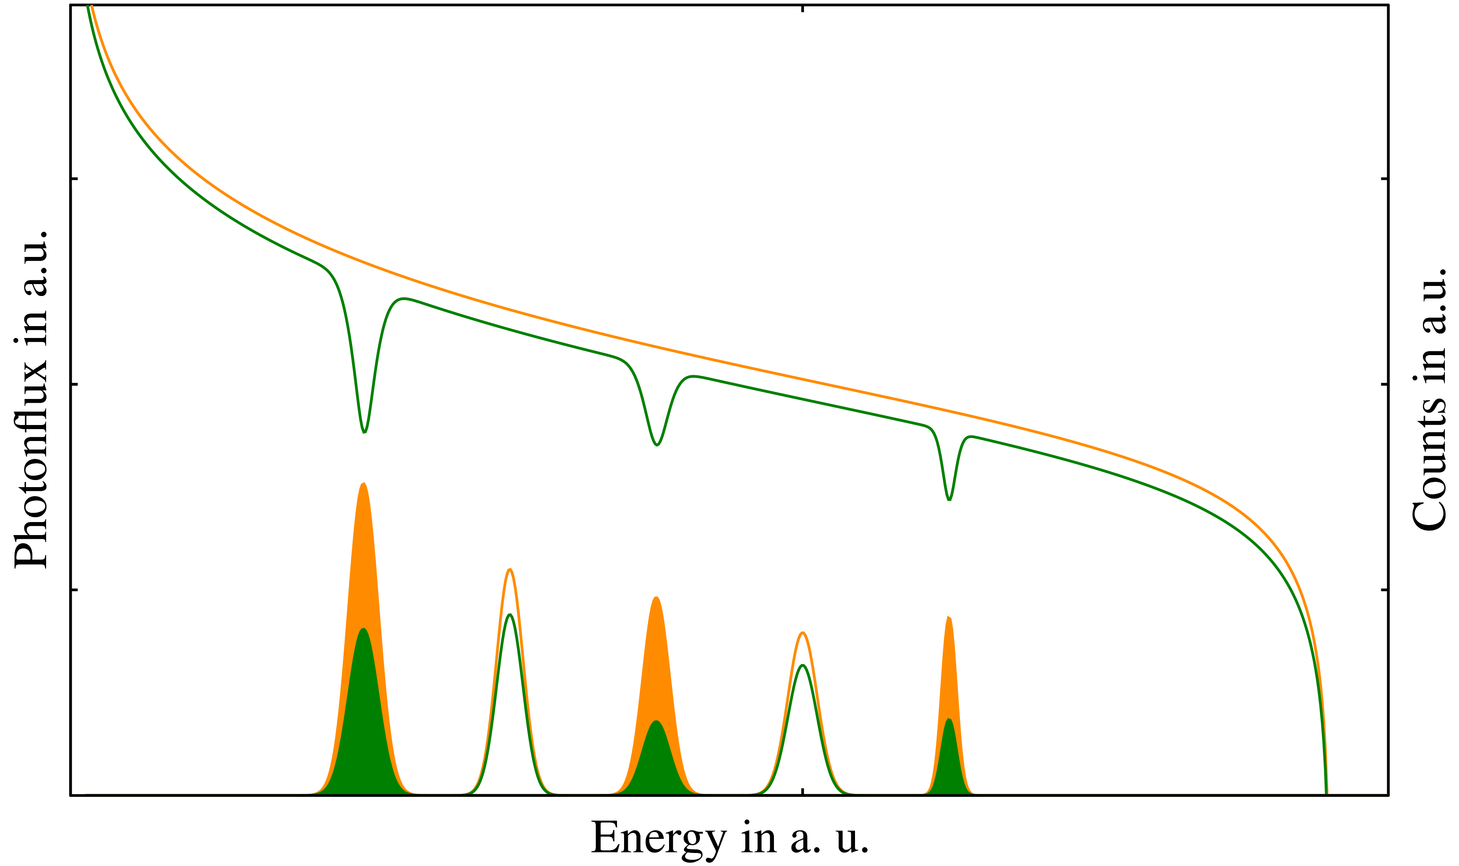
Relative self-absorption (rsa)
̶̶ ̶̶ w/o absorber
̶̶ ̶̶ w/ absorber
resonant absorption
atomic attenuation

Slide 7
Relative self-absorption (rsa)
Monitoring target:
has a few excited states
do not coincide with our scatterer
A normalization technique is applied which reduces the systematic uncertainties that are coming from SAbs measurements

Slide 8
relative self-absorption (rsa)
̶̶ ̶̶ w/o absorber
̶̶ ̶̶ w/ absorber
The self-absorption is:
$$R_{exp}=1−\frac{A_{mon}^{nrf}}{A_{mon}^{abs}}⋅\frac{A_{sc}^{abs}}{A_{sc}^{nrf}}$$
A. Zilges et. al.,Prog. Part. Nucl. Phys. 122 (2021) 103903

Slide 9
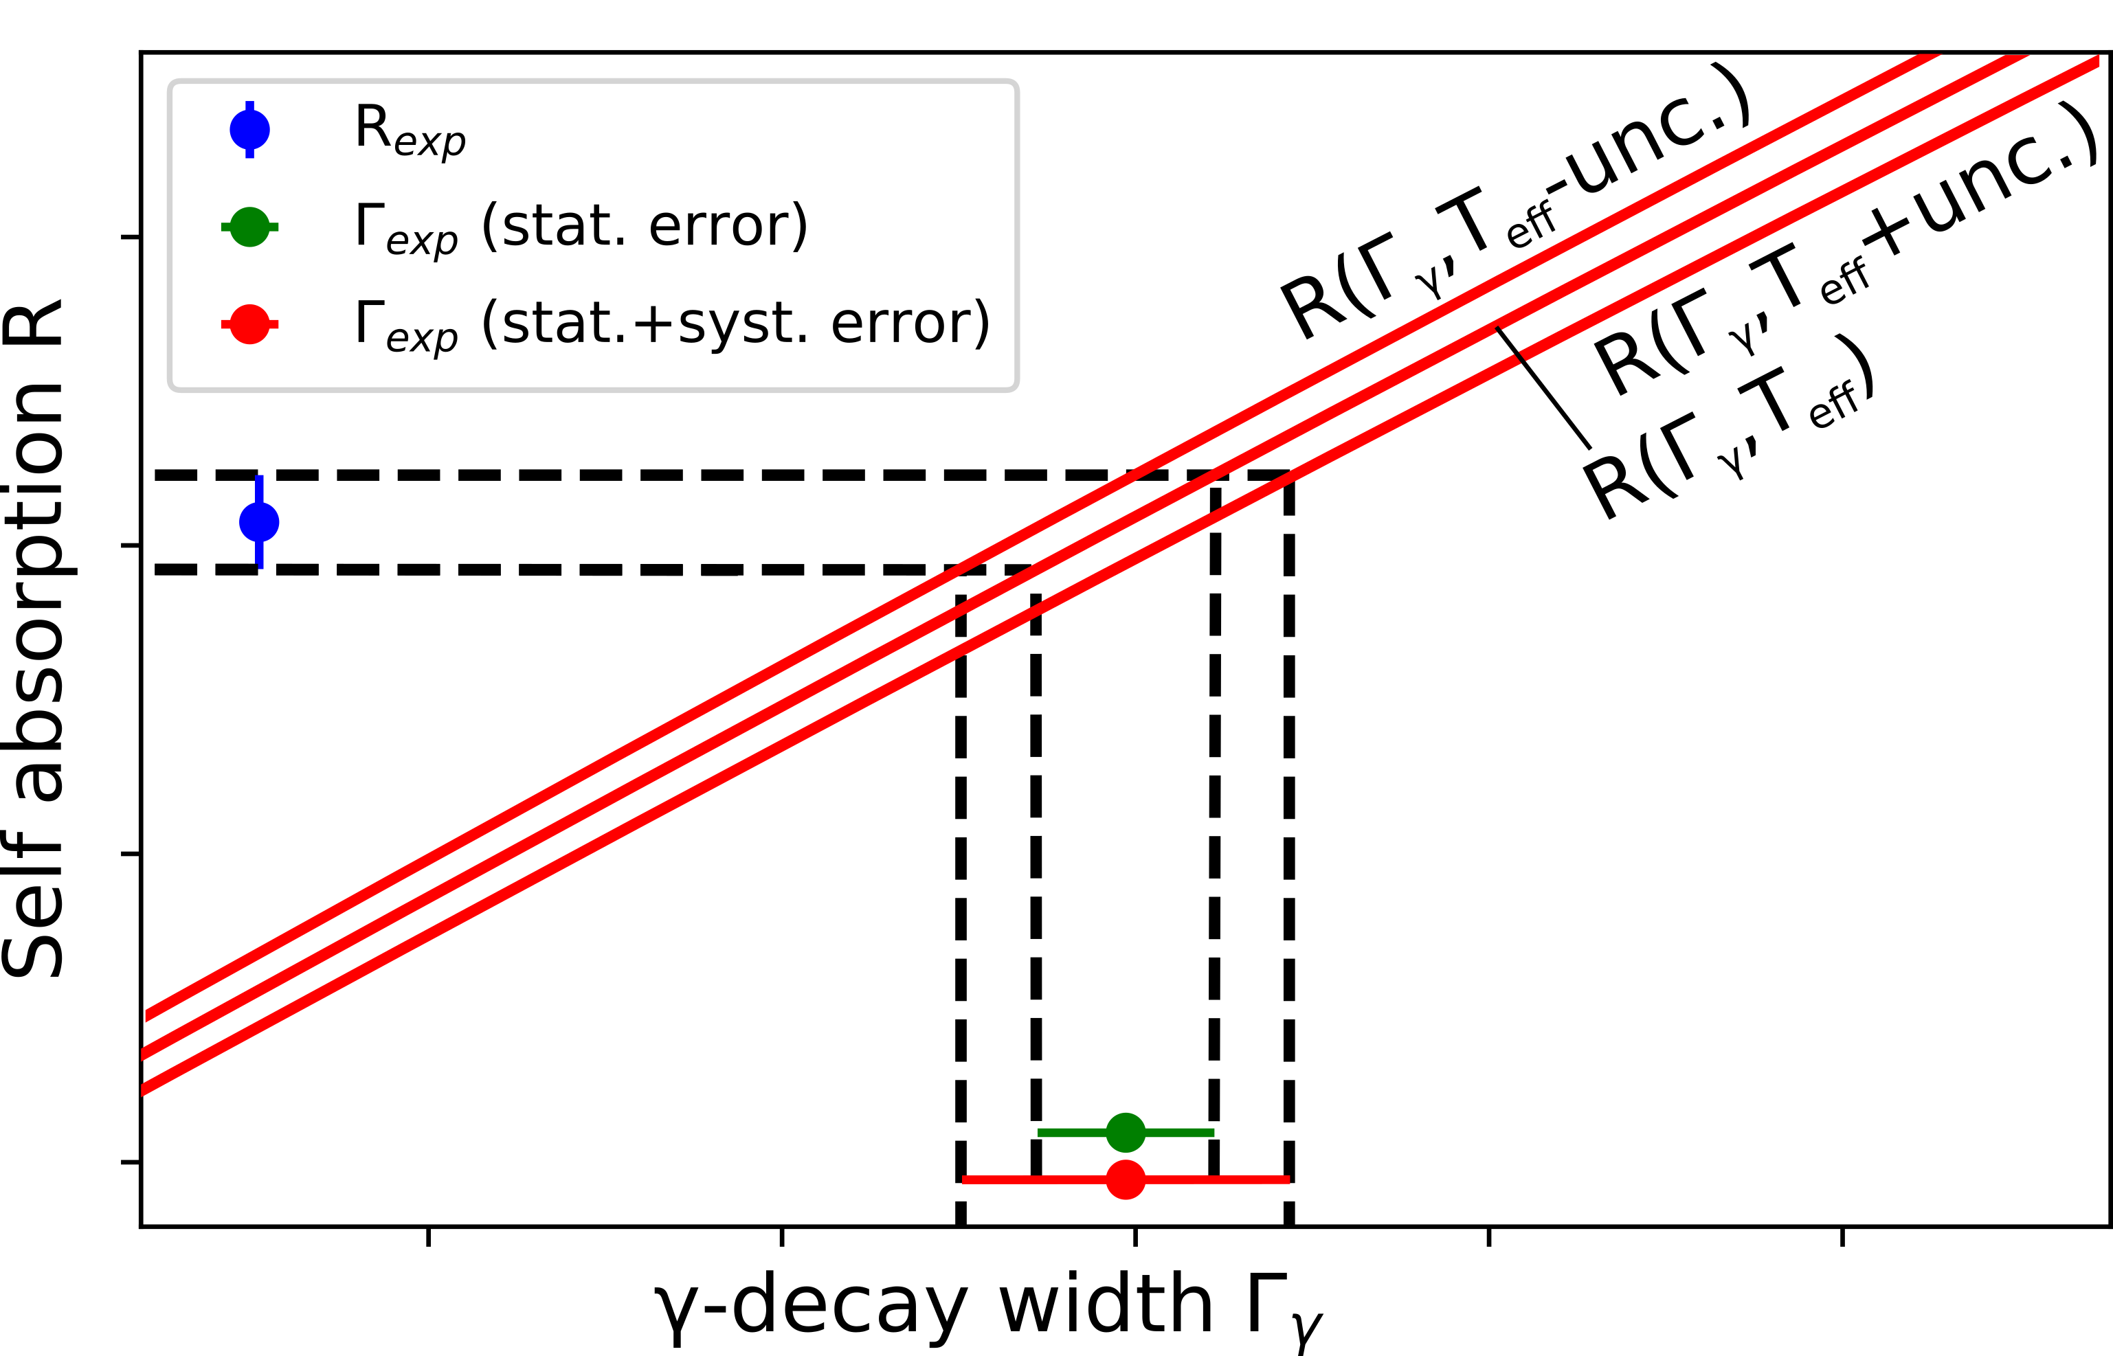
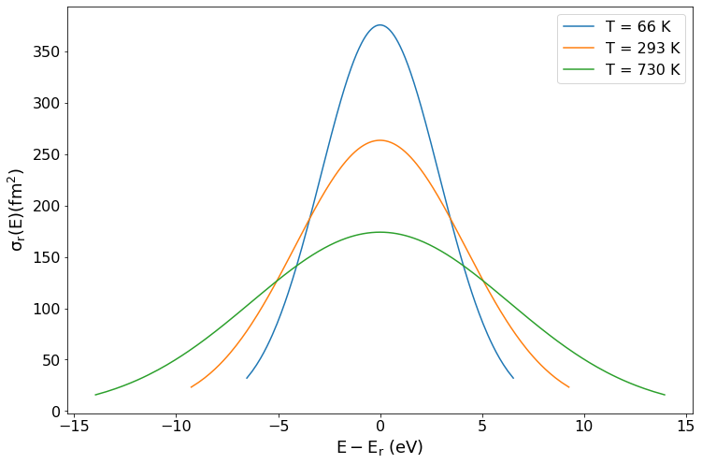
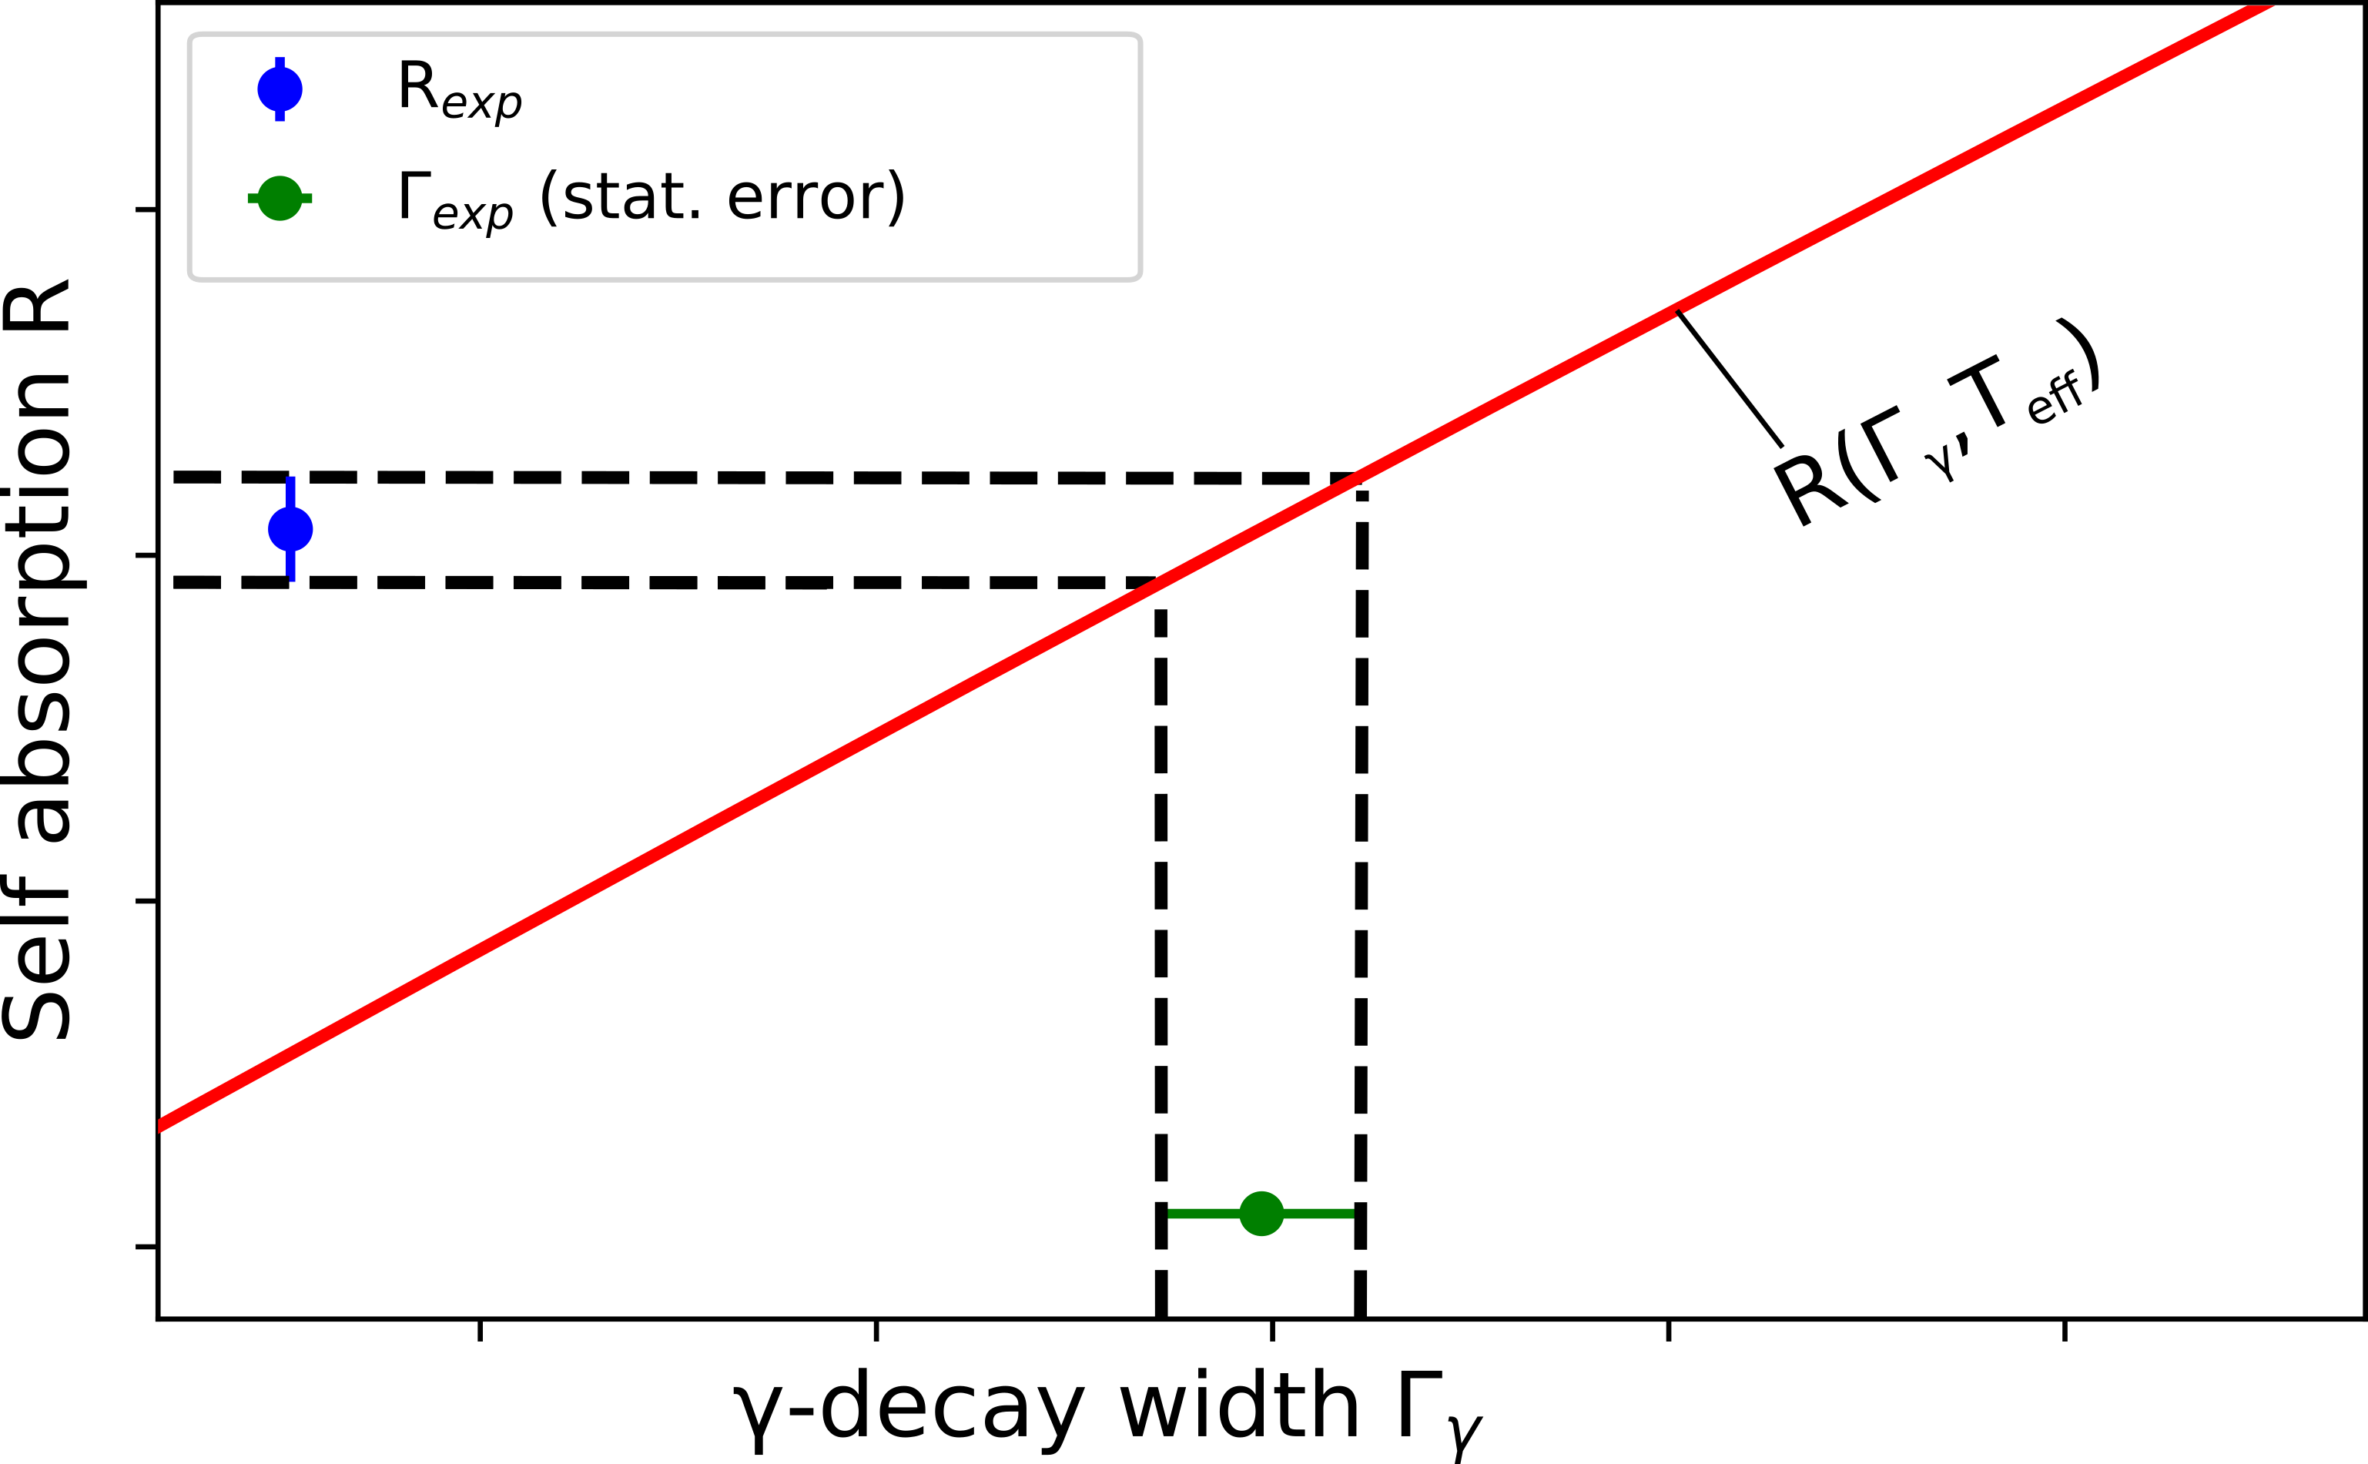
Relative self-absorption (RSA)
Uncertainty due to thermal motion in solid target
Due to thermal motion and lattice vibrations broaden the cross section.
The effective temperature from Debye approximation is given as
The self-absorption is:
$$R_{exp}=1−\frac{A_{mon}^{nrf}}{A_{mon}^{abs}}⋅\frac{A_{sc}^{abs}}{A_{sc}^{nrf}}=R(Γ, T_{eff})$$
$$T_{eff}=3T{\left(\frac{T}{T_{D}}\right)}^{3}\int_{0}^{\frac{T_{D}}{T}}{t^{3}\left(\frac{1}{e^{t}+1}+\frac{1}{2}\right)dt}$$

Slide 10
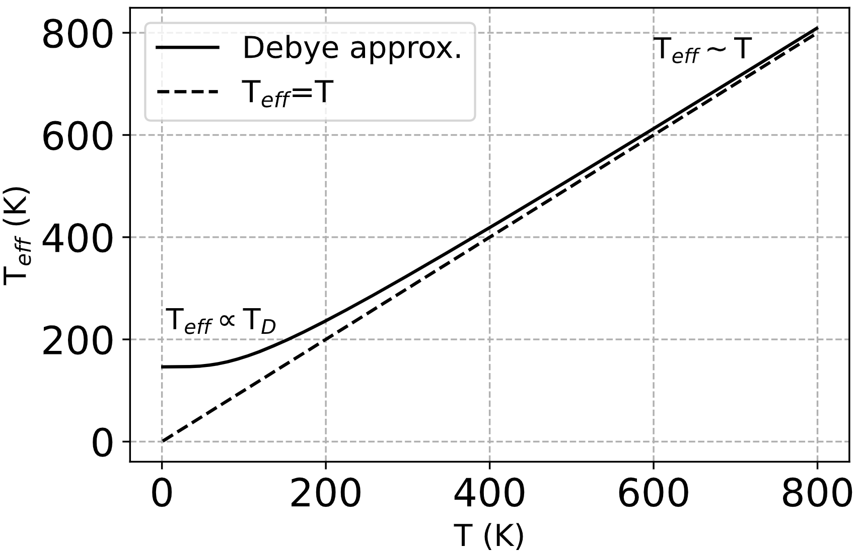
T-dependent relative self-absorption (t-rsa)
Temperature-dependent RSA measurements (T-RSA)
Heat up/Cool down the absorber and scatterer
A. Zilges et. al.,Prog. Part. Nucl. Phys. 122 (2021) 103903

Slide 11
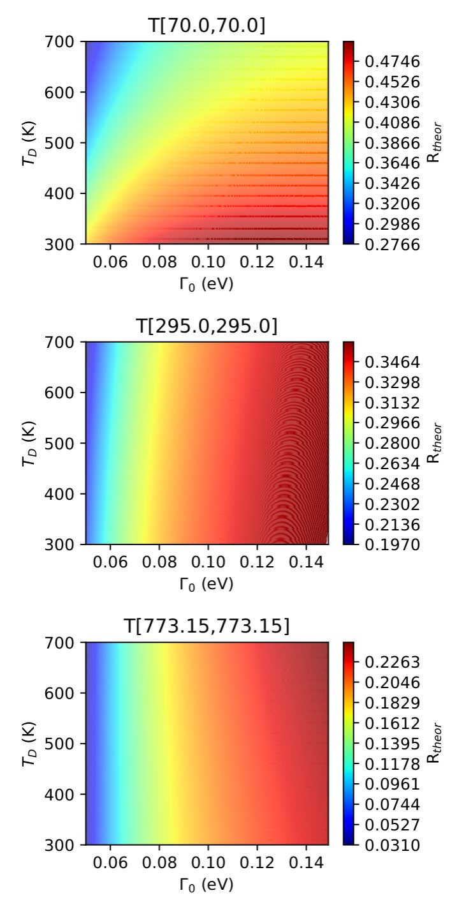
Simulation of self-absorption r for different t_{d} and γ₀
LN₂ temp.
The larger T, the smaller is the impact of T_{D}
Larger T_{D}
↓
Smaller R
room temp.
500ºC
Simulations by P. Koseoglou
Larger Γ→ Larger R

Slide 12
T-dependent relative self-absorption (t-rsa)
Get independent of theoretical calculations of the effective temperature and the uncertainty in the T_{D}
High precision level width and decay strength measurements
Reduce systematic uncertainties of the measured transition matrix elements
A. Zilges et. al.,Prog. Part. Nucl. Phys. 122 (2021) 103903

Slide 13
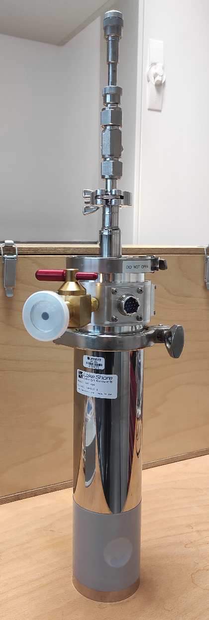
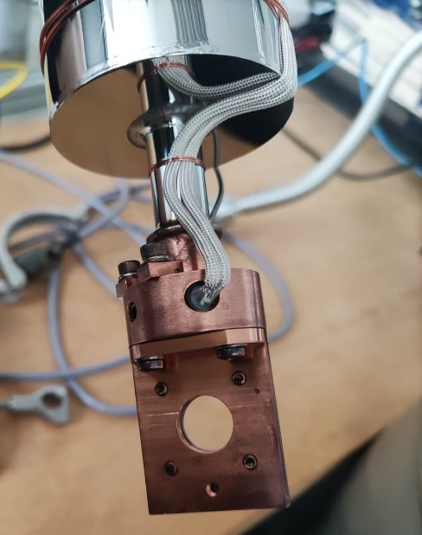
T-dependent relative self-absorption (t-rsa)
LAKE SHORE model VPF-800 system
LN₂ temperature – 800 K
Under vacuum

Slide 14
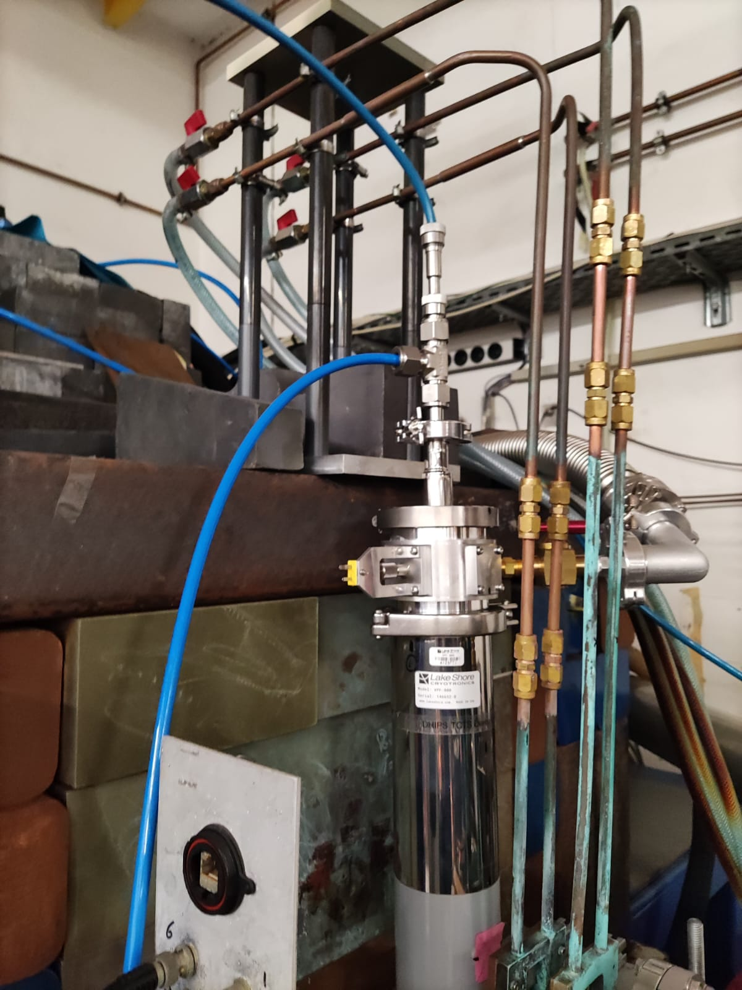
T-dependent relative self-absorption on ²⁷Al at dhips

Slide 15
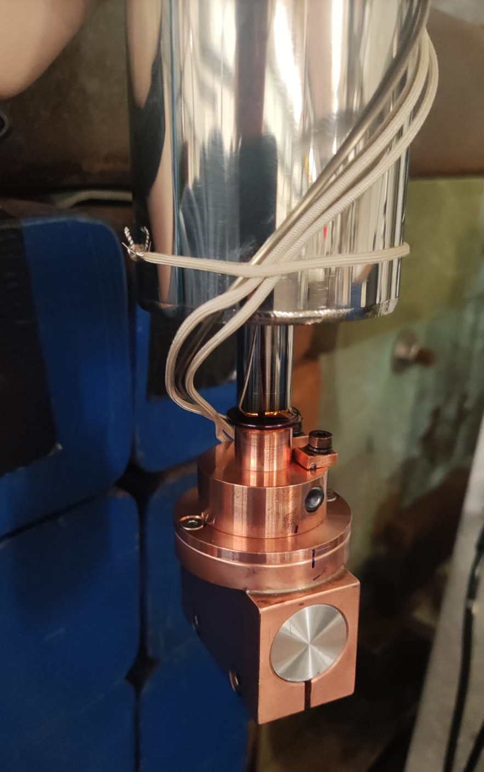
T-dependent relative self-absorption on ²⁷Al at dhips
E_{beam} = 5.5 MeV
t_{abs} = 50 mm
t_{sc} = 3 mm
T_{cold} = 77 K (LN2 temperature)
T_{room} = 320 K
T_{hot} = 600 K
A. Zilges et. al.,Prog. Part. Nucl. Phys. 122 (2021) 103903

Slide 16
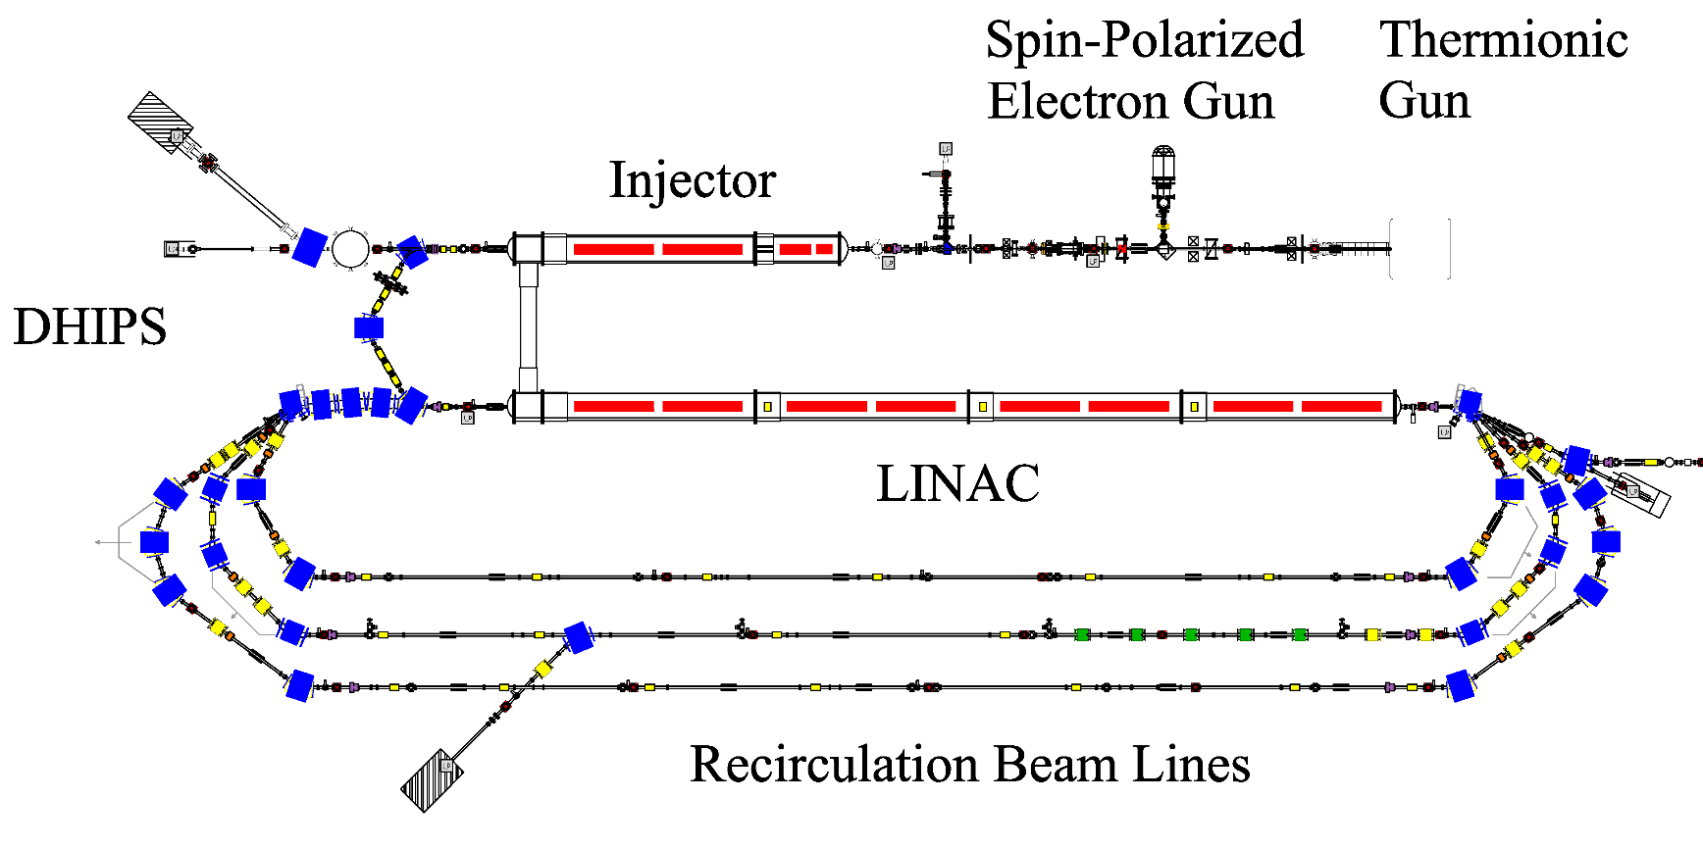
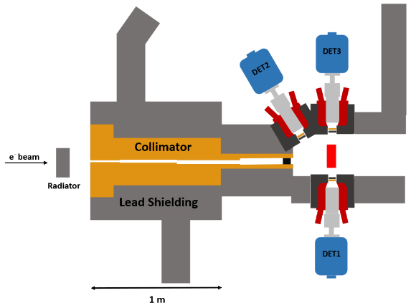
S-DALINAC
provided to DHIPS measuring site for NRF, RSA, and T-RSA measurements
enter the superconducting injector module, and the electrons are accelerated up to 14 MeV
pass the normal-conducting part of the S-DALINAC
e⁻ are provided by a thermionic gun
C. Romig, Ph. D. thesis, TUDarmstadt (2015)

Slide 17
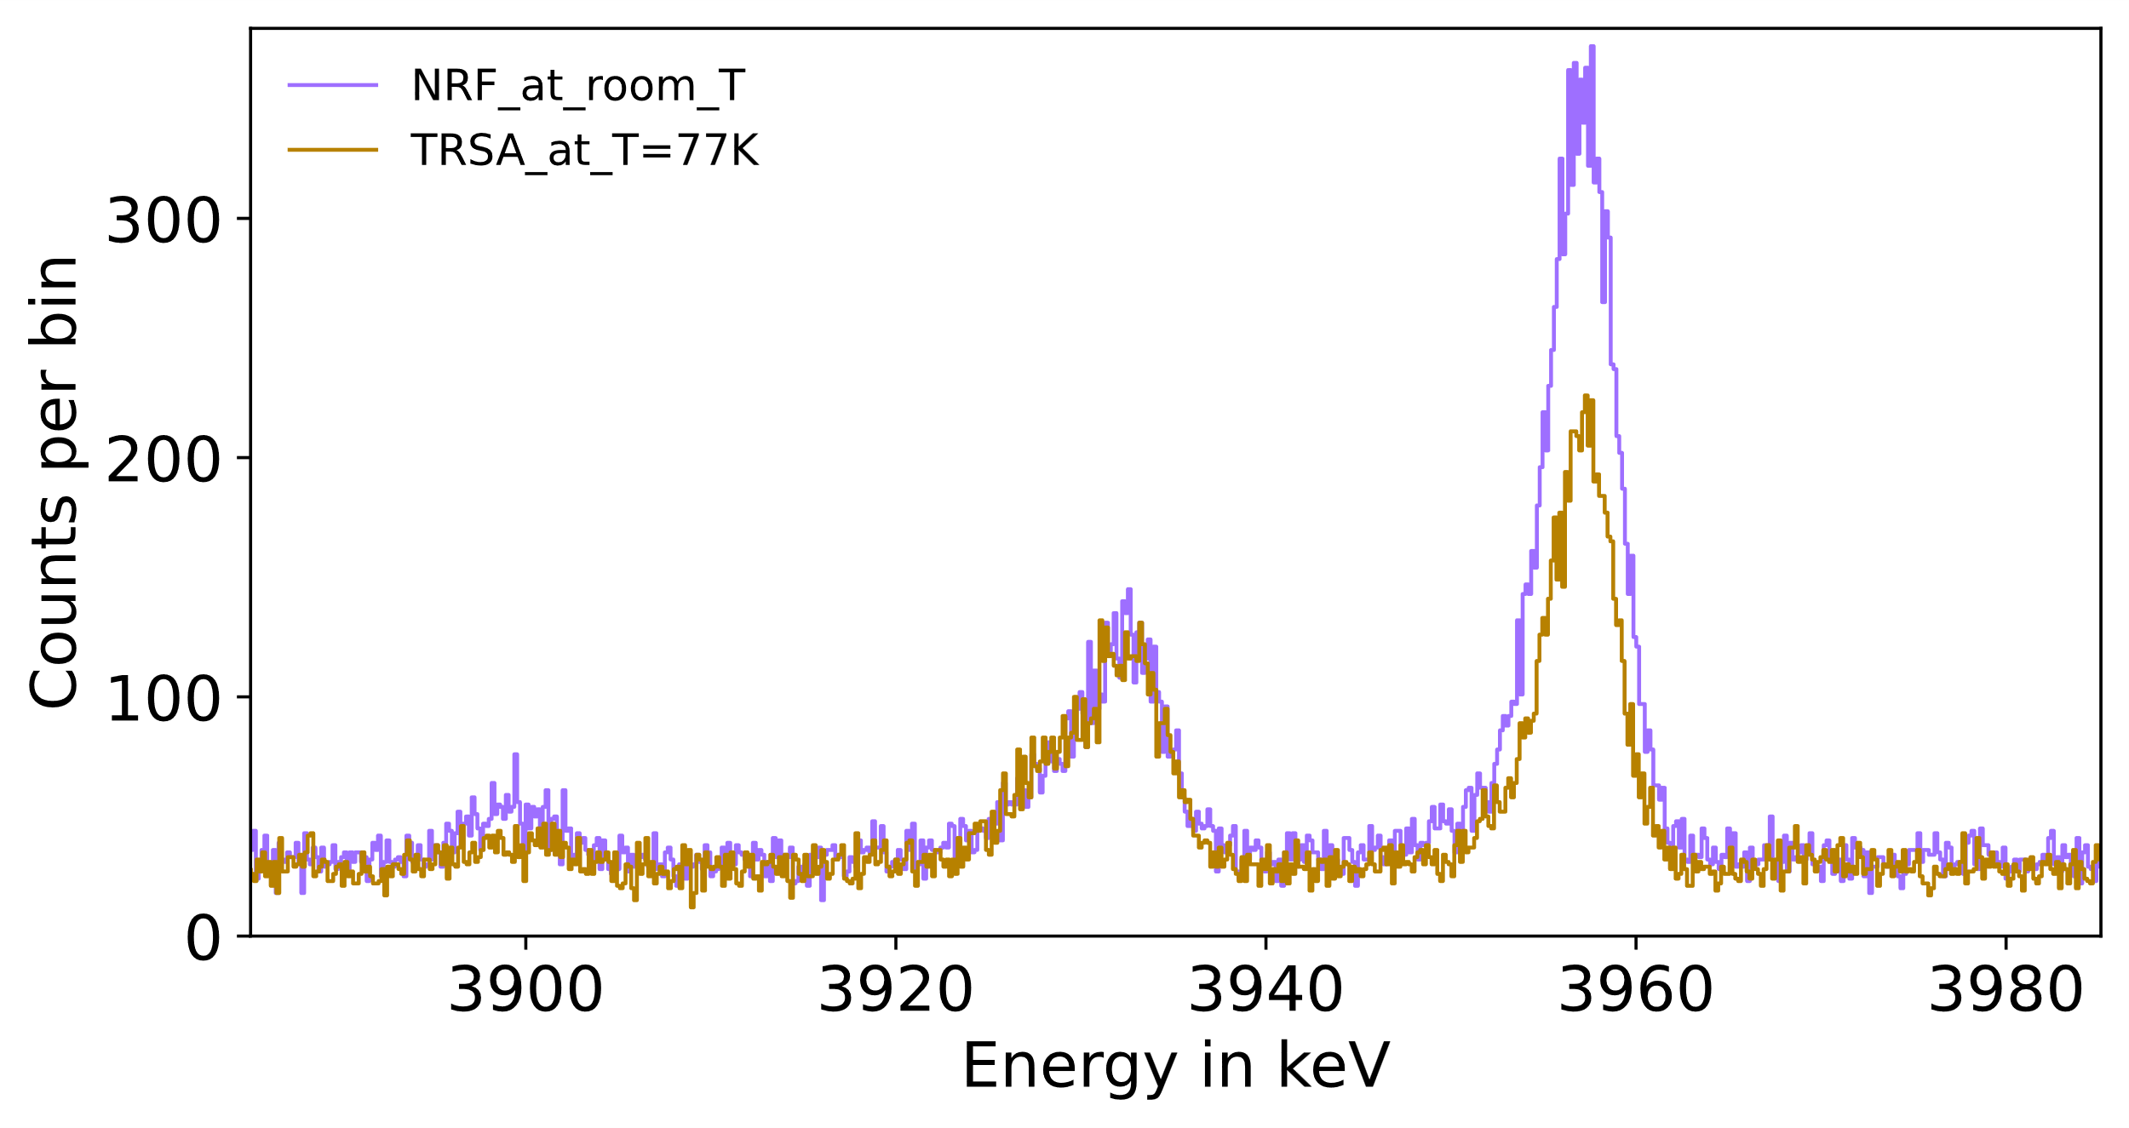
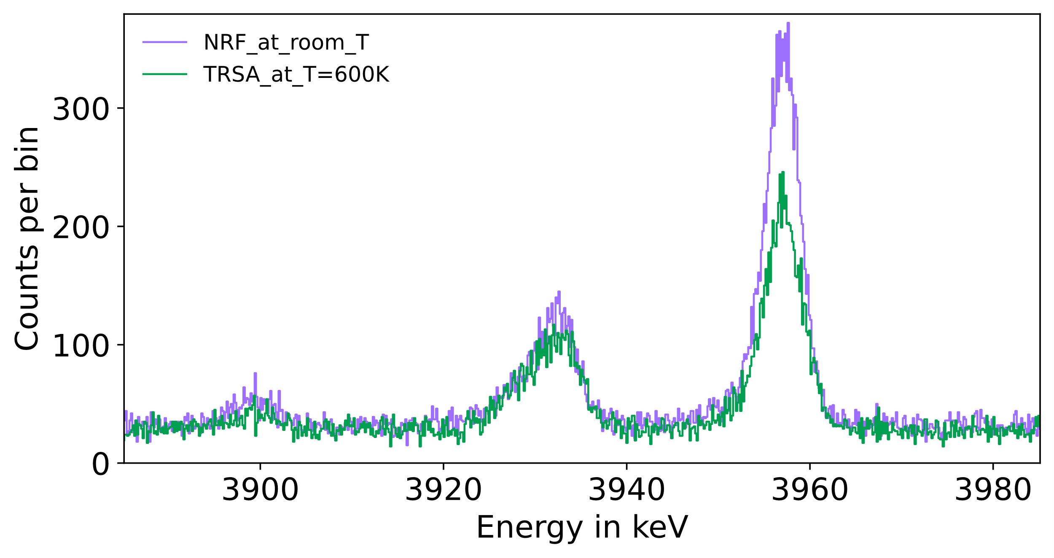
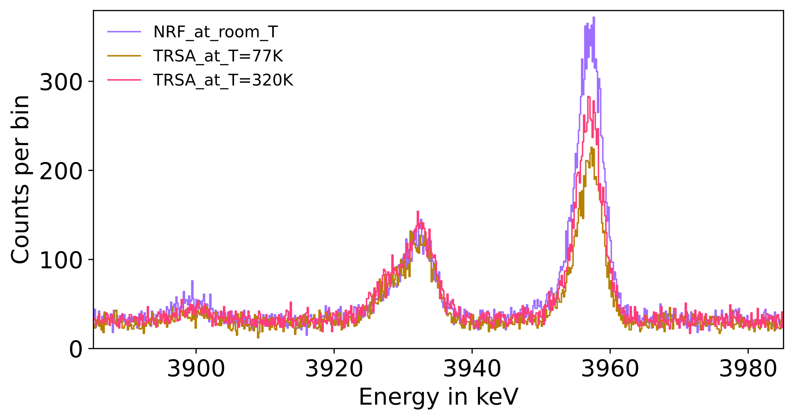
Measurement time:
TRSA:
@77 K: 241.6 h
@320 K: 277.1 h
@600 K: 237.4 h
NRF: 185.7 h

Slide 18
Thank you for your attention!
K. Prifti^{1,} , P. Koseoglou^{1,2}, J. Isaak¹, N. Pietralla¹, V. Werner¹, U. Ahmed¹, M. Baumann¹, M. Beuschlein¹, J. Bormans^{1,3}, I. Brandherm¹, M. L. Cortés¹, A. Gupta¹, B. Götz¹, J. Hauf¹, B. Hesbacher¹, M. Heumüller¹, K. E. Ide¹, I. Jurosevic¹, J. Kleemann¹, J. Lu¹, H. Mayr¹, A. R. Netto¹, C. Nickel1, O. Papst¹, D. M. Richter¹, M. Spall¹, T. Ramaker¹, T. M. Sebe⁴, T. Stetz¹ and R. Zidarova¹
¹IKP, TU Darmstadt
²National Kapodistrian University of Athens, Athens, Greece
³GSI Helmholtzzentrum für Schwerionenforschung, Darmstadt, Germany
⁴ELI-NP, University of Bucharest, Bucharest, Romania
kprifti@ikp.tu-darmstadt.de

