Slide 1
Non-equilibrium Green's function approach
to low-energy fission dynamics
Kotaro Uzawa (Kyoto U.)
Collaborators
K. Hagino (Kyoto U.)
G.F. Bertsch (U. of Washington Seattle)

Slide 2
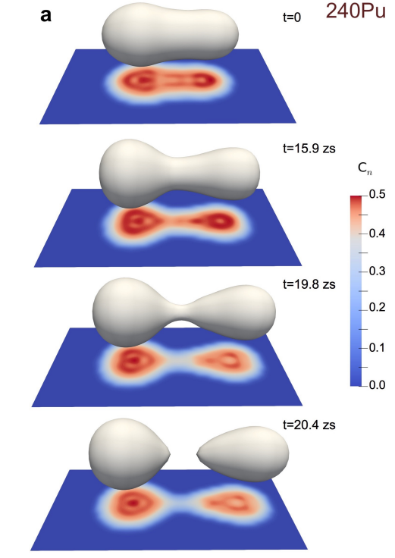
Nuclear Fission
A process of a heavy nucleus splitting into two smaller nuclei
Microscopic description of fission is extremely difficult.
There are several reasons,
① Fission is a large-amplitude motion
② Interaction between collective motion
and single-particle motion is complex
③ Connection between nuclear structure and reaction
G. Scamps and C. Simenel,
Nature 564 382 (2018).
Notes:
In this talk, chi-squared distribution is most important one.
chi-squared distribution is defined by this formula and nu is called DoF.
chi-squared distribution is sum of squared gauss distribution and nu corresponds to the number of gauss dist.
In the nuclear physics, chi-squared distribution play role for the compound nucleus reaction.
Lets consider neutron is absorbed by the target nuclei and compound nucleus is formed.
We use gamma_n as a decay width of neutron emission and it is called neutron width.
The neutron emission probability gamma_n is known to follow the chi-squared distribution with nu=1.
This fact was pointed out by the porter Thomas and this distribution is called PT distribution.
This is most well known example.

Slide 3
Nuclear Fission
A process of a heavy nucleus splitting into two smaller nuclei
Microscopic description of fission is extremely difficult.
There are several reasons,
① Fission is a large-amplitude motion
② Interaction between collective motion
and single-particle motions is complex
③ Connection between nuclear structure and reaction
G. Scamps and C. Simenel,
Nature 564 382 (2018).
Notes:
In this talk, chi-squared distribution is most important one.
chi-squared distribution is defined by this formula and nu is called DoF.
chi-squared distribution is sum of squared gauss distribution and nu corresponds to the number of gauss dist.
In the nuclear physics, chi-squared distribution play role for the compound nucleus reaction.
Lets consider neutron is absorbed by the target nuclei and compound nucleus is formed.
We use gamma_n as a decay width of neutron emission and it is called neutron width.
The neutron emission probability gamma_n is known to follow the chi-squared distribution with nu=1.
This fact was pointed out by the porter Thomas and this distribution is called PT distribution.
This is most well known example.

Slide 4
Nuclear Fission
A process of a heavy nucleus splitting into two smaller nuclei
Microscopic description of fission is extremely difficult.
There are several reasons,
① Fission is a large-amplitude motion
② Interaction between collective motion
and single-particle motions is complex
③ Connection between nuclear structure calculation
and reaction calculation is not straightforward
③ Connection between nuclear structure and reaction
G. Scamps and C. Simenel,
Nature 564 382 (2018).
Notes:
In this talk, chi-squared distribution is most important one.
chi-squared distribution is defined by this formula and nu is called DoF.
chi-squared distribution is sum of squared gauss distribution and nu corresponds to the number of gauss dist.
In the nuclear physics, chi-squared distribution play role for the compound nucleus reaction.
Lets consider neutron is absorbed by the target nuclei and compound nucleus is formed.
We use gamma_n as a decay width of neutron emission and it is called neutron width.
The neutron emission probability gamma_n is known to follow the chi-squared distribution with nu=1.
This fact was pointed out by the porter Thomas and this distribution is called PT distribution.
This is most well known example.

Slide 5
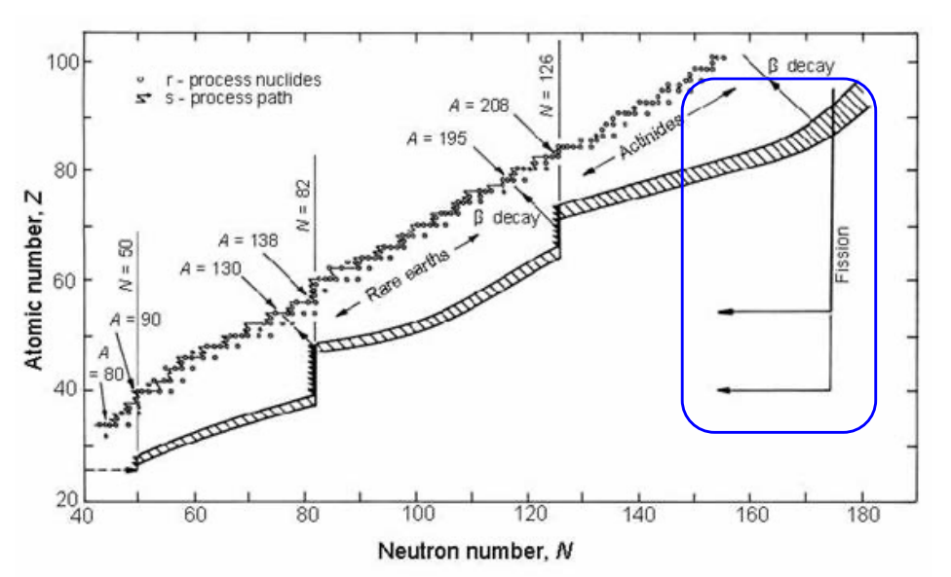
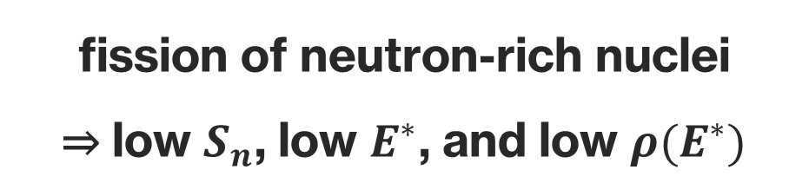
Why we need microscopic theory of fission ?r structure and reaction
In r-process, nuclear fission plays an important role (fission recycling)
fission of neutron-rich nuclei
⇒ low $S_{n}$, low $E^{∗}$, and low $ρ(E^{∗})$
fission recycling
Hauser-Feshbach theory or Langevin eq. may not be applicable…
⇒ Microscopic models without phenomenological assumptions
Notes:
In this talk, chi-squared distribution is most important one.
chi-squared distribution is defined by this formula and nu is called DoF.
chi-squared distribution is sum of squared gauss distribution and nu corresponds to the number of gauss dist.
In the nuclear physics, chi-squared distribution play role for the compound nucleus reaction.
Lets consider neutron is absorbed by the target nuclei and compound nucleus is formed.
We use gamma_n as a decay width of neutron emission and it is called neutron width.
The neutron emission probability gamma_n is known to follow the chi-squared distribution with nu=1.
This fact was pointed out by the porter Thomas and this distribution is called PT distribution.
This is most well known example.

Slide 6
Why we need microscopic theory of fission ?r structure and reaction
In r-process, nuclear fission plays an important role (fission recycling)
fission of neutron-rich nuclei
⇒ low $S_{n}$, low $E^{∗}$, and low $ρ(E^{∗})$
fission recycling
Hauser-Feshbach theory or Langevin eq. may not be applicable…
⇒ Microscopic models without phenomenological assumptions
We apply the non-equilibrium Green function method to nuclear fission!
Notes:
In this talk, chi-squared distribution is most important one.
chi-squared distribution is defined by this formula and nu is called DoF.
chi-squared distribution is sum of squared gauss distribution and nu corresponds to the number of gauss dist.
In the nuclear physics, chi-squared distribution play role for the compound nucleus reaction.
Lets consider neutron is absorbed by the target nuclei and compound nucleus is formed.
We use gamma_n as a decay width of neutron emission and it is called neutron width.
The neutron emission probability gamma_n is known to follow the chi-squared distribution with nu=1.
This fact was pointed out by the porter Thomas and this distribution is called PT distribution.
This is most well known example.

Slide 7
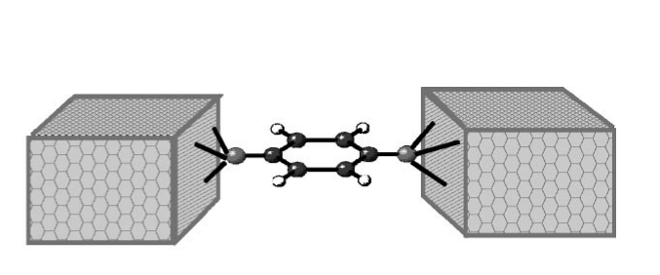
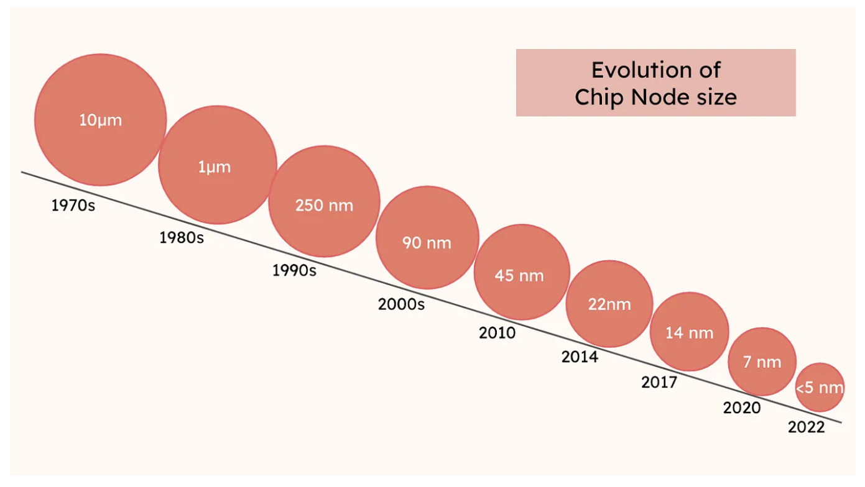



Non-Equilibrium Green Function (NEGF) method
With the time, the size of semiconductors continues to decrease
⇒ Quantum effects become important in the semiconductor design
NEGF method describes electron transports in nano-devices
based on its microscopic Hamiltonian!
Electron
reservoir
Electron
reservoir
Device
$$V_{L}$$
$$V_{R}$$
$I$: Electronic current
https://abhisheksingh-4899.medium.com
P. S. Damle et al., Phys. Rev. B 64, 201403.
Notes:
In this talk, chi-squared distribution is most important one.
chi-squared distribution is defined by this formula and nu is called DoF.
chi-squared distribution is sum of squared gauss distribution and nu corresponds to the number of gauss dist.
In the nuclear physics, chi-squared distribution play role for the compound nucleus reaction.
Lets consider neutron is absorbed by the target nuclei and compound nucleus is formed.
We use gamma_n as a decay width of neutron emission and it is called neutron width.
The neutron emission probability gamma_n is known to follow the chi-squared distribution with nu=1.
This fact was pointed out by the porter Thomas and this distribution is called PT distribution.
This is most well known example.

Slide 8





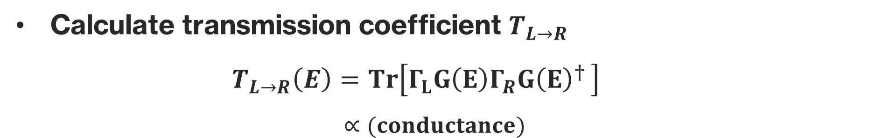
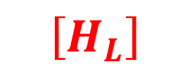
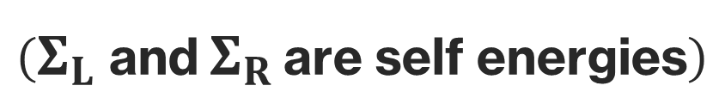



$$\left[H_{Device}+Σ_{L}+Σ_{R}\right]$$
$$\left[H_{L}\right]$$
$$\left[H_{Device}\right]$$
$$\left[H_{R}\right]$$
Projection
$$L$$
$$R$$
$$\left(Σ_{L} \text{and} Σ_{R} \text{are} \text{self} \text{energies}\right)$$
Introduce Green’s functions $G(E)$
$G\left(E\right)={\left(E−H_{Device}−Σ_{L}−Σ_{R}\right)}^{−1}$
$$Σ_{L}=Δ_{L}−\frac{i}{2}Γ_{L}$$
Calculate transmission coefficient $T_{L→R}$
$T_{L→R}\left(E\right)=Tr\left[Γ_{L}G\left(E\right)Γ_{R}G{\left(E\right)}^{† }\right]$
$∝(conductance)$
$$Σ_{R}=Δ_{R}−\frac{i}{2}Γ_{R}$$
Notes:
In this talk, chi-squared distribution is most important one.
chi-squared distribution is defined by this formula and nu is called DoF.
chi-squared distribution is sum of squared gauss distribution and nu corresponds to the number of gauss dist.
In the nuclear physics, chi-squared distribution play role for the compound nucleus reaction.
Lets consider neutron is absorbed by the target nuclei and compound nucleus is formed.
We use gamma_n as a decay width of neutron emission and it is called neutron width.
The neutron emission probability gamma_n is known to follow the chi-squared distribution with nu=1.
This fact was pointed out by the porter Thomas and this distribution is called PT distribution.
This is most well known example.

Slide 9
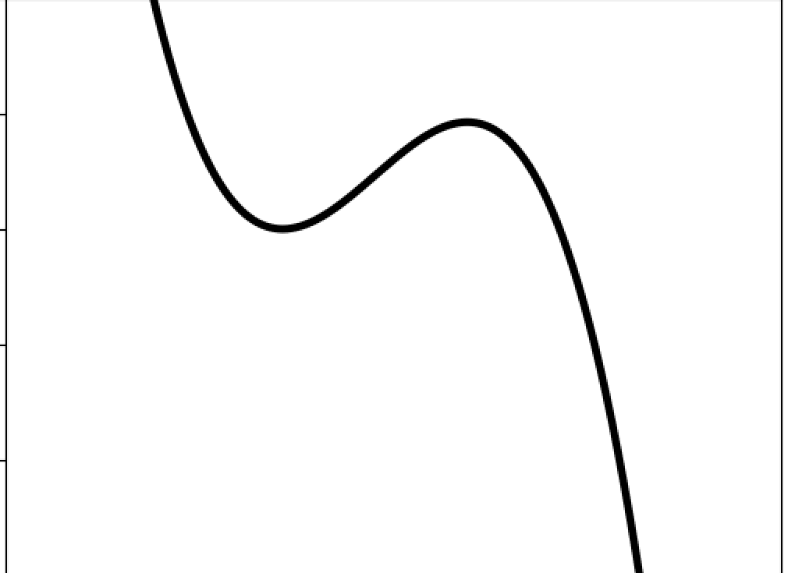
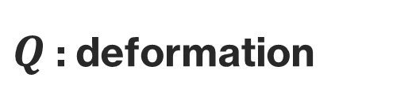
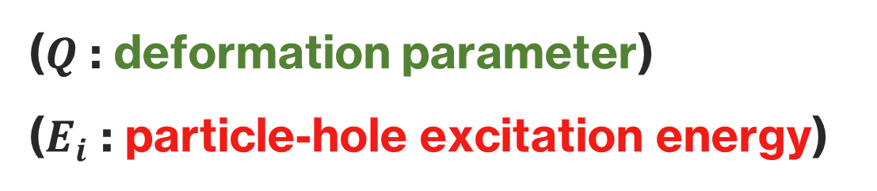


Theoretical Formulation
First, we prepare many-body basis
In nuclear fission, both excitation and deformation are important
Superpose Hartree-Fock w.f. $|HF\left(Q, E_{i}\right)⟩$ (i.e. GCM)
excited states
for certain $Q$
Hartree-Fock w.f.
$$V(Q)$$
($Q$ : deformation parameter)
($E_{i}$ : particle-hole excitation energy)
$Q$ : deformation
Notes:
In the induced fission both Deformation and Excitation are important
So In our approach we extend usual gcm ansatz and superpose not only local ground states but also excited states.
Phi is slater determinant, Q is deformation parameter and E_i is excitation energy of the ph excitation.
As shown in this picture we prepare many ph excitation states at each Q and superpose them.
Our method can be considered as a combination of usual gcm and shell model like approach.

Slide 10










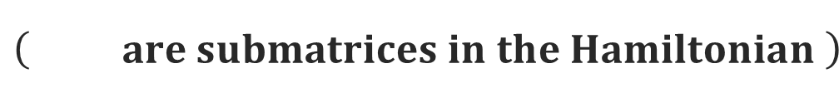





CN (Compound Nucleus)
Scission
$$n$$
$γ$ decay
fission
Barrier
$$Q$$
$$\left( are submatrices in the Hamiltonian \right)$$
$$Q_{i}$$
$H:$Hamiltonian
neutron
channel
$Q_{0}$
$$(CN)$$
$$Q_{1}$$
$$Q_{N−1}$$
$Q_{N}$
$$Γ_{n}$$
$$⋯$$
scission
$$Γ_{cap}$$
$γ$ decay
$$Γ_{fis}$$
fission
Notes:
I will show the setup of our model.
By absorbing neutron, compound nucleus is formed and we represent is by GOE random matrix.
Compound nuclei has probability of emitting neutron and gamma decay.
It is represented by the neutron width and capture width.
As for the fission, compound nuclei start to be deformed and cross fission barrier.
To describe this process we set DFT configurations explained before. And after the fission barrier we prepare scission configuration having fission width.

Slide 11


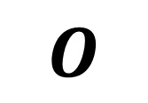

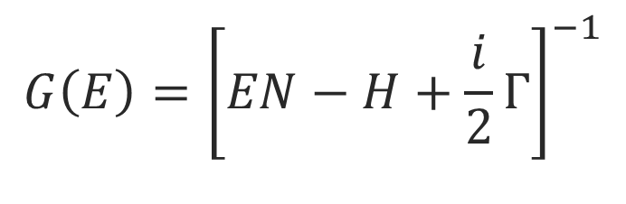


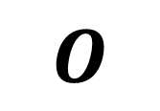


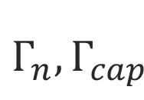


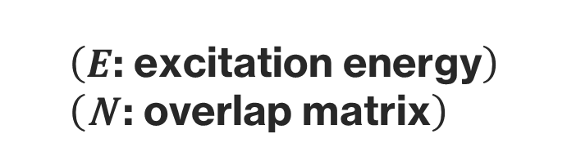

Non-equilibrium Green's function method
$H$ : Hamiltonian Matrix
Green's function
$$Q_{0}$$
$$G\left(E\right)={\left[EN−H+\frac{i}{2}Γ\right]}^{−1}$$
$$Γ_{n},Γ_{cap}$$
$$O$$
$$\left(E\text{: }\text{excitation} \text{energy}\right) \\ \left(\text{N} \text{: }\text{overlap} \text{matrix}\right)$$
$$Q_{1}$$
＆
$$⋱$$
$${ Q}_{N−1}$$
$$T_{n,fis}=Tr[Γ_{n}GΓ_{fis}G^{†}]$$
$$O$$
$$Q_{N}$$
$$Γ_{fis}$$
G. F. Bertsch and K. Hagino, PRC 107 044615 (2023).
K. Uzawa and K. Hagino, PRC 110 014321 (2024).
Notes:
Hamiltonian matrix has the structure like this.
We set GOE at the left end and add imaginary part gamma_n and gamma_cap.
DFT configuration has such block-structure and we call them Q-block.
Q is deformation parameter.
Hamiltonian has such tridiagonal block structure.
Then we invert the matrix and obtain green function.
Based on the datta formula widely used in the mesoscopic systems evaluate fission probability.
We

Slide 12
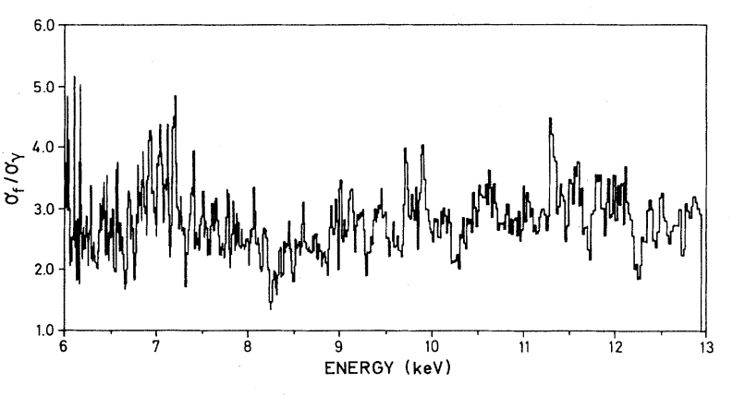
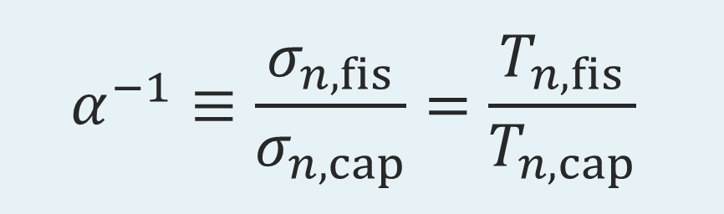

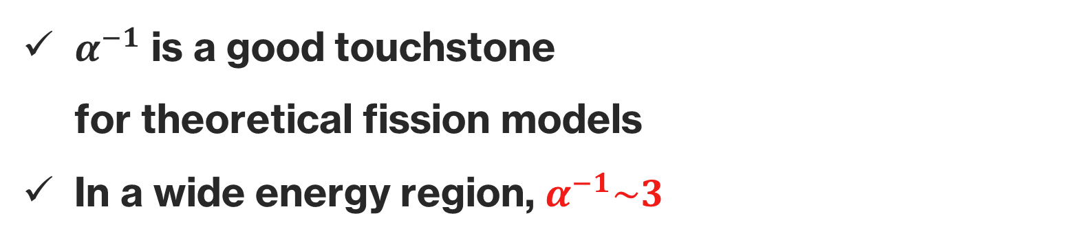
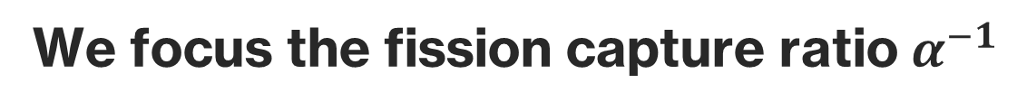

We focus the fission capture ratio $α^{−1}$
$$α^{−1}≡\frac{σ_{n,fis}}{σ_{n,cap}}=\frac{T_{n,fis}}{T_{n,cap}}$$
$$\left({\text{we} \text{can} \text{calculate} α^{−1} \atop \text{microscopically}}\right)$$
$$\left({}_{}^{235}{U+n} \right)$$
$α^{−1}$ is a good touchstone
for theoretical fission models
In a wide energy region, $α^{−1}\sim 3$
M.S. Moore et al., PRC30 214.
Notes:
Hamiltonian matrix has the structure like this.
We set GOE at the left end and add imaginary part gamma_n and gamma_cap.
DFT configuration has such block-structure and we call them Q-block.
Q is deformation parameter.
Hamiltonian has such tridiagonal block structure.
Then we invert the matrix and obtain green function.
Based on the datta formula widely used in the mesoscopic systems evaluate fission probability.
We

Slide 13
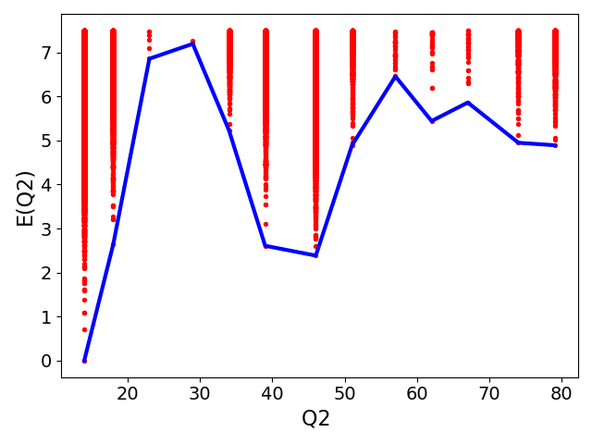
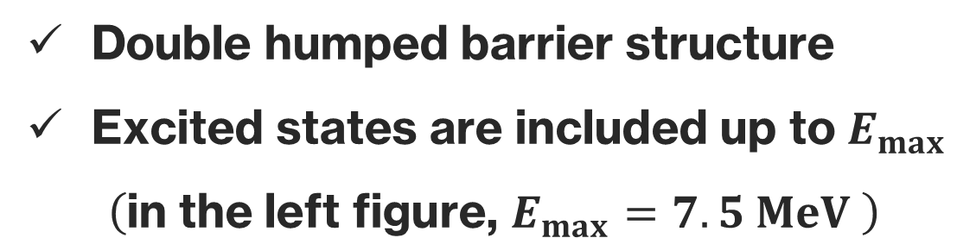
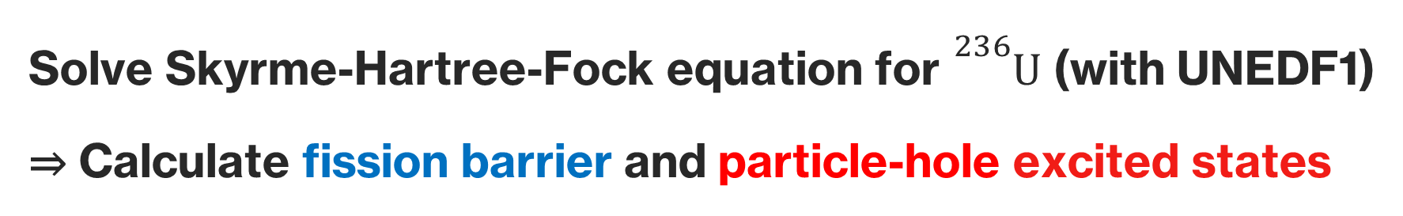
Application to ${}_{}^{235}U(n,f)$
Solve Skyrme-Hartree-Fock equation for ${}_{}^{236}U$ (with UNEDF1)
⇒ Calculate fission barrier and particle-hole excited states
fission barrier ＆ excited states
1st
Double humped barrier structure
Excited states are included up to $E_{max}$
$\left(\text{in} \text{the} \text{left} \text{figure}\text{, }E_{max}=7.5 MeV \right)$
2nd
Notes:
We apply our DFT based fission model to the induced fission of 235U.
We list detail of the calculation.
As a density functional we use undef1.
And as a ph excitation we restrict seniority zero configurations. It is significant drawback of our model.
In the previous work, this setup reproduce the fission property qualitatively. And Quantifiability is not perfect.
Imposing axial symmetry and we calculate PES as a function of Q2 and Q3.
At this point pairing is not included and monopole pairing is included when we perform GCM.
As a imaginary part gamma, we use these values. They are estimated from the experiment.

Slide 14



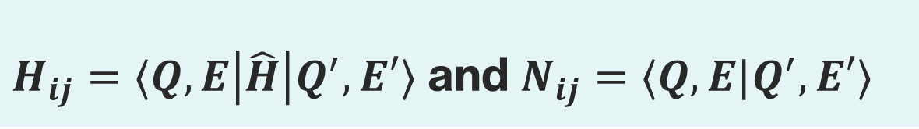
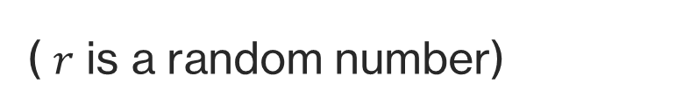
GCM calculation
Calculate Hamiltonian matrix $H_{ij}$ and overlap matrix $N_{ij}$ (GCM)
$H_{ij}=⟨Q,E\left|\hat{H}\right|Q^{′},E′⟩$ and $N_{ij}=⟨Q,E|Q^{′},E′⟩$
As residual interactions, we apply
constant pairing interaction and random particle-hole interaction
( $r$ is a random number)
Due to the randomness, we have to take an ensemble average
Notes:
Along the previous fission path we take GCM basis and plot them as a function of Q2.
As shown in PES after the1st barrier deformation become parity asymmetric and in our calculation we take account it.
We can confirm 1st and 2nd fission barrier.
Using these configurations we perform GCM and calculate GCM kernel.

Slide 15
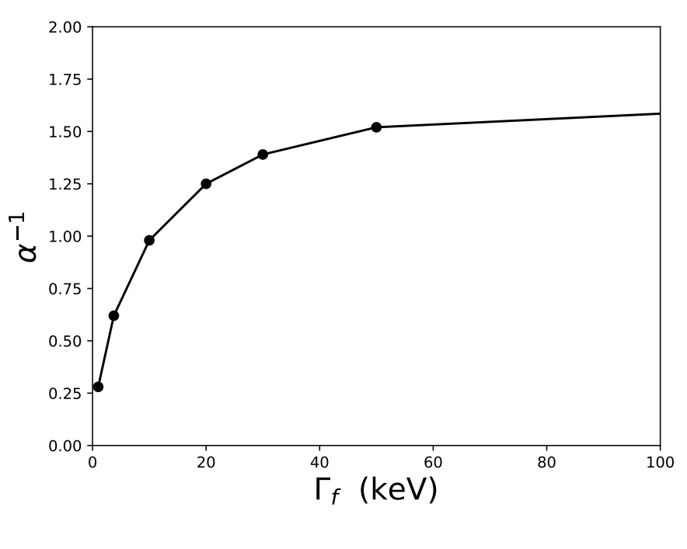







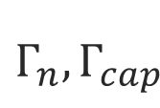



Decay widths
$H$ : Hamiltonian Matrix
$Γ_{n}$ and $Γ_{cap}$ are fitted to empirical values
in the RIPL library
$$Q_{0}$$
$$Γ_{n},Γ_{cap}$$
$$O$$
$α^{−1}=σ_{fis}/σ_{cap}$ is known to be insensitive
to the fission width $Γ_{fis}$ (fixed to 125 keV)
$$Q_{1}$$
$$⋱$$
$${ Q}_{N−1}$$
$$O$$
$$Q_{N}$$
$$Γ_{fis}$$
G. F. Bertsch and K. Hagino, PRC 107 044615 (2023).
K. Uzawa and K. Hagino, PRC 108 024319 (2024).
Notes:
Along the previous fission path we take GCM basis and plot them as a function of Q2.
As shown in PES after the1st barrier deformation become parity asymmetric and in our calculation we take account it.
We can confirm 1st and 2nd fission barrier.
Using these configurations we perform GCM and calculate GCM kernel.

Slide 16


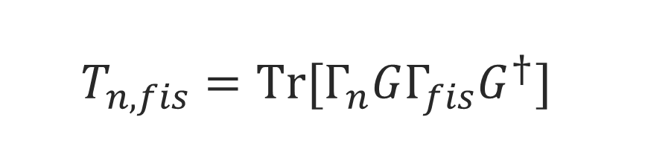


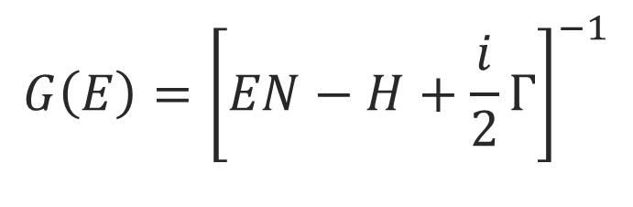
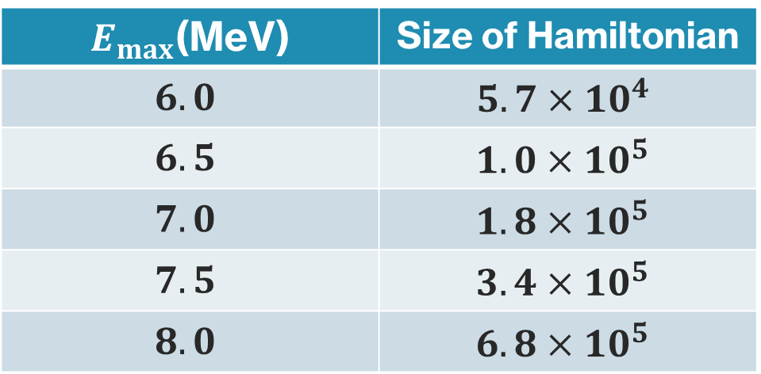
Excited states are included up to $E_{max}$
Dimension of the Hamiltonian increases as $E_{max}$
$$E_{max}$$
$E_{max}$(MeV) | Size of Hamiltonian
$$6.0$$ | $$5.7×10^{4}$$
$$6.5$$ | $$1.0×10^{5}$$
$$7.0$$ | $$1.8×10^{5}$$
$$7.5$$ | $$3.4×10^{5}$$
$$8.0$$ | $$6.8×10^{5}$$
$$V(Q)$$
$Q$ : deformation
Calculation of the Green function $G(E)$ becomes expensive!
$$T_{n,fis}=Tr[Γ_{n}GΓ_{fis}G^{†}]$$
$$G\left(E\right)={\left[EN−H+\frac{i}{2}Γ\right]}^{−1}$$
$$\&$$
Notes:
We apply our DFT based fission model to the induced fission of 235U.
We list detail of the calculation.
As a density functional we use undef1.
And as a ph excitation we restrict seniority zero configurations. It is significant drawback of our model.
In the previous work, this setup reproduce the fission property qualitatively. And Quantifiability is not perfect.
Imposing axial symmetry and we calculate PES as a function of Q2 and Q3.
At this point pairing is not included and monopole pairing is included when we perform GCM.
As a imaginary part gamma, we use these values. They are estimated from the experiment.

Slide 17
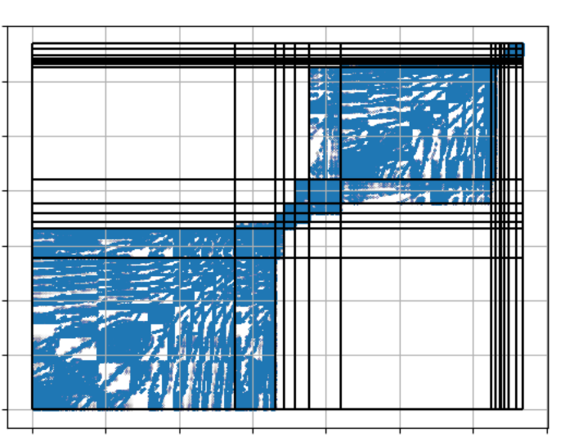

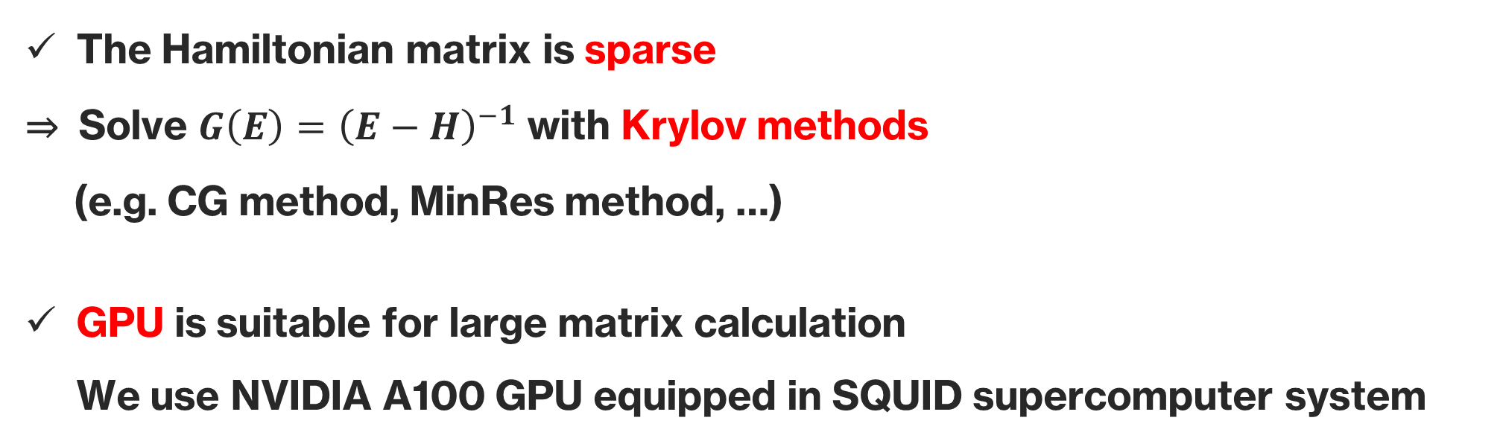
Hamiltonian matrix
Numerical techniques
The Hamiltonian matrix is sparse
⇒ Solve ${G\left(E\right)=\left(E−H\right)}^{−1}$ with Krylov methods
(e.g. CG method, MinRes method, …)
GPU is suitable for large matrix calculation
We use NVIDIA A100 GPU equipped in SQUID supercomputer system
Supercomputer system SQUID
at Osaka University
Notes:
Along the previous fission path we take GCM basis and plot them as a function of Q2.
As shown in PES after the1st barrier deformation become parity asymmetric and in our calculation we take account it.
We can confirm 1st and 2nd fission barrier.
Using these configurations we perform GCM and calculate GCM kernel.

Slide 18
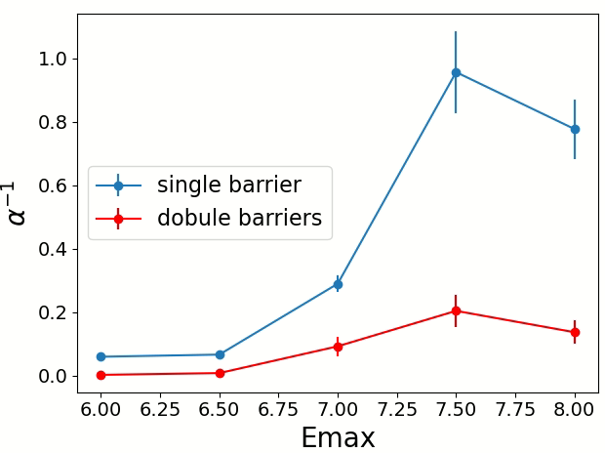
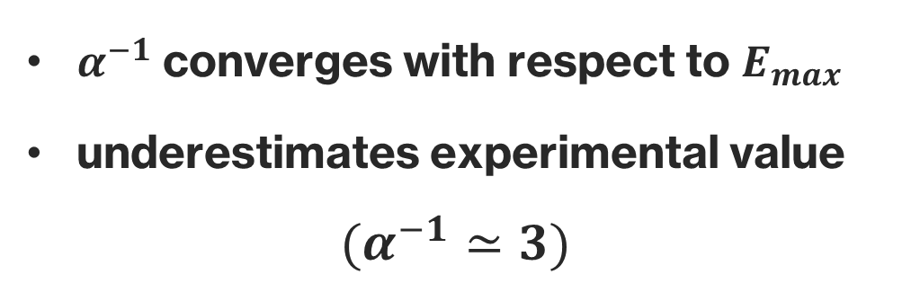
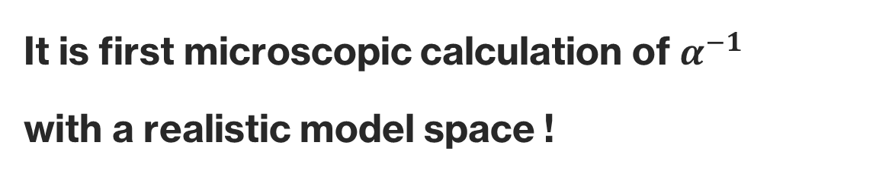
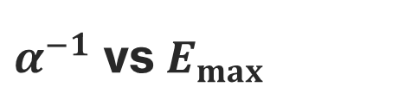
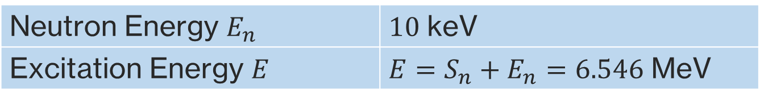
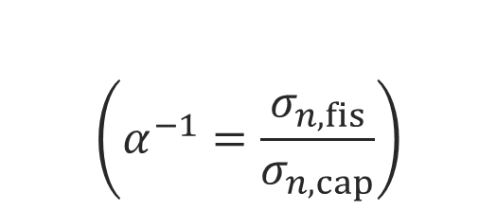
Calculate $α^{−1}=σ_{n,fis}/σ_{n,cap}$ with different $E_{max}$
$$\left(α^{−1}=\frac{σ_{n,fis}}{σ_{n,cap}}\right)$$
Neutron Energy $E_{n}$ | $10$ keV
Excitation Energy $E$ | $E=S_{n}+E_{n}=6.546$ MeV
$α^{−1}$ vs $E_{max}$
$α^{−1}$ converges with respect to $E_{max}$
underestimates experimental value
$(α^{−1}≃3)$
It is first microscopic calculation of $α^{−1}$
with a realistic model space !
Notes:
Along the previous fission path we take GCM basis and plot them as a function of Q2.
As shown in PES after the1st barrier deformation become parity asymmetric and in our calculation we take account it.
We can confirm 1st and 2nd fission barrier.
Using these configurations we perform GCM and calculate GCM kernel.

Slide 19
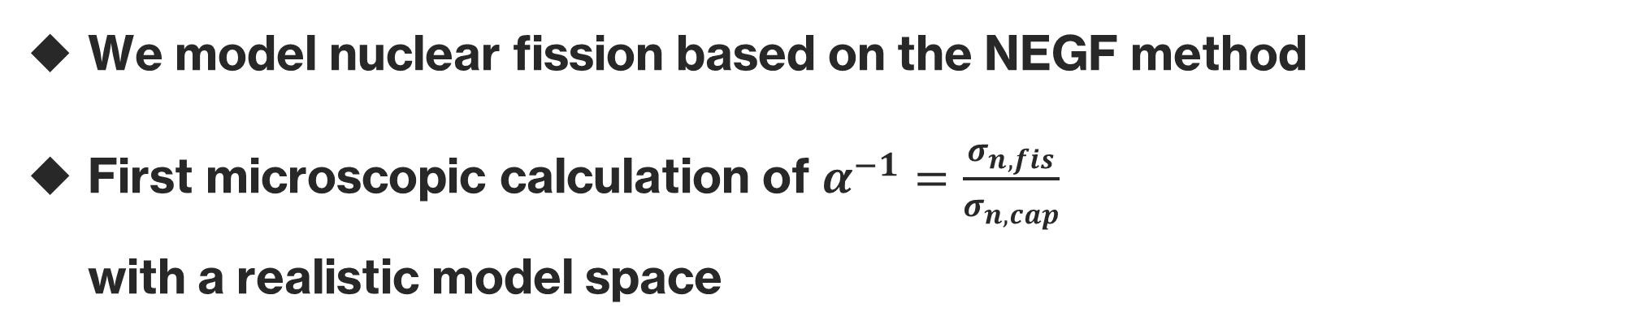
Summary
We model nuclear fission based on the NEGF method
First microscopic calculation of $α^{−1}=\frac{σ_{n,fis}}{σ_{n,cap}}$
with a realistic model space
Outlooks
Check the dependence of results on parameters
(especially nuclear-force parameters)
Application to fission of neutron-rich nuclei
Notes:
To advance our understanding about fission distribution, we apply F projection technique.
We prepare projection operator P and Q.
Then we divide model space and construct effective Hamiltonian for the P space.
Heff is defined by this equation.
In our setup we use GOE as P space. Remember that Left GOE corresponds to the compound nucleus.
And we use other Q-blocks as Q. The important point is there are imaginary component at the right end and due to it Eeff has also imaginary part.
And Gamma_eff corresponds fission width for compound states.

Slide 20

$$\left[H_{Device}+Σ_{L}+Σ_{R}\right]$$
$$\left[H_{L}\right]$$
$$\left[H_{Device}\right]$$
$$\left[H_{R}\right]$$
Projection
$$L$$
$$R$$
$$\left(\begin{matrix}H_{L} & V & \\ V & H_{Device} & V \\ & V & H_{R}\end{matrix}\right)$$
Notes:
In this talk, chi-squared distribution is most important one.
chi-squared distribution is defined by this formula and nu is called DoF.
chi-squared distribution is sum of squared gauss distribution and nu corresponds to the number of gauss dist.
In the nuclear physics, chi-squared distribution play role for the compound nucleus reaction.
Lets consider neutron is absorbed by the target nuclei and compound nucleus is formed.
We use gamma_n as a decay width of neutron emission and it is called neutron width.
The neutron emission probability gamma_n is known to follow the chi-squared distribution with nu=1.
This fact was pointed out by the porter Thomas and this distribution is called PT distribution.
This is most well known example.

Slide 21


S-matrix dispersion formula
$$S_{ab}=δ_{ab}−Σ_{μ}\frac{γ_{a,μ}γ_{μ,b}}{E−E_{μ}}$$
$${T_{ab}=\left|S_{ab}\right|}^{2}=Tr[Γ_{a}G\left(E\right)Γ_{b}G{\left(E\right)}^{† }]$$
Notes:
To advance our understanding about fission distribution, we apply F projection technique.
We prepare projection operator P and Q.
Then we divide model space and construct effective Hamiltonian for the P space.
Heff is defined by this equation.
In our setup we use GOE as P space. Remember that Left GOE corresponds to the compound nucleus.
And we use other Q-blocks as Q. The important point is there are imaginary component at the right end and due to it Eeff has also imaginary part.
And Gamma_eff corresponds fission width for compound states.

Slide 22


Size of random interaction
Notes:
To advance our understanding about fission distribution, we apply F projection technique.
We prepare projection operator P and Q.
Then we divide model space and construct effective Hamiltonian for the P space.
Heff is defined by this equation.
In our setup we use GOE as P space. Remember that Left GOE corresponds to the compound nucleus.
And we use other Q-blocks as Q. The important point is there are imaginary component at the right end and due to it Eeff has also imaginary part.
And Gamma_eff corresponds fission width for compound states.

Slide 23




capture width and fission width
Notes:
To advance our understanding about fission distribution, we apply F projection technique.
We prepare projection operator P and Q.
Then we divide model space and construct effective Hamiltonian for the P space.
Heff is defined by this equation.
In our setup we use GOE as P space. Remember that Left GOE corresponds to the compound nucleus.
And we use other Q-blocks as Q. The important point is there are imaginary component at the right end and due to it Eeff has also imaginary part.
And Gamma_eff corresponds fission width for compound states.

Slide 24

Notes:
To advance our understanding about fission distribution, we apply F projection technique.
We prepare projection operator P and Q.
Then we divide model space and construct effective Hamiltonian for the P space.
Heff is defined by this equation.
In our setup we use GOE as P space. Remember that Left GOE corresponds to the compound nucleus.
And we use other Q-blocks as Q. The important point is there are imaginary component at the right end and due to it Eeff has also imaginary part.
And Gamma_eff corresponds fission width for compound states.

Slide 25

Notes:
To advance our understanding about fission distribution, we apply F projection technique.
We prepare projection operator P and Q.
Then we divide model space and construct effective Hamiltonian for the P space.
Heff is defined by this equation.
In our setup we use GOE as P space. Remember that Left GOE corresponds to the compound nucleus.
And we use other Q-blocks as Q. The important point is there are imaginary component at the right end and due to it Eeff has also imaginary part.
And Gamma_eff corresponds fission width for compound states.

