Slide 1
Structure of light hypernuclei from view point of few-body problem
Emiko Hiyama (Tohoku Univ./RIKEN)

Slide 2
Major goals of hypernuclear physics
To understand baryon-baryon interactions
Fundamental and important for the study
of nuclear physics
Total number of
Nucleon (N) -Nucleon (N) data: 4,000
YN and YY potential models so far proposed
(ex. Chiral, Nijmegen,
Kyoto-Niigata) have large ambiguity.
・ Total number of differential cross section
Hyperon (Y) -Nucleon (N) data: ～ 40- 50
・ NO YY scattering data

Slide 3
Therefore, for the study of YN and YY interactions,
the systematic investigation of the
structure of light hypernuclei is one of the important
way.
(Some YN scattering experiments have been done
and further experiment is planned at J-PARC.)
Once YN and YY interactions are determined, we can
predict interesting phenomena which cannot be imagined so far.
In addition, we could study inner part of neutron stars which
have been observed.

Slide 4
Our few-body caluclational method
Gaussian Expansion Method (GEM) , since 1987
,
・A variational method using Gaussian basis functions
・Take all the sets of Jacobi coordinates
Developed by Kyushu Univ. Group,
Kamimura and his collaborators.
Review article :
E. Hiyama, M. Kamimura and Y. Kino,
Prog. Part. Nucl. Phys. 51 (2003), 223.
High-precision calculations of various 3- and 4-body systems:
Exotic atoms / molecules ,
3- and 4-nucleon systems,
multi-cluster structure of light nuclei,
Light hypernuclei,
3-quark systems,

Slide 5

Gaussian Expansion Method (GEM)
r
r
2
R
R
R
1
2
3
1
r
C=1
C=2
3
C=3
Notes:
Determined by diagonalizing H

Slide 6

r
r
2
R
R
R
1
2
3
1
r
C=1
C=2
3
C=3
Basis functions of each Jacobi coordinate
C_{NL,lm}
Determined by diagonalizing H

Slide 7
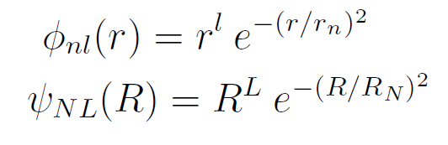
Radial part :
Gaussian
function
Gaussian ranges
in geometric
progression
Both the short-range correlations and the exponentially-damped tail are simultaneously reproduced accurately.
R
In the case of four-body problem,
We have one more Jabobi coordinate.
r
ρ

Slide 8
by solving eigenstate problem, we get
eigenenergy E and unknown coefficients C_{n .}
( H_{i n}) - E ( N_{i n} )
C_{n}
=0

Slide 9
Benchmark-test 4-body calculation : Phys. Rev. C64 (2001), 044001
①
by 7 groups
⁴He
②
n
n
③
p
p
④
4 nucleon
bound state
⑤
Realistic NN
force: AV8’
⑥
Only two-body NN interaction
⑦

Slide 10
Benchmark-test calculation of the 4-nucleon bound state
Good agreement among 7different methods
In the binding energy, r.m.s. radius and wavefunction density
GEM
ours
Notes:
ours

Slide 11
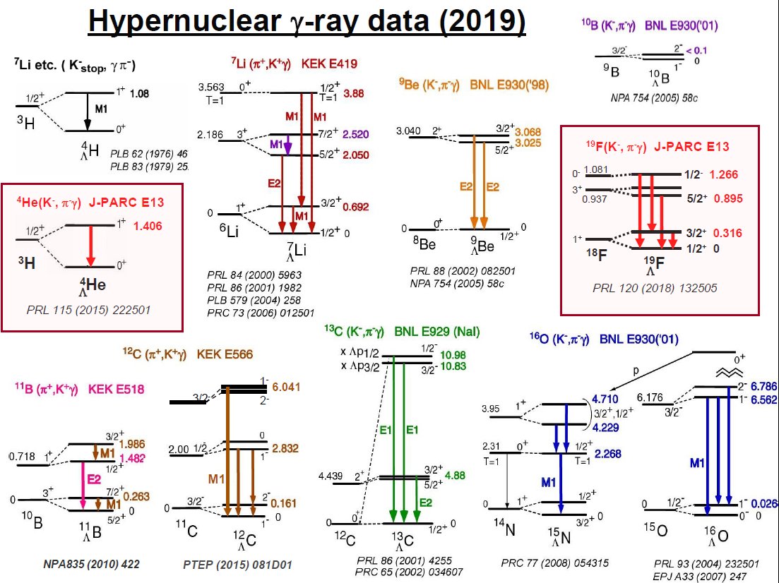
Since 1998
n
n
p
n
p
Λ
Ab-initio calculation
Shell model calculation
+
High-resolution experiments
N
Λ
We have been obtaining
information on ΛN
two-body interaction.

Slide 12
2021
Mass-Radius Relation of Neutron Stars
ΛN interaction updated by
structure study of Λ hypernuclei
+ EoS by coupled-cluster
variational calculation done
by Togashi
Still, the maximum mass of
neutron star is less than twice
of solar mass.
J1614-2230: Nature 467 (2010) 1081, APJ 832 (2016) 167
J0348+0432: Science 340 (2013) 1233232
J0740+6620: Nat. Astron. (2019)
GW170817: PRL 121 (2018) 161101
Hyperon puzzle
missing part of YN interaction: ΛN-ΣN coupling
Notes:
Observationaly Suggested region

Slide 13
S=-1
Mass is smaller.
It is expected that
Λ-Σ conversion
might affect
in structure of
Λ hypernuclei.
ΛN－ΣN coupling
Σ
Non-strangeness sector
80 MeV
N
Δ
Λ
ΛN-ΣN coupling is key issue to
construct YN two-body interaction
completely.
N
N
Δ
300MeV
N
Probability of Δ in nuclei is
not large.

Slide 14
Role of the ΛN-ΣN interaction
・ Three-body effect
N₁
Λ
N₂
N₃
N₁
Λ
N₂
N₃
①
②
Σ
Σ
N₁
Λ
N₂
N₃
N₁
Λ
N₂
N₃
Effective two-body force
Three-body force
In the neutron matter or neutron star, three-body force
might play important role.
・Charge symmetry breaking effect

Slide 15
Charge Symmetry breaking
In S=0 sector
Energy difference comes from
dominantly Coulomb force
between 2 protons.
Charge symmetry breaking
(n-n,p-p) effect is small.
Exp.
N+N+N
0 MeV
- 7.72 MeV
0.76 MeV
1/2⁺
- 8.48 MeV
³He
1/2⁺
³H
n
p
p
n
n
p

Slide 16
In S= -1 sector
Exp.
0 MeV
³He+Λ
0 MeV
³H+Λ
-1.00
-1.24
1⁺
1⁺
0.24 MeV
-2.04
-2.39
0⁺
0⁺
0.35 MeV
p
n
n
n
p
Λ
p
Λ
⁴H
⁴He
Λ
Λ

Slide 17
n
p
n
n
p
Λ
p
Λ
⁴He
⁴H
Λ
Λ
However, Λ particle has no charge.
⁴He
⁴H
Λ
Λ
p
n
n
p
p
n
p
p
+
+
p
Λ
Σ-
p
Λ
Σ-
p
n
+
+
+
+
p
n
n
n
p
n
n
n
+
+
p
Σ0
Σ+
n
Σ0
n
Σ+
p
Notes:
So, charge symmetry breaking effect is considered to come from interaction between Sigma and nucleon.Then, in order to CSB effect, these Σ coupling effect should be taken into account.

Slide 18
In order to explain the energy difference, 0.35 MeV,
N
N
N
N
+
N
Λ
N
Σ
(3N+Λ）
(3N+Σ）
・E. Hiyama, M. Kamimura, T. Motoba, T. Yamada and Y. Yamamoto,
Phys. Rev. C65, 011301(R) (2001).
・A. Nogga, H. Kamada and W. Gloeckle,
Phys. Rev. Lett. 88, 172501 (2002)
・H. Nemura. Y. Akaishi and Y. Suzuki,
Phys. Rev. Lett.89, 142504 (2002).
Coulomb potentials between charged particles (p, Σ±) are included.

Slide 19
0 MeV
³He+Λ
0 MeV
³H+Λ
-1.00
-1.24
1⁺
1⁺
(Exp: 0.24 MeV)
(cal: -0.01 MeV(NSC97e))
-2.04
-2.39
0⁺
0⁺
(Exp: 0.35 MeV)
(cal. 0.07 MeV(NSC97e))
n
n
n
p
p
Λ
p
Λ
・A. Nogga, H. Kamada and W. Gloeckle,
Phys. Rev. Lett. 88, 172501 (2002)
⁴H
⁴He
Λ
Λ
・E. Hiyama, M. Kamimura, T. Motoba, T. Yamada and Y. Yamamoto,
Phys. Rev. C65, 011301(R) (2001).
・H. Nemura. Y. Akaishi and Y. Suzuki,
Phys. Rev. Lett.89, 142504 (2002).
N
N
N
N
+
N
Λ
N
Σ
Notes:
Among these calculation, Nogga and his collaborators investigated the charge symmetry breaking effect by sophisticated 4-body calculation using modern realistic YN and NN interactions. These are results using Nijmegen soft core ’97e model. The calculated energy difference in the ground state is 0.07 MeV. And this value in the excited state is -0.01 MeV. Both of energy difference in the ground state and the excited state are inconsistent with the data. At the present, there exist no YN interaction to reproduce the charge symmetry breaking effect.

Slide 20
0 MeV
³He+Λ
0 MeV
³H+Λ
-1.00
-1.24
1⁺
1⁺
(Exp: 0.24 MeV)
(cal: -0.01 MeV(NSC97e))
-2.04
-2.39
0⁺
0⁺
(Exp: 0.35 MeV)
(cal. 0.07 MeV(NSC97e))
n
n
n
p
p
Λ
p
Λ
⁴H
⁴He
Λ
Λ
There has been exist NO YN interaction to reproduce the data.

Slide 21
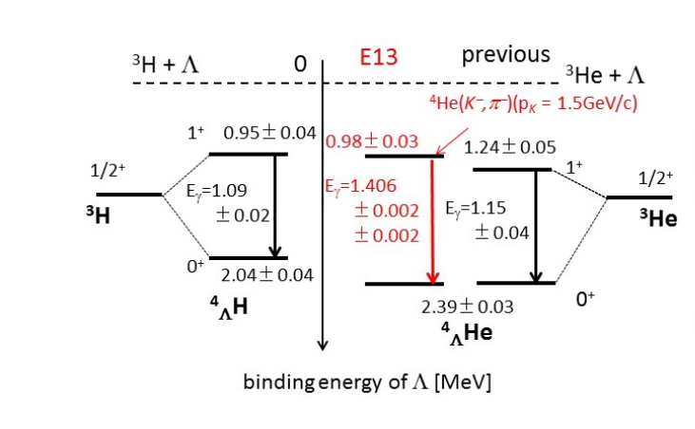
New data
Old data
T. O. Yamamoto, Phys. Rev. Lett.115, 2225 (2015).
M. Schafer et al., PRC106, L031001(2022)
Still it is difficult to reproduce the data for the study of CSB which is related to
ΛN-ΣN coupling. We need more data related to ΛN-ΣN coupling.

Slide 22
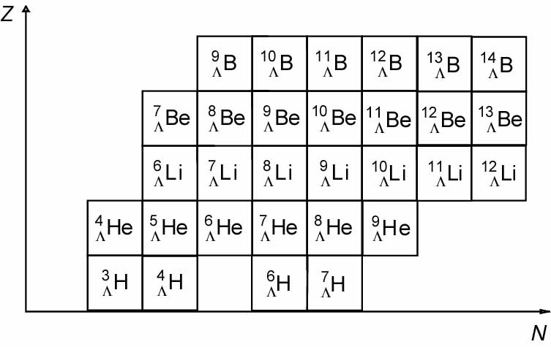
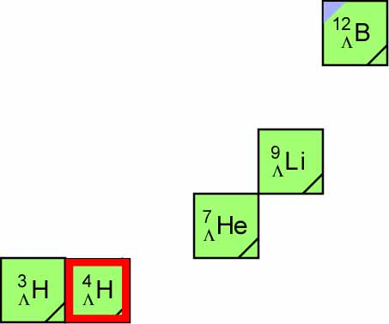
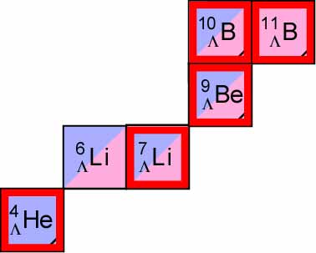
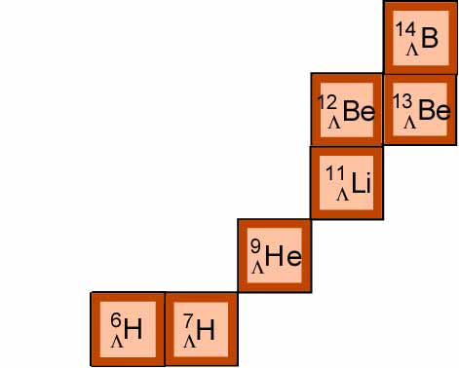
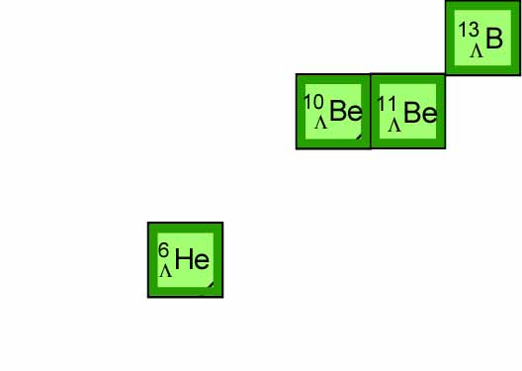

How do we obtain information on ΛN-ΣN coupling?
(1)YN scattering experiment at J-PARC
(2) To study neutron-rich Λ hypernuclei at J-PARC
difficult to obtain information on
ΛN-ΣN coupling
Total isosopin of core nuclei is small.
(K⁻, π⁻)
Z=N line
(π⁺ ,K⁺)
⁸ B
¹⁵B
^{Λ}
^{Λ}
Total isospin is larger.
ΛN-ΣN coupling give a great contribution
to binding energies of neutron-rich Λ
hypernuclei.
⁶Be
^{Λ}
(π⁻,K⁺)
⁵ Li
¹³Li
^{Λ}
^{Λ}
¹⁰He
¹¹He
^{Λ}
^{Λ}
Especially, He isotope is
important to obtain information
on ΛN-ΣN coupling, Because He
isotope Λ hypernuclei have been
observed. Among these Λ
hypernuclei, _{Λ}⁹He is planned to
produce in the future.
⁵H
⁸ H
^{Λ}
^{Λ}
These neutron-rich Λ hypernuclei are important.
Notes:
So, charge symmetry breaking effect is considered to come from interaction between Sigma and nucleon.

Slide 23
For ⁹_{Λ}He, there have been
no observed data.
To predict binding energy of
this hypernucleus, it is
necessary to reproduce the
energy spectra of core nucleus,
⁸He.
T. Myo and E. Hiyama,
Phys. Rev. C107, 054302(2023)
α+xn+Λ model
n
n
・・・
n
X=1～4
α
Λ
⁶_{Λ}He,⁷_{Λ}He,⁸_{Λ}He,⁹_{Λ}He
Cf. R. Wirth and R. Roth, Phys. Lett. B779, 336 (2019).: Non-core shell model+NN+NNN+YN
Since they did not focus on reproducing observed binding energies of hypernuclei and core nuclei,
it was difficult to predict the energy spectra of ⁹_{Λ}He.

Slide 24
Energy spectra of He Isotope core nuclei:
Λ
n
n
・・・
n
α
The theoretical results are in good agreement with data.
Let’s add a Λ particle into He isotope nuclei.

Slide 25
B_{Λ}=2.49MeV
+Λ
B_{Λ}=7.09MeV
In ⁹_{Λ}He, three bound states are predicted.
By (π⁻,K⁺) reaction at J-PARC using ⁹Be target, it is possible
to produce this hyperucleus.
This would be observation of the
most heavy He isotope Λ hypernucleus .

Slide 26
・YN scattering experiment
proposal:J-PARC-E90
Improvement of potentials
Chiral potential etc.
・YN interaction from view point of Ab-initio calculation such as
Lattice QCD
YN interaction by HAL QCD
It will be possible to employ
the interaction.
slide by T. Doi

Slide 27
S=-2 hypernuclei
and
YY interaction

Slide 28
What is the structure when one or more Λs are
added to a nucleus?
Λ
+
Λ
+
Λ
+
Λ
+ ・・・・
Λ
nucleus
It is conjectured that extreme limit, which includes
many Λs in nuclear matter, is the core of a neutron star.
In this meaning, the sector of S=-2 nuclei ,
double Λ hypernuclei and Ξ hypernuclei is
just the entrance to the multi-strangeness world.
However, we have hardly any knowledge of the YY interaction
because there exist no YY scattering data.
Then, in order to understand the YY interaction, it is crucial to
study the structure of double Λ hypernuclei and Ξ hypernuclei.

Slide 29
Before 2000
Only three double Λ hypernuclei
Λ
Λ
Λ
Λ
Λ
Λ
⁸Be
¹¹B
α
¹³B
⁶He
¹⁰Be
ΛΛ
ΛΛ
ΛΛ
Ambiguity for identifying these double Λ hypernuclei
There was NO observed double Λ hypernuclei
without ambiguity.

Slide 30
In 2001, the epoch-making data has been reported by the
KEK-E373 experiment.
Observation of ⁶He
ΛΛ
Uniquely identified without
Ambiguity for the first time
α+Λ+Λ
Λ
Λ
６．９1±0.16 MeV
α
0⁺

Slide 31
Strategy of how to determine YY interaction from the study of light hypernuclear structure
YY interaction
Nijmegen model D
①
use
③
Suggest reducing the strength of
spin-independent force by half
⁶He
ΛΛ
Accurate structure calculation
Λ
Λ
α
②
compare between the theoretical result
and the experimental data of the biding
energy of ⁶He
prediction of new
double Λ hypernuclei
④
ΛΛ
Spectroscopic experiments
Emulsion experiment (KEK-E373)
by Nakazawa and his collaborators

Slide 32
・E07
“Systematic Study of double strangness systems at J-PARC”
by Nakazawa and his collaborators(done in 2018)
It is difficult to determine
(1) spin-parity
(2) whether the observed state is
the ground state or an excited state
My theoretical contribution
using few-body calculation
comparison
Emulsion experiment
Theoretical calculation
input: ΛΛ interaction to reproduce
the observed binding energy of ⁶He
ΛΛ
the identification of the state

Slide 33
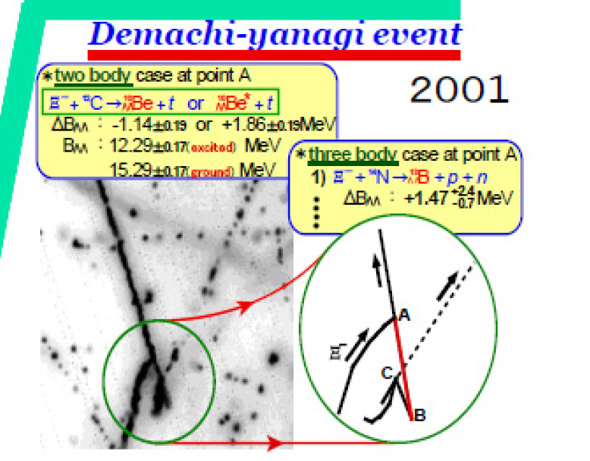
Successful example to determine spin-parity of
double Λ hypernucleus --- Demachi-Yanagi event for ¹⁰Be
ΛΛ
Observation of ¹⁰Be
--- KEK-E373 experiment
ΛΛ
Λ
Λ
⁸Be+Λ+Λ
α
α
11.90±0.13 MeV
¹⁰Be
ground state ?
excited state ?
ΛΛ
¹⁰Be
ΛΛ
Demachi-Yanagi event

Slide 34
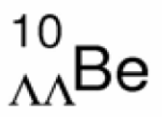
Successful interpretation of spin-parity of
Λ
Λ
α
α
E. Hiyama, M. Kamimura,T.Motoba, T. Yamada and Y. Yamamoto
Phys. Rev. 66 (2002) , 024007
11.83
11.90
α+Λ+Λ
6.91 ±0.16 MeV
Λ
Λ
Demachi-Yanagi
event
-14.70
α

Slide 35
Spectroscopy of ΛΛ-hypernuclei
E. Hiyama, M. Kamimura,T.Motoba, T. Yamada and Y. Yamamoto
Phys. Rev. 66 (2002) , 024007
New data:
-20.64 MeV
I have been looking forward to having
new data in this mass-number region.
H. Ekawa et al.
PTEP 2019, 021D02
(2019)

Slide 36
Ξ hypernuclei

Slide 37
Ξ⁻
core
nucleus
For the study of ΞN interaction, it is important to study
the structure of Ξ hypernuclei.
However, so far there was no observed Ξ hypernucleus.
Therefore, we do not know that ΞN interaction is attractive or repulsive.
If we observe Ξ hypernuclei as bound states, we understand ΞN interaction should be attractive. Thus, we have been searching bound Ξ hypernclei experimentally.

Slide 38
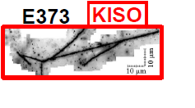
The first measurement of bound Ξ hypernucleus,
¹⁴N-Ξ.
¹⁴N-Ξ-
0 MeV
-1.03 ± 0.18 MeV
or
-3.87 ± 0.21 MeV
Ξ⁻
¹⁴N
We understood Ξ-nuclear
potential should be attractive.

Slide 39
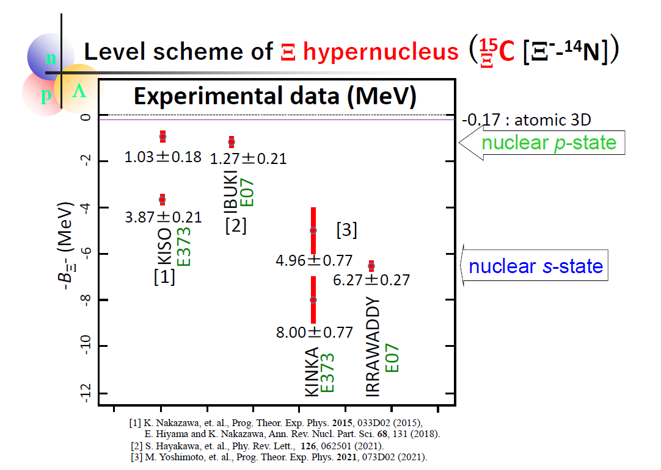
Slide by Nakazawa
After observation of Kiso event, they observed several
events of ¹⁴N-Ξ hypernucleus.
Some are observed as excited state and
some are observed as ground state.

Slide 40
V_{ΞN} = V₀ + σ・σ V_{σ・σ} ＋ τ・τ V_{τ・τ}＋ (σ・σ)(τ・τ) V_{σ・σ τ・τ}
¹⁵_{Ξ}C
By observation of ¹⁵_{Ξ}C(¹⁴N-Ξ), we find that V_{ΞN} itself is attractive.
α
α
Ξ⁻
Because,
All of the terms contribute to binding energy of ¹⁵_{Ξ}C (¹⁴N is not spin-, isospin- saturated).
α
d
Next,
we want to know desirable strength of V_{0,} the spin-,isospin-independent term.

Slide 41
V_{ΞN} = V₀ + σ・σ V_{σ・σ} ＋ τ・τ V_{τ・τ}＋ (σ・σ)(τ・τ) V_{σ・σ τ・τ}
In order to obtain useful information about V₀,
the following systems are suited, because
the (σ・σ), (τ・τ) and
(σ・σ) (τ・τ) terms of
V_{ΞN} vanish
by folding them
into the α-cluster
wave function that are
spin-, isospin-satulated.
Ξ⁻
Ξ⁻
α
α
α
problem : there is NO target to produce them
by the (K⁻, K⁺) experiment .
Because, ・・・

Slide 42
To produce αΞ⁻ and ααΞ⁻ systems by (K⁻, K⁺) reaction,
target
K⁺
K⁻
These systems
are unbound.
Then, we
cannot use them as targets.
p
Ξ⁻
α
α
⁵H
⁵Li
Ξ-
K⁺
K⁻
p
Ξ⁻
α
α
α
α
⁹B
⁹Li
Ξ-

Slide 43
As the second best candidates to extract information about the spin-, isospin-independent term V₀, we propose to perform…
K⁺
K⁻
p
n
Ξ⁻
n
α
n
α
n
⁷Li (T=1/2)
⁷H
(T=3/2)
Ξ⁻
Why they are suited
for investigating V₀?

Slide 44
(more realistic
illustration)
Core nucleus ⁶He is known to be halo
nucleus. Then, valence neutrons are located
far away from α particle.
n
n
α
Ξ⁻
Valence neutrons are located in p-orbit,
whereas Ξparticle is located in 0s-orbit.
Then, distance between Ξ and n
is much larger than the interaction range of
Ξ and n.
n
Ξ⁻
⁷H
(T=3/2)
Ξ⁻
Then, αΞ potential, in which only V₀ term
works, plays a dominant role in the binding
energies of this system.

Slide 45
Before the experiments will be done,
we should predict whether this
hypernucleus will be observed as
bound states or not.
Namely, we calculate the binding energies of this hypernucleus.
Ξ
Ξ⁻
n
α
n
⁷H
(T=3/2)
Ξ⁻

Slide 46
ΞN interaction
・ESC04 (Nijmegen soft core) and ND (Nijmegen Model D)
HAL potential (based on Lattice QCD)
V_{ΞN}=V₀(r)+(σ_{Ξ}・σ_{N})V_{s}(r)+(τ_{Ξ}・τ_{N})V_{t}(r)+（σ_{Ξ}・σ_{N})(τ_{Ξ}・τ_{N})V_{ts}(r)
All terms are central parts only.

Slide 47
Property of the spin- and isospin-components of ESC04, ND,HAL
V(T,S)
ESC04
ND
HAL
T=0, S=1 strongly attractive
T=0, S=0
weakly attractive
T=1, S=1
T=1, S=0
Weakly attractive
(a bound state)
weakly repulsive
Strongly attractive
weakly attractive
Weakly attractive
weakly repulsive
Weakly repulsive
Although the spin- and isospin-components of these models are
very different (due to the different meson contributions),
we find that the spin- and isospin-averaged property,
V₀ = [ V(0,0) + 3V(0,1) + 3V(1,0) + 9V(1,1) ] / 16,
namely, strength of the V₀- term is similar to each other.

Slide 48
4-body calculation of
⁷H
E. Hiyama et al.,
PRC78 (2008) 054316
Ξ⁻
ESC04
MeV
ND
α+ n + n + Ξ⁻
HAL
1.71
MeV
α+ n + n + Ξ⁻
MeV
0.96
α+ n + n + Ξ⁻
0.75
⁶He + Ξ⁻
1.00
0.39
(αΞ⁻ ) + n + n
0.0
0.0
⁶He + Ξ⁻
(αΞ⁻ ) + n + n
⁶He + Ξ⁻
0.04
0.0
(αΞ⁻ ) + n + n
-1.35
1/2⁺
-1.56
1/2⁺
⁷H
-2.80
1/2⁺
⁷H
Ξ⁻
⁷H
Ξ⁻
Ξ⁻
n
Ξ⁻
Similar binding
energies using ND and
ESC04.
In experiments,
we can expect
a bound state.
α
n

Slide 49
T
S
V₀ = [ V(0,0) + 3V(0,1) + 3V(1,0) + 9V(1,1) ] / 16,
which partial contribution makes attractive for V₀ ?
ΞN interaction: T=0, S=0
T=0, S=1
T=1, S=0
T=1, S=1
Ξ
N
t=1/2
S=1/2
t=1/2
S=1/2
we have a two-body bound state for ΞN system?
No idea
Cf. NN interaction
N
N
T=0, S=0,l=odd
T=0, S=1
T=1, S=0
T=1,S=1,l=odd
strong attraction to have a bound state
as a deuteron

Slide 50
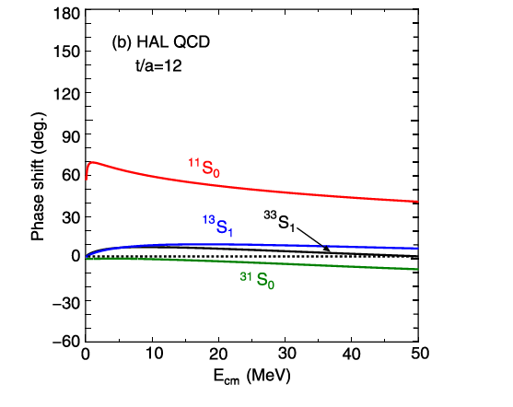
Property of the spin- and isospin-components of HAL
V(T,S)
HAL
T=0, S=1(¹³S₁)
T=0, S=0 (¹¹S₀)
T=1, S=1 (³³S₁)
T=1, S=0(³¹S₀)
Weakly attractive
Strongly attractive
Weakly attractive
Weakly repulsive

Slide 51
To investigate bound state of ΞN system, it might be
possible to perform the following experiment:
n
n
T=1, S=0 or S=1
K⁻
K⁺
p
Ξ⁻
It would be difficult to obtain information on ΞN interaction (T=1,S=0 or 1).
Because, there might be no bound state for this system.

Slide 52
To obtain ΞN two-body interaction,
the suited systems to study are s-shell Ξ hypernuclei such as
NNΞ and NNNΞ systems.
E. Hiyama et al., PRL124, 092501 (2020)
N
N
N
N
Ξ
Ξ
N
I show my results of these light systems.
NN interaction: AV8 potential
ΞN interaction :
Nijimegen extended soft core potential (ESC08c)
Realistic potential (only ΞN channel)
ΞN interaction by HAL collaboration (Lattice QCD calculation)
The potential was made by K. Sasaki, Miyamoto, Hatsuda
and Aoki.

Slide 53
N
N
T=1/2, J=1/2⁺ and J=3/2⁺
Ξ
ESC08c
Unbound
0 MeV
d+ Ξ
d+ Ξ
0 MeV
J=1/2+
-2.57 MeV
J=3/2⁺

Slide 54
N
T=1/2, J=1/2⁺ and J=3/2⁺
N
Ξ
HAL potential
0 MeV
d+ Ξ
0 MeV
d+ Ξ
No bound state
J=3/2⁺
J=1/2+

Slide 55
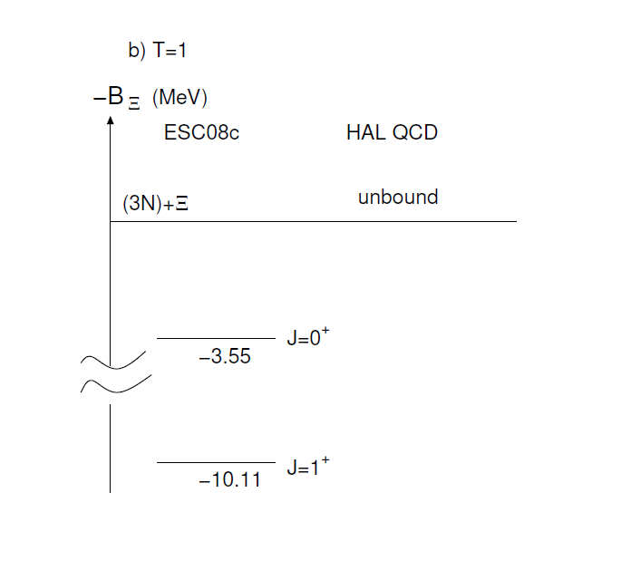
N
N
N
Ξ

Slide 56
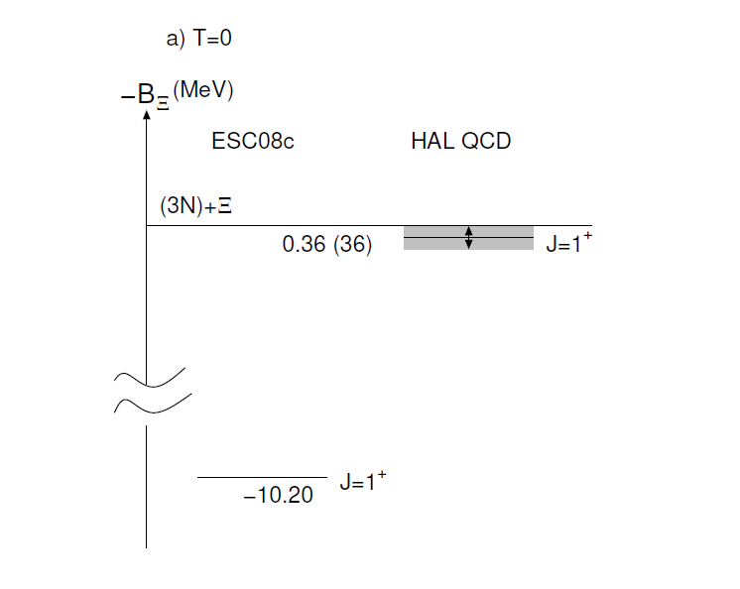
N
N
N
Ξ
H.Le et al., EPJA57, 339 (2021).
NNNΞ

Slide 57
K ⁺
T=1/2
^{K-}
Using ³He and ⁴He target,
It might be possible
to produce NNΞ and NNNΞ
systems by (K⁻,K⁺) reaction.
Another tool is to use
Heavy ion collision.
n
p
n
p
p
Ξ-
³He
K ⁺
K ⁻
In the future,
we hope to observe
these light Ξ hypernuclei.
n
n
p
p
n
Ξ
n
p
⁴He
T=1

Slide 58
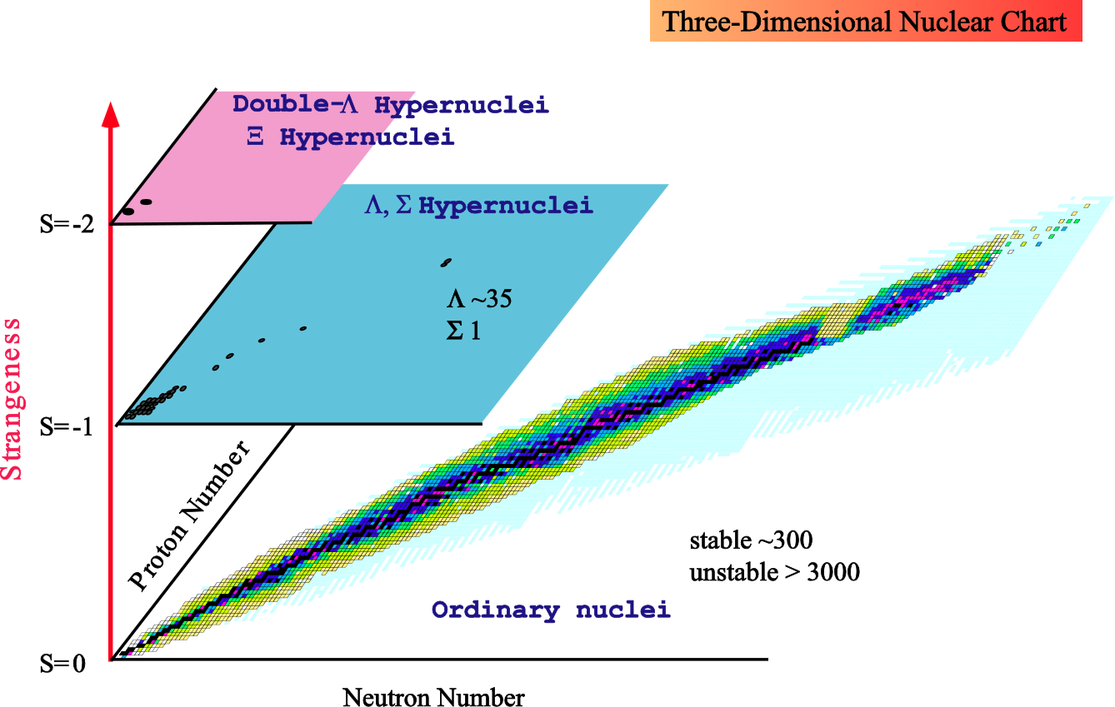
Concluding remark
Multi-strangeness system
such as Neutron star
J-PARC
ALLICE
GSI
JLab
J-PARC

Slide 59
Thank you

Slide 60
K⁺
K⁻
p
n
Ξ⁻
n
Λ
Λ
n
n
p
α
n
n
V _{ΛΛーΞN}
p
n
n
n
n
p
⁷Li (T=1/2)
⁵_{ΛΛ}H
⁷H
Ξ⁻
Weak decay
Λ
p
p
＋ π⁻
n
n
⁵_{Λ}He
J-PARC E-75 spokesperson: H. Fujioka (TIT)

Slide 61
4-body calculation of
⁷H
E. Hiyama et al.,
PRC78 (2008) 054316
Ξ⁻
ESC04
MeV
ND
α+ n + n + Ξ⁻
HAL
1.71
MeV
α+ n + n + Ξ⁻
MeV
0.96
α+ n + n + Ξ⁻
0.75
⁶He + Ξ⁻
1.00
0.39
(αΞ⁻ ) + n + n
0.0
0.0
⁶He + Ξ⁻
(αΞ⁻ ) + n + n
⁶He + Ξ⁻
0.04
0.0
(αΞ⁻ ) + n + n
-1.35
1/2⁺
1/2⁺
-1.56
Γ=0.27MeV
Γ=2.64MeV
-2.80
Γ=0.03 MeV
⁷H
1/2⁺
⁷H
Ξ⁻
⁷H
Ξ⁻
Ξ⁻
n
Ξ⁻
Similar binding
energies using ND and
ESC04.
α
In experiments,
we can expect
a bound state.
n
However, decay width is dependent on
on employed ΞN potential

Slide 62
Ξ⁻
N
Ξ⁻
N
T=1, S=0 or S=1
α
α
α
We can add a α or two α_{s}.
Due to the attraction of αΞ and αN interactions,
ΞN system might have bound system.

Slide 63
Ξ
n
This Ξ hypernucleus
is suited for study of spin-isospin
ΞN interaction.
α
α

Slide 64
n
Ξ
α+α+n
Ξ
(0s)
S=1
α
α
3/2⁻
σ_{n}・σ_{Ξ}
2⁻
n
n
1⁻
Ξ
α
α
⁹Be
α
T=1 or T=0
S=0
α

Slide 65
From the level structure of A=10 Ξ hypernuclei, we obtain information on spin- isospin parts of ΞN interaction.
Level ordering is important.

Slide 66
To obtain information on two-body partial wave contribution,
it is useful to employ ¹⁰B target.
K⁻
K⁺
p
n
Ξ
n
¹⁰B
T=1
α
α
α
α
K⁻
K⁰
p
n
Ξ
n
¹⁰B
T=0
α
α
α
α

Slide 67
Strategy of how to solve ‘hyperon puzzle’ together with
Theory and experiment using K1.1 and HIHR

Slide 68



International network is important.
My collaborators
Brazil: M. Yamashita(Sao Paulo)
Japan: M.Isaka(Hosei), H. Sagawa(Aizu),M. Kimura(Hokkaido)
T. Doi(RIKEN),T. Hatsuda(RIKEN),T. Myo(Osaka),
M. Oka(JAEA),K. Sasaki(Kyoto),
Y. Tanimura(Tohoku),T. Motoba(Osaka),
Y. Yamamoto(Tsuru),
T. Yamada(Kanto), Y. Funaki(Kanto),
A. Umeya(Nihon)
Korea: H-C. Kim(Inha), Y. Oh(Kyunpook)
M.Choeun(Soongsil),C. Ho(Daegu)
China: S-G Zhou(CAS), L. Geng(Beihang),X-R.Zhou(Shaighai),
Q.Meng(Nanjing), J. Hu(Nankai), Y. Zhang(Tenjing),
T.Sun(Zhenzhou)
south Africa: E. F. Meoto(Univ. of South Africa)
USA: B.F.Gibson(LANL), J.Stone(ONL)
Indonessia：.T. Mart(Indonessia)
Italy: H-J. Schulze, I.Vidana(Catania)
Germany:W. Weise (TUM), J.Haidenbauer(Juelich)
France: J.Carbonell(Saclay),
R. Lazauskas(Strasburg)
Netherland:Th. Rijken(Nijmegen)
Czech: P. Byzovsky(CAS)

Slide 69
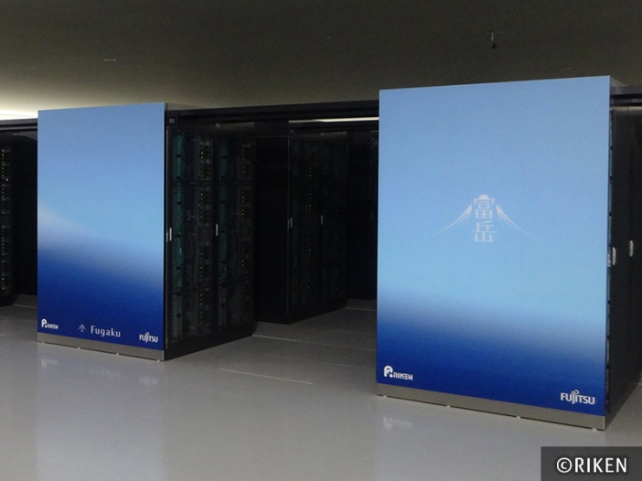
YN scattering experiment (K1.1)
Femtoscopic experiment
Realistic YN interaction
Chiral effective field theory (J. Haidenbauer, L. Geng),
Nijmegen:meson-exchange potential (Th.A. Rijken)
Lattice QCD (T. Doi, K. Sasaki etc.)
+
Fugaku
supercomputer
Ab- initio calculation: No-core shell model calculation(R. Worth etc.)
Self-consistent Green’s function method(C. Barbieri)
Gaussian Expansion Method(E. Hiyama)
comparison
Data on s-shell Λ hypernuclei
and light neutron-rich Λ hypernuclei
at HIHR (better than 100 keV accuracy)
Determination of YN interaction

Slide 70
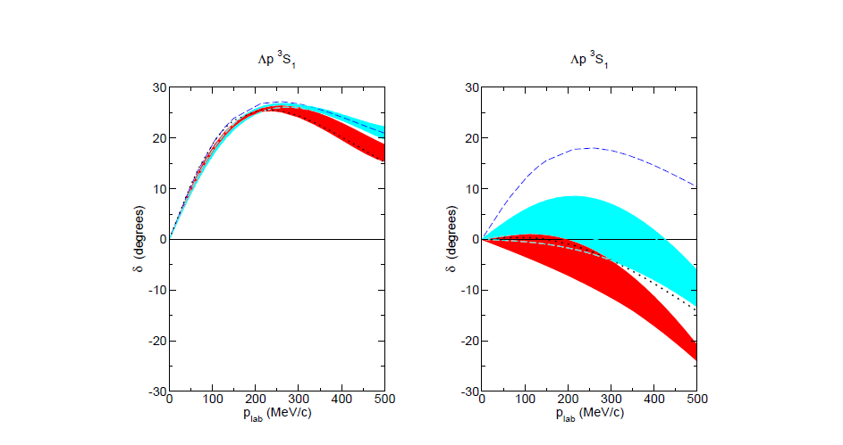
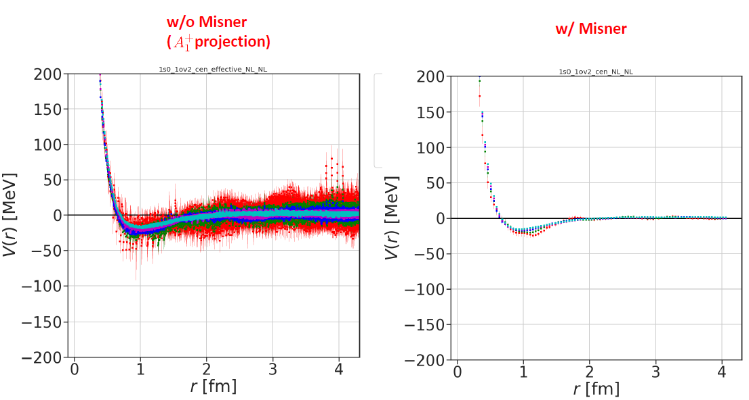
Current situation
HAL potential (based on Lattice QCD)
Two-body interaction
ΛN effective potential
¹S₀
m_{π}=146MeV
Chiral 2019
given by Takahiro Doi
at Lattice21 symposium
Chiral 2013
Phase shift with ΛN-ΣN
coupling
Phase shift without
ΛN-ΣN couping
Chiral YN interaction (2013,2019):
still, we have a large degree of ambiguity for
ΛN-ΣN coupling.

Slide 71
YN scattering experiment (K1.1)
Femtoscopic experiment
Realistic YN interaction
Chiral effective field theory (J. Haidenbauer, L. Geng),
Nijmegen:meson-exchange potential (Th.A. Rijken)
Lattice QCD (T. Doi, K. Sasaki etc.)
+
Fugaku
supercomputer
Ab- initio calculation: No-core shell model calculation(R. Worth etc.)
Faddeev method(A. Nogga, R. Lazauskas etc)
Gaussian Expansion Method(E. Hiyama)
comparison
Data on s-shell Λ hypernuclei
and light neutron-rich Λ hypernuclei
at HIHR (better than 100 keV accuracy)
Determination of YN interaction

Slide 72
Current situation
Ab-initio calculation
Faddeev method: up to 4-body calculation
Gaussian Expansion method: up to 5-body calculation
Non-core shell model calculation: up to 13-body calculation
By development of
Supercomputer,
It is possible to
extend the method
to more than
10-body calculation.

Slide 73
Heavy Λ hyperclei (Pb, Sn, Zr, La, Y ・・・) at HIHR
Relativistic mean field theory(J. Hu, Y. Zhang, S-G. Zhou, T. Sun, H. Sagawa etc.)
Skyme Hartree Fock theory(X-R. Zhou)
Brueckner-Hartree-Fock(H-J. Schulze, I. Vidana)
AMD calculation (M. Isaka)
+
Effective YN interaction +ΛNN three-body interaction
Provide energy spectra with
better than 100 keV accuracy at HIHR
Determination of short-range part of
ΛNN interaction
Realistic two-body interaction +ΛNN three-body interaction
Coupled-cluster calculation (Togashi)
Brueckner-Hartree-Fock (Schlze,Vidina)
Reliable EOS

Slide 74
At the same time, another important issue is to explore interesting phenomena in Λ hypernuclei.
No Pauli principle
Between N and Λ
Λ particle can reach
deep inside, and
attract the
surrounding nucleons
towards the interior
of the nucleus.
Hypernucleus
Λ
Λ particle behaves as ‘impurity’ in nuclei.
Especially, in heavy Λ hypernuclei, it is expected that
there are many interesting phenomena .
・nuclear density is different in states.
・clustering, shell structure
・linear chain state in high excited state
・super-deformed states

Slide 75
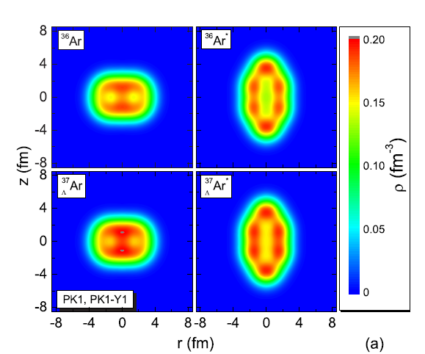
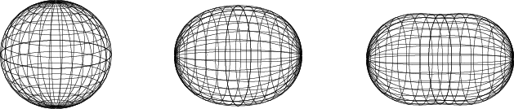
For example:
ground state
excited state(super-deformed state)
Λ
Λ
spherical
Normal deformed (ND)
Super-deformed
(SD)
Super-deformed shape is related to the
appearance of a large shell gap at a 2:1
axis ratio of the nuclear deformation for
Specific numbers.
B-N. Lu, E. Hiyama,
H. Sagawa, S-G. Zhou, PRC89,
044307(2014).
We can see ring-shape structure
more clearly by the addition of
Λ particle.
Once we have a lot of data on heavy Λ hypernuclei, we can explore interesting phenomena
in Λ hypernuclei.
Wait for many data of heavy Λ hypernuclei at HIHR

Slide 76
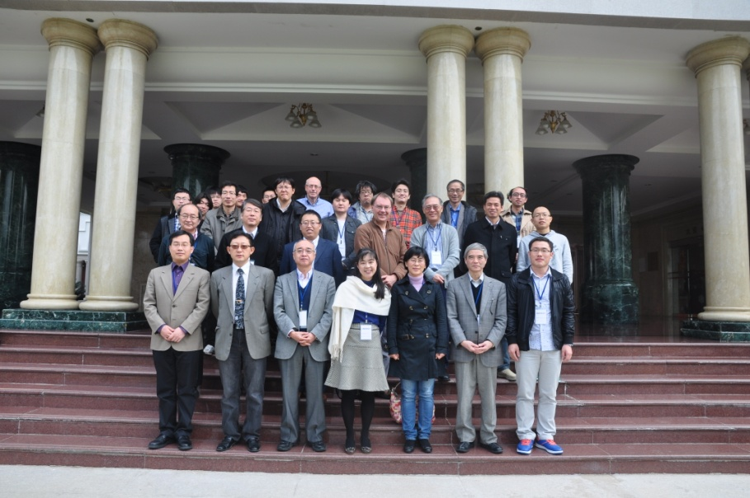
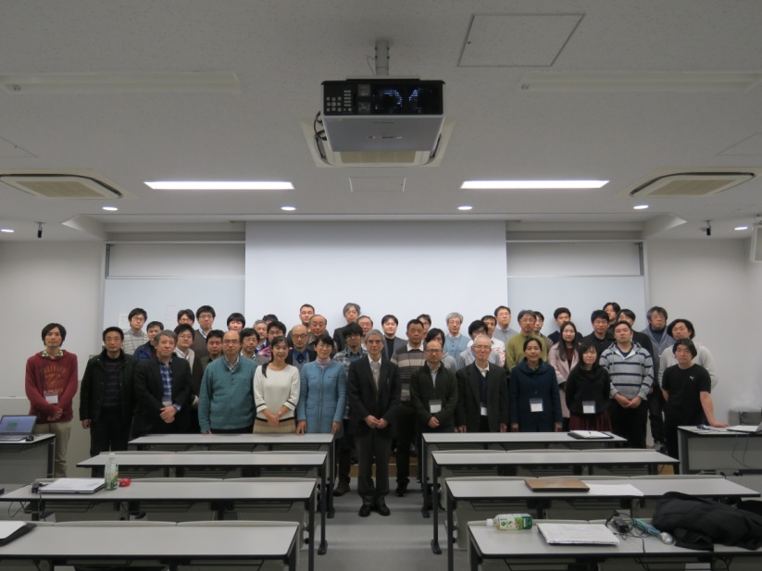
Chinese theorists are quite interested in hypernuclear physics from
view point of mean field theory.
To stimulate the Chinese researchers furthermore, I organized strangeness nuclear physics
workshop in China and Japan.
SNP workshop, Osaka, Japan, 2017
SNP workshop, Changsha,China, 2014
SNP workshop, Xiamen, China, 2013
SNP workshop, Xiamen, China, 2013
SNP workshop, Osaka, 2017

Slide 77
Next SNP workshop (online)
・International workshop on Strangeness nuclear physics
--- future prospect using K1.1 and HIHR new beam line at J-PARC
Dec. 18,19, 2021
Chair: J. Hu (Nankai, China), E. Hiyama(Tohoku/RIKEN)
To encourage PhD students:
・Domestic workshop on Strangeness nuclear physics
Sep. 21-23, 2021 : Hybrid-style(Online+onsite) at Aobayama science hall

Slide 78
International network is important.
My collaborators
Brazil: M. Yamashita(Sao Paulo)
Japan: M.Isaka(Hosei), H. Sagawa(Aizu),M. Kimura(Hokkaido)
T. Doi(RIKEN),T. Hatsuda(RIKEN),T. Myo(Osaka),
M. Oka(JAEA),K. Sasaki(Kyoto),
Y. Tanimura(Tohoku),T. Motoba(Osaka),
Y. Yamamoto(Tsuru),
T. Yamada(Kanto), Y. Funaki(Kanto),
A. Umeya(Nihon)
Korea: H-C. Kim(Inha), Y. Oh(Kyunpook)
M.Choeun(Soongsil),C. Ho(Daegu)
China: S-G Zhou(CAS), L. Geng(Beihang),X-R.Zhou(Shaighai),
Q.Meng(Nanjing), J. Hu(Nankai), Y. Zhang(Tenjing),
T.Sun(Zhenzhou)
South Africa: E. F. Meoto(Univ. of South Africa)
USA: B.F.Gibson(LANL), J.Stone(ONL)
Indonessia：T. Mart (Indonessia)
Italy: H-J. Schulze, I.Vidana(Catania)
C. Barbieri(Milano)
Germany:W. Weise (TUM), J.Haidenbauer(Juelich)
Netherland:Th. Rijken(Nijmegen)
Czech: P. Byzovsky(CAS)
France: J.Carbonell(Saclay),
R. Lazauskas(Strasburg)

Slide 79
In this way, the binding energies of Ξ hypernuclei with
A=7 and 10 are dominated by αΞ potential, namely,
spin-, and iso-spin independent ΞN interaction（Ｖ₀）.
Then, to get information about this part, we propose to perform
the (K⁻,K⁺) experiment by using ⁷Li and ¹⁰B targets
At J-PARC.
Also next, it is interesting to know
which partial contribution makes attractive for V_{ΞN} ?

Slide 80
4-body calculation of
¹⁰Li
E. Hiyama et al.,
PRC78 (2008) 054316
⁻Ξ
ESC04d
ND
MeV
α+ α+ n +Ξ⁻
5.17
MeV
⁹Be + Ξ⁻
α+ α + n +Ξ⁻
3.60
2.86
⁹Be + Ξ⁻
1.32
0.0
(ααΞ⁻ ) + n
(ααΞ⁻ ) + n
0.0
-2.96
2⁻
-3.18
2⁻
Γ=0.75MeV
Γ=5.87MeV
Similar binding
energies using ND and
ESC04d.
¹⁰Li
¹⁰Li
Ξ⁻
Ξ⁻
Ξ⁻
n
Independent on employed
ΞN potential
In experiments,
we can expect
a bound state.
α
α
But, decay width is dependent on
employed ΞN interaction.

Slide 81
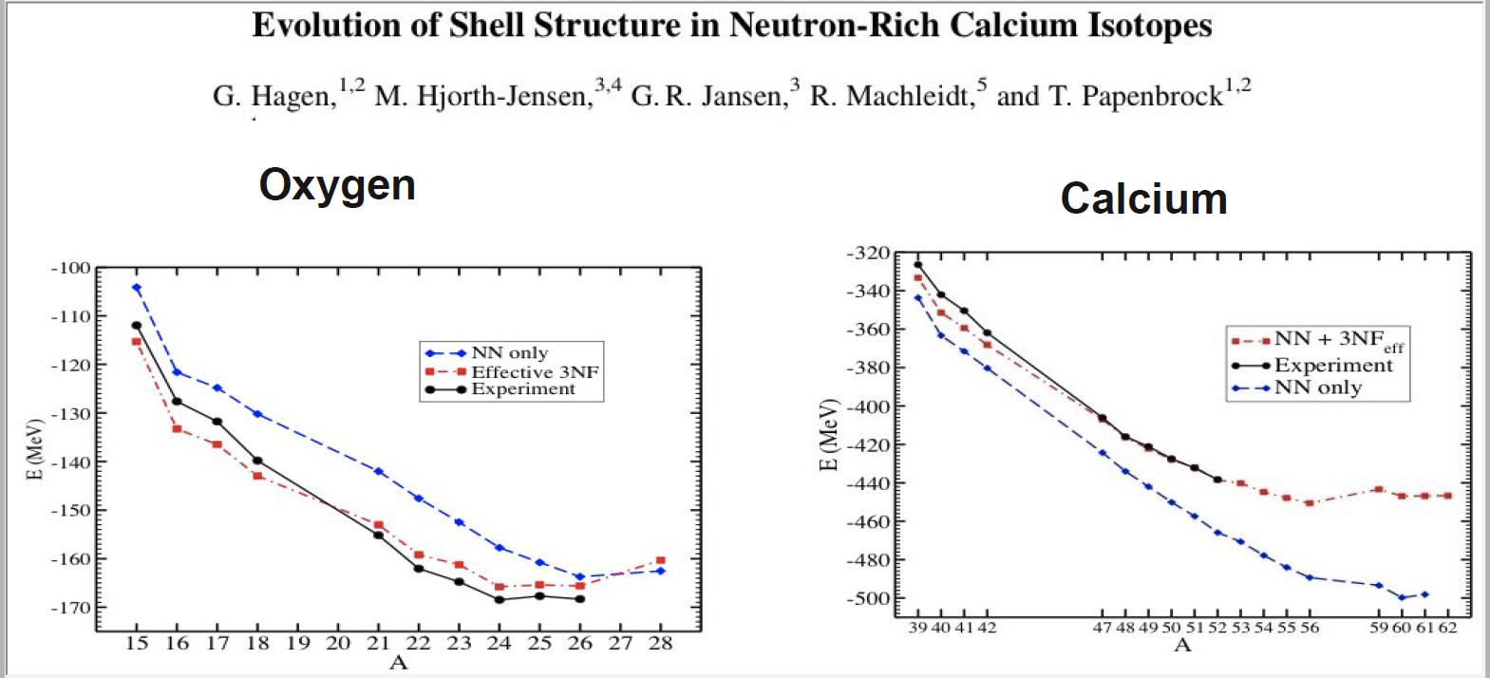
G. Hagen et al., PRL 109 (2012) 032502

Slide 82
0.89 MeV
3/2⁻
0MeV
α+Ξ+n
n
^{Ξ}
0 MeV
αn
（ΞN)+α
-1.56 MeV
α
J^{π}=3/2 ⁻
1⁻
?
n
What about level structure
of αΞN system using HAL
potential?
2⁻
σ_{N}・σ_{Ξ}
α
Ξ
S=1of ΞN is dominant
⁵He
0s_{1/2}
S=0 of ΞN system is dominant

Slide 83
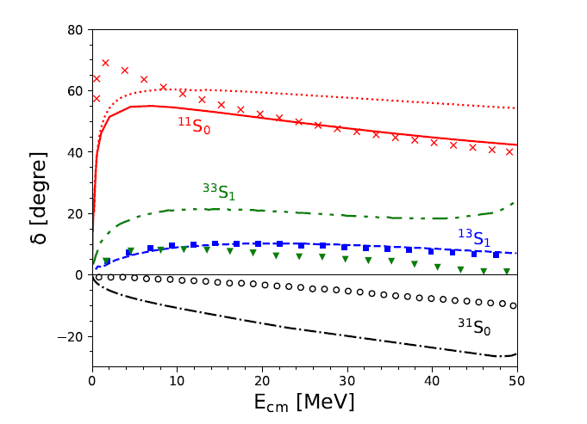
0MeV
α+Ξ+n
T=1,S=1
No bound
-1.22
（αΞ)+n
HAL
Attractions of T=1,S=1,
T=1,S=0 are not enough
to make bound states.
T=1
0MeV
α+Ξ+n
（αΞ)+n
-1.22
2⁻
-1.47 MeV
If we use ³³S₁
information based
on chiral EFT potential,
We have a bound
state in 2⁻.
H. Le, et al., EPJA57,339(2021)
Chiral EFT ΞN interaction.

Slide 84
K⁻
K⁺
n
T=1,S=0 or S=1
p
Ξ⁻
n
α
α
Experimentally,
It is possible to
produce Ξ hypernucleus.
⁶Li
0MeV
α+Ξ+n
0MeV
α+Ξ+n
（αΞ)+n
No bound
-1.22
-1.22
2⁻
（αΞ)+n
-1.47 MeV
HAL
Chiral EFT
Bound state is dependent on ΞN potential employed. Then, it would be risky
to use ⁶Li target by (K⁻,K⁺) reaction.

Slide 85
K⁰
K⁻
N
N
Ξ
N
T=0,S=0 or S=1
α
We can obtain
information on
T=0, S=0 and S=1
ΞN interaction.
α
⁶Li
0MeV
α+Ξ+n
（αΞ)+n
-0.31
J=1⁻
E=-0.40, Γ=0.01
T=0,S=0 of ΞN
interaction
dominant
HAL
T=0
Currently, (K⁻,K⁰) reaction would be
difficult experiment. Then, it might be risky to use ⁶Li target.

Slide 86
To extract ΞN interaction, we need deeper binding energy.
α
N
^{Ξ}
α
We can add one more α particle.

Slide 87
In 2001, the epoch-making data
has been reported by the
KEK-E373 experiment.
Observation of ⁶He
ΛΛ
Uniquely identified without ambiguity
for the first time
Λ
Λ
α+Λ+Λ
α
６．９1±0.16 MeV
0⁺

Slide 88
Strategy of how to determine YY interaction from the study of light hypernuclear structure
YY interaction
Nijmegen model D
Suggest reducing the strength of
spin-independent force by half
⁶He
①
use
③
ΛΛ
Λ
Λ
Accurate structure calculation
α
compare between the theoretical result
and the experimental data of the biding
energy of ⁶He
②
prediction of new
double Λ hypernuclei
④
ΛΛ
Spectroscopic experiments
Emulsion experiment (KEK-E373)
by Nakazawa and his collaborators

Slide 89
Hoping to observe new double Λ hypernuclei in future
experiments, I predicted level structures of
these double Λ hypernuclei
within the framework of the α+x+Λ+Λ 4-body model.
E. Hiyama, M. Kamimura, T. Motoba, T.Yamada and Y. Yamamoto
Phys. Rev. C66, 024007 (2002)
Λ
Λ
x
=
t
³He
n
p
d
=
=
=
=
=
α
x
⁸Li
⁹Be
⁷He
⁷Li
⁸Li
ΛΛ
ΛΛ
ΛΛ
ΛΛ
ΛΛ

Slide 90
ΞN interaction
Only one experimental information about ΞN interaction
Y. Yamamoto, Gensikaku kenkyu 39, 23 (1996),
T. Fukuda et al. Phys. Rev. C58, 1306, (1998);
P.Khaustov et al., Phys. Rev. C61, 054603 (2000).
Well-depth of the potential between Ξ and ¹¹B: -14 MeV
Among all of the Nijmegen model,
ESC04 (Nijmegen soft core) and ND (Nijmegen Model D)
reproduce the experimental value.
OtherΞN interaction are repulsive or weak attractive.
We employ ESC04 and ND.
The properties of ESC04 and ND are quite different from each other.

Slide 91

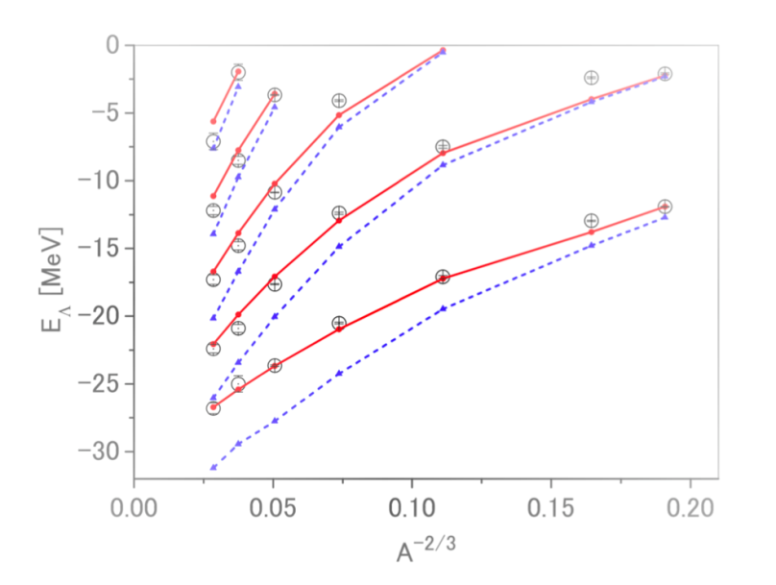
heavier Λ hypernuclei
For example: Pb, Sn, Zr, La, Y etc. Istopes
Λ
Density of heavier nuclei is high and then, Λ particle is acting
in such high dense matter.=> We could obtain information on
the short-range part of ΛNN interaction.
In heavier nuclei,
density becomes high.
²⁰⁸_{Λ}Pb, ¹³⁹_{Λ}La,⁸⁹_{Λ}Y: plan in the project at HIHR
Heavy Λ hypernuclei exp. + theoretical cal.
Isotope dependence of
ΛNN three-body force
Determine ΛNN interaction
Calc. by Nijmegen ESC16 model
g_{Λ}
f_{Λ}
d_{Λ}
p_{Λ}
Reliable EOS
s_{Λ}
w/ ΛN int. w/o ΛNN int.
ΛNN int
w/ ΛN int. w/ ΛNN int.

Slide 92
Our few-body caluclation method
Gaussian Expansion Method (GEM) , since 1987
,
・A variational method using Gaussian basis functions
・Take all the sets of Jacobi coordinates
Developed by Kyushu Univ. Group,
Kamimura and his collaborators.
Review article :
E. Hiyama, M. Kamimura and Y. Kino,
Prog. Part. Nucl. Phys. 51 (2003), 223.
High-precision calculations of various 3- and 4-body systems:
Exotic atoms / molecules ,
3- and 4-nucleon systems,
multi-cluster structure of light nuclei,
Light hypernuclei,
3-quark systems,

Slide 93
PRC 64, 044001(2001)
Benchmark-test calculation to solve the 4-nucleon bound state
7 different groups (18 co-authors)
⁴He
1. Faddeev-Yakubovski (Kamada et al.)
2. Gaussian Expansion Method
(Hiyama and Kamimura)
3. Stochastic varitional (Varga et al.)
4. Hyperspherical variational (Viviani et al.)
5. Green Function Variational Monte Carlo
(Carlson at al.)
6. Non-Core shell model (Navratil et al.)
7. Effective Interaction Hypershperical HarmonicsEIHH (Barnea et al.)
n
n
p
p
4-nucleon
bound state
NN: AV8’

Slide 94
Benchmark-test calculation of the 4-nucleon bound state
Good agreement among 7different methods
In the binding energy, r.m.s. radius and wavefunction density
GEM
ours
Congratulations!! I was very happy
Notes:
ours

