Slide 1
International School of Nuclear Physics
43rd Course: Neutrinos in Cosmology, in Astro-, Particle and Nuclear Physics
Erice, Sicily, 16 – 22 September 2022
Neutrino telescopes
Uli Katz
Erlangen Centre for Astroparticle Physics
Friedrich-Alexander University of Erlangen-Nürnberg
18 September 2022

Slide 2
The plan for the next 35+5 minutes
Motivation: Why build neutrino telescopes?
How do neutrino telescopes work?
Neutrino telescopes: from past to future
Selected results (IceCube & KM3NeT)
  Cosmic neutrinos and their sources
  Neutrino oscillations

Slide 3
Motivation –
Why bulid neutrino telescopes?

Slide 4
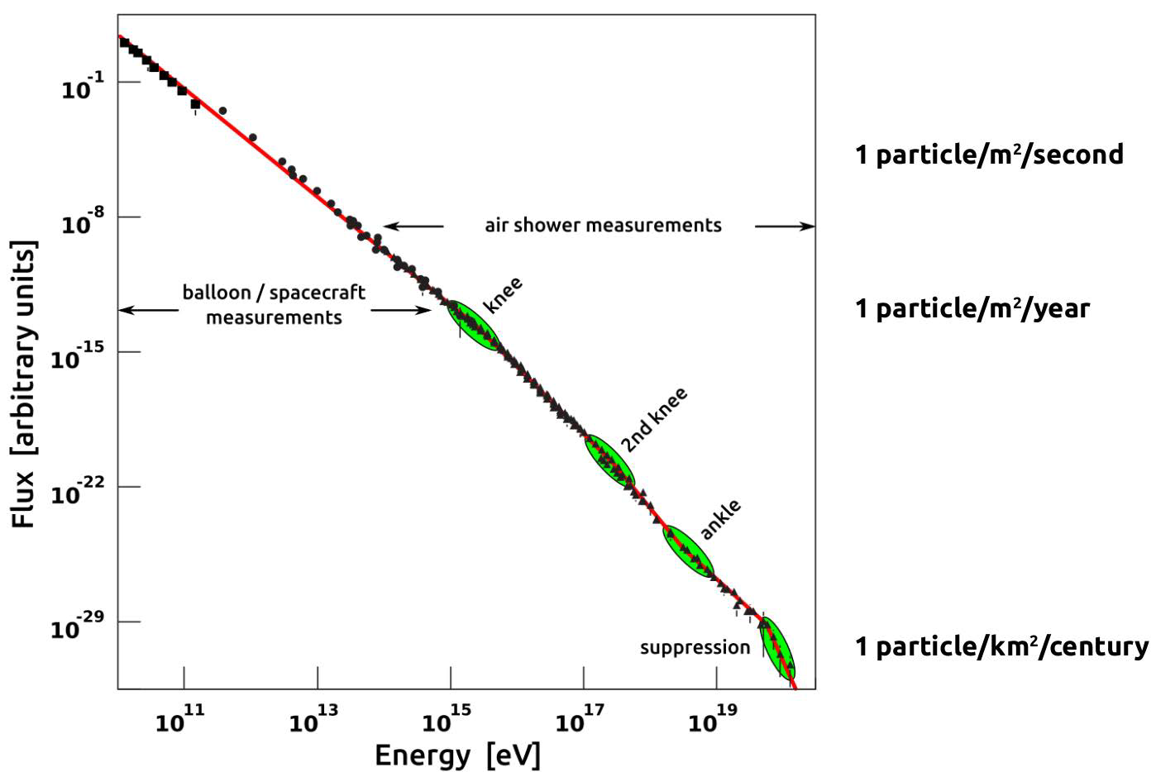
Cosmic rays and their energies
Power law with features
Non-thermal
LHC cms energy
LHC beam
Where from?
Chemical composition?
What causes suppression?
Transition galactic-extragalactic?

Slide 5
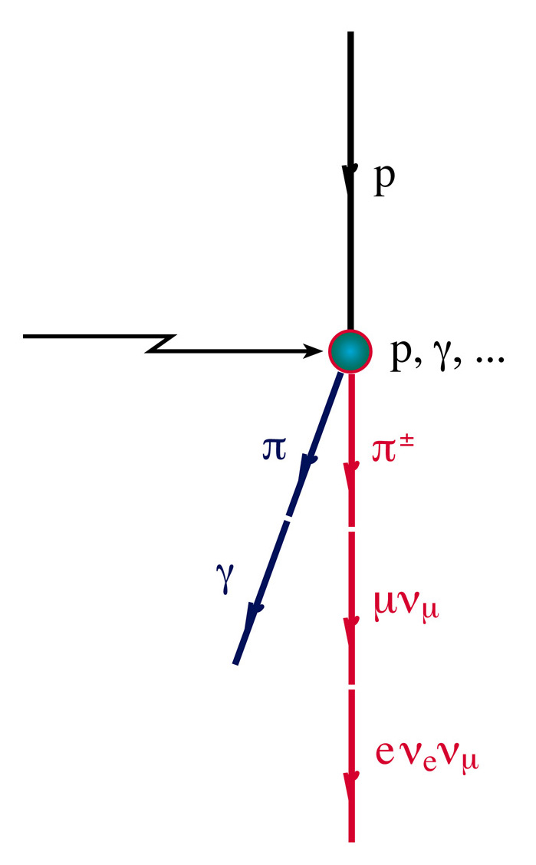
Neutrino production mechanism
Neutrinos are produced in the interaction of high energy nucleons with matter or radiation:
Cosmic rays
Simultaneously, gamma production takes place:
Cosmic rays
Cosmic ray acceleration yields neutrinos and gammas!
… but gammas also from purely leptonic processes

Slide 6
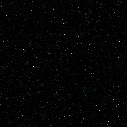
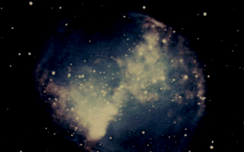

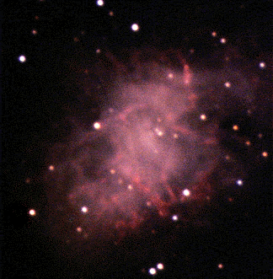
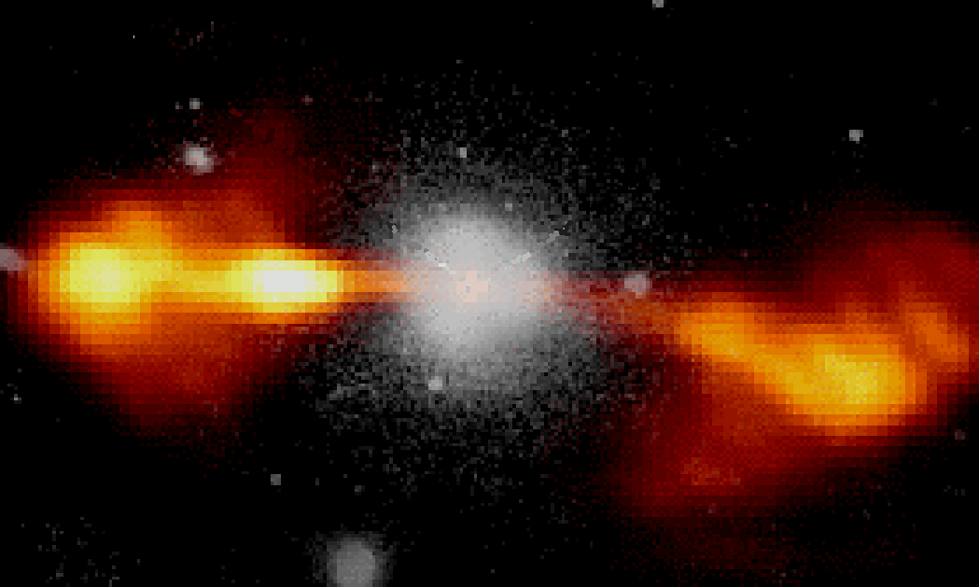
Particle propagation in the Universe
protons E>10¹⁹ eV (few 10 Mpc)
neutrinos
gammas (0.01 - 10 Mpc)
Cosmic accelerator
protons E<10¹⁹ eV
1 parsec (pc) = 3.26 light years (ly)
Photons: absorbed on dust and radiation;
Protons/nuclei: deviated by magnetic fields, reactions with radiation (CMB)

Slide 7
Different messengers → Multi-messenger
The exploration
of the high-energy
Universe requires
multi-messenger studies
including neutrinos!
→ Talk by Julia Tjus

Slide 8
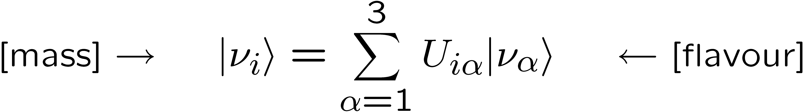
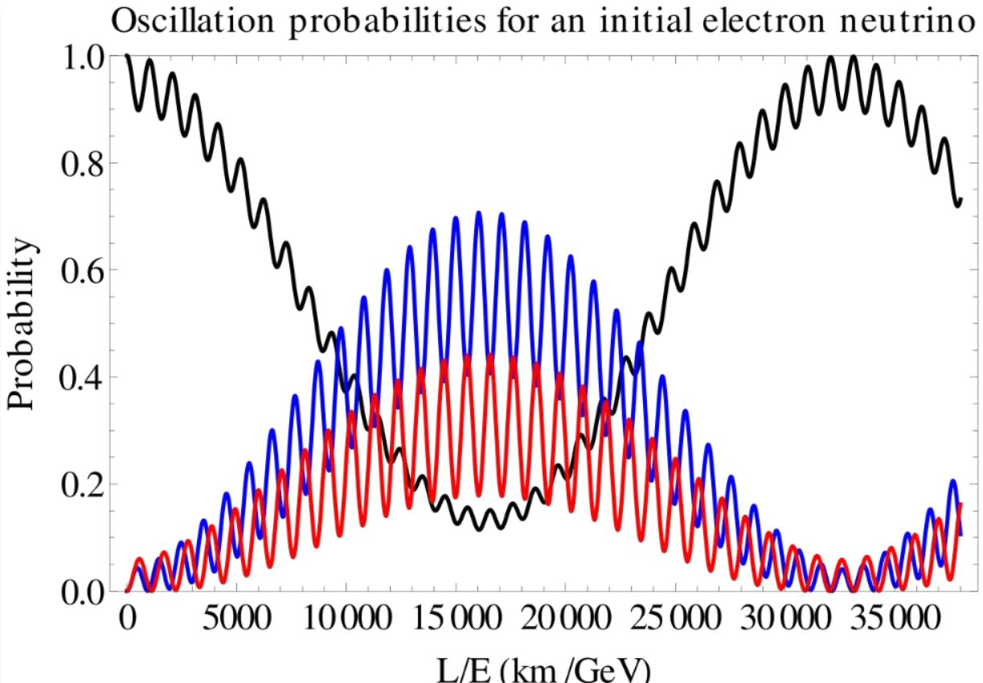
Neutrino oscillations
Neutrino flavour and mass eigenstates are not the same:
Fundamental process,
relevant for particle &
nuclear physics,
cosmology, …
Governed by
3 angles, 3 masses,
1 complex phase
Propagation through
matter modifies pattern
Neutrinos created in
atmosphere provide
laboratory for
neutrino oscillations
(propagation)
(production, reaction)

Slide 9
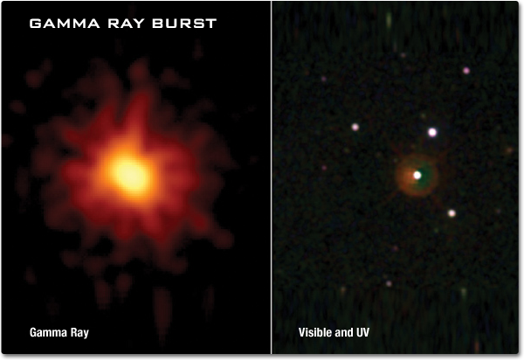
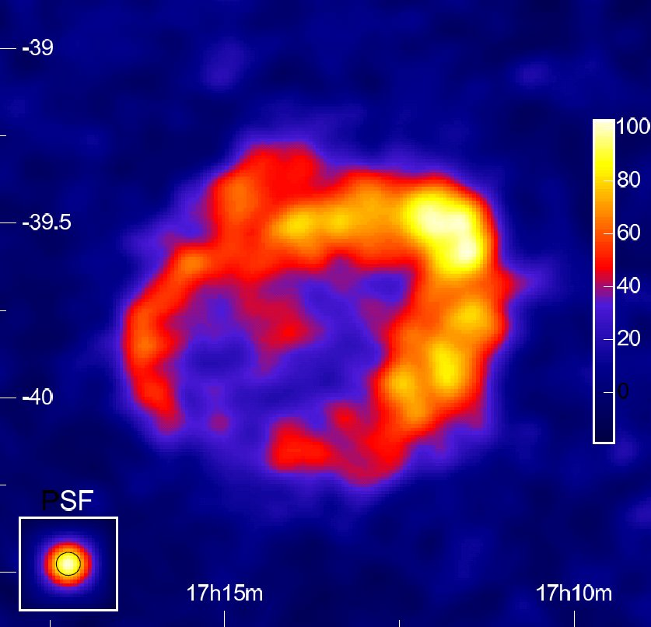
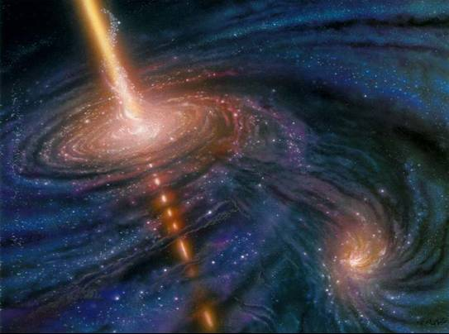
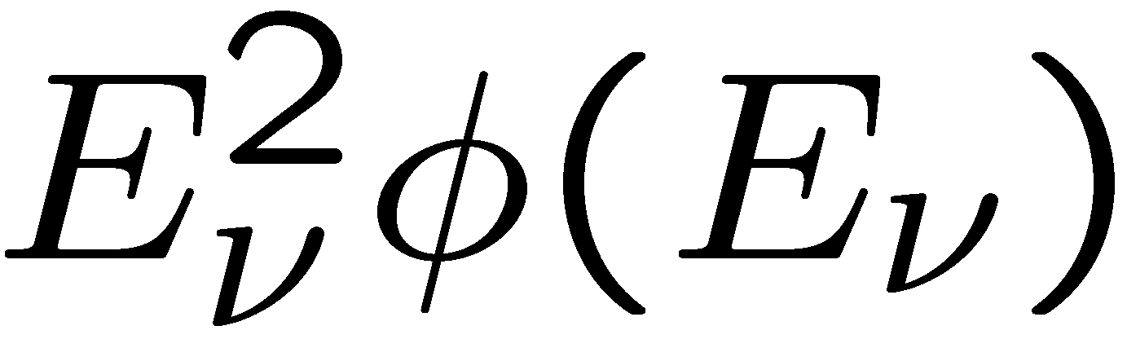

Example targets of ν astronomy
Galactic neutrino sources
Extragalactic sources
Transient sources
Diffuse neutrino flux
Neutrinos from Dark Matter
annihilations
Particle physics with
atmospheric neutrinos
Search for exotics
(monopoles, nuclearites,…)
Extremely bright gamma ray flash (sec-min)
from hypernovae or BH/NS mergers or …
Isotropic distribution → extragalactic
Active Galactic Nuclei (AGN):
Super-massive black hole in centre of galaxy
with accretion disk and jet emission
Isotropic high-energy neutrino flux
above atmospheric neutrino background
from unresolved astrophysical sources
or of cosmogenic origin (GZK)
Example: Supernova remnant RX J1713
Gamma observation by H.E.S.S.

Slide 10
How do neutrino telescopes work?

Slide 11
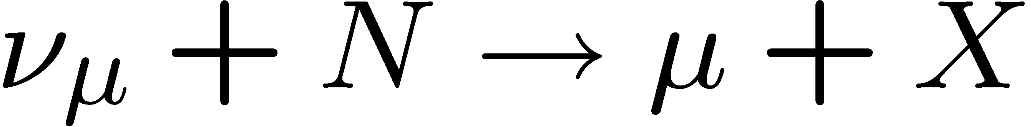
How does a neutrino telescope work?
Neutrino interacts in the
(vicinity of the) telescope
Charged secondary particles cross the detector volume (water or ice) and induce Cherenkov emission
Recorded by a 3D-array of photo-sensors
“Traditional” channel:
Cascades from almost all other reaction channels
Energy range :
10(0) GeV – some PeV

Slide 12
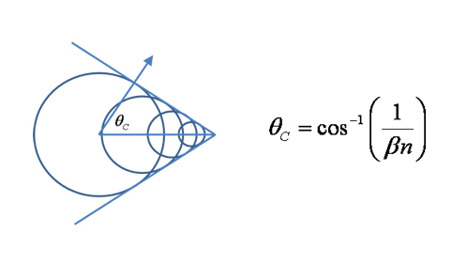
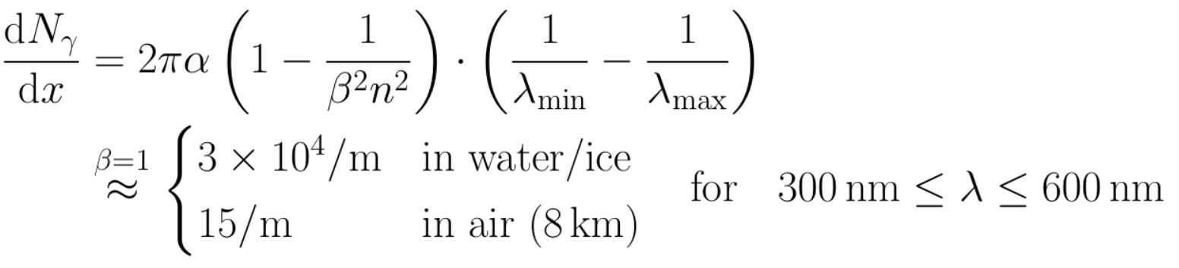
Cherenkov radiation
= ca. 42°/ 40°in water / ice

Slide 13
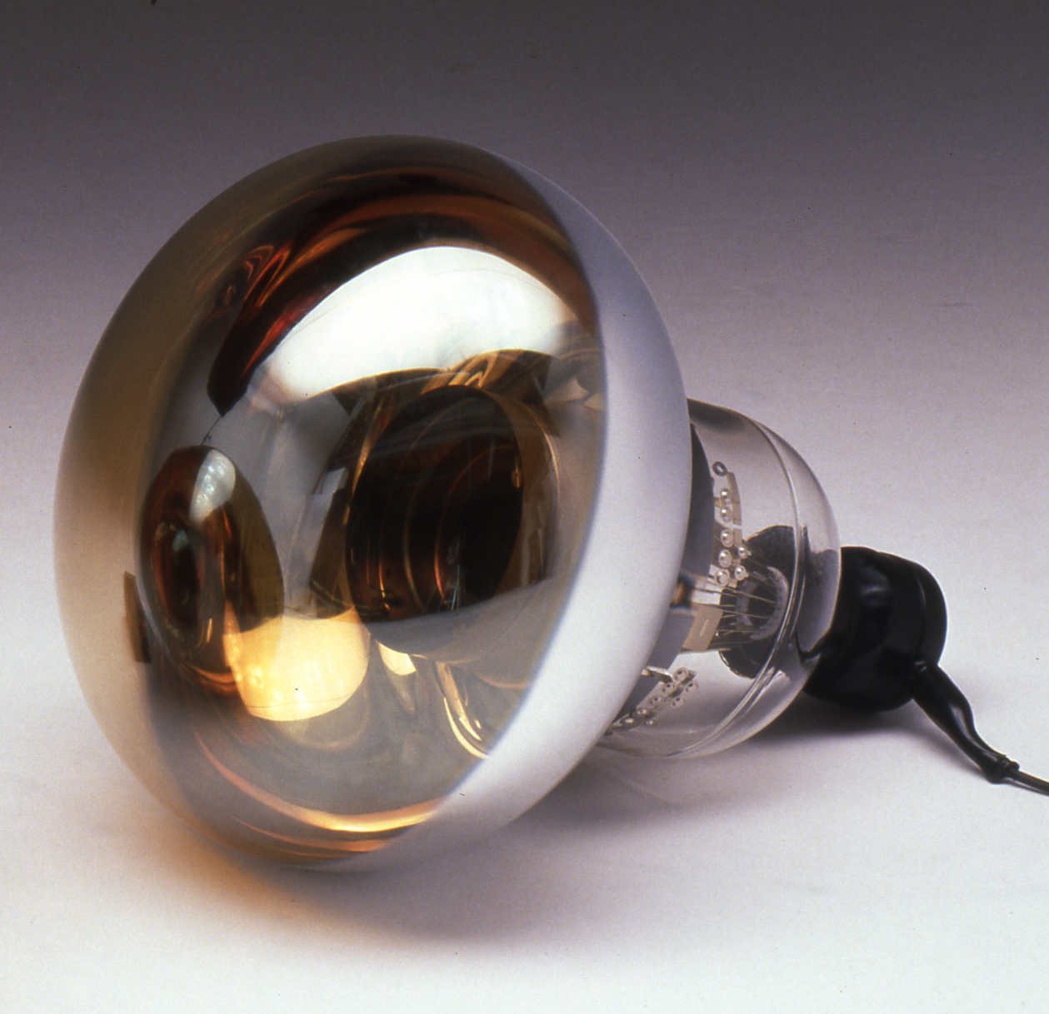
Detection of Cherenkov radiation
Very faint light
Detection requires
    Single-photon detection
    Timing at nanosecond level to suppress backgrounds
Photodetectors = Photomultiplier tubes (PMTs) or SiPMs
Synchronisation of large detector arrays at sub-nanosecond precision
Position calibration of photodetectors
with ~10 cm precision
Hamamatsu 20-inch PMT

Slide 14
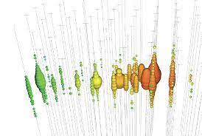
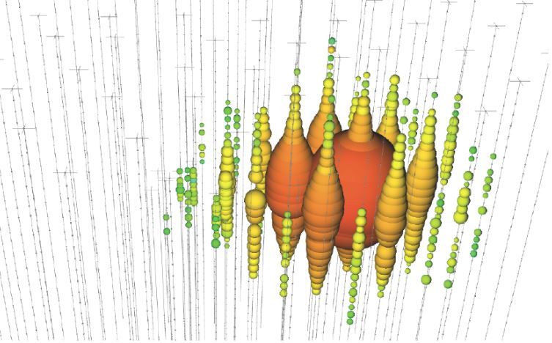
Event reconstruction
Measure arrival times and number of photons, photodetector position
Two major event topologies for energies beyond some GeV:
Event topology → flavour sensitivity,
→ determines ansatz for reconstruction
Reconstruction → direction, energy, time
Events with
high-energy muon
→
trajectories up to several km
„track-like“
Events without
high-energy muon
→
cascades (some 10m)
„point-like“

Slide 15
What a neutrino telescope sees
Cosmic neutrinos (rare!)
Atmospheric neutrinos from cosmic-ray interactions in atmosphere
  important calibration source
  allow us to study oscillations
  indistiguishable from cosmic
  neutrinos on event-by-event basis
Atmospheric muons from cosmic-ray interactions in atmosphere above NT
  penetrate to NT
  exceed neutrino event rate by
  several orders of magnitude
Sea water: light from K40 decays and bioluminescence
➔ Sensitivity depends on source position
and neutrino energy spectrum.
p
μ
NT
Earth
ν
ν
Atmosphere
p

Slide 16
Neutrino telescopes: from past to future

Slide 17
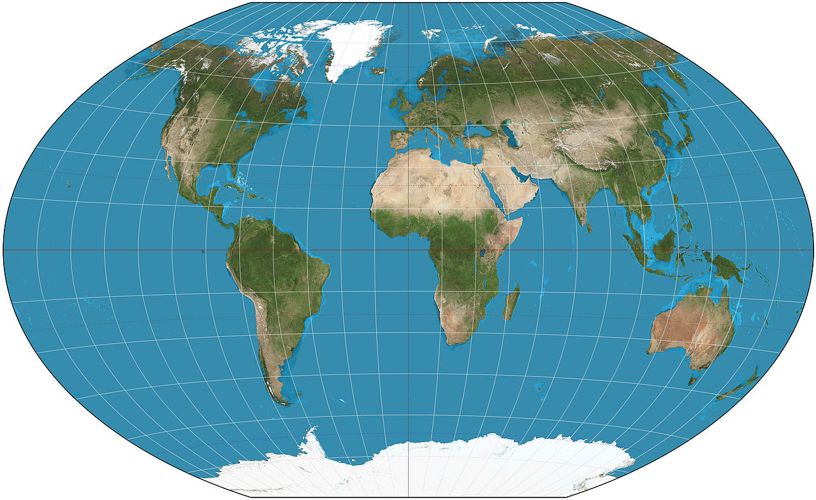




The HE neutrino telescope world map 2018
ANTARES
Deep water
0.01 km³
2008 – 2019
Baikal/GVD
Deep water
~1 km³
Construction
KM3NeT
Deep water
1 + 0.006 km³
Construction
IceCube
Deep ice
1 km³
2011 –
IceCube-Gen2
Deep ice
~10 km³
Projected, 1st
phase imminent

Slide 18
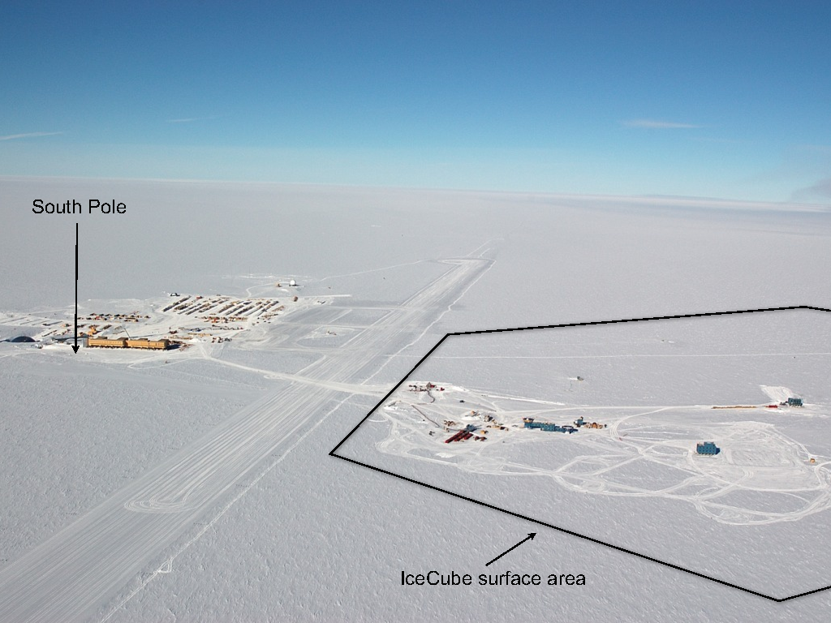
IceCube: A km³ detector in the Antarctic ice

Slide 19
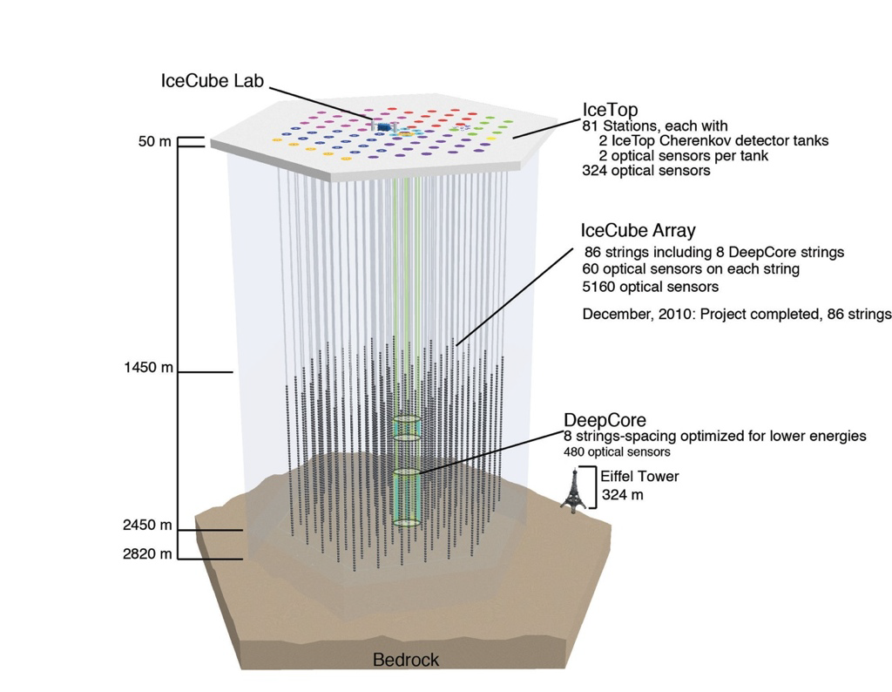
IceCube: Most sensitive v telescope to date
86 strings altogether
  125 m horizontal spacing
  17 m vertical distance
  between Optical Modules
  1 km³ instrumented
  volume, depth 2450m
Deep Core
  densely instrumented
  region in clearest ice
Completed in Dec. 2010
Extremely stable and
efficient operation since then

Slide 20
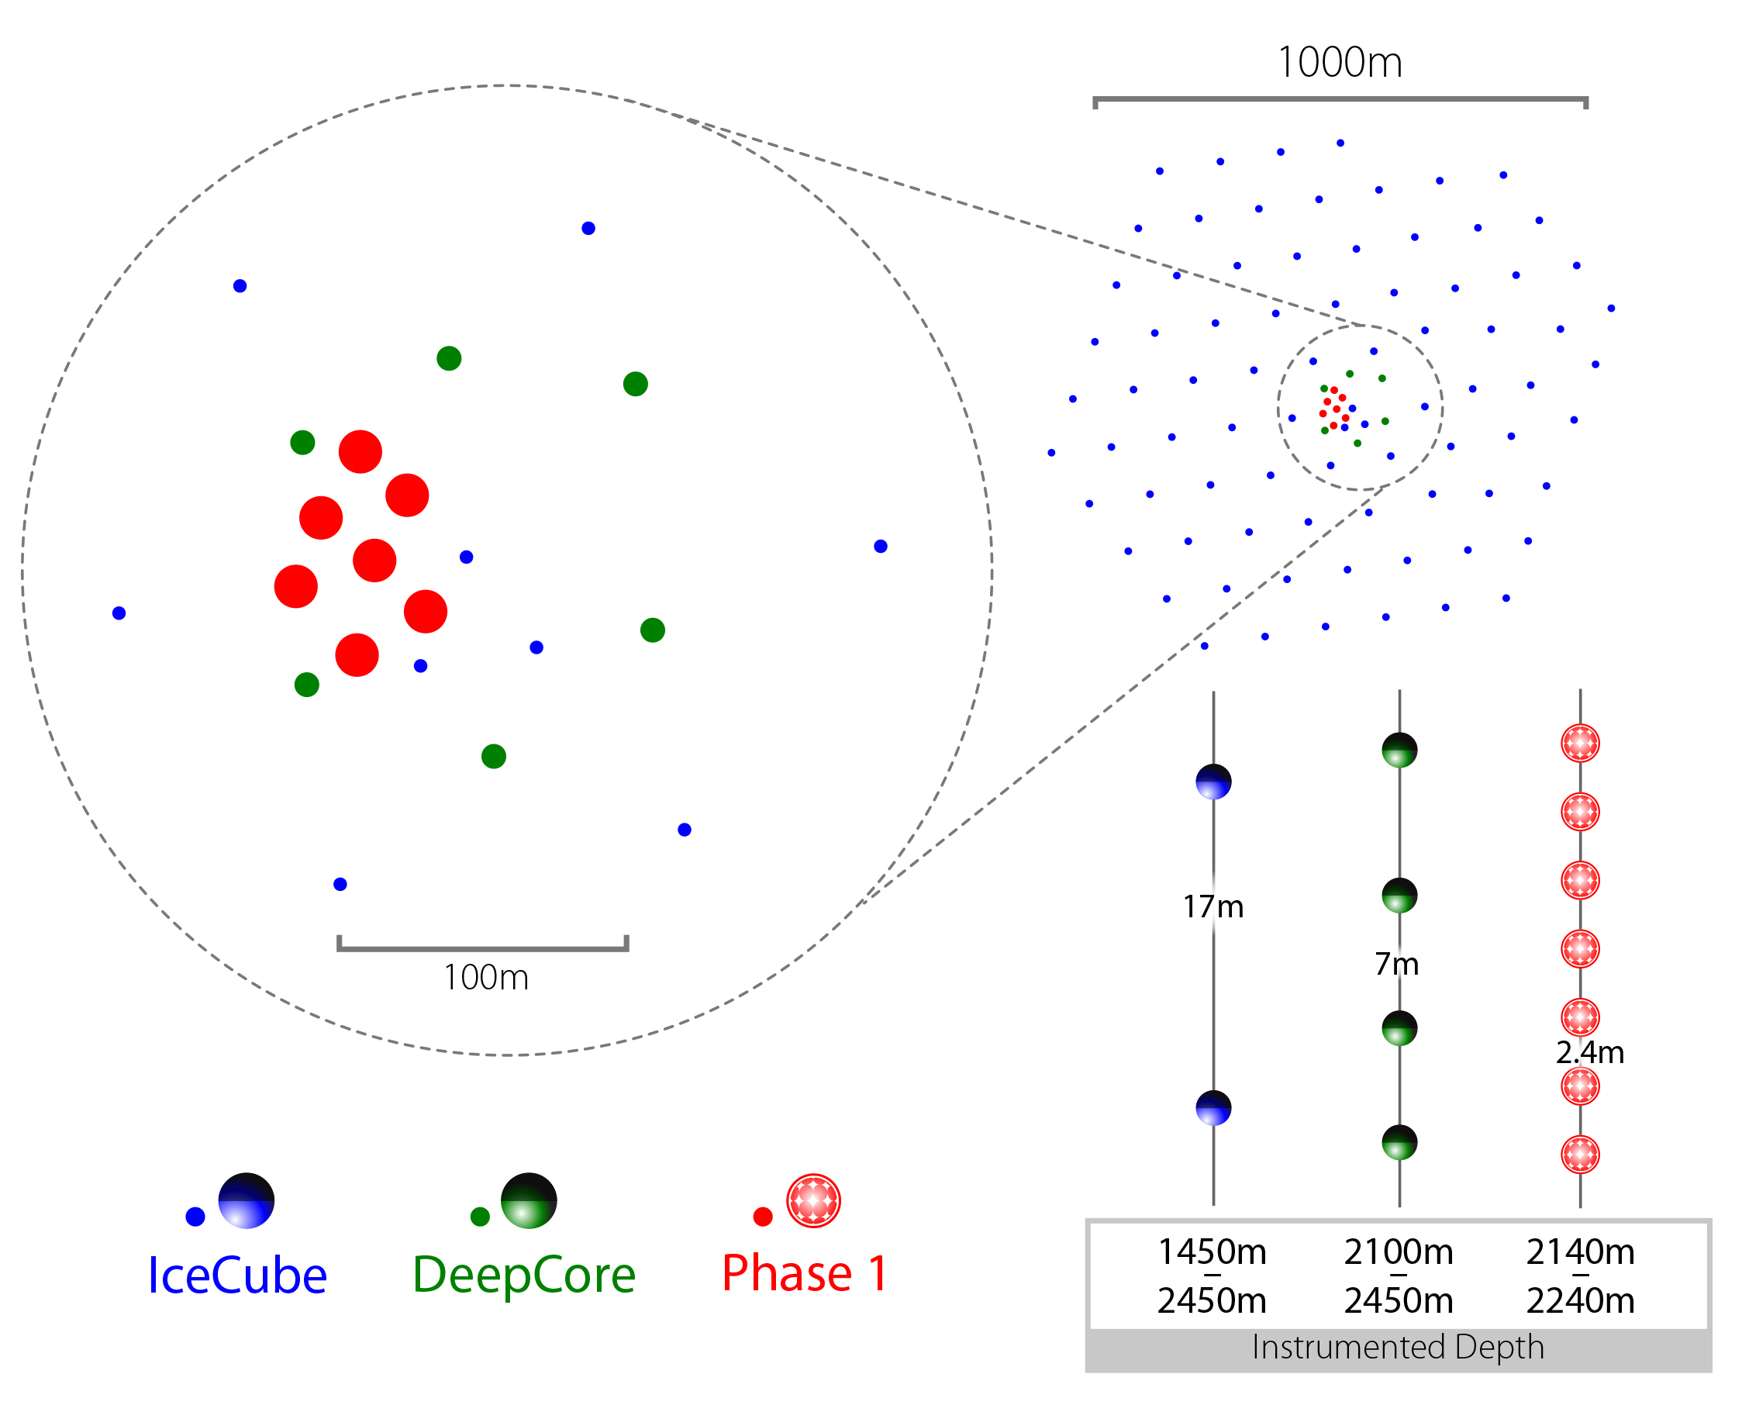
IceCube: next step = Upgrade
IceCube-Upgrade
7 additional strings in Deep Core domain, densely instrumented
Objectives:
GeV neutrinos:
v_{τ} appearance,
Dark Matter, …
Improved understanding of ice
properties → better precision, reduced systematic uncertainties
Opportunity to test new
hardware developments
Fully funded
Array | String Spacing | Module Spacing | Modules / String
IceCube | 125 m | 17 m | 60
DeepCore | 75 m | 7 m | 60
Upgrade | 20 m | 2 m | 125

Slide 21
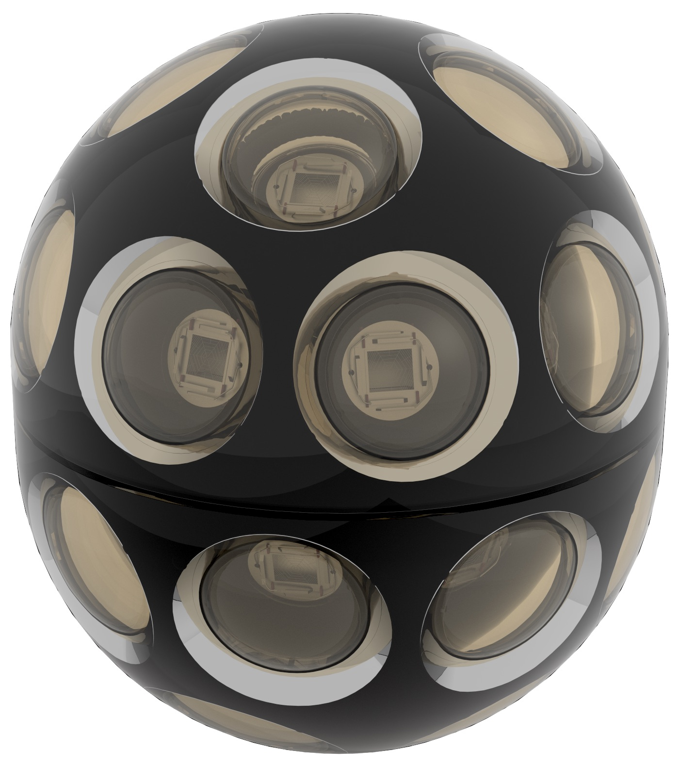
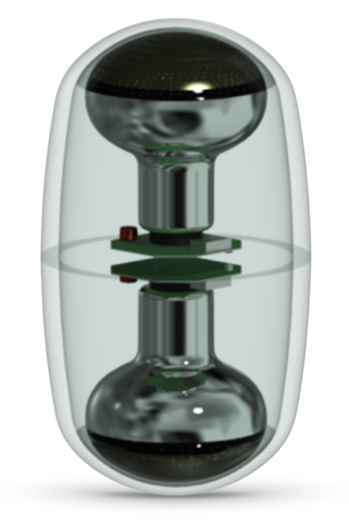
IceCube: Sensor developments
  Multi-PMT optical module (mDOM)
  24× 3” PMTs (e.g. Hamamatsu 12199-02)
  14” borosilicate glass vessel rated @ 700 bar
  Based on proven KM3NeT design
  Baseline design for Upgrade
  “D-Egg”
  2 x 8” PMTs
  UV-transparent glass
  and gel
  R&D and production by
  Japanese groups
Further light sensor
technologies under study

Slide 22
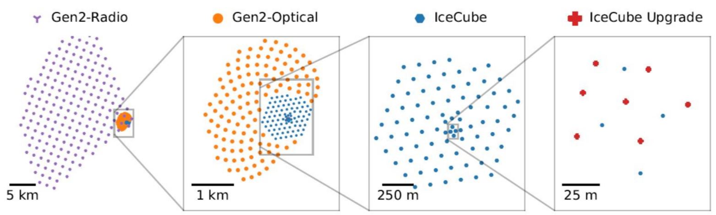
IceCube Gen2
Next-generation neutrino observatory at South Pole, with
High-energy deep-ice detector
Cosmic-ray and veto surface scintillator array
Radio array
Extend enery range, find point sources

Slide 23
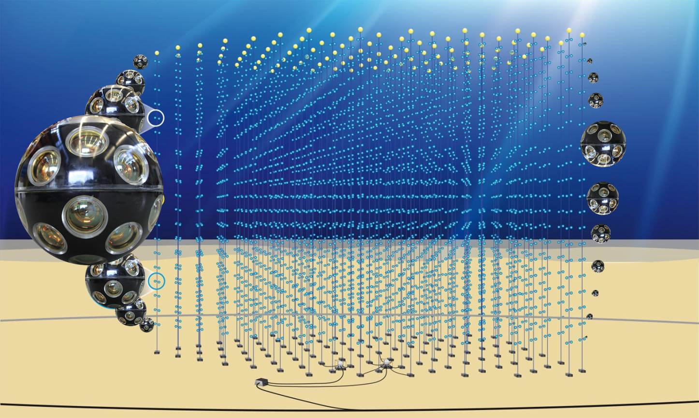
In the Mediterranean Sea: KM3NeT
31 3’’-PMTs per optical module
18 modules per string
115 DUs per building block
ARCA: 2 blocks for v astronomy
ORCA: 1 block for v oscillations
Builds on ANTARES experience

Slide 24
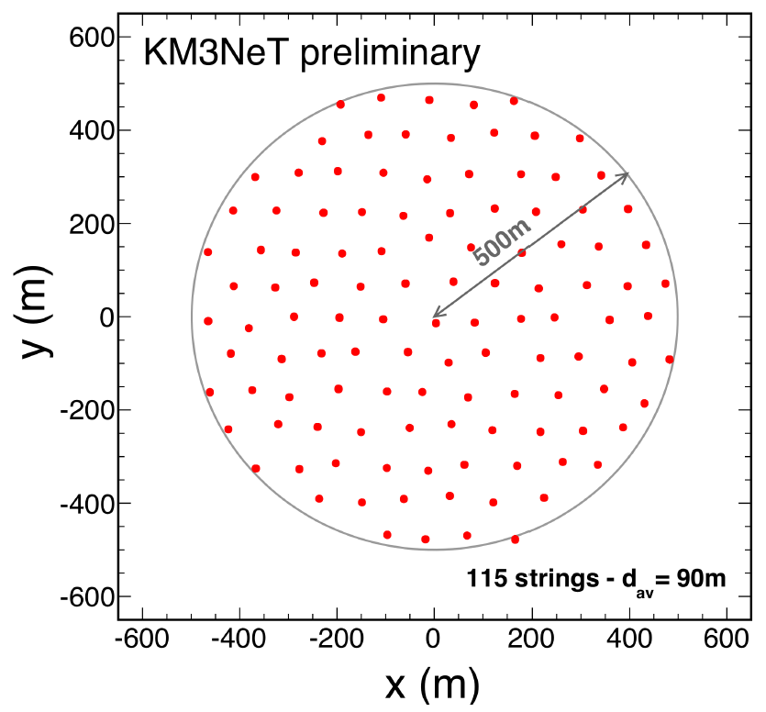
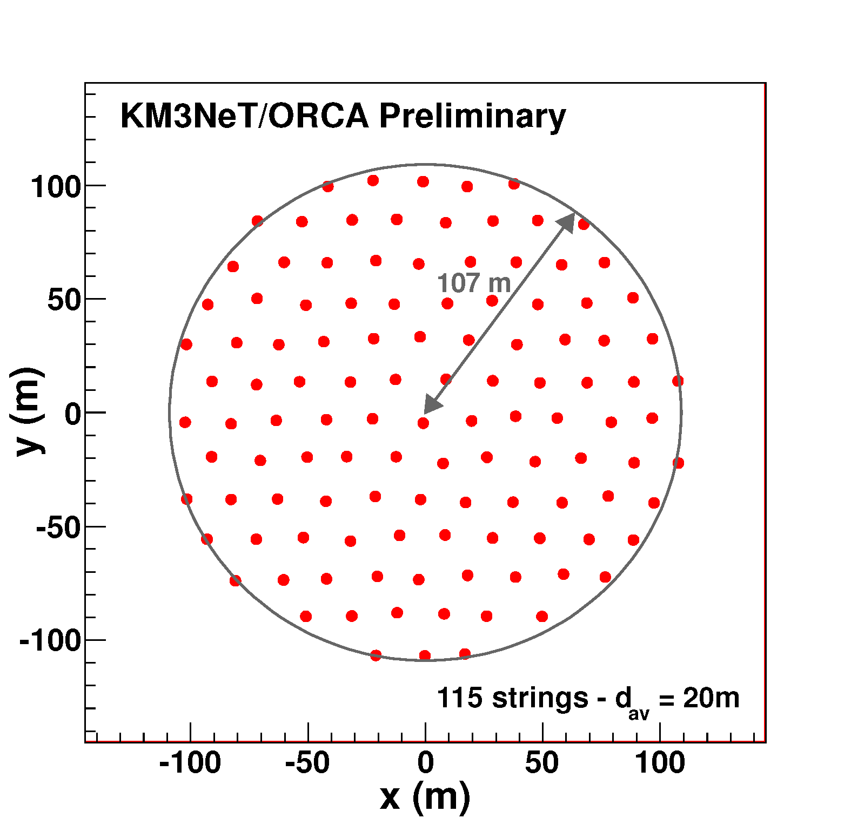
KM3NeT = ARCA and ORCA
ARCA =
Astroparticle
Research with
Cosmics in the
Abyss
500m
500m
21
+
Vertical DOM
distance = 36 m
ORCA =
Oscillation
Research with
Cosmics in the
Abyss
Currently installed
11
107m
KM3NeT 2.0 Letter of Intent:
arXiv:1601.07459 and
J.Phys. G43 (2016) 084001
Vertical DOM
distance = 9 m

Slide 25
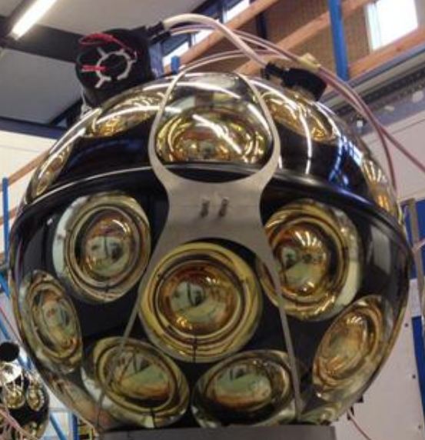
The KM3NeT Digital Optical Module
31 3-inch PMTs in 17-inch glass sphere (cathode area ~3x10-inch PMTs)
Front-end electronics, digitisation,
optical signal → glass fibre
Single penetrator
Advantages:
  Increased photocathode area
  1-vs-2 photo-electron separation
  → better detection of coincidences
  Directionality
  Cost / photocathode area
  Minimal number of penetrations
  → reduced risk

Slide 26
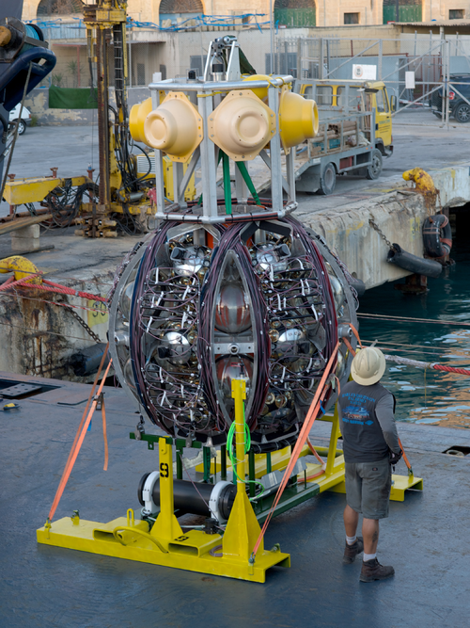
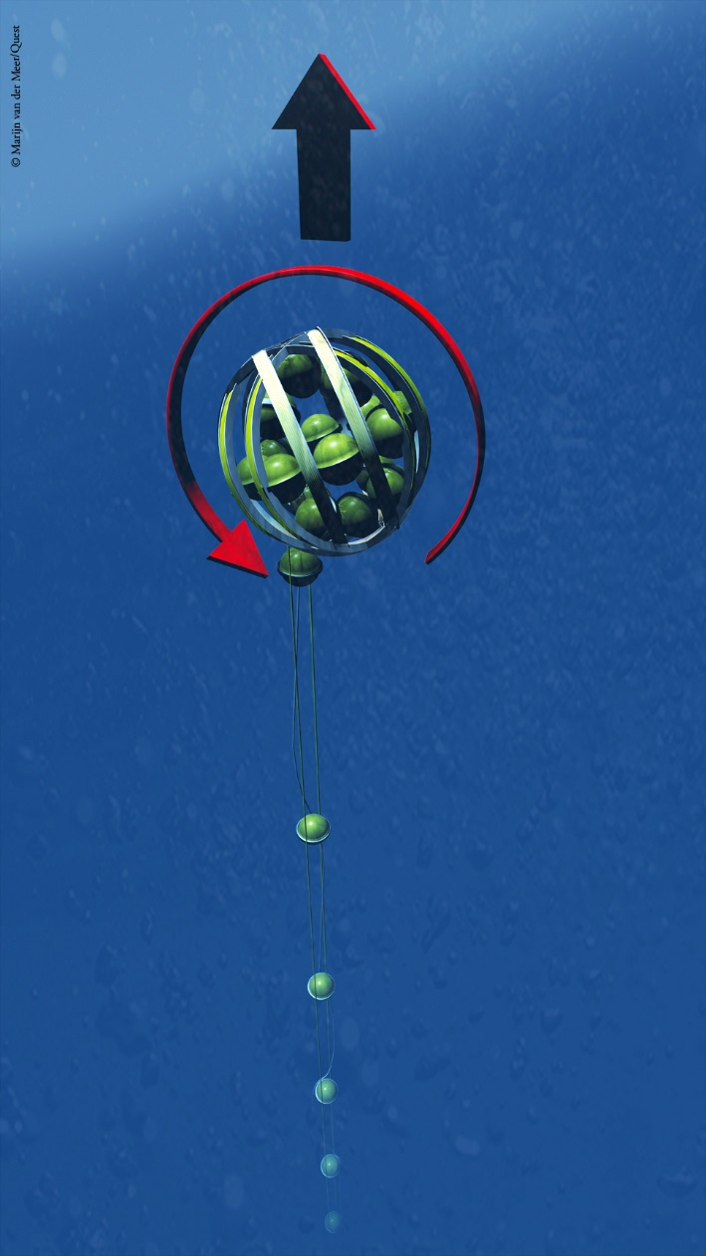
KM3NeT Deployment
← Deploy
to sea bed
Release
by ROV
Unfurl →
Collect
frame

Slide 27
The Baikal GVD
First results from 2016+17 data:
→ Understanding atmospheric muons
→ Seeing atmospheric neutrinos
→ Limits on v flux from GW170817
→ A 157 TeV cascade event
525 m
120 m
700 m
Project to construct a Gigaton (=km³) detector in Lake Baikal, Russia
Phase 1 (GVD-1): 8 clusters, 0.4 km³, completed 2021
1-2 more clusters to be deployed per season, goal 1 km³
Data taking & analysis in progress
Next-generation extension in preparation

Slide 28
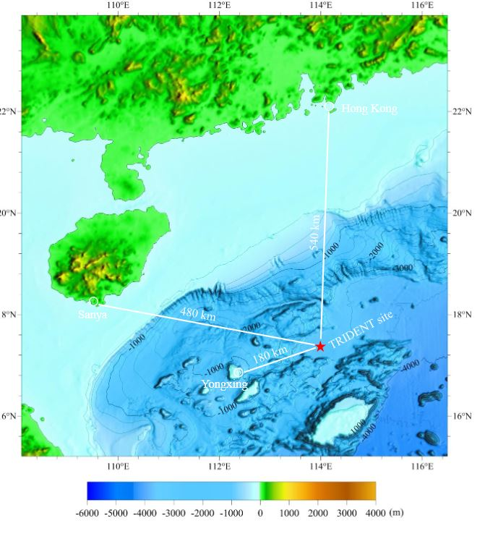
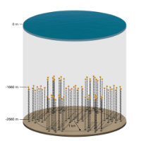
Other future plans
P-ONE
Pacific Ocean, offshore Canada
Mainly US, Canadian, German groups
Uses existing deep-sea network and expertise
R&D phase, first pathfinder deployments, site characterisation
Trident
Chinese proposal for neutrino telescope in South China Sea
Site proposed and explored,
first R&D activities
arXiv 2207.04519
www.asatronews.com

Slide 29
Selected results (1):
Cosmic neutrinos and their sources

Slide 30
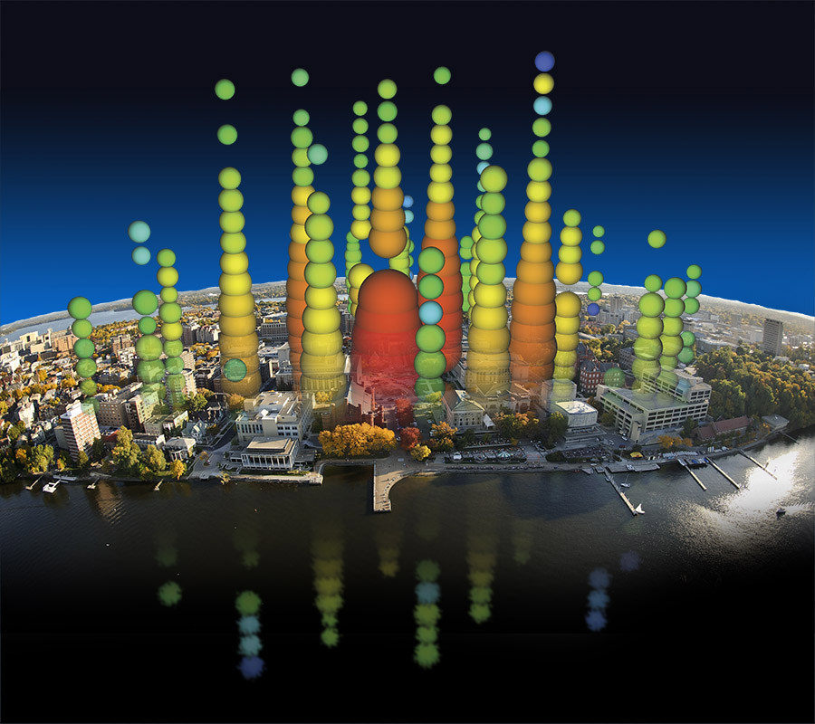
A first glimpse at cosmic ν’s
By Francis Halzen
2013: Discovery of HE cosmic neutrinos
2018: First neutrino source
Big Bird, 2.0 PeV

Slide 31
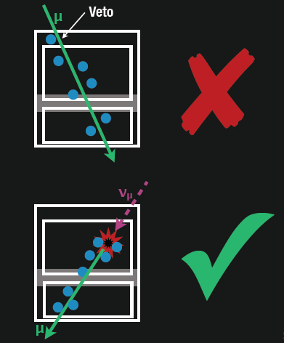
Systematic search for such events …
Select events interacting
inside the detector only
No light in the veto region
Veto for atmospheric
muons and neutrinos
(which are typically
accompanied by muons)
Energy measurement:
total absorption calorimetry
→ “High-energy starting
events” (HESE)
Meanwhile further analyses

Slide 32
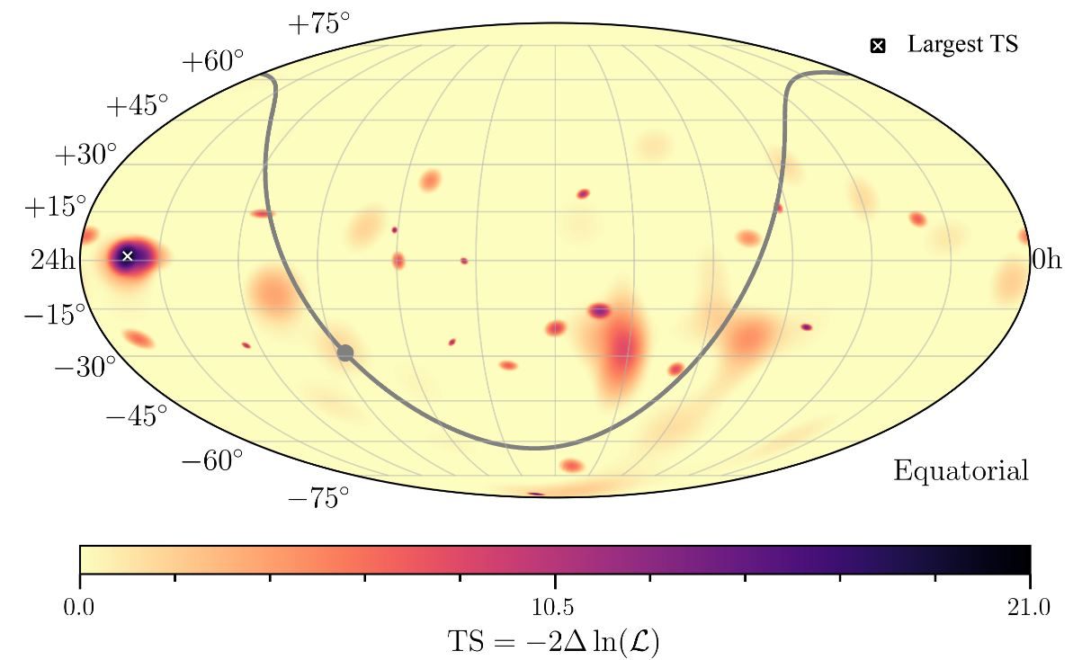
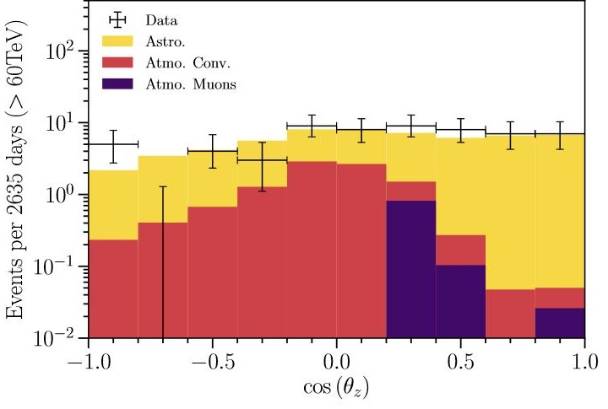
Where do they come from?
HESE
7.5 years
PRD 104 022002
(2021)
Absorption in Earth above some 10 TeV
60 events, expected background 0.9/9.1 atmospheric µ/v
No significant clustering or correlation with Galactic Plane
More events from Southern than from Northern sky

Slide 33
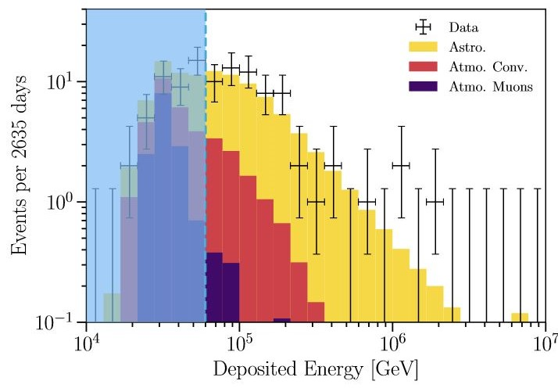
What is their energy spectrum?
HESE 7.5 years
PRD 104 022002 (2021)
Extending to PeV
Consistent with
power-law energy
spectrum ~E^{-2.87}
Neither energy nor
zenith distribution
consistent with
background-only
including prompt
neutrinos

Slide 34
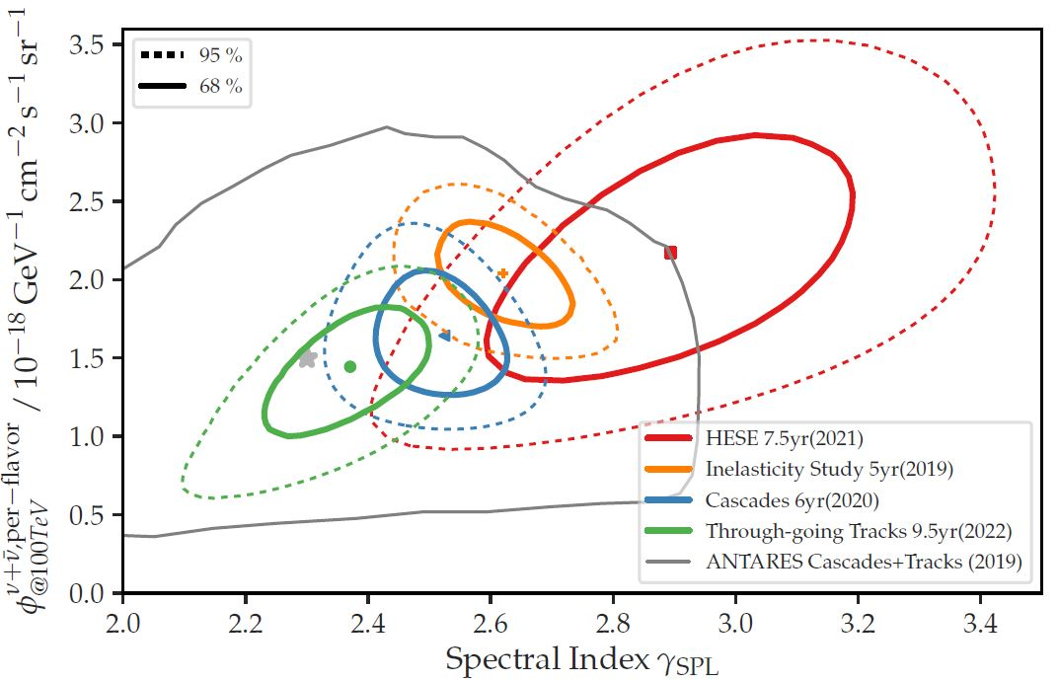
Is it a power law in E_{v}?
Important for interpreting acceleration processes / source classes
Several analyses , in paticular using through-going muons
Statistical fluctuation? Non-power-law spectra? Different source classes?

Slide 35
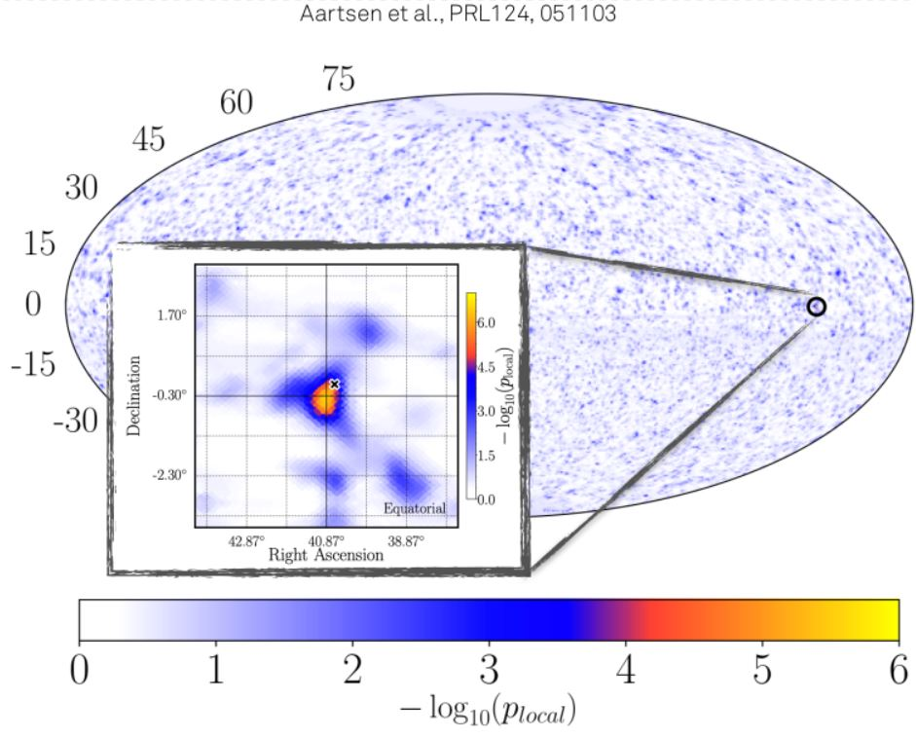
Are there steady neutrino sources?
Searches for event excess from specific celestial directions
(track events from
Northern sky)
Also: Constrained
to predefined list
of gamma-ray sources
Most significant signal (2.9σ) very close to NGC 1068
(a Seyfert-II galaxy)

Slide 36
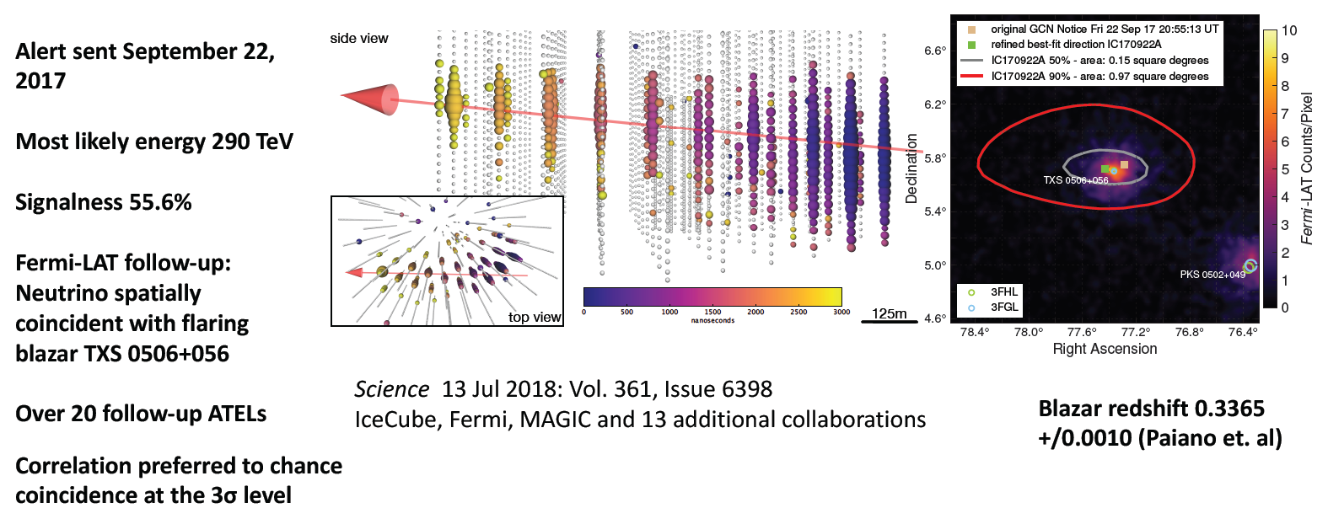
The neutrino from TXS 0506+056 – a first glimpse at a transient source …
Slide copied from Dawn Williams, RICH 2018
Also detected by MAGIC (energies up to 400 GeV)
First compelling evidence for neutrino-source association
Begin of multi-messenger astronomy with neutrinos&gamma-rays !?

Slide 37
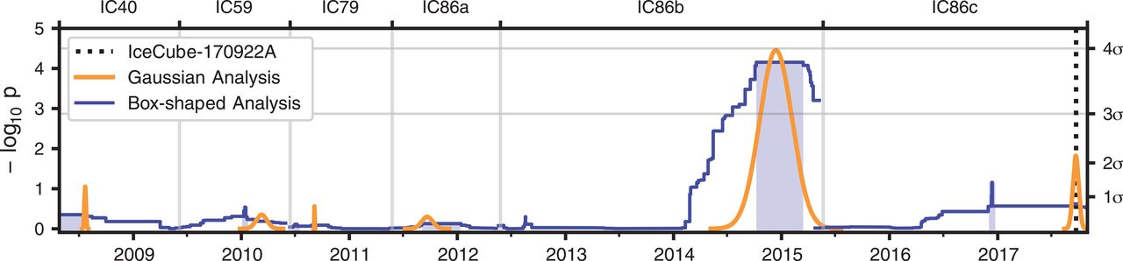
… earlier neutrinos from TXS 0506+056
Search in archival IceCube data for neutrinos from same source
Excess of 13±5 events found between Sept. 2014 and March 2015
Background-only hypothesis excluded at 3.5 σ
But: No flare of the blazar during that period → interpretation intricate

Slide 38
Selected results (2):
Neutrino oscillations

Slide 39
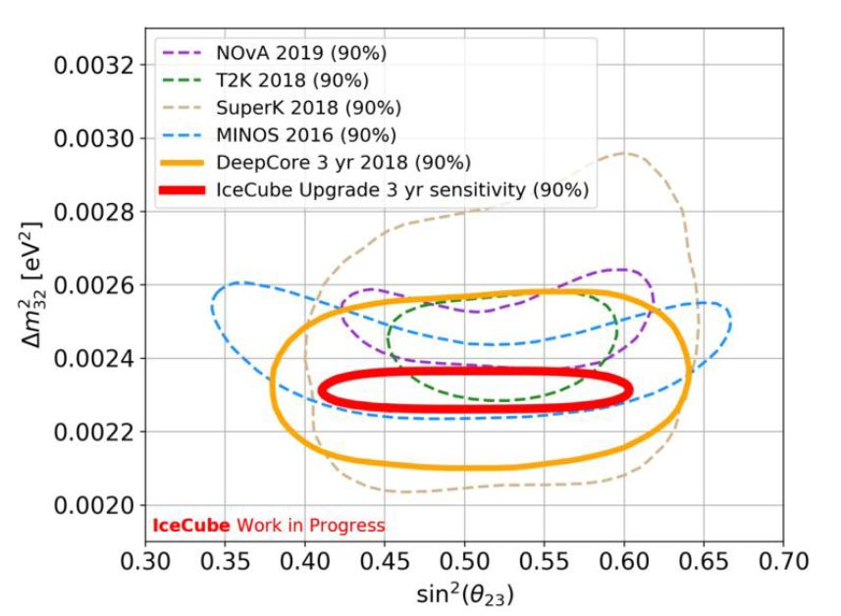
Neutrino oscillations with IceCube
Investigate:
V_{µ} disappearance
V_{τ} appearance
Determine
θ₂₃ vs. Δm²₂₃
Most sensitive
result from
DeepCore
Improvement
expected from
Upgrade
PoS (NuFact2012) 64

Slide 40
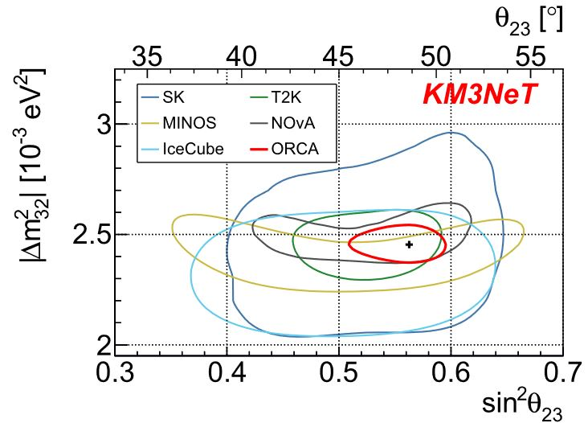
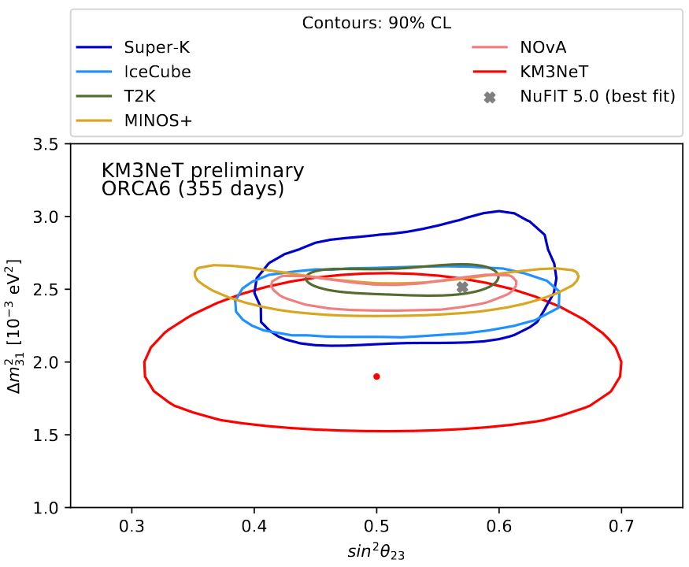
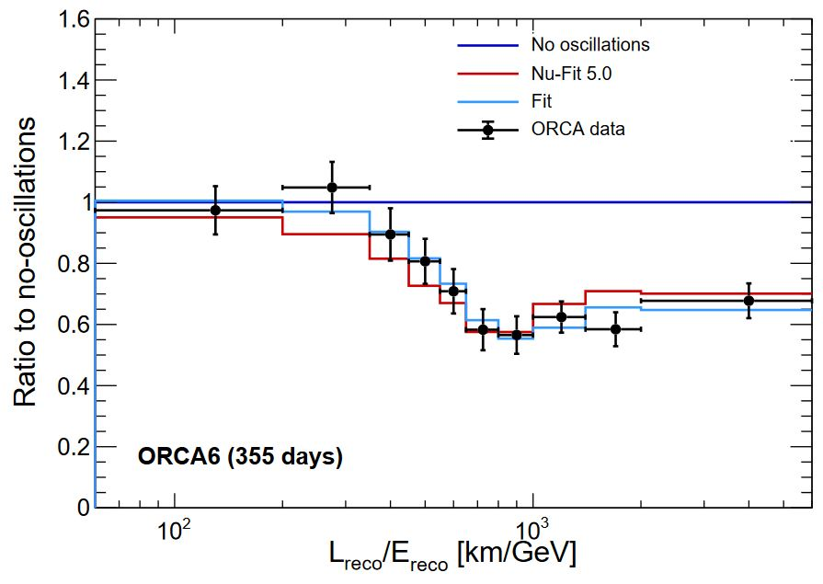
A first KM3NeT/ORCA result
6/115 detection units, one year of operation:
Eur. Phys. J. C82 (2022) 26
PoS (NuFact2012) 64
Clear demonstration of sensitivity
Result after 3 years with full ORCA highly competitive

Slide 41
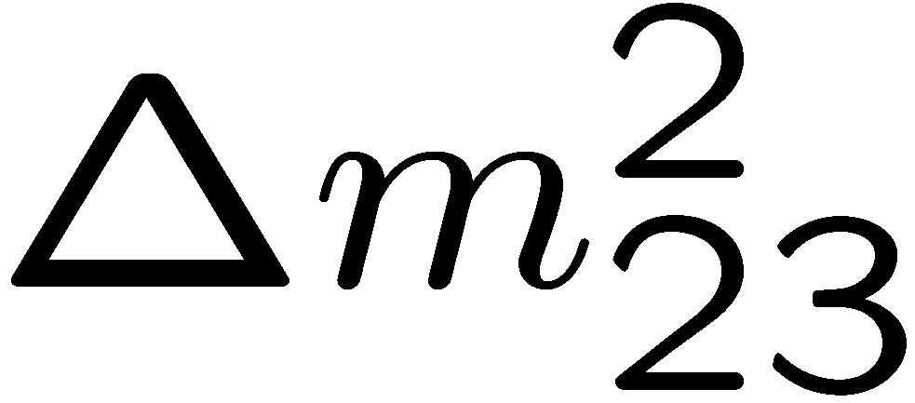
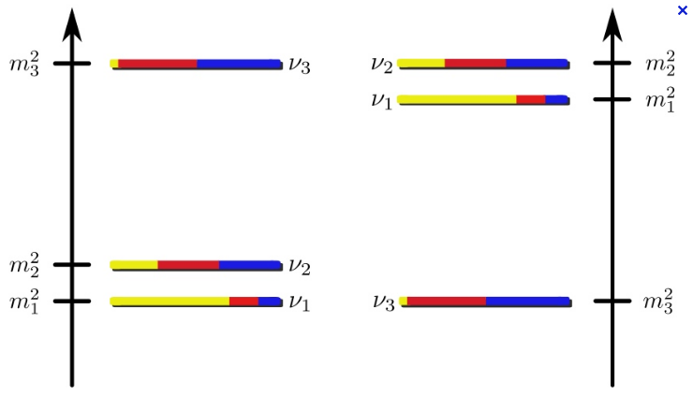
The neutrino mass ordering (NMO)
Depending on sign of :
“normal ordering” or “inverted ordering”
(NO) (IO)
Knowledge required to investigate neutrino CP violation;
important for cosmology

Slide 42
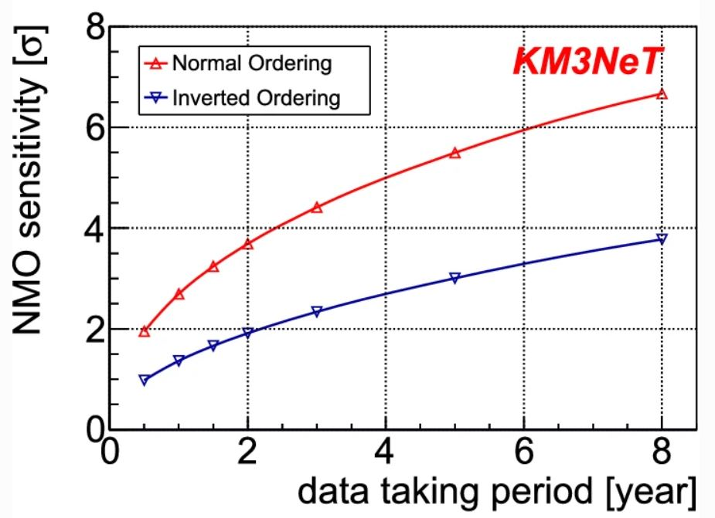
Towards measuring the NMO
Can be measured
using propagation of atmospheric neutrinos through
Earth matter
Different oscillation
patterns for NO / IO
Alternative: Reactor
neutrinos (JUNO)
KM3NeT and JUNO
are complementary
in systematics (see
arXiv:2108.06293)

Slide 43
Conclusions

Slide 44
Neutrino telescopes 2022
Lots of progess in neutrino astronomy:
Transit from from searches to measurements
First cosmic neutrinos and neutrino sources
More data coming in, new telescopes becoming active
Major contributions to neutrino physics:
Precision measurement of oscillation parameters
Towards exploring neutrino mass ordering
Many further exciting science perspectives
Ambitious future plans

