Slide 1
Neutron multiplicity measurement in muon capture on oxygen in SK-Gd
Sep. 17, 2022
@Erice school
Shintaro MIKI (ICRR, Univ. of Tokyo)
smiki@km.icrr.u-tokyo.ac.jp

Slide 2
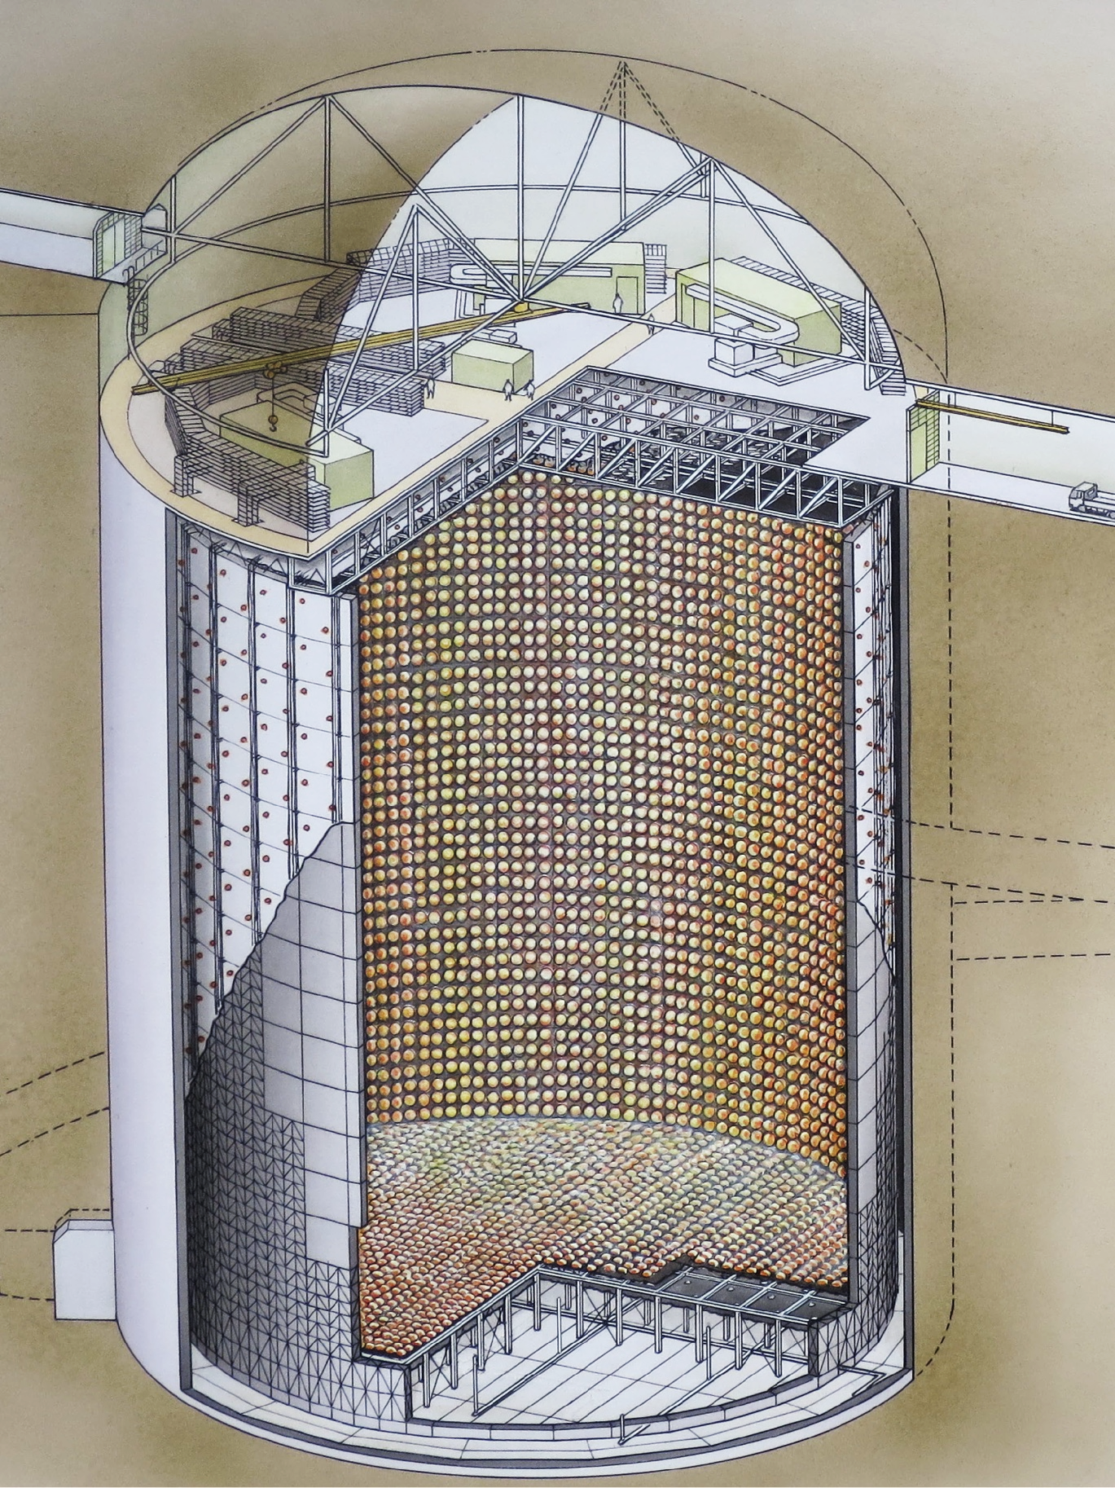
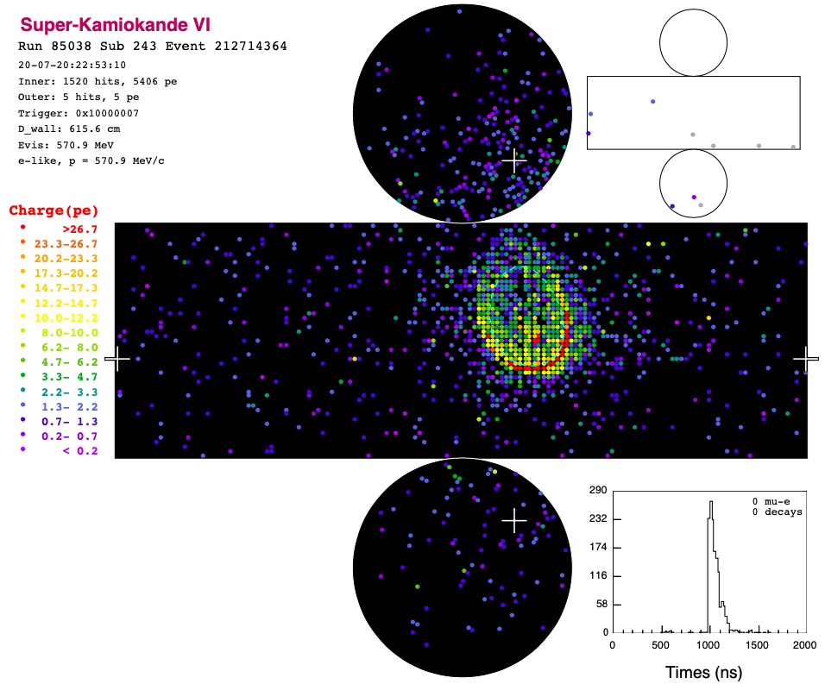
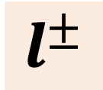


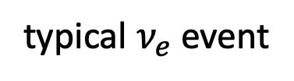
Super-Kamiokande
1000m underground
Water-Cherenkov detector @Kamioka mine, Japan.
50 kton pure water + ~11,000 50cm PMTs
Aims mainly for $ν$ observation & proton decay.
41.4 m
Cherenkov radiation
$$l^{±}$$
$$ν$$
typical $ν_{e}$ event
39.3 m
Notes:
Super-Kamiokande, or SK, is the world-largest water-Cherenkov detector located 1 km underground at Kamioka mine in Japan.
It holds 50 kton pure water as a target, and when a charged particle runs in the detector, Cherenkov photons are detected by the 50cm PMTs on the wall and particle species, its position, direction and momentum are reconstructed.
It aims mainly for neutrino observation from various sources and proton decay detection which will be an evidence for grand unification theory.

Slide 3
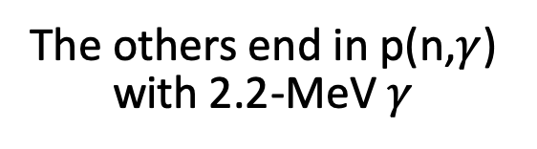
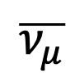
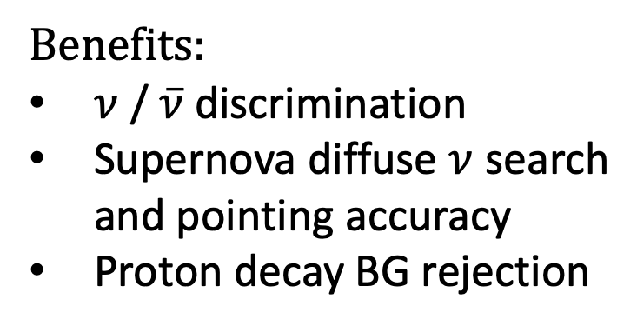
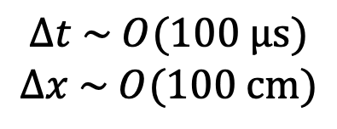
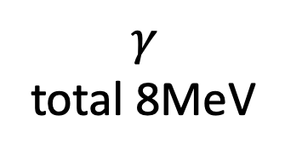

SK-Gd project
n
Gd
p
$$\overline{ν_{μ}}$$
Gadolinium was added to SK water
to enhance neutron tagging efficiency.
$$γ$$
total 8MeV
$$μ^{+}$$
Year | Gd concentration | Gd capture fraction
1996 - 2020 | 0% | 0%
2020 - 2022 | 0.01% | 50%
2022 - ongoing | 0.03% | 75%
Goal | 0.1% | 90%
$$Δt \sim O(100 μs)$$
$$Δx \sim O(100 cm)$$
Benefits:
$ν$ / $\overline{ν}$ discrimination
Supernova diffuse $ν$ search
and pointing accuracy
Proton decay BG rejection
The others end in p(n,$γ$) with 2.2-MeV $γ$
This talk mainly focuses on this period.
Notes:
SK has been running for more than 25 years. Two years ago, gadolinium sulfate was added to the SK water and SK-Gd era started. Here thermalized neutrons are captured by gadolinium and total 8 MeV gamma rays are emitted. This energy is high enough to be detected in SK, so Gd enhances neutron tagging efficiency.
This will have many benefits on physics. Neutrino and anti-neutrino discrimination, supernova diffuse neutrino search sensitivity, pointing accuracy in supernova burst, and background rejection in proton decay search.
In this year, Gd concentration got three times higher and more fraction of neutrons are captured by Gd, and so neutron detection power became stronger. But in talk, I will focus on the period with 0.01% Gd where about half of neutrons are captured by Gd and tagging efficiency is around 50%.

Slide 4
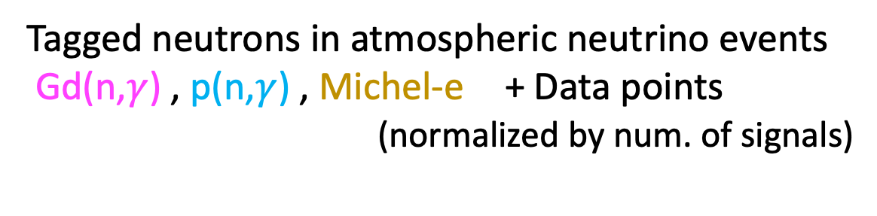
Neutron signals in SK-Gd
Neutron signals are tagged with neural network.
Tagged neutrons in atmospheric neutrino events
Gd(n,$γ$) , p(n,$γ$) , Michel-e + Data points
(normalized by num. of signals)
signal
more energetic
more isotropic
shorter lived
Notes:
Technically, neutron capture signals are tagged with neural network. The upper figure shows the distribution of signal likelihood. The gray line represents noise and the colored lines are for physical signals. Noise and signals can be separated by this value.
In the bottom figures, some feature values of neutron signals are compared between Monte Carlo and data. They agree well in each case and the neutron signals are observed almost as expected in SK-Gd.

Slide 5
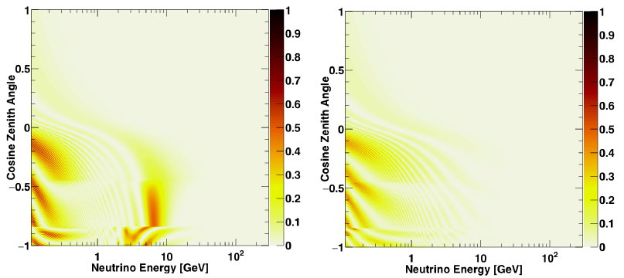
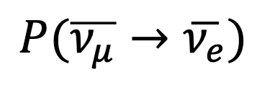

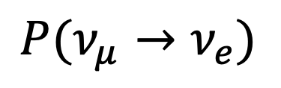
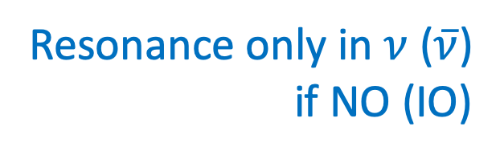
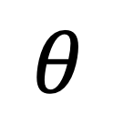

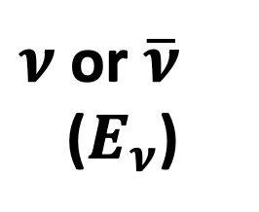
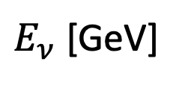
Atmospheric neutrino oscillation
$$θ$$
SK
Sensitive to mass ordering, $δ_{CP}$ , and $θ_{23}$ .
Important: Energy resolution, Direction resolution,
and $ν$ / $\overline{ν}$ discrimination
$ν$ or $\overline{ν}$
($E_{ν}$)
downgoing↓
1
$$P(ν_{μ}→ν_{e})$$
$$P(\overline{ν_{μ}}→\overline{ν_{e}})$$
air
・
0.5
cosmic rays
$$\cos{θ}$$
0
-0.5
Resonance only in $ν$ ($\overline{ν}$)
if NO (IO)
upgoing↑
-1
1
10
100
1
10
100
$E_{ν}$ [GeV]
(Assume NO)
Notes:
As the physics goal, atmospheric neutrino is produced in interactions between cosmic rays and air on the earth. By observing atmospheric neutrinos coming from the other side of the earth, we can determine the mass ordering, delta_CP and theta_23 in the neutrino mixing matrix.
The bottom figures show oscillation probabilities for neutrino and anti-neutrino. It depends on neutrino energy in the horizontal axis and neutrino direction in the vertical axis. Therefore, to enhance physics sensitivity, energy and direction resolution and nu/nubar discrimination power are important.

Slide 6
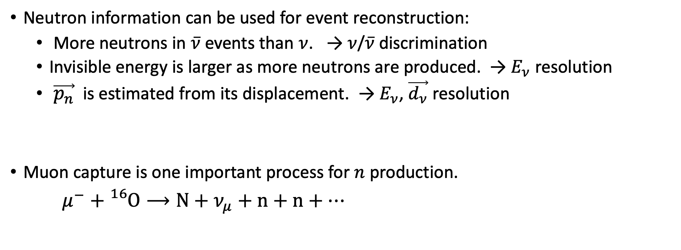
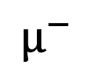

Neutrons for atmospheric neutrino
Neutron information can be used for event reconstruction:
  More neutrons in $\overline{ν}$ events than $ν$. → $ν$/$\overline{ν}$ discrimination
  Invisible energy is larger as more neutrons are produced. → $E_{ν}$ resolution
  $\vec{p_{n}}$ is estimated from its displacement. → $E_{ν}$, $\vec{d_{ν}}$ resolution
Muon capture is one important process for $n$ production.
$μ^{−}+{}_{}^{16}O⟶N+ν_{μ}+n+n+⋯$
n
n
...
$$μ^{−}$$
¹⁶O
¹⁶O
$$ν$$
...
Muon capture
(This talk)
How many neutrons ?
Neutrino interaction
n
n
Notes:
In atmospheric neutrino analysis in SK-Gd, neutron information can be used for event reconstruction. More neutrons are likely to be generated in anti-neutrino events than neutrino events, so nu/nubar discrimination can be improved. Invisible energy taken away by hadrons is larger as more neutrons are produced. By correcting this part, energy resolution of neutrino is improved. Also, the momentum of each neutron can be estimated from its displacement and from that value, energy and direction resolutions are improved.
Among neutron production processes in atmospheric neutrino, muon capture is one important process. After mu- stops in water, it is trapped by oxygen nuclei and in 20% probability it is captured via weak interaction and 0, 1, or some neutrons are emitted. The main topic in this talk is the neutron multiplicity here.

Slide 7
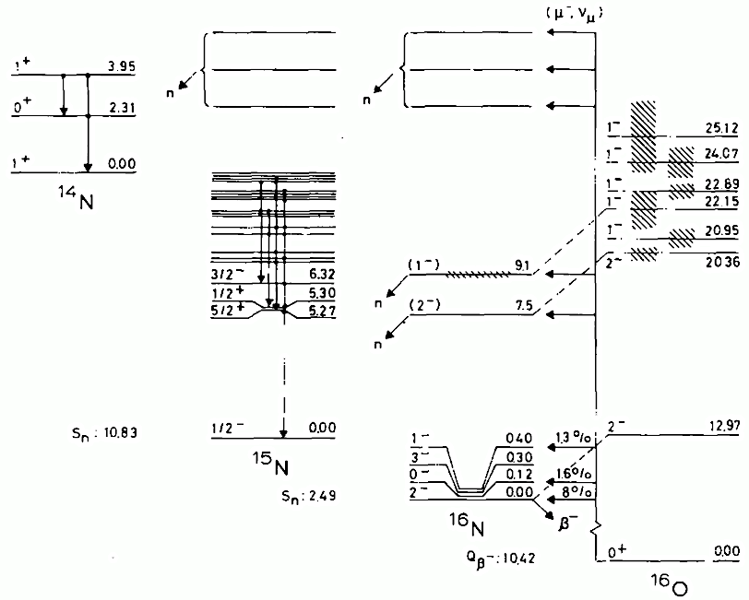
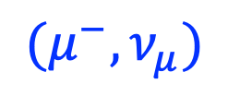
What we know about muon capture on ¹⁶O
Neutron emission
Neutron is emitted if excited nuclei has enough energy.
Otherwise, de-excited to ground state by gamma emission.
Neutron emission
¹⁴N
¹⁵N
¹⁶N
$$(μ^{−}, ν_{μ})$$
¹⁶O
Notes:
Before my analysis, it is a general description of muon capture.
After muon capture reaction, the target nuclei changes into nitrogen16. If that nuclei has enough energy typically several MeV, a neutron is emitted.. If the excited energy is not so large, the nuclei is de-excited to the ground state by gamma emission.

Slide 8
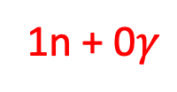
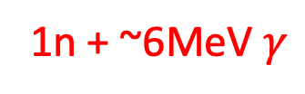
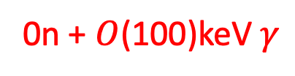
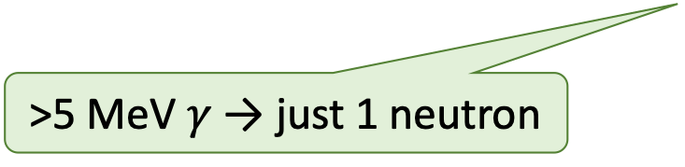
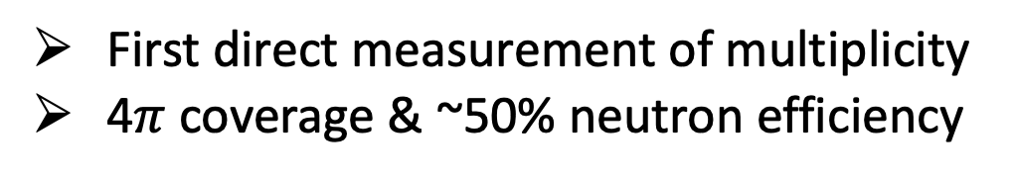
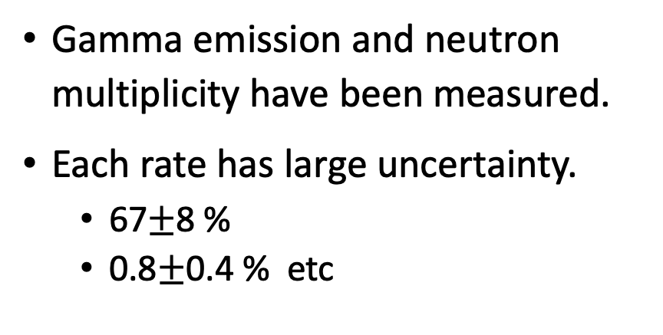
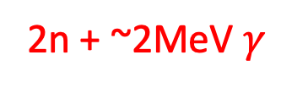
What we know about muon capture on ¹⁶O
2n + ~2MeV $γ$
Neutron emission
Gamma emission and neutron multiplicity have been measured.
Each rate has large uncertainty.
  67$±$8 %
  0.8$±$0.4 % etc
0.8%
1n + ~6MeV $γ$
Neutron emission
¹⁴N
67%
>5 MeV $γ$ → just 1 neutron
1n + 0$γ$
0n + $O$(100)keV $γ$
We measured neutron multiplicity
with cosmic ray stopping muons in SK-Gd.
21%
¹⁵N
11%
¹⁶N
First direct measurement of multiplicity
4$π$ coverage & ~50% neutron efficiency
$$(μ^{−}, ν_{μ})$$
¹⁶O
Notes:
In the previous studies, gamma emission and neutron multiplicity have been measured. 11% of the reaction goes to nitrogen16 ground or bound states without neutron emission. In 67% of the reactions, it emits 1 neutron and around 6 MeV gamma rays. 21% emits 1 neutron without gamma. 0.8% has more excitation energy and emits second neutrons resulting in nitrogen14.
In those measurements, each value has large uncertainty and is measured in coincidence with deexcitation gamma.
In this study, we measured neutron multiplicity with cosmic ray stopping muons in SK-Gd. This is the first direct measurement of the multiplicity. The strong points of SK for this measurement are 4 pi coverage of the detector and high neutron detection efficiency.

Slide 9

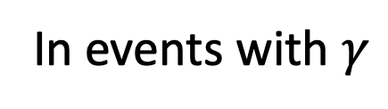
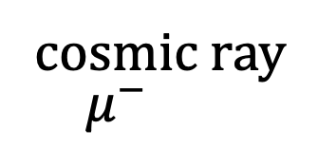
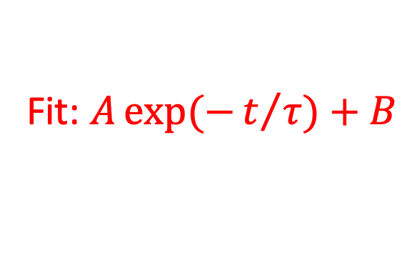
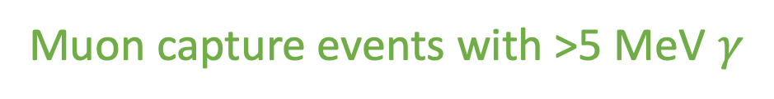
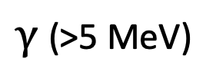
Tagging efficiency calibration
Measure neutron tagging efficiency by preparing 1-neutron control sample.
Muon capture events with >5 MeV $γ$
cosmic ray
$μ^{−}$
from fit
SK
In events with $γ$
Efficiency
Fit: $A\exp{(−t/τ)}+B$
N(tagged n)
n
=
N(gamma)
¹⁶O
= 46.1%
$γ$ (>5 MeV)
Neutron capture time [μs]
Notes:
First, we measured neutron tagging efficiency in SK-Gd. For this purpose, we use cosmic ray muons that stop in the detector tank. Among such stopping muons, muon capture events with gamma rays whose energy is more than 5 MeV should be accompanied by only one neutron. (前ページ) Such energetic gamma rays appear only in this branch. So by selecting muon capture events with energetic gamma rays, we can obtain 1-neutron control sample.
In such a sample, neutron signals are searched for and their capture time distribution is shown in the middle figure. Its nice exponential curve is fitted and the number of tagged neutrons is estimated. By dividing this number by the number of gamma rays, we obtain the neutron tagging efficiency as 46.1%.

Slide 10
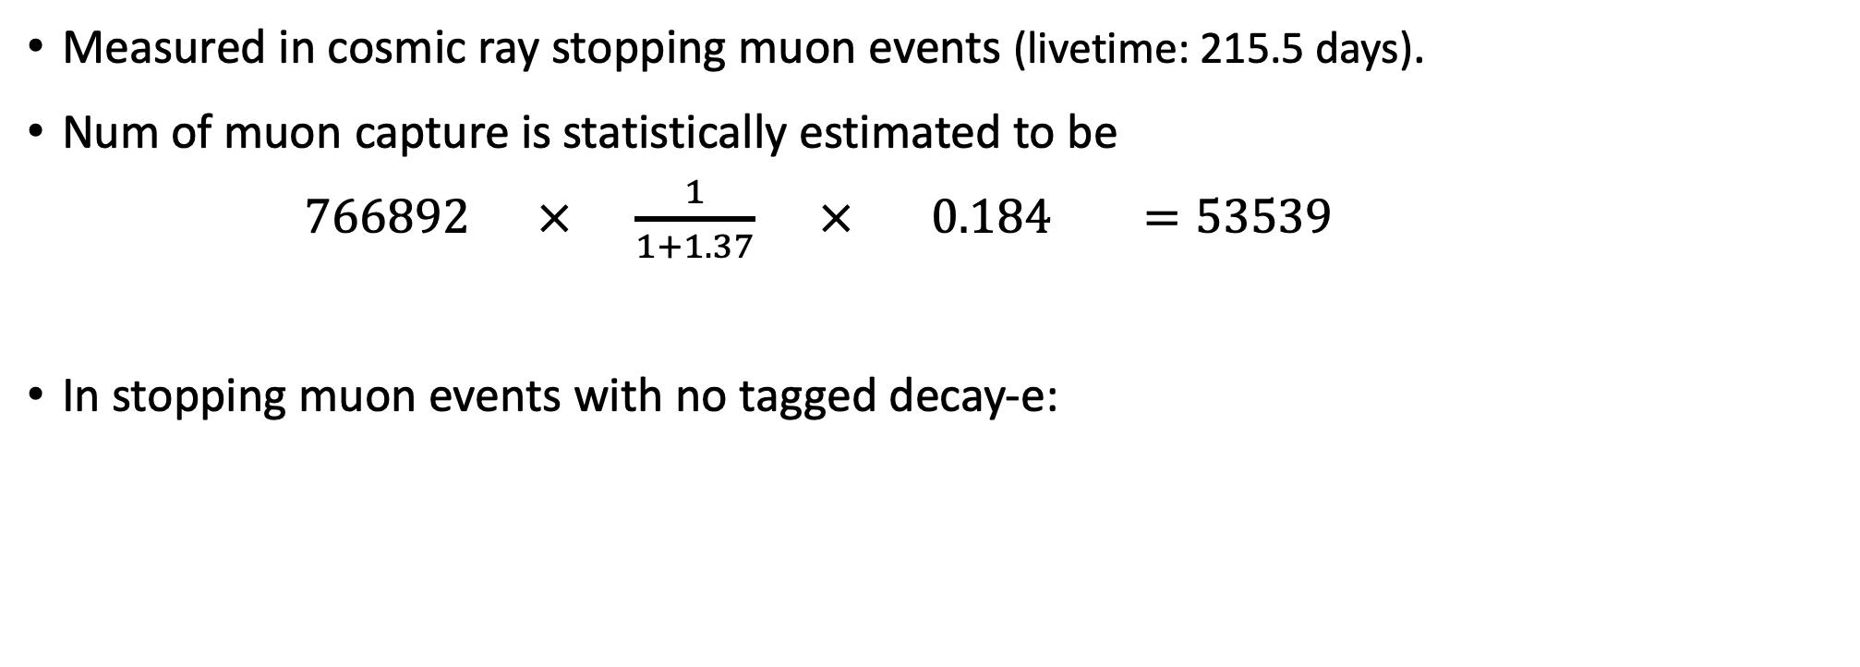
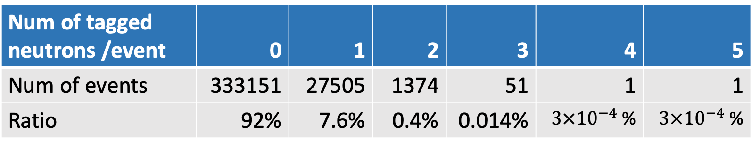
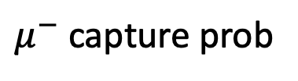
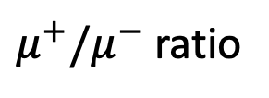
Neutron multiplicity measurement
Measured in cosmic ray stopping muon events (livetime: 215.5 days).
Num of muon capture is statistically estimated to be
$766892 × \frac{1}{1+1.37} × 0.184 =53539$
In stopping muon events with no tagged decay-e:
Num of muons
$μ^{+}/μ^{−}$ ratio
$μ^{−}$ capture prob
Num of tagged neutrons /event | 0 | 1 | 2 | 3 | 4 | 5
Num of events | 333151 | 27505 | 1374 | 51 | 1 | 1
Ratio | 92% | 7.6% | 0.4% | 0.014% | $3×{10}^{−4}$ % | $3×{10}^{−4}$ %
Notes:
Neutron multiplicity was measured with the same stopping muon events.
In the 760 thousand stopping muons, the number of muon capture events is statistically estimated assuming muon charge ratio and muon capture probability.
Independent from this calculation, in stopping muon events with no tagged decay electron, the distribution of the number of tagged neutrons was counted as shown in the table.
This distribution is distorted by neutron efficiency and mis-tagging, so we should correct the effects.

Slide 11


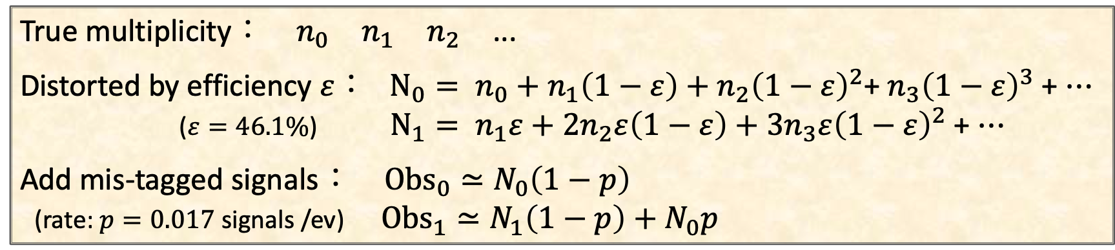
Correction for multiplicity
Measured multiplicity is distorted by tagging efficiency & mis-tagged signals:
Inversely, get $n_{i}$ from $Obs_{i}$ .
Reduce num of 0n events to meet with expected num of capture events.
(for the remaining decay-e events)
True multiplicity： $n_{0}$ $n_{1}$ $n_{2}$ ...
Distorted by efficiency $ε$： $N_{0}= n_{0}+n_{1}\left(1−ε\right)+n_{2}{\left(1−ε\right)}^{2}$+ $n_{3}{\left(1−ε\right)}^{3}$ + $⋯$
($ε=46.1\%$) $N_{1}= n_{1}ε+2n_{2}ε\left(1−ε\right)+3n_{3}ε{\left(1−ε\right)}^{2}$ + $⋯$
Add mis-tagged signals： $Obs_{0}≃N_{0}\left(1−p\right)$
(rate: $p=0.017$ signals /ev) $Obs_{1}≃N_{1}\left(1−p\right)+N_{0}p$
Notes:
When we set the true multiplicity distribution as n0, n1, n2, ... , the distribution distorted by neutron efficiency epsilon is written as the formula. Also in the real measurement, we may mis-identify some noise as a neutron signal. By adding this mis-tagged signals, the observed distribution should be like obs0, obs1, ... . This process is a simple algebra and inversely, we can get the true distribution n_i from the observed distribution.
Moreover, the number of 0 neutron events, n_0, includes the remaining events where the parent muon decays to electron. To account for this, we reduced the number of 0 neutron events to meet with the expected number of captured events, which is calculated in the previous page.

Slide 12

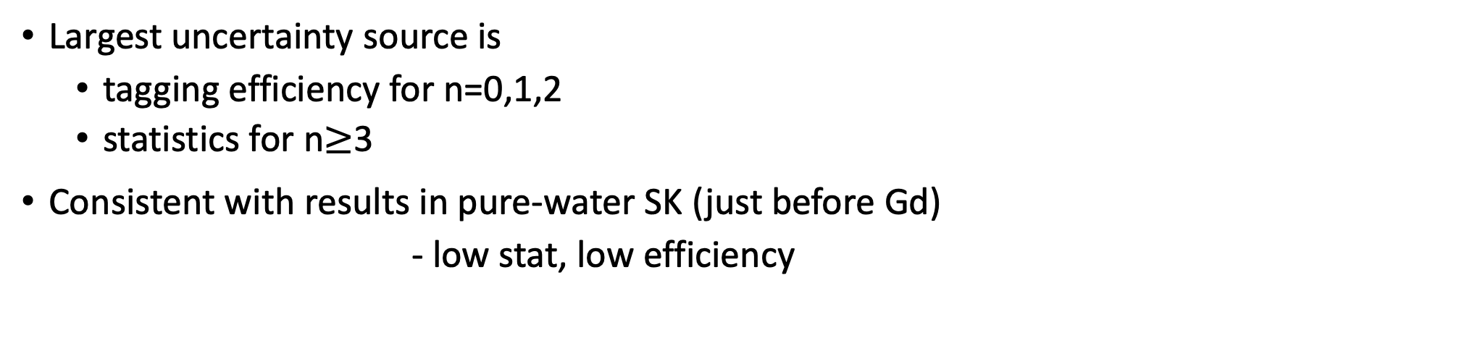




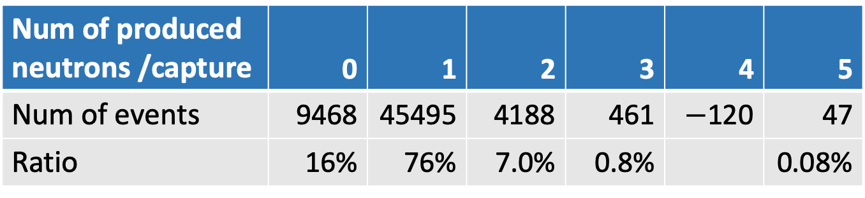

Multiplicity result
First direct measurement of neutron multiplicity
Num of produced neutrons /capture | 0 | 1 | 2 | 3 | 4 | 5
Num of events | 9468 | 45495 | 4188 | 461 | $−$120 | 47
Ratio | 16% | 76% | 7.0% | 0.8% |  | 0.08%
$$76±4 \%$$
Largest uncertainty source is
  tagging efficiency for n=0,1,2
  statistics for n$≥$3
Consistent with results in pure-water SK (just before Gd)
- low stat, low efficiency
$$16±4 \%$$
$$7.0±0.7 \%$$
$$0.08±0.08 \%$$
$$0.8±0.3 \%$$
$$<0.2 \%$$
Notes:
After these corrections, we obtained the multiplicity distribution of neutrons produced in muon capture reaction. This is the first direct measurement of the neutron multiplicity.
For the uncertainties shown in the graph, the largest source is neutron tagging efficiency for n=0,1,2, and statistics for n larger than 2.
The same kind of analysis can be done with pure-water SK data before Gd loading. It is lower statistics and lower efficiency so uncertainty is larger than in SK-Gd analysis, but the results are consistent.

Slide 13
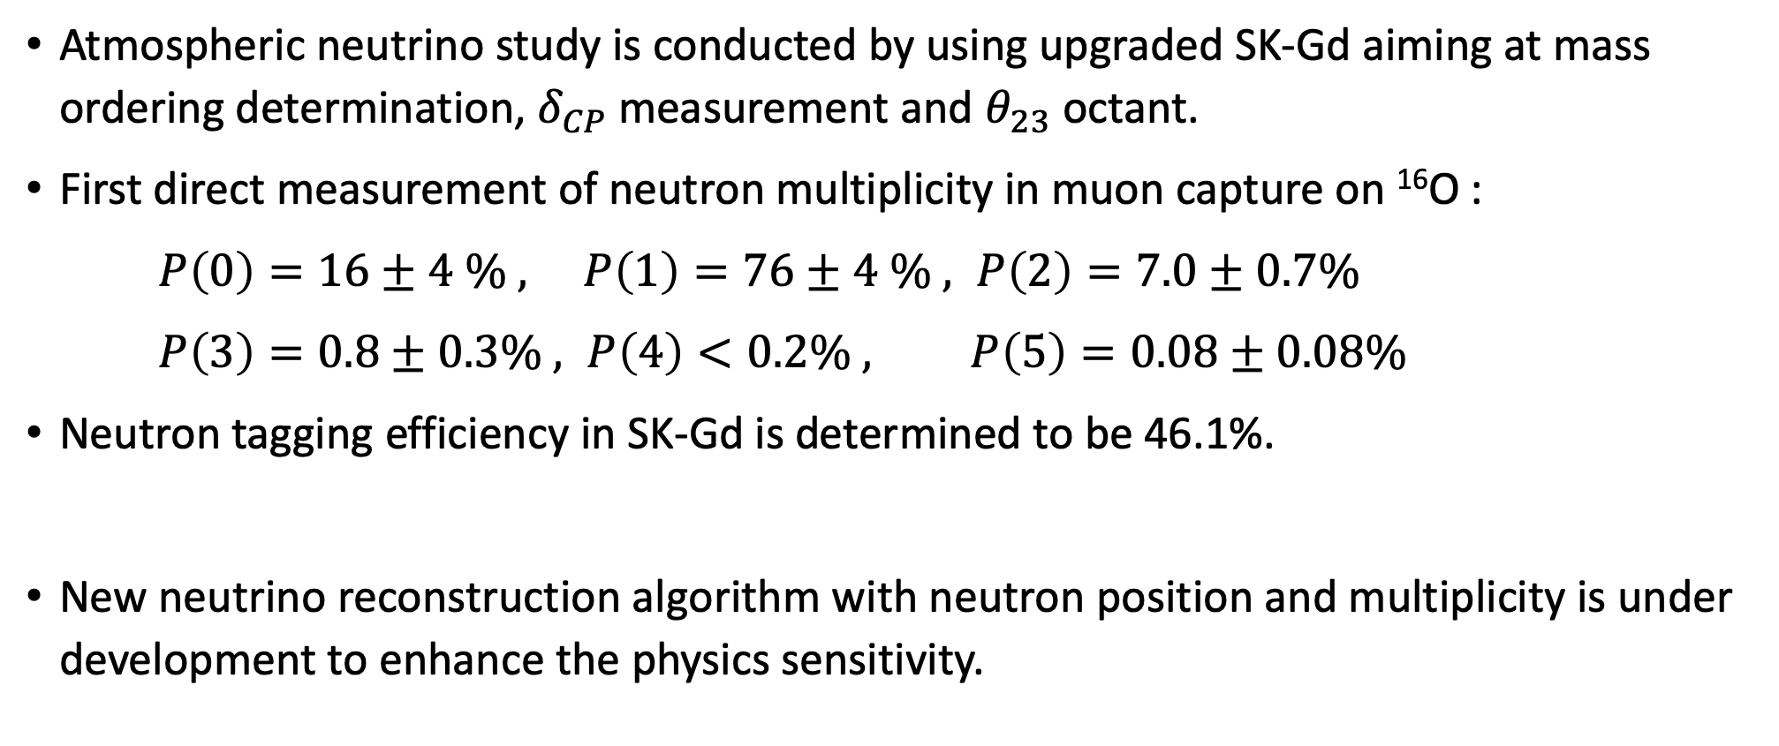
Summary and prospects
Atmospheric neutrino study is conducted by using upgraded SK-Gd aiming at mass ordering determination, $δ_{CP}$ measurement and $θ_{23}$ octant.
First direct measurement of neutron multiplicity in muon capture on ¹⁶O :
$P\left(0\right)=16±4 \% , P\left(1\right)=76±4 \% , P\left(2\right)=7.0±0.7\%$
$P\left(3\right)=0.8±0.3\% , P\left(4\right)<0.2\% , P\left(5\right)=0.08±0.08\%$
Neutron tagging efficiency in SK-Gd is determined to be 46.1%.
New neutrino reconstruction algorithm with neutron position and multiplicity is under development to enhance the physics sensitivity.
Notes:
As a summary, 読む

Slide 14
Back up

Slide 15
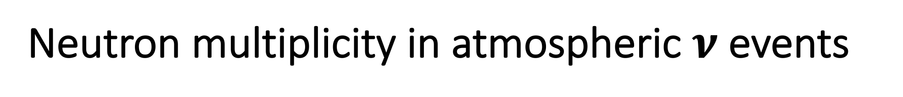
Neutron multiplicity in atmospheric $ν$ events
Less neutrons are tagged in data
especially in low energy events.

Slide 16
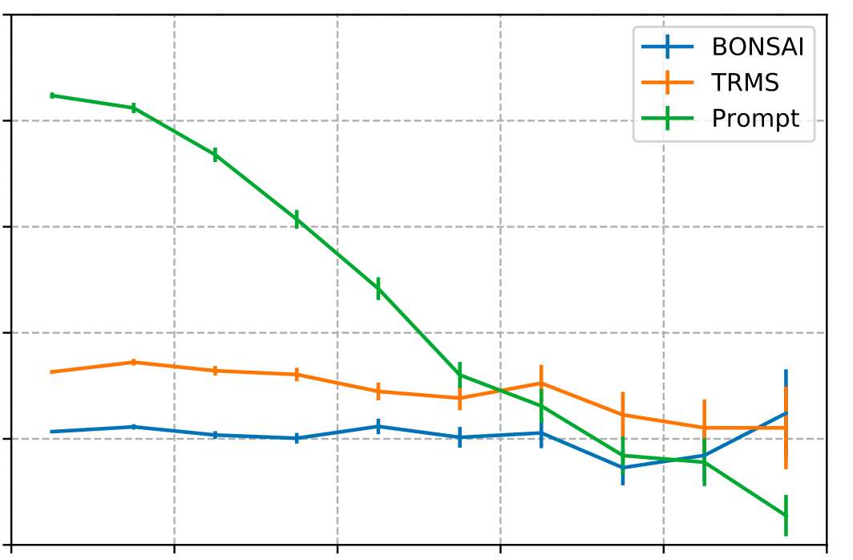
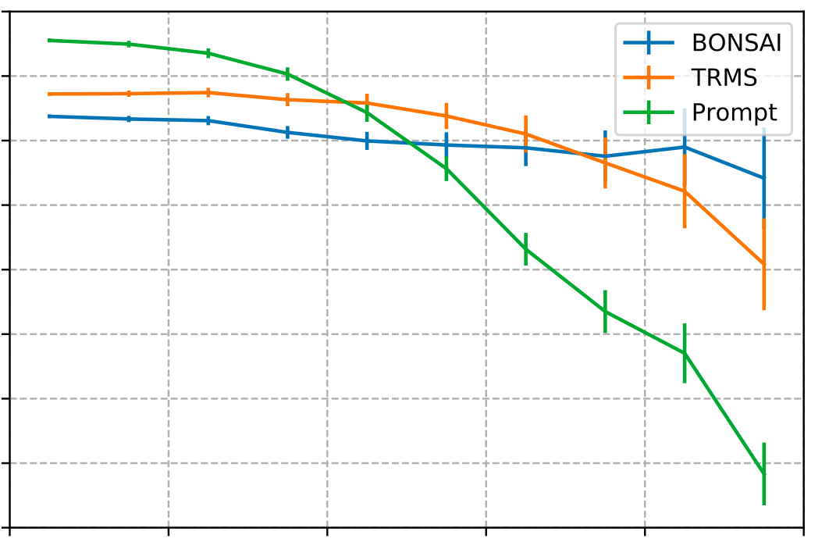
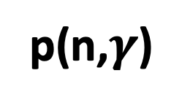

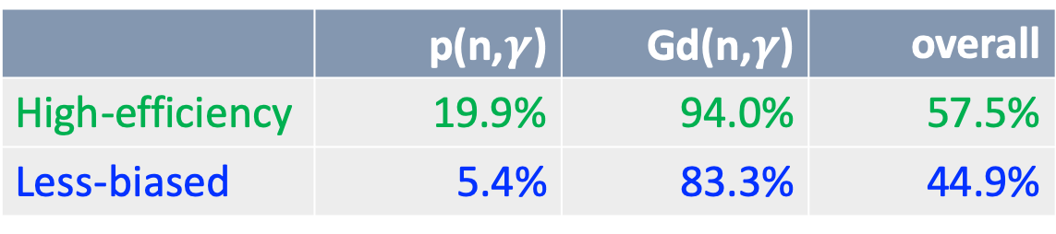
Neutron tagging performance
20
We have two mode for neutron tagging:
  High-efficiency mode
  Assume neutron capture vertex is same as generation vertex.
  Less-biased mode
  Neutron capture vertex is used in the algorithm.
p(n,$γ$)
10
Tagging efficiency [%]
0
100
80
Neutron tagging efficiency:
60
 | p(n,$γ$) | Gd(n,$γ$) | overall
High-efficiency | 19.9% | 94.0% | 57.5%
Less-biased | 5.4% | 83.3% | 44.9%
Gd(n,$γ$)
40
20
0
100
200
300
400
Neutron travel distance [cm]

