Slide 1
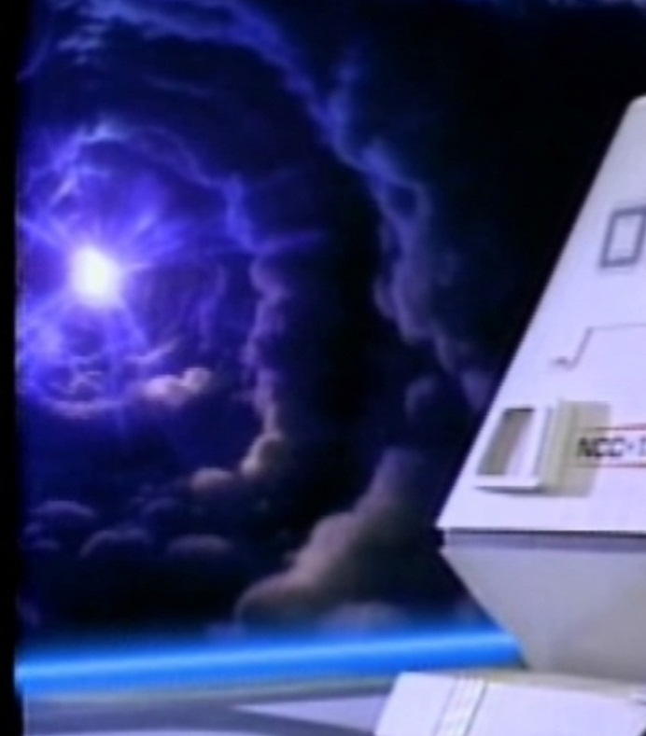
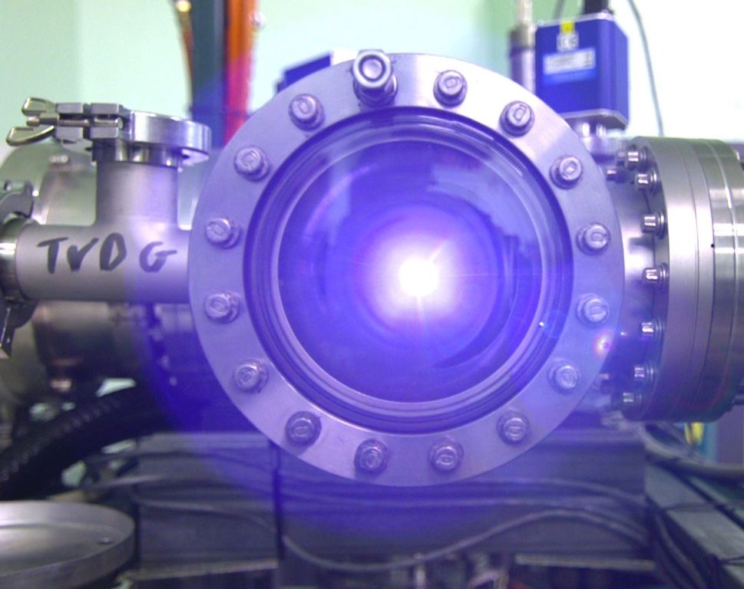




A Windowless Window to the Universe
The Use of a Plasma Window as a Vacuum-Atmosphere Interface for Measurements of Stellar Neutron-Induced Reaction Cross Sections
Ophir Ruimi (Physics Ph.D. Student)
Advisor: Prof. Guy Ron
Erice School on Nuclear Physics, September 20th, 2021

Slide 2
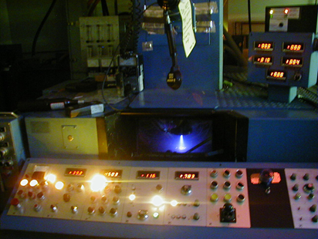
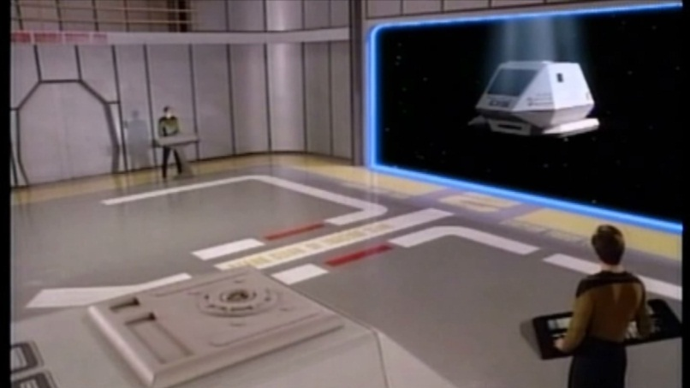
Talk Outline
What is a Plasma Window?
The Plasma Window is a novel apparatus that utilizes a stabilized plasma arc as an interface between vacuum and atmosphere or pressurized targets without solid material. It’s useful in non-vacuum electron-beam welding, as well as in some Physics experiments.
Why Plasma Windows
Operation principles, applications, Sci-Fi
Motivation: Stellar nucleosynthesis
Nuclear Astrophysics at SARAF: Liquid Lithium and enriched water targets
Results, conclusions and future work
Answer questions
Star Trek: The Next Generation (1987)

Slide 3
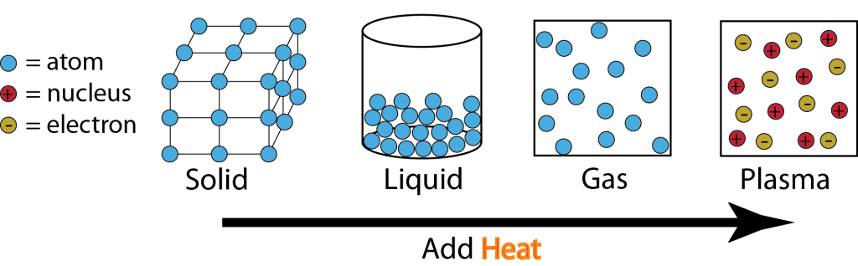
Plasma is ionized gas comprising of ions and electrons. Just like any other gas, plasma exerts pressure. Electric and magnetic fields exert forces on plasmas, which can confine plasmas in vacuum whose pressure can block, curb or confine other fluids. In a Plasma Window, electric and/or magnetic fields confine plasmas, whose pressure is large enough to balance atmospheric pressure (or even higher).
The states of matter and the idea behind a Plasma Window
A plasma is much less dense when than a gas when both are at the same pressure.
Plasmas have a much larger resistance to flow (viscosity) than gases.
A plasma “plug” or “window” can slow down the flow of gases with
little effect of fast particles passing through it.

Slide 4
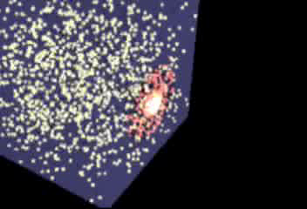
Simulation of a cube in empty space filled with air having a hole plugged by a Plasma Window; Courtesy of Jeffery Mitchell (BNL)

Slide 5
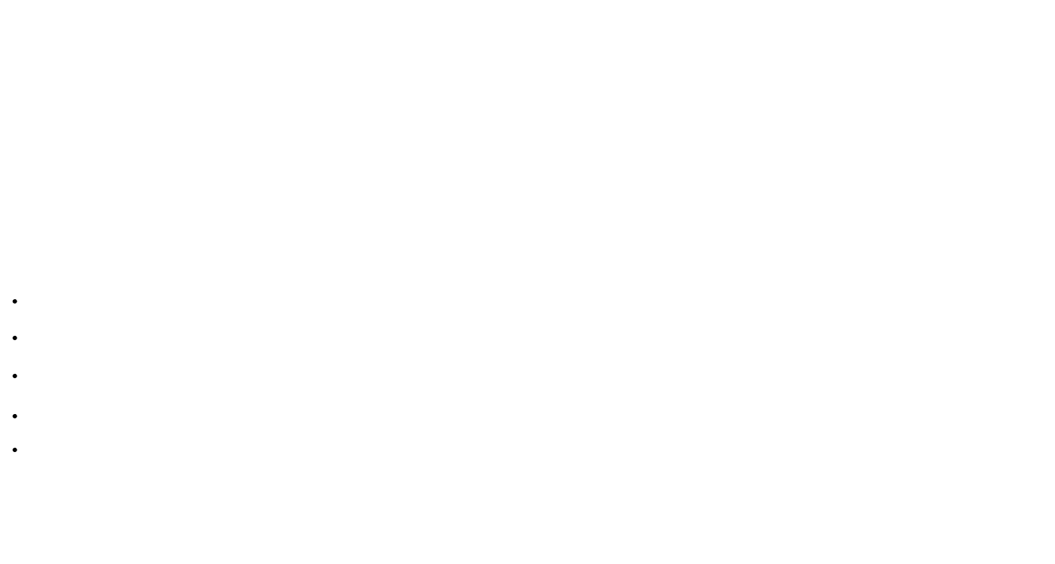
Operation Principles
Ideal Gas: p = nkT
Where p is the partial pressure, n is the density and T is the temperature of the gas or the plasma, k is the Boltzmann constant.
Viscosity: $Q= \frac{πd^{4}}{16ηl}p_{a}\left(p_{1} − p_{2}\right)$
Poiseuille equation for the gas flow rate Q, where d and ℓ are the tube radius and length, η is the gas viscosity, and p_{a} is the arithmetic mean of p₁ and p₂.
A critical assumption, gas is incompressible. Compressibility can be neglected if the Mack number M satisfies 0.5 M² << 1. Some of the assumptions are no longer valid once a discharge is initiated, since the flow becomes compressible and nonisothermal. Therefore, a thorough analysis of such a gas and plasma flow requires solution of Naviar-Stokes equation for the gas. For electrons and ions, the relevant transport equations are the continuity, momentum transfer and viscosity equations:
$\frac{D}{Dt}n_{e,i}+n_{e,i}∇⋅{\underline{V}}_{e,i}=0$
$m_{e,i}n_{e,i}\frac{D}{Dt}{\underline{V}}_{e,i}=−∇p_{e,i}−∇⋅{\underline{P}}_{e,i}+q_{e,i}n_{e,i}\left[\underline{E}+{\underline{V}}_{e,i}×\underline{B}\right]+{\underline{R}}_{e,i}$
$η_{i}=2×{10}^{5}μ^{1/2}\frac{k}{λ_{i}}{T_{i}}_{}^{5/2}$
$η_{e}=2.5×{10}^{7}\frac{k}{λ_{e}}{T_{e}}_{}^{5/2}$
$η_{gas}=aT^{x}$
Where m is the particle mass and q its charge. R is the species total momentum transfer, p its partial pressure and P is the stress tensor, $D/{Dt}=∂_{t}+∇⋅\underline{V}$; η is the viscosity, λ is the Coulomb logarithm. The Naviar-Stokes equation is basically the momentum equation without the electric and magnetic field terms. Note viscosity dependence on temperature x>1 for gases.

Slide 6

The Sky is not the Limit – When Sci-Fi Meets Reality:
Plasma Window Has Captured People’s Imagination
Featured in popular science magazines, newspapers, Michio Kaku‘s book Physics of the Impossible and in an accompanying syndicated article 10 Impossibilities Conquered by Science @#8 PW is listed under Creating force fields.
Star Trek Shuttle’s Bay Door
A Plasma Window at BNL

Slide 7
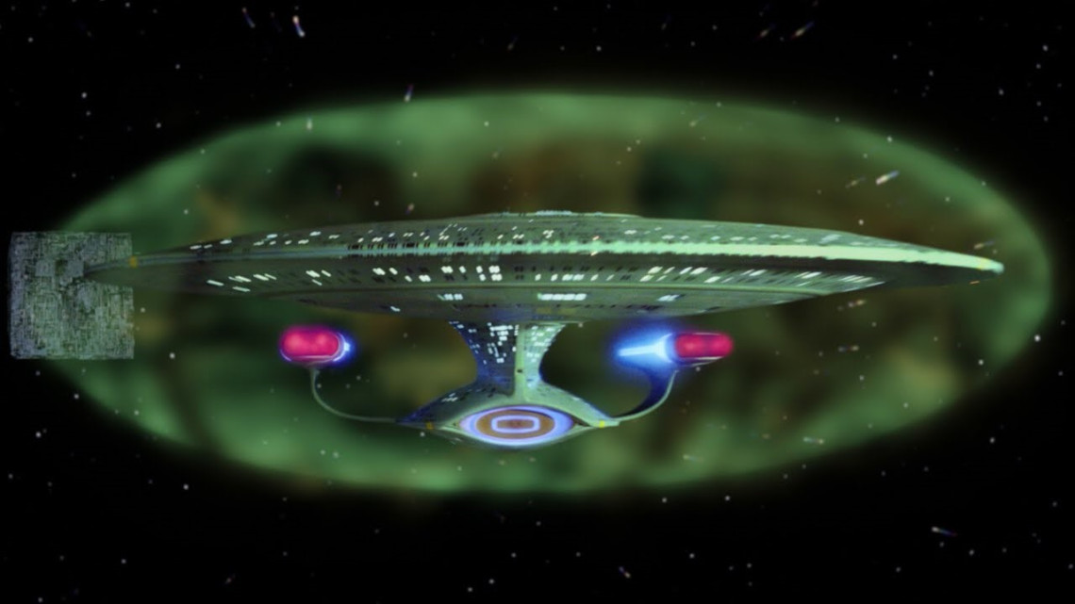
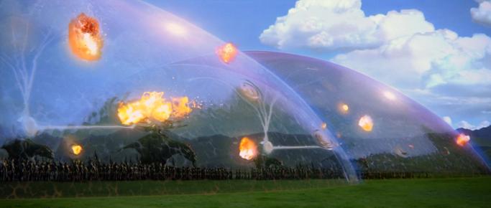
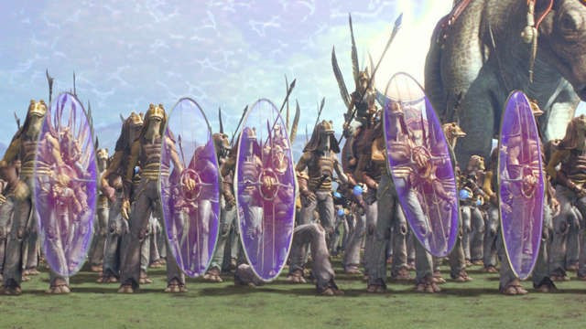
Force fields
Star Wars: A New Hope (Episode IV), George Lucas
1977
The shield around the USS Enterprise
Dome in the battle of Wakanda
Avengers: Infinity wars (2018)
The Gungan handheld shields
Notes:
The Plasma Shield is a Plasma Window extended to engulf a workpiece.

Slide 8
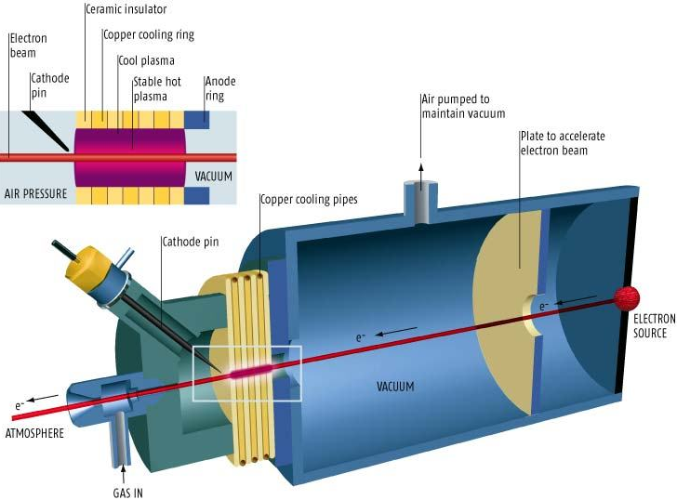
Down to Earth
Schematic diagram of a Plasma Window
The stabilized plug of plasma seals the vacuum chamber to air but allows particle beams to pass through

Slide 9
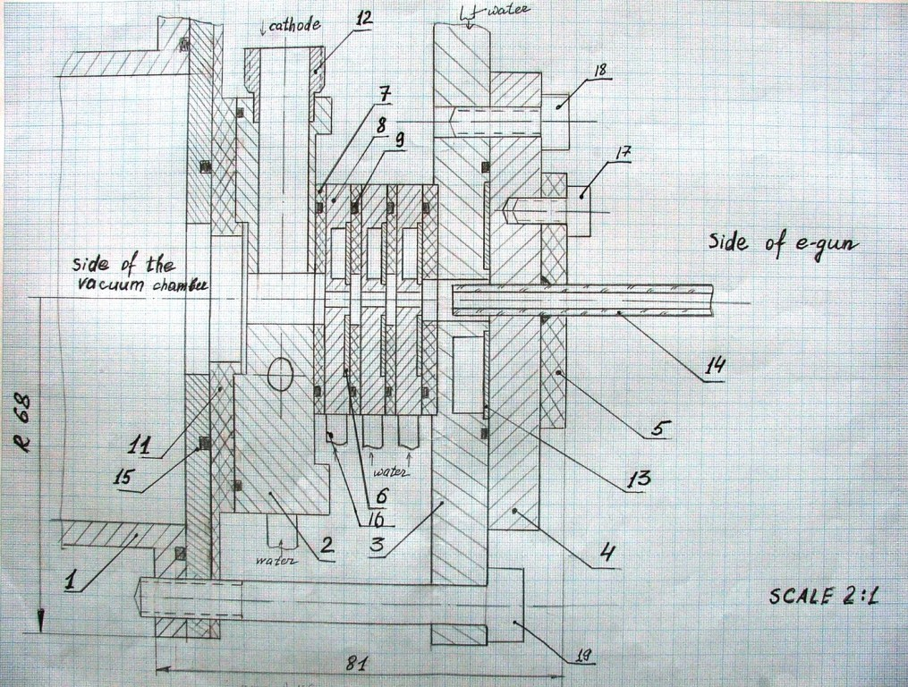
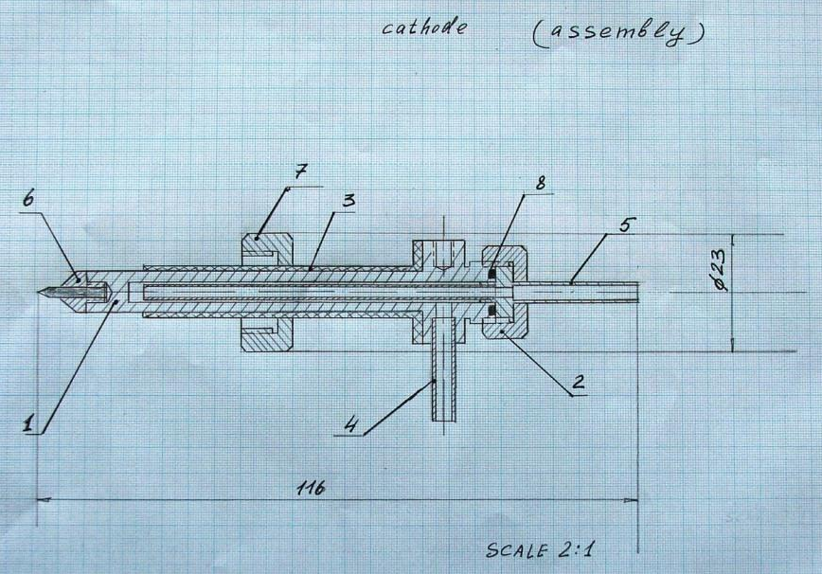
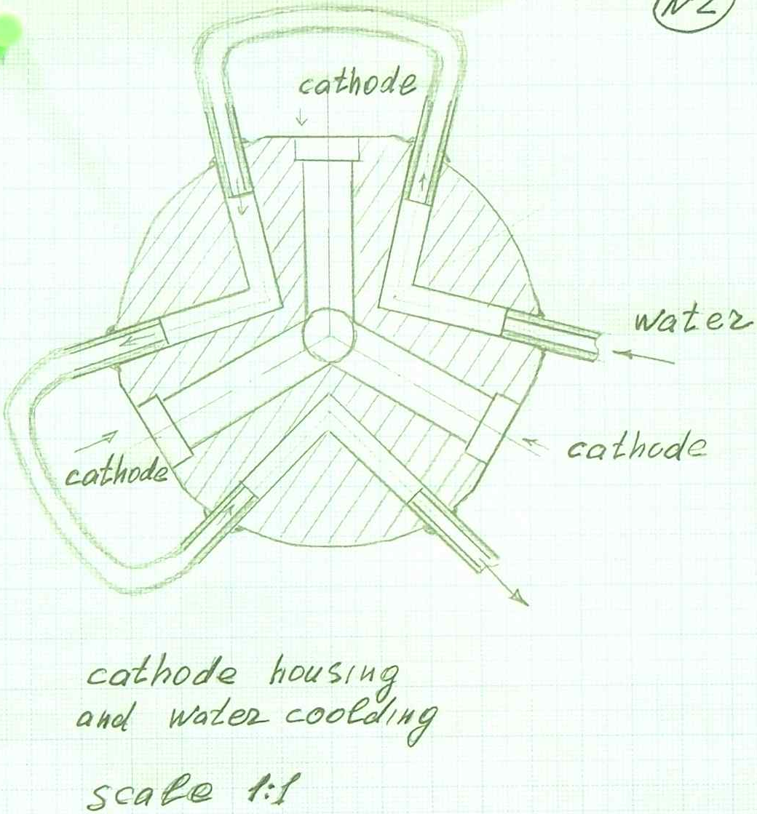
Producing a 3D CAD model from hand-written drawings

Slide 10
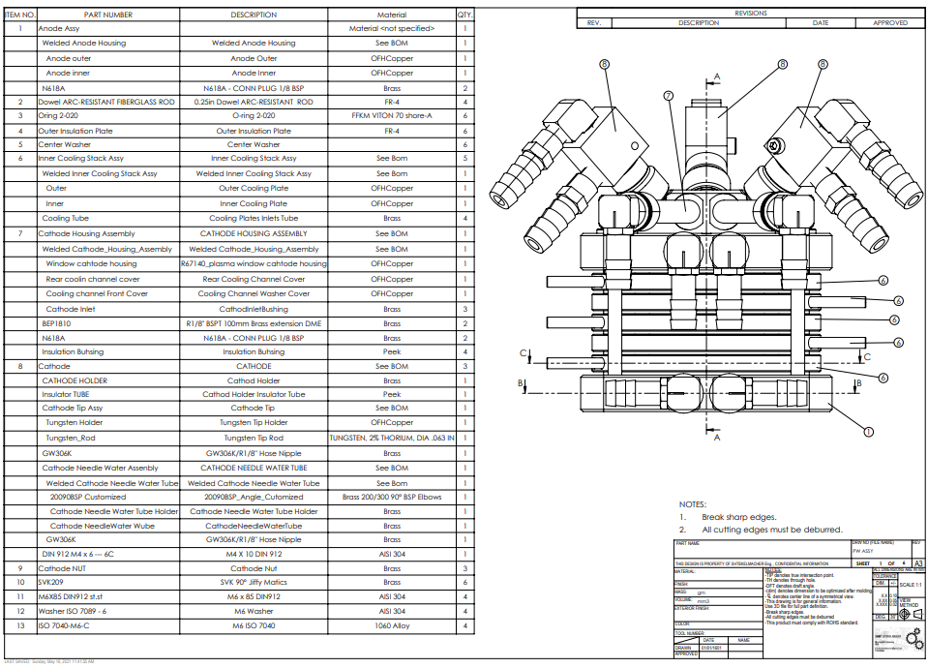
Producing a 3D CAD model from hand-written drawings

Slide 11
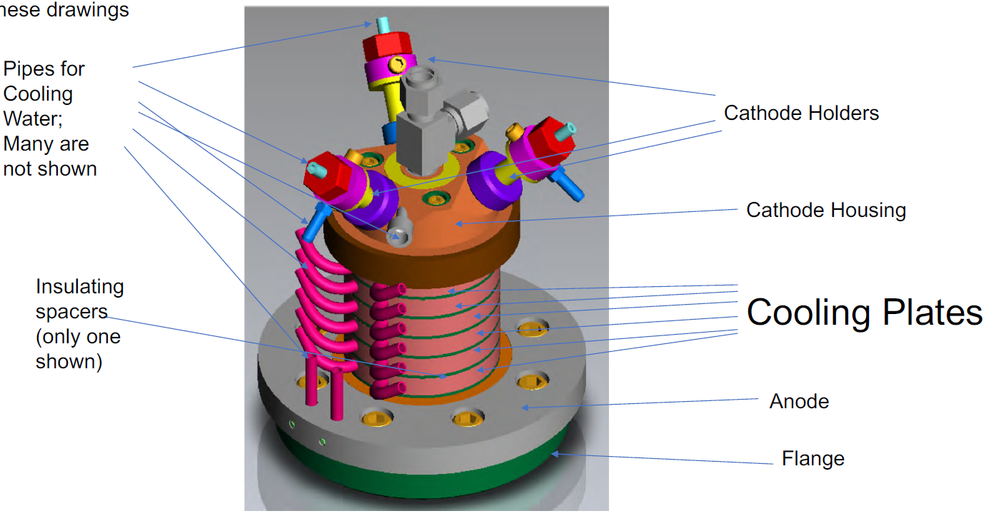
Plasma Window components’ terminology
(OFHC Cu)

Slide 12
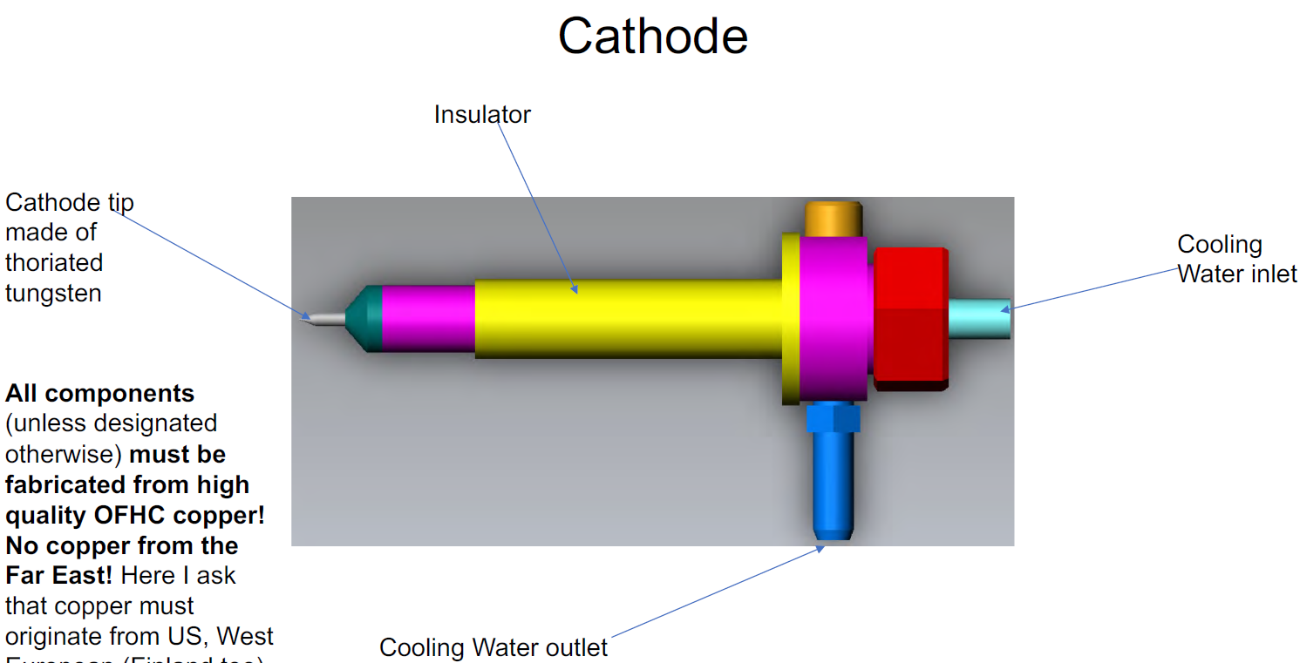

Slide 13
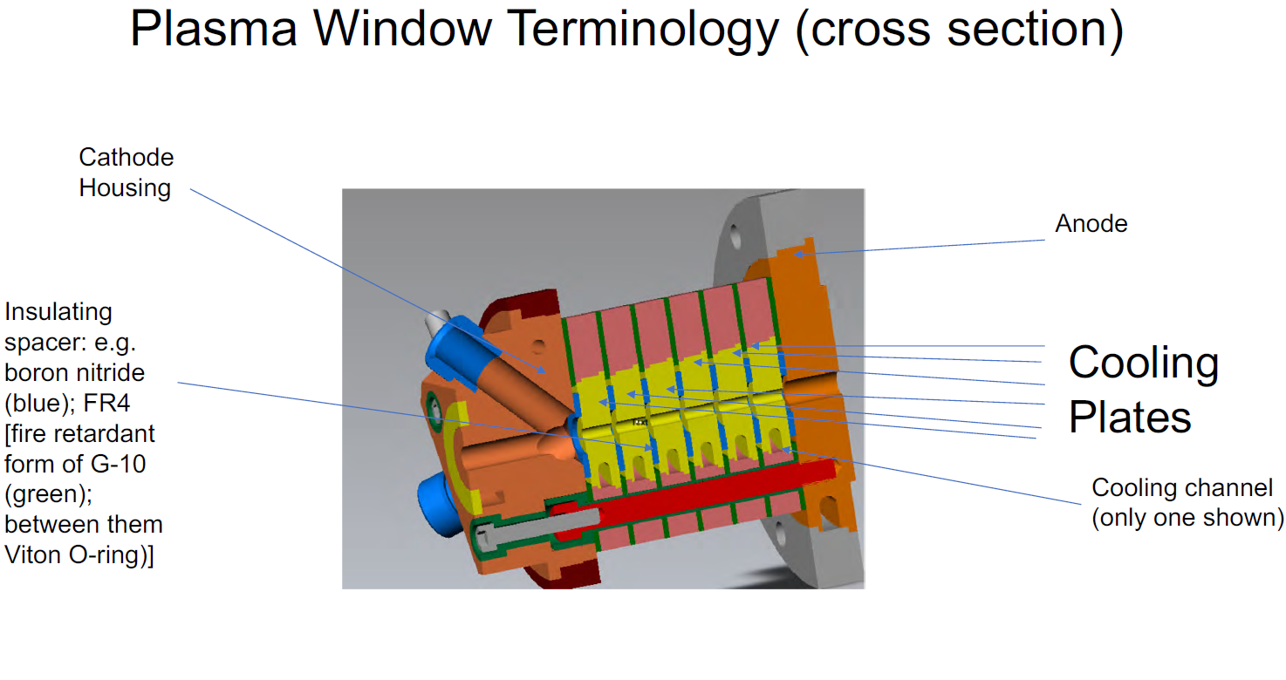
119.9 mm
9.5 mm, insulators: 1.4 mm
66.8 mm
(OFHC Cu)
Central aperture: 5 mm

Slide 14
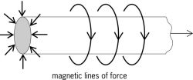
Plasma Lens
(Focuses charged particles similar to light focusing by an optical lens)
F_{r}
V_{z}
B_{θ}
Electron beam
exiting plasma
window
Electron beam
entering plasma
window
Current
$$\underline{F_{r}}=q\underline{V_{z}}×\underline{B_{θ}}$$

Slide 15
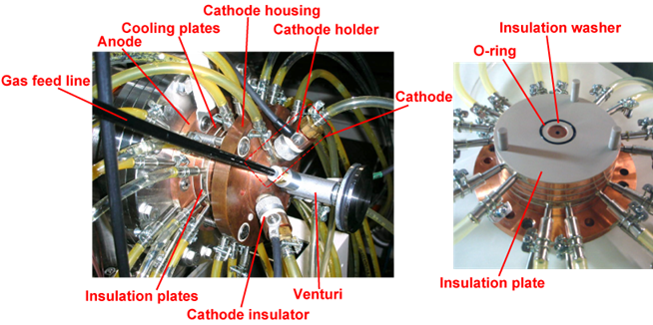

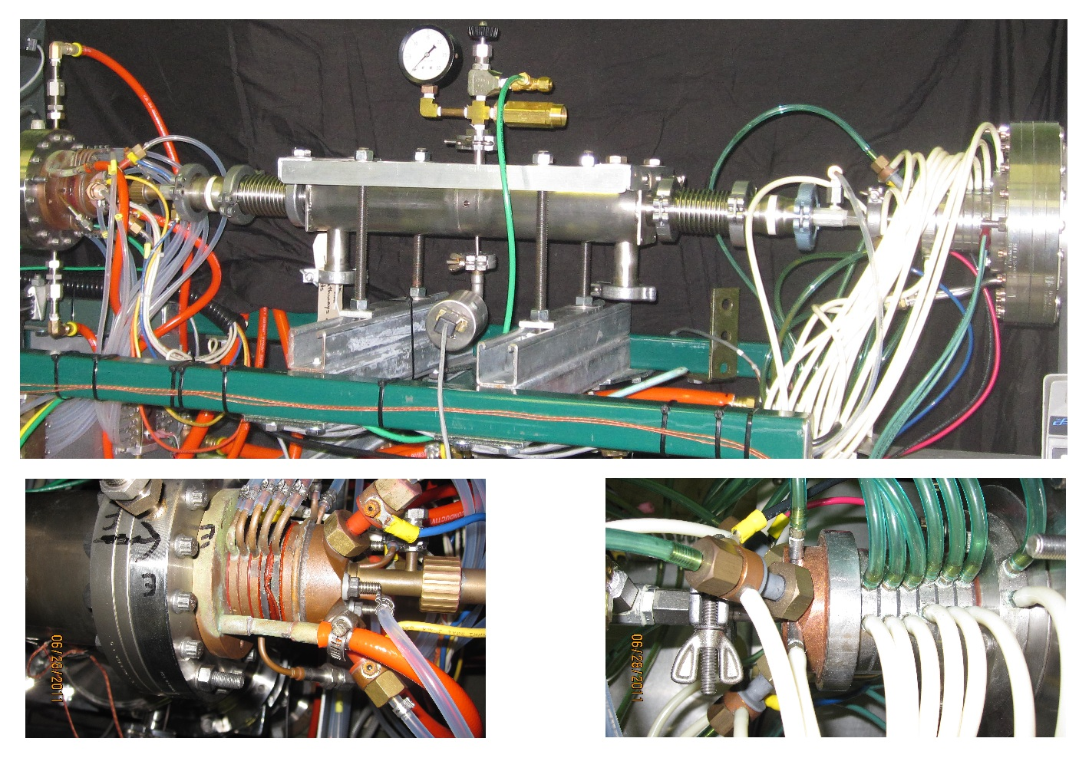
RIKEN (RIBF) Plasma Window
Ady Hershcovitch
BNL Gas Stripper R&D for MSU FRIB

Slide 16
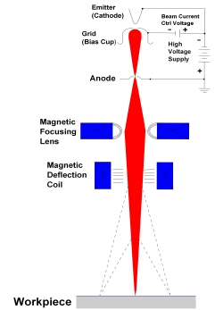
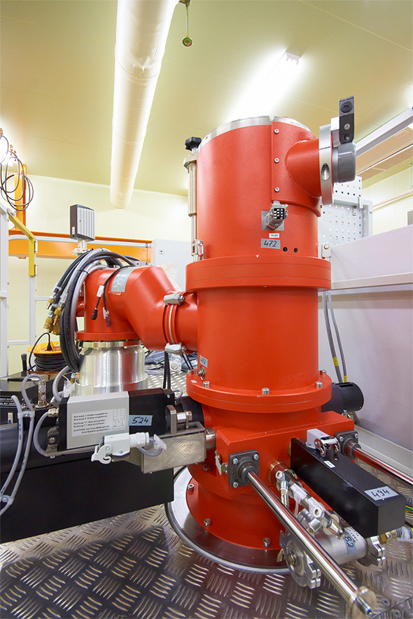
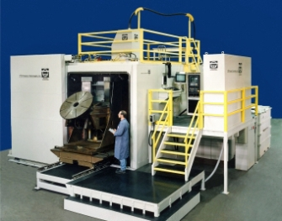
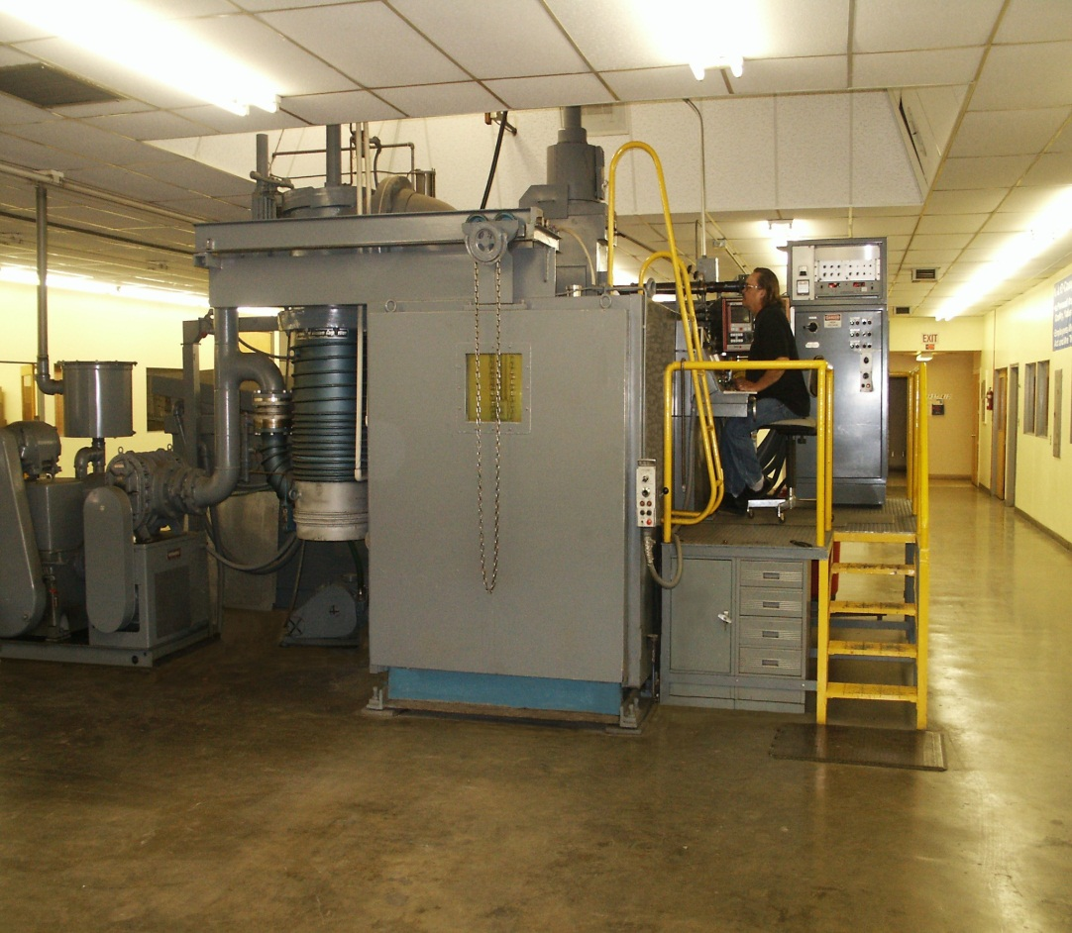
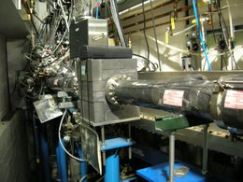
The challenge: Particle beams and electromagnetic radiation are usually generated in vacuum. For some applications it is desirable to bring beams in air or pass the beams through internal gas targets. Such applications include Nuclear Physics experiment, as well as electron beams for welding, X-ray, VUV, EUV for use in microscopy, lithography, etc.
Motivation
Electron-beam welding is the highest quality welding that can be performed. But, it’s done in vacuum, resulting in low production rates and limits on object size. Double hull ship can’t fit in a vacuum system. Past in-air EBW: lower quality.

Slide 17
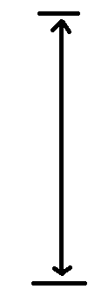
Electron Beam Through Plasma Window
Motivation
1 m
Workpiece

Slide 18

Further applications: Commercial & Scientific
Several different types of accelerator systems can benefit from the utilization of the PW system.
Commercial Applications:
Non-vacuum electron beam welding: With PWs, higher production rates, no limit on the size of target objects, and high quality electron beams in atmosphere.
Non-vacuum material modifications by ion implantation, and dry etching, or micro-fabrication: Presently performed only in vacuum, since ion beams at energies used in these applications are completely attenuated by foils and by long differentially pumped sections.
Electron beam melting: for manufacturing alloys is performed at a pressure of about ${10}^{−2}$Torr. A major drawback of operating at this pressure range is the loss of elements with low vapor pressure. Consequently, it is desirable to raise the operating pressure to a higher level.
Electron beam generation of photo-neutrons for the production of medical isotopes (e.g., Tc-99): A 40 MeV electron beam strikes a W target. Resultant radiation can dislodge a neutron (via a giant resonance) to create a new element. With a plasma window, the target can be in the air, sufficiently cooled to absorb an intense electron beam to generate photo-neutrons.
Windowless gas targets for fast neutron radiography to detect nitrogen (weapons) and carbon (diamonds), as well as for other forms of neutron tomography and therapy (BNCT).
Windows for high power lasers (especially high-pressure gas lasers).
Scientific Applications:
Windowless beamlines for transmission of synchrotron radiation: Plasma windows offer many advantages over presently used beryllium windows:
radiation passes through the window unaffected. A plasma window cannot be damaged by radiation. UV filter for rejection of ‘high-order’ light is of
significant benefit to experiments like threshold photoionization spectroscopy, where contamination even at the ${10}^{−4}$ harmonic content can obscure
the features of the spectrum of interest. X-ray microscopies, since it is free from the attenuation and spatial structure that attend the use of
conventional window materials (e.g. beryllium or SiN), i.e., no scratches.
Windowless gas targets for fast (fusion) neutron generation (neutron sources).
Radioactive waste transmutation (ATW): protons are accelerated to 2 GeV unto a heavy metal target in air. Resultant spallation neutrons
reduce radioactive waste. Presently, windows limit proton output.
APT – tritium production by accelerator: Solid windows limit beam and tritium output.
Spallation Neutron Source (SNS): To replace various solid windows with cooling problem.
Windows for high power x-ray source (DARHT).
Internal (gas or plasma) targets, strippers, lenses in storage rings: A plasma stripper/lens or an internal gas target "sandwiched" between two PWs. Examples: BNCT based on recirculating proton beams and various internal targets (including spin polarized).
Fast acting valves in UHV beamlines. In case of vacuum breach, plasmas can be ignited faster than mechanical valves without damage to beamline (unlike, presently used, msec spring loaded shutters).

Slide 19
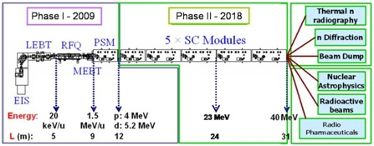
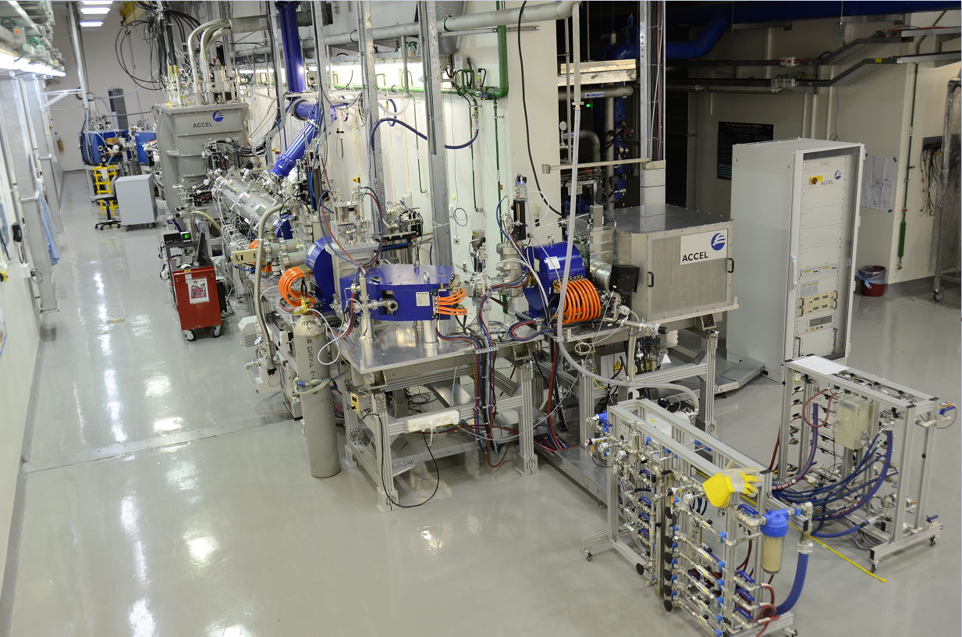
The Soreq Applied Research Accelerator Facility - SARAF
Motivation
A multi-user and versatile particle accelerator. It is based on a proton/deuteron RF superconducting linear accelerator, with variable energy (up to 40 MeV) and a continuous wave (CW) high ion current (0.04-5 mA), located at the Soreq Nuclear Research Center.
2023

Slide 20
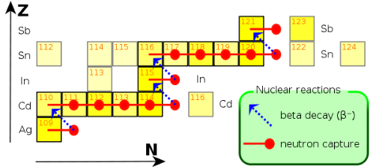
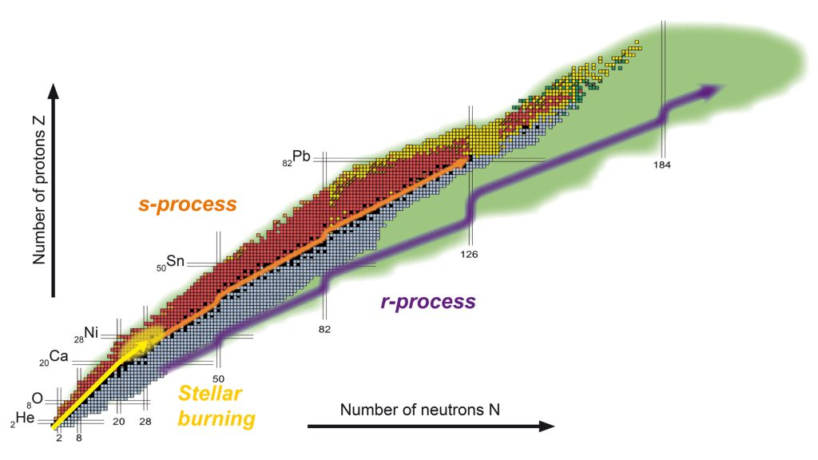



Motivation
Characterization of neutron-induced reaction rates on unstable isotopes is essential for understanding the nucleosynthesis occurring in astrophysical events involving massive stars (s-processes - e.g., the s-process acting in the range from Ag to Sb):
$$n → p + e^{−} +{\overline{ν}}_{e}$$
An enriched water ($H_{2}{}_{}^{18}O$) target is under consideration at SARAF, for using the (p,n) reaction at an accelerated proton energy of 2.6 MeV in order to produce a 5 keV Quasi-Maxwellian neutron spectrum. So far, this reaction has been operated on solid targets, with corresponding low proton current and neutron flux. We aim to make use of the very high current available at SARAF-II to produce orders of magnitude more neutrons, and thus require a high-density target that is able to withstand high currents, which leads us to select a liquid based target. The only relevant liquid is $H_{2}{}_{}^{18}O$.
$$MACS=〈σ〉=\frac{〈σv〉}{v_{T}}=\frac{2}{\sqrt{π}}\frac{\int_{0}^{∞}{e^{−E/kT}σ\left(E\right)EdE}}{\int_{0}^{∞}{e^{−E/kT}EdE}}$$
Image courtesy of EMMI, GSI/Different Arts.

Slide 21
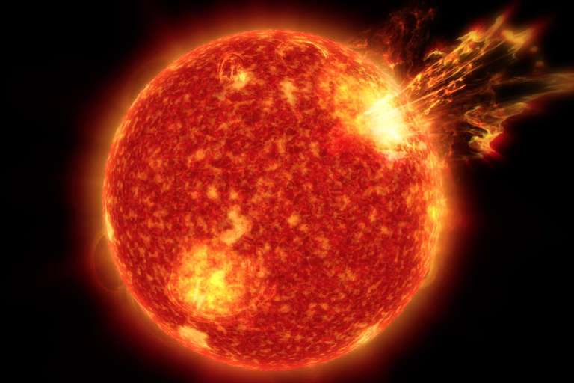
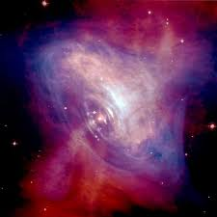

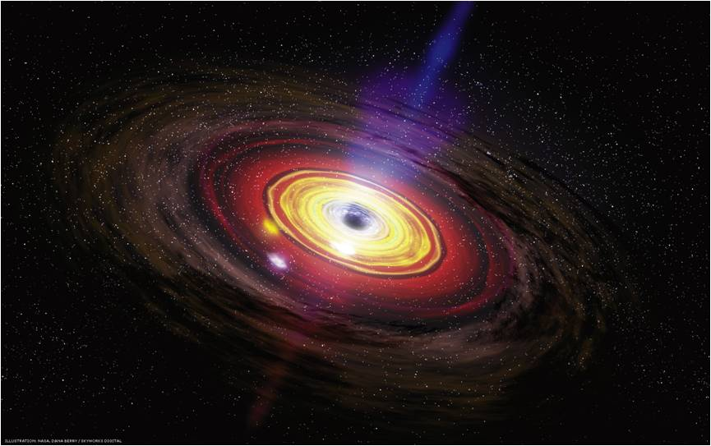
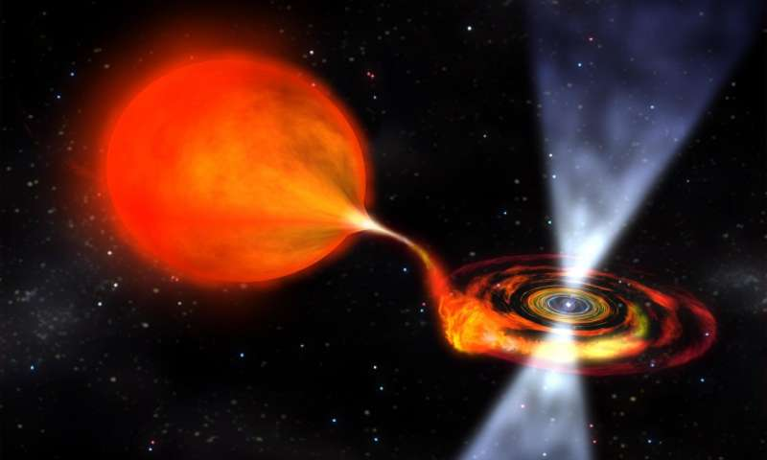
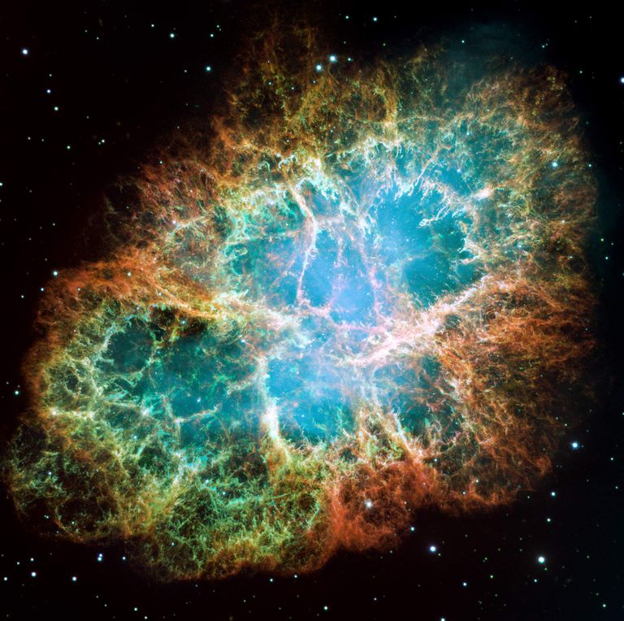
Motivation
Endgoal – The better understanding of processes occuring in:
Asymptotic giant branch stars
Pulsars, binary mergers
Active galactic nuclei
Supernova explosions
Notes:
These data will then be used in state-of-the-art nucleosynthesis codes simulating the interior of stars during different burning stages with complicated temperature and pressure profiles. (in collaboration with Rene Reifarth’s group, Frankfurt a.M.)

Slide 22
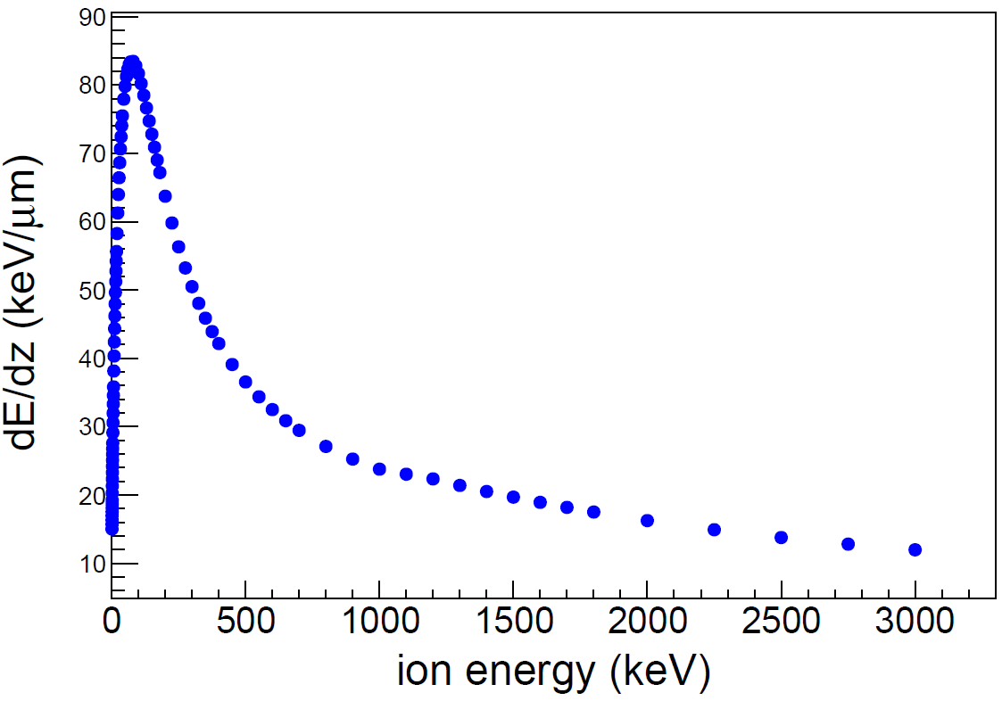
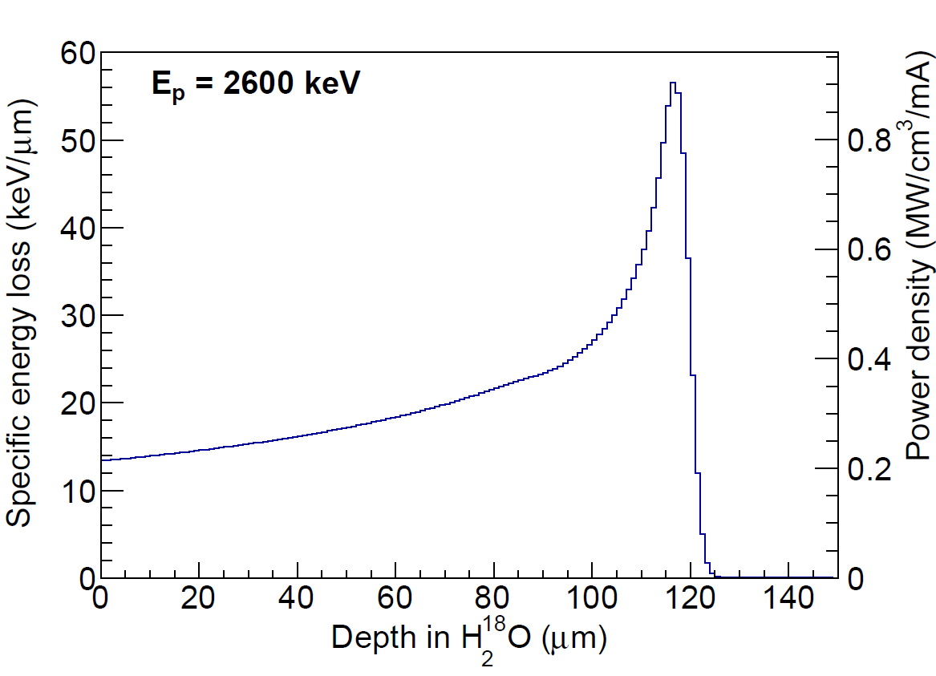
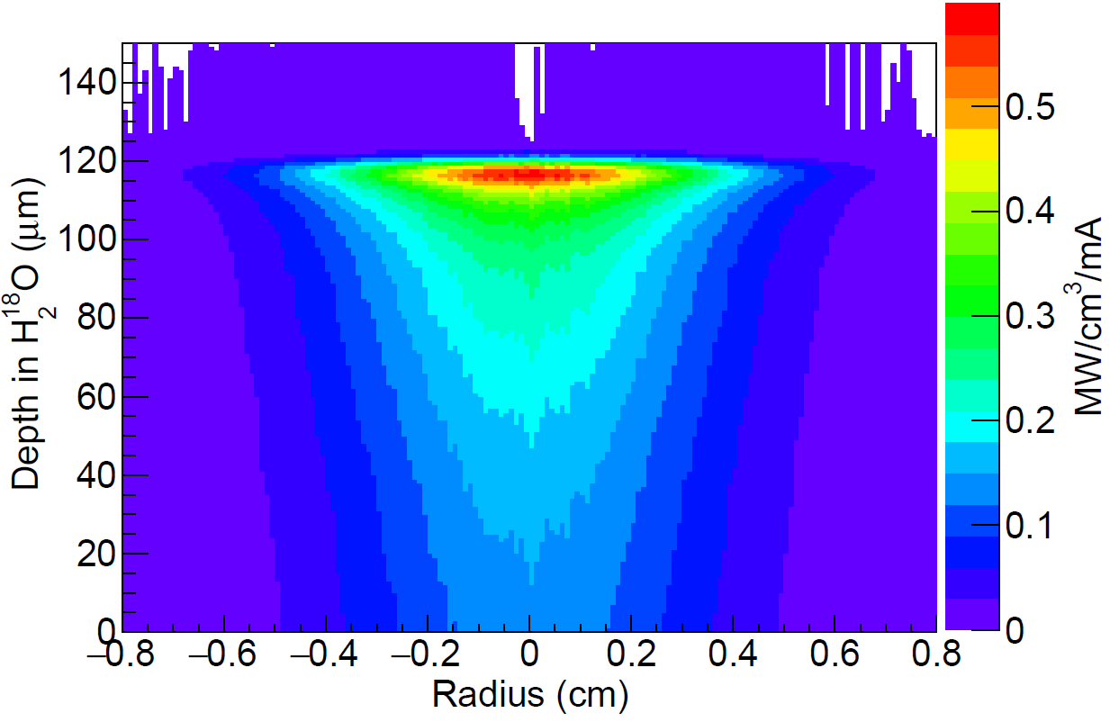
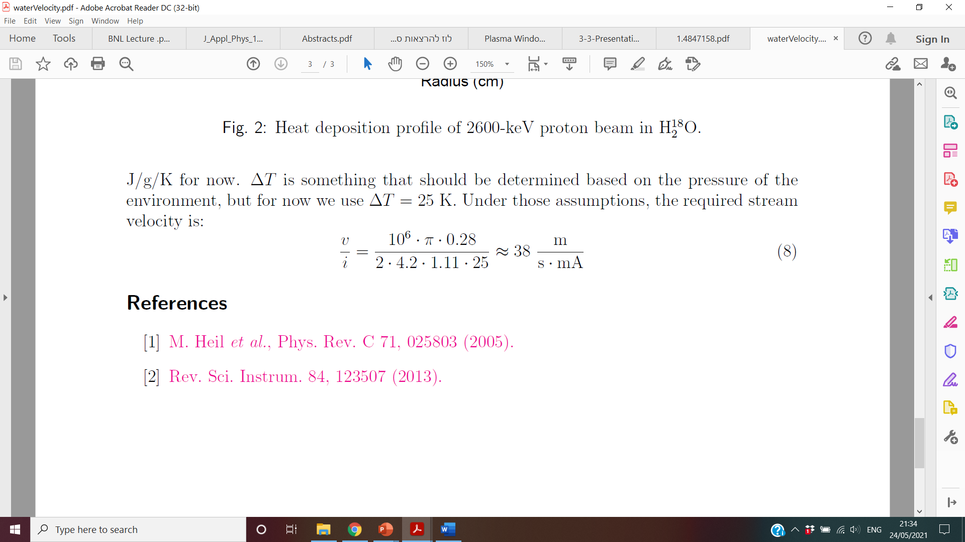

Simulation of $H$ energy and heat deposition in $H_{2}{}_{}^{18}O$ target – preliminary results
Courtesy of Moshe Friedman (HUJI)
Energy loss and heat deposition probe of 2600-keV proton beam in $H_{2}{}_{}^{18}O$. The volume power density plotted is the power deposited within one radial standard deviation.
Energy loss rate vs. initial beam energy
Energy loss vs. depth in the target
Heat deposition
Conservation of the expensive $H_{2}{}_{}^{18}O$entails the use of a circulating target, containing a
reservoir, a heat exchanger and a cooling loop, which controls the liquid's temperature and
flow rate.
The high vapor pressure of $H_{2}{}_{}^{18}O$ is incompatible with accelerator vacuum.
We opt to solve this by using a Plasma Window.
Required stream velocity on impact:

Slide 23
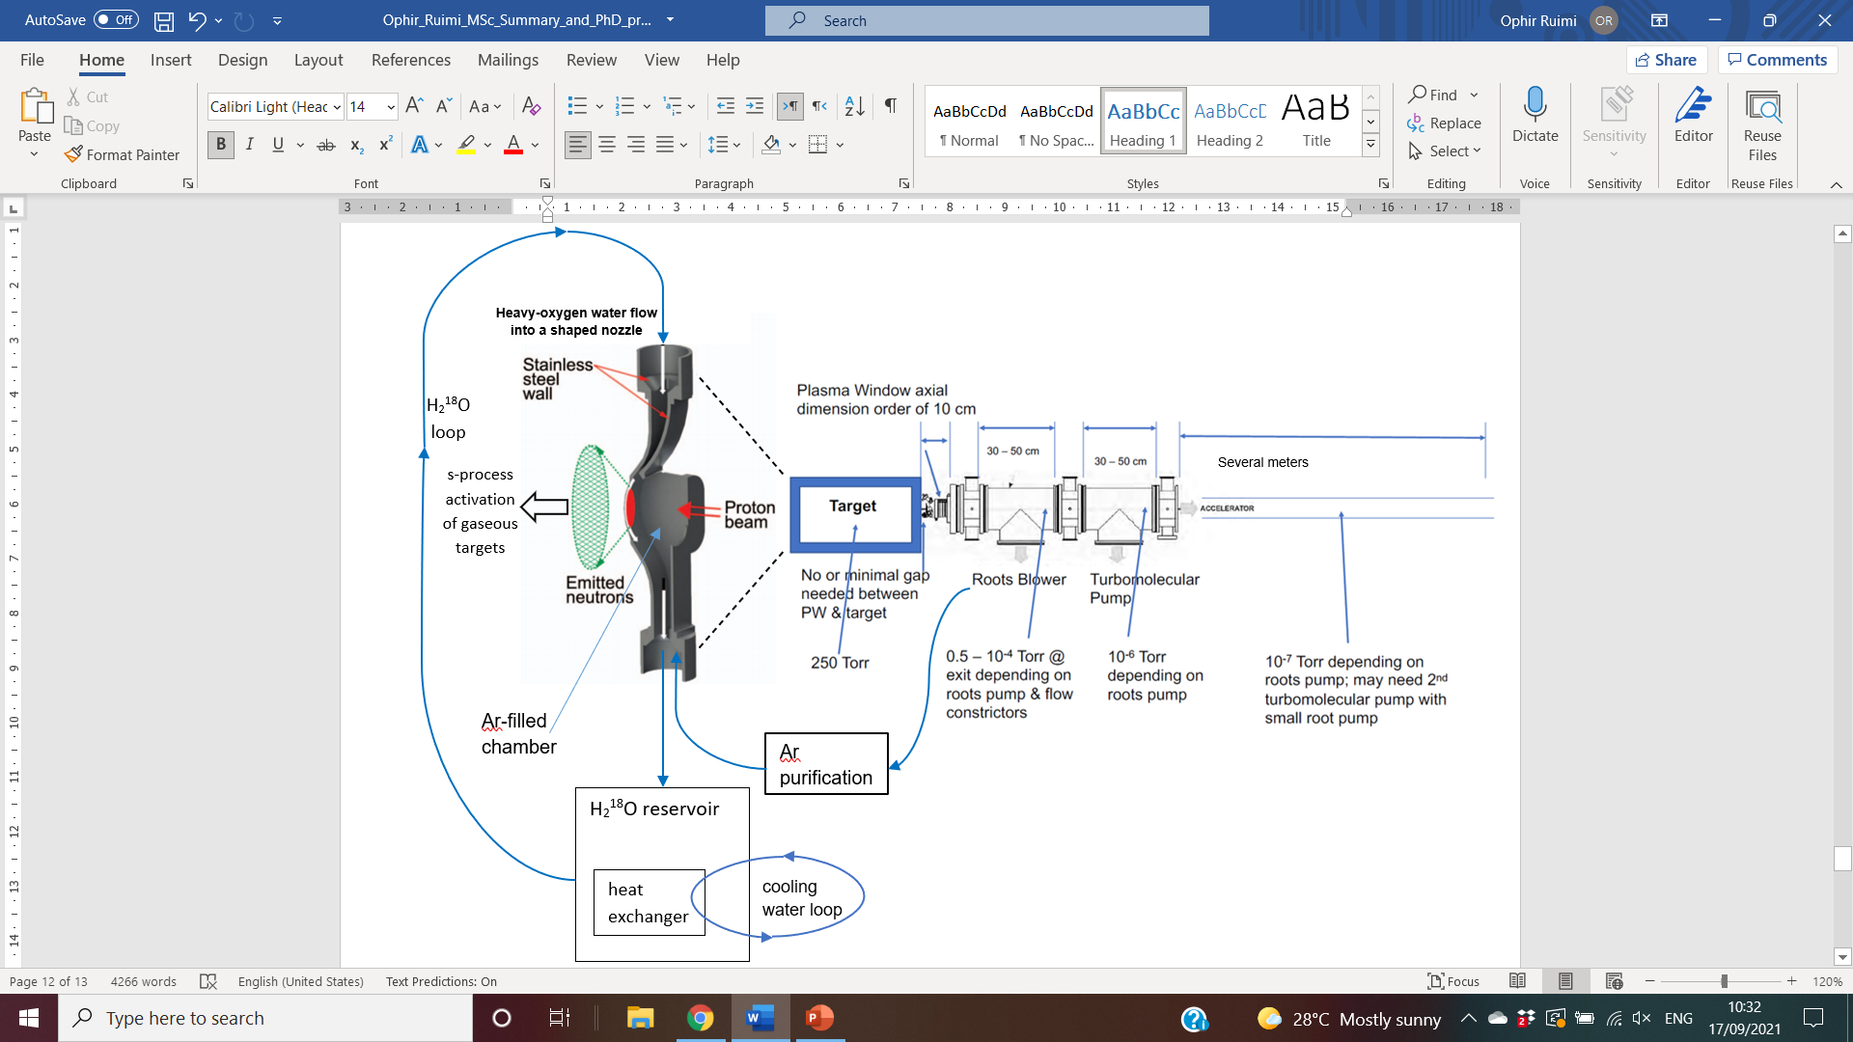
Experiment overview

Slide 24
Summary and future work
PW production tasks:
Produce full solid works model, containing integration with machine infrastructure – Done
Produce construction drawings for machine shop – Done
Build a Plasma Window prototype at HUJI (maintain atmosphere pressure difference) – Start September 2021
PW + Target design tasks:
Based on the energy loss in the Ar gas define the required gas pressure to optimize energy loss and pressure (to be a factor of a few above the water vapor pressure) – Done
Determine required water temperature based on vapor pressure, beam heating, and target density – TBD
Based on beam heating define required flow rate and target thickness (heat capacity and conductance of water) and
beam parameters (areal density – beam radius) – Done
Define safety protocols and requirements – TBD
Based on beam parameters and required pressure define plasma window parameters – Ar flow rate, opening
radius, required power, etc. – Mostly done
Define required pumping systems, cooling loop and Ar recovery – TBD
Simulate – Partly done
Conduct experiment – SARAF’s phase II is under construction, beamtime planned for early 2023

Slide 25
Questions?
Thank You for your Attention

