Slide 1
Big Bang Nucleosynthesis with Time-dependent Quark Mass
Kanji Mori (森寛治) National Astronomical Observatory of Japan University of Tokyo
Mori & Kusakabe, PRD 99 (2019) 083013.

Slide 2
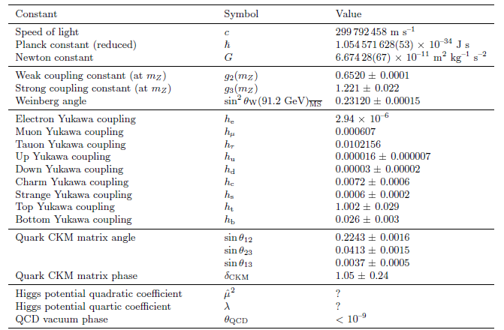
Parameters in the standard model
Q. Are the “constants” really constant?
Uzan, Living Rev. Relativity 14 (2011) 2.

Slide 3
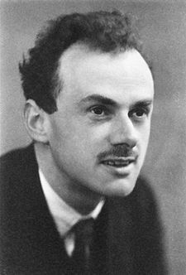
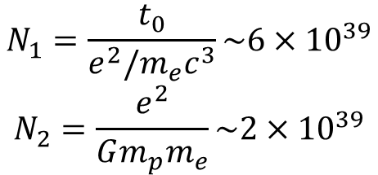
Large number hypothesis
Dirac, Nature 137 (1937) 323.
$$N_{1}=\frac{t_{0}}{e^{2}/m_{e}c^{3}}\sim 6×{10}^{39}$$
$$N_{2}=\frac{e^{2}}{Gm_{p}m_{e}}\sim 2×{10}^{39}$$
Cosmic age v.s.
classical electron radius / c
Coulomb force v.s.
Gravitational force
$$N_{1}\sim N_{2}$$
$N_{1}\sim N_{2} implies G∝1/t$
(if other constants are constant).
P. A. M. Dirac
(1902-1984)

Slide 4
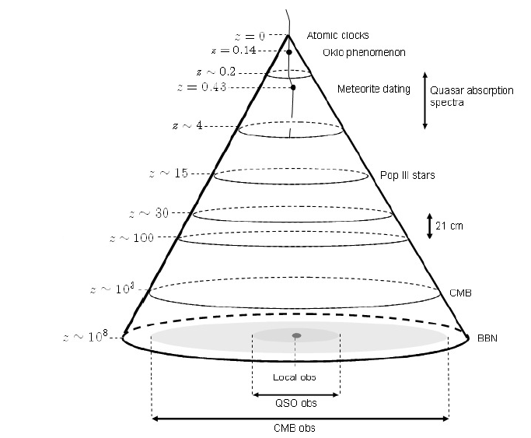
Cosmic probes into time-dependent constants
Uzan, Living Rev. Relativity 14 (2011) 2.
BBN as a probe into physics in the earliest Universe!

Slide 5
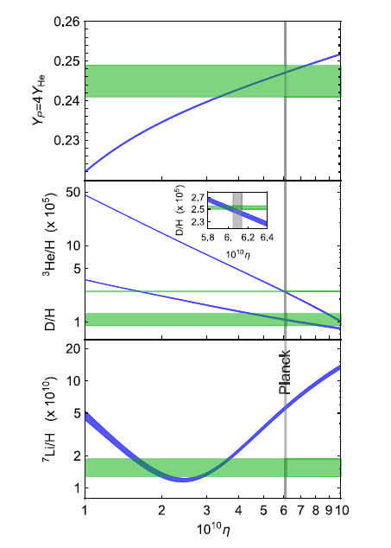
Big Bang Nucleosynthesis (BBN)
H and He (& Li) were produced within ~1000 sec after the Big Bang.
Prediction about primordial abundances of ⁴He, ²H, and ⁷Li can be compared with astronomical observation.
→ BBN is a probe for non-standard physics in the early universe.
Predicted ⁷Li abundance is higher than observations (primordial Li problem).
D/H
³He/H
Pitrou et al., Phys. Rep. 754 (2018) 1.

Slide 6
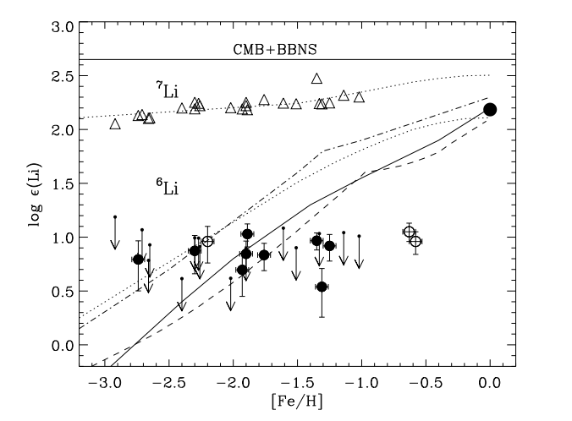
Primordial ⁷Li problem
Li abundance in metal-poor stars is constant as a function of [Fe/H] (Spite plateau).
Possible solutions:
Stellar physics (photospheric model, evolution of low-Z stars, …)
Nuclear physics (uncertainty in reaction rates, distribution function, …)
Beyond-standard physics
Asplund et al., ApJ 644 (2006) 229.

Slide 7
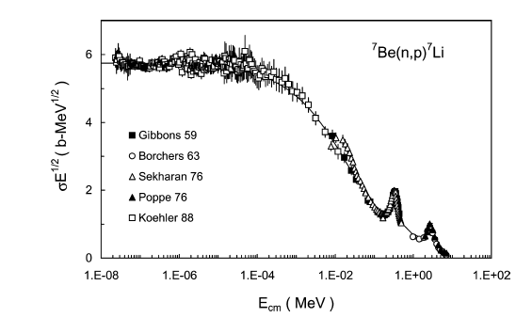
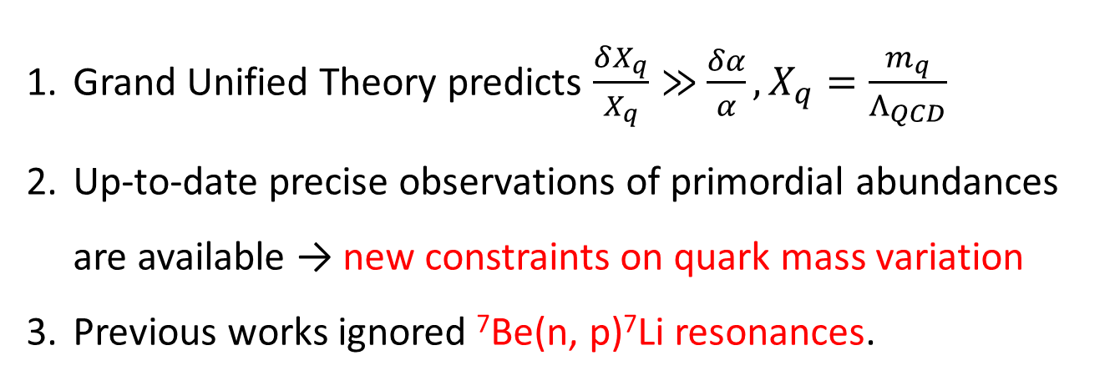
Motivation: Why quark mass?
Grand Unified Theory predicts $\frac{δX_{q}}{X_{q}}≫$ $\frac{δα}{α}, X_{q}=\frac{m_{q}}{Λ_{QCD}}$
Up-to-date precise observations of primordial abundances are available → new constraints on quark mass variation
Previous works ignored ⁷Be(n, p)⁷Li resonances.
cf. Berengut, Flambaum & Dmitriev, PLB 683 (2010) 114.
Cheoun, Kajino, Kusakabe & Mathews, PRD 84 (2011) 043001.
2⁻
3⁺
3⁺
Descouvemont et al., ADNDT 88 (2004) 203

Slide 8
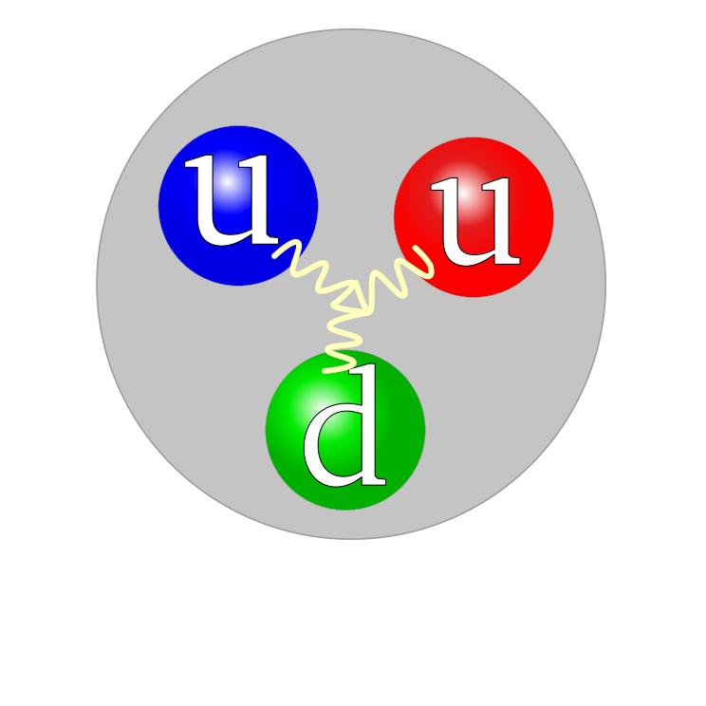
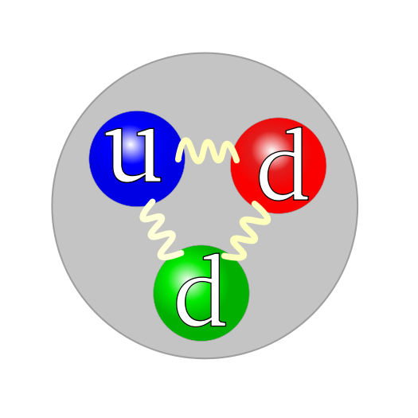
Quark mass variation and nuclear reaction rates
Quark mass variation
→ Variation of binding energy of nuclei.
→ 1. Q-values of each reaction change.
1-1. For radiative captures$σ\left(E\right)\sim {(Q+E)}^{3}$ (e.g. ²H(p,γ)³He)
1-2. For other reactions
$σ\left(E\right)\sim \sqrt{Q+E}\text{exp}\text{(}−\sqrt{E_{g}/(Q+E)}\text{)}$
2. Resonance energies change for ³He(d,p), ³H(d,n) and ⁷Be(n,p).
→ Reaction rates change.
Flambaum & Wiringa, PRC 76 (2007) 054002.
from Wikipedia
proton
neutron

Slide 9
Resonance energy variation
⁸Be
ΔE_{r} is model-dependent…
Case A. ΔE(exited state)=ΔE(ground state)
ex) ΔE(⁸Be*)=ΔE(⁸Be)
Case B. Resonance energies of inverse reactions do not change
ex) ΔE(⁸Be*)=ΔE(⁷Li)
Case C. ΔE_{r}=0
ex) ΔE(⁸Be*)=ΔE(⁷Be)
E_{r}
⁷Be+n
⁷Li+p
The same assumptions are applied to ³He(d,p) and ³H(d,n).

Slide 10
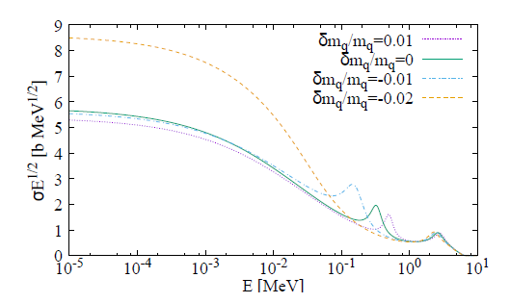
⁷Be(n,p)⁷Li reaction cross sections
Case A i.e. ΔE(⁸Be*)=ΔE(⁸Be)
Case B i.e. ΔE(⁸Be*)=ΔE(⁷Li)
BBN Temp.
BBN Temp.
Small m_{q}
Mori & Kusakabe, PRD 99 (2019) 083013.
⁷Be(n,p)⁷Li cross sections change significantly in Case A.

Slide 11
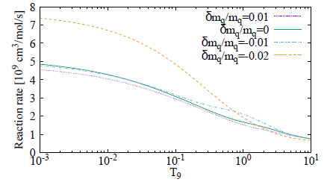
⁷Be(n,p)⁷Li reaction rates
Case A i.e. ΔE(⁸Be*)=ΔE(⁸Be)
BBN Temp.
Mori & Kusakabe, PRD 99 (2019) 083013.
⁷Be(n,p)⁷Li reaction rates increase significantly when quark mass variation is negative.

Slide 12
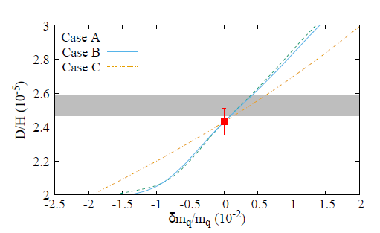
Constraints from the deuterium abundance
Keck+HIRES spectroscopic observation of a metal-poor absorption system toward quasar Q1243+307 achieved 1% determination of primordial D abundances.
Ref. Cooke, Pettini & Steidel, ApJ 855 (2018) 102.
Observation (2σ)
Theoretical uncertainty
Mori & Kusakabe, PRD 99 (2019) 083013.
Comparison between prediction and observation
→ |δm_{q}/m_{q}| < 1%

Slide 13
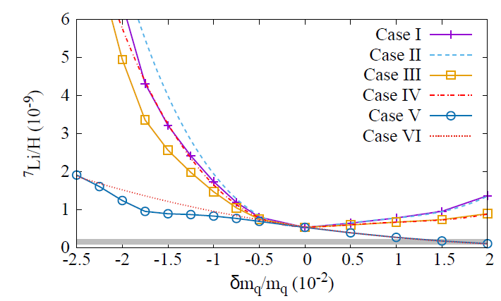
⁷Li production
In Case V & VI, the Li problem is mitigated!
Observation (2σ)
Mori & Kusakabe, PRD 99 (2019) 083013.
Increase of ⁷Li production is suppressed when quark mass variation is negative, because ⁷Be is destructed by ⁷Be(n,p).

Slide 14
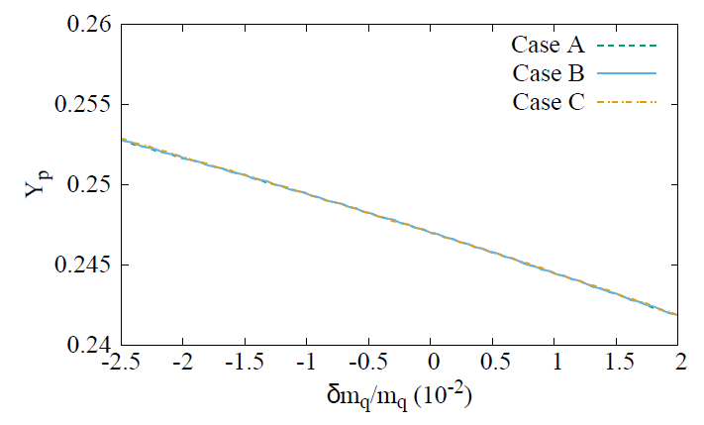
⁴He abundance
Mori & Kusakabe, PRD 99 (2019) 083013.
Observation (2σ)
Constraints from the ⁴He abundance are weak.

Slide 15
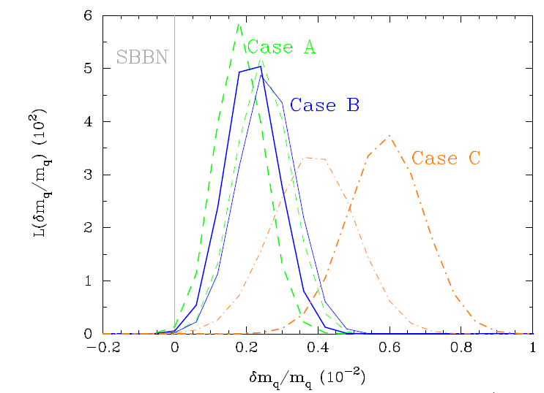
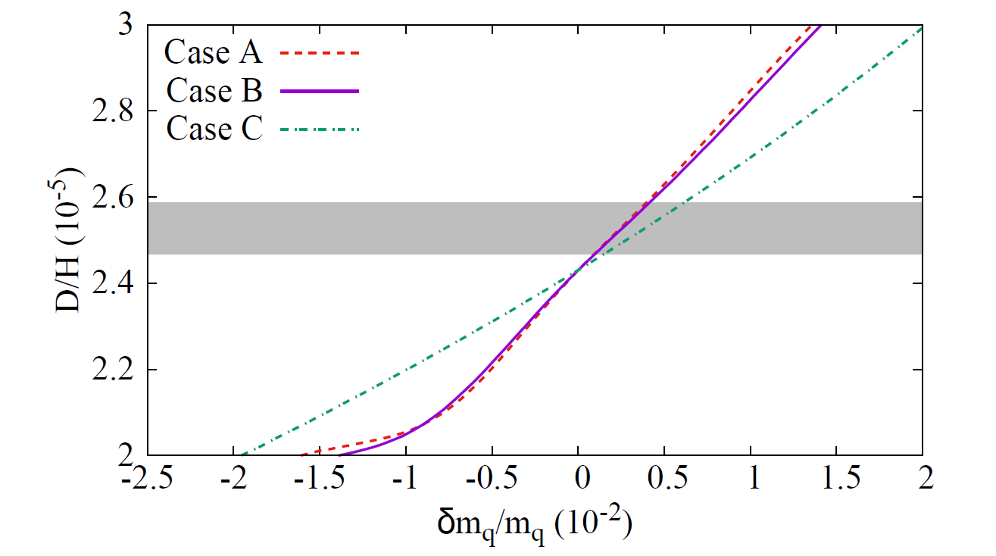
Deviation in the D abundance?
D abundance
Mori & Kusakabe, PRD 99 (2019) 083013.
Thick: w/ Li
Thin: w/o Li
Observation (2σ)
SBBN
Likelihood
Discrepancy between SBBN and the observation
Δm_{q}/m_{q} > 0 is preferred.
Theoretical uncertainties are not included.

Slide 16
Summary
We investigated BBN with time-dependent quark mass.
The quark mass variation during the BBN epoch should be less than 1%.
⁷Li production increases if the quark mass is smaller. But the effect of ⁷Be(n,p)⁷Li can lead to smaller ⁷Li production than that of previous works.
⁷Li production decreases and the Li problem can be mitigated if the quark mass is larger.
Theoretical works on the quark mass dependence of resonances are desirable.

Slide 17
Quark-mass dependence of D & ⁴He
Deuterium increases and ⁴He decreases monotonously as a function of m_{q}.
D
Reason:
Large m_{q}
→ Small Q-value of ¹H(n, γ)²H
→ Late freeze-out of D
→ D is less destructed and ⁴He is less produced
⁴He

Slide 18
Quark-mass dependence of ⁷Li
⁷Li basically decreases as a function of m_{q}.
Reason:
Large m_{q}
→ Small Q-value of ¹H(n, γ)²H
→ Late freeze-out of D
→ More neutrons
→ ⁷Be are more destructed via ⁷Be(n, p).

