Slide 1
EXO-200 and nEXO: present and future
Andreas Piepke
For the EXO-200 and nEXO collaborations
University of Alabama

Slide 2
The schedule has 5 talks about double beta decay, total of 200 minutes, before mine. I decided to skip a general intro entirely. I have one, should it be needed.
I will, therefore, limit my intro to some general observations regarding double beta decay experiments and the choice of the decaying nuclide.
What has been done before and what was particularly successful?

Slide 3
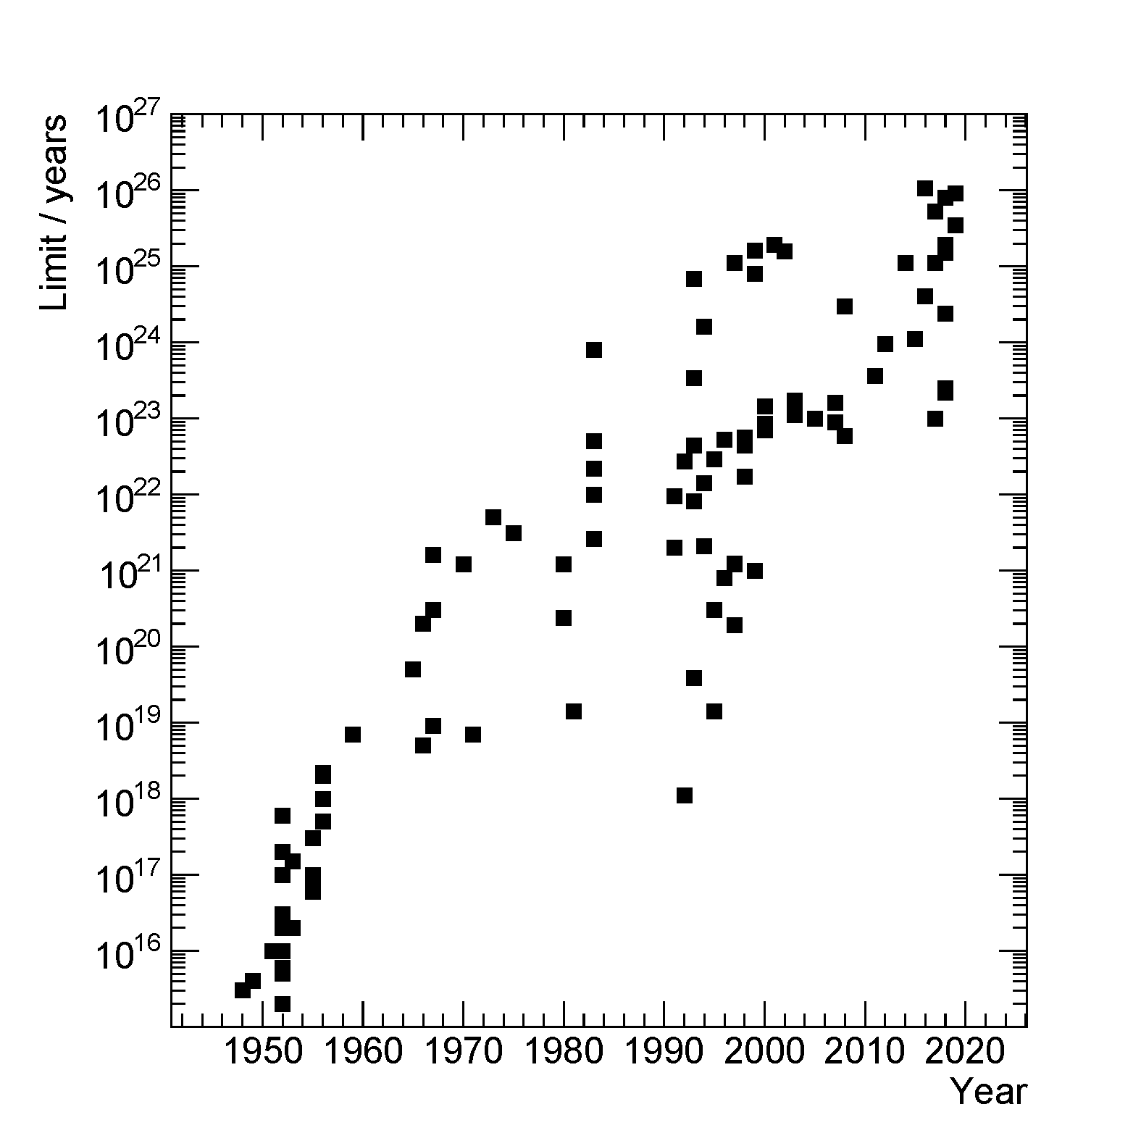
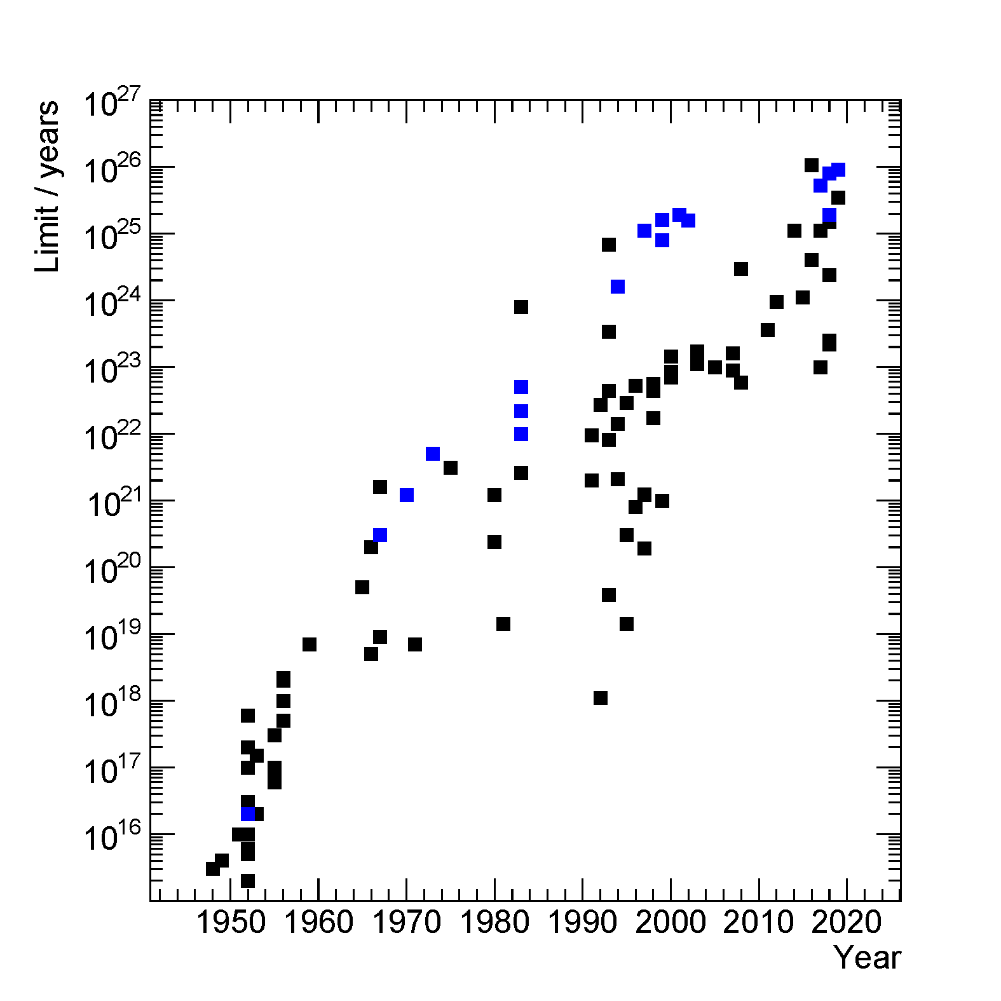
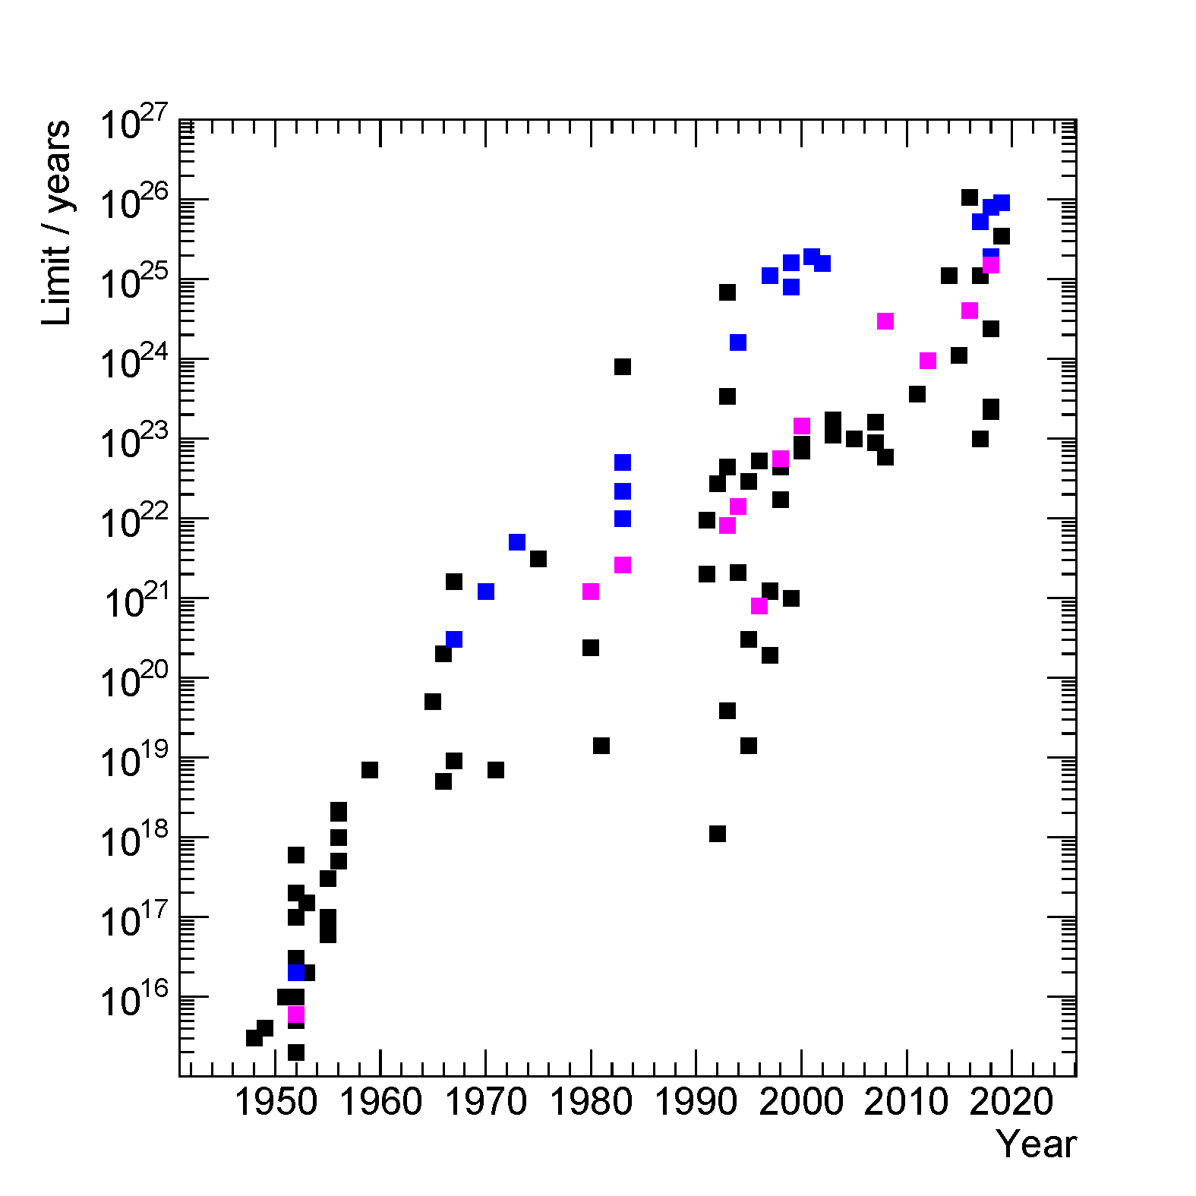
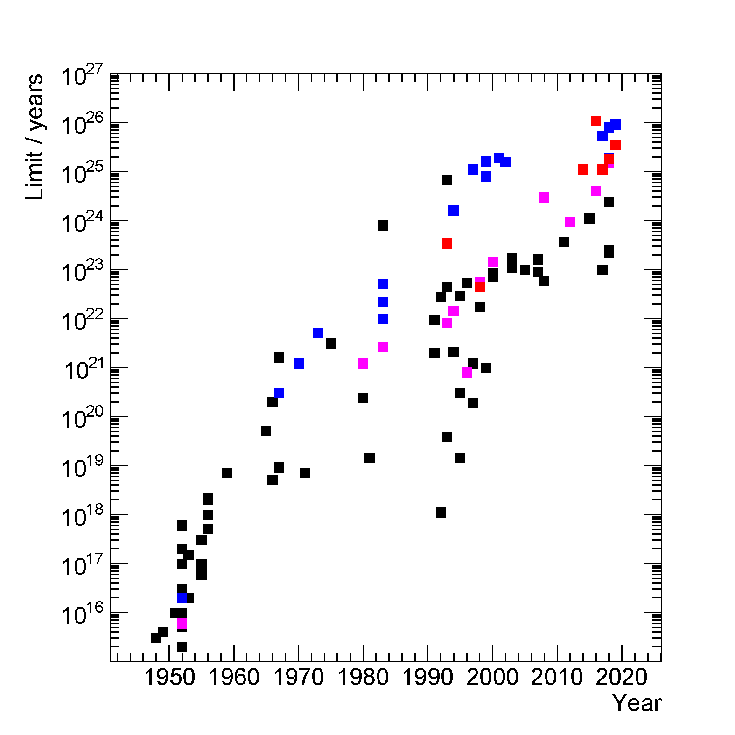
How did experiments on $ββ$-decay develop over time?
This subject has been investigated experimentally for some 7 decades now.
For a long time ⁷⁶Ge calorimetry, initially with natural, later with isotopically enriched Ge, was the most sensitive approach.
Experiments based on ¹³⁰Te are sensitive. Because of the high natural abundance of ¹³⁰Te no enrichment is needed.
By now experiments with isotopically enriched Xe are competitive. Tracking detectors can be built.
“Improved” version of plot by Giorgio Gratta

Slide 4
The high resolution calorimeter and one dimensional peak search have long been the mainstay of $0νββ$-searches.
The strongest results, for a long time, came from Ge solid state detectors, capitalizing on their superb energy resolution and ever improving background rates.
This supremacy is being challenged: experiments using ¹³⁶Xe are now comparable in reach.
My talk is about an approach beyond calorimetry: using tracking TPCs, filled with isotopically enriched liquid xenon, enabling a multi-dimensional decay search.
My talk has two parts:
The past: EXO-200 and the final results derived from the entire data set
The (possible) future: nEXO our planned tonne scale search with enriched ¹³⁶Xe

Slide 5
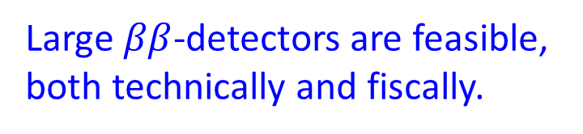
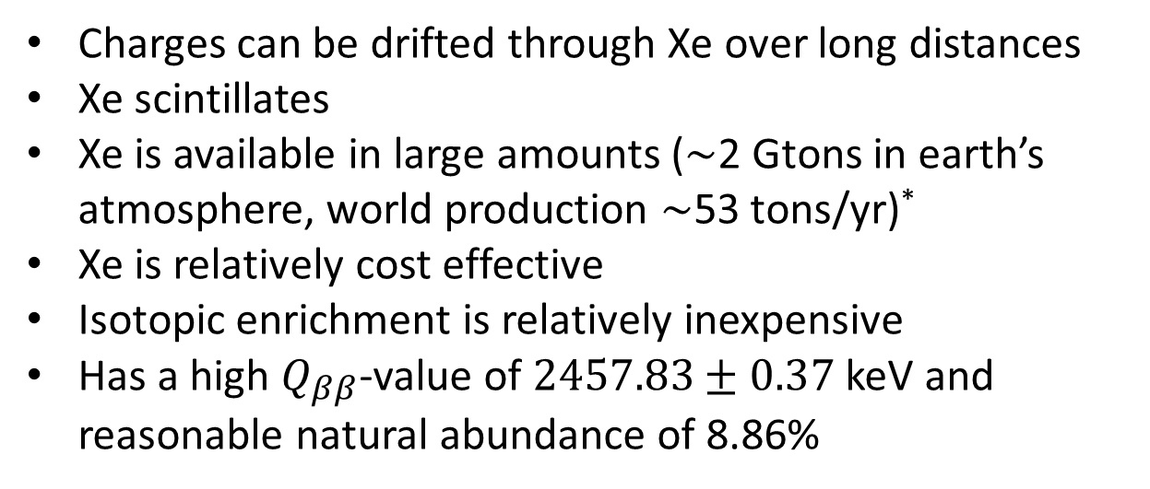
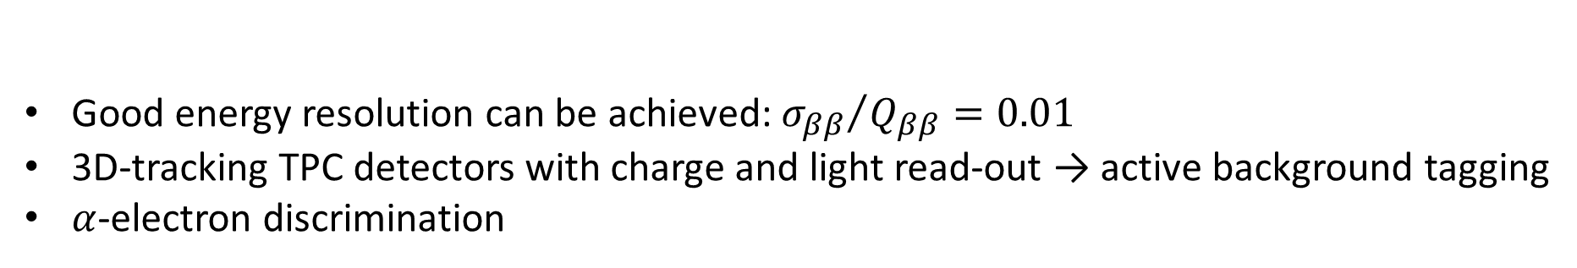
¹³⁶Xe is an excellent candidate for $0νββ$-decay experiments:
Charges can be drifted through Xe over long distances
Xe scintillates
Xe is available in large amounts ($\sim$2 Gtons in earth’s atmosphere, world production $\sim$53 tons/yr)*
Xe is relatively cost effective
Isotopic enrichment is relatively inexpensive
Has a high $Q_{ββ}$-value of $2457.83±0.37$ keV and reasonable natural abundance of 8.86%
Large $ββ$-detectors are feasible, both technically and fiscally.
Good energy resolution can be achieved: ${σ_{ββ}}/{Q_{ββ}=0.01}$
3D-tracking TPC detectors with charge and light read-out → active background tagging
$α$-electron discrimination
*Source: NASA & Linde 2015

Slide 6
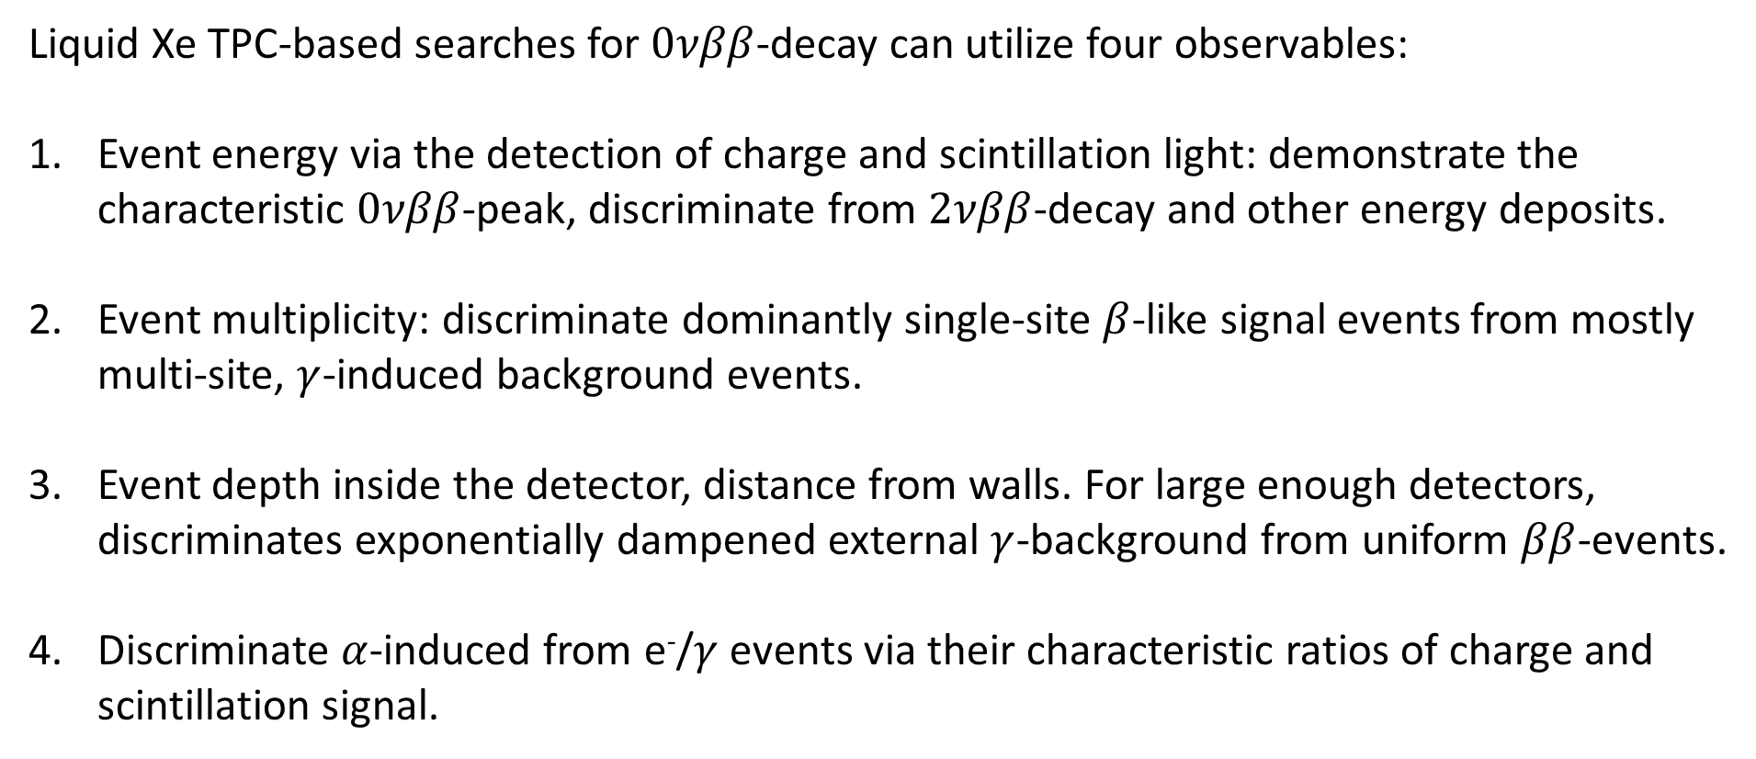
Liquid Xe TPC-based searches for $0νββ$-decay can utilize four observables:
Event energy via the detection of charge and scintillation light: demonstrate the characteristic $0νββ$-peak, discriminate from $2νββ$-decay and other energy deposits.
Event multiplicity: discriminate dominantly single-site $β$-like signal events from mostly multi-site, $γ$-induced background events.
Event depth inside the detector, distance from walls. For large enough detectors, discriminates exponentially dampened external $γ$-background from uniform $ββ$-events.
Discriminate $α$-induced from e⁻/$γ$ events via their characteristic ratios of charge and scintillation signal.

Slide 7
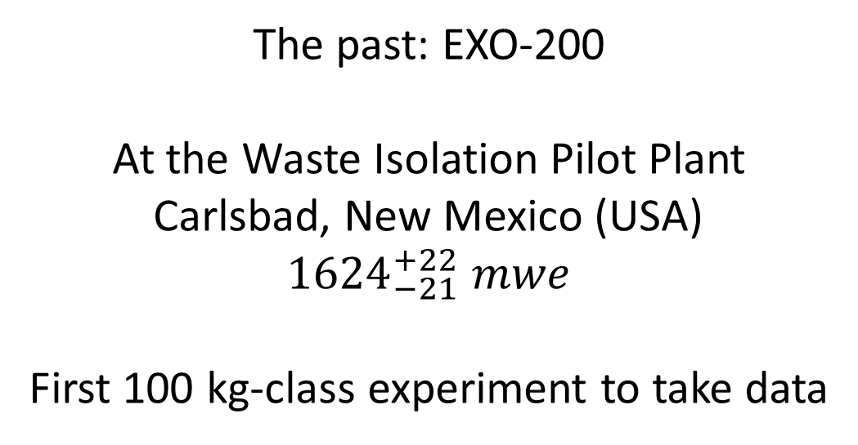
The past: EXO-200
At the Waste Isolation Pilot Plant
Carlsbad, New Mexico (USA)
$${1624}_{−21}^{+22} mwe$$
First 100 kg-class experiment to take data

Slide 8
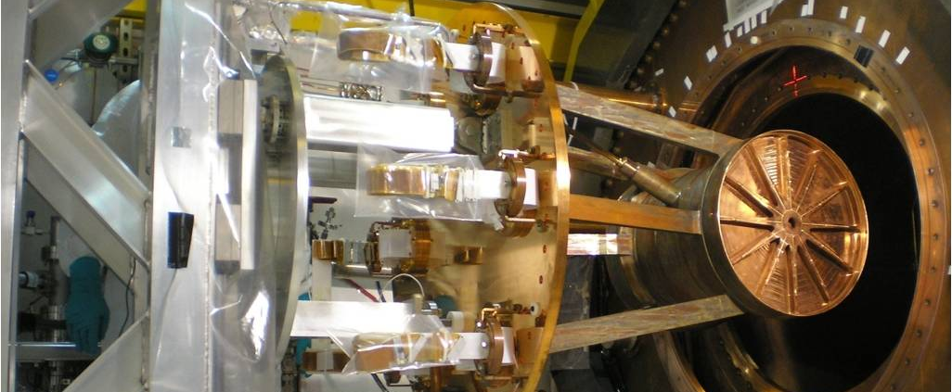
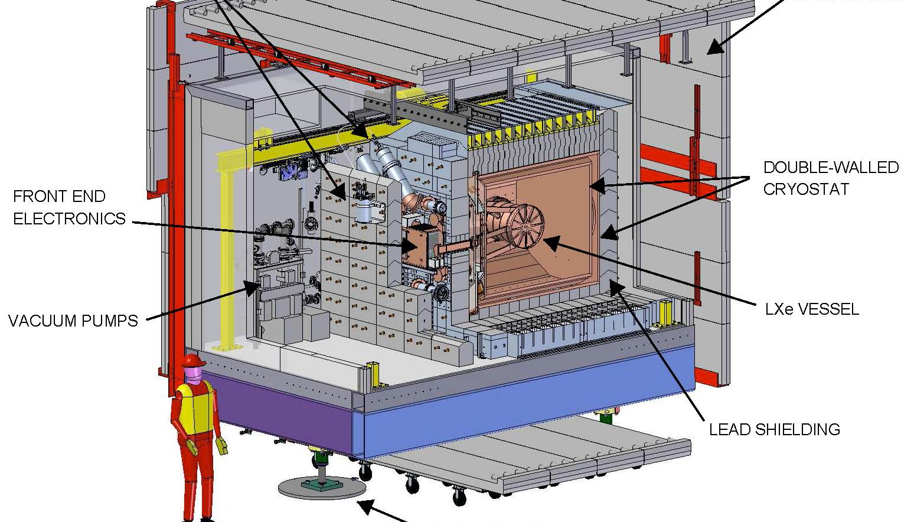
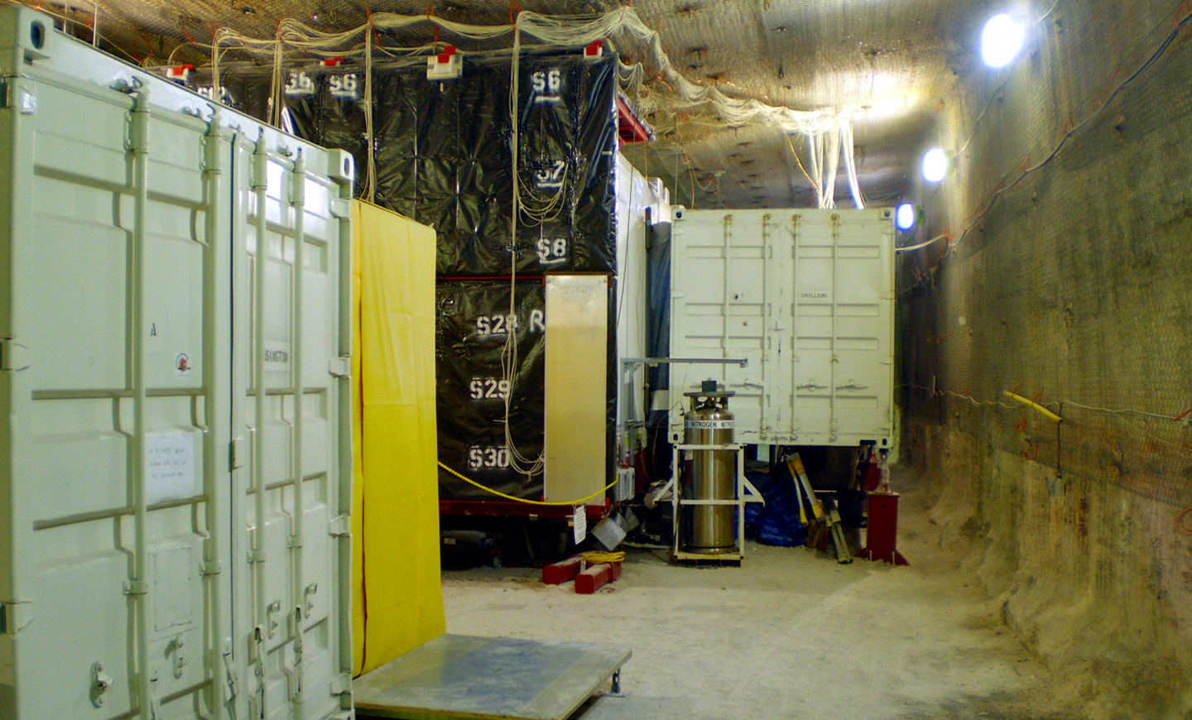
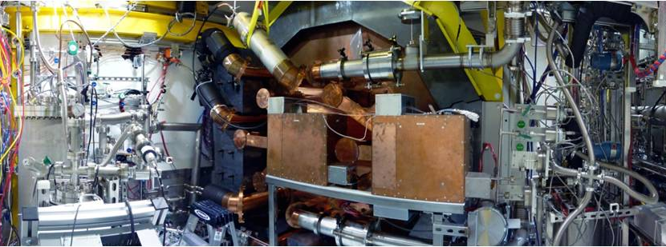

Slide 9
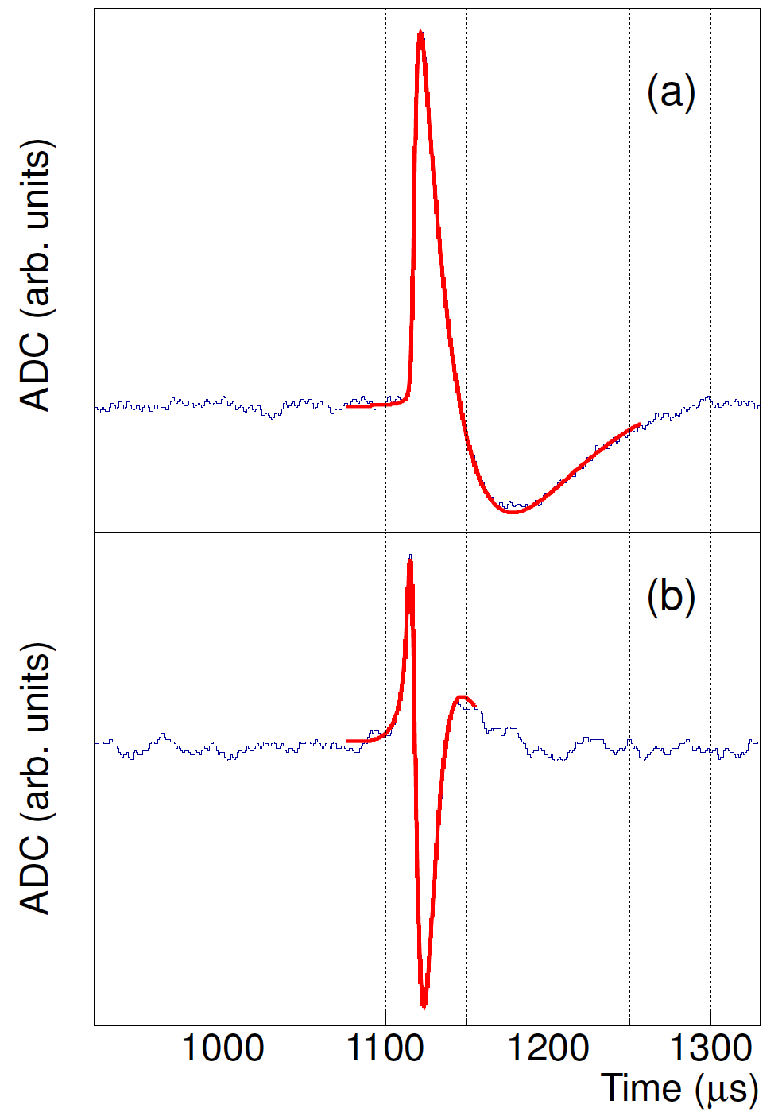
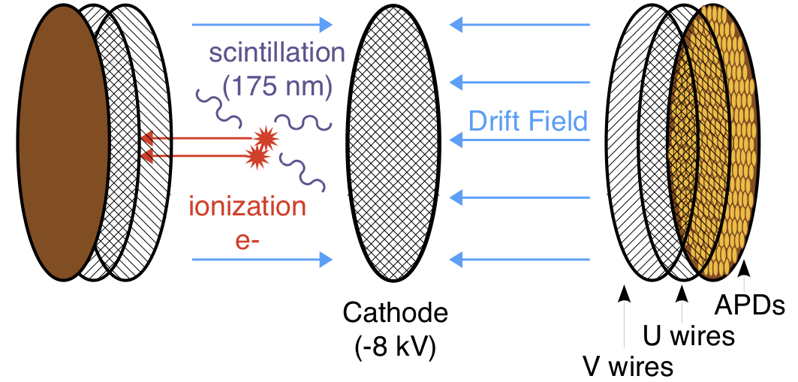
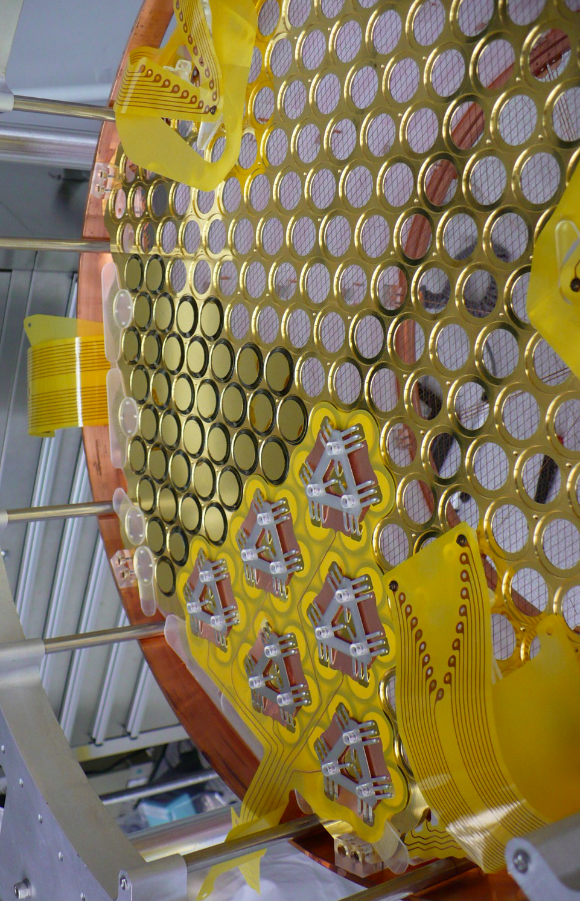
The EXO-200 Time Projection Chambers
Collection
Induction
175 kg LXe, 110 kg in active region, enriched to 80.6% in ¹³⁶Xe
38 charge and 38 induction channels per side (3mm pitch), 238 APDs per side
19.2 cm maximum charge drift length
Electric drift field: 380 V/cm (phase I: -8 kV), 567 V/cm (phase II: -12 kV)
Charge mean life time (chemical Xe purity): up to 4 ms
Teflon light reflectors/diffusers
→ 3-dim location

Slide 10
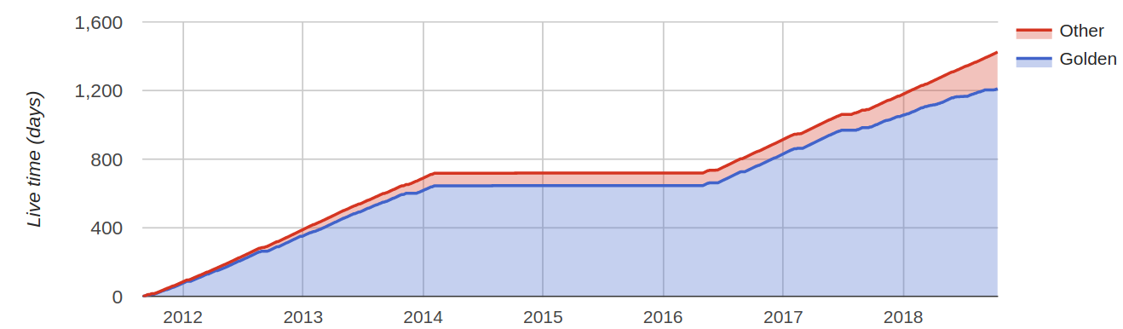
EXO-200 began operations in Sept 2011
In Feb 2014 operations were interrupted by an accident at the host facility
In Jan 2016 operations restarted along with system upgrades
Operation of the detector concluded in Dec 2018
Accumulated a total of 1181.3 days of livetime
Published data
New data
Phase II restarted
Upgraded electronics
De-radonator
-12 kV bias
WIPP accident
Phase II
Phase I
No access to detector
Xe remotely recovered

Slide 11
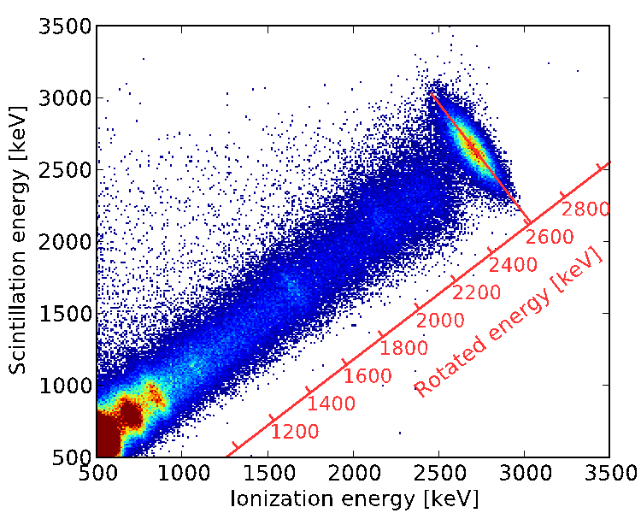
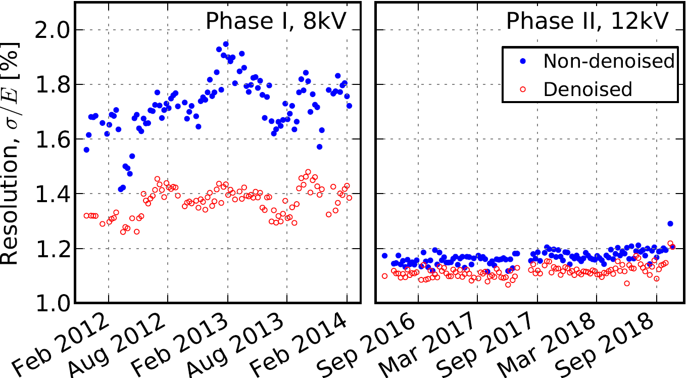
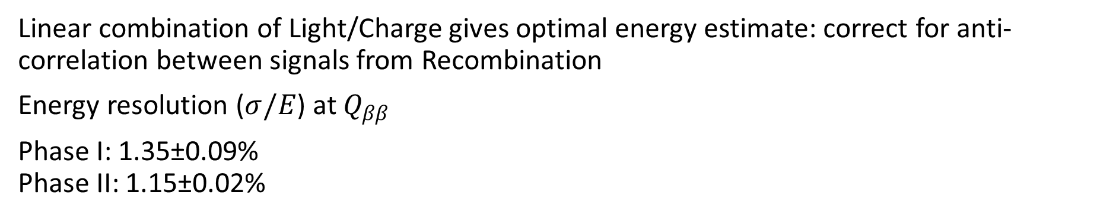
EXO-200 energy measurement: utilize charge and light induced signals
Linear combination of Light/Charge gives optimal energy estimate: correct for anti-correlation between signals from Recombination
Energy resolution ($σ/E$) at $Q_{ββ}$
Phase I: 1.35±0.09%
Phase II: 1.15±0.02%
Phase II upgrades:
Cathode HV increased
Front end electronics
²²⁸Th calibration data at cathode

Slide 12
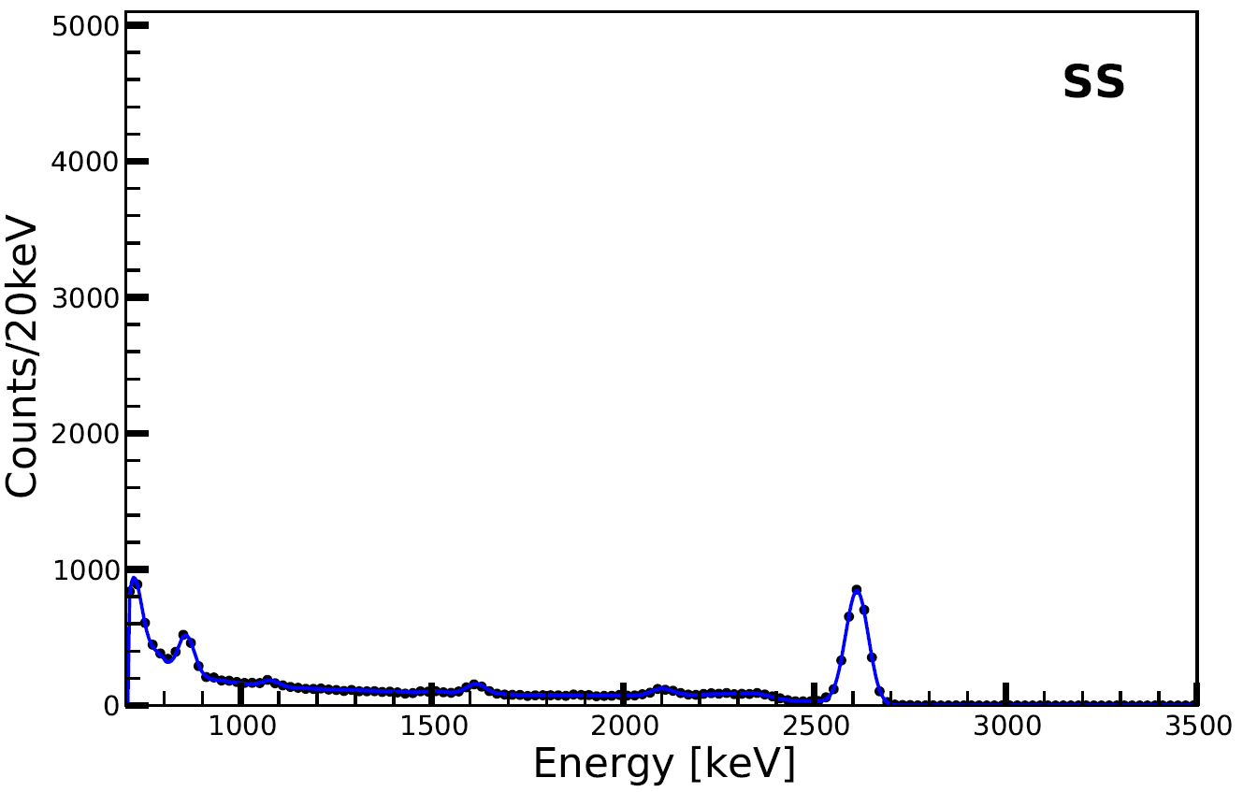
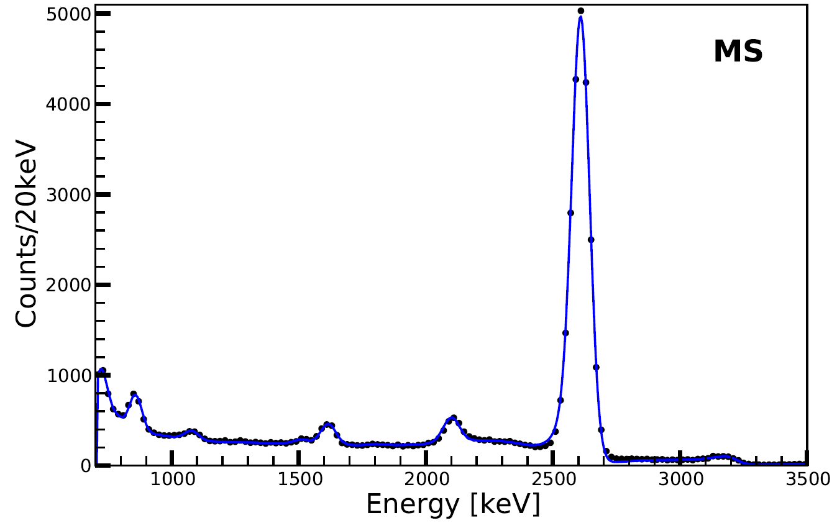
SS/MS Classification
²²⁸Th calibration data at cathode
Classic discriminator: separation of distinct deposits
  TPC allows for 3D reconstruction of deposits
ββ mostly deposit in single locations (SS)
γ backgrounds tend to produce multi deposits (MS) from Compton's
Data
Monte Carlo
coll.
ind.
coll.
ind.

Slide 13
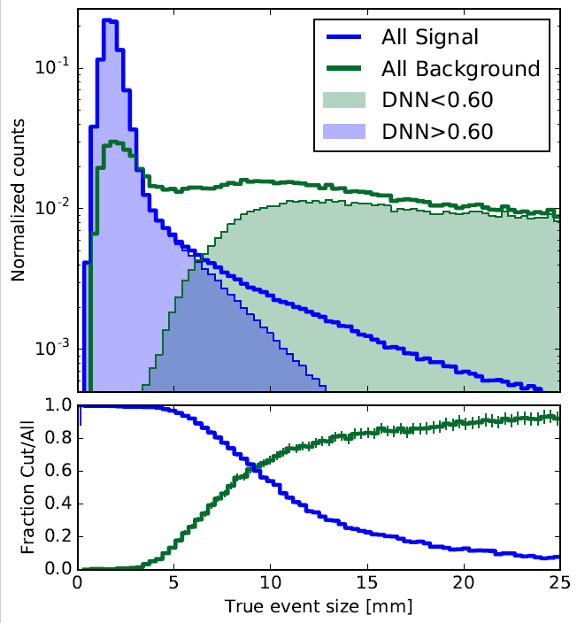
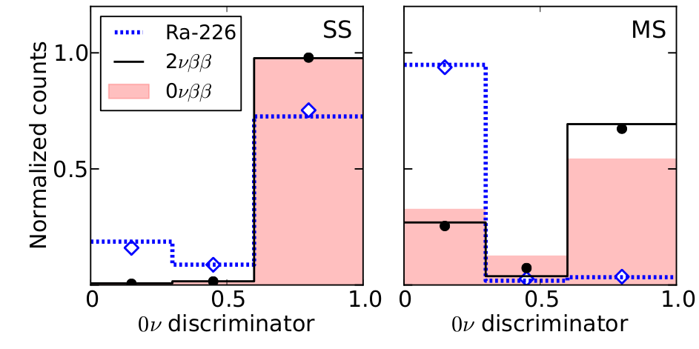
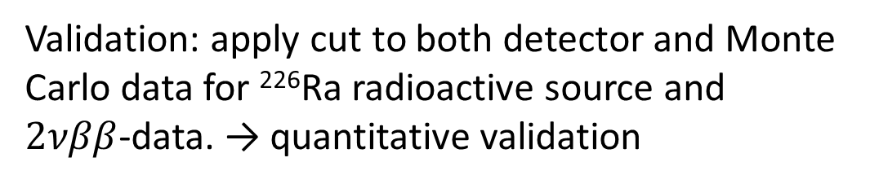
Use a Deep Neural Network (DNN) event discriminator to measure “signal-likeness”.
Incorporates “lower level” information such as the wire signals. This signal-likeness is correlated with the event size (JINST 13 (2018) 08, P08023).
Validation: apply cut to both detector and Monte Carlo data for ²²⁶Ra radioactive source and $2νββ$-data. → quantitative validation

Slide 14

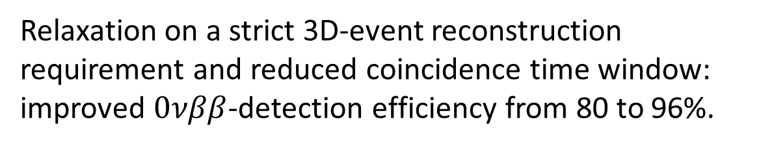
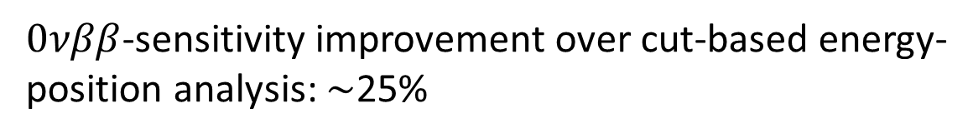
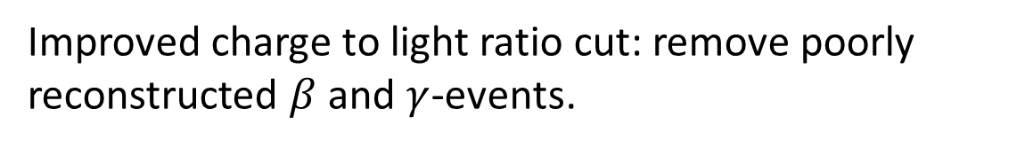
Three fit dimensions in simultaneous Maximum Likelihood analysis of SS and MS data sets:
Energy
Spatial (distance from detector boundary)
Event discriminator variable
$0νββ$-sensitivity improvement over cut-based energy-position analysis: $\sim$25%
Relaxation on a strict 3D-event reconstruction requirement and reduced coincidence time window: improved $0νββ$-detection efficiency from 80 to 96%.
$$α$$
Improved charge to light ratio cut: remove poorly reconstructed $β$ and $γ$-events.

Slide 15
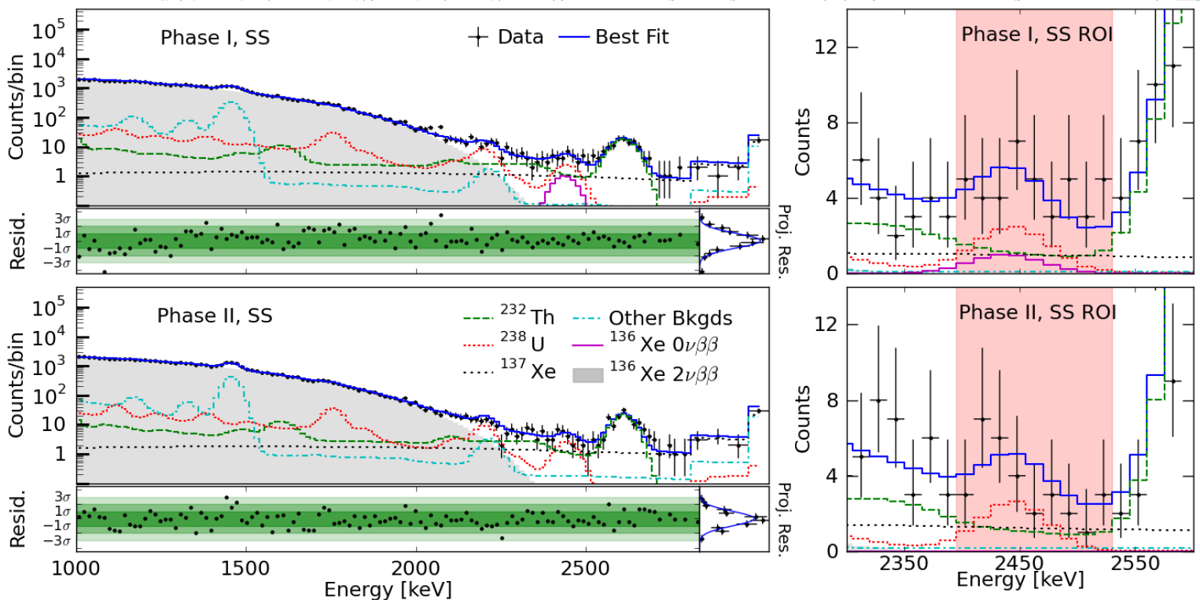
Result (arXiv:1906.02723)
No statistically significant evidence for $0νββ$-decay (blind analysis)

Slide 16
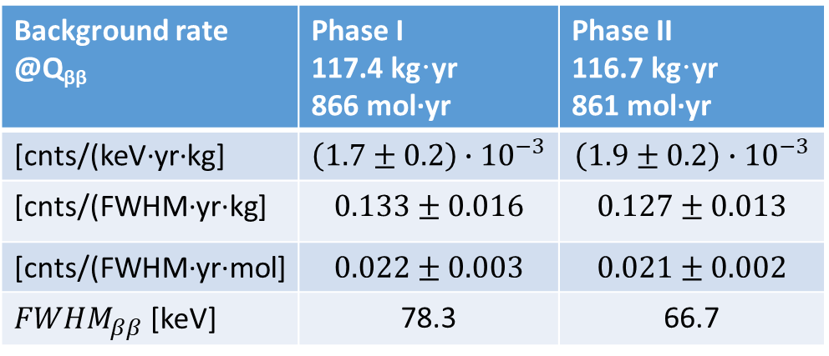
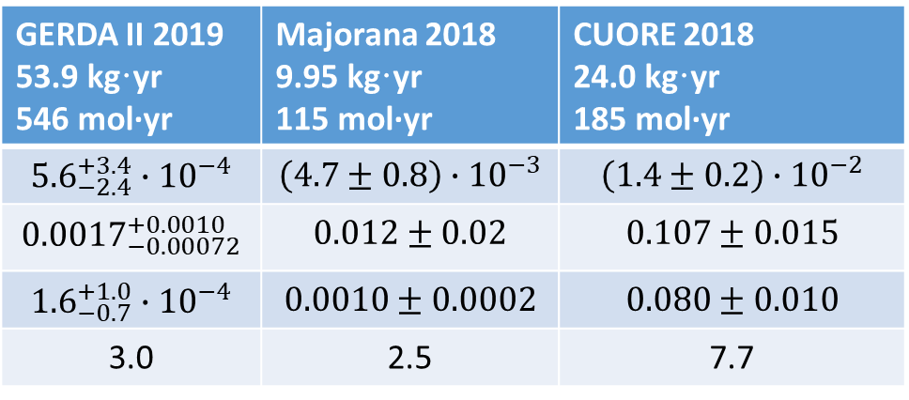
What was found signal and background wise?
The EXO-200 energy specific background rate is competitive but now clearly surpassed by GERDA.
Contributions to Q_{ββ}±2σ | Phase I 117.4 kg·yr [cnts] | Phase II 116.7 kg·yr [cnts]
²³²Th | 12.6 | 12.0
²³⁸U | 10.0 | 8.2
¹³⁷Xe | 8.7 | 9.3
Total | 32.3±2.3 | 30.9±2.4
Data | 39 | 26
external γ-radiation
The energy resolution is worse than for other experiments but xenon can be made into large detectors. As far as the Majorana neutrino mass is concerned: ¹³⁶Xe has a large phase space factor.
external γ-radiation
n-induced
Background rate @Q_{ββ} | Phase I 117.4 kg·yr 866 mol·yr | Phase II 116.7 kg·yr 861 mol·yr
[cnts/(keV·yr·kg] | $$\left(1.7±0.2\right)∙{10}^{−3}$$ | $$\left(1.9±0.2\right)∙{10}^{−3}$$
[cnts/(FWHM·yr·kg] | $$0.133±0.016$$ | $$0.127±0.013$$
[cnts/(FWHM·yr·mol] | $$0.022±0.003$$ | $$0.021±0.002$$
${FWHM}_{ββ}$ [keV] | 78.3 | 66.7
GERDA II 2019 53.9 kg·yr 546 mol·yr | Majorana 2018 9.95 kg·yr 115 mol·yr | CUORE 2018 24.0 kg·yr 185 mol·yr
$${5.6}_{−2.4}^{+3.4}∙{10}^{−4}$$ | $$\left(4.7±0.8\right)∙{10}^{−3}$$ | $$\left(1.4±0.2\right)∙{10}^{−2}$$
$${0.0017}_{−0.00072}^{+0.0010}$$ | $$0.012±0.02$$ | $$0.107±0.015$$
$${1.6}_{−0.7}^{+1.0}∙{10}^{−4}$$ | $$0.0010±0.0002$$ | $$0.080±0.010$$
3.0 | 2.5 | 7.7
Notes:
Background rates are per unit detector mass and per mol of decaying nuclide.

Slide 17
The low EXO-200 background was achieved by:
Rigorous radioactivity testing program utilizing
  ICPMS / GDMS
  NAA
  Ge counting
  Rn atom counting
Coordination with the Monte Carlo simulation to formulate quantitative acceptance criteria for every experiment component.
Detector design and construction decisions were governed by these criteria.
Method | ²³²Th cnts in Q_{ββ}±2·σ_{ββ} | ²³⁸U cnts in Q_{ββ}±2·σ_{ββ}
EXO-200 data | 10.3-13.9 | 5.3-7.1
EXO-200 radioassay | 0.5-7.7 | 2.0-9.5
Pre-data prediction | 0.9-10.3 | 6.3-26.8
This approach works and we have shown it with an experiment as complex as EXO-200.
For nEXO we plan to use the same approach.
From 477.6 d of phase I running, 90% CL ranges for number of background events (PRC 92 (2015) 015503).
Notes:
J. Albert et al., PRC 92 (2015) 015503

Slide 18
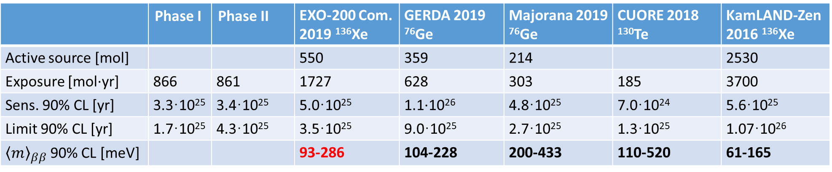

EXO-200 physics results
No evidence for $0νββ$-decay was observed
 | Phase I | Phase II | EXO-200 Com. 2019 ¹³⁶Xe | GERDA 2019 ⁷⁶Ge | Majorana 2019 ⁷⁶Ge | CUORE 2018 ¹³⁰Te | KamLAND-Zen 2016 ¹³⁶Xe
Active source [mol] |  |  | 550 | 359 | 214 |  | 2530
Exposure [mol·yr] | 866 | 861 | 1727 | 628 | 303 | 185 | 3700
Sens. 90% CL [yr] | 3.3·10²⁵ | 3.4·10²⁵ | 5.0·10²⁵ | 1.1·10²⁶ | 4.8·10²⁵ | 7.0·10²⁴ | 5.6·10²⁵
Limit 90% CL [yr] | 1.7·10²⁵ | 4.3·10²⁵ | 3.5·10²⁵ | 9.0·10²⁵ | 2.7·10²⁵ | 1.3·10²⁵ | 1.07·10²⁶
${\left\langle m\right\rangle }_{ββ}$90% CL [meV] |  |  | 93-286 | 104-228 | 200-433 | 110-520 | 61-165
The sensitivity is the appropriate estimator of a measurement. It contains all information and shows less statistical fluctuation than the limit.
The final EXO-200 half-life sensitivity is comparable to all but that of GERDA.
The neutrino mass constraint is derived from the EXO-200 data is among the best.
Systematic uncertainties: 7.1(6.5)% background model, 3.1% efficiency

Slide 19
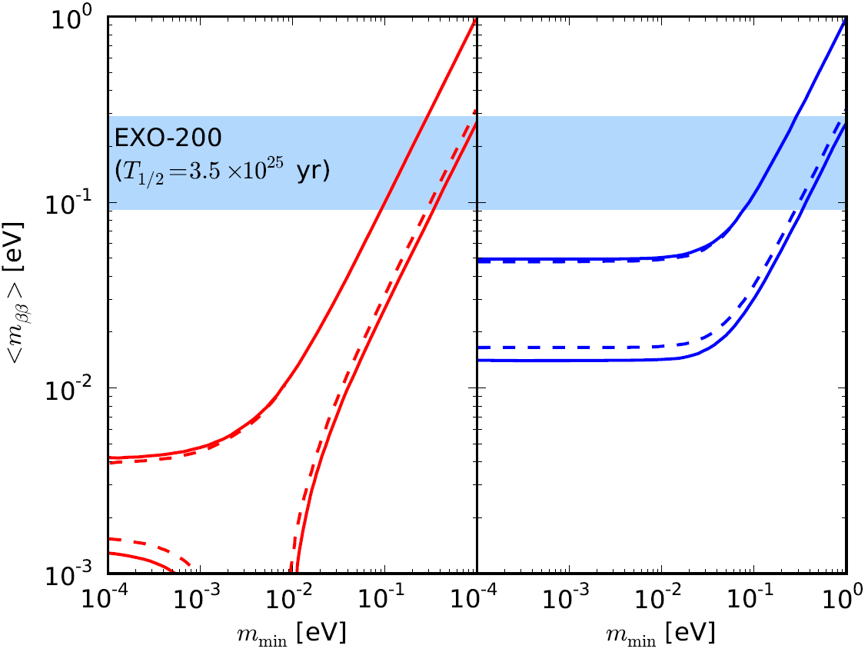
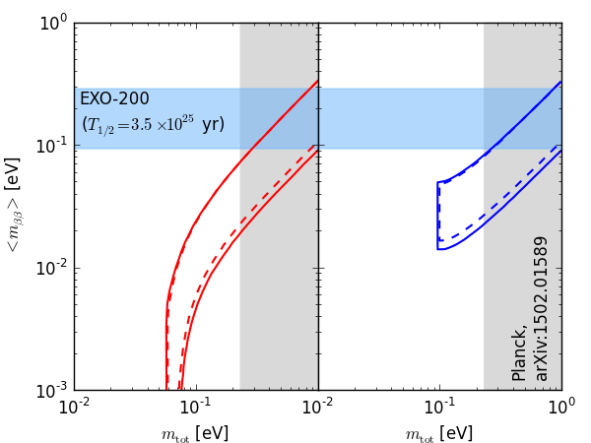
Neutrino Mass Limits

Slide 20
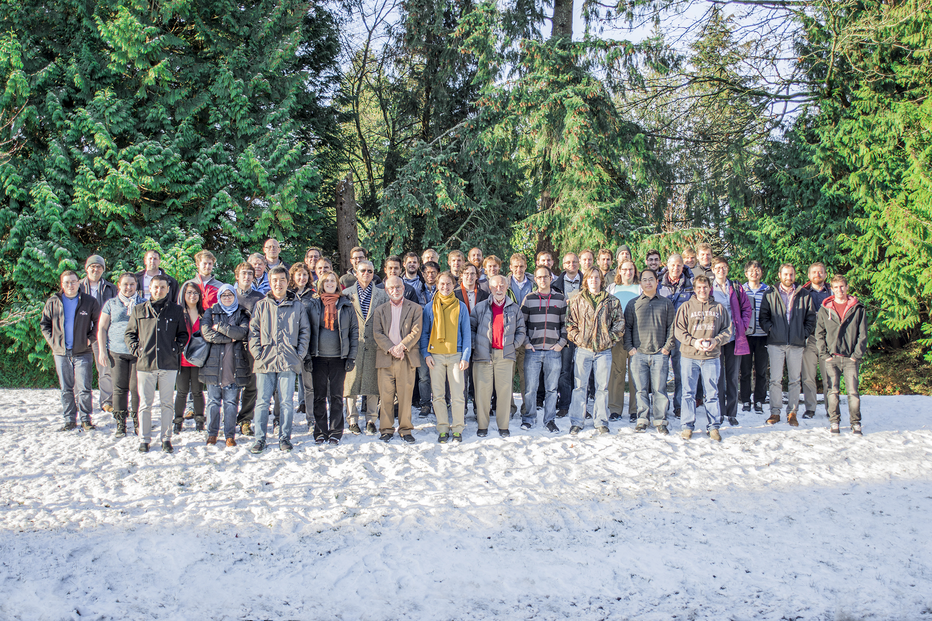








University of Alabama, Tuscaloosa AL, USA — M Hughes, I Ostrovskiy, A Piepke, AK Soma, V Veeraraghavan
University of Bern, Switzerland — J-L Vuilleumier
University of California, Irvine, Irvine CA, USA — M Moe
California Institute of Technology, Pasadena CA, USA — P Vogel
Carleton University, Ottawa ON, Canada — I Badhrees, W Cree, R Gornea, K Graham, T Koffas, C Licciardi, D Sinclair
Colorado State University, Fort Collins CO, USA — C Chambers, A Craycraft, W Fairbank Jr, D Harris, A Iverson, J Todd, T Walton
Drexel University, Philadelphia PA, USA — MJ Dolinski, EV Hansen, YH Lin, Y-R Yen
Duke University, Durham NC, USA — PS Barbeau
Indiana University, Bloomington IN, USA — JB Albert, S Daugherty
Laurentian University, Sudbury ON, Canada — B Cleveland, A Der Mesrobian-Kabakian, J Farine, A Robinson, U Wichoski
University of Maryland, College Park MD, USA — C Hall
University of Massachusetts, Amherst MA, USA — S Feyzbakhsh, S Johnston, A Pocar
McGill University, Montreal QC, Canada — T Brunner, Y Ito, K Murray
The EXO-200 Collaboration
SLAC National Accelerator Laboratory, Menlo Park CA, USA — M Breidenbach, R Conley, T Daniels, J Davis,
S Delaquis, A Johnson, LJ Kaufman, B Mong, A Odian, CY Prescott, PC Rowson, JJ Russell, K Skarpaas, A Waite, M Wittgen
University of South Dakota, Vermillion SD, USA — J Daughhetee, R MacLellan
Friedrich-Alexander-University Erlangen, Nuremberg, Germany
G Anton, R Bayerlein, J Hoessl, P Hufschmidt, A Jamil, T Michel, M Wagenpfeil, G Wrede, T Ziegler
IBS Center for Underground Physics, Daejeon, South Korea — DS Leonard
IHEP Beijing, People’s Republic of China — G Cao, W Cen, T Tolba, L Wen, J Zhao
ITEP Moscow, Russia — V Belov, A Burenkov, M Danilov, A Dolgolenko, A Karelin, A Kuchenkov, V Stekhanov, O Zeldovich
University of Illinois, Urbana-Champaign IL, USA — D Beck, M Coon, S Li, L Yang
Stanford University, Stanford CA, USA — R DeVoe, D Fudenberg, G Gratta, M Jewell, S Kravitz, G Li, A Schubert, M Weber, S Wu
Stony Brook University, SUNY, Stony Brook, NY, USA — K Kumar, O Njoya, M Tarka
Technical University of Munich, Garching, Germany — W Feldmeier, P Fierlinger, M Marino
TRIUMF, Vancouver BC, Canada — J Dilling, R Krücken, Y Lan, F Retière, V Strickland
Yale University, New Haven CT, USA — Z Li, D Moore, Q Xia

Slide 21
The (possible) future: nEXO
At SNOLAB
Sudbury, Ontario (Canada)
6010 mwe
The baseline configuration without Ba-tagging

Slide 22
The nEXO plan
Use 5 tons of isotopically enriched xenon in a liquid Xe TPC with the goal of reaching a Majorana neutrino mass sensitivity of 15 meV (lower edge of inverted mass ordering).
Perform a multi-parameter measurement to resolve a $0νββ$-signal from background in more than one dimension.
Build a homogenous detector to take full advantage of the high xenon purity and the fact that gamma attenuation lengths at the relevant energy are much shorter than the linear dimensions of the detector. Have as little passive materials inside as possible. This is based on the observation that the EXO-200 background was dominated by “external” radioactivity.

Slide 23
The nEXO plan
I have only little time to discuss a complex project. I will sketch five aspects:
Detector size
Resolution
Background
Sensitivity
Path to approval

Slide 24
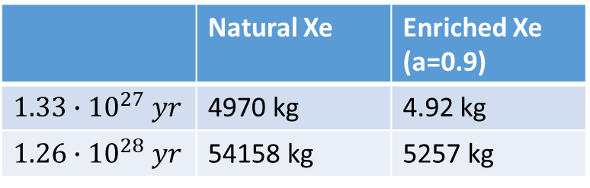
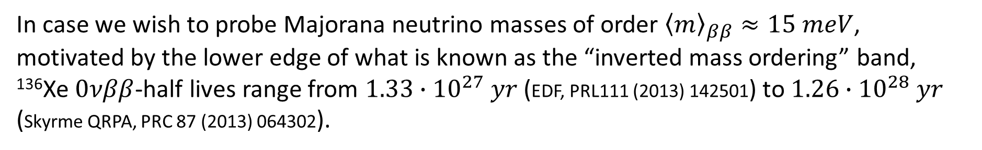
Why are multiple experiments planning detectors at the tonne scale?
In case we wish to probe Majorana neutrino masses of order ${\left\langle m\right\rangle }_{ββ}≈15 meV$, motivated by the lower edge of what is known as the “inverted mass ordering” band, ¹³⁶Xe $0νββ$-half lives range from $1.33∙{10}^{27} yr$ (EDF, PRL111 (2013) 142501) to $1.26∙{10}^{28} yr$ (Skyrme QRPA, PRC 87 (2013) 064302).
Assume you want a “3-sigma effect”, 9 counts, after 10 years (0.9 life time, 0.95 efficiency). What decaying Xe mass is needed for above range of half lives for 0.9 enriched (natural) xenon to get 1 event per year?
 | Natural Xe | Enriched Xe (a=0.9)
$1.33∙{10}^{27} yr$ | 4970 kg | 4.92 kg
$1.26∙{10}^{28} yr$ | 54158 kg | 5257 kg
Much smaller detectors just won’t have decays to work with, independent of any background considerations.

Slide 25


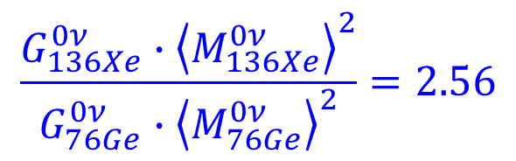
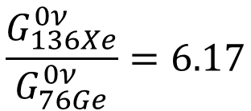
Is ¹³⁶Xe, perhaps, a bad choice as far as decaying nuclides is concerned? I compare to ⁷⁶Ge, the other popular choice in terms of Majorana neutrino mass testing.
$$\frac{G_{136Xe}^{0ν}}{G_{76Ge}^{0ν}}=6.17$$
$${\left\langle M_{136Xe}^{0ν}\right\rangle }_{23}=3.06±1.10$$
$${\left\langle M_{76Ge}^{0ν}\right\rangle }_{26}=4.75±1.20$$
Using this particular neutrino mass-based (light neutrino exchange driven) metric: compared to ⁷⁶Ge there is no reason why one would need a much larger decaying sample.
$$\frac{G_{136Xe}^{0ν}∙{\left\langle M_{136Xe}^{0ν}\right\rangle }^{2}}{G_{76Ge}^{0ν}∙{\left\langle M_{76Ge}^{0ν}\right\rangle }^{2}}=2.56$$

Slide 26
LXe mass (kg) | Diameter or length (cm)
5000 | 130
150 | 40
5 | 13
A cartoon illuminating how a large homogenous detector interacts with external gammas.
2.45 MeV γ
attenuation length
8.7 cm =
5 kg
150 kg
5000 kg
This works best for a monolithic detector

Slide 27
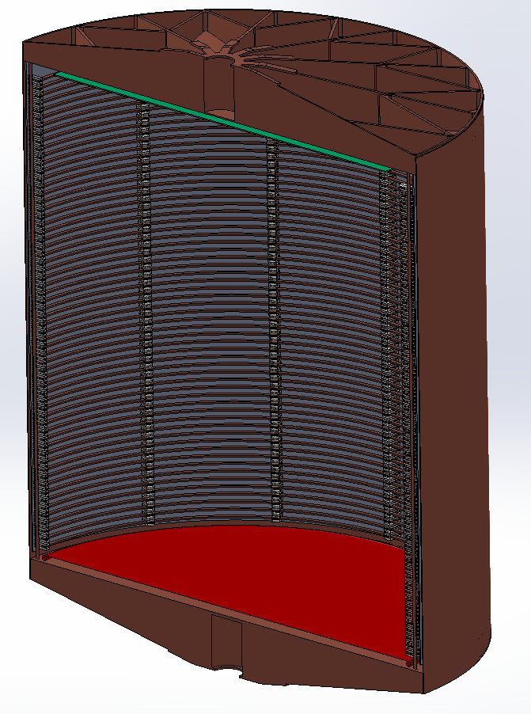
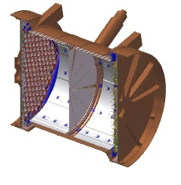
The nEXO detector
A 5000 kg enriched LXe TPC, extrapolated from EXO-200
130 cm
46 cm

Slide 28
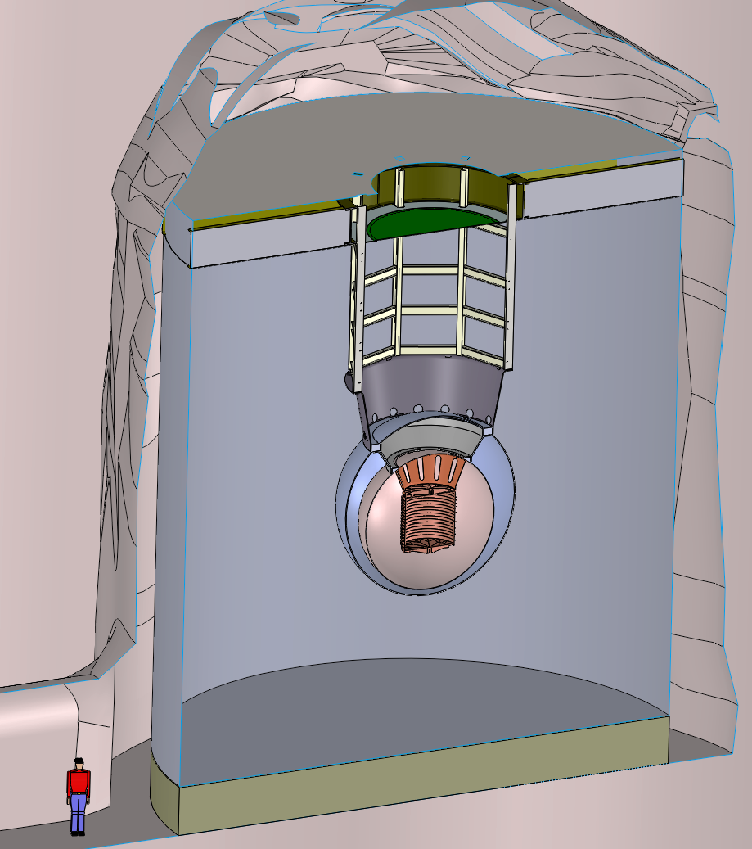
Artist view of nEXO in the SNOLAB Cryopit
13m
14m
14 m
Ø13 m

Slide 29
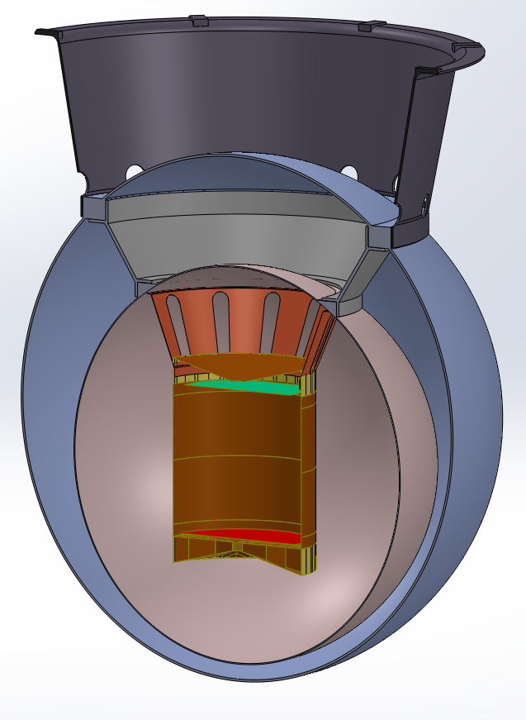
The nEXO baseline TPC
Charge readout
strips (anode)
In LXe
electronics
(charge and SiPMs)
SiPM `staves’
plastering
barrel behind
field-shaping
rings
1.3 m
e⁻ drift
Cathode
29

Slide 30
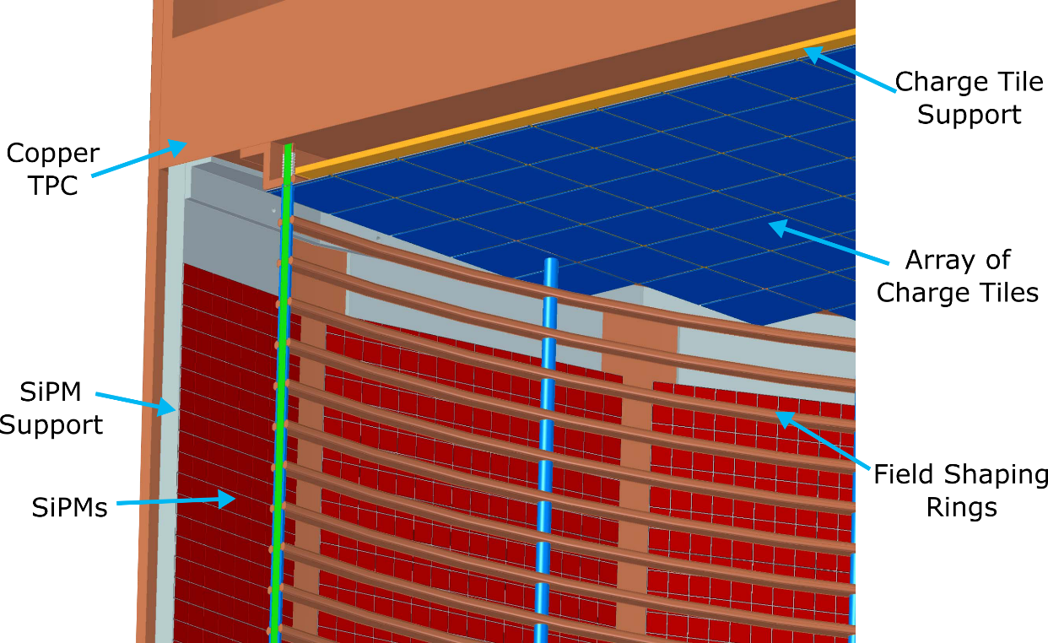
Charge readout
No free standing wires (EXO-200 option) because of concerns about length, temperature cycling, material for harp support and modularity.
Quartz tiles are modular, reliable, eventually with built-in readout.
Critical parameters:
Pitch (6 mm favored)
Radioactivity
Capacitance
Readout from the rear
Signal shape (no shielding grid)

Slide 31
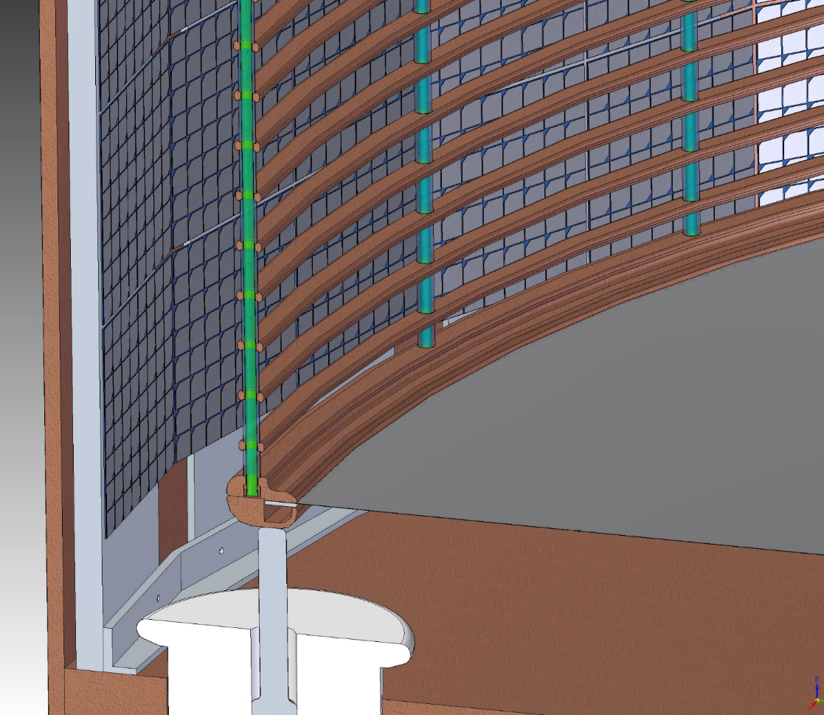
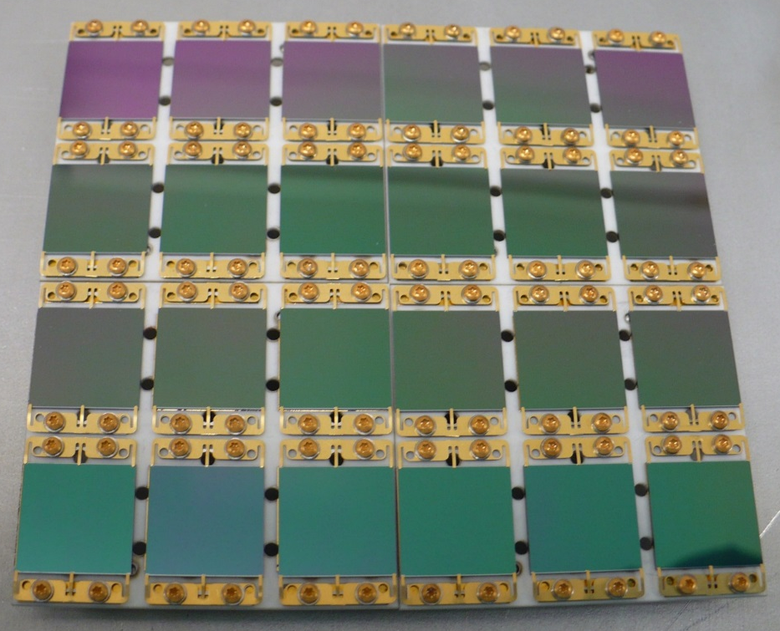
Light readout
Photodetectors: 4.5m² of VUV-sensitive SiPMs
To be used as bare dies to minimize the radioactivity inside the detector.
First sizeable arrays are now available
(the dismountable hardware is temporary)
1cm

Slide 32
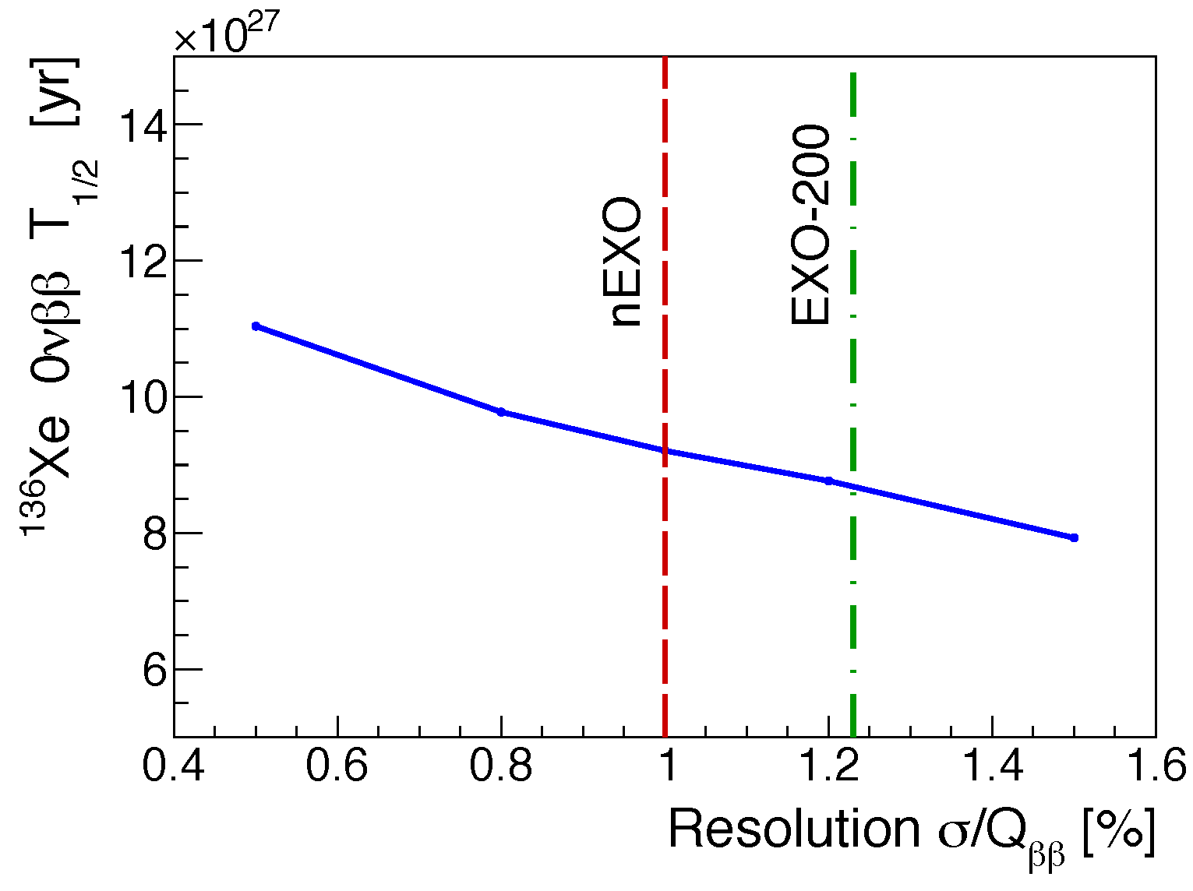
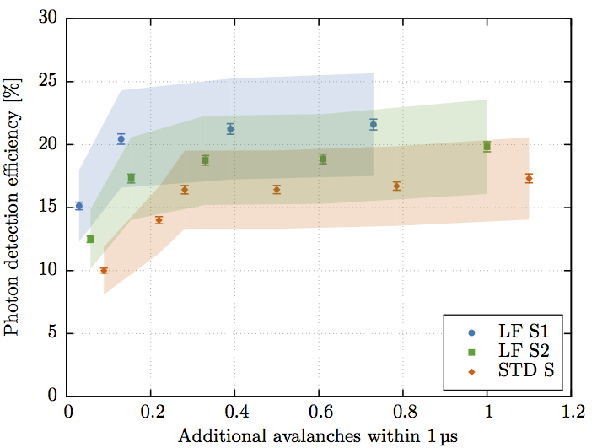
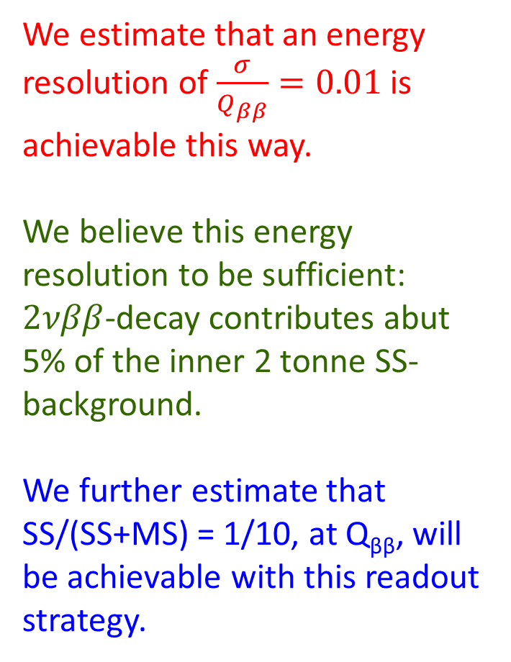
After initial R&D: 1 cm² VUV devices now match nEXO specs, with a bias of about 30 V
(compared to 1500 V of EXO-200 APDs)
We estimate that an energy resolution of $\frac{σ}{Q_{ββ}}=0.01$ is achievable this way.
We believe this energy resolution to be sufficient: $2νββ$-decay contributes abut 5% of the inner 2 tonne SS-background.
We further estimate that SS/(SS+MS) = 1/10, at Q_{ββ}, will be achievable with this readout strategy.
nEXO
goal
IEEE Trans. NS 65 (2018) 2823
Radioactive found to be within requirements

Slide 33
Detector background (PRC 97 (2018) 065503)
The nEXO detector background and sensitivity estimates are based on a detailed GEANT4 Monte Carlo model. The Monte Carlo provides appropriate PDFs.
The PDFs are normalized by measurements of the radioactivity content of all relevant materials. With the exception of Rn, all normalizations derive from actual material measurements made for EXO-200 and nEXO.
The radon production of the nEXO systems have been conservatively assumed to be 3 times worse than what has been observed in EXO-200. The entire EXO-200 xenon piping has been re-assembled at SLAC. We have started an active program to understand how to scale up an actual system.

Slide 34
nEXO has an active radioactivity measurement program utilizing:
ICPMS
NAA
AMS
γ-ray spectroscopy
Radon counting
α-spectroscopy
The data it generates provides the normalizations of the background model. The background model currently contains about 130 different components. The materials database contains about 160 nEXO specific measurements, plus 315 EXO-200 entries.

Slide 35
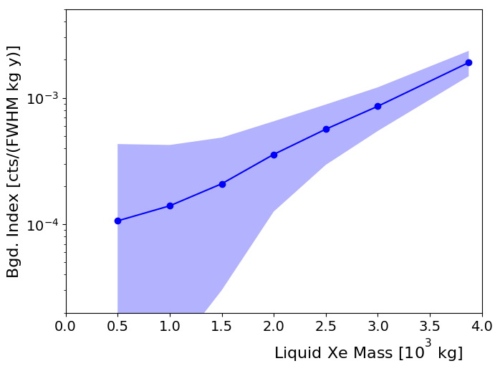

In a detector as large as nEXO the background rate is not characterized by a single number but is a position-dependent function.
Note that the nEXO analysis does not utilize a fiducial volume cut, essentially discarding much of the detector.
$$B=0.36 \frac{cnts}{FWHM tonne yr}$$
A fit to the entire data utilizes the outer layers to measure external background (the dominant component) simultaneously with a signal.
Gives factor 1.5 better sensitivity.

Slide 36

Current composition of background in inner 2 tonnes of xenon
Is already reasonably balanced. Progress cannot be made by focusing on any single component.

Slide 37

How will nEXO deal with the E=2447.7 keV (b=0.0155) gamma emitted in ²¹⁴Bi decay? At the estimated energy resolution it will not be energy-resolved from a possible $0νββ$-peak.
Whatever ²¹⁴Bi (emitted external to the Xe) events survive the SS-event requirement, will show a different spatial distribution than homogenous $ββ$-events. The large homogenous detector and the full 3D spatial sensitivity of the TPC will resolve such background peak from an effect by means of the additional event dimension.
This is different to the one dimensional peak search discussed very often, characterized by energy resolution alone and parametrized by a single background rate.
The nEXO collaboration believes that this will enable a robust case for discovery, if the physics is there.

Slide 38

10 yr data, 0νββ at the nEXO discovery threshold, or T_{1/2}=5.1x10²⁷ yr
SS
MS

Slide 39



²³⁸U SS
²³²Th SS
2νββ SS
0νββ SS

Slide 40




The nEXO 90% CL sensitivity and $3∙σ$ discovery potential were derived from repeated analyses of data-based Monte Carlo simulations (PRC 97 (2018) 065503). No Gaussian approximations (square root assumption) were made, the actual PDFs were explored.
10 yr life time 90% CL sensitivity:
$$T_{1/2}^{0νββ}>9.2∙{10}^{27} yr$$
$${\left\langle m\right\rangle }_{ββ}<5.7−17.7 meV$$
10 yr life time $3∙σ$ discovery potential :
$$T_{1/2}^{0νββ}=5.7∙{10}^{27} yr$$
$${\left\langle m\right\rangle }_{ββ}<7.3−22.3 meV$$

Slide 41


Slide 42
Reality content
The nEXO collaboration has been talking about these ideas, in ever refined ways of course, for the last 5 years how close to are we to realization?
The 2015 Long Range Plan for Nuclear Science listed a ton scale double beta decay experiment as its highest construction priority.
Late 2018 DOE issued a Critical Decision 0, indicating mission need for such an experiment. No decision was made on the type of experiment.
The 2019 Presidential Budget explicitly lists such a project.
For the last year the nEXO collaboration prepared for becoming a construction project. In 2018 we published a detailed pre-Conceptual design Report (arXiv:1805.1142).
The collaboration is working towards a possible down-select review in 2019.

Slide 43
Conclusion
EXO-200 was the first 100 kg-class experiment to run. The experiment has been concluded and dismantled. We showed that a large liquid xenon low background experiment can be operated for a long time in a hostile environment.
Results derived from its final data set have been presented here. They are competitive, the energy specific background is among the lowest in the field.
We are now working on a new 5 tonne detector that we believe will significantly advance the field. Its sensitivity will cover the inverted mass ordering and cover part of the normal one.
The nEXO collaboration is now preparing for a construction decision by DOE.

Slide 44


The nEXO collaboration
at the last collaboration meeting,
Jun 2019 Stony Brook, NY

Slide 45








University of Alabama, Tuscaloosa AL, USA --- M Hughes, O Nusair, I Ostrovskiy, A Piepke, AK Soma, V Veeraraghavan
University of Bern, Switzerland — J-L Vuilleumier
Brookhaven National Laboratory, Upton NY, USA — M Chiu, G Giacomini, V Radeka, E Raguzin, S Rescia, T Tsang
University of California, Irvine, Irvine CA, USA — M Moe
California Institute of Technology, Pasadena CA, USA — P Vogel
Carleton University, Ottawa ON, Canada — I Badhrees, R Gornea, C Jessiman, T Koffas, D Sinclair, B. Veenstra, J Watkins
Colorado State University, Fort Collins CO, USA --- C Chambers, A Craycraft, D Fairbank, W Fairbank Jr, A Iverson, J Todd
Drexel University, Philadelphia PA, USA --- MJ Dolinski, P Gautam, E Hansen, YH Lin, E Smith, Y-R Yen
Duke University, Durham NC, USA — PS Barbeau, J Runge
Friedrich-Alexander-University Erlangen, Nuremberg, Germany --- G Anton, J Hoessl, T Michel, M Wagenpfeil, T Ziegler
IBS Center for Underground Physics, Daejeon, South Korea — DS Leonard
IHEP Beijing, People’s Republic of China — G Cao, W Cen, Y Ding, X Jiang, P Lv, Z Ning, X Sun, T Tolba, W Wei, L Wen, W Wu, J Zhao
IME Beijing, People’s Republic of China — L Cao, X Jing, Q Wang
ITEP Moscow, Russia — V Belov, A Burenkov, A Karelin, A Kobyakin, A Kuchenkov, V Stekhanov, O Zeldovich
University of Illinois, Urbana-Champaign IL, USA --- D Beck, M Coon, J Echevers, S Li, L Yang
Indiana University, Bloomington IN, USA --- JB Albert, SJ Daugherty, G Visser
Laurentian University, Sudbury ON, Canada — B Cleveland, A Der Mesrobian-Kabakian, J Farine, C Licciardi, A Robinson, U Wichoski
Lawrence Livermore National Laboratory, Livermore CA, USA --- J Brodsky, M Heffner, A House, S Sangiorgio, T. Stiegler
University of Massachusetts, Amherst MA, USA --- S Feyzbakhsh, D Kodroff, A Pocar, M Tarka
McGill University, Montreal QC, Canada --- S Al Kharusi, T Brunner, L Darroch, T McElroy, K Murray, T Totev,
University of North Carolina, Wilmington, USA — T Daniels
Oak Ridge National Laboratory, Oak Ridge TN, USA — L Fabris, RJ Newby
Pacific Northwest National Laboratory, Richland, WA, USA — I Arnquist, EW Hoppe, JL Orrell, G Ortega, C Overman, R Saldanha, R Tsang
Rensselaer Polytechnic Institute, Troy NY, USA — E Brown, K Odgers
Université de Sherbrooke, Sherbrooke QC, Canada --- F Bourque, S Charlebois , M Côté, D Danovitch, H Dautet, R Fontaine, F Nolet, S Parent, JF Pratte, T Rossignol, J Sylvestre, F Vachon
SLAC National Accelerator Laboratory, Menlo Park CA, USA --- S Delaquis, A Dragone, G Haller, LJ Kaufman, B Mong, A Odian, M Oriunno, PC Rowson, K Skarpaas
University of South Dakota, Vermillion SD, USA --- T Bhatta, A Larson, R MacLellan
Stanford University, Stanford CA, USA --- J Dalmasson, R DeVoe, D Fudenberg, G Gratta, M Jewell, S Kravitz, B.Lenardo, G Li, M Patel, A Schubert, M Weber, S Wu
Stony Brook University, SUNY, Stony Brook NY, USA --- K Kumar, O Njoya
Technical University of Munich, Garching, Germany --- P Fierlinger
TRIUMF, Vancouver BC, Canada --- J Dilling, P Gumplinger, R Krücken, Y Lan, F Retière, V Strickland
Yale University, New Haven CT, USA — A Jamil, Z Li, D Moore, Q Xia

