Slide 1
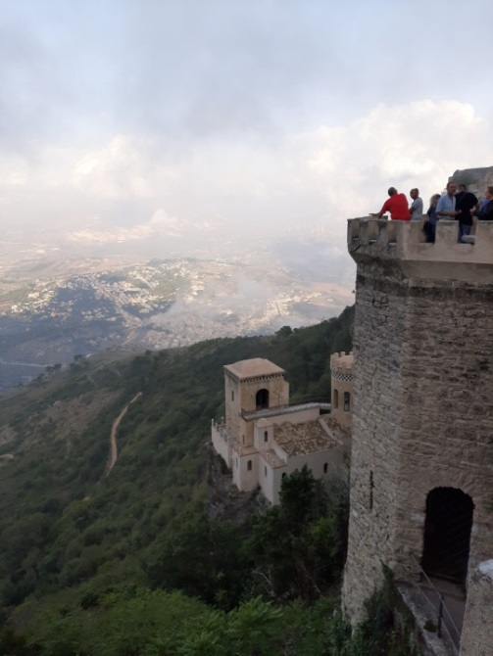
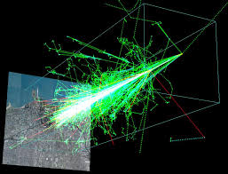
Tau Neutrino airshower
Astronomy on Earth and Space
Erice 22 Sept 2019
Daniele Fargion

Slide 2
Neutrino Astronomy: MUON ←→ Tau
Because of CR their interactions in atmosphere we observe on Earth also a huge rain of atmospheric secondaries as muons and neutrinos. Just Noise.
Because of the neutrino are neutral they are undeflected and they may also lead to a deeper hard astronomy, as the observed TeV gamma ones.
Neutrinos are weak and to see them we need a huge mass targed as Icecube Km detector (or mountains or Earth) usually in deep underground to shield them from atmospheric muons.
However the same abundant CR secondariy rain , shine also a parasite huge atmospheric neutrino noises, by Pions, Kaons, Charmed Mesons
(GeV- TeV energy) atmospheric muon neutrino track noise are over abundant , but above 40 TeV Icecube since 2013 tested a flavor change, more cascades than tracks, implying a Neutrino Astronomy.
Or testing a new hadronic charmed or prompt atmospheric noise.

Slide 3
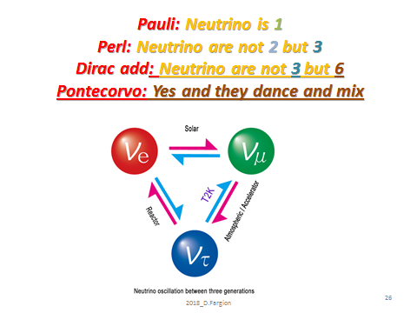
SIX NEUTRINO ASTRONOMY
Ruled by neutrino mass :
Majorana? Dirac?

Slide 4
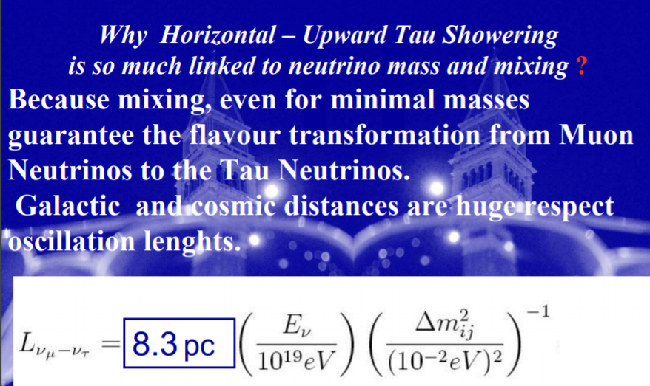

Slide 5
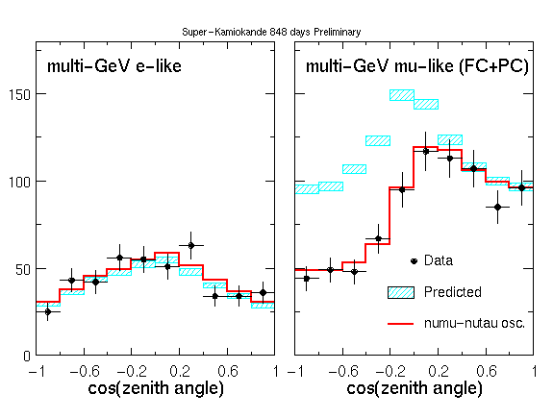
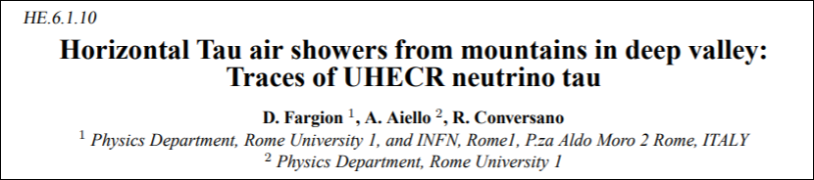
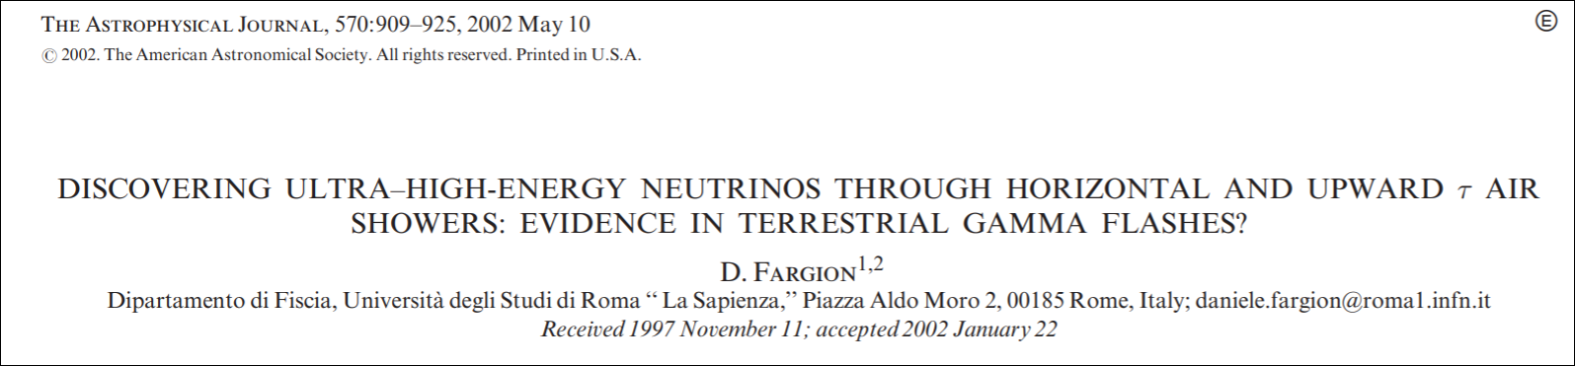
Kamiokande 1997 Assimmetry→
ICRC 1999 : TAU airshower
Salt Lake, USA June

Slide 6
Why Tau Airshower is the best candidate to noise free Neutrino Astronomy?
Tau above TeVs are (almost) no atmospheric: No production nor oscillation along the Earth: Noise Free
Tau it is an astrophysical guaranteed flavor by oscillation (muon-tau) and mixing across Universe.
Tau Airshower it is not an unique track, but it is a wide area and huge number amplified signal.
Tau Track at EeV energy it is the longest lepton track , overcoming muon lenght.

Slide 7
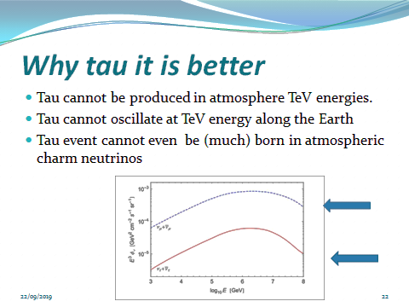

Slide 8
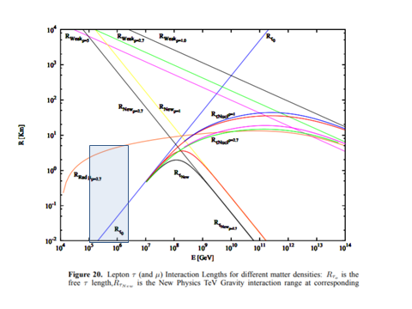

Why UHE Tau Track may win by their penetration, the muon one

Slide 9
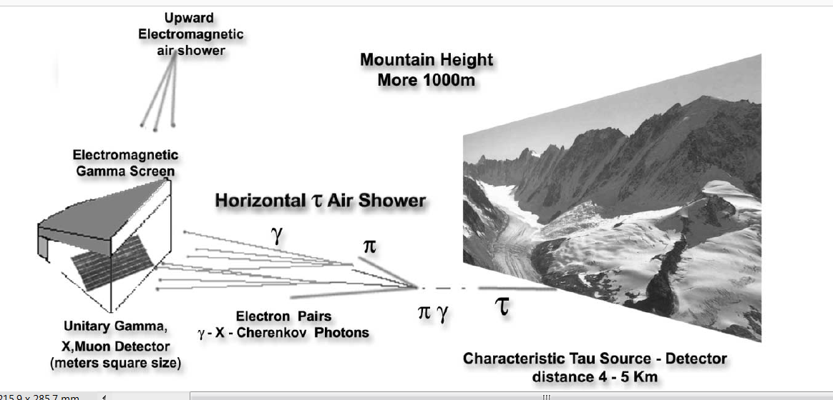
Deep Valley or Mountain chain
Both for ASHRA, and GIANT

Slide 10
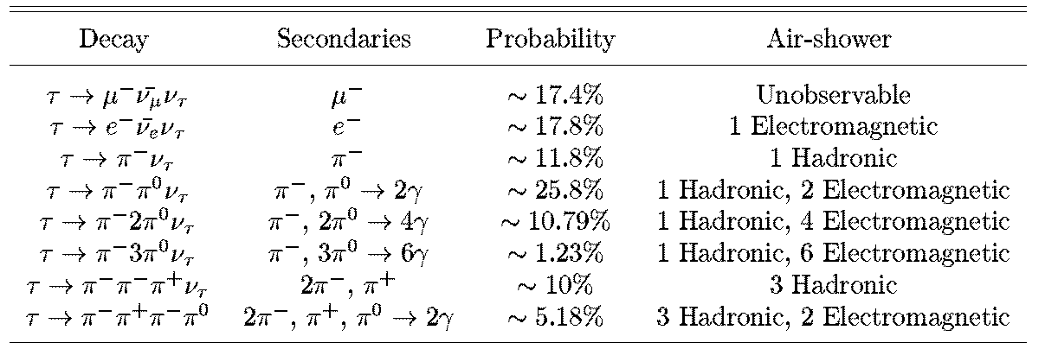
Tau airshower : a particle physics test

Slide 11
Tau Airshower from the top of Mountains:
ASHRA and MAGIC and CTA from the Top Mountains.

Slide 12
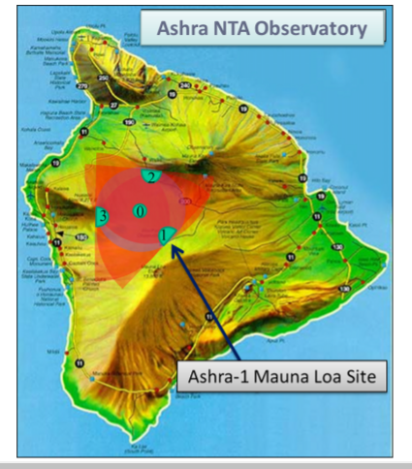
ASHRA array early attempts

Slide 13
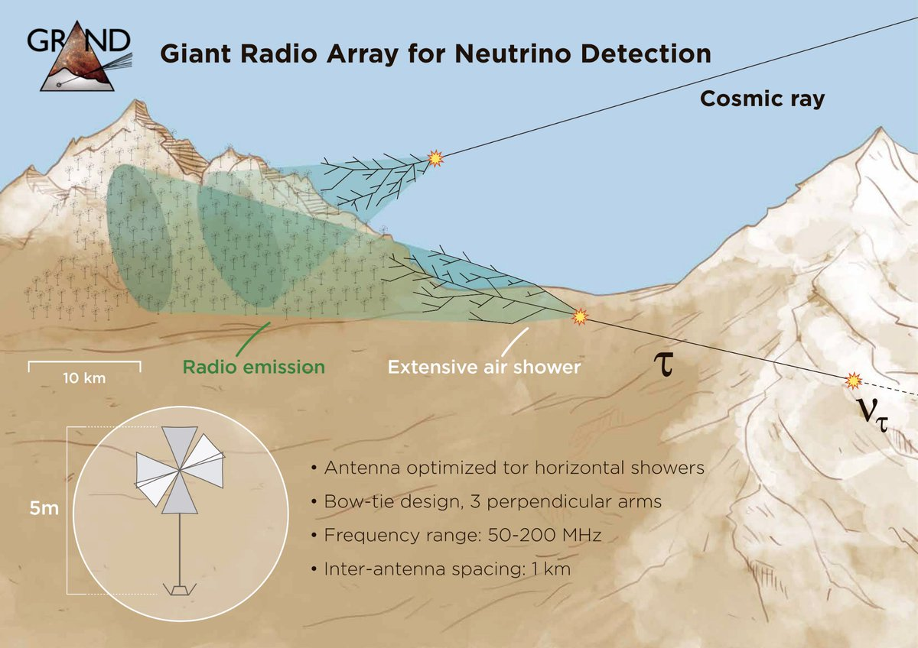
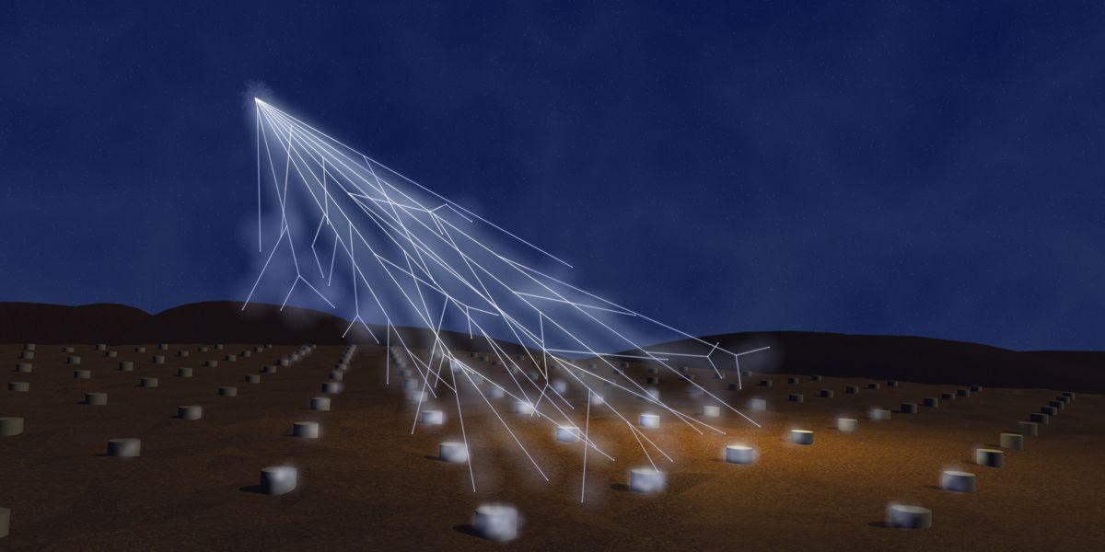
Tau Airshowers are huge amplifier of an unique neutrino in number and in area .
Huge (GIANT) radio arrays will be filtering from Earth all atmospheric noises

Slide 14
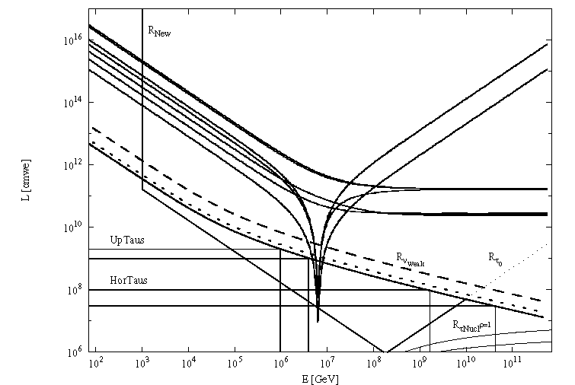
Uptaus and Hortaus

Slide 15
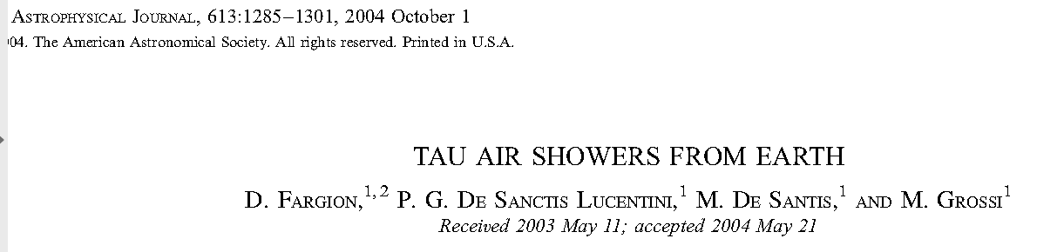
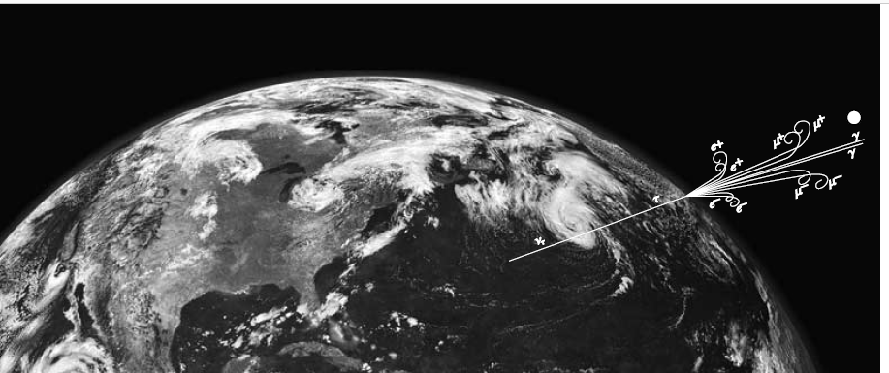
Tau escaping from Earth
Because Earth opacity, mostly inclined at PeV upward. At EeV energy only horizontal

Slide 16
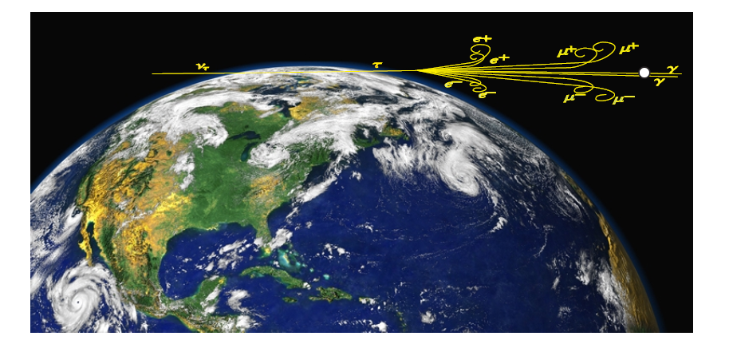
Tau Airshower into space:
POEMMA, JEM-EUSO
See: TAU AIRSHOWER from EARTH DF et all, Apj 2004

Slide 17
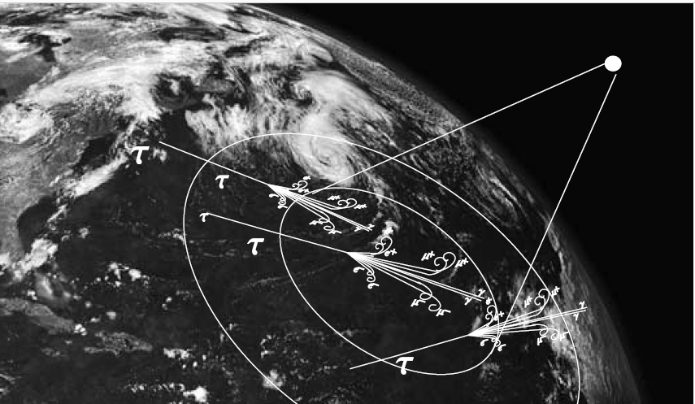
Euso Horizontal and Upward tau rare, mostly at Earth horizons

Slide 18

How to estimate the Upward Tau?

Slide 19
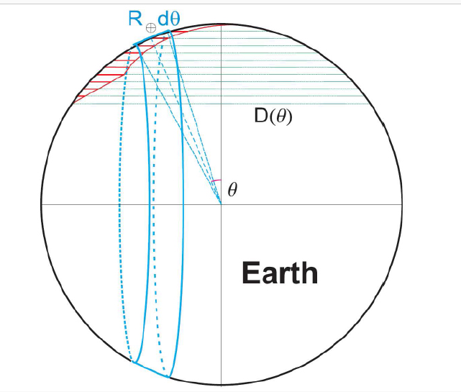

The Earth skin for skimming tau

Slide 20
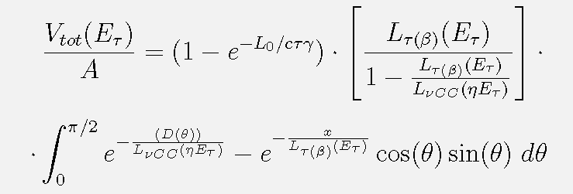
Effective volume for tau air-showering on Earth, with a finite atmosphere size

Slide 21
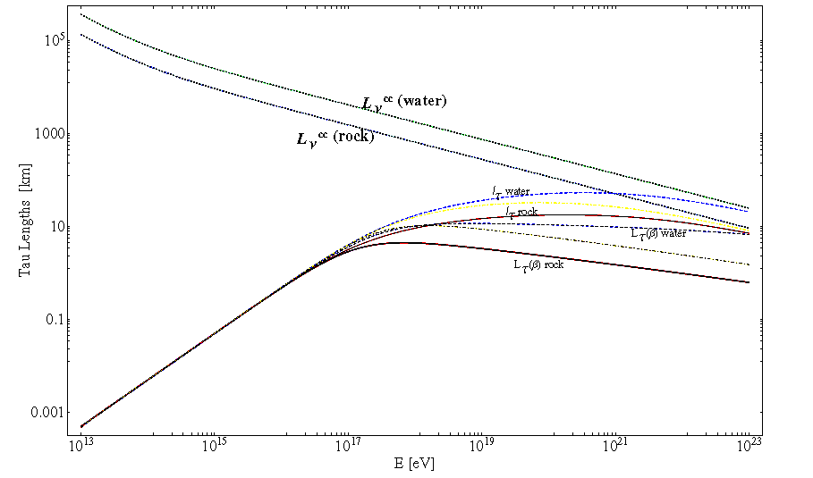

Penetrating Lenght L in water and rock

Slide 22
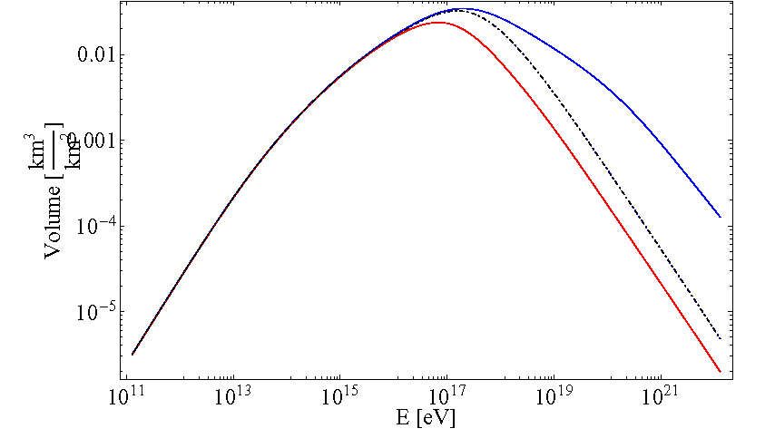
How much volume equivalent for each square km? Water win!

Slide 23
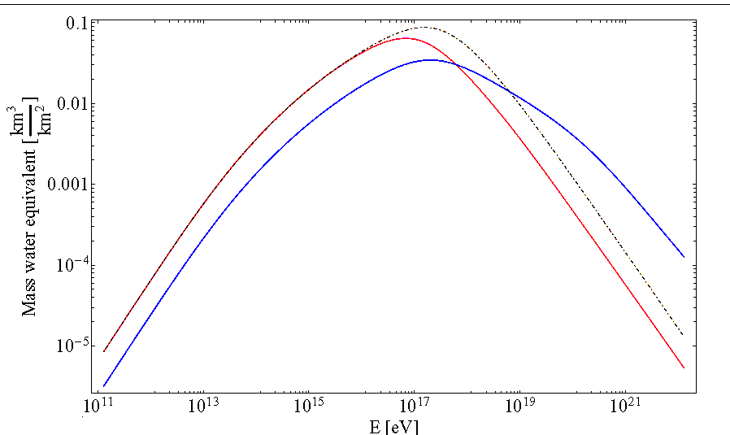
Mass equivalent for square km
Rock win and loose

Slide 24
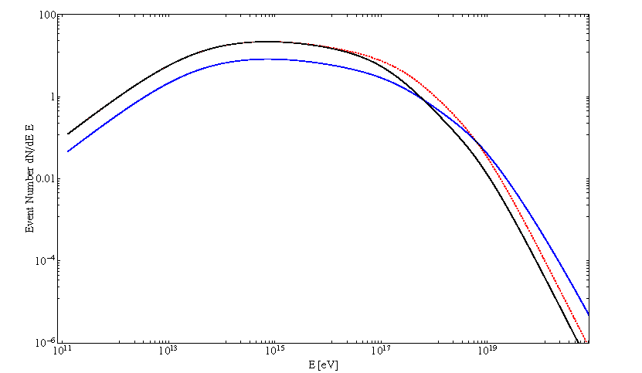
Number of upgoing Tau in Auger every 3 years for WB limit

Slide 25
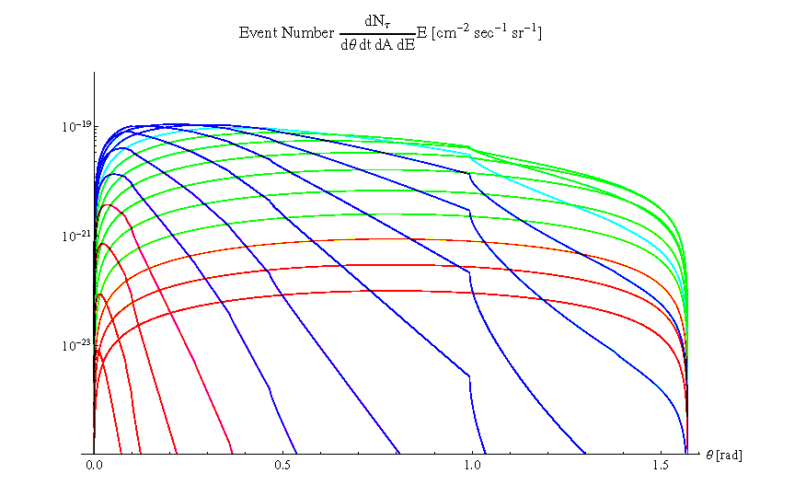
Differential event rate for energy and skimming angle 10 GeV eV up to 0.1 ZeV energy: tau rate for WB flux

Slide 26
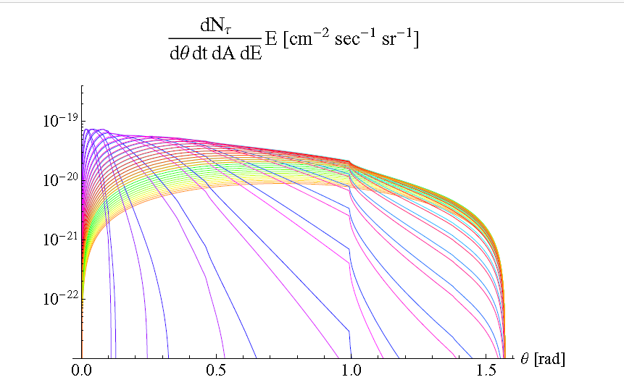
Resonant Glashow contribute

Slide 27
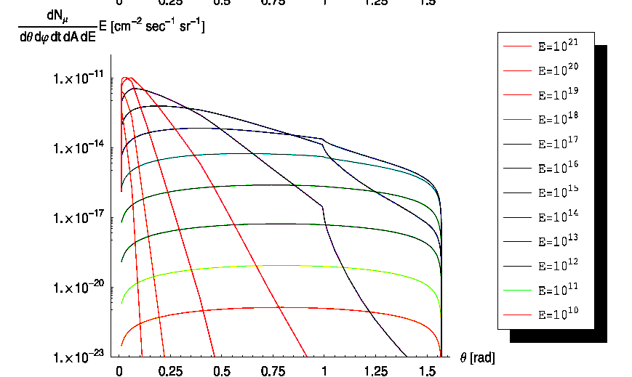
The average muon rate upgoing by tau airshower ones> atmospheric

Slide 28
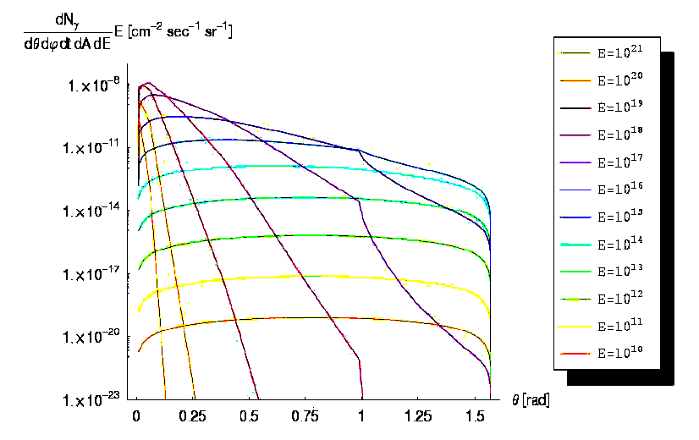
Gamma and electron pairs by tau airshower

Slide 29
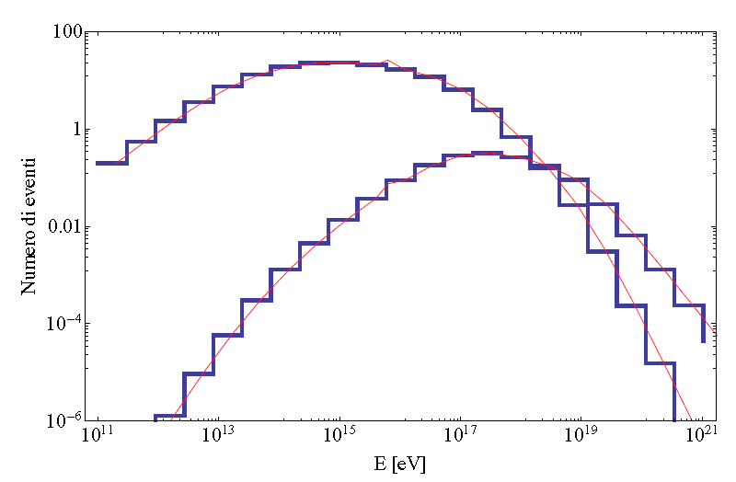
SD versus Fluorescence D event rate
FLUORESCENCE win above EeV in AUGER

Slide 30
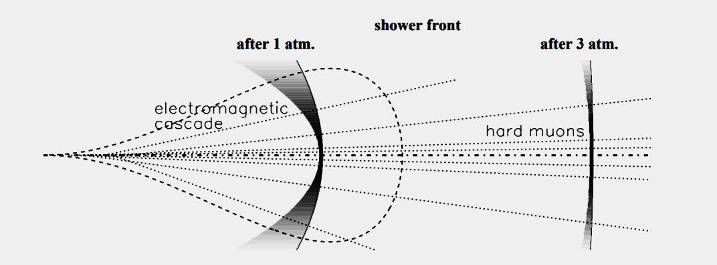
Auger NON detection of Tau only by Ground Detctors because only searching young showers.
Much Much Better would be in night the discover by Cherenkov or fluorescence telescopes, because tau shower are at high altitude

Slide 31
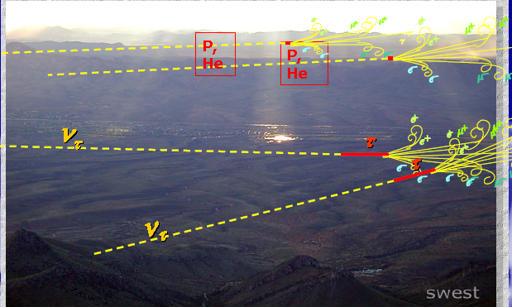
AUGER best view at horizons: at 30-40 km altitude: Down-horizontal Hadron UHECR at 5-15 km: UPWARD Tau Airshowers

Slide 32
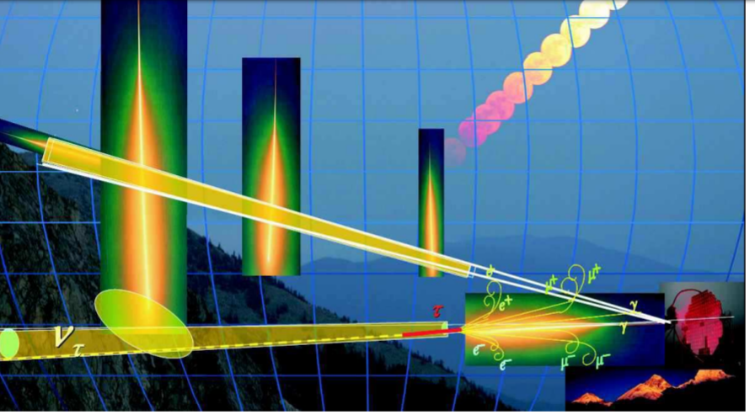
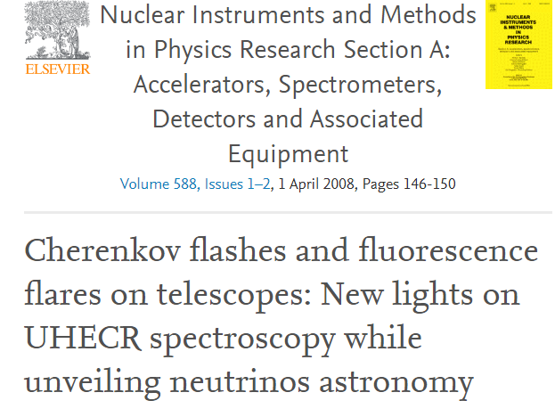
Fluorescence and Cherenkov cooperative lights: Same telescope

Slide 33
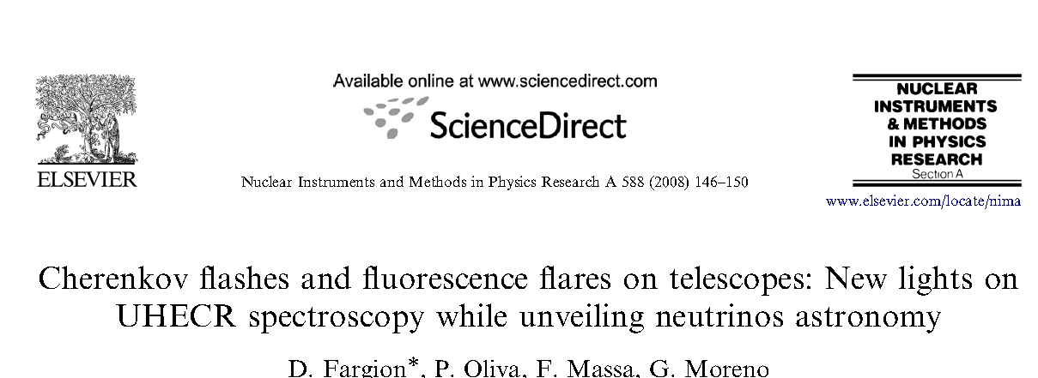
Cherenkov for Fluorescence taus

Slide 34
NEW: Muon TOMOGRAPHY in ETNA
ALSO FOR TAU airshowers arXiv:1805.11612v1
The MEV project: design and testing of a new high-resolution telescope for Muography of Etna Volcano D. Lo Presti1,2 at all.
Each PS plane, therefore, is a matrix of N × N pixels, with N = 99.

Slide 35
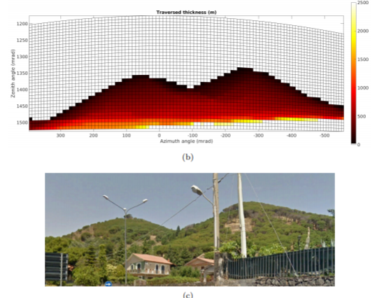
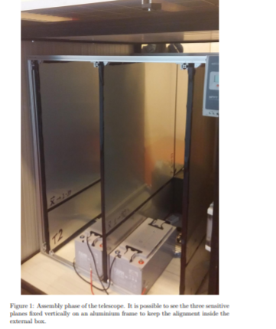
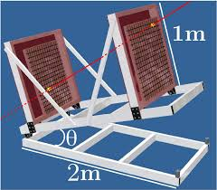
DETECTOR ALREADY tested: one year on 3000 meter on ETNA-→ a few (12-24) in twin circle would be COMPARABLE or even better than ICECUBE above 20 PEV energy for Tau Neutrino event

Slide 36
Neutrino muon versus tau Astronomy
cascades or showers are Smeared in spherical balls. Do not make astronomy. Tau below tens TeV are also showering. Tau Double bang to be found in better shape and signals.
Muons are offering better longer tracks , reaching kilometers sizes , much sharper in their angular resolution.
Highest TeVs Muon, while travelling across the Icecube from side to side, may reach wider target detection volumes and rate of events: the trough going tracks.
Since 2013 Icecube find no any muon neutrino track self clustering nor overlapping with known gamma sources, while ARGO, Hawc tens TeVs maps showed galactic plane and well defined sources.

Slide 37
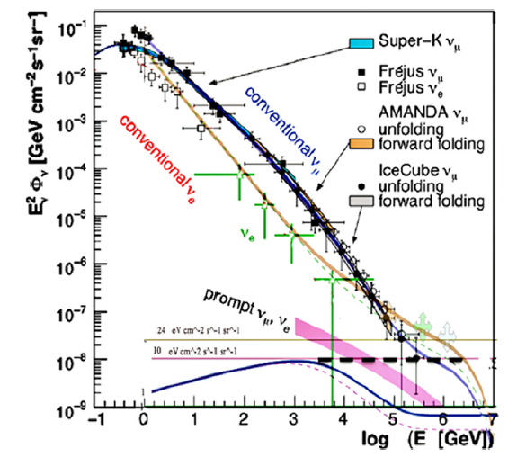
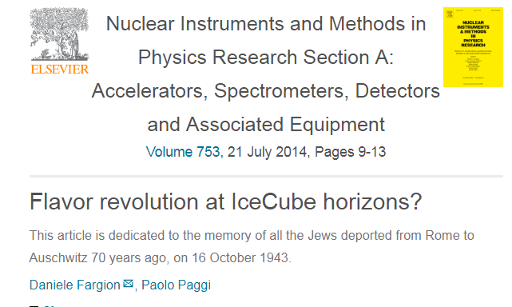
2013 . The ICECUBE by flavor revolution: From track to showers

Slide 38
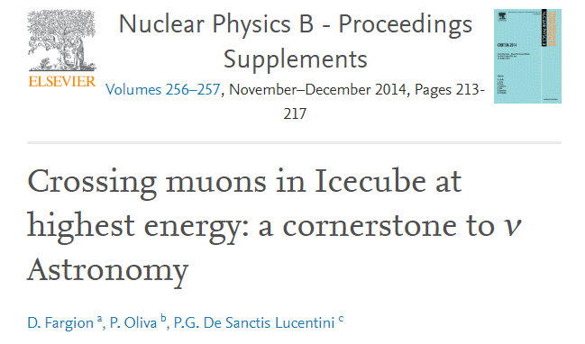

Slide 39
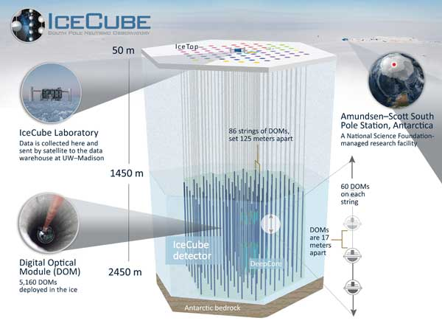
Neutrino Telescope screened by Ice Top array ( veto detecting airshowers)

Slide 40
a critical view of Icecube results
arXiv:1808.10493v4
No guaranteed neutrino astronomy without (enough)
double bang tau and downward HESE muon tracks
DF, M.Khlopov,P.Oliva,P. Lucentini

Slide 41
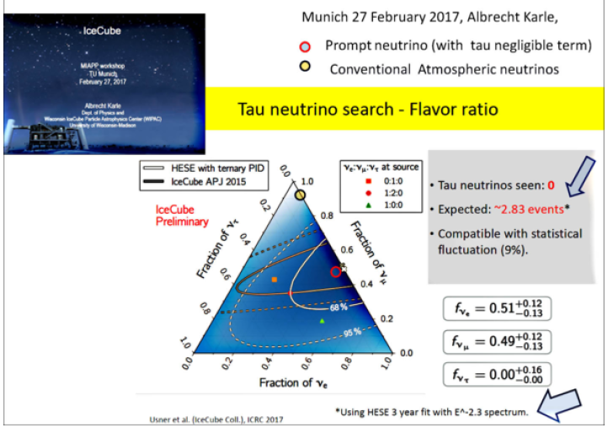

Slide 42
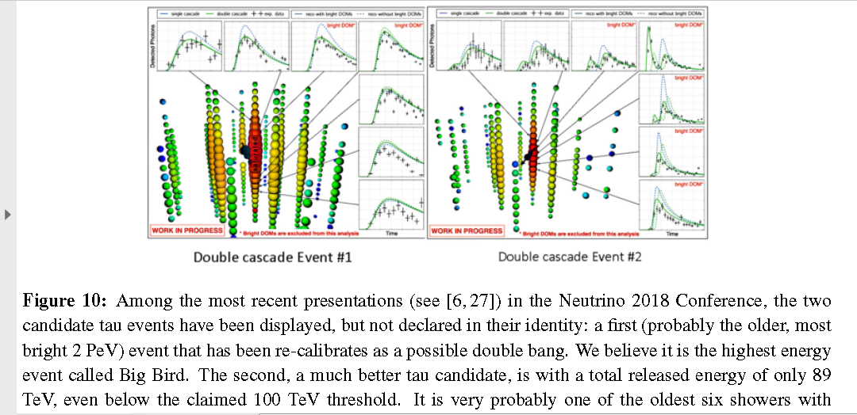
Two (unprobable) Tau double bangs within 36
UHE events above 100 TeV: Too few!

Slide 43
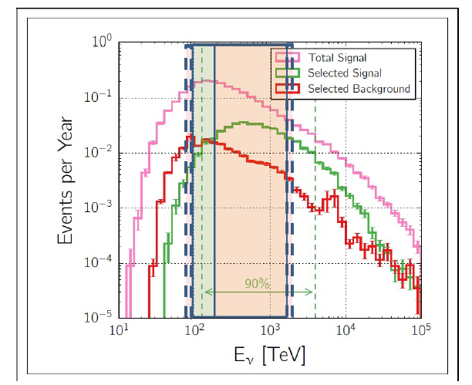
Both Tau neutrino events claimed by ICECUBE found in the noisy extreme regions while being absent in most probable area

Slide 44
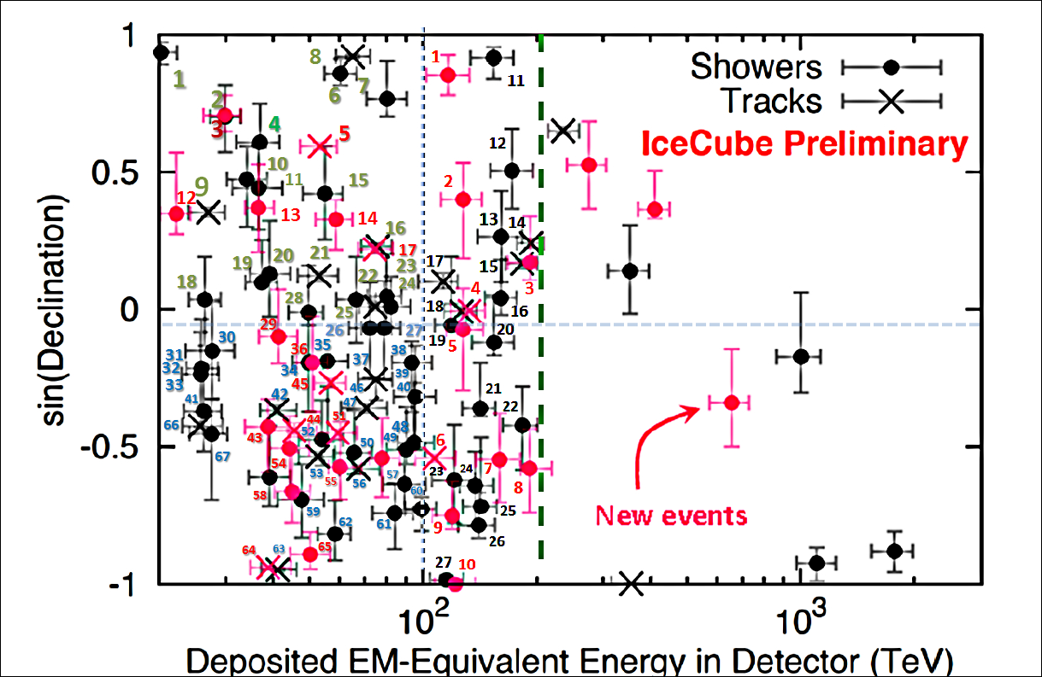

Slide 45
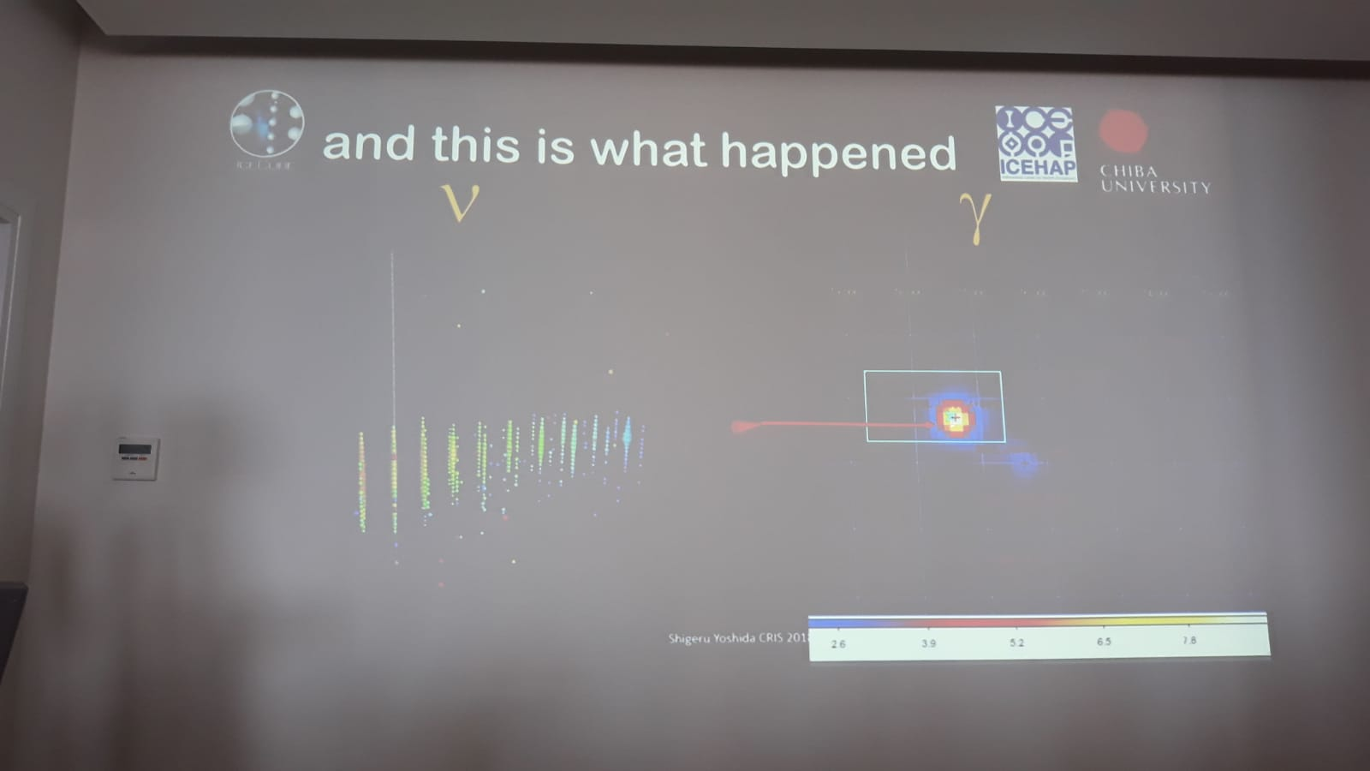
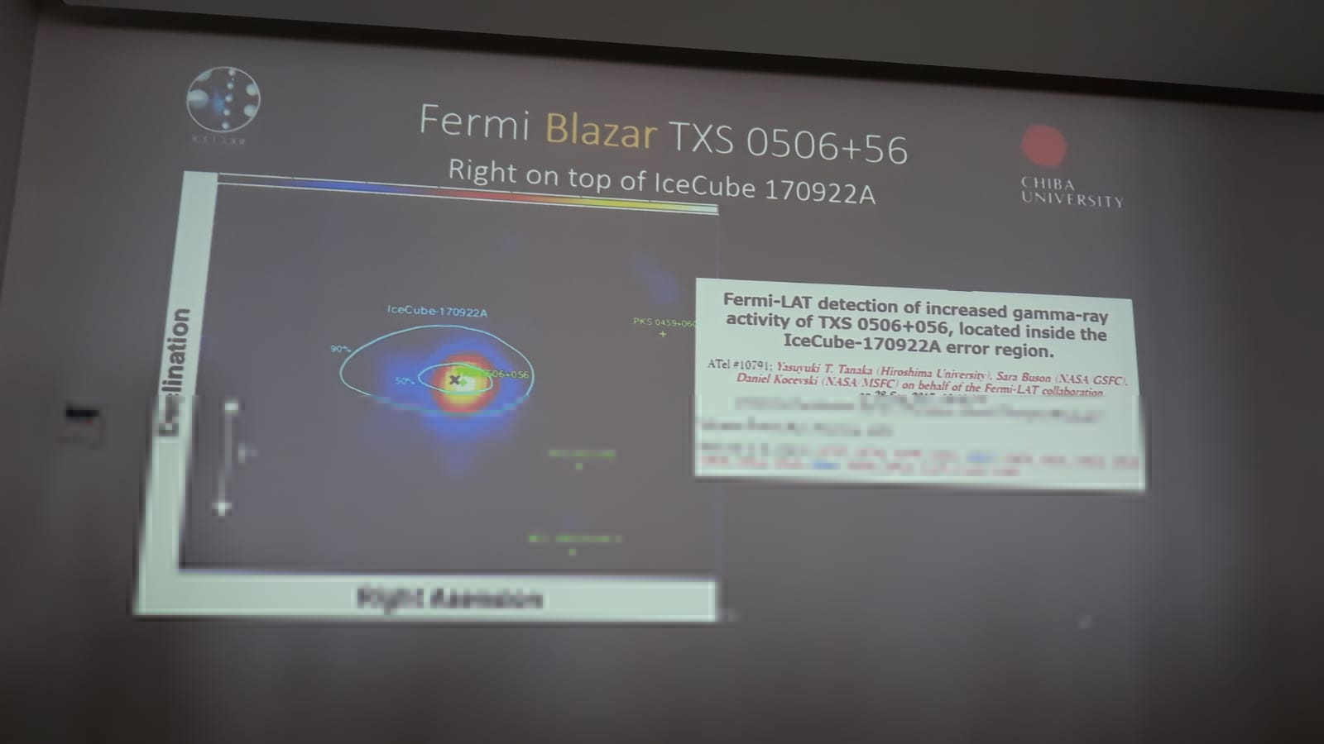
Maybe a final UHE neutrino and gamma correlated event on 23 sept 2017?
Too rare and less and less correlated

Slide 46
CONCLUSIONS: BACK TO TAU AIRSHOWERS→ named skimming neutrinos
High ALTITUDE Horizontal Airshower are
→ SPLITTED AIRSHOWERS
Geomagnetic field do split the airshower
In 3 or 5 independent jet like tails:
Electron pairs bent east west or up down making spiral corns or tails
Gamma in the center ..becoming later in air again a twin electron jet
Muon tracks make much much far away a weaker twin electron tails spiral jet

Slide 47
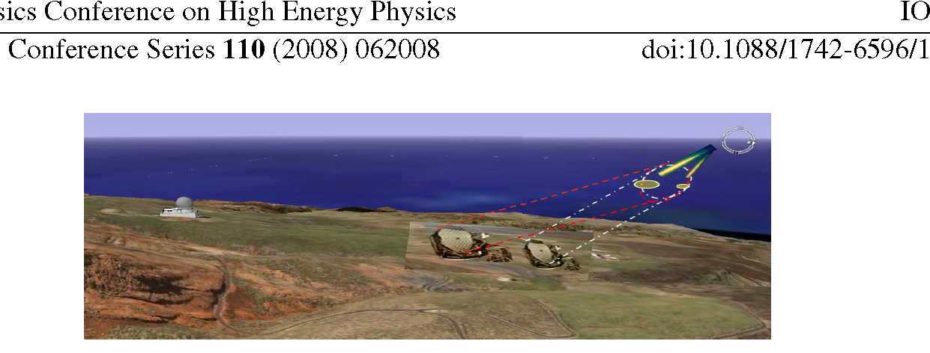
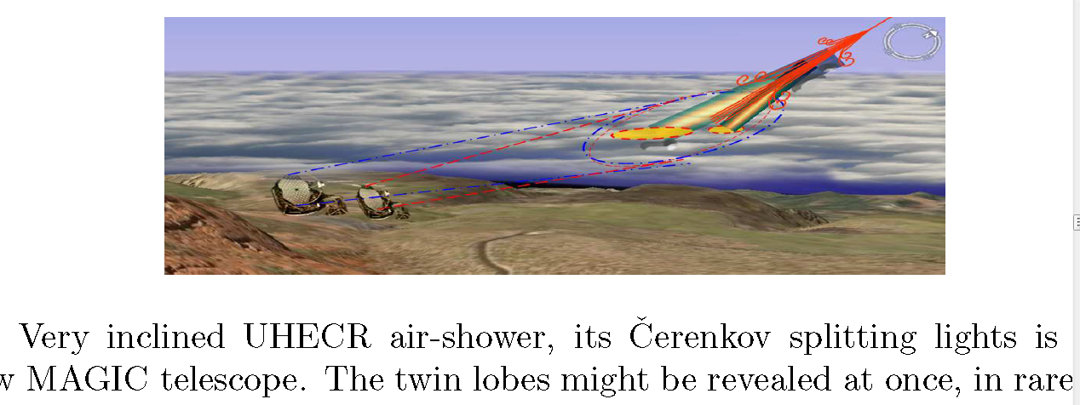
Magic Telescope proposal might see the far beamed split Cherenkov flashes

Slide 48

Taus on the clauds: A winning tool

Slide 49
The Giant Radio Array for Neutrino Detection in China: GRAND is
DIRECTIONAL BECAUSE GEOMAGNETIC FIELD it is directional too.
. The Giant Radio Array for Neutrino Detection (GRAND) is a planned array of ∼ 2·105 radio antennas deployed over ∼ 200 000 km2 in a mountainous site. It aims primarly at detecting high-energy neutrinos via the observation of extensive air showers induced by the decay in the atmosphere of taus. The instrument will also detect UHECRs

Slide 50

A vertical POEMMA twin linked satellites geometry
(up-down) will be better to disentangle at zenith the far source, not at far different azimuth angle

Slide 51
Conclusions
The tau neutrino Astronomy it is beyond the edge
Anita might be observing one such a tau signal
Array detector as GRAND and ASHRA and POEMMA, AUGER: may discover the tau signal among the High Altitude Hadron Airshower :
ETNA MUON S array may SEE ALSO TAU at tens PeV !!
From above looking below.
Splitted jet corns are the imprint. POEMMA;
They need a twin vertical (zenith) not horizontal twin satellite to disentangle UHECR from tau ones,

Slide 52
In brief , the Earth is the sky of the sky or better to say the Earth is the sky of UHE tau neutrinos
Thank you for the attention

Slide 54


Slide 55


More Sudden cascades changes

Slide 56

From 36 showers how many tau? Atmospheric versus astrophysics

Slide 57
The apparent splitted fan airshower, observed on blaze front never on fluorescence side
The Cherenkov flashes
The vertical up-down bent pair component (for equatorial B)
The horizontal bending at magnetic poles
The consequent view: Sprites?
Elves? Terrestrial gamma flash:
What are the PeVs upward Taus: The Blue Jet?
Are UHECR and Tau the trigger in a giant Wilson room (the atmosphere) for TGF?

Slide 58


Slide 60

DATA ICRC 2019 and Neutrino 2018
Marcel Usner, M.Sc.
Thesis and ICECUBE presentation
June 2018- NEUTRINO 2018

Slide 61

ICRC 2019
Updated ICECUBE maps
ICRC19
A. Barbano
Data samples
Neutrinos: : 82 Tracks-76 Cascades
[1]Astrophys. J. Letters 768 (May, 2013) L1
[2] Astrophys.J. 804 (2015) no.1, 15
[3] EPJ Web Conf.210(2019) 01005
(UHECR-Stacking Analyses)
•IceCube:
(i)7-year neutrino point-source sample [4]
(ii)latest 3.5 years of the gamma-ray
follow-up sample [5]
→1.4M eventsin total, between2008 and 2018
•ANTARES:11-year point-source sample including events until 2017 [6]
[4] Astrophys. J. 835 (2017) 151
[5] Science 361 (2018) 147–151
[6]Astrophys. J. 863 (2018) L30
•TA:143 events(E > 57 EeV, zenith angle ≤ 80°), from May 2008 to May 2017 [1]
•Auger:324 events (E > 52 EeV, zenith angle ≤ 80°), recorded with the SD from Jan. 2004 to Apr. 2017 [2]
•Rescaling applied to event energies to match TA and Auger fluxes (-14% and 14% respectively) [3]
UHECRs:10

