Slide 1


The Equation of State of Nuclear Matter and Neutron Stars’ Structure
COST Action MP1304
M. Baldo, H.-J. Schulze, G. Taranto, D. Zappalà (INFN Sezione di Catania)
V. Greco, U. Lombardo, S. Plumari (INFN-LNS)
A. Bonanno (INAF Catania)
V. Ferrari, L. Gualtieri (Dip. Fisica “La Sapienza”, Roma)
A. Li, X. R. Zhou (Xiamen University, China)
M. Buballa (TU Darmstadt, Germany)
H. Chen (Wuhan University, China)
N. Yasutake (Institute of Technology, Chiba, Japan)
V. Urpin (IOFFE Institute, Saint-Petersburg, Russia)
F. Weber (San Diego State University, USA)
W. Zuo (Lanzhou University, China)
Fiorella Burgio
INFN Sezione di Catania
International School of Nuclear Physics, 36° Course,
Nuclei in the Laboratory and in the Cosmos, Erice, September 16-24, 2014

Slide 2
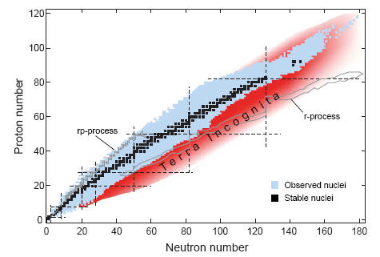
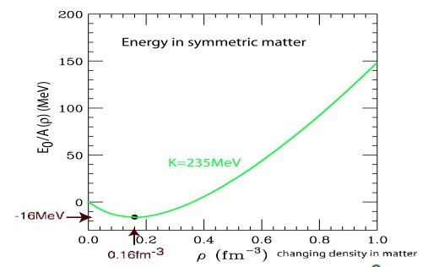
The EoS : where do we stand ?
In symmetric nuclear matter
By defining the asymmetry parameter , then in the vicinity of ρ₀ the binding energy is usually expanded as
Symmetry energy
Nuclear Incompressibility
L and K_{sym} parameters characterizing the density dependence of the symmetry energy around the saturation point

Slide 3
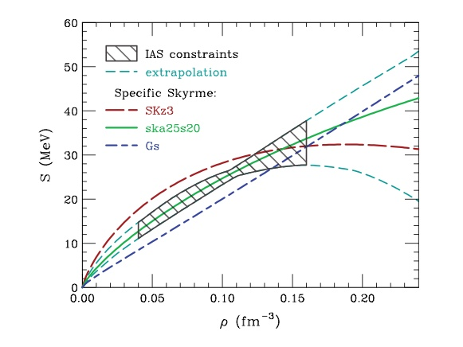
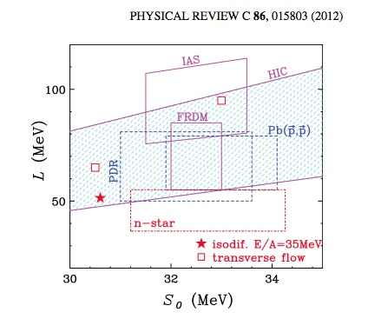
The Symmetry Energy S and its slope L
R_{NS} ?
_{Lattimer & Prakash,}
_{ApJ(2001)}
Composition of neutron star matter.
Proton fraction : onset of DURCA processes in cooling.
Onset of hyperons.
Tsang et al.,
Danielewicz & Lee, Nucl. Phys. A922, 1 (2014)

Slide 4
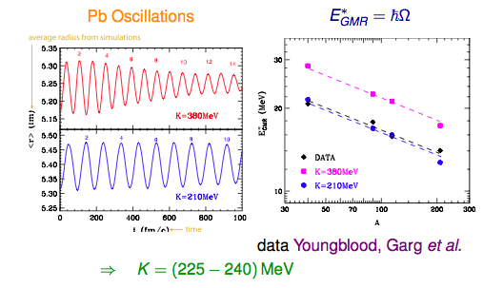
Nuclear Incompressibility for symmetric matter K₀
210 MeV < K₀< 250 MeV
Results are confirmed also by experiments on K⁺ multiplicity in HIC
K⁺ produced by :
with production rate dependent on the maximal density -----> K₀
Largest density explored : ρ ≈ 2-3 ρ₀
Only calculations with a compression 180 ≤ K₀ ≤ 250 MeV can describe the data (Fuchs, 2001)
The nuclear equation of state up to 2-3ρ₀ is SOFT !

Slide 5
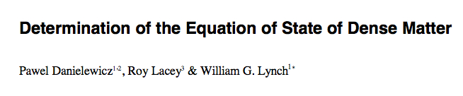
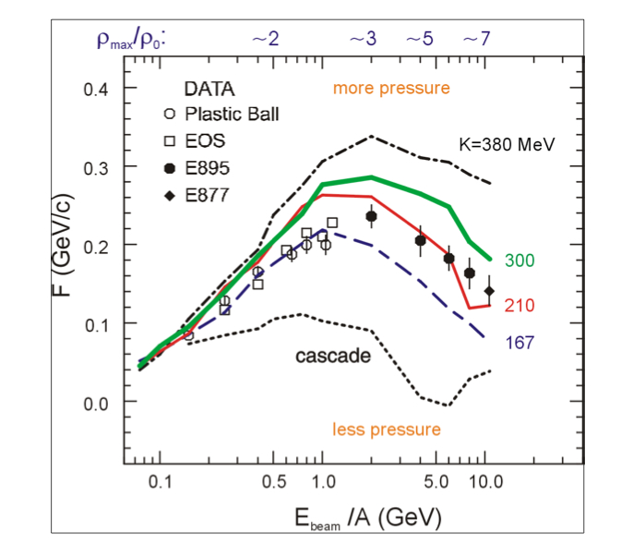
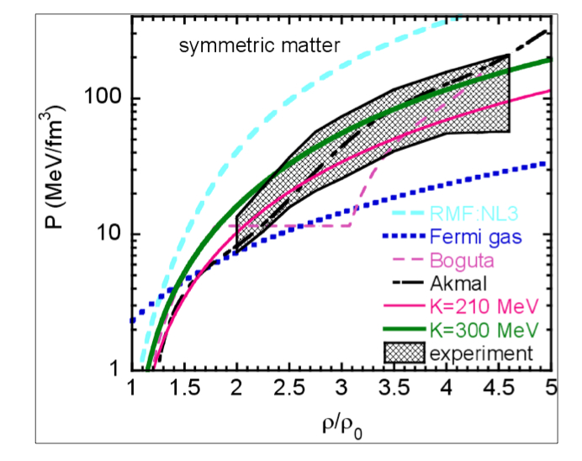
Science 298,
1592 (2002)
Transverse flow measurements in Au + Au collisions at E/A=0.5 to 10 GeV
Pressure determined from simulations based on the Boltzmann-Uehling Uhlenbeck transport theory
Flow data exclude
very repulsive equations of state,
very soft EoS (e.g. Fermi gas)

Slide 6
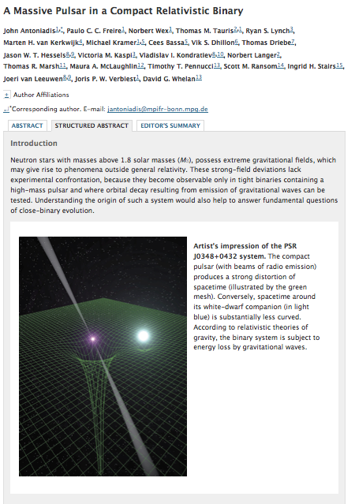
Compilation by Jim Lattimer
Science 340 (6131), 2013
Several soft EoS are EXCLUDED !

Slide 7

Four main layers
Outer crust ⁵⁶Fe ions immersed in an electron gas, as in normal metals.
Inner crust Neutron gas in chemical equilibrium with electrons and ions. Ions get very neutron rich, until the neutrons drip from nuclei. Nuclear matter from drip point (4x10¹¹ g/cc) up to about half the saturation density.
Outer core Asymmetric nuclear matter above saturation. Mainly composed by neutrons, protons, electrons and muons. Its exact composition depends on the nuclear matter Equation of State (EoS).
Inner core The most unknown region. “Exotic matter” . Hyperons. Kaons? Pions? Quarks ?
by Dany Page, UNAM Mexico City

Slide 8
“Recipe” for neutron star structure calculation :
Energy density :
Chemical potentials :
Beta-equilibrium :
Charge neutrality :
Composition :
Equation of state :
TOV equations :
Structure of the star :
Need theoretical method to calculate the energy density

Slide 9
The Brueckner-Bethe-Goldstone theory of Nuclear Matter
Bethe-Goldstone equation for the G-matrix
parameter free theory
self-consistent procedure
Results : energy density, s.p. properties, cross sections, .....
K. A. Brueckner, and J. L. Gammel, PR 109,1023 (1958) for nuclear matter

Slide 10
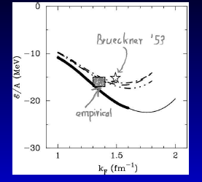
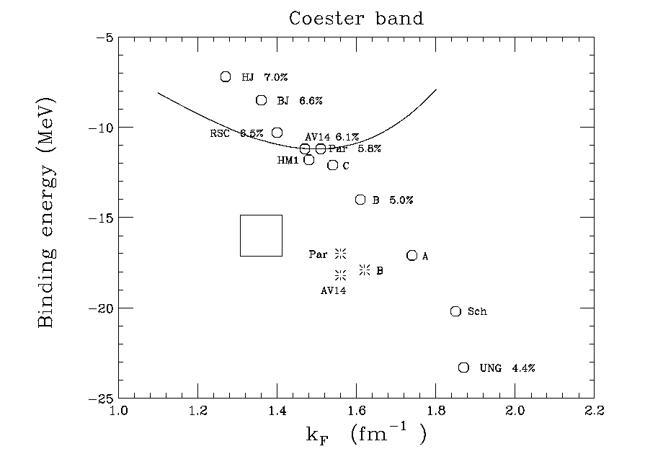
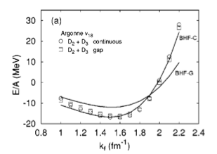
Missing the saturation point …….
Coester et al.,
Phys. Rev. C1, 769 (1970)
Systematics by R. Machleidt,
Adv. Nucl. Phys. 19, 1989.
Argonne v₁₄
Results up to three hole lines :
SP
•
•
Results depend on the adopted NN potential.
The saturation point is missed even including the 3h.

Slide 11
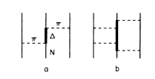
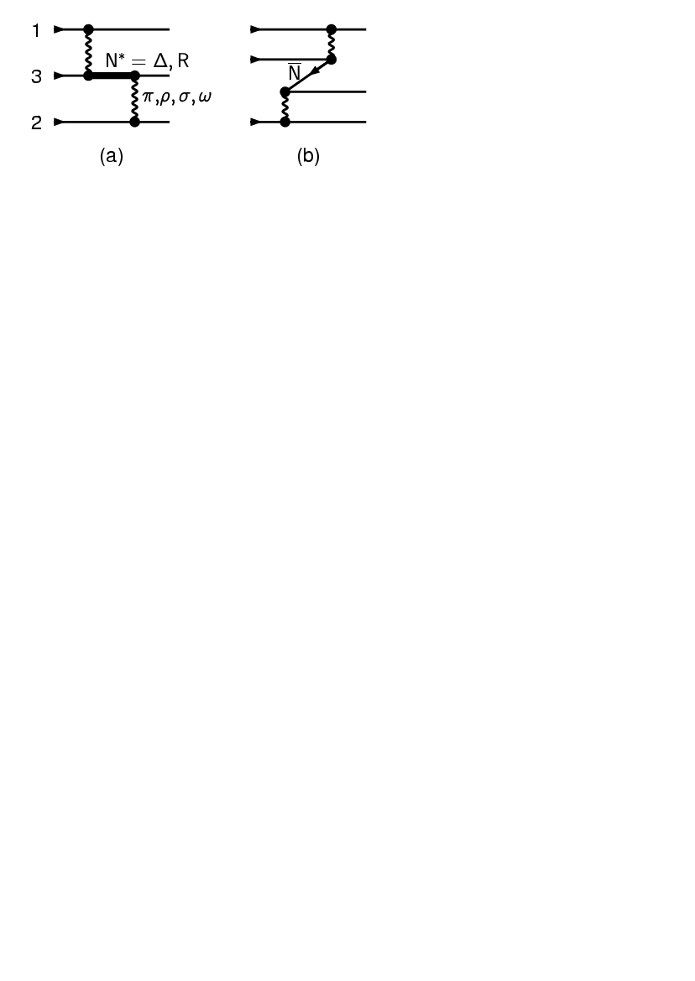
Three-nucleon forces
Only small effect required [δ(B/A)≈ 1 MeV at ρ₀
Model dependent , no complete theory available yet !
Use and compare phenomenological and microscopic approaches :
Urbana IX phenomenological model :
Only 2π-TBF + repulsion
Fit saturation point
Carlson et al.,
NP A401,(1983) 59
Microscopic model :
Exchange of π,ρ,σ,ω via Δ(1232), R(1440),NN.
Parameters compatible with two-nucleon
potential (Paris, Argonne v₁₈, ...)
P. Grange’ et al,
PR C40, (1989) 1040

Slide 12
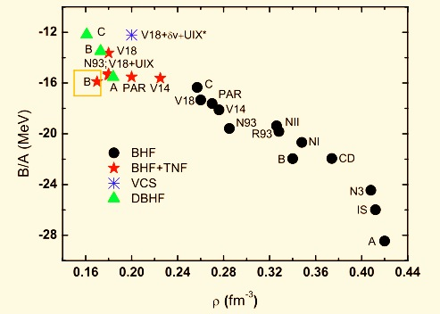
BHF binding energy and saturation properties
Z.H. Li, U. Lombardo, H.-J. Schulze, W. Zuo,
PRC 74, 047304 (2006)
New Coester band
Dependence on NN potential
TBF needed to improve saturation properties
Uncertain high-density behaviour due to unknown TBF ....

Slide 13
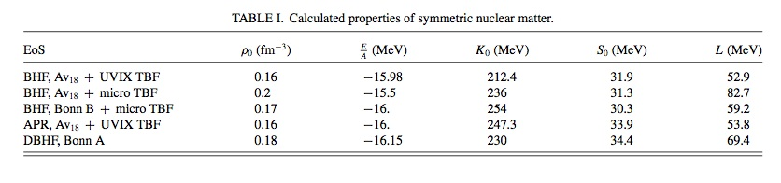
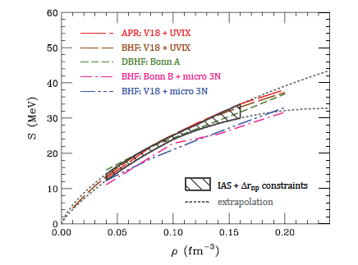
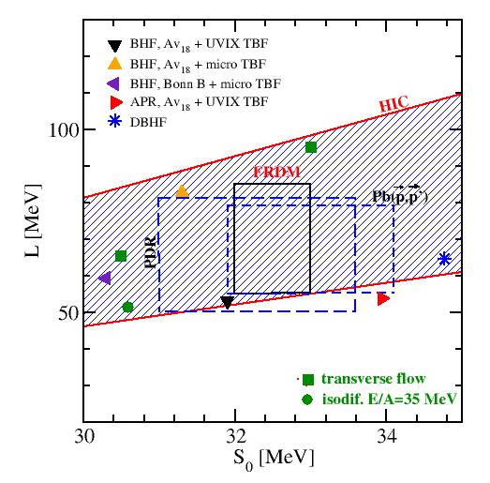
Microscopic EoS’s reproduce well the data from phenomenology
G. Taranto et al., Phys. Rev. C87, 045803 (2013)

Slide 14
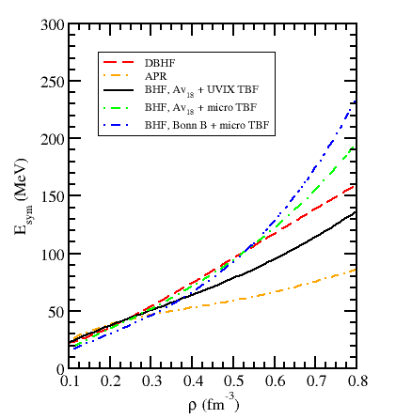
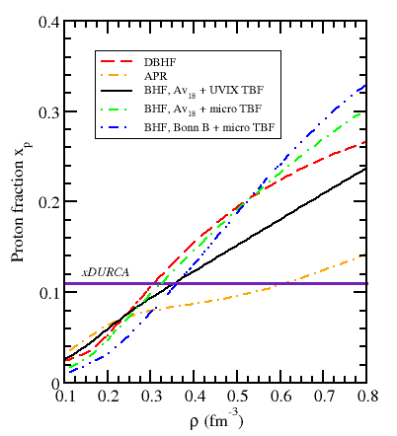
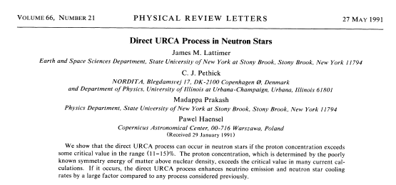
Microscopic calculations of E_{sym}
( n, p, e, μ) beta-stable matter
Early onset of DURCA processes if BHF/DBHF are used.
In APR medium mass NS do not cool down via DURCA.

Slide 15
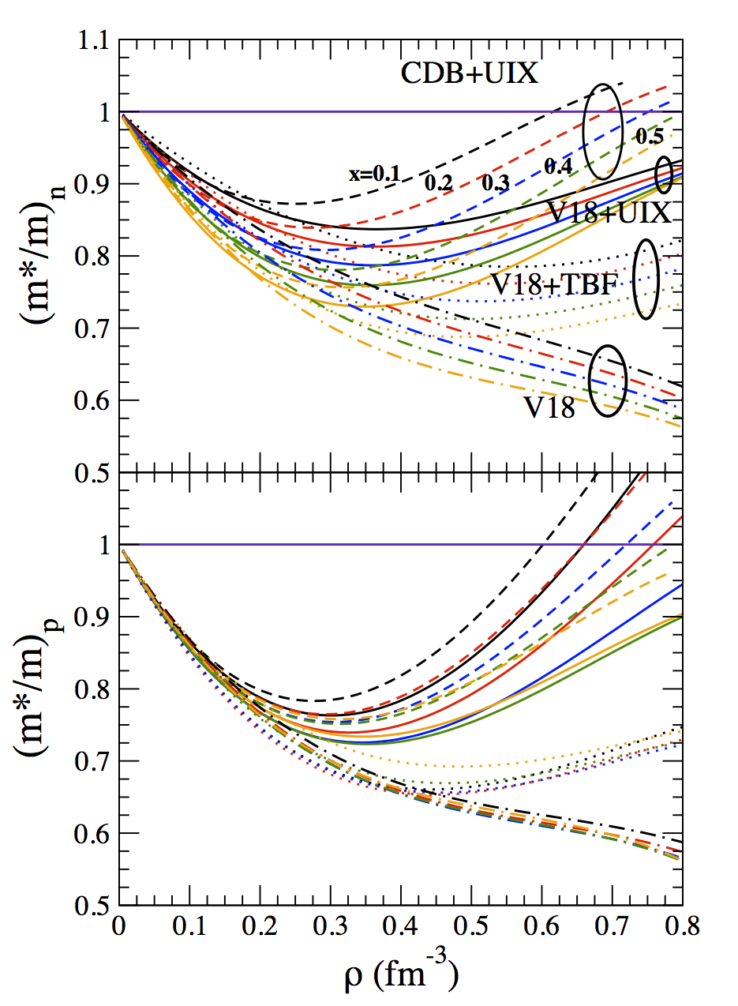
Effective mass
Related to many nuclear phenomena such as
the dynamics of HIC at intermediate energies
the neutrino emissivity in NS cooling
In direct URCA processes :
In-medium suppression of the emissivities, which depends strongly on the employed interactions, and reflects the current lack of knowledge regarding nuclear TBF at high density.

Slide 16
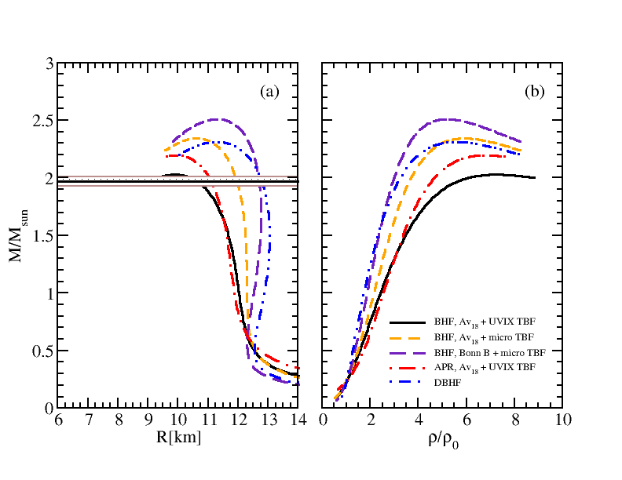
Neutron star Mass M and Radius R
Different many-body techniques and matter compositions predict different results for the M-R relation.

Slide 17
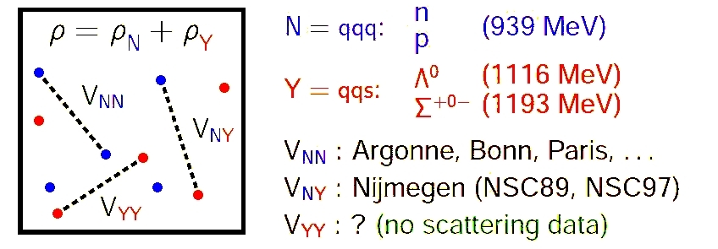
INCLUDING HYPERONS
Extension of the BBG theory.
Several reaction channels involved, more time consuming calculations.
Few experimental data of hypernuclei
on nucleon-hyperon interaction.
Nijmegen parametrization, Phys. Rev. C40, 2226 (1989) (NSC89)
Unknown HH interaction.
Use of an extrapolation of NSC89, called NSC97
Strong consequences for NS structure.
Softening of the EoS

Slide 18

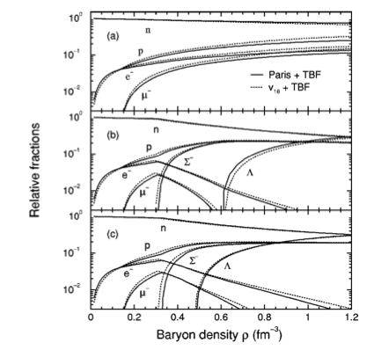
Implications for composition
No hyperons
Free hyperons
Interacting hyperons
(Σ⁻ repulsive, Λ attractive)
NY interaction determines Y onset

Slide 19
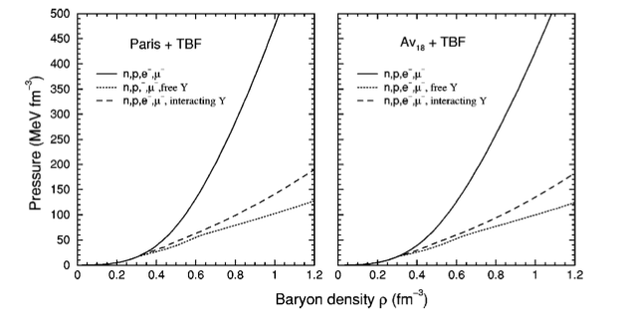
Eos of neutron star matter
Strong softening due to hyperons !
(more Fermi seas available)

Slide 20
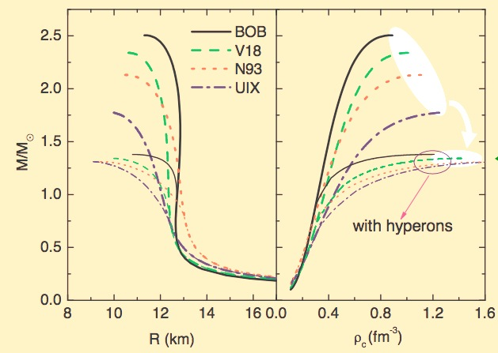
Mass-Radius relations with different nucleonic TBF’s
NSC89 NY potential
No YY
No hyperon TBF
Large variation of M_{max} with nucleonic TBF’s
Self-regulating softening due to hyperon appearance
(stiffer nucleonic EOS -----> earlier hyperon onset)

Slide 21
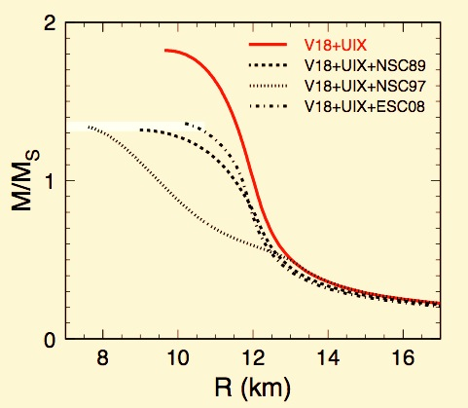
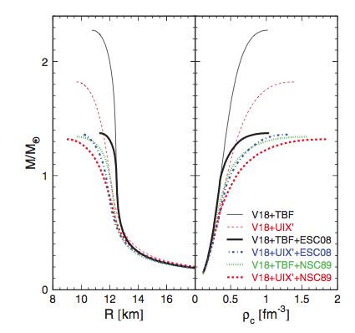
Using different NY, YY potentials
Maximum mass independent of potentials.
Maximum mass too low (< 1.4 M₀ ! )

Slide 22
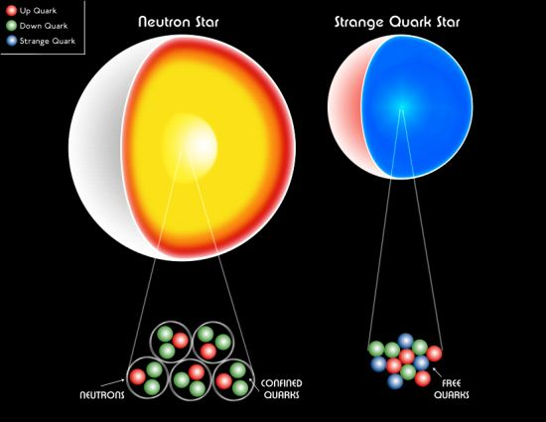
Quark matter in NS (hybrid stars)
Since we have no theory which describes both confined and deconfined phases, we use two separate EOS for baryon and quark matter and look at the crossing in the P-μ plane .
Constraints from nuclear phenomenology on the general quark EOS : In symmetric nuclear matter one can expect a transition to quark matter at some density, but it must be larger than at least normal nuclear matter density.
Maximum NS mass at least equal to 1.97 M₀
Several models of quark matter
  MIT bag model
  Nambu-Jona—Lasinio model
  Color Dielectric model
  Dyson-Schwinger model
  They all give different hybrid star structure and mass limits.

Slide 23
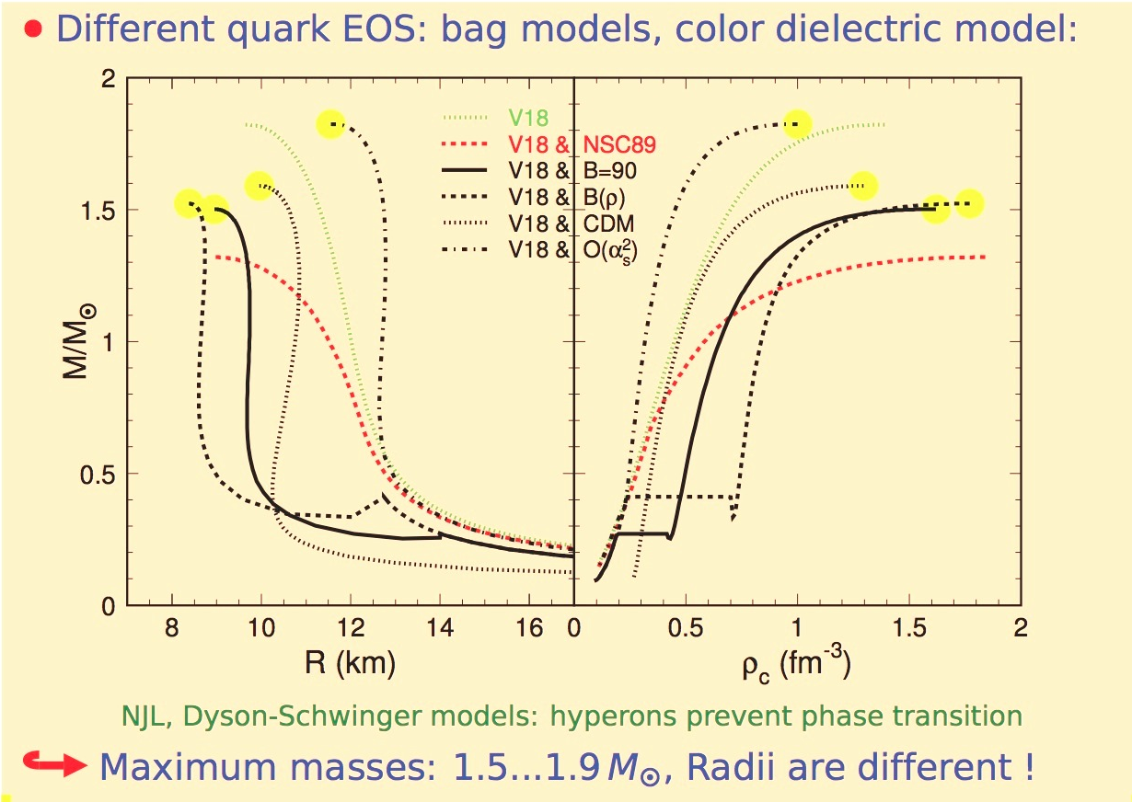

Slide 24
Final considerations
The EoS of nucleonic matter is much under control up to 4-5 times normal density.
Excellent agreement with experimental data on nuclei from HIC.
Large uncertainty in the TBF’s.
Hyperons appearance : open question
Phase transition to quark matter : open question
The observation of PSR J0348+0432, M=2.01± 0.04 Mo implies that additional repulsion is required in the currently adopted quark models.

Slide 25
Thank you !

Slide 26
Convergence of the BBG hole-line expansion
Baldo et al,
Phys. Rev. C65, 017303 (2001)
-40 MeV
+ 2 MeV
≈22 MeV
(for symmetric matter
at ρ=ρ₀)
Results up to three hole lines :
The hole-line expansion appears well converged, but slightly misses the correct saturation point.
•
•
just like in early calculations

