Slide 1
Production of Unstable Nuclei for Astrophysical Studies and the new Accelerator Project at MSU
David Morrissey
Facility for Rare Isotope Beams
18 September 2014

Slide 2
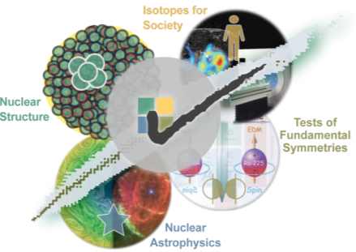
Facility for Rare Isotope Beams: Program
Properties of atomic nuclei
  Develop a predictive model of nuclei and their interactions
  Many-body quantum problem: intellectual overlap to mesoscopic
  science, quantum dots, atomic clusters, etc.
Astrophysics: Nuclear Processes in the Cosmos
  Origin of the elements, chemical history
  Explosive environments: novae,
  supernovae, X-ray bursts …
  Properties of neutron stars
Tests of laws of nature
  Effects of symmetry violations are
  amplified in certain nuclei
Societal applications and benefits
  Medicine, energy, material
  sciences, national security

Slide 3
Nucl. Astro.: Large Number of Reactions,
Much Larger Number of Nuclei …
Big Bang Nucleosynthesis
pp-chain
CNO cycle
Helium, C, O, Ne, Si burning
s-process
r-process
rp-process
νp – process
p – process
α - process
fission recycling
Cosmic ray spallation
pyconuclear fusion
+ others added all the time …
Sample reaction paths
(α,γ)
fission
(p,γ)
β⁻
(α,p)
(n,2n)
^{A}Z
(n,γ)
β⁺ , (n,p)
(γ,p)

Slide 4
More than half of Z>28 from an r-process
E. M. Burbidge, G. R. Burbidge, W. A. Fowler, and F. Hoyle. (1957). "Synthesis of the Elements in Stars". Rev Mod Phy 29: 547, must be an r-procees (90% of gold from r-process)
We know majority must be made in a neutron-rich environment T > 10⁹ K, ρ_{neutron} ≈ 10²⁰⁻²⁸ cm⁻³ , that lasts for about 1 second; called the rapid-neutron capture process, r-process
Type II supernovae are a possible site (no realistic model works)
  Neutrino driven shock wave, however models do not produce the entropy and neutron flux needed to match abundance data (although we can’t say that for sure)
  Shock waves in C-O layers
  Magnetic outflows
Colliding neutron stars work, but can we understand the nature of the early universe to know if there would be enough such events
Once the underlying physics is known, we can infer information of the site from observational data

Slide 5
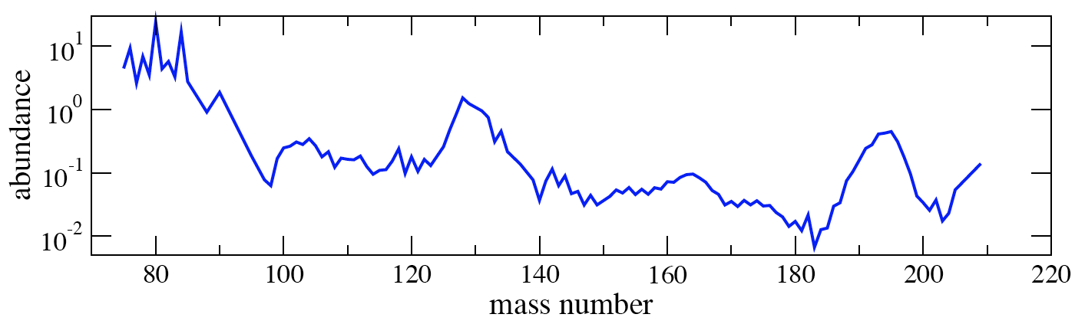
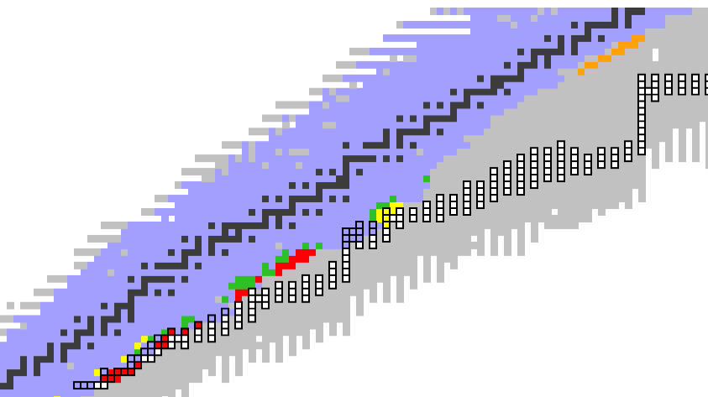
Information Needed from Nuclear Physics
Speakers have already described different regions in the chart are needed to probe many aspects of astrophysical models to be compared to observations.
N=126
N=82
Critical region probes:
Main r-process parameters
Production of actinides
Critical region:
Disentangle
r-processes
Critical region probes:
r-process freezeout behavior
From:
H. Schatz
Critical region probes:
Main r-process parameters
Critical region probes:
Neutrino fluence

Slide 6
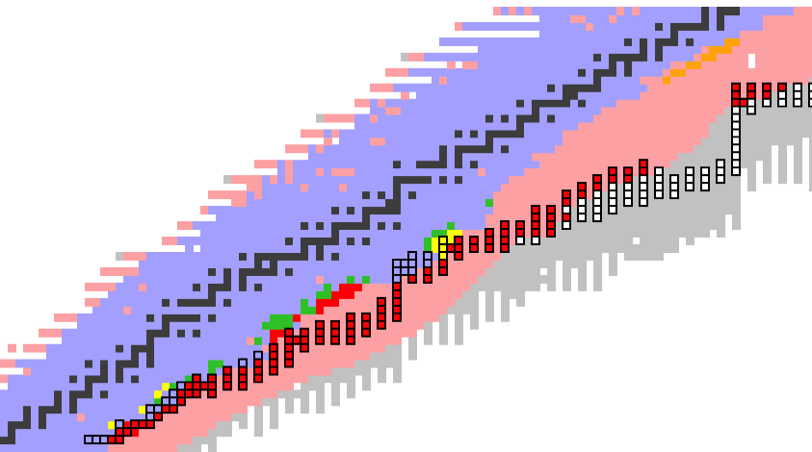
Information Needed from Nuclear Physics
Speakers have already described different regions in the chart are needed to probe many aspects of astrophysical models to be compared to observations.
FRIB reach for T_{1/2}, masses,
and β-delayed neutron emission
N=126
N=82
Critical region probes:
Main r-process parameters
Production of actinides
Critical region:
Disentangle
r-processes
Critical region probes:
r-process freezeout behavior
From:
H. Schatz
Critical region probes:
Main r-process parameters
Critical region probes:
Neutrino fluence

Slide 7
Can We Measure All the Nuclear Reactions?
No, clearly not!
We want a path to solve the nuclear physics part of the puzzle.
Construct detailed, predictive model(s) of nuclear structure
Produce the rare isotopes that are important for modeling and measure only their properties and reactions

Slide 8
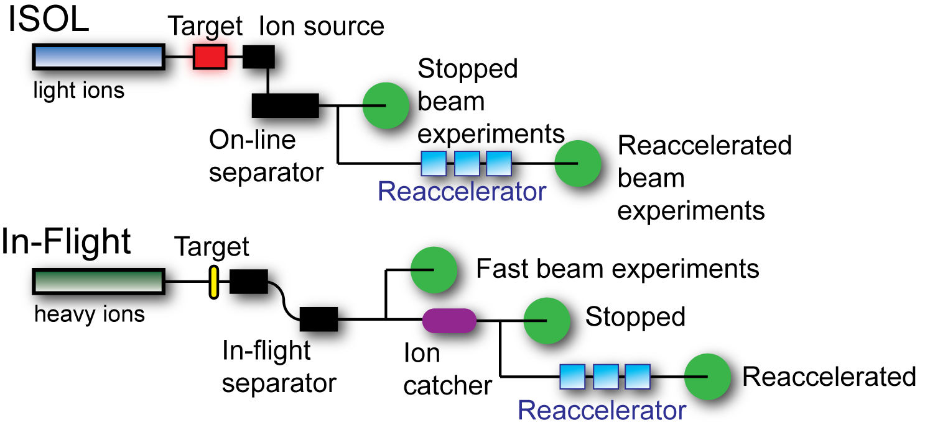
Rare Isotope Production Methods

Slide 9
In-flight Isotope Production Sensitivity
Cartoon of the isotope production process at RIB facilities:
Inverse mechanism for ISOL production (p + heavy target)
To produce a potential drip line nucleus like ¹²²Zr the production cross section (from ¹³⁶Xe) is estimated to be: 2x10⁻¹⁸ b
(2 attobarns, 2x10⁻⁴⁶ m² )
Nevertheless with a 200 MeV/u ¹³⁶Xe beam of 8x10¹³ ion/s (12 pμA, 400 kW) a few atoms per week can be made and studied (why? >80% collection efficiency; 1 out of 10²⁰)
(?)
projectile
target
Notes:
Just like radioactive decay is sensitive to one nucleus (with a suitable detector) … PF can be sensitive to individual nuclei.

Slide 10
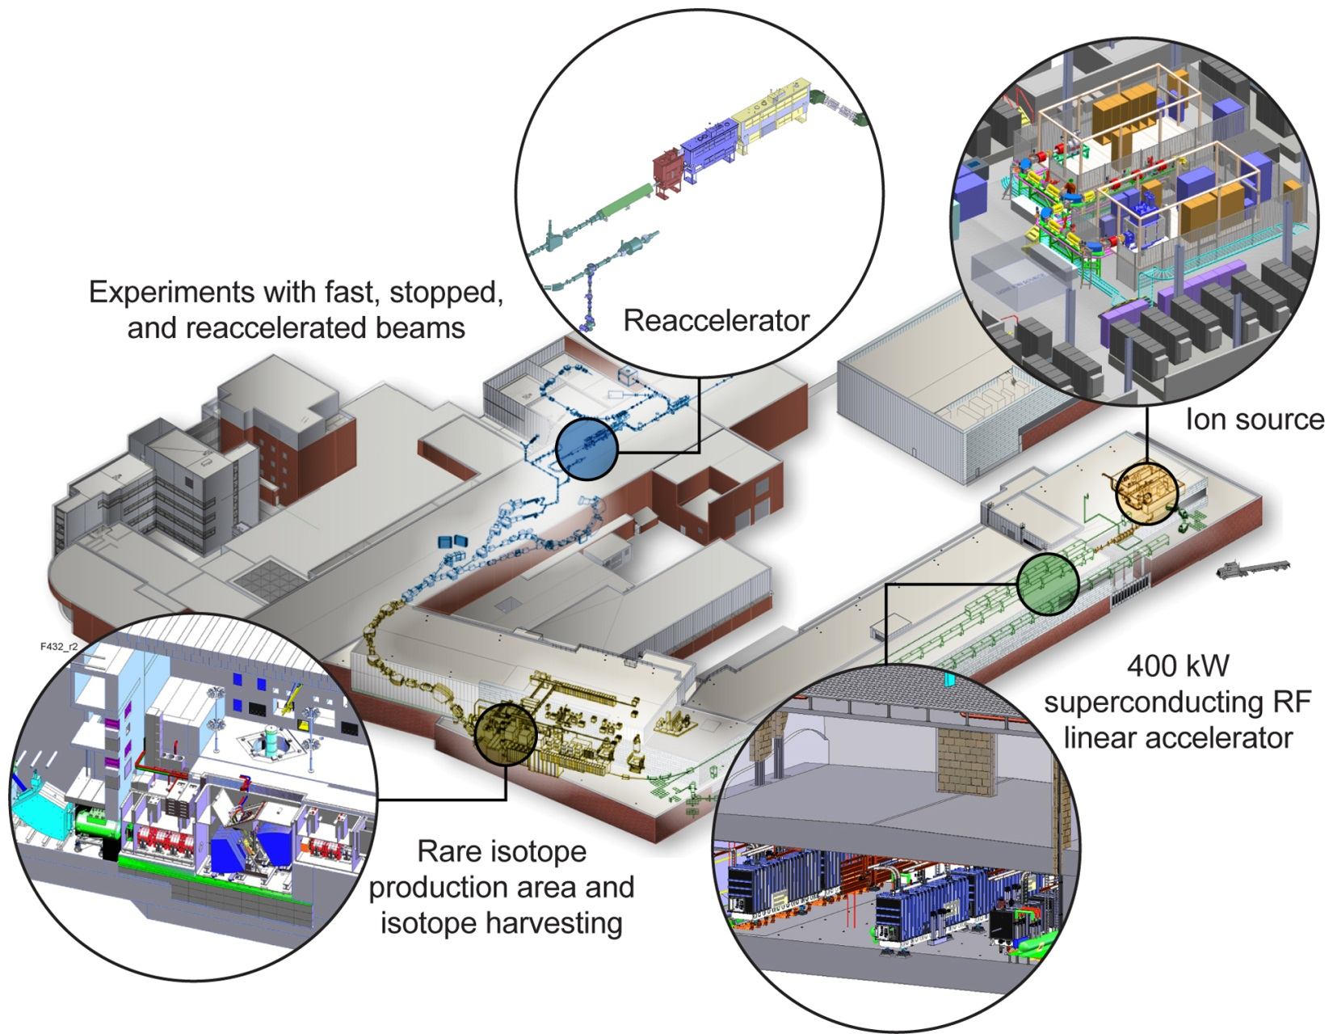
Facility for Rare Isotope Beams, FRIB
Funded by DOE Office of Science, T. Glasmacher, FRIB Project Director
Key Feature is 400kW beam power
(5x10¹³ ²³⁸U/s)
Separation of isotopes
“In-flight”
Suited for all elements
and short half-lives
Fast, stopped, and
reaccelerated radioactive beams

Slide 11
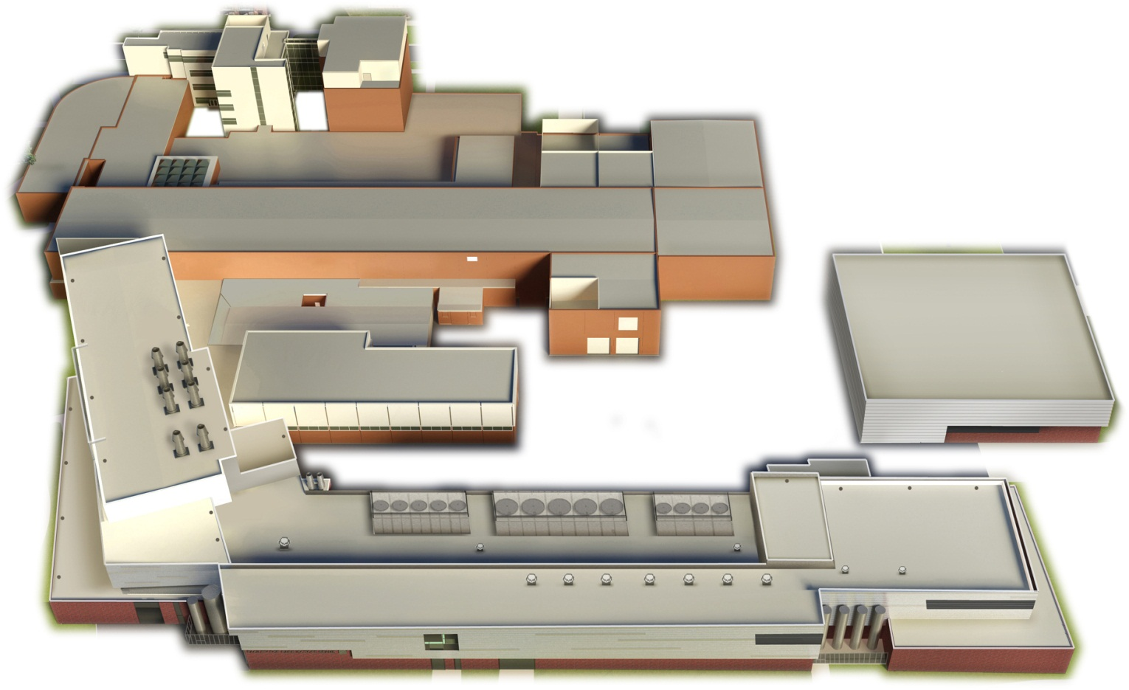
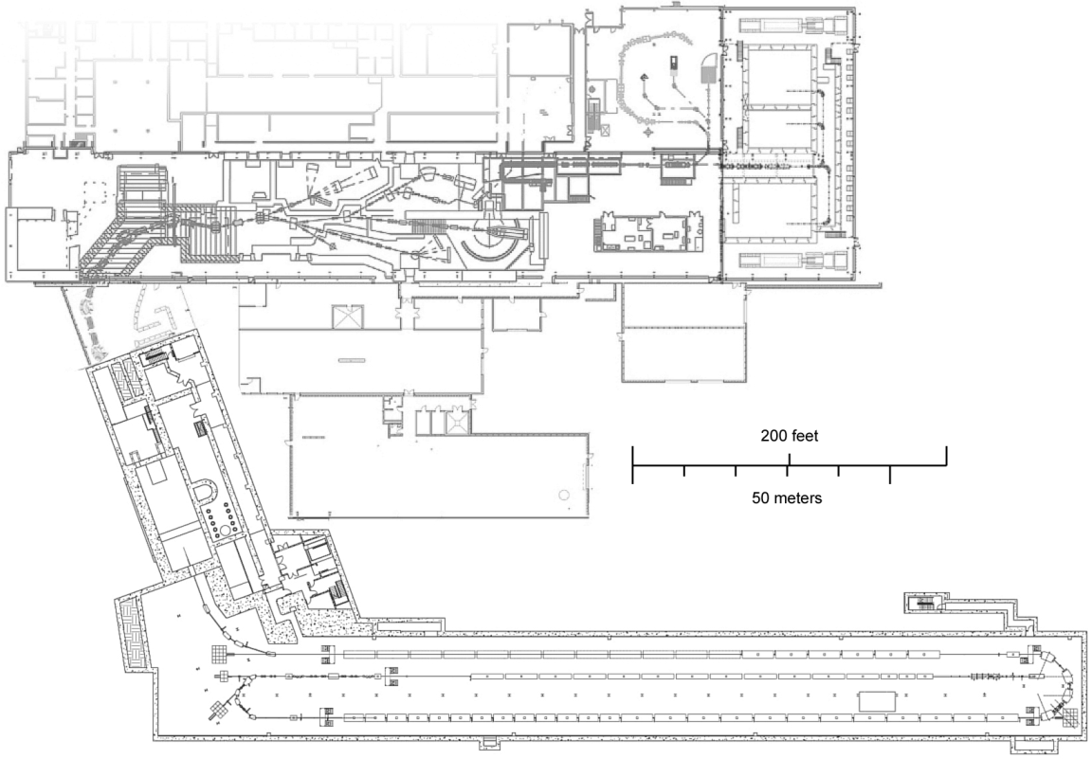
Layout of FRIB Accelerator and NSCL Experimental Areas
Fast Beam Area
Gas Catching
Thermalized Beam Area
Reaccelerated Beam Areas
New
Accelerator
Complex
Fragment Separator
Reaccelerator
Target
Beam Delivery System
Front End
Folding Segment 2
Linac Segment 1
Folding Segment 1
Linac Segment 2
Linac Segment 3

Slide 12
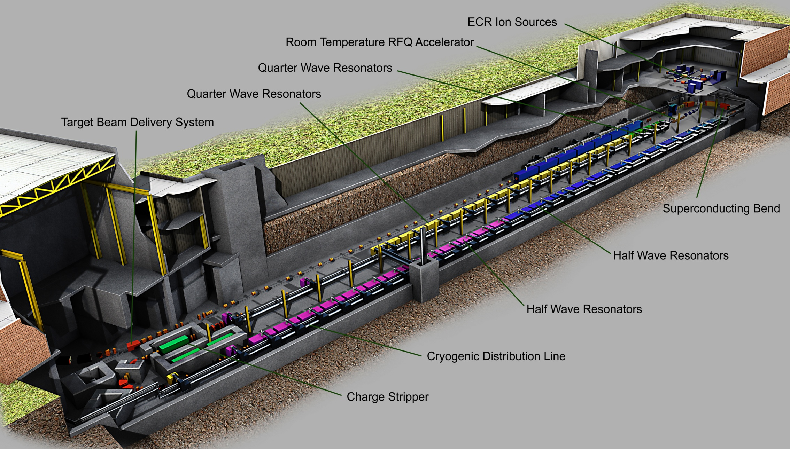
FRIB Driver: New Linear Accelerator

Slide 13
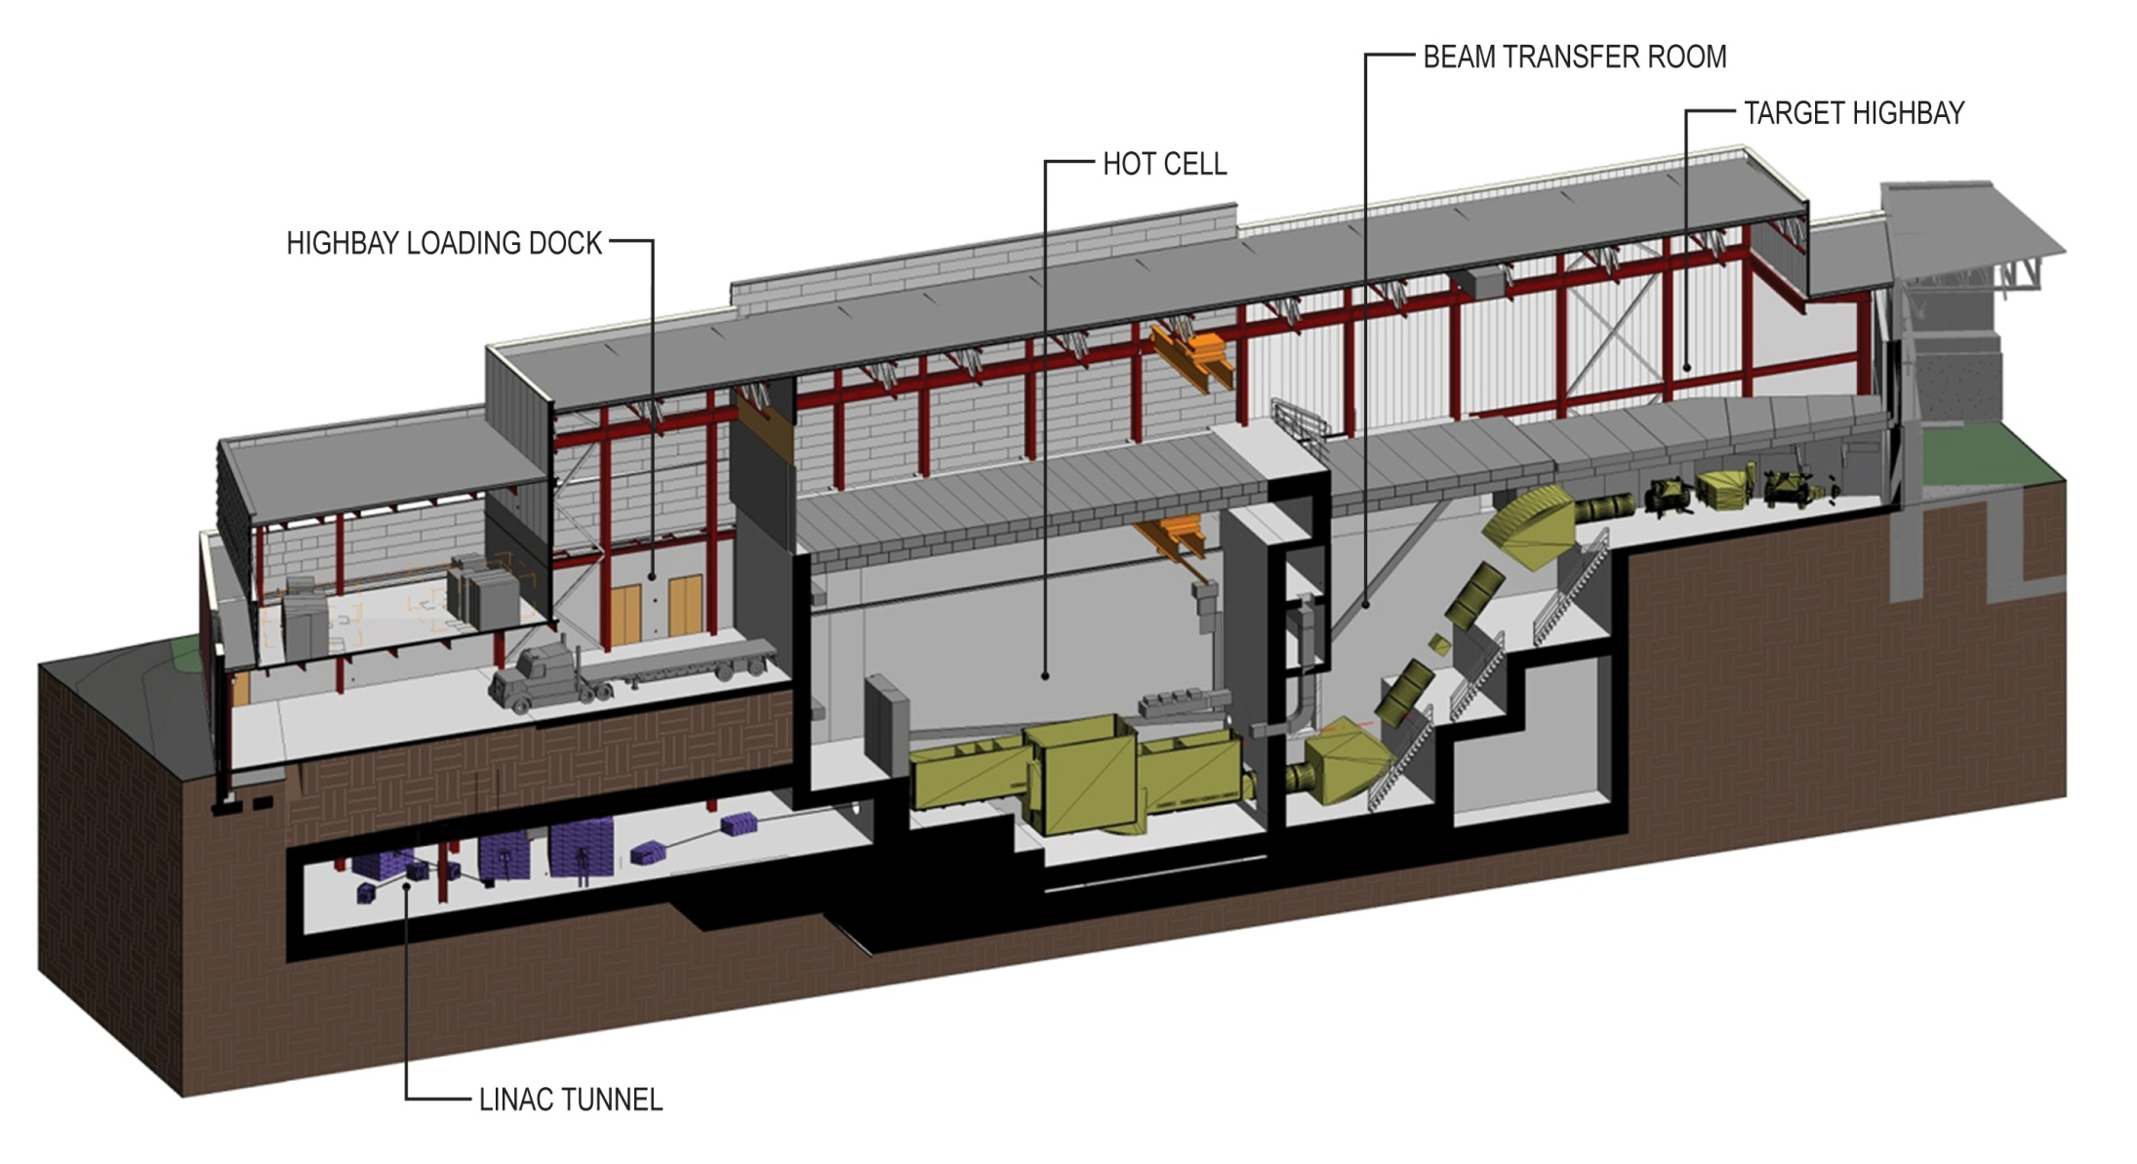
FRIB Production: New Hot Cell & Separator

Slide 14
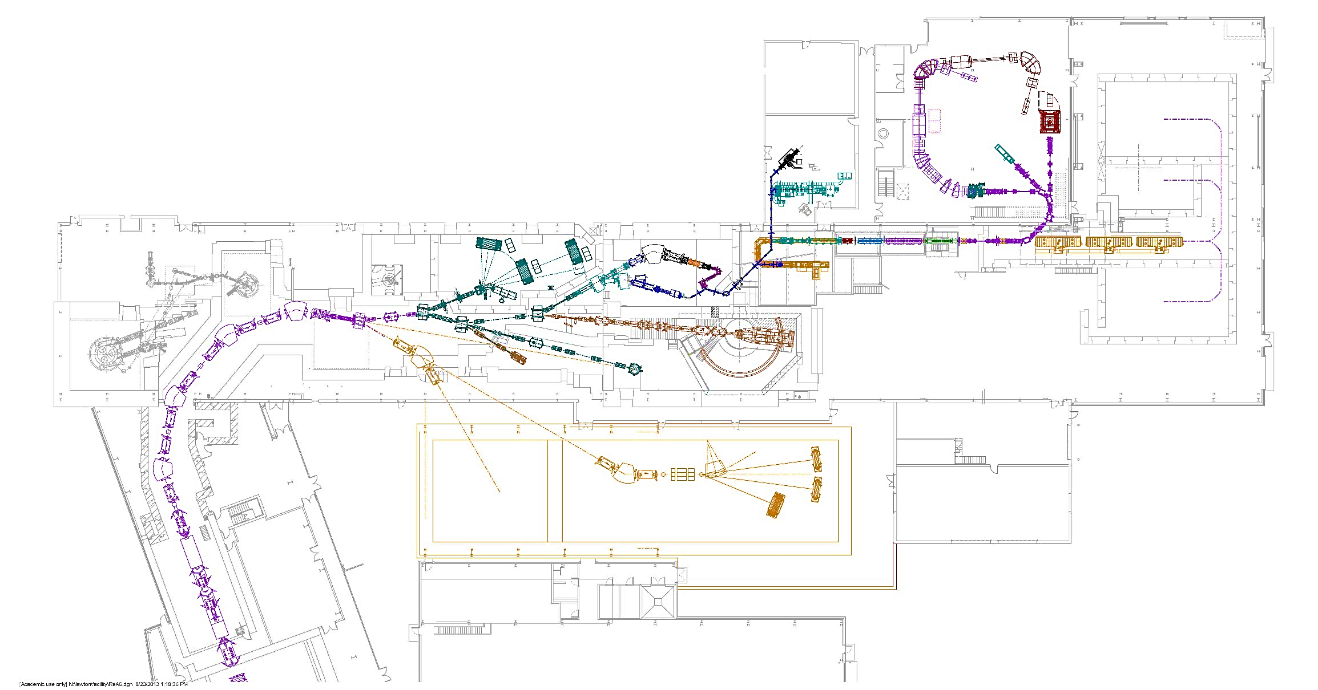
Three Experimental Energy Regimes
Radioactive Ion Beams are needed/available in three energy domains:
Fast → ~100 MeV/u
Thermalized → 60 keV/q
Reaccelerated → 0.3 up to x MeV/u
Reaccelerated
Thermalized
Fast
Reaccelerated
(equip. planned)
Note: darker-shaded areas in use at present NSCL.
Fast (planned)

Slide 15
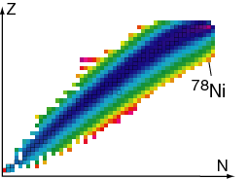
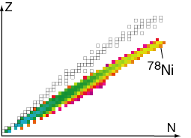
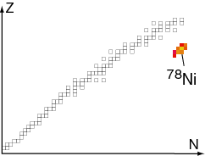
Separation of Fast Beams
Example of Fragment Selection Technique: ⁸⁶Kr₅₀ → ⁷⁸Ni₅₀ ΔZ= -8
fragment yield after target
fragment yield reaching wedge
fragment yield at focal plane
Secondary beams are produced at ~100 MeV/u and often “cocktail” beams thus, event-by-event ID of beam particles is usually necessary
→Detailed Nuclear Structure work has been successful with spectrometers
→Detailed Decay Studies have been successful by tagging implanted nuclei
Not suited to direct reactions, precision work due to poor emittance both longitudinal and transverse

Slide 16
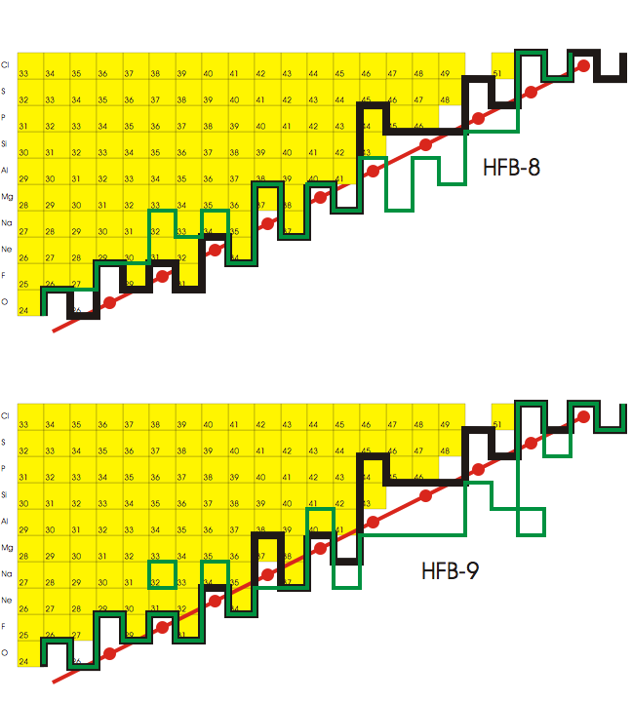
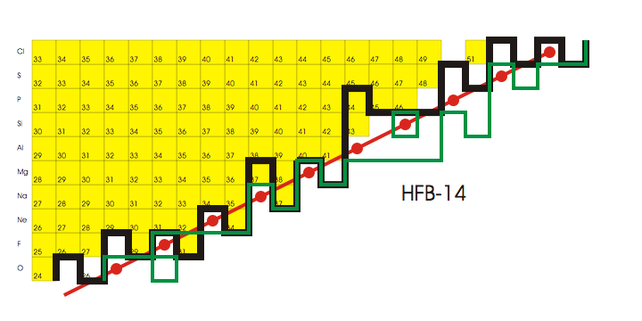
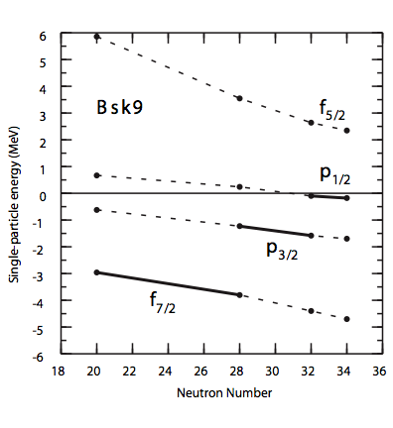
Where is the Neutron Drip-line in Theory
Z=13
Z=13
Z=13
Z=13
Yellow Squares: already observed w/ Fast Beams
Black Line: Finite-Range Liquid-Drop
Moeller, et al. ADNDT 59 (1995) 185
Green Lines: Hartree-Foch-Bogoliubov
Goriely, et al. Nucl.Phys. A750 (2oo5)425
http://www-astro.ulb.ac.be/Html/hfb14.html
e.g., Shell Model by B.A. Brown (MSU)
Notes:
Some variation in predictions … The problem can be seen in the figure at the lower right – the single-particle energy levels for neutrons in the fp shell in Aluminum nuclei from a recent Shell model calculation by Brown uisng a Skyrme interation. The dripline is crossed when the energy crosses zero, note the slopes become shallow. [Red line with dots A = 3 (Z+1) ]

Slide 17
Ratio of Measured Cross Section to Systematics (EPAX3)
⁸²Se (139 MeV/u) + ⁹Be target
O. Tarasov, et al. PRC 87 (2013) 054612
Black Sq. – stable
Colored Sq. – measured σ, dσ/dp
⁸²Se

Slide 18
Evolution of Shell Structure Observed with Fast Beams in Neutron-rich Nuclei
cf. recent review by R. Kanungo, Phys. Scr. 2013 014002

Slide 19
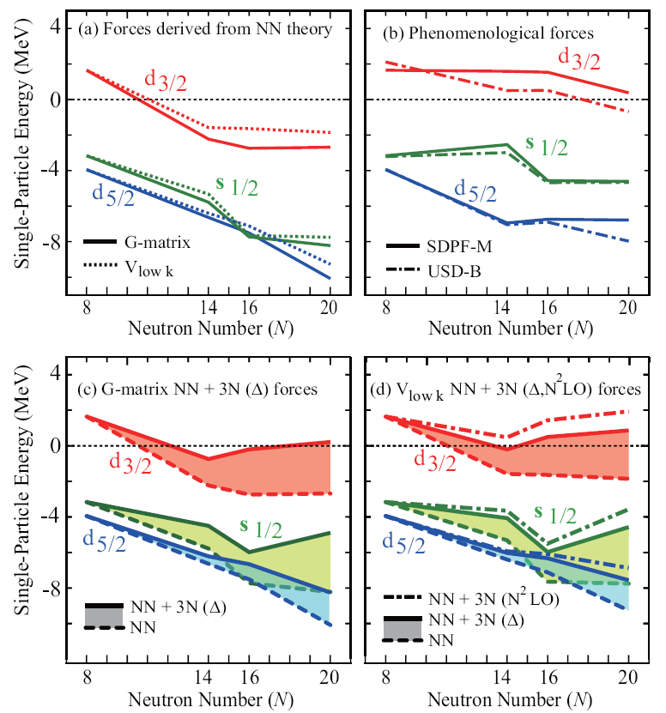
New Insight from Rare Isotopes –
Oxygen Drip Line
T. Otsuka et al., PRL 104, 032501
T. Otsuka et al., PRL 105, 032501
Shell model single particle binding energies for Oxygen Isotopes (Otsuka, Suzuki, Holt, Schwenk, Akaishi, PRL 2010)
NNN force is necessary to understanding the Oxygen drip line
Coupling to the continuum is also important (gain in binding is around 1 MeV)
Traditional picture works but is missing physics!
²⁴O
SDPF-M - Utsuno et al., PRC (1999); PRC (2004).
USD- B Brown and Richter, PRC (2006)
²⁴O

Slide 20
Thermalized Beams for Nuclear Science
Thermalized target fragments have a long and rich history,
e.g., ISOLDE, TRIUMF, IGISOL, etc-SOL
Thermalized projectile fragments are now available, selection of individual isotopes from proj. fragment “cocktail” is now possible.
→ Precise Mass Measurements of very exotic nuclei
→ Detailed Decay Studies are possible with pure sources
(no Particle ID tagging and extraneous backgrounds)
→ Laser spectroscopy of very exotic nuclei for nuclear moments and other fundamental properties

Slide 21
Mass Measurements in rp-process region
one of the shortest-lived nuclei
studied in a Penning trap
Rp-process waiting point
Proton drip-line nucleus
δm= 500 eV
⁶⁶As
T_{1/2}=95ms
⁶⁸Se
T_{1/2}=35s
^{70m}Br
T_{1/2}=2.2s
⁶⁶As measured with ≈ 10 ions/hr
rp-process waiting point
⁶⁴GeH
T_{1/2}=63.7s
N=Z
Schury, et al. PR C75 (2oo7) 055801
Savory, et al. PRL 102 (2oo9) 132501

Slide 22
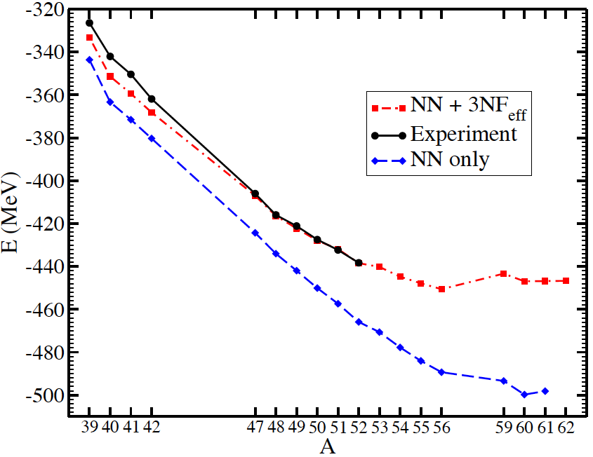
Masses of the Heavy Calcium Isotopes
G. Hagen et al., PRL 109 (2012) 032502
E. Olsen, J. Erler
Mass Number, A = N+20
Neutron Number, N
Ab initio approaches
Mean-field approaches
Newest data: ⁵⁴Ca, Nature 498 (2013) 346

Slide 23
FRIB Reach for r-Process Measurements
Zr
Known mass
Zn
Mass measurements
Drip line to be established ?
Ca
H. Schatz

Slide 24
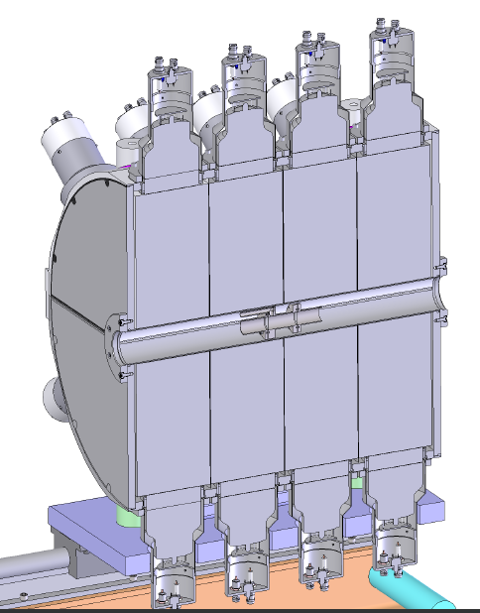
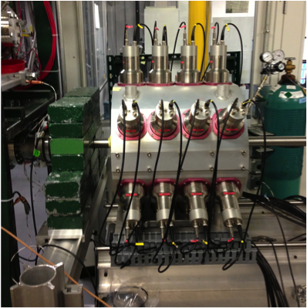
Total Absorption Spectroscopy pure sources of Projectile Fragments
Detector
15” x 15” NaI(Tl)
Beam
⁷⁶Ga @ 45 keV
~ 500 pps
“No beam contaminants observed.”
Silicon Trigger detector
A.Spyrou, et al., PRL (2014) submitted

Slide 25
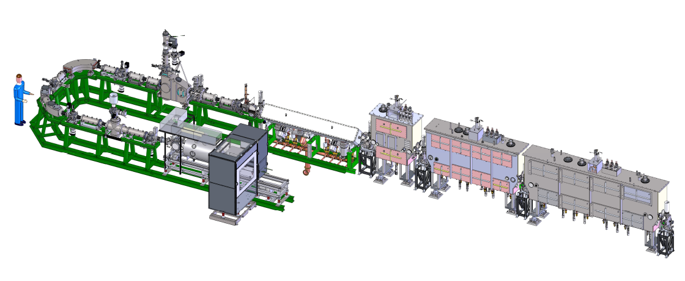
Reaccelerated Beam of Nuclear Science
Reacceleration of target fragments is beginning, e.g., HIE-ISOLDE, TRIUMF-ISAC, etc.
Reacceleration of projectile fragments is also starting with thermalized proj. fragments
ReA3 at MSU
stable Rb¹⁺ ions from N4 (Mar/13)
⁷⁶Ga from A1900/N4 (meas. Decay, Apr/13)
ANASEN (active target device) ³⁷K Jul/13
n+ ions
1+ ions

Slide 26
FRIB Reach for Novae and X-ray burst reaction rate studies
Predicted Reaccelerated
beams rates
10^{>10}
rp-process
10⁹⁻¹⁰
10⁸⁻⁹
10⁷⁻⁸
direct (p,γ)
10⁶⁻⁷
direct (p,α) or (α,p)
transfer
10⁵⁻⁶
10⁴⁻⁵
(p,p),
some transfer
10²⁻⁴
Most reaction rates up to ~Sr can be directly measured
Specialized equipment
(SECAR & gas Target) allow direct rxn studies
Highest intensities: Allow reaction rates up to ~Ti
could be directly measured
From H. Schatz
Notes:
key reaction rates can be indirectly measured including ⁷²Kr waiting point

Slide 27
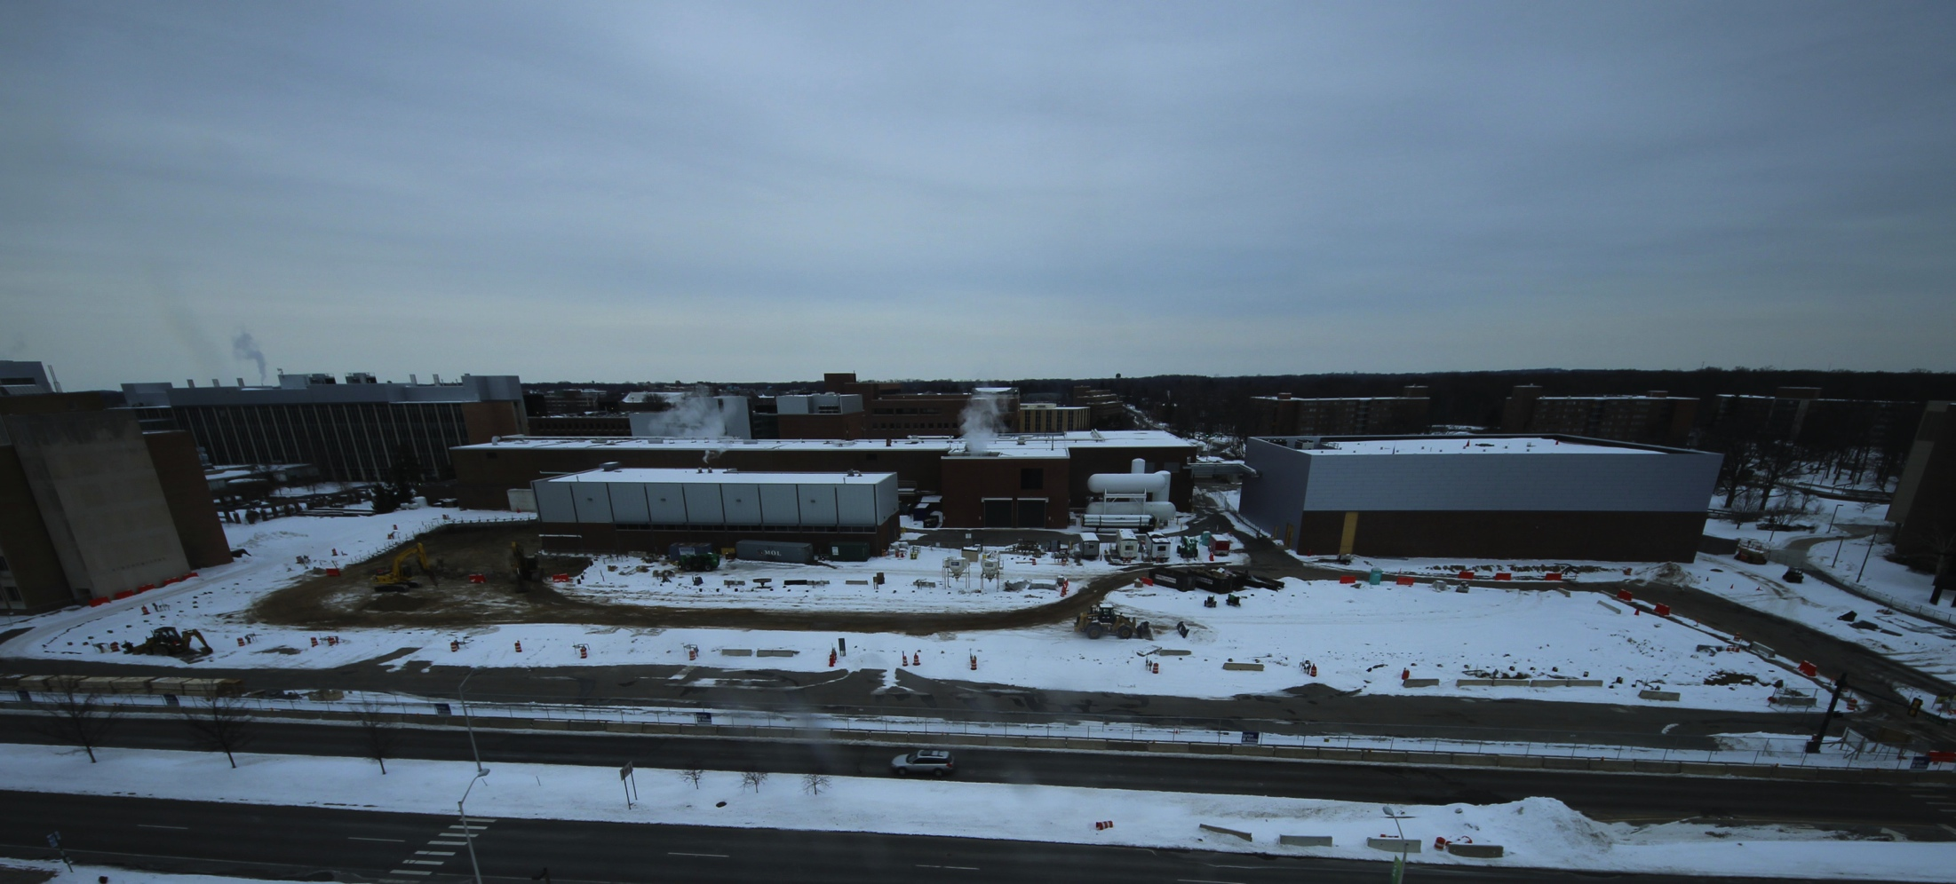
FRIB is Becoming Real: Ground Breaking
March 17, 2014
FRIB construction site 17 March 2014 – www.frib.msu.edu

Slide 28
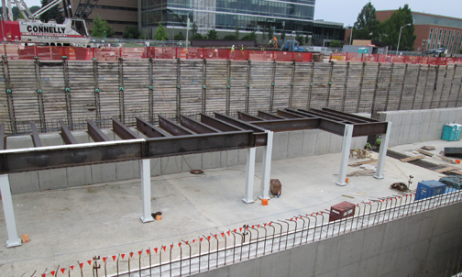
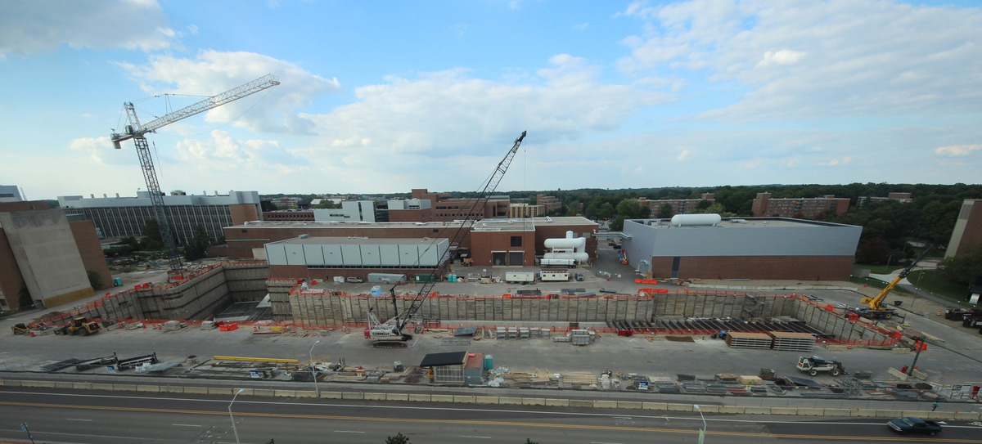
FRIB is Becoming Real: Civil Construction is a Few Weeks Ahead of Baseline Schedule
FRIB construction site: 17 Sept 2014 – webcam: www.frib.msu.edu

Slide 29
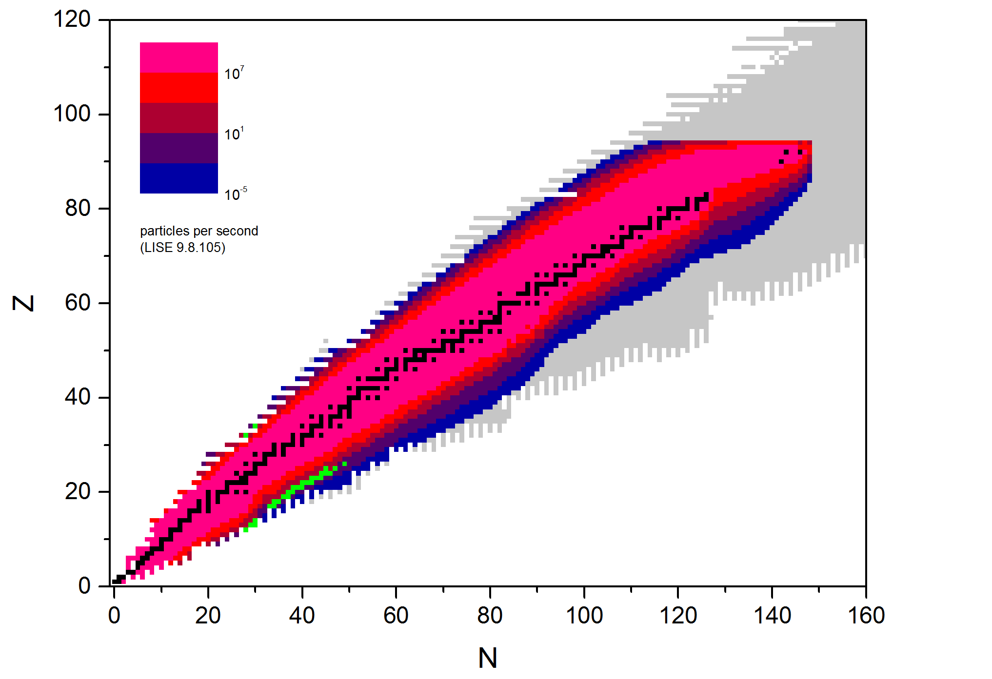
FRIB Projected Production Rates
Predicted separated fast beam rates based on EPAX3 systematics
Blue = 1 / day
http://groups.nscl.msu.edu/frib/rates/
from O. Tarasov

Slide 30
FRIB Project: Milestones and Budget
Project started in June 2009
  Michigan State University selected to design and establish FRIB
  Cooperative Agreement signed by Dept. of Energy (DOE) and MSU in June 2009
Conceptual design completed; Critical Decision 1 (CD-1) approved in Sept. 2010
Preliminary technical design, final civil design, and R&D complete
CD-2/3A approved in August 2013
  Project baseline and start of civil construction after additional notice from the DOE Office of Sci.
Civil Construction began March 3, 2014
Final technical design begins with goal to be completed in 2014
CD-3B review in June 2014, approved in Aug, 2014 → formal start of construction
Managing to early completion in 2020
  CD-4 (formal project completion) is 2022
Cost to DOE - $635.5 million
  Total project cost of $730M includes $94.5M cost share from MSU
  Value of MSU contributions (building/equipment) above cost-share exceeds $265M

Slide 31
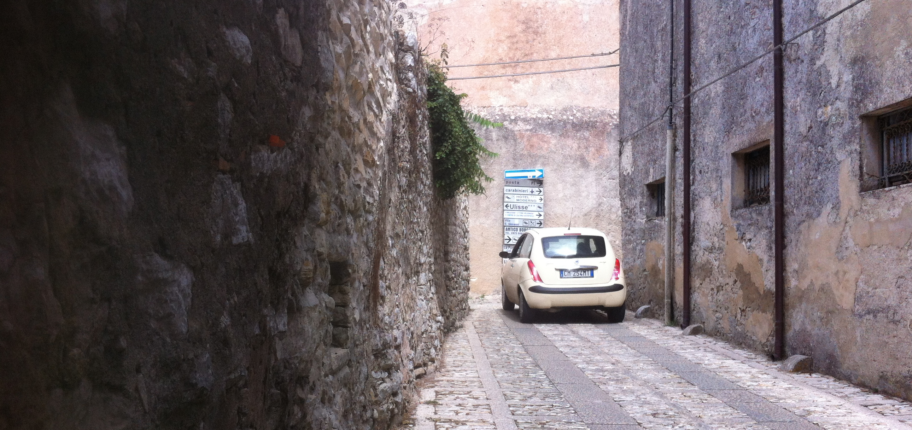
Thank you for your attention !
It may have been a long road but we’re almost there !

Slide 32
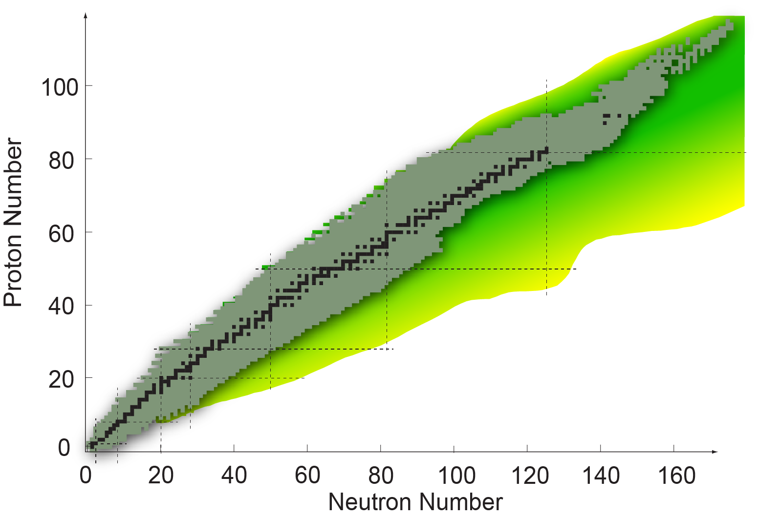
The Nuclear Landscape
256 “Stable” – no decay observed
3184 Total in the NNDC Database

Slide 33


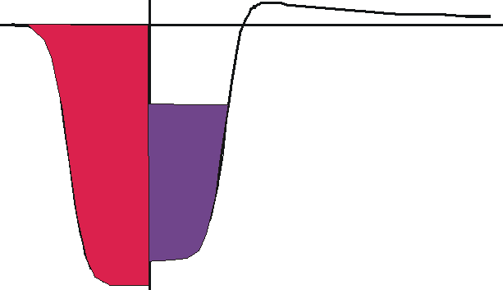
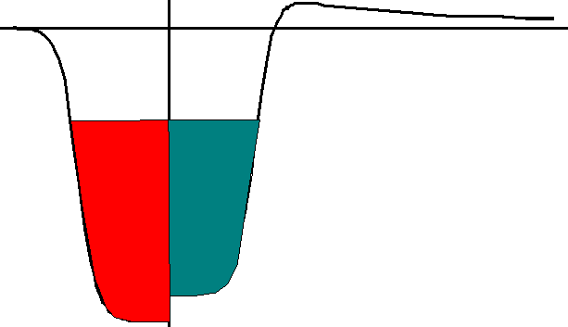
Nuclear Balance across Chart of Nuclides
Less than 300 isotopes
(stable or long-lived)
Upper end limited by electrostatic explosion
“known” nuclei
“possible” nuclei
proton drip-line
neutron drip-line

Slide 34
Challenges to Nuclear Science
Develop a comprehensive model of atomic nuclei – How do we understand the structure and stability of atomic nuclei from first principles?
Understand the origin of elements and model extreme astrophysics environments
Use of atomic nuclei to test fundamental symmetries and search for new particles (e.g. in a search for CP violation)
Search for new applications of isotopes and solution to societal problems
Why do atoms exist?
Where do atoms come from?
What are atoms made of?
What are they good for?
Studies at the extremes of neutron and proton number are necessary to answer these questions.

Slide 35
Shifting Energy Levels in Nuclei
126
p_{1/2}
f_{5/2}
h_{9/2}
112
3p
i_{13/2}
p_{3/2}
f_{5/2}
2f
h_{9/2}
p_{1/2}
f_{7/2}
p_{3/2}
V=5
82
f_{7/2}
1h
h_{11/2}
d_{3/2}
70
3s
h_{11/2}
g_{7/2}
2d
s_{1/2}
d_{3/2}
g_{7/2}
s_{1/2}
V=4
d_{5/2}
1g
d_{5/2}
50
40
very diffuse
surface
neutron drip line
g_{9/2}
harmonic
oscillator
l ²
no spin
orbit
near the
valley of
β-stability
g_{9/2}
Dobaczewski, et al.
PRL 72 (94) 981
For A=100
Drip Lines: Zn – Sn

Slide 36
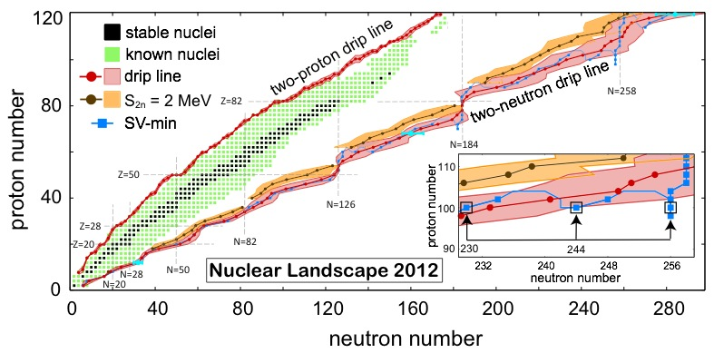
Prediction of the limits of the nuclear landscape
J. Erler et al., Nature 486, 509 (2012); A.V. Afanasjev et al. PLB 726, 680
Total number of 6900(500) possible for atomic numbers less than 120.
Notes:
Map of bound even–even nuclei as a function of Z and N. There are 767 even–even isotopes known experimentally,2, 3 both stable (black squares) and radioactive (green squares). Mean drip lines and their uncertainties (red) were obtained by averaging the results of different models. The two-neutron drip line of SV-min (blue) is shown together with the statistical uncertainties at Z = 12, 68 and 120 (blue error bars). The S2n = 2 MeV line is also shown (brown) together with its systematic uncertainty (orange). The inset shows the irregular behaviour of the two-neutron drip line around Z = 100.

Slide 37
The Predicted Limits for Zr Isotopes
Mod. Phys. Lett. A29 (2014) 1430010

Slide 38
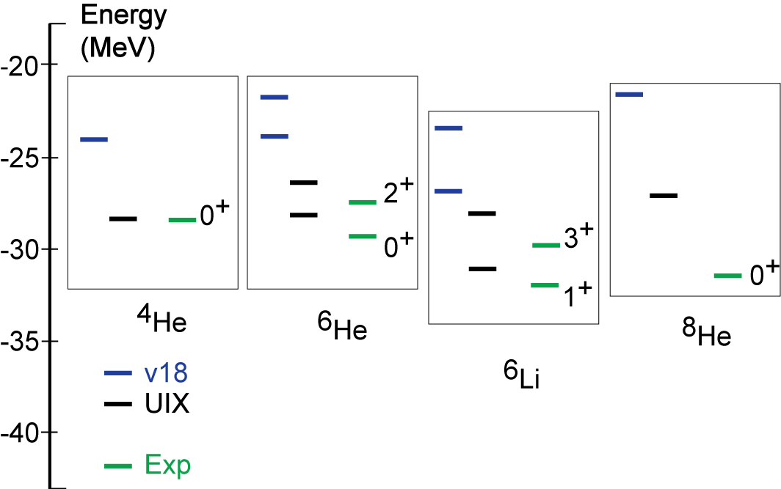
Comparison of Calculated and Measured Binding Energies with NN models
Greens Function Monte Carlo techniques allow up to mass number 12 to be calculated
Blue 2-body forces V₁₈
S. Pieper B.Wiringa J Carlson, et al.
NN potential
NN + NNN potential
Notes:
UIX included three body forces. Comparison to 8He showed dramatically that something was missing. Adjusting the isospin dependant three-body forces lead to IL 2R and dramatic improvement for both rare and less rare isotopes. Properties of 8He were critical in this development.

Slide 39
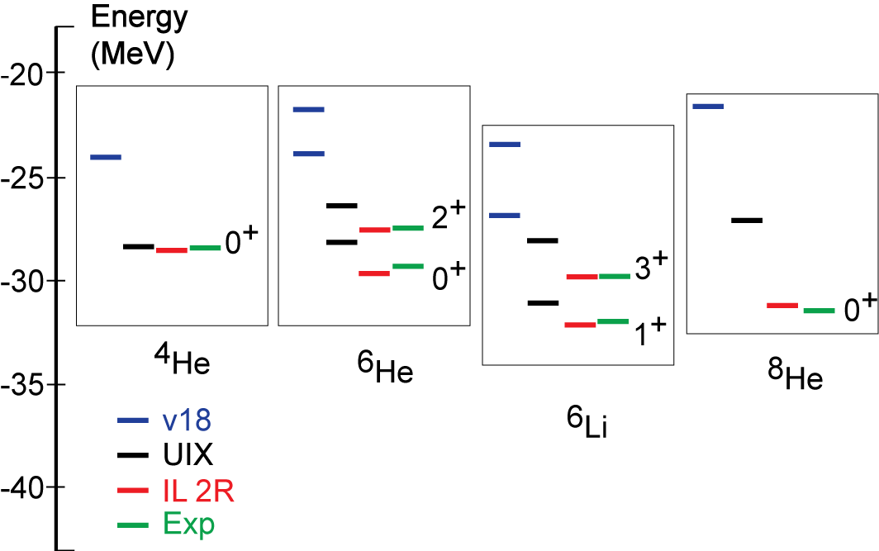
New information from exotic isotopes
S. Pieper B.Wiringa, et al.
Neutron rich nuclei were key in determining the isospin dependence of 3-body forces and the development of IL-2R from UIX
New data on exotic nuclei continues to lead to refinements in the interactions
NN + improved NNN potential
Properties of exotic isotopes are essential in determining NN and NNN potentials

Slide 40
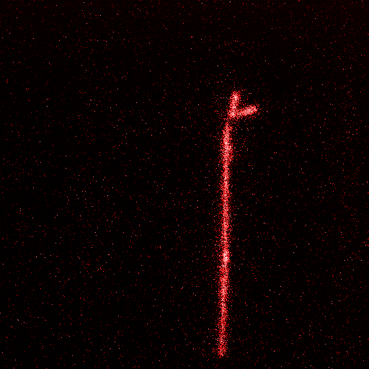
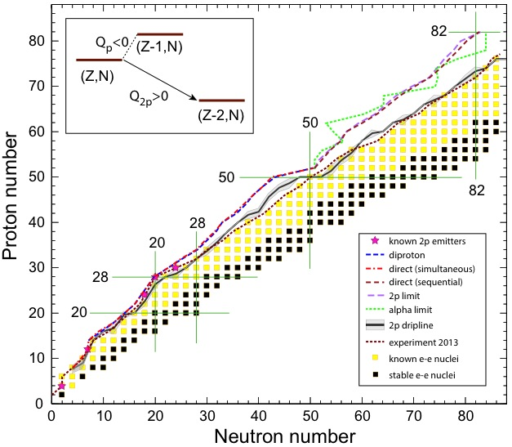
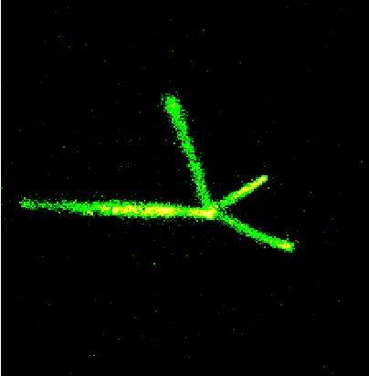
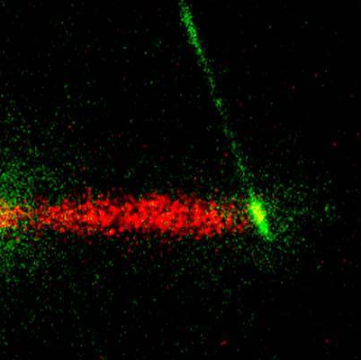
The landscape of two-proton radioactivity
NSCL
E. Olsen et al, PRL 111, 139903 (2013)
http://www.fuw.edu.pl/~pfutzner/Research/OTPC/OTPC.html
⁴⁸Ni 2p
sequential
GSI - FRS
simultaneous
³¹Ar β3p
ISOLDE
⁶He  α + d
W. Nazarewicz

Slide 41
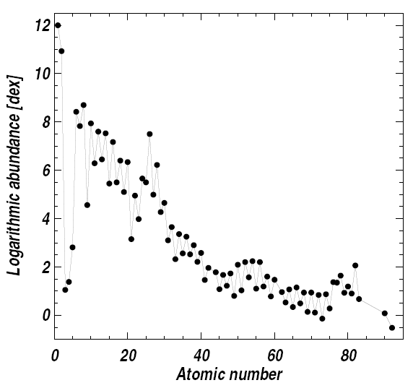
One of the Challenges – Origin Elemental Abundances in our Solar System
Stars are mostly made of hydrogen and helium, but each has a unique pattern of other elements
The abundance of elements tell us about the history of events prior to the formation of our sun
The plot at the right shows the composition in the visible surface layer of the Sun (photosphere)
How were these elements created prior to the formation of the Sun?
Asplund, M., Grevesse, N., Sauval, A.J., Scott, P.: Annu. Rev. Astron.
Astrophys. 47, 481 (2009)

Slide 42
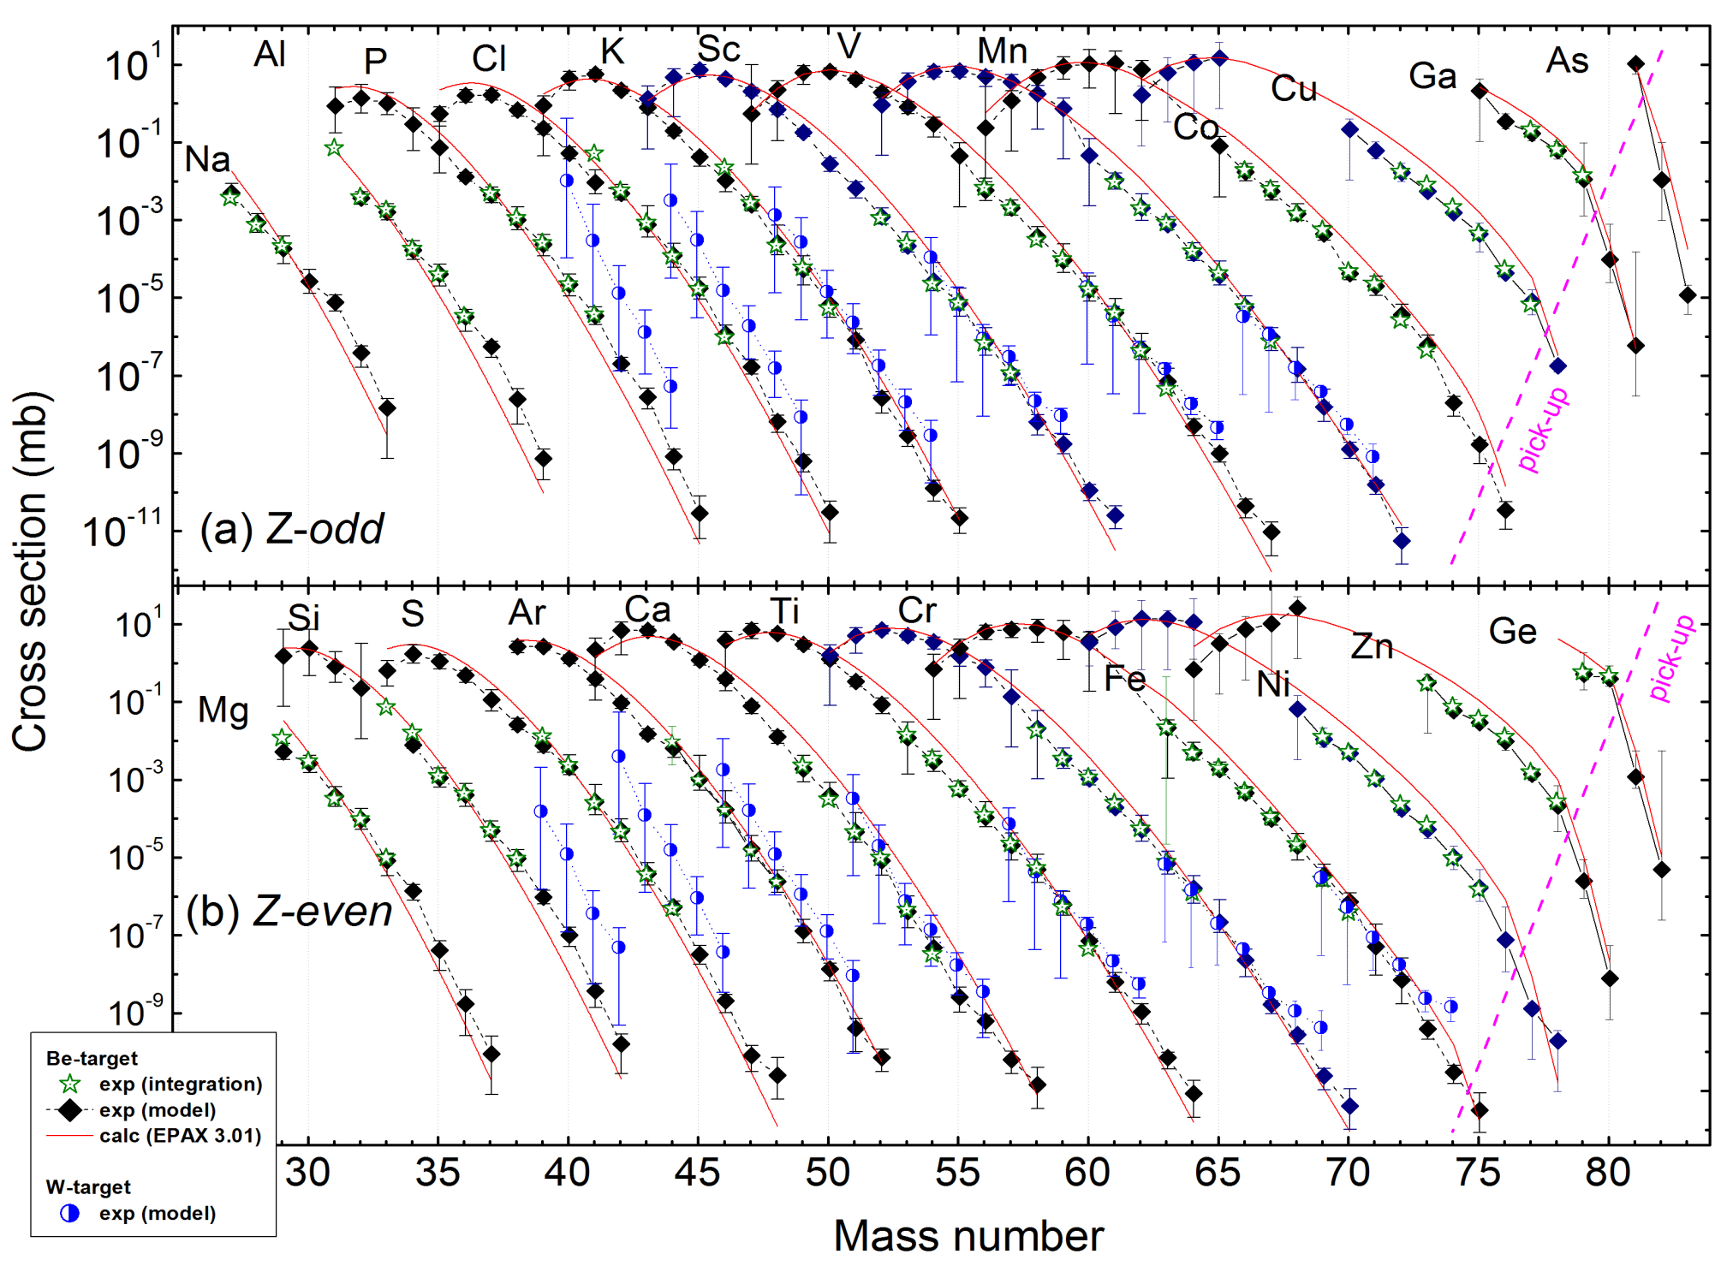
Sample data ⁸²Se (139 MeV/u) + Be, W
O. Tarasov et al. PRC 87 (2013) 054612

Slide 43
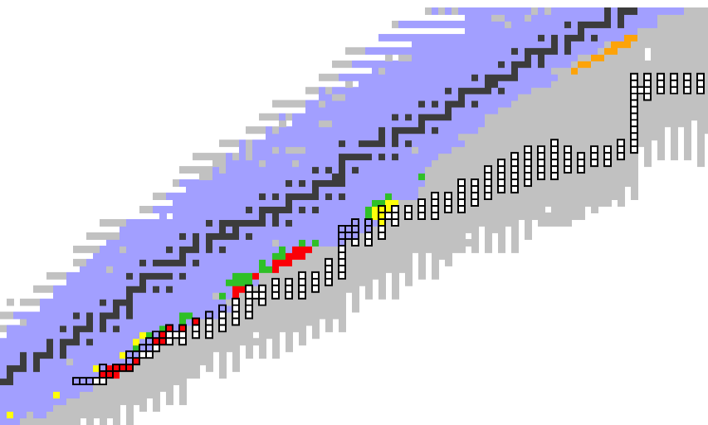
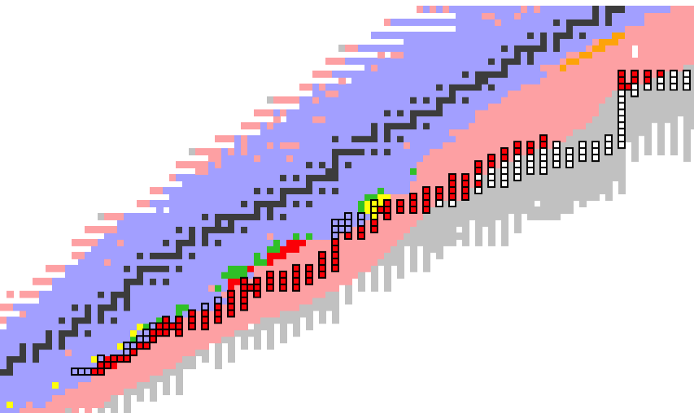
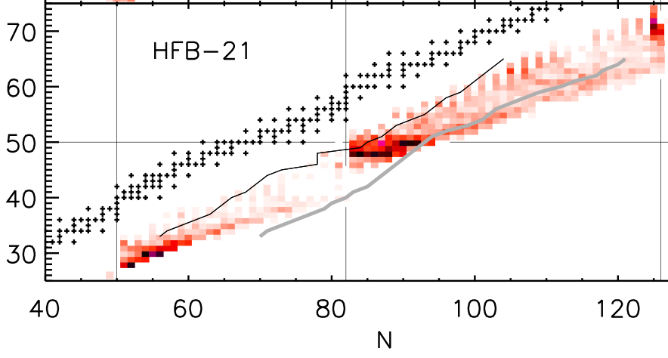
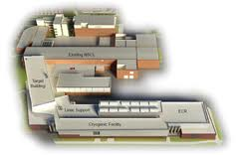
The Quest for r-process Nuclear Physics
Z
Brett et al. 2012 Sensitivity to Masses
N=126
N=82
ANL Trap @ CARIBU
FRIB reach
CARIBU reach
N
ORNL (d,p)
GSI
ESR Ring
Jyvaskyla
Trap
+ Neutrino Physics
+ Nuclear Matter EOS
+ Fission
TRIUMF Trap
CERN/ISOLDE
Trap
FRIB
CERN/ISOLDE
T_{1/2} P_{n}
NSCL
TOF
GSI/Mainz T_{1/2} P_{n}
FAIR, RIBF, SPIRAL2, EURISOL
⁹Be(γ,n)
HIγS
RIKEN T_{1/2}
N=50
NSCL T_{1/2} P_{n}
H Schatz
ORNL T_{1/2} P_{n}

Slide 44
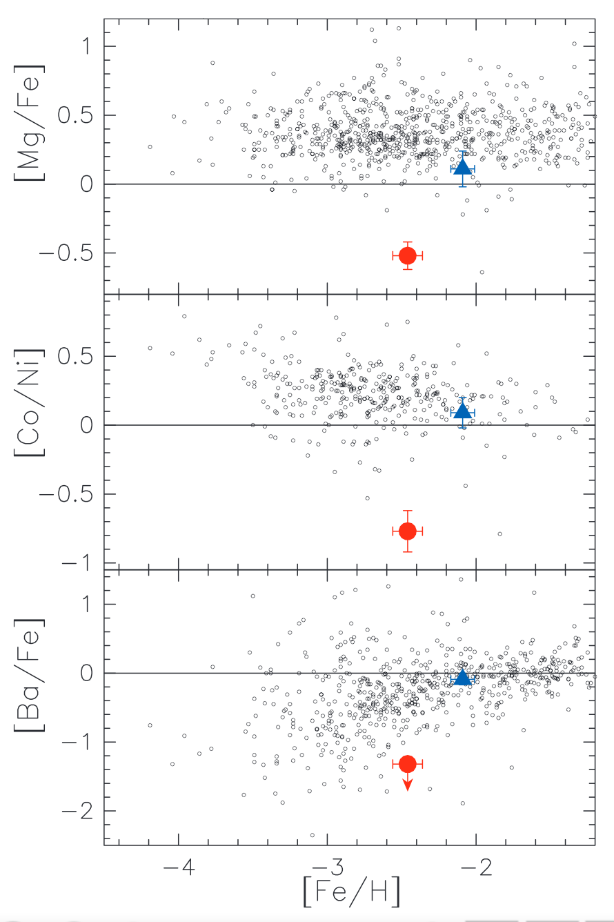
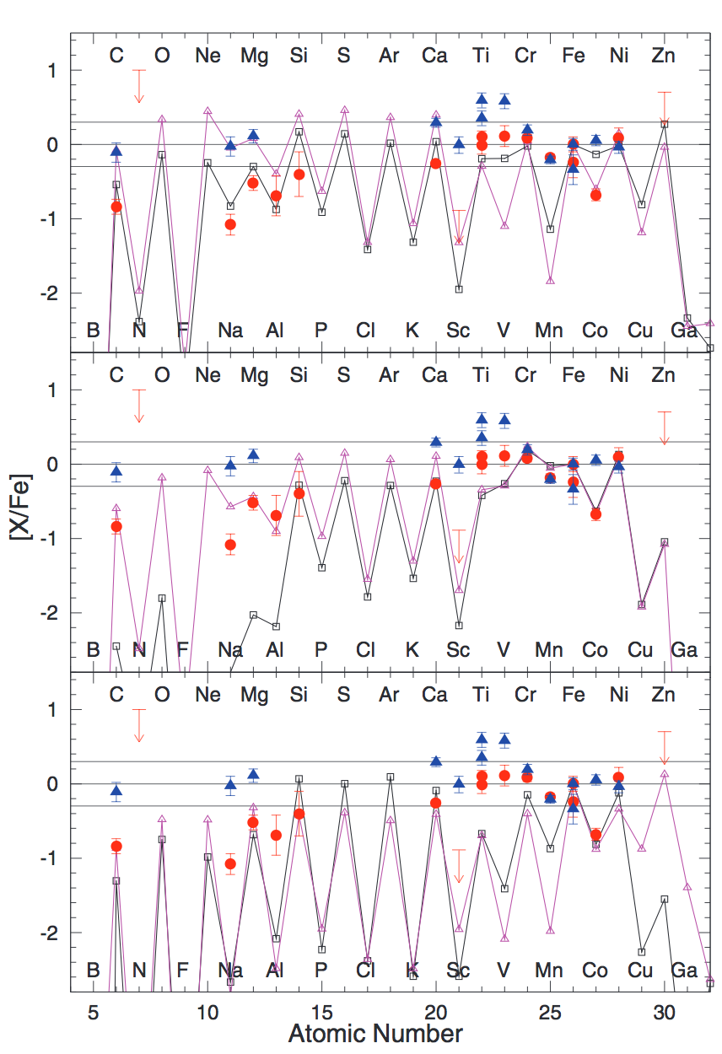
Evidence for the First Stars in the Universe
SDSS J001820.5–093939.2 SUBARU Observations Aoki et al., SCIENCE 345 (2014)
Unique features
Type II
Type Ia
PISM
Model comparisons

Slide 45
Importance of 3N forces
Big Bang Nucleosynthesis: Calculate all key reactions
Neutron star masses
Half-life of ¹⁴C (Maris, Navratil et al. PRL), structure of calcium isotopes (Wienholtz et al. Nature), etc.
S. Gandolfi et al., PRC85, 032801 (2012)
Talk on Monday
Nazarewicz et al.

Slide 46
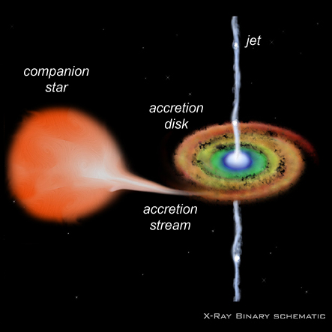
Stellar Hydrogen Explosions:
Common (100/day) and Not Understood
www4.nau.edu
Open questions
  Neutron star size
  Short burst intervals
  Multiple peaked bursts
  Nature of superbursts
  Ejected mass (Nucleosynthesis)
  Observable gamma emitters
  Why such a variety
  Path to Ia supernovae
H Schatz

Slide 47
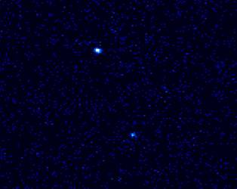
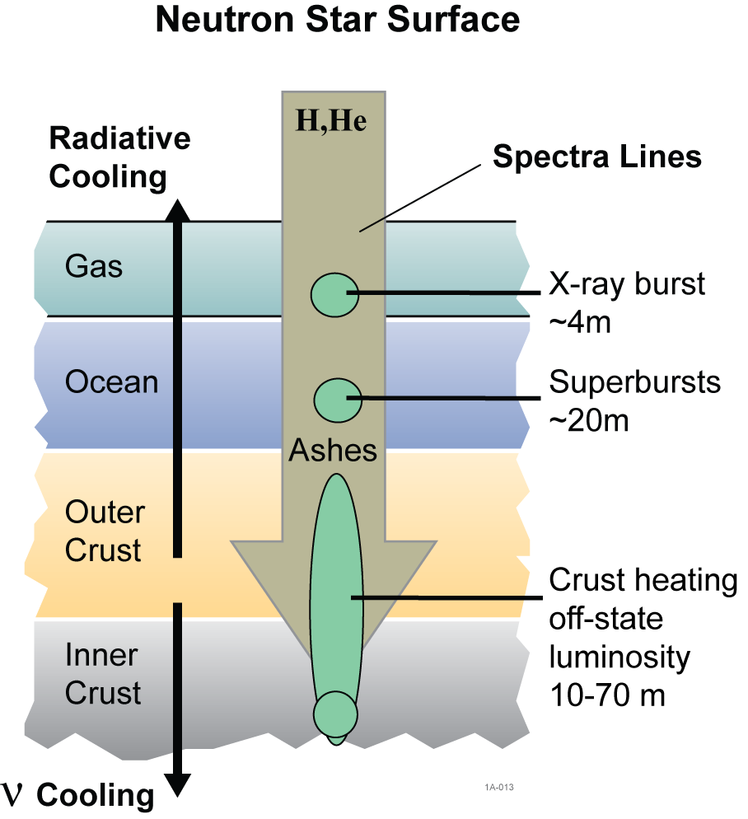
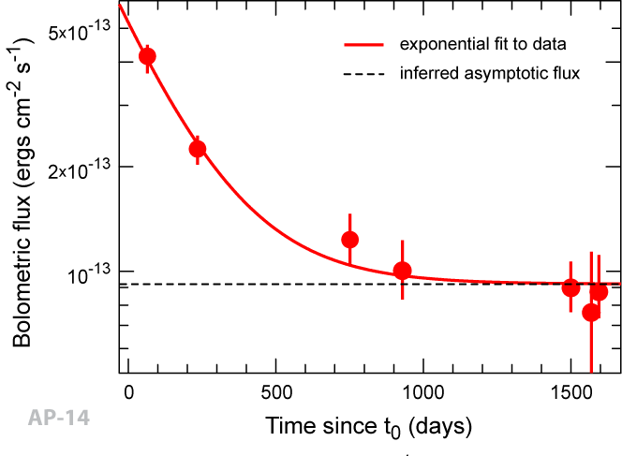
Rare Isotope Crusts of Accreting
Neutron Stars
KS 1731-260
(Chandra)
Cackett et al. 2006 (Chandra, XMM-Newton)
Nuclear reactions in the crust set
thermal properties (e.g. cooling)
Can be directly observed in transients
Directly affects superburst ignition
Understanding of crust reactions offers possibility to constrain neutron star properties (core composition, neutrino emission…)
H. Schatz

Slide 48
Beta-delayed Particle Emission
Mass Excess, Δ

Slide 49
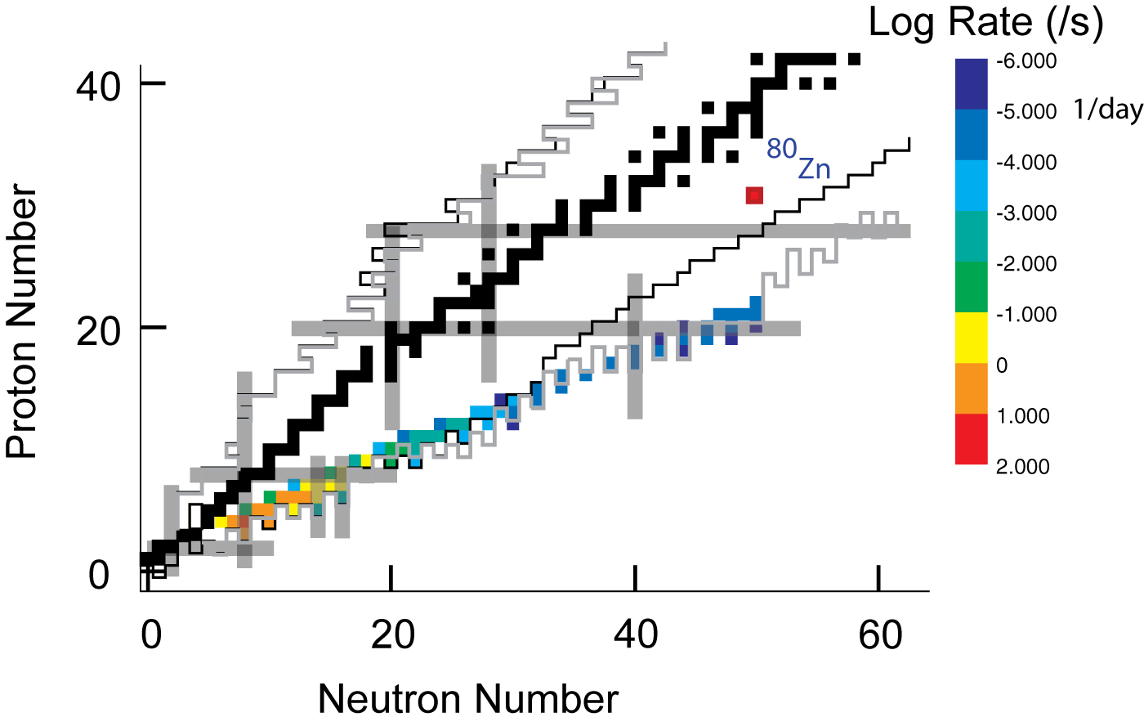
Future Prospects for Drip Line Study (EURISOL or upgraded FRIB with ISOL)
Use proton induced fission of ²³⁸U with 400 kW 600 MeV protons from FRIB
ISOL Production of 5×10⁸/s ⁸⁰Zn
Acceleration to 160 MeV/u with the K1200 Cyclotron (200 MeV/u maximum energy)
Production of nuclei along the drip line up to ⁷⁰Ca

