Slide 1


Nuclear Astrophysics @ n_TOF, CERN
Tagliente Giuseppe
Istituto Nazionale Fisica Nucleare, Sez. di Bari
(on behalf of the n_TOF collaboration)
International School of Nuclear Physics
36th Course:
Nuclei in the laboratory and in the cosmos
1

Slide 2
The n_TOF Collaboration
(~100 Researchers from 30 Institutes)
CERN
Technische Universitat Wien Austria
IRMM EC-Joint Research Center, Geel Belgium
Charles Univ. (Prague) Czech Republic
IN2P3-Orsay, CEA-Saclay France
KIT – Karlsruhe, Goethe University, Frankfurt Germany
Univ. of Athens, Ioannina, Demokritos Greece
INFN Bari, Bologna, LNL, LNS, Trieste, ENEA – Bologna Italy
Univ. of Tokio Japan
Univ. of Lodz Poland
ITN Lisbon Portugal
IFIN – Bucarest Rumania
CIEMAT, Univ. of Valencia, Santiago de Compostela,
University of Cataluna, Sevilla Spain
University of Basel, PSI Switzerland
Univ. of Manchester, Univ. of York UK
Notes:
Motivazioni Zr, Mg / Misure precedenti Os (orela ’80) / Proprietà nucleari (average level spacing, average radiative width, average neutron strength) / ISO 2919

Slide 3
n_TOF Scientific Motivations
  Neutron cross sections relevant for Nuclear Astrophysics
  Measurements of neutron cross sections relevant for Nuclear Waste Transmutation and related Nuclear Technologies (ADS)
  Neutrons as probes for fundamental Nuclear Physics

Slide 4
Abundances beyond Fe–ashes of stellar burning
α-nuclei
¹²C,¹⁶O,²⁰Ne,²⁴Mg, …. ⁴⁰Ca
Gap
B,Be,Li
Elements heavier than Fe are the result of neutron capture processes
NEUTRONS
H 30 000
C 10
Fe 1
Au 2 10⁻⁷
r-process peaks (nuclear shell closures)
s-process peaks (nuclear shell closures)
Fe peak
Th, U
Au
Pb

Slide 5
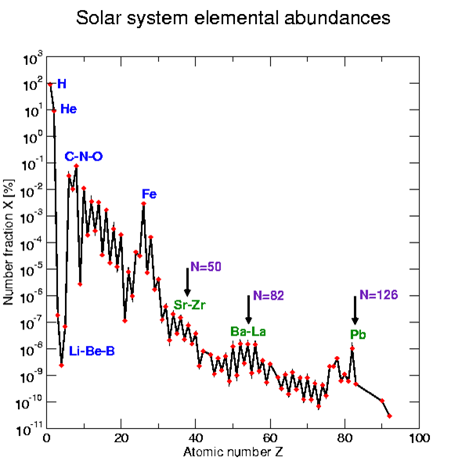
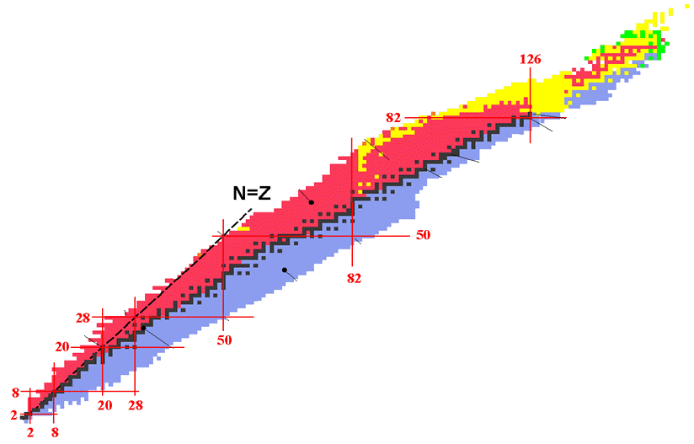
Nucleosynthesis
s-process lifetime 10⁴ years n_{n}≈10⁸ neutron/cm³
r-process lifetime μs n_{n}≈10²² neutron/cm³
β-decay lifetime: few hours to some months
The canonical s-process
neutrons

Slide 6
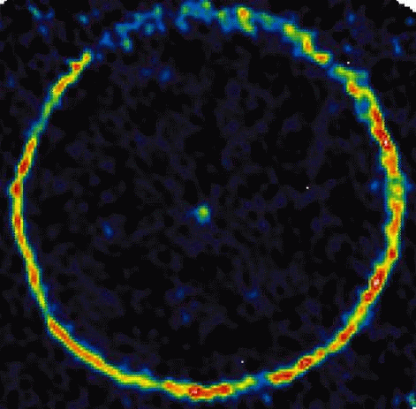
Asympotic Giant Branch (AGB)
False-color picture of CO molecules tracing material around the AGB star TT-Cygni

Slide 7
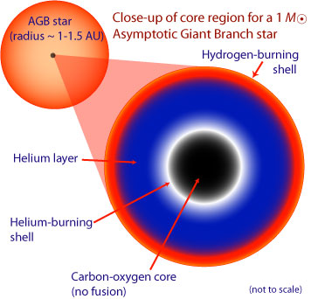
Asympotic Giant Branch (AGB)

Slide 8
Neutron surces in AGB stars
¹³C(α,n)¹⁶O T ~ 10⁸ K N_{n} < 10⁷ neutron/cm³
²²Ne(α,n)²⁵Mg T>3.5 10⁸K N_{n}~10¹⁰-10¹² neutron/cm³

Slide 9
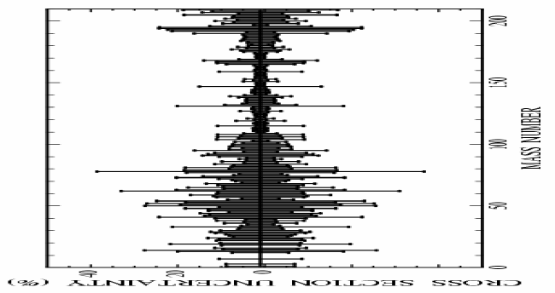
n_TOF Goal
*** cross section uncertainties <5%
*** safe control of systematic uncertainties

Slide 10
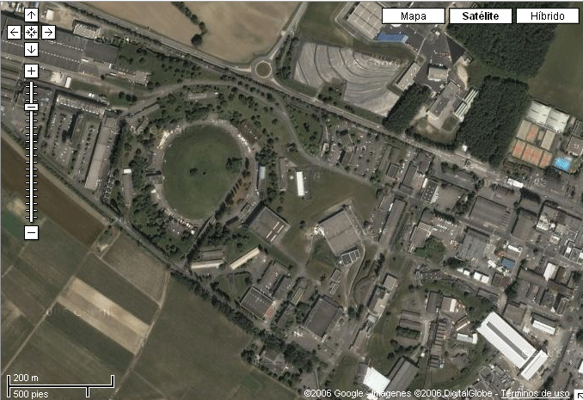

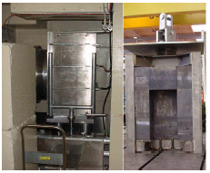
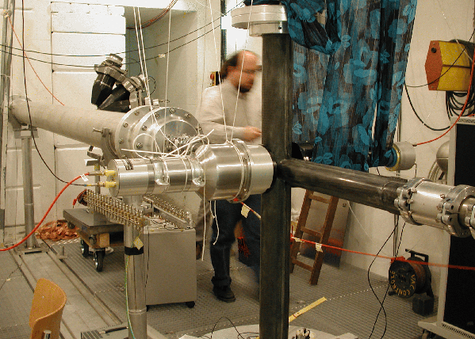
n_TOF Facility
n_TOF features | Use in astrophysics
broad neutron energy range | neutron capture cross sections for s-process studies (thermal– 1 MeV)
high instantaneous flux | small capture cross sections small sample quantities (isotopically enriched samples) radioactive samples (low intrinsic background)
excellent energy resolution | resonance dominated cross sections
low neutron sensitivity low backgrounds | accurate cross section measurements even for large σ_{el}/σ_{capture}
proton beam momentum | 20 GeV/c
intensity (dedicated mode) | 7 x 10¹² protons/pulse
repetition frequency | 1 pulse/2.4s
pulse width | 6 ns (rms)
n/p | 300
lead target dimensions | 80x80x60 cm³
cooling & moderation material | H₂O
moderator thickness in the exit face | 5 cm
n_TOF 200m Tunnel
Sample
Pb Spallation Target
Proton Beam
20GeV/c
7x10¹² ppp
Booster
1.4 GeV
n-beam
Neutron Beam
10º prod. angle
Linac
50 MeV
PS 20GeV

Slide 11

The time-of-flight technique
neutron production target
γ
sample
pulsed neutron beam
pulsed charged particle beam
γ
flight length L

Slide 12
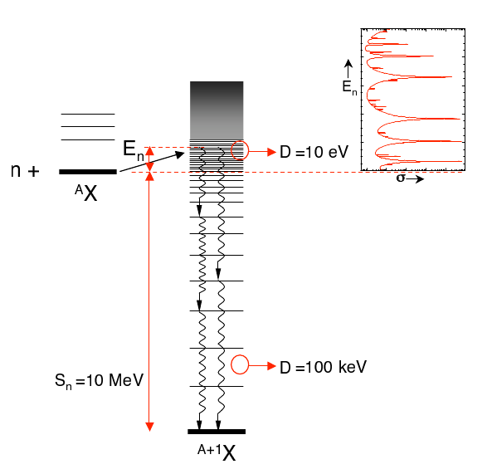
The time-of-flight technique
Excitation Energy:
detection of full γ cascade
ε_{c}~ 100 %
4π detector array
detection of single γ‘s
e.g. apply pulse height weighting technique:
pulse height dependent weight on signals to achieve
ε_{γ}=k*E_{γ}
so that: ε_{c}= k*(E_{n}+S_{n})

Slide 13
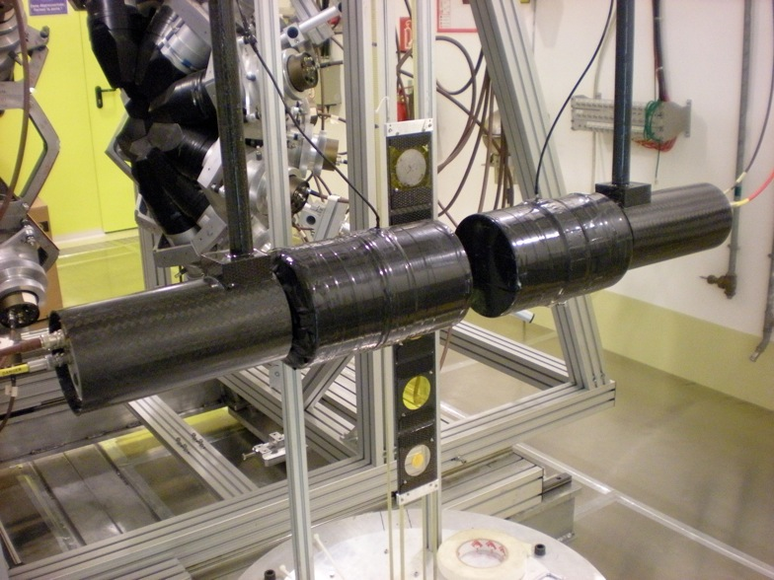
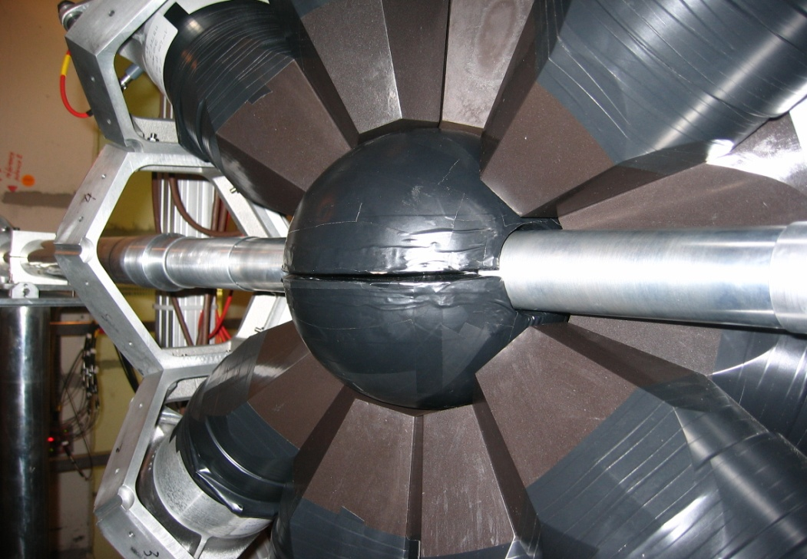
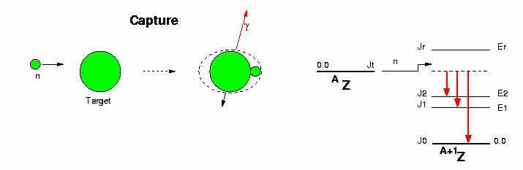
Detectors for capture reactions
Capture reactions are measured by detecting γ-rays emitted in the de-excitation process.
At n_TOF, two detection systems are used, for different purposes.
C₆D₆ (deuterated liquid scintillators)
  low neutron sensitivity device
  used for low cross-section samples
Neutron beam
Total Absorption Calorimeter (TAC)
High-efficiency 4π detector (40 BaF₂ scintillators with neutron shielding)
mostly used for fissile isotopes (actinides)
C₁₂H₂₀O₄(⁶Li)₂
13

Slide 14
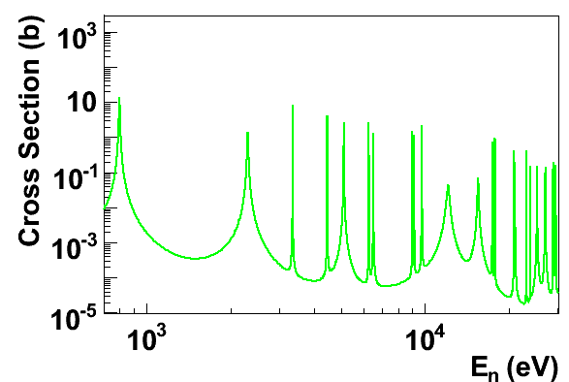
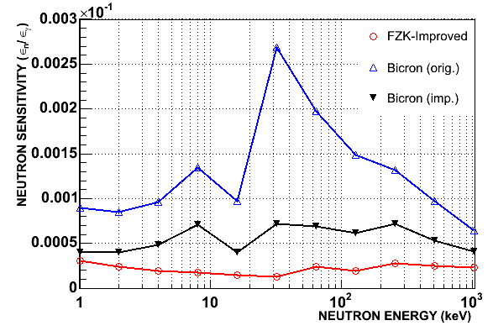
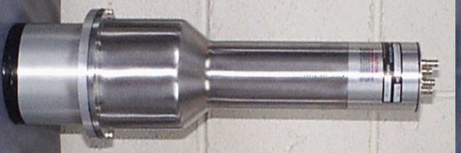
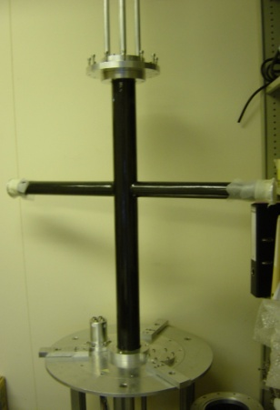
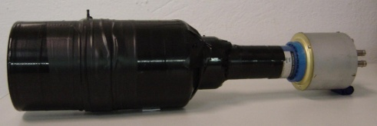
(n,γ) Total energy detection @ n_TOF
Improvements in the Experimental Setup & Data Analysis
Lowest neutron sensitivity No neutron background corrections !
(n,γ)
R. Plag et al., Nucl. Instr. & Methods A, 496 (2003) 425

Slide 15
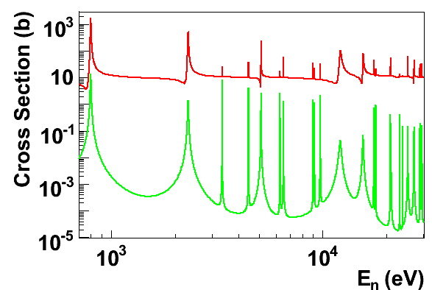
(n,γ) Total energy detection @ n_TOF
Improvements in the Experimental Setup & Data Analysis
Lowest neutron sensitivity No neutron background corrections !
(n,n)
(n,γ)
n_TOF: first facility with a neutron sensitivity optimized below measurable levels.
All the (n,γ) measurements with C₆D₆ (since start in 2002) were made with this improved setup.
R. Plag et al., Nucl. Instr. & Methods A, 496 (2003) 425

Slide 16
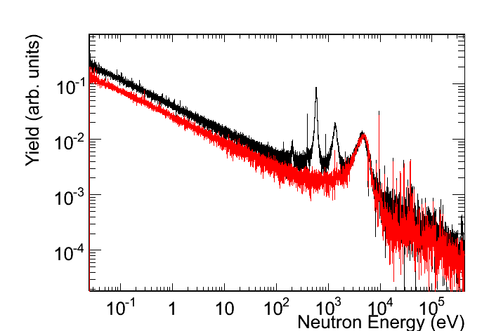
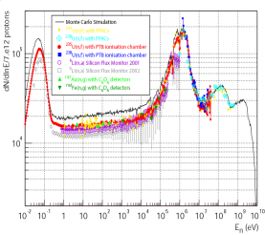
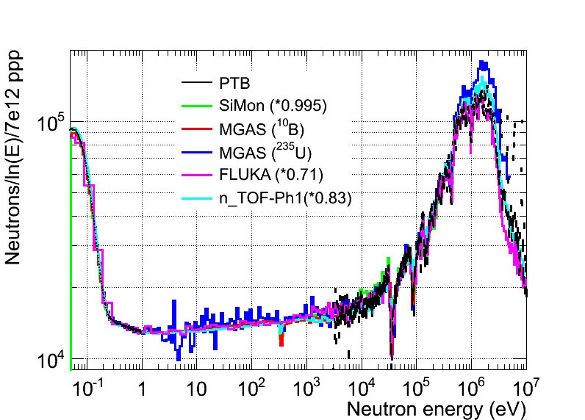
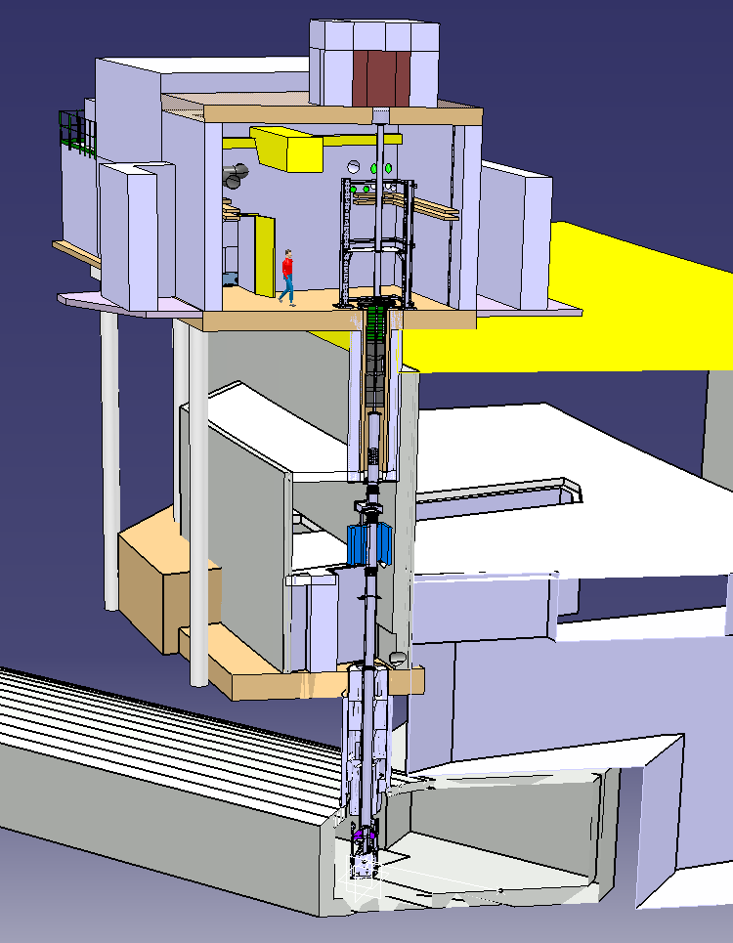
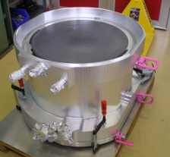
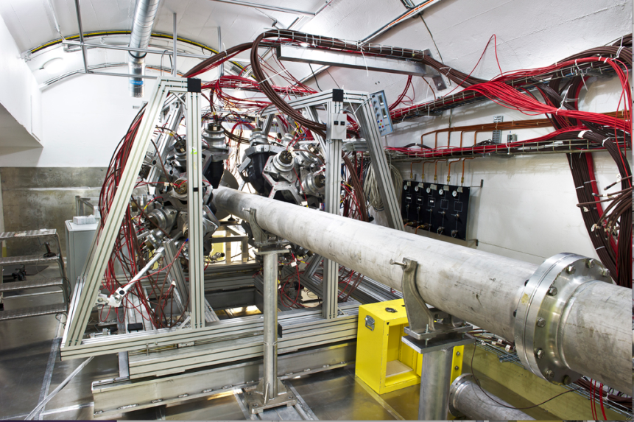
n_TOF Time line
2001-2004
2009-2012
⁶³Ni
⁶²Ni
Commissioning
Commissioning
2000
2009
Phase I
Measurement campaign
Phase II
Measurement campaign
Phase III
1997
2012
2014
Construction
started
2nd Exp. area
1999
New Target
installed
2014
2008
Upgrades
¹⁰B-water
Class-A area
2010
Concept
by C.Rubbia
CERN/ET/Int. Note 97-19
1997

Slide 17
The experimental activity at n_TOF: Ph I
¹⁵¹Sm
^{204,206,207,208}Pb^{,209}Bi
^{24,25,26}Mg
^{90,91,92,94,96}Zr, ⁹³Zr
¹³⁹La
^{186,187,188}Os
Cross sections relevant in
Nuclear Astrophysics
    s-process: branchings
    abundancies in presolar grains
    Magic nuclei
    Isotopes of particular interess
In the period 2002-2004 measured long-needed capture and fission cross-sections for 36 isotopes, 18 of which radioactive.
The unprecedented combination of excellent resolution, unique brightness and low background has allowed to collect high-accuracy data, in some cases for the first time ever.

Slide 18
n_TOF Phase II

Slide 19
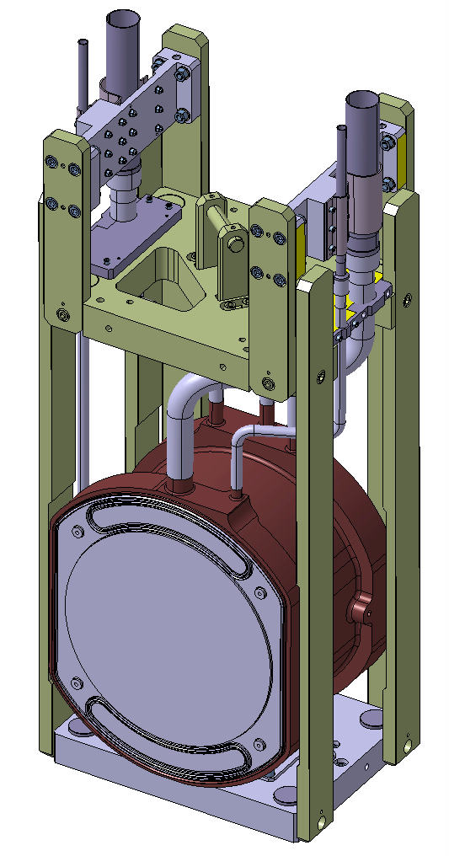
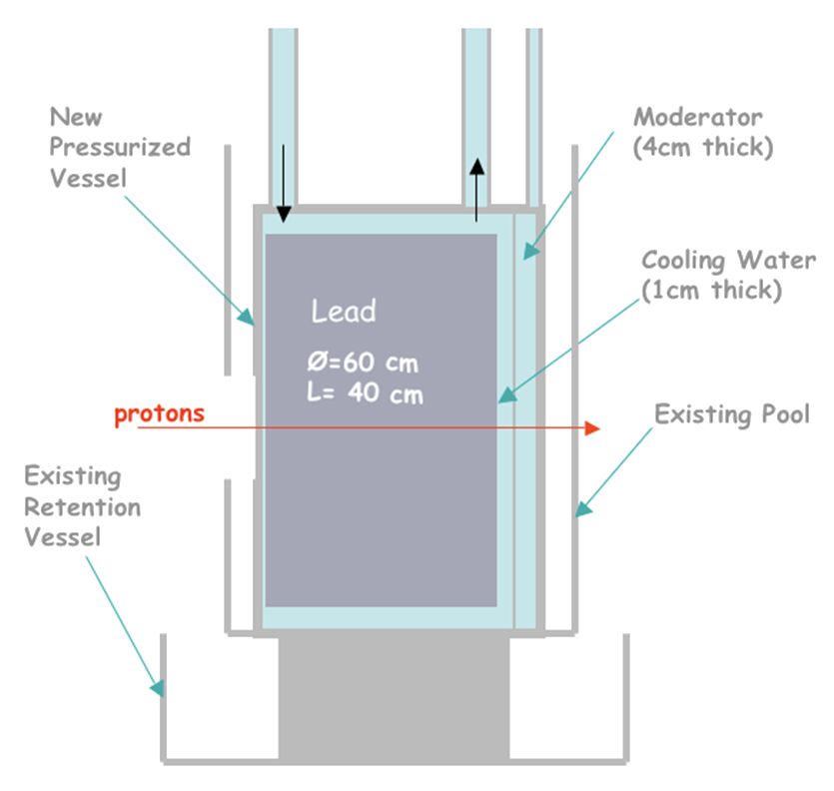
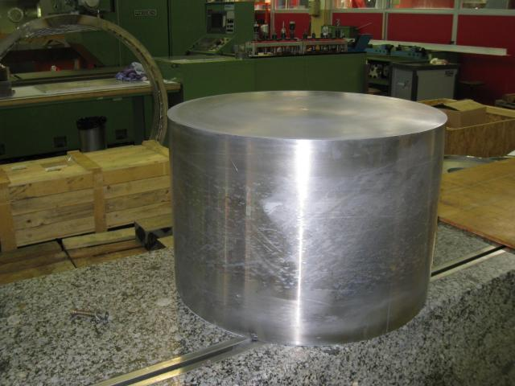
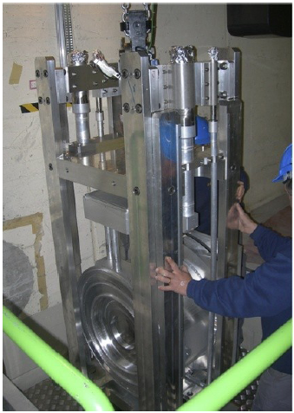
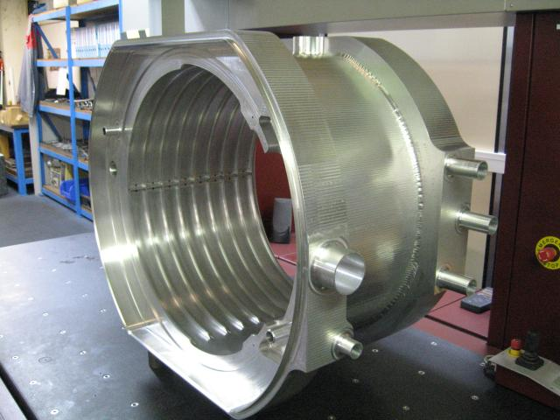
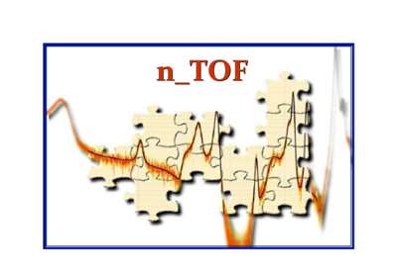
The new spallation Target
The cooling and the moderator systems in the target are separated, so to optimize neutron spectrum or minimize background
Vessel
Moderator (4 cm)
Cooling water
(1 cm)
Pb
Ø = 60 cm
L = 40 cm
protons
Retention vessel

Slide 20
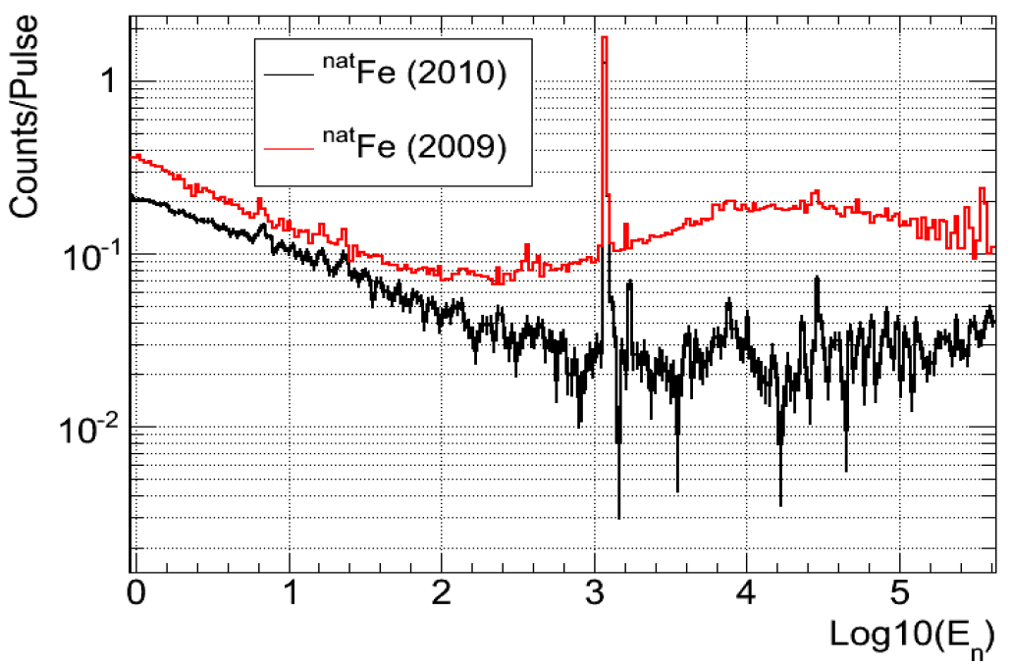
The new spallation Target
Moderator
2009 H₂O
2010 H₂0 + H₃BO₃ (borated water)
The borated water as moderator reduces the background of a factor 10!!
In the energy region 1-100 keV !

Slide 21
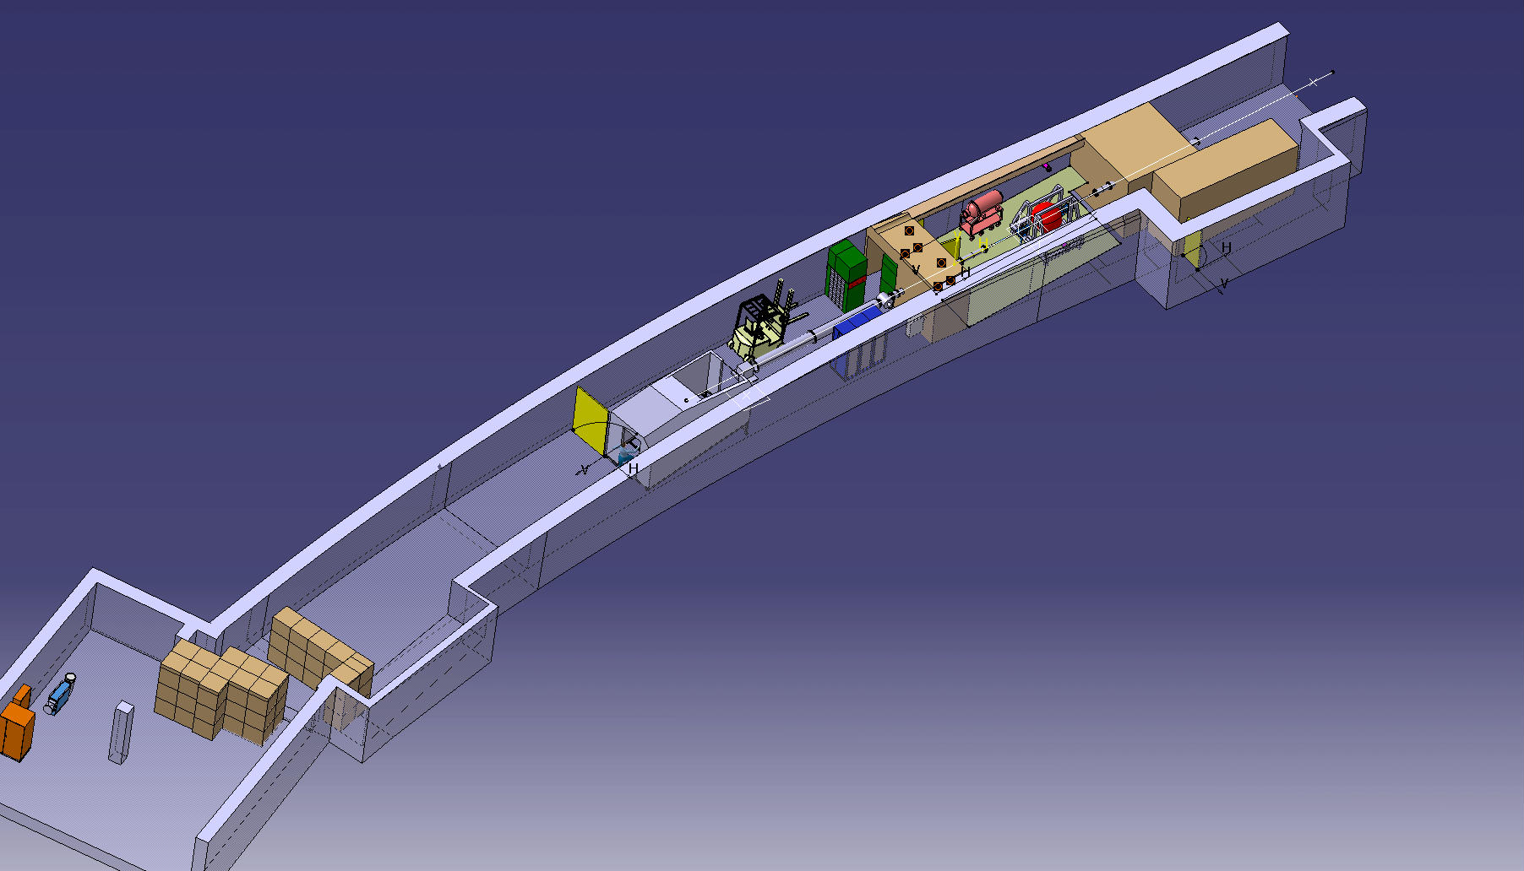
Work Sector of Type A
Since 2010 the n_TOF experimental area was transformed in work sector type A.
It allows to measure sample with very high activity.

Slide 22
The experimental activity @ n_TOF: Ph II
^{54,56,57}Fe
^{58,60,62}Ni,⁶³Ni
²⁵Mg
⁹³Zr
Cross sections relevant in Nuclear Astrophysics
    s-process: seeds isotopes
In the period 2009-2012 measured long-needed capture and fission cross-sections for 22 isotopes, 14 of which radioactive.

Slide 23
Experimental results

Slide 24
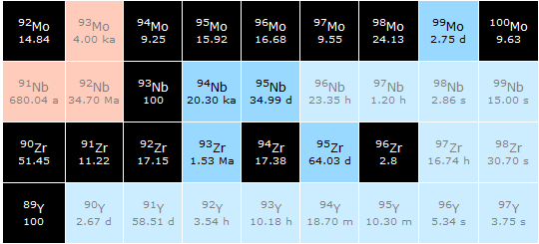

Slide 25
The experimental results: Zr isotopes
Courtesy of R. Gallino and S. Bisterzio
Nucleus | N_{ʘ} Normalized to N(Si)=10⁶ atoms | N_{s}/ N_{ʘ} % Old | N_{s}/ N_{ʘ} % n_TOF
⁹⁰Zr | 5.546 | 0.789 | 0.844
⁹¹Zr | 1.21 | 1.066 | 1.024
⁹²Zr | 1.848 | 1.052 | 0.981
⁹⁴Zr | 1.873 | 1.217 | 1.152
⁹⁶Zr | 0.302 | 0.842 | 0.321
Solar abundances, N, from Lodders 2009, accuracy 10%
The s-abundances, N_{s}, are calculated using the TP stellar model for low mass AGB star (1.5 - 3 M).

Slide 26
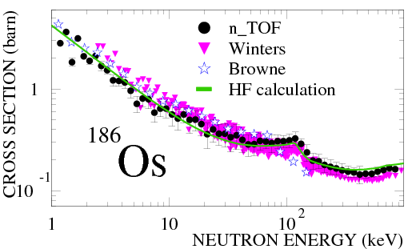
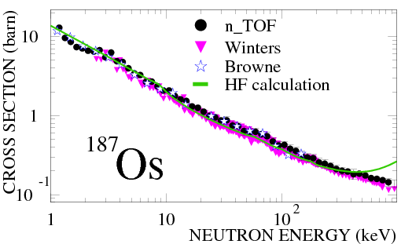
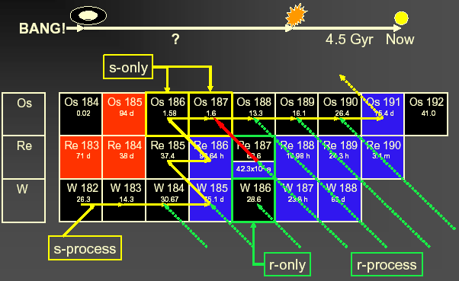
The experimental results: ^{186,187}Os

Slide 27
The experimental results: ^{186,187}Os
Cosmological way
Astronomical way
Nuclear way: Re/Os clock Th/U clock
13.7 ± 0.2 Gyr
14 ± 2 Gyr
14.9 ± 2 Gyr(*)
14.5 ± 2.5 Gyr
(*) 0.4 Gyr uncertainty due to cross-sections

Slide 28



The experimental results: ¹⁵¹Sm
Laboratory t_{1/2} = 93 yr
reduced to t_{1/2} = 3 yr
at s-process site
¹⁵²Gd
¹⁵⁴Gd
¹⁵¹Eu
¹⁵²Eu
¹⁵³Eu
¹⁵⁴Eu
s-Process
¹⁵⁰Sm
¹⁵¹Sm
¹⁵²Sm
¹⁵³Sm
The branching ratio for ¹⁵¹Sm depends on:
  Termodynamical condition of the stellar site (temperature, neutron density, etc…)
  Cross-section of ¹⁵¹Sm(n,γ)
  ¹⁵¹Sm used as stellar thermometer !!

Slide 29
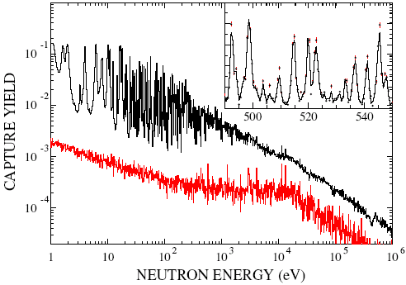
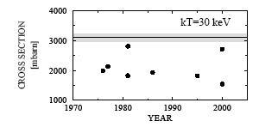
The experimental results: ¹⁵¹Sm
background
Measured for the first time at a time-of-flight facility
Resonance analysis with SAMMY code.
Maxwellian averaged cross-section experimentally determined for the first time
s-process in AGB stars produces 77% of ¹⁵²Gd,
23% from p process
Maxwellian averaged (n,γ) cross section of the ¹⁵¹Sm and previous calculation (symbol)
NO PREVIOUS MEASUREMENTS!

Slide 30
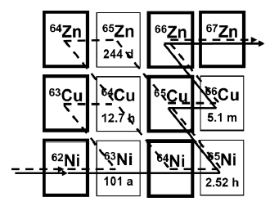
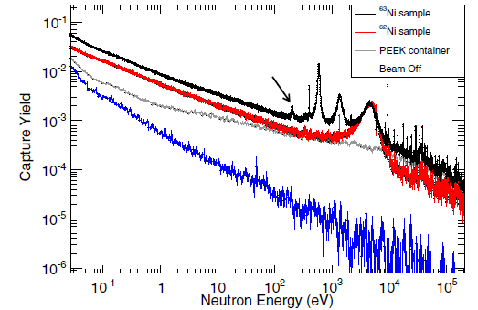
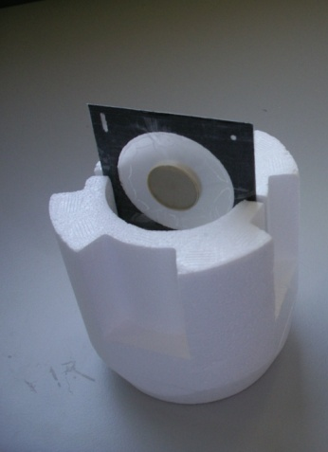
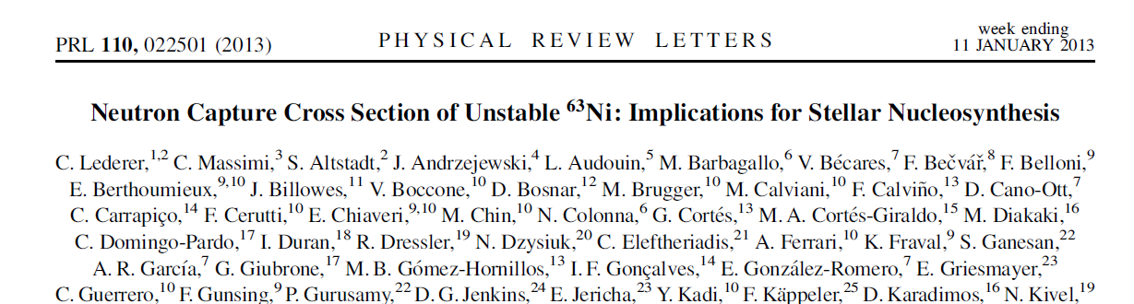
The experimental results: ⁶³Ni
⁶³Ni (t_{1/2}=100 y) represents the first branching point in the s-process, and determines the abundance of ^{63,65}Cu
⁶²Ni sample (1g) irradiated in thermal reactor (1984 and 1992), leading to enrichment in ⁶³Ni of ~13 % (131 mg)
In 2011 ~15.4 mg ⁶³Cu in the sample (from ⁶³Ni decay).
After chemical separation at PSI, ⁶³Cu contamination <0.01 mg
First high-resolution measurement of ⁶³Ni(n,γ) in the astrophysical energy range.

Slide 31
Publications
Isotope | Reference
^{24,25,26}Mg | PRC 85 (2012) 044615
⁵⁸Ni | PRC 89 (2014) 014605
⁶²Ni | PRC 89 (2014) 025810
⁶³Ni | PRL 110 (2013) 022501
⁹⁰Zr | PRC 77 (2008) 035802
⁹¹Zr | PRC 78 (2008) 045804
⁹²Zr | PRC 81 (2010) 055801 APJ 780 (2014) 95
⁹³Zr | PRC 87 (2013) 014622
⁹⁴Zr | PRC 84 (2011) 015801
⁹⁶Zr | PRC 84 (2011) 055802
¹³⁹La | PRC 75 (2007) 035807
¹⁵¹Sm | PRL 93 (2004) 161103 – PRC 73 (2006) 034604
^{186,187,188}Os | PRC 82 (2010) 015802 – PRC 82 (2010) 015804
²⁰⁴Pb | PRC 75 (2007) 015806
²⁰⁶Pb | PRC 76 (2007) 045805
²⁰⁷Pb | PRC 74 (2006) 055802
²⁰⁹Bi | PRC 74 (2006) 025807

Slide 32
The second Experimental ARea @ n_TOF

Slide 33
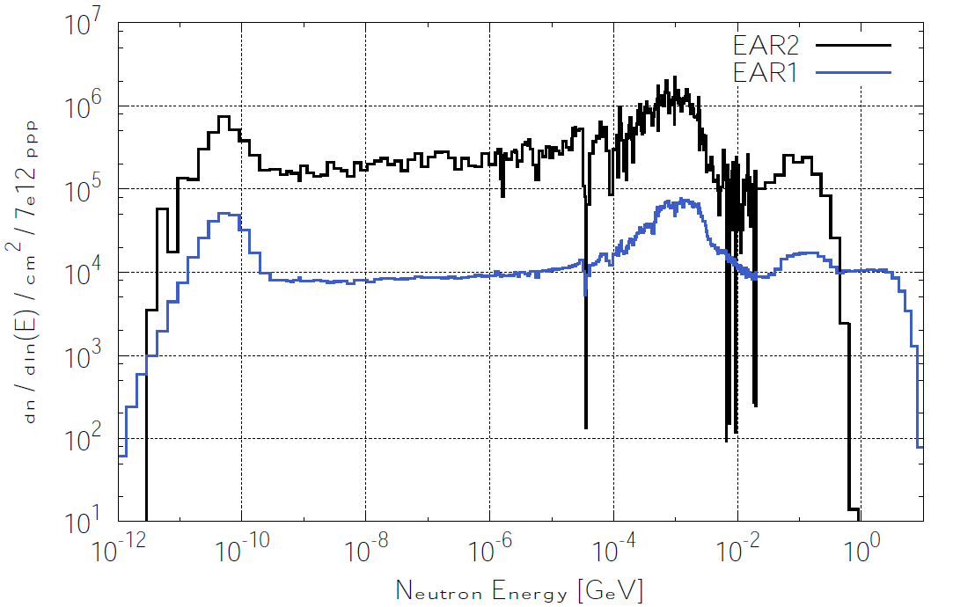
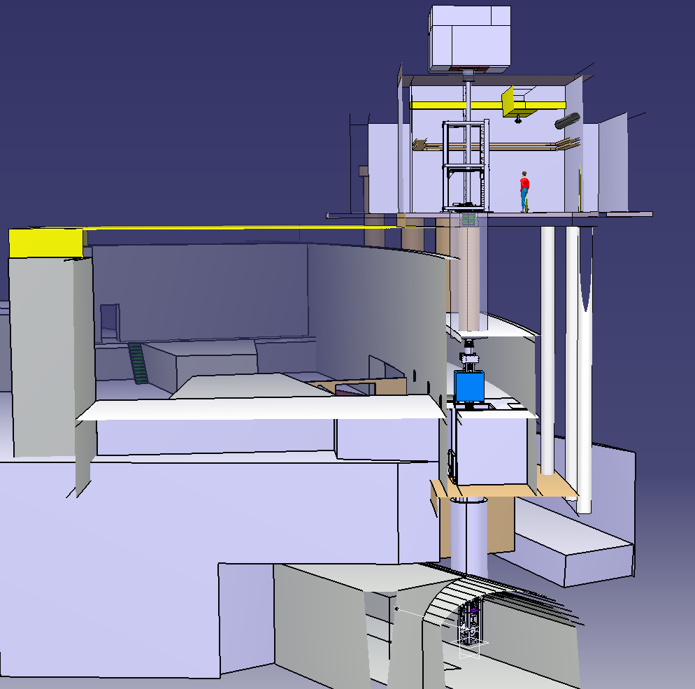
n_TOF Experimental Area 2
Experimental Area 2 (EAR2) is placed (vertically) at 20m from spallation target.
x30
20 m
Beam line
Higher fluence, by a factor of 30, relative to EAR1.
The shorter flight path implies a factor of 10 smaller time-of-flight.
Global gain by a factor of 300 in the signal/background ratio for radioactive isotopes!
200 m Beam line
Spallation target

Slide 34
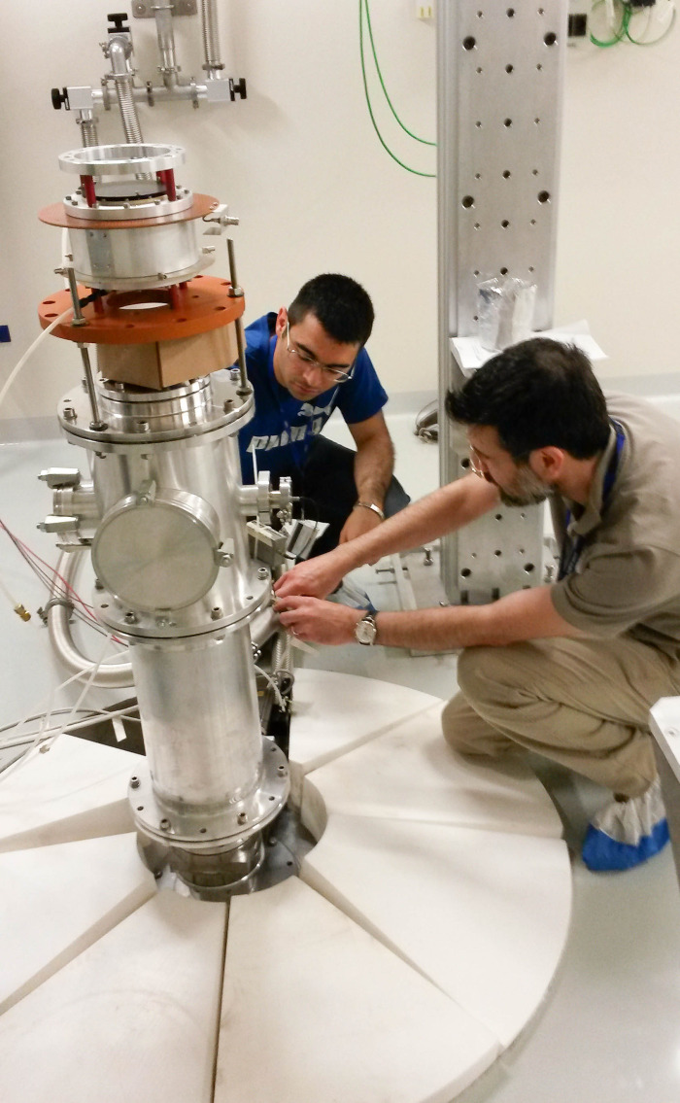
n_TOF Experimental Area 2
neutrons
The facility is presently undergoing the commissioning phase, particularly in terms of flux and background.
A rich experimental program is foreseen in EAR2, with many measurements already approved by the ISOLDE and the NTOF Committee (INTC) at CERN.

Slide 35
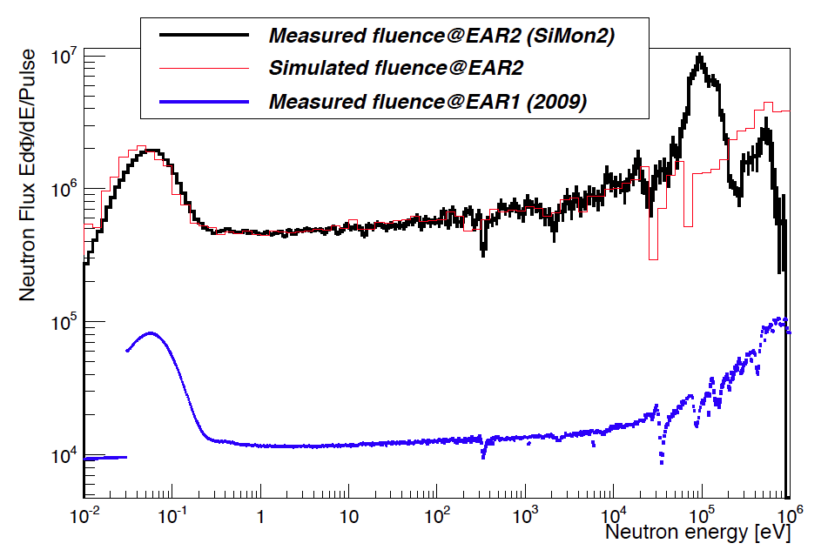
The neutron flux in EAR 2
PRELIMINARY

Slide 36
The experimental program EAR 2
The EAR2 will allow to:
  measure samples of very small mass (<1 mg)
  measure short-lived radioisotopes (down to a few years)
  collect data on a much shorter time scale
  measure (n,charged particle) reactions with thin samples
Measurements in EAR2:
  (n,p) and (n,α) cross sections on ⁷Be, ²⁵Mg, ²⁶Al
  Fission cross sections of the short lived actinides ²³²U, ^{238,241}Pu and ²⁴⁴Cm
  Capture cross section of ⁷⁹Se, ²⁴⁵Cm
  Cross section and angular distribution of fragments from ²³²U(n,f)
ISR
Status of the EAR2:
Construction finished May-2014
First neutron beam mid-June-2014
Commissioning 2014
Physics start in 2015
n_TOF target pit

Slide 37
AstroPhysics program EAR I & EAR II
Isot. | R | Comments
^{70,72,73}Ge | (n,γ) | s-process flow
¹⁷¹Tm,²⁰⁴Tl | (n,γ) | Branching points
Isot. | R | Comments
¹⁴⁷Pm | (n,γ) | Branching point
²⁶Al | (n,p/α) | ²⁶Al galactic abundance
⁵³Mn | (n,γ) | Explosive stage of stellar evolution
Be,C,¹⁴N,O,¹⁹F | (n,α) | n capture in light nuclei
⁷⁹Se | (n,γ) | Branching point

Slide 38
Conclusions
There is need of accurate new data on neutron cross-section both for astrophysics and advanced nuclear technology.
Since 2001, n_TOF@CERN has provided an important contribution to the field, with an intense activity on capture and fission measurements.
Several results of interest for stellar nucleosynthesis (Sm, Os, Zr, Ni, Fe, etc…).
Important data on actinides, of interest for nuclear waste transmutation.
To date, high resolution measurements performed in EAR1 in optimal conditions (borated water moderator, Class-A experimental area, etc…).
A second experimental area at 20 m for high flux measurements is actually in commissioning.
The EAR2 (starting in 2015) will open new perspectives for frontier measurements on short-lived radionuclides.
38

