Slide 1
New Large* Neutrino Detectors
Erice (Italy) in September 2013
Lothar Oberauer
TU München
Physik-Department
*Here: large > ca. 20 kton mass

Slide 2
Content
Why new large detectors ?
neutrino mass hierarchy, CP phase
astrophysics and astroparticle physics
Which experimental concepts ?
long baseline (~ 1000 km or more) oscillation experiments
short baseline oscillation experiments
Which detector concepts ?
liquid argon detector
liquid scintillator detector
Cherenkov detector
Mass hierarchy and CP phase
LBNO & LBNE; JUNO; PINGU & ORCA, Daedalus
Selected topics on astroparticle physics
DSNB and Solar MSW

Slide 3
Why new large neutrino detectors ?
atmospheric ν
+ K2K, MINOS
Δm²₂₃= 2.4· 10⁻³ eV²
Θ₂₃ ~ 42°
reactor ν
DC, DB, RENO, T2K
Δm²₃₁≈Δm²_{atm}
Θ₁₃~ 9 °
solar ν
+ KamLAND
Δm²₁₂ = 7.6· 10⁻⁵ eV²
θ₁₂=(34±3)°
Some open questions in neutrino physics:
Mass hierarchy (MH) ? Δm²₃₁ = m²₃ – m²₁ > 0 or < 0 ?
CP phase δ ?

Slide 4
Why new large neutrino detectors ?
Large detectors are necessary for low energy neutrino astrophysics and
astroparticle physics!
How does core collapse Supernovae perform ?
Can we see SN-neutrinos resolved in energy and flavor ?
Are there less Supernovae as thought ?
Can we measure the Diffuse Supernovae Neutrino Background and
what would they tell us?
Why don‘t we see the MSW up-turn in the solar 8-B spectrum ?
Can we measure the MSW up-turn in future experiments ?
Can we see new physics with solar neutrinos ?
What is the solar metallicity ?
Can we measure the solar CNO cycle ?
Do we understand the Earth‘s heat bilance ?
What can geo-neutrinos tell us ?
Is Baryonic number conserved ? Is the proton stable ?
What can new large neutrino detectors reach ?

Slide 5
Which experimental concepts ?
Neutrino properties MH, CP
Long baseline oscillation ν_{μ} − ν_{e} appearance experiments: MH and CP
source: accelerator neutrinos
baseline ~ 1000 km or longer
high energies (E > GeV)
LBNE-LAr (USA), LBNO (EU), Hyper-K (Japan)
Long baseline oscillation disappearance experiments: MH
source: atmospheric neutrinos
high energies (E > GeV)
PINGU (South-pole), ORCA (EU)

Slide 6
Which experimental concepts ?
Neutrino properties MH, CP
Short baseline oscillation disappearance experiments: MH
source: reactor neutrinos
baseline ~ 60 km
low energies (E ~ 4 MeV)
JUNO (China), RENO-2 (South-Korea)
Short baseline appearance experiments: CP
source: neutrinos from stopped pions
baseline ~ 30 km
low energies (E ~ 30 MeV)
Daedalus idea
LENA, Water-Cherenkov

Slide 7
Which experimental concepts ?
Astrophysics and Astroparticle physics
Supernova neutrinos (burst)
source: all neutrino flavors (de-leptonization-, accretion-, and cooling phase)
ca. 1 < E/MeV < ca. 30
LENA, Hyper-K, LAr, JUNO, ...
Diffuse Supernova neutrinos *
source: ν_{e}
ca. 10 < E/MeV < ca. 30
detection: ν_{e} + p −> e⁺ + n
LENA, SuperK + Gd, Hyper-K + Gd
Solar neutrino MSW up-turn *
source: ν_{e} from solar pp-III branch
E/MeV < 5 MeV
LENA
*covered in this talk

Slide 8
Which experimental concepts ?
Astrophysics and Astroparticle physics
Solar neutrinos CNO
  source: ν_{e} from solar CNO cycle
  E ~ 1 MeV
  Borexino, SNO+, LENA
Geo neutrinos
source: ν_{e}
2 < E/MeV < 4 MeV
detection: ν_{e} + p −> e⁺ + n
Borexino, SNO+, LENA
Proton decay
p −> π⁰ e⁺ , K⁺ ν, ...
Hyper-K, LENA, LAr

Slide 9
Which detector concepts ?
Water Cherenkov detectors
Aim ~ Mton
Hyper-Kamiokande (Japan), Memphys* (EU)
predecessor: SuperKamiokande
Liquid Argon detectors
Aim ~ 10 kton up to 100 kton in phases
LBNE (USA), GLACIER*(EU)
predecessor: Icarus
Liquid Scintillator detectors
Aim ~ 20 kton up to 50 kton
JUNO (China), RENO-2 (South-Korea), LENA*(EU)
predecessor: BOREXINO, KamLAND
*Currently studied within LAGUNA-LBNO

Slide 10
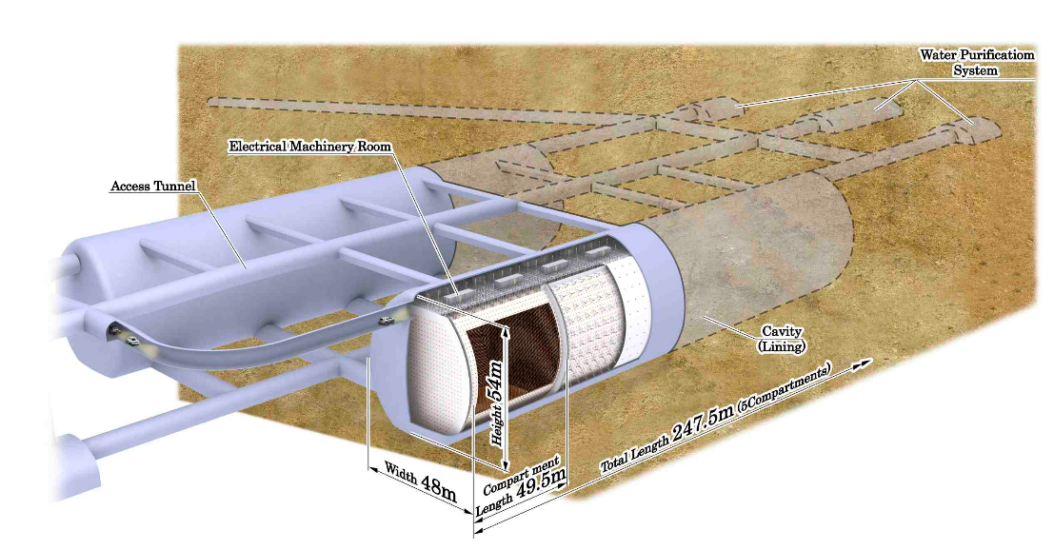
Water Cherenkov
Hyperkamiokande:
two detector modules
total (fiducial) mass of 0.99 (0.56) Mton
1750 m.w.e. Shielding HyperK coll. arxive: 1109.3262

Slide 11
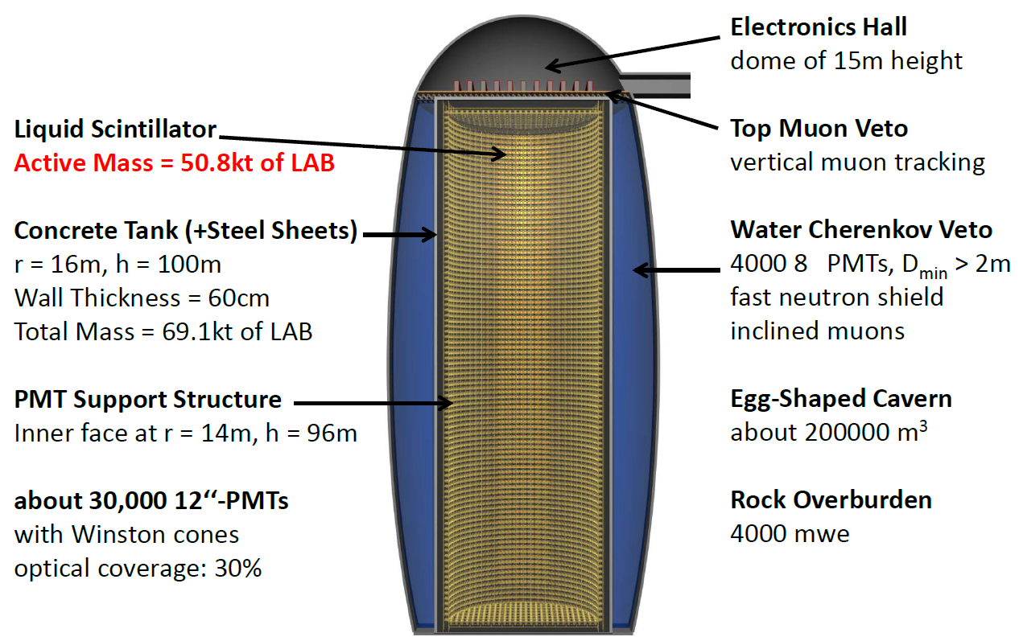
Liquid Scintillator
LENA design study (LAGUNA consortium) for Pyhäsalmi (Finland)
arxive:1104.5620

Slide 12
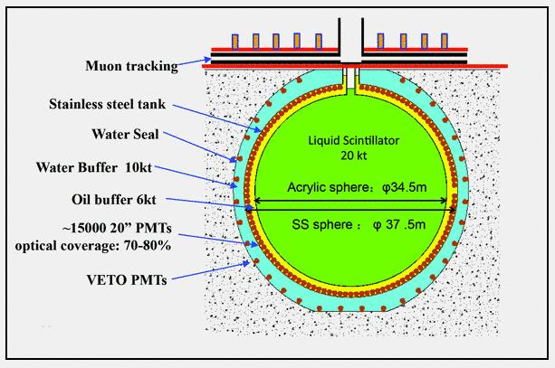
Liquid Scintillator
JUNO liquid scintillator detector (schematic view)
RENO-2 follows a similar concept
Yifang Wang, 27. June 2013, San Francisco

Slide 13
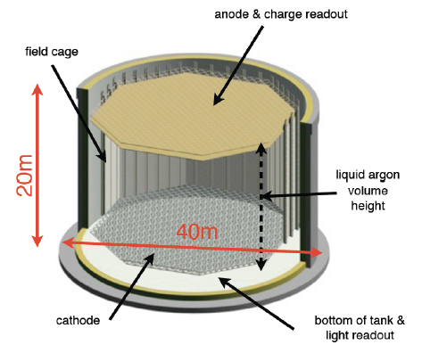
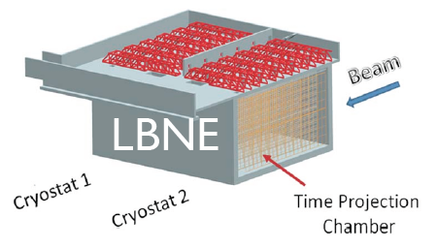
Liquid Argon
LBNE: 10 kton Lar detector
Single phase (?)
Fermilab to Homestake
Surface (?)
Brian Rebel, June 2013
LBNO: 20 kton Lar detector (1st stage)
Double phase detector
Expandable to 100 kton (?)
CERN to Pyhäsalmi
4000 m.w.e.
Thomas Patzak, BLV 2013

Slide 14
Mass Hierarchy and
CP-Phase

Slide 15
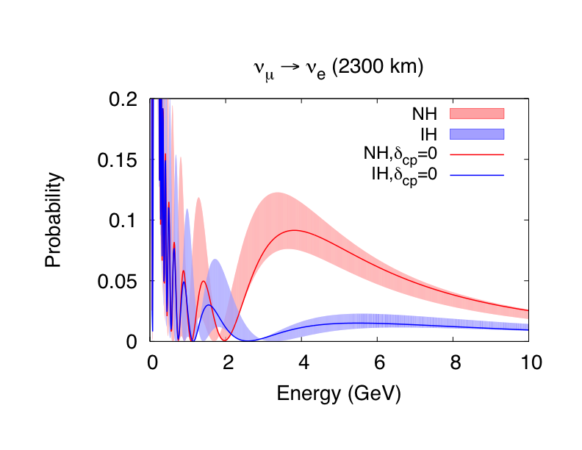
Long baseline oscillation ν_{μ} <−> ν_{e} appearance experiment
CERN -> Pyhäsalmi
Neutrino energy at 3 – 4 GeV: Clear mass hierarchy determination – no CPV degeneracy

Slide 16
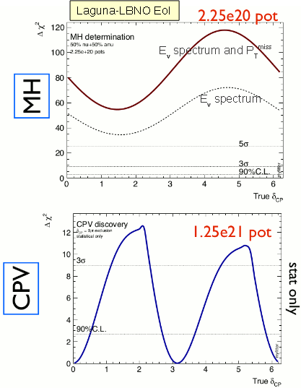
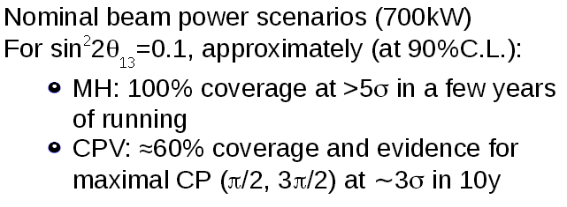
LAGUNA-LBNO sensitivities LAr
(CERN -> Pyhäsalmi)
20kt two phase Lar +
35kt magnetized muon iron neutrino detector (MIND)
F. Di Ludovico, NNN12

Slide 17
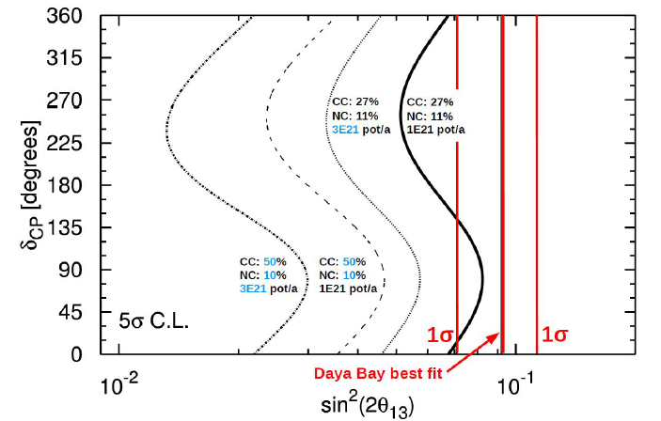
LENA sensitivity on neutrino mass hierarchy
50 kton Liquid Scintillator detector at Pyhäsalmi
Reactor results on Θ₁₃
5+5y measurement
10²¹ pot/a corresponds to a beam power of 750 kW

Slide 18
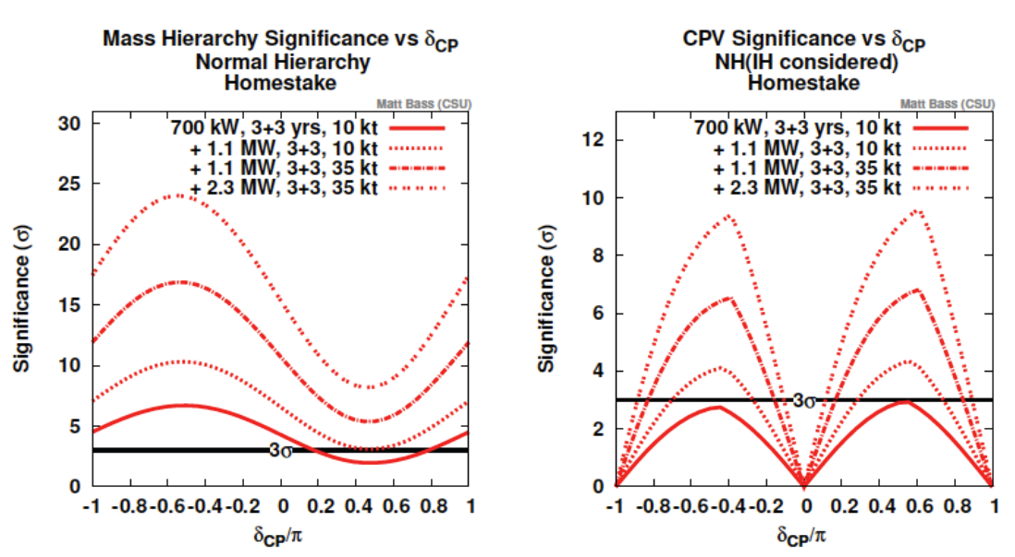
LBNE sensitivities
Baseline 1300 km
M. Diwan; Bad Honnef (Germany) Jan. 2013

Slide 19
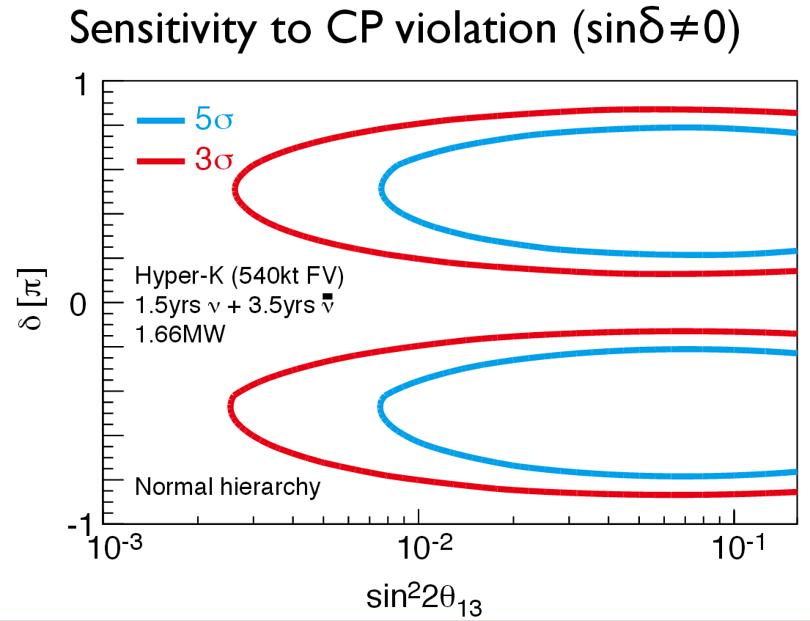
Hyper-Kamiokande sensitivity on CP
Actual value
HK has also sensitivity on MH
Depending on oscillation parameter
M. Yokoyama, TIPPI I, Chikago, 2011

Slide 20
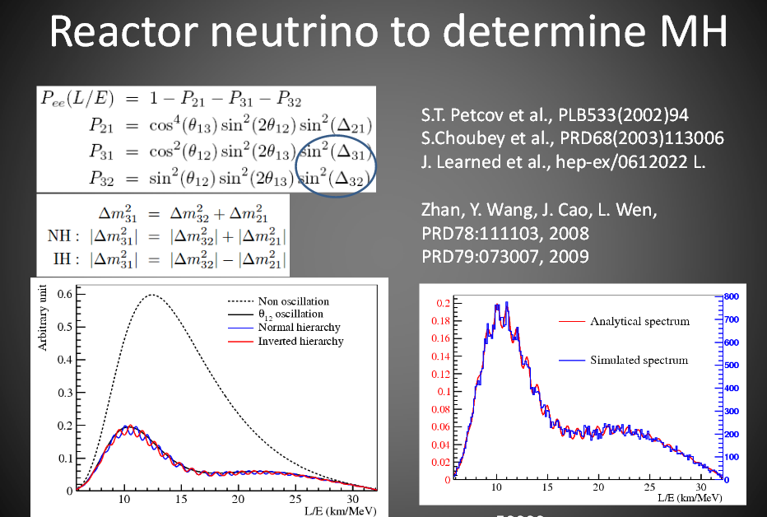
JUNO sensitivity on MH
20 kton Liquid Scintillator Detector
L. Zhan, NOW 2012

Slide 21
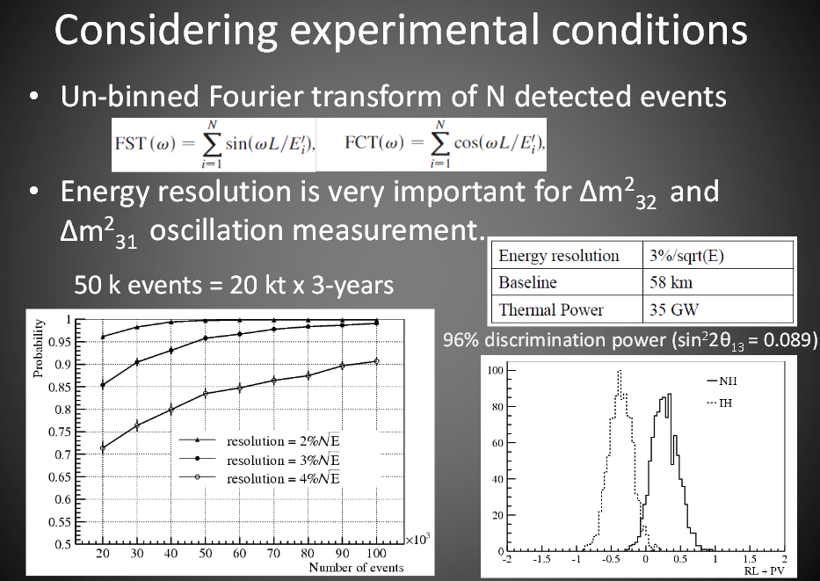
L. Zhan, NOW 2012

Slide 22
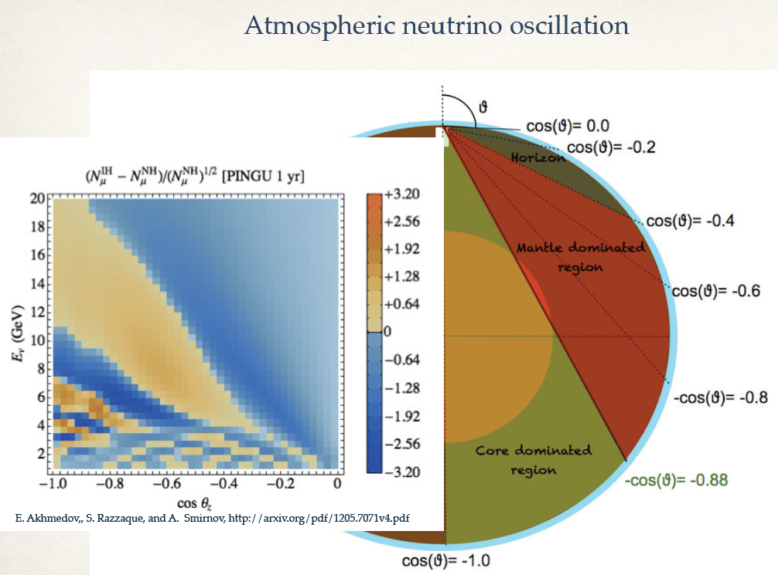
PINGU and ORCA (MH)
E. Resconi, Bad Honnef, 2013

Slide 23
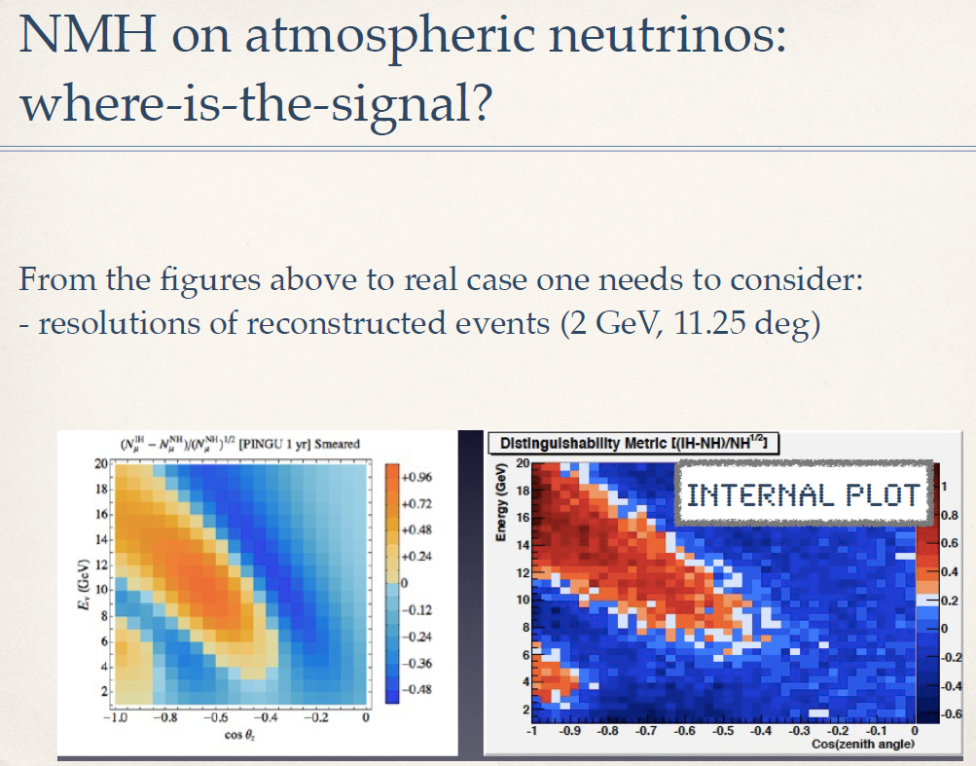
PINGU sensitivity on MH ?
E. Resconi, Bad Honnef, 2013

Slide 24
PINGU sensitivity on MH
Arxive:1306.5846
Varying CP-parameter in
δ, Θ₁₂, Δm² not yet considered
authors assume, that the impact is not to large
Sensitivity should be indeed statistics limited

Slide 25
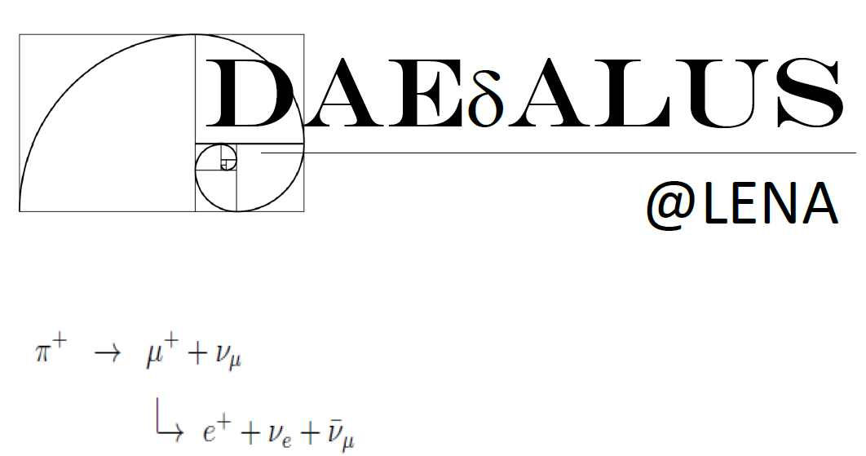
S. Agarwalla, J. Conrad, M. Shaevitz, arxive:1105.4984

Slide 26
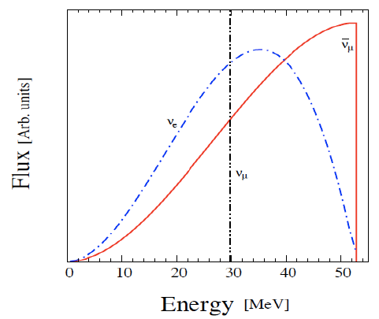

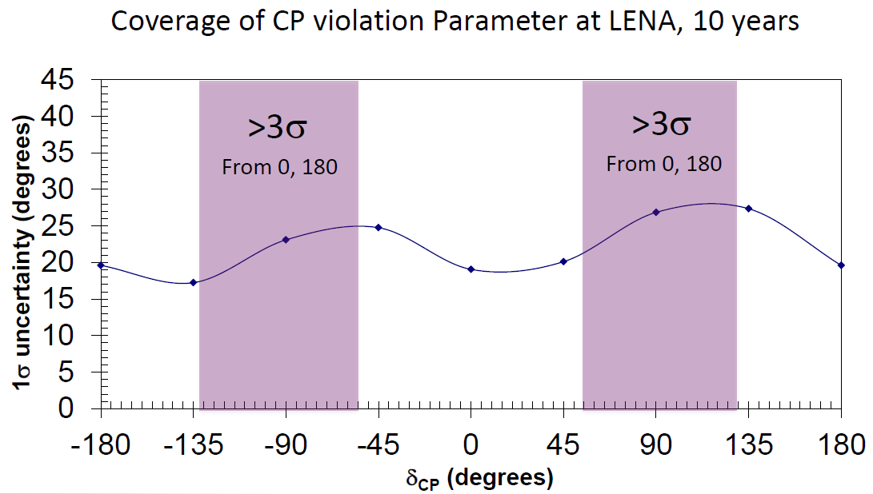
Neutrino source:
Pion+ decays at rest
From 800 MeV H2+ cyclotron
Perfectly suited for liquid scintillator detectors like LENA or JUNO
Basically free of background
S. Agarwalla, J. Conrad, M. Shaevitz, arxive:1105.4984
Plot shown in L. Oberauer (neutrino 2012)

Slide 27
Astroparticle Physics
Solar MSW up-turn
DSNB neutrinos
LENA based studies
R. Möllenberg, TU München, PhD thesis 2013

Slide 28
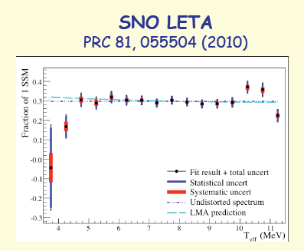
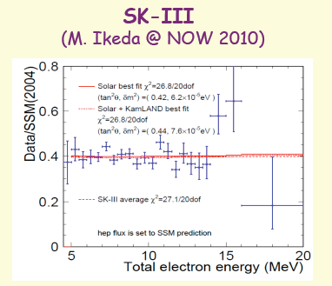
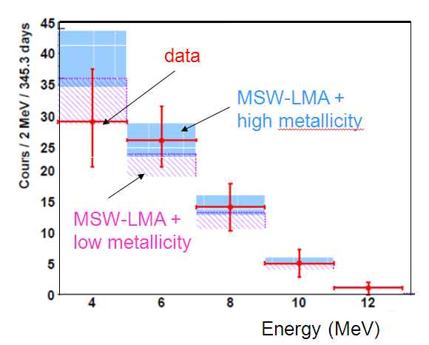
Solar MSW up-turn (?)
BOREXINO
Phys. Rev. D 82 (2010)
Can future experiments probe the MSW up-turn ?

Slide 29
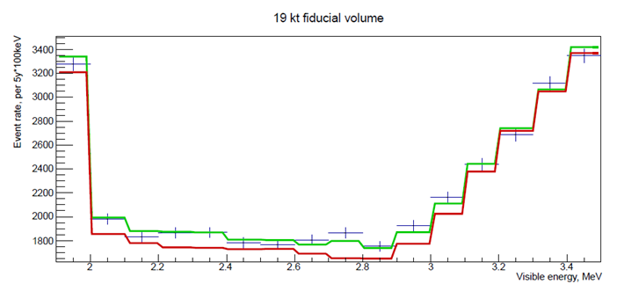

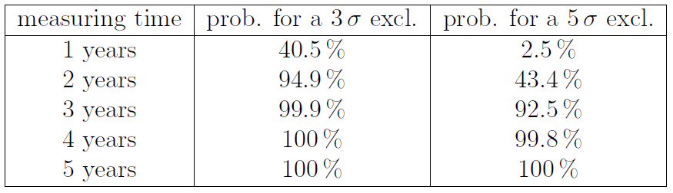
LENA
4000 m.w.e.
19 kton fid. Vol.
LENA can probe the MSW up-turn at >5 sigma in less than 5 years

Slide 30
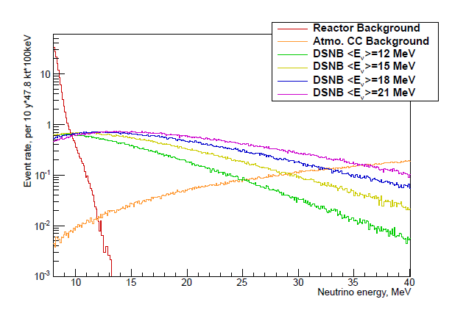
DSNB neutrinos
DSNB neutrinos
Antineutrino detection via inverse beta decay in 10 < E/MeV < 25
5 to 10 events per year expected from SN models and SN (z-dep.) rates

Slide 32
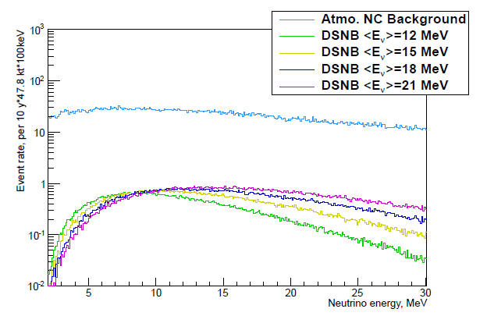
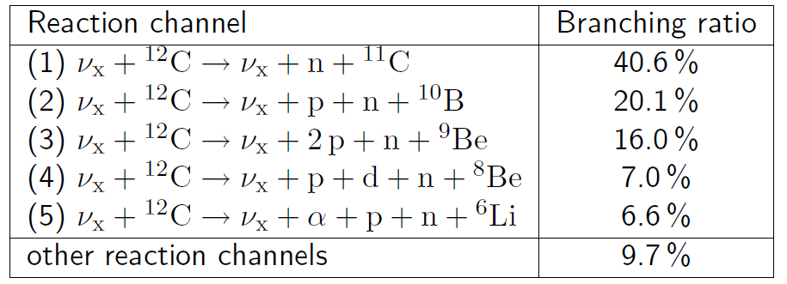
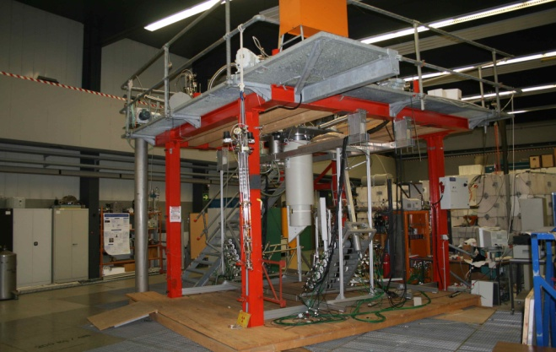
Most dangereous bg:
Atmospheric ν nc events on ¹²C
Factor ~ 20 above signal
Only ~ 40% can be tagged (via ¹¹C)
PSD techniques applicable ?
Labor measurements at TUM
LENA MC simulations
?
Atmospheric neutrino events as bg for DSNB neutrino search via IBD in LENA

Slide 33
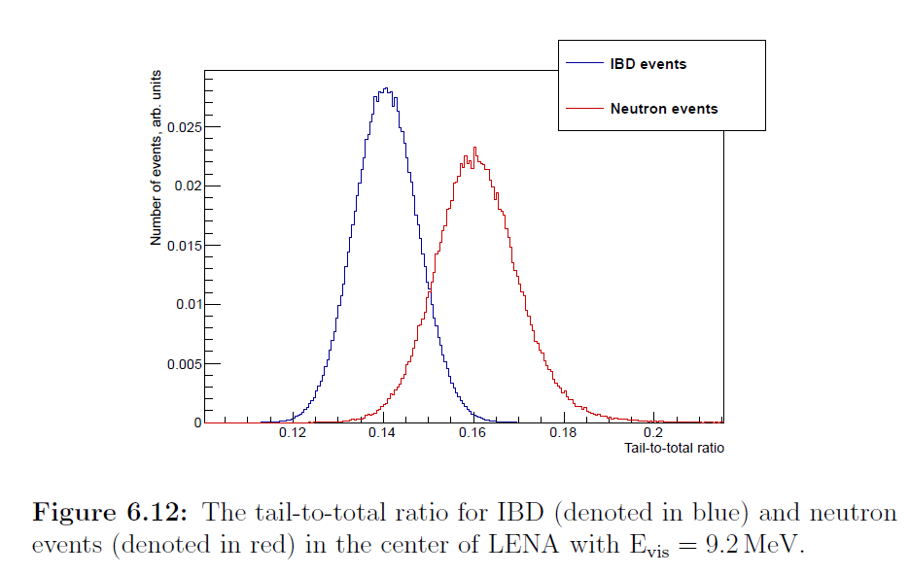
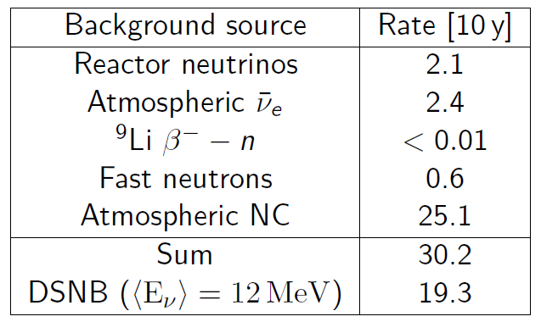
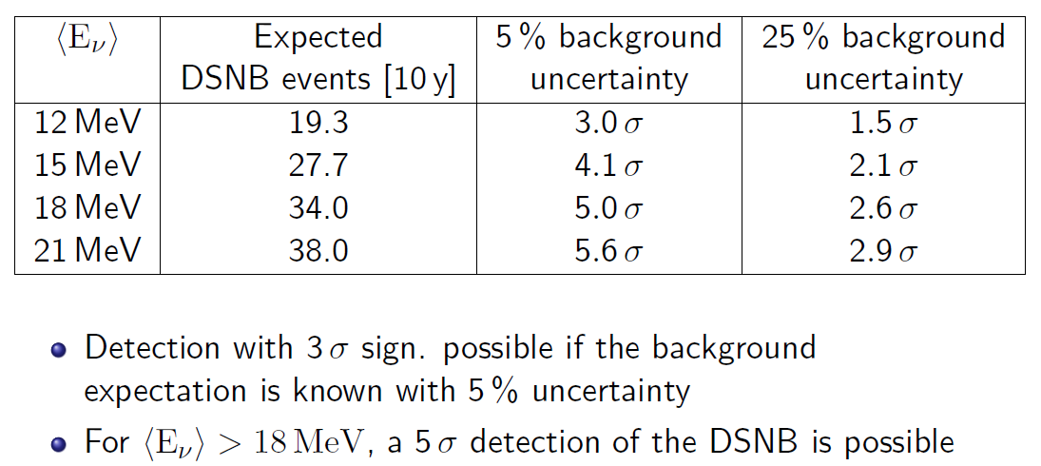
Results on PSD in LENA

Slide 34
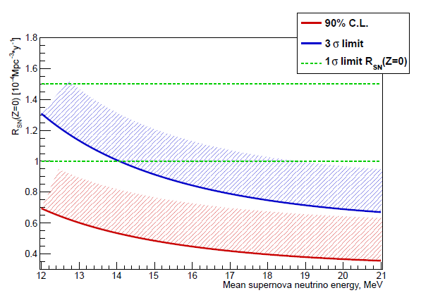
LENA exclusion potential after 10y of measurements
Current DSNB expectations
Dark side of Supernovae
Assumption: LENA sees no hint on DSNB (only bg)
All current DSNB models would be excluded by at least 90% cl
For <E> above 14 MeV even at least at 3 sigma

Slide 35
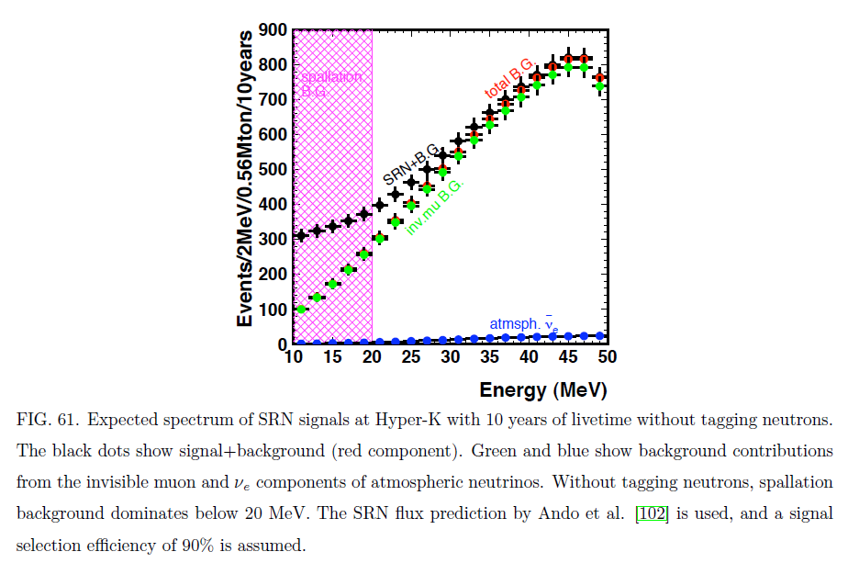
DSNB measurement in Hyperkamiokande
Without neutron tagging
HyperK coll. arxive: 1109.3262

Slide 36
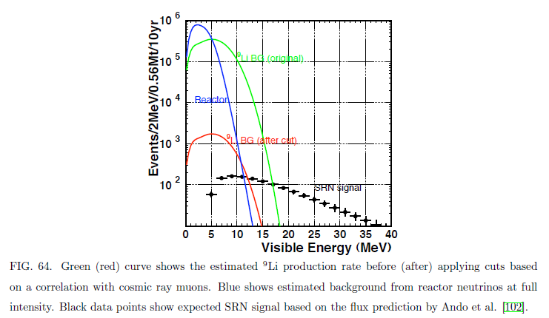
DSNB measurement in Hyperkamiokande
With Gd in water as tool for neutron tagging

Slide 37
Conclusions
World wide programs (EU, USA, Japan) on future large neutrino detectors
LAr, LSc, LWa detecor concepts are studied
Very high potential on MH
CP is very challenging for all concepts
Offer a high discovery potential on astro- and astroparticle physics

