Slide 1
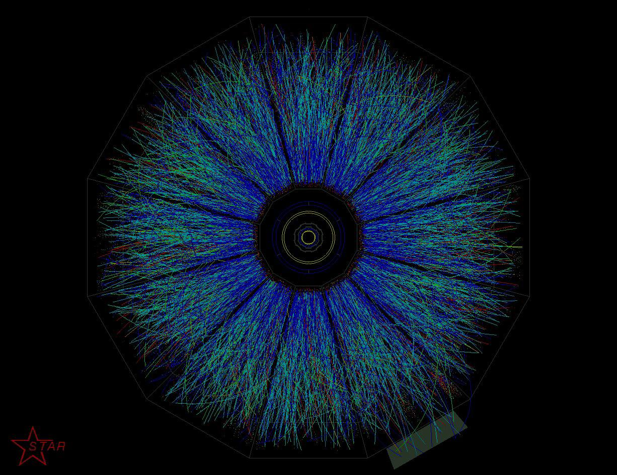
Strong field physics in high-energy heavy-ion collisions
Kazunori Itakura (KEK Theory Center)
20th September 2012@Erice, Italy

Slide 2
Contents
Strong field physics:
what, why, how strong, and how created?
Vacuum birefringence of a photon
Its effects on heavy-ion collisions
Other possible phenomena
Summary

Slide 3
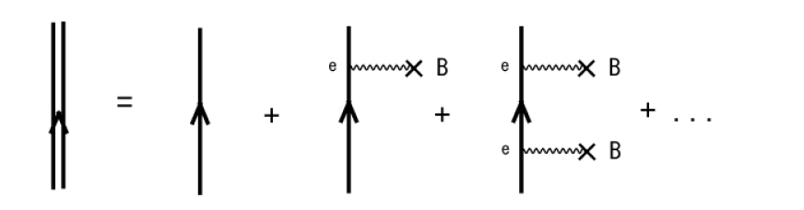
What is “strong field physics”?
Characteristic phenomena that occur under
strong gauge fields (EM fields and Yang-Mills fields)
Typically, weak-coupling but non-perturbative
ex) electron propagator in a strong magnetic field
Schwinger’s critical field
eB/m²=B/Bc∼10⁴-10⁵ @ RHIC, LHC
→ must be resummed to infinite order when B >> B_{c}
→ “Nonlinear QED”

Slide 4
Why is it important?
Strong EM/YM fields appear in the very early time of heavy-ion collisions. In other words, the fields are strongest in the early time stages.
Indispensable for understanding the early-time dynamics in heavy-ion collisions
strong YM fields (glasma) → thermalization
strong EM fields → probe of early-time dynamics
- carry the info without strong int.
- special to the early-time stages

Slide 5
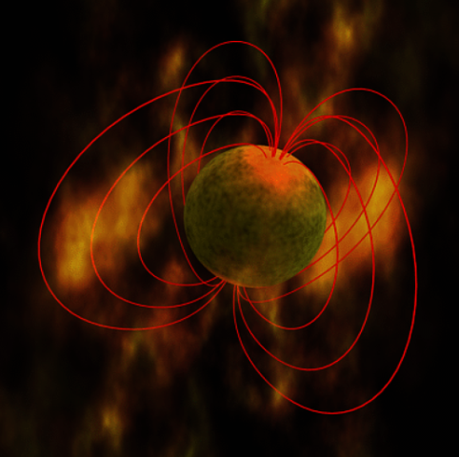
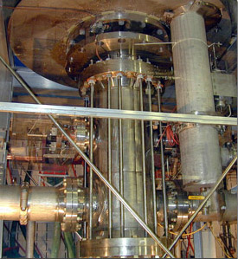
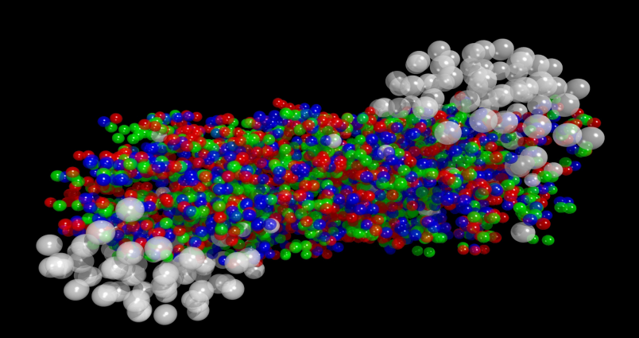
How strong?
1 Tesla = 10⁴ Gauss
10¹⁷—10¹⁸ Gauss
√eB ~ 1 – 10 m_{π}:
Noncentral heavy-ion coll.
at RHIC and LHC
Also strong Yang-Mills
fields √gB ~ 1– a few GeV
10¹⁵Gauss :
Magnetars
4x10¹³ Gauss : “Critical” magnetic field of electrons
√eB_{c}= m_{e} = 0.5MeV
45 Tesla : strongest steady magnetic field (High Mag. Field. Lab. In Florida)
10⁸Tesla=10¹²Gauss:
Typical neutron star
surface
Super strong magnetic field could have existed in very early Universe. Maybe after EW phase transition? (cf: Vachaspati ’91)
8.3 Tesla : Superconducting magnets in LHC

Slide 6

How are they created?
Strong magnetic fields are created in non-central HIC
Strong
B field
b
Lorentz contracted electric field is accompanied by strong magnetic field
x⊥’ , Y : transverse position and rapidity (velocity) of moving charge

Slide 7
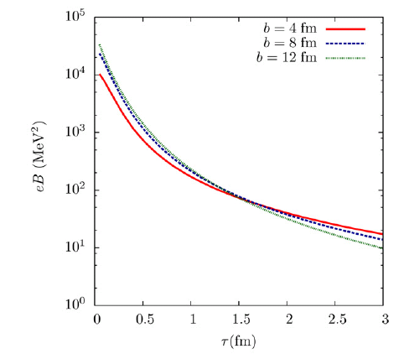
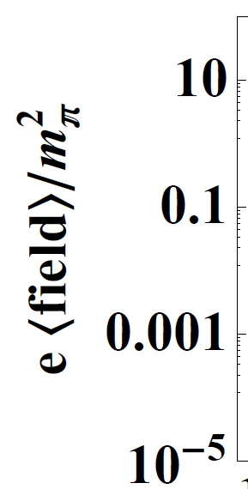
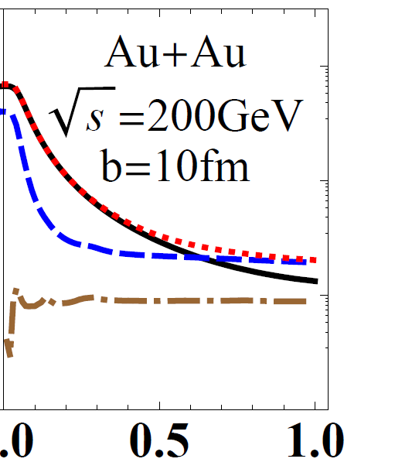
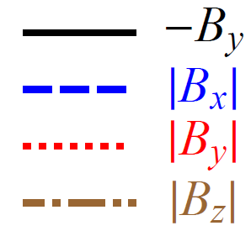

Time dependence
Simple estimate with the Lienardt-Wiechert potential
Kharzeev, McLerran, Warringa, NPA (2008)
Au-Au collisions at
RHIC (200AGeV)
Event-by-event analysis with HIJING
Deng, Huang, PRC (2012)
10⁴
eB (MeV²)
Au-Au 200AGeV, b=10fm
Time after collision (fm/c)
√eB ~ 1 – 10 m_{π}

Slide 8
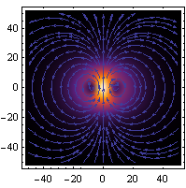
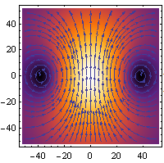
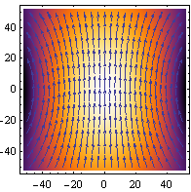
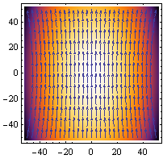
Time dependence
Rapidly decreasing
→ Nonlinear QED effects are prominent
in pre-equilibrium region !!
→ Still VERY STRONG even after a few fm,
QGP will be formed in a strong B !!
(stronger than or comparable to Bc for quarks
gBc~m_{q}²~25MeV²)
QGP
200GeV (RHIC)
Z = 79 (Au),
b = 6 fm
Plot: K.Hattori
t = 0.1 fm/c
0.5 fm/c
1 fm/c
2 fm/c

Slide 9
Strong Yang-Mills fields (Glasma)
Just after collision: “GLASMA”
CGC gives the initial condition
→ “color flux tube” structure
with strong color fields
√gB ~ √gE ~ Q_{s}
~ 1 GeV (RHIC) – a few GeV (LHC)
Instabilities lead to isotropization (and hopefully thermalization?):
-- Schwinger pair production from color electric field
-- Nielsen-Olesen instability of color magnetc field [Fujii,KI,2008] [Tanji,KI,2012]
-- Schwinger mechanism enhanced by N-O instability when both are present
Non-Abelian analog of the nonlinear QED effect
-- Synchrotron radiation, gluon birefringence, gluon splitting, etc

Slide 10
An example of nonlinear QED effects
K. Hattori and KI arXiv:1209.2663
and more
“Vacuum birefringence”
Polarization tensor of a photon
is modified in a magnetic field
through electron one loop, so
that a photon has two different
refractive indices. Has been
discussed in astrophysics….
B
z
q
Dressed fermion in external B
(forming the Landau levels)
present only in external fields
II parallel to B
transverse to B
T

Slide 11
Vacuum Birefringence
Maxwell equation with the polarization tensor :
Dispersion relation of two physical modes gets modified
→ Two refractive indices : “Birefringence”
z
q
q^{μ}
γ
B
x
Need to know χ₀, χ₁ , χ₂
N.B.) In the vacuum, only χ₀ remains nonzero → n=1

Slide 12
Recent achievements
K.Hattori and KI
arXiv:1209.2663
and more
Obtained analytic expressions for χ₀, χ₁, χ₂ at any value of B and any value of photon momentum q.
Obtained self-consistent solutions to the refractive indices with imaginary parts including the first threshold
Strong field limit: the LLL approximation
(Tsai and Eber 74, Fukushima 2011 )
No complete understanding
has been available
Weak field & soft
photon limit (Adler 71)
Numerical results only
below the first threshold
(Kohri and Yamada 2002)
χ_{i} contain refractive indices
through photon momentum

Slide 13
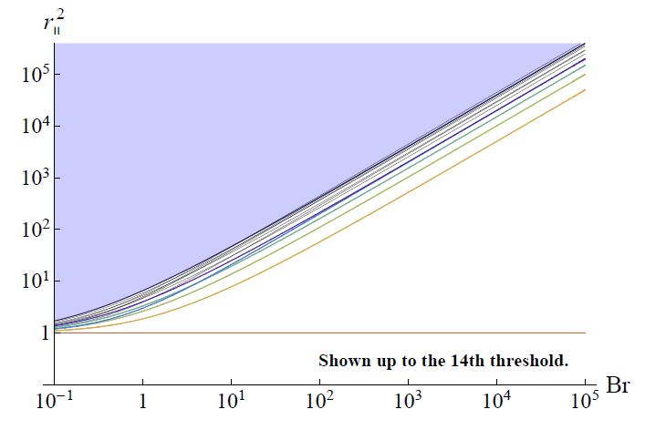
Where are we?
Photon energy
squared
Prompt photon ~ GeV²
Thermal photon ~ 300²MeV²
~ 10⁵MeV²
HIC
Magnetar
B=B_{c}
B_{r} = B/B_{c} = eB/m²
HIC ---Need to know effects from higher Landau levels
Magnetar – Need to know at least the lowest LL

Slide 14

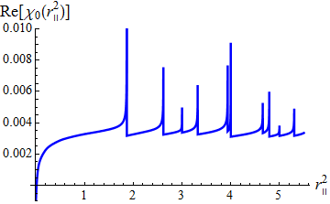
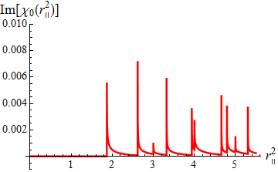
Properties of coefficients χ_{i}
sum over two infinite series of Landau levels
“one-loop” diagram, but need to sum infinitely many diagrams
Imaginary parts appear at the thresholds
invariant masses of an e+e- pair in the Landau levels
corresponding to “decay” of a (real) photon into an e+e- pair
Refractive indices are finite while there are divergences at each thresholds

Slide 15
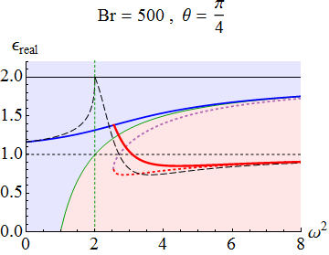
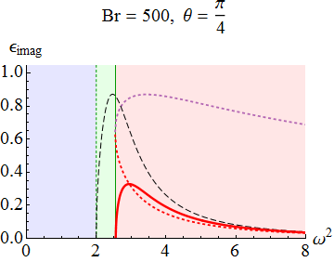



Self-consistent solutions
(in the LLL approximation )
Dielectric
constants
$$ω^{2}/4m^{2}$$
$$ω^{2}/4m^{2}$$
``Parallel” dielectric constant (refractive index) deviates from 1
There are two branches when the photon energy is larger than the threshold
New branch is accompanied by an imaginary part indicating decay

Slide 16
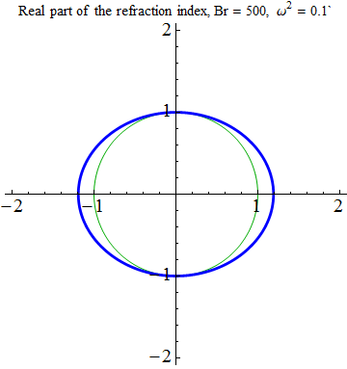
Effects on heavy-ion events
Refractive indices depend on the angle btw the photon momentum q and the magnetic field B.
Length: magnitude of n
Direction: propagating
direction
Angle dependence of the refractive indices yields
anisotropic spectrum of photons

Slide 17
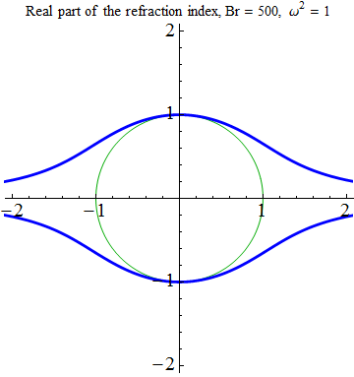
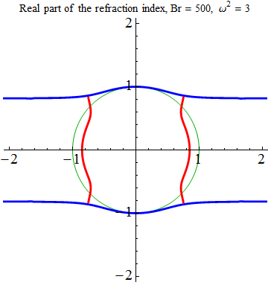
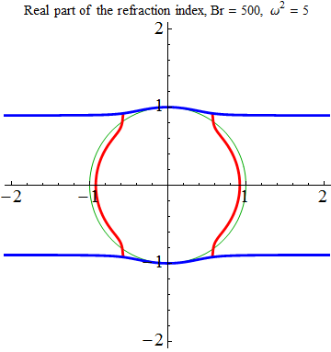
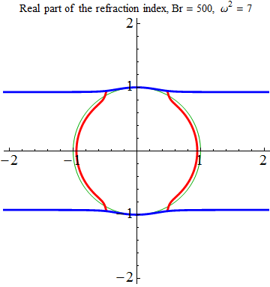
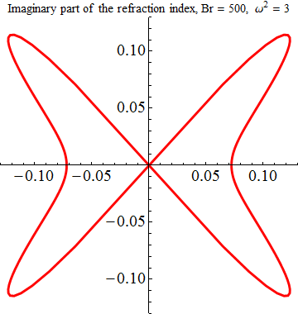
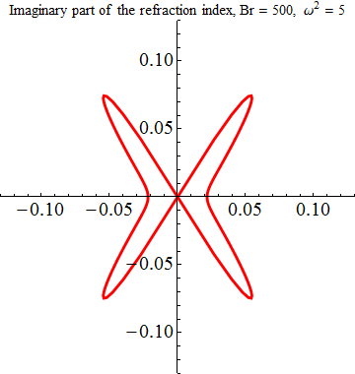
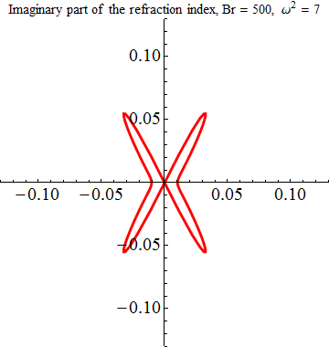
Angle dependence at various photon energies
Real part
Imaginary part
No imaginary part

Slide 18
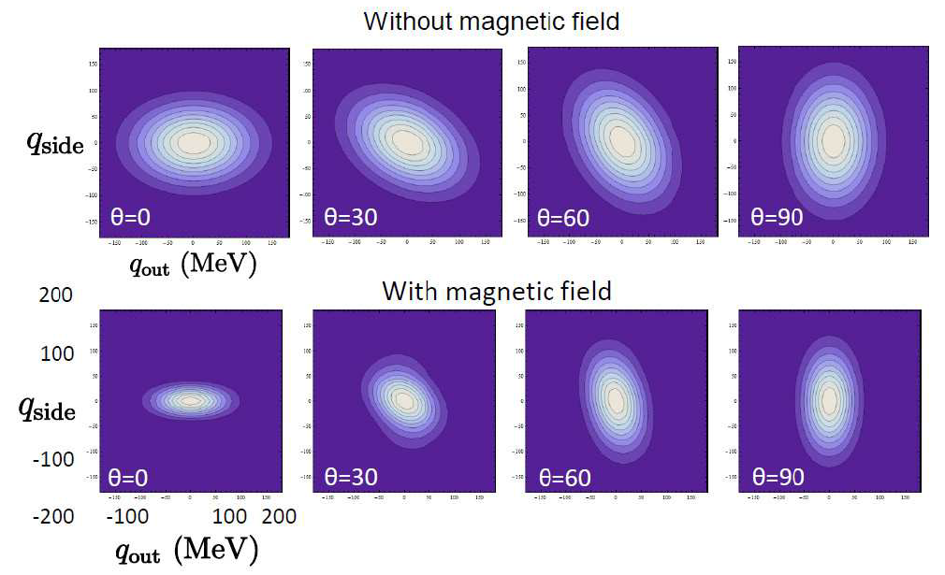
Consequences in HIC?
Generates elliptic flow (v₂) and higher harmonics (v_{n})
(at low momentum region) work in progress with K.Hattori
Distorted photon HBT image due to vacuum birefringence
Based on a simple toy model with moderate modification
Hattori & KI, arXiv:1206.3022
“Magnetic lenzing”
Magnification and distortion
← can determine the profile of photon source if spatial distribution of
magnetic field is known.

Slide 19
Other possible phenomena
Synchrotron radiation of photons/gluons [Tuchin]
→ enhanced v₂ of photons or pions (scaling)
photon v₂ will be further modified by birefringence
Photon splitting → anomalous enhancement of soft photons
Interplay with color Yang-Mills fields/glasma
(such as Chiral Magnetic Effects)
Strong B
dilepton
QGP
photons
Real photon
quark
QGP
gluons

Slide 20
Summary
Strong-field physics of EM and YM fields is an indispensable aspect in understanding the early-time dynamics of HIC events. A systematic analysis will be necessary.
One can, in principle, extract the information of early-time dynamics by using the strong-field physics as a probe.
An example is “vacuum birefringence and decay” of a photon which occurs in the presence of strong magnetic fields. Photon self-energy is strongly modified. Its analytic representation is available now. It will yield nontrivial v2 and higher harmonics, and distorted HBT images (and additional dilepton production).

