Slide 1
Is the QGP produced in LHC collisions more opaque than that produced in RHIC collisions?
Roy A. Lacey
Chemistry Dept.,
Stony Brook University

Slide 2
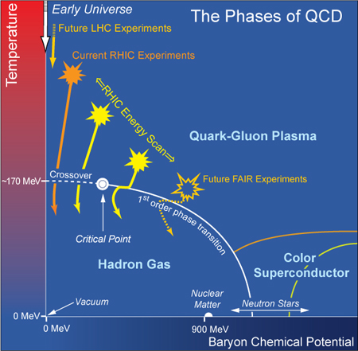
p
Quantitative study of the QCD phase diagram is central to our field
Conjectured Phase Diagram
Interest
Location of the critical End point
Location of phase coexistence lines
Properties of each phase
All are fundamental to the phase diagram of any substance
Spectacular achievement:
Validation of the crossover
transition leading to the QGP
Full characterization of the QGP is a central theme at RHIC and the LHC

Slide 3
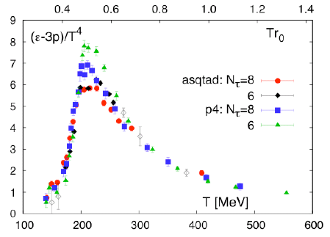
QGP Characterization?
Characterization of the QGP produced in RHIC and LHC
collisions requires:
Development of experimental constraints to map the
topological, thermodynamic and transport coefficients
Development of quantitative model descriptions of
these properties
Experimental Access:
Temp/time-averaged constraints as
a function of √s_{NN}
(with similar expansion dynamics)
(II)
(I) Expect space-time averages to evolve with √s_{NN}

Slide 4
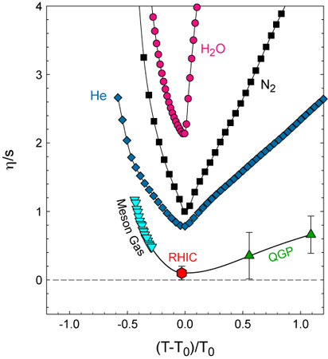
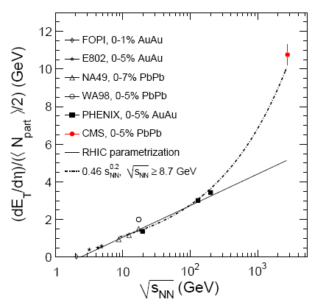
The energy density lever arm
Lacey et. al, Phys.Rev.Lett.98:092301,2007
Energy scan
Essential questions:
How do the transport coefficients
evolve with T?
Any indication for a change in
coupling close to T_{o}?
RHIC (0.2 TeV) → LHC (2.76 TeV)
Power law dependence (n ~ 0.2)
increase ~ 3.3
Multiplicity density increase ~ 2.3
<Temp> increase ~ 30%
Take home message:
The scaling properties of flow and
Jet quenching measurements give crucial new insights

Slide 5
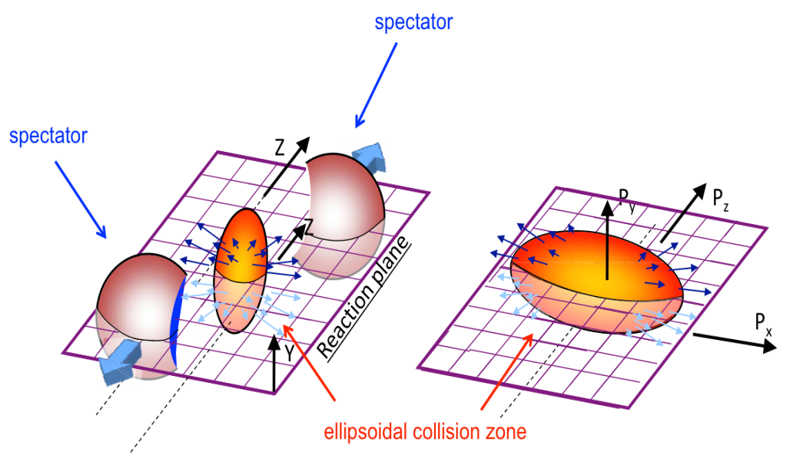
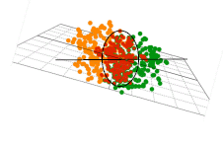
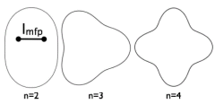
The Flow Probe
Anisotropic p
Idealized Geometry
Isotropic p
Yield(φ) =2 v₂ cos[2(φ−Ψ₂]
Crucial parameters
Actual collision profiles are not smooth,
due to fluctuations!
Initial Geometry characterized by many shape harmonics (ε_{n}) → drive v_{n}
Acoustic viscous modulation of v_{n}
Staig & Shuryak arXiv:1008.3139
Initial eccentricity (and its attendant fluctuations) ε_{n} drive momentum anisotropy v_{n} with specific scaling properties

Slide 6
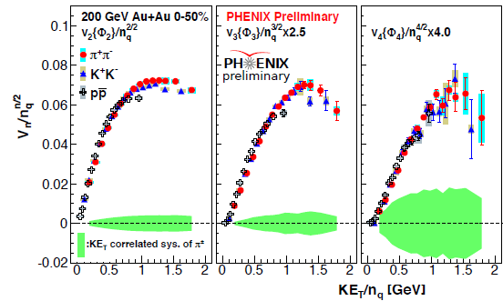
Flow is partonic @ RHIC
v_{n} PID scaling
KE_{T} & scaling validated for v_{n}
→ Partonic flow

Slide 7
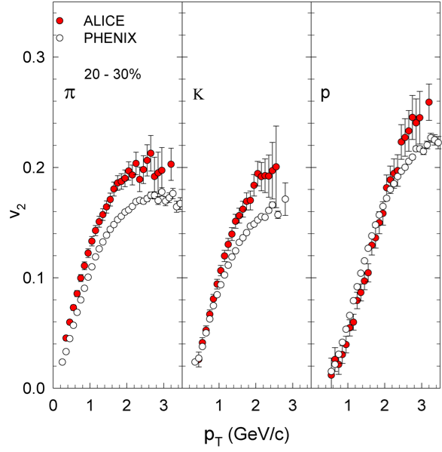
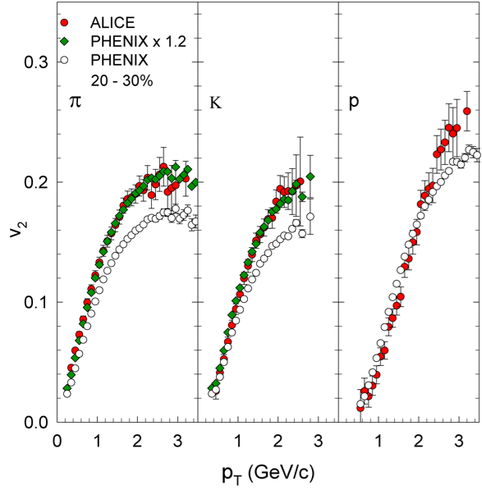
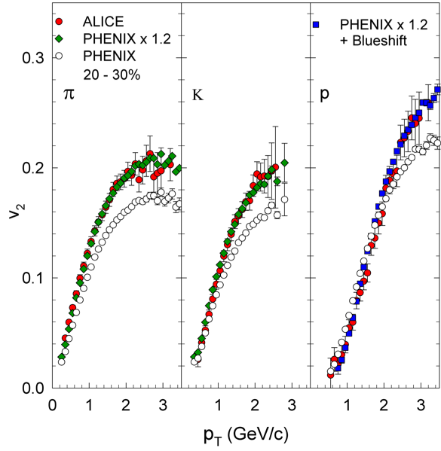
Flow increases from RHIC to LHC
Flow increases from RHIC to LHC
Sensitivity to EOS
increase in <c_{s}>
Proton flow blueshifted [hydro prediction]
Role of radial flow
Role of hadronic re-scattering?

Slide 8
Flow is partonic @ the LHC
Scaling for partonic flow validated after
accounting for proton blueshift
Larger partonic flow at the LHC

Slide 9
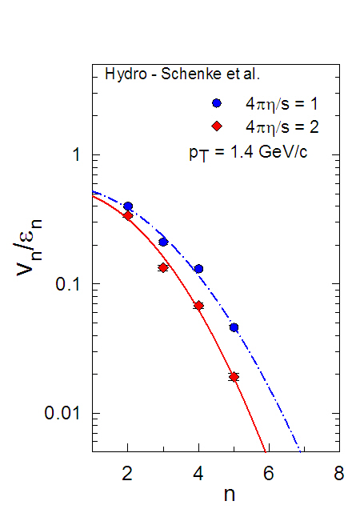
Hydrodynamic flow is acoustic
ε_{n} drive momentum anisotropy
v_{n} with modulation
Modulation→ Acoustic
Associate k with harmonic n
Note: the hydrodynamic response to the initial geometry [alone] is included
Characteristic n² viscous damping for harmonics
→ Crucial constraint for η/s

Slide 10
Constraint for η/s & δf
Deformation
Characteristic p_{T} dependence of β
→ reflects the influence of δf and η/s

Slide 11
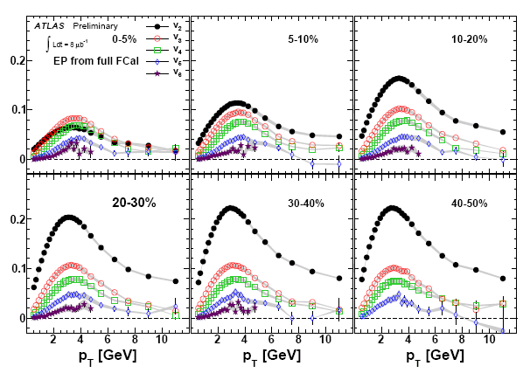
v_{n}(ψ_{n}) Measurements - ATLAS
ATLAS-CONF-2011-074
High precision double differential Measurements are pervasive
Do they scale?

Slide 12
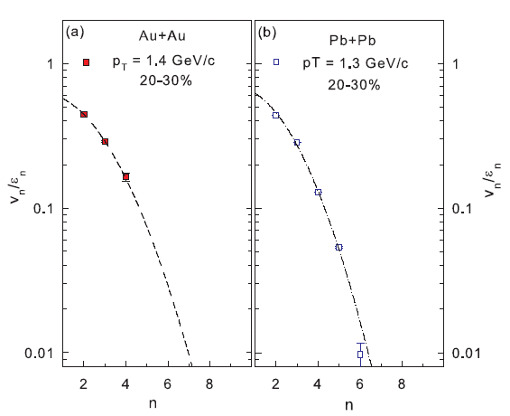
arXiv:1105.3782
Acoustic Constraint
RHIC
LHC
Wave number
Characteristic viscous damping
of the harmonics validated
Important constraint
at RHIC; small increase for LHC

Slide 13
Acoustic Scaling
β is essentially independent of centrality for a broad centrality range

Slide 14
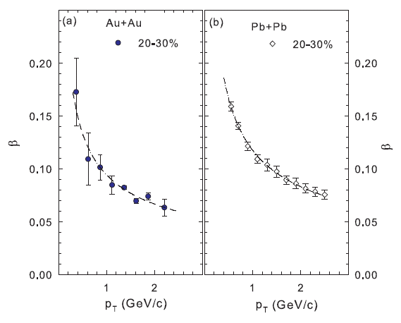
Constraint for η/s & δf
β scales as 1/√p_{T} → Important constraint
<η/s> ~ 1/4π at RHIC; small increase for LHC

Slide 15
Scaling properties of Jet Quenching
Notes:
15

Slide 16
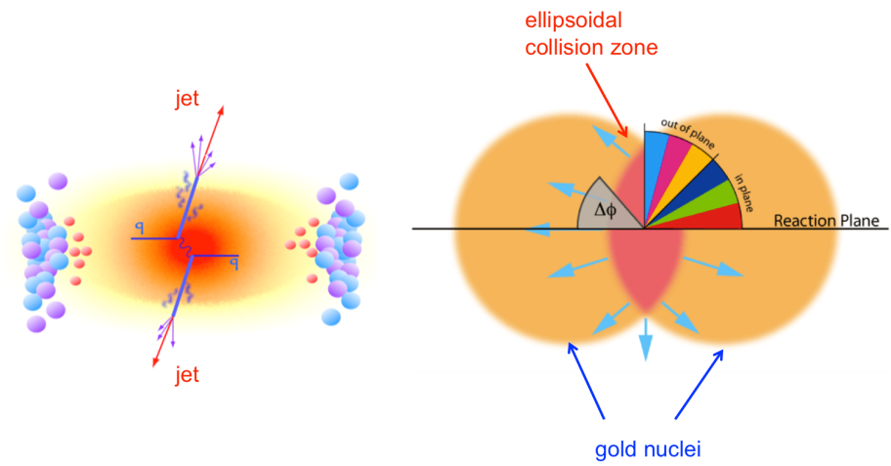
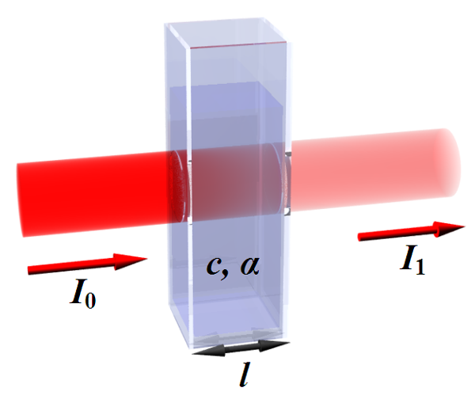
Fixed Geometry
Jet suppression Probe
More
suppression
Modified jet
Less
suppression
Suppression (∆L) – pp yield unnecessary
Suppression (L)
For Radiative Energy loss:
Path length
(related to collision
centrality)
, Phys.Lett.B519:199-206,2001
Jet suppression drives R_{AA} & azimuthal anisotropy with specific scaling properties
Notes:
16

Slide 17
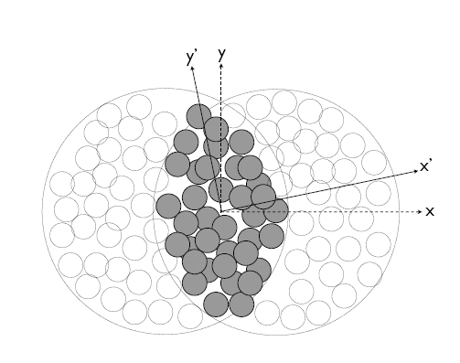
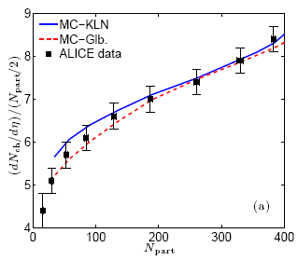
Geometric Quantities for scaling
Phys. Rev. C 81, 061901(R) (2010)
A
B
arXiv:1203.3605
σ_{x} & σ_{y} → RMS widths of density distribution
Geometric fluctuations included
Geometric quantities constrained by multiplicity density.

Slide 18
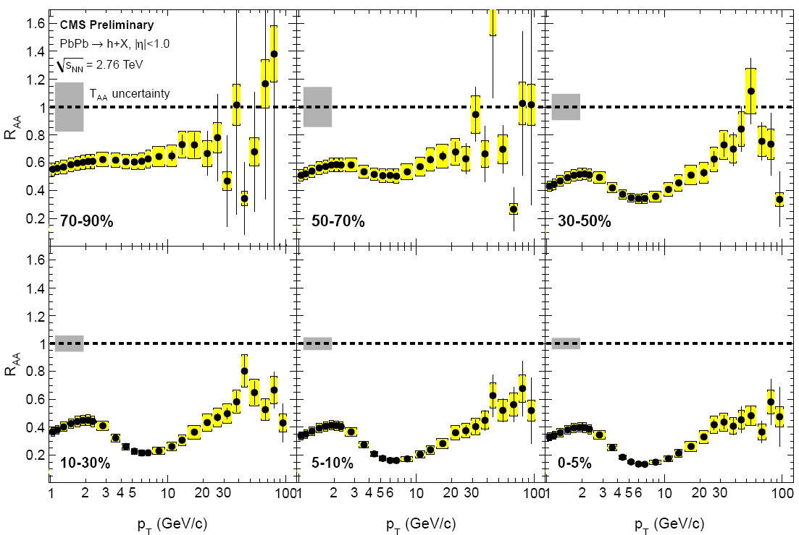
R_{AA} Measurements - CMS
Eur. Phys. J. C (2012) 72:1945 arXiv:1202.2554
Centrality
dependence
p_{T} dependence
Specific p_{T} and centrality dependencies – Do they scale?
Notes:
18

Slide 19
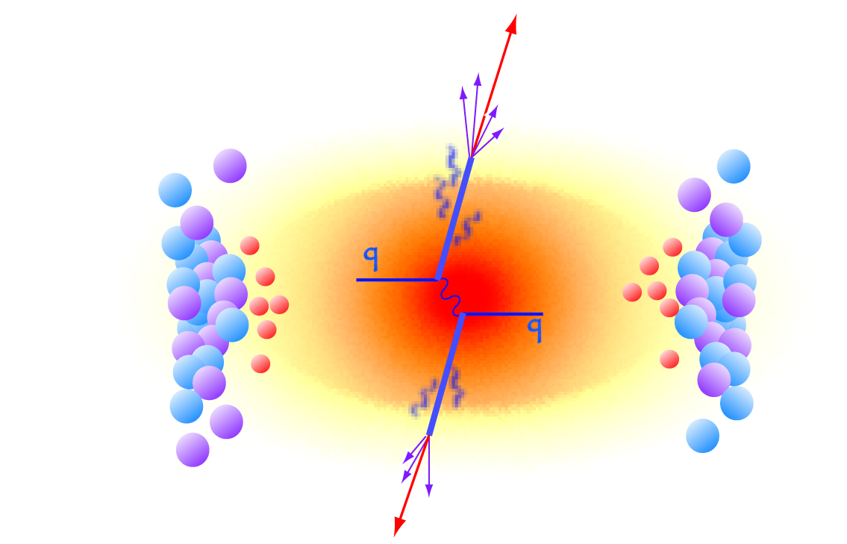
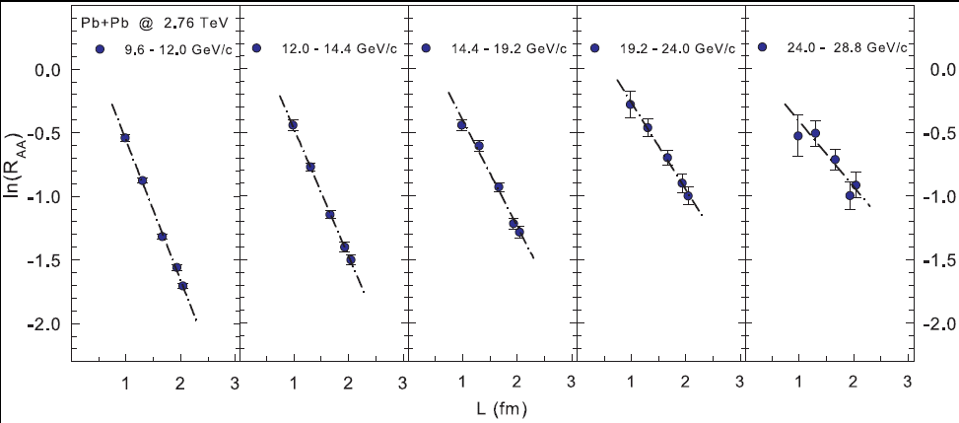
L scaling of Jet Quenching - LHC
, Phys.Lett.B519:199-206,2001
arXiv:1202.5537
ˆ
R_{AA} scales with L, slopes (S_{L}) encodes info on α_{s} and q
Compatible with the dominance of radiative energy loss
Notes:
19

Slide 20
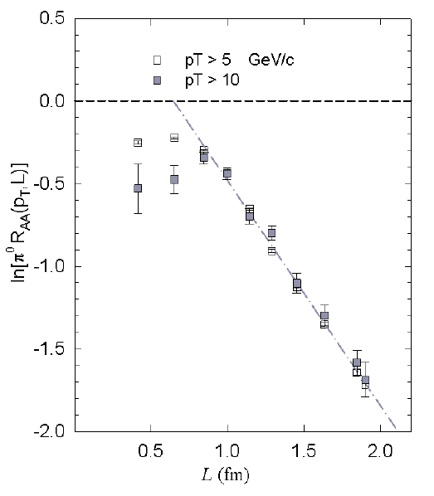
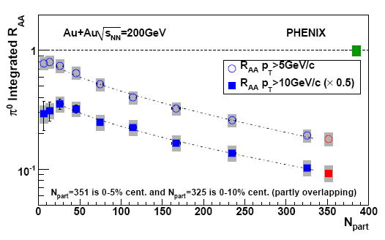
L scaling of Jet Quenching - RHIC
Phys.Rev.C80:051901,2009
R_{AA} scales with L, slopes (S_{L}) encodes info on α_{s} and q
Compatible with the dominance of radiative energy loss
ˆ
Notes:
20

Slide 21
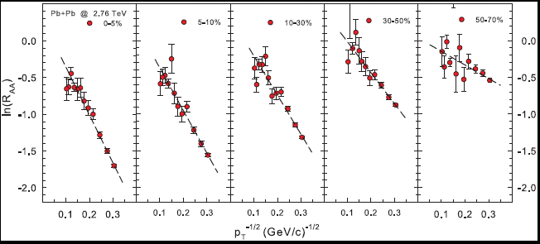
p_{T} scaling of Jet Quenching
, Phys.Lett.B519:199-206,2001
arXiv:1202.5537
ˆ
R_{AA} scales as 1/√p_{T} ; slopes (S_{pT}) encode info on α_{s} and q
L and 1/√p_{T} scaling → single universal curve
Compatible with the dominance of radiative energy loss
Notes:
21

Slide 22
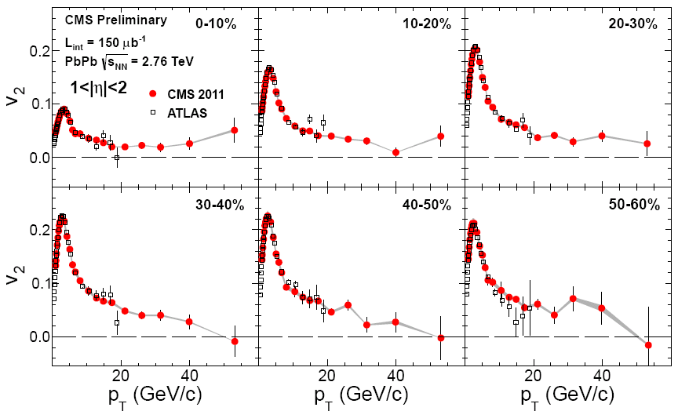
High-pT v₂ measurements - CMS
arXiv:1204.1850
Centrality
dependence
p_{T} dependence
Specific p_{T} and centrality dependencies – Do they scale?
Notes:
22

Slide 23
High-pT v₂ measurements - PHENIX
Centrality dependence
p_{T} dependence
Specific p_{T} and centrality dependencies – Do they scale?
Notes:
23

Slide 24
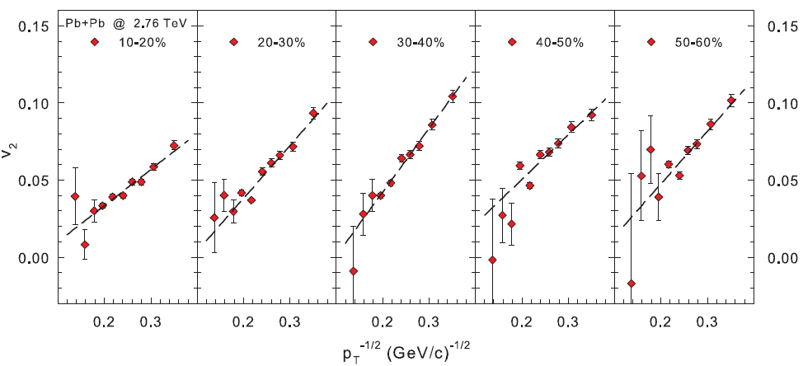
High-pT v₂ scaling - LHC
arXiv:1203.3605
v₂ follows the p_{T} dependence observed for jet quenching
Note the expected inversion of the 1/√p_{T} dependence
Notes:
24

Slide 25
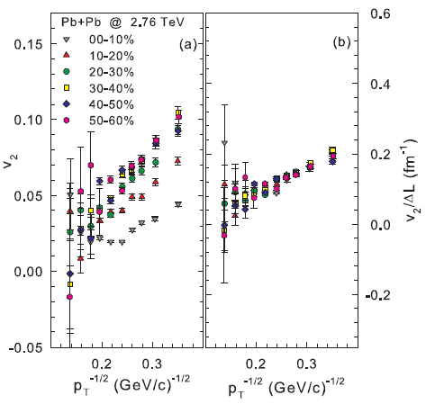
∆L Scaling of high-pT v₂ – LHC & RHIC
arXiv:1203.3605
Combined ∆L and 1/√p_{T} scaling → single universal curve for v₂
Notes:
25

Slide 26
∆L Scaling of high-pT v₂ - RHIC
Combined ∆L and 1/√p_{T} scaling → single universal curve for v₂
→ Constraint for ε_{n}
Notes:
26

Slide 27
Jet v₂ scaling - LHC
ATLAS
(z ~ .62)
v₂ for reconstructed Jets follows the p_{T} dependence for jet quenching
Similar magnitude and trend for Jet and hadron v₂ after scaling
Notes:
27

Slide 28
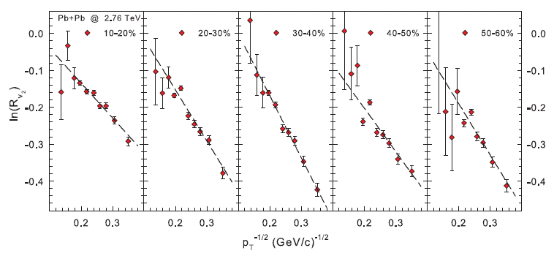
Jet suppression from high-pT v₂
arXiv:1203.3605
Jet suppression obtained directly from pT dependence of v₂
ˆ
α_{s} and q
R_{v2} scales as 1/√p_{T} , slopes encodes info on
Notes:
28

Slide 29
Jet suppression from high-pT v₂ - RHIC
Jet suppression obtained directly from pT dependence of v₂
α_{s} and
ˆq
R₂ scales as 1/√p_{T} , slopes encodes info on
Notes:
29

Slide 30
Heavy quark suppression
ˆ
q_{LHC}
Consistent obtained
Notes:
30

Slide 31
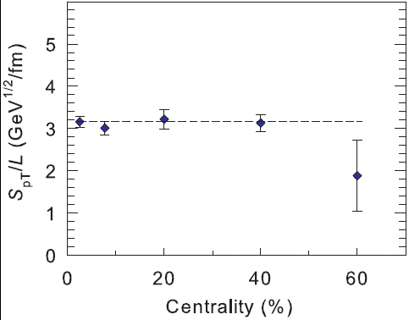
Extracted stopping power
Phys.Rev.C80:051901,2009
arXiv:1202.5537
arXiv:1203.3605
ˆ
q_{LHC}
obtained from high-pT v₂ and R_{AA} [same α_{s}] → similar
- medium produced in LHC collisions less opaque!
ˆ
q_{RHIC} > q_{LHC}
Conclusion similar to those of Liao, Betz, Horowitz,
→ Stronger coupling near T_{c}?
Notes:
31

Slide 32
Summary
Remarkable scaling have been observed for both Flow and Jet Quenching
They lend profound mechanistic insights, as well as New constraints for
estimates of the transport and thermodynamic coefficients!
What do we learn?
R_{AA} and high-pT azimuthal anisotropy stem from the same energy loss mechanism
Energy loss is dominantly radiative
R_{AA} and anisotropy measurements give consistent estimates for <ˆq >
R_{AA} for D’s give consistent estimates for <ˆq >
The QGP created in LHC collisions is less opaque than that produced at RHIC
Flow is acoustic
Flow is pressure driven
Obeys the dispersion relation for sound propagation
Flow is partonic
exhibits scaling
Constraints for:
initial geometry
η/s similar at LHC and RHIC ~ 1/4π

Slide 33
End

Slide 34
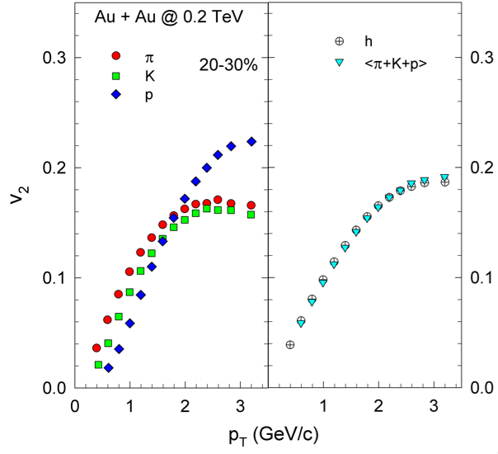
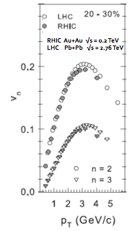
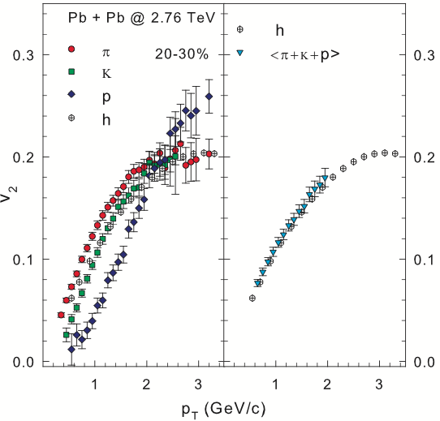
Flow @ RHIC and the LHC
Charge hadron flow similar @ RHIC & LHC
Multiplicity-weighted PIDed flow results reproduce inclusive charged hadron flow results at RHIC and LHC respectively

Slide 35
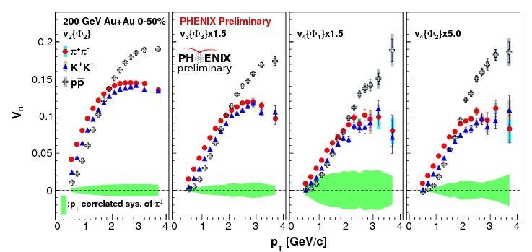
Is flow partonic?
Note species dependence for all v_{n}
For partonic flow, quark number scaling expected
→ single curve for identified particle species v_{n}

