Slide 1
Bound-Free Electron-Positron Pair Production Accompanied by Coulomb Dissociation
M. Yılmaz Şengül
Kadir Has University & İstanbul Technical University
M. C. Güçlü
İstanbul Technical University

Slide 2
- INTRODUCTION
* Free Electron-Positron Pair Production
* Bound-Free Electron-Positron Pair Production
* Pair Production by Nuclear Dissociation - Free Pair Production
- Bound-Free Pair Production
- FORMULATION
* Formulation for Free Electron-Positron Pair Production
* Cross Section Calculations for Bound-Free Electron-Positron Pair Production
* Other Methods for Bound-Free Electron-Positron Pair Production Cross Section Calculations
* Impact Parameter Dependent Bound-Free Electron-Positron Pair Production
* Comparison of the Impact Parameter Dependent Bound-Free Electron-Positron Pair Production Calculations with the Other Methods
* Bound-Free Electron-Positron Pair Production Cross Section Calculations by Coulomb Dissociation
RESULTS
* Cross Section Results for Bound-Free Electron-Positron Pair Production by Giant Dipole Resonance

Slide 3
INTRODUCTION
*Free Electron-Positron Pair Production
Ion 1
Ion 2
time
Pair Production
Emits photon
Emits photon

Slide 4
Z
e⁺
e⁻
Z

Slide 5
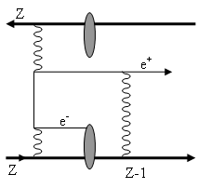
* Bound-Free Electron-Positron Pair Production
Fig-1: Pair production with capture in relativistic heavy ion colliders [1].

Slide 6
Z
e⁺
e⁻
e⁻
Z
Z-1

Slide 7
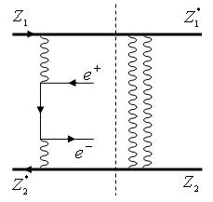
* Pair Production by Nuclear Dissociation
- Free Pair Production;
Fig-2: Free pair production accompanied by GDR in a relativistic heavy
ion collisions.

Slide 8
n
n
n
n
n
n
e⁺
e⁻
n
n
n
n
n
n

Slide 9
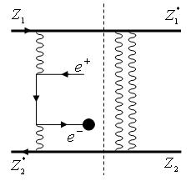
- Bound-Free Pair Production;
Fig-3: BFPP accompanied by GDR in a relativistic heavy ion collisions.

Slide 10
n
n
n
n
n
n
e⁺
e⁻
e⁻
n
n
n
n
n
n

Slide 11
- FORMULATION
* Formulation for Free Electron-Positron Pair Production
Semi-Classical Action Integral
Free Fermion Lagrangian Density
Interaction Lagrangian Density
EM Lagrangian Density

Slide 12
Dirac wave-function of electrons&positrons
Electromagnetic vector potential
Electromagnetic field tensor

Slide 13
Equations of Motion

Slide 14
Perturbative Expansion

Slide 15
4-Vector Potentials of Colliding Ions

Slide 16
The time-evolved vacuum state in the interaction picture;
Total cross section for electron-positron pair production;

Slide 17
Second order terms for direct and crossed diagrams;

Slide 18
* Cross Section Calculations for Bound-Free Electron-Positron Pair Production
Captured electron (Darwin) wave function [2,3];

Slide 19
Positron (Sommerfeld-Maue) wave-function [1,4];
Distortion (correction) term due to the large charge of the ion.
Normalization constant.

Slide 20
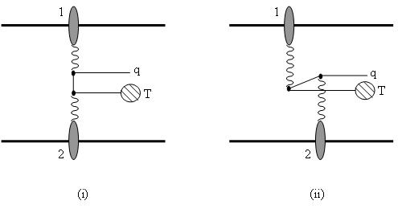
Fig-4: Lowest-order Feynman diagrams for the pair production of a bound-free electron-positron pair in heavy-ion collisions: (i) direct and (ii) crossed diagrams for the simultaneous capture of the electron into a bound state of target (T) ion. In the figure, 1 and 2 represents the two ions, and q is the momentum of the positron [5].

Slide 21
S- transition matrix element for direct term of Feynman diagrams;

Slide 22
Scalar parts of the fields as associated with ions 1 and 2;

Slide 23
The virtual photons frequency of ion 1 & ion 2;

Slide 24
Transition amplitudes;

Slide 25
After making all the simplifications, the final form of the BFPP cross section can be expressed as;
Some proper products of the transition amplitudes and scalar parts of the fields as associated with ions 1 and 2.

Slide 26
* Other Methods for Bound-Free Electron-Positron Pair Production Cross Section Calculations
* Bertulani and Baur [1988]
* Rhoades-Brown, Bottcher and Strayer [1989]
* Baltz, Rhoades-Brown and Weneser [1991-94]

Slide 27
* Impact Parameter Dependent Bound-Free Electron-Positron Pair Production [6,7]

Slide 28
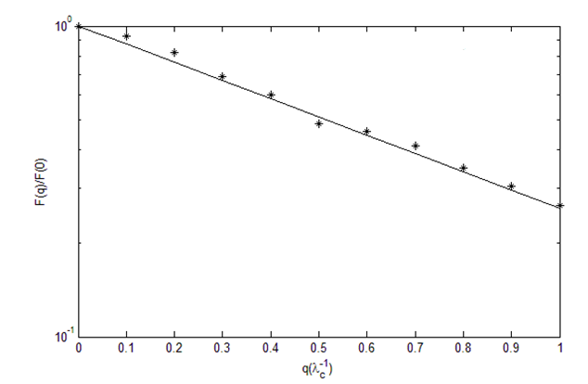
Fig-5: The function is calculated . The points show the results of the Monte Carlo calculations and the smooth curve is our fit for these points. The slope of this function gives the value of a as .

Slide 29
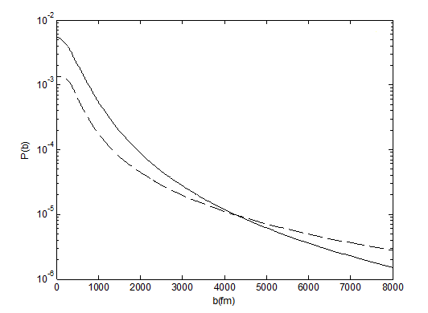
* Comparison of the Impact Parameter Dependent Bound-Free Electron-Positron Pair Production Calculations with the Other Methods
RHIC-Au+Au
RHIC-Pb+Pb
Fig-6: Probability of positron production with gold beams at RHIC as a function of b; the solid line shows our work and the dashed line shows the work of Baltz [7].

Slide 30
* Bound-Free Electron-Positron Pair Production Cross Section Calculations by Coulomb Dissociation
the probability of bound-free electron-positron
pair production probability;
the probability of GDR excitation in one ion;
the probability of a simultaneous nuclear excitation as
a function of impact parameter;

Slide 31
the total cross section for BFPP with mutual nuclear excitation;
the probability for at least one Coulomb excitation;
the total cross section for BFPP with mutual nuclear excitation at least one Coulomb excitation;

Slide 32
* Cross Section Results for Bound-Free Electron-Positron Pair Production by Giant Dipole Resonance
- RESULTS
Table-1: Integrated cross sections for Au+Au collision at RHIC energies and for Pb+Pb collisions at LHC energies for free and bound-free pair production.

Slide 33
Table-2: Integrated cross sections for Pb+Pb collisions at RHIC energies by using our calculations and for the same collision at RHIC energies by using the calculations of Baltz [7].

Slide 34
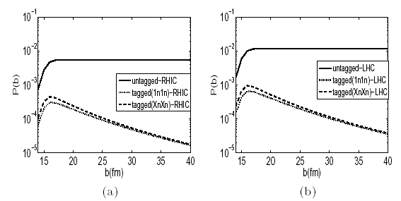
Fig-7: The probability of positron pair production with (a) gold beams at RHIC and (b) lead beams at the LHC as a function of b with XnXn (dashed line) and 1n1n (dotted line) and without nuclear excitation [7].

Slide 35
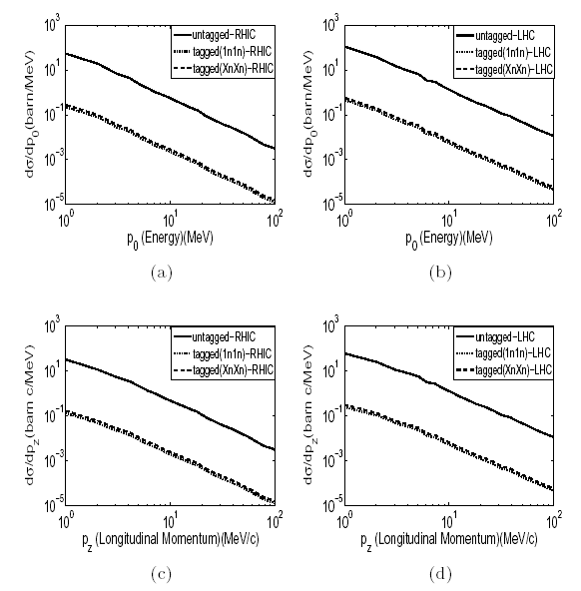
Fig-8: The differential cross section as function of energy of the produced positrons is
shown in the graph (a) for RHIC and (b) for LHC. And the differential cross section is
shown as function of the longitudinal momentum of the produced positrons in the graph
(a) for RHIC and (b) for LHC [7].

Slide 36
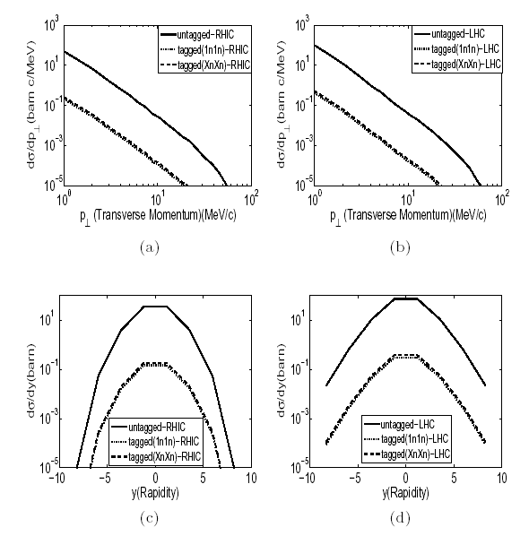
Fig-9: The differential cross section as function of transverse momentum of the produced
positrons is shown in the graph (a) for RHIC and (b) for LHC. And the differential cross
section is shown as function of the rapidity of the produced positrons in the graph (a) for RHIC
and (b) for LHC [7].

Slide 37
Finally;
By using semi-classical two photon method, we have obtained bound-free electron-positron pair production cross section.
By using this method, we have calculated impact parameter dependent bound-free electron-positron pair production probability.
We have calculated the cross section of bound-free electron-positron pair production accompanied by giant dipole resonance for the first time in the literature.
We have obtained the differential cross section of produced positrons as a function of energy, transverse momentum, longitudinal momentum and rapidity for the bound-free electron-positron pair production accompanied by giant dipole resonance.
We are planning to implement this method to calculate the cross section of different particles such as mesons, heavy leptons and anti-hydrogen.

Slide 38
- REFERENCES
1) C.A. Bertulani, D. Dolci, Nucl. Phys. A 683, 635(2001).
2) V.B.Berestetskii, E.M. Lifshitz, L.P. Pitaevskii, Relativistic
Quantum Field Theory (Pergamon Press, NewYork, 1979).
3) J. Eichler, W.E. Meyerhof, Relativistic Atomic Collisions (Academic Press, California, 1995).
4) C.A. Bertulani, G. Baur, Phys. Rep. 163, 299 (1988).
5) M.J. Rhoades-Brown, C. Bottcher, M.R. Strayer, Phys. Rev. A 40, 2831 (1989).
6) M.C. Güçlü, Nucl.Phys. A 668, 149 (2000).
7) M.Y. Şengül, M.C. Güçlü, Phys. Rev. C 83, 014902 (2011).
8) A.J. Baltz, M.J. Rhoades-Brown, J. Weneser, Phys. Rev. E 54, 4233 (1996).
THANKS FOR YOUR ATTENTION!

